Slide 1



Machine Learning in HEP
1ère partie
David Rousseau, LAL-Orsay
rousseau@lal.in2p3.fr @dhpmrou
Ecole de GIF, Ecole polytechnique, Palaiseau
2-6 septembre 2019

Slide 2
Outline
Part 1
  Introduction to ML techniques
    Boosted Decision Tree
    Neural Networks
  Brief look back : BDT for Higgs discovery
Part 2
  Various HEP applications
  What is so special with ML and HEP
  No images
  Accurate models
  Big data
  Uncertainty evaluation
  Wrapping up
See also “Machine Learning in High Energy Physics Community White Paper” on arXiv:1807.02876

Slide 3
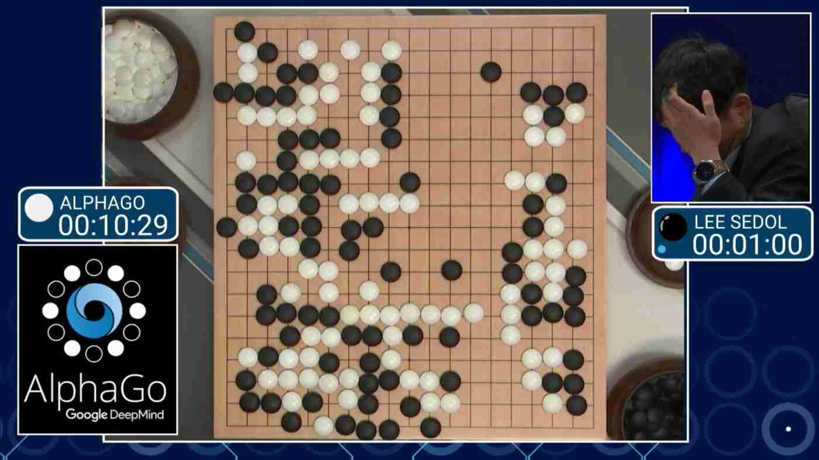

Slide 4
Régression Linéaire
Boskovic, Legendre, Laplace, Gauss
y
Bonheur moyen
x
y=f(x)
PNB par habitant

Slide 5

f
Etant donné x, on veut y ➔ comment construire f ?
x
y
Ecriture manuscrite ➔ texte
Image ➔ chien ou chat ?
Photo ➔ maman ou mamie ?
« Comment ça va ? » ➔ « »
Parole ➔ texte
Compte facebook ➔ publicité ciblée
Position des pièces ➔ prochain coup
Camera + capteurs+GPS➔ action sur volant

Slide 6
Informatique traditionelle
Règles
logiques
Problème
Solution

Slide 7
Apprentissage automatique
Données
Règles
d’apprentissage
Problème
Solution
Apprendre = optimiser les paramètres internes de l’algorithme : n=2 to millions

Slide 8
Beaucoup de pièges
Interpolation
Extrapolation

Slide 9
Comment ça marche ?

Slide 10
Classifiers

Slide 11
Some vocabulary
“Classifier”
  A model F(x)=y : with y=0 or 1 (e.g. 0=Background 1=Signal)
    In practice : y ranking variable, the larger the more signal-like
  If size (y)>1: (not in this course)
    Multiclass : Σ y=1 : Cat or Dog or Elephant
    Mutlilabel : Σ y>=1 : Cat, Dog, Animal, Mammal…
“Signal” : True Positive, “Background” : False Positive
“Features”
  Variables (x)
“Hyper-parameters”:
  These are all the “knobs” to optimize an algorithm, e.g.
    number of leaves and depth of a tree
    number of nodes and layers for NN
    and much more
  “Hyper Parameter Optimisation (HPO)”== optimising the knobs for the best performance

Slide 12
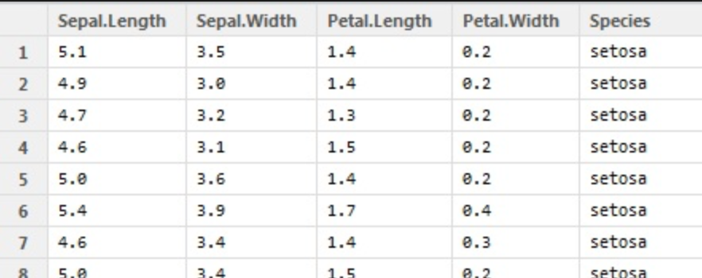
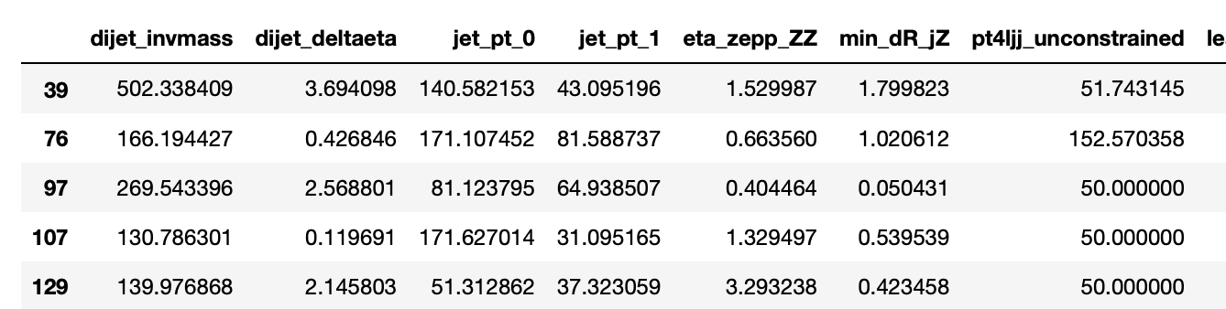
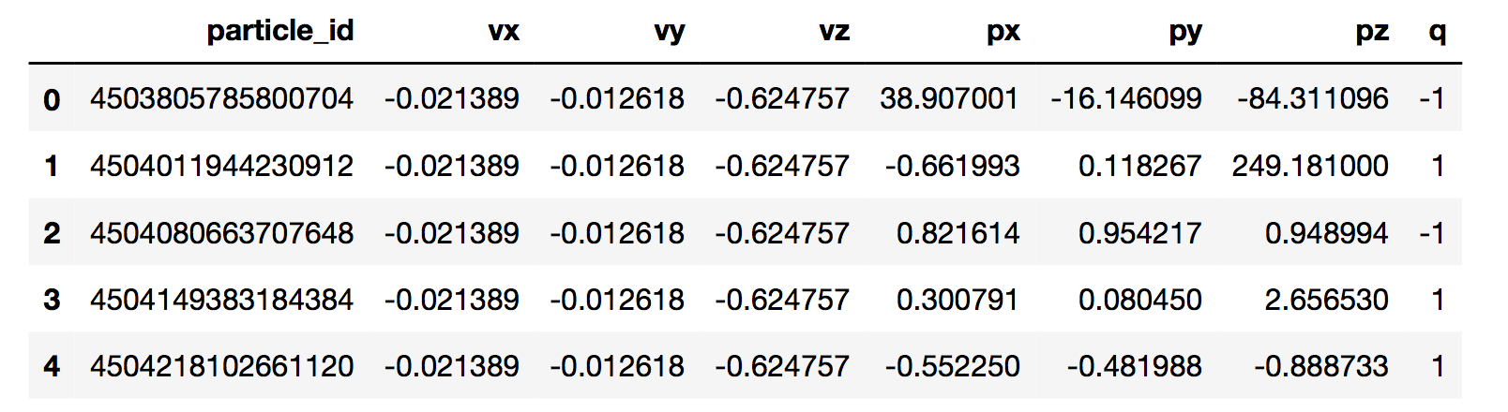
Datasets
Tabular datasets (mostly)

Slide 13
K-Nearest Neighbour

Slide 14
Nearest-Neighbour classifier (1)

Slide 15
Nearest-Neighbour classifier (2)

Slide 16
Nearest-Neighbour classifier (3)

Slide 17
Nearest-Neighbour classifier (4)
Not used in HEP, no real use case

Slide 18
Decision Trees

Slide 19
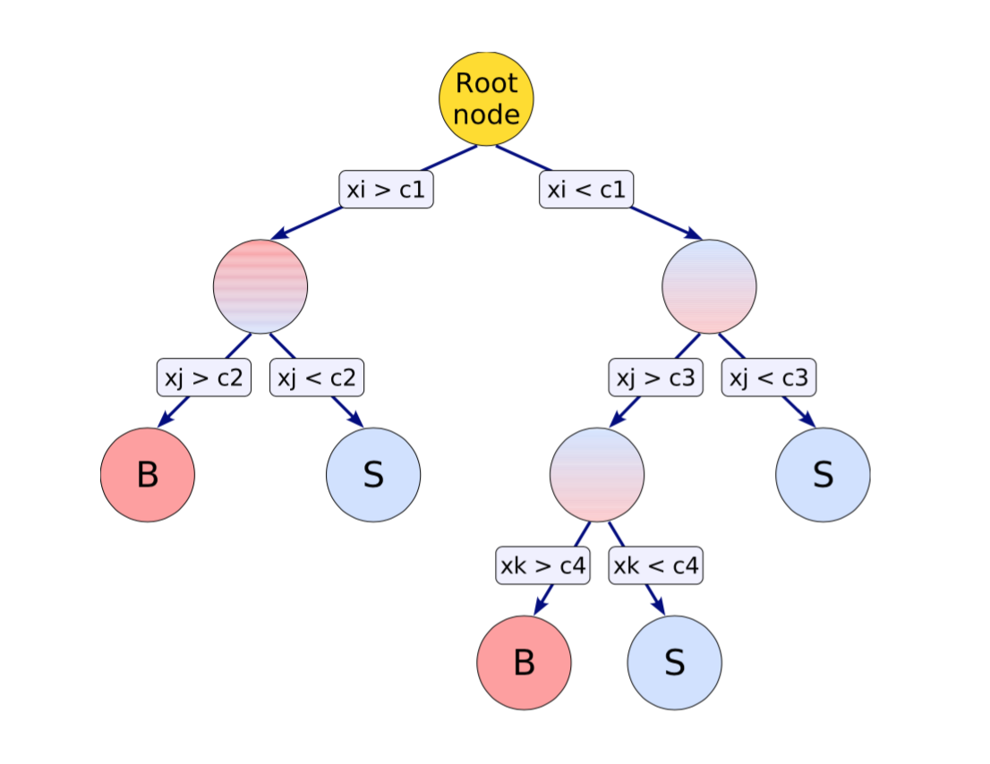
Boosted Decision Tree
Single tree (CART) <1980
AdaBoost 1997 : rerun increasing the weight of misclassified entries ➔Boosted Decision Trees (Gradient boosting many weighted trees)

Slide 20
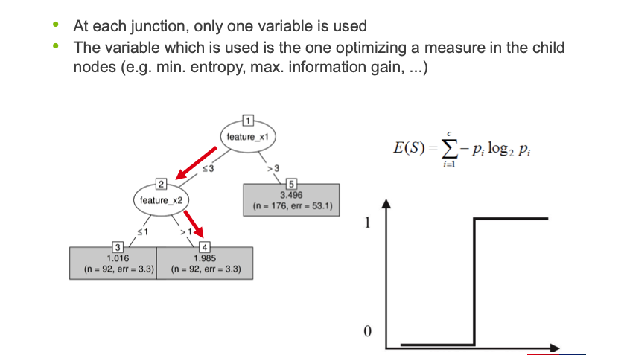
Building the Tree
In practice, use a combination of
trees (Adaboost, Gradient boosting)
Software : XGBoost, LightGBM (TMVA bof >10 times slower)

Slide 21
Trees at work

Slide 22
Trees at work

Slide 23
Trees at work

Slide 24
Trees at work

Slide 25
Trees at work

Slide 26
Trees at work

Slide 27
Trees at work

Slide 28
Trees at work

Slide 29
Trees at work

Slide 30
Trees at work

Slide 31
ROC curve and more
ROC curve, sensitivity curve, learning curve, dataset imbalance

Slide 32
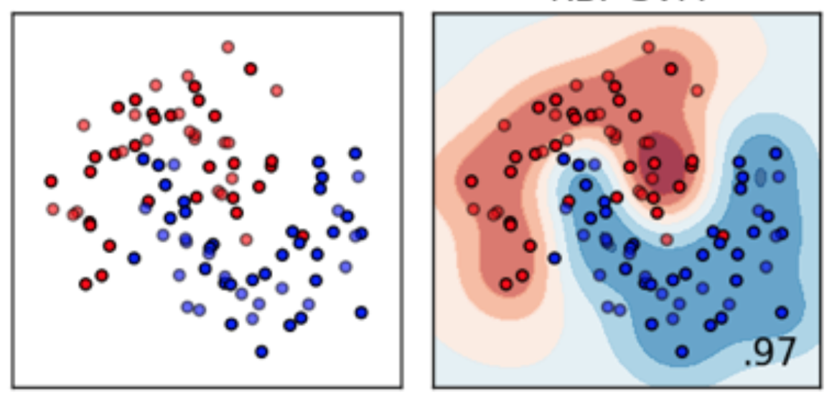
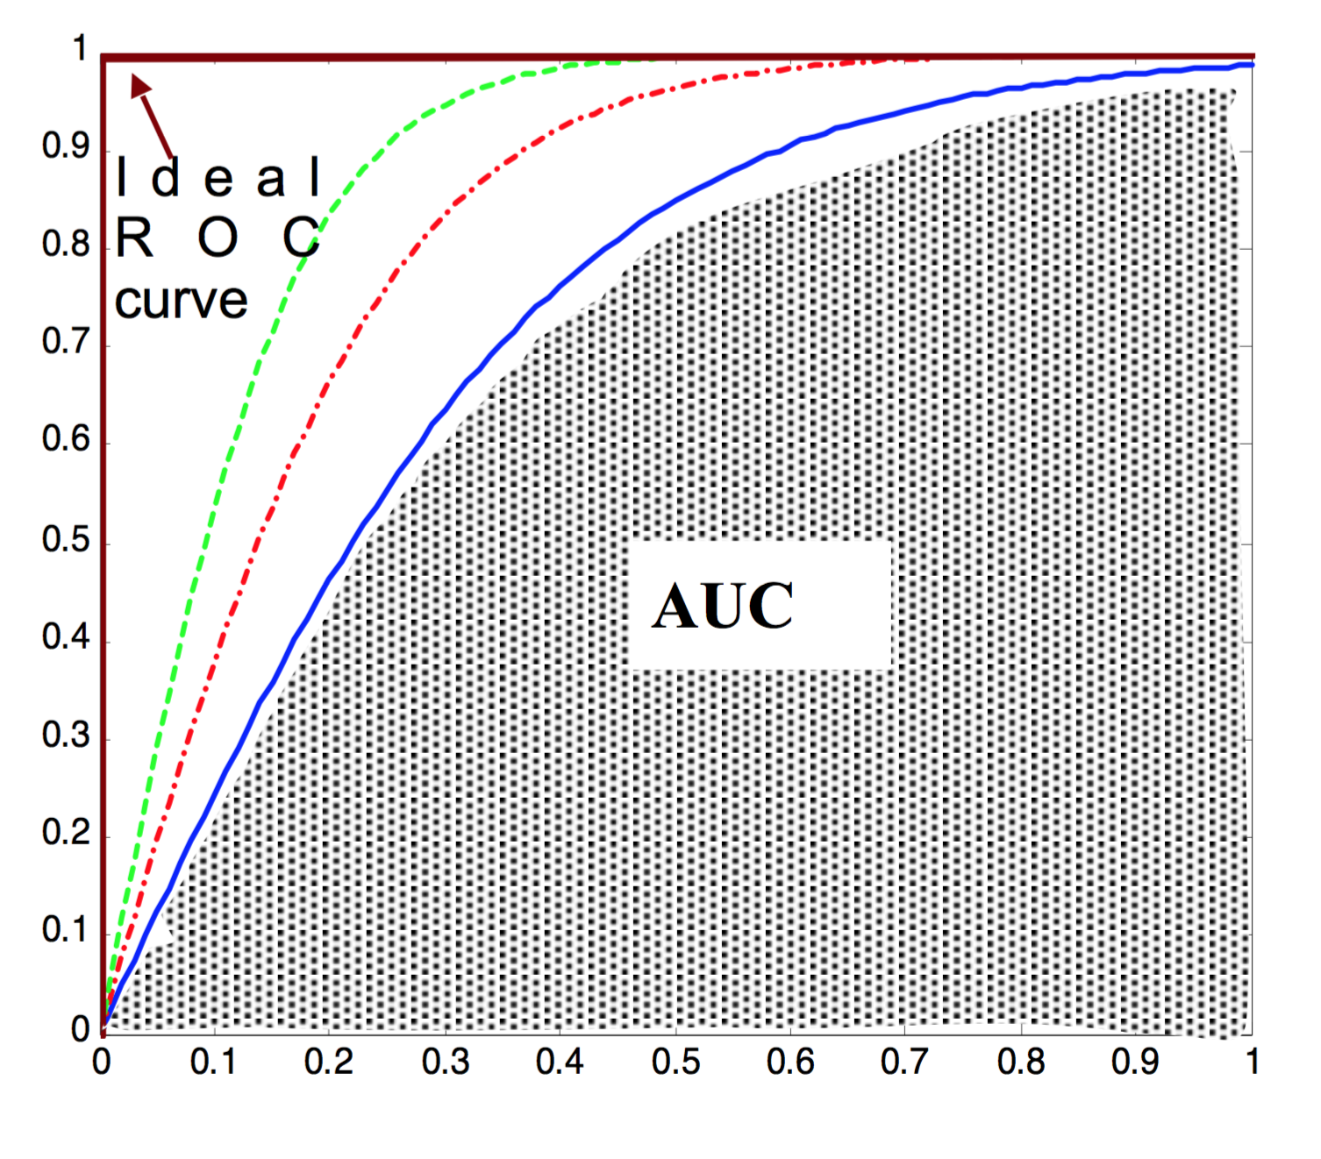
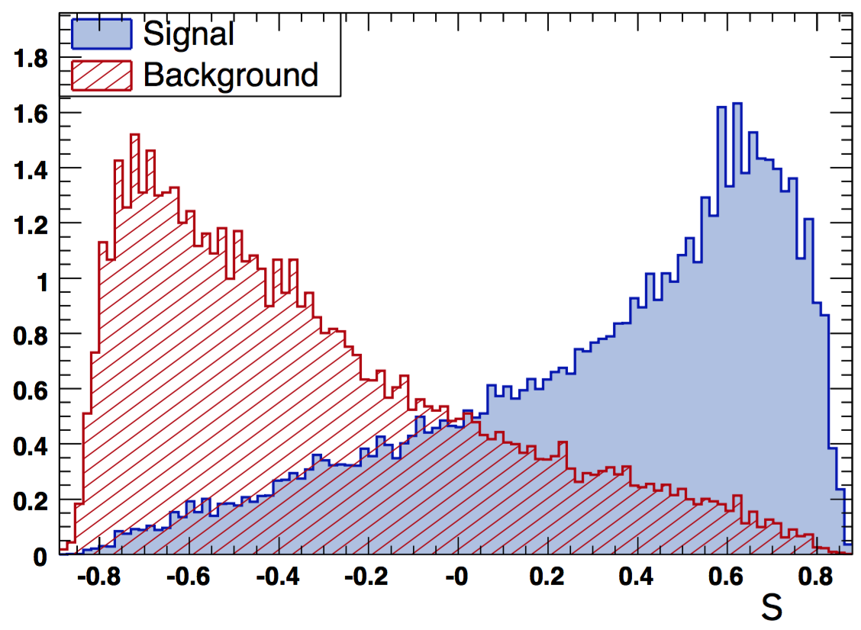
Classifier basics
BB
Train on Signal and Background Monte-Carlo
➔learn the separation between S and B distribution
Apply on test sample
Apply on data
AUC : Area Under the (ROC) Curve
Signal eff.
We’re often here
score
Background eff.

Slide 33
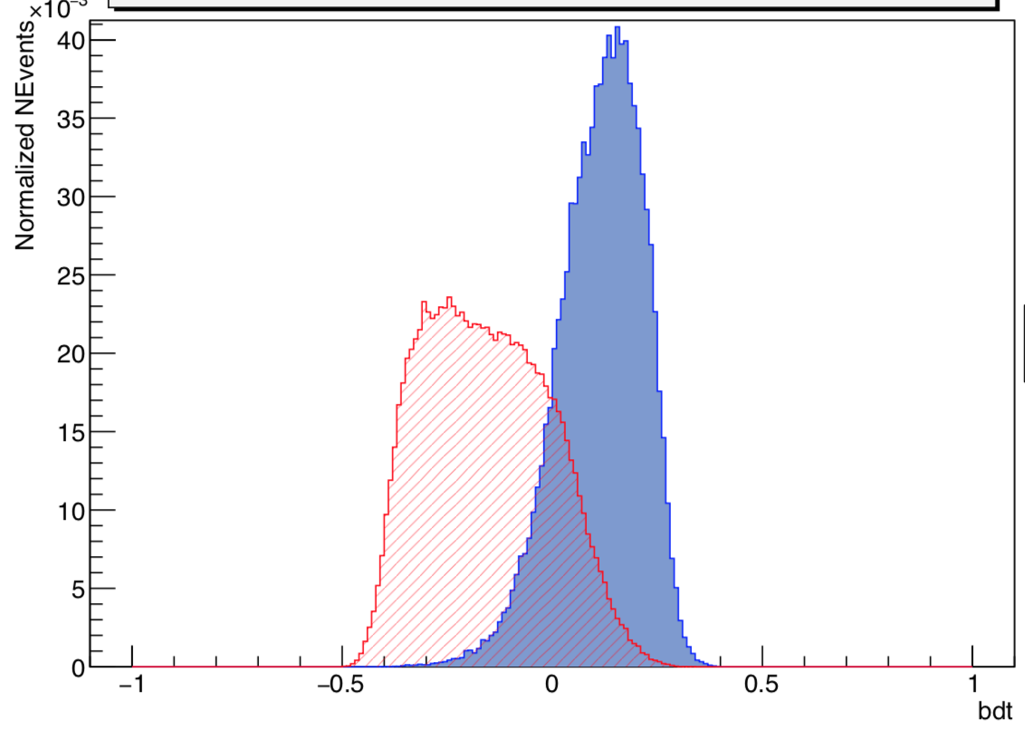
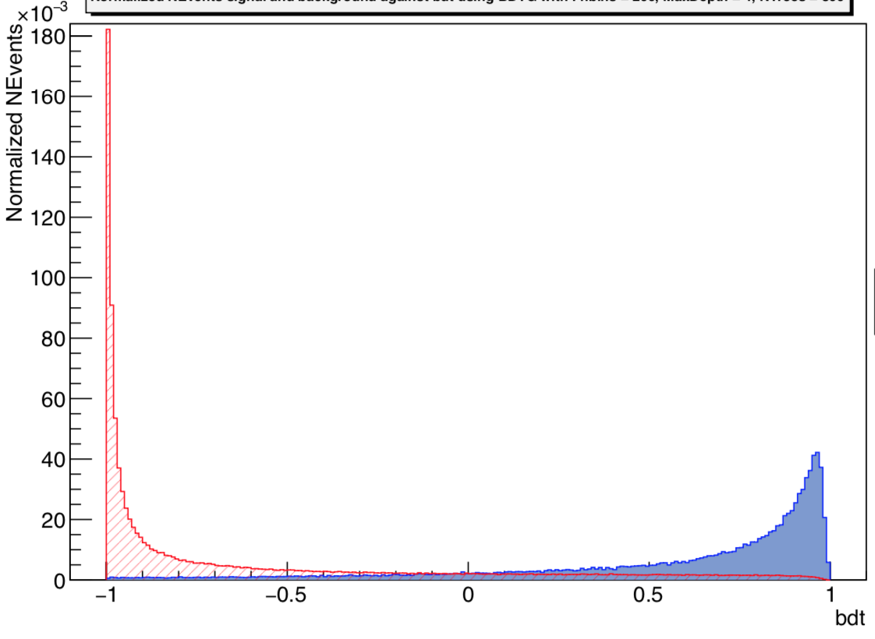
Score
Score output by algorithm is actually a ranking-variable
  From most background like to most signal-like
  Shape is (almost) meaningless
Root BDT
Adaboost
Root BDT
Gradient boost

Slide 34
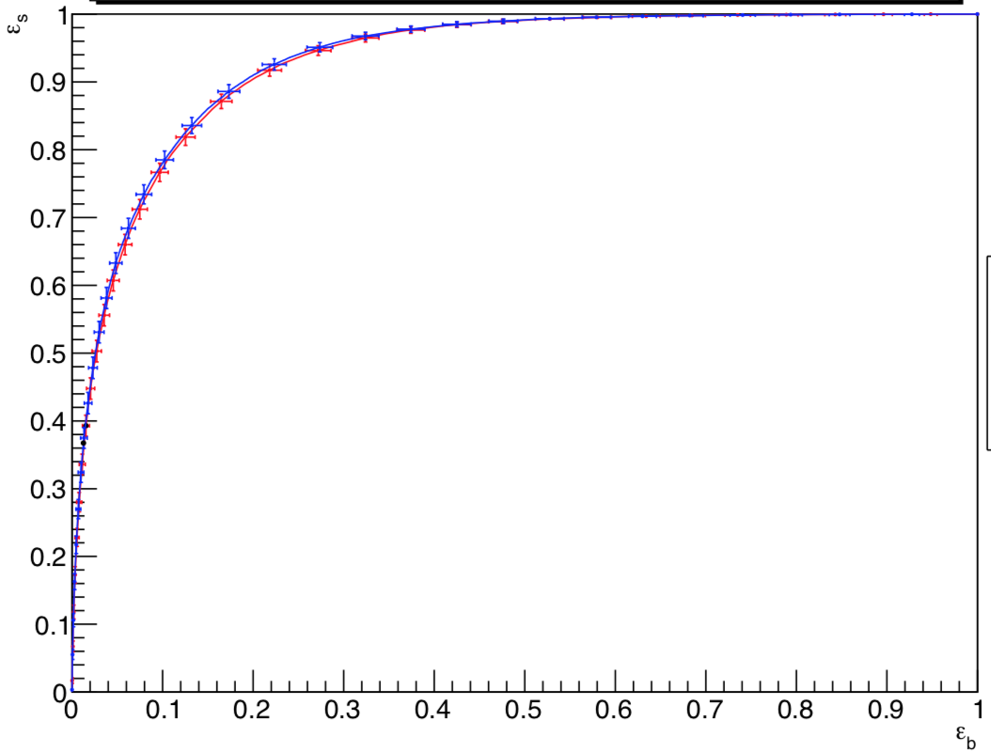
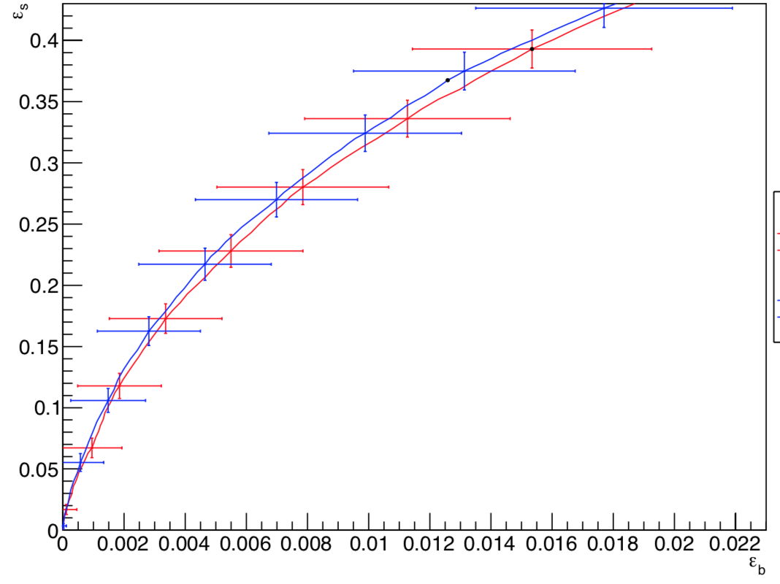
Score (2)
- Adaboost
- Adaboost
- Gradient boost
- Gradient boost

Slide 35
Significance
Imagine counting experiment above threshold:
  Number of expected Signal S Background B events
  Expected « Asimov » significance:
  ~ if s<<b
S
B

Slide 36
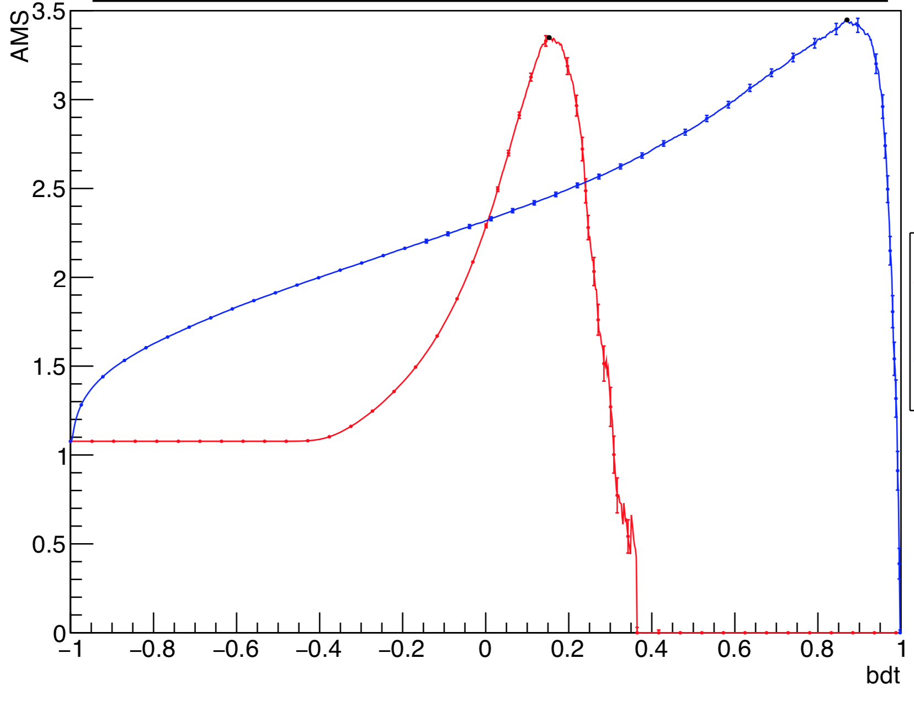
Significance (2)
- Gradient boost
- Adaboost

Slide 37
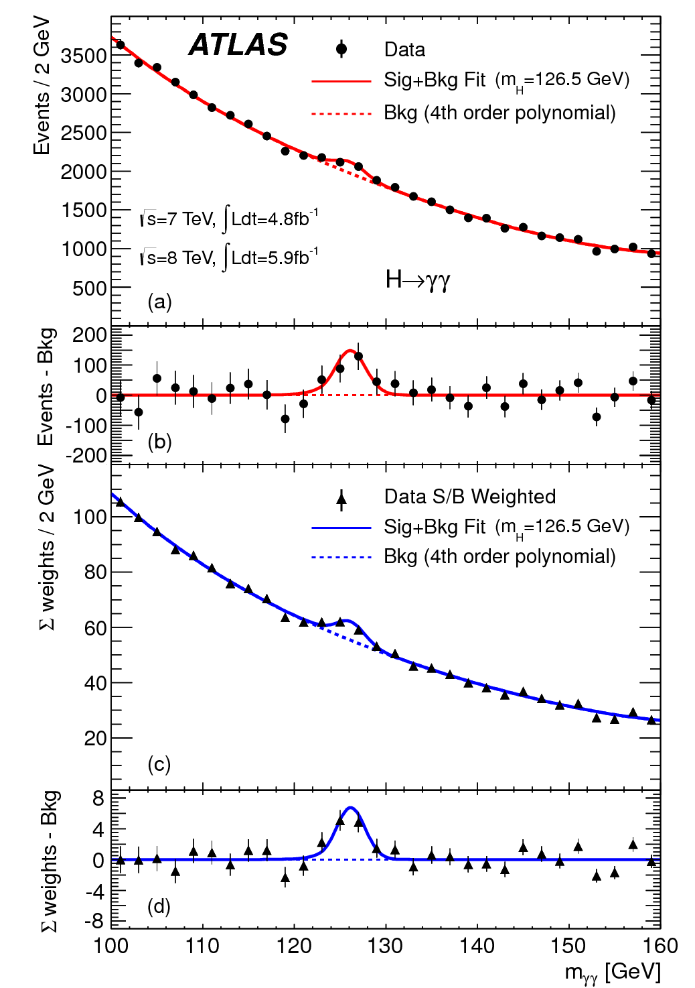
Application H➔τ⁺τ⁻
BDT sur ~10 variables : masses invariantes, angles, etc…
Higgs !
JHEP 04, 117 (2015) 1501.04943

Slide 38

Higgs Machine Learning challenge
Idée : simplifier une analyse Higgs, poster les données simulées sur le web, demander aux spécialistes de l’Intelligence Artificielle de l’améliorer
Organisé en 2014 sur la plateforme Kaggle

Slide 39
HiggsML : Dataset
ASCII csv file, with mixture of Higgs to tautau signal and corresponding background, from official GEANT4 ATLAS simulation
Weight and signal/background (for training dataset only)
weight (fully normalised)
label : « s » or « b »
Conf note variables used for categorization or BDT:
DER_mass_MMC
DER_mass_transverse_met_lep
DER_mass_vis
DER_pt_h
DER_deltaeta_jet_jet
DER_mass_jet_jet
DER_prodeta_jet_jet
DER_deltar_tau_lep
DER_pt_tot
DER_sum_pt
DER_pt_ratio_lep_tau
DER_met_phi_centrality
DER_lep_eta_centrality
Primitive 3-vectors allowing to compute the conf note variables (mass neglected),
16 independent variables:
PRI_tau_pt
PRI_tau_eta
PRI_tau_phi
PRI_lep_pt
PRI_lep_eta
PRI_lep_phi
PRI_met
PRI_met_phi
PRI_met_sumet
PRI_jet_num (0,1,2,3, capped at 3)
PRI_jet_leading_pt
PRI_jet_leading_eta
PRI_jet_leading_phi
PRI_jet_subleading_pt
PRI_jet_subleading_eta
PRI_jet_subleading_phi
PRI_jet_all_pt
}
}
VBF
signature
VBF
signature

Slide 40
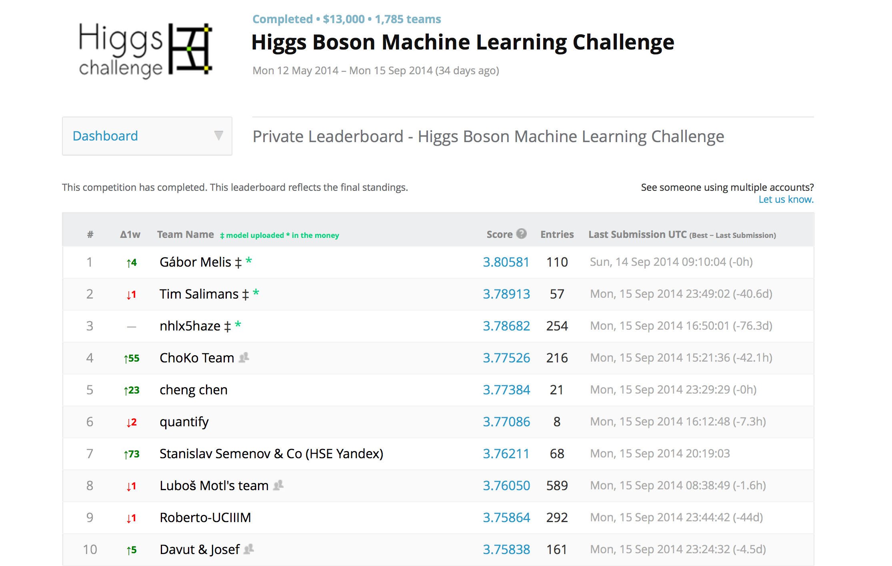
qss
Ecart standard
7000$
4000$
2000$
991 TMVA (CERN standard) 3.2

Slide 41
HIggsML : Real analysis vs challenge
Systematics (and data vs MC)
2 categories x n BDT score bins
Background estimated from data (embedded, anti tau, control region) and some MC
Weights include all corrections. Some negative weights (tt)
Potentially use any information from all 2012 data and MC events
Few variables fed in two BDT
Significance from complete fit with NP etc…
MVA with TMVA BDT
No systematics
No categories, one signal region
Straight use of ATLAS G4 MC
Weights only include normalisation and pythia weight. Neg. weight events rejected.
Only use variables and events preselected by the real analysis
All BDT variables + categorisation variables + primitives 3-vector
Significance from “regularised Asimov”
MVA “no-limit”
Simpler, but not too simple!

Slide 42
Why challenges work ?
Not just ML, but a general trend:
Open Innovation

Slide 43
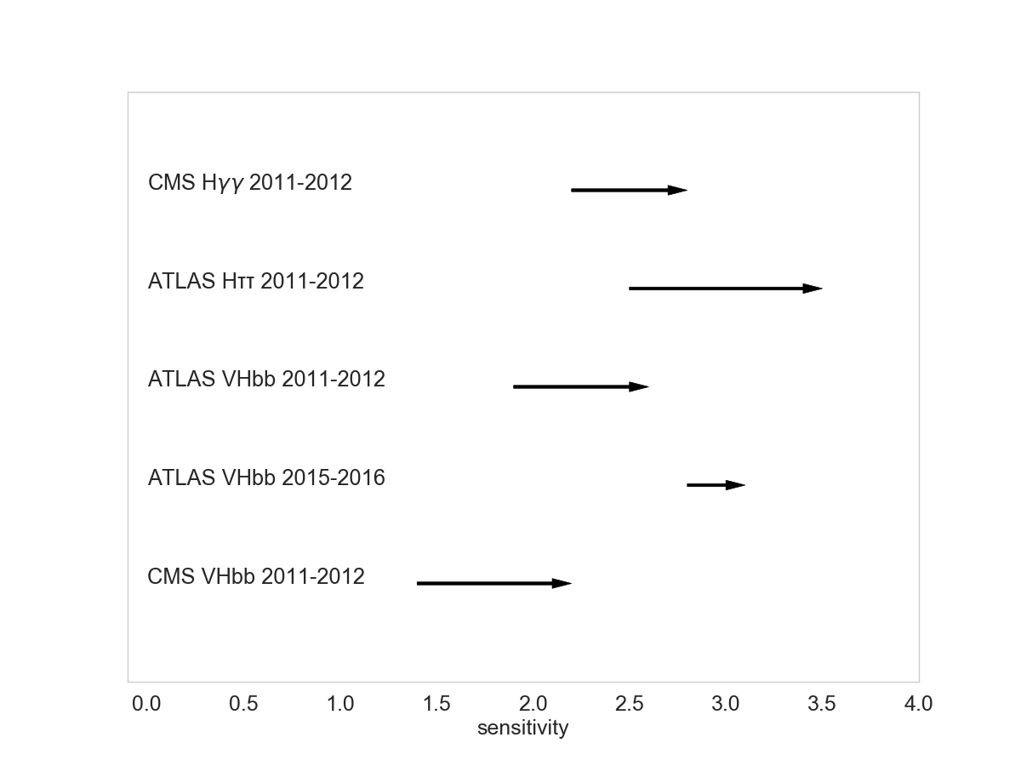
ML on Higgs Physics
At LHC, Machine Learning used almost since first data taking (2010) for reconstruction and analysis
In most cases, Boosted Decision Tree with Root-TMVA, on ~10 variables
For example, impact on Higgs boson sensitivity at LHC, conservatively assuming measurements are statiscally dominated:
51%
85%
73%
15%
125%
From Nature 560, 41–48 (2018) |
σ
➔~50% gain on LHC running

Slide 44

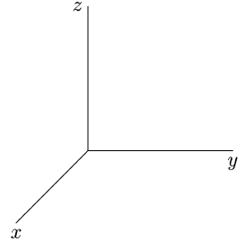
Que fait un classifieur ?
Le classifieur “projette” les deux “blobs” multidimensionnels en maximisant leur difference
A
B
score

Slide 45
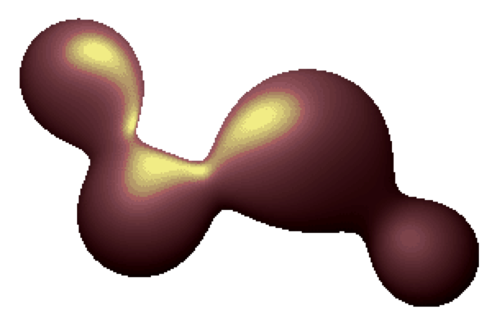
Inférence sans modèle
Kyle Cranmer et al
x(m)
Apprentissage séparation en fonction de m
Ajuster m sur les données
score

Slide 46
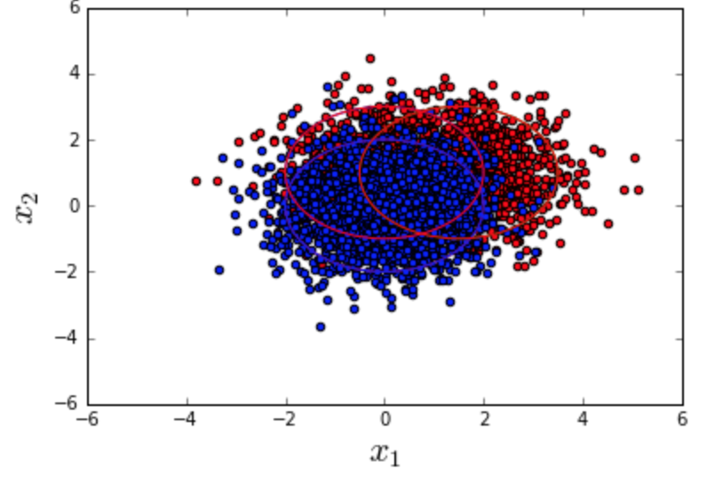
Pas de miracle
Si les fonctions de densité de probabilité (pdf) sont connues, on ne peut faire mieux que le rapport de vraisemblance (théorėme de Neyman-Pearson) :
  L_{S}(x)/L_{B}(x)
  OK mais en général L_{S} L_{B} ne sont pas connus (même pas leur forme)
    + x de grande dimension
ML devient intéressant dans ce cas là
➔approche mixte
B
S

Slide 47
Overtraining / overfitting

Slide 48
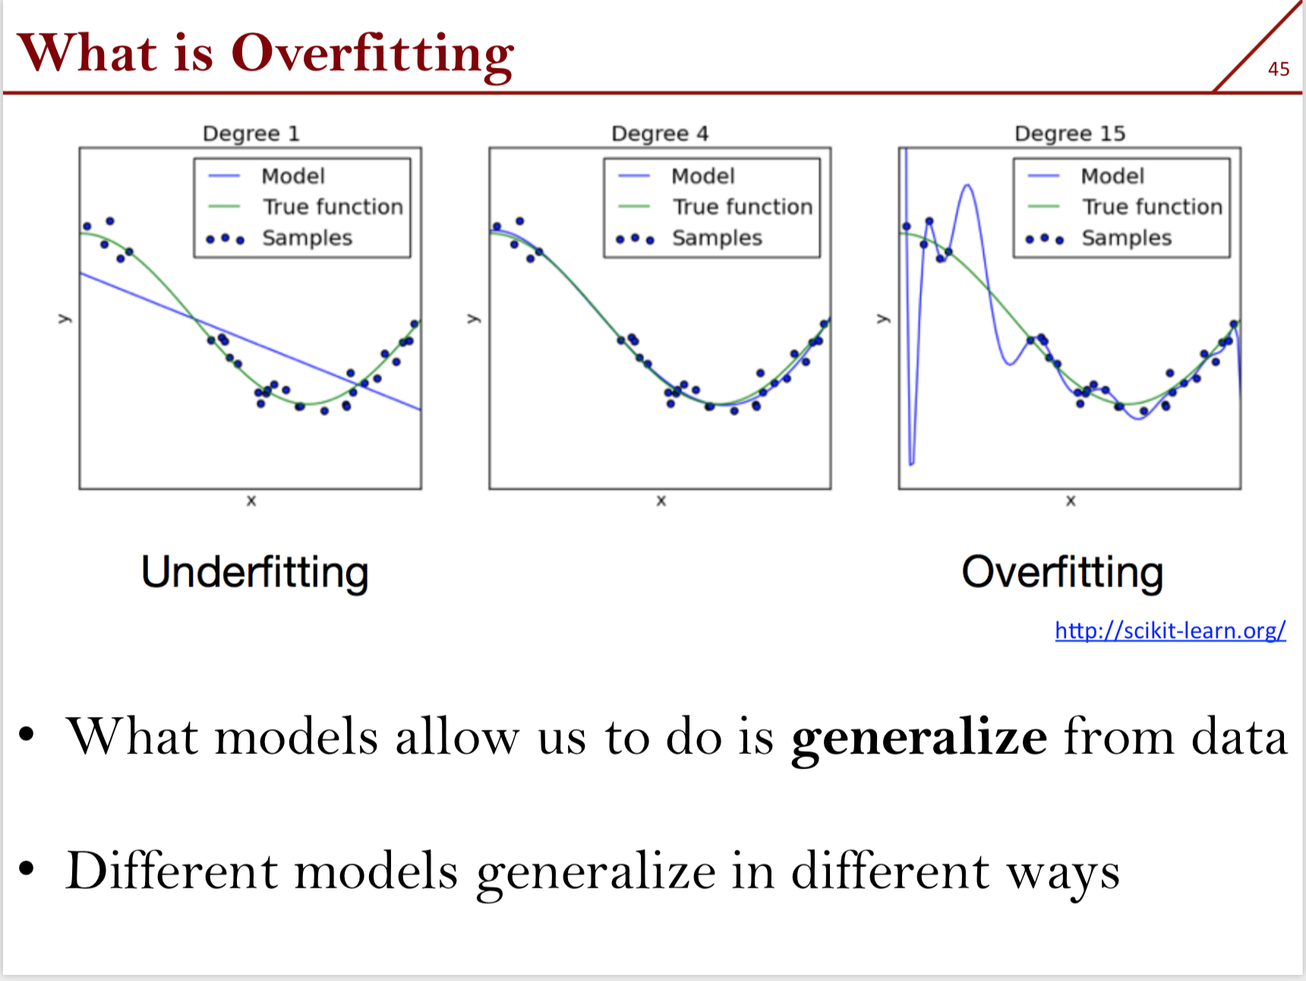

Slide 49
Bias Variance Tradeoff (1)

Slide 50
Bias vs Variance tradeoff (2)

Slide 51
Bias Variance Tradeoff (3)
/ Dataset size

Slide 52
Regularization

Slide 53
Training vs test check
The score distribution should match…
…some discrepancy is OK « dispell the myth » ! Yann Coadou )

Slide 54
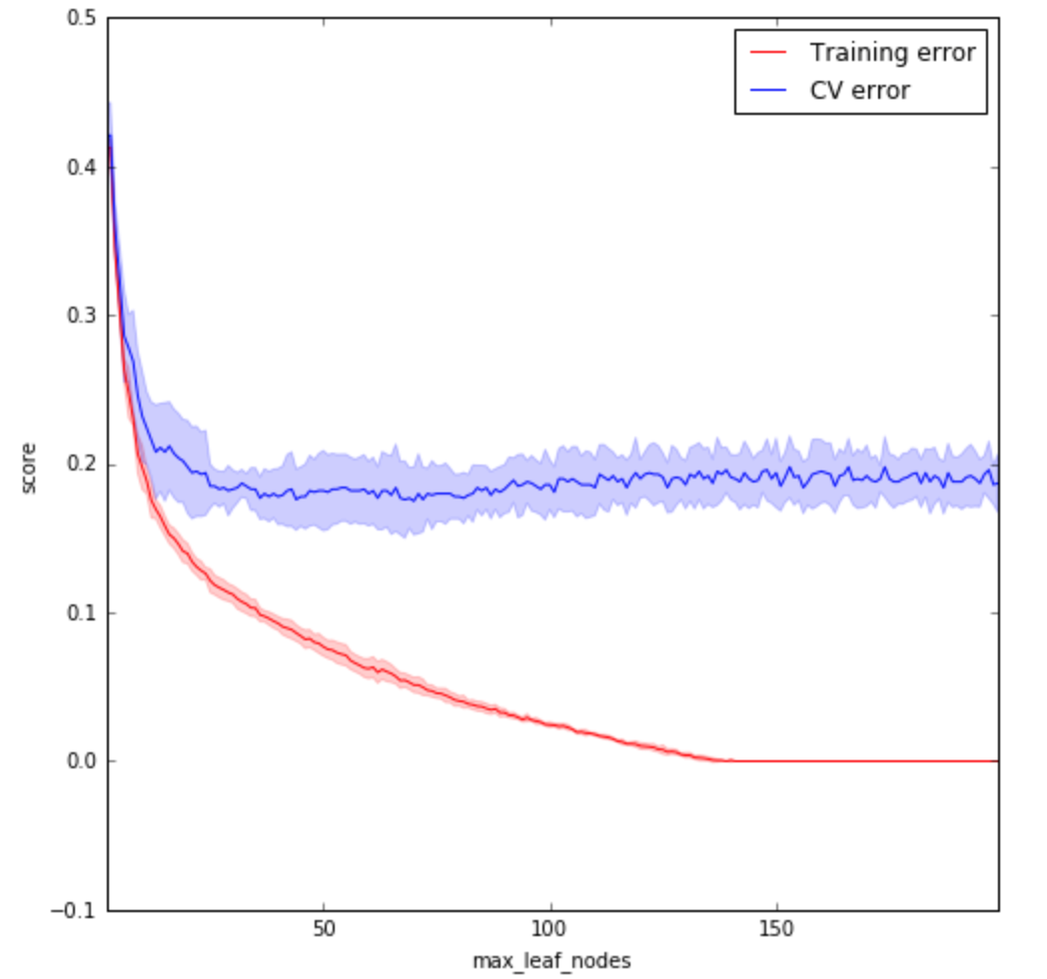
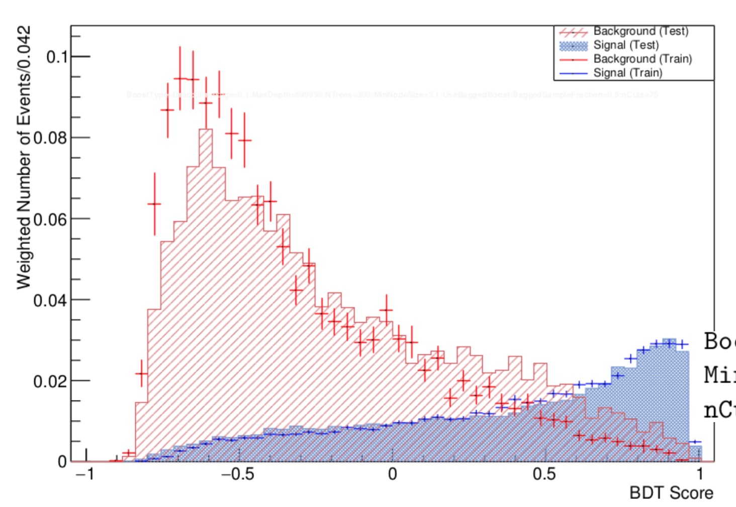
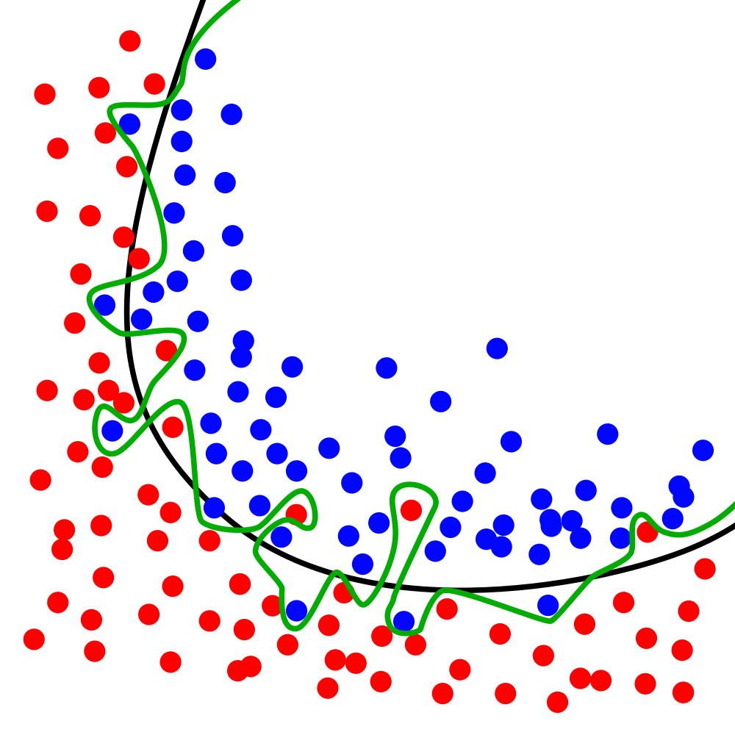
under/over training
Gilles Louppe, github
undertraining
Example of
« controlled »
overtraining
Performance of the classifier
some over training
optimal
clear over training
Some overtraining is good
…provided CrossValidation done correctly!
Complexity of the classifier

Slide 55
Training vs test check (2)
Important to check
⬅Bug!

Slide 56
Cross-validation

Slide 57
Cross-Validation
Goal of CV is to measure performance
and optimise hyper-parameters
One-fold Cross Validation
A
B
A
B
Standard basic way (default TMVA until recently)

Slide 58
Cross-Validation
Two-fold Cross Validation
A
B
A
B
  ➔test statistics = total statistics
  ➔double test statistics wrt one fold CV
  ➔(double training time of course)

Slide 59
Cross-Validation
5-fold Cross Validation
A
B
C
D
E
A
B
C
D
E
  same test statistics wrt two-fold CV,
  larger training statistics 4/5 over ½ (larger training time as well)

Slide 60
Cross-Validation
5-fold Cross Validation
A
B
C
D
E
A
B
C
D
E

Slide 61
Cross-Validation
5-fold Cross Validation
A
B
C
D
E
A
B
C
D
E

Slide 62
Cross-Validation
5-fold Cross Validation
A
B
C
D
E
A
B
C
D
E

Slide 63
Cross-Validation
5-fold Cross Validation
A
B
C
D
E
A
B
C
D
E
  Note : if hyper-parameter tuning, need a third level of independent sample “nested CV”

Slide 64
Cross-Validation
5-fold Cross Validation “à la Gabor” (winner of HiggsML challenge)
A
B
C
D
E
some kind of Average
A
B
C
D
E
  Average of the scores on A B C D is
  often better than the score of one training ABCD
  bonus: variance of the samples an estimate of the statistical uncertainty
  (also save on training time)

Slide 65
Cross-validation
Train on …
 | A | B | C | D | E
A | X
B |  | X
C |  |  | X
D |  |  |  | X
E |  |  |  |  | X
➔Testing variance
➔Testing variance
Test on …
➔Testing variance
➔Testing variance
➔Testing variance
➔Training variance
➔Training variance
➔Training variance
➔Training variance
➔Training variance

Slide 66
Training, Validation, Test
Ideally, look at it only once at the end

Slide 67
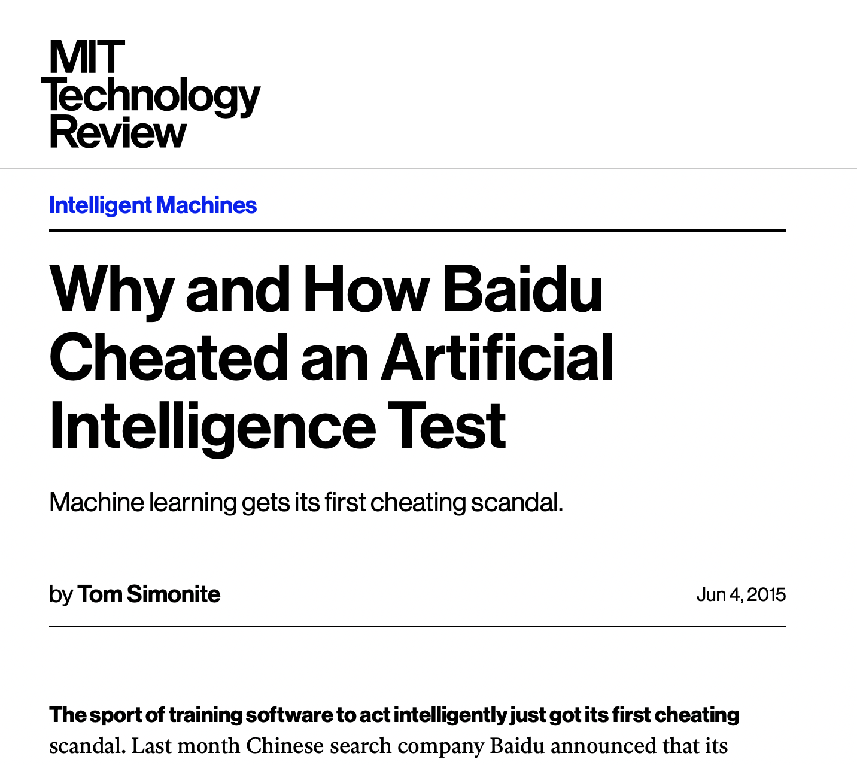
Horror stories
See page
Abuse of validation
set (and no test set)
lead to exagerated claim
Also in physics…
Training on test set particularly
bad because undetectable
unless:
training reproducible
new i.i.d data

Slide 68
Training/Validation/Test
Super important to organise when working in collaboration

Slide 69
Learning curve

Slide 70
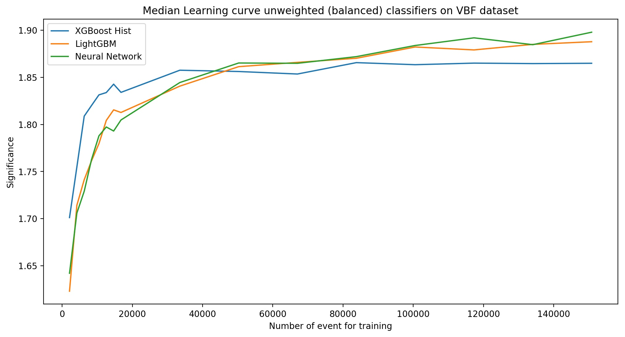
Learning curve
Performance as a function of number of training events
Just an example, things to look at
plateau with full dataset ?
behavior at low values ?

Slide 71
Hyper-Parameter Optimisation (HPO)

Slide 72
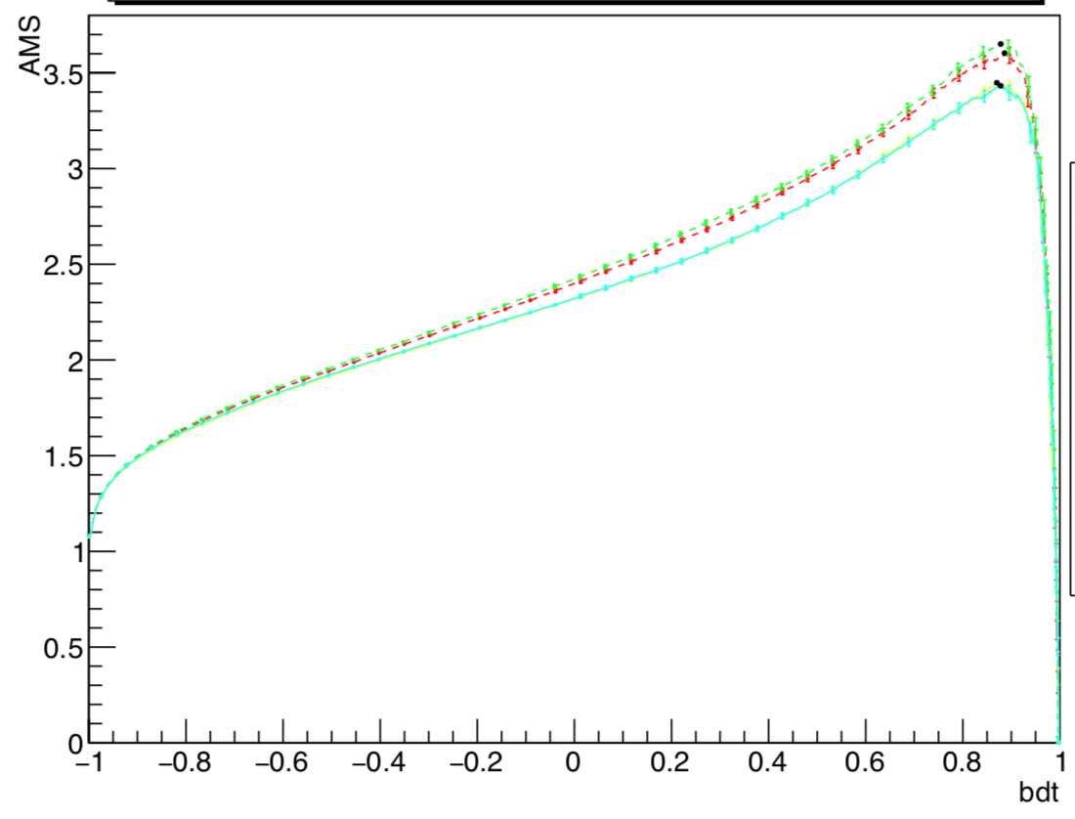
Hyper Parameters Optimisation
HP : all the auxiliary parameters of the algorithm, like Depth of the tree, Number of trees etc….
Very algorithm dependent
(also sklearn GridSearchCV)
A few Hyper Parameters are usually meaningful, easy to spend too much time on it

Slide 73
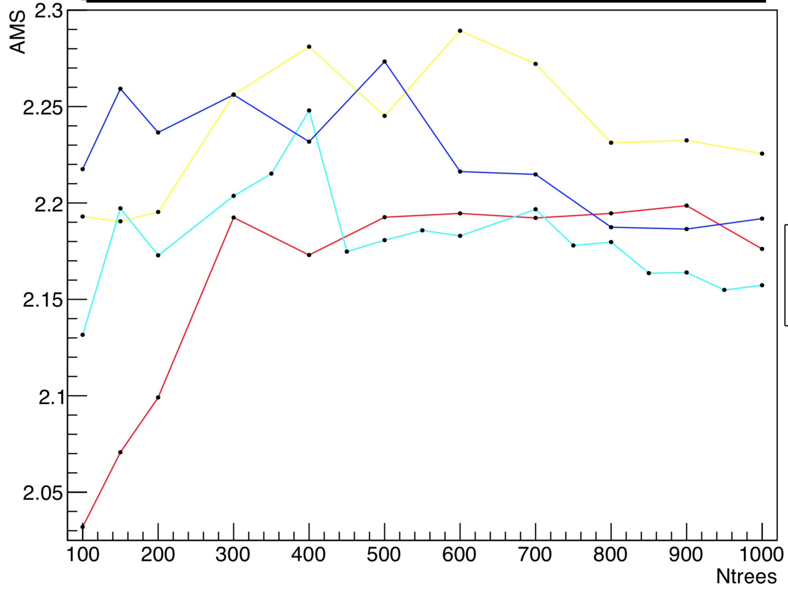
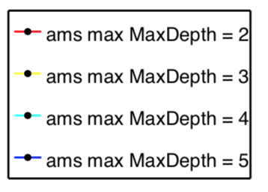
HPO (2)

Slide 74
Feature Importance, and Feature Selection
BB.

Slide 75
Feature Importance
BB
Built-in in algorithms
XGBoost : how often the feature is used
…not what we really want

Slide 76
Feature Selection
Example of an ATLAS experiment analysis, see transp
12 out of 26 features

Slide 77
Feature selection techniques
sdsdsd
Missing : permutation importance (see later)

Slide 78
Results
AUC
sdsd
To be updated with
permutation importance

Slide 79
Permutation Importance
from pip install eli5
Unfortunately does not handle weights well
BB

Slide 80
Data Augmentation

Slide 81
Data augmentation
Classic in general ML
Little used in physics, surprising given that
We are often lacking data
We have some invariances

Slide 82
Reweighting

Slide 83
Re-weighting
Suppose a variable distribution is slightly different between a Source (e.g. Monte Carlo) and a Target (e.g. real data)
  ➔reweight! …then use reweighted events
Weights : w_{i}
=
p_{target}(var_{i})/p_{source}(var_{i})
Target
Source
Target
Source
var
var
What if multi-dimension ?
Usually : reweight separately on 1D projections, at best 2D, because of quick lack of statistics
Can we do better ?

Slide 84
Multidimension reweighting
See demo on Andrei Rogozhnikov github and also Kyle Cranmer’s github
Related : uBoost
Train on separating
Target from Source
Weights : w_{i}
=
P_{target}(score_{i})/p_{source}(score_{i})
Target
Source
Target
Source
score
score

Slide 85
Multi dimensional reweighting (2)
Reweighting the Source distribution on the score allows multidimensional reweighting without statistics problem
Usual caveat still hold : Target support should be included in Source support, distributions should not be too different otherwise unmanageable very large or very small weights
(Note : “reweighting” in HEP language <==> “importance sampling” in ML language)
Only use (that I know off) in published analyses in LHCb
Why ?

Slide 86
Likelihood-free inference
Kyle Cranmer et al.
x(m)
Learn splitting as a function of m
Fit m on data
score

Slide 87
Neural Net

Slide 88
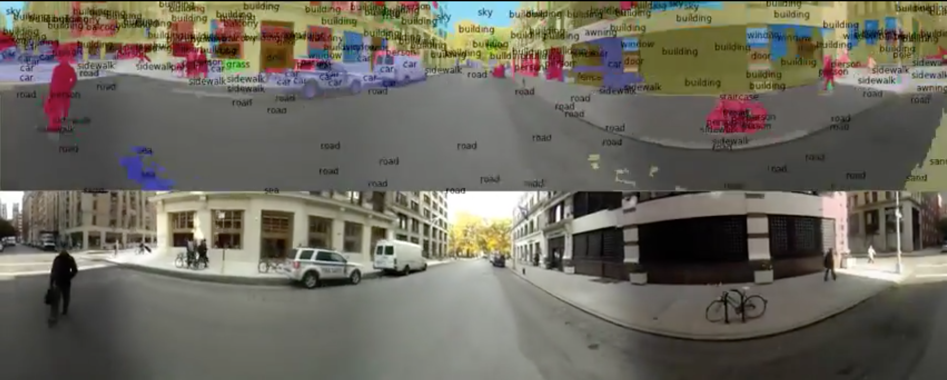
Typical Deep Learning application

Slide 89
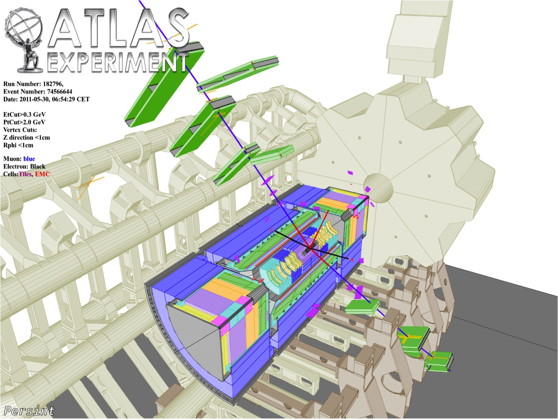
Un événement
H➔Z(➔μ⁺μ⁻)Z(➔e⁺e⁻)

Slide 90
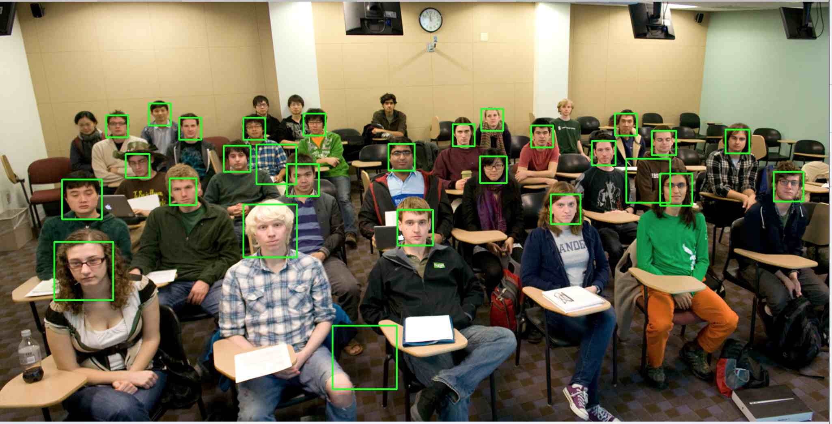
Efficacité
Pureté
Vitesse
…same in HEP
but no image

Slide 91
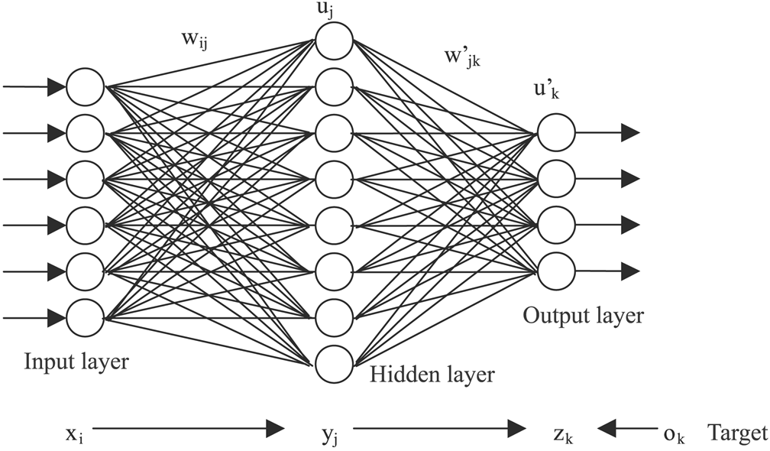
Neural Net in a nutshell
Discrete (classification)
or continous (regress-
Neural Net ~1950!
But many many new tricks for learning, in particular if many layers (also ReLU instead of sigmoïd activation)
“Deep Neural Net” up to 100 layers
Computing power (DNN training can take days even on GPU)

Slide 92
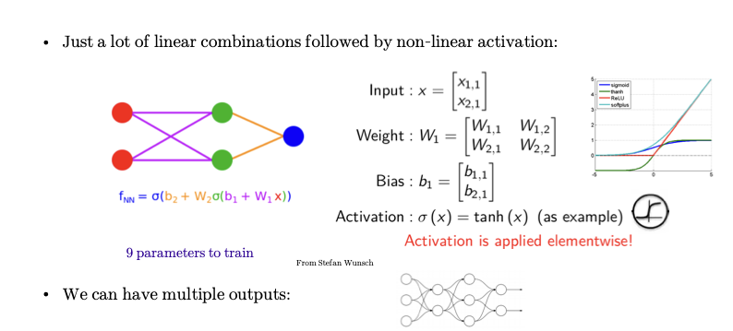
Simplest NN
x
y

Slide 93
Universal Approximation theorem
Mathematical theorem 1991 https://en.wikipedia.org/wiki/Universal_approximation_theorem
Any continuous, bounded function R^{n}➔R^{p}
… can be approximately sufficiently well (better than a given ε)
… with a sufficiently large single hidden layer neural net
But how to build it ?
x_{n}
y_{p}
Addendum ResNet 1 neuron sufficient depth

Slide 94
Universal Theorem at work

Slide 95
Universal Theorem at work

Slide 96
Universal Theorem at work

Slide 97
Universal Theorem at work

Slide 98
Universal Theorem at work

Slide 99
Universal Theorem at work

Slide 100
Universal Theorem at work

Slide 101
Universal Theorem at work

Slide 102
Universal Theorem at work

Slide 103
Universal Theorem at work

Slide 104
Universal Theorem at work

Slide 105
Universal Theorem at work

Slide 106
Universal Theorem at work

Slide 107
Universal Theorem at work

Slide 108
Universal Theorem at work

Slide 109
Activation functions
~classic
~NEW (this century)!

Slide 110
Optimisation
Note : https://www.college-de-france.fr/site/stephane-mallat/course-2019-03-20-09h30.htm

Slide 111
Neural Network Optimization

Slide 112
Régression Linéaire
Boskovic, Legendre, Laplace, Gauss
y
Bonheur moyen
x
y=f(x)
PNB par habitant

Slide 113
Neural Network loss function

Slide 114
Minimisation dimension 1
Taylor Young
Looking for position of minimum x_{m}

Slide 115
Minimisation dimension n
gradient
hessien
gradient

Slide 116
Gradient descent
BB
Computing Hessian not practical!

Slide 117
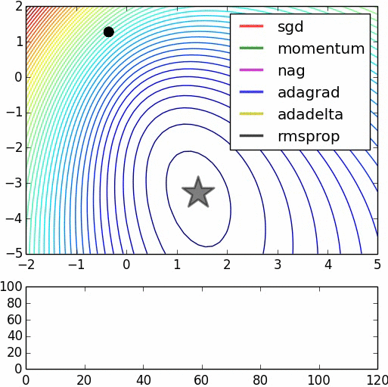
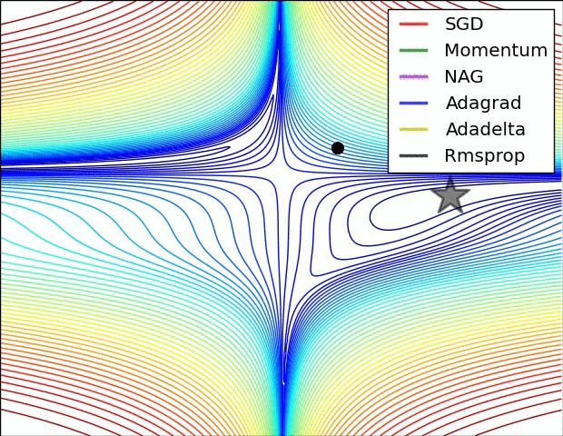
Optimisation
Up to million of parameters to optimise….
Wealth of newish algorithms in particular Stochastic Gradient Descent (SGD) and more
Alec Radford
~NEW (this century)!

Slide 118
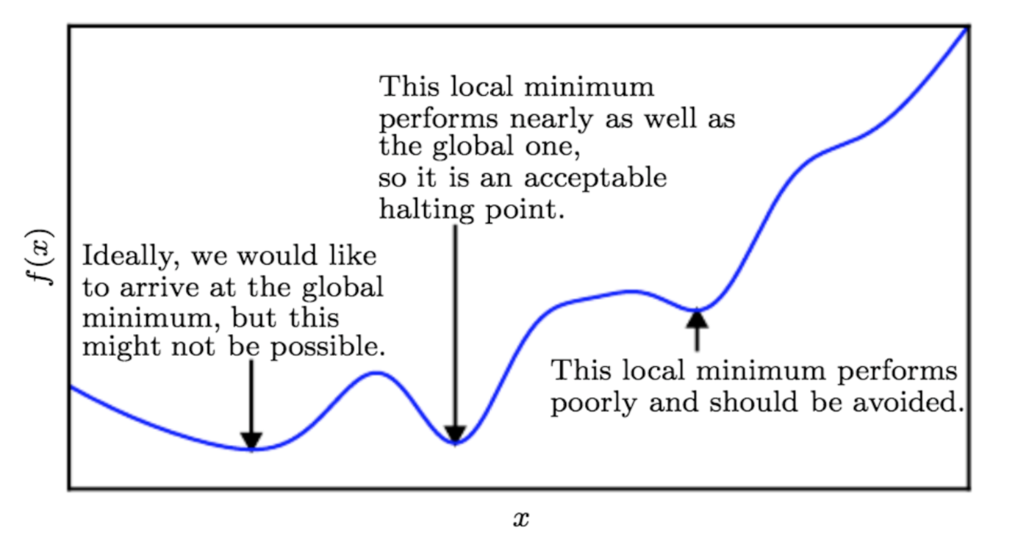
Addendum on optimisation
Many minima but….

Slide 119
Example

Slide 120
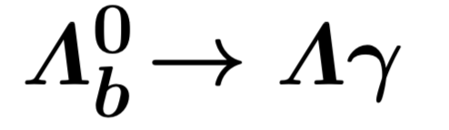
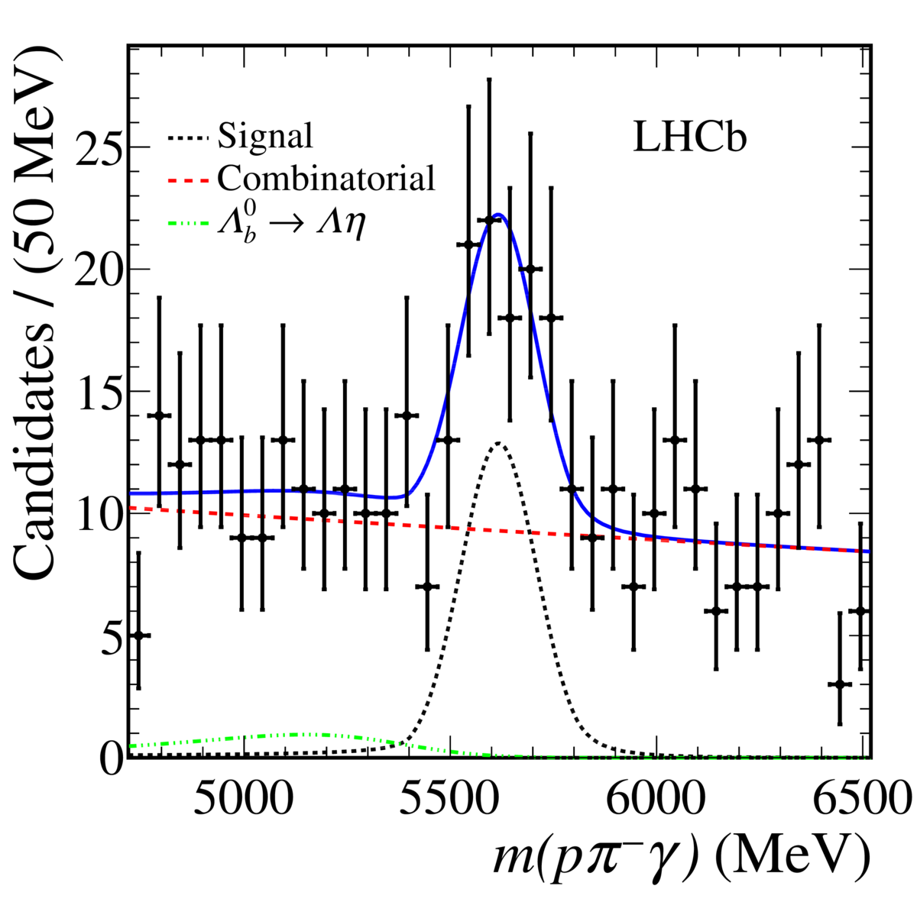
BDT/NN with mass peak
arXiv 1904.06697
Example: LHCb first evidence for
BDT with a dozen variables
➔rejection of bkg 99.8% while retaining 33% sig.
(make sure it does not sculpt the mass spectrum)
Fit the mass spectrum:
➔hard to find a B physics analysis NOT using BDT or shallow NN

Slide 121
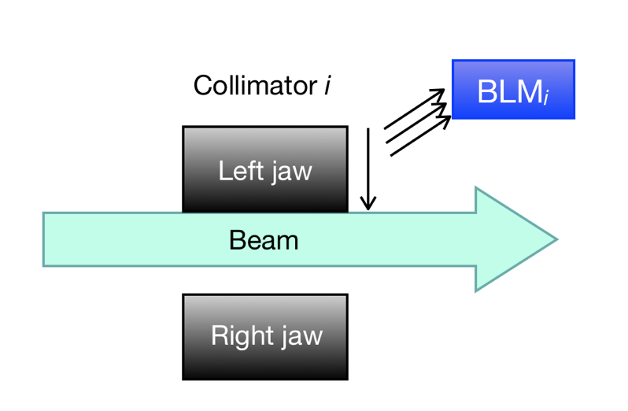
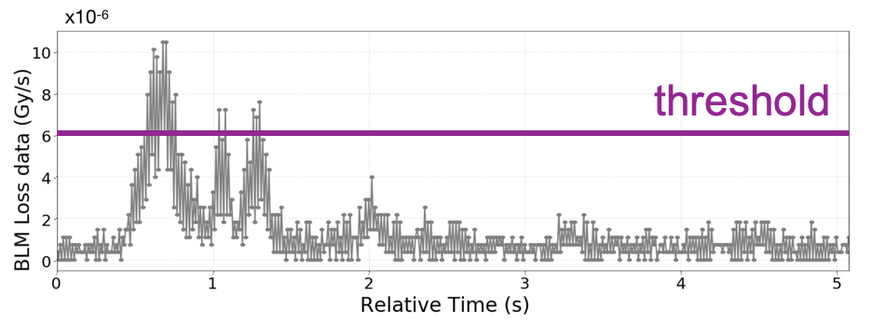
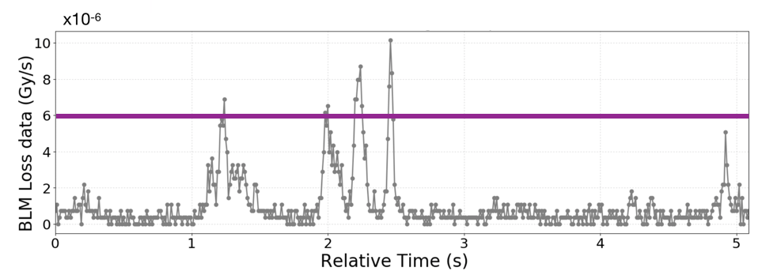
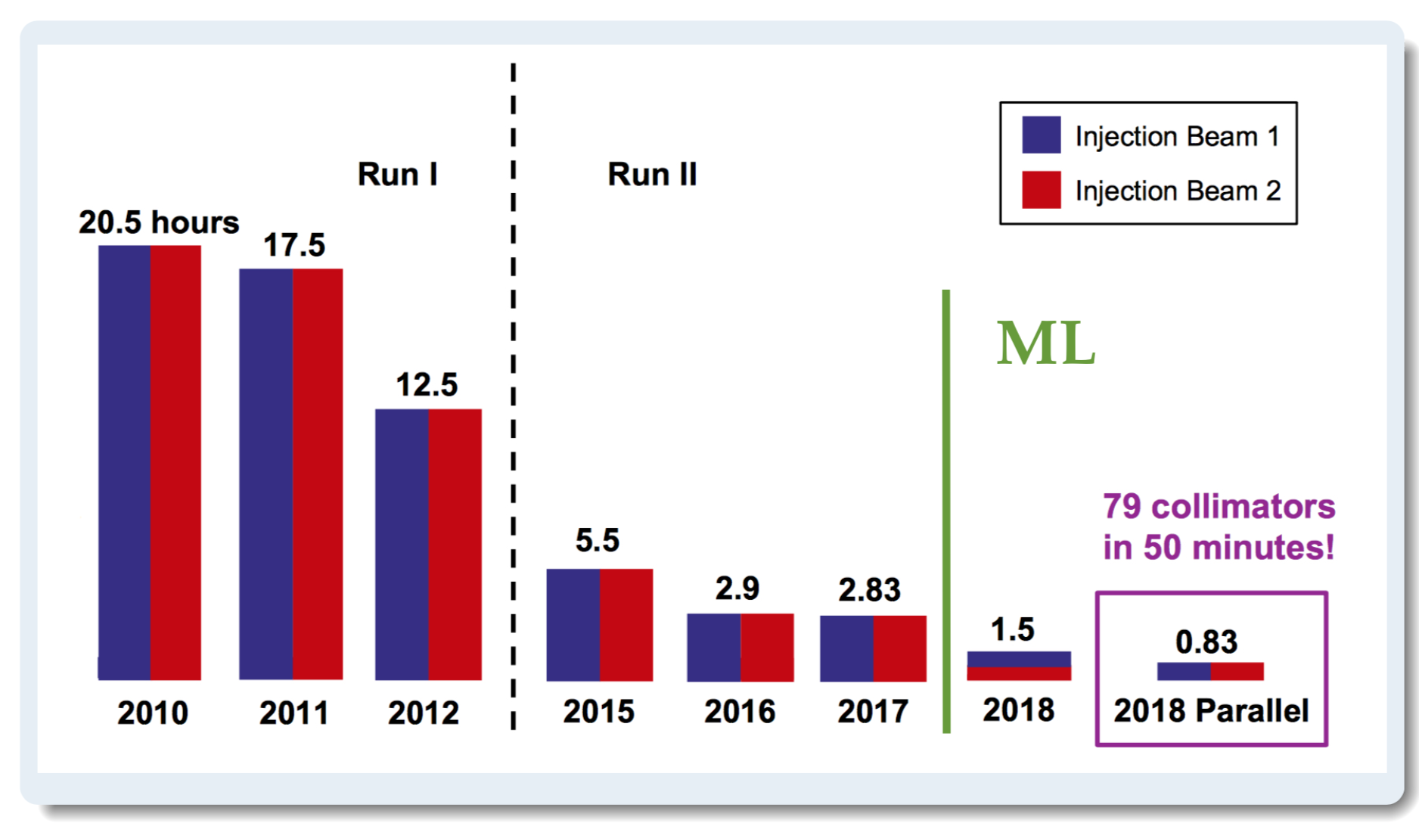
LHC spikes classification
G. Azzopardi, et al., NIM-A, 2019. Frederik Van Der Veken , EPS HEP 2019
« signal »
« background »
Classifier trained from
~9000 real spikes
labelled by hand (!)
Now used in production
for automatic collimator
alignment

Slide 122
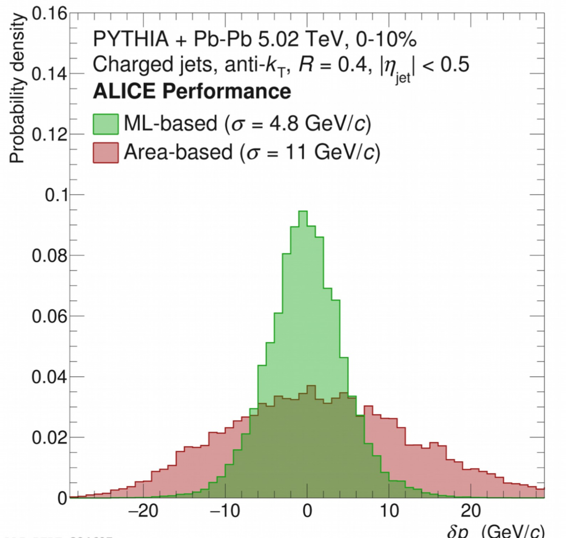
Heavy Ion Jet regression
Ruediger Haake, EPS HEP 2019, RH et al., PRC 99, 064904 (2019)
ML regression (predicting a scalar rather than a binary value) is very similar to classification, same techniques, same tools, e.g. :
Anti-kT jet reconstruction in HI suffer from specific enviromnent
Embed jet in PbPb data
Regress original jet energy from Area-based jet energy Nconst, angularity and 8 track jet moments
Use 3 layers NN
➔it works!

Slide 123
Modern Software and Tools
New version of TMVA (root 6.0.8 on beyond)
  Jupyter interface
  Hyper-parameter optimisation / Cross-validation
  Interface to R, sk-learn etc…
  Still clumsy and slow wrt to the software below
  However : better convert ntuples to numpy array (uptoroot) and use the software below
Non HEP software
  Sci-kit learn : de facto standard toolbox ML (except Deep Learning) (python, but fast)
  Keras+TensorFlow (Google) : NN toolbox (build a NN in a few lines of python)➔ but pyTorch (Facebook) lately gaining speed ➔ TensorFlow 2 is integrating Keras interface
  XGBoost best BDT, both speed (x 10) and performance (c++ with python interface) (check T. Keck Comput Softw Big Sci (2017) 1: 2 for a comparison with TMVA and others). First use in physics paper :ATLAS Higgs ttH arxiv 1712.08891 ➔LightGBM (Microsoft, but open source) gaining speed lately
  Jupyter interface for development (not production) ➔ demo
PyHEP to be watched (HEP layer on top of the above)
Note : for ~20 variable classification/regression task gradient BDT is still the tool of choice!
Platforms
  Your laptop is sufficient in many cases : install e.g. Anaconda https://docs.continuum.io/anaconda/install
  If not, more and more platforms looking for users, maybe on your campus
  GridCL @ LLR (not for production though)
  50 GPU platform at Lyon CC-IN2P3
  Google Colab
For CERN users:
  SWAN interactive data analysis on the web see https://swan.web.cern.ch/content/machine-learning
  CVMFS ML setup for any CVMFS enabled platform
  Dockerised environments gainins speed

Slide 124
Break

