Slide 1
Les expériences du future: détecteurs
École de GIF 2019, 2-6 Septembre 2019
École polytechnique - Palaiseau
D. Contardo - IP2I CNRS/IN2P3

Slide 2
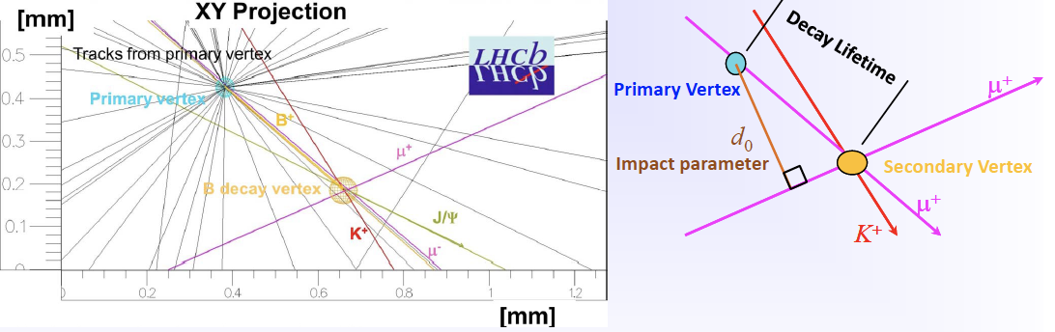
Tracking systems
Provide most precise measurement of charged particle trajectories to form primary (interaction) and secondary (decay) vertices,
to estimate momentum from curvature in magnetic field
ATLAS
cτ c(b) quarks ≃ 120(470) µm

Slide 3
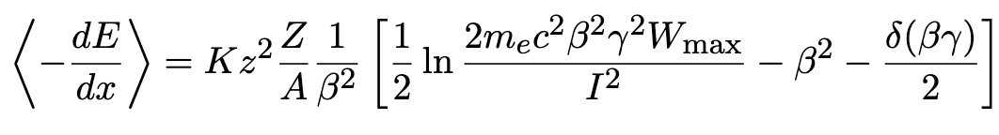
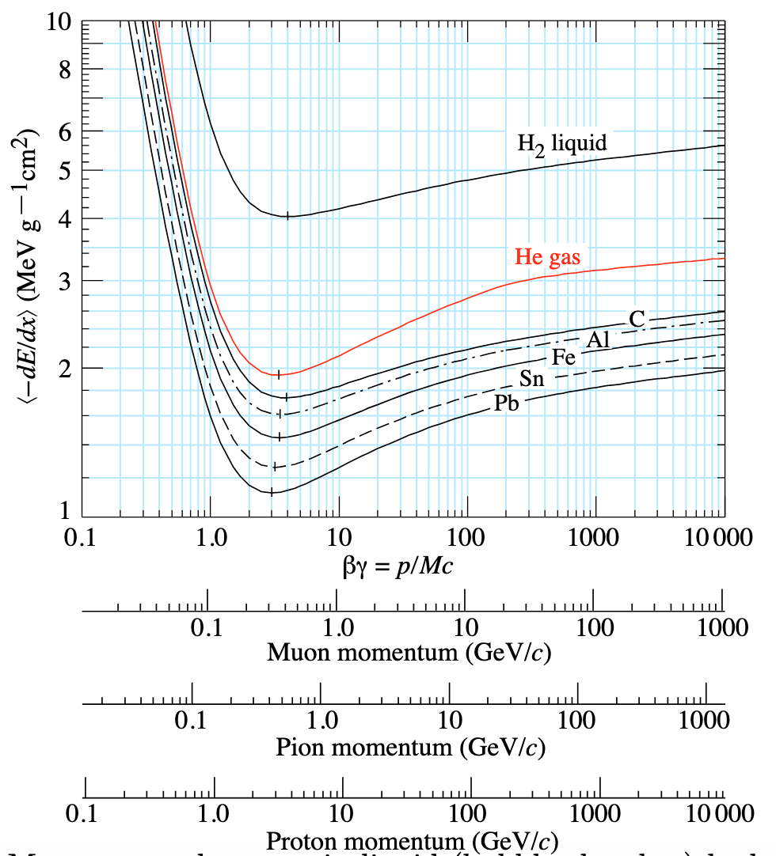
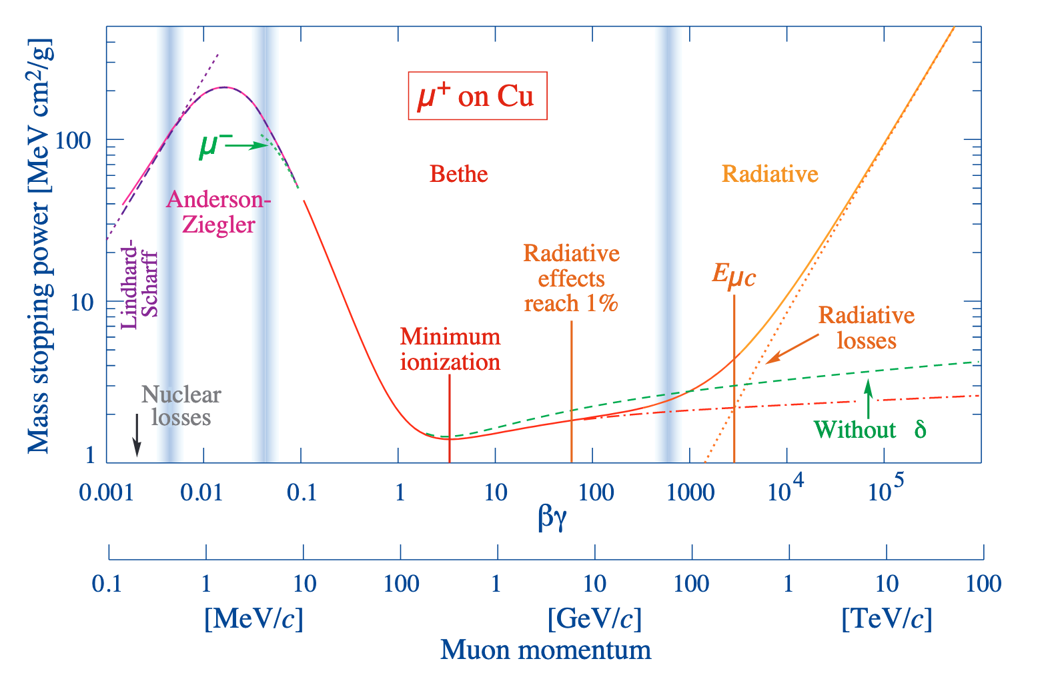
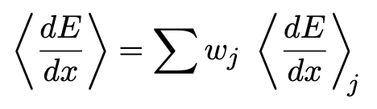
Charged particle energy loss in matter
Bethe & Bloch formula (MeV g⁻¹ cm²), M ⨠ m_{e}
Detectors are in the range 0.1 GeV to TeV
Trackers are measuring ionization
e
In composite material
* Particle Data Booklet http://pdg.lbl.gov/2019/reviews/rpp2018-rev-passage-particles-matter.pdf and https://arxiv.org/pdf/1804.11246.pdf
Notes:
Low speed more time for ionization, 1/β²
relativistic rise (⊥ field increase with γ frather interactions more probable) ln β²γ²
Plateau polarization effect δ/2
Rise from bremsstrahlung radiation
At very low energies, also shell corrections –C/Z

Slide 4
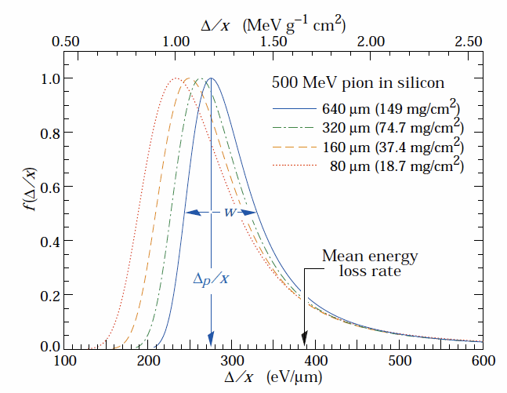
Charged particle energy loss in matter: signal
Signal in thin material layers is described by Landau-Vavilov-Bichsel distribution
In Silicon dE/dx = 3.88 MeV/cm and average e-h pair pair energy is 36 eV/
→ S ≃ 106(70) e-h pairs/µm average(maximum probability)
* Particle Data Booklet http://pdg.lbl.gov/2019/reviews/rpp2018-rev-passage-particles-matter.pdf and https://arxiv.org/pdf/1804.11246.pdf

Slide 5
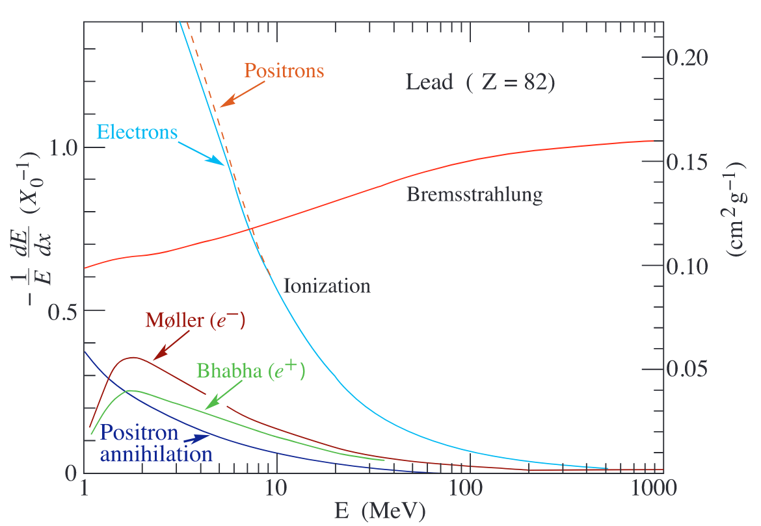

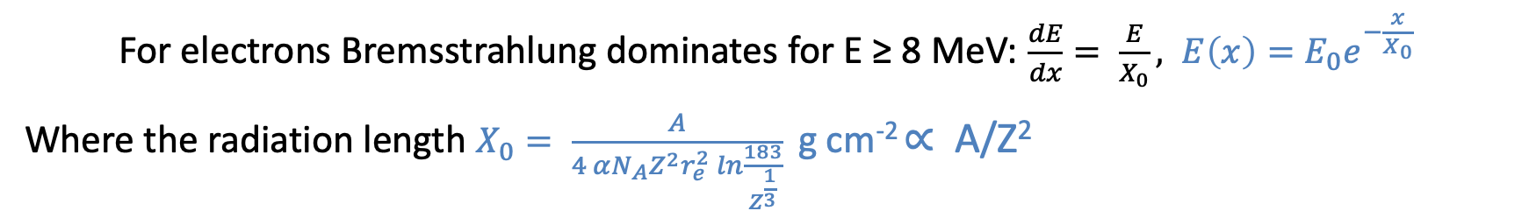
Charged particle energy loss in matter: Bremsstrahlung
$$\frac{dE}{dx}=4 αN_{A}\frac{z^{2}Z^{2}}{A}{\left(\frac{1}{4πϵ_{0}}\frac{e^{2}}{mc^{2}}\right)}^{2}E ln\frac{183}{Z^{\frac{1}{3}}}∝\frac{E}{m^{2}}$$
For electrons Bremsstrahlung dominates for E ≥ 8 MeV: $\frac{dE}{dx}= \frac{E}{X_{0}}, E\left(x\right)=E_{0}e^{−\frac{x}{X_{0}}}$
Where the radiation length $X_{0}= \frac{A}{4 αN_{A}Z^{2}r_{e}^{2} ln\frac{183}{Z^{\frac{1}{3}}}}$ g cm⁻² ∝ A/Z²
, for composite: 1/X₀ = Σ_{j} w_{j}/X_{j}
* Particle Data Booklet http://pdg.lbl.gov/2019/reviews/rpp2018-rev-passage-particles-matter.pdf and https://arxiv.org/pdf/1804.11246.pdf

Slide 6
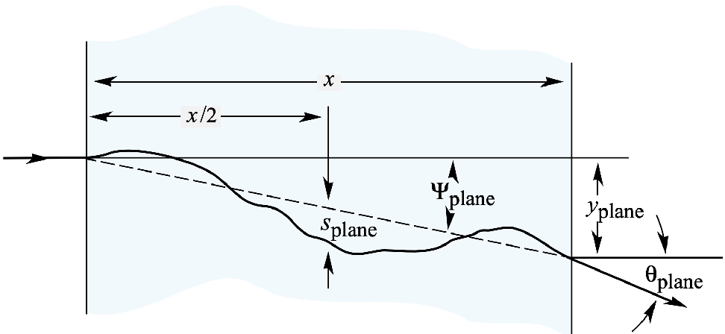


Charged particle passage in matter: multiple scattering (MS)
Multiple scattering is a limitation to trajectory measurement precision
Gaussian approximation sufficient for most application

Slide 7
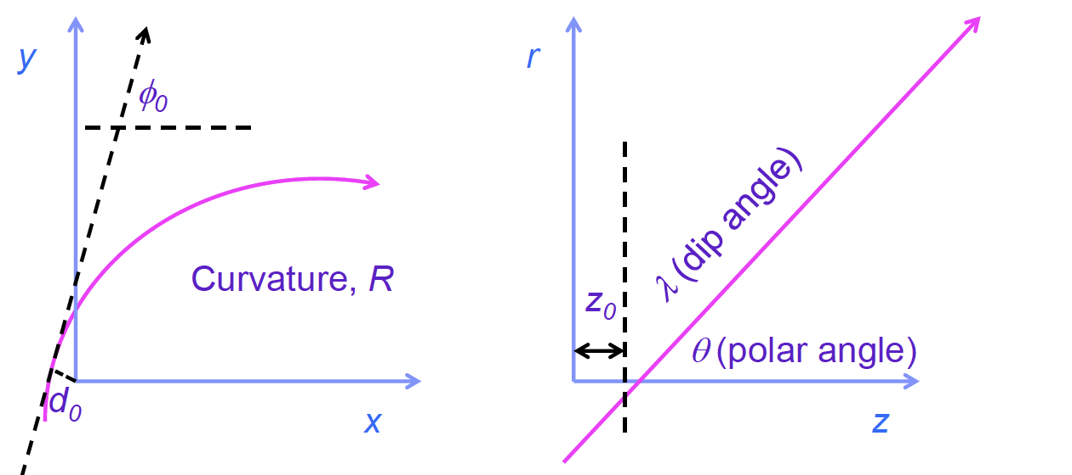
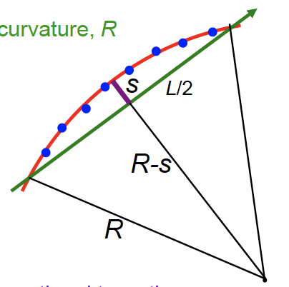
Tracking systems design: momentum measurement in B-field
Track parameters
  Transverse (xy) and longitudinal (rz) projections, Impact Parameters (IP) d₀ and z₀
Transverse momentum
  p_{T} (GeV/c) = 0.3 B(T) R(m)
  R = L²/8s + s/2 ≃ L²/8s
  L = path in B-field
Resolution¹⁾: σ(p_{T})/p_{T} = 8p_{T}σ(s)/0.3BL²
With N equally spaced points of resolution σ(rΦ): σ(s) = √(720/(N+4)) . σ(rΦ)/8 (Gluckstem formula)
σ(rΦ) has a constant term from intrinsic precision + a multiple scattering term ∝ 1/(p_{T} sin^{1/2} (θ)) √(L/X0)
σ(p_{T})/p_{T} = ap_{T} ⊕ b/sin^{1/2}(θ)
Where a depends on 1/BL², number of layers & intrinsic resolution and b depends on B, L number of X₀
Detectors are aligned with muons (from collisions and cosmic) and measured field MAP is corrected from mass measurements (ex. J/Ψ)

Slide 8
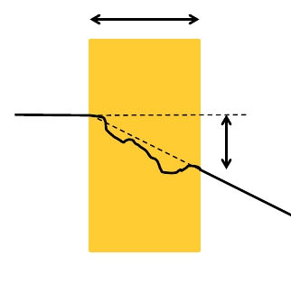
Tracking systems design: transverse (longitudinal) IP resolution
Track origin resolution determines quality of association to collision vertex and decays
  Geometry term: σ²_{geom.} (d₀) = [(r₁σ₁)² + (r₂σ₂)² ]/(r₂ – r₁)²
    r₁ - r₂ and σ₁/σ₂ inner/outer radii and hit resolutions
  MS term: σ²_{MS}(d₀) = Σ^{n}_{j} (r_{j} σ(Φ))² , n number of layers
    σ_{j}(d₀) = r_{j}σ(Φ) = (r/sin(θ)p)13.6(MeV)√(x/sin(θ) X₀) [1 + 0.38 log (x/sin(θ)X₀)]
      x layer thickness, X₀ radiation length θ track polar angle, Φ scattering angle
x
Φ
Transverse IP resolution: σ(d₀) ≃ a ⊕ b/p_{T} sin^{1/2} (θ)
Constant term depends only on geometry, multiple scattering term depends on material, transverse momentum and pseudo-rapidity η¹⁾
σ(d₀) is driven by the vertex detector performance (Si-pixel detector)
η = -log [tan(θ/2)]

Slide 9
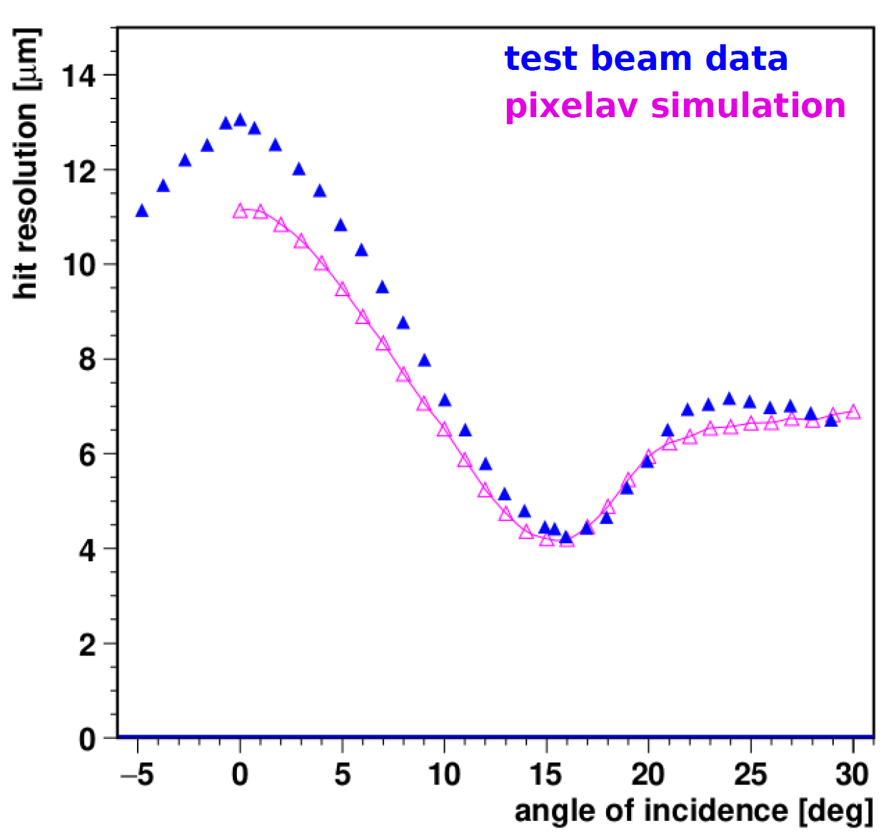
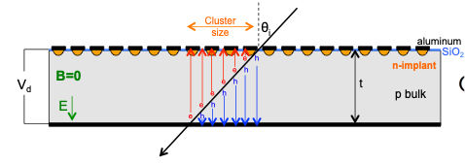
Tracking systems design: hit position resolution
Intrinsic resolution is driven by channel pitch, charge sharing across channels, and Signal to Noise ratio (S/N)
  In binary readout (no amplitude measurement) position is given by the center of the channel or 1/2 depending on cluster size, eg number of channels with S/N above threshold: σ(x) = d/√12 to d/2√12
  In digital readout position can be weighted with signal amplitude: σ(x) ∝ 1/(S/N)
pitch d
Si-sensor
CMS HL-LHC pixel sensors
150 µm thick, 50x50 µm²
Charge sharing depends on diffusion¹⁾ in sensitive element, S/N²⁾, incident angle and B-field, Resolution³⁾ optimization is a compromise in layer thickness, pitch and configuration parameters⁴⁾ It should also consider 2-tracks separation, requiring thorough simulation and measurements
Diffusion σ = √(2Dt_{d}), t_{d} drift time, D = µ kT/q → σ ≃ 8 µm for 300 µm thickness
S/N degrades with irradiation and cross-talk effect should be considered
Ultimate resolution is also limited by δ-rays emission that shift center of gravity (favoring small thickness but allowing lower diffusion),
Compensating or not Lorentz angle in B-field and/or tilting modules compared to ⊥ incidence

Slide 10
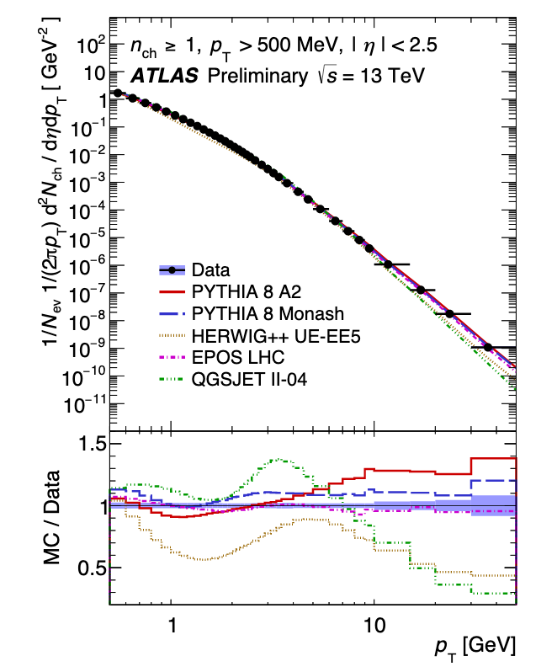
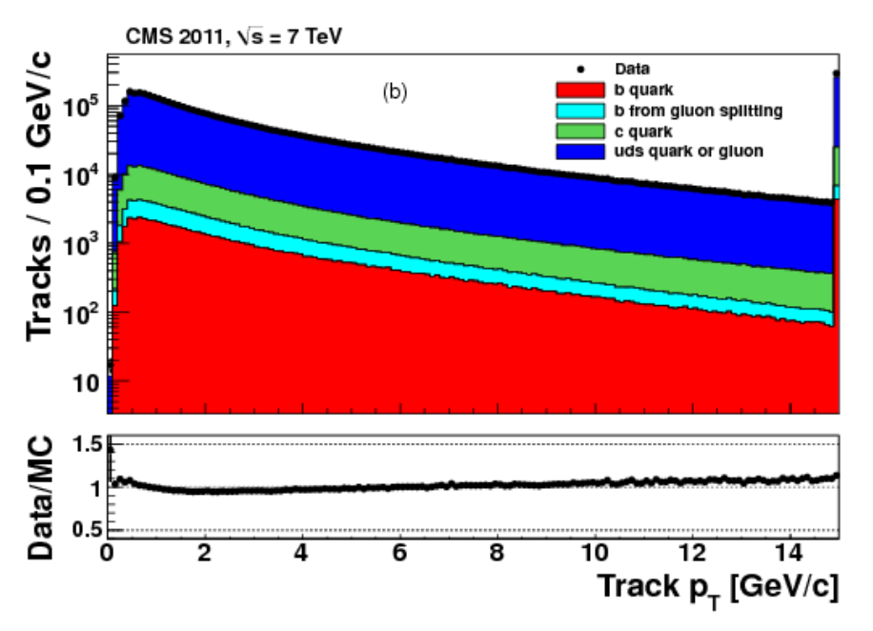
Tracking system design: physics parameters
Measuring low momentum tracks is important for hard scatter vertex and for pile-up mitigation

Slide 11
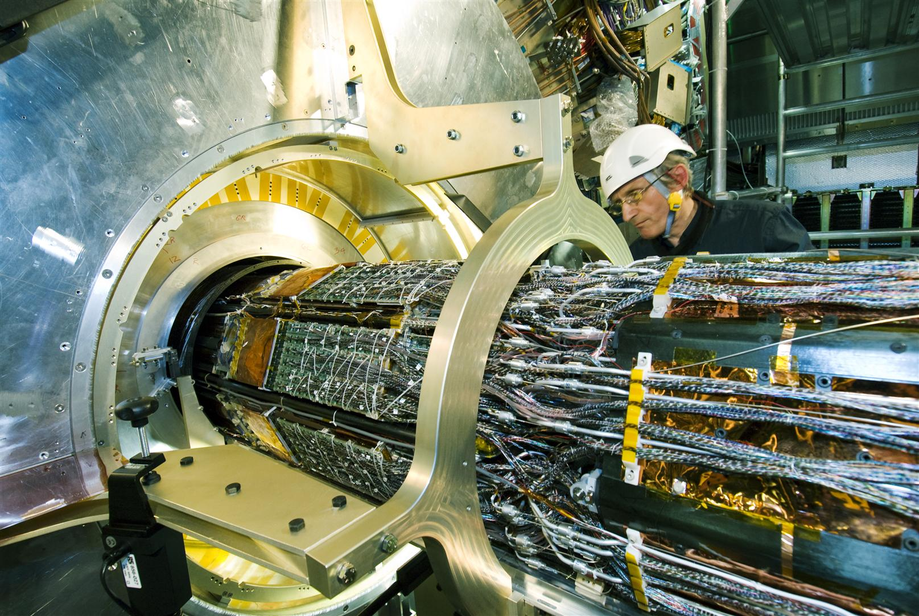
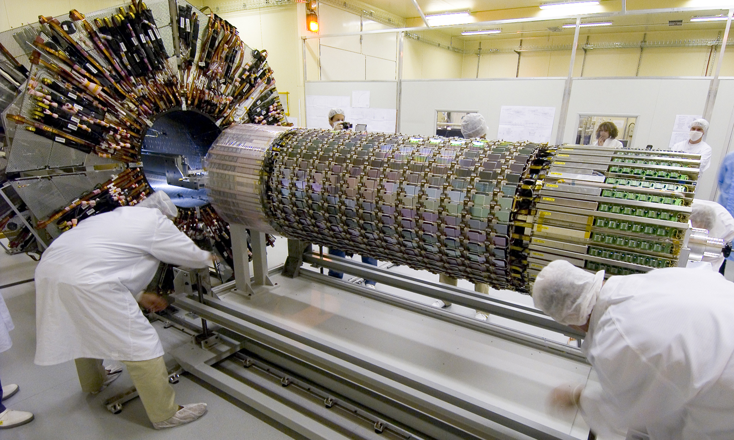
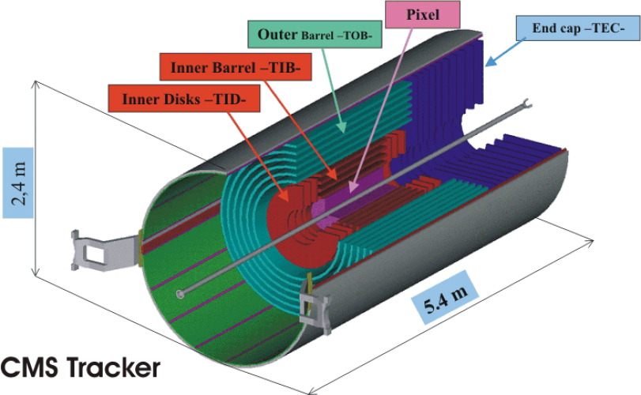
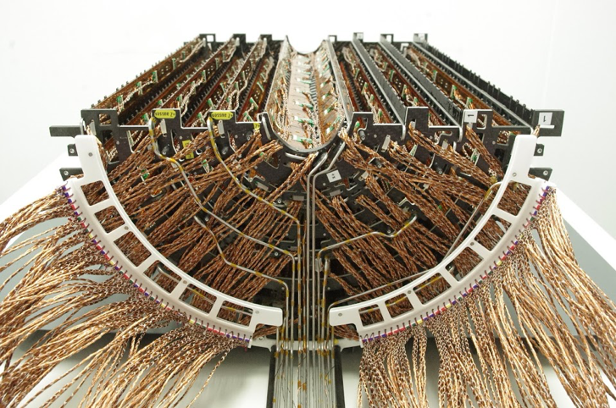
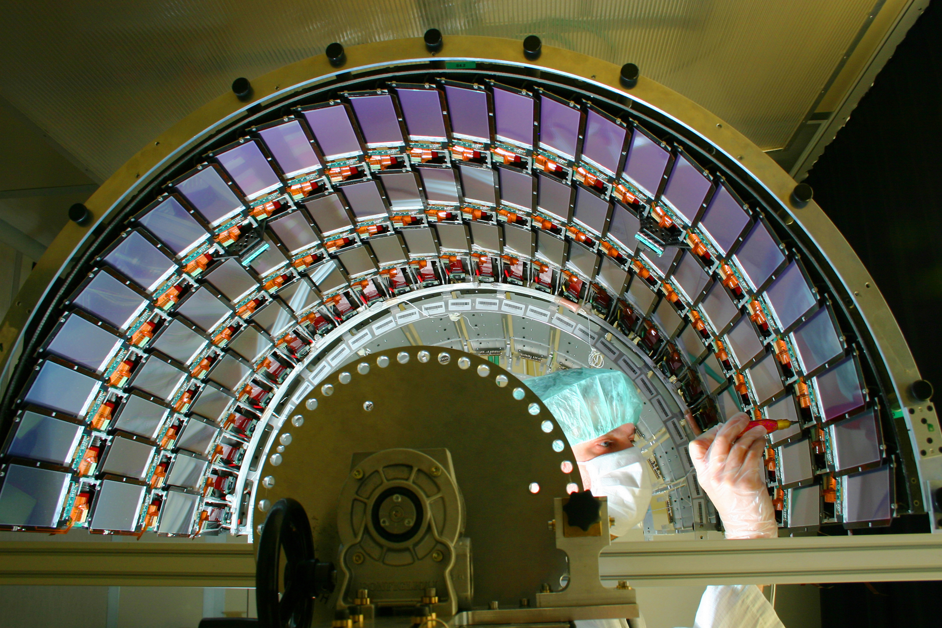
Current trackers: ATLAS and CMS examples
ATLAS
36 TRT 4 mm straws precision ≃ 120 - 140 µm, 4x2 Si strips layers precision ≃ 120 - 140 µm
Silicon Pixels
50 x 250-400 µm² ~ 1.7 m² ~ 80 Mch
Barrel Silicon Strips
80 µm pitch ~ 60 m² ~ 6 Mch
4 barrel layers and 3 disks
precision ≃ 10 -15 µm
10 x 2 barrel layers and 9 disks
precision ≃ 20 - 30 µm
CMS
Silicon Pixels
100 x 150 µm² ~ 1.3 m² ~ 124 Mch
Barrel Silicon Strips
80 - 180 µm pitch ~ 200 m² ~ 9.6 Mch

Slide 12
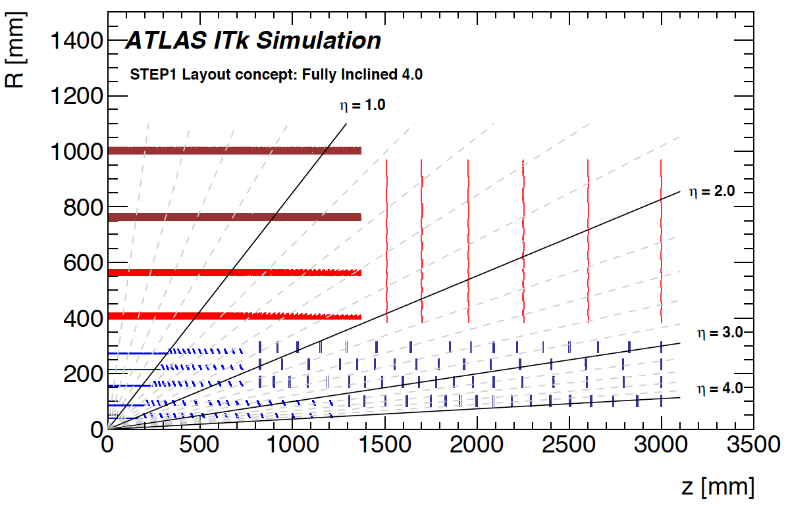
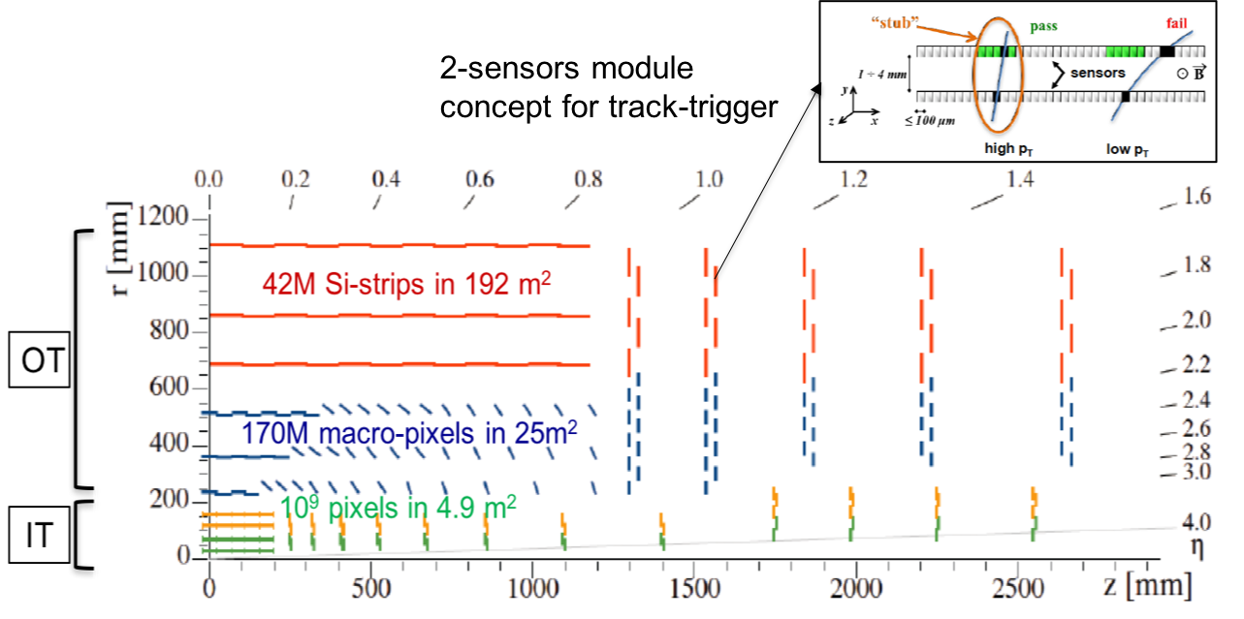
Future Silicon trackers: ATLAS and CMS optimizations at HL-LHC
Overall configuration drivers
Both trackers extend Inner Tracker pixel (IT) coverage up to η ≃ 4 for VBF-H and VBS physics
ATLAS has a 5 layers barrel pixel detector
  Should optimize IP resolution (depending on MS), and also improve two track separation
CMS has a design to provide Outer Tracker (OT) track parameters in hardware trigger at 40 MHz
  Possible thanks to the high B-field, requires a pixelated layer close enough to the beam for z-coordinate measurement, but prevents a 5th pixel barrel layer
Inner pixel layers are replaceable both in ATLAS and CMS
Stereo for z/r-coordinate in OT
OT
291 mm
160 mm
IT
39 mm
29 mm

Slide 13
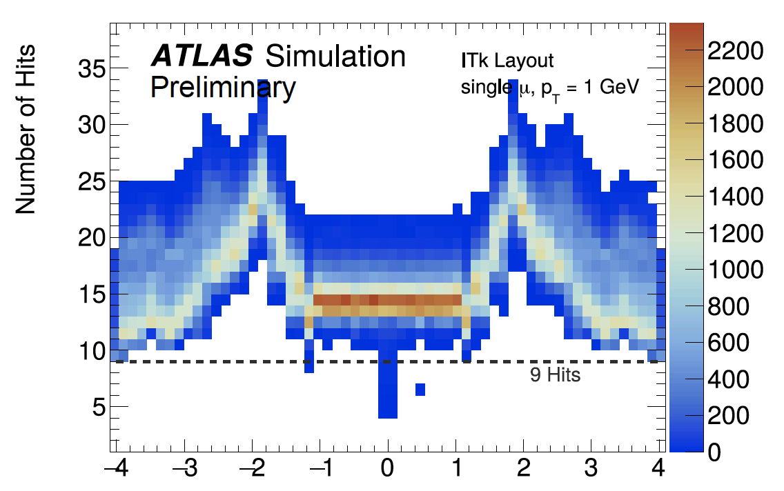
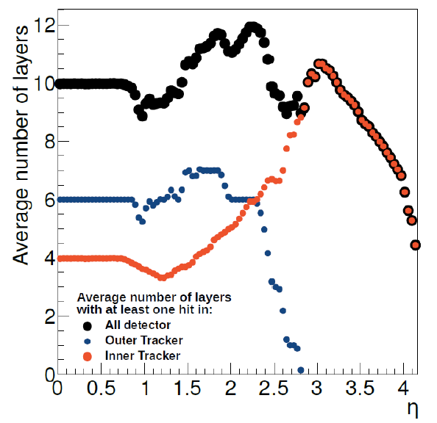
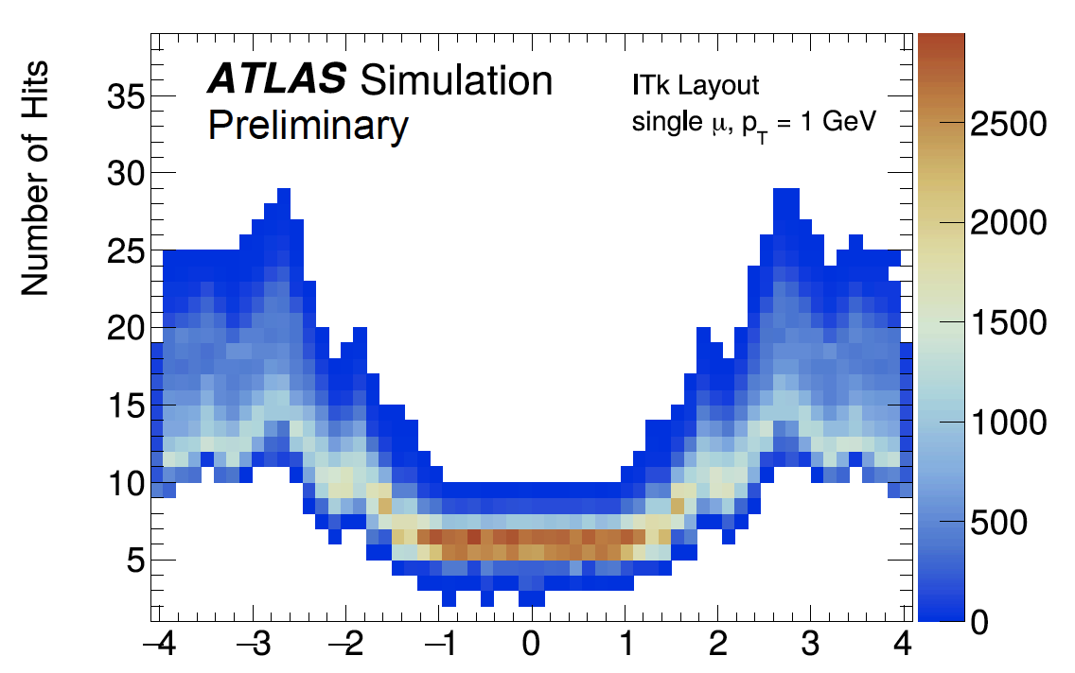
Future Silicon trackers: ATLAS and CMS optimizations at HL-LHC
Main configuration parameters
Number of hits per track: the figure of merit is the efficiency, including redundancy
Not fully comparable ATLAS plots include overlaps
total
Pixels only
https://cds.cern.ch/record/2669540/files/ATL-PHYS-PUB-2019-014.pdf

Slide 14
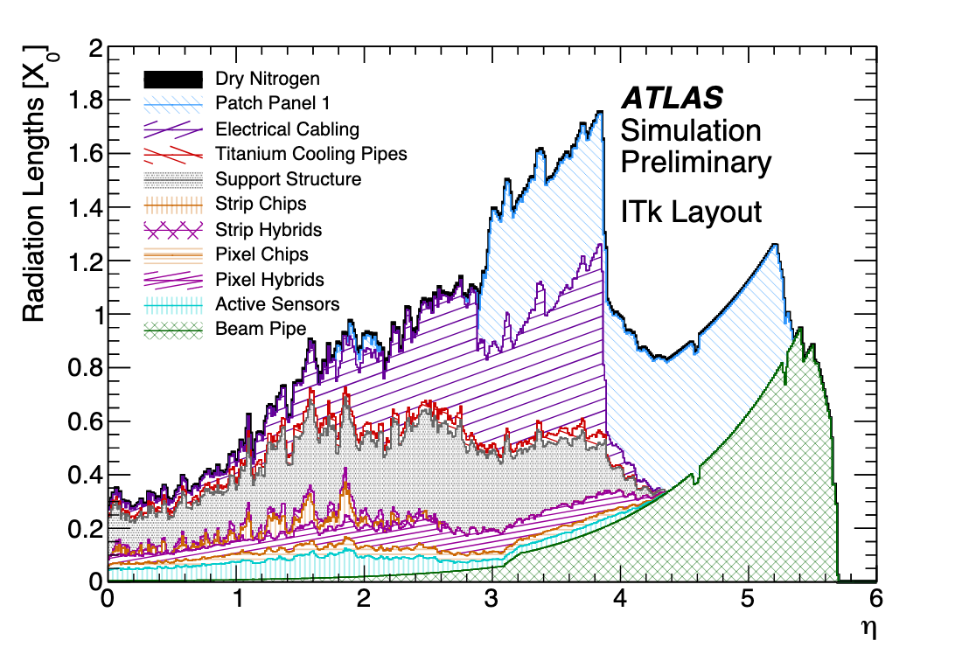
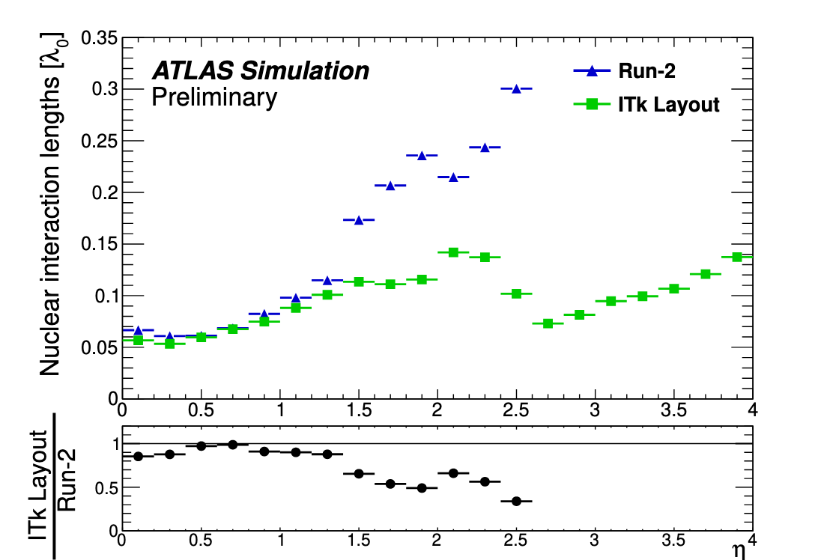
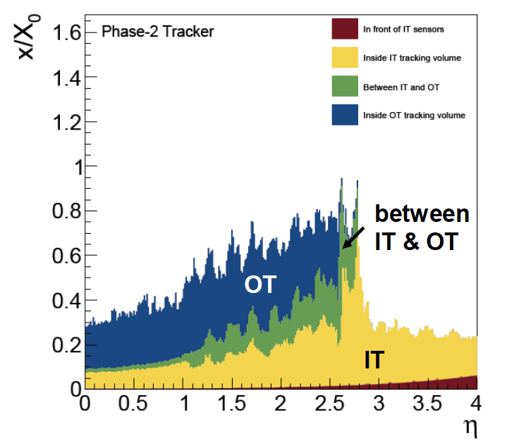
Future Silicon trackers: ATLAS and CMS optimizations at HL-LHC
Main configuration parameters
Detector weight: divided by 2, with less layers, lighter mechanics, tilted modules in forward regions, new CO₂ cooling, DC-DC powering to reduce cable material and better arrangement of services, figures of merit:
  Low fraction of radiation length reduce MS, γ-conversion and e-bremsstrahlung
  Large interaction length reduce hadron interaction rates
CMS seems to have slightly lower X/X₀ (particularly in endcaps)
Tracker acceptance volume

Slide 15
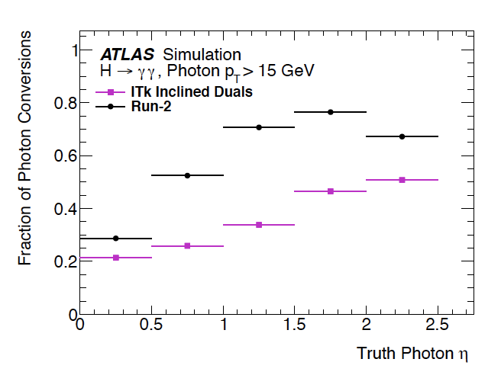
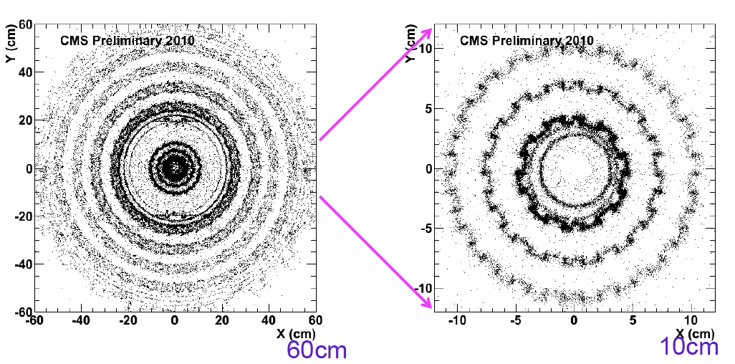
Future Silicon trackers: ATLAS and CMS optimizations at HL-LHC
Detector weight:
  Thorough weighting of parts and registration of material at construction needed for simulation
  Photon conversion and hadron interaction radiographies from data allow to correct description

Slide 16
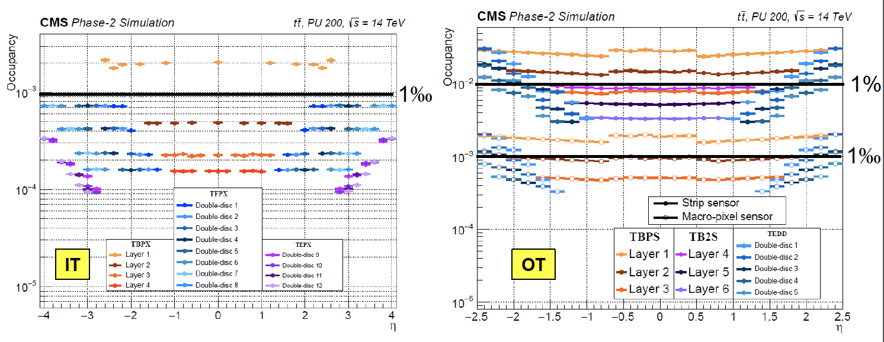
Future Silicon trackers: ATLAS and CMS optimizations at HL-LHC
Sensor parameters: the figure of merits are hit occupancies and resolutions
  Number of channels has been increase by ≃ 4 to 6 x present trackers¹⁾
    Pixel sizes ≃ 25 x 100 µm², 100 - 150 µm thickness
    Strip pitch ≃ 75 to 90 µm and length ≃ 2.5 to 5 cm length (likely 290 µm thickness)
    n-in-p and 3D sensors, radiation tolerance up to NIEL ≃ 2 x 10¹⁶ 1 MeV neq/cm² and TID of 1 Grad
1) High # of channel is more a density and power issue in FE electronics than a data bandwidth issues with zero suppression in FE

Slide 17
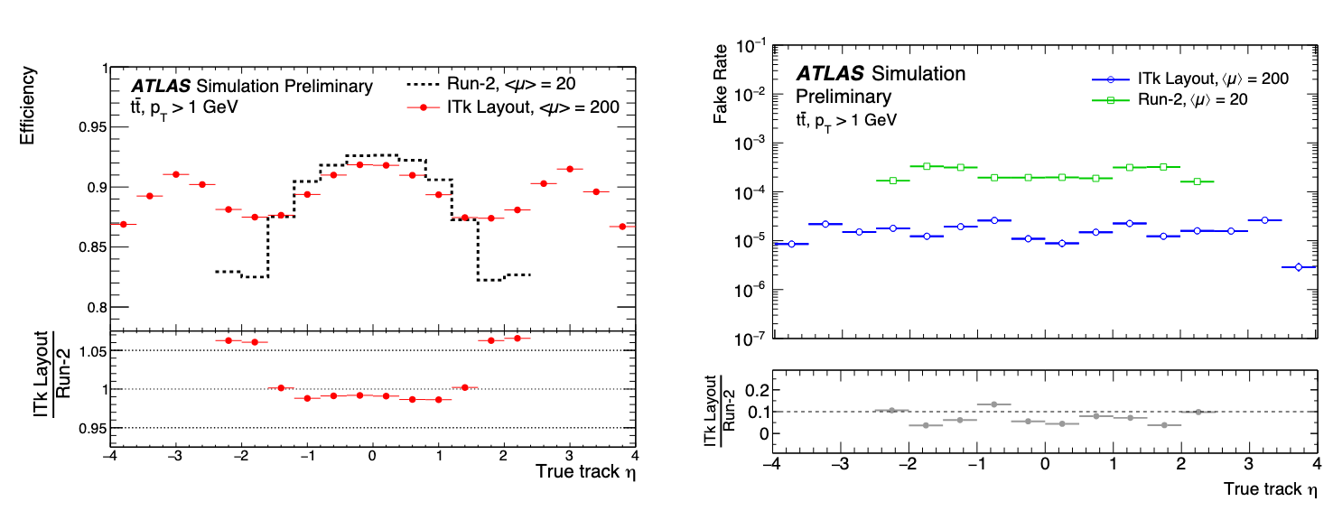
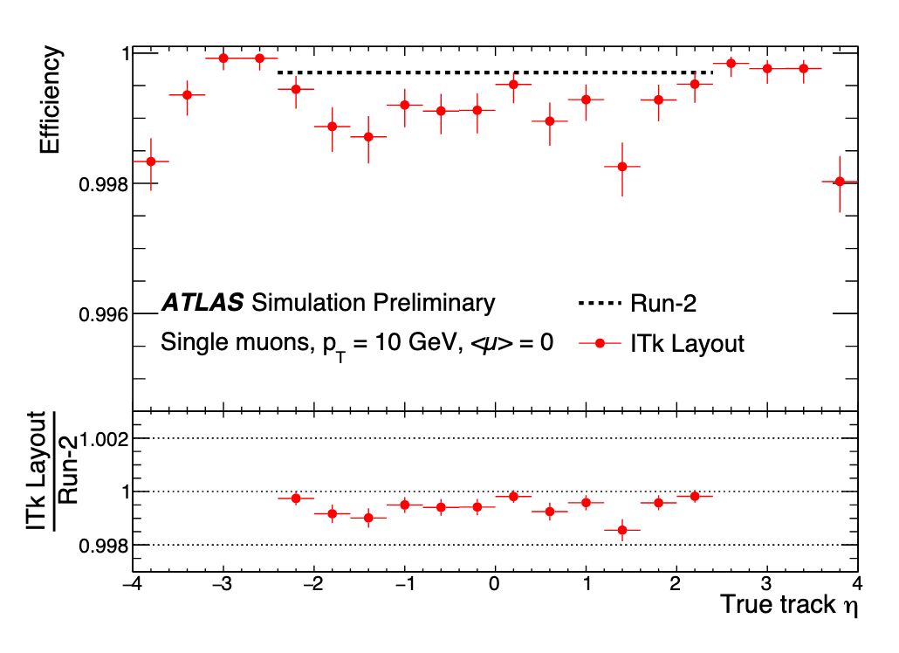
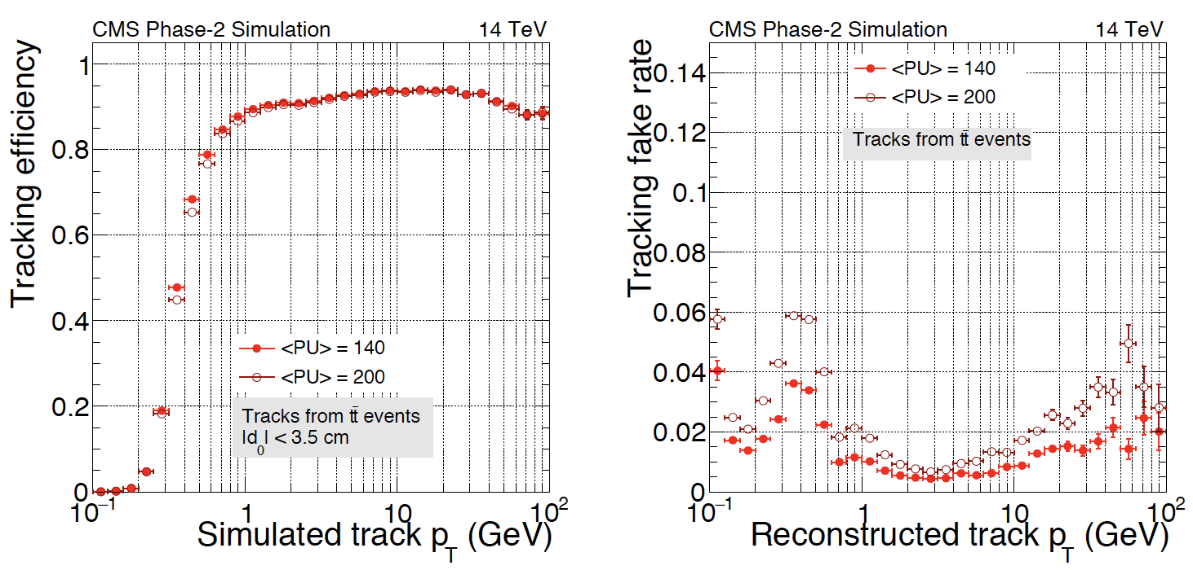
Future Silicon trackers: ATLAS and CMS optimizations at HL-LHC
Performance criteria: efficiency and fake rate
https://cds.cern.ch/record/2669540/files/ATL-PHYS-PUB-2019-014.pdf
interactions
https://cds.cern.ch/record/2272264/files/CMS-TDR-014.pdf

Slide 18
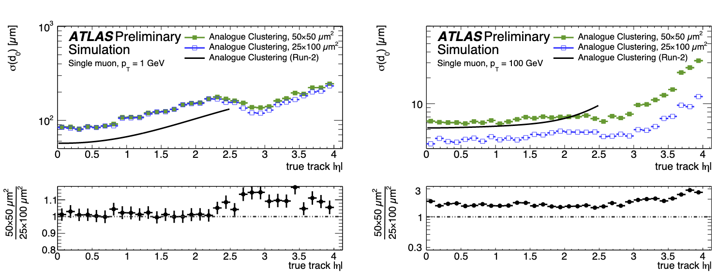
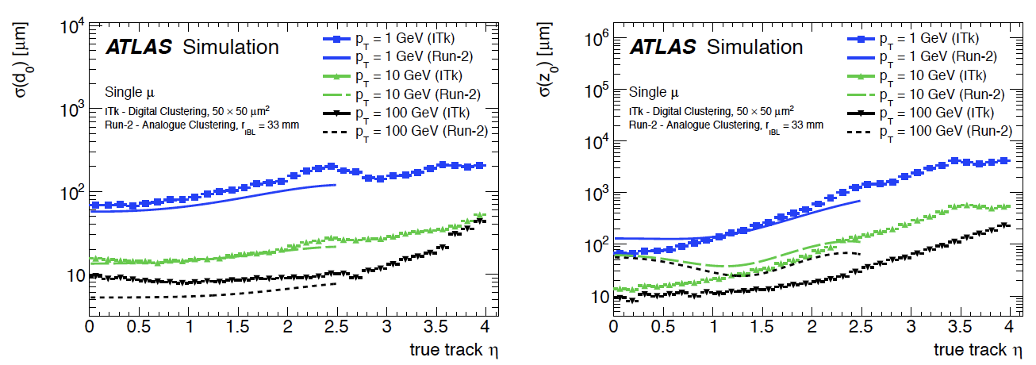
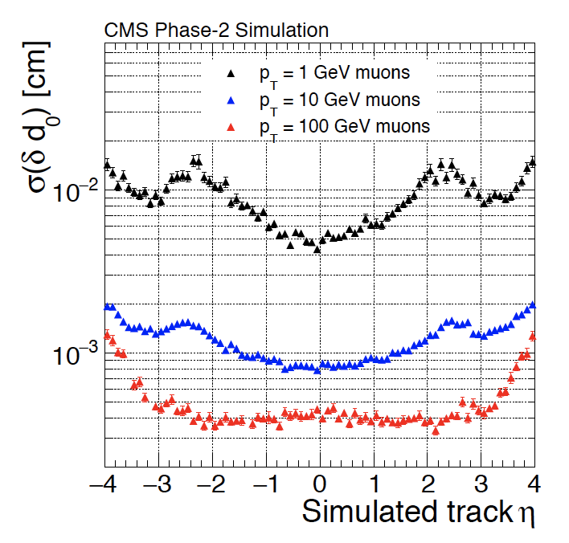
Future Silicon trackers: ATLAS and CMS optimizations at HL-LHC
Performance criteria: transverse Impact Parameter resolution
  ATLAS studies:
    Smaller radius of first layer dominates geometry factor compared to benefit of 5th layer
    ≃ GeV track resolution is dominated by MS¹⁾
    Digital clustering is beneficial compared to binary mostly at high p_{T}
    25 x 100 µm² form factor is better than 50 x 50 µm²
MS dominates
MS limit
Jet tracks are in the range 1 -10 GeV, similar behavior in longitudinal direction with slightly smaller performance due to angle and MS

Slide 19
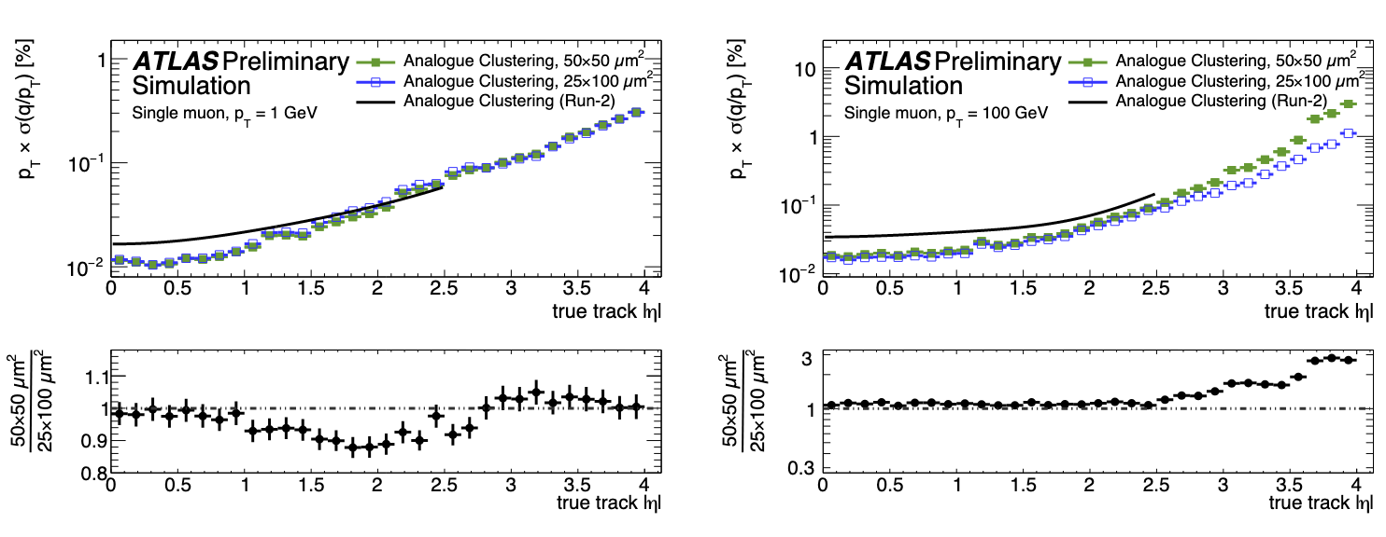
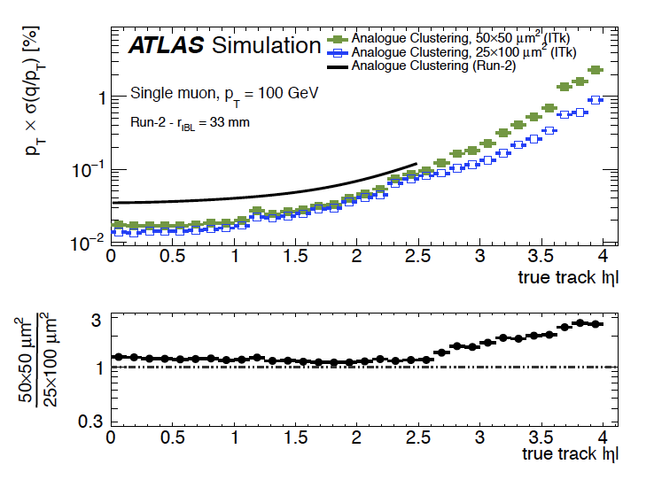
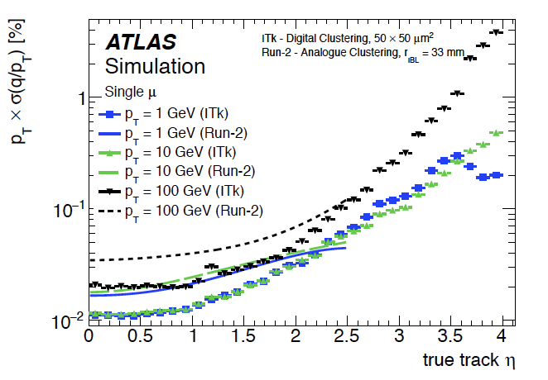
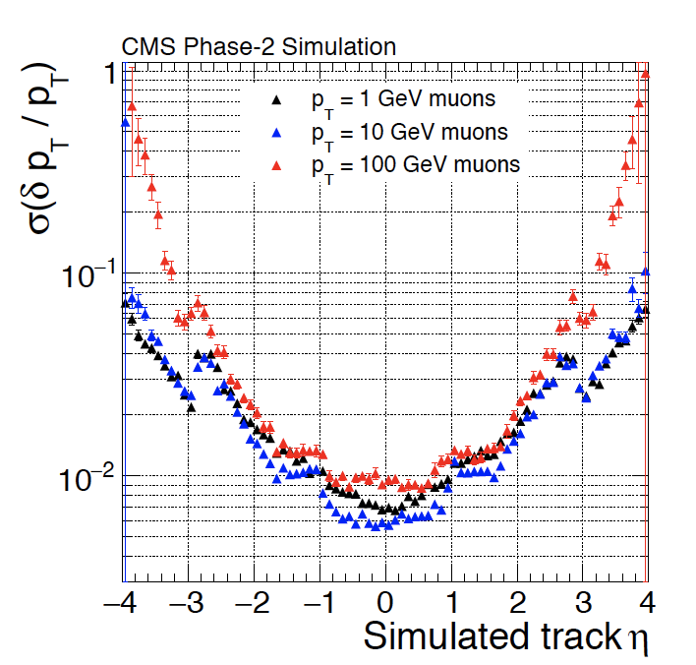
Future Silicon trackers: ATLAS and CMS optimizations at HL-LHC
Performance criteria: p_{T} resolution
  ATLAS studies:
    σ(p_{T}) up to > 10 GeV dominated by MS
    σ(p_{T}) 100 GeV sensitive to resolution
Resolution effect
Bending &
resolution limit
MS limit
CMS has a better σ(p_{T}) due to higher B-field

Slide 20
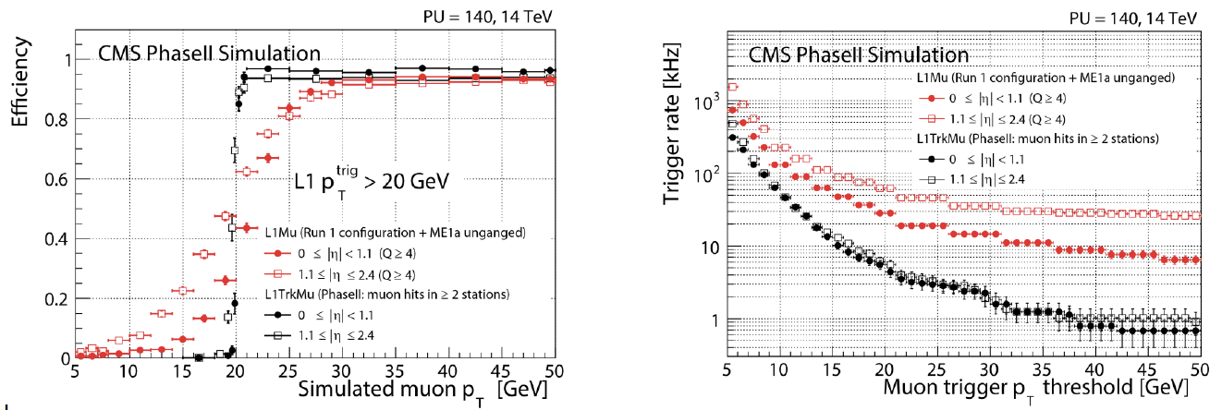
Future Silicon trackers: CMS Track Trigger
Example of efficiency and background rate reduction for a muon trigger threshold at 20 GeV

Slide 21
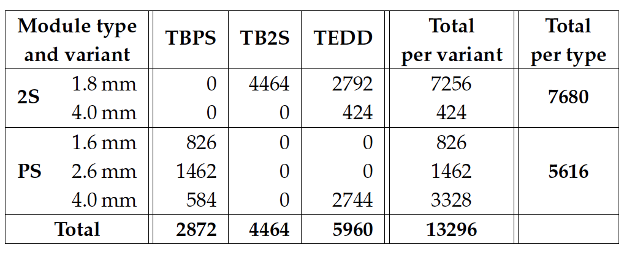
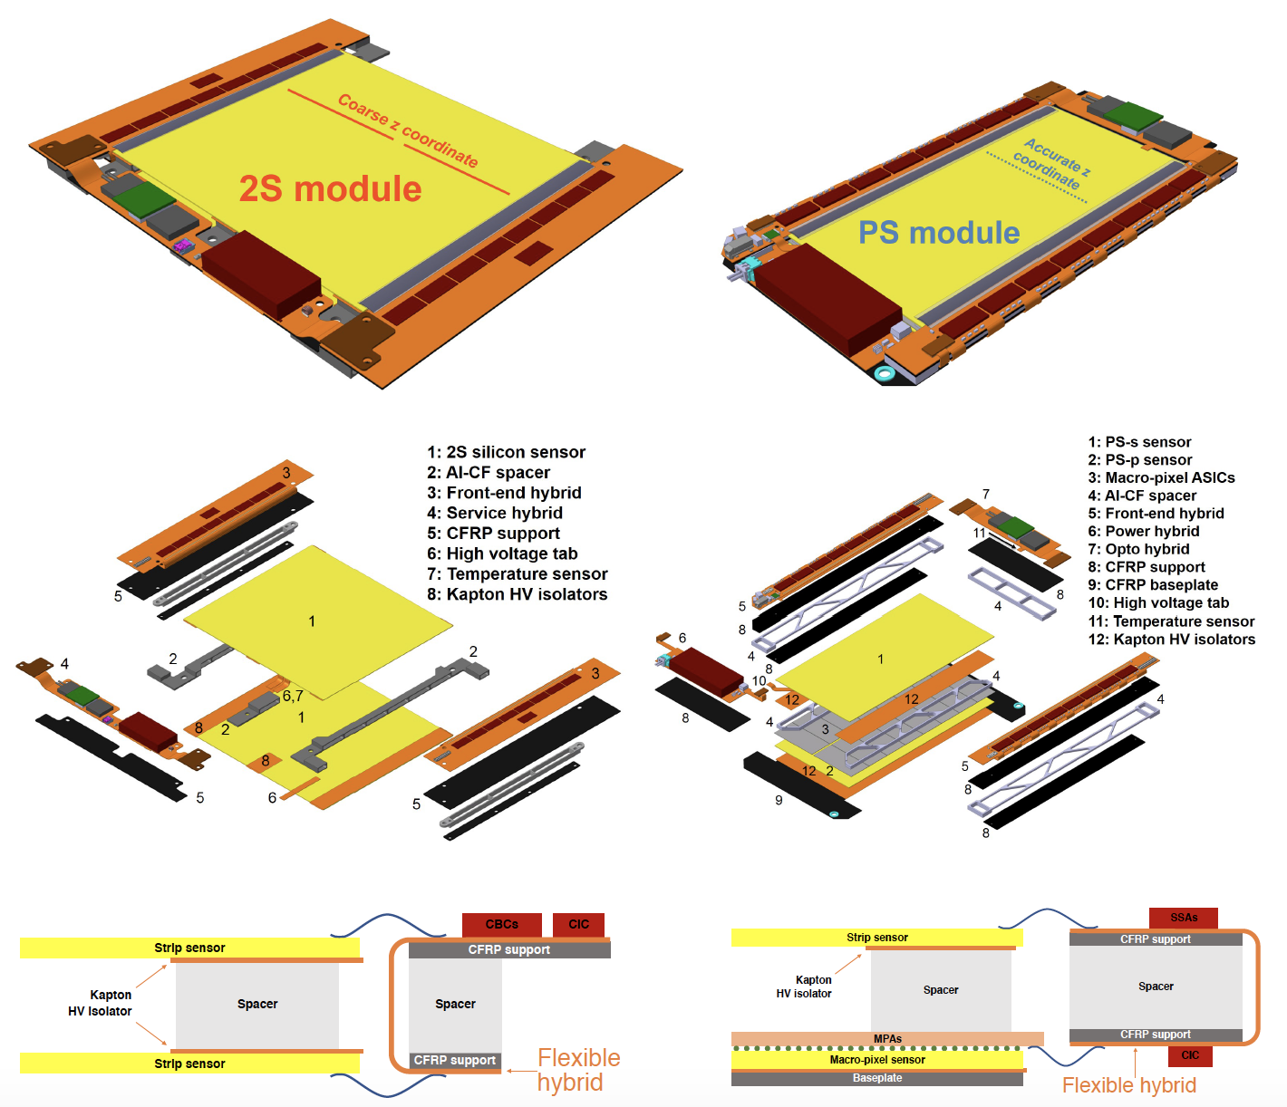
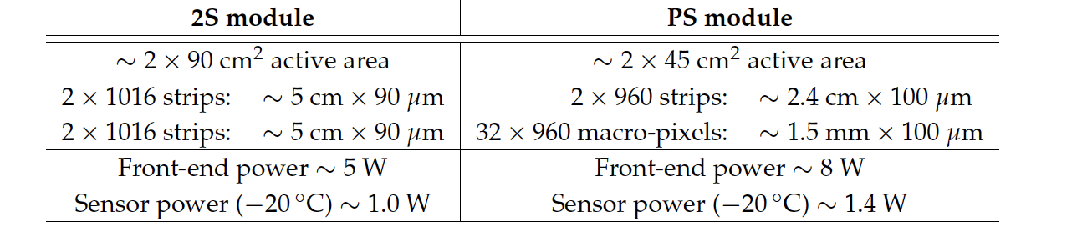
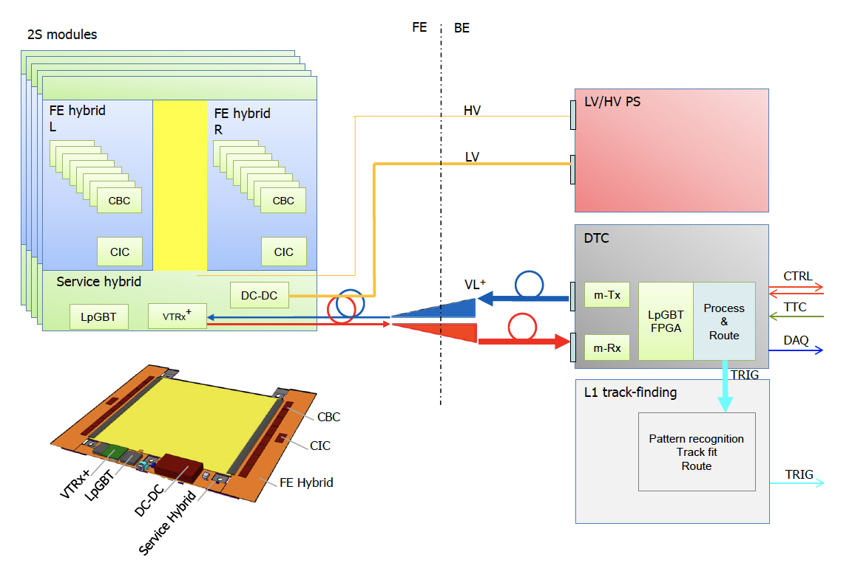
Future Silicon trackers: CMS HL-LHC OT modules example
Two types of modules: < 50 g, power consumption
FE 20(50) ns peaking(full) time, 0.5 mW/channel
Total cooling power (-35∘): 100(50) kW Outer(Inner) Tracker

Slide 22
Future Silicon trackers: next colliders performance target
e-e experiments (ILC/CLIC/FCC-ee/CepC): track P_{T} and Impact Parameter resolutions ≃ /5 LHC
    σ(p_{T})/p_{T}² ≃ 3 x 10⁻⁵ GeV⁻¹ (p ≤ 100 GeV)
    σ(d₀)/d₀ ≃ 2/3-5/10-20 µm (100/10/1 GeV at 90∘)
  R&D challenge
    ≃ 3 µm hit resolution with ≃ 0.2 % X₀ per layer in pixel vertex detector
h-h experiments FCC-hh/SppC need similar detectors
    Resolutions ≃ x 2 e-e (due to larger inner layer radius (rates/radiation) and mass (power/cooling))
  Additional R&D challenge
    Hit rate readout capability ≃ 30 GHz/cm² in inner pixel layer
    Current technology would not survive R ≤ 30 cm for radiation tolerance

Slide 23
Future Silicon trackers: next colliders concepts
Tracker parameters / experiments | ILD-ILC | SiD-ILC | CLICdet-CLIC | CLD-FCC-ee | IDEA FCC-ee/CepC | Baseline-CepC | FCC-hh (SppC)
Silicon: Planar, 3D sensors, HR/HV CMOS, hybrid/3D/SoI interconnection or monolithic readout
In/Out layer radius (mm) | 16/60 | 14/60 | 30/60 | 17/60 |  | Same as ILD | 25/200
Number of layers/disks | 3 x double layers | 5/4 | 3x double-layers | Same as CLICdet | Same as CLD
Thickness (µm) | 50 to 100 (depending on elctronics) |  |  |  |  |  | 50 to 100
Pitch/cell size (µm x µm) | ≤ 25 x 25 |  |  |  |  |  | 25 x 50 - 33 x 400
Hit resolution (µm) | 3 |  |  |  |  |  | 7
(X0)/layer (%) | 0.2 |  |  | 0.3 |  |  | 1
σ(Δd₀) (µm) (1/10/100 GeV) | 10/3/2 |  | 20/5/2 | 20/5/2 |  |  | 30/10/5
Max NIEL (1 MeV neq/cm²)/TID (Mrad) | 10¹¹/0.1 | 10¹¹/0.1 | 10¹¹/0.1 | 2 x 12¹²/1 |  |  | 6 x 10¹⁷/ 30 x 10³
Outer Tracker technologies | TPC¹⁾ + Si | Si | Si | Si | DC²⁾ + Si | Si | Si
Layer/Outer radius (mm) | 153/300/1800 | 1200 | 1500 | 2100 | 2000 | Same as ILD | 200/1600
Number of layers/disks (IT/OT) | 2/1 double Si inner/outer TPC | 5/4 | 3+3/7+4 | same as CLICdet | 12 layers 1 cm² x 1.2 m
Transverse pitch (µm) | 50 |  |  |  |  |  | 33
Transvers hit resolution (µm) | 7 |  |  |  | 100 |  | 10
X0/layer (%) (Barrel) | 1 |  |  |  | 1.6 (total) |  | 2/2.5
σ(Δp_{T})/p_{T}² (GeV⁻¹) (< 100 GeV, 90∘) | 2-3 x 10⁻⁵ |  |  |  |  |  | 5 x 10⁻⁵
Min NIEL (1 MeV neq/cm²)/TID (Mrad) |  |  |  |  |  |  | 5 x 10¹⁵ / 10
Time integration window | 0.5 - 5 µs | 0.5 - 5 µs | 5 ns | 1 µs | 1 µs | 1 µs | 25 ns
Outer Tracker Vertex pixel detector
Number of hits in TPC ≃ 225 with expected resolution of ≃ 150 µm
Number of hits in DC ≃ 122 with expected resolution of ≃ 100 µm

Slide 24
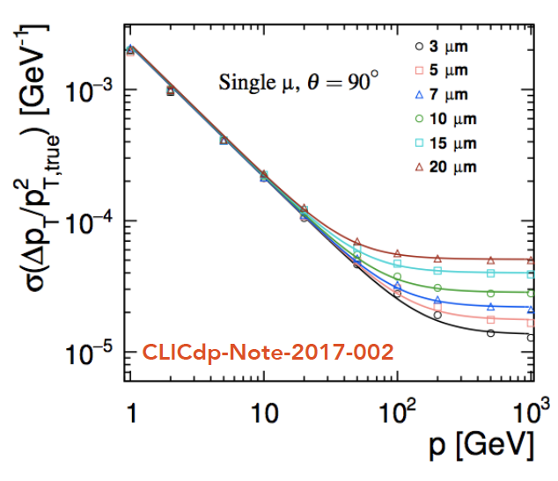
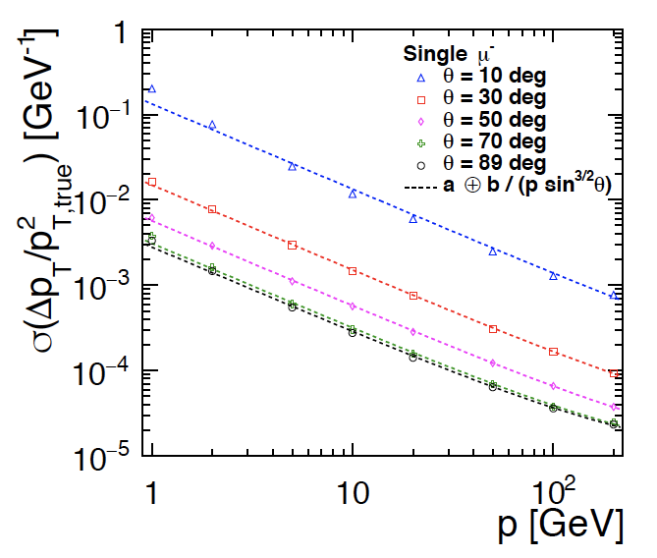
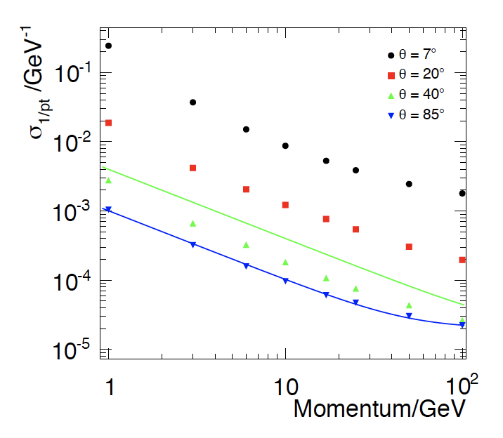


Future Silicon trackers: e-e collider performance simulations
hit resolution
σ(p_{T})/p_{T}² = a ⊕ b /psin^{3/2}(θ)
Dominated by MS
CLIC
Dominated by σ(hit)
CLIC
FCC-ee
FCC-ee IDEA DC +Si
Θ =90∘
SiD
ILD
ILD
TPC(DC) + Si seems to do slightly better than full Si for MS (small p_{T})

Slide 25



Future Silicon trackers: e-e collider performance simulations
SiD
ILD
CLIC
CLIC
Impact parameter resolution is more sensitive to multiple scattering than intrinsic resolution
CLIC, ILD and SiD designs provide similar precision
At high momentum resolution seems better than expected from parametrization
σ(d₀) ≃ a ⊕ b/p_{T} sin^{1/2} (θ) = a ⊕ b/psin^{3/2} (θ)

Slide 26
Future Silicon trackers: FCC-hh design proposal
Φ = 3 m, L=2 x 16, η_{max} ≃ 6, ≃ 400 m², 16 x 10⁹ channels*, cell size 25 µm x 50 µm - 33 µm x 400 µm - 33 µm x 2-50 mm
  δp_{T}/p_{T} ≃ 0.5(2)% at 0.1(1) TeV (η<2)
d₀ resolution of 5/10/30 μm at η= 0 for p_{T} = 100/10/1 GeV/c at 90∘
Cell size down to 25 x 50 µm in inner layers for low occupancy and ≃ 5-10 µm hit resolution for 2-track separation in boosted objects
Tilted design to minimize MS, conversions, interactions
10 GHz/cm², fluence ≃ 10¹⁸ 1 MeV neq /cm² and ≃ 30 GRad for 30 ab⁻¹ at inner layer radius 2.5 cm
Current sensor and readout technologies would not
sustain radiation for R < 40 cm,
effective Pile-Up of ≃ 50 would require ≃ 5 ps Time of Flight precision**
* Compared to 6 x 10⁹ and 2.2 x 10⁹ for ATLAS/CMS Phase-II Trackers; ** Compared to 30-40 ps in ATLAS/CMS HL-LHC MIP Timing Detectors

Slide 27

Tracking systems: Silicon technology
Si-crystals semiconductor properties:
  Small energy gap 1.2 eV (between valence & conduction band), E (e-h pair creation)¹⁾ ≃ 3.6 eV
  High density 2.33 g/cm³; dE/dx (MIP) ≈ 3.8 MeV/cm ≈ 106 e-h/μm (average)
  High carrier mobility: μ_{e}(μ_{h}) =1450(450) cm²/V.s,
    v = μE, fast charge collection can go down to O(1) ns
  Material used in industrial process, relatively low cost
Alternative semi-conductors: Ge need cryogeny with liquid nitrogen at 77k, Diamond less signal and expensive
≃ 30 eV LAr and 100 eV in scintillators

Slide 28





Tracking systems: Silicon sensors
Several Si-sensors types and design, differences are in depletion, electronic readout implementation and eventually in performance, hybrid designs much more radiation tolerant
300 µm 1 µm
p⁺
p⁺
50 µm
n-in-n
n-in-p
CMOS and DepFET
Monolithic Active Pixel:
Microelectronic process, collection electrodes readout with MOS electronics grown on substrate
CMOS not depleted (no E-field) e⁻ are collected through diffusion, DepFET has some low voltage depletion
Works for small pitch, thin sensors slow signal time integration
Hybrid design pixels/strips: planar and 3D
More complex process (double sided) to allow depletion voltage
  p/n doping (acceptors (B, …)/donors (P, As, …) allow to work as a p-n junction with reverser bias and full depletion of free carriers (noise)¹⁾
Electrodes connected to electronics through bump(wire) bonding in pixels(strips)
≃ 10⁴ more free carriers in Si than MIP signal

Slide 29



Tracking systems: Si-sensors electronic scheme and noise
Noise:
  ENC_{C} = a + b .C dominates total noise, b ∝ 1 / τ (integration time) and C electrode capacitance (proportional to size)
  ENC_{I} = (e/2)√(I_{leak}τ/e) leakage current noise becomes important after irradiation
  ENC_{Rp} = (e/e) √[kTτ/2R_{p]} (bias resistor)
  ENC_{Rs} = 0395C √(R_{s}kT/τ)
  e euler number, e electron charge
DC coupling
Detector equivalent scheme
DC coupling
DC coupling used for small size pixels/mini-strips (small C and I_{leak})
AC coupling preferred for strips to avoid large I_{leak} (strips have also larger C)
Typical noise for Si-sensors today is ≃ 100(1000) e⁻ for pixels/strips
Choice of S/N threshold is an optimization of hit efficiency versus noise occupancy (bandwidth), a minimum of 1/5 of S is considered acceptable¹⁾²⁾
AC coupling
In pixels a higher threshold ≃ 10 x N is needed to contain absolute bandwidth
Precise timing measurements need higher S/N to reduce noise contribution to resolution

Slide 30


Tracking systems: Si-sensors irradiation effects
Irradiation introduces default in the crystal lattice that reduce signal and/or increase noise
  Mostly displacement of Si-atoms and doping modification (affecting band gap levels) result in:
    Increased leakage current¹⁾ , and therefore noise
    Modified doping concentration mostly toward p-type, requiring V_{d} increase
    Creation of trapping²⁾ centers that captures electrons and holes, reducing
    Charge Collection Efficiency, the most critical effect at high irradiation level
  Surface damage (SiO₂ layer) that do not affect CCE but can create operation issues
    Typically solved with design features
  Annealing decrease I_{leak} and allows diffusion of defaults/change of
  doping but beneficial annealing is followed is by reverse annealing
Operation optimizations
  Temperature as low as possible, annealing scenarios during maintenance
Sensor optimizations³⁾
  n-in-p (p-type bulk) collect electrons (less trapping), avoid some micro discharges creating noise
    ATLAS, CMS and LHCb choice for LHC upgrade
  Thinner sensors (deep signal is not collected), reduce V_{bias} and I_{leak} and allow higher electric field
  Material and fabrication process details are important
I_{leak} varies exponentially with Temperature x 2 every 7∘, hence operation at low temperature for noise and also to avoid thermal runaway
Trapping is characterized by collection time → prefer electron collection (faster), and higher electric field
Non-Ionization Energy Loss concept do not fully apply at highest irradiation, requiring thorough testing with all particles (n,p,γ)

Slide 31



Tracking systems: Si-sensors Outer Tracker S/N (depleted case)
In Si-sensors with full depletion, charge collection efficiency before irradiation is ≃ 100%
  Ex. 200 µm thickness: max probability(average) charge¹⁾ number is ≃ 14000(21200) e⁻
  This allows comfortable S/N, typically ≥ 15 for all type of designs²⁾
Example of CMS at HL-LHC n-in-p sensors after irradiation
  S/N remains comfortable at 12 with sufficient margin, sensor specification to sustain 800 V to provide further margin, but would approach thermal runaway limit
2S strip sensors, S/N ≃ 12 at 2 x 3000 fb⁻¹
PS strip sensors, S/N ≃ 12 at 1.5 x 3000 fb⁻¹
For S/N seed strip signal (after charge sharing) needs to be considered
S/N referring to the collected charge assumes that the preamplifier-shaper integrate all the charge

Slide 32



Tracking systems: Si-sensors Inner Tracker S/N (depleted case)
CMS pixels 1st (2nd) layers are exposed to 2(0.5) 10¹⁶ 1 MeV neq/cm² for HL-LHC 3000 fb⁻¹
  Efficiencies measured for S/N threshold (RD53) = 1200 (10⁻⁶ noise occupancy ≃ 1% of hits in layer 4)
CMS planar pixel sensors ongoing tests: 2nd layer can sustain 3000 fb⁻¹ at 600 V
3D pixel sensors ongoing tests with RD53 chip:
1st layer in CMS¹⁾ should sustain at least ½ of 3000 fb⁻¹ with full efficiency at 150
10¹⁶ neq/cm²
6400 e⁻
ATLAS
CMS
1) 1st layer in CMS is closer to the beam line than in ATLAS with about 1.6 x more fluence

Slide 33



Silicon trackers state of the art: LHCb vertex (pixel) detector
LHCb VELO upgrade for installation during 2020
  12 disks of 4 modules, inner radius ≃ 4.5 mm
  Planar n-in-p sensors fully depleted up to ≃ kV
  200 µm thick, 55 x 55 µm² pixels, ≃ 10 µm hit resolution
  120 x 120 μm² micro cooling-channel etched in sensor substrate
    ≃ 1.5% X/X₀ per disk
  Radiation tolerance ≃ 10¹⁵ 1 MeV neq/cm² (T ≃ -20∘)
Original strip detector new one with pixels
R measuring strips
with double metal r/o
Phi measuring strips
.
ATLAS
old
new
.
ALICE ITS2 - Belle-II vertex

Slide 34




Silicon trackers state of the art: ALICE ITS2 (installation 2020)
Monolithic Active Pixels (MAPs): CMOS standard process with readout grown on Si-sensors
lightest and most precise designs, relatively slow readout and low radiation tolerance
7 layers of MAPs ≃ 10 m² with 12.5 Gpix up to η = 1.3
3 inner layer each 0.35% X/X₀ from 22 to 40 mm
4 outer layers of 1% X/X₀ up to 400 mm
Installation in 2020
    Sensors CMOS TowerJazz 180 nm technology (no depletion :
      Epitaxial 50 µm thick, pixels, 29 x 27 µm², ≃ 5 µm resolution
    Binary zero suppressed readout 100 kHz, ≃ 5 µs integration time
    Radiation tolerance ≃ 2 x 10¹³ neq/cm² and ≃ 3 Mrad
.
.
ATLAS
CMS
Outer Barrel Stave (1.5 m long)

Slide 35





Silicon trackers state of the art: BELLE-II pixel detector
Monolithic Active Pixels (MAPs) in depFET technology
Pixel detector¹⁾: 2 layers at 1.4 cm and 2.2 cm, 0.03 m²
  Thickness ≃ 75 µm, pixels ≃ 50 x 50/85 µm² , σ(hit) ≃ 15 μm resolution ≃ 0.2% X₀/layer
  Binary readout continuous row by row, 20 µs integration time
  Radiation tolerance ≃ 10¹³ neq/cm² and ≃ 10 Mrad
σ(d₀) = 20 µm for p_{T} = 1 GeV
3D-prointed support cooling blocks
1) SVD is ≃ 1m², 4 double side stereo layers at 3.9, 8, 10.4, 13.5 cm,

Slide 36
Silicon sensors: R&D goals
An ideal detector would be monolithic with high:
hit and time precision, speed and rate capability, radiation tolerance; and low cost
  Improve hit precision → e⁺-e⁻ colliders
    Smaller pitch and thickness: deeper sub-micron technology
    Improve charge sharing: new design ex. ELAD
  Improve radiation tolerance → h-h colliders
    Smaller pitch and thickness, deeper sub-micron technology
      Planar, 3D to maintain high field and small electron path
    Work on material and fabrication process to reduce damages
  Improve integration of electronics → e⁺-e⁻ colliders, h-h colliders
    Monolithic, new connection scheme to electrodes, ASICs interconnection
  Improve cost → e⁺-e⁻ colliders, h-h colliders
    Develop process as close as possible to standards used in microelectronics and imaging industries

Slide 37



Silicon sensors: R&D examples¹⁾
3D sensors
Hybrid design
pixels < 50 x 50 µm²
Design for charge sharing
process variants for pitch
Interconnection
AC connection through insulating glue
Through SiO₂ via process
can also apply here
Monolithic devices
CMOS modified process for depletion HV-CMOS (left)and HR-CMOS (right)
1) Design of sensors particularly for field configurations is supported by simulation tools ex. TCAD, it can be interfaced with GEANT to assess signal fluctuation effects, ex CLIC studies

Slide 38








Silicon sensors: R&D demonstrators (not exhaustive)
Connection to high rate capability ASIC planar and CMOS
CMOS modified process for radiation tolerance
faster and higher rate readout
Planar/3D finer pitch for resolution
Smaller pitch and thinner planar and 3D pixels bump bonded
SoI process
Si/ASIC wafers connected
through Insulator Oxyde layer
Capacitive Coupling (PD) of HV CMOS design to ASIC through insulating glue
Modified HV-CMOS
depletion (< 100 V)
Modified HR-CMOS
depletion (6V)
with faster and higher rate readout capabilities
CLICPix¹⁾
Cracov SoI
CLIPS
CCPD C3DP
MALTA
CLIPS
ALICE investigator
CLICTD
MALTA
ATLASPix²⁾
Demonstrators ≃ 2 x 2 cm²
Sinergy with 1) CERN MEDIPIX, 2) Mu3e experiment

Slide 39
Silicon sensors: R&D demonstrators (not exhaustive)
Silicon sensor R&D | Hybrid | SoI |  | CMOS Monolthitic |  |  |  | CCPD | CCPD
Demonstrator | CLICpix | Cracov | CLIPS (CLIC) | ALICE investigator | CLICTD* | Malta/Monopix | ATLASpix(Mu3ePix) | C3DP/CLICpix | C3DP+CLICpix
Sensor | planar | planar | planar | HR-CMOS standard | HR-CMOS modified process |  | HV-CMOS
Connection to readout electronics | bump bonding | SoI | SoI | momolithic | monolthitic | monolithic | monolitic | CC with glue
ASIC technology (nm) | 65 | 200 | 200 | 180(TJ) | 180 (TJ) | 180(TJ)/150(LF) | 180(AMS)/150(LF) | 65
Thickness (µm) | 50 / 200 | 300 / 500 | 100 / 500 | 50 | 50 / 100 | 100 | 60 | 50
Pitch/cell size (µm x µm) | 25 x 25 | 30 x 30 | 20 x 20 | 28 x 28 | 30 x 300 | 36 x 36 | 40 x 130 | 25 x 25
Hit resolution (µm) | 9 / 3 | 5/2 |  | 5 |  | 4 | 13 | 6
Time resolution (ns) | 7 |  |  | 6 |  | < 10 | 7 | 7
Max NIEL (1 MeV neq/cm2)/TID (Mrad) | O(10¹⁶)/Grad |  |  | O(10¹³)/300 |  |  | O(10¹⁵)/100
* In production
CLICPix¹⁾
Cracov SoI
CLIPS
CCPD C3DP
ALICE investigator
CLICTD
MALTA
ATLASPix²⁾
Sinergy with 1) CERN MEDIPIX, 2) Mu3e experiment

Slide 40

Silicon sensors: R&D demonstrators outcome and outlook
  CMOS MAPs suitable for outer trackers and close to fulfil needs for ee- collider vertex detectors
    3 µm hit resolution likely needs < 25 x 25 µm² pixels (charge sharing¹⁾ too small with 50 µm thickness)
    ≃ 200 MHz/cm² hit rate capability and ≃ 5 ns time precision (CLIC requirement achieved)
      However CLIC inner pixel layer hit rate requires 6 GHz/cm²
    Enlarged sensor size 15 x 15 cm² with stitching process is being investigated
  New ASIC connection techniques still at early stage, bump-bonding difficult with smallest pixels
  O(100) better radiation tolerance achieved in HR/HV CMOS modified process 2 x 10¹⁵ neq/cm²
    Still marginally at the level of requirement for an outer tracker FCC-hh/SppC layer
Deeper sub-micron technologies 65 nm or less can improve in all aspects
    Ex. ALICE ITS3 upgrade proposal: CMOS MAPs in 65 nm technology, 10 x 10 µm² pixels, ≃ 20 µm thick sensors for 0.05% X₀
  FCC-hh/SppC remains a challenge for hit rate and radiation tolerance
    Also alternative material R&D for radiation tolerance, ex. pCVD diamond CERN RD42
1) Some design studies (ELAD) with implants in depth of sensors to control charge sharing through E-field configuration

Slide 41

Topics not addressed in this section
  Other tracking technologies
    TPC, MPGDs in Gas detector section
    Scintillating devices in calorimeter section
  Si-sensors for other purpose
    Pad-sensors for High Granularity Calorimeters in calorimetry section
    Exploitation of precision timing with regular sensors¹⁾
    LGAD technology for precision timing in MIP Timing Detector section
  Other silicon technologies used for photodetection
    APDs, HPDs, SiPMs, in calorimetry section
    1) Regular silicon sensors could provide ultimate timing precision of ≥ 70 ps at S/N ≥ 10
NA62 vertex detector achieve ≃ 115 ps precision https://indico.cern.ch/event/577856/contributions/3420172/attachments/1878363/3093866/eps2019_na62_kleimenova.pdf
CMS HGC measurement of time resolution in Si-diodes

Slide 42



Topics not addressed in this section: LHCb scintillating Fiber Tracker
3 stations, each 2.5% X/X0 - 4 plans (X-U-V-X) with ± 5∘ stereo angle - 50-75 µm resolution
  3 M fibers Φ 250 µm x 2.5 m (10 000 km)
    3 Mrad in inner region
    High precision assembly of fiber mats
  Readout with 128 SiPM array 250 µm pitch
    40∘C cooling to sustain 1.2·10¹² neq. /cm2
2x 2.5 m
2x 3m

Slide 43
Additional information

Slide 44

Charged particle interaction in matter: parameters

Slide 45

Charged particle interaction in matter: Bethe-Bloch terms

Slide 46
Charged particle interaction in matter: particle energies
Energy Range | Sources of Radiation
eV | visible light, secondary electrons, thermal neutrons
keV | X-rays, electrons from radioactive β decay
MeV | α particles, photons from excited nuclei, acceleration with cyclotrons, solar neutrinos
GeV | air showers from cosmic rays, acceleration with synchrotrons
TeV | high-energy accelerators (e.g. LHC) TeV gamma rays from galaxy
> TeV | cosmic accelerators: quasars, super-massive black holes, supernova remnants, …

