Slide 1
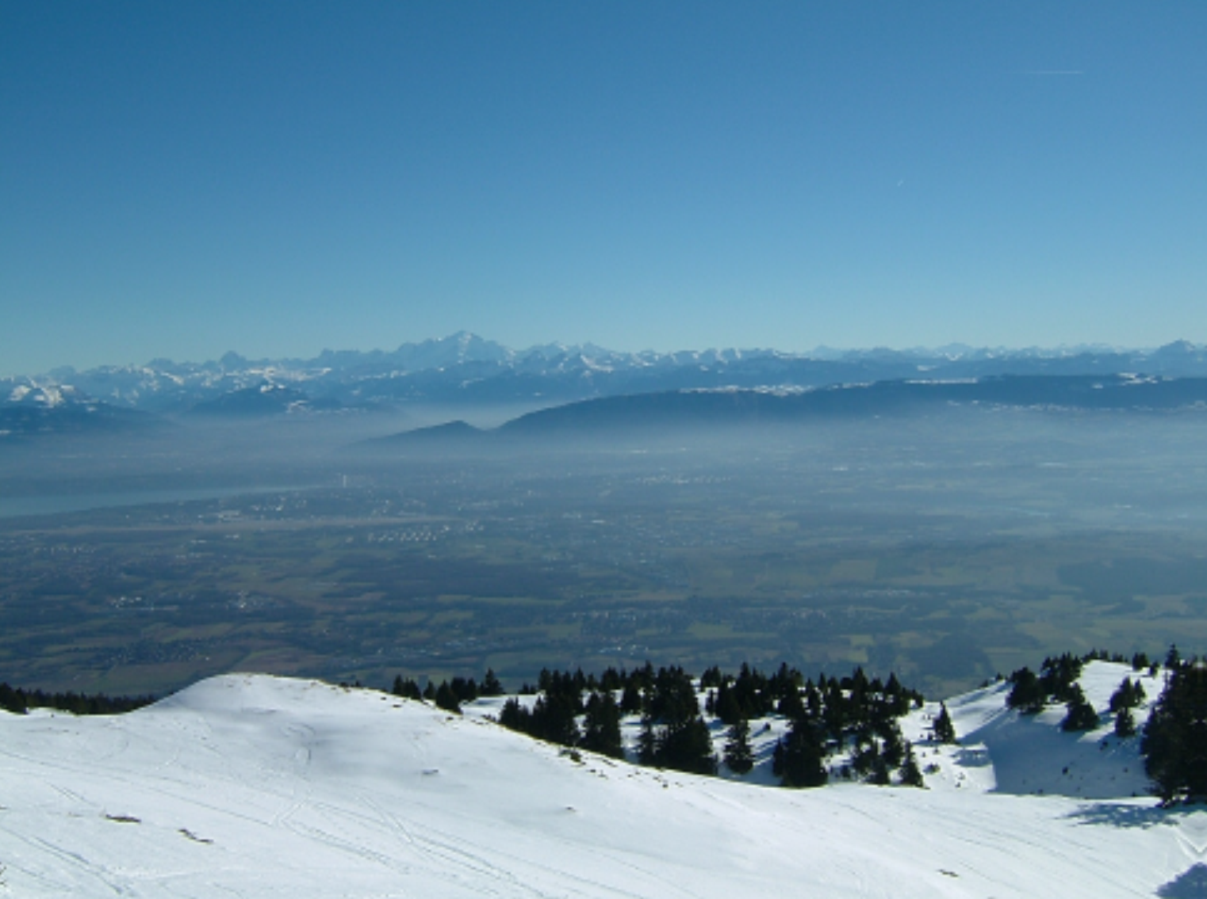
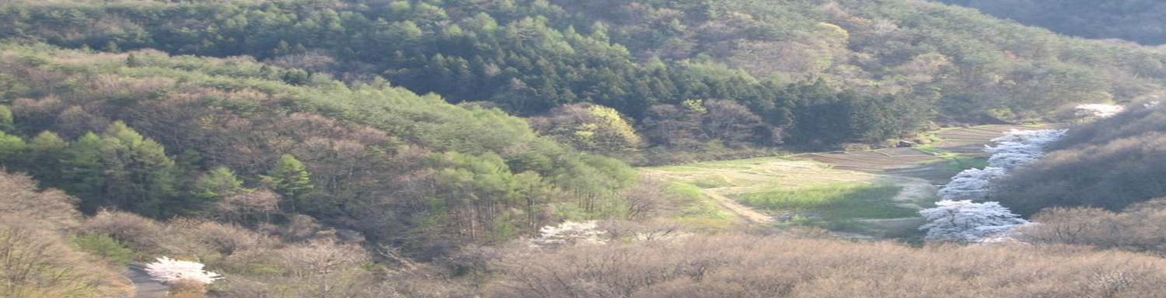
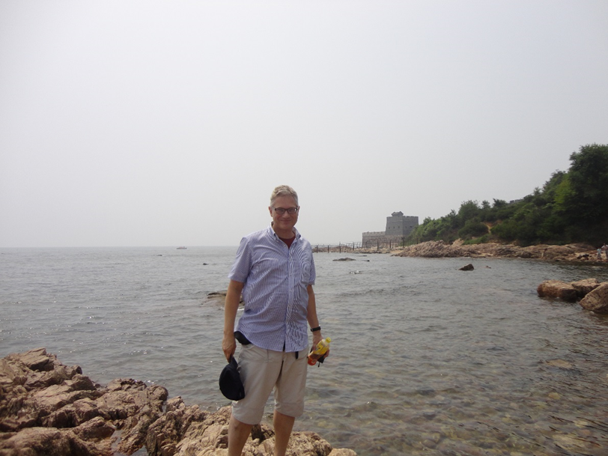


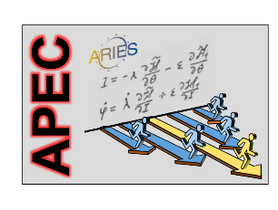
Future Accelerators
Geneva site
Kitakami site
Frank Zimmermann, CERN
Ecole GIF 2019, Ecole Polytechnique
Lecture 2: electron-positron colliders
Frank Zimmermann
CERN, BE Department
Helmholtz School CALC2018 Dubna
Qinhuangdao site
Work supported by the European Commission under Capacities 7th Framework Programme, Grant Agreement 312453

Slide 2
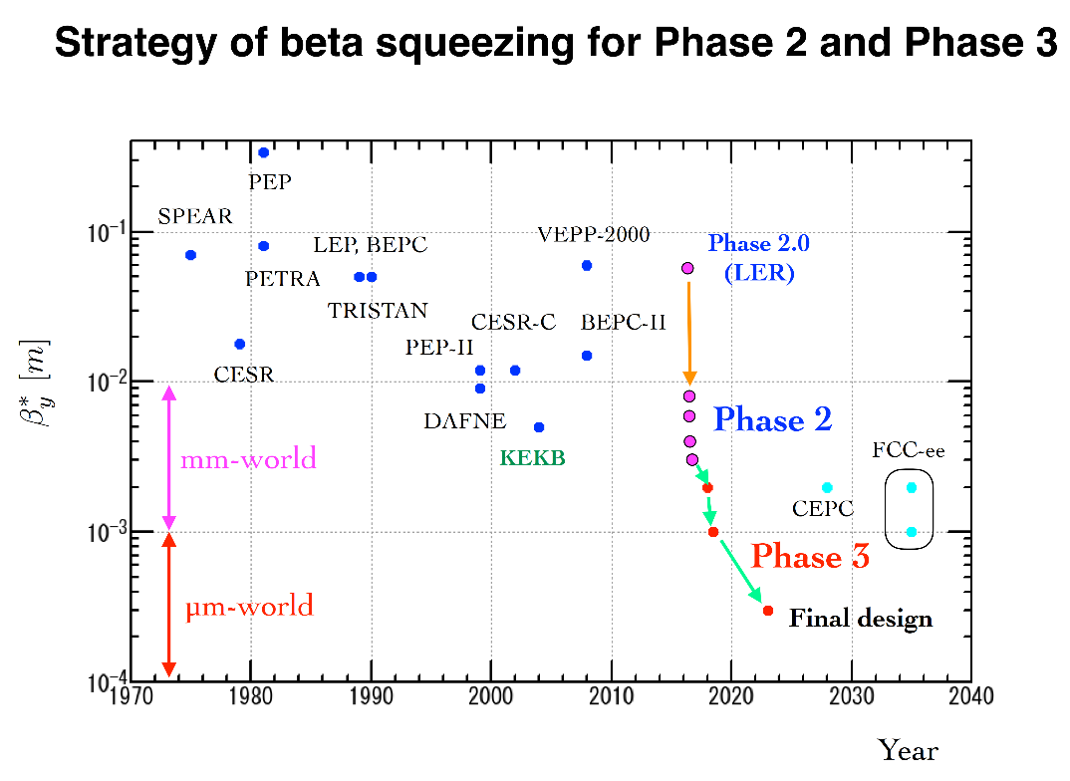

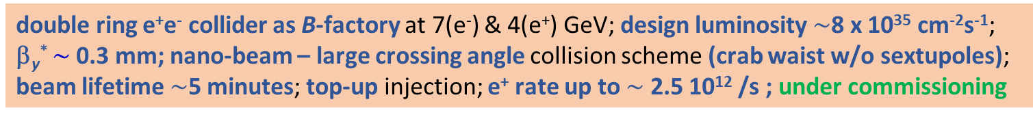
Super KEKB – pushing the frontiers of L & β*
double ring e⁺e⁻ collider as B-factory at 7(e⁻) & 4(e⁺) GeV; design luminosity $\sim$8 x 10³⁵ cm⁻²s⁻¹; β_{y}* $\sim$0.3 mm; nano-beam – large crossing angle collision scheme (crab waist w/o sextupoles); beam lifetime$\sim$5 minutes; top-up injection; e⁺ rate up to $\sim$ 2.5 10¹² /s ; under commissioning
Phase-2 goal of β_{y}* = 3 mm achieved in spring 2018
Further commissioning in progress this year but impacted by budget constraints.
Y. Funakoshi, Y. Ohnishi

Slide 3
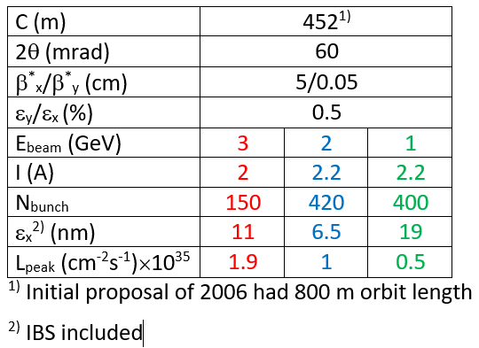

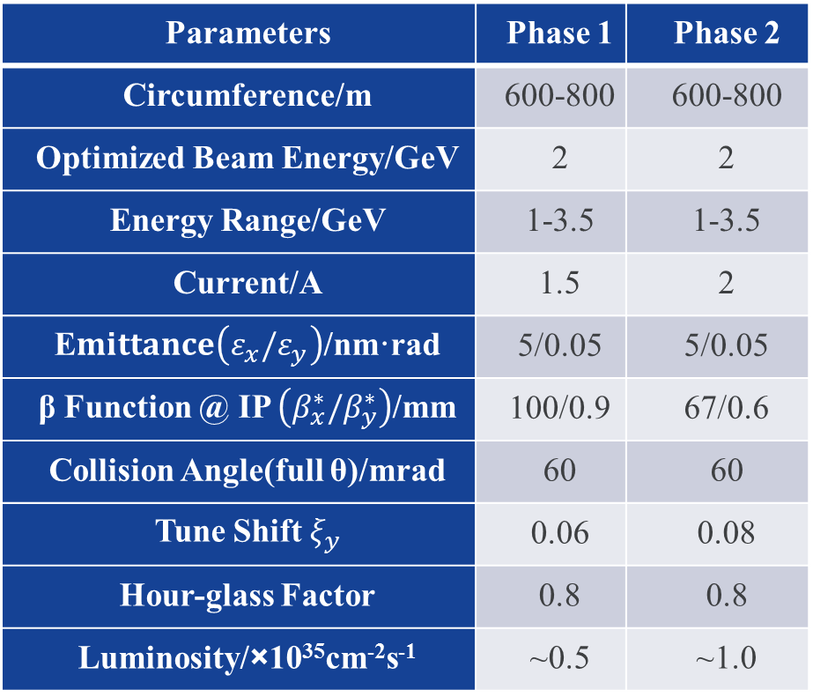

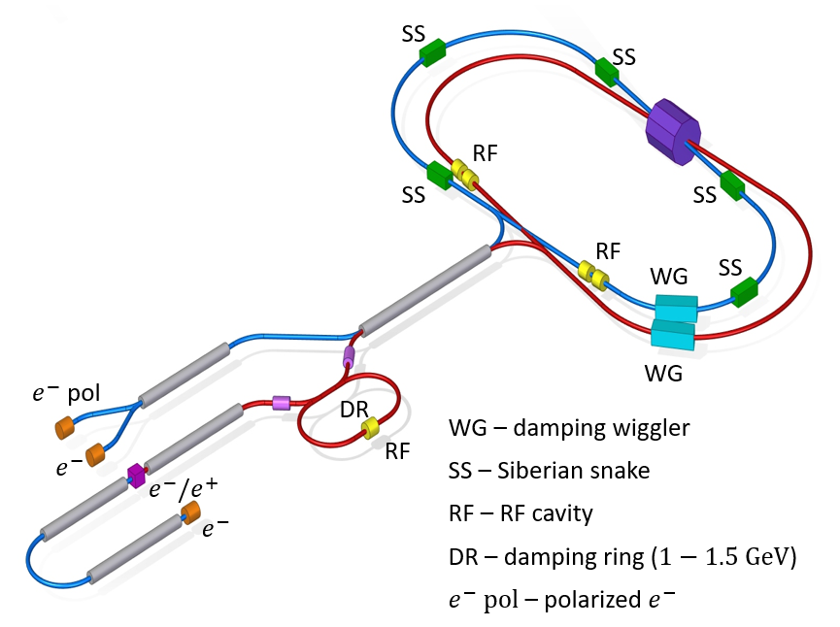
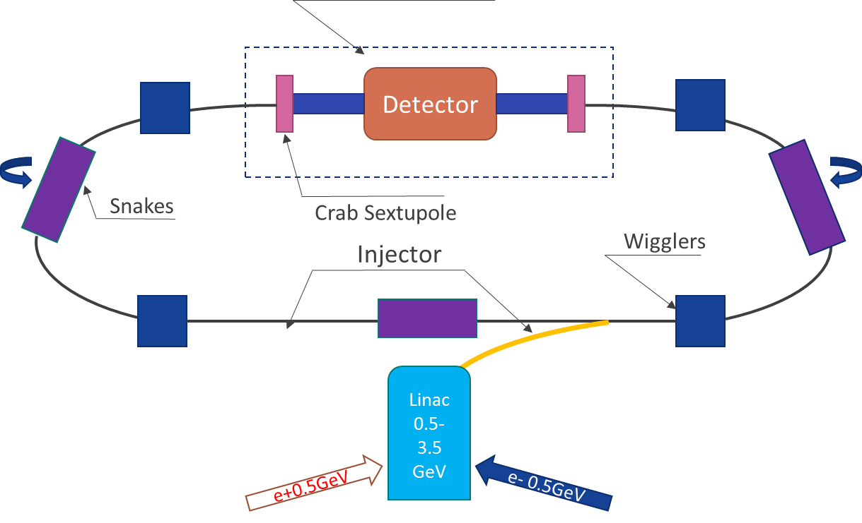
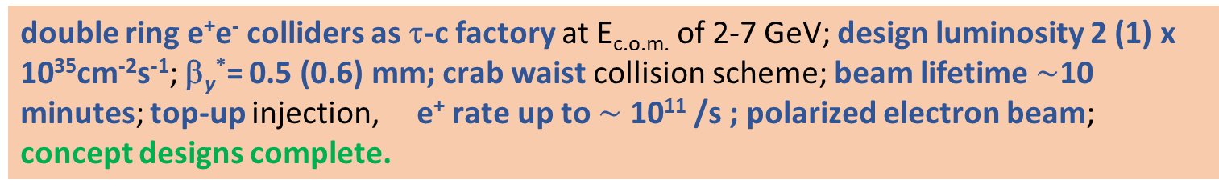
Super Charm Tau Factories
double ring e⁺e⁻ colliders as τ-c factory at E_{c.o.m.} of 2-7 GeV; design luminosity 2 (1) x 10³⁵cm⁻²s⁻¹; β_{y}*= 0.5 (0.6) mm; crab waist collision scheme; beam lifetime$\sim$10 minutes; top-up injection, e⁺ rate up to $\sim$ 10¹¹ /s ; polarized electron beam; concept designs complete.
Values in brackets refer to HIEPA
HIEPA, China
new CDR in October 2019
3
E. Levichev
Q. Guo

Slide 4
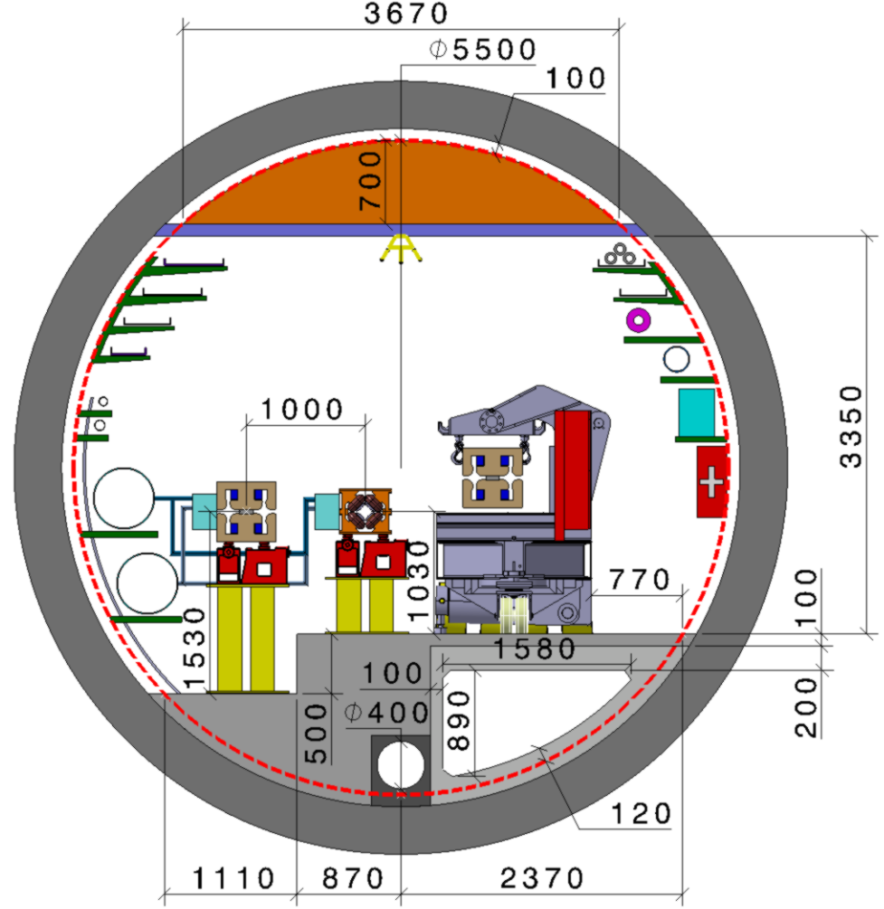
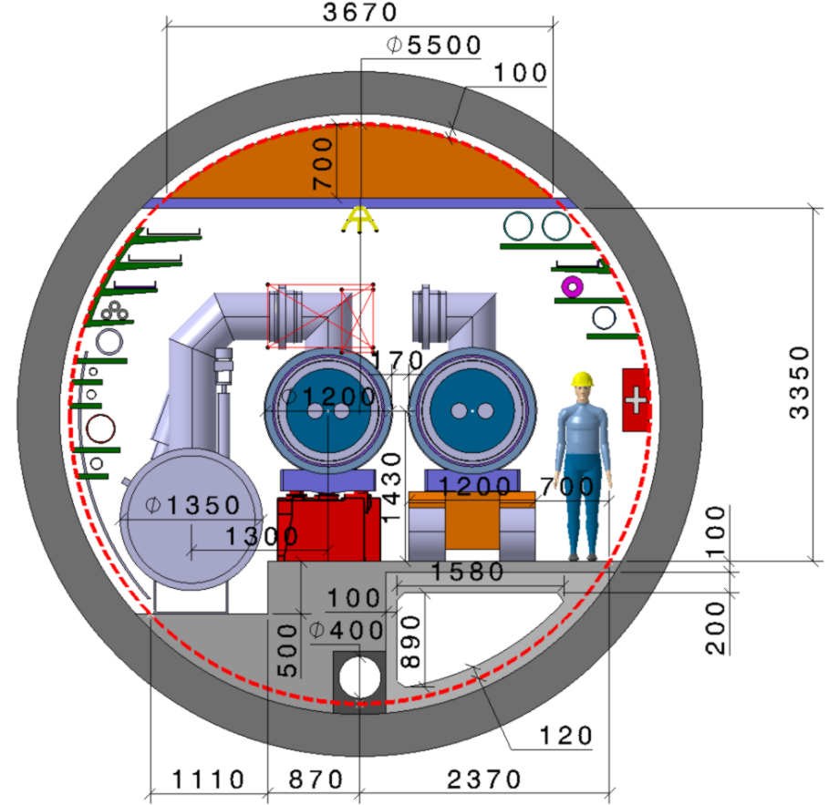
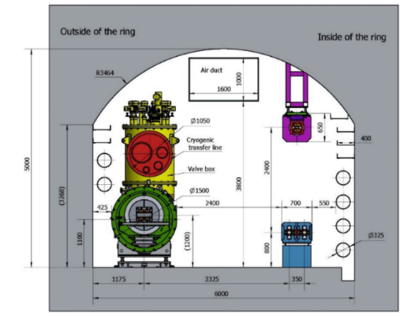
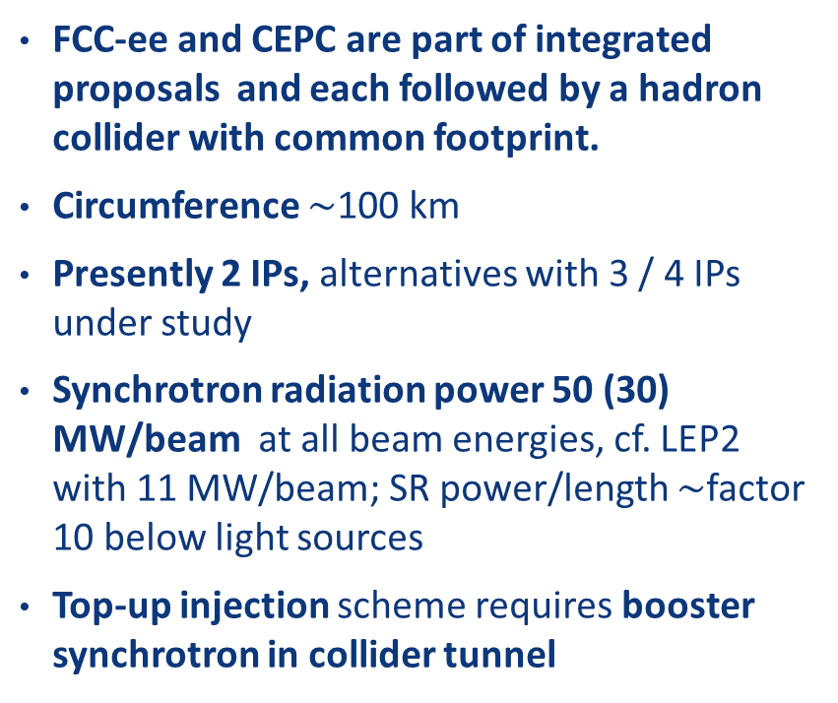
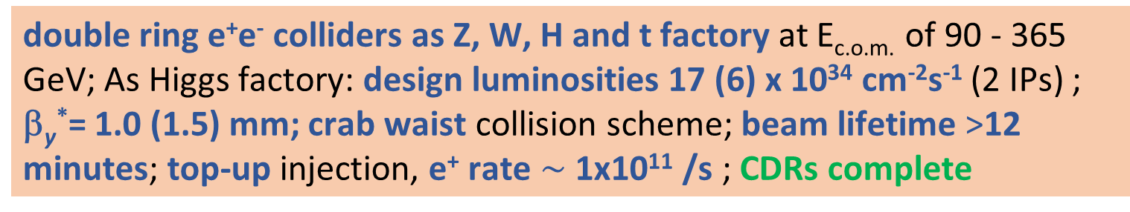
FCC-ee & CEPC – circular lepton energy frontier
double ring e⁺e⁻ colliders as Z, W, H and t factory at E_{c.o.m.} of 90 - 365 GeV; As Higgs factory: design luminosities 17 (6) x 10³⁴ cm⁻²s⁻¹ (2 IPs) ; β_{y}*= 1.0 (1.5) mm; crab waist collision scheme; beam lifetime >12 minutes; top-up injection, e⁺ rate $\sim$ 1x10¹¹ /s ; CDRs complete
FCC-ee and CEPC are part of integrated proposals and each followed by a hadron collider with common footprint.
Circumference $\sim$100 km
Presently 2 IPs, alternatives with 3 / 4 IPs under study
Synchrotron radiation power 50 (30) MW/beam at all beam energies, cf. LEP2 with 11 MW/beam; SR power/length $\sim$factor 10 below light sources
Top-up injection scheme requires booster synchrotron in collider tunnel
FCC-ee
FCC-hh
CEPC
SppC
values in brackets
refer to CEPC

Slide 5
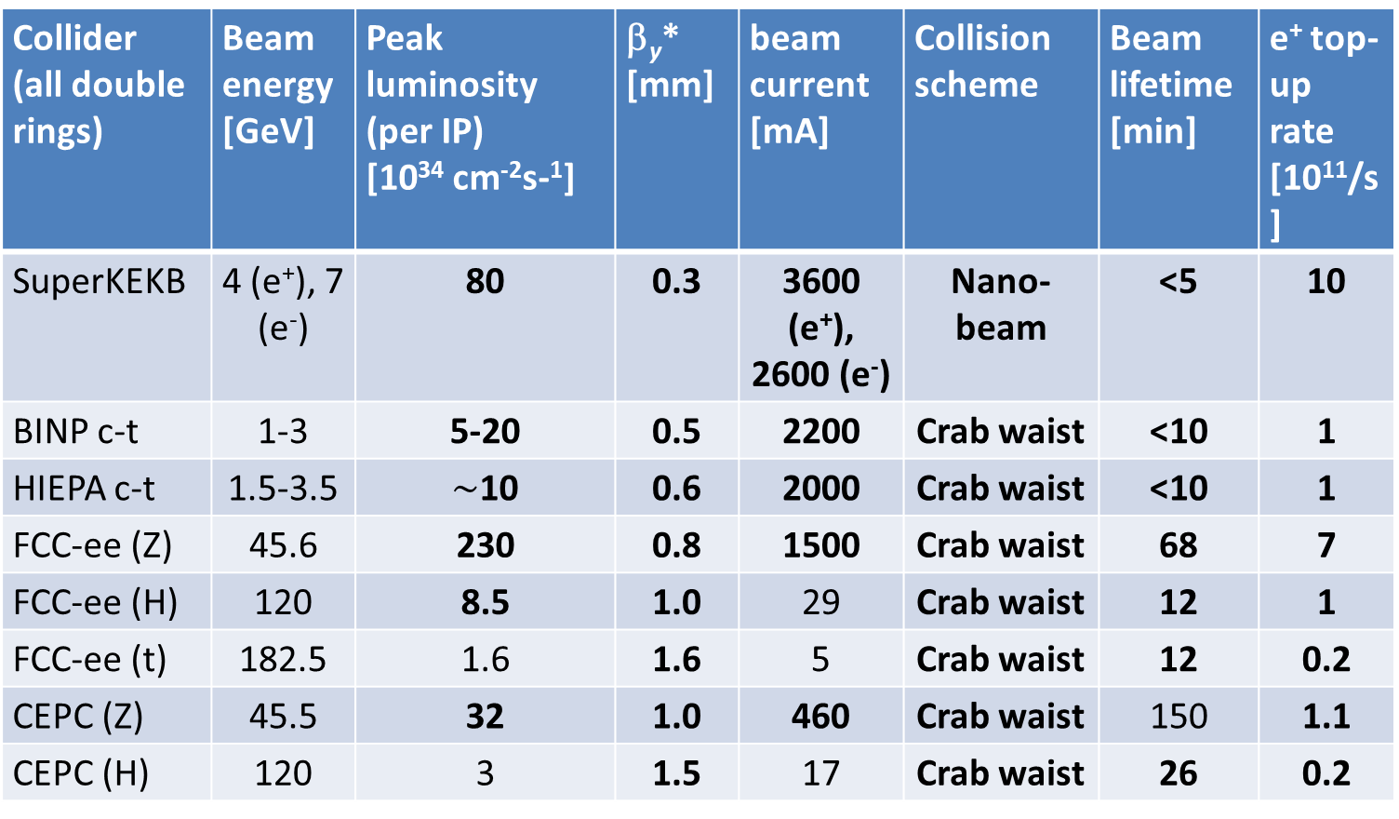
key parameters of future circular e⁺e⁻ colliders
Collider (all double rings) | Beam energy [GeV] | Peak luminosity (per IP) [10³⁴ cm⁻²s-¹] | β_{y}* [mm] | beam current [mA] | Collision scheme | Beam lifetime [min] | e⁺ top-up rate [10¹¹/s]
SuperKEKB | 4 (e⁺), 7 (e⁻) | 80 | 0.3 | 3600 (e⁺), 2600 (e⁻) | Nano-beam | <5 | 10
BINP c-t | 1-3 | 5-20 | 0.5 | 2200 | Crab waist | <10 | 1
HIEPA c-t | 1.5-3.5 | $\sim$10 | 0.6 | 2000 | Crab waist | <10 | 1
FCC-ee (Z) | 45.6 | 230 | 0.8 | 1500 | Crab waist | 68 | 7
FCC-ee (H) | 120 | 8.5 | 1.0 | 29 | Crab waist | 12 | 1
FCC-ee (t) | 182.5 | 1.6 | 1.6 | 5 | Crab waist | 12 | 0.2
CEPC (Z) | 45.5 | 32 | 1.0 | 460 | Crab waist | 150 | 1.1
CEPC (H) | 120 | 3 | 1.5 | 17 | Crab waist | 26 | 0.2
Many similar parameters and strong synergies for design

Slide 6
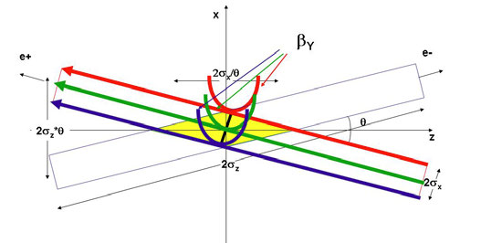
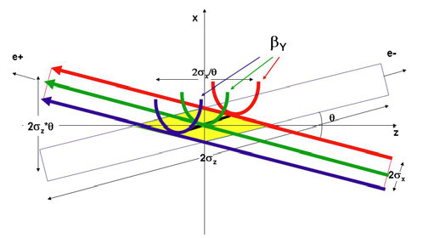
crab-waist crossing for flat beams
regular crossing
P. Raimondi, M. Zobov,
et al.
crab waist -
vertical waist position
in s varies with horizontal
position x
allows for small β_{y}* and for small ε_{x,y}
and avoids betatron resonances (→higher beam-beam tune shift)

Slide 7
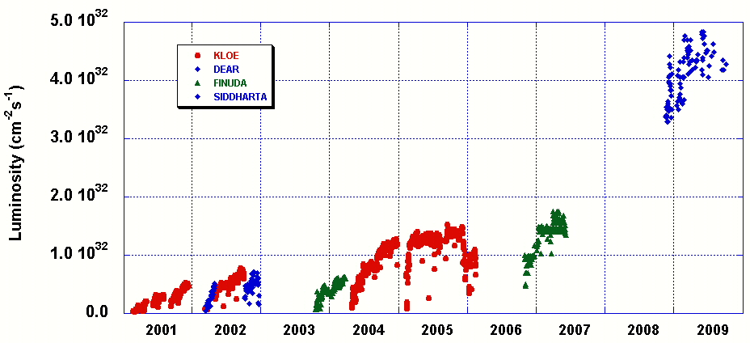
DAΦNE: “crab waist” collisions
DAΦNE Peak Luminosity
Design Goal
CRAB-WAIST Collision Scheme
M. Zobov et al., “Test of “Crab-Waist” Collisions at the DAΦNE Φ Factory”, Phys. Rev. Lett. 104, 174801 (2010).
M. Zobov

Slide 8
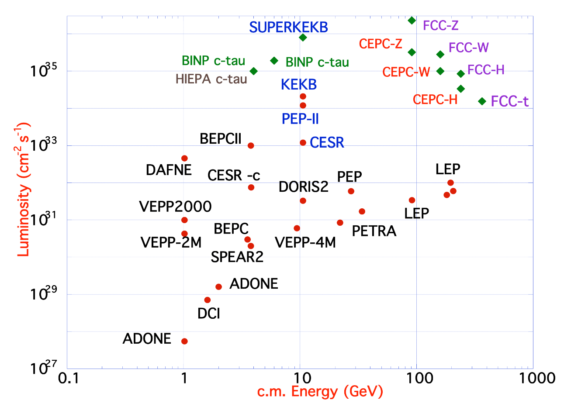
future circular lepton factories based on proven concepts and techniques from past colliders and light sources
B-factories: KEKB & PEP-II:
double-ring lepton colliders,
high beam currents,
top-up injection
DAFNE: crab waist, double ring
SuperB-factories, S-KEKB: low β_{y}*
LEP: high energy, SR effects
VEPP-4M, LEP: precision E calibration
KEKB: e⁺ source
HERA, LEP, RHIC: spin gymnastics
L/IP
Marica Biagini
combining successful ingredients of several recent colliders → highest luminosities & energies

Slide 9
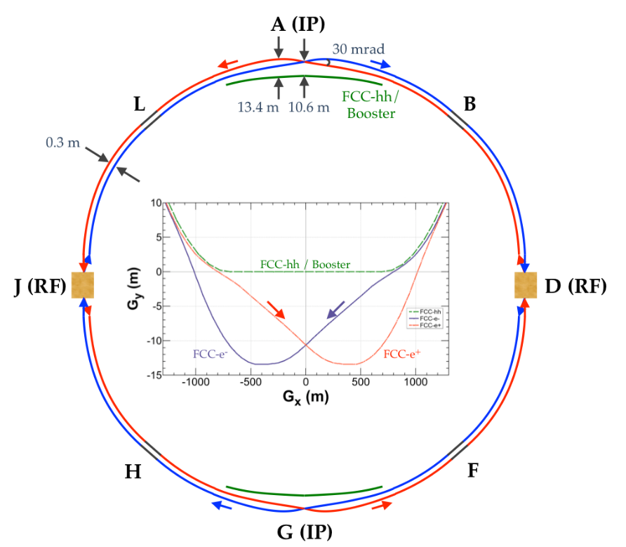
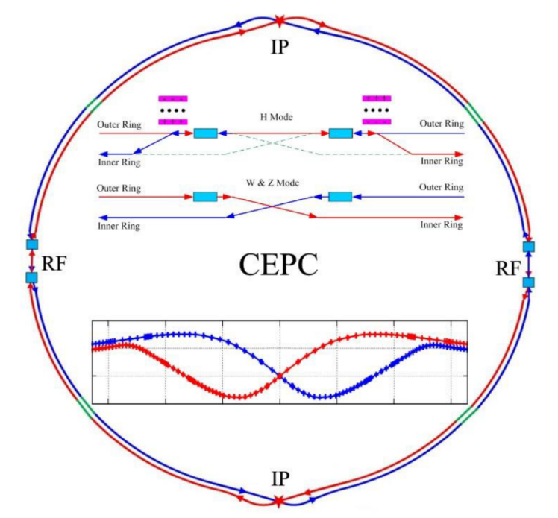
similar solutions for FCC-ee and CEPC
Double ring colliders with full-energy top-up booster ring,
CEPC evolved from initial 54 km - single-ring design, practically to the FCC-ee 100 km design.
2 IPs, 2 RF straights, tapering of arc magnet strengths to match local energy
Asymmetric IR layout to limit SR of incoming beams towards detectors and generate large crossing angle
Common use of RF systems for both beams at highest energy working point (ttbar/ZH for FCC-ee/CEPC)
FCC

Slide 10
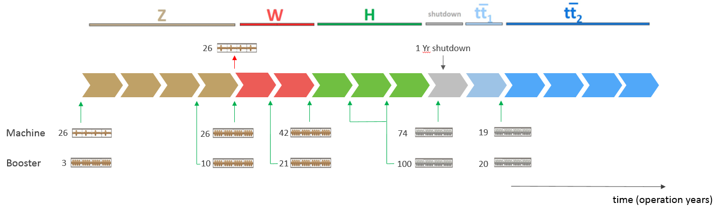
FCC-ee machine evolution and RF staging
“Ampere-class” machine
three sets of RF cavities to cover all options for FCC-ee & booster:
high intensity (Z, FCC-hh): 400 MHz mono-cell cavities (4/cryom.)
higher energy (W, H, t): 400 MHz four-cell cavities (4/cryomodule)
ttbar machine complement: 800 MHz five-cell cavities (4/cryom.)
installation sequence comparable to LEP ( ≈ 30 CM/shutdown)
WP | V_{rf} [GV] | #bunches | I_{beam} [mA]
Z | 0.1 | 16640 | 1390
W | 0.44 | 2000 | 147
H | 2.0 | 393 | 29
ttbar | 10.9 | 48 | 5.4
“high-gradient” machine
O. Brunner

Slide 11
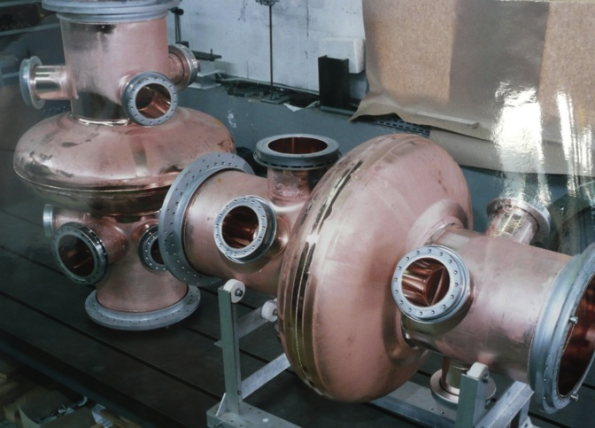
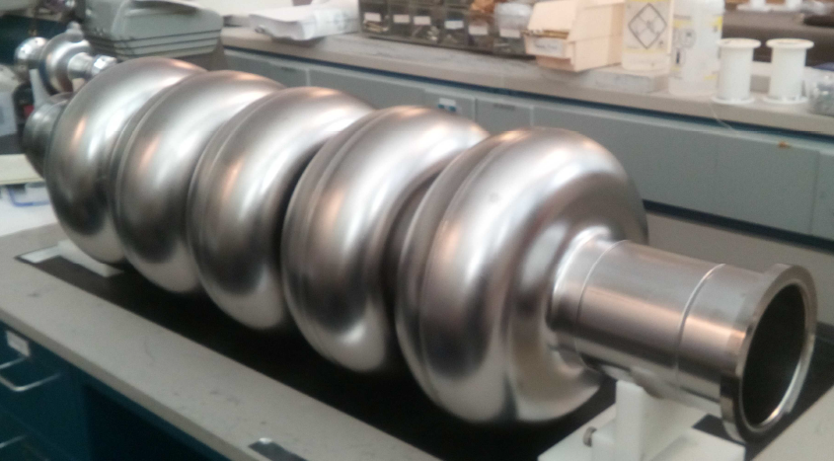
FCC-ee cavities
Z running:
single cell cavities,
400 MHz,
Nb/Cu at 4.5 K,
like LHC cavities
ttbar running:
five-cell cavities,
800 MHz,
bulk Nb at 2 K,
in addition to
400 <MHz
four-cell cavities
at 400 MHz
Z-pole FCC-ee: 116 single-cell cavities
JLAB, Oct 25, 2017
F. Marhauser et al
ttbar FCC-ee: 396 four-cell 400 MHz + 852 five-cell 800 MHz cavities

Slide 12
FCC-ee injector layout
S. Ogur, K. Oide, Y. Papaphilippou
SLC/SuperKEKB-like 6 GeV linac accelerating; 1 or 2 bunches with repetition rate of 100-200 Hz
same linac used for e+ production @ 4.46 GeV e+ beam emittances reduced in DR @ 1.54 GeV
injection @ 6 GeV into of Pre-Booster Ring (SPS or new ring) and acceleration to 20 GeV
injection to main Booster @ 20 GeV and interleaved filling of e+/e- (below 20 min for full filling) and continuous top-up
CEPC: 10 GeV linac, no prebooster

Slide 13
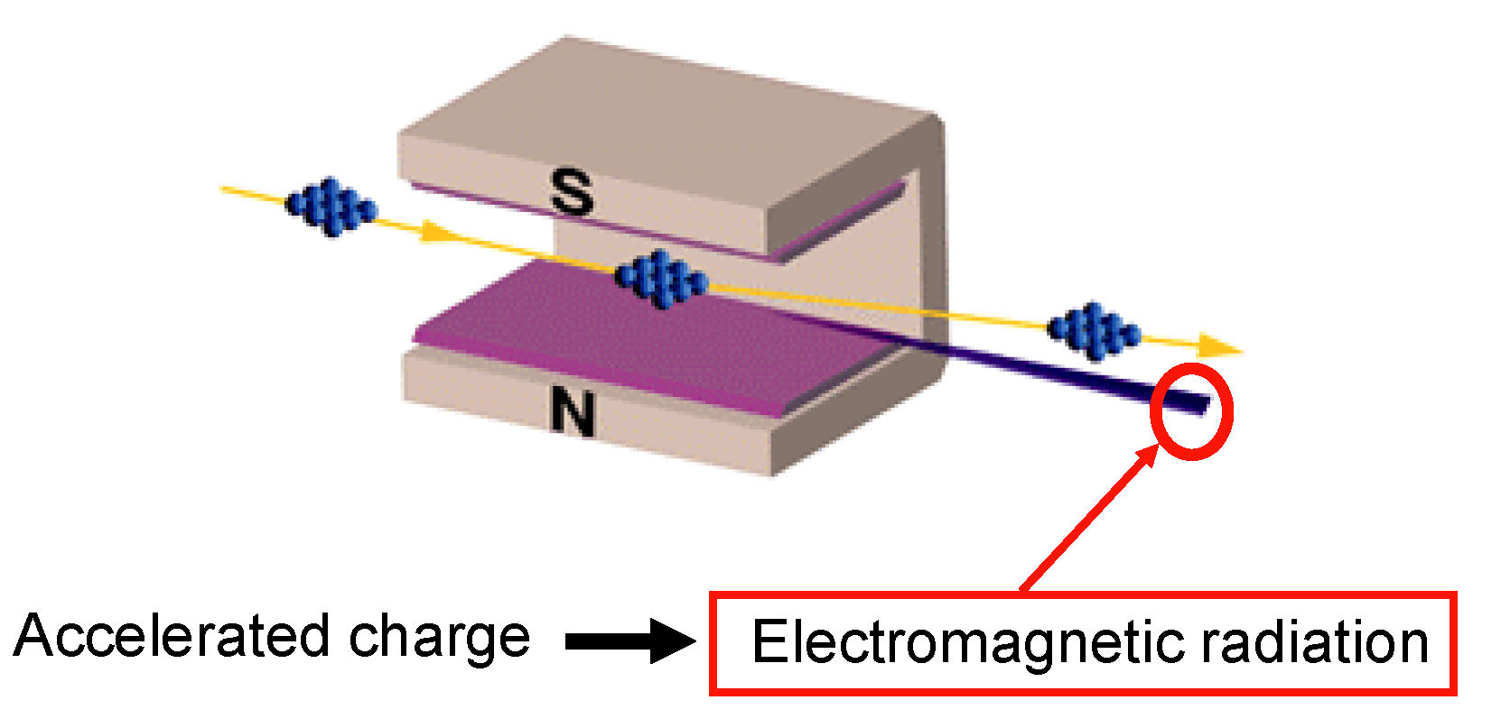
curved orbit of e⁻ in magnetic field
L. Rivkin

Slide 14
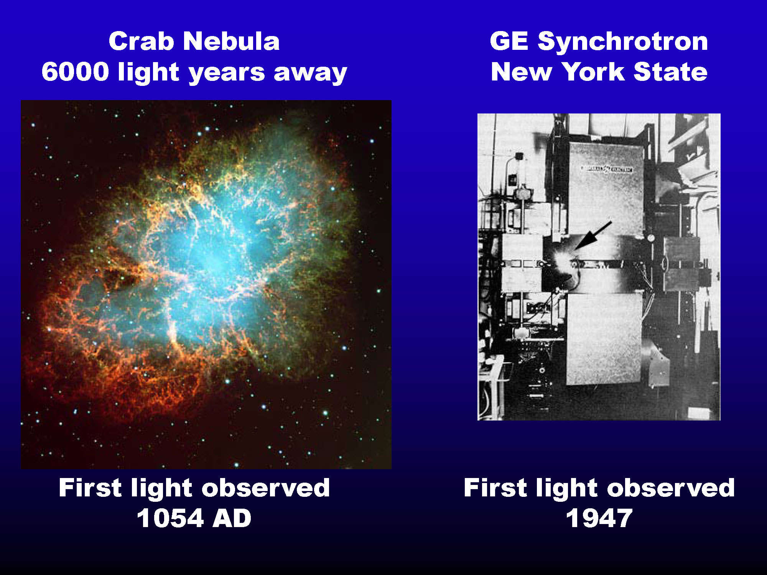
L. Rivkin

Slide 15
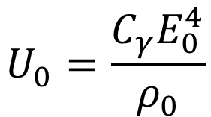
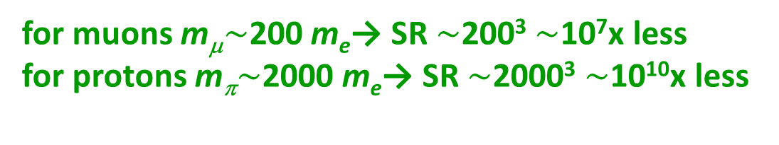
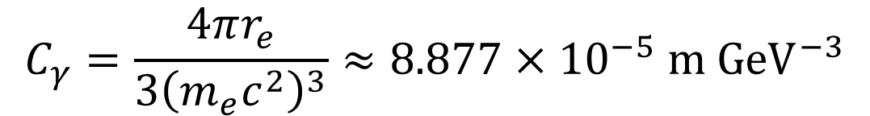
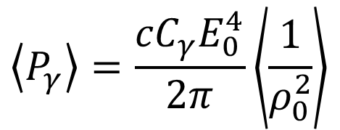
linear collider advantage:
little synchrotron radiation at high energy
synchrotron radiation in a storage ring of bending radius ρ₀
energy loss per turn
synchrotron-radiation power
for one electron
$$U_{0}=\frac{C_{γ}E_{0}^{4}}{ρ_{0}}$$
$$\left\langle P_{γ}\right\rangle =\frac{{cC}_{γ}E_{0}^{4}}{2π}\left\langle \frac{1}{ρ_{0}^{2}}\right\rangle$$
$$C_{γ}=\frac{4πr_{e}}{3{\left(m_{e}c^{2}\right)}^{3}}≈8.877×{10}^{−5} \text{m} {\text{GeV}}^{−3}$$
for muons m_{μ}$\sim$200 m_{e}→ SR $\sim$200³ $\sim$10⁷x less
for protons m_{π}$\sim$2000 m_{e}→ SR $\sim$2000³ $\sim$10¹⁰x less

Slide 16
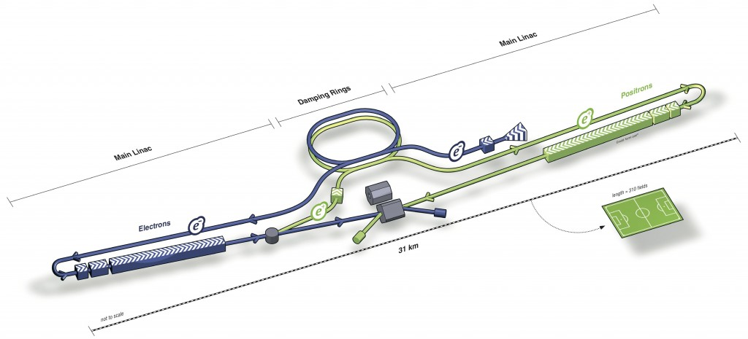
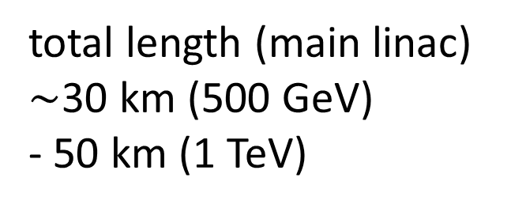
ILC
total length (main linac)
$\sim$30 km (500 GeV)
- 50 km (1 TeV)
Parameters | Value
C.M. Energy | 250 GeV
Peak luminosity | 1.35 x10³⁴ cm⁻²s⁻¹
Beam power | 5 MW
Beam Rep. rate | 5 Hz
E gradient | 31.5 MV/m +/-20%

Slide 17
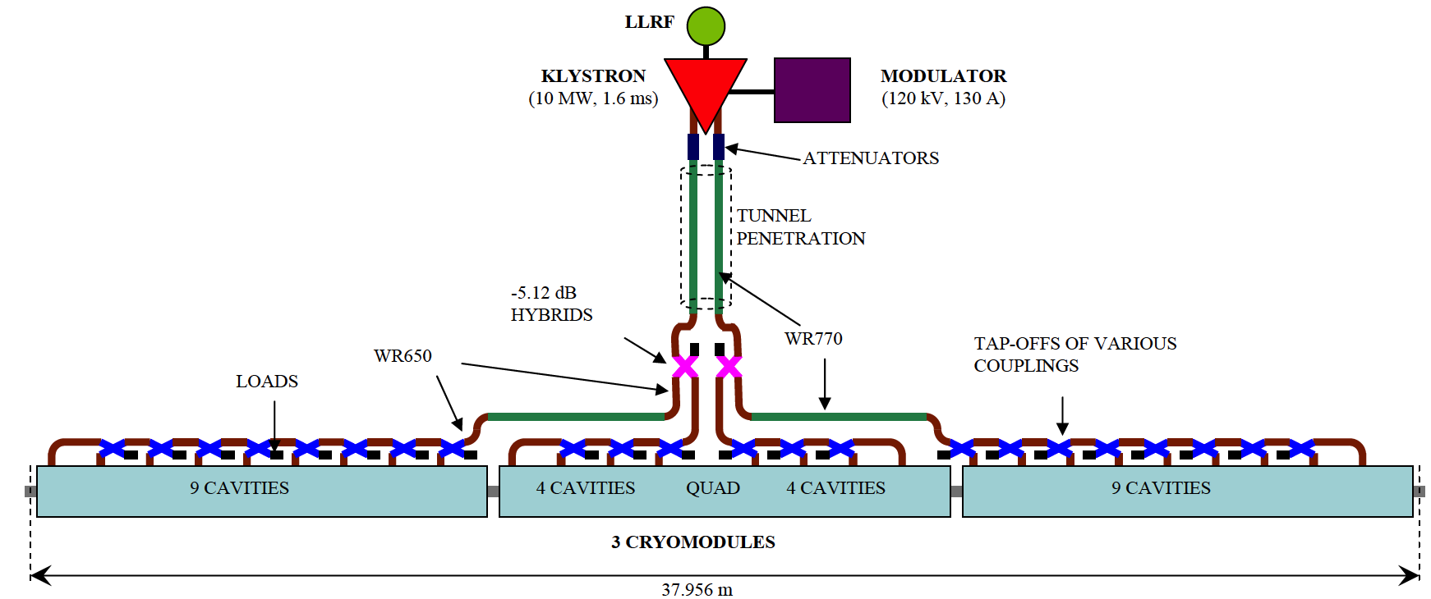
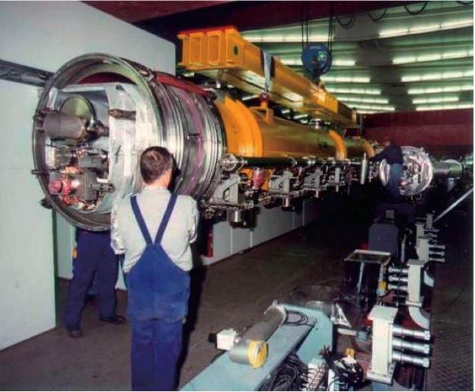
Main Linac Unit
Accelerating cavities
O(65%) of linac length
Beam guiding quadrupole
Beam position monitor
Corrector kicker
Accelerating cavities
Total length for 500 GeV cms 31 km, some length for beam cleaning and focusing

Slide 18
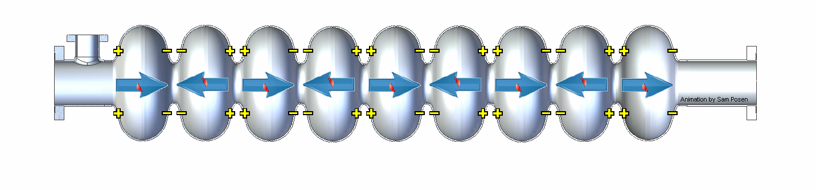
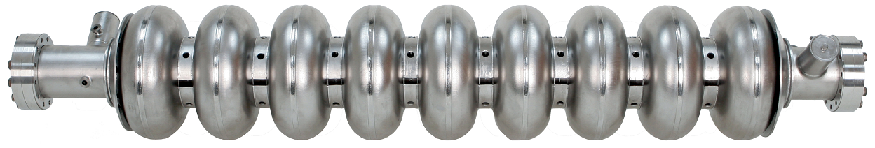
ILC cavity
Input RF power at 1.3 GHz
Slowed down by factor of approximately 4x10⁹
Niobium
~1 m
500 GeV ILC: 16,000 9-cell cavities in 31 km linac

Slide 19
ILC Achieved Gradient
From N. Walker

Slide 20
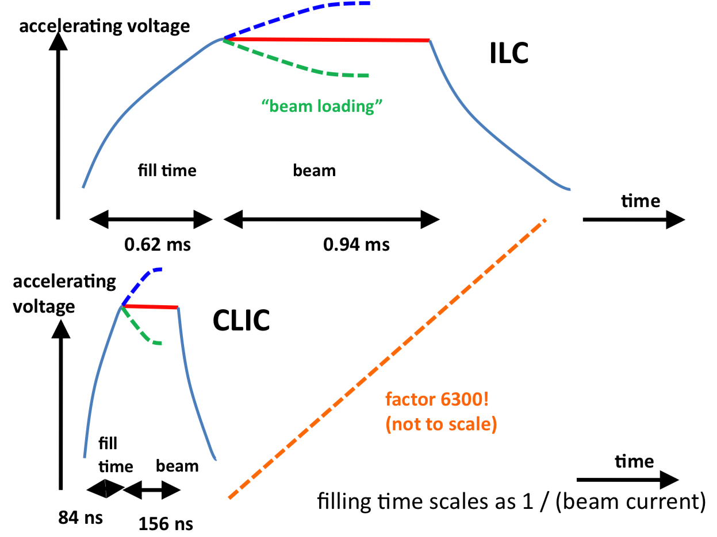
Note: Pulsed Operation
0.9ms
0.73ms
5 RF pulses of 1.6 ms per second (1312 bunches in 0.73 ms):
Because field leads to losses in the wall
About 1 W/m
With no pulsing losses would be O(100) times worse
RF power in pulse: 5 MW / (5 x 0.73 ms) = O(1500 MW) = O (150 klystrons) for 250 GeV

Slide 21
CLIC
total length (main linac) $\sim$11 (500 GeV) - 48 km (3 TeV)

Slide 22
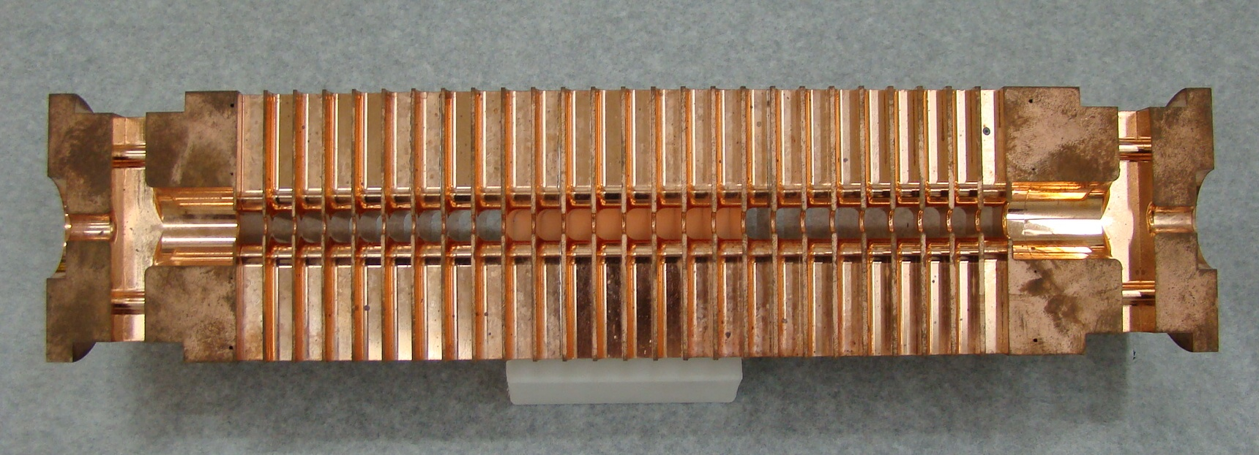
CLIC Accelerating Structure
Power flow
1/3 lost in cavity walls
1/3 in filling the structure and into load
1/3 into the beam
12 GHz, 23 cm long, normal conducting
Loaded gradient 100 MV/m
Allows to reach higher energies
140,000 structures at 3 TeV
But strong losses in the walls
50 RF bursts per second
240 ns, 60 MW, 312 bunches
Power during pulse 8.5 x 10⁶ MW (3000 x ILC)
Average RF power about 3 kW/m
About 1 kW/m into beam

Slide 23
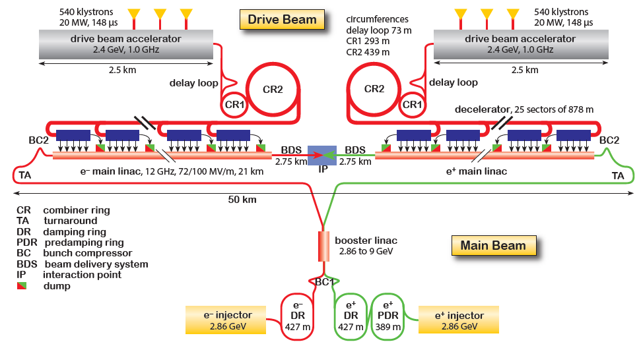
CLIC complex
Goal: Lepton energy frontier
Drive Beam Generation Complex
CLIC at 3TeV shown
50km
Main Beam Generation Complex
Stages at E_{cms}=0.38, 1.5 and 3TeV L=6x10³⁴cm⁻²s⁻¹ at 3TeV
Beam power 30MW at 3TeV

Slide 24
Examples of ILC and CLIC Main Parameters
Parameter | Symbol [unit] | SLC | ILC | CLIC | CLIC
Centre of mass energy | E_{cm} [GeV] | 92 | 250 | 380 | 3000
Luminosity | L [10³⁴cm⁻²s⁻¹] | 0.0003 | 1.35 | 1.5 | 6
Luminosity in peak | L_{0.01} [10³⁴cm⁻²s⁻¹] | 0.0003 | 1 | 0.9 | 2
Gradient | G [MV/m] | 20 | 31.5 | 72 | 100
Particles per bunch | N [10⁹] | 37 | 20 | 5.2 | 3.72
Bunch length | σ_{z} [μm] | 1000 | 300 | 70 | 44
Collision beam size | σ_{x,y} [nm/nm] | 1700/600 | 516/7.7 | 149/2.9 | 40/1
Vertical emittance | ε_{x,y} [nm] | 3000 | 35 | 30 | 20*
Bunches per pulse | n_{b} | 1 | 1312 | 352 | 312
Bunch distance | Δz [mm] | - | 554 | 0.5 | 0.5
Repetition rate | f_{r} [Hz] | 120 | 5 | 50 | 50

Slide 25
in linear colliders
full energy must be provided to beam
for every collision
long RF sections w. e.g. 2 x 125 (2 x 1500) GV voltage
e⁻
e⁺
both beams lost after single collision
supply full energy for each collision
requires small spot size to get target luminosity

Slide 26
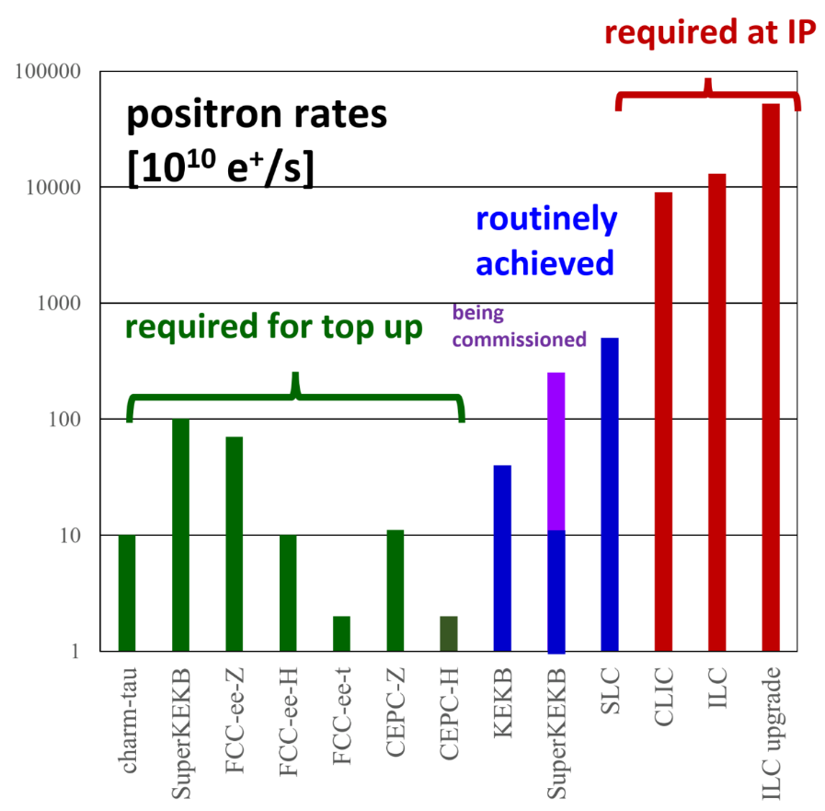
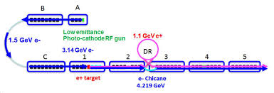
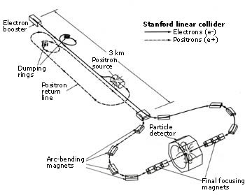
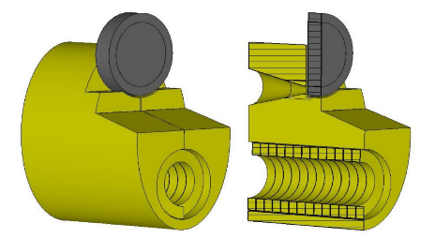
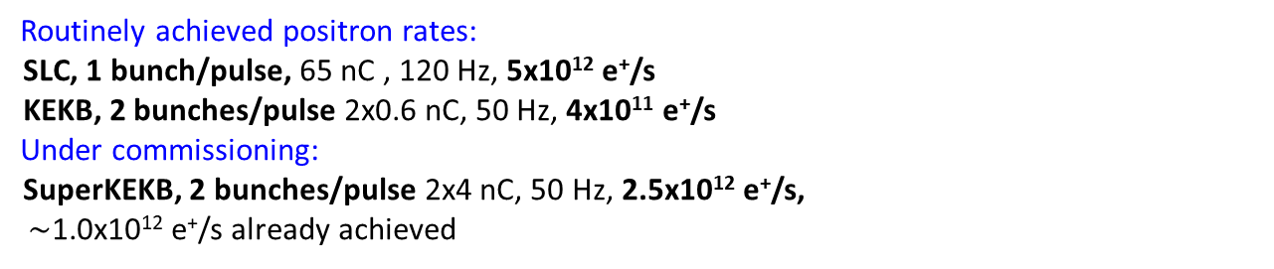
positron challenge
SuperKEKB injector
SLC complex
Routinely achieved positron rates:
SLC, 1 bunch/pulse, 65 nC , 120 Hz, 5x10¹² e⁺/s
KEKB, 2 bunches/pulse 2x0.6 nC, 50 Hz, 4x10¹¹ e⁺/s
Under commissioning:
SuperKEKB, 2 bunches/pulse 2x4 nC, 50 Hz, 2.5x10¹² e⁺/s,
$\sim$1.0x10¹² e⁺/s already achieved
FCC-ee
e⁺ source flux
concentrator
 | FCC-ee | S-KEKB | SLC | CLIC380 | ILC250
e⁺ / s | 7x10¹¹ at Z | 3 x 10¹² | 6 x 10¹² | 10¹⁴ | >2x10¹⁴

Slide 27
Key technology for e⁺e⁻ colliders: RF system
 | f_{RF} [MHz] | #cavities | #cells/cavity | V_{RF,tot} [MV] | acc. gradient [MV/m] | technology
SuperKEKB | 509 | 30 (ARES) 8 (SCC) | 1 1 | 15 12 | 2 6 | warm Cu bulk Nb
charm-tau | 500 | 1 / ring | 1 | 2x1 | 6 | bulk Nb
FCC-ee-H | 400 | 136 / ring | 4 | 2000 | 10 | Nb/Cu
FCC-ee-t (addt’l) | 800 | 372 | 5 | 6930 | 19.8 | bulk Nb
CEPC | 650 | 240 | 2 | 2200 | 19.7 | bulk Nb
ILC250 | 1,300 | 8,000 | 9 | 250,000 | 31.5 | bulk Nb
ILC1000 | 1,300 | 32,000 | 9 | 1,000,000 | >31.5? | bulk Nb
CLIC380 | 10,000 | 20,368 | 33 | 380,000 | 72 | warm Cu
CLIC3000 | 12,000 | 140,000 | 33 | 3000,000 | 100 | warm Cu
preference for SC cavities,
FCC-ee RF system optimized for each working point, CEPC features single system

Slide 28
green accelerators
subsystems with high energy efficiency & low power consumption: SC RF (=SRF), efficient RF power sources, low-power NC magnets, SC magnets
recover beam energy (storage ring, ERL)
recycle particles (e+ ,pbar …)

Slide 29
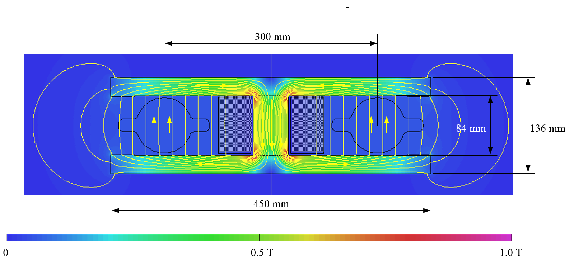
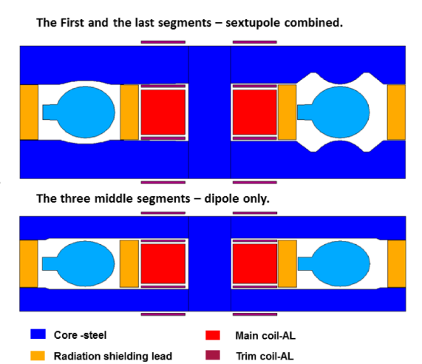
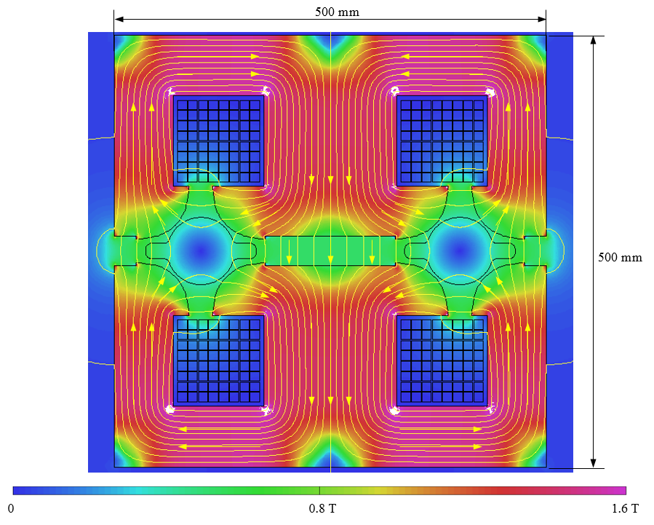
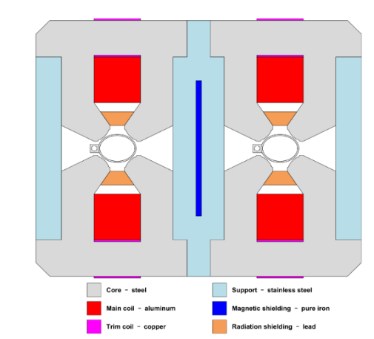



design of low-power magnets for FCC-ee and CEPC
FCC-ee
challenge of low-field magnets !
$\sim$500 G collider, $\sim$30 booster
CEPC
Twin-dipole design with 2× power saving
16 MW at 175 GeV
Twin arc magnet combined function dipole with sextupole component
Twin F/D arc quad with 2× power saving
25 MW at 175 GeV
dipole prototype
Twin F/D arc quad with 2× power saving
quadrupoleprototype
power reduction by factor 2 w.r.t. single-aperture magnets

Slide 30





RF R&D activities – towards higher efficiency
FCC R&D aims at improving performance & efficiency + reducrf cost:
  Improved Nb/Cu coating/sputtering (e.g. ECR fibre growth, HiPIMS)
  New cavity fabrication techniques (e.g. EHF, improved polishing, seamless…)
  Coating of A15 superconductors (e.g. Nb₃Sn)
  Bulk Nb cavity R&D at FNAL, JLAB, Cornell, also KEK and CEPC/IHEP
  High efficiency klystrons (e.g. COM, BAC, CSM) – synergy with HL-LHC and CLIC
  MW-class fundamental power couplers for 400 MHz
800 MHz 5-cell Nb
prototype / JLAB
80%
Klystron R&D - FCC CSM

Slide 31


circular accelerator/collider concept
“There's just no use trying to build this up. You may get a few million volts. That's limited. What we've got to do is to devise some method of accelerating through a small voltage, repeating it over and over. Multiple acceleration.” E.O. Lawrence, 1929
beams collide many times, e.g. 2x / turn
RF compensates SR loss
($\sim$1% E_{beam} / turn)
RF system $\sim$100x smaller than for LC
e⁻
e⁺
#collisions / (beam energy) $\sim$200x

Slide 32
comparison of parameters FCC-ee & ILC
Parameter | LEP2 | FCC-ee |  |  | ILC
 |  | Z | H | t | H | 500 | 1 TeV
E (GeV) | 104 | 45.6 | 120 | 182.5 | 125 | 250 | 500
<I (mA)> | 4 | 1390 | 29 | 5.4 | 0.021 | 0.021 | 0.021
P _{SR/b,tot} [MW] | 22 | 100 | 100 | 100 | 5.9 | 10.5 | 27.2
P_{AC} [MW] | ~200 | ~260 | ~280 | ~360 | ~129 | ~163 | ~300
η_{wall→beam} [%] | ~30 | 30-40 | 30-40 | ~30 | 4.6 | 6.4 | 9.1
N_{bunch/ring (pulse)} | 4 | 16’640 | 328 | 48 | 1312 | 1312 | 2450
f_{coll} (kHz) | 45 | 50000 | 4000 | 294 | 6.6 | 6.6 | 9.8
β*_{x/y} (m/mm) | 1.5/ 50 | 0.15 /.8 | 0.3 /1 | 1.0/1.6 | .013/.41 | .011/.48 | .011/.48
ε_{x} (nm) | 30-50 | 0.27 | 0.63 | 1.46 | 0.04 | 0.02 | 0.01
ε_{y} (pm) | ~250 | 1 | 1.3 | 2.9 | 0.14 | 0.07 | 0.03
ξ_{y} (ILC: n_{γ}) | 0.07 | 0.13 | 0.12 | 0.126 | (1.91) | (1.72) | (2.12)
n_{IP} | 4 | 2 | 2 | 2 | 1 | 1 | 1
L_{0.01}/IP | 0.012 | 230 | 8.5 | 1.55 | 0.5 | 1.05 | 2.2
L_{0.01,tot} (10³⁴ cm⁻²s⁻¹) | 0.048 | 460 | 17 | 3.1 | 0.5 | 1.05 | 2.2

Slide 33


early linear-collider proposals
Maury Tigner, “A Possible Apparatus for Clashing-Beam Experiments”, Nuovo Cimento 37, 1228 (1965)
these early proposal always
recovered the energy of the spent beam!
Ugo Amaldi, “A possible scheme to obtain e-e- and e+e- collisions at energies of hundreds of GeV”, Physics Letters B61, 313 (1976)

Slide 34


LHeC: Recirculating Linac with ERL Operation
lepton-hadron collider based on the LHC
Super Conducting Recirculating Linac with Energy Recovery
Choose ⅓ of LHC circumference ➔
Two 1 km long, 10 GeV
SC LINACs with
3 accelerating and
3 decelerating passes in CW operation
SRF sees 6*current
at the IP (≈ 4ns spacing)
➔ Q₀ = 10¹⁰ requires
cryogenic system
comparable to LHC
system! Q₀ > 10¹⁰
944 cavities; 59 cryo modules per linac
ca. 9 km underground tunnel installation
more than 4500 magnets (same magnet design as for RR option)

Slide 35
LHeC 10³⁴ cm⁻² s⁻¹ Luminosity reach | PROTONS | ELECTRONS
Beam Energy [GeV] | 7000 | 60
Luminosity [10³³cm⁻²s⁻¹] | 16 | 16
Normalized emittance γε_{x,y} [μm] | 2.5 | 20
Beta Funtion β∗_{x,y} [m] | 0.05 | 0.10
rms Beam size σ∗_{x,y} [μm] | 4 | 4
rms Beam divergence σ∗_{x,y} [μrad] | 80 | 40
Beam Current @ IP[mA] | 1112 | 25
Bunch Spacing [ns] | 25 | 25
Bunch Population | 2.2*10¹¹ | 4*10⁹
Bunch charge [nC] | 35 | 0.64
Over 600MW Beam power in electron Beam!!!
ERL is a must for efficient operation!!!
O. Brüning

Slide 36

FCC-ee ERL upgrade – recent proposal from BNL
Green FCC ee w. 10% of R-R power consumption
V. Litvinenko, T. Roser, M. Chamizo
FCCee
?
?
ERL based FCC ee at 100 MW SR
ERL based FCC ee at 10 MW SR
*Luminosity scaled linear with SR power – would see other limitations

Slide 37


Multi-pass high-current ERL test facility for LHeC (and FCC-ee-ERL?)
under construction at LAL Orsay
arXiv:1705.08783
2 Linacs (Four 5-Cell 801.58 MHz SC cavities)
3 turns (160 MeV/turn)
Max. beam energy 500 MeV
1 : 3 : 5
ΔE = 80 MeV
injector
7 MeV
ΔE = 80 MeV
2 : 4 : 6
7 MeV
dump
ΔC = λ_{RF}/2
Footprint: 24 x 5.5 x 0.8 m³
W. Kaabi, A. Bogacz, O. Bruning

Slide 38
a bit of history

Slide 39

LEP/LEP2: highest energy so far
circumference 27 km
in operation from 1989 to 2000
maximum c.m. energy 209 GeV
maximum synchrotron radiation power 23 MW
LEP energy close to FCC-ee target + record synchrotron radiation with ~MeV photons

Slide 40


“An e⁺-e ⁻ storage ring in the range of a few hundred GeV in the centre of mass can be built with present technology. ...would seem to be ... most useful project on the horizon.”
(original LEP proposal, 1976)
Burt Richter
1976
350 GeV c.m.
↔
~90 km
cost-optimized
circumference
B. Richter, Very High Energy Electron-Positron Colliding Beams for the Study of Weak Interactions, NIM 136 (1976) 47-60

Slide 41



SLC: the first & so far only linear collider
20 pb⁻¹ from 1989 to 1998
Burton Richter et al, “The Stanford Linear Collider”, 11th Int. Conf. on High-Energy Accelerators, CERN (1980)

Slide 42

commissioning time & performance of the first linear collider
LEP1
(per IP)
LEP1 design
SLC design
SLC
CERN-SL-2002- 009 (OP), SLAC–PUB–8042 [K. Oide, 2013]
SLC
½ design value reached after 11 years

Slide 43
back to the future

Slide 44

proposed linear & circular colliders
ex. Geneva basin
to go beyond
the LHC we
need larger
machines
CLIC
FCC
C NZZ

Slide 45




proposed linear & circular colliders
ex. Japan
J-ILC
circular
machines
appear closer
to Tokyo
J-ILC
Tristan-II
(1983)
Kitakami site
F. Takasaki
F. Takasaki
not pursued
Tristan-II
(1983)
Tsukuba site
Fukushima site

Slide 46





proposed circular colliders
6
1
ex. China
1)
4
4
2
2)
5
1) Qinhuangdao, Hebei Province（Completed in 2014）
2) Huangling, Shanxi Province（Completed in 2017)
3) Shenshan, Guangdong Province(Completed in 2016)
4) Baoding (Xiong an), Hebei Province (Started in August 2017)
5) Huzhou, Zhejiang Province (Started in March 2018)
6) Chuangchun, Jilin Province (Started in May 2018)
3)
3
J. Gao

Slide 47
the nanobeam challenge

Slide 48


IP spot size
$${σ^{∗}}_{x,y}=\sqrt{{β^{∗}}_{x,y}ε_{x,y}}$$
ILC$: ε∝1/E$
(adiabatic damping)
FCC-ee:
1. $ε∝E^{2}{θ_{dip}}^{3}$ (synchr. rad.)
2. beam-beam tune shift
1. final focus optics
2. bunch length
3. beamstrahlung
(for β_{x})
smaller emittances
needed for linear colliders

Slide 49


β* [m]
year
SPEAR
PEP, BEPC, LEP
PETRA
TRISTAN
DORIS
CESR-c, PEP-II
BEPC-II
CESR
DAFNE
KEKB
SLC
FCC-ee
SuperKEKB
ILC
$$σ^{∗}=\sqrt{{εβ}^{∗}}$$

Slide 50

vertical rms IP spot size
collider / test facility | ${σ_{y}}^{∗}$ [nm]
LEP2 | 3500
KEKB | 940
SLC | 700
ATF2, FFTB | 41 (35), 77
SuperKEKB | 50
FCC-ee-H | 44
ILC | 5 – 8
CLIC | 1 – 2
β_{y}*:
5 cm→
1 mm
ε_{y}:
250 pm→
1.3 pm
in regular
font:
achieved
in italics:
design
values
β_{y}*:
1.5 mm→
0.5 mm
ε_{y}:
90 pm→
0.1 pm

Slide 51
beam-beam effects

Slide 52

betatron oscillation & tune
schematic of betatron oscillation around storage ring
tune Q_{x,y}= number of (x,y) oscillations per turn
quadrupole magnet
(many)
focusing elements:
quadrupole magnets

Slide 53

beam-beam tune shift
beam-beam
deflection
center of
opposing
beam
at small amplitude similar to effect of focusing quadrupole
beam-beam tune shift
(for head-on collision)

Slide 54







ee luminosity w crab waist and its constraints
synchrotron radiation power / beam:
$$P_{SR}=n_{b}N_{b}\frac{cC_{γ}E^{4}}{ρC}$$
beam-beam tune shift
constant
$$ξ_{y}=\frac{r_{e}N_{b}}{2πγ}\frac{β_{y}^{∗}}{σ_{x}^{∗}σ_{y}^{∗}\sqrt{1+φ_{piw}^{2}}}$$
$$ξ_{x}=\frac{r_{e}N_{b}}{2πγ}\frac{β_{x}^{∗}}{σ_{x}^{∗2}\left(1+φ_{piw}^{2}\right)}$$
maximum
acceptable
Piwinski
angle
$$φ_{piw}≡\frac{θ_{c}σ_{z}}{2σ_{x}^{∗}}>1$$
$$L=\frac{c}{C}\frac{n_{b}N_{b}^{2}}{4πσ_{x}^{∗}σ_{y}^{∗}\sqrt{1+φ_{piw}^{2}}}F_{hg}\left(\frac{β_{y}^{∗}\sqrt{1+φ_{piw}^{2}}}{σ_{z}}\right)$$
luminosity
luminosity formula for H, Z, W, t factory
$$≈1$$
$$L=C_{lum}\frac{P_{SR}ρξ_{y}}{β_{y}^{∗}E^{3}}$$
with
$$C_{lum}≡\frac{3{\left(m_{e}c^{2}\right)}^{2}}{8πr_{e}^{2}}≈4×{10}^{15}\frac{{\text{TeV}}^{2}}{{\text{m}}^{2}}$$

Slide 55

beam-beam tune shift for FCC-ee
tune shift limit empirically scaled from LEP data (4 IPs)
J. Wenninger
R. Assmann & K. Cornelis, EPAC2000
in reasonable agreement with simulations
S. White
crab waist collision scheme allows for even larger tune shifts

Slide 56
linear collider luminosity and parameter drivers
Can re-write normal luminosity formula
Disruption
enhancement
Beam power
Luminosity
spectrum
Beam Quality
(+bunch length)
Need to ensure that we can achieve each parameter

Slide 57


beam-beam effect in linear colliders
Beam-beam force off
Y direction [nm]
Dense beams to reach high luminosity
Beam focus each other
Beam-beam force on
Z direction [μm]

Slide 58

beam-beam disruption at the SLC
at highest luminosity
more than 100% luminosity
increase

Slide 59

beam-beam effect: beamstrahlung
degraded
energy
spectrum
Emit beamstrahlung
Develop luminosity spectrum
Typically aim for O(1)
Beam-beam force on
Z direction [μm]

Slide 60
comparison of e⁺e⁻ colliders

Slide 61

design luminosity vs. energy
Luminosity versus c.m. energy for e+e- Higgs Factories.
Two IPs are assumed for the circular colliders FCC-ee and CEPC.
D. Schulte, B. List

Slide 62



Foreseen integrated luminosities versus year.
ILC
CLIC
FCC

Slide 63

a figure of merit for collider efficiency
E. Jensen, M. Seidel

Slide 64
physics operation plans for all post-LHC colliders

Slide 65

timelines of various collider projects,
in years and starting at time T₀
D. Schulte,

Slide 66
what is time T₀? readiness timelines
Timeline | ~ 5 | ~ 10 | ~ 10 |  |  | ~ 15 |  | ~ 20 |  | ~ 25 | ~ 30 | ~ 35
Lepton Colliders
SRF-LC/CC | Proto/pre-series | Construction | Construction |  |  |  |  | Operation |  |  | Upgrade
NRF—LC | Proto/pre-series | Construction | Construction | Construction |  |  |  | Operation |  |  | Upgrade
Hadron Collider (CC)
8~(11)T NbTi /(Nb3Sn) | Proto/pre-series |  | Construction |  |  |  |  | Physics Experiment | Operation |  |  | Upgrade | Upgrade
12~14T Nb₃Sn | Short-model R&D |  |  |  | Proto/Pre-series |  |  |  | Construction | Construction to Physics Experiment | Operation
14~16T Nb₃Sn | Short-model R&D |  |  |  |  |  | Prototype/Pre-series |  |  |  | Construction | Construction
Note: LHC experience: NbTi (10 T) R&D started in 1980’s --> (8.3 T) Production started in late 1990’s, in ~ 15 years
A relative timeline expected for realizing future lepton and hadron colliders (from A. Yamamoto, presented at the Open Symposium in Granada, and updated based on the discussion followed).
A. Yamamoto

Slide 67
next frontier collider summary table
Project | Type | Energy [TeV] | Int. Lumi. [a⁻¹] | Oper. Time [y] | Power [MW] | Cost
ILC | ee | 0.25 | 2 | 11 | 129 (upgr. 150-200) | 4.8-5.3 GILCU + upgrade
 |  | 0.5 | 4 | 10 | 163 (204) | 7.98 GILCU
 |  | 1.0 |  |  | 300 | ?
CLIC | ee | 0.38 | 1 | 8 | 168 | 5.9 GCHF
 |  | 1.5 | 2.5 | 7 | (370) | +5.1 GCHF
 |  | 3 | 5 | 8 | (590) | +7.3 GCHF
CEPC | ee | 0.091+0.16 | 16+2.6 |  | 149 | 5 G$
 |  | 0.24 | 5.6 | 7 | 266
FCC-ee | ee | 0.091+0.16 | 150+10 | 4+1 | 259 | 10.5 GCHF
 |  | 0.24 | 5 | 3 | 282
 |  | 0.365 (+0.35) | 1.5 (+0.2) | 4 (+1) | 340 | +1.1 GCHF
LHeC | ep | 60 / 7000 | 1 | 12 | (+100) | 1.75 GCHF
FCC-hh | pp | 100 | 30 | 25 | 580 (550) | 17 GCHF (+7 GCHF)
HE-LHC | pp | 27 | 20 | 20 |  | 7.2 GCHF
1 GILCU=10⁹ ILC Units= 1G$ 2012
D. Schulte

Slide 68

V. Shiltsev

Slide 69
European Strategy for Particle Physics
Update

Slide 70

European Particle Physics Strategy Update (EPPSU)- 2019/20
H. Abramowicz – Chair of the EPPSU Secretariat

Slide 71
EPPSU meeting in Granada
Great progress in ν physics since 2013 EPPSU at accelerator and non-accelerator based facilities. Experiments ongoing to address:
  order of the ν masses,
  absolute value of ν masses,
  ν nature (Dirac or Majorana)
  existence of sterile neutrinos
Hidden (Dark) sector searches and identifications of portals to this sector:
  An increasing number of experiments are extending/focussing their analysis in this area in the LHC (LHC experiments, FASER) and in the SPS North Area (NA62 and its possible extension)
  New experiments proposed: SHiP and beam dump facility, e-SPS
G. Arduini

Slide 72
EPPSU meeting in Granada
Synergies with astro-particle physics highlighted once more:
  Theory
  The new Einstein Telescope (3rd generation underground Gravitational Wave interferometer) has requested CERN to help on:
      Underground infrastructure, cryogenics
      Vacuum, material and surface science
      Electronics and data acquisition, computing
Consensus that an e+-e- collider for precision physics is the next required step:
  Higgs factory ➔ Higgs could be one of the portals to the Dark Sector
  t-tbar physics
  Providing large event set at the Z-pole (~90 GeV)
A hadron collider at ~100 TeV C.o.M. energy is the long term goal
G. Arduini

Slide 73
EPSSU longer term perspective
More promising but (by far) less developed and uncertain:
  Muon colliders
  Plasma wakefield acceleration
  …and their possible combination..
….but they are in this stage since long….
Need to be studied to assess how realistic the schemes are and to identify the key questions to answer
While for plasma wakefield acceleration effort is ongoing driven by interest for potential applications, muons are of interest only for particle physics.
G. Arduini

Slide 74

EPPSU discussions in Granada
Strategy = A plan of action designed to achieve a long-term or overall aim
we are looking at a time scale of several decades
  Cost but also Upgradeability
Whatever large scale collider project requires O(1000) accelerator experts - Oide’s principle - out of ~4500 accelerator experts worldwide.
Clearly we (CERN) need to maintain and further develop our expertise in accelerator physics/design/technology
G. Arduini

Slide 75


Slide 76
conclusions
FCC study develops high-performance energy frontier circular colliders for post-LHC era – input to ESU’19/20
consensus that an e⁺e⁻ collider for precision physics is the next required step:
  Higgs factory → Higgs could be one of the portals to the Dark Sector
  t-tbar physics
  providing large event set at the Z-pole (~90 GeV)
hadron collider in the 100 TeV C.o.M. energy is the long term goal
coherent strategy needed
effort to design greener accelerators
a lot of activity in France, esp. FCC, also γ-F., PERLE & LAL

