Slide 1


Triggering with ATLAS
GDR Terascale @ Heidelberg
14.10.2009
Rainer Stamen
Kirchhoff-Institut für Physik
Universität Heidelberg

Slide 2
Content
Trigger Challenge
Concepts and Implementation
The Trigger Strategy
Examples

Slide 3
Disclaimer
I am talking about ATLAS. Most of what I am going to say also holds for CMS.
Most plots are outdated. The message given by these plots is still valid.

Slide 4
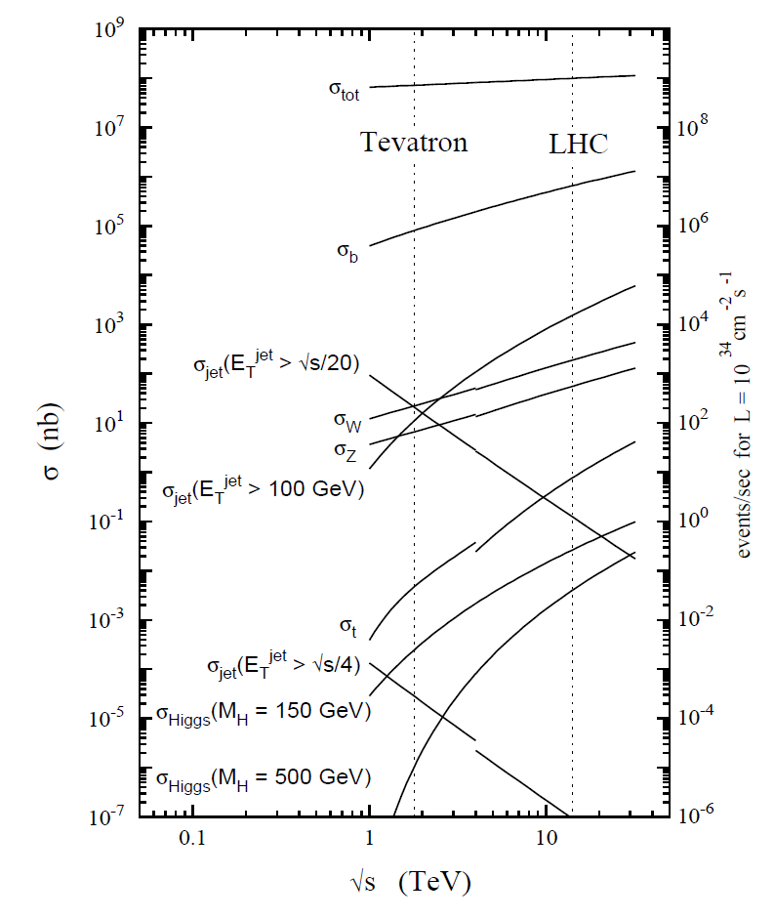
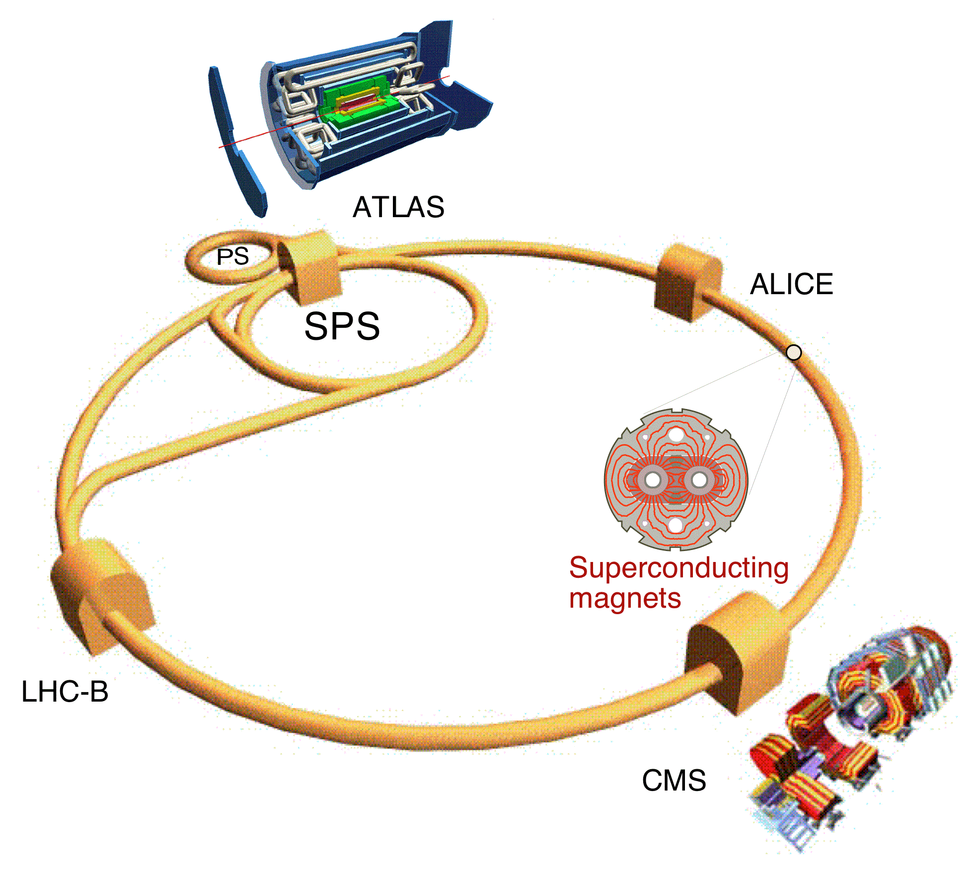
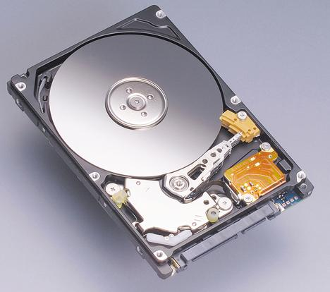
The Trigger Challenge
High luminosity: L_{inst} = 10³⁴ cm⁻¹s⁻¹
ATLAS
- 10⁸ channels
Eventrate
- 40 MHz
(20 events per BX)
Datarate
- 60TB/s
Reduction: 1/200 000
Data Storage (forseen)
~ 200 Events/s
~ 300 MB/s
(limited by offline
ressources)

Slide 5
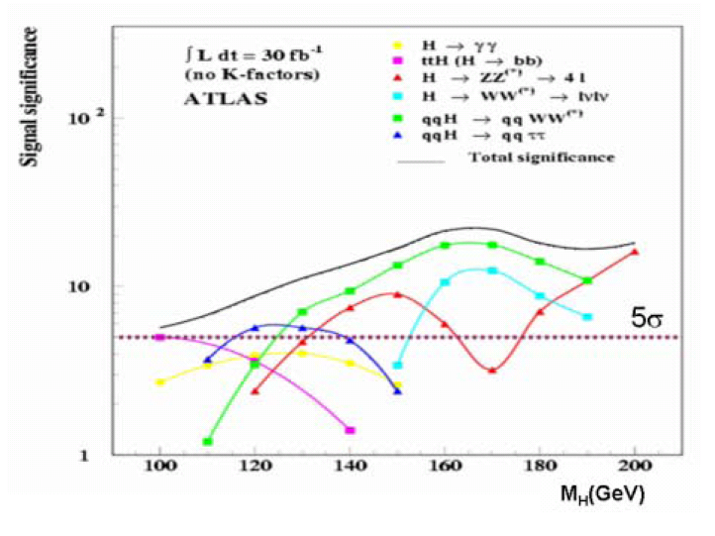
Physics Objects
Objects needed for
event selection
-> also needed for Trigger:
- Electrons
- Photons
- Muons
- Jets
- b-Jets
- forward jets
- Taus
- Missing Energy
- (B-physics triggers)
Trigger object close to offline Physics objects required

Slide 6
Realisation
Complete data readout not possible (60TB/s (already with zero supression))
Need quick decision based on reduced information
Then readout data and perform refined decision
But: Whatever is rejected by the trigger cannot be recovered

Slide 7
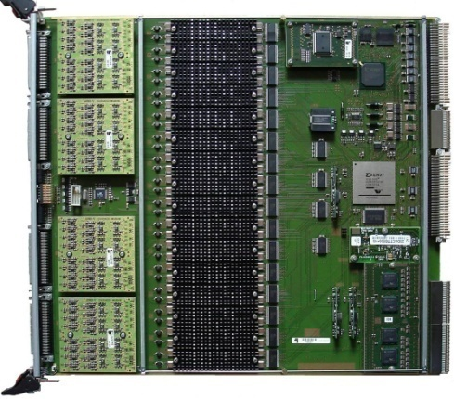
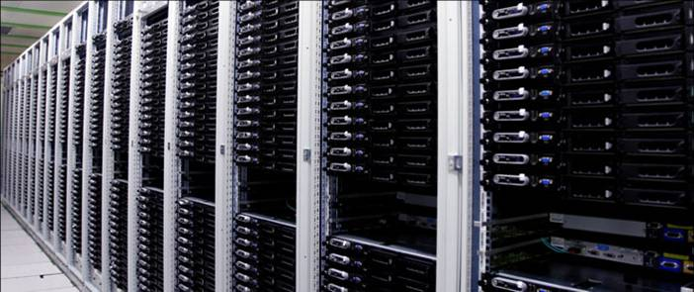
Trigger Design
Level 1
Hardware
Calorimeter, Muons
(2.5 μs)
Event rate
Data volume
ATLAS-PPr-System
(KIP Heidelberg)
Level 2
CPU-Farm
All detector (RoI based)
(~10 ms)
Available
ressources
Prozessing time
Event Filter
CPU-Farm
All detector
(partly RoI based) (~1s)

Slide 8
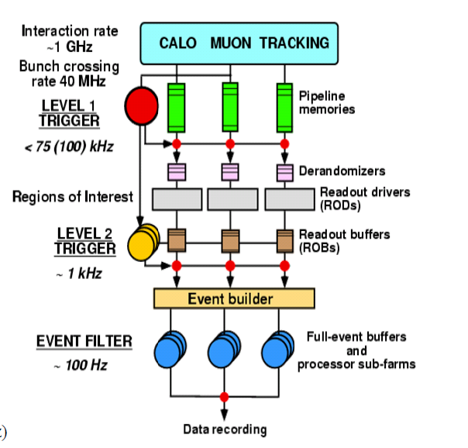
Trigger and Data Acquisition
In Reality the Trigger is
intimately connected with
the Data Acquisition System
ATLAS TDAQ Group:
~400 persons

Slide 9
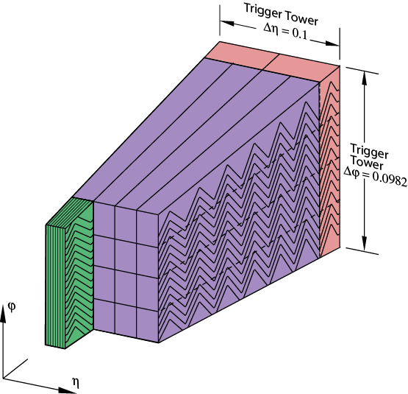
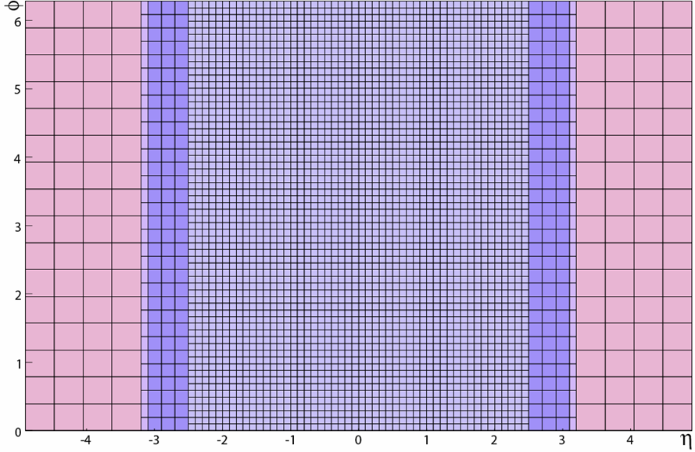
Level 1 Calorimeter Trigger
Granularity
LAr Calorimeter
Position
Δη x Δϕ
φ
|η|< 2.5
0.1x0.1
2.5 <|η|< 3.1
0.2x0.2
3.1 <|η|< 3.2
0.1x0.2
3.2 <|η|< 4.9
0.4x0.4125
Reduced Granularity
- Trigger Tower
- sum up to 60 cells
- still finer granularity
than e.g. CDF
η
trigger towers map

Slide 10
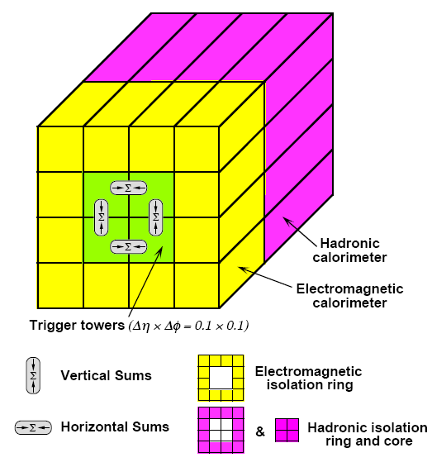
Level 1 Calorimeter Trigger
e/τ Algorithm
Cluster Processor
Jet Algorithm
ECAL+HCAL
Sliding Window technique used to identify electrons, taus and jets
Sum up Trigger Towers to determine E_{T}^{miss} and E_{t}^{sum} (no muons incl.)

Slide 11
Jet Trigger efficiencies (MC)
Trigger figure merit
These are efficiencies which you will see in one or two years from now
At the beginning this will be much worth

Slide 12
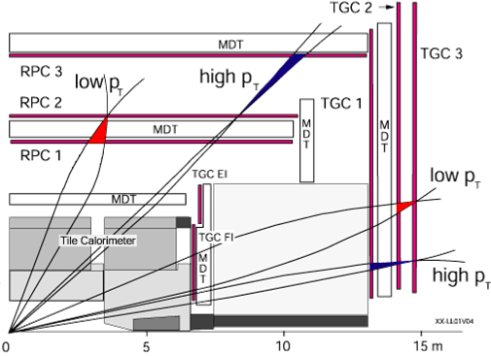
Level 1 Muon-Trigger
Predefined patterns
- special Trigger
layers
- seeded from
middle layer
- different hardware
- overlap removal

Slide 13
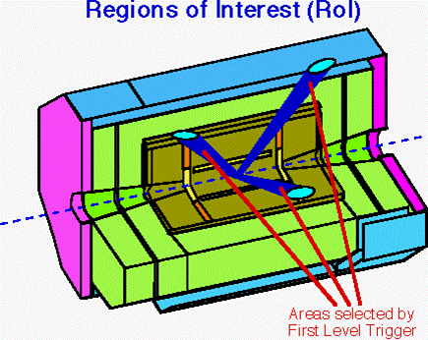
Higher-Level-Trigger
Level 1 uses only coarse granularity information
Objects found by Level 1 can still be very much refined using information of finer granularity
Use L1 to guide the reconstruction on HLT
Region of Interest (RoI) approach
Only small amount of ressources needed on L2 (2%)

Slide 14
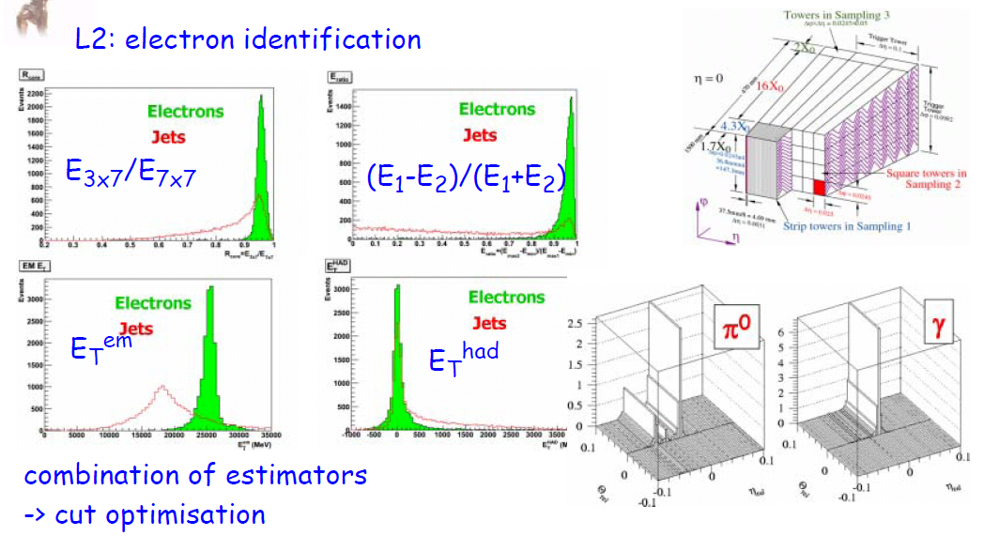
HLT Algorithms
-> As close to offline as possible, but still fast
Outdated, just for illustrational purpose

Slide 15
Trigger strategy and Trigger menu
Bring everything together
  Physics selection (importance of signatures)
  Calibration Triggers
  Monitor Triggers

Slide 16
Trigger Strategy
What defines the thresholds?
  Operational Parameters
    Rates and stability of data taking
  Physics
    Standard candles (Z,W, incl. Jets, ...)
    Higgs (SM Higgs: m_{H} > 100 GeV)
    SUSY, Black Holes, ...
    B-Physics (at least some)
How can we ensure to be as open to new physics as possible?
  Inclusive strategy

Slide 17
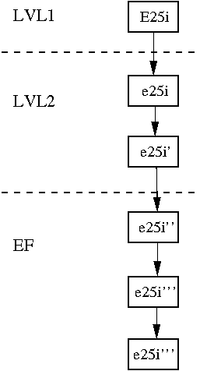
Trigger Chains
Hardware
The Trigger processes the
data in Chains
Decisions are taken after
each step and chains/paths
are stopped and eventually
events are rejected
You gain lots of performance
w.r.t a system where you fully
reconstruct the event
L2 cluster alg.
L2 track alg.
EF cluster alg.
EF track alg.
EF Bremsstrahl.
recovery

Slide 18
Trigger Chains

Slide 19
Trigger menu Level 1
Outdated, just for illustration purposes

Slide 20
Trigger menu HLT
Outdated, just for illustration purposes

Slide 21
Rastafari Diagram of difficulty
# of objects
Black holes
SUSY
Leptoquarks
Compositness
E_{T} of objects

Slide 22
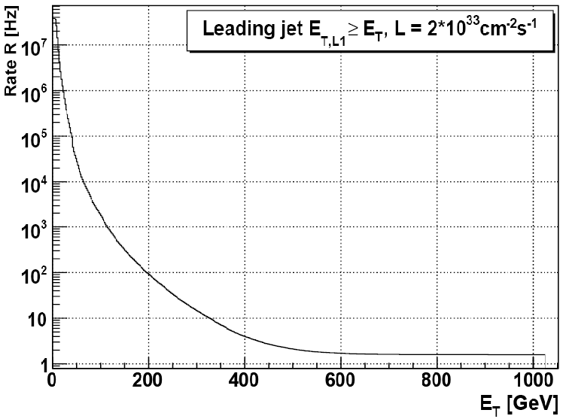
Trigger rates
Overall rate is mostly
dominated from QCD
Dijets (not only jet
triggers)
-> Going to low E_{T} gives huge rates
(What about jet cross sections at low E_{T}?)

Slide 23
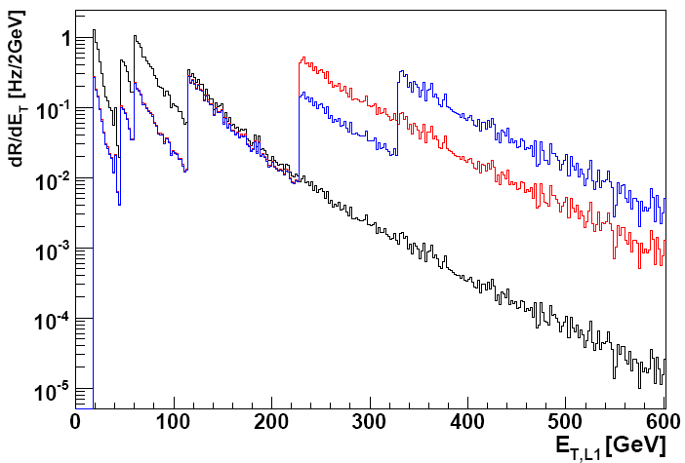
Prescales
3 different lumi scenarios
How to handle high
rates of low E_{T} objects?
-> introduce low thresh-
holds and apply prescales
prescaled
Prescale P -> only take
every Pth event
unprescaled
Powerful tool to keep low ET physics (reduced rate, low effective lumi),
-> calibration triggers, monitor triggers, etc ...

Slide 24
Triggering low E_{T} physics
(B-physics)
E.g. Hadronic B_{S} -> φπ
(no chance to trigger on this)
B_{S}
b
_
b
μ + X
Do not trigger on your signal but about something which comes
with your signal (similar to VBF for Higgs physics) (small eff.)

Slide 25
Summary
Trigger is very essential for the experiments
Trigger is very challenging
Currently most new physics processes are well covered (unprescaled)
Concepts for low E_{T} high σ processes in place
Concepts for low E_{T} small σ processes in place (low efficiency)

