Slide 1
Stealth Dark Matter
w/ GBélanger, TMa, YSoreq
work in progress
Cédric Delaunay
LAPTh
IRN Terascale meeting
May 21st, 2019
Annecy

Slide 2
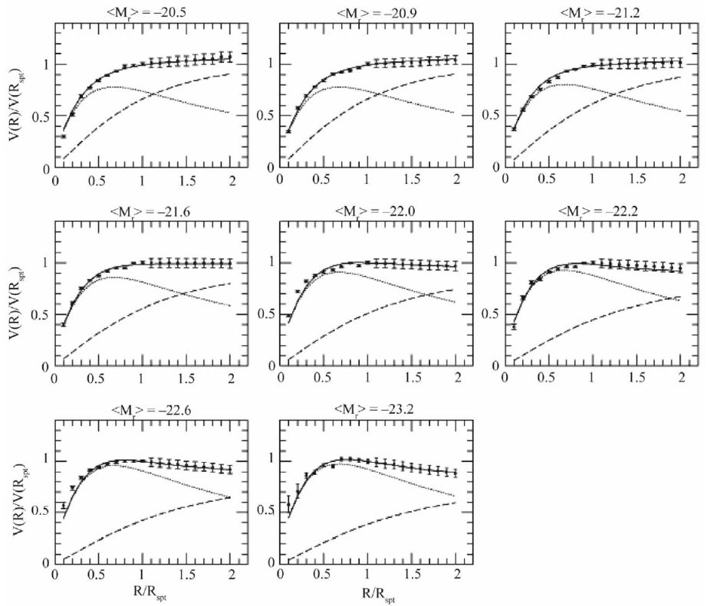
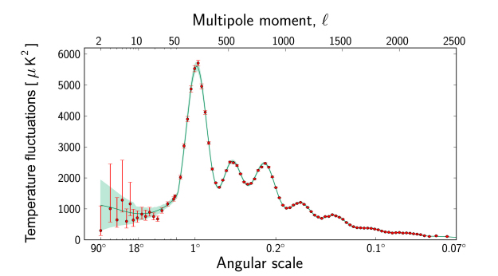
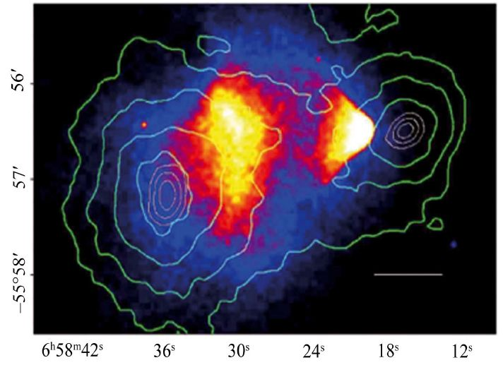
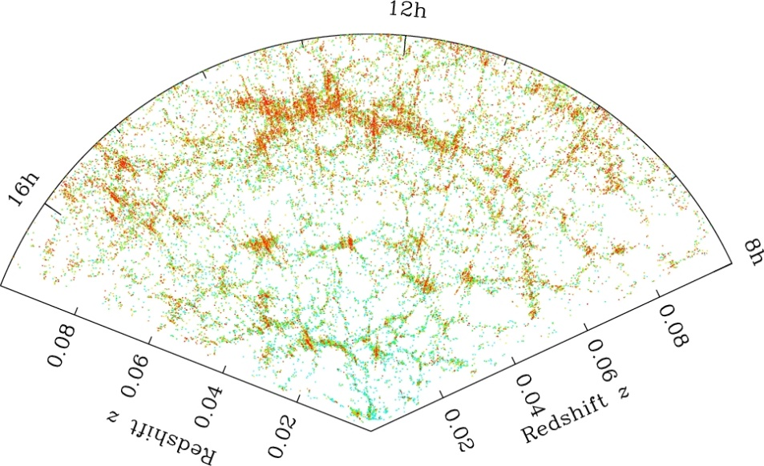
Dark Matter
compelling
observational
evidence
through gravity
only

Slide 3
DM Theory
The standard lore:
DM is made of cold particles
(possibly stabilized by symmetry)
with non-gravitational interactions
to ensure production in the early Universe
is the basis of all opportunities to study DM on earth, through:
detection (directly or not) Witten ’85
production at high-energy colliders (eg. MET signature)

Slide 4
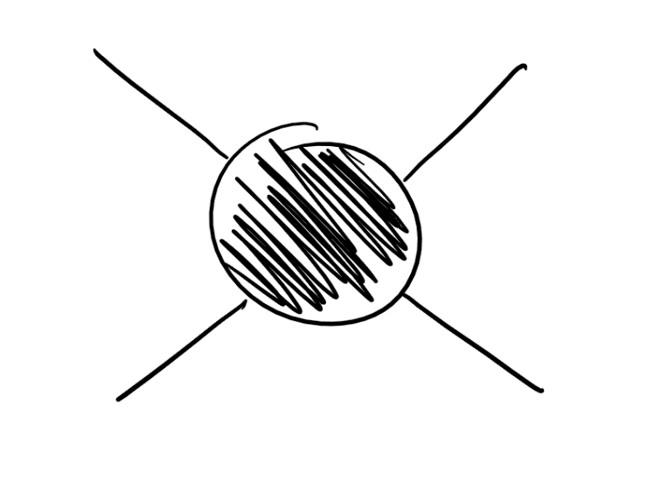
Direct detection status
Best game in town: DM nuclear scattering
Liu-Chen-Ji Nature Physics ‘17
DM
DM
nucleus
nucleus
Z exchange excluded long ago
Higgs exchange → similar fate?

Slide 5
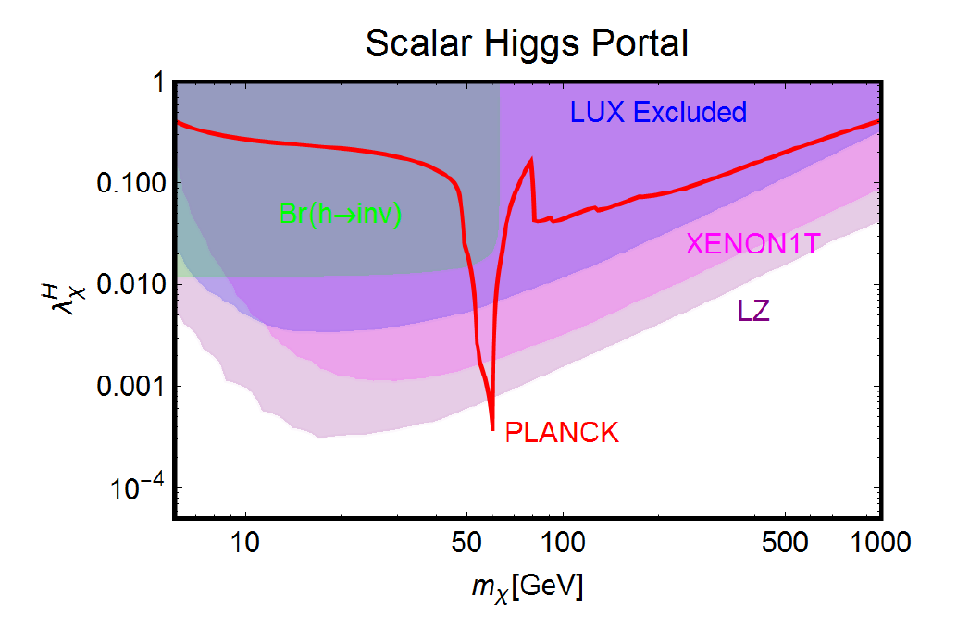
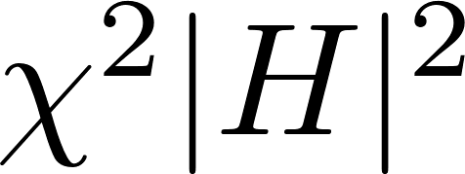
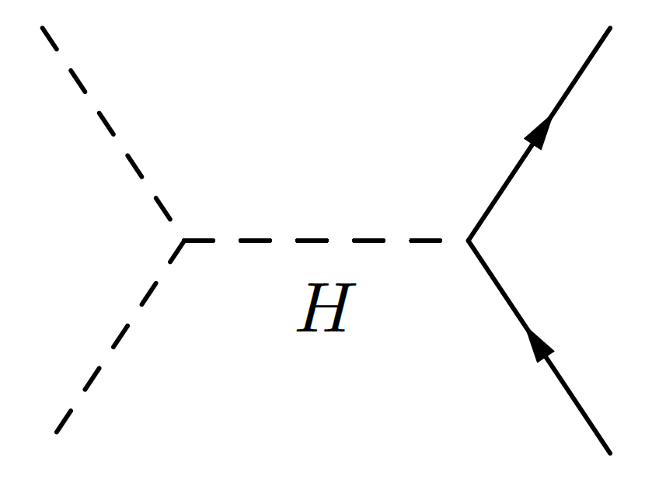
Theory implications
Null results in all direct detection experiments have repelled canonical models to special corner of their parameter space. → the WIMP needs a miracle now!
eg. Higgs portal
Cross sections for thermal freeze-out are excluded everywhere but near the resonance region
Arcadi et al.
1703.07364 [hep-ph]

Slide 6
DM Theory at the crossroad
Most HEP models should have led to detection of DM by now.
The standard lore is under siege → time to learn a lesson?
Radical alternatives are being pursued where eg.
DM is not a particle, instead classical fields: fuzzy DM, (rel)axion…
DM only gravitates: produced through -suppressed operators around the end of high-scale inflation Garni-Sandora-Sloth 1511.03278 [hep-ph]
DM is made of primordial black holes Hawking ’74
Should we really change paradigm about DM?

Slide 7
Our motivation
Can we write a particle physics model where DM:
enjoys non-gravitational couplings to SM
is produced through an IR-dominated mechanism
passes all constraints from cosmology and astrophysics
is not accessible at any detection experiments
preferably without invoking unnatural values of parameters or ad-hoc symmetries?
and it’s strickingly simple..

Slide 8
Outline
Vector Dark Matter, a simple model
Freeze-in through decay
Constraints and (no?) signatures

Slide 9
Vector Dark Matter
as a simple model of stealth DM

Slide 10
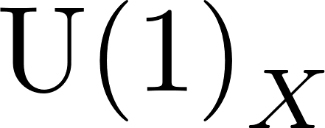
Our model
Take a dark sector to simply be a Higgsed charge sequestered from the SM fields:
U(1) gauge field = Dark Matter candidate

Slide 11
Our model
Take a dark sector to simply be a Higgsed charge sequestered from the SM fields:
Vector-like fermion
with
is anomaly-free

Slide 12
Our model
Take a dark sector to simply be a Higgsed charge sequestered from the SM fields:
Scalar singlet
with
spontaneously breaks

Slide 13
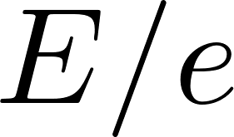
Our model
Take a dark sector to simply be a Higgsed charge sequestered from the SM fields:
Talking to us through renormalizable portals:
Higgs portal
leads to -mixing with Higgs,
take in the UV
IR contribution ( loop)
is strongly suppressed:
~negligible

Slide 14
Our model
Take a dark sector to simply be a Higgsed charge sequestered from the SM fields:
Talking to us through renormalizable portals:
Hypercharge portal
= kinetic mixing

Slide 15
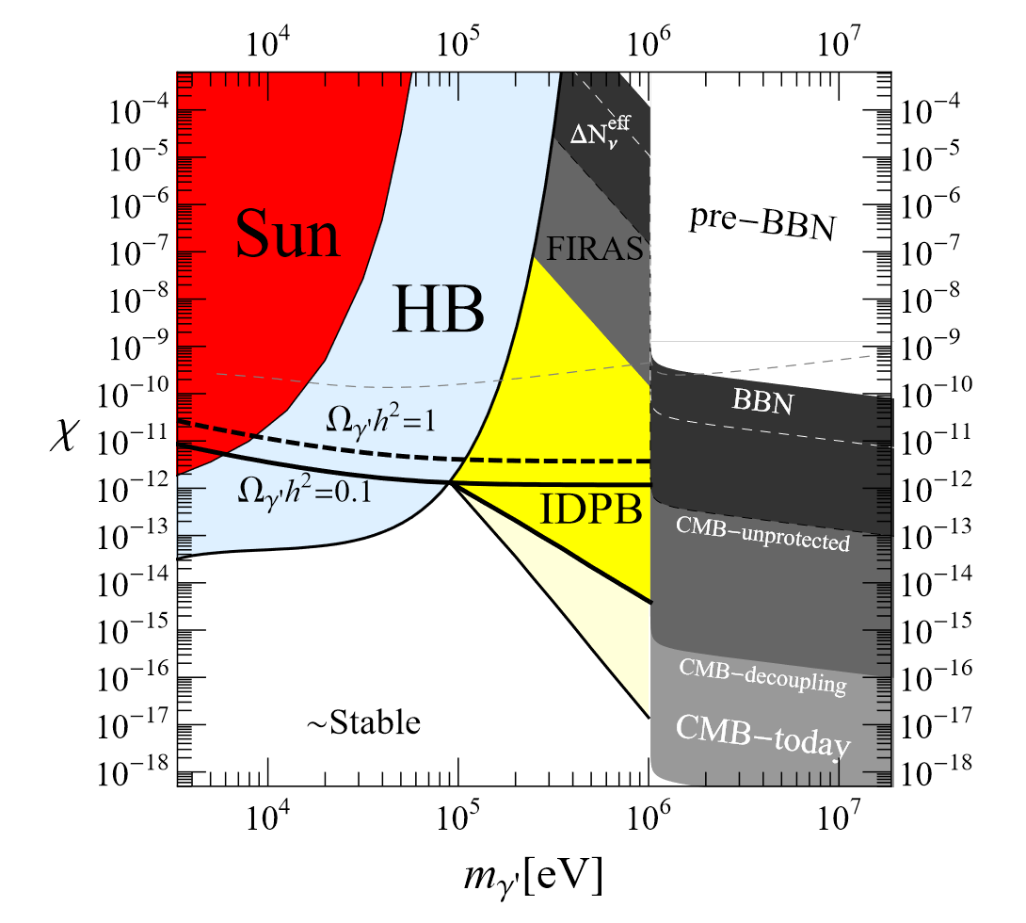
Kinetic mixing
Strongly constrained (eg. star cooling)
Take in the UV
IR contribution from the loop:
Assuming kinetic mixing is small enough provided:
Redondo-Postma
0811.0326 [hep-ph]
Holdom ‘86
( )
envisaged
DM mass range

Slide 16
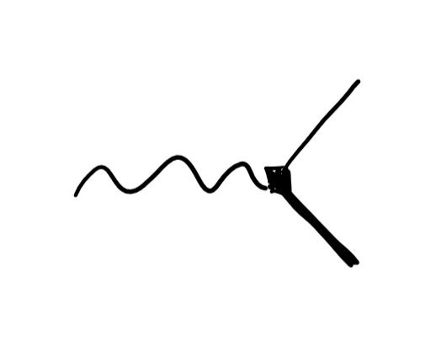
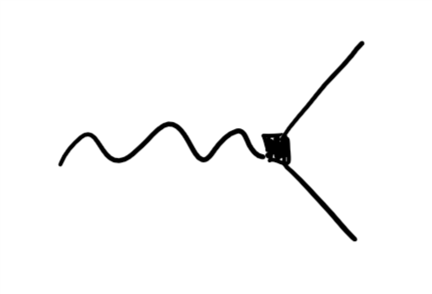
Our model
Take a dark sector to simply be a Higgsed charge sequestered from the SM fields:
Talking to us through renormalizable portals:
mass mixing:
RH lepton portal
parametrically separated!

Slide 17
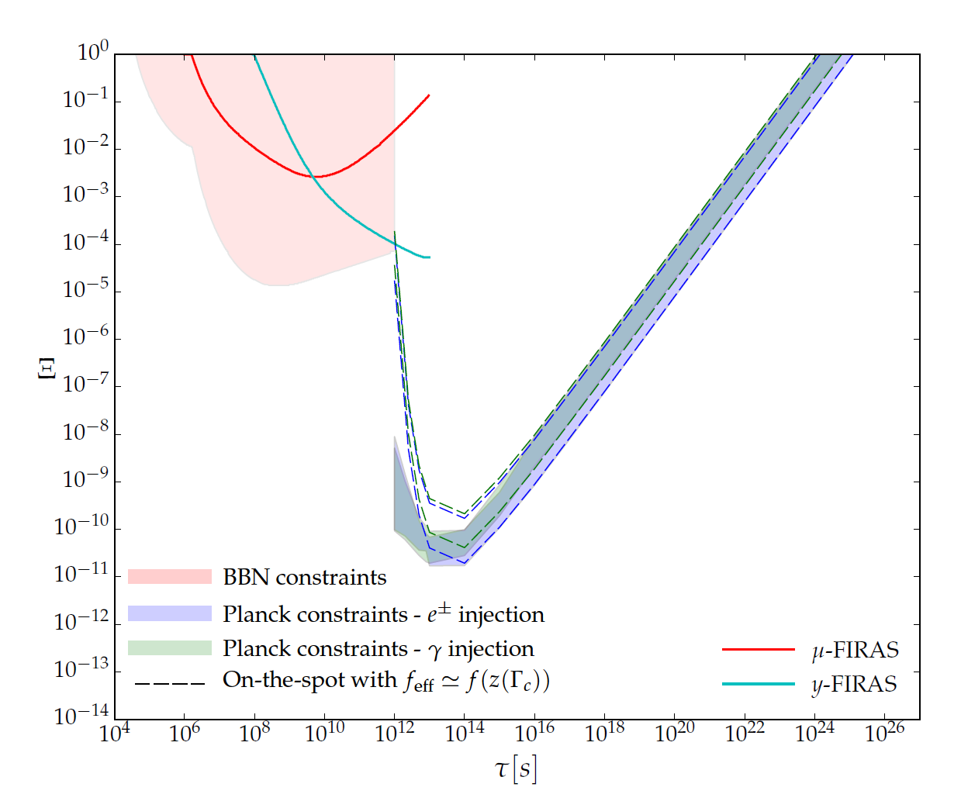
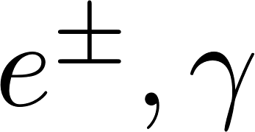
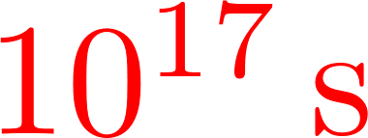
DM required traits
Sufficiently long-lived to avoid strong CMB anisotropies:
if all of DM decays to
age of Universe
age of Universe
Poulin-Lesgourgues-Serpico
1610.1005 [astro-ph]

Slide 18
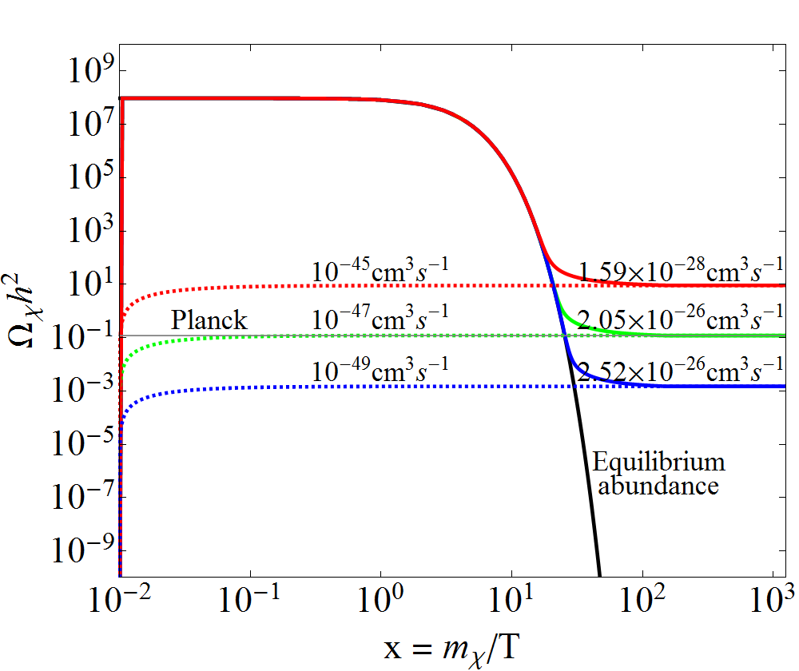
DM required traits
Sufficiently long-lived to avoid strong CMB anisotropies:
if all of DM decays to
Correct relic density preferably via an IR-dominated mechanism
age of Universe
DM
freeze-out
SM
eg.
DM
freeze-in
SM

Slide 19
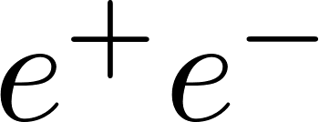
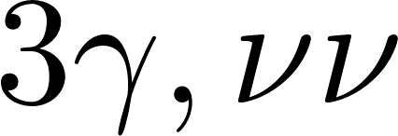
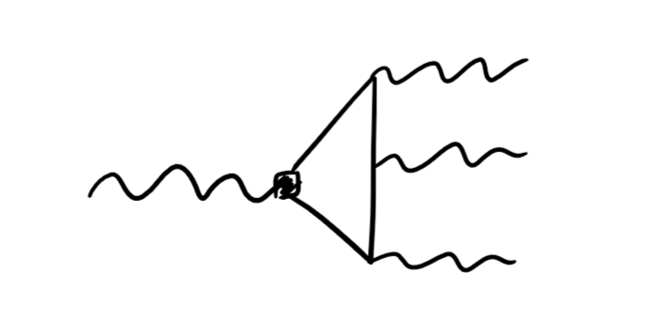
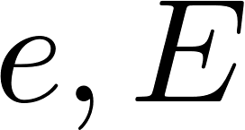
VDM lifetime
Consider to forbid channel at tree-level
Only decays into at one-loop:
weakest bound from kinetic mixing
for
scalar vev could be close to cutoff
no extra hierarchy problem
suppressed by 3body, dim-8
+ accidental factors
Pospelov-Ritz-Voloshin
0807.3279 [hep-ph]

Slide 20
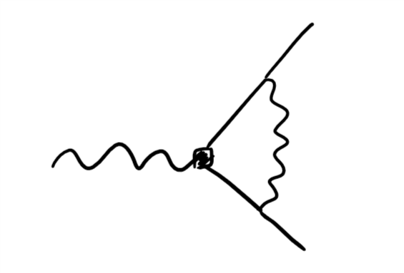
VDM lifetime
Consider to forbid channel at tree-level
Only decays into at one-loop:
weakest bound from kinetic mixing
for
scalar vev could be close to cutoff
no extra hierarchy problem
suppressed by loop + electron/ mass ratio

Slide 21
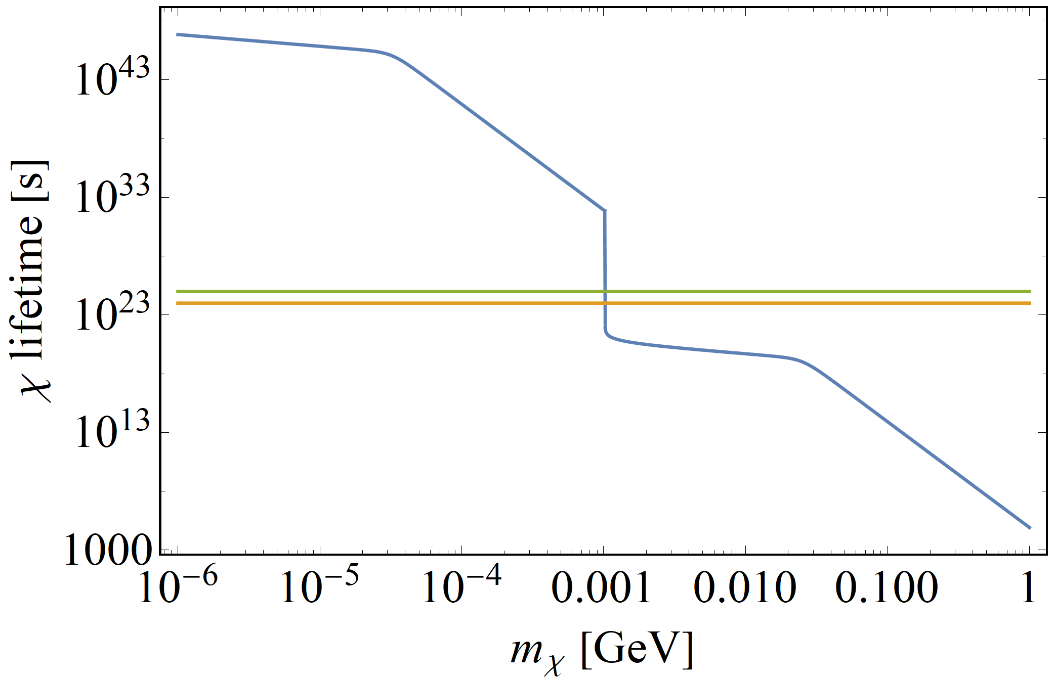
VDM lifetime
Thanks to small gauge coupling and lepton mixing parameter, DM is extremely long-lived
benchmark:
CMB anisotropies

Slide 22
VDM freeze-in
from dark lepton in-equilibrium decay

Slide 23
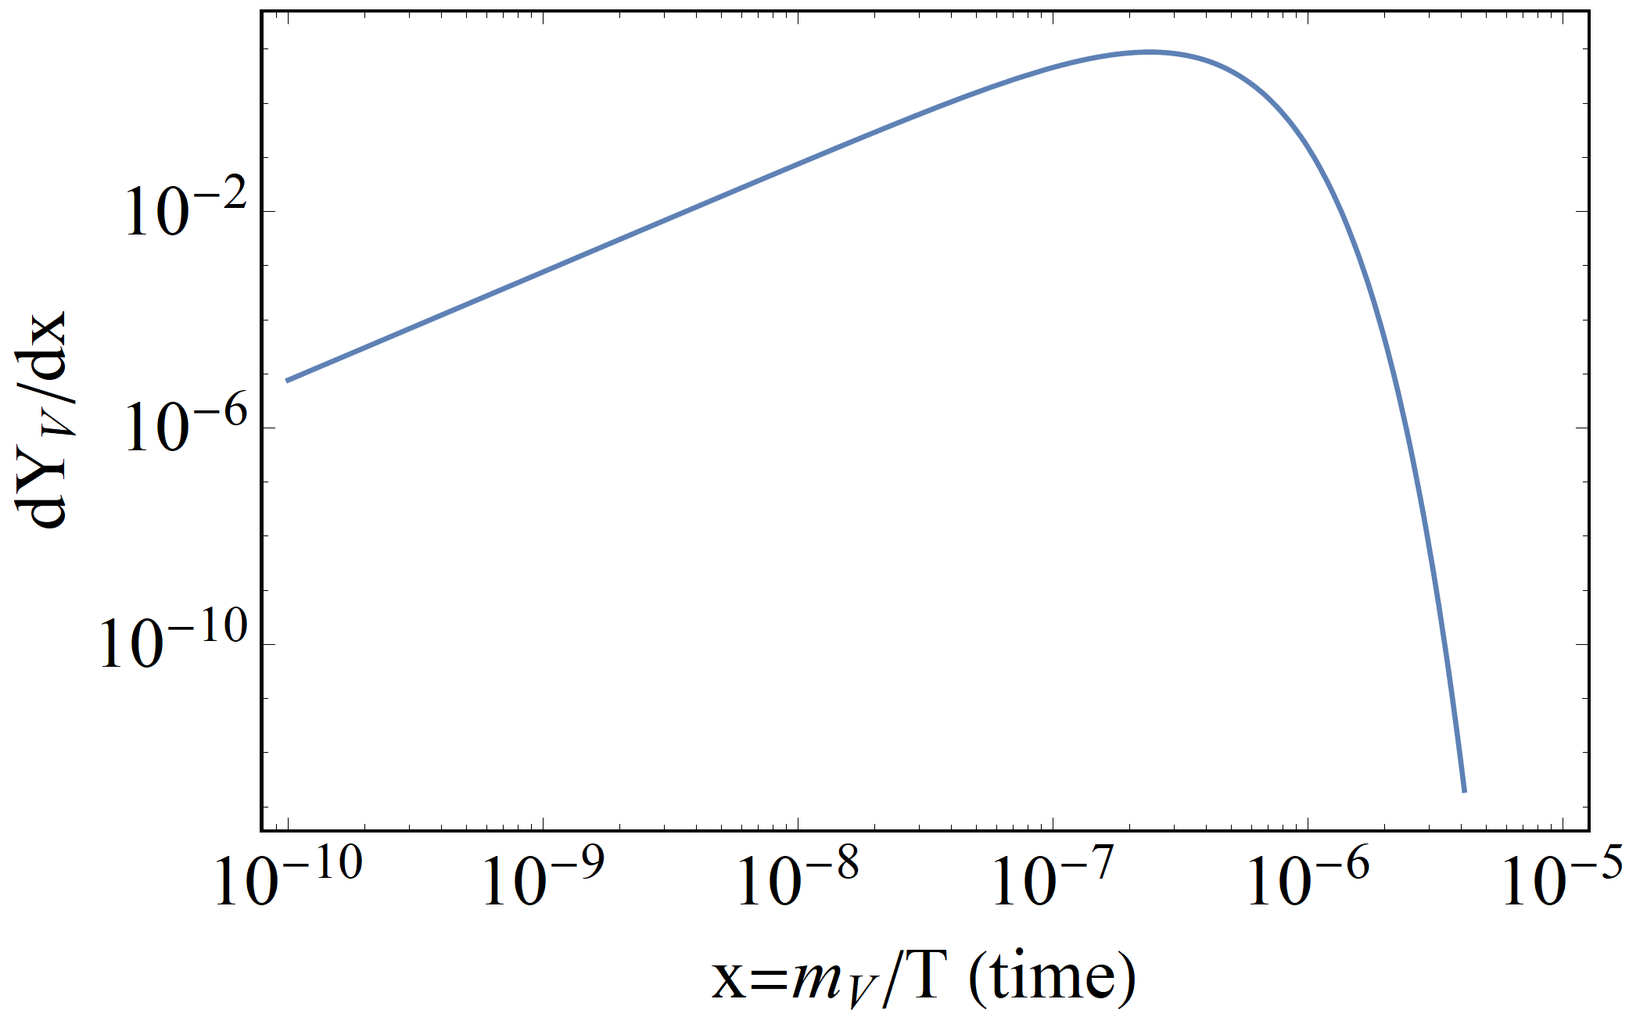
VDM production
Assume negligible dark abundances right after reheating:
instantly reaches chemical equilibrium with SM thanks to hypercharge:
While , decays in eq. thus slowly building up DM
When , density drops decay quickly goes sub-Hubble
→ DM freezes in
at

Slide 24
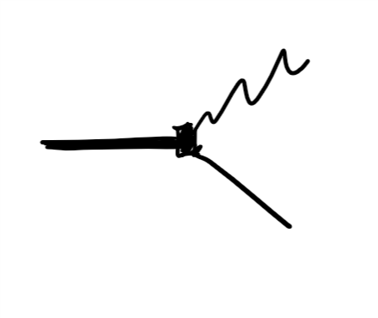
VDM production
Boltzmann eq. controled by decay width:
Hence:
enhancement from
longitudinal polarization
small Yukawa corresponding to lepton mixing angle of
which strongly suppresses visible couplings of DM

Slide 25
Testing VDM

Slide 26
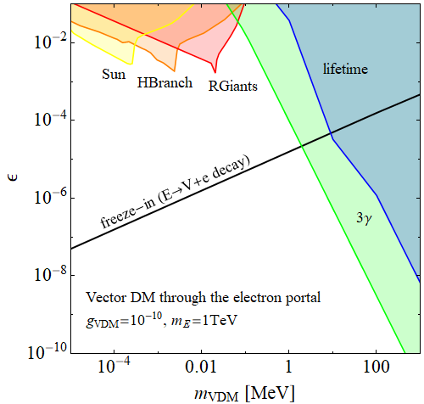
Constraints
preliminary
too efficient
cooling of stars
overly large
CMB anisotropies
too much diffuse γ-ray
background
free
streaming
??
too long free-streaming
during structure formation

Slide 27
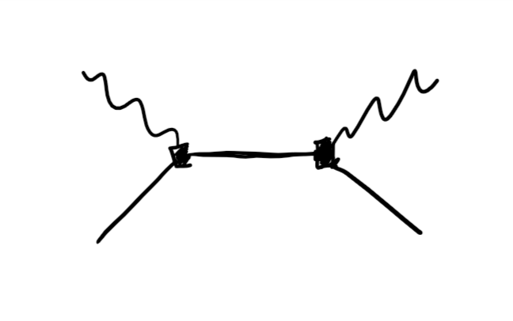
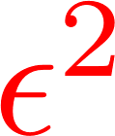
Direct detection prospect?
DM/electron scattering in atoms:
Hopelessly small

Slide 28
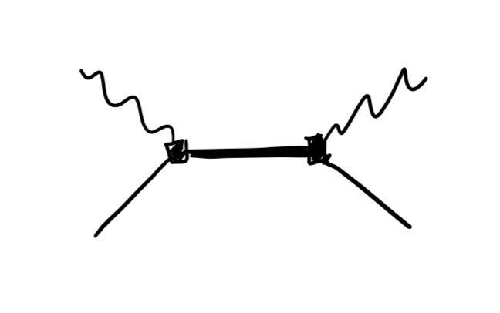
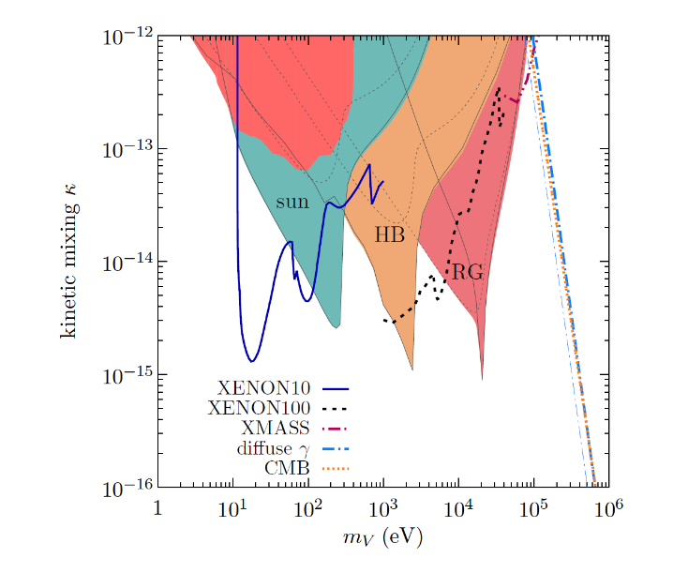
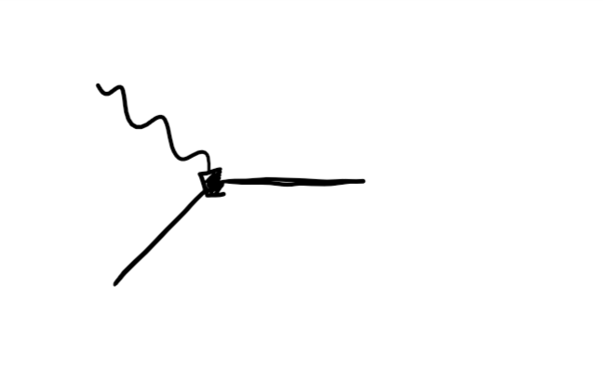
Direct detection prospect?
DM/electron scattering in atoms:
DM absorption by atomic electrons:
Hopelessly small also
yields ionisation signal when
Xenon data put weak bound
An-Pospelov-Pradler-Ritz
1412.8378 [hep-ph]

Slide 29
Conclusion

Slide 30
Concluding remarks
There are natural DM models within the standard lore that are not accessible by known detection experiments
We presented a proof of existence of such models where DM is a sub-MeV decaying vector state produced by freeze-in through decay of a heavy dark lepton
Unless a new experimental probe is found, that tests these models, future null direct detection results would leave theorists in the dark (presummably for a long time) about the nature of the dark matter

Slide 31
backup

Slide 32
Dark sector phase transition?
Finite temperature corrections to the free-energy ( ):
However is so feebly coupled to thermal bath that symmetry restoration requires ultra-high temperatures:
symmetry restored when
→

Slide 33
VDM production details
Reverse process negligible since
2-to-2 scattering processes (eg. , ) subdominant
Late time production from decay after freezes out negligible

