Slide 1
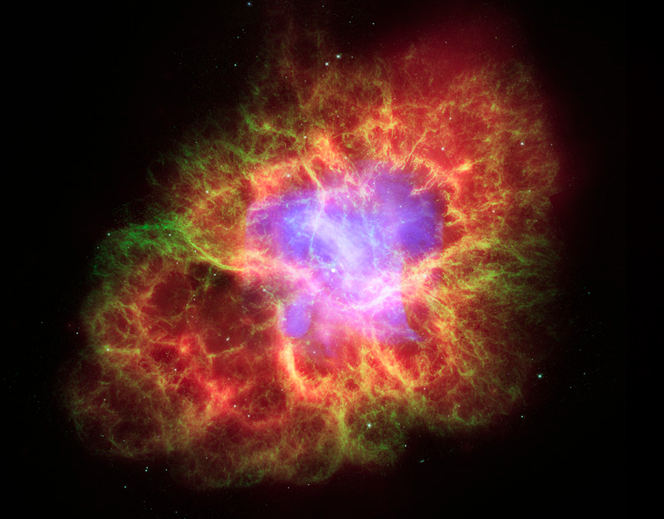
Supernova-produced ⁶⁰Fe found in the terrestrial microfossil record
Shawn Bishop, TU Munich

Slide 2
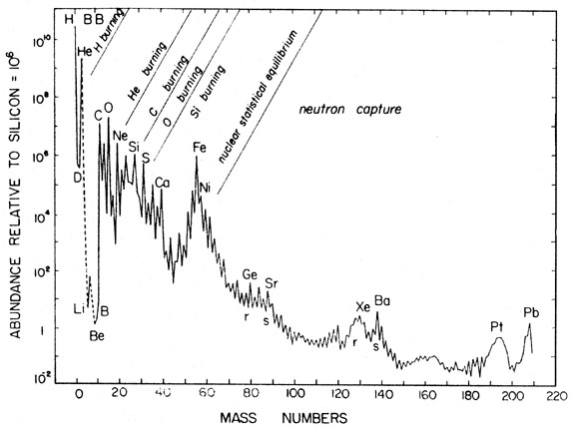
Where in Nature are Elements Beyond Fe-Peak Made?
Iron-group abundance peak
~5 or 6 order drop in
abundance from Fe-group

Slide 3
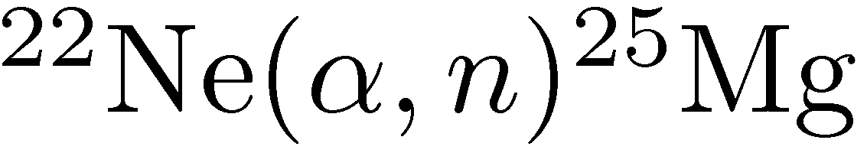
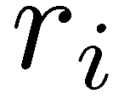
Cosmic Sites of ⁶⁰Fe Production
Stars with masses > 10 solar masses
Conclusion of core He-burning → He-burning shell → T ~ 4 x 10⁸
Temp. drives the reaction sequence:
Followed by:
Free neutrons drive an s-process in the shell → ⁶⁰Fe production
¹²C(¹²C,α)²⁰Ne occurs in core
Free α’s undergo reaction sequence above → ⁶⁰Fe production
Convection carries ⁶⁰Fe to lower temperatures, so that some survives against further n-capture
He Shell
H Envelope
C & O

Slide 4
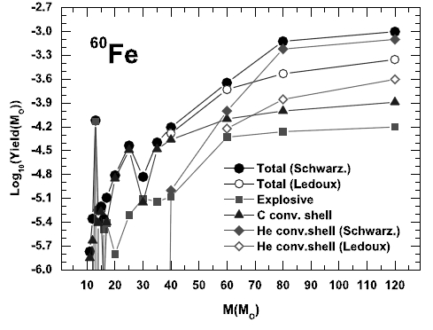
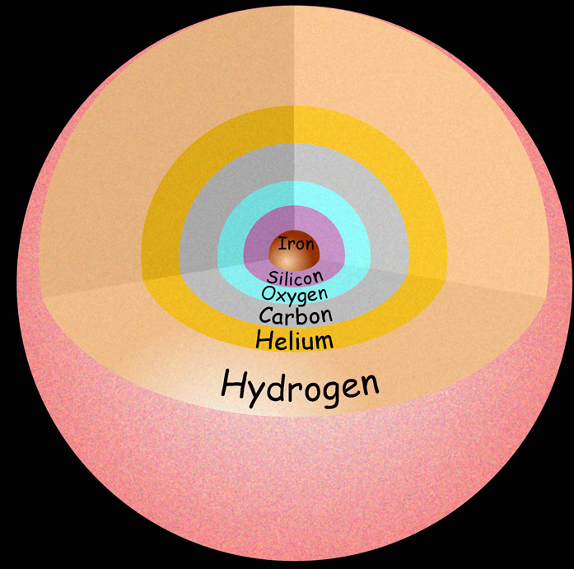
Core Collapse Supernova
M. Limongi et al., ApJ. 647:483, (2006)
Shock wave from core bounce slams into carbon and He shells
Shells are shock heated
  Heating drives the reaction to faster rate
  Shells are also expanding (explosively)
  Neutron capture process as before occurs, but much faster
  Neutron capture rates are comparable, or faster, than expansion rate of shell
⁶⁰Fe synthesized in these shells ejected into space (5000 km/s)

Slide 5
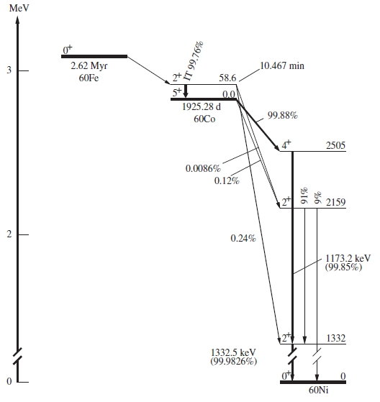
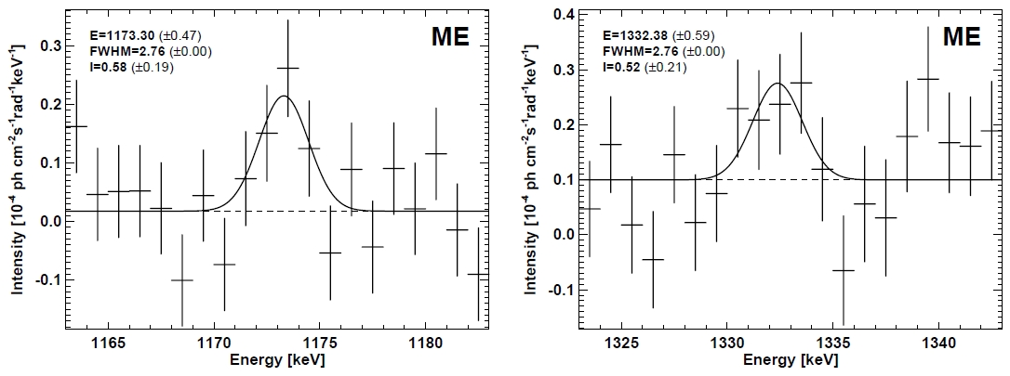
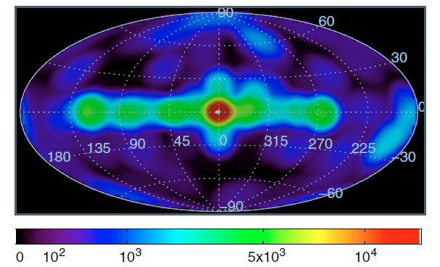
⁶⁰Fe Astrophysics Points
G. Rugel et al., PRL 103 (2009)
Half-life = 2.62 Myr
Gamma-rays observed with INTEGRAL satellite of European Space Agency
Wang et al., Astron. & Astrophys. 469 (2007)
⁶⁰Fe data obtained from observing same region as ²⁶Al
²⁶Al also known to be produced in massive stars that become supernovae
Finding ⁶⁰Fe in same places as ²⁶Al => observational confirmation ⁶⁰Fe comes from massive stars and SN

Slide 6
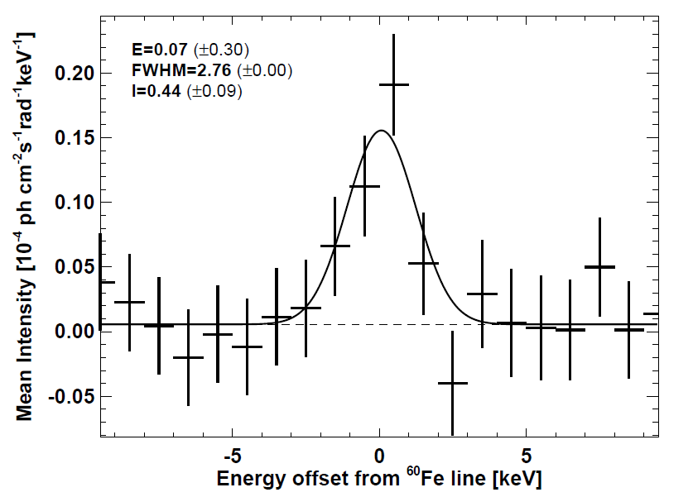
Combined data give 4.9 σ

Slide 7
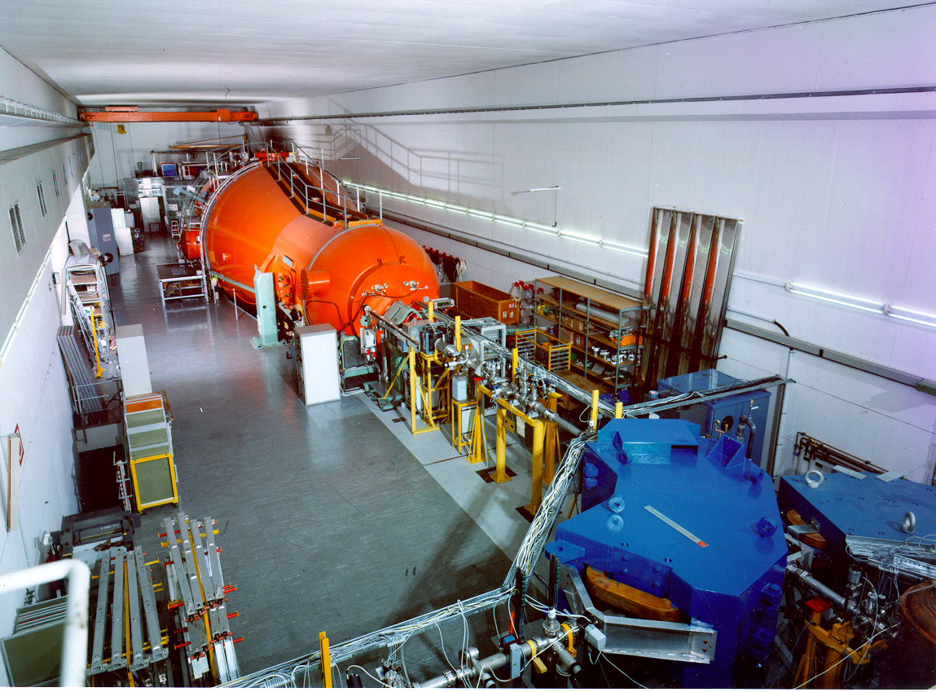
Accelerator mass spectrometry
How to Find a Needle in the Haystack

Slide 8
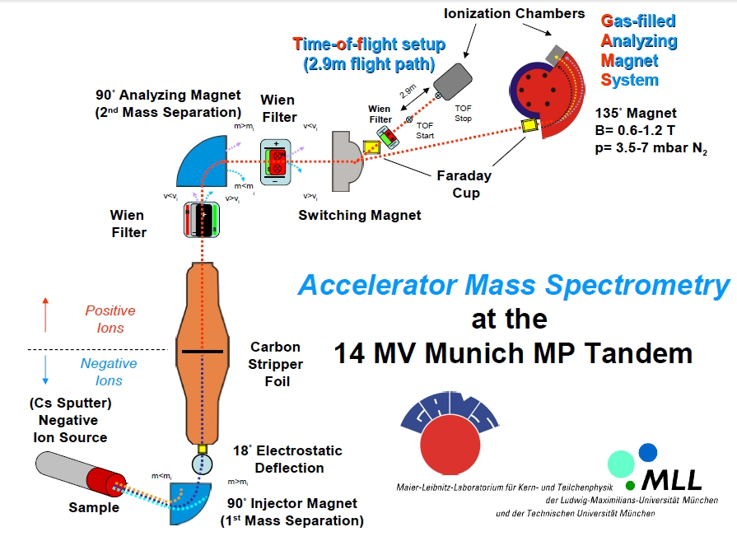
AMS Facility: Schematic

Slide 9
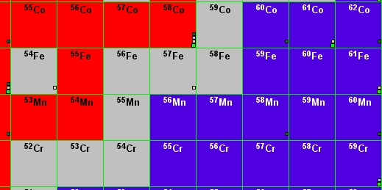
⁶⁰Ni Isobaric Contamination in AMS
⁶⁰Ni
⁶¹Ni
⁶²Ni

Slide 10
The “Trick” for Background Suppression
Magnet selects charge:mass ratio
For same ion energy from Tandem:
  Kinetic E is same:
  If masses are same, cannot separate
Magnet filled with few mbar N₂ gas
  Then, q depends on atomic number:

Slide 11
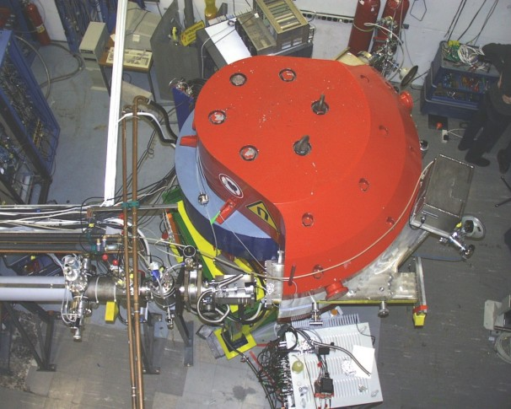
The “Business” End of the AMS Facility
Ion Chamber
Beam

Slide 12
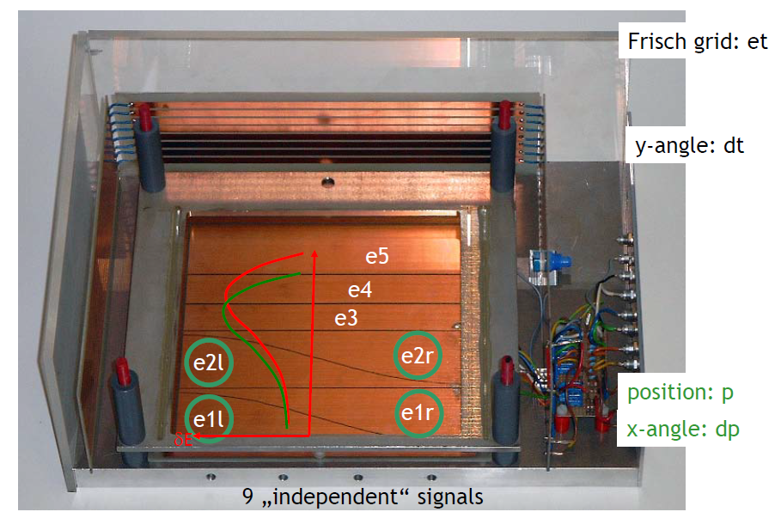
Segmented Anode Ionization Chamber

Slide 13
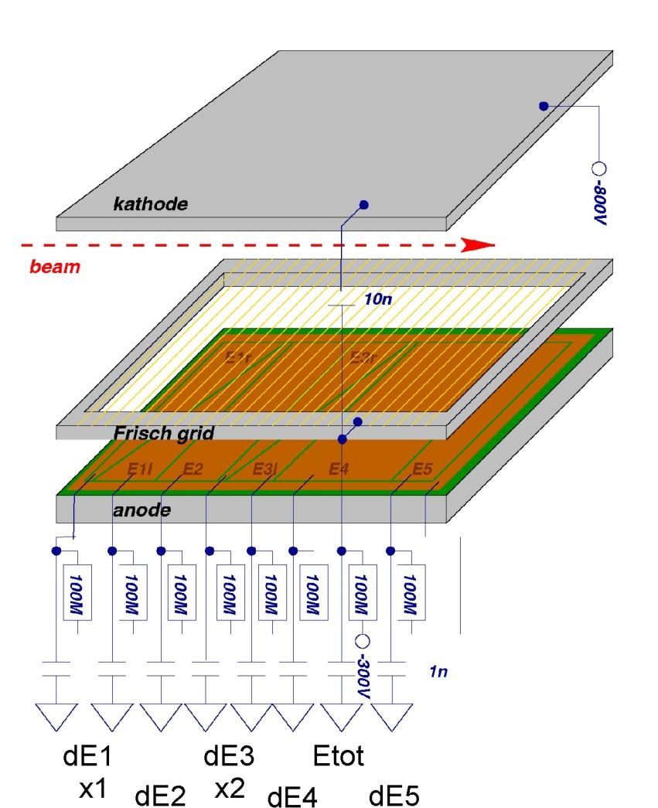
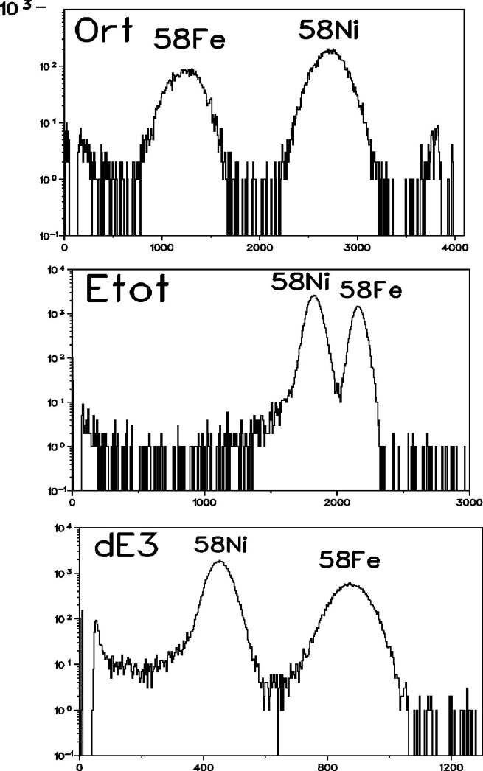
Final Particle Identification

Slide 14
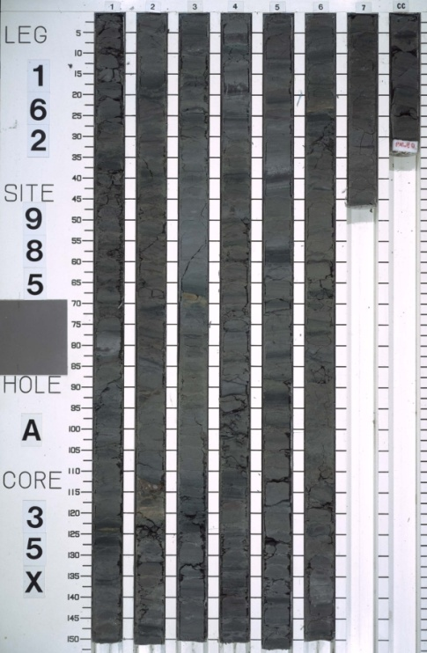
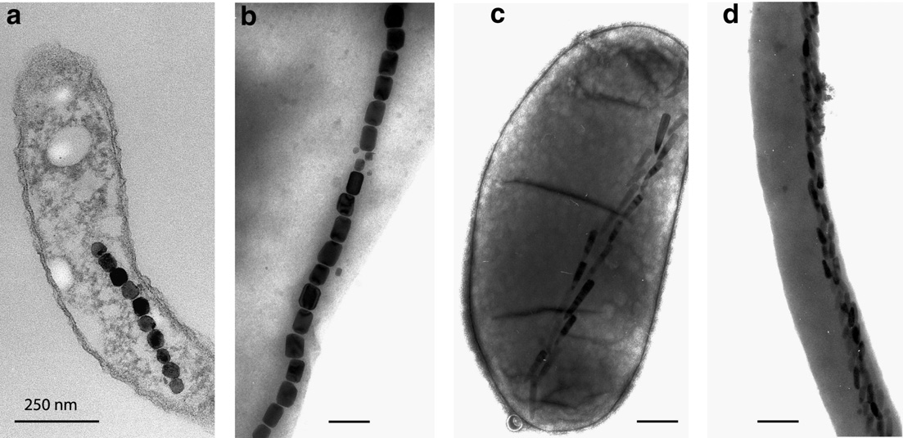
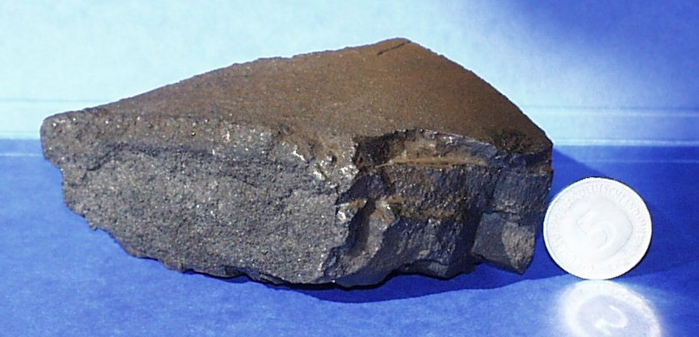
Terrestrial ⁶⁰Fe reservoirs
Where can we look?

Slide 15
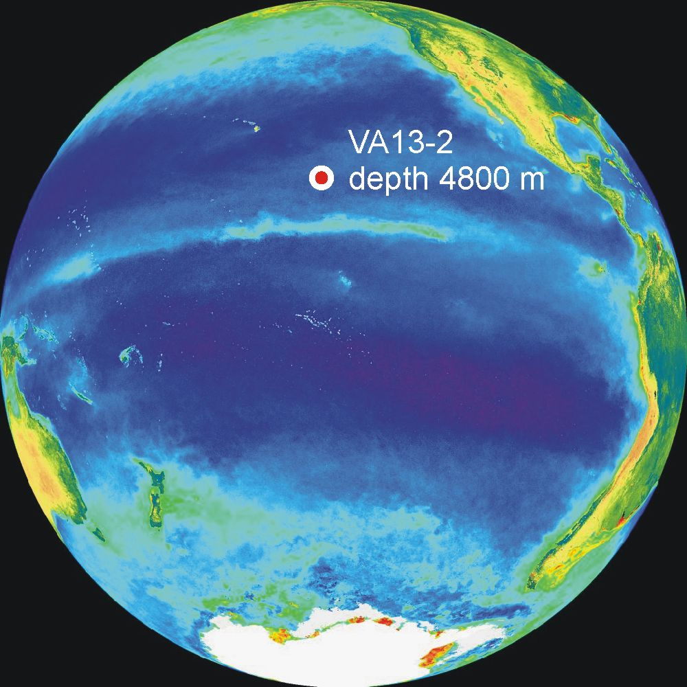
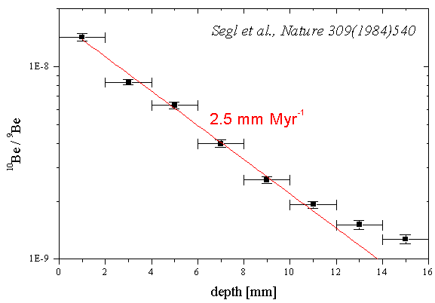
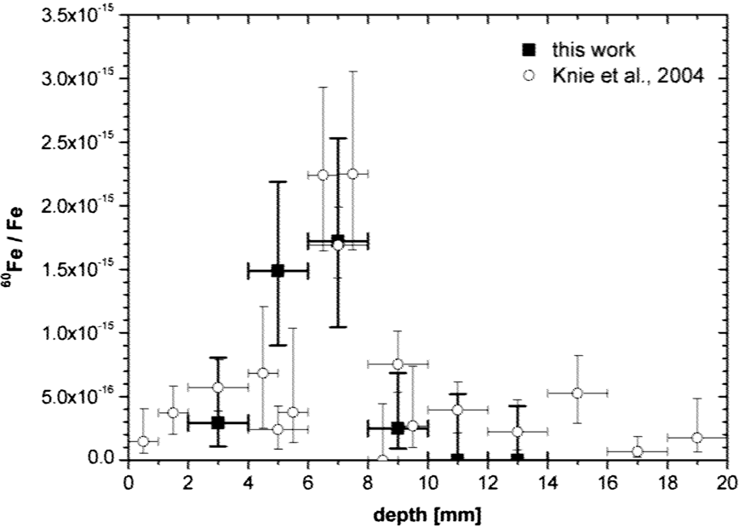
The FeMn Crust ⁶⁰Fe Results
C. Fitoussi et al, PRL 101 (2008)
K. Knie et al, PRL 93 (2004)
t ~ 2.2 Myr ago

Slide 16
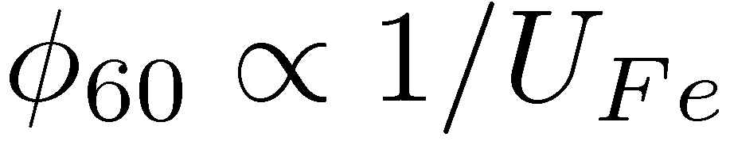
Results from Ferro-Manganese Crust Findings
Terrestrial ⁶⁰Fe fluence determined as φ₆₀ = 2.8 x 10⁸ atom/cm² (after new ⁶⁰Fe t_{1/2} correction)
Fluence:
Uptake used was 0.6%, but:
  Could be as large as unity (arguments for this not published)
If unity, Knie et al. fluence reduced by ~165 times
  Distance estimate wrong by ~15
Second attempt made in Norwegian Sea sediment: publication reports no statistically significant signal
Motivated to find a different/new ⁶⁰Fe reservoir for cross checking and constraining uncertainties
What is the new reservoir?

Slide 17
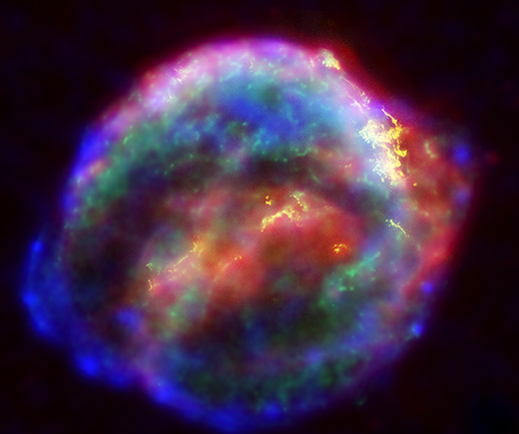
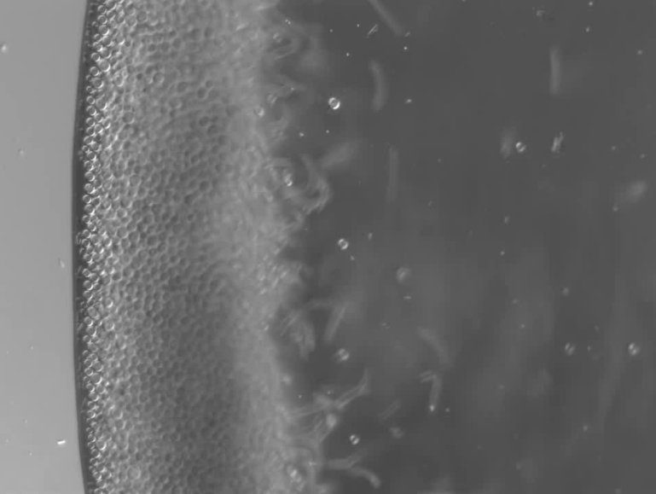
supernova signature of biogenic origin
There are more things in heaven and earth, Horatio, than are dreamt of in your philosophy. -- Hamlet

Slide 18

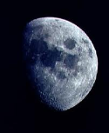
The Hypothesis
Supernova ⁶⁰Fe flux arrives in upper atmosphere
  Molecular, fine grains/dust
Mixes into atmosphere enters Earth’s Fe-cycle
SN ⁶⁰Fe (and stable Fe) oxidized
Forms nano-size oxide grains
Nano-oxides reach ocean
Rapidly dissolves and re-precipitates
Forms poorly crystalline ferric hydroxides (“rust”)
Settles into sediment
Ocean
Sediment

Slide 19
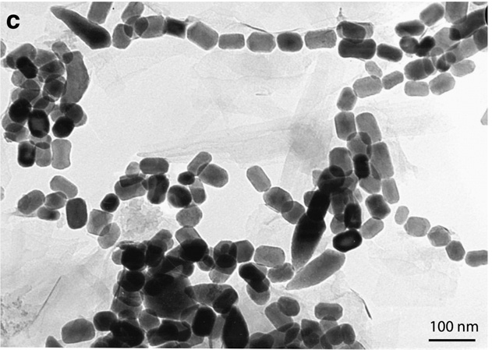
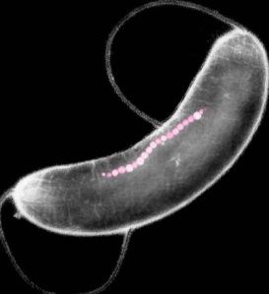
Magnetotactic Bacteria: The Essentials
Form ~90 nm sized magnetic crystals of magnetite: Fe₃O₄
Live in sediment just below the surface-water interface
Process ferric hydroxide nano-grains into magnetosomes
Bulk Fe phases from detrital sources not the primary Fe source → magnetosomes effectively sequester ⁶⁰Fe
Bacteria co-move with sediment-water interface as it grows
Magnetosomes become “magnetofossils”
Any ⁶⁰Fe is “locked” inside
150 Myr BP

Slide 20
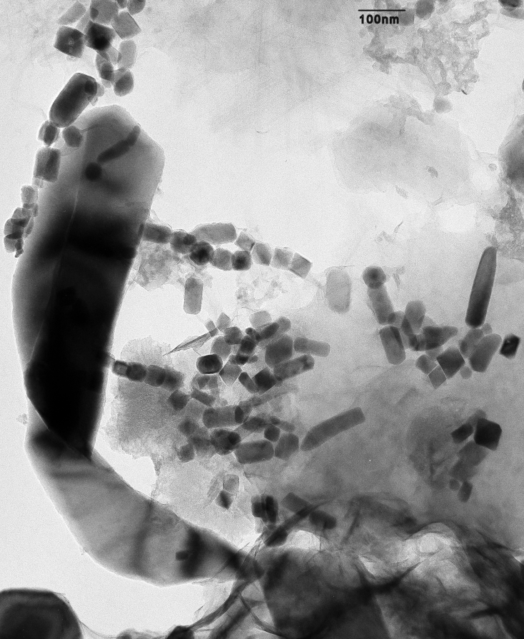
Are we really extracting these from the “dirt”?

Slide 21
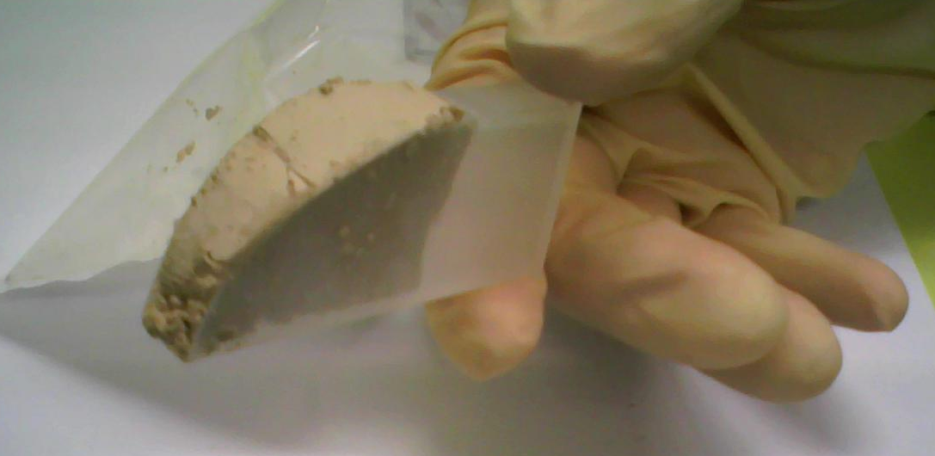
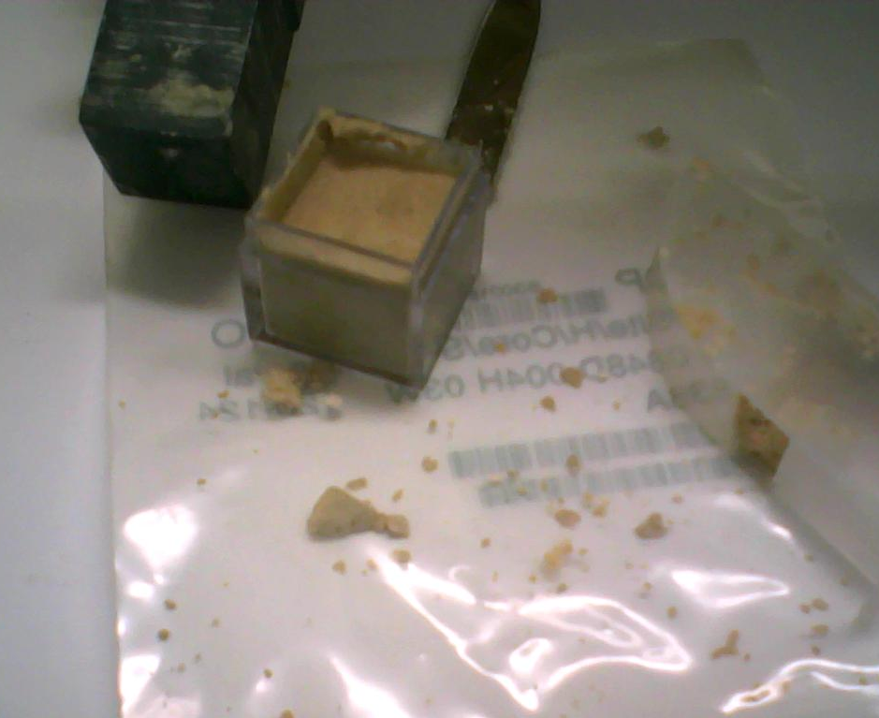
Ocean Drill Core Samples
Core 848, leg 138, equatorial Pacific
Water depth: 3870 m
Predominantly Calcium-carbonate (80%) and SiO₂ (20%)
Column height obtained: 0 – 3.3 Myr BP
Location: reduces detrital Fe inputs from continental run-off
Core 848, leg 138,
3870 m

Slide 22
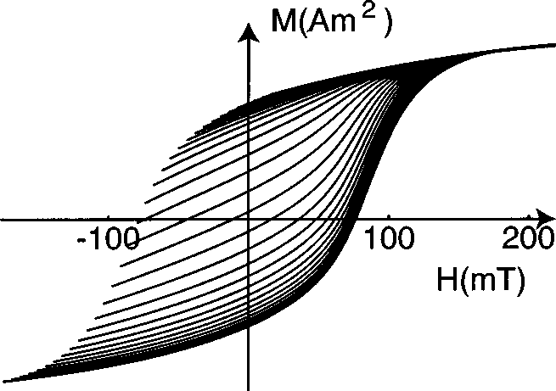
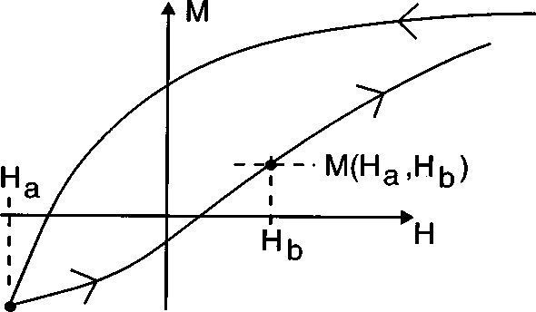

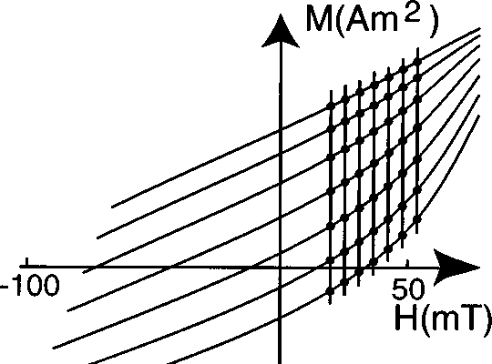
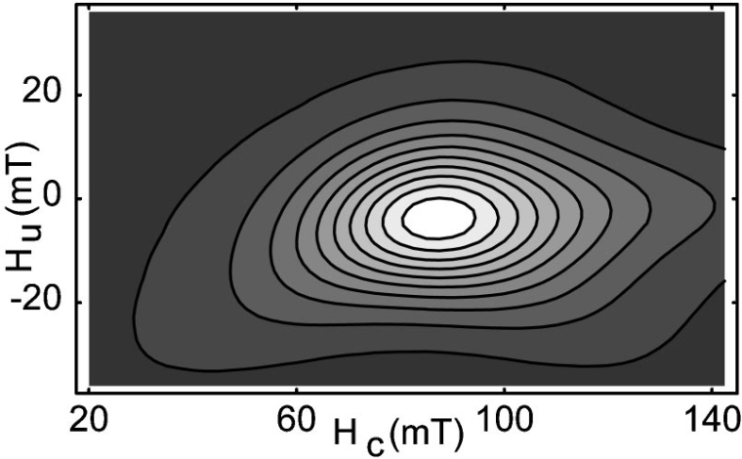
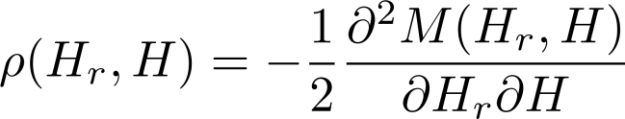

First Order Reversal Curves (FORC’s)
Reversal field =
r
r
Each curve has it’s associated H_{r}. With grid in (H_{r},H), one makes the mixed derivative.

Slide 23
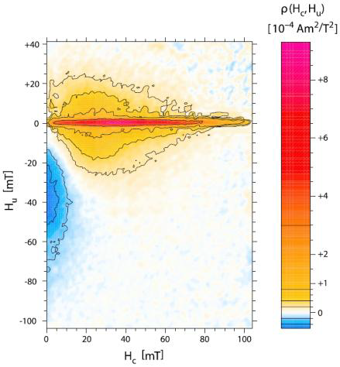
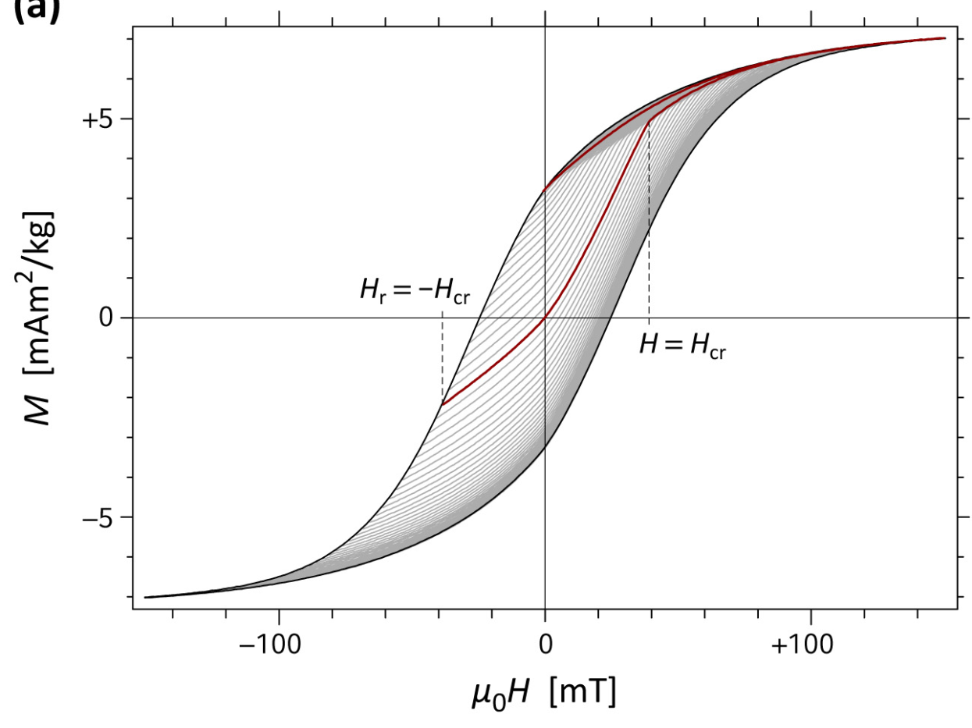
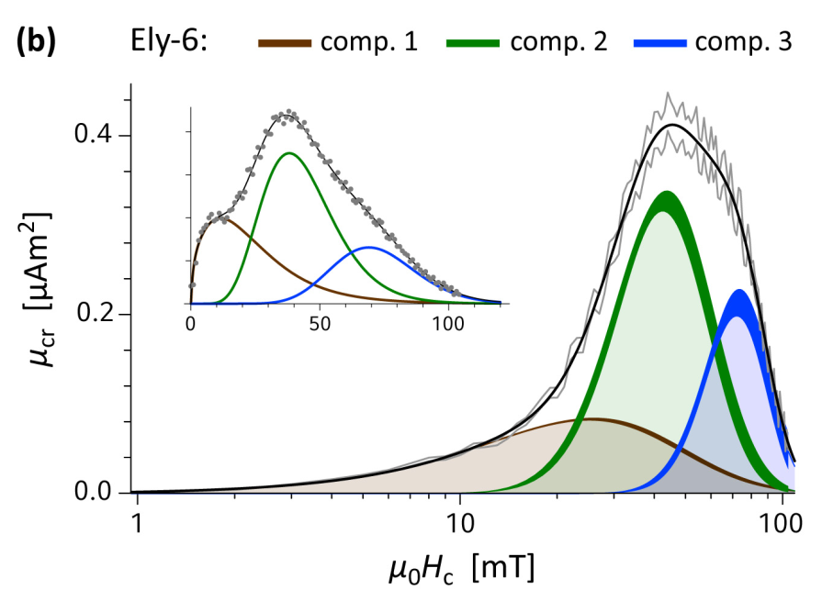
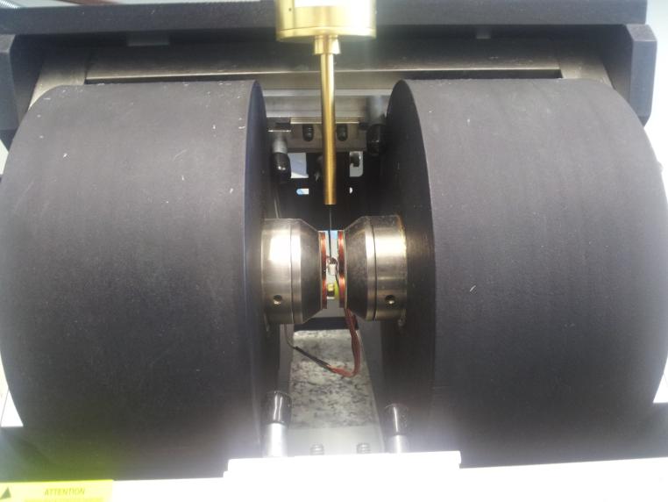
knie
Lake sediment sample with living bacteria within
Central ridge: “fingerprint” of magnetosomes
Projection of ridge onto Hc axis allows a 3-component model to fit the data
Biogenic hard
Biogenic soft
Extracellular
What does this look like with our sediment samples in which we hope there are magnetofossils?

Slide 24
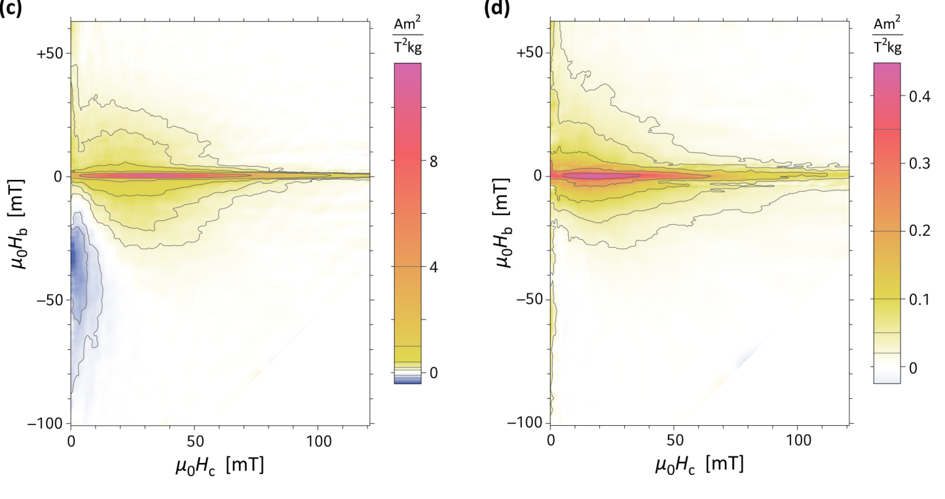
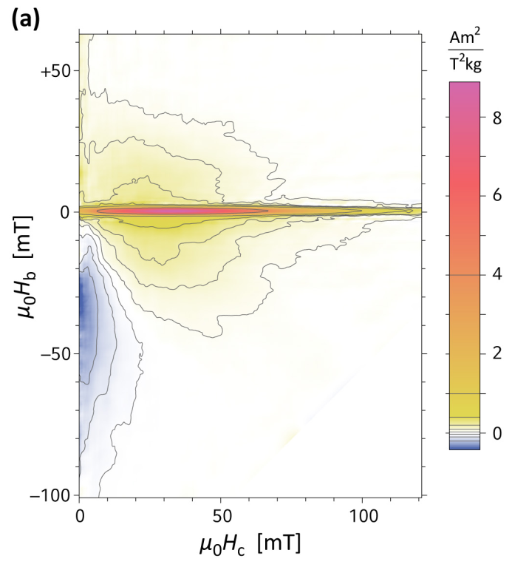
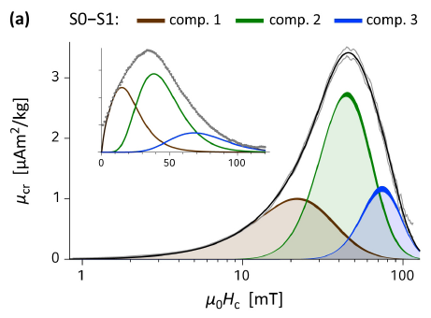
FORC’s of Our Sediment
-
=
Untreated Treated
3% by mass Fe 60% from mag.
60 ppm SD Iron minerals
Approx. 3% Fe in mag. > 27% from bacteria
minerals (biogenic and others) < 6% from primary
P. Ludwig et al., Glob. Plan. Change 110 (2013)

Slide 25
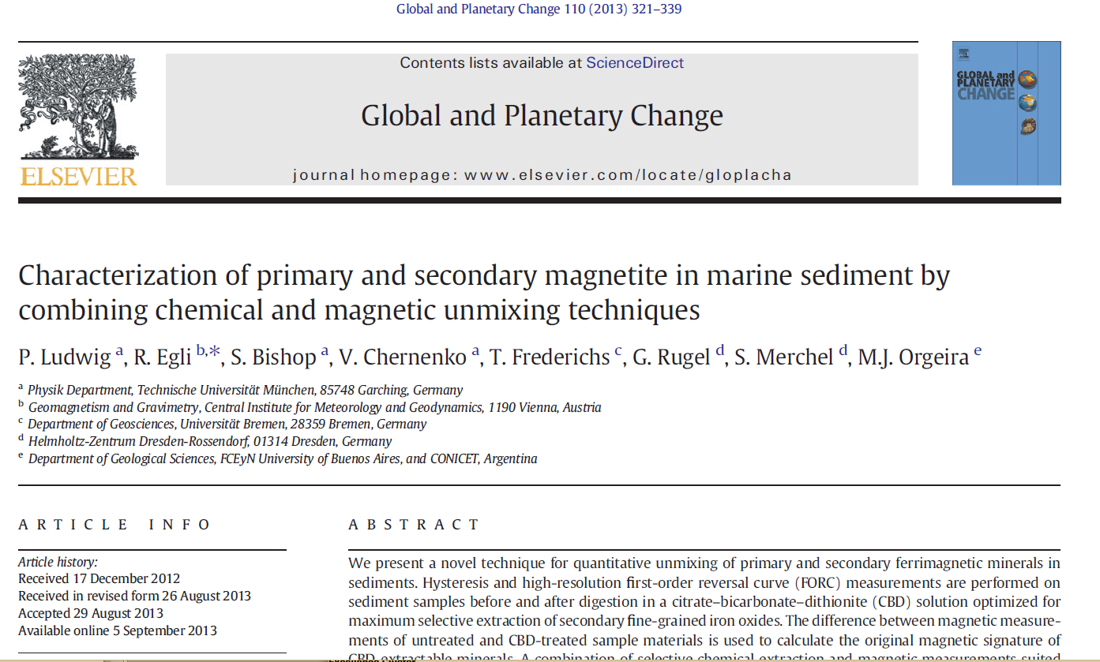

Slide 26
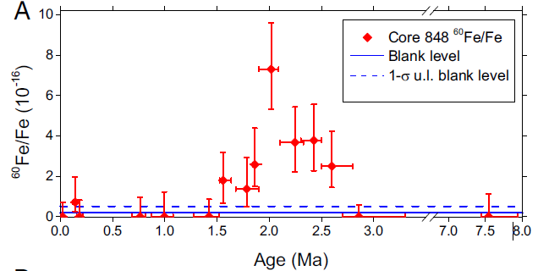
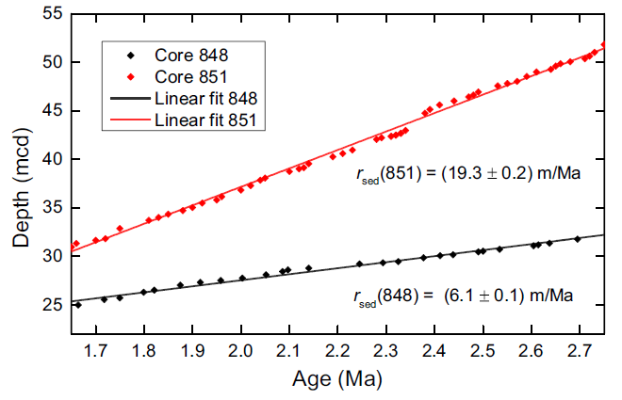
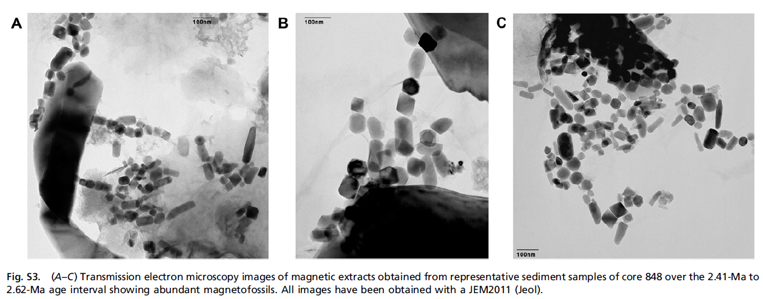
⁶⁰Fe found in biogenic reservoir
⁶⁰Fe found in two Pacific Ocean sediment cores (848 and 851)
Sed. Rate is well characterized; time profile of signal resolved
Onset of signal coincides with Plio-Pleistocene boundary; marine extinction event occurred and global cooling period began at that same time.
Mere coincidence, or a causal connection?
What other cool things could bacteria be doing in geology for astrophysics?
Plio-Pleistocene marine extinction
P. Ludwig et al., PNAS 113 (2016)

Slide 27
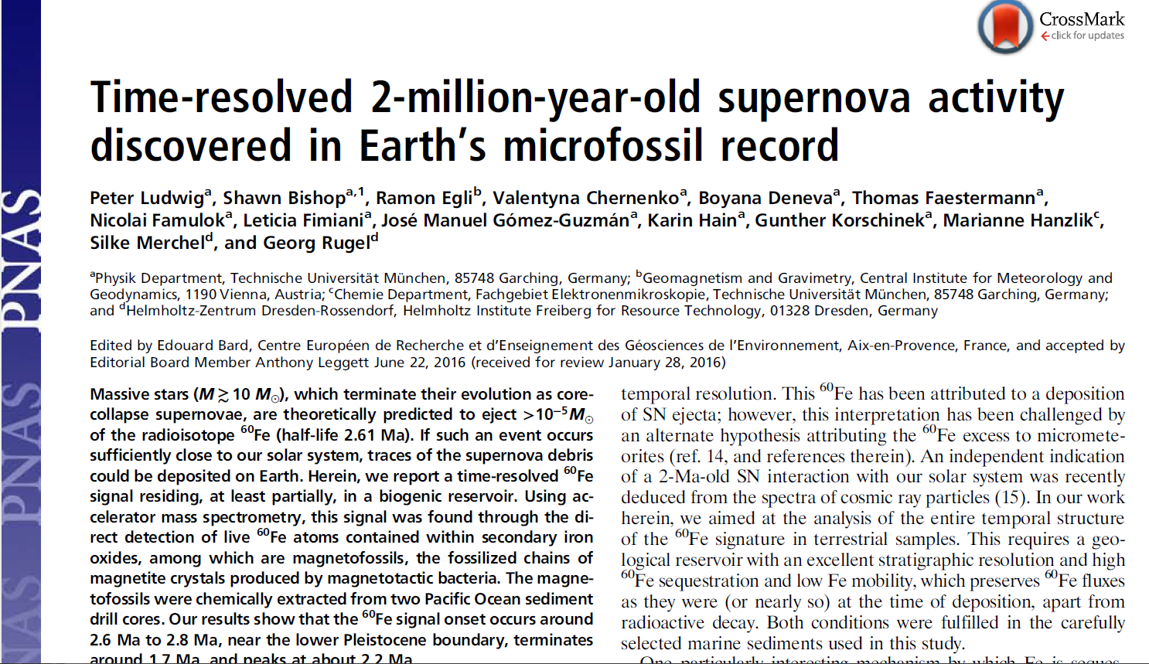
www.pnas.org/cgi/doi/10.1073/pnas.1601040113

Slide 28
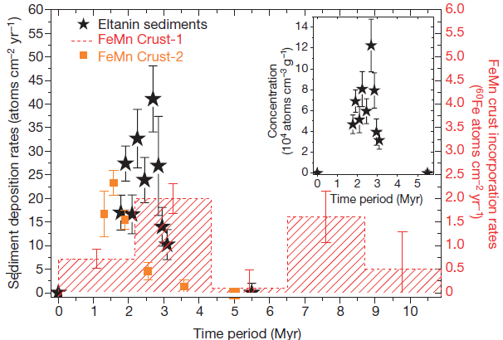

2016: The Year of ⁶⁰Fe
Lunar Regolith
A. Wallner et al., Nature 532 (2016)
L. Fimiani et al., PRL 116 (2016)
W. R. Binns et al., Science (2016)

Slide 29


More on cosmic rays: One supernova, or more?
M. Kachelrieß, et al., PRL 115, 2015

Slide 30

Detection of ²⁴⁴Pu and ²⁴⁷Cm in cosmic rays
Satellite mission carrying stacks of Lexan sheets stop cosmic ray particles
High energy, high Z cosmics produce tracks in Lexan (think of “fission tracks”)
Lexan retrieved and etched in the lab.
Difference in etching rate between bulk Lexan and cosmic-ray track is a measure of ionization damage done along track → leads to Z and velocity
“…results are consistent with…source material which is mainly ordinary ISM with some recent contamination by freshly synthesized material.”
J. Donnelly et al., ApJ 747 (2012)

Slide 31


“Curious Curie” and Curium
F. L. H. Tissot et al., Sci. Adv. (2016)
²⁴⁷Cm (half life 15.6 Myr) alpha-chain decays to ²³⁵U
Very recent measurements of ²³⁵U excess in CAIs (Ca-Al-rich Inclusion) from Allende meteorite lead to a larger initial abundance of ²⁴⁷Cm in Early Solar System (ESS)
New initial ²⁴⁷Cm abundance, when now combined with ESS initial ¹²⁹I and ²⁴⁴Pu abundances all fit to a model curve of a common “free decay interval” Δ
Δ represents the time interval between last nucleosynthetic event producing these elements and their subsequent entrainment into ESS objects (such as CAI’s)
Implication: ¹²⁹I, ²⁴⁴Pu, ²⁴⁷Cm all co-produced in a common r-process event

Slide 32
Summary
Supernova signal residing in a biogenic reservoir
First time-resolved SN signal transiting solar system
  Does the time profile map the density profile of that material?
  Width of ~800 kyr
  Is the shape determined by dynamics of supernova ejecta with interstellar medium?
  Is the shape determined by terrestrial “residence times?
  Combination of these both?
  More than 1 supernova to explain the width?
What’s next? r-process only isotope coincident in geological-time with ⁶⁰Fe:

Slide 33
Remainder of presentation redacted
Not for public consumption

