Slide 1
Euclid Scientific Archive System
B. Altieri, Euclid Archive Scientist
S. Nieto, P. de Teodoro, E. Racero and F.Giordano
from ESDC Team @ESAC

Slide 2
Euclid Mission Overview
1.2m telescope, L2 orbit
6 years mission duration
Map the sky in 1 optical band, 3 NIR bands and NIR slit-less spectroscopy
Launch on Soyuz in Q2 2022
ESA is responsible for the mission.
The Euclid Consortium will supply ESA with the instruments and most of the SGS.
Euclid Consortium & Other teams
  15 countries, 130 institutes,
  1300 consortium members and 700 scientists
Ordinary Matter
5%
Dark Matter
26%
Dark Energy
69%

Slide 3
Euclid Data Flow
VIS: images + catalogue
NIR: images + catalogue
MER: Mosaic image + catalogue
SIR: 1D + 2D Spectrum
SPE: SPE Redshifts measurements
PHZ: Photometric redshifts
SHE: Shear measurement
LE3: Final scientific products

Slide 4
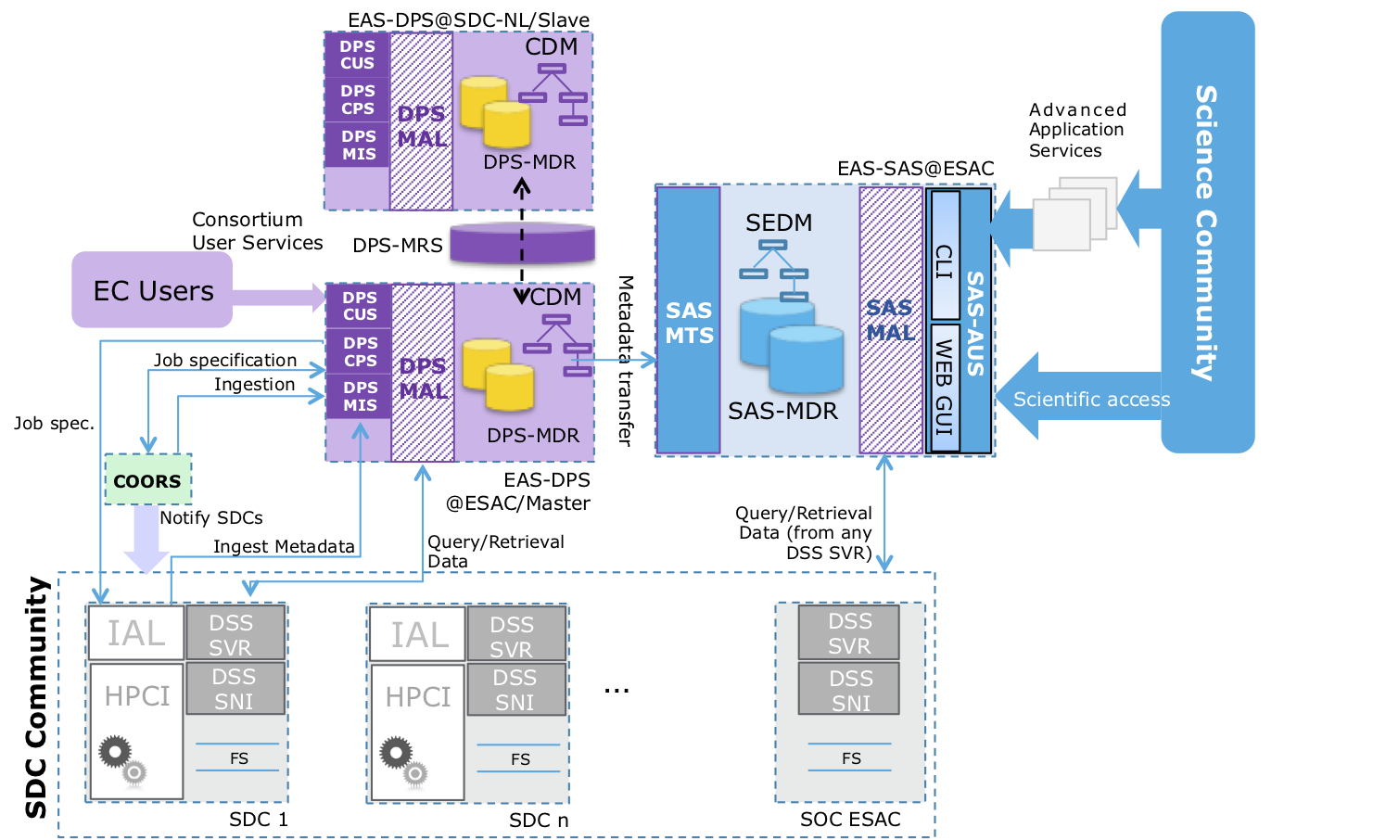
SGS and EAS Overall Architecture
SAS Components:
SAS-MAL: Metadata Access Service
SAS-MDR: Metadata Repository
SAS-MTS: Metadata Transfer Service
SAS-AUS: Archive User Services
SAS-CLI: Command Line Interface
SAS-GUI: Graphical User Interface
SEDM: Science Exploitation Data Model

Slide 5
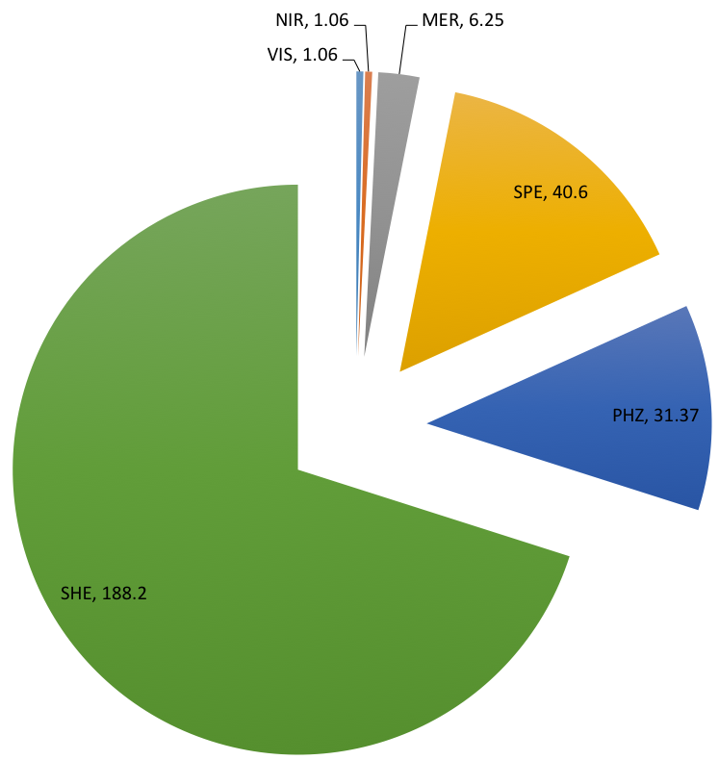
Euclid DR Estimations
  ~45000 observations in 6 years mission
Wide survey (15000 deg2)
  Catalogue: ~268TB
    VIS, NIR, MER: 8.4TB
    SPE columns: 40.6TB
    PHZ columns: 31.4TB
    SHE columns: 188TB
  VIS and NISP imaging: ~3.5PB
    VIS: 3PB (570TB per year)
    NIR: 0.5PB (90TB per year)
  Spectra: 3.22PB (600TB per year)
  Other archive products, HiPS maps: 0.5PB*
  Excluded external catalogues: DES, KiDS, etc.
Deep survey (40 deg2 and 2 times deeper than WS)

Slide 6
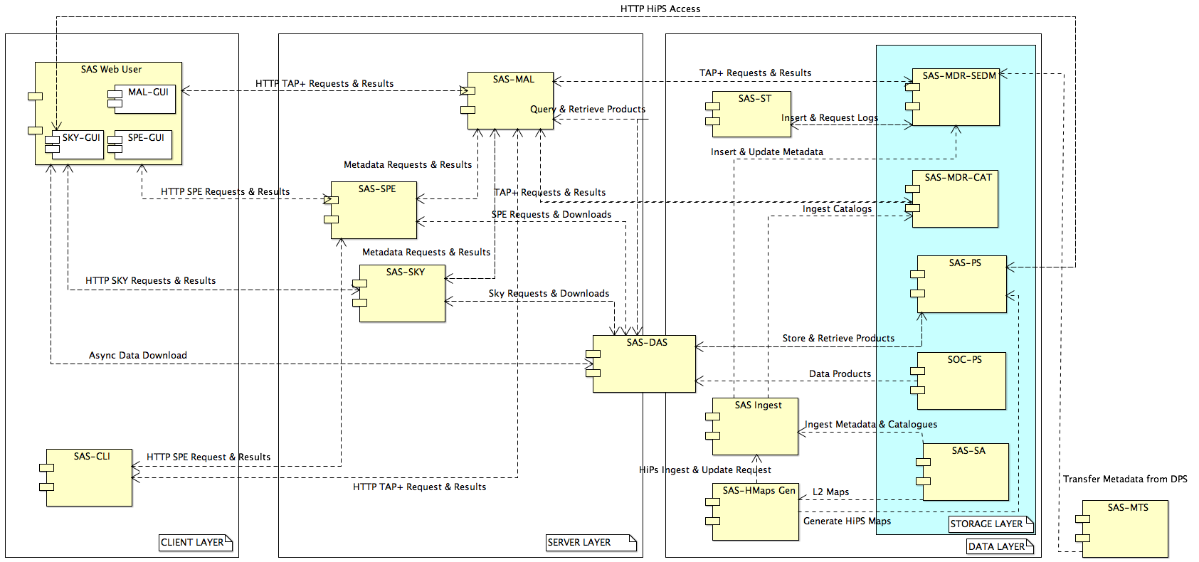
SAS Component Diagram
Notes:
CLIENT LAYER:
MAL-GUI: Metadata Access Layer Graphical User Interface
SKY-GUI: Sky Graphical User Interface
SPE-GUI: Spectra Graphical User Interface
SAS-CLI: Command Line Interface
SERVER LAYER:
SAS-MAL: SAS Metadata Access Layer
SAS-SPE: SAS Spectra
SAS-SKY: SAS Sky
SAS-DAS: Data Access Service
DATA LAYER:
SAS-ST: SAS Statistics
SAS-INGEST: SAS Ingest
SAS-Hmaps Gen: HiPS Maps Generator
SAS-MDR-SEDM: Metadata Access Layer for SEDM
SAS-MDR-CAT: Metadata Access Layer for Catalogues
SAS-PS: SAS Product Storage
SAS-SA: SAS Storage Area
SAS-MTS: SAS Metadata Transfer Layer

Slide 7
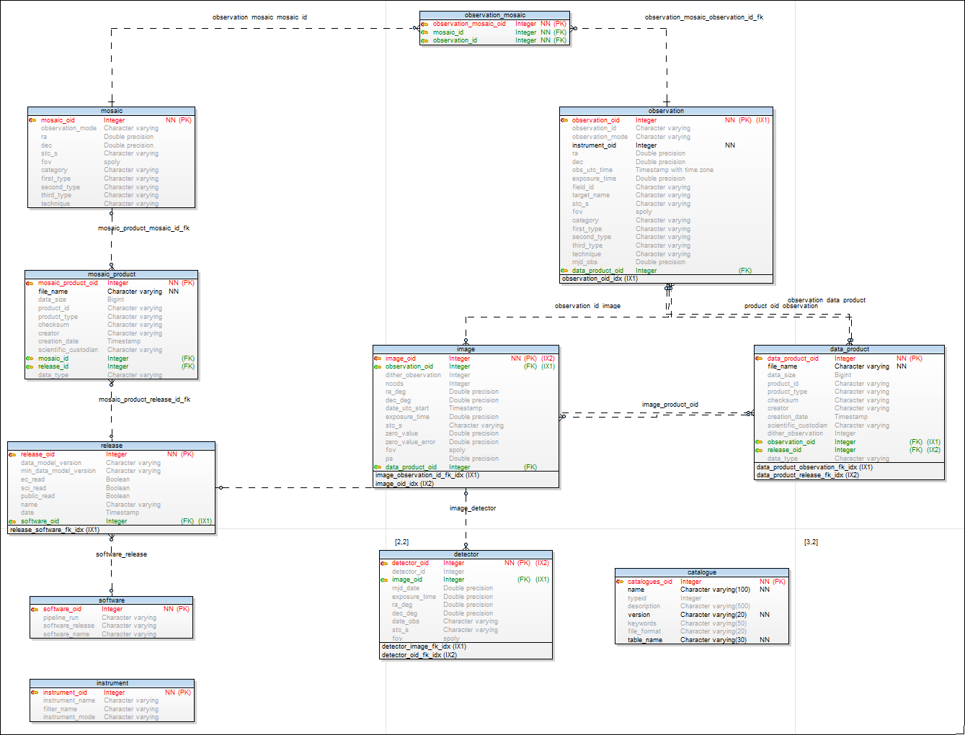
IVOA Standards in Euclid SAS
SEDM based on VODM Standards:
  ObsCore DM
  Provenance DM
TAP+ (Table Access Protocol)
ADQL (Astronomical Data Query Lang.)
UWS (Universal Worker Service)
VOSpace (Virtual Observatory space)
HiPS (Hierarchical Progressive Survey)
SAMP (Simple Application Messaging Prot.)
SIAP (Simple Image Access Prot.)
DataLink
Euclid SEDM evolves as of ECDM
SEDM v0.6 is based on ECDM 1.6.7

Slide 8
Euclid SAS v0.8 (Feb. 2019)
Current version v0.8:
  Ingestion of SC3 L2 data: Maps, Catalogue and Intermediate products
  Simulated catalogue of 2.7 Billion sources (30% of the final catalogue)
  Catalogue searches similar to Gaia archive (TAP+ with ADQL)
  Products download
  Sky exploration:
    Maps visualization
    Overlay of Catalogues and Query results
    Footprints overlay for Observations and Mosaics
  GreenPlum PoC (presentation by P. de Teodoro)
  On-going projects:
    Spark PoC for massive catalogue/images exploitation

Slide 9
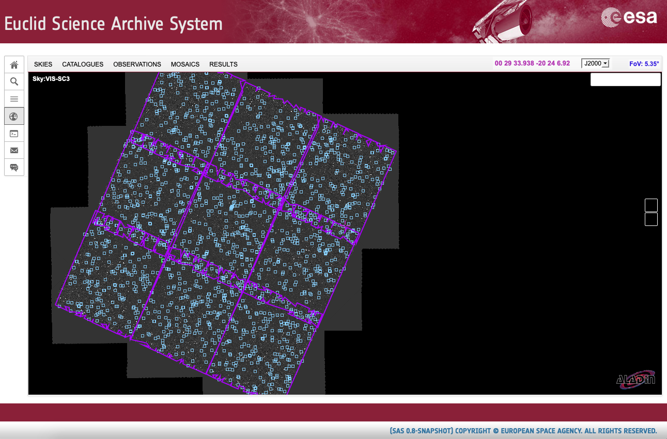
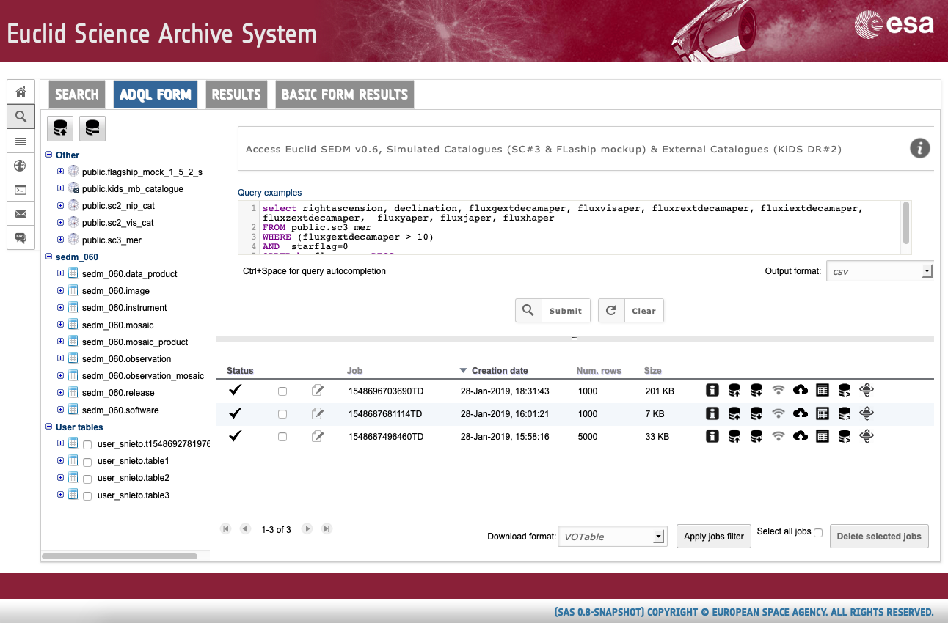
SAS v0.8

Slide 10
Spark PoC: Motivation
SAS storage estimation (6 years mission)
  10PB
Data heterogeneity
  Metadata tables
  Images
  Spectra
Science Use Cases:
  Big catalogue analysis
  Source extraction on images
  Machine learning

Slide 11
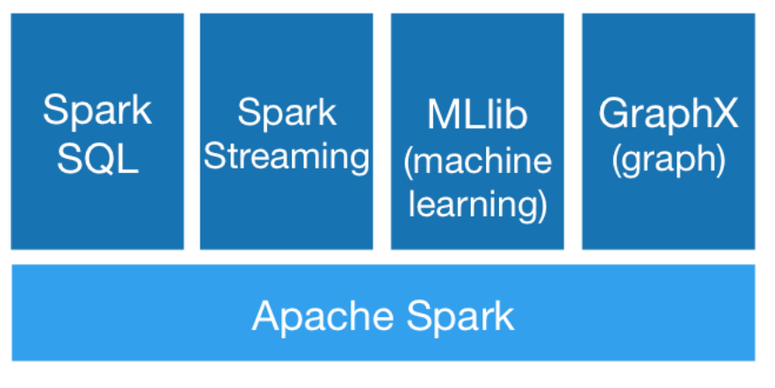
Apache Spark
Framework for large scale cluster computing in Big Data contexts
Open source platform with big and active community
Written in Scala with multilanguage API support for Python, Java and R
Platform of platforms:
  Machine Learning, SQL-like, Streaming and Graphs

Slide 12
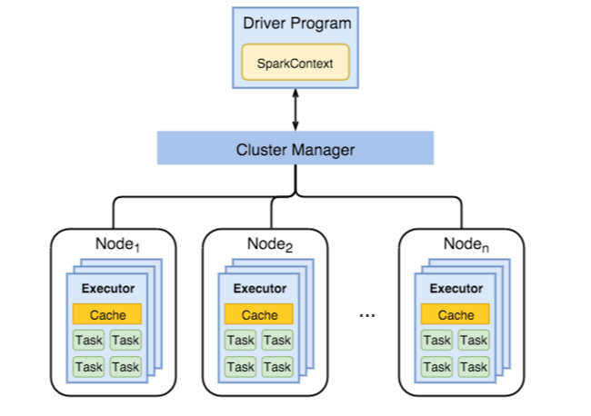
Spark cluster
Spark v2.3.1
Spark virtual infrastructure:
  Master: 24GB and 8 Cores
  6 Workers: 48 Cores 180 GB RAM
Standalone mode
  No YARN, MESOS
Shared NFS storage
JupyterHub server
  PySpark kernel

Slide 13
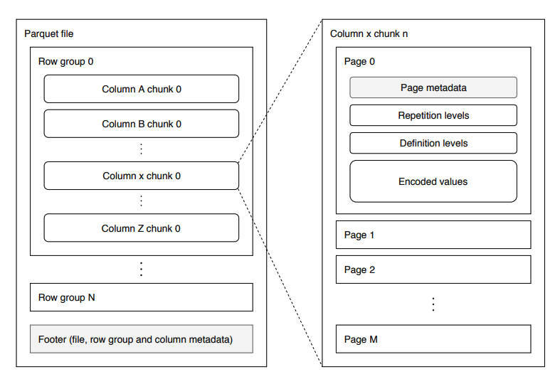
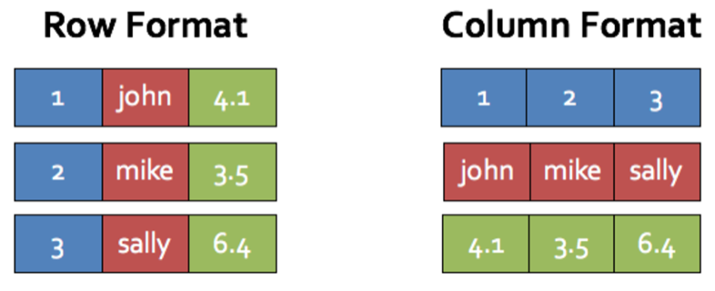
Datasets
Simulated catalogue of 2.9TB spited in CSV chunks
  2.7 billion rows aprox. and 119 columns
  Each CSV chunk (10.5GB) contains 10M rows
  10.5GB/128MB = 85 partitions by default (maxPartitionBytes)
  Snappy compression: size savings 26%
Bulk CSV2Parquet migration ~7h

Slide 14
SparkSQL Test: Parametric search +OrderBy
dfp.createOrReplaceTempView("Table")
#SQL Query selection
query = sqlContext.sql("SELECT * \
FROM TABLE \
WHERE ra_gal > 48 AND ra_gal < 50 AND dec_gal > 8 AND dec_gal < 12 AND (euclid_nisp_y - euclid_nisp_h) < 2”).orderBy("galaxy_id”)
Test on 2.7 Billion rows
elapsedTime => 141883 (2.4 min)
Test on 2.7 Billion rows
elapsedTime => 471366 (7.9 min)
I/O amounts to ~90%
CPU time is ~10%

Slide 15

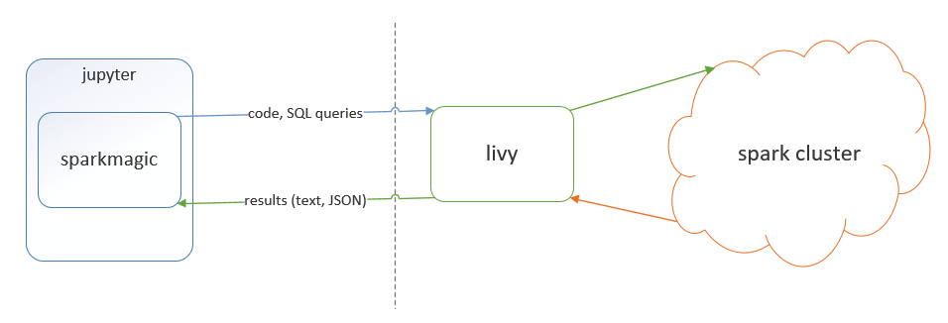
JupyterLab connection
Interactive analysis through JupyterLab
  PySpark kernel - tested
  Apache Toree
Dynamic resource allocation is needed
  spark.dynamicAllocation.enabled
Livy – a REST based Spark interface to run statements, jobs and applications
  Using programmatic API
  Running interactive statements through REST API
  Submitting batch applications with REST API
Notes:
https://anaconda.org/conda-forge/sparkmagic

Slide 16
Conclusions
Shared NFS storage is a bottleneck
Less overall IO to do, meaning jobs run faster
Dynamic resource allocation is needed
Cache (in memory) results after filtering to continue working boosts performance
Lack of Astronomical APIs for Spark: cone search, Xmatch, ADQL
Difficult to debug errors from Jupyter Notebook
Interactive monitoring: spark job progress

Slide 17
SAS v0.9 (by May 2019)
Official participation in SC456 challenge; Ingestion of SC456 and EXT (DES and KiDS) products; new SEDM compliant with products schema; Integration Plotr tool in SAS for fast plotting of result; Cut-out service on FITS images; Processing environment close to SAS (JupyterLab); Merge of Catalogue form and TAP form in GUI; A&A layer to all SAS interfaces; Interface between SAS and DPS based on Field Id.
Data Processing System (DPS) planned work: Maintenance of DPS services for ingestion, query, processing and data retrieval (DSS); Maintenance of Oracle databases and infrastructure; Support for testing; Participation in SC456 as Master@ESAC

Slide 18
Questions
Thanks for your attention

