Slide 1
Heaters Loading @CPPM
Eric Vigeolas 17/12/2018

Slide 2
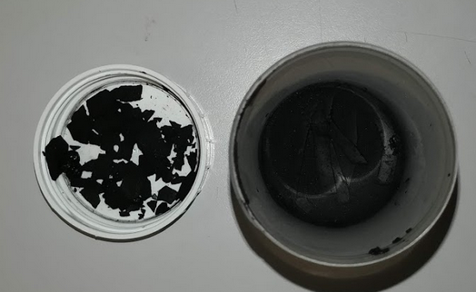
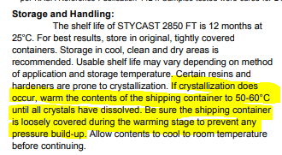
Stycast 2850FT
Following the observation we made that the glue tend to dry out and get more viscous in a 1kg Pot. We decided to split, at the opening, the glue in several little cartridges → Worth after one month non of the pot are usable
Viscosity change will make this glue usage quite difficult during detector assembly
We will try a systematic warm up of the glue (50°C) 1 h before mixing to increase repeatability

Slide 3
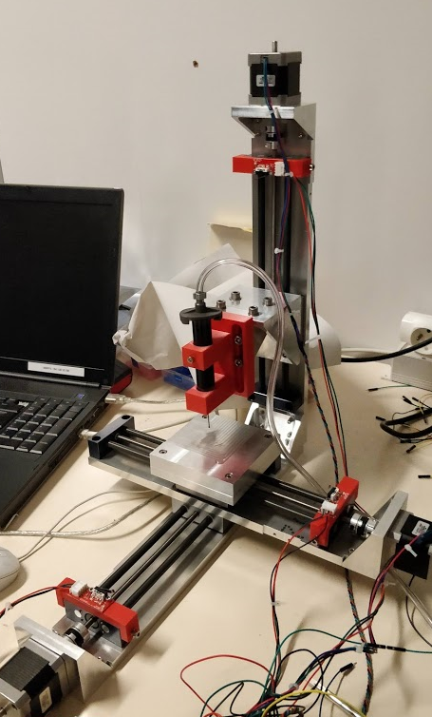
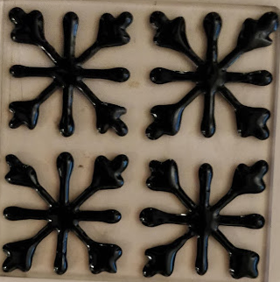
Tooling design progress
3 axis deposition tool is ready
We started the first deposition trials
January we will run glass deposition test to control repeatability and optimize pattern and surface coverage
We will perform minimal thickness measurement vs load

Slide 4
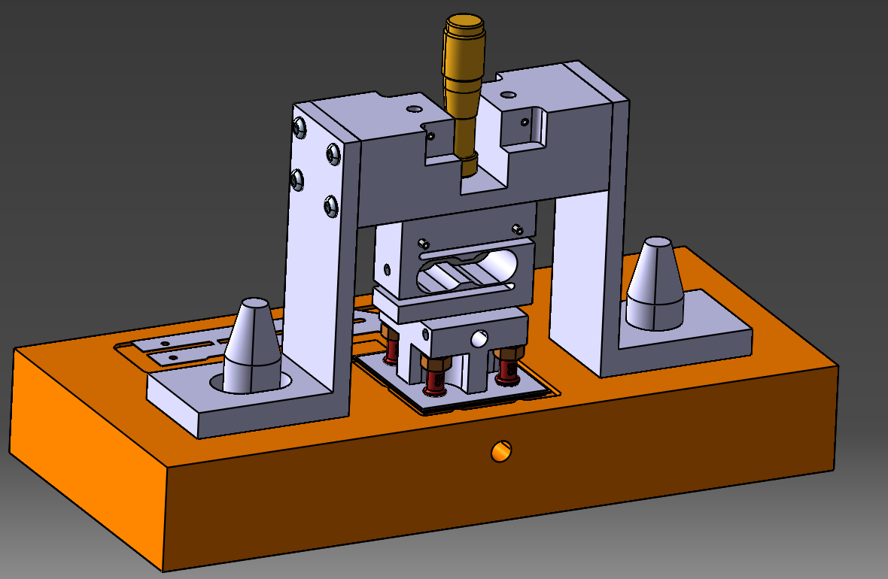
Heater loading tool
Design almost done, just need to complete the bridge design
Load cell has been added + micro screw for vertical adjustment

Slide 5
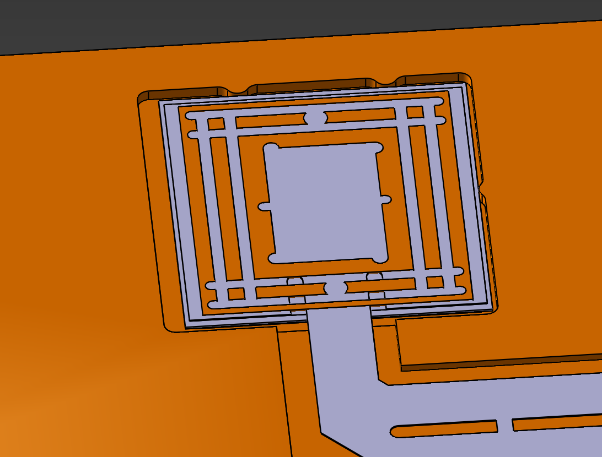
Heater placement
Specific alignment references has been added to align the heater before cell mounting and heater loading
Alignment blocs
Heater footprint

Slide 6
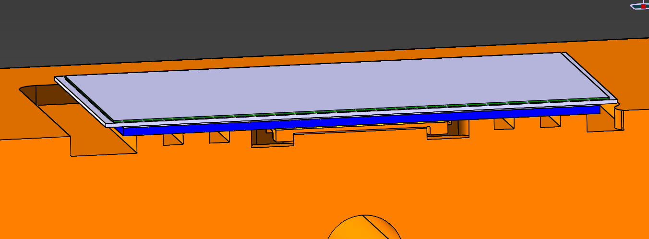
Cell handling
Cell will be vacuumed on the TPG surface, gap will be added on the cooling bloc to create a kinematic assembly
Cell alignment is done with the cooling bloc pins
TPG vacuum grove
Grove to prevent from glue excess
Gap for kinematic assembly

Slide 7
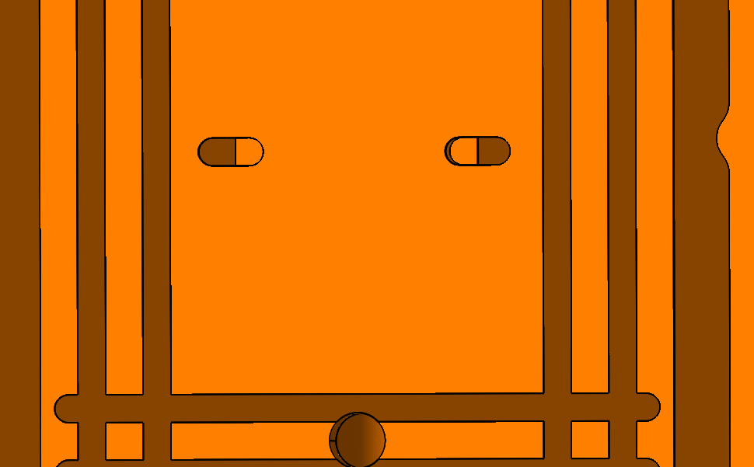
Cell Alignment
A kinematic assembly has been designed for the cell alignment

Slide 8
Conclusion
We expect a better management of the glue with the warming step which will be added prior to the deposition
By January we will focus on glue deposition optimization and repeatability tests on glass tiles
By end of January we will be ready for heaters assembly

