Slide 1

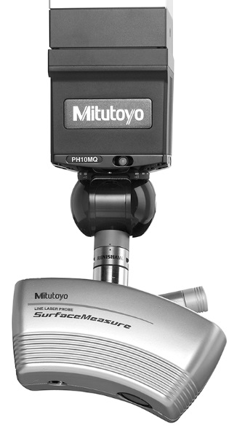
MITUTOYO Laser scanner at Unige
Sébastien MICHAL
05th November 2018

Slide 2
INTRODUCTION
A metrology tool is needed to perform the quality control of local support for the ITK project
  Envelope verification of objects up:
    2300 x 60 x 60 mm³ (SLIM v1)
    800 x 60 x 60 mm³ (pixel OB longeron)
    500 x 300 x 30 mm³ (pixel OB inclined ring)
    700 x 700 x 350 (L4 inclined unit)
  QC performed on a limited time
    200 functional local supports to qualify in several step
      Bare trusses and rings + end supports / brackets
      Functional local supports
      Loaded local supports
    12 Inclined units
  Repeatability of the metrology process
    Automating
  Contactless process

Slide 3
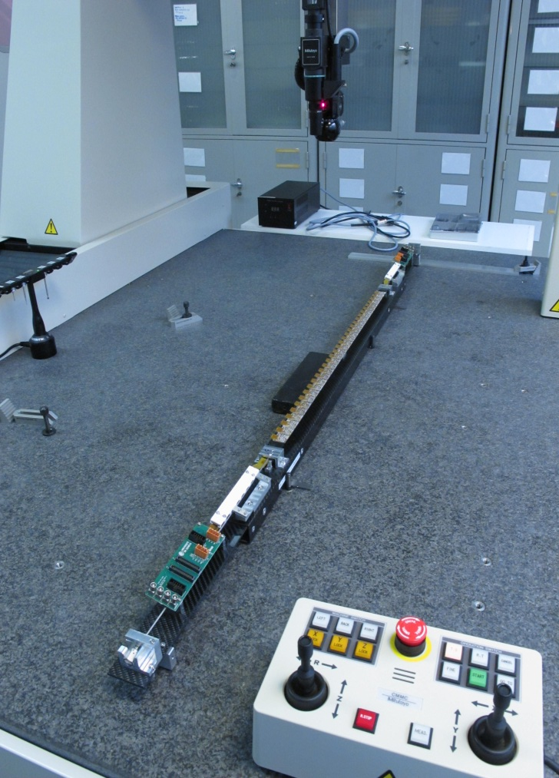
INTRODUCTION
Previous ATLAS metrology were using high camera
  IBL metrology
  Not possible with tilted modules
The laser scanner solution proposed by Mitutoyo is fulfilling such requirements
  Possible inclination of the metrology head by 7.5 ° steps
  Fully automated scanning process
  Post processing can also be automated

Slide 4
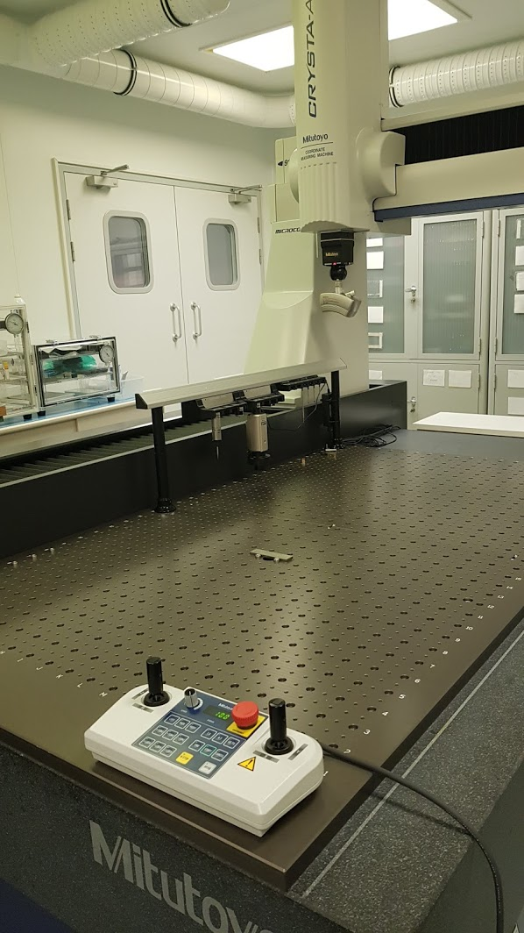
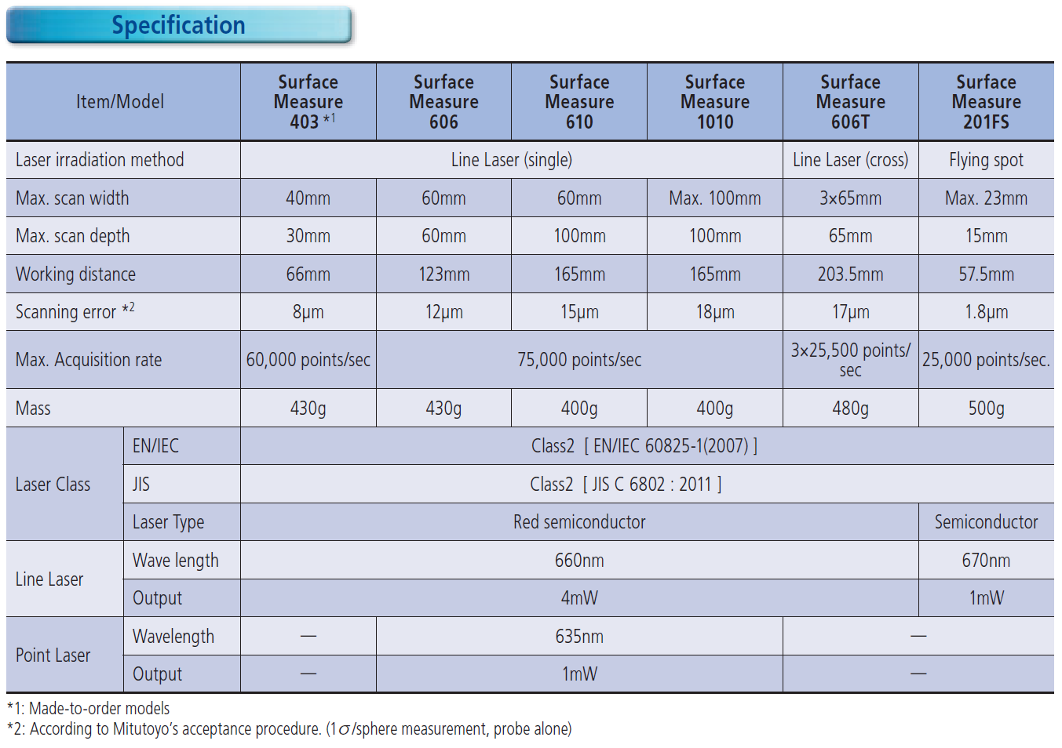
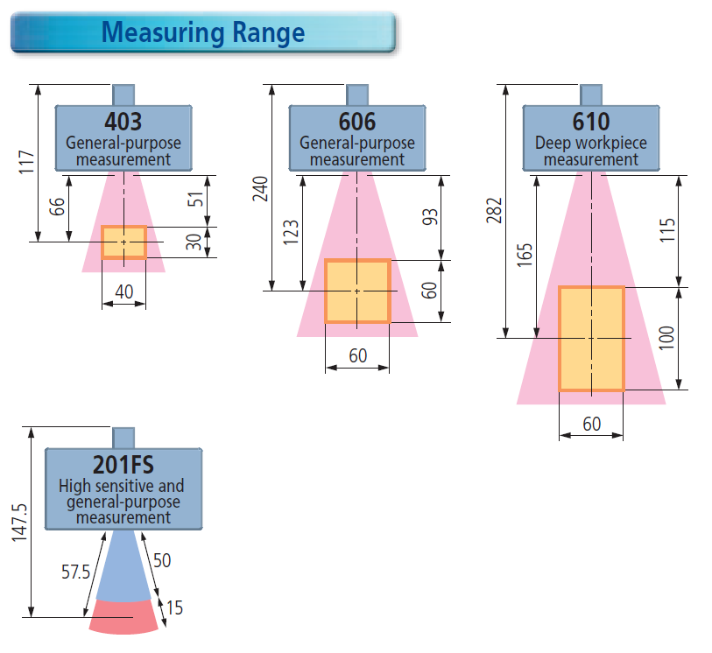

MITUTOYO LASER SCANNER
The laser scanner solution proposed by Mitutoyo is fullfilling such requirement
  SurfaceMeasure 606: good compromise between precision, scanning volume, price and speed

Slide 5
SCANNING PROCESS
References
CAD model
ALIGNMENT
SCANNING PROCESS
POINT OF CLOUD
COMPARISON
References
Laser parameters
Macro
Filters

Slide 6
Practical exemples

Slide 7
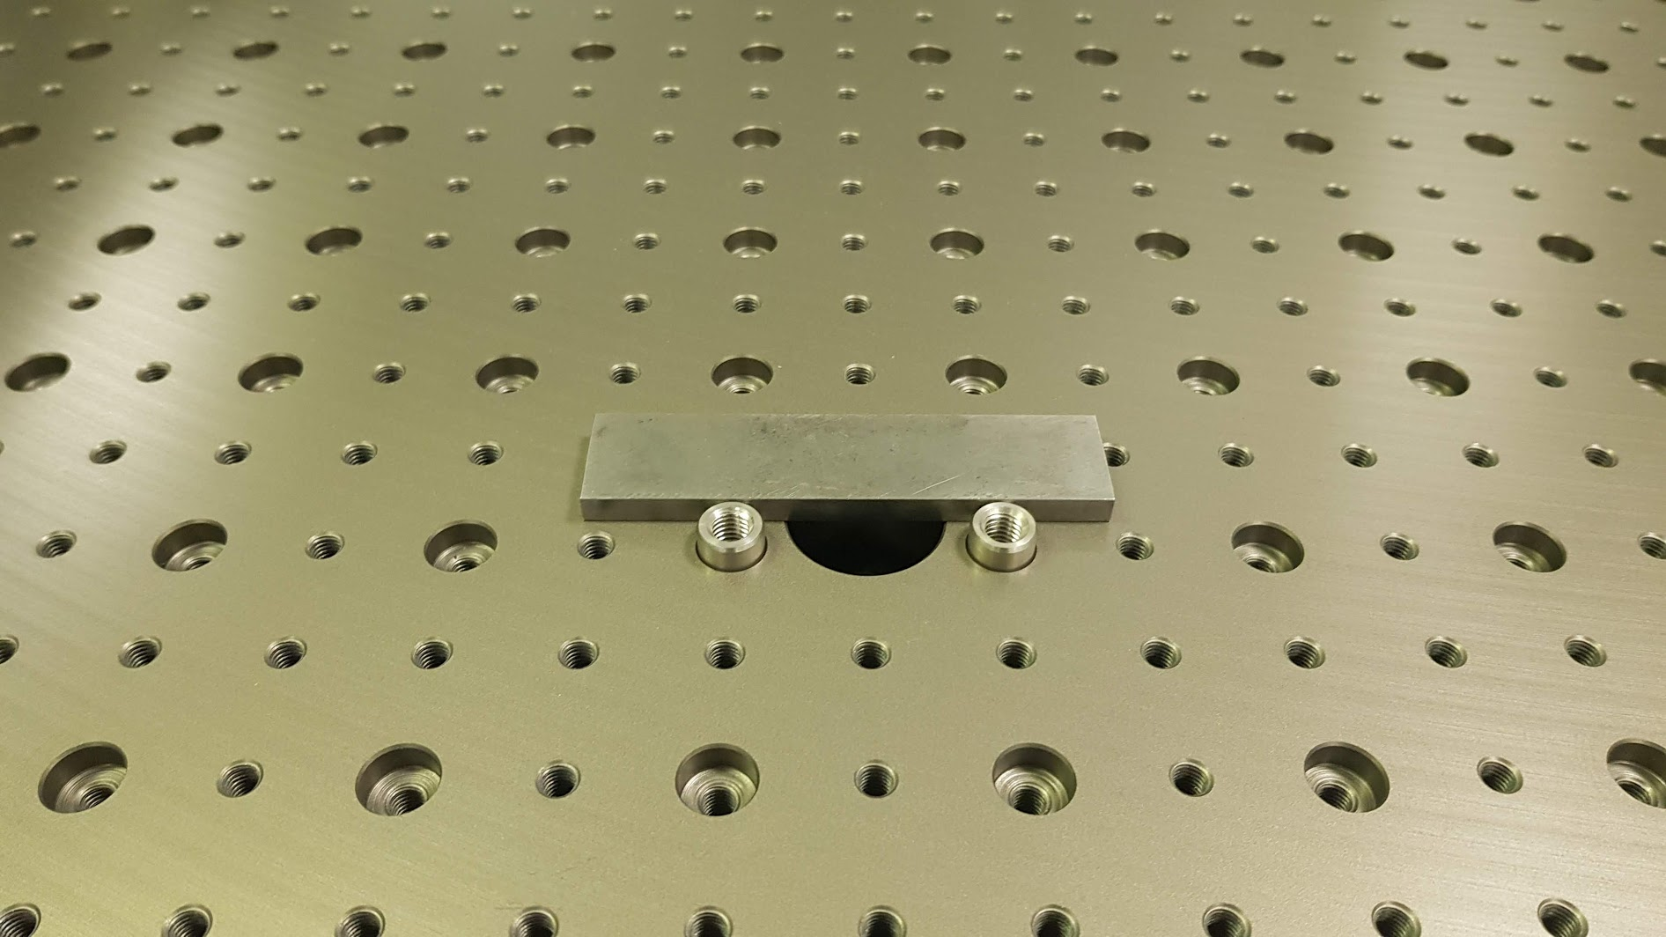
Calibrated shim
Simple exemple to look at various steps and assess scanner precision

Slide 8
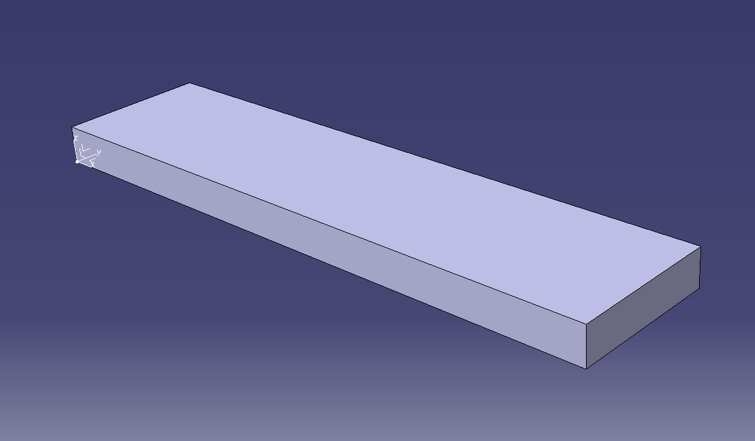
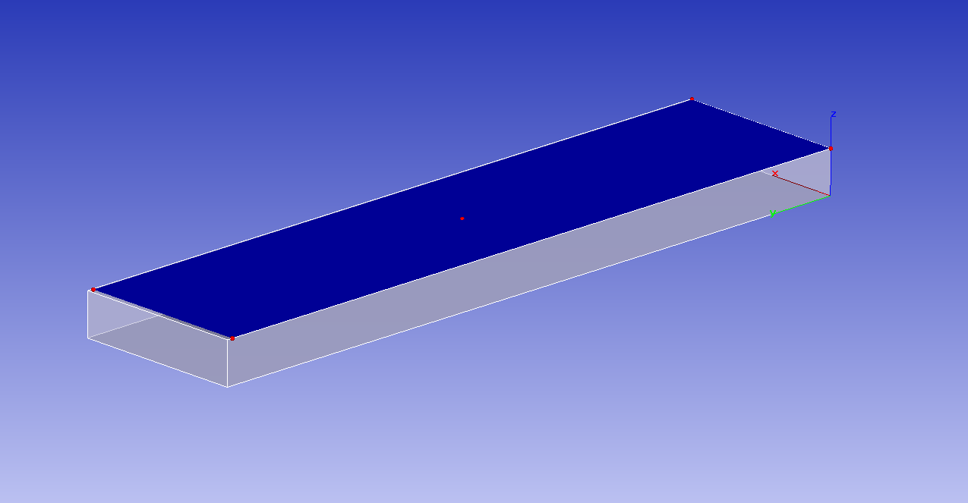
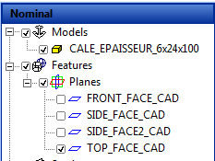
Calibrated shim
CAD model
  6 x 24 x 100 mm³
  Coordinate system of CAD set as global CS
Reference features on CAD model
  Alignment of points cloud with respect to CAD
  Reference surfaces !!
    Choice of references will drive the outcome of the metrology process
    Alignment must be performed using surfaces as precise as possible

Slide 9

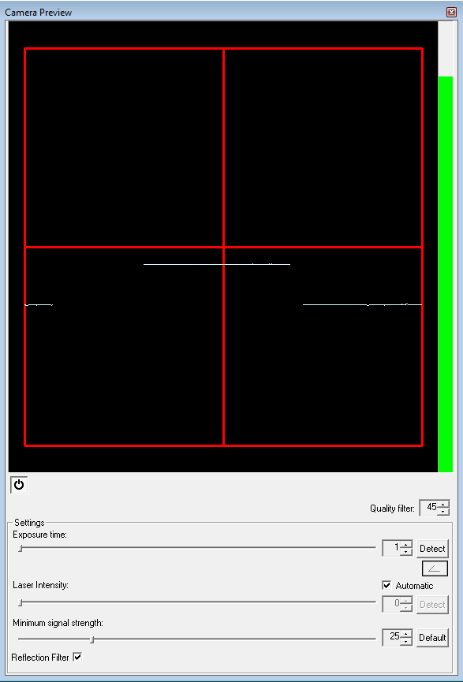
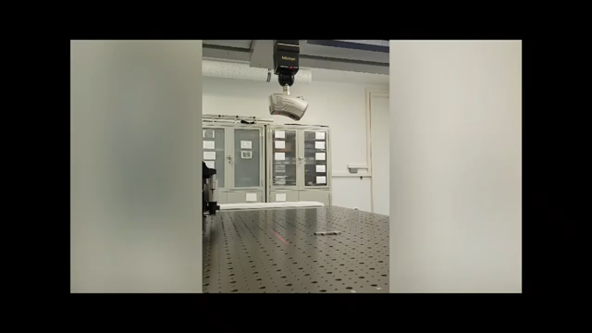
Calibrated shim
Parameters of scan
  Laser parameters
  Define head orientation and scan paths
Scan of the object
Fully automatize process
Speed x4 (real time = 4’23”)

Slide 10
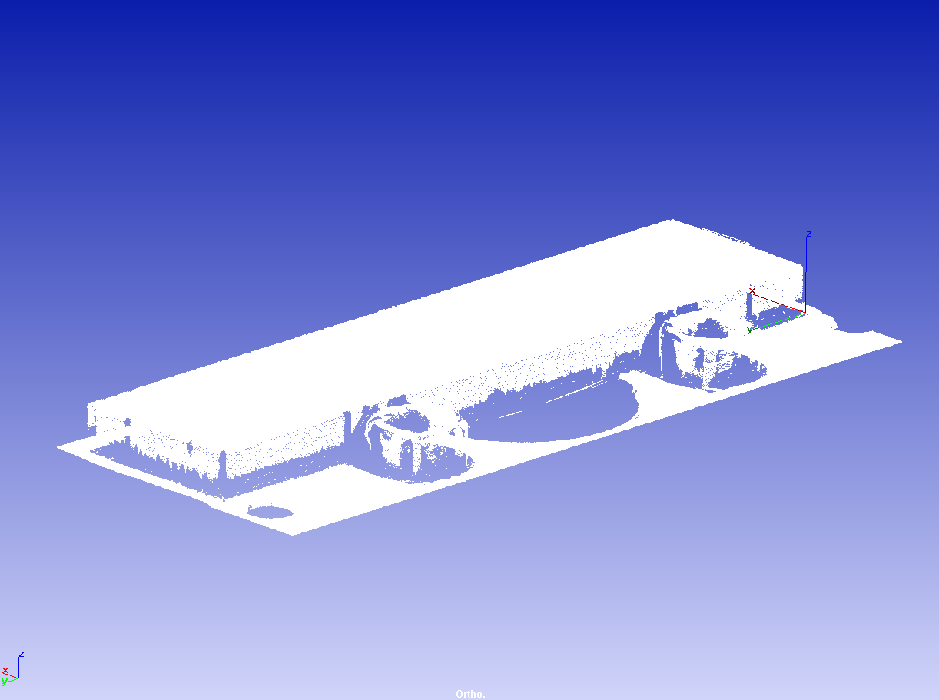

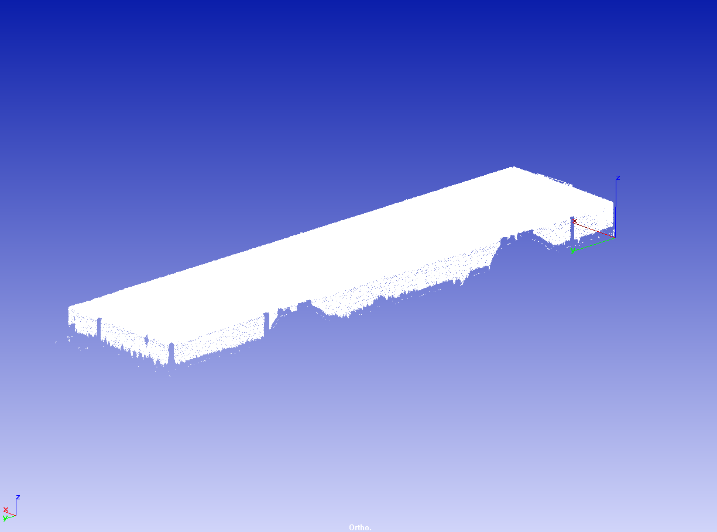
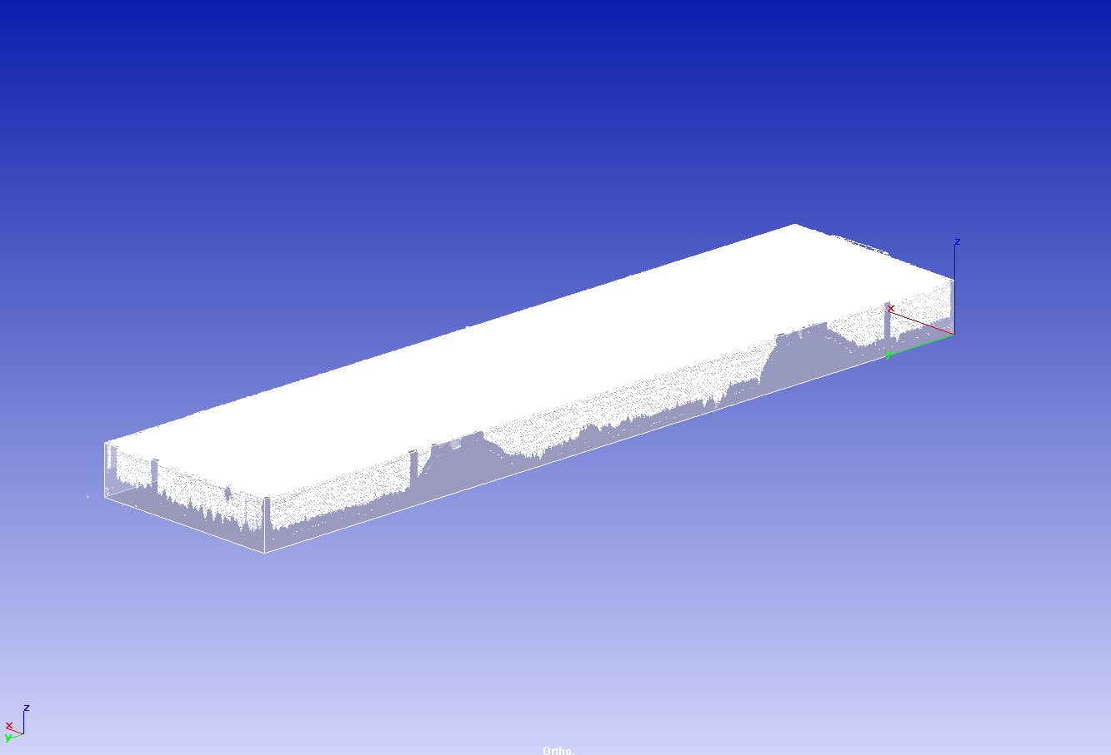
Calibrated shim
Processing of cloud
  Selection of points
  Define reference features
    same as CAD model
Alignment of cloud wrt to CAD
  Using features
Majority of points between marble
table and sample rejected
Selection
Aligment

Slide 11
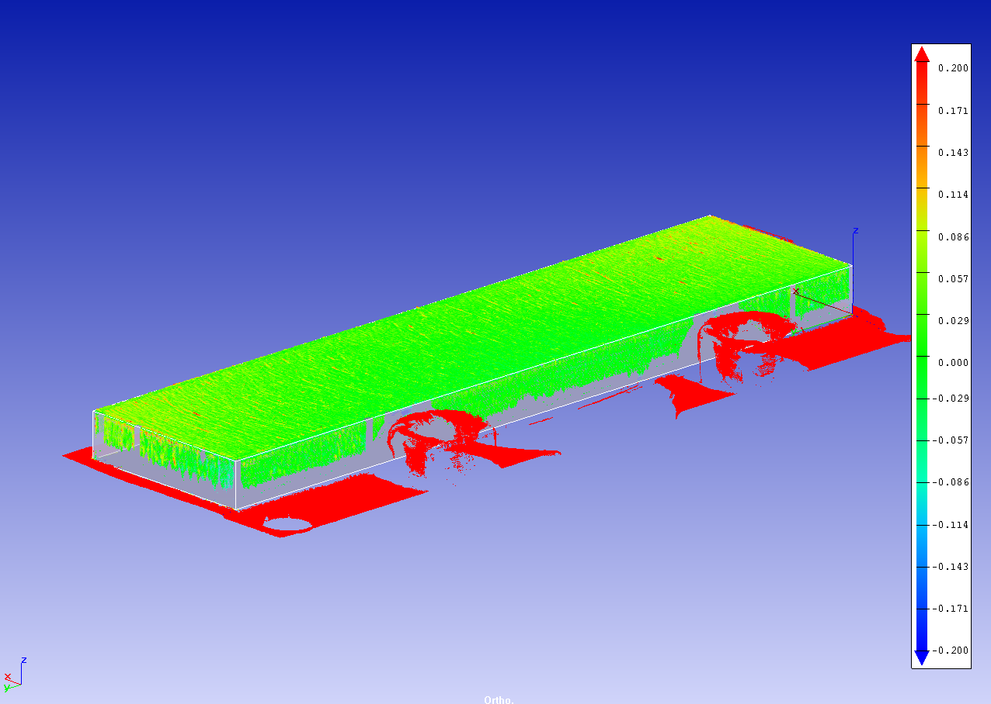
Calibrated shim
Comparison

Slide 12
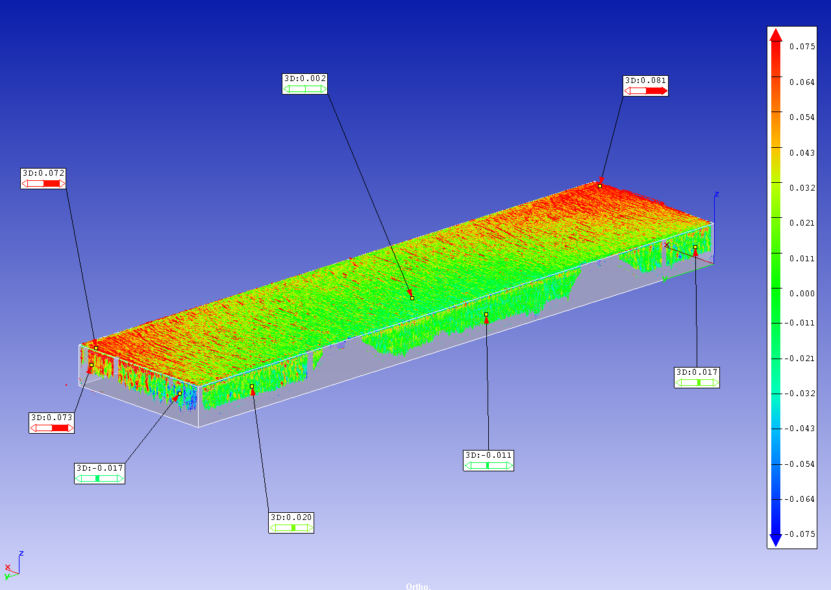
Calibrated shim
More detailled comparison
  Edge effects
    reflection
  Is this bow at top surface real ?

Slide 13
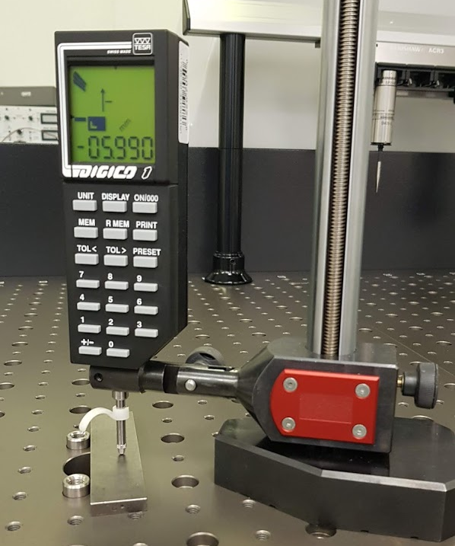
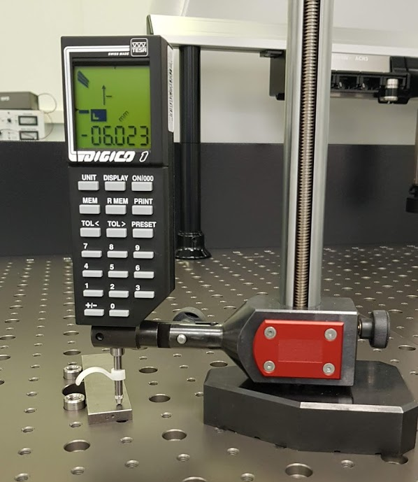
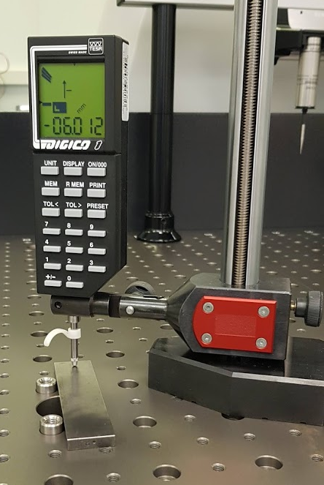
Calibrated shim
More detailled comparison
  Bow measured at ~ 40 µm
    Shim is rocking
  Max deviation is ~40 µm

Slide 14
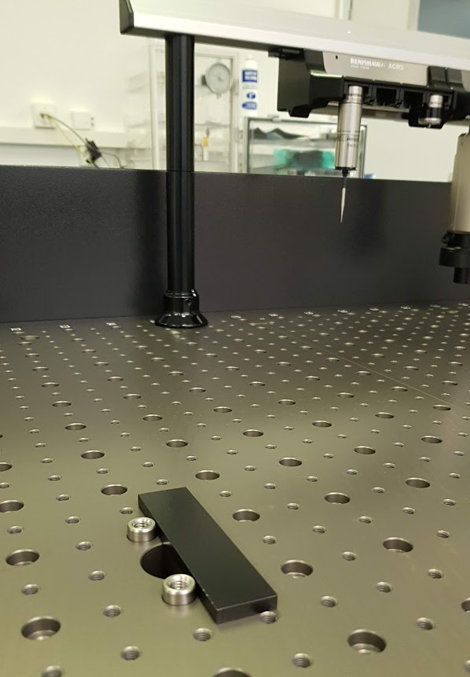
Calibrated shim
Same shim has been paint in black to assess impact of emissivity in measurement
  Shim up side down compare to previous metrology
    Inverse bow

Slide 15
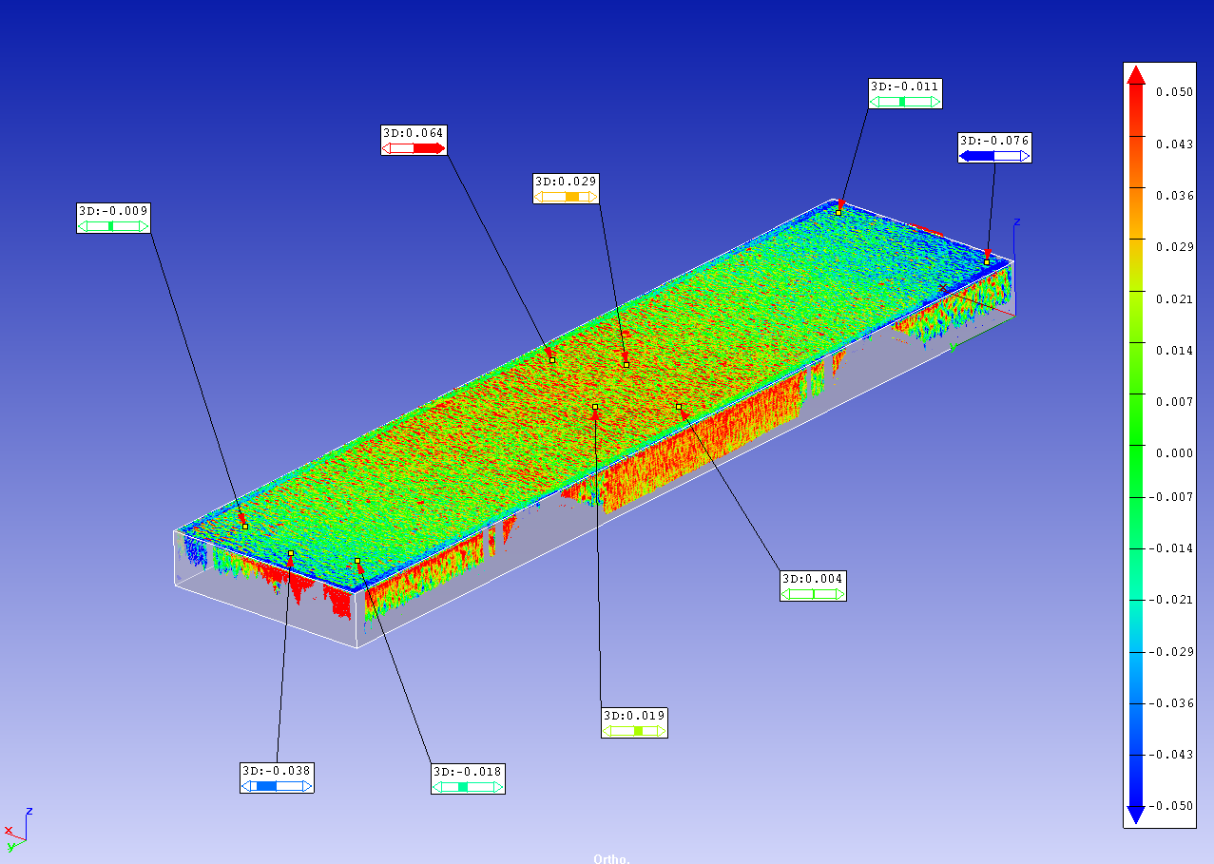
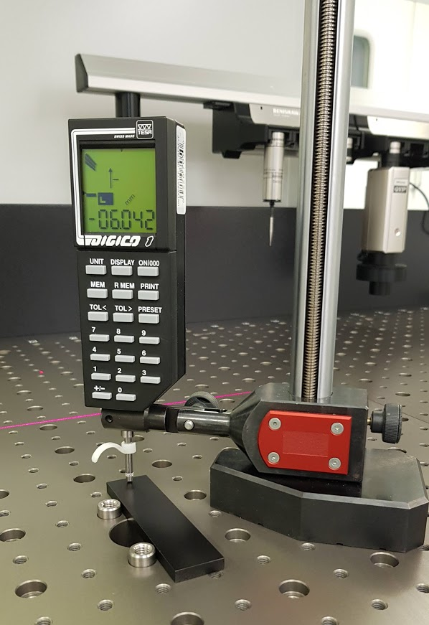
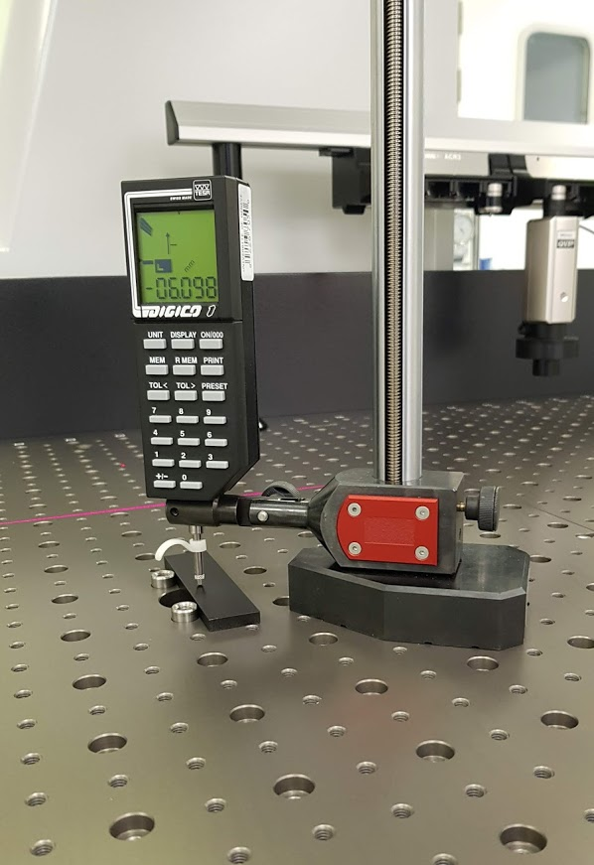
Calibrated shim
More detailled comparison
  Same bow amplitude on top surface
  Similar precision

Slide 16
OB Local support
Demonstrator longeron

Slide 17
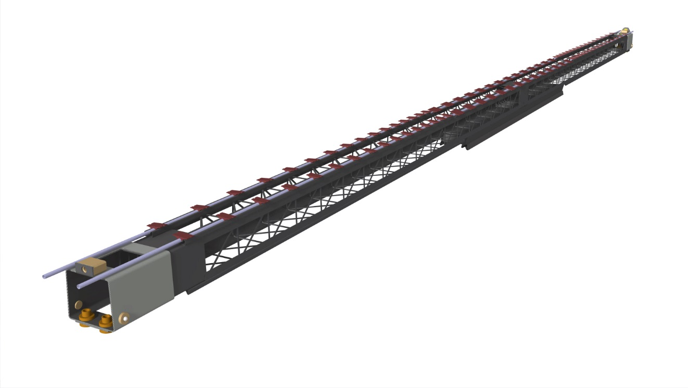
Final demonstrator: bare functional longeron
Functional longeron:
  2 cooling lines
    28 Barrel blocks
    64 tilted blocks
  CRFP components
    Truss assembly
      CERN
    2 x end supports
    6 x interface block

Slide 18
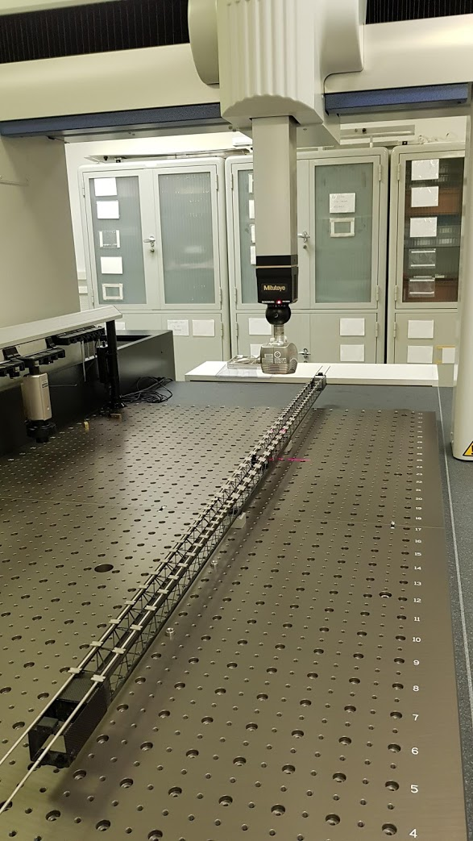
Bare functional longeron scanning
Several full length scans:
  Top, Left and right 45 and 90

Slide 19
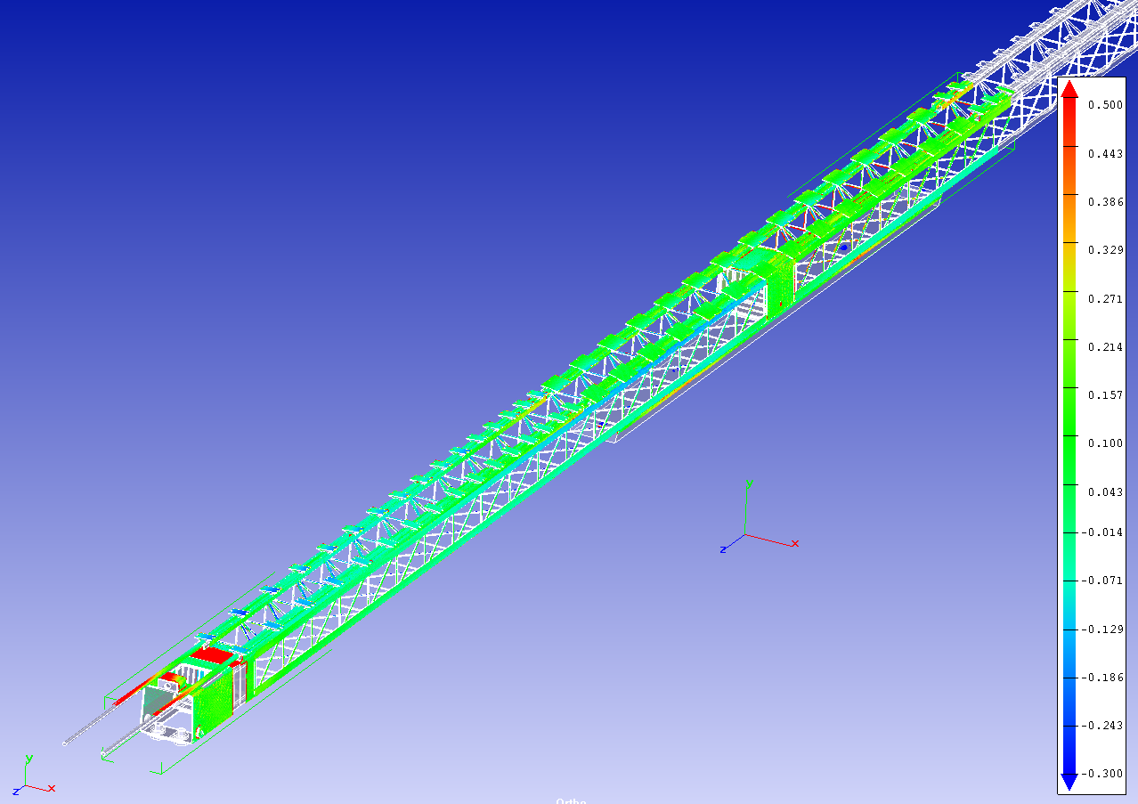
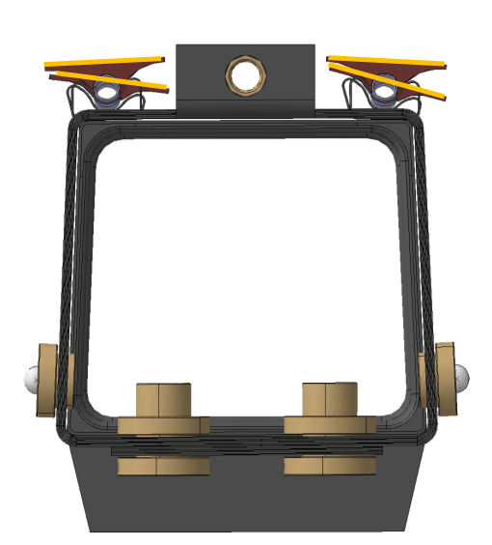
Bare functional longeron scanning
Alignement with CAD
  Alignement using BB block functional surfaces

Slide 20
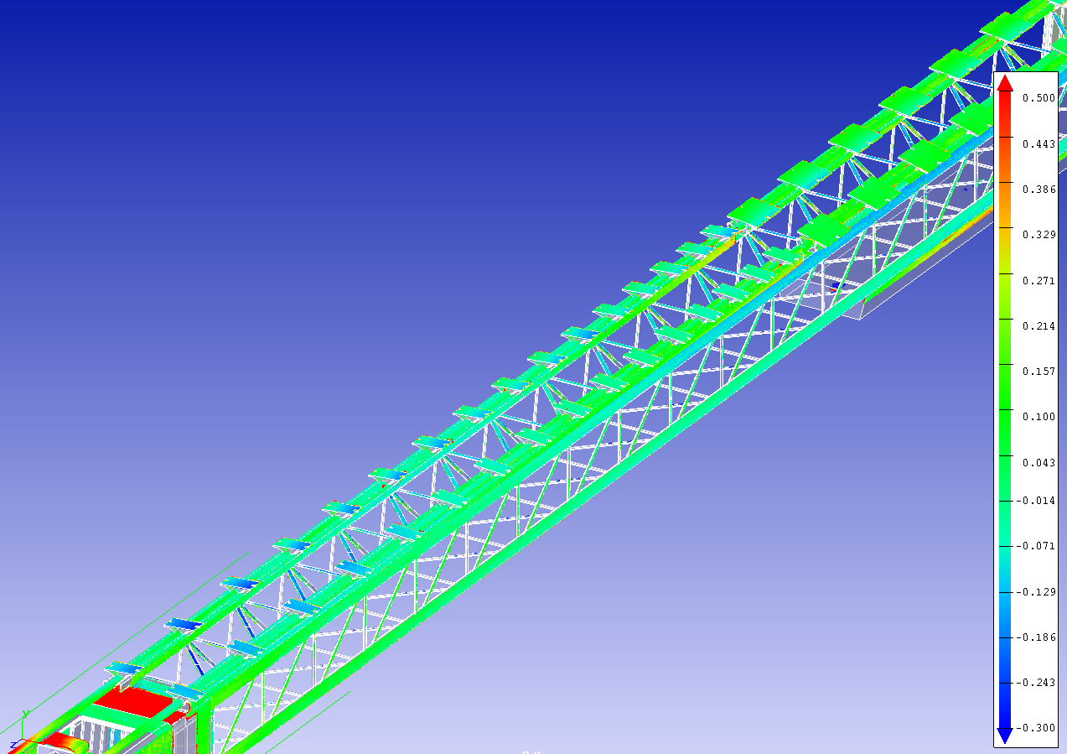
Bare functional longeron scanning
Totality of central base blocks perfectly positioned
tilted base blocks
Barrel base blocks

Slide 21
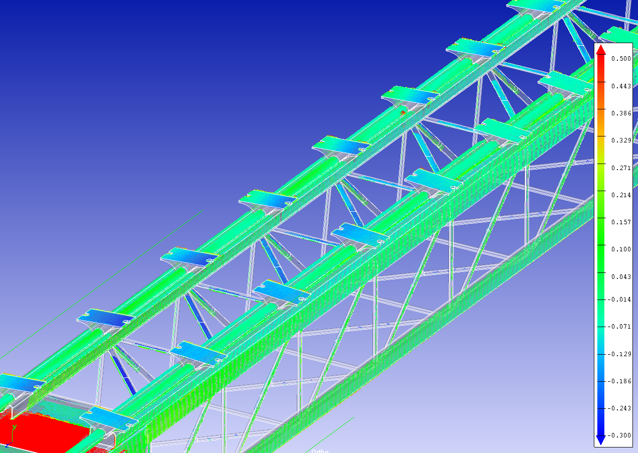
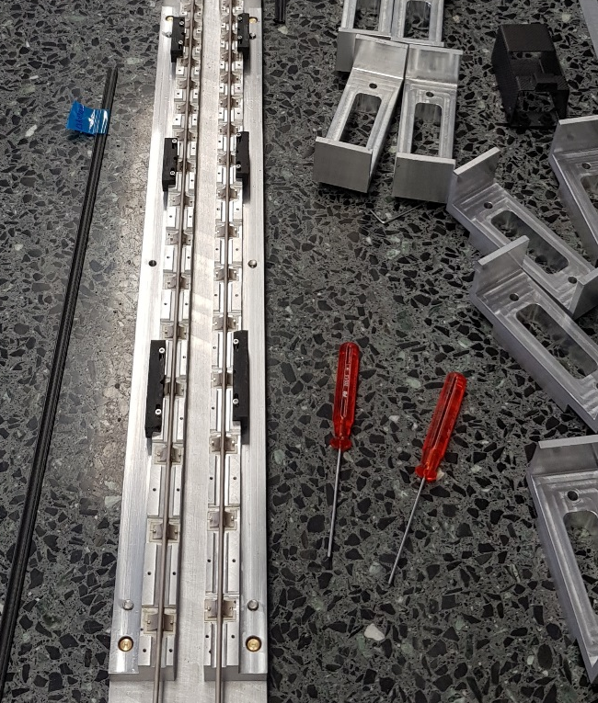
Bare functional longeron scanning
Outer edges of BB better positioned
  Clamping
Overall twist on tilted CL
  More visible on X- side
Clamps

Slide 22
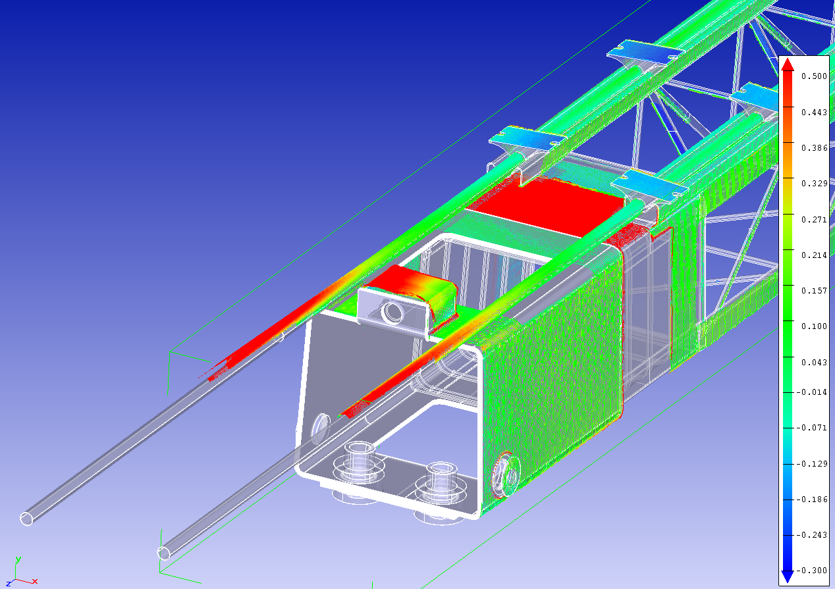
Bare functional longeron scanning
CAD model not up to date
Pipe extremities bent
Threaded insert rotated
  Not impacting functionallity
CAD model not accurate
Bent pipes

Slide 23
References features
First scan trial already provides important feedbacks but:
  Alignment done with 4 planes extracted by cloud of :
    14 barrel BB X+
    14 barrel BB X-
    32 tilted BB X+
    32 tilted BB X-
  Introducing misalignment of the local support
Target is to quantify local support’s deformations using perfect boundary conditions
  Precise references surfaces mandatory

Slide 24
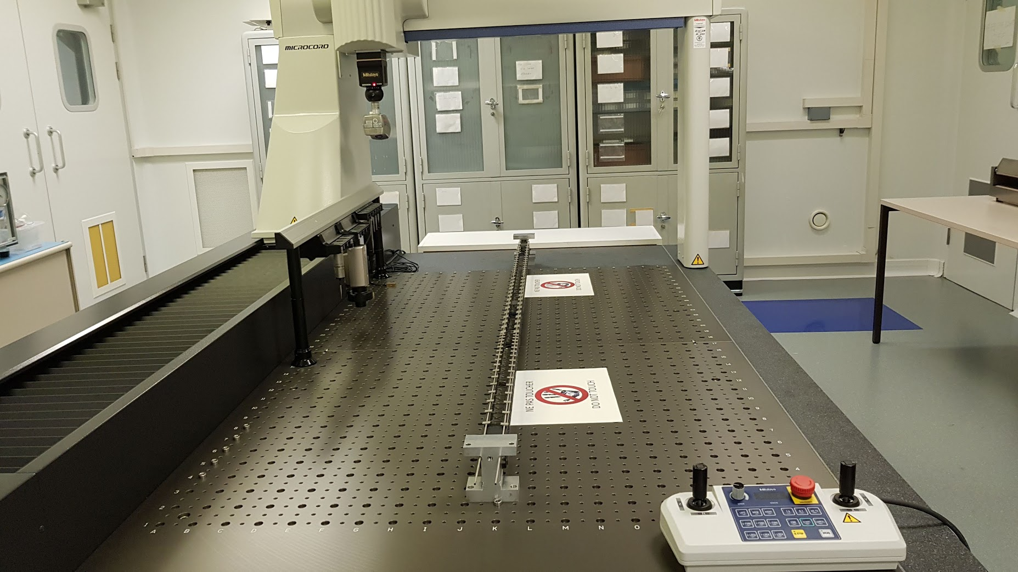
Bare functional longeron on reference blocks

Slide 25
SCANNING PROCESS
References
CAD model
Reference jig
ALIGNMENT
SCANNING PROCESS
POINT OF CLOUD
COMPARISON
References
Laser parameters
Macro
Filters

Slide 26
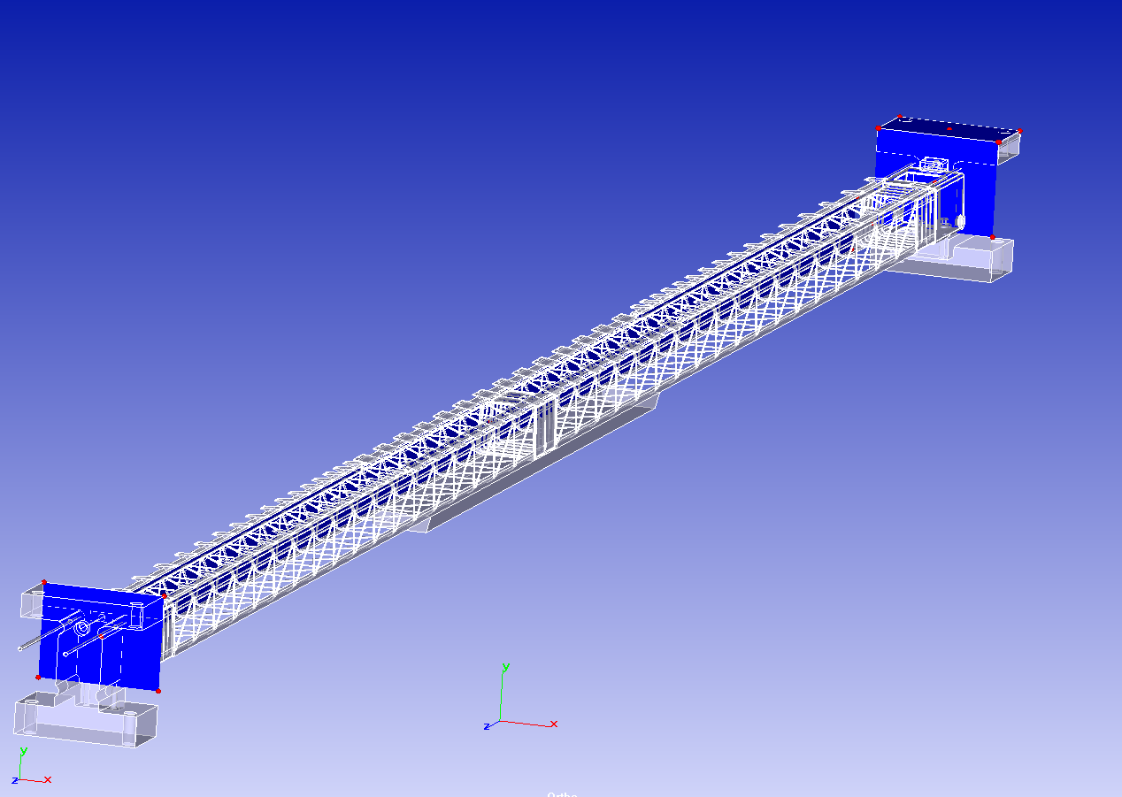
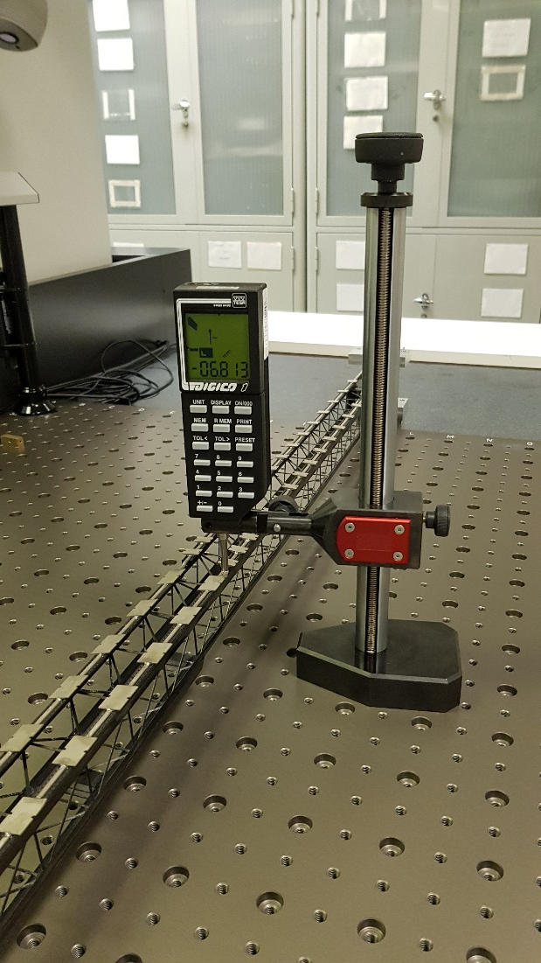
Functional longeron scanning
Aluminium blocks from jig: perfect positioning
Used as reference for alignment
X-check with mechanical sensing

Slide 27
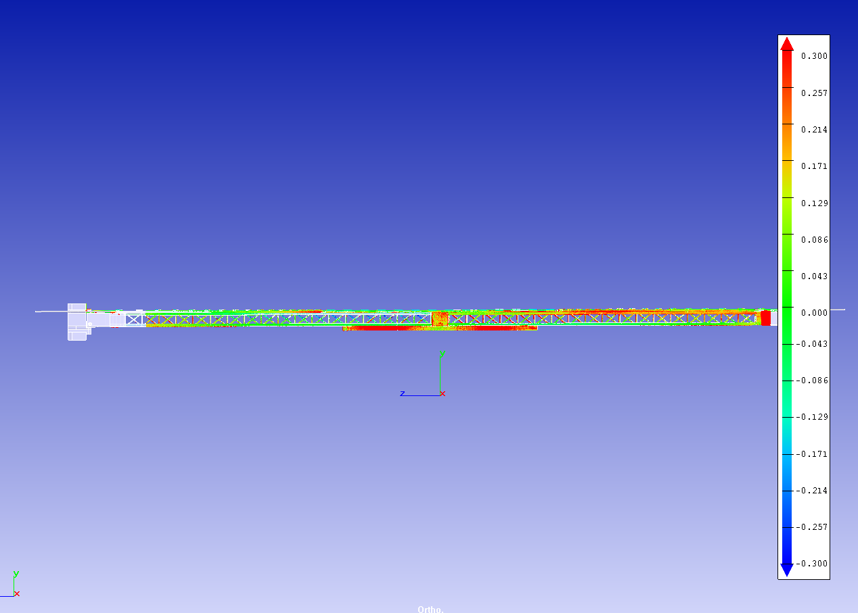
Bare functional longeron scanning
Side view
Reference surfaces

Slide 28
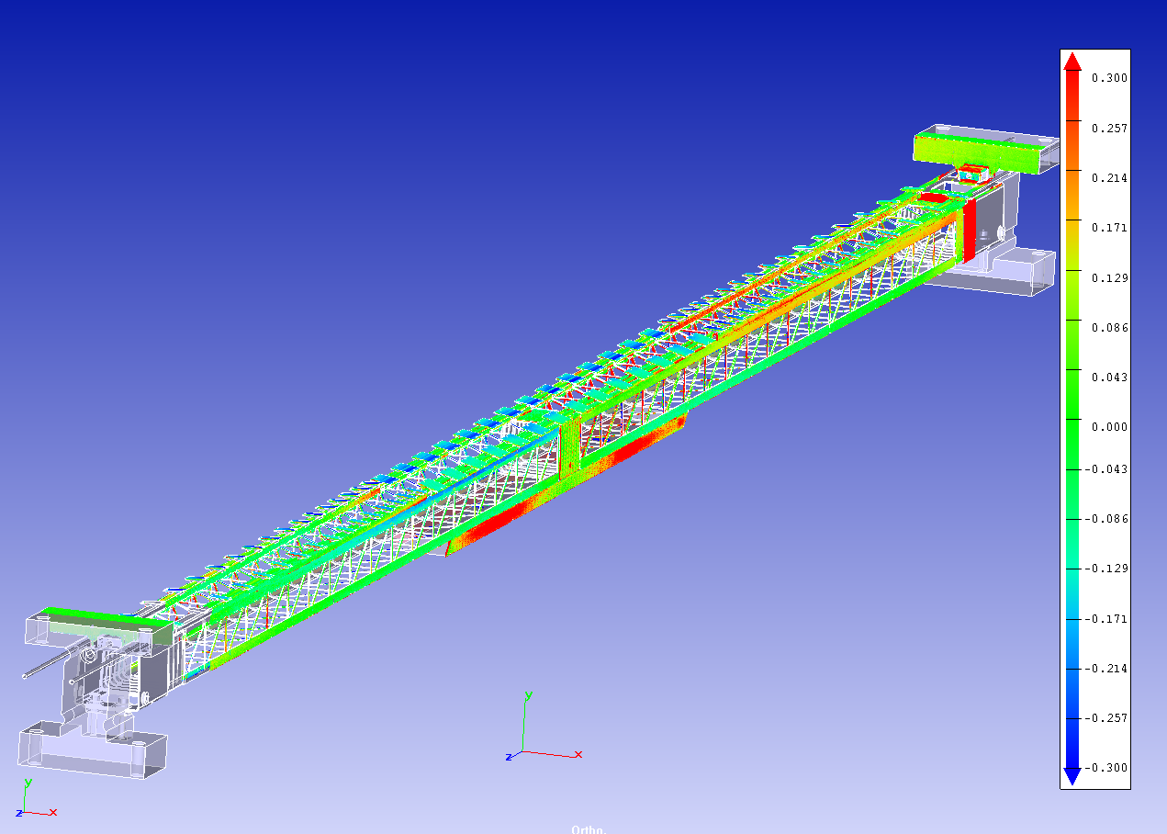
Bare functional longeron scanning
Reference surfaces perfectly aligned:
Nominal position (ref)
Nominal position (ref)

Slide 29
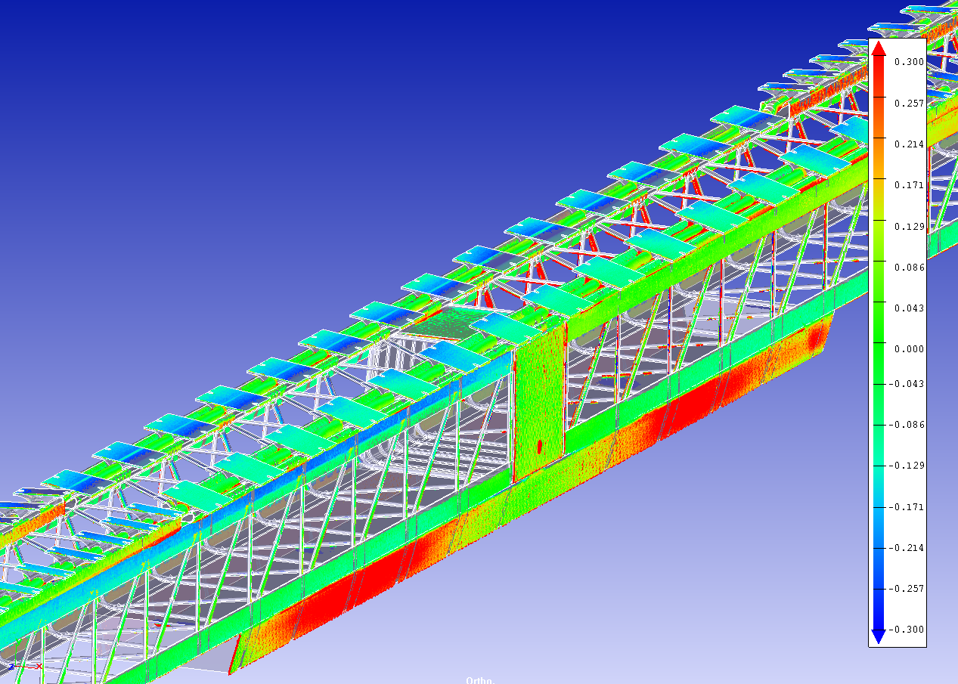
Bare functional longeron scanning
Barrel section
Twist X-
X+ very close to nominal
- 130 µm
Sandwich inflates
(machining for
bolted connection)

Slide 30
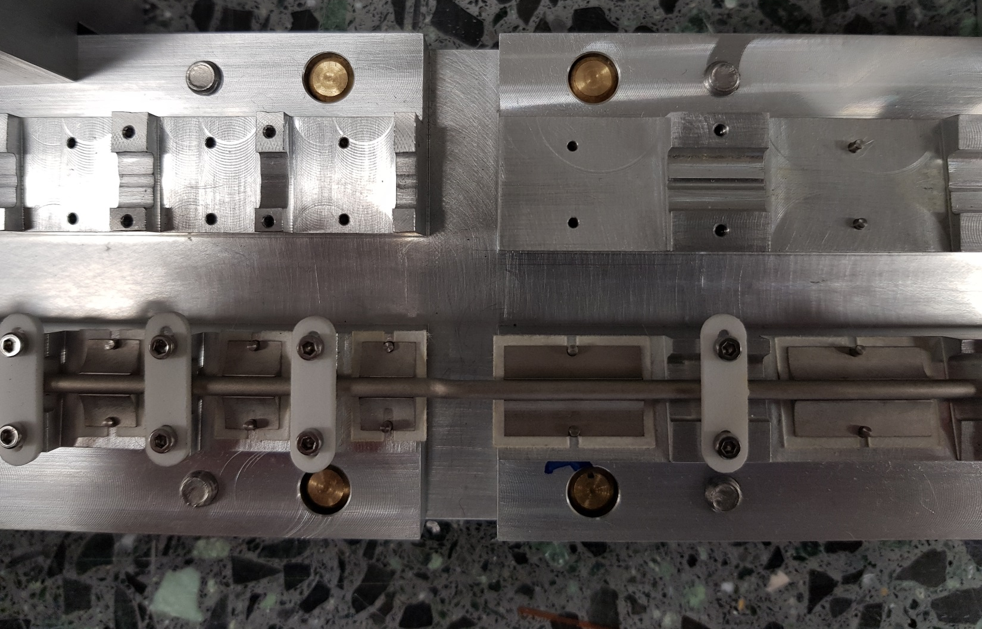
Final demonstrator: functional longeron
Soldering done with insulation foils
  Limit heat dissipation on tooling
  130 µm thick
  Not implemented in CAD tooling design

Slide 31
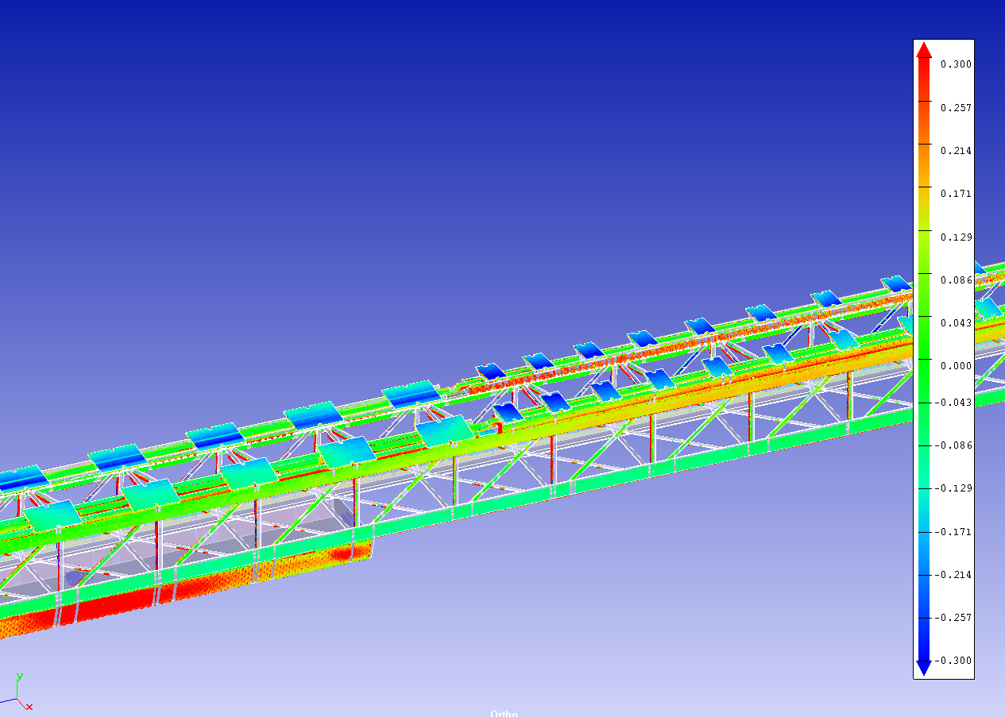
Bare functional longeron scanning
Barrel section
Twist X-

Slide 32
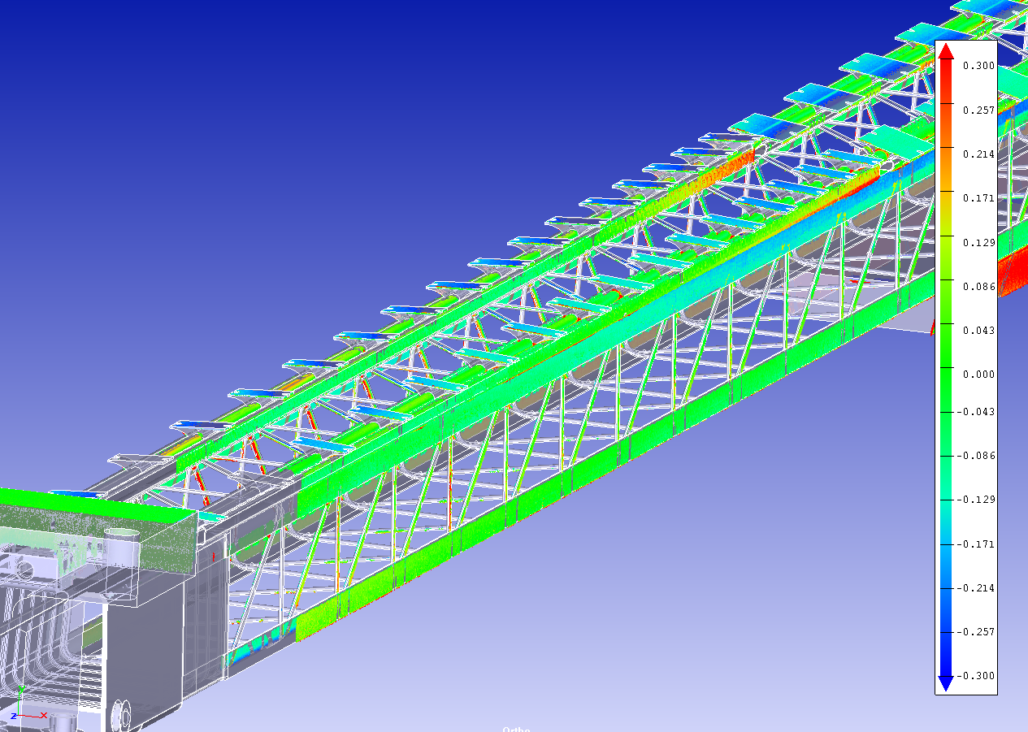
Bare functional longeron scanning
Inclined section

Slide 33
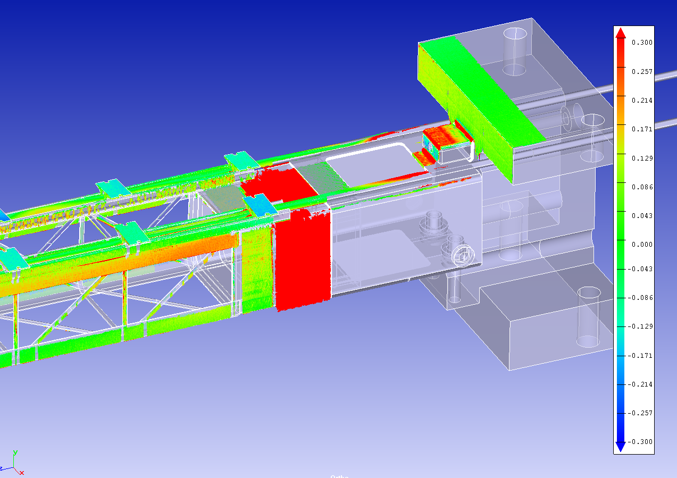
Bare functional longeron scanning
Barrel section
Reference surfaces
Inclination of top edge

Slide 34
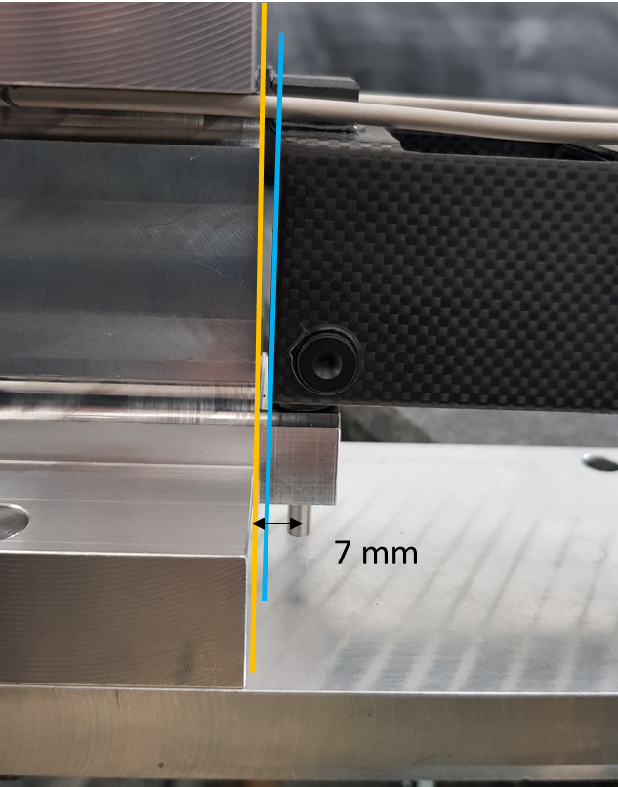
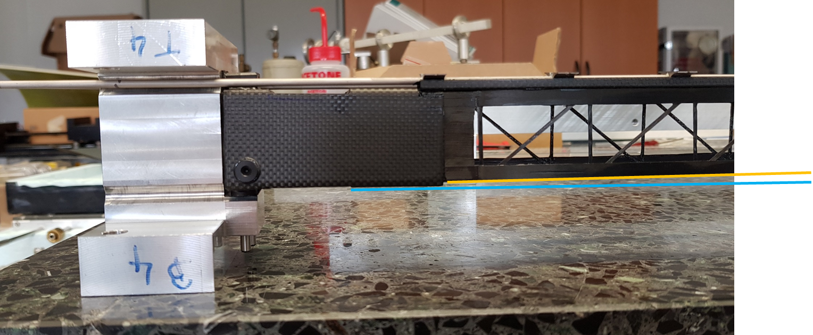
Functional longeron assembly
Optical control:
  We have seen after assembly that the end supports are not corretly positioned
  Discrepancy between assembly tool and bonding tool for inserts
    7mm nominal
    7.5 mm in bonding tool for inserts
→ Tilting of end supports wrt longeron

Slide 35
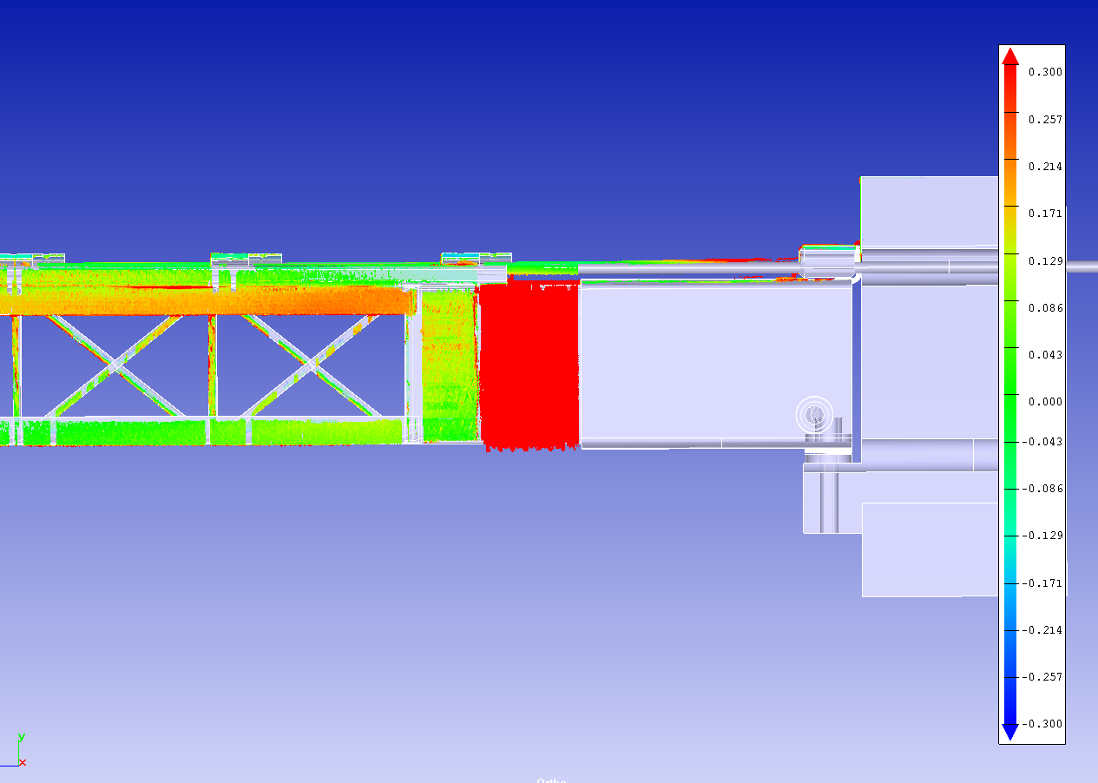
Bare functional longeron scanning
Barrel section
Reference surfaces

Slide 36
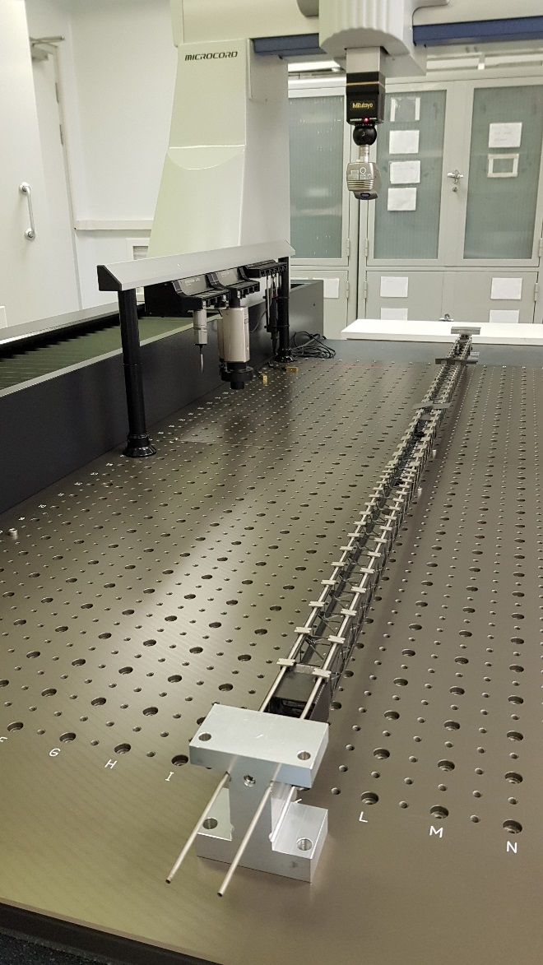
Functional integrated longeron scanning
Same bondary conditions
Bare barrel and inclined cells integrated
  2 barrel and 2 inclined on side A

Slide 37
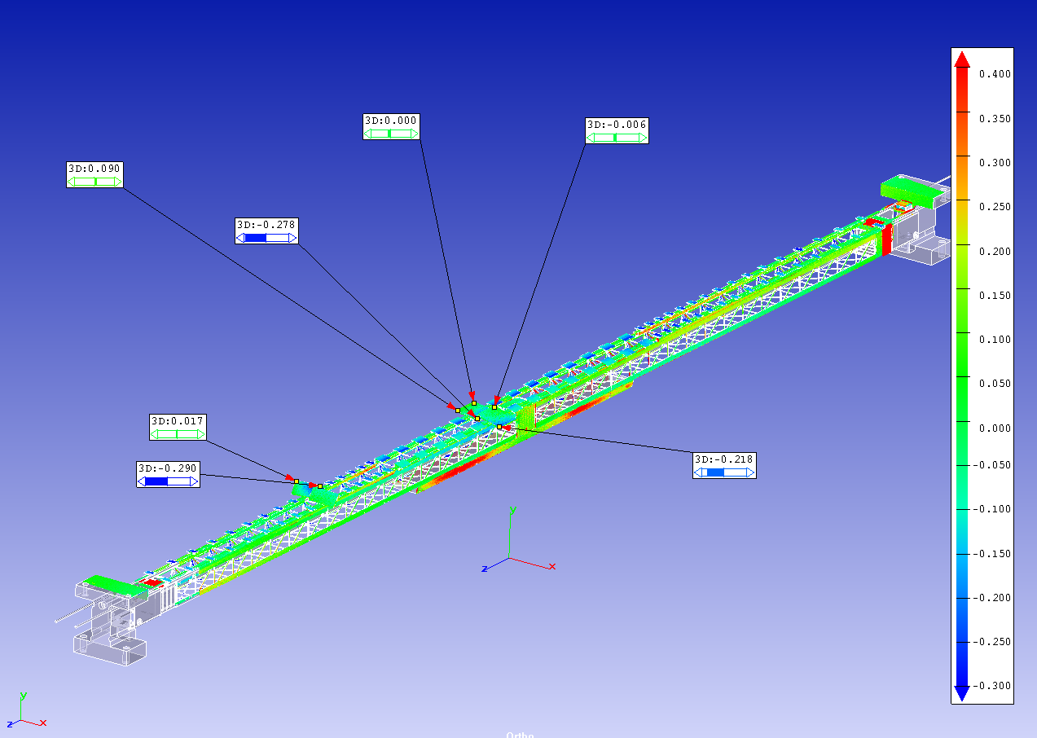
Bare functional longeron scanning
Create «flyouts» at critical locations
Reference surfaces

Slide 38
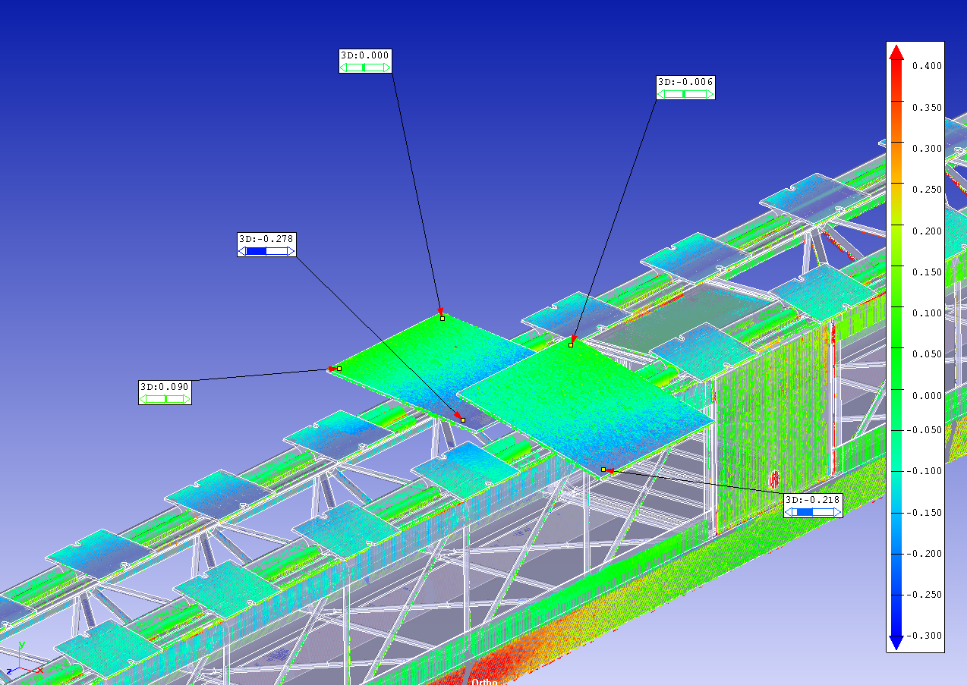
Bare functional longeron scanning
Barrel cells
  Expected tilting of cells
    1 screw per cell on outer side

Slide 39
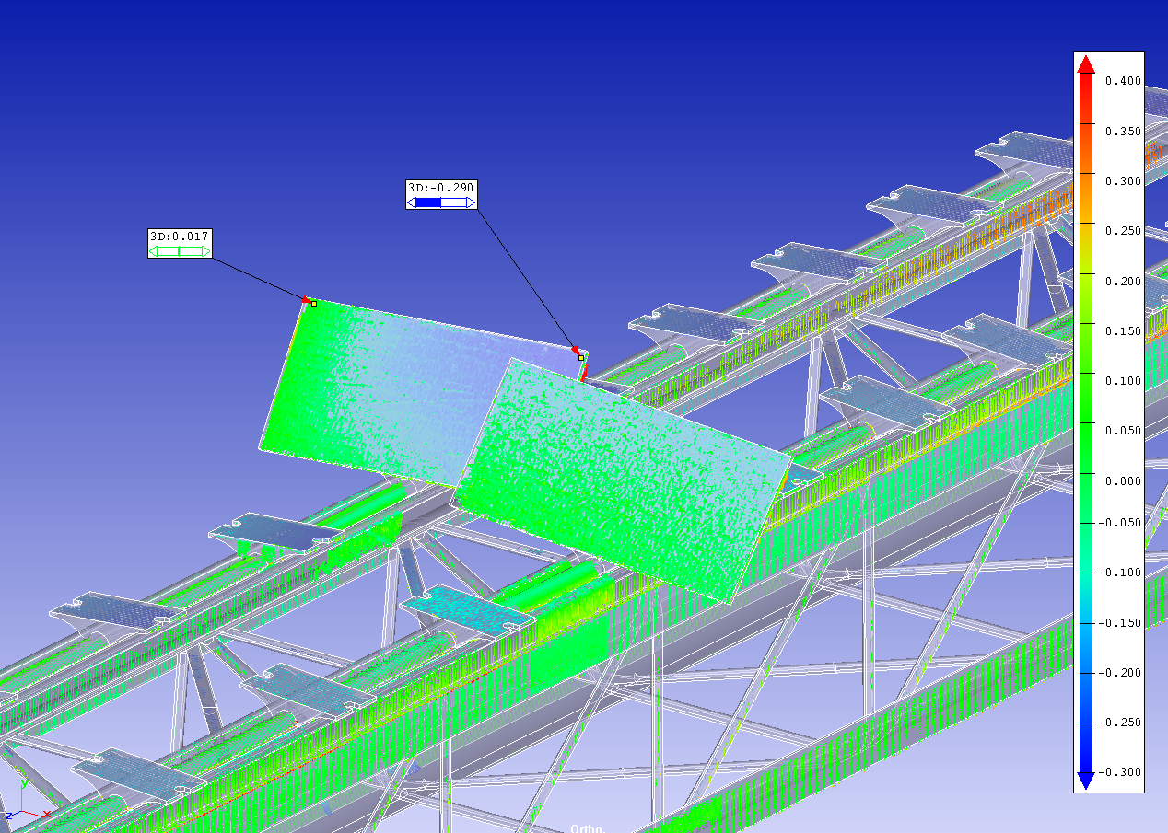
Bare functional longeron scanning
Inclined cells
  Tilting of the X- cell following base block
  X+ cell is ok

Slide 40
SUMMARY
Scanner precision is estimated to be ~ 40 µm for parts with emissivity equivalent to stainless steel (~ 0.3) up to emissivity of black paint (~0.9)
  Similar results observed on simple
  Precision good enough for local support qualification and control
OB local supports
  3d laser scanner tool is providing QC information we are needing.
    Control the correct assembly procedure or tool
      Scan of tool to be performed
    Qualify envelopes
      Functional local supports
      Integrated local supports

Slide 41
SUMMARY
But solid references surfaces are mandatory to have useful outputs from the scan
→ Reference jig mandatory for scan of functional local support
  Perfect support conditions as in the detector.
  Optimal emissivity if possible
    Prototyping material
  Mechanical metrology of jig reference surfaces
    Input for CAD model
Metrology of bare functional local support on its HF is not mandatory

Slide 42
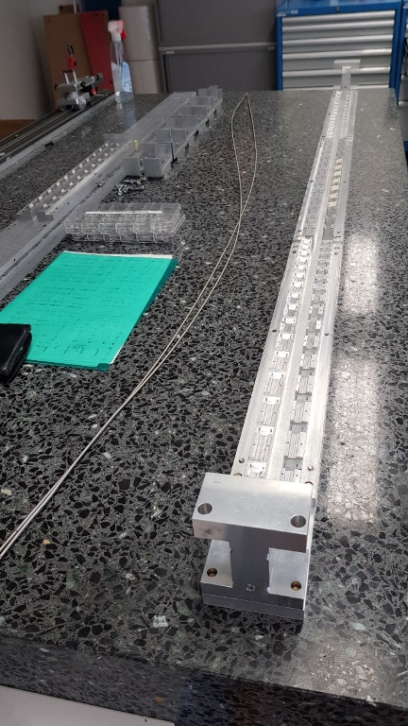
SUMMARY
Current assembly precision of LS not satisfactory
  Metrology of the various parts before starting assembly
    Identify non conformity
  Nominal thickness of the Nomex sheets will be implemented in the tool design: base block in nominally position
  Clamping of block is mandatory
    Pipes are deformed after coating
    Shoulder screws

Slide 43
SUMMARY
Scan of integrated local support extremely important
  Envelope qualification
  Wich reference surfaces could we use ?
    Reference Jig ?
      Transfer of loaded LS on jig risky
    HF precise enough ?

Slide 44
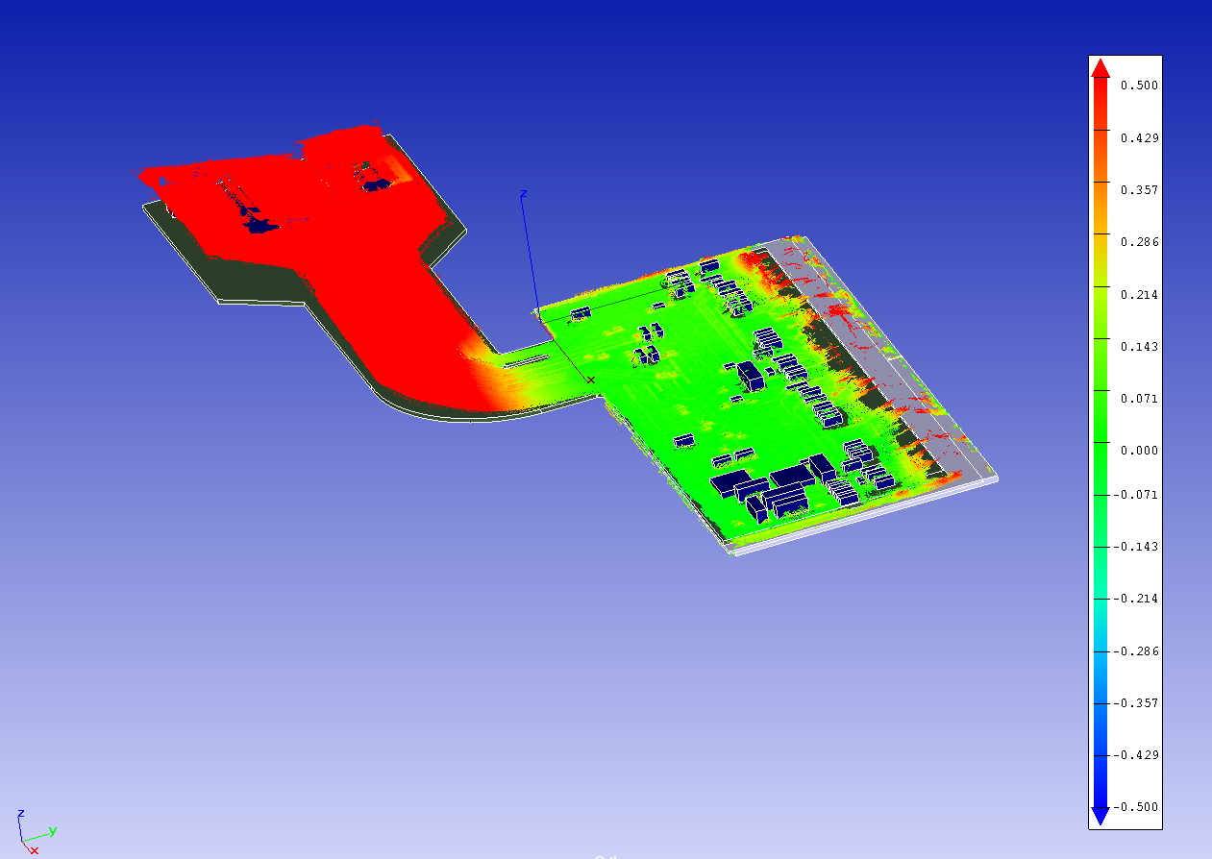

TO BE TESTED
Control of loaded local supports envelopes with module assembly
  More difficult than bare cells
With services
  Big variations expected with respect to nominal CAD model

