Slide 1
Welcome
Giovanni LAMANNA
18 july 2019

Slide 2
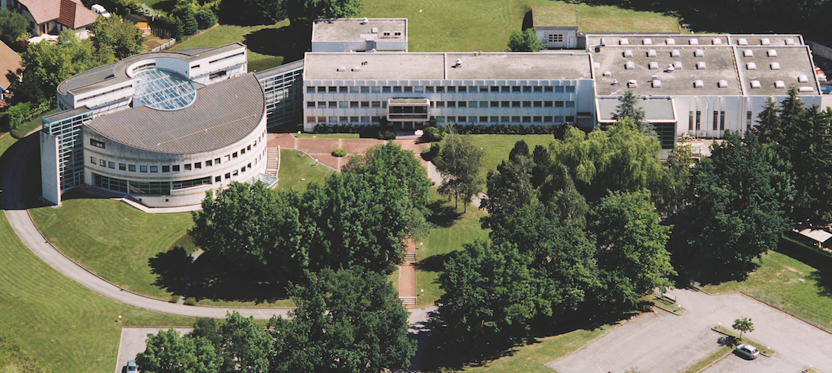
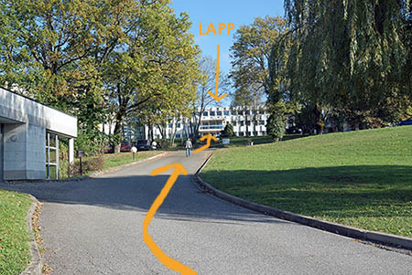
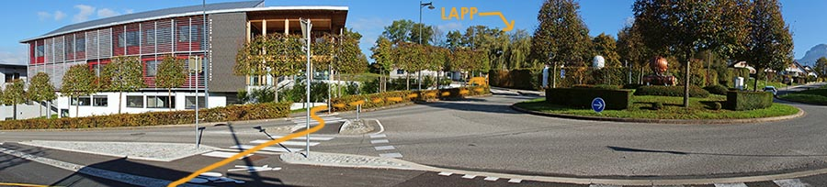
Fundamental research in Annecy
Created in 1976, LAPP is a laboratory of the CNRS National Institute for Nuclear and Particle Physics (IN2P3).
Particle and Astroparticle physics.
Combination of the experimental investigations of the two infinites, from the largest-scale structures in the observable Universe to the most fundamental particles
LAPP, 18/07/2019
G. Lamanna
2

Slide 3
Fundamental research in Annecy
LAPP was born 43 years ago by the wish of CNRS scientists to have a French laboratory close to CERN.
Today more than 150 researchers, engineers, technicians, administrative personnel, students..
Frontier technologies in different fields:
  mechanics,
  electronics,
  mechatronics,
  computer science,
  scientific and control software and e-infrastructures.
LAPP hosts a Theory Laboratory (LAPTh) within its premises.
LAPP, 18/07/2019
G. Lamanna
3

Slide 4
Fundamental research in Annecy
During the past 43 years we contributed to some of the most striking global results in Particle and Astroparticle Physics.
The researches conducted at LAPP participates in or are associated with major discoveries and are also awarded with Nobel Prizes in Physics.
Important discoveries:
  Z and W bosons (1983)
  Higgs boson (2012)
  Neutrinos oscillation
  Gravitational waves (2015)
It is within international collaborations, gathering thousands of researchers, that LAPP pursues its experimental programme.
LAPP has an international reputation and a recognised engagement in the next generation facilities prioritised in the European Strategy Forum on Research Infrastructures (ESFRI) roadmap and in other world-class projects.
LAPP, 18/07/2019
G. Lamanna
4

Slide 5
Particle physics
ATLAS
LHCb
Neutrinos
At LHC, CERN
At LHC, CERN
Matter-antimatter asymmetry
Neutrino properties: oscillation, 4th family, matter-antimatter asymmetry
Search for new physics
Higgs boson discovery, 2012
STEREO, SuperNEMO and WA105/DUNE
Search for new physics
One of the major French contributions in ATLAS
Long-term involvement In ν-physics
Important involvement in the upgrading for the HL-LHC
LAPP, 18/07/2019
G. Lamanna
5

Slide 6
Astroparticle physics and Cosmology
AMS
HESS & CTA
Virgo
Search for dark matter and antimatter in the Universe
Search for dark-matter
Gravitational waves detection
LSST
On the ISS
Telescopes in Namibia, Chile and La Palma
Study of high energy cosmic rays sources
Interferometer installed in Pisa, Italy.
General relativity, gravitational astronomy
Chile.
Dark matter and dark energy studies
Particle physics in Space
27 years involvement. Pioneer and a reference leading role in Virgo.
A key role in CTA and the largest CNRS-IN2P3 contribution
LAPP, 18/07/2019
G. Lamanna
6

Slide 7

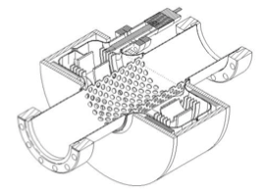
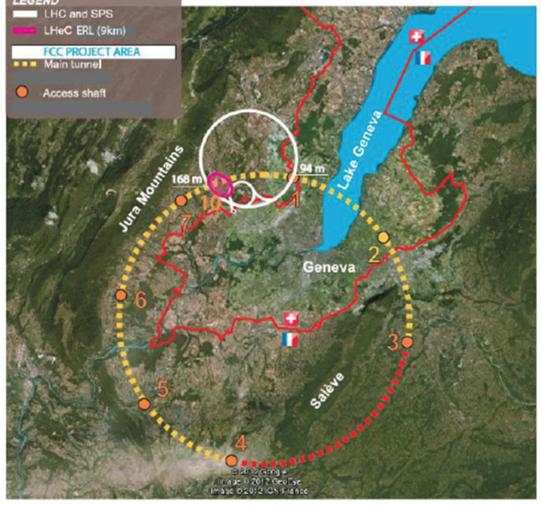
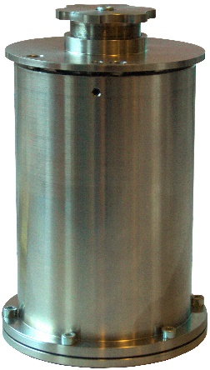

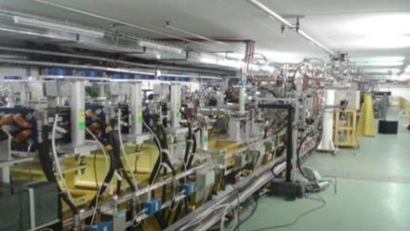
Future colliders
Post-LHC colliders R&D at CERN
Would be deployed in the Haute Savoie region and bringing the CERN experiments close to the LAPP site.

Slide 8

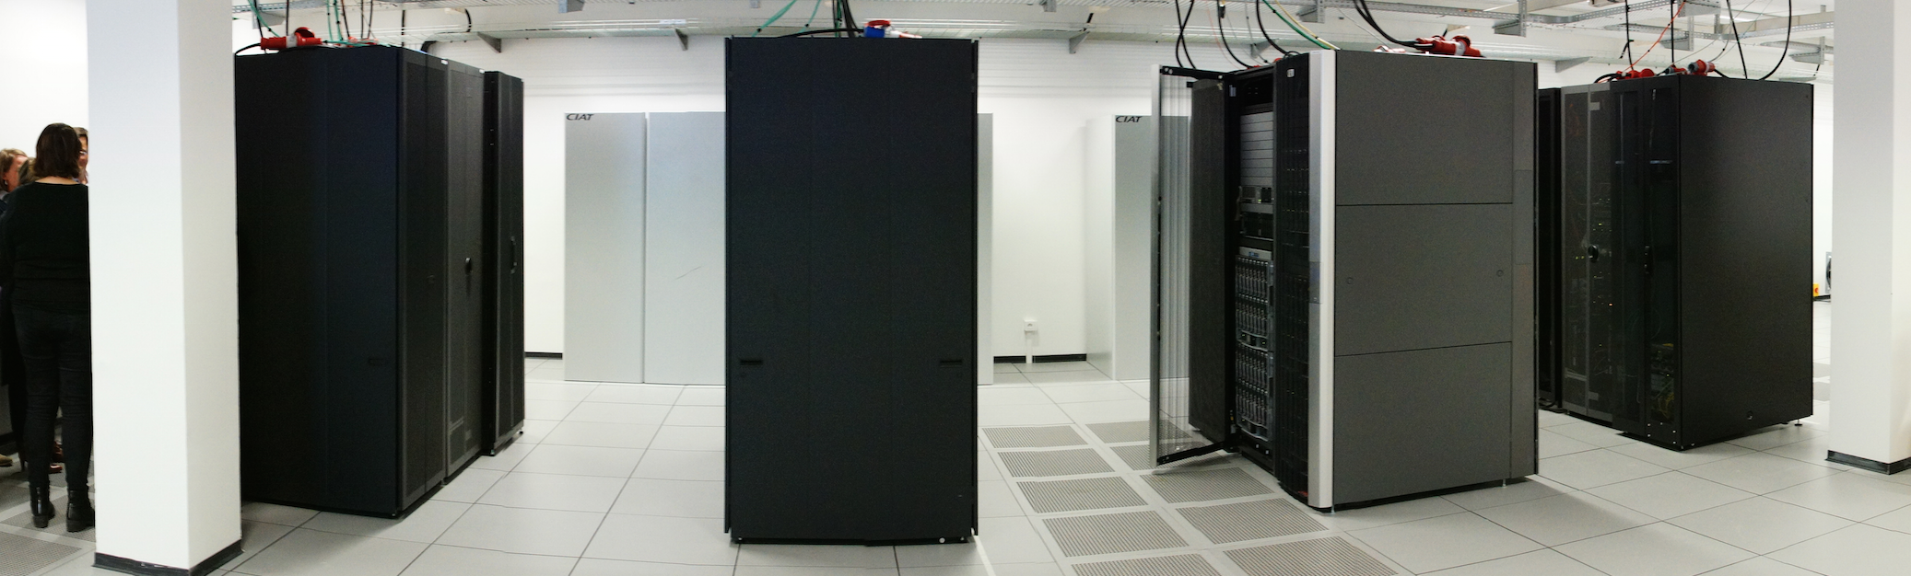
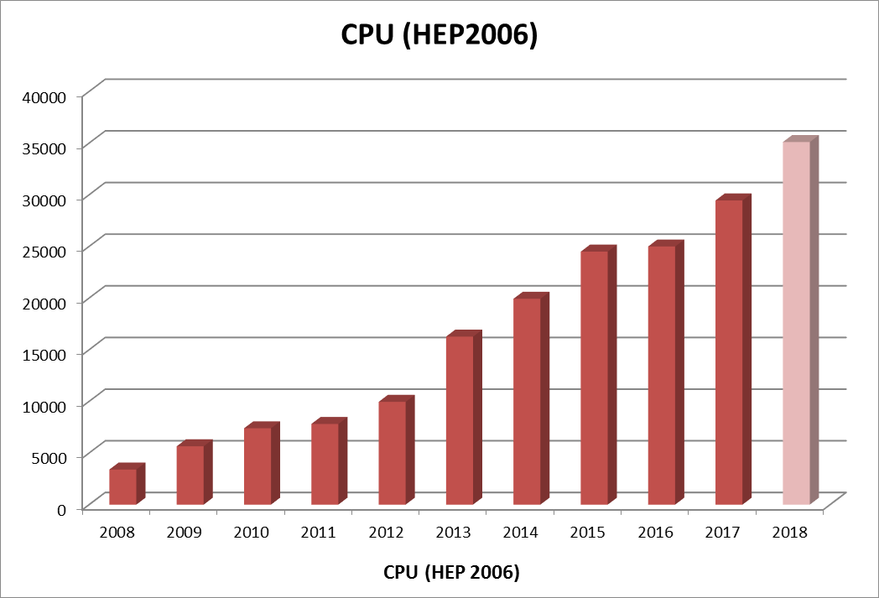
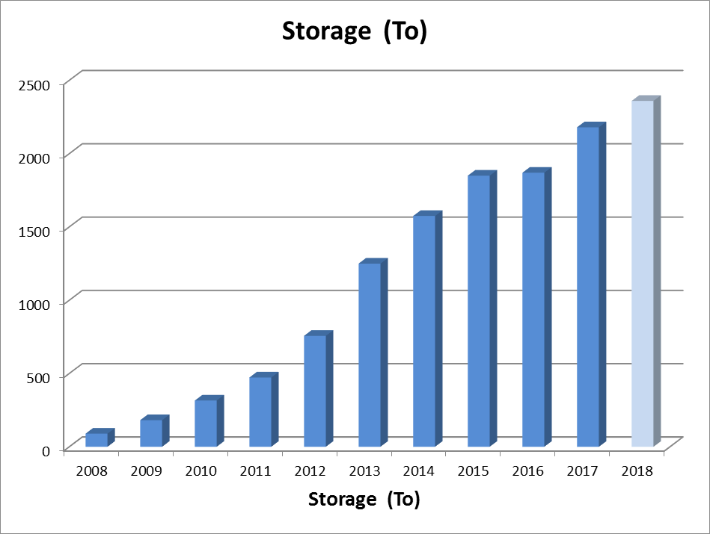
Computing and data science
LAPP hosts the MUST multidisciplinary Data and Computing Centre
(WLCG Tier2/ ATLAS Nucleus, CTACG and various projects).
In 2018:
3600 cores
2.3 PB
Sustainable Data Centre
with continuous growing capacities
LAPP, 18/07/2019
G. Lamanna
8

