Slide 1
SVOM Burst Advocate System How to start? Lessons from GWAC system
Yang Xu, Liping Xin, Xuhui Han and Jianyan Wei
On behalf of SVOM-GWAC team
2019.10.16 Nanning, SVOM science meeting

Slide 2
Motivation
SVOM will be launched at 2021-2022
The development of BA tools will be started soon.
A lot of ideas of this system have been obtained thanks for the efforts by all SVOM teams, including the tools developed for the GWAC-O3 by Damien et al.,
GWAC as a part of SVOM mission, has a very similar purpose to search for short-duration transients.
There are also duty scientists whose job is very similar with the tasks of SVOM BA, including validation, follow-up, alert message, GCN et al.,
Feedback from GWAC sysyem

Slide 3
Data challenges of GWAC BA System
2015.10~2018.5 Mini-GWAC
First Original System: 2013.12
Original Fits Image: 6.2 millions
Optical Transient Candidates(not filtered): 640 thousands
Manually Triggered (F60A/B) Follow-up Observation: 8312
Identified Flares: 25
2017.11~Now GWAC
Original Fits Image: 9.5 millions (about 166TB compressed data)
Optical Transient Candidates(not filtered): 3.9 millions
Automatically Triggered (F60A/B) Follow-up Observation: 22 thousands
Identified Flares: 103 (2018.10~2019.03: 83)

Slide 4
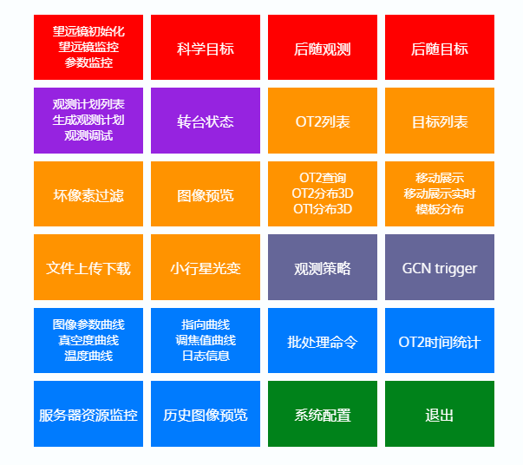
Login and Index Page of GWAC BA System
Meet most of requirements of GWAC BA and IS/IE
User management
Optical transient candidates list
Follow-up observation schedule
Page of real OTs
Achieved data query
System HK monitors: hardware, and software.
….
Key philosophy is stable and efficiency

Slide 5
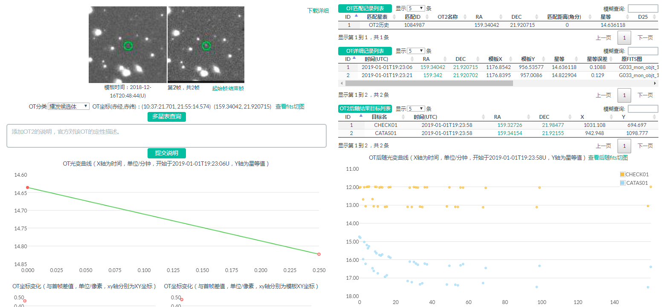
To validate one optical transient candidate
Catalog match result
Images
Detail information from GWAC
Classification
Astronomical DB
Detail information from FU
Comment zoo
Light curve of GWAC
Light curve of F60/F30

Slide 6
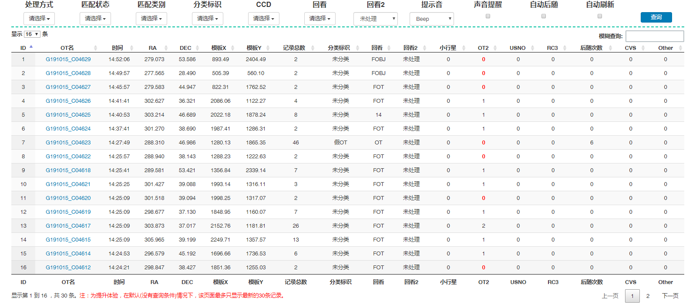
Page of OT in Real-Time for validation by BA
Voice Auto FU Alert

Slide 7
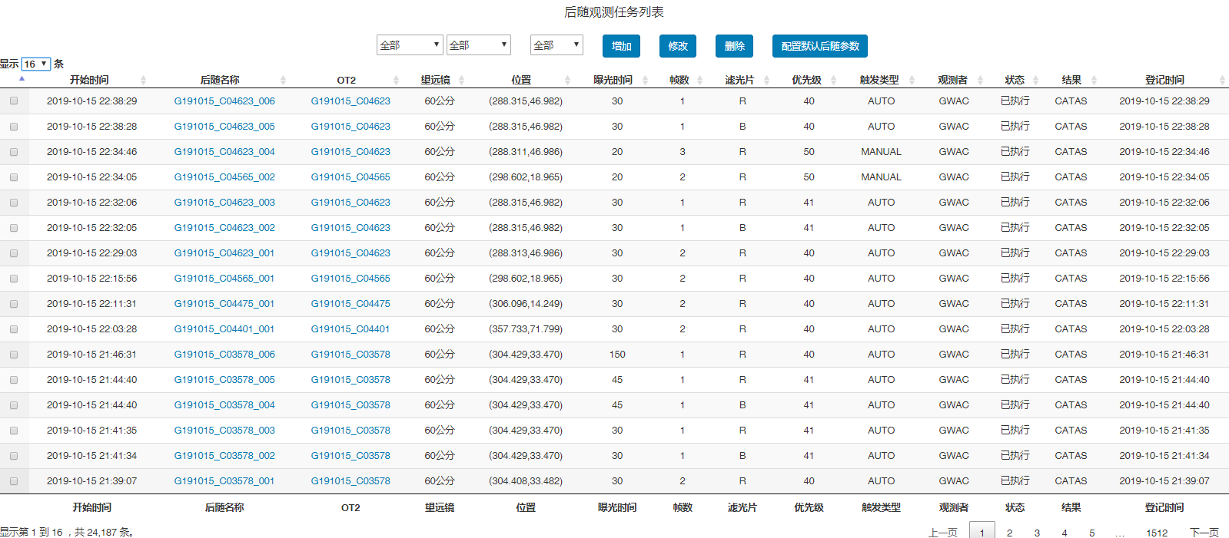
Page of Follow-up observation schedule

Slide 8
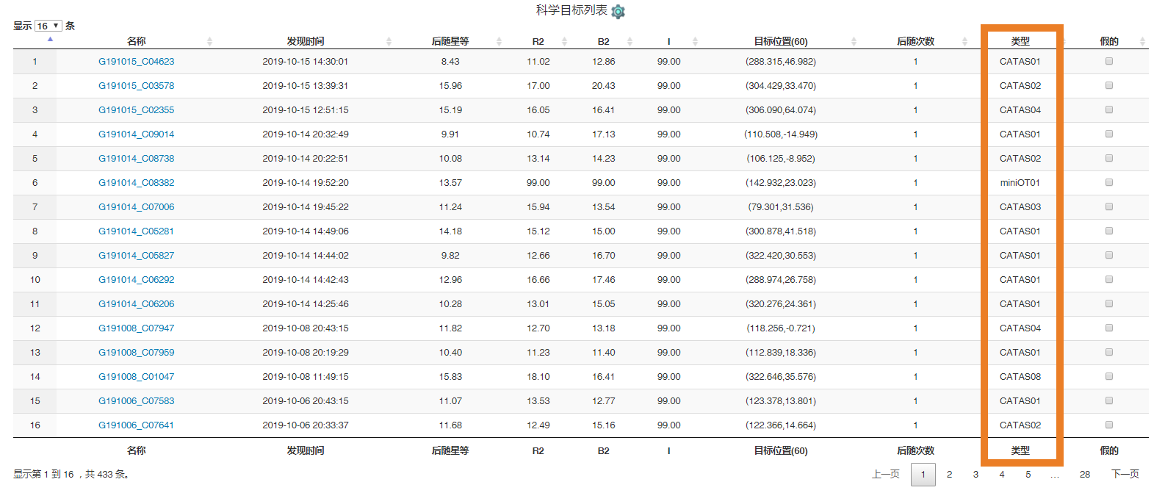
Page of Candidates after Auto Follow-up
An automatically Identification Result

Slide 9
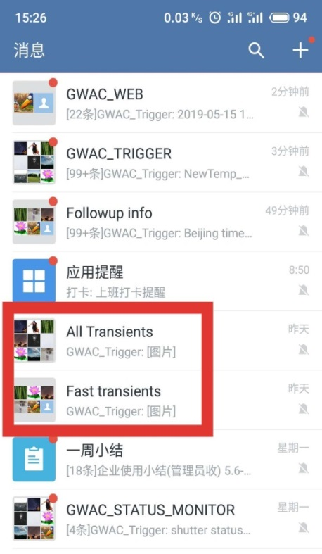
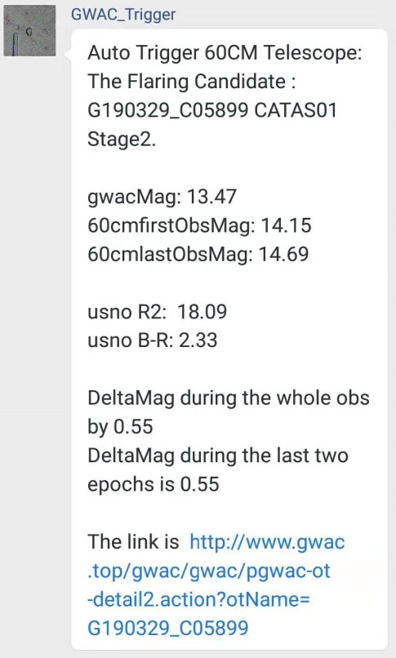
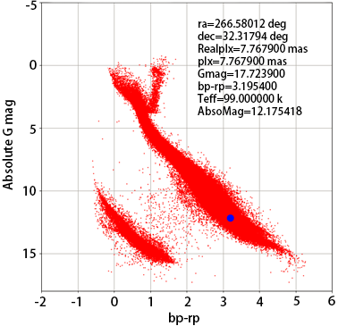
Alert message for BA with Wechat with some key scientific results

Slide 10
Page of validated OTs
Name, Detection time, Coordinates, Magnitude, BA name, Instruments. Comments

Slide 11
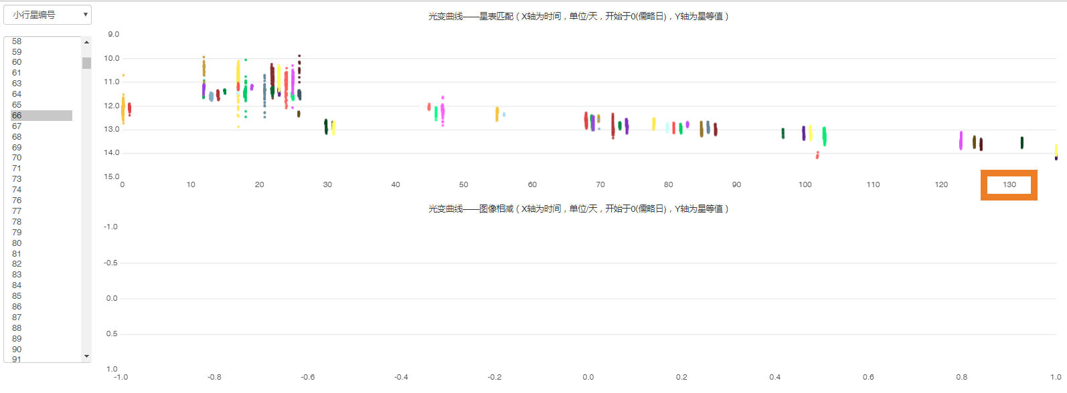
Long term light curves for OTs.
total 130 Days
One example of a minor planet #66

Slide 12
More tools is coming
Followup schedule tools: F60A/B and F30 for all kinds of triggers inner or external GWACs, second version upgrade by Xuhui Han et al.,
Archival data search tools: get stamp or full image by coordinate and time, the history image coordinate index has already been created, waiting the web UI.
Image difference pipeline with machine learning: second version upgrade for combined image
…..

Slide 13
A brief summary of tools and functions for GWAC BA system
Could meet most of the requirements of GWAC-BA for their intense works
User management
Big data processing in real time
OT validations
Follow-up coordinate
Archival data management
HK monitor for the whole system
Alert message
…...

Slide 14
More words to say
Not only for CP, there are a lot of data (>100 produces for CP + HK + ToO-MM + info from follow-ups.)
How to picked up a few of these data for BA, which are more helpful to make a fast validation？
otherwise big data means big overload, efficiency of the whole validation would be degraded.
One stable, friendly, effective system is very essential

