Slide 1
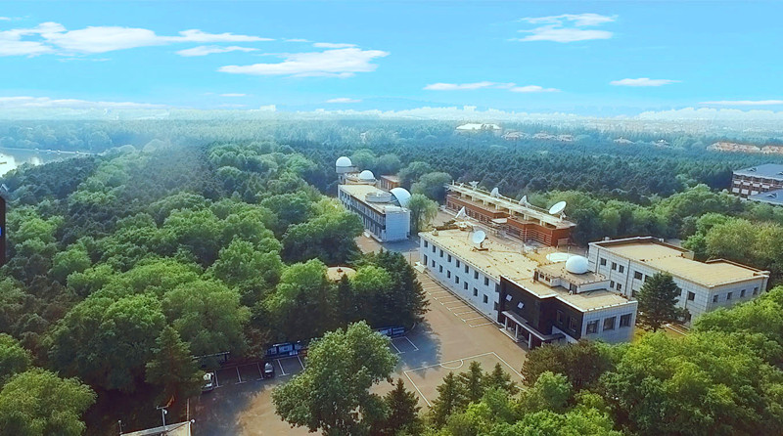
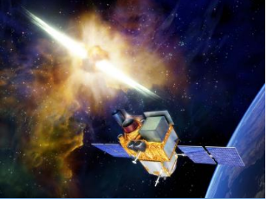
The Ground Follow-up Telescope of SVOM
at Changchun Observatory
Linchu Han on behalf of
Changchun Observatory, NAO, CAS

Slide 2
1. Introduction
2. The GFT at Changchun
3. 3-Channel CCD Photometer

Slide 3
1. Introduction

Slide 4
Main characteristics of CGFT
(From requirements)
Parameter | Value
Energy range | 400-950 nm
Field of View | 21’ x 21’
Aperture(diameter) | 1 m
Channels | 3 channels of g,r,i
Detector | 3 CCD camera mounted
Sensitivity (AB mag, 5 sigma) | Mag(r) = 19 @100s (new Moon)
Localization accuracy | 0.5 arcsec
Observation rate | >20% burst triggered by ECLAIRs

Slide 5
Sites @map:
Jilin obs.
xinglong
Beijing
Jilin
Longitude: 126d 19m 49.66s
Latitude. : 43d 49m 27.76s
Altitude. : 320 m

Slide 6
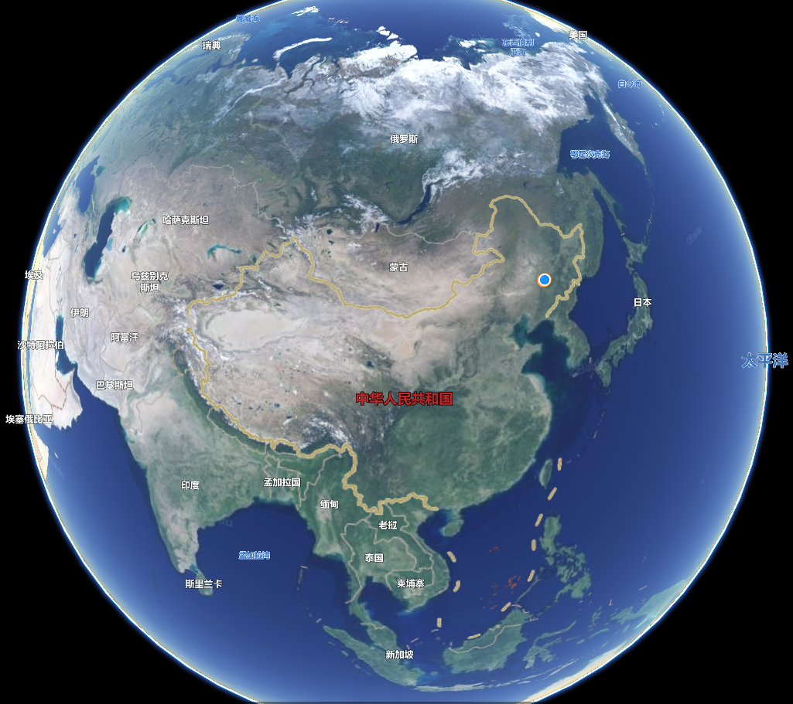
1.1 About the Changchun Observatory
5. Keerqin station
3. Fuyuan station
Heilongjiang
Jilin
6. San Jun
（Argentina）
Changchun
Inner Mongolia
Liaoning
4. Changling station
2. Jilin Observatory

Slide 7
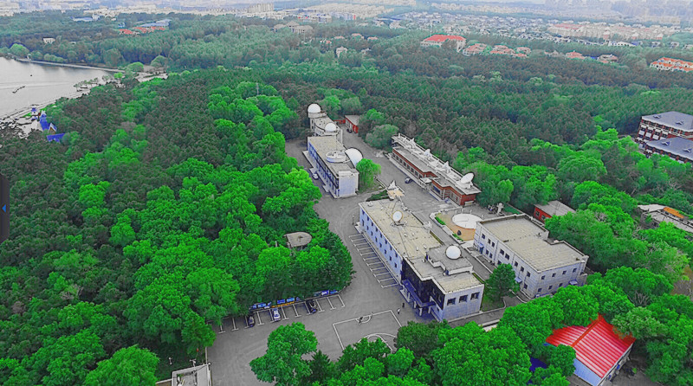
The Aerial view of Changchun Observatory

Slide 8
1.2 The Jilin Station
Jilin station is one of most primary observing station of Changchun Observatory. The average altitude of the Jilin Observatory is about 313 m. The Jilin Observatory is located at Jilin city, Jilin Province, which lies about 120 km (about 2 hours’ drive) to the Changchun Observatory. The mean seeing value of the Jilin Observatory are 1.2′′. On average, there are 240 observable nights per year based on the data of 2015-2018 year. The sky brightness is about 21.1 mag in V band at the zenith.
Longitude: 126°20′16′′ E
Latitude: 43°49′56′′ N,
Altitude: 313 Meter
Night Sky: 21 Magnitude
Planning Diagram of Jilin Station

Slide 9
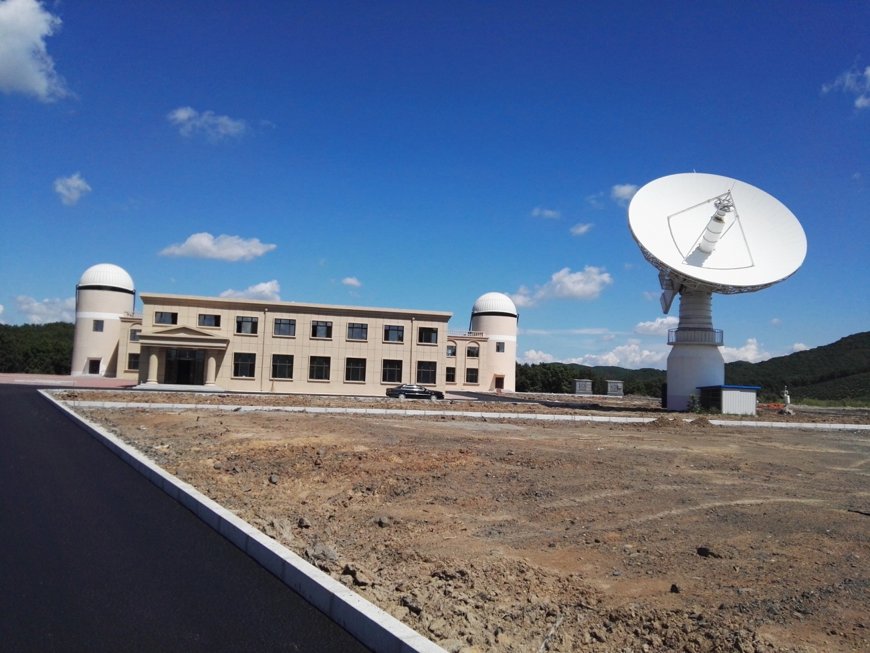
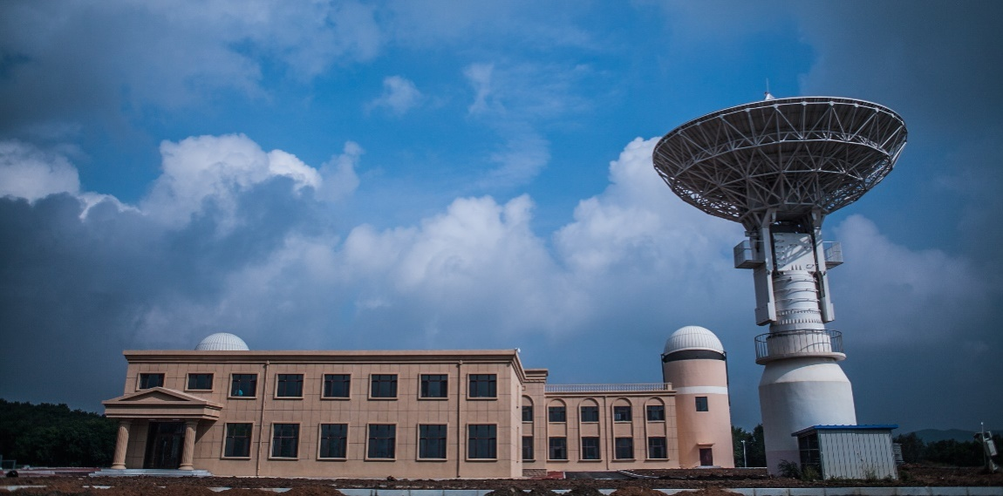
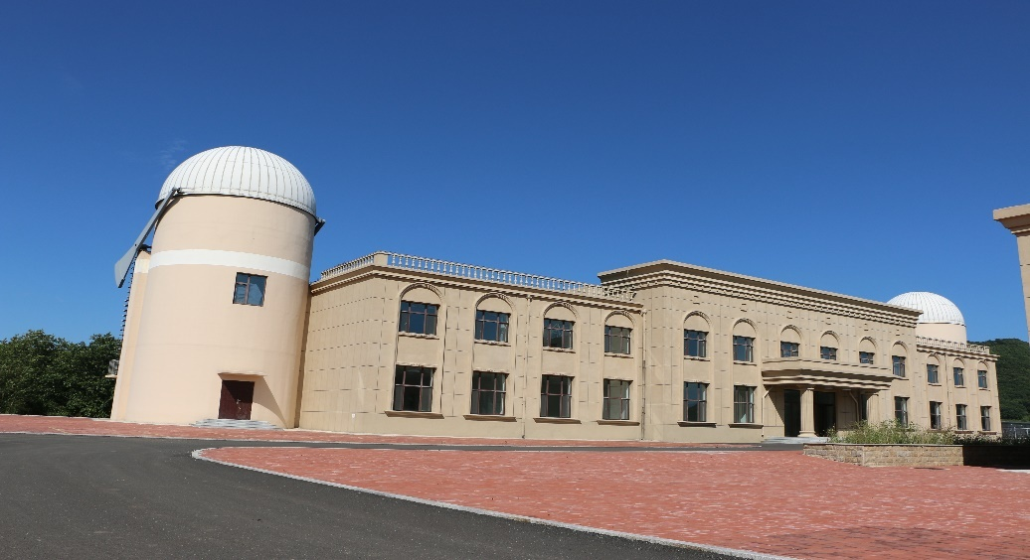
1.3 The Photography of Jilin Station

Slide 10
2. The GFT at Changchun Observatory

Slide 11
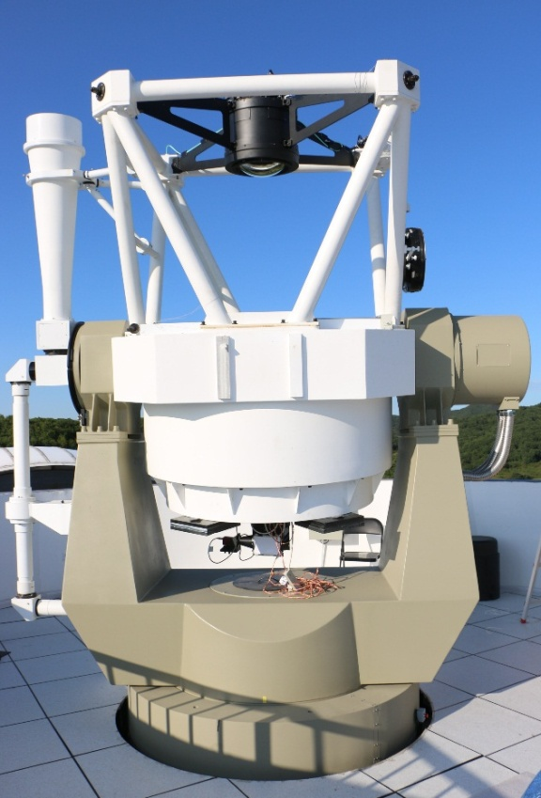
2.1 The Parameters of 1.2 meter telescope
Switching Mechanism
Telescope aperture 1198 mm
Prime focus
Focal length 2198 mm
FOV 1.5° × 1.5°
Optical efficiency 74%
CCD 4k×4k
Pixel 15μm
Cassegrain focus
Focal length 9195 mm
FOV 11′ × 11′
Optical efficiency 84%
CCD 2k×2k
Pixel 13.5μm
Tracking vel.
Azimuth Vel. ≥ 6°/ s
Pitch Vel. ≥ 2°/ s
Acc. ≥ 1°/ s²
Tracking precision
Star 0.2″/10s
space debris 5″
Pointing accuracy 2.4 ″
Axis range
Azimuth ±270°
Pitch 0−95°

Slide 12
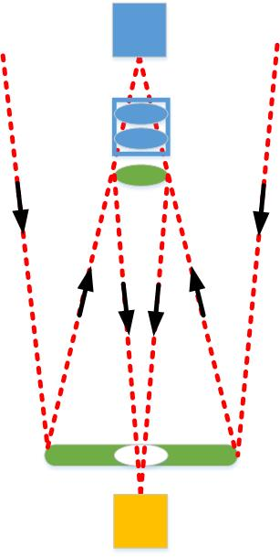
Prime focus
Lens
Switching
mechanism
Secondary mirror
Primary mirror
Cassegrain focus

Slide 13
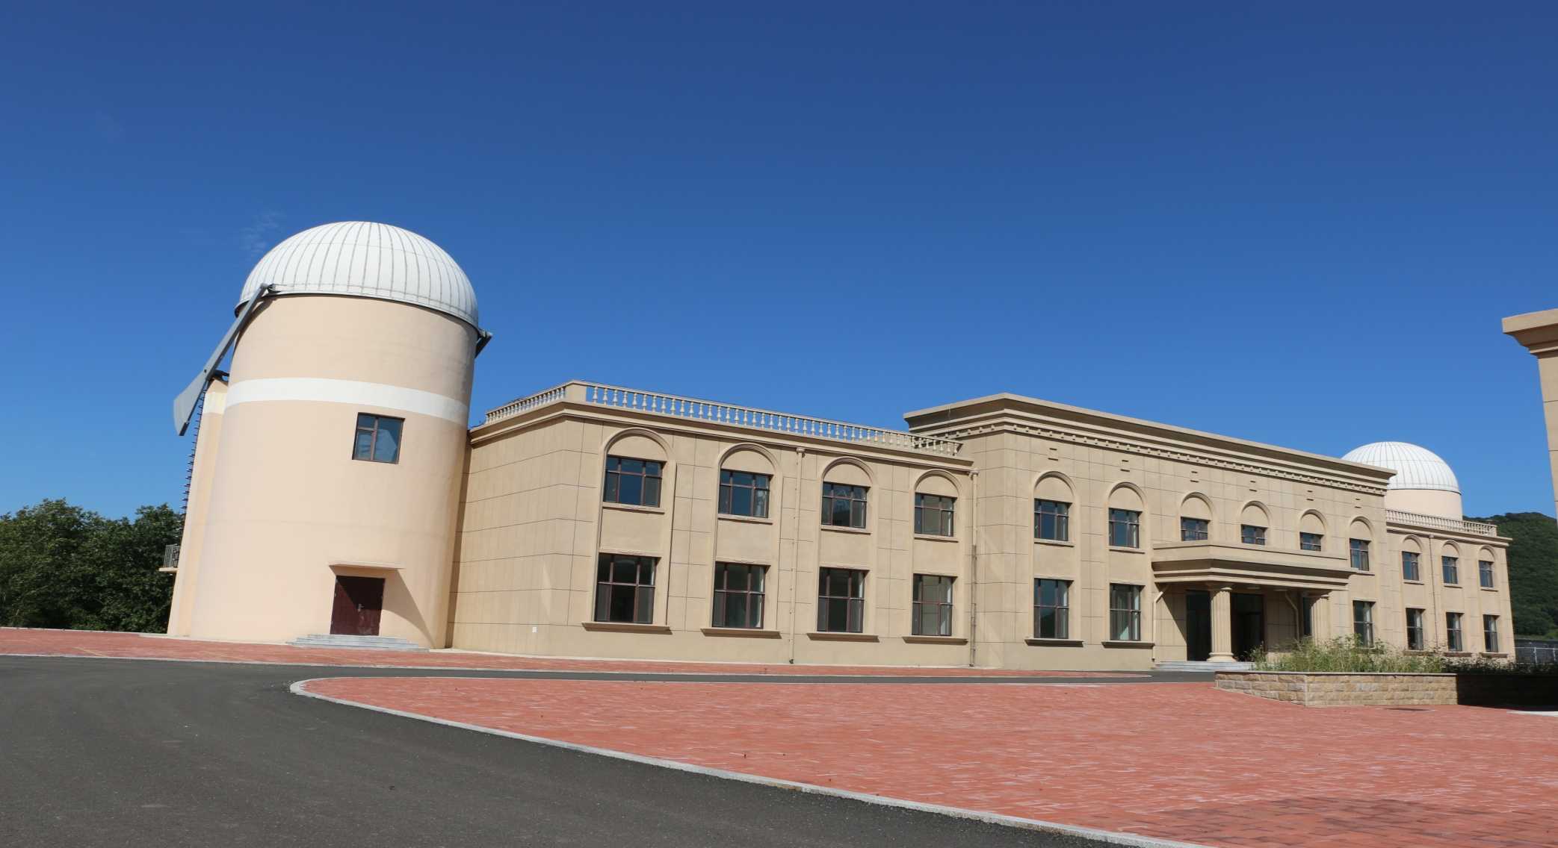
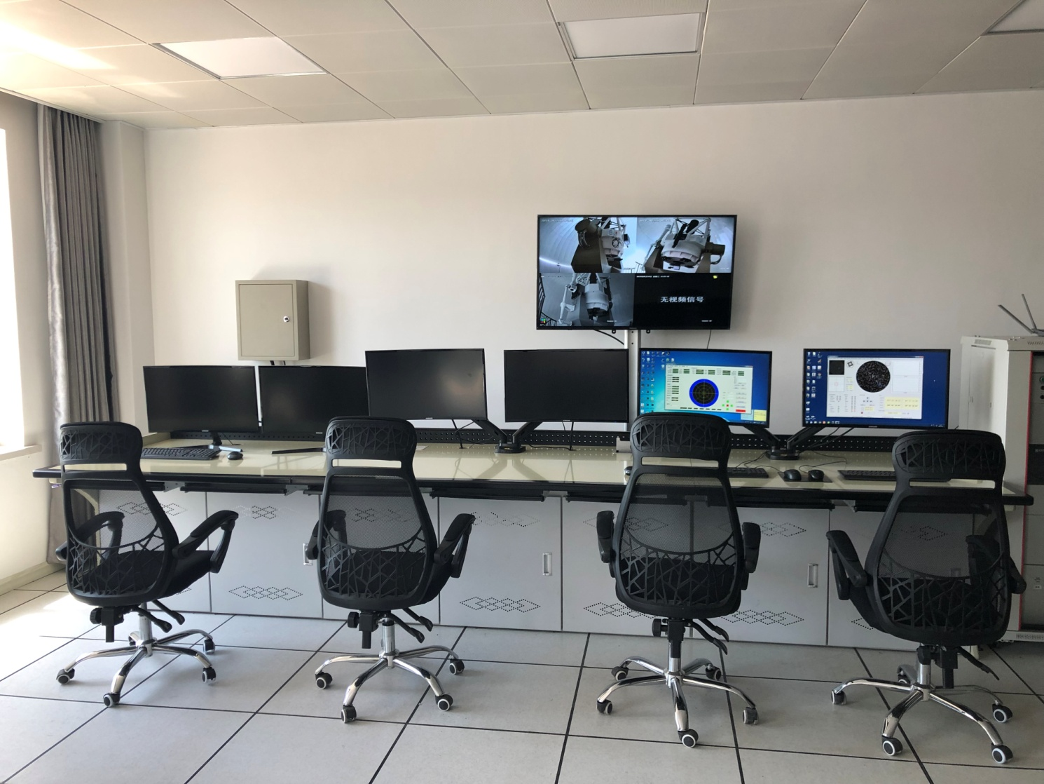
Central control room
Monitor
1.2 m Telescope system
Control System

Slide 14
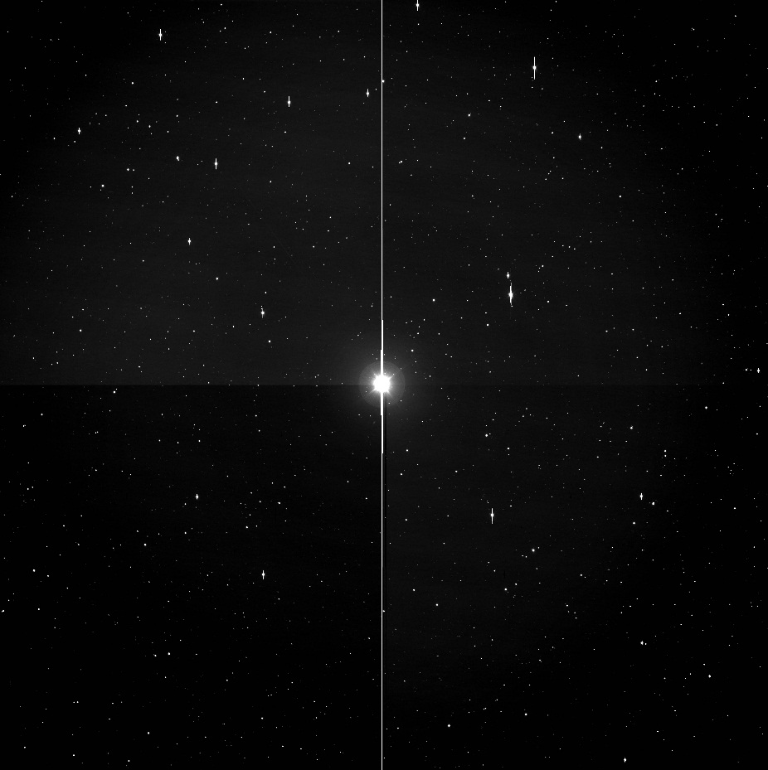
2.2 The Images of 1.2 meter telescope
(First light @ 2017.07)
A. Image by Cassegrain focus
B. Image by Prime focus

Slide 15
3. 3-Channel CCD Photometer

Slide 16
3.1 The 3-Channel CCD Photometer
3-Channel Photometer
Scientific CCD Cameras
Filters
Control system
In addition, we have constructed a 3-channel CCD photometer, it can obtain photometric data simultaneously in three visible bands which is attached to the Ritchey-Chretien focus of 1.2 meter telescope. It has four parts, the photometer, filters, scientific CCD cameras and control system.

Slide 17
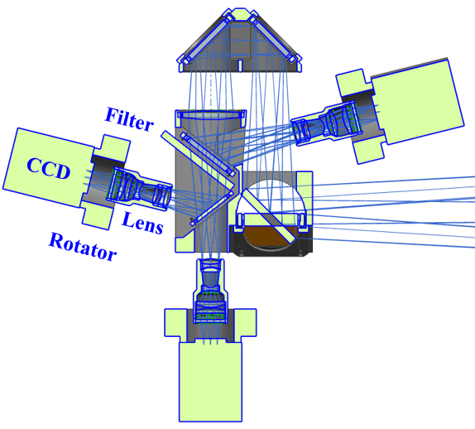
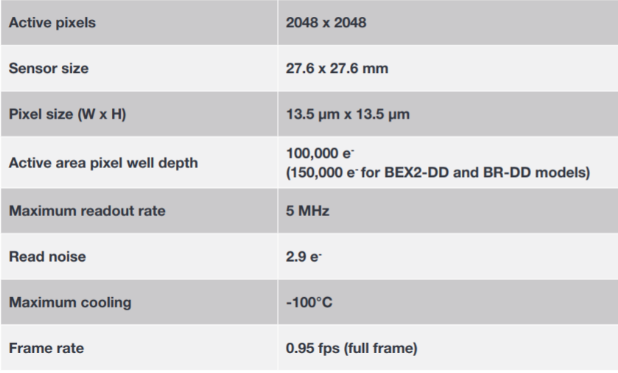
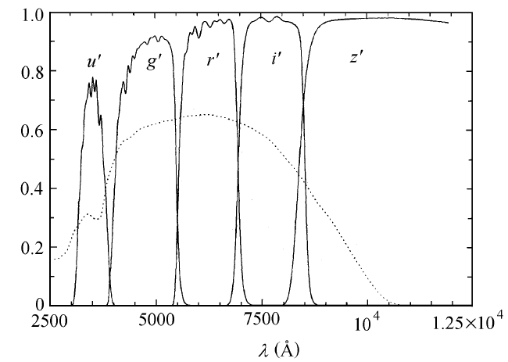
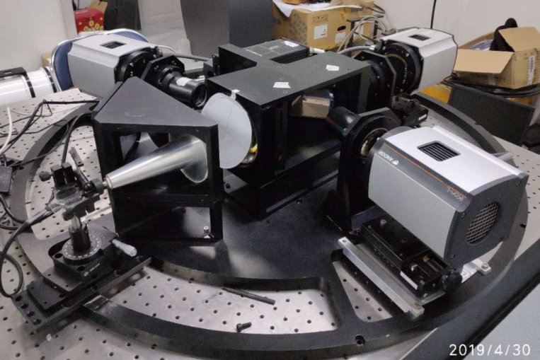
Schematic
diagram
Color subject
Parameters ：
1）Optical Waveband (SDSS)：
2）Transmittance of g′ band:≥60 %；
3） Transmittance of r′ band:≥60 %；
4） Transmittance of i′ band:≥60 %；
5） Field of View:≥21′×21′；

Slide 18
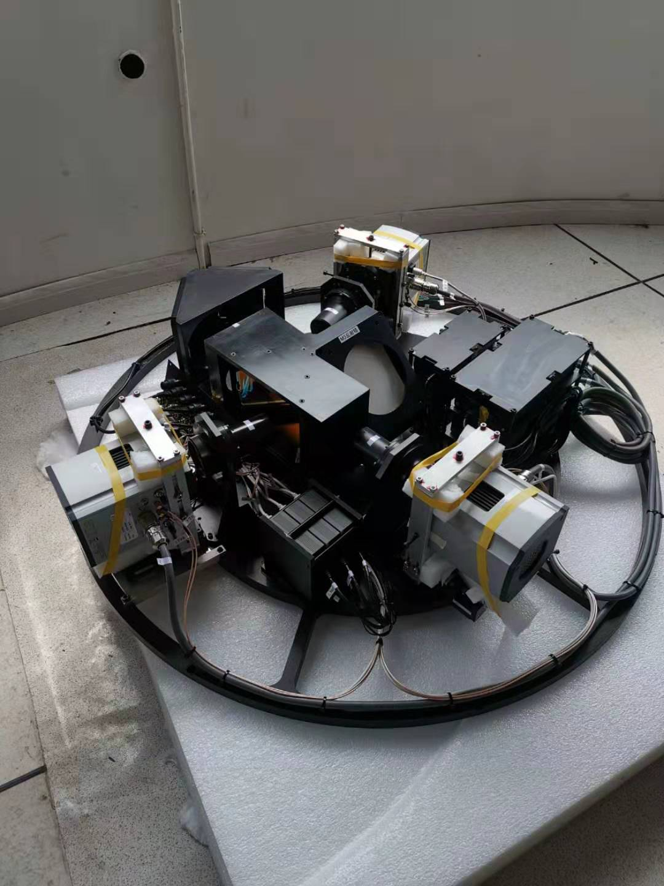
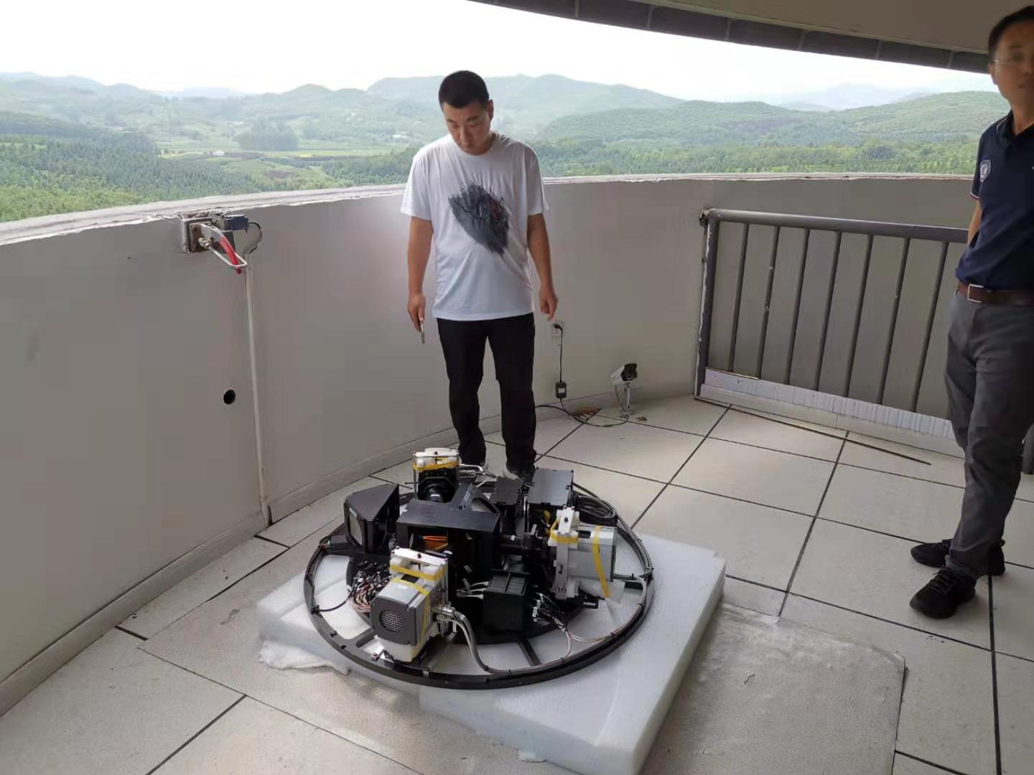
Schedule update

Slide 19
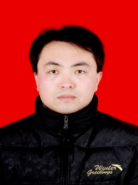
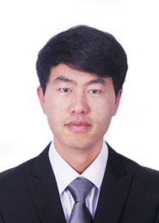
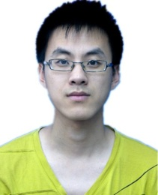
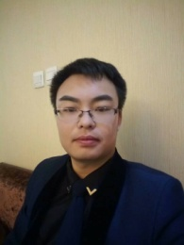
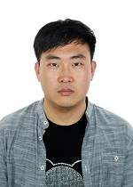
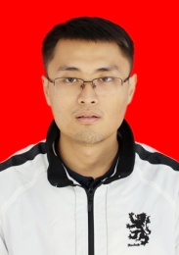
3.2 Others
There are 5 scientists and 6 observers in our team. Every day, one scientist and two observers on duty. We use the telephone to communicate and use apps to receive the observation plans. Up to now, we have done the observation of transient sources for more than 200 h.
Team members
Director
Staff
Observer

Slide 20
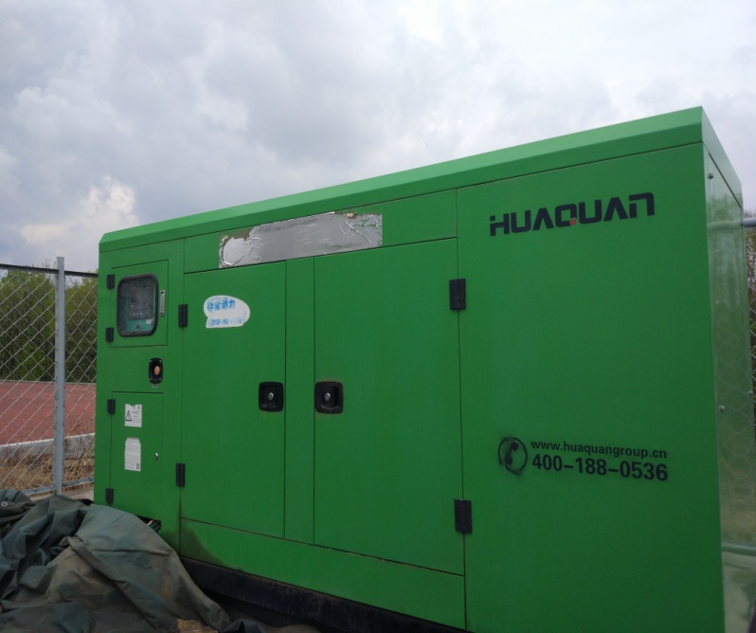
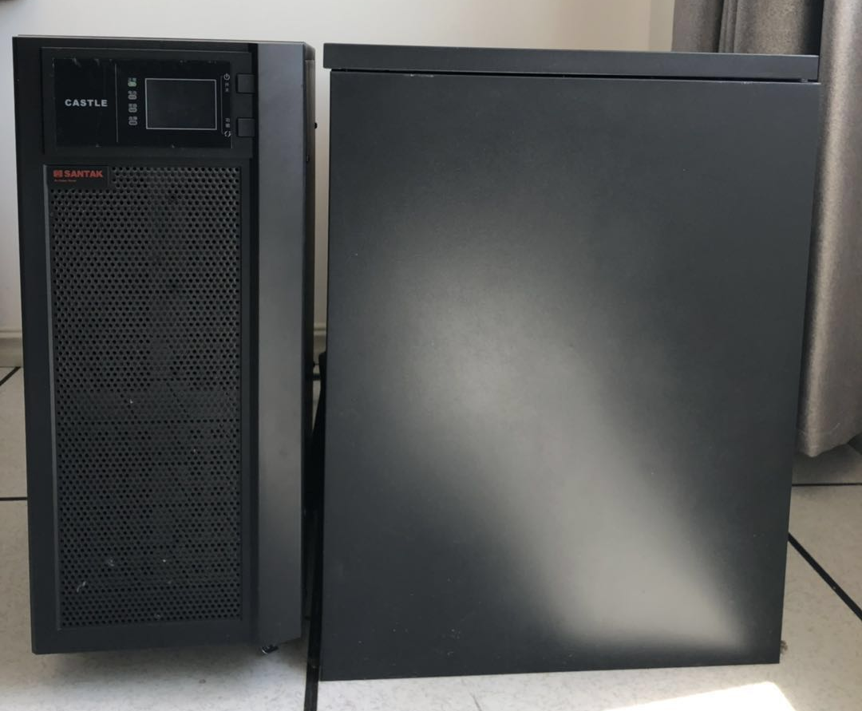
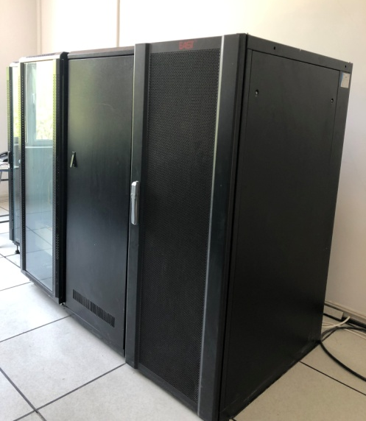
Power Supply System
1.2 m telescope UPS
Network load UPS
Diesel generator
Single UPS
Capacity: 10 KVA
Power: 9KW
Loading time: 45 minutes
Ensure the power supply all day long

Slide 21
Thank You!

