Slide 1
SVOM Follow-up 2.4-m telescope @Lijiang
Jirong MAO
Yunnan Observatories,
Chinese Academy of Sciences

Slide 3
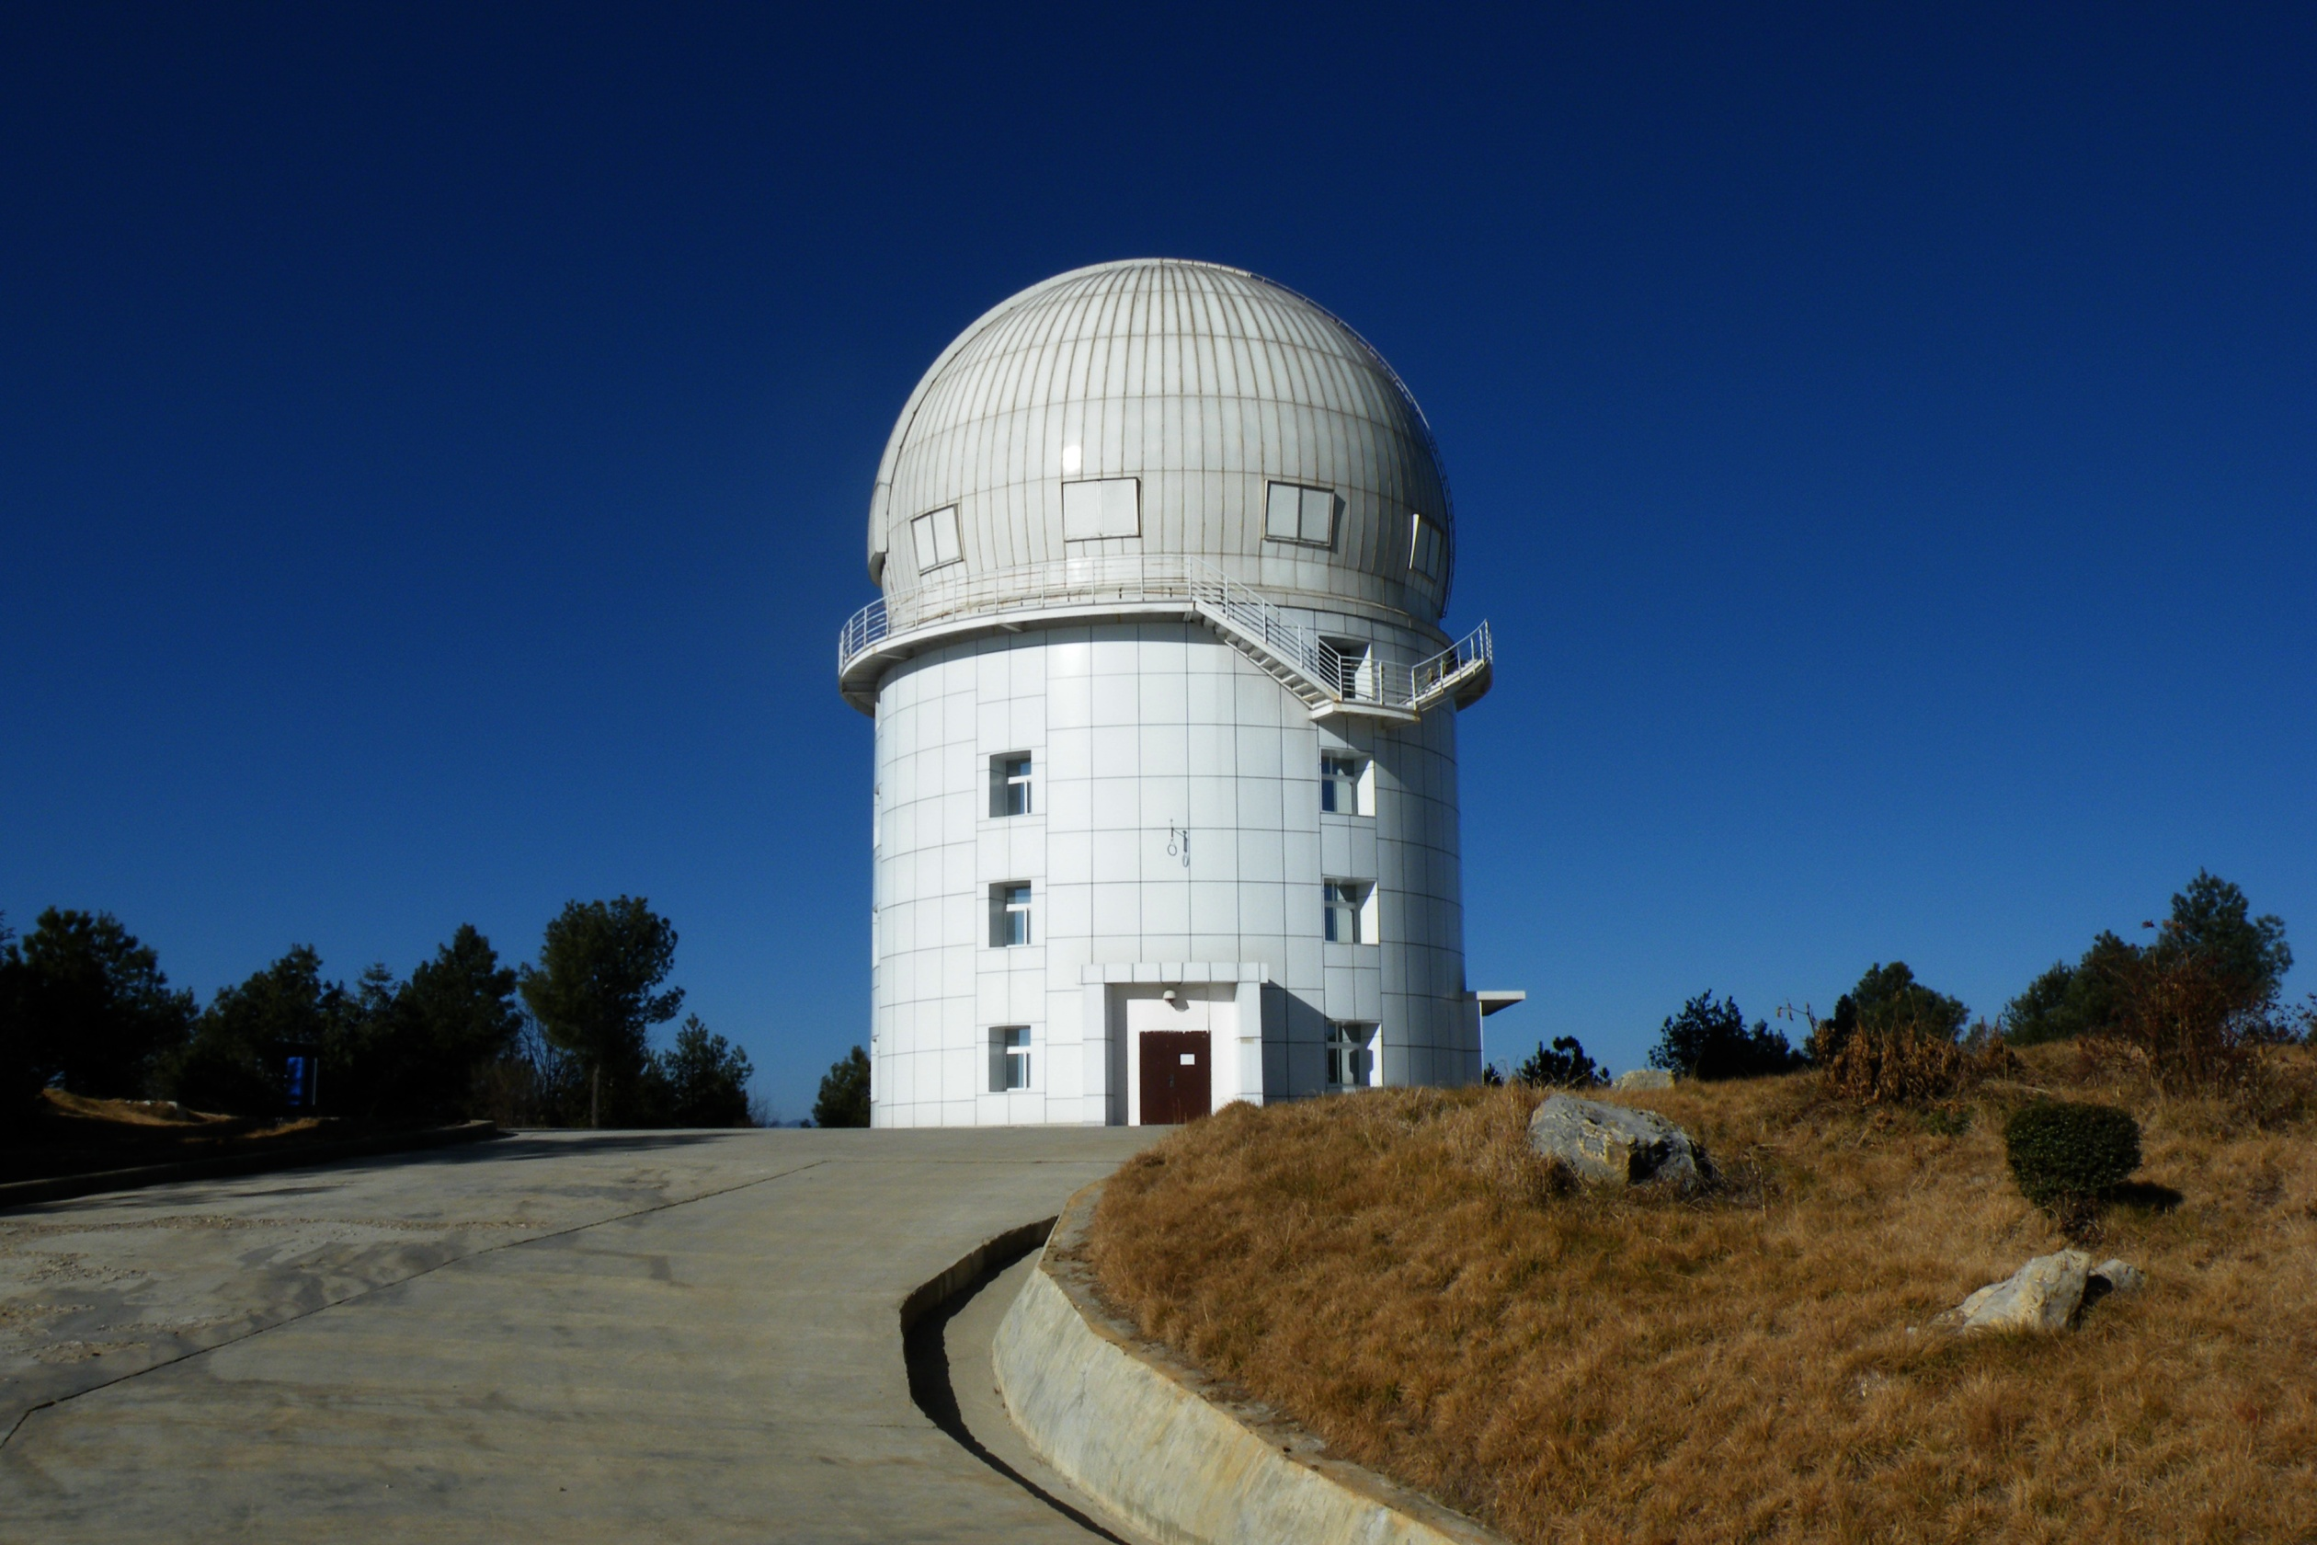
2.4-meter Telescope: 3200m above the sea level
Notes:
姓名、工作单位

Slide 4
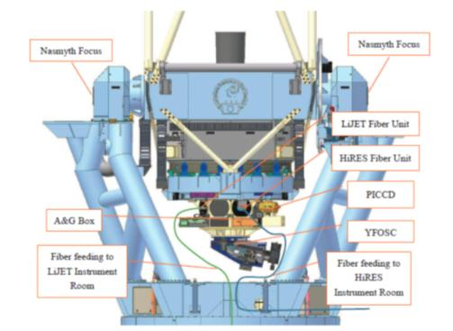
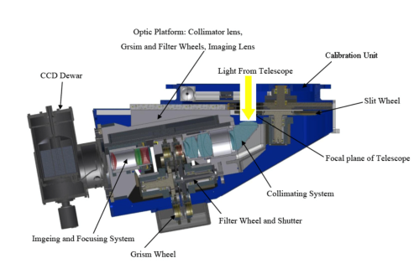

Slide 6
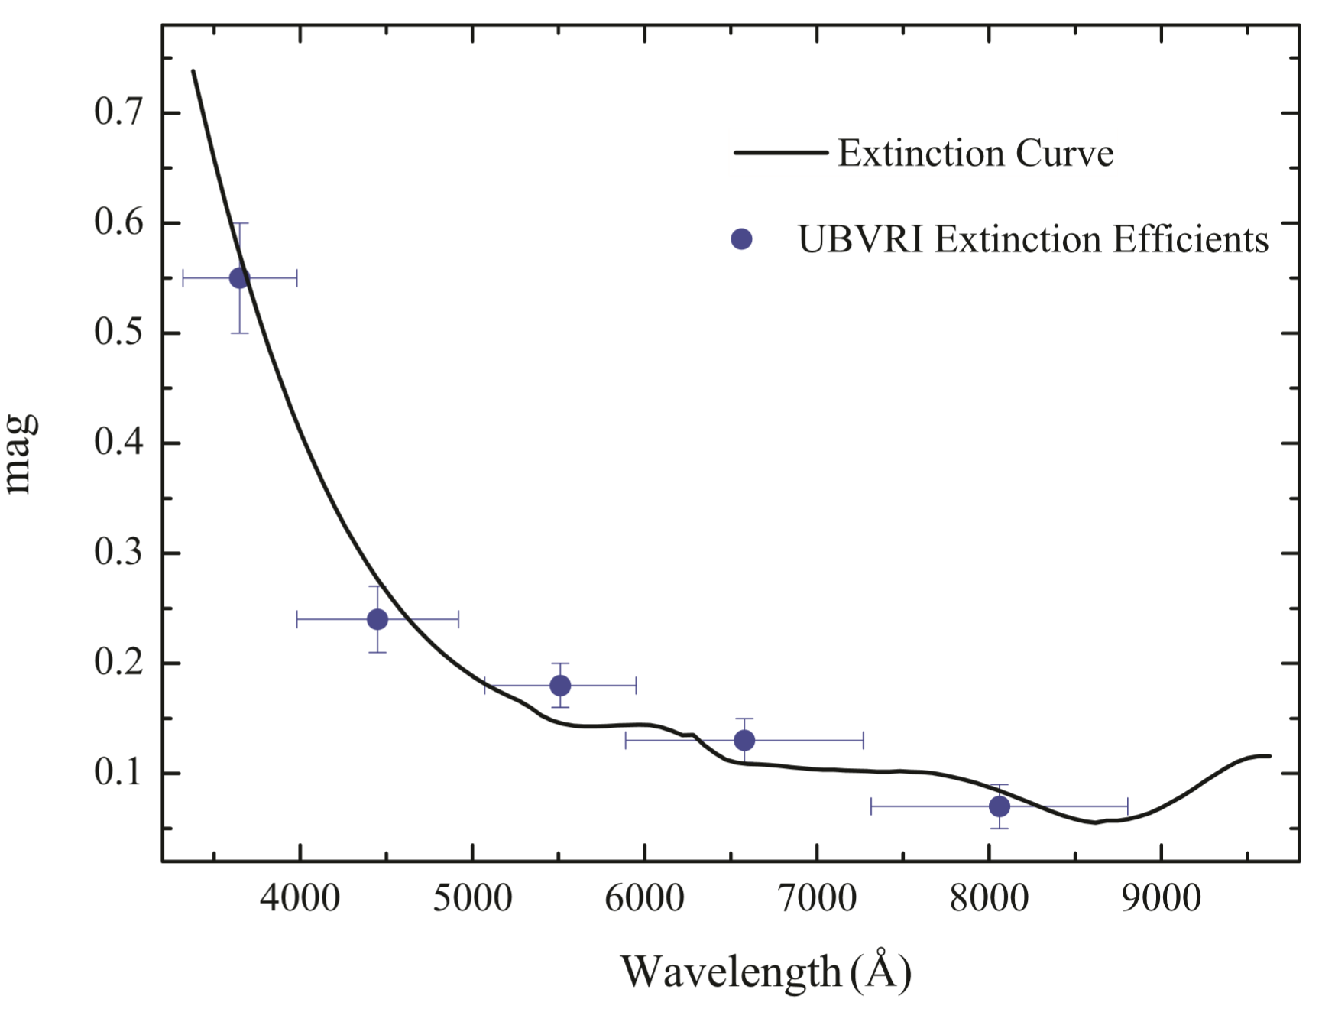

Slide 7
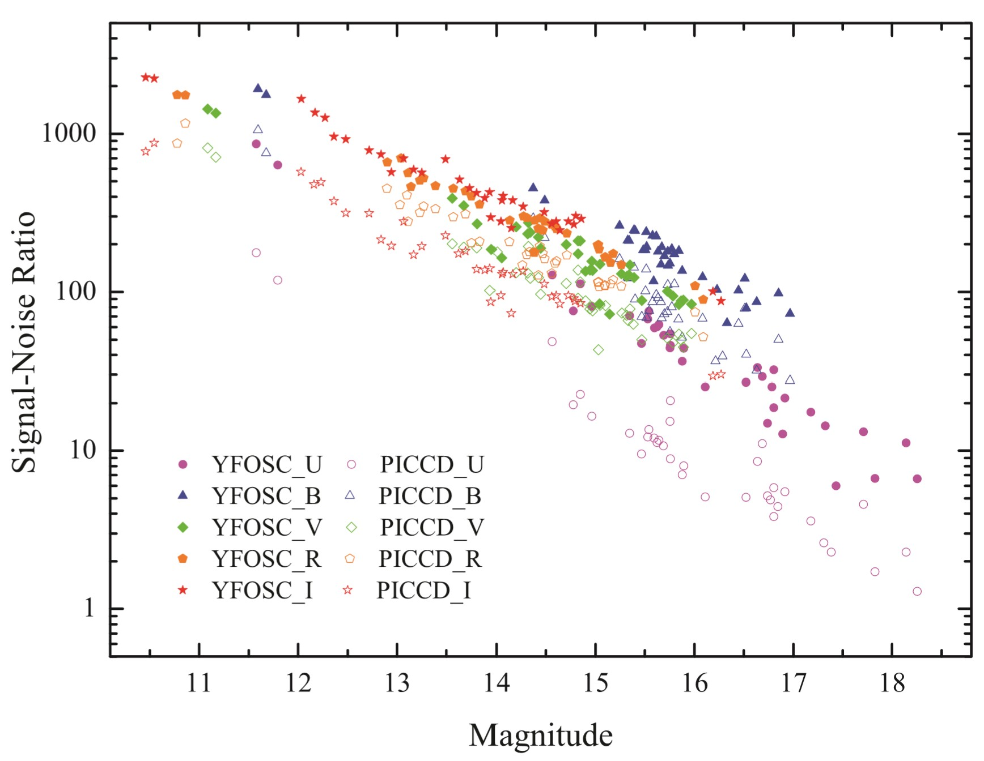

Slide 9
Observational Capability
Multi-band photometry
wide &narrow bandpass
Spectral observation
middle & high resolution
Quick response for all kinds of transient

Slide 10
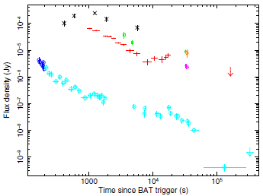
GRB Optical Observation

Slide 11
Cooperation
Domestic telescope network
International cooperation:
BOOTES, TAROT, VLT, SALT, …

Slide 12
Transient Observation
Good experience: optical and high-energy
GRB and other transients
GWAC follow-up: training for future SVOM observations
GW EM counterpart detection: O2 & O3

Slide 13
SVOM Follow-up by 2.4-m Telescope
GRBs, GW-EM counter part, GW-GRBs
SNe & GRB related SNe
Other kinds of transients

Slide 14
Follow-up for SVOM-GRB
2.4-m telescope: field-of-view is small
10 arcmin*10 arcmin
GRB alert: position is defined
Positive if candidates is very bright and clear (GWAC)

Slide 15
GW O3 and Follow-up of Follow-up
2.4-m telescope: field-of-view is small
10 arcmin*10 arcmin
GW alert
Slack and WeChat
GWAC and F30/F60 candidates：
grade candidates and galaxy list
Follow-up

Slide 16
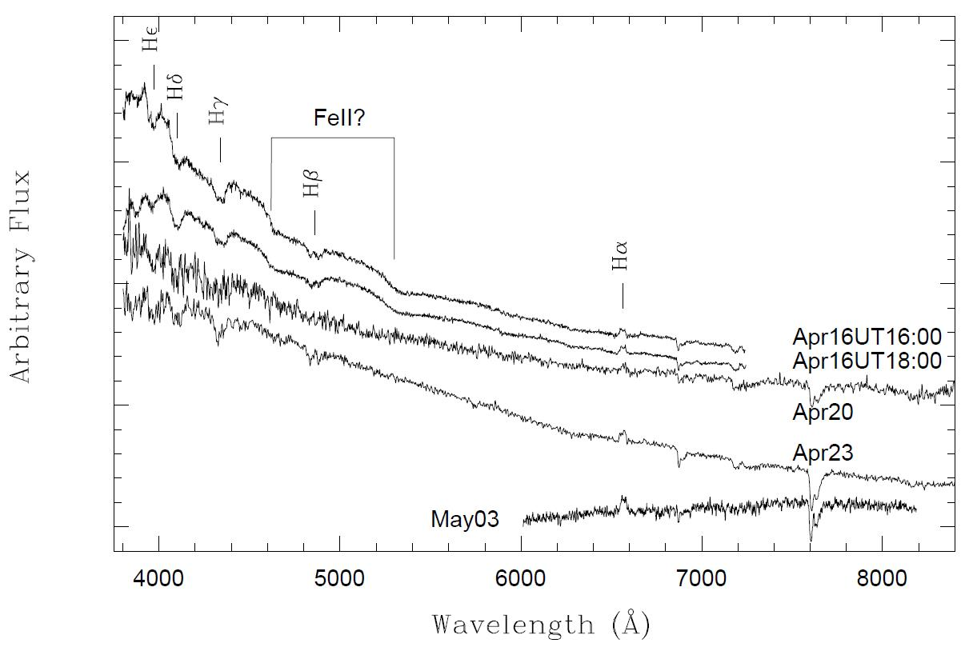
GWAC Trigger: One Example

Slide 17
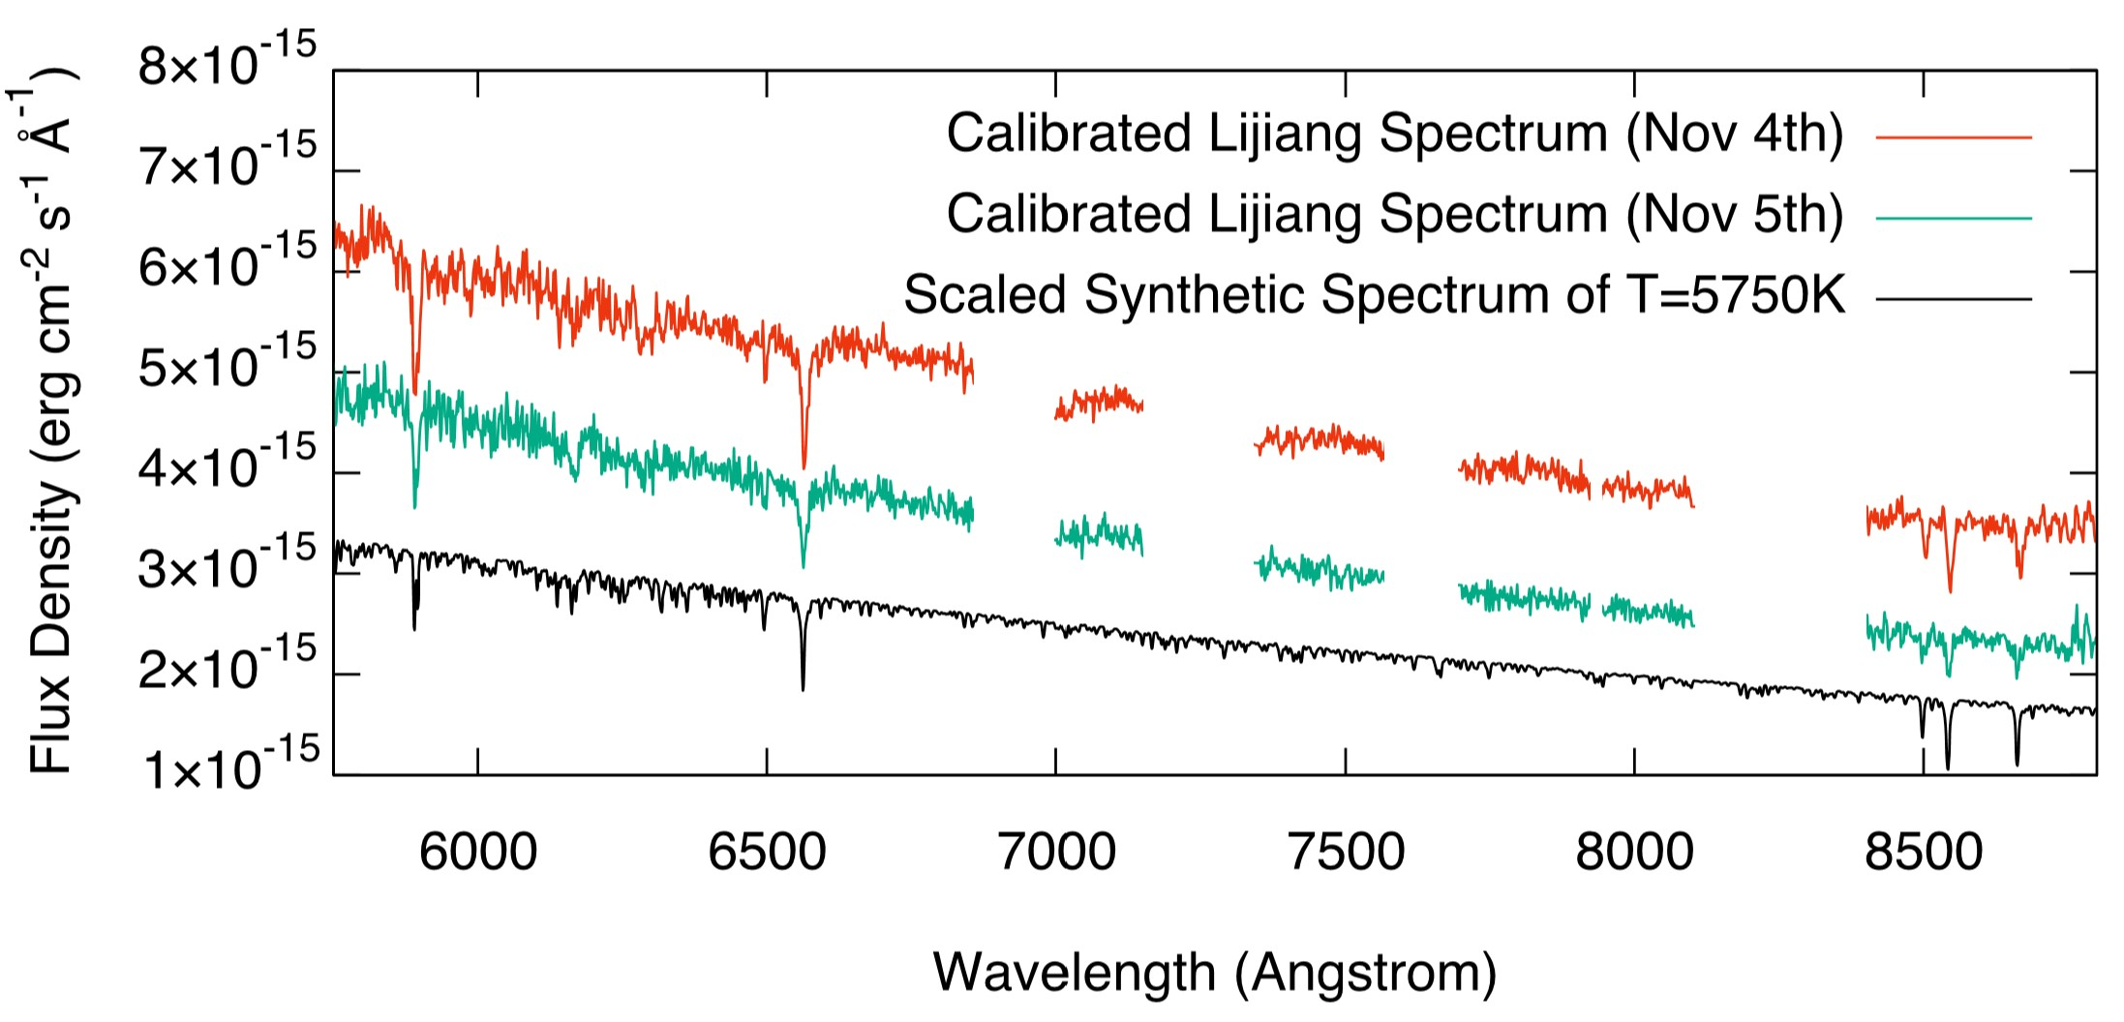
Millisecond Pulsar

Slide 18
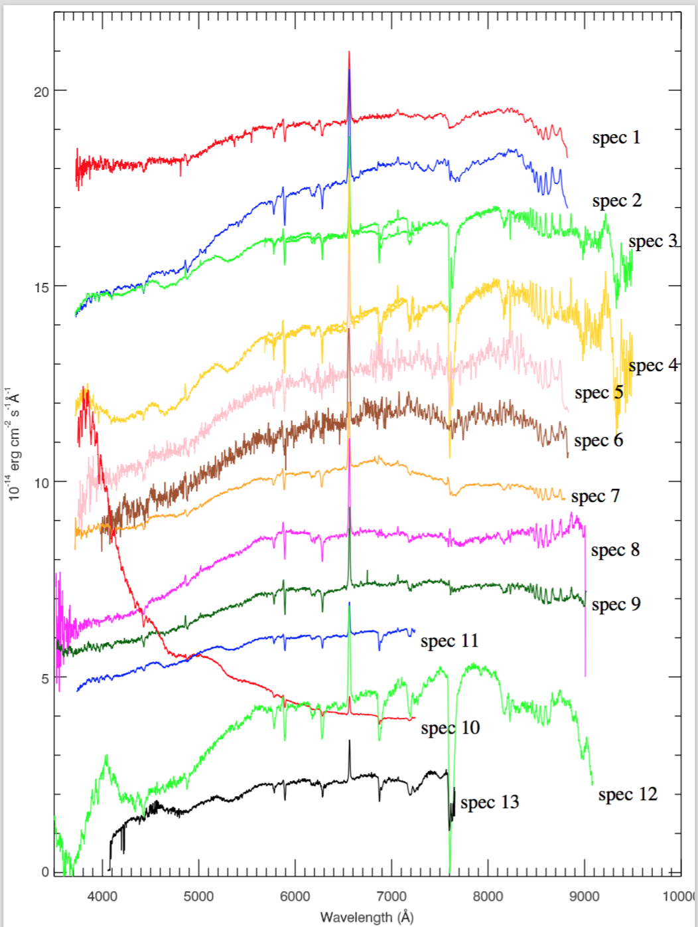
X-ray Binary

