Slide 1
Evolution of underground science in LSM
Laboratoire souterrain de Modane
From digging to modern experiments

Slide 2
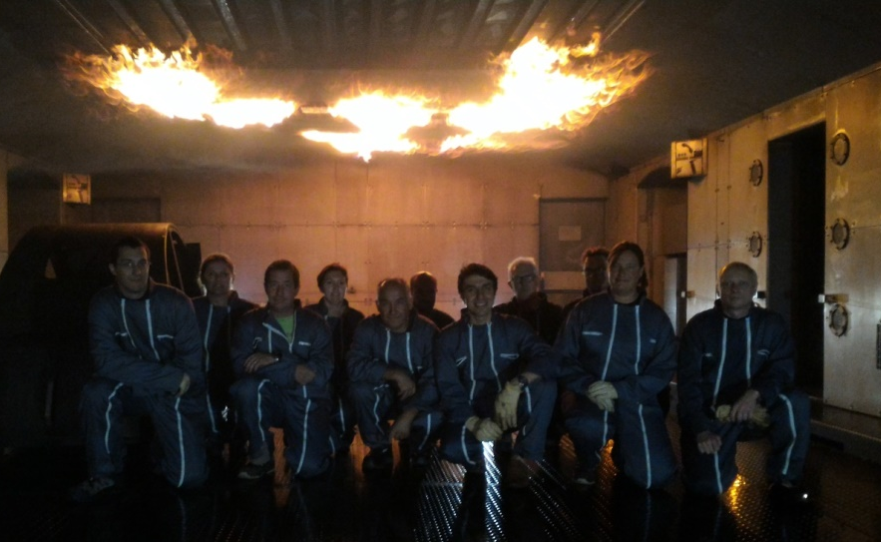


Laboratoire Souterrain de Modane
Located in Modane
12 permanents
1000 visitors days per year
Wide range of interdisciplinary topics
Astroparticles, nuclear physic, environment, electronics, radioactivity measurement, biology

Slide 3

Laboratoire Souterrain de Modane
Merger with Laboratoire de Physique Subatomique & Cosmologie (LPSC-IN2P3) in Grenoble
  70 researchers, 90 Engineers & technicians
  Covering fields in particle & nuclear physics, astroparticle and cosmology
LSM now becomes a « national facility » as labelled by the CNRS
  National facility for IN2P3 / CNRS
LSM as an national experimental facility for :
  Fundamental Physics
    Neutrino property determination
    Direct Dark matter search
  Gamma spectrometry measurement
    14 detectors measuring continuously
    Open to geosciences, materials, biology and medecine
      Actually 1000 samples measured per year
    PARTAGe project to automatize measurments
      Increase significantly the scope of the LSM

Slide 4
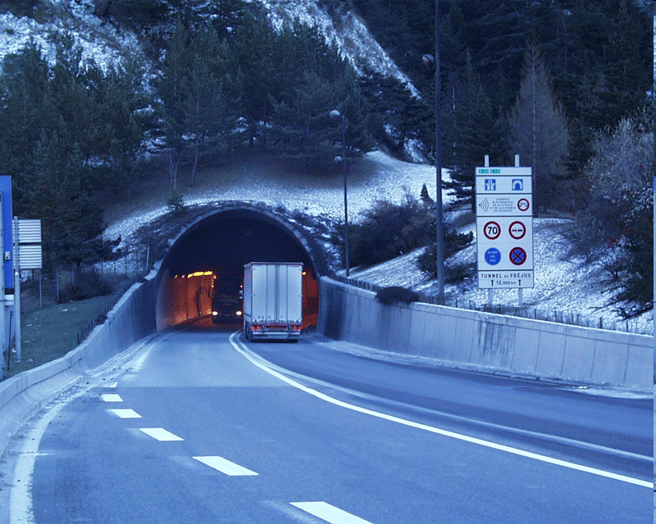
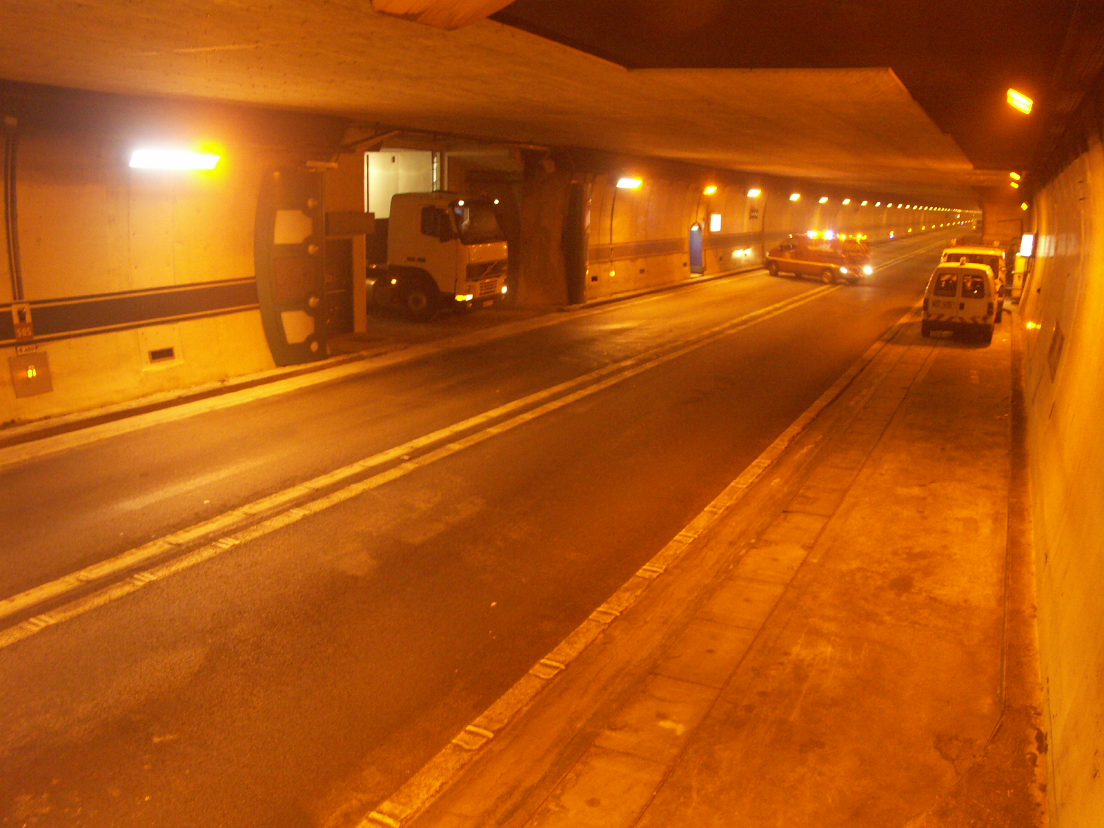
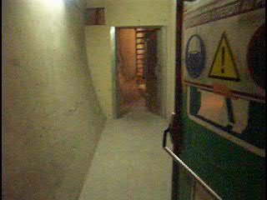
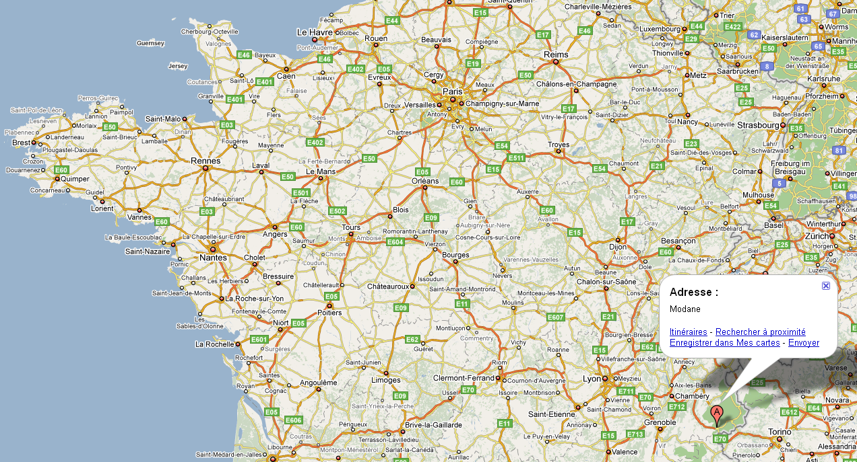
Location and access
4 fire-proof doors
Footmen entrance
LSM
Tunnel Routier du Fréjus

Slide 5
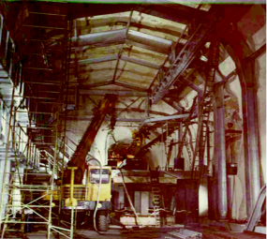
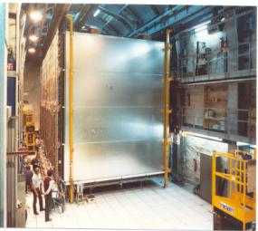
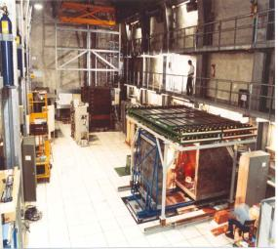
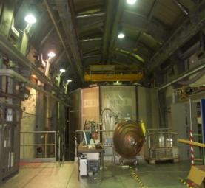
History of LSM
1979 - 1981
1982- 1990
1990- 2000
2000 - ….
Digging
Proton decay
Prototypes Experiments
4 µ/m2.d
3500m3
400m2
15Bq/m3 Rn in air
Radonless air 125m3/h 15mBq/m3

Slide 6
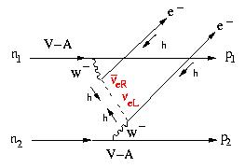
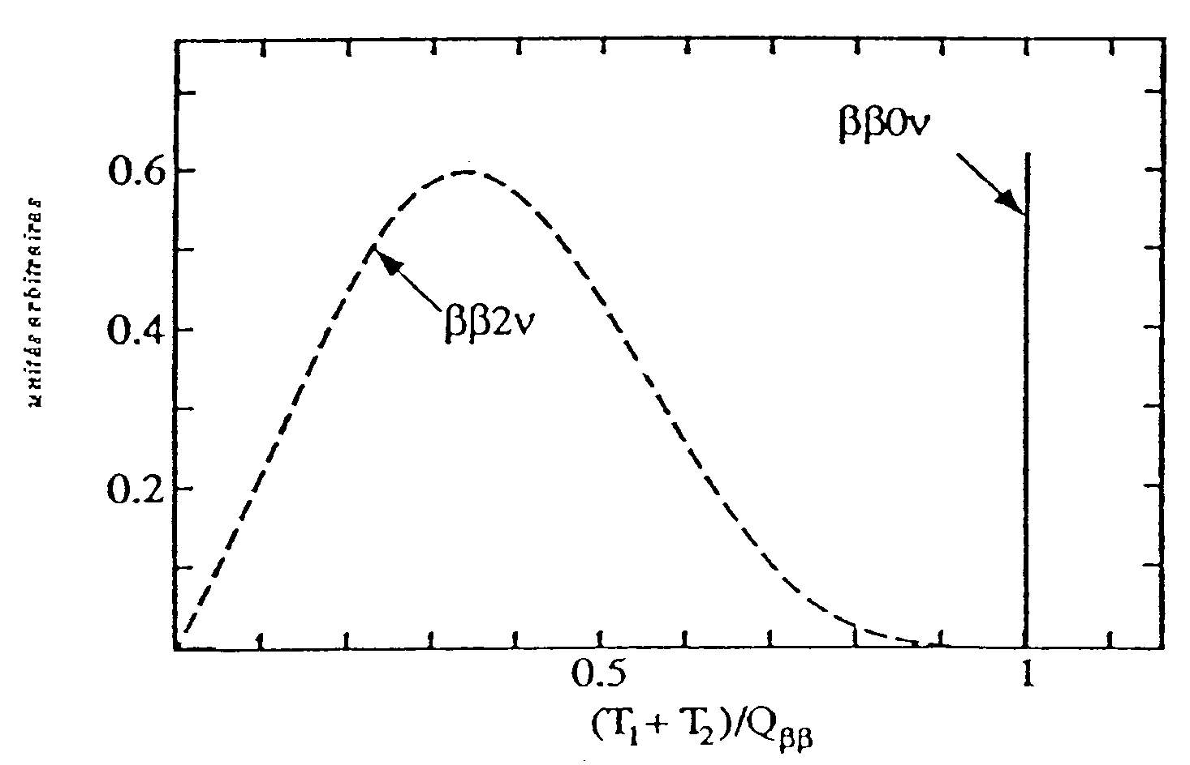
Double beta decay
bb0n : (A,Z) → (A,Z+2)+2e⁻
Double beta decay
DL = 2
n = ‾n Majorana’s neutrino
m_{n} ≠ 0
⇔
Measure
( )⁻¹ = C ( ) M² <m_{n}>²
Q⁵
_{bb}
C : phase space factor
M : nuclear matrix element
< m_{n} > : effective neutrino mass
(Q_{bb} ~ MeV)
Full electron energy
< m_{n} > ⇒ mass hierarchy

Slide 7
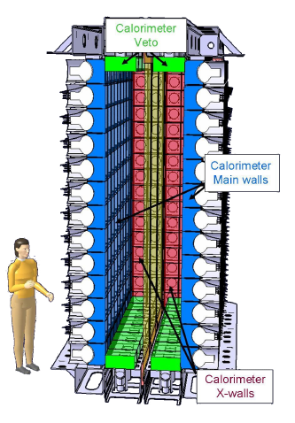
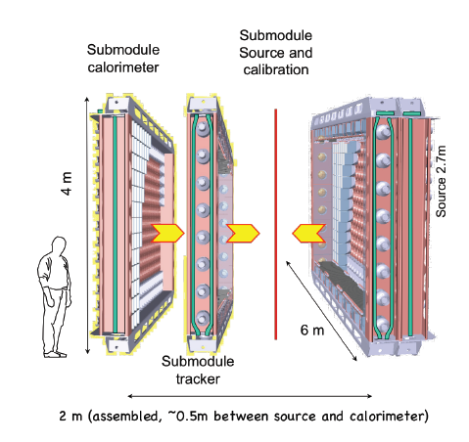
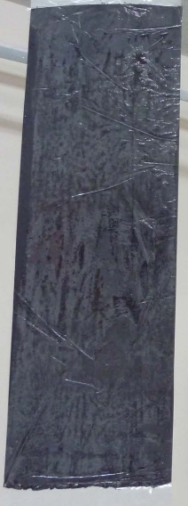
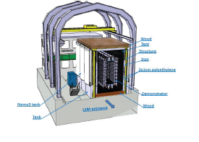
SuperNemo experiment
ß⁻
ß⁻
ß⁻
82 Se source
Extreme radiopurity requirement
Special granularity to obtain the source

Slide 8
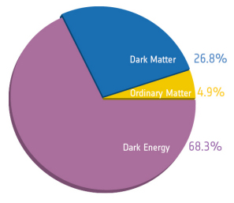
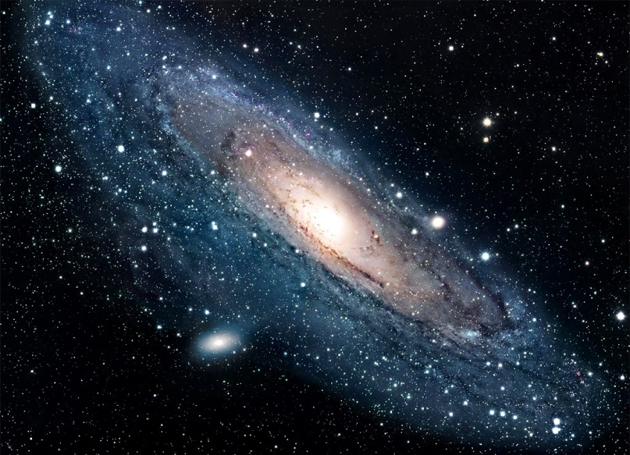
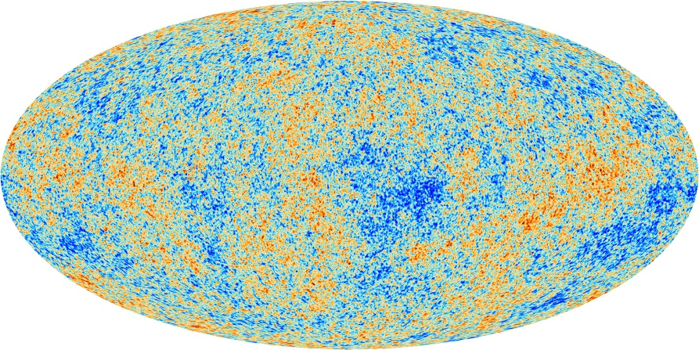
Dark matter search
Major physics goal
Direct detection would answer to a lot of question
WIMP candidate is a target for underground detection
CMB anisotropy
Speed
Measured
Theoretical

Slide 9
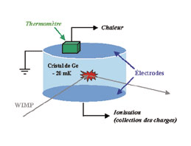
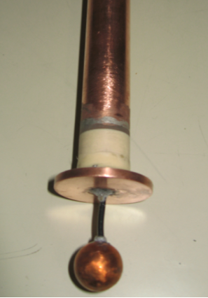
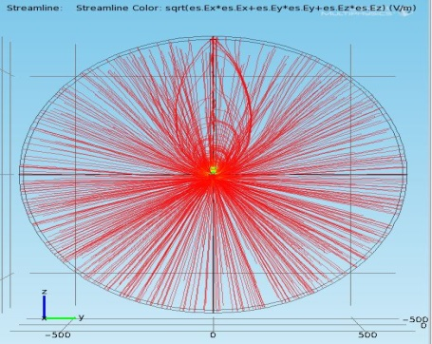
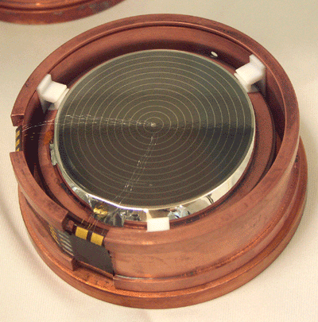
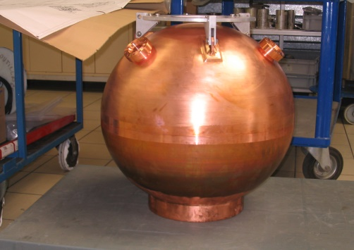
Dark matter search
Edelweiss
NEWS
Field simulation

Slide 10
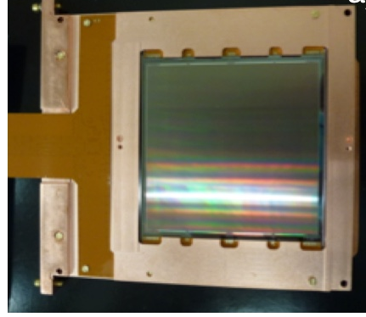
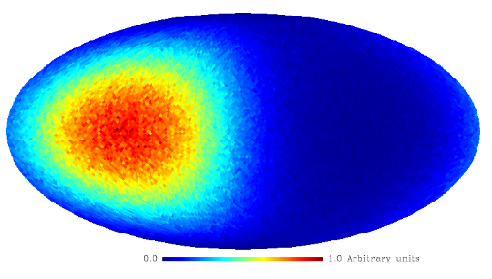
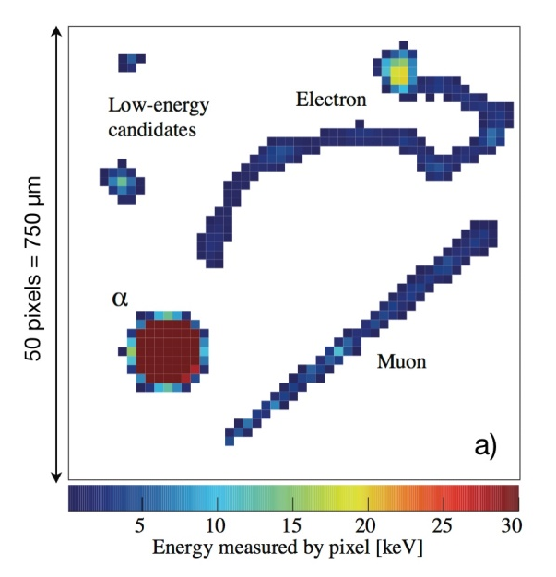
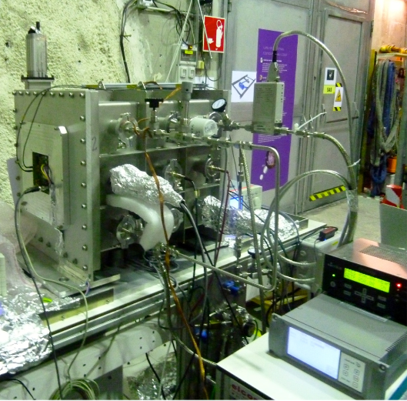
Dark matter search
DAMIC-M
MIMAC
  Directional recoil
Galactic coordinates
Event topology

Slide 11
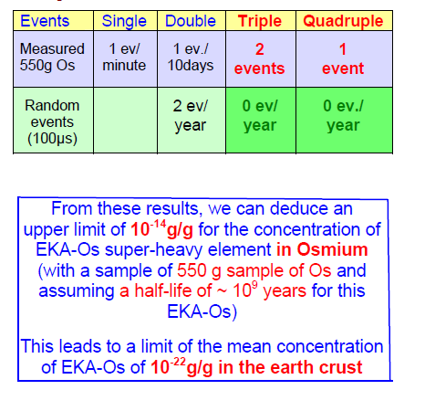
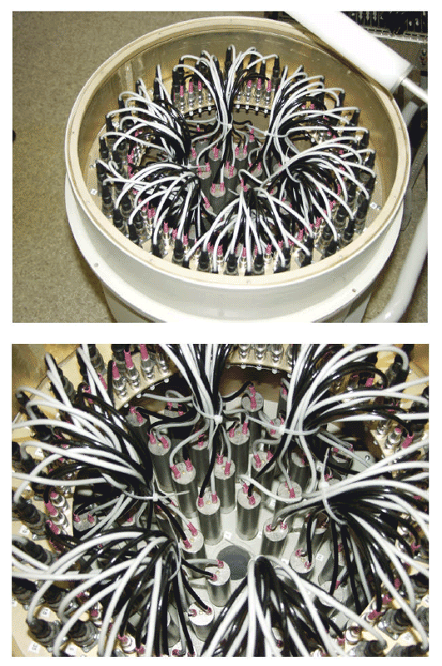
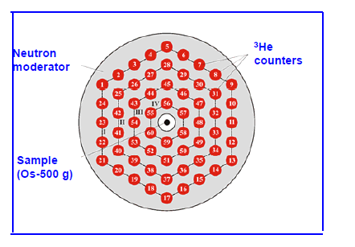

SHIN
Super heavy element with half life >²³⁸U
Z=108 targeted with self fission producing >5n
Nuclear physics
Super Heavy Element In nature
SHIN (osmium ore surrounded by 3He neutron detectors)
TGV II

Slide 12
Low radioactivity constraints
Requirement on material below mBq
Strong pressure on analytical capabilities
Increased number of pieces and longer time
Main measurement performed by gamma ray spectrometry
Constant effort took place in LSM to develop ultra low background germanium
Expected 24 HPGe by 2020

Slide 13
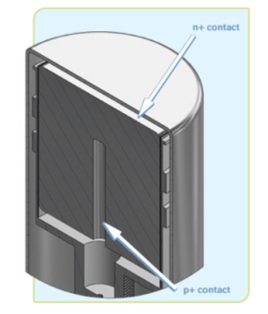
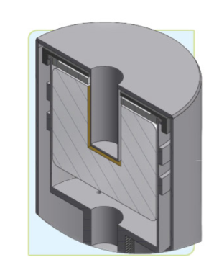
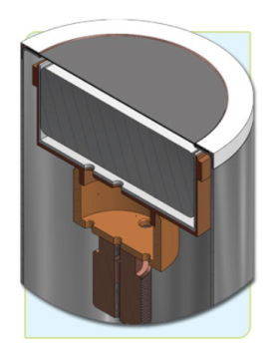
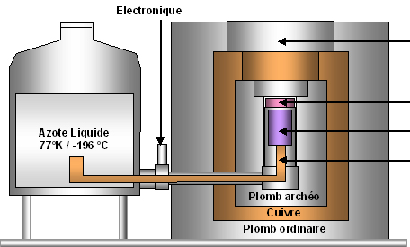
High purity germanium
Semi conductor crystal cooled down to 77 K
Sample at room temperature
Sensitive to gammas from 20keV up to 3MeV
Non destructive measurement
Sensitive to muons and cosmic activation
Different detectors adapted to samples shape
Coax
Well
Planar
endcap
sample
crystal
cold finger
Notes:
Quick reminder of the basis of a Germanium detector

Slide 14
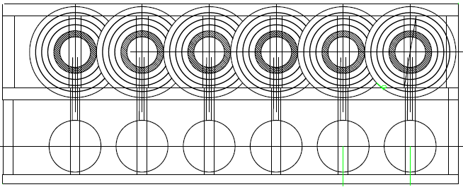
Future of measurement at LSM
PARTAGe project
  Combining shields in common walls
Robotisation
Optimisation of measurement time based on the radiopurity objectives

Slide 15
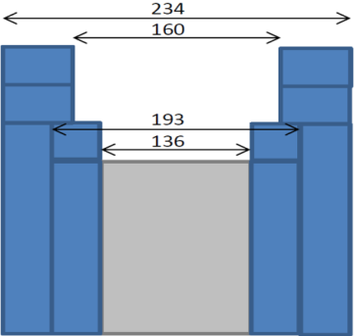
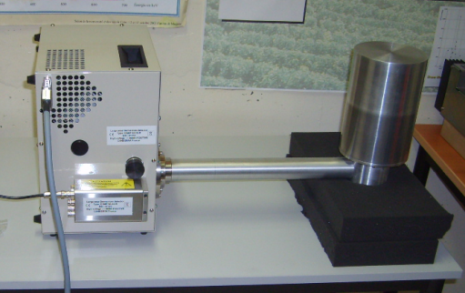

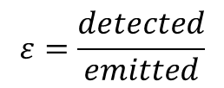
Germanium detector
Example of detection limits
Mafalda : (our swiss army knife)
Size 150 cc – 43,1%
  Φ 80mm h 31,7mm
Resolution
  122 keV 920 eV
  1,33MeV 1,97keV
  Background
    Integral 115±3,5 count/day
    133 c/kg
    Peaks
    46,5 keV 1,49 ± 0,37 c/d [210Pb]
    75 keV 3,6 ± 0,62c/d [Pb]
Shielding
536
Std
Std
ARCH
Silicon wafer measurement
700 000s 650g
limit (Bq)$=\frac{1,43+2,36\sqrt{1,36+bdf×t}}{ε\left(m\right) m t}$
Nucleide |  | Bq/kg
210Pb | < | 1,58E-02
²²⁶Ra | < | 1,27E-03
238U | < | 6,27E-03
228Ra | < | 3,82E-03
228Th | < | 8,66E-04
$$ε=\frac{detected}{emitted}$$

Slide 16
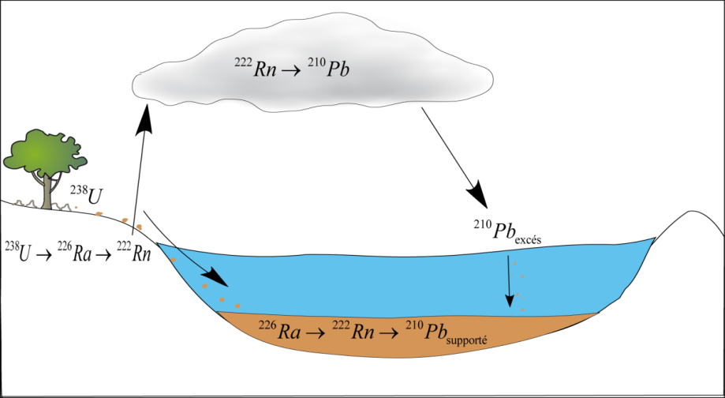
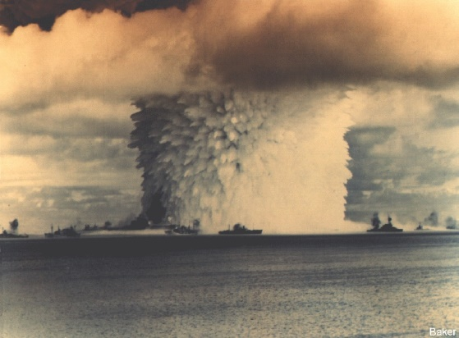
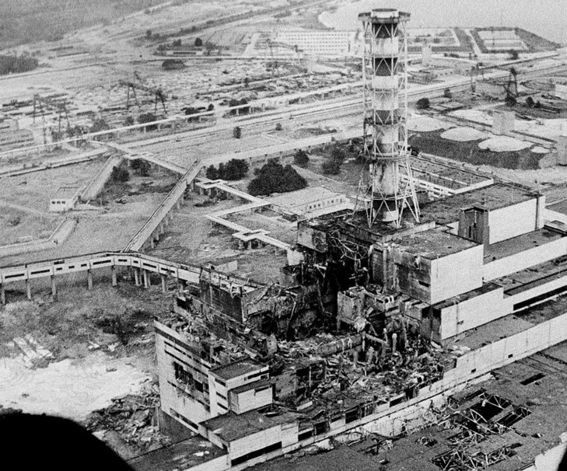

Analitycal power for interdiciplinarity
Possibility to measure a wide range of nucleides
Used in many environmental datation
Relative datation
Absolute datation
¹³⁷Cs + ²⁴¹Am
1963
¹³⁷Cs only
1986

Slide 17
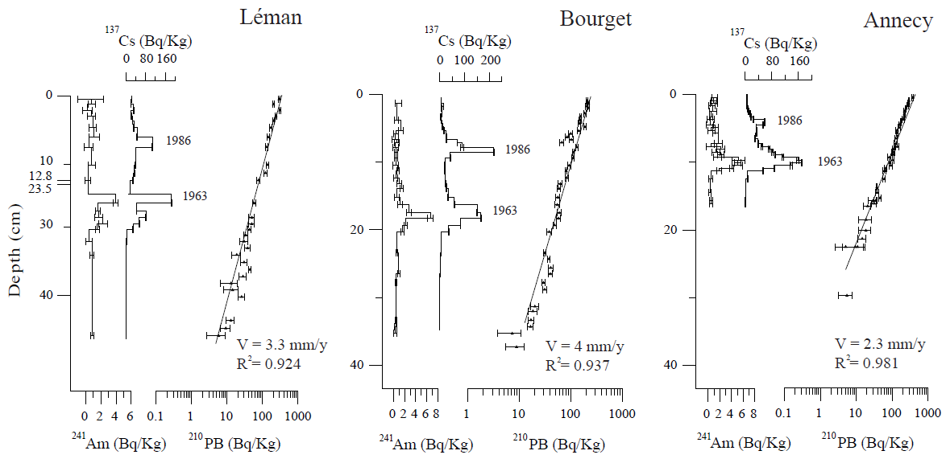
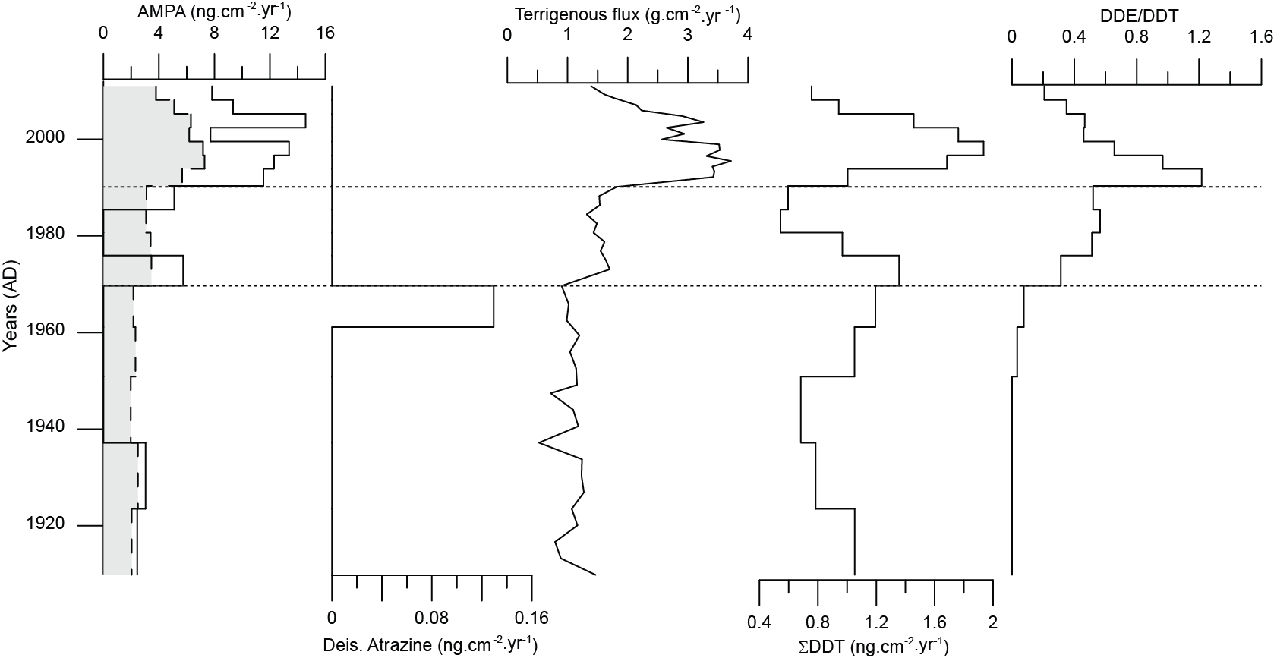

Lake survey
210Pb gives the sedimentation rate
Confirmed by artificials nucleides
Allowing to reconstruct the history of a lake without archives
Sabatier et al., 2014, PNAS

Slide 18
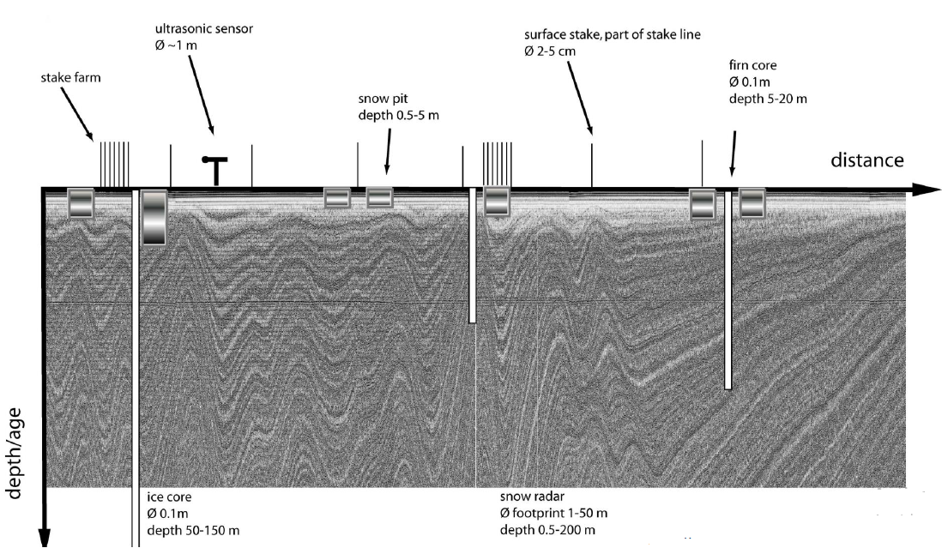
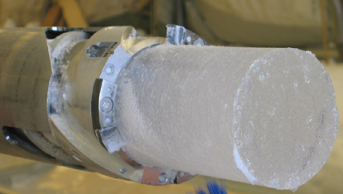

Ice survey
Datation of ice core in antartica
Calibration of radar
Temporal marker for climate change
2 days measure needed in underground lab

Slide 19
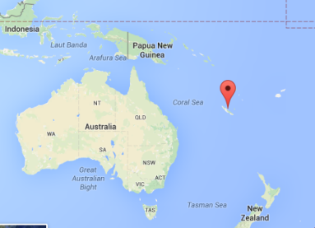
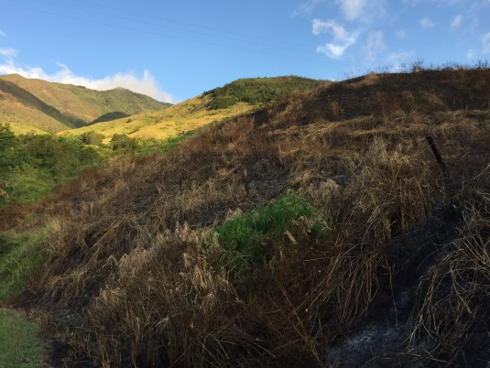
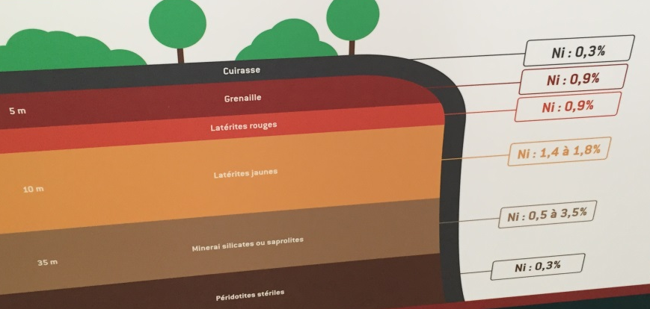
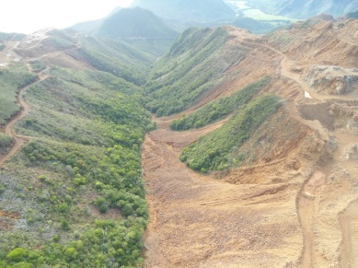
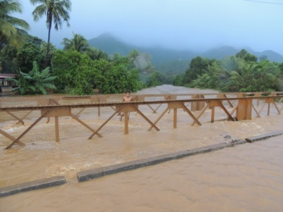


Erosion survey
Sources of sediment in mining catchments of New Caledonia
Two main sources of sediment to the main river
Non-mining tributaries
Mining tributaries
¹³⁷Cs
Ø ¹³⁷Cs
Discrimination of contributions of both types of tributaries based on their activities in natural/artificial radionuclides
Quantification using mixing models
Analysis of sediment cores collected in the delta to reconstruct changes in source contributions with time

Slide 20


Electronic SER test
Sensitivity of electronic to ionising radiation
At sea level neutron and alpha contribution
LSM reference point in JEDEC standard for 0 neutron
Adapted after Baumann, IEEE Trans. Device Mater. Reliab. 5, 305-316 (2005)

Slide 21




Biology at LSM
Evolution driven by radiation
Comparison between surface and underground bacteria culture 800 generations harvested

Slide 22


Stem cell storage
LSM-pasteur institute collaboration
Funded by interdisciplanary mission from CNRS
Allowed to test a stem cell storage shielded from natural radioactivity and terrestrial cosmic rays
Patented solution
Publication in progress
Industrial prototype in
development

Slide 23
Conclusion
Underground labs are designed for large scale fundamental physics
Unique environment find always a use sometimes unforeseen at digging
Leaves room for interdisciplinary program at moderate cost
New fields and discoveries made possible by the access to low level radiation environment

