Slide 1
Partage
Réunion Germanium 2018

Slide 2
Partage spirit
Reduce footprint of Germanium detectors
Free space for more detectors
Keep the same level of shielding
Improve radon mitigation
March toward robotisation

Slide 3
Fundings
Idex 140 000€
UGA 150 000€
Région Auvergne 400 000€
In2p3 150 000€
With time constraint of 2018 for Idex

Slide 4
Movings
Movement of TGV and SHIN
TGV
SHIN

Slide 5
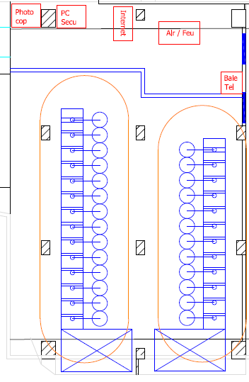
Partage implantation

Slide 6
Expected expanse
Main support frame to support and tune dewars and lead
Lead shield
Crane
Nitrogen filling tubes
Radon tent
Sample storage
Electronic & software
Notes:
Real summary

Slide 7
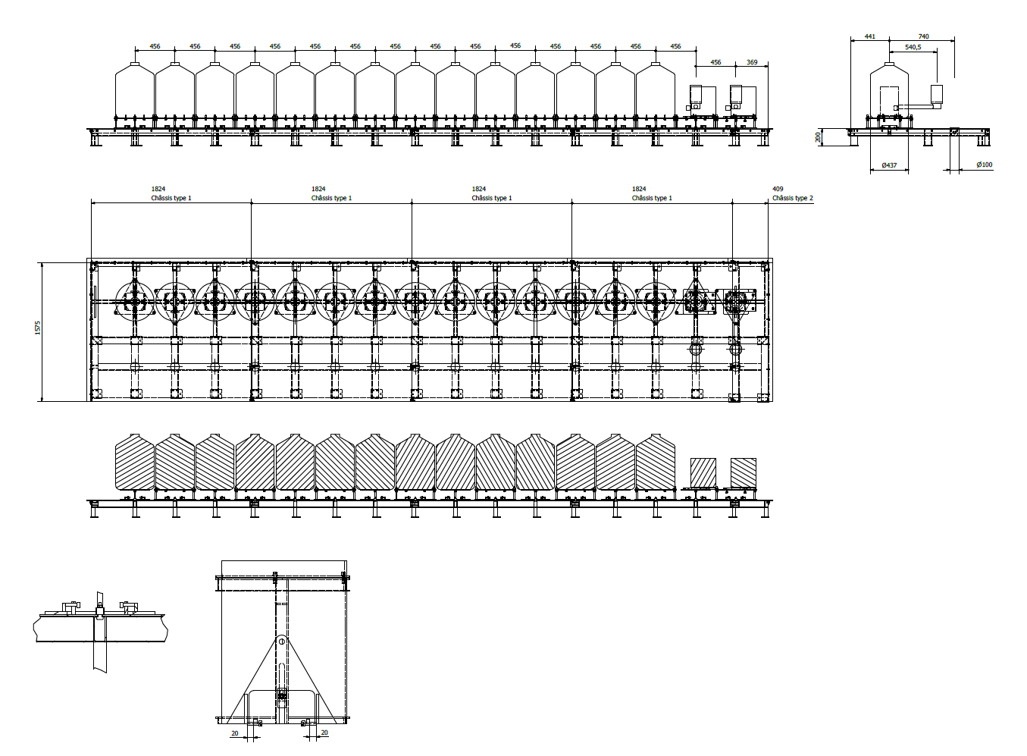
Already bought

Slide 8
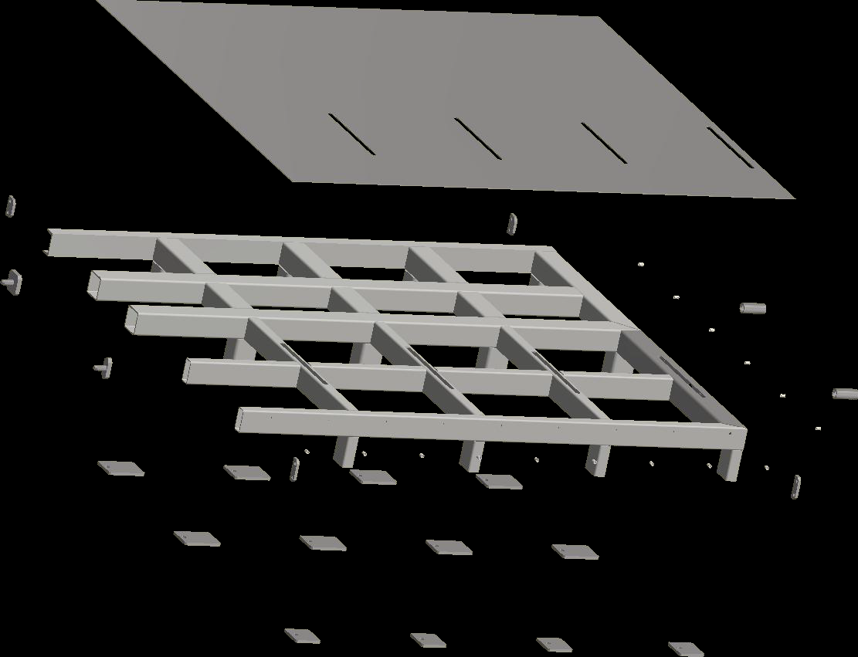
Support frame
Main floor
Welding on the sides to ensure the air tighness
Welding on the square tube to ensure the air tighness

Slide 9
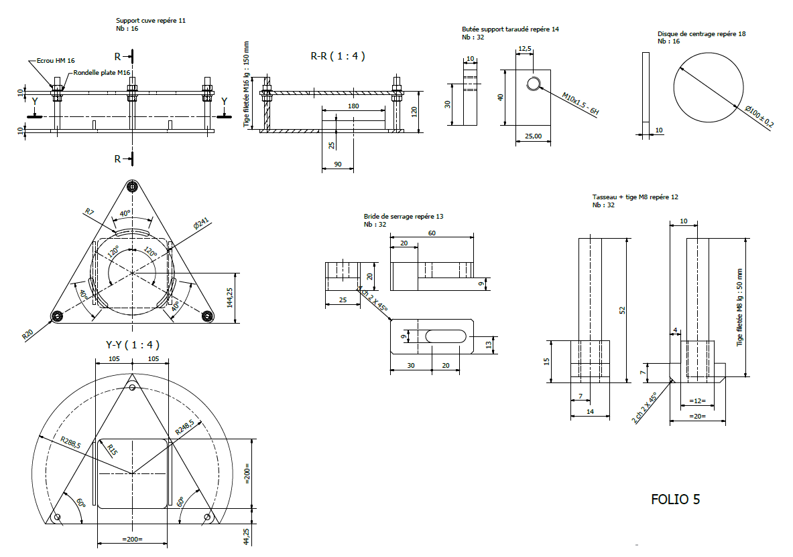
Positionning triangles

Slide 10
Already bought
The standard lead shielding
Philosophy 2 type of shields
Small one : 16 detector max sample 130mm
Big one : 8 detectector max marinelli phi 250mm
Building/moving time 1 year minimum
3 shields delivered every 2 month
3 new detector come with the other
2 rooms functionning in parallel

Slide 11
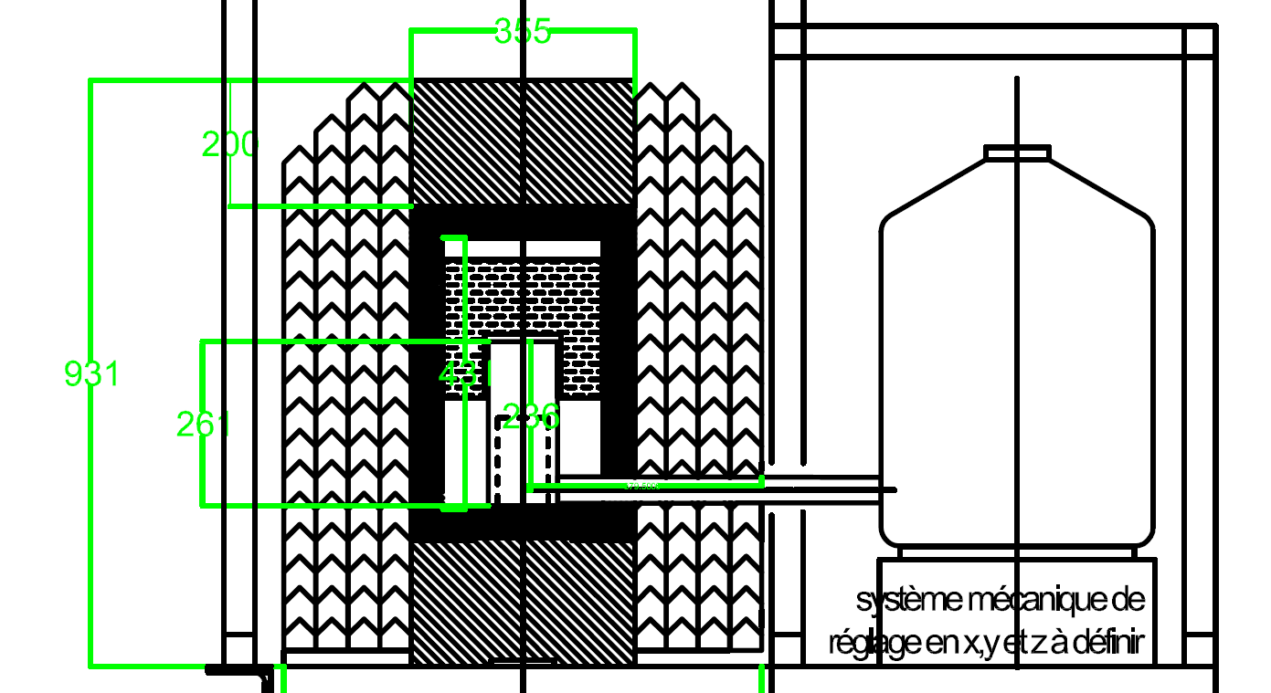
Lead shield for marinelli
Global doctrine : 20 cm standard lead 5cm archeological
No specific design
All shield are
the same
Standard lead removed with crane
Standard bricks
Archeological lead

Slide 12
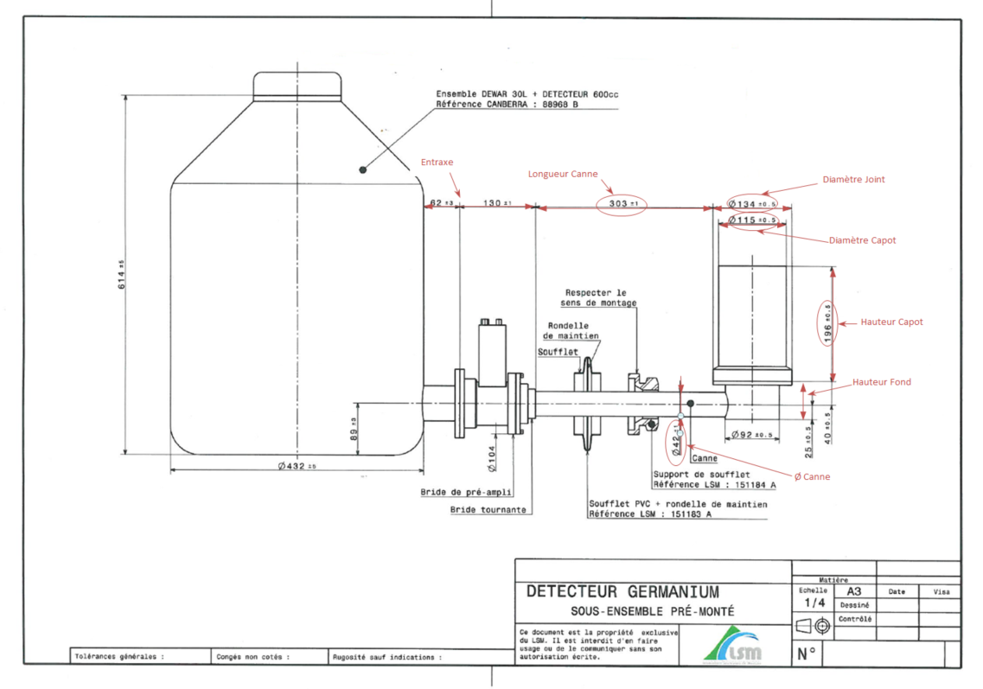
Constraints
Critical dimension can block the shields closure

Slide 13
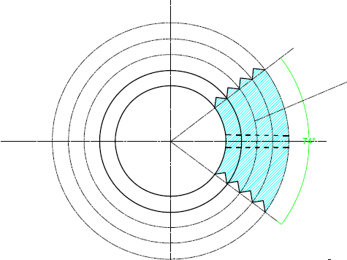
Lead shield for marinelli
Top view from circular bricks
The blue bricks are small enough to be removed by hands (cane is designed in dotted line)
The detector is then free to be taken out independantly from other detector
This is first shield next shield are periodical

Slide 14
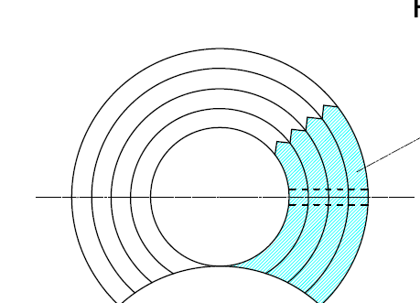
Lead shield
Same commentary as above
Imagine this as a periodical assembly
Each detector has at least the same as actuel obélix shield
The inner volume can host the 250 mm diameter Marinelli

Slide 15
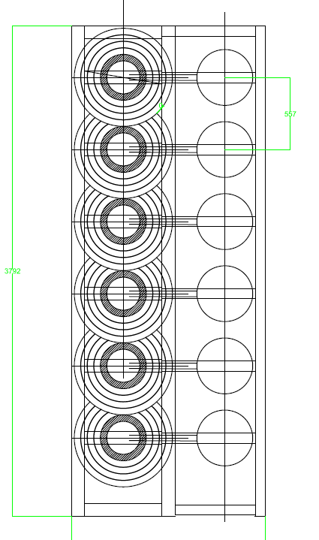
Big shields
Manually operated
Designed for heavy samples
1 measurement geometry

Slide 16
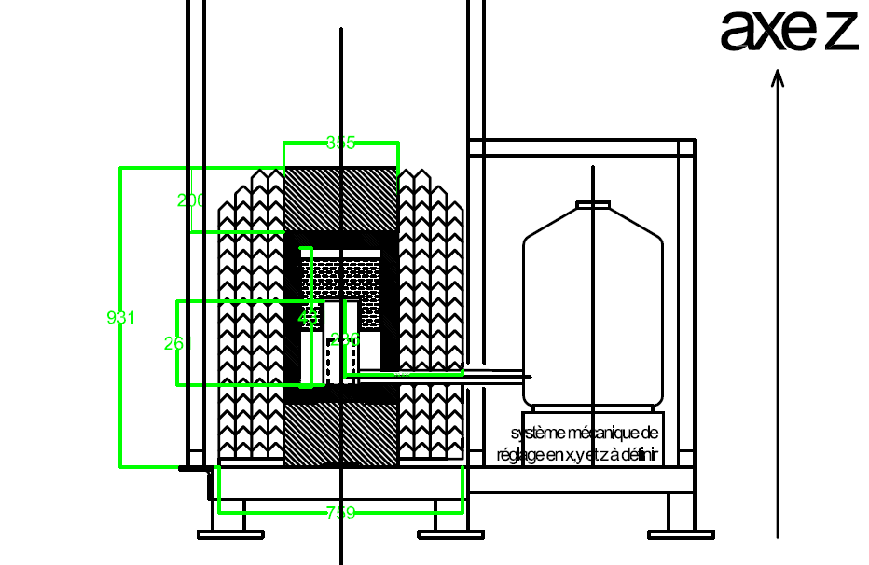
Big shields
272 kg

Slide 17
Big shields
Possibility to measure about 100 kg
Long measurement foreseen
Less constraints on changing samples but very strong constraint on stability
Expandable line with the upcoming detector changing the previous statements
Very special attention to cross contamination due to sample transportation

Slide 18
Small shields
Non-marinelli samples ie phi 130 max
Expected to have multiple changes per day
To be automatised in the following years
A lot of sample will be analysed per week

Slide 19
Small shields

Slide 20
Small shields
Different sample and detector shape
Inner shield adapted to the shape of detector
Unified opening system
Unified way to carry the sample
Order in the line might be taking the changing frequency into account
Lead or Copper : we are out of archeoligical lead and propose copper instead

Slide 21
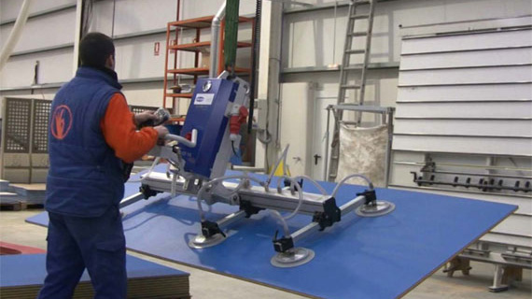
Crane under discussion
2D Crane attached to the support frame
Manual command from outside
Able to lift up 150kg/250kg
Sample lifted by a second crane or holder
Compatible with robotisation
Include the sample transportation syste
Special care to the lift of marinelli sample , never delivered with lifting features
Toward suction cup for handling sample and lead cap

Slide 22
Crane

Slide 23
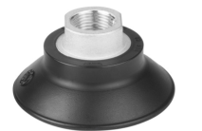
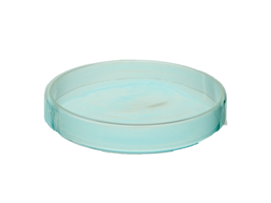
250mm

Slide 24
Robot
Belong to long term task but influence the design to make minimum changes
Concern only the first line
To be linked with the renewal of electronic
Define also who’s where
Strong link with partage

Slide 25
Radon tent under discussion
Radon tent to mitigate the presence of radon in the measurement chamber
Sealing to be made only on the support frame and between panels of tent
Radon decay time decorelated from time in detector
Provide clean environnement for samples and detector
Gas input from radonless air and nitrogen evaporation

Slide 26
Model
SuperNemo tent
Easy to build
Modular
Tightness possible

Slide 27
Radon tent

Slide 28
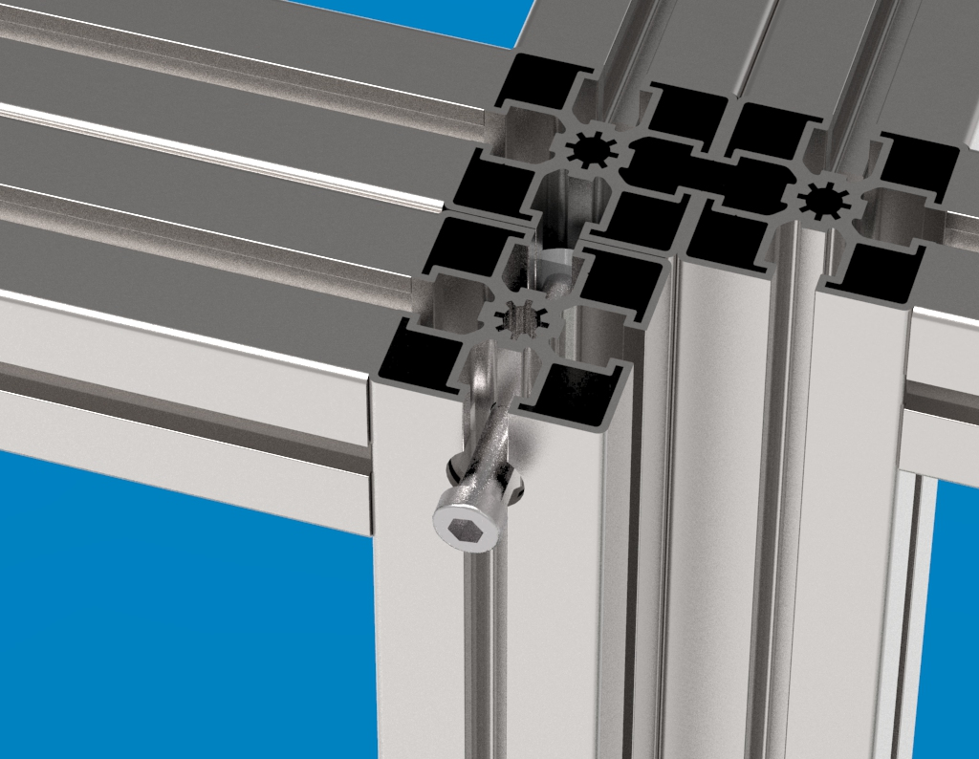
Tent requirement
Sealant
Nitrogen filling
Sample change
Tightness
Sealed to the
support frame
Not internal sas

Slide 29
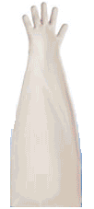
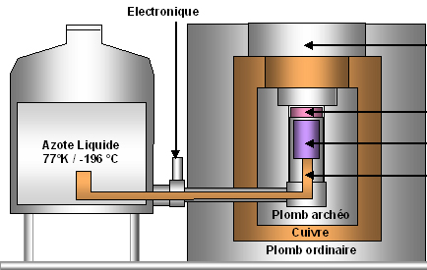
Tent
O-ring
Metalic enveloppe

Slide 30
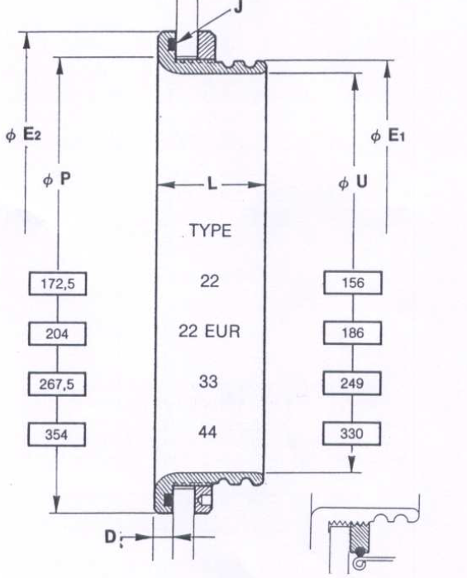
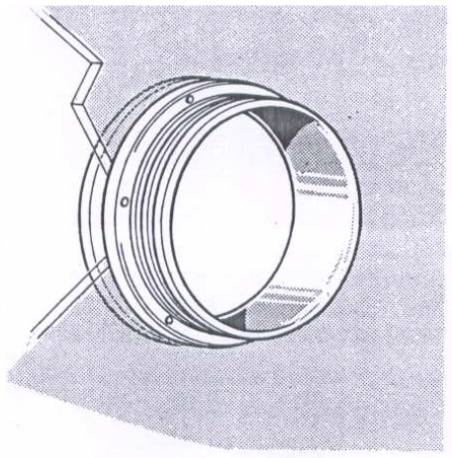
Tent glove seal
1 glover per detector
Glove for the sample
entrance

Slide 31
Tent requirement
Leak < 10 m3/h (now <1l/min)
Compensated by radonless air facility
Interest in nitrogen evaporation
According to Cerna et al < 1 Bq/m3
Estimated evaporation 2,1 m3/h per 2 tents
Mitigation of factory failures could be nitrogen boil off?
10m3/h => 325l/day

Slide 32
Opening the shield
Detector critical failure
Working under radonless air
Plug a sas to the tent and inflate with radonless air
Get inside and open 1 sector of tent
Remove only the detector side of the shield
Remove detector
Close shield-close tent

Slide 33
Radon tent

Slide 34
Opening the tent

Slide 35
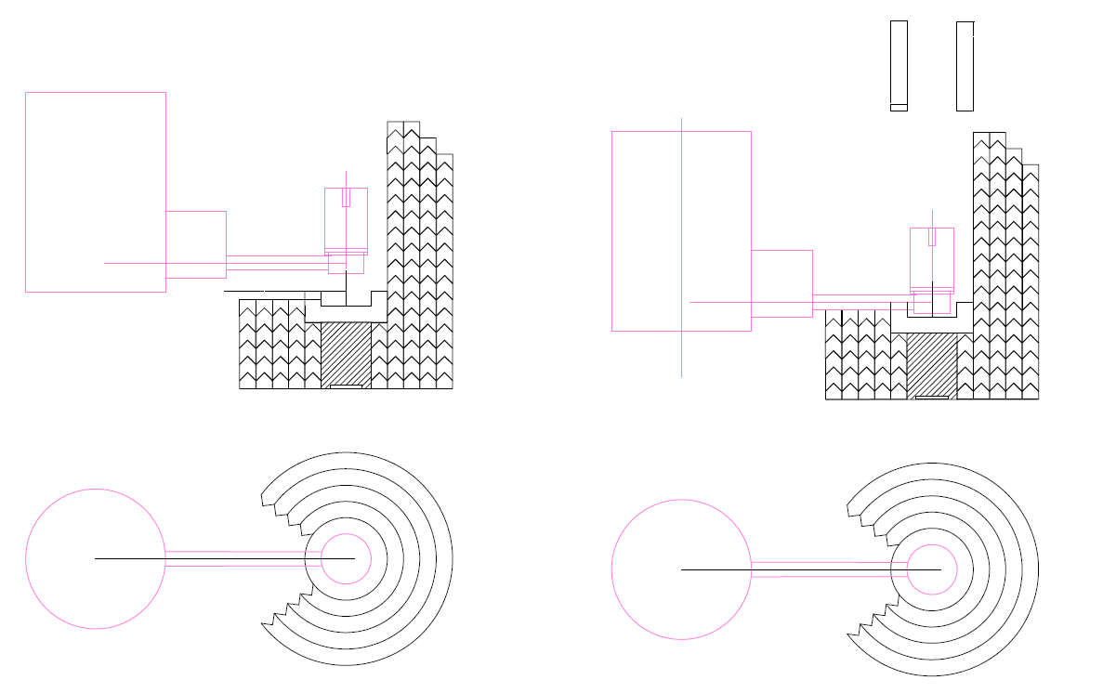
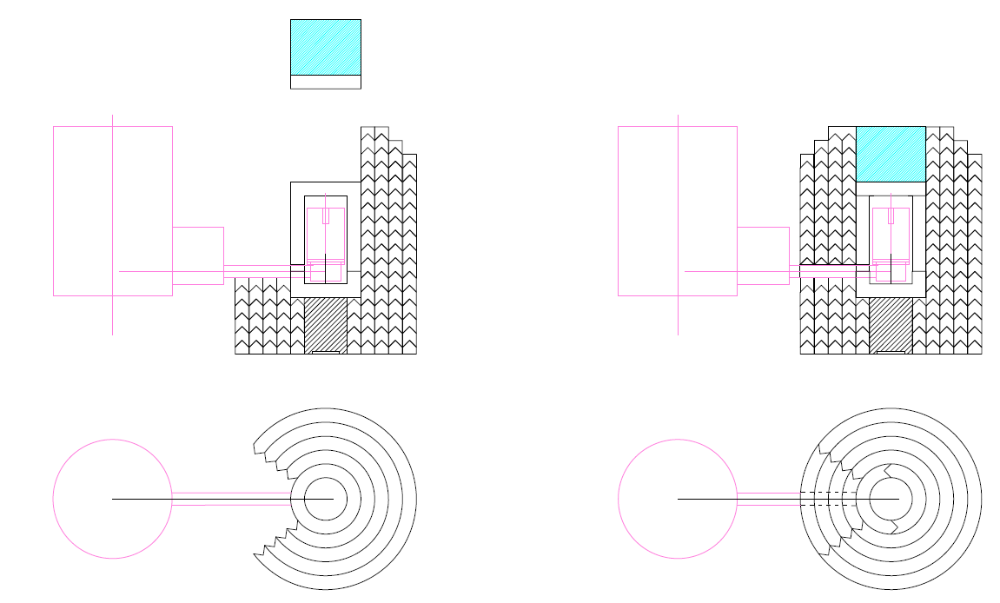
Opening shield
Multi step process under radon free air
Removing of archeological lead

Slide 36
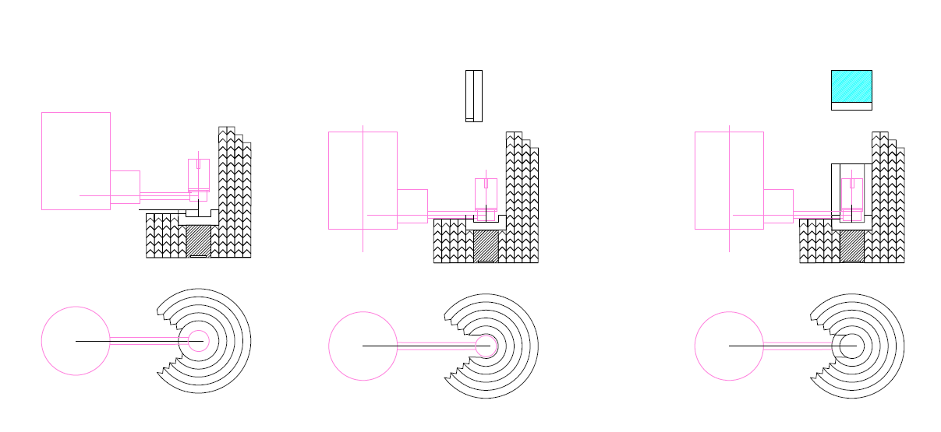
Opening shield
Multi step process under radon free air
Side opening of archeological lead

Slide 37
Nitrogen filling under discussion
Smooth tube connected to 600 L dewar
Minize leak and movements
Goes through the roof plateform
Metallic tube isolate the the atmosphere’s tent from the room’s air
Filling is foreseen as a manual operation for a long time

Slide 38
Tent
O-ring
Metalic enveloppe

Slide 39
Nitrogen filling

Slide 40
Electronic
Mathieu retired
Fusion with LPSC
Electronic service has made a custom board for germanium
Possibility to adapt the design to low background detector
Technical support from electronic service

Slide 41
Caen legacy
Salsa may be gone
Anagram has minor bugs but also potentialities
New device from caen
Numeric device are a requirement for new inverted coaxial detectors

Slide 42
Sample loader under reflexion
Requirement
Dont break the atmosphere
Keep track of the samples
Impossibility to physically tag the samples
Carry the samples
Automatisation in sight or not?

Slide 43
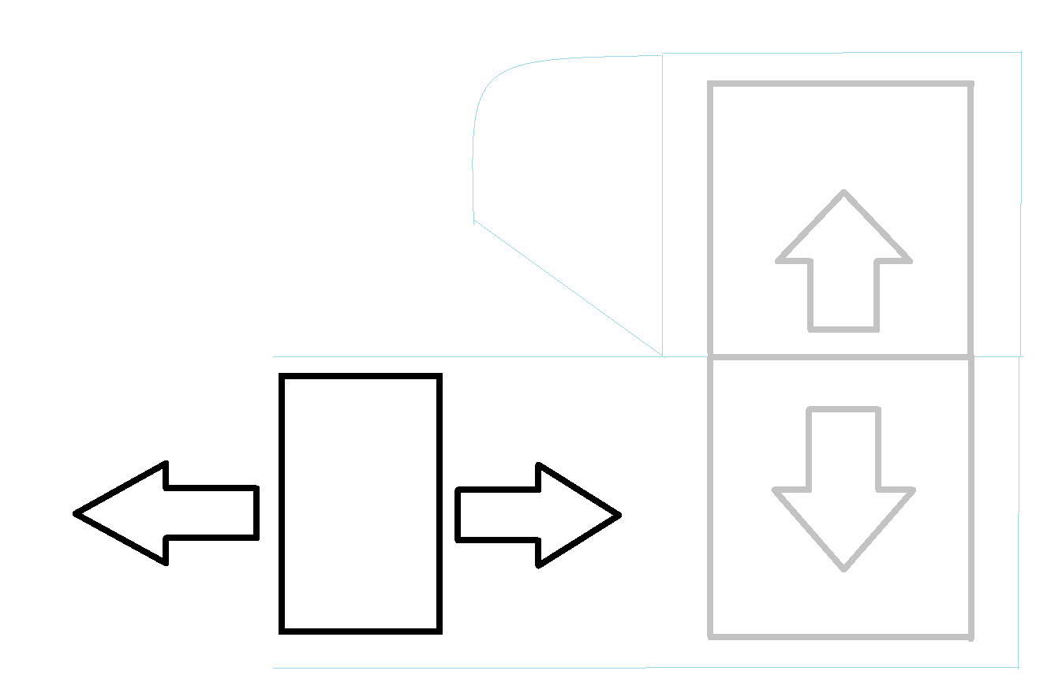
Reflexion
Put the drawer in radon zone
Put sample
Airlock and wait 1 day ?
Take drawer with the glover
Put it to the sample holder
Remove the sample from bag over the detector

Slide 44
Reflexion about the design
Pilar and access issues

Slide 45
Conclusion
Problems to assess
Missing dimension from detector
Lead property
Major improvement in users measurement
Necessity to welcome new users
24 detectors expected in PARTAGe shield
Help, ideas and manpower always welcome

Slide 49
Coordonnées
Stage germanium
Guillaume.warot@lsm.fr
Stage sphère
Ali.dastgheibi-fard@lsm.fr

