Slide 1
Material samples measured in LSM for low background experiments ( 2014- 2018)
COBRA experiment (lacquer, epoxy, CZT detectors, copper);
LEGEND experiment (PEN granulate);
TGV-2 experiment ( 106Cd);
PICO experiment (reflective foils);
NPRI samples (air filters from power plants)

Slide 2
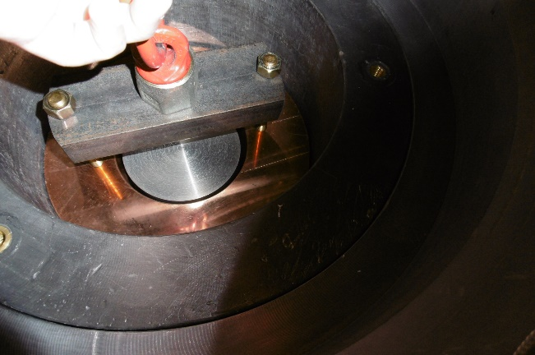
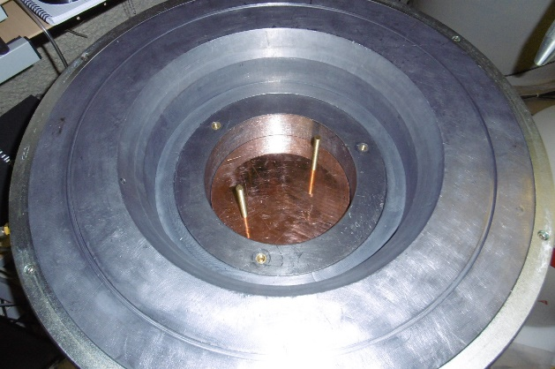
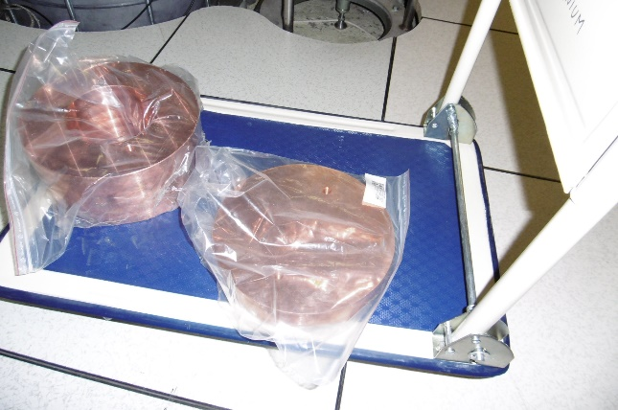
Some results:
COBRA experiment – CdZnTe 0ν Double Beta Research Apparatus,
searching for neutrinoless double beta decay in several isotopes
E [keV] | Nuclide | Activity [mBq/kg]
238 | 212Pb (228Th) | 0.12±0.02
295 | 214Pb | 0.15±0.05
352 | 214Pb (226Ra) | 0.13±0.02
583 | 208Tl | <0.02
609 | 214Bi | 0.11±0.04
661 | 137Cs | <0.01
811 | 58Co | 0.24±0.05
834 | 54Mn | <0.02
847 | 56Co | 0.07±0.01
911 | 228Ac | 0.06±0.03
1173, 1332 | 60Co | <0.02
1238 | 56Co | 0.05±0.02
1460 | 40K | 0.32±0.08
Copper sample measured with Obelix
mass = 49.3 kg
T = 894h

Slide 3
PICO experiment - searching for dark matter with superheated liquids
Reflective foils measurement with Obelix
 | 3M4090
E (keV) | Isotope | Activity [mBq/kg]
238 | 212-Pb | 4.42±0.32
295 | 214-Pb | 17.9±0.8
352 | 214-Pb | 11.8±0.4
583 | 208-Tl | 1.8±0.5
609 | 214-Bi | 10.9±0.9
1460 | K-40 | <20.9
2614 | 208-Tl | 6.92±0.14
 | 3M3930
E(keV) | Isotope | Activity [mBq/kg]
238 | 212-Pb | 2.83±0.33
295 | 214-Pb | 2.5±0.4
352 | 214-Pb | 4.9±0.3
583 | 208-Tl | 0.9±0.2
609 | 214-Bi | 4.02±0.4
1460 | K-40 | <16.3
2614 | 208-Tl | 9.3±0.3

Slide 4
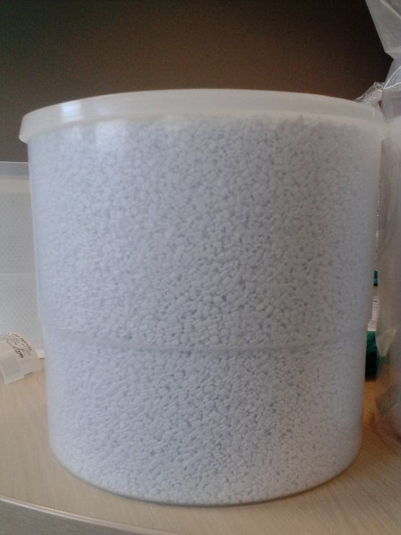
LEGEND experiment – next generation of Gerda and Majorana projects of searching for neutrinoless double beta decay in 76Ge
Polyethylene Naphthalate (PEN) granules
2 samples,
~2.8 kg mass of each sample,
measured with Obelix
Isotope | Obelix [mBq/kg]
Ra-226 | 0.30±0.02
Th-228 | 0.11±0.02

