Slide 1
Good Practices Concerning Samples

Slide 2
Sample measurement at LSM, it’s :
1000 Samples / year
21 Detectors in the lab and shortly 24
10 different representatives
Ge room’s reorganisation in progress
New LSM staff organisation
Underground entrance

Slide 3
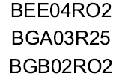
Samples numbering
Capital letters & underscores for space and dash
→
0O ? → 0=Ø O=Θ
→
Saphir Louis - N1
Saphir Louis - N2

Slide 4
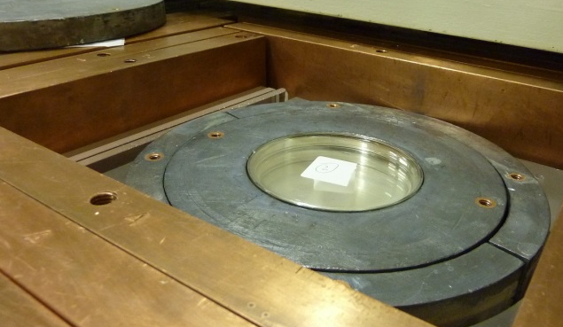
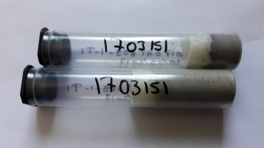
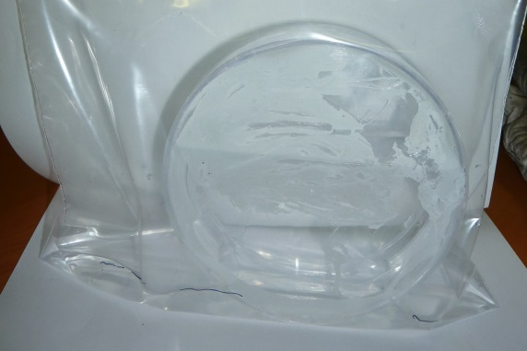
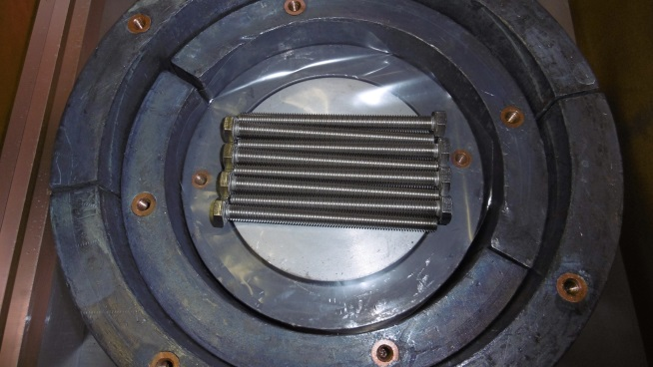
Packaging
Use Petri boxes or tubes
suitable for detector size
✗ No loose samples
Close your samples Airtightly
✗ No liquids
✗ No corrosive glues
Center your samples in the box
Write observations into BadGe

Slide 5
Delivery
Send delivery notes
Put samples into ascending order
Send an email to badge@lsm.in2p3.fr

Slide 6
Samples follow ups
For every message : badge@lsm.in2p3.fr
Searches into BadGe
Sample’s state
Nitrogen filling record…

Slide 7
Measurement’s planning
Regularly checks
Copy samples names already written down into BadGe
3 possible programs:
Sample
Source
Background

Slide 8
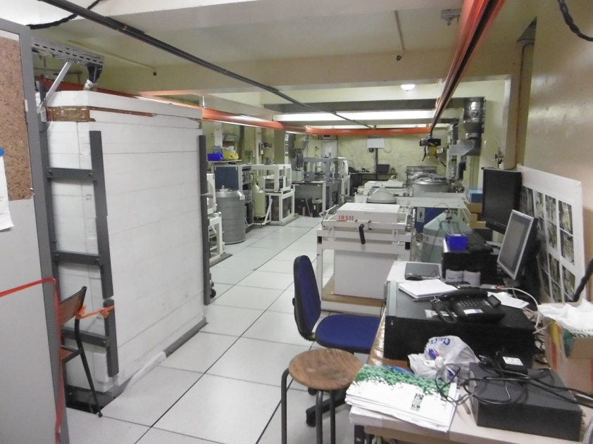
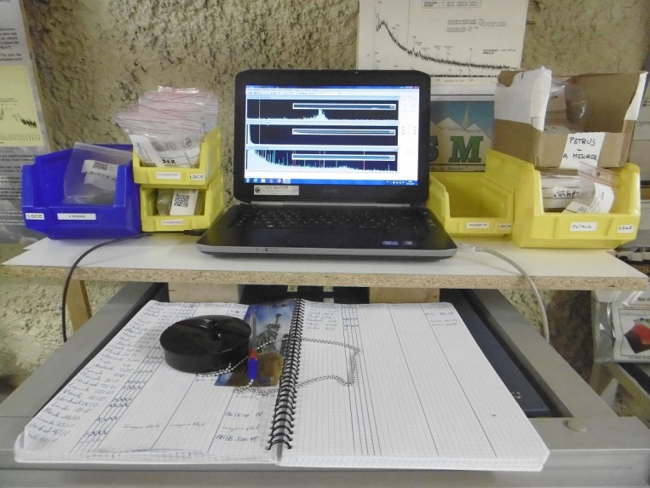
LSM storage
The main Ge room is full, so :
Don’t send too much samples in advance
Think about asking sample returns as soon as possible after measurements

Slide 9
Anticipate
Radioactive sources needs
Nitrogen fillings endings
Detector’s arrival or departure
LSM attendances

