Slide 1
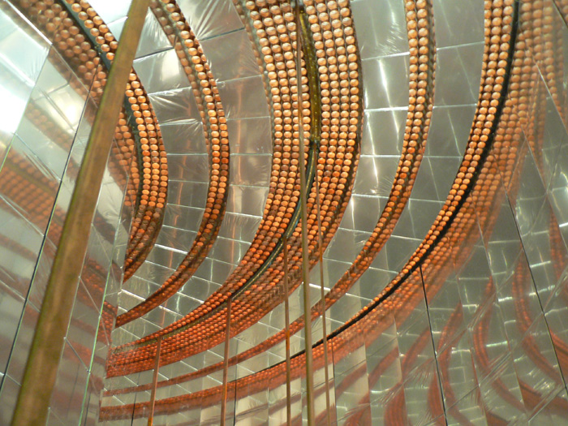
From Majorana to SuperNEMO
The nature of neutrino
Pr. Jose Busto
CPPM / Université d’Aix Marseille
Marseille
July 6th 2019

Slide 2
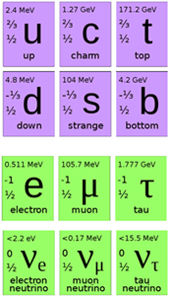






Standard Model of particle and interactions
Matter Particles (fermions)
Interaction Particles (bosons)
photon
EM Int.
γ
Quarks
gluon
gluon
gluon
g
g
g
gluon
g
Strong Int.
gluon
gluon
gluon
g
g
g
gluon
g
Leptons
+
0
-
Weak Int.
W
Z
W
Interaction by exchange of a boson :
Electron scattering
Beta decay

Slide 3
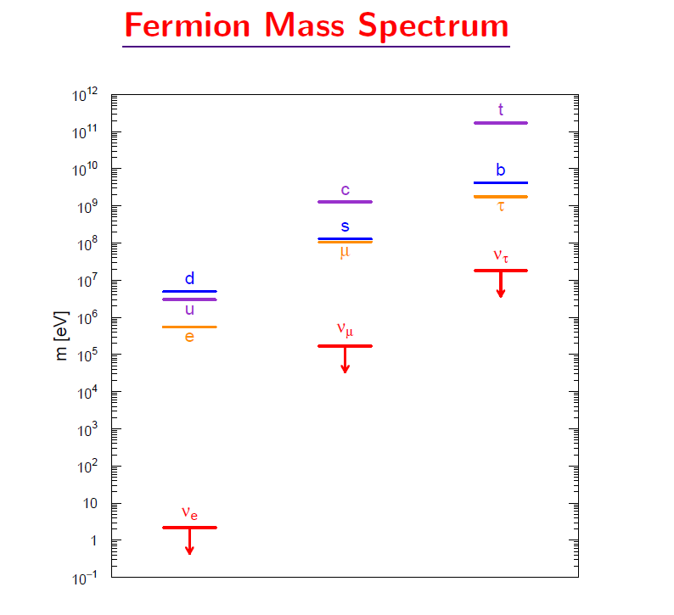
Charge and mass
Electric charge : +2/3
mass
Electric charge : - 1/3
“No mass (in SM)”
No charge
ν_{e} < 2.2 eV
ν_{μ} < 170 keV
ν_{τ} < 15.5 MeV
Direct mass limits
Neutrino : Only fundamental particle without electric charge and practically no mass
Remark : In Minimum Standard Model neutrino is massless particle

Slide 4
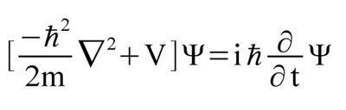


The evolution of a microscopic system in
Quantum Mechanics
Non relativistic Particle : Schrodinger Equation
Relativistic Particle : Dirac Equation
$$E^{2}=p^{2}c^{2}+m^{2}c^{4}$$
Positive and Negative energy solutions
Particle (p), antiparticle (p^{c})
If charge particle is Q < 0, antiparticle is Q > 0 => Charge conjugation operator (C)
C
e⁻ (particle) e⁺ (antiparticle)
Four solutions in Dirac Equation (spin ½) :
$e^{−}\left(+\frac{1}{2}\right)$, $e^{−}\left(−\frac{1}{2}\right)$, $e^{+}\left(+\frac{1}{2}\right)$, $e^{+}\left(−\frac{1}{2}\right)$
What about neutral particles ?

Slide 5
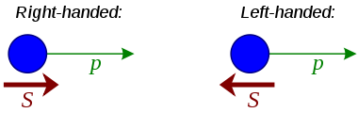




Helicity operator
Projection of spin on momentum
RH
LH
Helicity is not a good quantum number. It depends on the framework
Helicity is a good quantum number for massless particles (Helicity ≡ Chirality)
c
, ψ_{R}, ψ_{L} , ψ_{R}
Massive particle
ψ_{L}
c
Chiral
representation
c
ψ_{R}
ψ_{L} , ψ_{R}
ψ_{L}
Massless particle
OR
c
$$ψ=ψ_{R}+ψ_{L}$$
If neutrino is massless, or very light => two possibilities : Left Handed or Right Handed
Which one is the good helicity for a massless particle ?

Slide 6
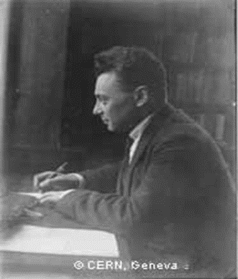
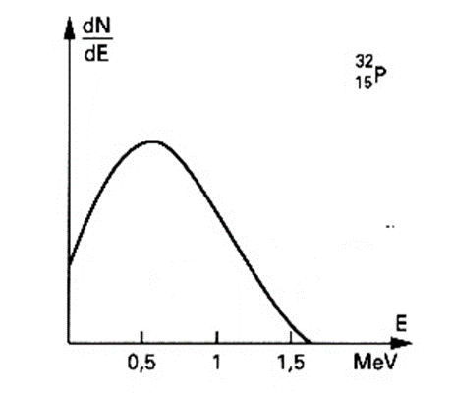
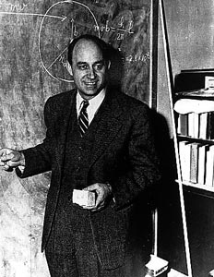
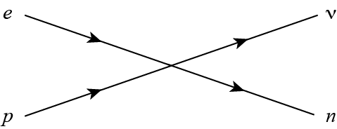


Beta decay
Pauli 1930
$${}_{Z}^{A}{X→{}_{Z+1}^{A}{Y+e^{−}+υ_{e}^{c}}}$$
Continuous spectrum neutrino hypothesis
$$n→p+e^{−}+"υ"$$
Point interaction, no W boson
New, neutral and very small mass, particle
Fermi 1933

Slide 7



What’s “ ν “ ?
electric charge
energy
momentum
angular momentum
baryon number
lepton number
Conservation laws
Strong symmetries
$$a+b→c+d$$
It works
(Requirement for SM)
+1 Lepton (e⁻, μ⁻, τ⁻, ν)
-1 antiLepton ( e⁺, μ⁺, τ⁺, ν^{c})
0 No lepton (quarks)
Lepton number L :
$$n→ p + e^{−}+"υ"$$
Lepton Number 0 = 0 +1 -1
=> “ ν “ must be an antineutrino
$$n→ p + e^{−}+υ^{c}$$
very small mass =>
Anti-neutrino : Left Handed or Right Handed ??

Slide 8
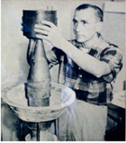
Goldhabert measure the neutrino helicity in 1958

Slide 15

$$υ_{LH }^{}and υ_{RH}^{c}$$

Slide 16
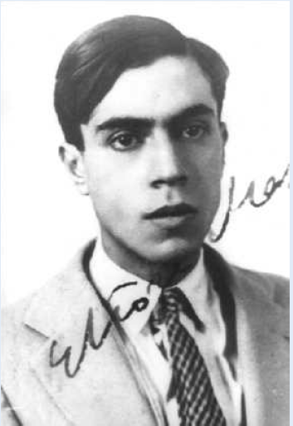
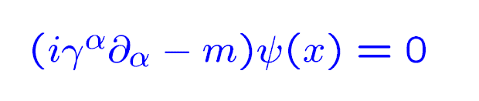
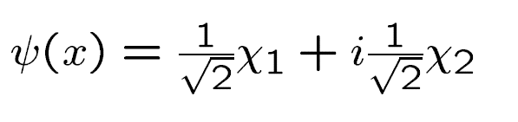
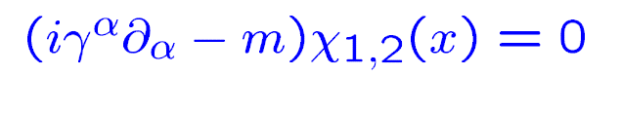
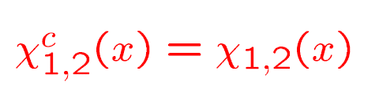
What is the nature of the neutrino ?
« Symmetric theory of electron and positron »
Ettore Majorana 1937 (brilliant student of Fermi)
In Dirac equation, fields ψ (x) are complex functions.
Majorana looks for real solutions of Dirac equation.
However
Particle ≡ anti-Particle
Only possible for neutrinos (Q =0)

Slide 17
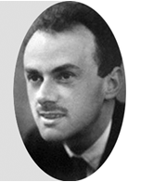
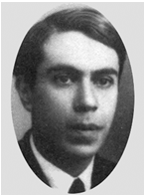


Dirac
or
Majorana
$$υ_{D}≠υ_{D}^{C}$$
$$υ_{M}=υ_{M}^{C}$$
?????
If ν is Majorana, Lepton number is not conserved.
Need new physics beyond de SM

Slide 18
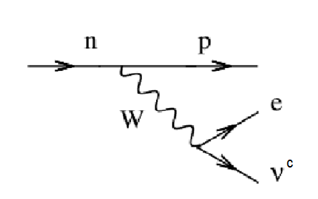
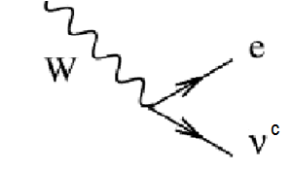
From single beta to double beta
A
Z
A
Z+1
β⁻
Single beta decay
u
d
u
u
d
d

Slide 19
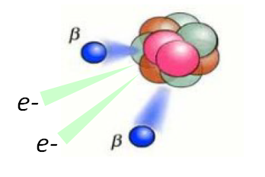
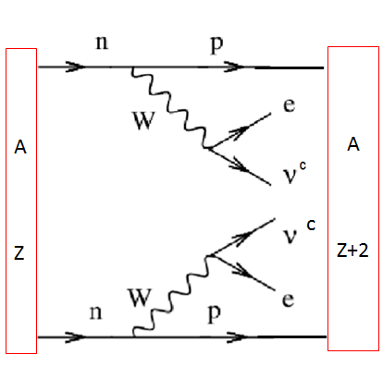
Double Beta Decay
(ββ)_{2ν}
Two neutrinos DBD
β⁻
β⁻
Two decays in the same nucleus at the same time
Prosed by Maria Goeppert – Mayer en 1935
Observed for the first time in 1987 by Michael Moe
→ 10¹⁹ to 10²¹ y
Very rare but allowed process (longest radioactive process)

Slide 20
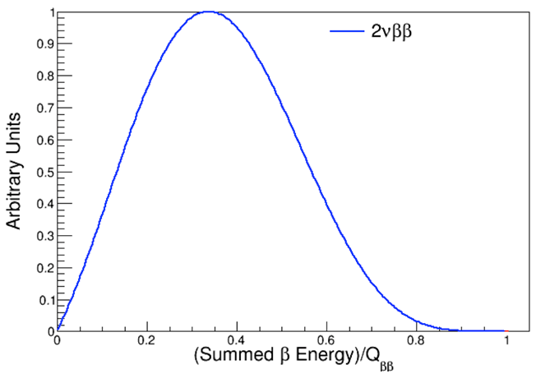


Two neutrinos spectrum
(ββ)_{2ν}
$${}_{Z}^{A}X→{}_{Z+2}^{A}Y+2e^{−}+2υ_{e}^{c}$$
$$Q_{ββ}=M\left({}_{Z}^{A}X\right)−M\left({}_{Z+2}^{A}Y\right)$$

Slide 21
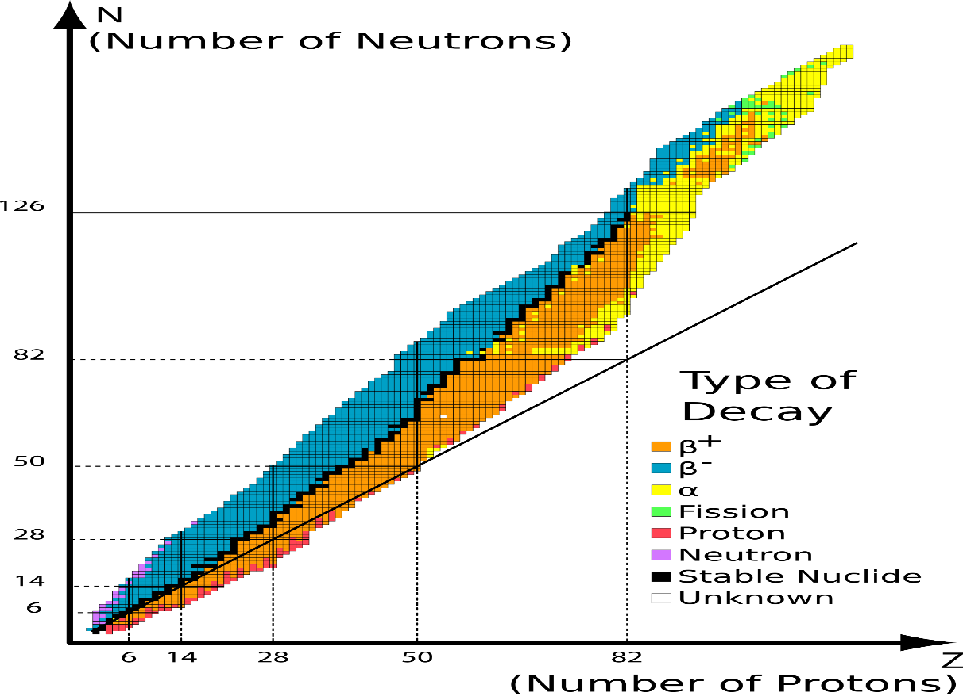
Which nucleus can decay by (ββ)_{2ν}
A = Constant

Slide 22
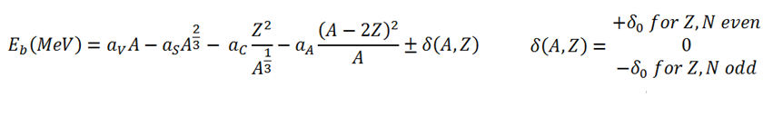
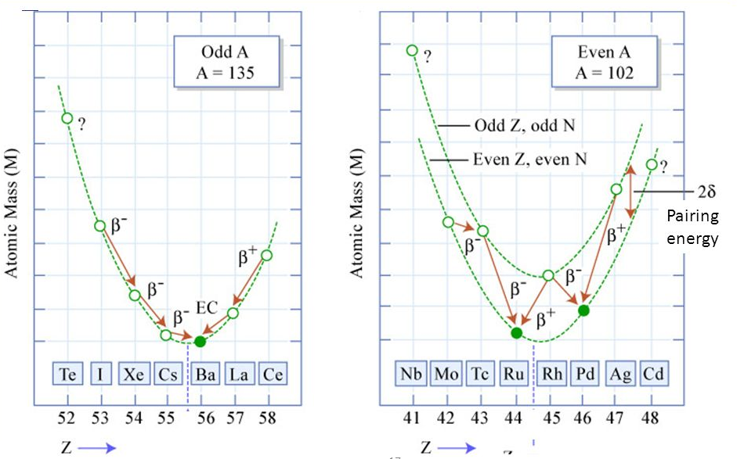
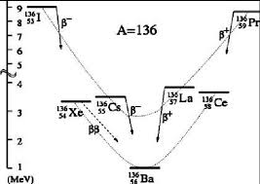
Bethe Weizsaecker formula
(Liquid drop model)
Mass or binding energy of nucleus
A = constant
For some even nucleus decay
to (A, Z+1) is impossible

Slide 23
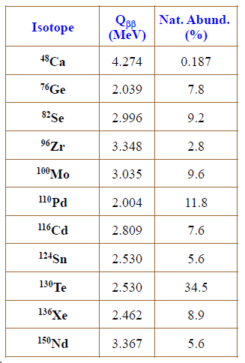
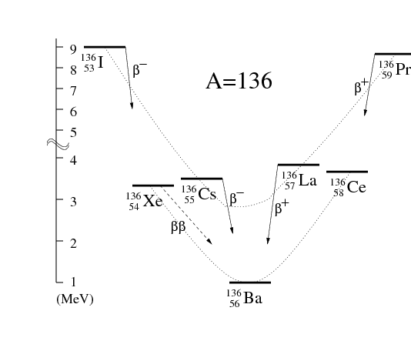
Some ββ candidates

Slide 24



Neutrinoless Double Beta Decay
(ββ)_{0ν}
$${}_{Z}^{A}X→{}_{Z+2}^{A}Y+2e^{−}$$
$$n→p+e^{−}+"υ"$$
Beta Decay
BD
Racah mecanism
$$\text{"}\text{υ}\text{" +}\text{n}→p+e^{−}$$
Inverse Beta Decay
(Neutrino capture
IBD
: ν (BD) is a RH anti-Neutrino
: ν(IBD) is a LH neutrino
In SM

Slide 25
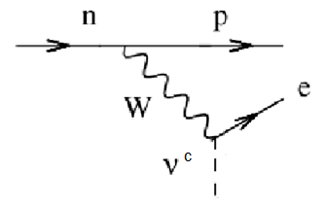
Neutrinoless Double Beta Decay
(ββ)_{0ν}
A
Z

Slide 26
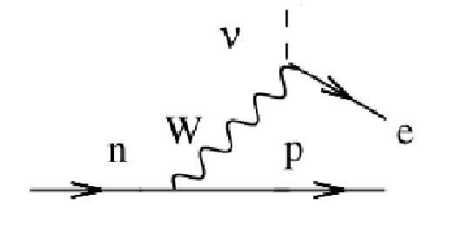

Neutrinoless Double Beta Decay
(ββ)_{0ν}
A
Z
A
Z+2
$$υ≡ υ^{c}$$
ΔL ≠ 0
=> Forbiden in the SM

Slide 27
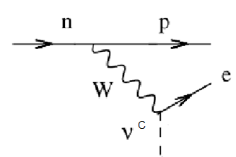

Neutrinoless Double Beta Decay
(ββ)_{0ν}
A
Z
A
Z+2
R
Need spin flip
L
L.T.
$υ_{R}^{M }{ → υ}_{L}^{M}$
=> Massive neutrino
Spin flip :
In SM IBD ν is Left-handle (LHC)
=> New interaction : IBD ν is Right-handle (RHC)
=> RH courrent → V+A interaction

Slide 28


Neutrinoless ββ spectrum
0νββ
$${}_{Z}^{A}X→{}_{Z+2}^{A}Y+2e^{−}$$
$$Q_{ββ}=M\left({}_{Z}^{A}X\right)−M\left({}_{Z+2}^{A}Y\right)$$
Phase space
Effective neutrino mass
ν mass eigenstates
Nuclear matrix
ν mixing
Quantitative parameter for a (ββ)0ν experiment

Slide 29
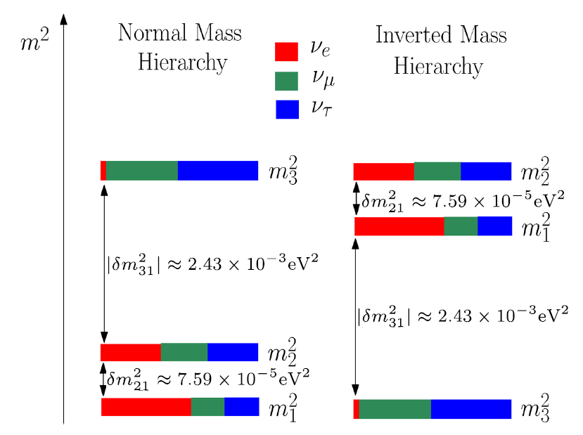
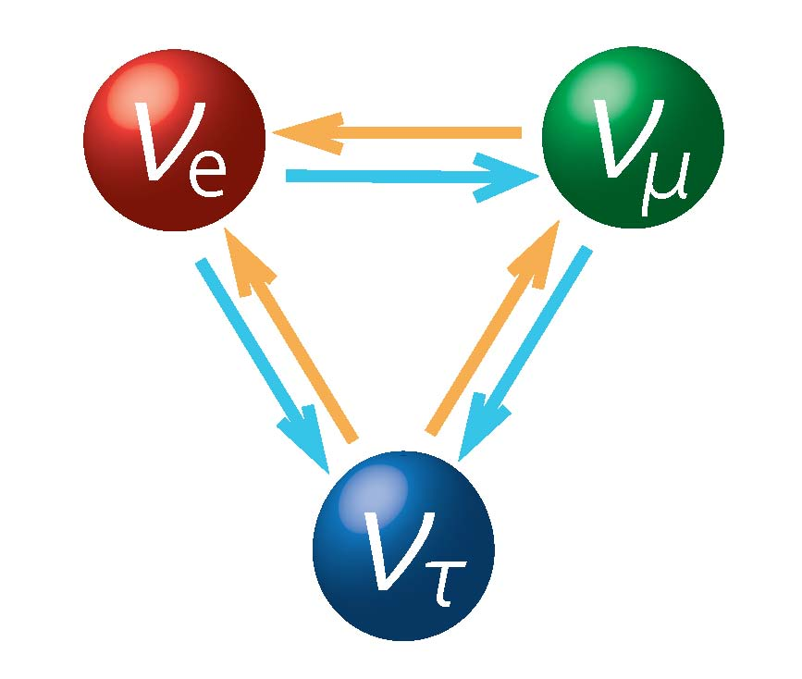
Oscillations of neutrino

Slide 30
Remarks
(ββ)_{0ν} has never been observed
(ββ)_{0ν} is a very good process to test physics beyond the SM in which Lepton Number is not conserved.
Grand Unification Theories, Super Symetry, . . .
In general Quantum Field Theory, and in particular in GUT the
see-saw mechanism is a generic model to produce neutrinos with
very small mass. Those neutrinos are Majorana

Slide 31

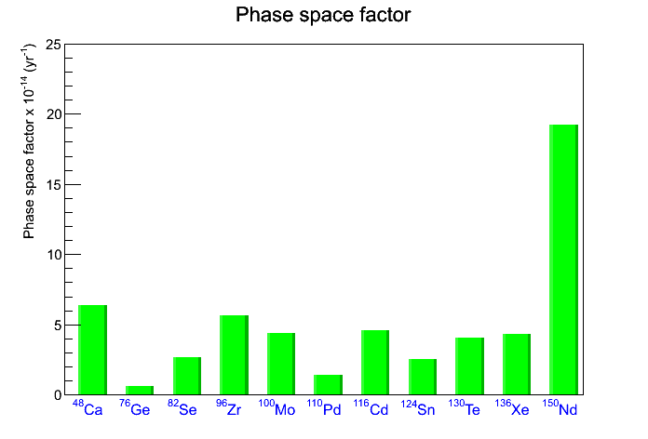
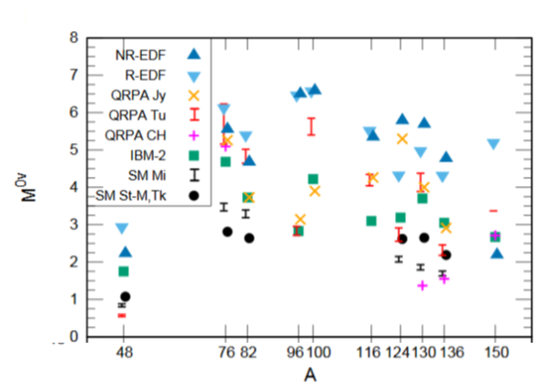
The errors on Nuclear Matrix Elements are the main
limitation for (ββ)0ν if observed

Slide 33
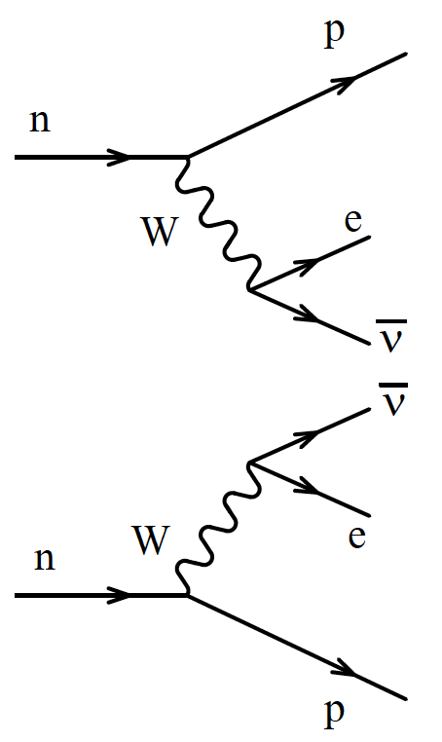
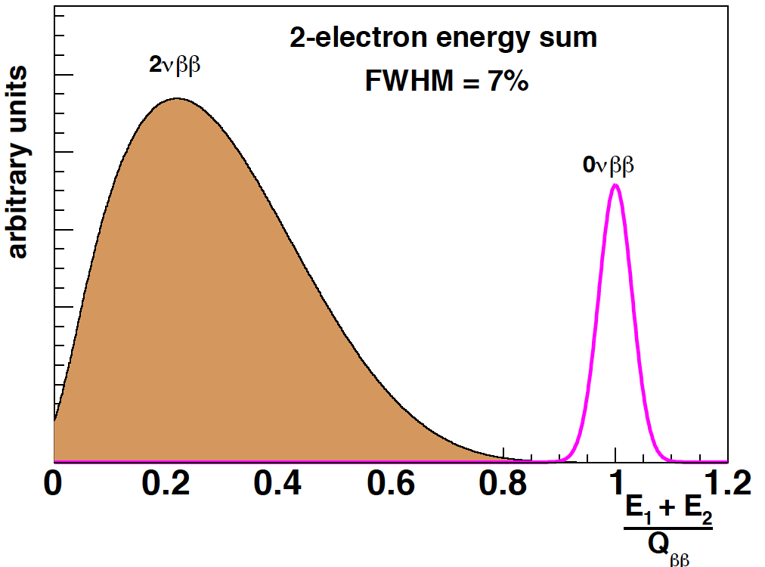
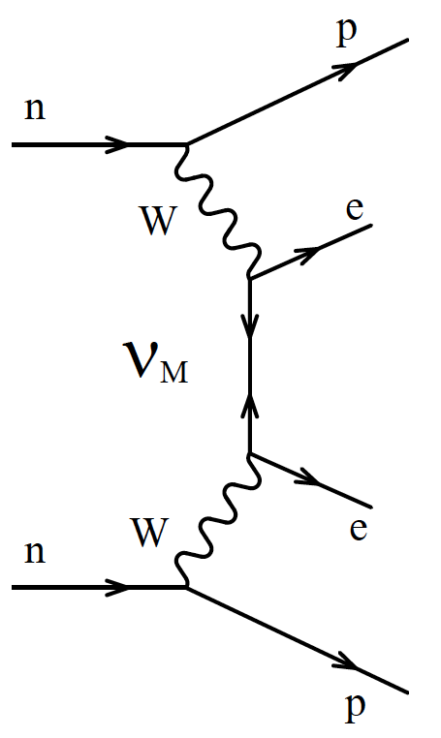
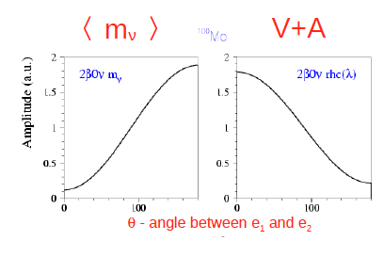
Some experimental aspects
Two electrons from the same point at the same time
Energie
4-body
final state
Angular
Distribution

Slide 34
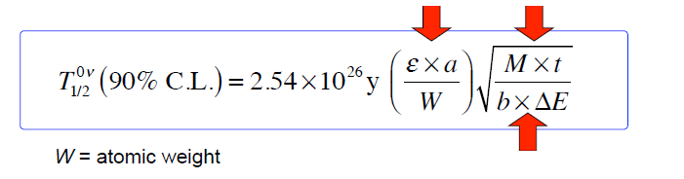
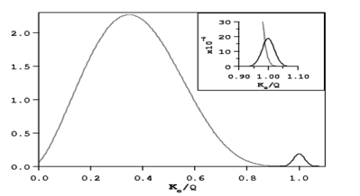
How to make a ββ experiment
Increase efficeincy ( ε) and enrichment (a)
Increase the mass ( Μ) and time (t)
Reduce radioactive background ( b) and energy resolution (ΔE)
* ΔE =>
Energy sum of two electron

Slide 35
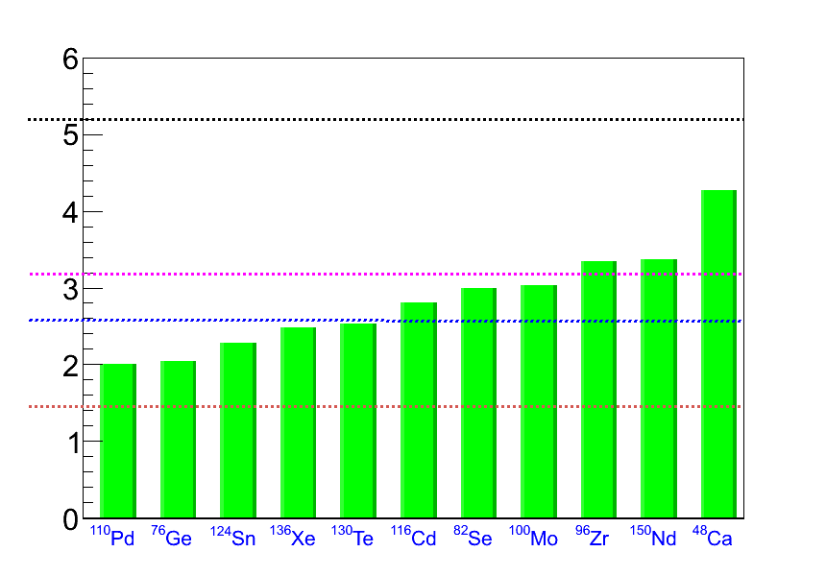
Few words about radioactive background
Origin of the background
Gamma -> e+, e-
Gamma -> 2 Compton electrons
Beta + Compton electron
Natural Radioactivity
E (MeV)
Q_{ββ}
²⁰⁸Tl (and thoron)
²¹⁴Bi (and radon)
Other background surces
Cosmic rays
γ ( (n,γ) reactions ,μ bremstrahlung
Muon spallation products
²⁰⁸Tl (2.6 MeV γ )
⁴⁰K, ⁶⁰Co,…
Need very few radioactive atoms per gram
Ex: SuperNEMO < 70 atoms of radon/m³

Slide 36
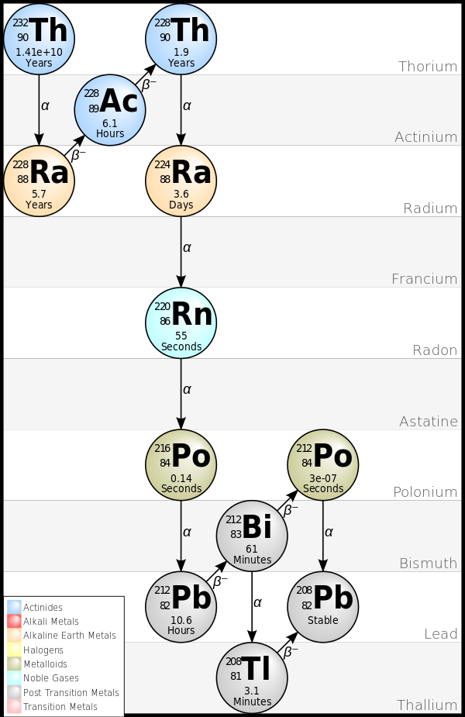
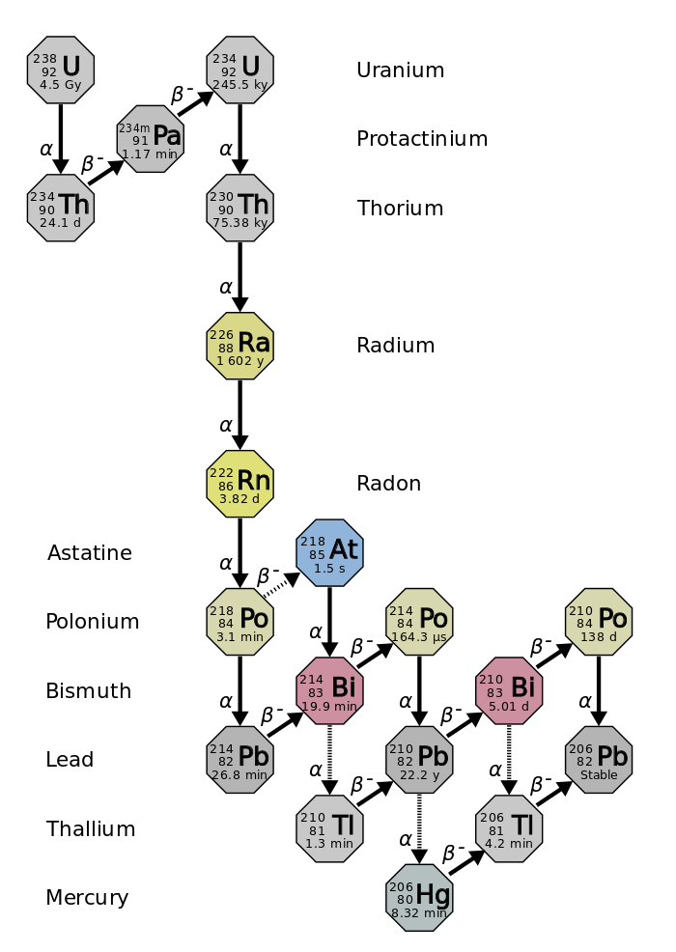
Natural radioactive chains
Many, α, β and γ particles. Up to 5 MeV electrons

Slide 38
How to make a ββ experiment
Detector = ββ Source
Detector ≠ ββ Source
Energy + time
β
Position
Energy
β
β
β
Energy + time
Calorimetry
Tracking + calorimetry
+ ΔE , ε
- kinematic
+ kinematic
+ isotope choice
+ ΔE , ε

Slide 39

Bolometer
Detector = Source
Detector ≠ Source

Slide 40
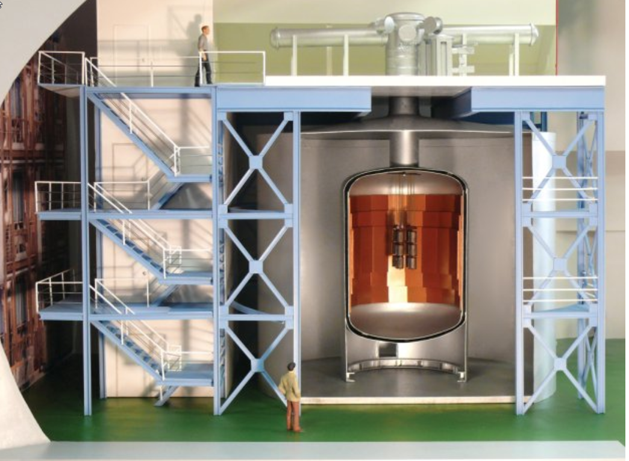
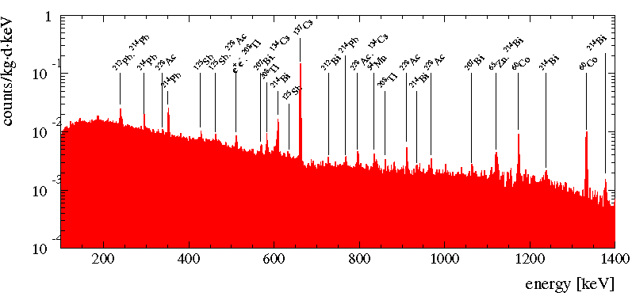
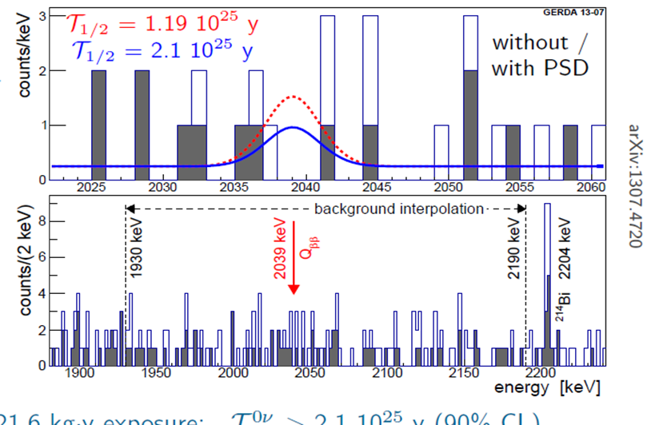
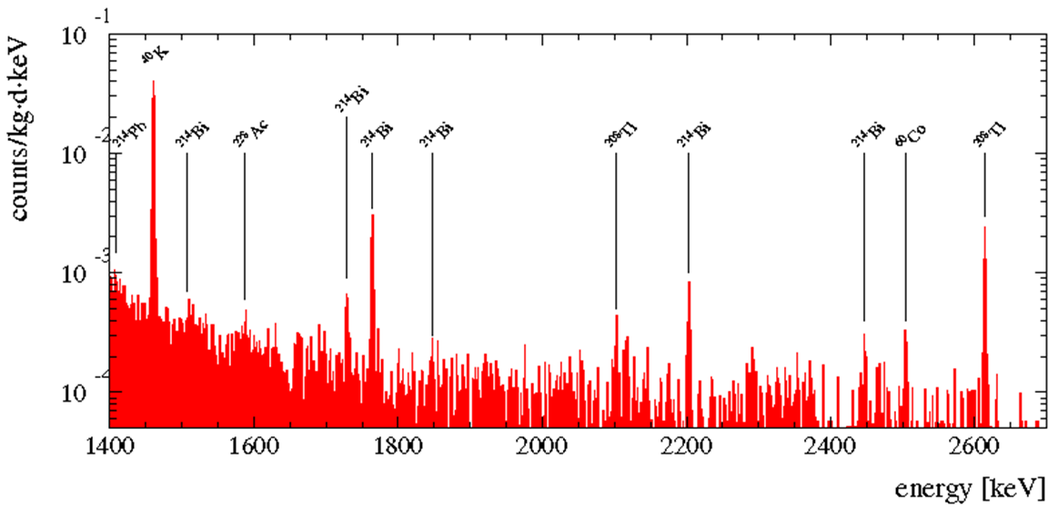
⁷⁶Ge
Very good ΔE

Slide 41
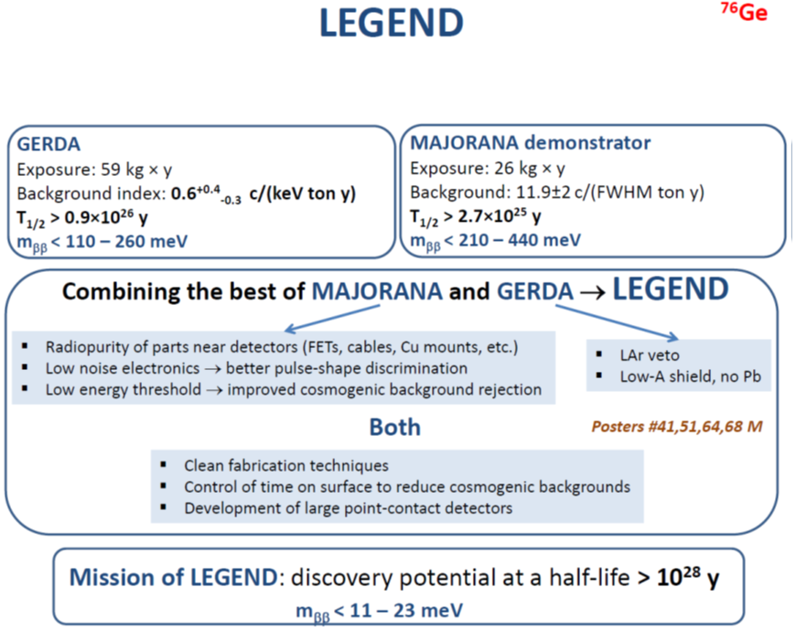
Merge of two Ge experiments
“standard” Ge detector

Slide 43
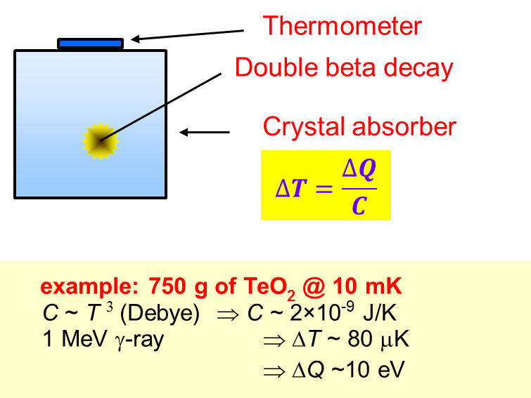


¹³⁰Te, ¹⁰⁰Mo, ⁸²Se
Bolometer technique

Slide 45

¹³⁶Xe

Slide 46

¹³⁶Xe

Slide 47

Already existing detector (Reactor Neutrino oscillations)

Slide 48
Already existing detector (Solar Neutrino oscillations)

Slide 49


Neutrino Ettore Majorana Observatory
From NEMO III
to SuperNEMO

Slide 50

The NEMO-3 Technique
The multi-observable principle:
topology, kinematics, timing
Tracking
(Geiger mode)
e⁻
Plastic
scintillator
calorimeter
e⁻
isotopic
foil
B field

Slide 51


Slide 52
NEMO-3 detector
20 sectors
Source: 10 kg of ββ isotopic foils
area = 20 m², thickness ~60 mg/cm²
Tracking detector:
drift wire chamber (9 layers)
in Geiger mode (6180 cells)
Gas: He + 4% ethyl alcohol + 1% Ar + 0.1% H₂O
Calorimeter:
1940 plastic scintillators
low radioactivity 3’’ & 5’’ PMTs
B field : 25 Gauss
Shielding:
gamma shield: pure iron (d = 18cm)
neutron shield:
30 cm water (ext. wall)
40 cm wood (top / bottom)
(since March 2004: water + boron)
3 m
B (25 G)
4 m
Particle ID: e⁻, e⁺, γ and α

Slide 53



NEMO-3 data taking: 2003 - 2010

Slide 54





NEMO3 Lab.
LSM Modane, France
(Tunnel Frejus, depth of ~4,800 mwe )

Slide 55
NEMO-3: 7 isotopes + events images
Isotope | Mass (g) | Q_{ββ} (keV)
¹⁰⁰Mo | 6 914 | 3035
⁸²Se | 932 | 2995
¹¹⁶Cd | 405 | 2805
⁹⁶Zr | 9.4 | 3350
¹⁵⁰Nd | 37 | 3367
⁴⁸Ca | 7 | 4272
¹³⁰Te | 454 | 2529
^{nat}Te | 491
^{nat}Cu | 621
Deposited energy: E₁+E₂= 2088 keV
Internal bkg hypothesis: (Δt)_{mes} –(Δt)_{theo} = 0.22 ns
Common vertex: (Δvertex)⊥ = 2.1 mm
Trigger: at least 1 PMT > 150 keV
≥ 3 Geiger hits (2 neighbouring layers+1)
Trigger rate = 7 Hz
25 ββ events per hour

Slide 56

Results
Angle between
2 electrons
Energy of
2 electrons
Energy of
1 electron
> 700 000 of 2-electron
Signal/Background : 76
T_{1/2} (2νββ) = (7.16 ± 0.01) x 10¹⁸ y

Slide 57

¹⁰⁰Mo and ⁸²Se (ββ)_{0ν} results
[2.8 – 3.2] MeV 18 observed events, 16.4 ± 1.3 expected
[2.6 – 3.2] MeV 14 observed events, 11.3 ± 1.3 expected
¹⁰⁰Mo (for exposure of 31.2 kg * y )
T_{1/2} (0νββ) > 1.0 x 10²⁴ y (90% C.L.)
m_{ββ} < 0.31 – 0.96 eV
⁸²Se (for exposure of 4.2 kg * y )
T_{1/2} (0νββ) > 3.2 x 10²³ y (90% C.L.)
m_{ββ} < 0.94 – 2.6 eV

Slide 58



Physics Studies: RHC
MM
RHC
cos(θ) cos(θ)
Evènements
attendus
Evènements
reconstruits
Energy difference between electrons

Slide 59






NEMO-3 (ββ)_{2ν} results
932 g,
3.49 y
13,719 events
S/B = 4
⁸²Se
¹¹⁶Cd
¹³⁰Te
E₁ + E₂ (MeV)
[ 9.6 ± 0.1 _{(stat)} ± 1.0 _{(syst)} ] x 10¹⁹ y
[ 2.88 ± 0.04_{(stat)} ± 0.16_{(syst)} ] x 10¹⁹ y
[ 7.0± 0.9_{(stat)} ± 1.1_{(syst)} ] x 10²⁰ y
⁴⁸Ca
133 events
S/B 6.76
⁹⁶Zr
¹⁵⁰Nd
1221 days
S/B 0.98
9.41g
948 days
7g
E₁ + E₂ (MeV)
[ 9.11 ^{+0.25}_{-0.22 (stat)} ± 0.63_{(syst)} ] x 10¹⁸ y
[ 2.35 ± 0.14_{(stat)} ± 0.16_{(syst)} ] x 10¹⁹ y
[ 4.4 ^{+0.5}_{-0.4} _{(stat)}± 0.4 _{(syst)} ] x 10¹⁹ y

Slide 60


From NEMO-3 to SuperNEMO
NEMO-3 | R&D since 2006 | SuperNEMO
¹⁰⁰Mo | Isotope | ⁸²Se (or ¹⁵⁰Nd or ⁴⁸Ca)
7 kg x 5 years | Exposure | 100 kg x 5 years
18% | 0νββ efficiency | 30%
T_{1/2}^{0νββ} >(1-2) x 10²⁴ years <m_{ν}> < 0.3 – 0.8 eV | Sensitivity | T_{1/2}^{0νββ} > 1 x 10²⁶ years <m_{ν}> < 0.04 – 0.1 eV

Slide 61


SuperNEMO demostrator
Objective: to reach the background level for 100 kg
to perform a no background experiment with 7 kg isotope of ⁸²Se in 2 yr
Source
²¹⁴Bi < 10 μBq/kg
(NEMO3 100 μBq/kg)
208Tl < 2 μBq/kg
(NEMO3 100 μBq/k)
Calorimeter
ΔE/E < 4% @ 3 MeV
(NEMO3 8.6% at 3MeV)
Tracker
3.7 m long (NEMO3 2.7 m)
σ_{t} = 5 mm, σ_{z} = 1 cm
Radon < 0.15 mBq/m³
(NEMO3 5 mBq/m³)
Wiring robot
Global efficiency : 30 % (NEMO3 8%)

Slide 63
Conclusion
Neutrino is a fantastic particle to explore new physics beyond de SM.
Despite the important advances in neutrino physics (neutrino oscillations demonstrate that MSM is wrong), we don’t know what is the nature of neutrino : Dirac or Majorana.
Neutrinoless double beta decay is the best way to test the neutrino nature and open the door to new physics beyond the SM.
The field is extremely active : Variety of approaches and technologies

Slide 64
Backup

Slide 65



SuperNEMO R&D: Tracker
90-cell prototype
Wiring robot
Design verified with 90-cell prototype
  Resolution: 0.7mm transverse, 1cm longitudinal
  Cell efficiency > 98%
Automated wiring robot being commissioned for mass production in ultra low background conditions
  500000 wires to string, crimp and terminate
Readout electronics under development
Anode
Cathode 1
Cathode 2

Slide 66



SuperNEMO R&D: Calorimeter
Target ΔE/E reached with hexagonal and cubic blocks and high QE 8’’ Hamamatsu R519MOD PMTs:
7.2% FWHM at 1 MeV
(equivalent to 4% at Q_{ββ} = 3.0 MeV)

Slide 67


Slide 68



Isotope enrichment
Why so many experiments and projects
Nucleus | Existing method | R&D
⁴⁸Ca |  | Laser separation, gazeous diffusion
⁷⁶Ge | Centrifugation
⁸²Se | Centrifugation
⁹⁶Zr |  | Laser separation
¹⁰⁰Mo | Centrifugation
¹¹⁶Cd | Centrifugation
¹³⁰Te | Centrifugation
¹³⁶Xe | Centrifugation
¹⁵⁰Nd |  | Centrifugation, Laser
R&D in KAERI (Korea) for
⁴⁸Ca enrichment by laser
R&D in Russia for
¹⁵⁰Nd enrichment
by centrifugation
R&D in France for
¹⁵⁰Nd enrichment
by laser

Slide 69




En 1957 Bruno Pontecorvo
Si les états propres de saveur et les états propres
de masse ne sont pas confondus
=> Oscillations de neutrinos
E.P. Saveur
E.P. Masse
Matrice Mélange
${m2}_{1}^{}$ - ${m2}_{2}^{}$
Pontecorvo-Maki-Nakasawa-Sakata

Slide 70






Oscillations de neutrinos
E_{ν} ~ 10 GeV
L ~ 10 Km
ν_{e,,} ν_{μ,}
p + p → d + e⁺ + ν
E_{ν} ~ 10 MeV
L ~ 10⁸ Km
ν_{e}
atmosphériques
solaire
E_{ν} ~ 1 GeV
L ~ 300 Km
ν_{μ,}
E_{ν} ~ 1 MeV
L ~ 1 Km –100 Km
ν_{e,}
accélérateur
réacteur
V_{PMNS}
=>
m_{ν} ≠ 0
m_{ν} = ?

Slide 71

Hiérarchie de masse

Slide 72

ββ v.s. oscillations

Slide 73

Neutrinos abundance in the Univers
Second most abundance particle
in the universe
413 photons/m³
340 neutrinos/cm³ ( ν_{e} ,ν_{μ} ,ν_{τ} )
(−)
(−)
(−)
Better knowledge of neutrino
physics => direct impact in astrophysics
and cosmology

