Slide 1
The Cosmic Ray angular distribution
Group member: You Qi, Zhou Hang, Sang Haoyu
Project counselor: Massimiliano Lincetto

Slide 2
Outline
Background of Cosmic Rays
Experiment
Data Analysis
Results and Conclusions

Slide 3
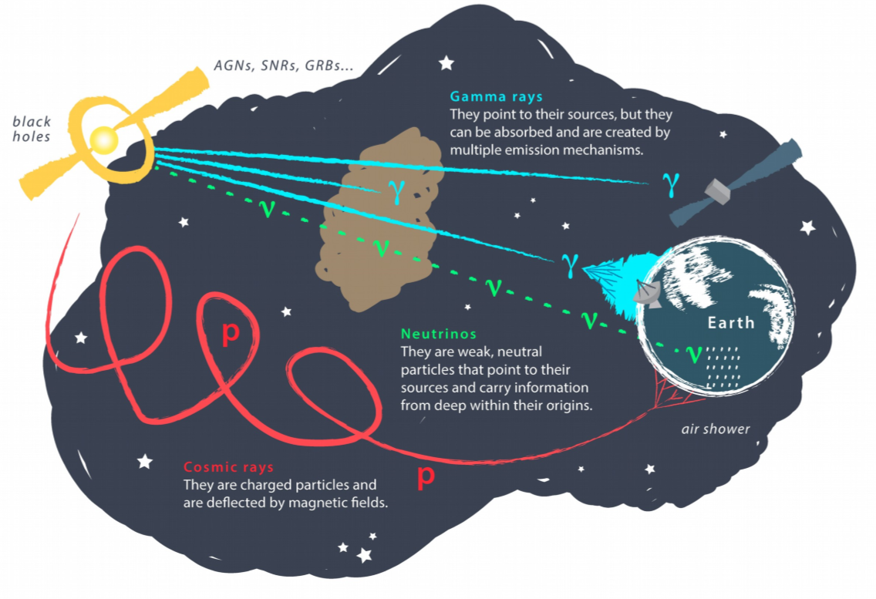
Background of Cosmic Rays
Muons are the main component of cosmic rays observed at sea level;
Most of the muons are produced at 15 km above sea level from the decay of charged mesons, including pions and few kaons.
$$π^{±}→μ^{±}+ν_{μ}\left({\overline{ν}}_{μ}\right)$$
$$K^{±}→μ^{±}+ν_{μ}({\overline{ν}}_{μ})$$

Slide 4
Experiment
Background of Cosmic Rays
Experiment
Data Analysis
Results and Conclusions

Slide 5
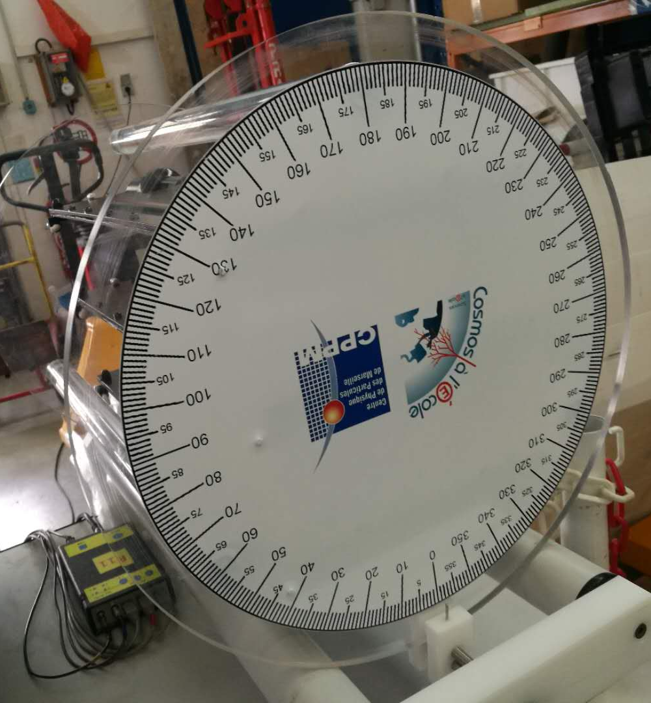
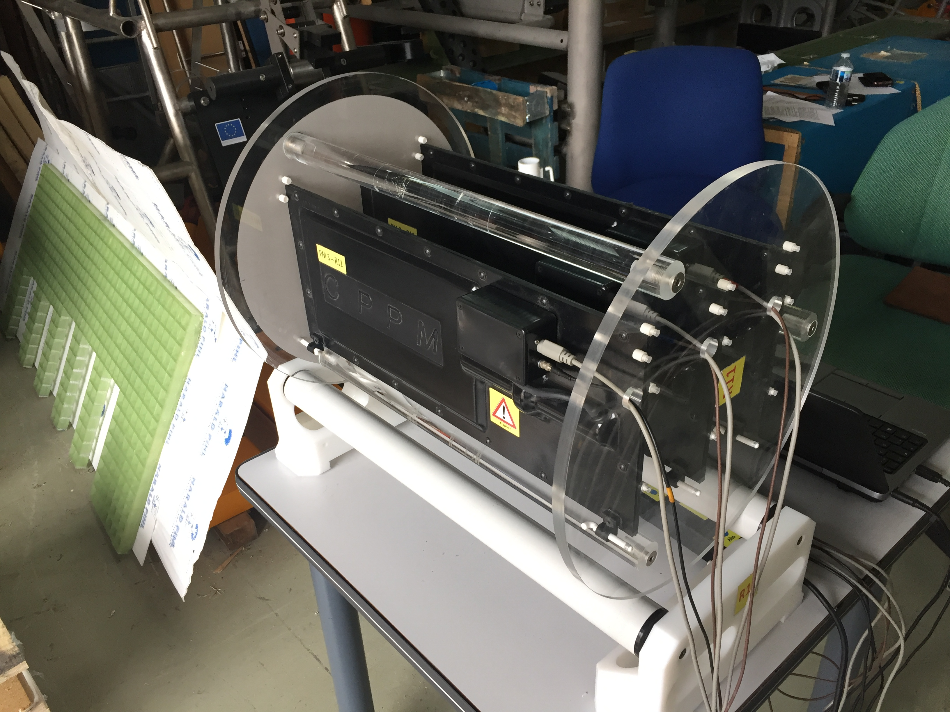
Experimental Device
three plastic scintillator detectors
angle disc
Scintillator
PMTs
Coincidence Techniques

Slide 6
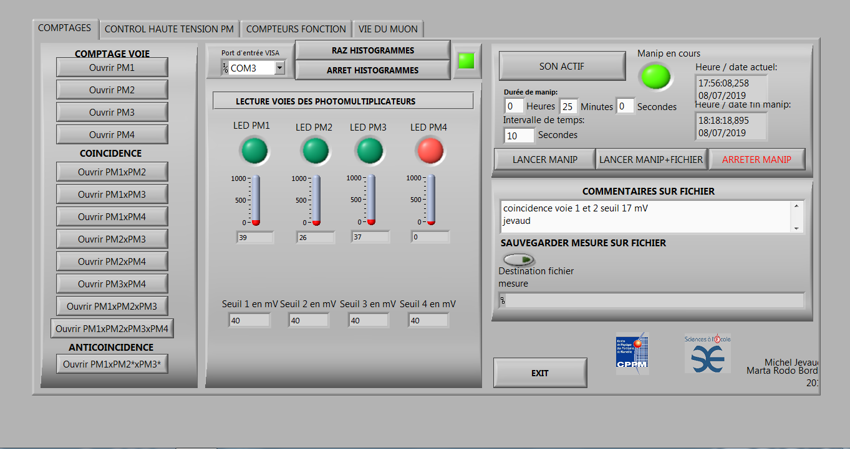

Slide 7
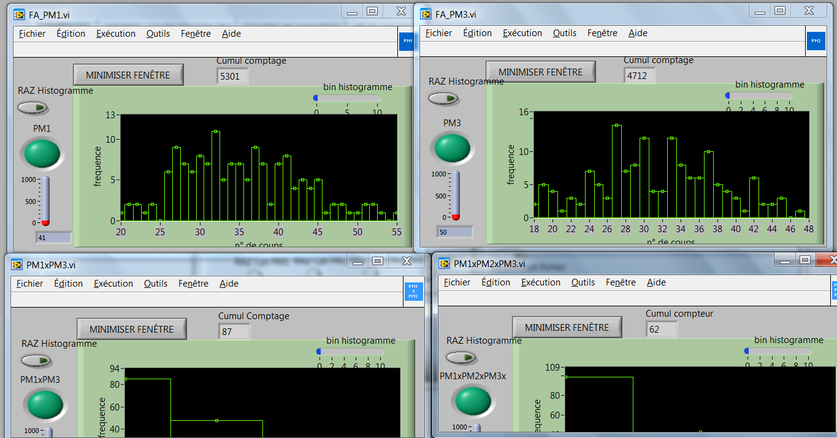
PM1
PM3
√
PM1×3
PM1×2×3

Slide 8
Data Analysis
Background of Cosmic Rays
Experiment
Data Analysis
Results and Conclusions

Slide 9
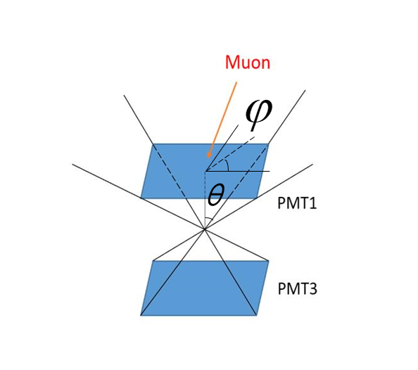
Data Analysis

Slide 10
Error Estimation

Slide 11
Results and Conclusions
Background of Cosmic Rays
Experiment
Data Analysis
Results and Conclusions

Slide 12
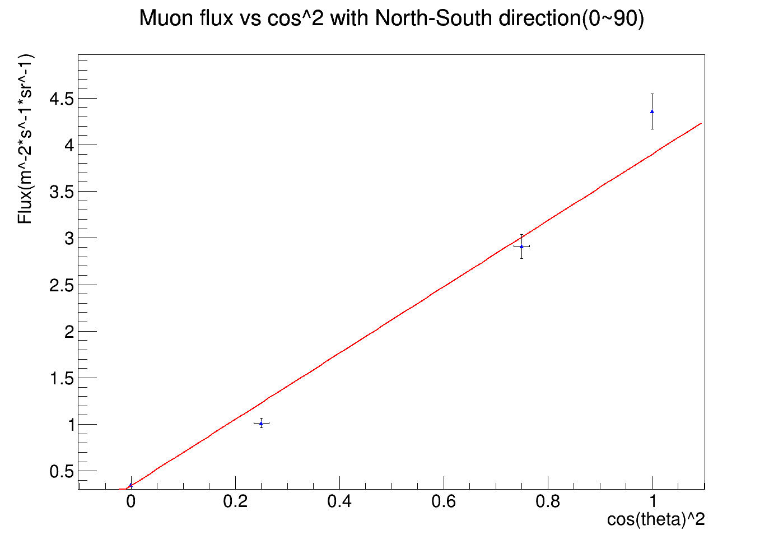
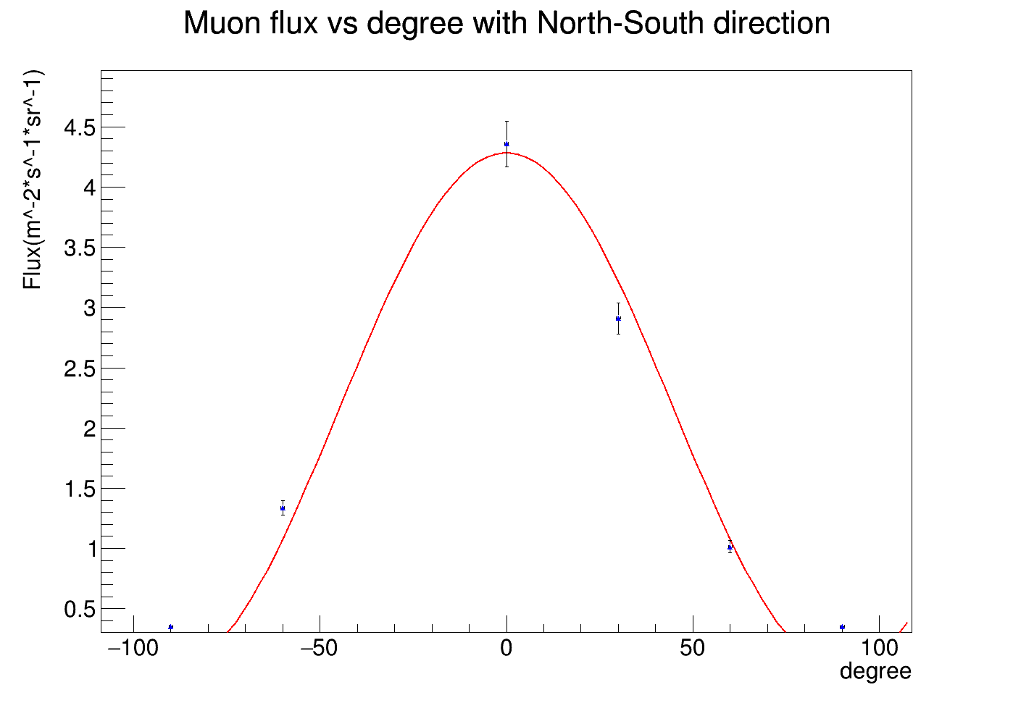
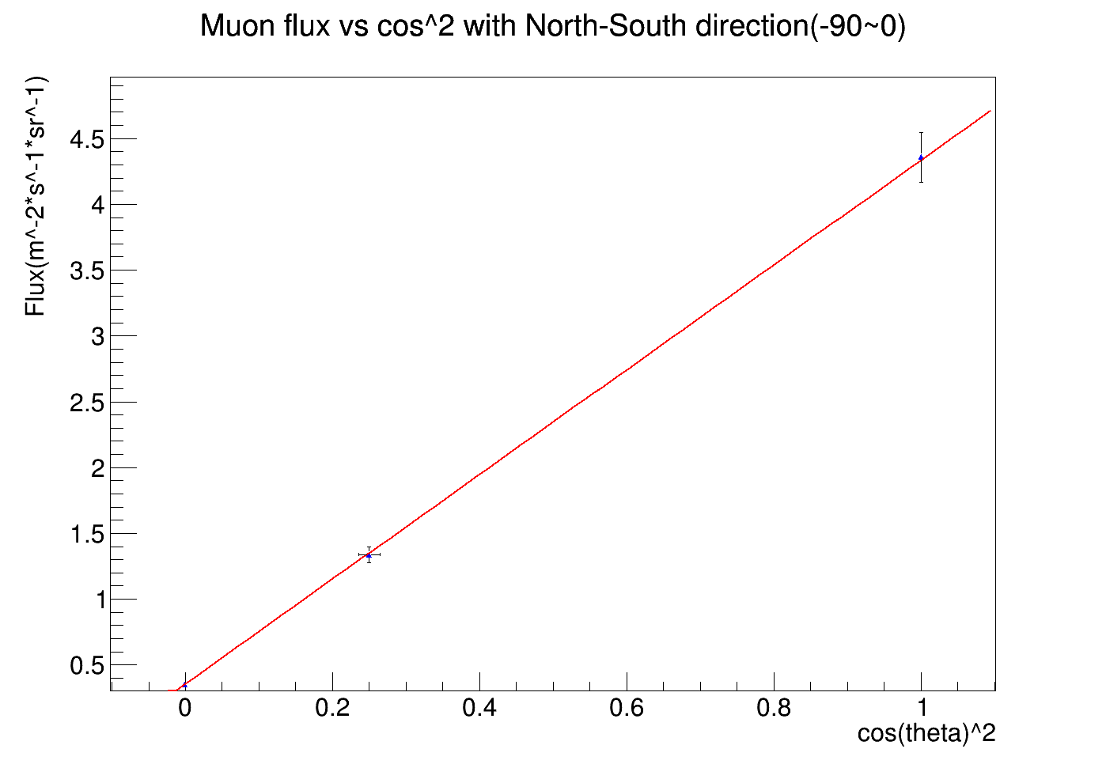
North-south direction
F ~ cos²θ
F ~ θ
F ~ cos²θ

Slide 13
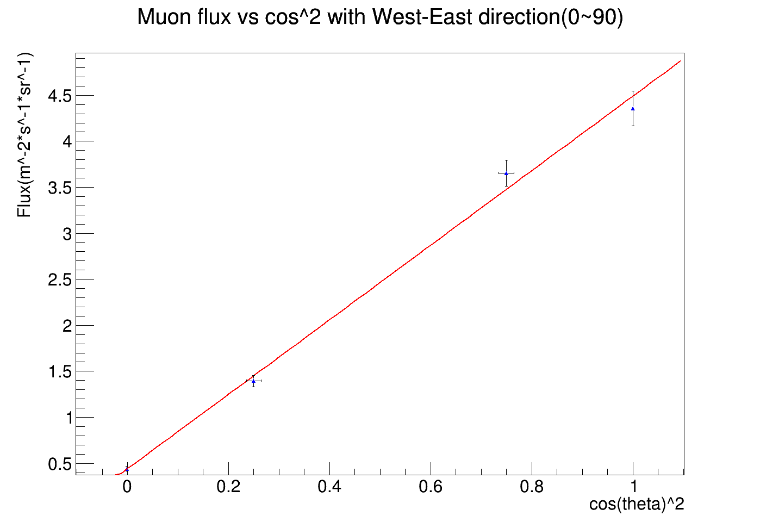
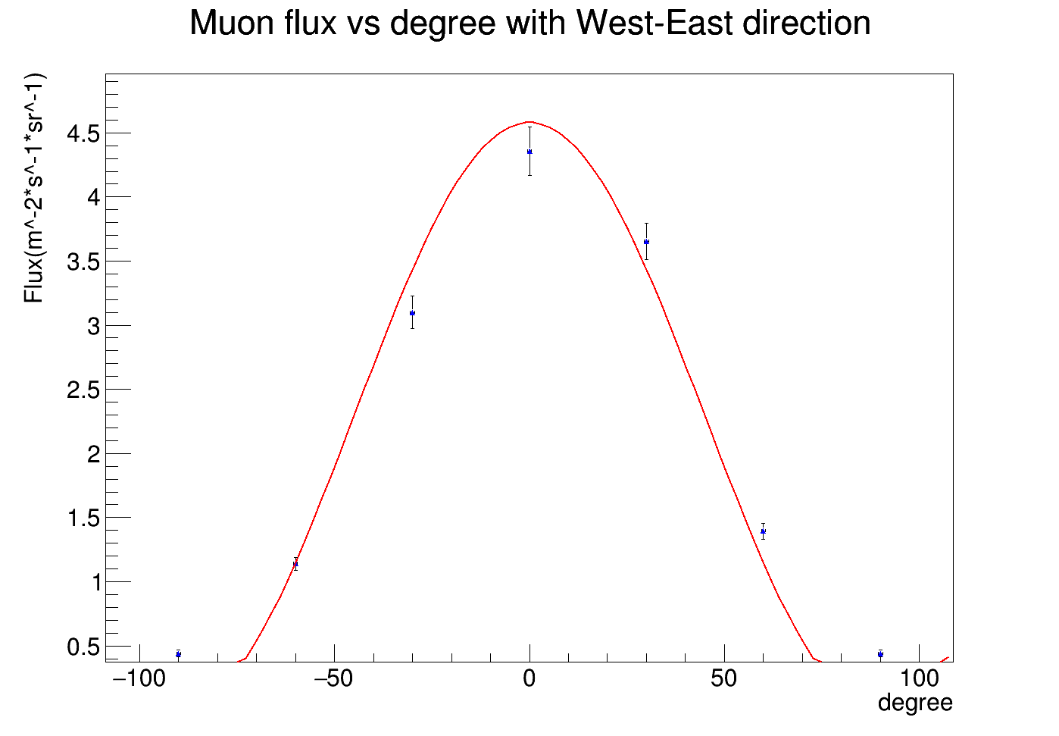
West-east direction
F ~ cos²θ
F ~ θ
F ~ cos²θ

Slide 14
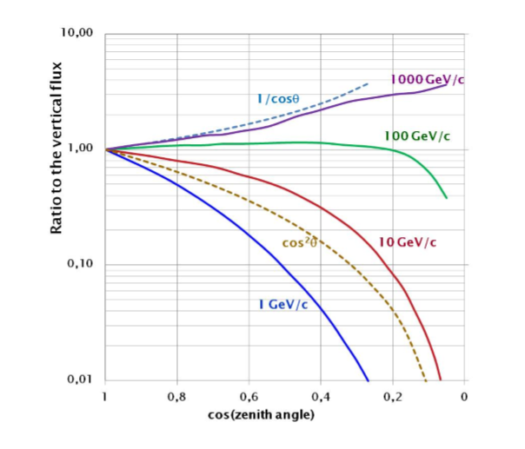
Some Explanations
F ∝ cos²θ
The overall angular distribution of muons measured at sea level is ∝ cos²θ, which is characteristic of muons with Eµ ∼ 3 GeV.^{[1]}

Slide 15
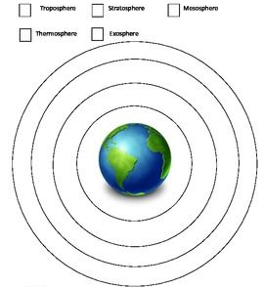
0°
90°

Slide 16
Appendix — fitting parameters and statistical errors
North-south direction
West-east direction

Slide 17
Reference
Cecchini S , Spurio M . Atmospheric muons: experimental aspects[J]. Geoscientific Instrumentation, Methods and Data Systems,1,2(2012-11-21), 2012, 2(2):185-196.

