Slide 1
ESCAPE General Assembly WP1
Jayesh Wagh, CNRS-LAPP

Slide 2
Project Overview
Grant Agreement
Communication and dissemination
Consortium Agreement
Grant Agreement Amendments
Notes:
Add project management slide from GL ppt

Slide 3
H2020-ESCAPE Beneficiaries
Countries | Beneficiaries
France | 1
Intergovernmental | 2
Netherlands | 4
Germany | 10
Italy | 6
Belgium | 1
UK | 3
Spain | 4
ESCAPE convenes a large scientific community
31 partners (including 2 SMEs)
7 ESFRI projects & landmarks: CTA, ELT, EST, FAIR, HL-LHC, KM3NeT, SKA
2 pan-European International Organizations: CERN, ESO (with their world-class established infrastructures, experiments and observatories).
4 supporting ERA-NET initiatives: HEP (CERN), NuPECC, ASTRONET, APPEC
1 involved initiative/infrastructure: EURO-VO
2 European research infrastructures: EGO and JIV-ERIC
Notes:
Add table instead of chart

Slide 4
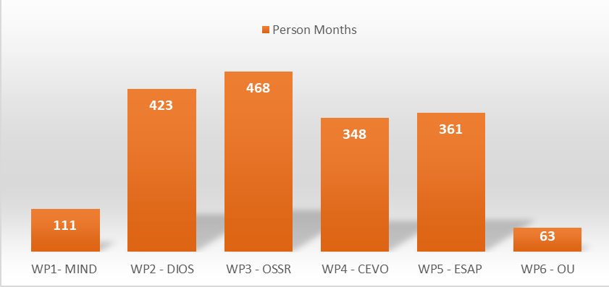
Workpackages and person months
Notes:
Remove the + of WP1

Slide 5
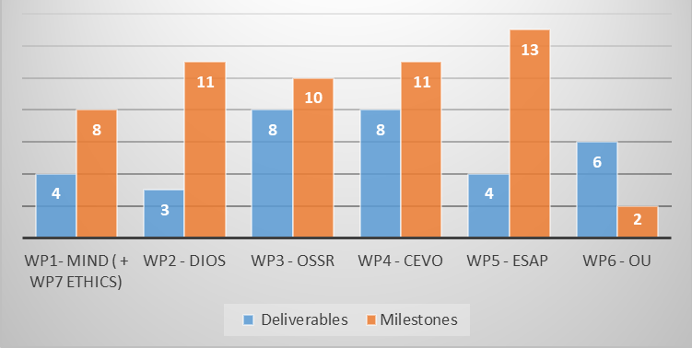
Deliverables and Milestones
Total number of deliverables = 33
Total number of milestones = 55
First project deliverable = POPD requirement 1 (WP7 Ethics) due on April 2019 – CNRS
First project milestone = Project kickoff meeting ( WP1 MIND) due on February 2019 – CNRS
Notes:
Reduce font size

Slide 6
First deliverables by WP =
WP1– M3, WP2– M8, WP3 – M12, WP4 – M6, WP5 – M6, WP6 – M5
First milestones by WP =
WP1 – M1, WP2- M12, WP3-M12, WP4 – M12, WP5 –M12, WP6 – M18
Article 19 ESCAPE Grant Agreement – We must respect the deadline for deliverables, milestones and periodic reports.
Workpackage leaders are responsible for timely submission and quality control of the deliverable.
Internal workpackage management is necessary to delegate and coordinate tasks.
Maintain a timescale for deliverable submission and aim for completion atleast couple of weeks before the deadline mentioned on the GA.
All the finalized deliverables will be made public on the project website.
Notes:
Reduce font size

Slide 7
H2020-ESCAPE Grant Agreement
Signed by EC and ESCAPE consortium.
Grant Agreement number 824064.
Can be downloaded from the participants portal. Please check with your respective admin contacts for ECAS logins.
Entered into force on 22 November 2018
Official project kickoff date = 01 February 2019
Project duration = 42 months
Maximum grant amount = EUR 15,983,301.25
Prefinancing amount (48.33%) = EUR 8,524,427.33
Guarantee fund (5%) = EUR 799,165.06
Reporting periods = 3 (M18, M36 & M42)
Notes:
Reduce font size

Slide 8
Promoting the action and results
Important details to be listed while attending conference, seminars , workshops etc.
Event title, date and venue
Type of dissemination and communication activities – presentation, poster etc.
Estimated number of persons reached ( scientific community, industries, policy makers , general public etc.

Slide 9
Communication of activities
“This project has received funding from the European Union’s Horizon 2020 research and innovation programme under grant agreement No 824064”

Slide 10
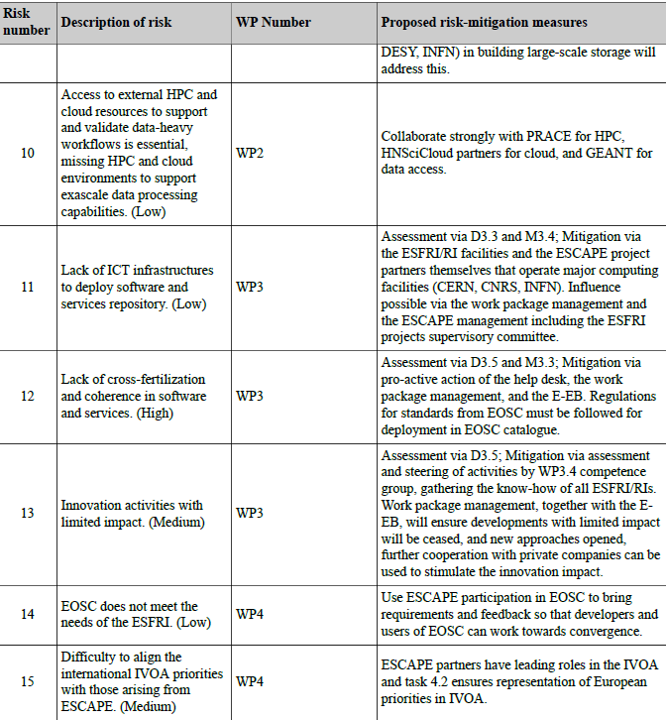
Critical risks and mitigations
21 risks enlisted on the GA with varying impact levels low, medium, high.
Each WP leader is invited to monitor and take corrective measures for their respective workpackage
Required for the periodic reporting

Slide 11
Financial Overview
Prefinancing payment will be released from CNRS
3 Financial reports M18, M36, M42
Each beneficiary is expected to submit the financial forms on the participant portal
Timesheets – extremely important for personnel cost.
Please ensure that the recruitments are being carried out as planned.
Contact the coordinator, if in doubt for cost eligibility.
We count on your support for financial reporting and forecasts.
Notes:
Recice font size

Slide 12
Consortium Agreement
Finalized on 10 December 2018.
Defines the governance model for the consortium of 31 beneficiaries.
General Assembly as the ultimate decision-making body of the Consortium.
Ex. Amendments. It consists of consist of one representative of each Party.
General Assembly meetings will be organized atleast once a year.
Executive Board as the supervisory body for the execution of the Project which shall report to and be accountable to the General Assembly. Consists of the Project Coordinator and the WP leaders.
Executive Board meeting will be carried out quarterly.
Project coordinator (party) – interface between the consortium and EC.
Management Support Team assists the Executive Board and the Coordinator.

Slide 13
Amendments to the ESCAPE Grant Agreement
Amendment 1 : EGO
Amendment details: Addition of Universita' degli Studi di Urbino Carlo Bo (PIC 997437906) as a linked third party to European Gravitational Observatory (EGO) with transfer of 30k€ from EGO budget.
Justification for the amendment: expected key contribution from University of Urbino and for EGO-Virgo community in the realisation of Virtual Observatory tools (WP 4, see table 3.1a.4 of the ESCAPE proposal). The role of University of Urbino as third party was already expected at the proposal phase, but because of some delay we decided to postpone to the first occasion in the project life.
Notes:
Add 2nd amendment - USMB as LTP to CNRS, To be confirmed

Slide 14
Amendment 2 : CNRS (LAPP)
Amendment details: Université Savoie Mont Blanc (USMB) as a linked third party to CNRS (To be confirmed).
Justification for the amendment: One of the key member involved in ESCAPE activities is an employee of the USMB.

Slide 15
Addition of a linked third party - Amendment required

Slide 16
Thank you !

