Slide 1
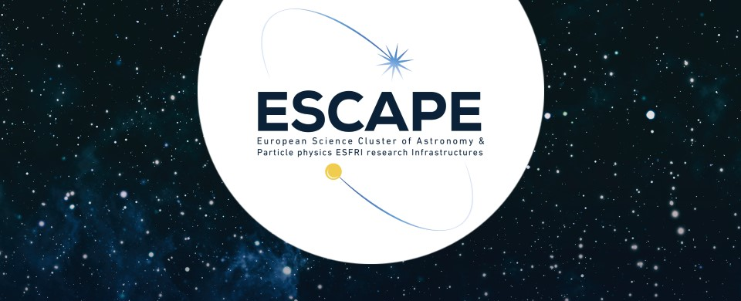
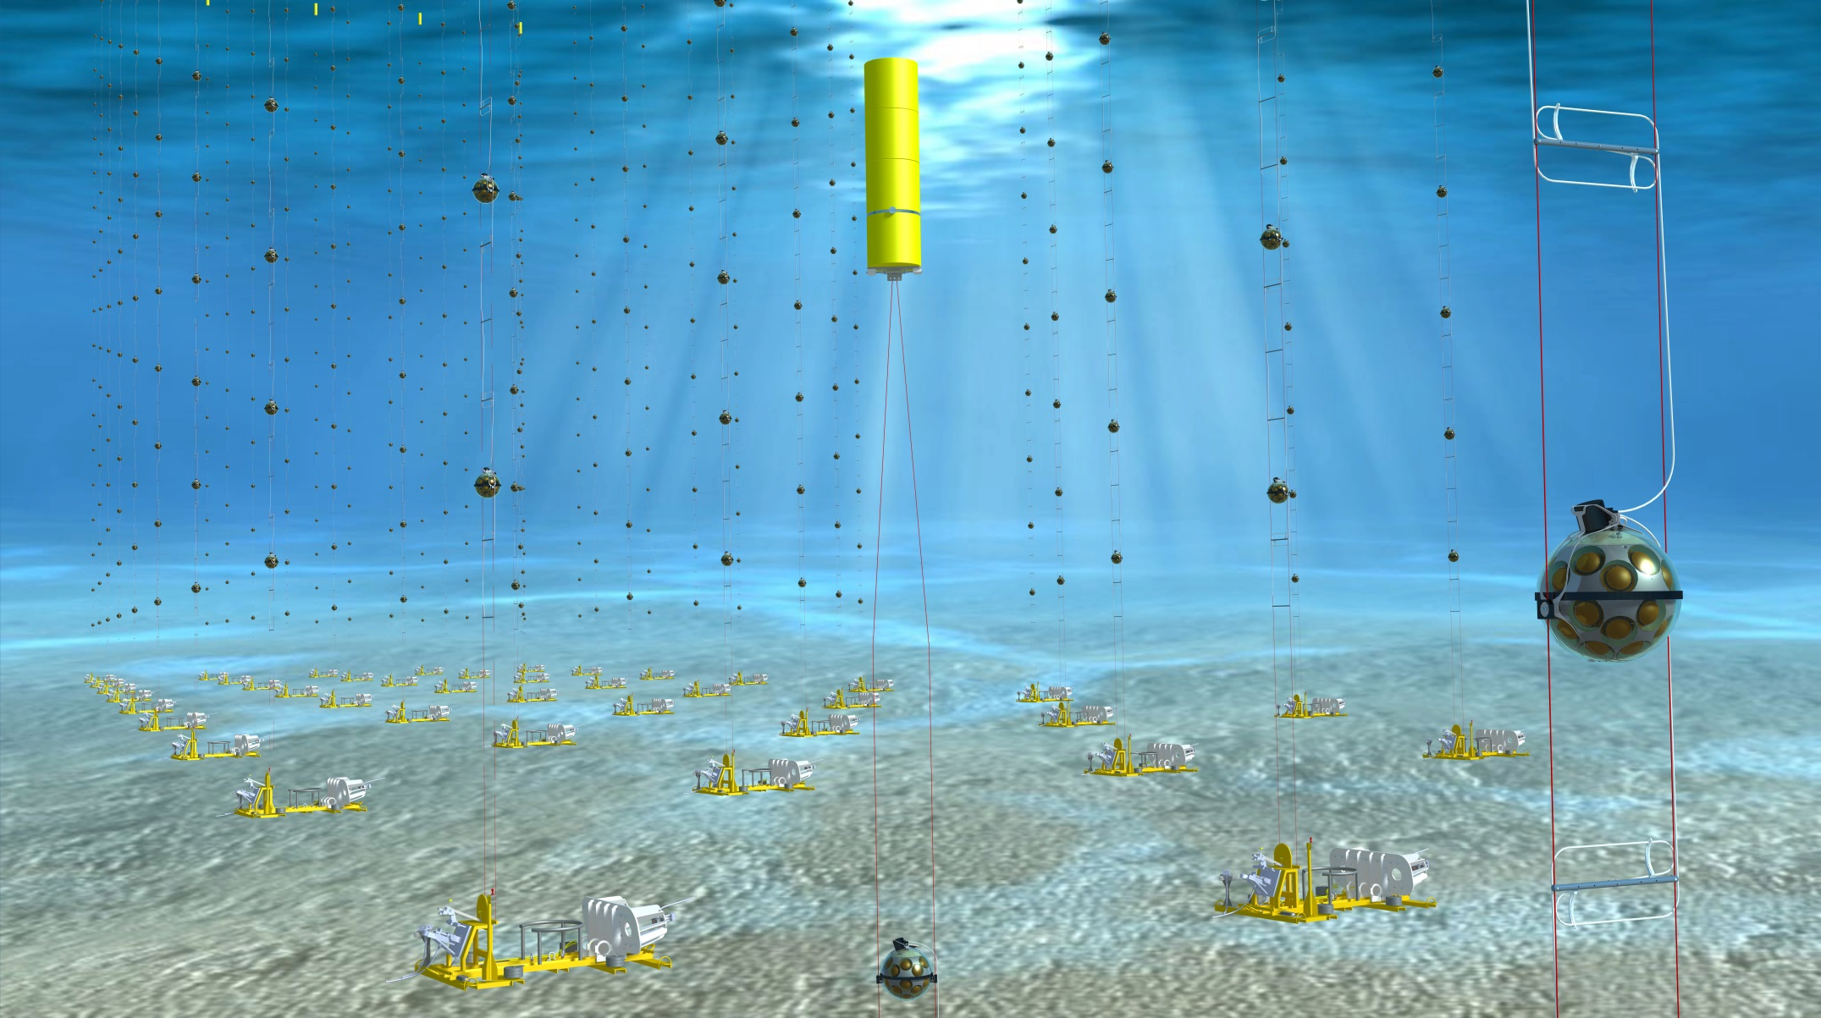
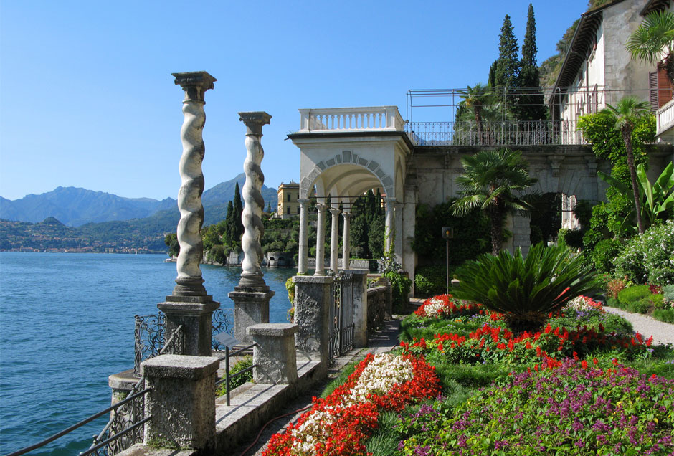


KM3NeT opening a new window on our Universe
ESCAPE Kick-off Meeting
7-8 February 2019, CNRS-LAPP, Annecy
Mauro Taiuti

Slide 2
Outline
Physics Motivations
The Detectors
The Data Management
Conclusions

Slide 3
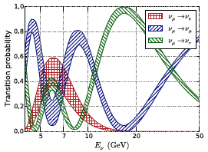
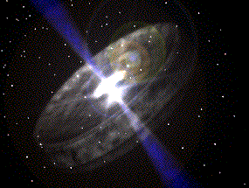
Motivations & Objectives
Low Energy
MeV < E_{ν} < 100 GeV
Medium Energy
10 GeV < E_{ν} < 1 TeV
High Energy
E_{ν} > 1 TeV
ν Oscillations
Supernovae
Dark matter
Monopoles, Nuclearites
Cosmic ν
Origin and production mechanism of HE CR
KM3NeT- ORCA KM3NeT- ARCA
+ oceanography, biology, seismology,…

Slide 4
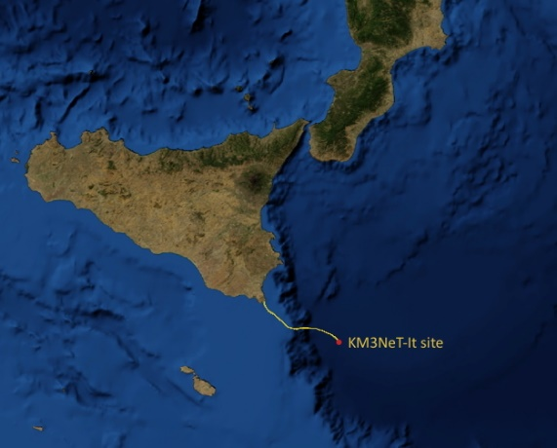
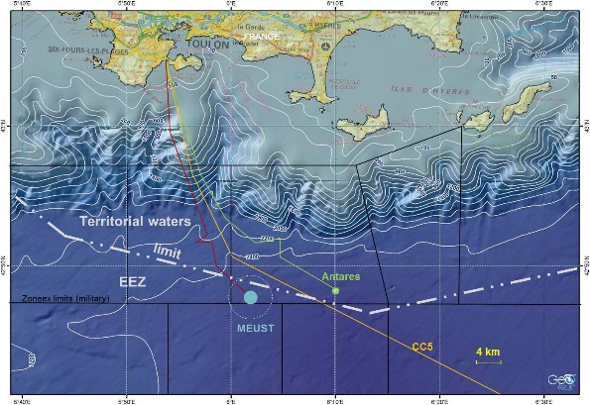
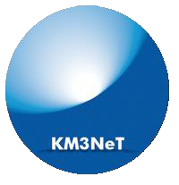
Motivations & Objectives
KM3NeT is the neutrino research infrastructure in the deep Mediterranean Sea
  discover and observe high neutrino sources in the Universe
  ARCA (off shore Capo Passero, It @ 3500 m depth)
  determine neutrino mass hierarchy
  ORCA (off shore Toulon, Fr @2500 m depth)
Same collaboration, same technology, two installation sites
Astroparticle
Research
with Cosmics
In the Abyss
Oscillation
Research
with Cosmics
In the Abyss
2475m
ORCA
3400m
ARCA

Slide 5
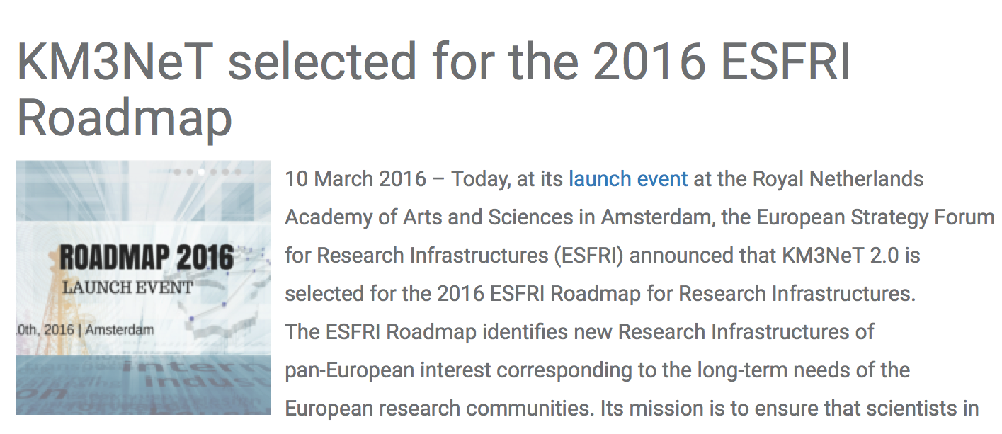
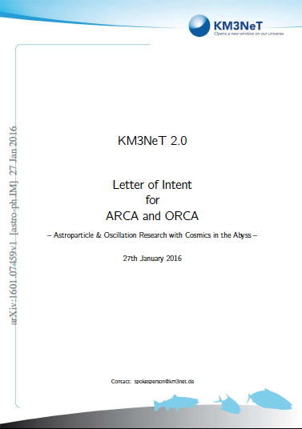
The Roadmap
LoI: J. Phys. G, 43 (2016) 084001
H2020: funds to prepare the ERIC
Since 2016 KM3NeT is back in the ESFRI roadmap
Since 2018 KM3NeT is in the APPEC roadmap

Slide 6
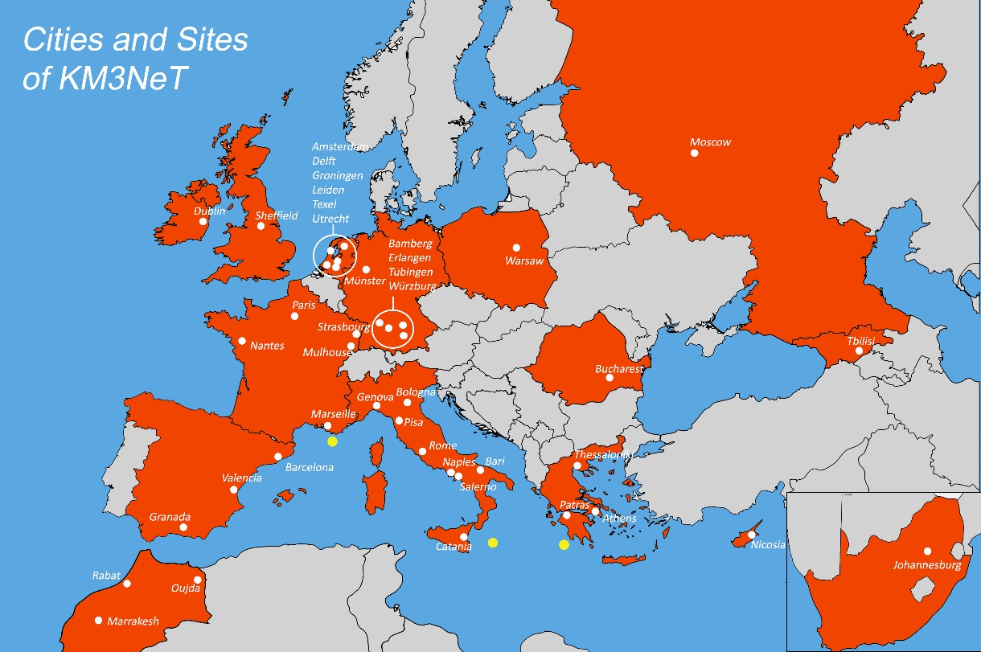
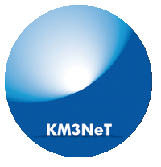
The KM3NeT Collaboration
15 Countries
55 Institutes
>240 Scientists
Number of Institutes and Scientists constantly increasing
ORCA
ARCA
+ Australia

Slide 7
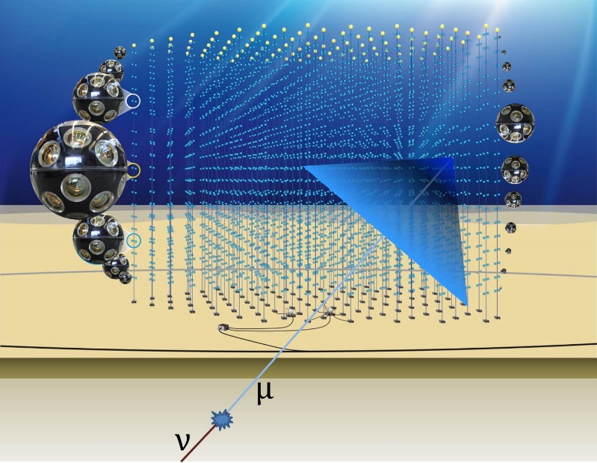
The KM3NeT Telescope Design
Detection principle Optical Cherenkov radiation
  6 order of magnitude in energy (GeV-PeV )
  All flavour detection
A 3D array built with a modular design
Optical sensor: multi-PMT (DOM)
Detection units (DU)
  vertical slender strings host 18 DOMs
Building blocks of 115 DUs each
Power and data distributed by a single backbone cable with breakouts at DOMs
Sea network of submarine cables and Junction Boxes connected to shore via a main e/o cable
All data to shore
 | ARCA | ORCA
Location | Italy | France
DU distance | 90 m | 20 m
DOM spacing | 36 m | 9 m
Instrumented mass | 2*500 Mton | 5.7 Mton

Slide 8
A Phased Approach
PHASE | BLOCKS | PRIMARY DELIVERABLES | FUNDS
1 | 0.2 | Proof of feasibility and first science results 24 ARCA + 6 ORCA strings | Fully funded
2 | 2+1 | All flavor neutrino physics and astronomy 2x115 ARCA strings 1x115 ORCA strings | Funding in progress
3 | 6 | Neutrino astronomy including Galactic sources | Not yet

Slide 9
Construction Plan - Present
One DU working in ARCA
6 DUs ready for deployment in ORCA
More than 1/3 of the full detector will be operative or under construction in the next three years

Slide 10
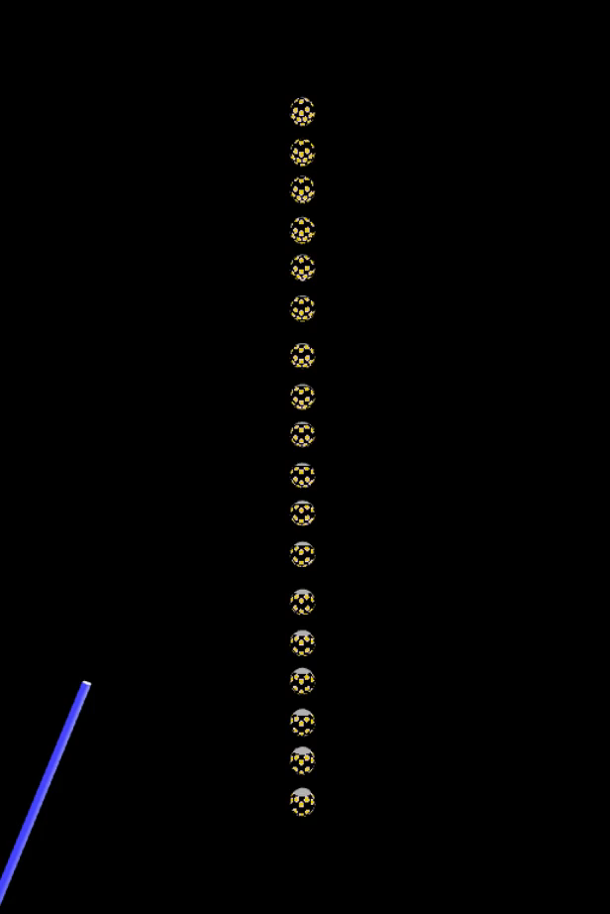

Slide 11
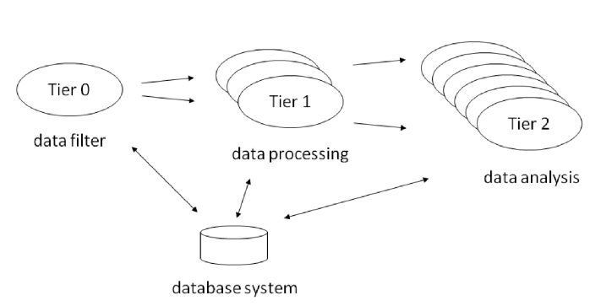
KM3NeT Detector and Data
Detector
  31 3-inch PMTS = 1 digital optical module (DOM)
  18 DOMs = 1 detection unit (DU)
  115 DUs = 1 building block (BB)
  3 BBs = KM3NeT Phase 2
  Altogether: 192500 PMTs, 5-10 kHz single-photon rate each,
  all data to shore  some GB/second
Data processing
  Online data filter (on shore)
  Calibration and reconstruction
  Data analysis
  + Monte Carlo
  + Online analysis for alerts etc.
  + Earth and sea sciences
Requires advanced
data management

Slide 12
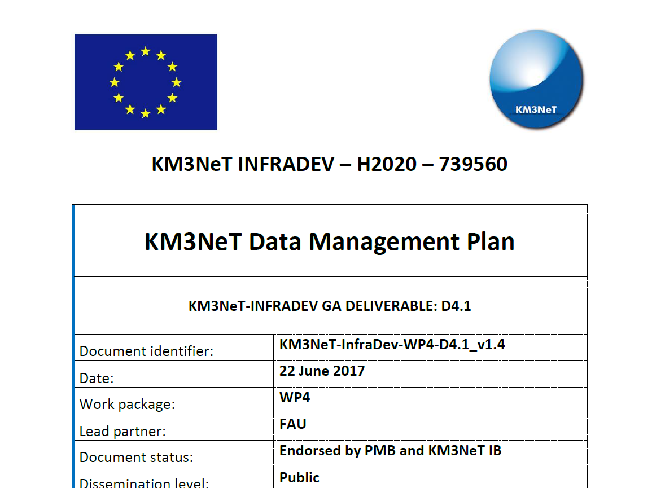
The Data Management Plan
Computing model
FAIR data:
- Findable
- Accessible
- Interoperable
- Re-usable

Slide 13
Computing Model: General Scheme
Tier-like structure, mixed access: GRID + direct (batch)
Data transfer between the computing centers based on GRID
access tools (where applicable)
Central services funded through CNRS and INFN, additional services by the collaboration institutes
Tier | Computing Facility | Processing steps | Access
Tier-0 | at detector site | triggering, online-calibration, quasi-online reconstruction | direct access, direct processing
Tier-1 | computing centres | calibration and reconstruction, simulation | direct access, batch processing and/or grid access
Tier-2 | local computing clusters | simulation and analysis | varying

Slide 14
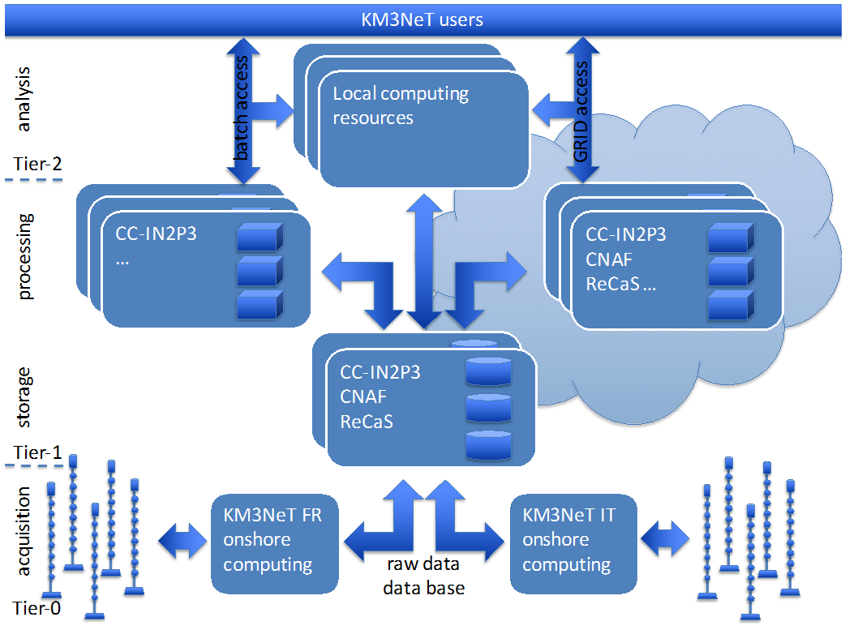
Computing Model

Slide 15
1 Building Block, 1 Year
processing stage | size per proc. (TB) | time per proc. (HS06.h) | size per year (TB) | time per year (HS06.h) | periodicity (per year)
Raw Data
Raw Filtered Data | 300 | - | 300 | - | 1
Monitoring and Minimum Bias Data | 150 | - | 150 | - | 1
Experimental Data Processing
Calibration (incl. Raw Data) | 750 | 24 M | 1500 | 48 M | 2
Reconstructed Data | 150 | 119 M | 300 | 238 M | 2
DST | 75 | 30 M | 150 | 60 M | 2
Simulation Data Processing
Air showers | 100 | 14 M | 50 | 7 M | 0.5
atm. Muons | 50 | 1 M | 25 | 638 k | 0.5
neutrinos | 2 | 22 k | 20 | 220 k | 10
total: | 827 | 188 M | 995 | 353 M
KM3NeT Preliminary

Slide 16
Data Management Plan
Data formats and meta-data following common practice
(root, xml, ascii) → allow for integration in eCommons
Use of existing
  services (data transfer over gridftp/iRODs via national/international networks, Tier-1 computing centres)
  and software (e.g. from ANTARES), some specific development via ASTERICS & ESCAPE
Data processing & storage:
  essential:
    Fast dissemination of scientific results
    reproducibility of all scientific results and data usability over full time of experiment (+ at least 10 years after end of operation)
  data and software as bundle

Slide 17
Open-access Data Policy
Public access to data
  Summary data (event information plus quality information) after fixed latency (typically 2 years)
  Web-based downloads of data and softwares
  Also: Simulation data
On request: More (detailed) data, earlier releases, etc.
Harmonise with wider community (→ GNN and ASTERICS & ESCAPE),
use common tools/platforms (→ Virtual Observatory, VO),
link to other eCommons
GNN = Global Neutrino Network;
ASTERICS = Astronomy ESFRI and Research Infrastructure Cluster;

Slide 18
KM3NeT towards ESCAPE
So far computing based on tier structure with grid/batch access ⇒ cloud is the future also for the computing needs of KM3NeT
Developments in EC activities:
  ASTERICS main developments:
    ROAst (root library for astronomical tasks)
    CORElib (common CORSIKA production for Cherenkov telescopes)
    Data/analysis preservation using container solutions
    ANTARES data to VO
  KM3NeT INFRADEV main developments:
    Open data access (via VO) according to the FAIR principle
    Generating the legal base for data access and sharing

Slide 19
KM3NeT in ESCAPE
Ideas, Goals and Requests:
  Developing EOSC services keeping in mind the needs of astro/particle physics; driving the development rather than following it later;
    So far computing based on tier structure with grid/batch access ⇒ cloud is the future also for the computing needs of KM3NeT
  Going a step beyond VO for FAIR usage of data:
    Enable (full/advanced) data processing in a science cloud environment - for the collaborations but also for the scientific community and beyond (respecting restrictions by the MoUs);
    data storage but also data processing/analyses preservation for the lifetime (+10years) of the infrastructure;
KM3NeT institutes part of all work packages to ensure those points

Slide 20
Summary
KM3NeT construction started, money to build the equivalent of 1 blocks secured
Data management plan and computing model established
KM3NeT adopts Tier-model for data management
(large data volumes, significant CPU requirements)
ESCAPE would be well suited to tackle the challenges of KM3NeT

Slide 21
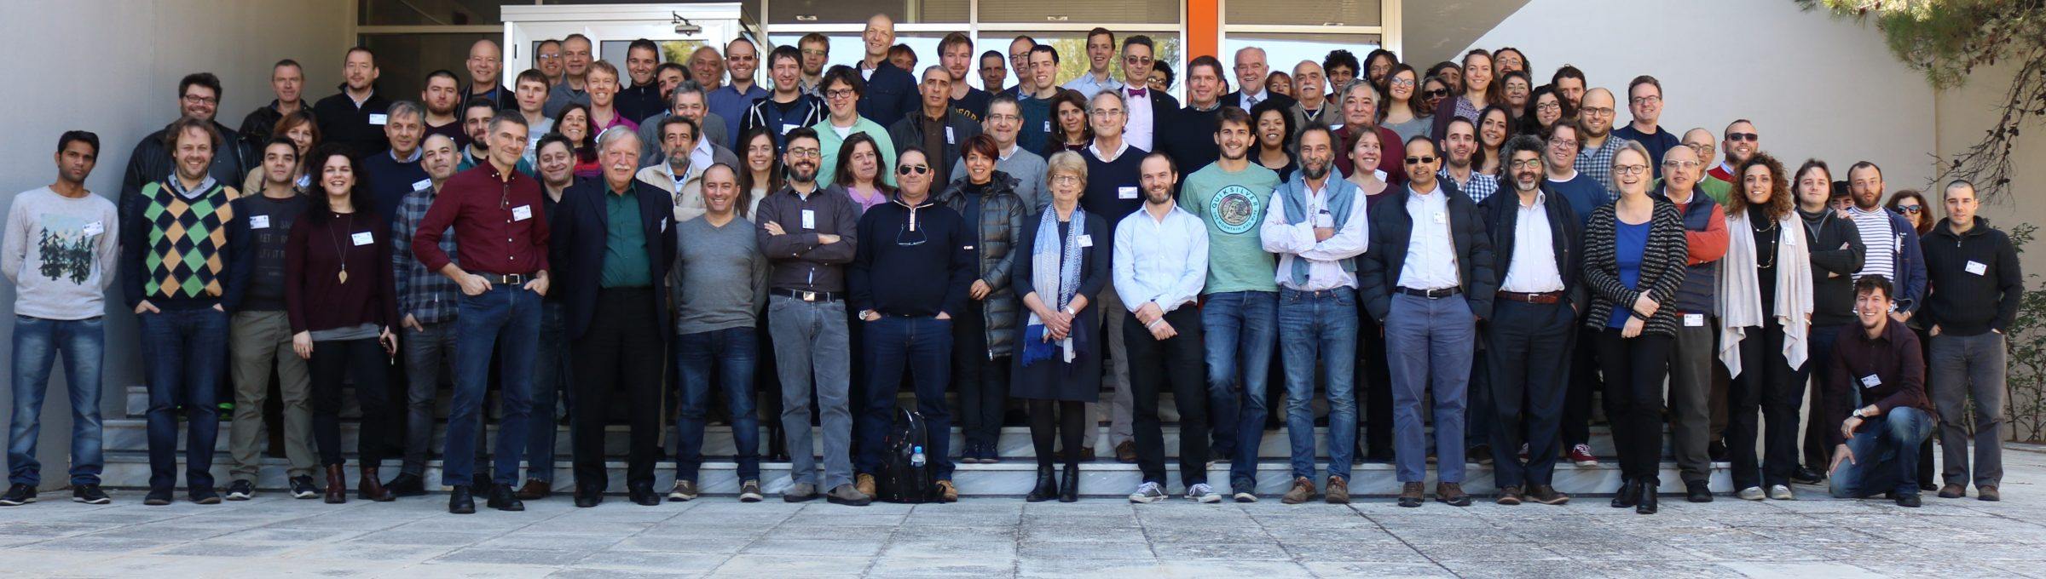
Thank you!

