Slide 1
The Extremely Large Telescope
(and ESO)
Martino Romaniello, Michael Sterzik
ESO
Public

Slide 2
ESO
Intergovernmental science and technology organisation in astronomy
Headquarters in Germany, sites in Chile
  La Silla Paranal Observatory: optical and infrared
  ALMA Observatory: mm and sub-mm
16 Member States
    Austria, Belgium, Czech Republic, Denmark, Finland, France, Germany, Ireland, Italy, The Netherlands, Poland, Portugal, Spain, Sweden, Switzerland, United Kingdom
  Host Country: Chile
  Strategic Partnership with Australia for the La Silla Paranal Observatory
    Started in 2017 for 10 Years
Research Infrastructure

Slide 3
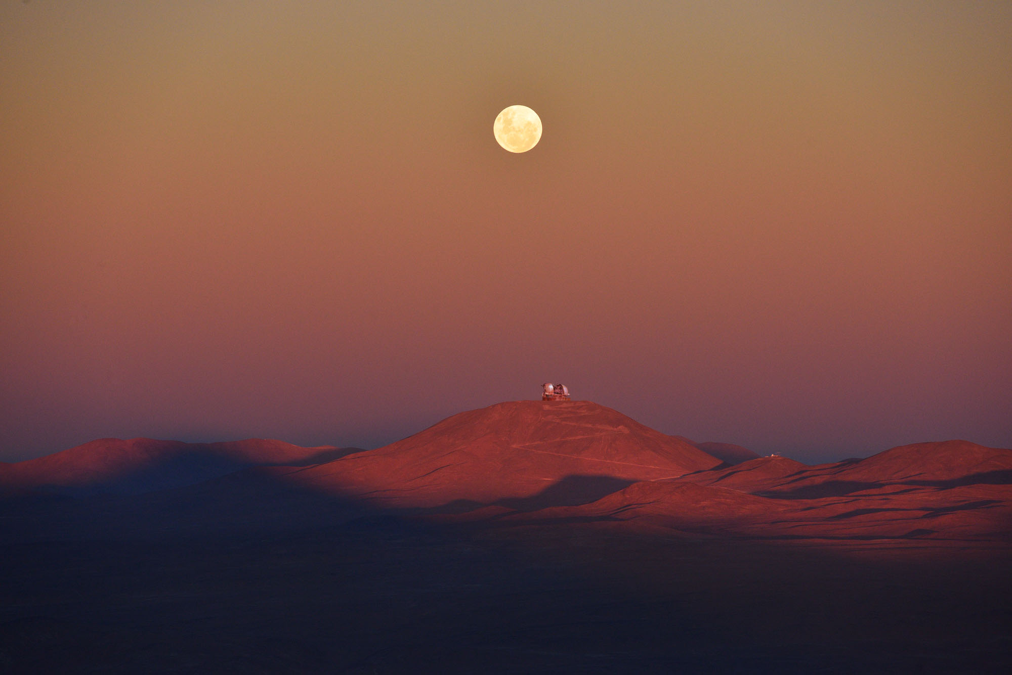
The Extremely Large Telescope
(ELT)

Slide 4
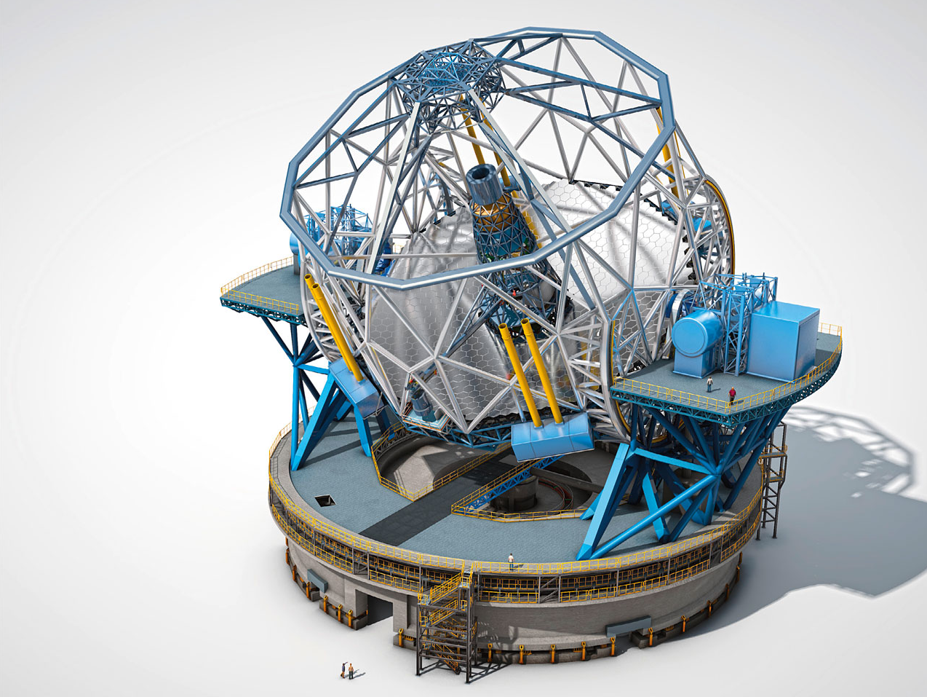
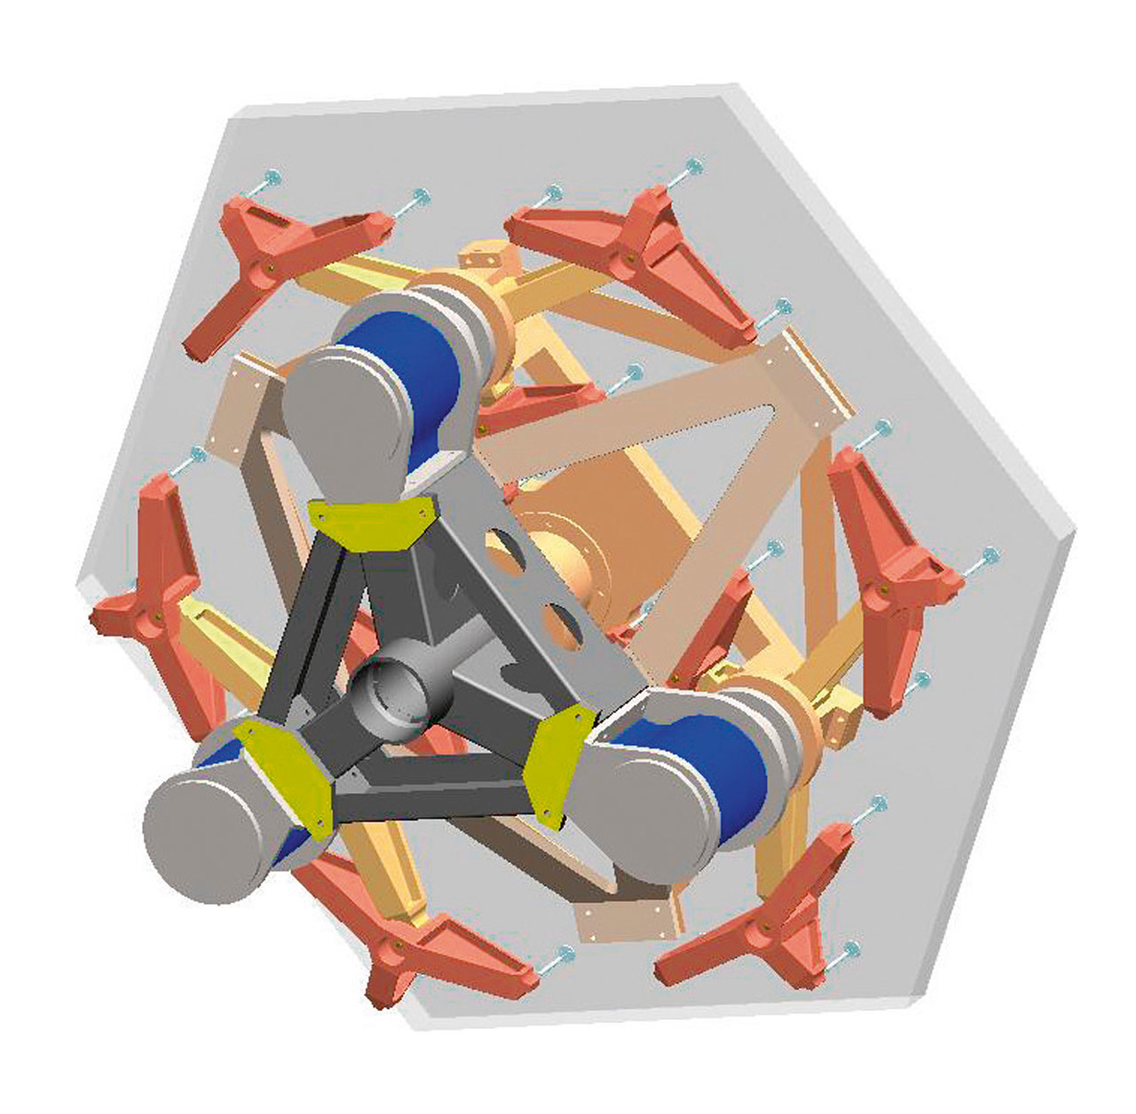
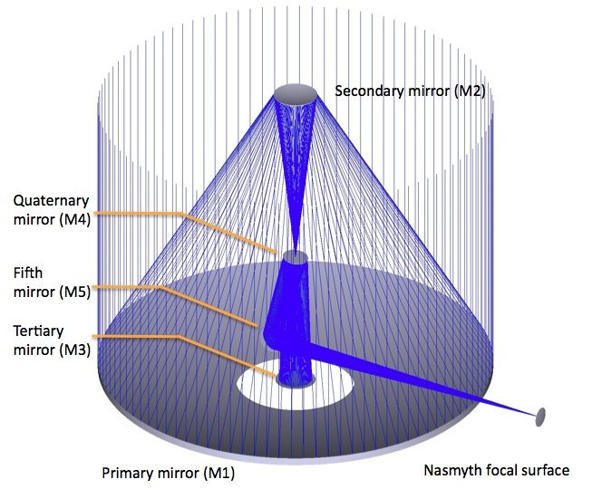
The ELT in a Nutshell
The next (giant) step in optical-infrared astronomy
  Built and operated by ESO
  Landmark ESFRI
39 meters in diameter, filled segmented aperture
  798 1.4-meter hexagonal segments
  5 mirror adaptive optics design: M4 with ~5000 actuators
  6 Laser Guide Stars
Two Nasmyth platforms for the instruments
  Possibility of a Coudé focus for ultra-stable instruments

Slide 5
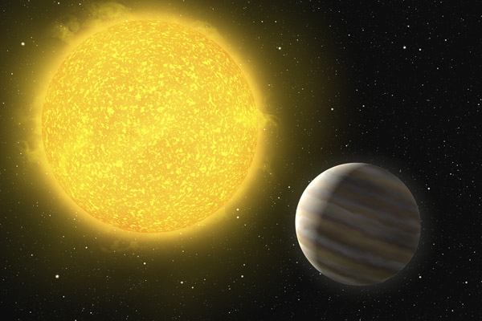
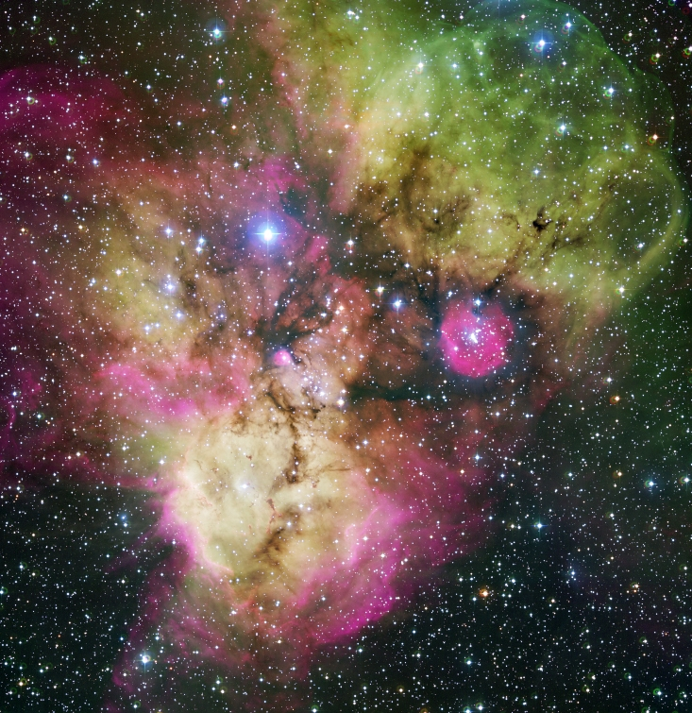
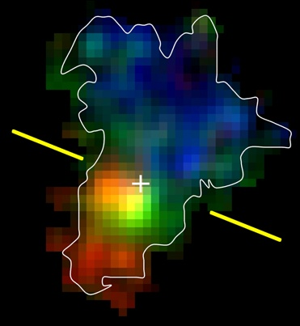
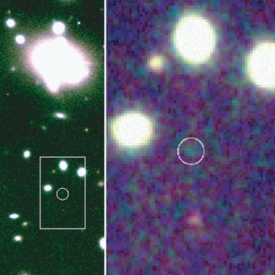
Top Level Science Cases
Extra-solar planets: discovery of Earth-like planets, direct imaging of larger planets and, possibly, their atmospheres
Resolved stellar populations: resolve a representative sample of galaxies in the nearby Universe into stars to reconstruct directly their formation and evolution history
Physics of the high redshift universe: spatially resolved spectroscopy to the highest redshift galaxies to derive their stellar masses, ages, chemical compositions, star formation histories and dynamical states across cosmic time
Cosmology and fundamental physics: direct observation and measurement of the expanding Universe; variations the of fundamental physical constants over cosmic time

Slide 6
ELT Timeline
Initial concepts: early 2000s
ELT as Strategic Priority: December 2004
Design phase: 2006+
Site selection: April 2010
Approval of the ELT Programme: June 2012
Ground breaking ceremony: June 2014
Green light for construction: December 2014
Contract for Dome & Main Structure: May 2016
First stone: May 2017
Mirror casting: M2, M3 2017, first M1 segments 2018
First light: 2025
  Transition to Science Operations: 2026

Slide 7
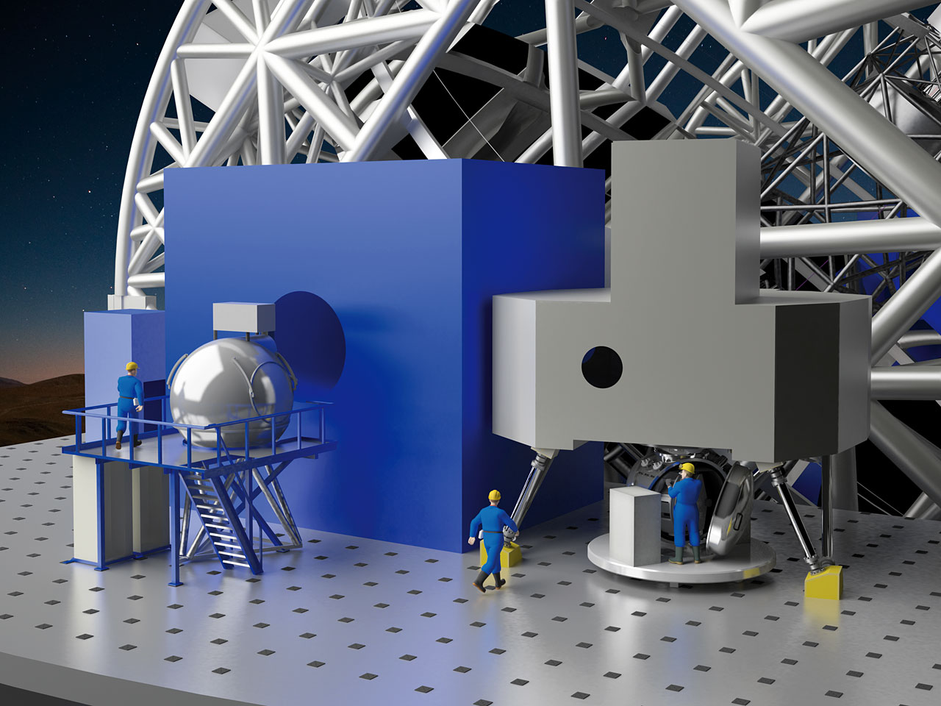
Instrumentation

Slide 8
ELT Instrumentation
Comprehensive instrumentation programme to exploit the capabilities of the ELT itself
First generation instruments
  Part of telescope construction
  First-light: MICADO, HARMONY
  METIS
  MAORY adaptive optics module
Instruments 4 & 5 (Phase A)
  Multi-object spectrograph (MOSAIC)
  High-resolution spectrograph (HIRES)

Slide 9
First-generation Instruments (1)
Two first-light instruments
  MICADO: Optical near-infrared Imager and Spectrograph with Adaptive Optics
    Spectral range: 0.8 – 2.5μm
    Spectral resolution: 3000
    Field of view: up to 53''
  HARMONI: Single Field Integral-field Spectrograph
    Spectral range: 0.47 – 2.45μm
    Spectral resolution 4000, 10 000, 20 000
    Field of view: 10″x5″ or 1″x0.5″

Slide 10
First-generation Instruments (2)
METIS: Imager and Spectrograph
  Spectral range: 3 – 20 μm
  Spectral resolution: 1000 (L,M,N bands),
  10,000 (N band), 100,000 (L,M bands)
  Field of view: 11″x 11″
MAORY: Adaptive Optics Module
  Feeds MICADO and 2nd generation instrument
  Multi-Conjugate Adaptive Optics
  Field of view: 1’

Slide 11
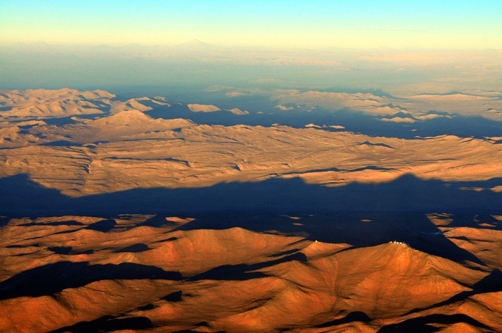
Two sites, one Observatory
Armazones Paranal
ELT
VLT

Slide 12
Science Operations
The ELT will be fully integrated in the existing La Silla Paranal Observatory
Operational model derived from the VLT
  Competitive access to observing time
  Mix of different observing modes and programme types to optimize efficiency and science return
  Science archive: raw data, data products
    Cooperation with other data centers
Builds on 25+ years of experience with VLT
Data transferred online for near-real time quality control and transient science

Slide 13


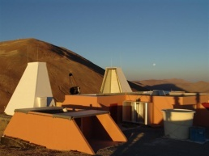

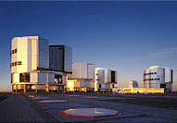
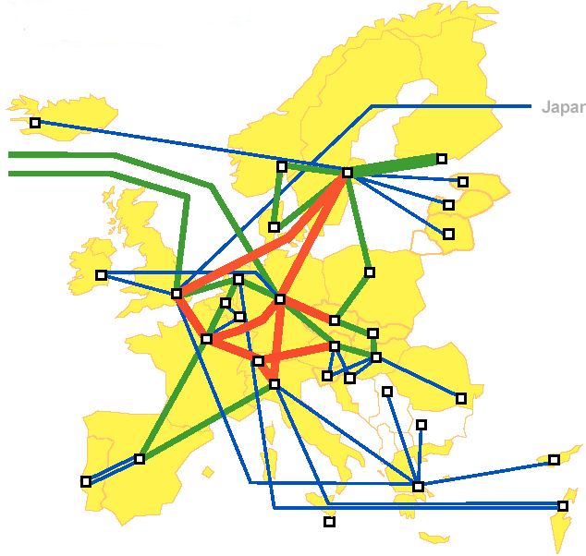





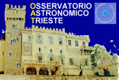

Data Transfer Infrastructure
Armazones (originally Bochum)
100km Optical Fiber
Paranal
GEANT2/DANTE
Trans-Atlantic link
GB-NREN
NL-NREN
DFN (D-NREN)

Slide 14
ELT Data Management
ELT data will be scarce and precious
  There will be fewer 30-40 meter optical-infrared telescopes worldwide than 8 meters on Paranal alone
  Wider context of big data
Data rates and storage
  Science data expected to be similar to the VLT: data volume not critical
  Telescope/instrument telemetry: more challenging
Data will be complex
  Fully adaptive telescope
  Telescope and instrument telemetry and atmosphere profile needed for science data processing
  WIP

Slide 15
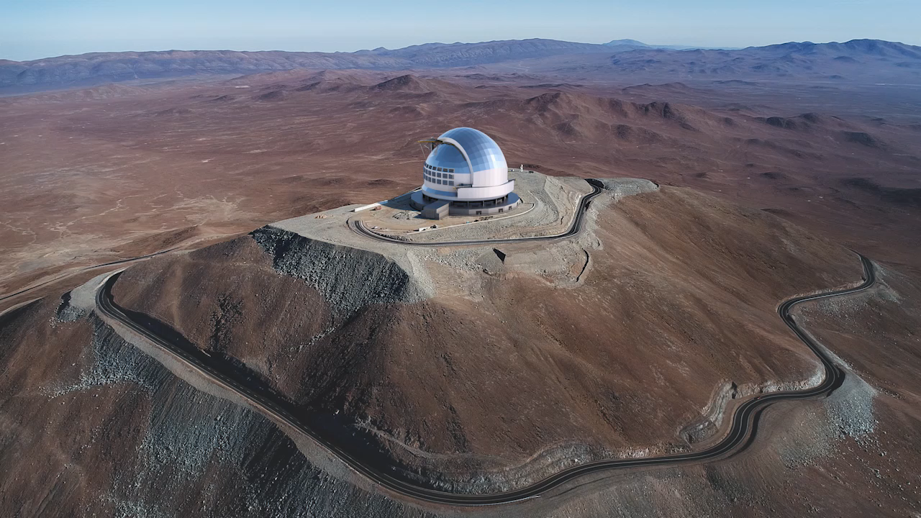
The Extremely Large Telescope
(ELT)

