Slide 1
HL-LHC ESFRI Landmark
Ian Bird
CERN, Geneva, Switzerland
Annecy, 7 January 2019

Slide 2
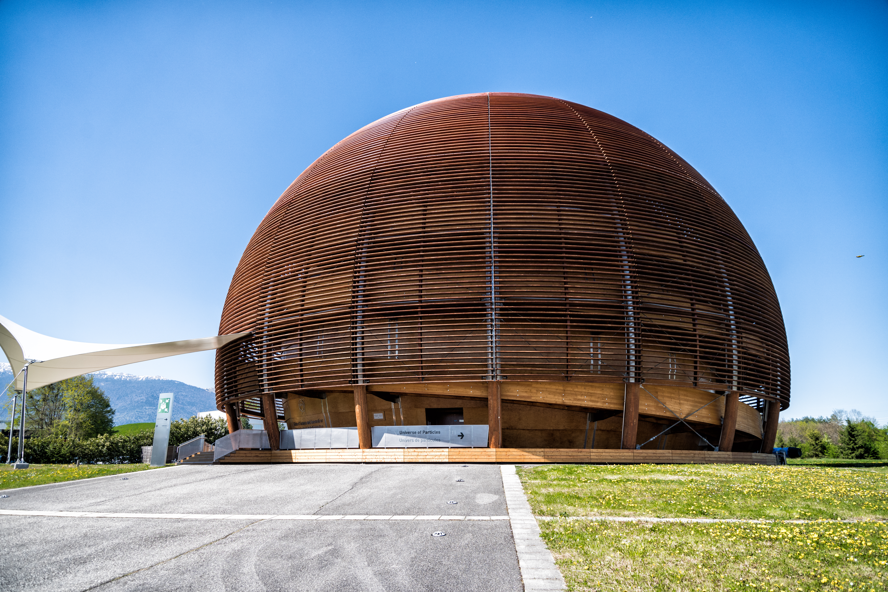






















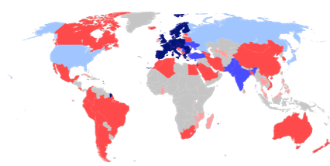














Member states
A world-wide endeavour
Associate member states in the pre-stage to membership
Associate member states
Observers
Budget (2017)
1100 MCHF
Cooperation agreements
CERN: founded in 1954 by 12 European States
Under UNESCO “Science for Peace” programme
Today 22 member states and supports a global community of 15,000 researchers.
Notes:
From 12 funding member states it has grown to 22 member states plus associates and observers. It has got a budget of 1B/year and and supports a community of 15000 researchers located world-wide.

Slide 3
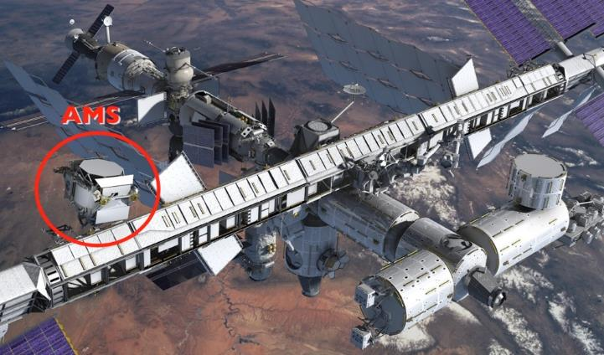
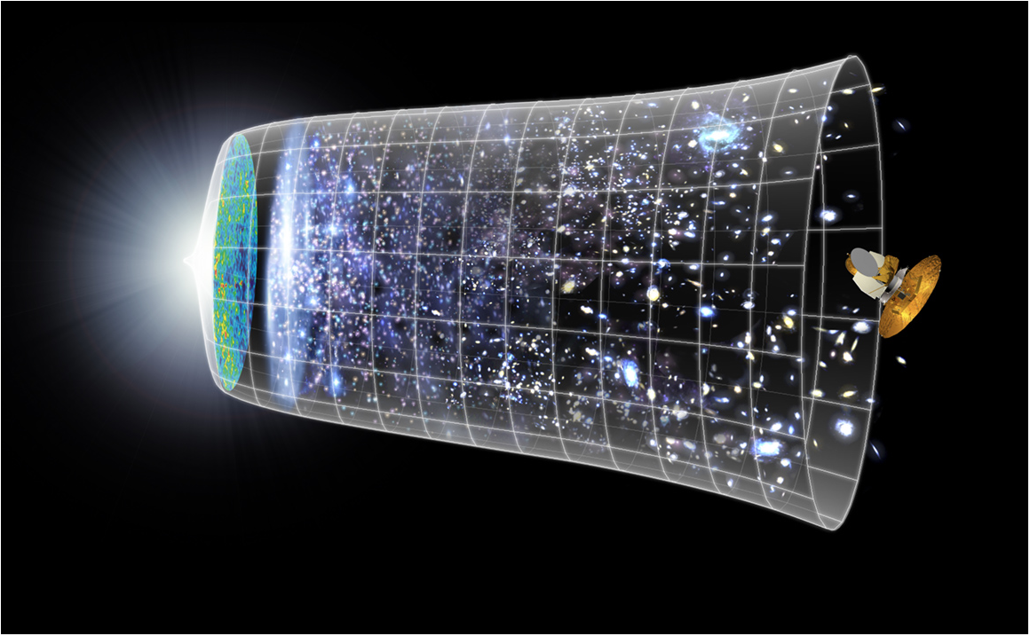
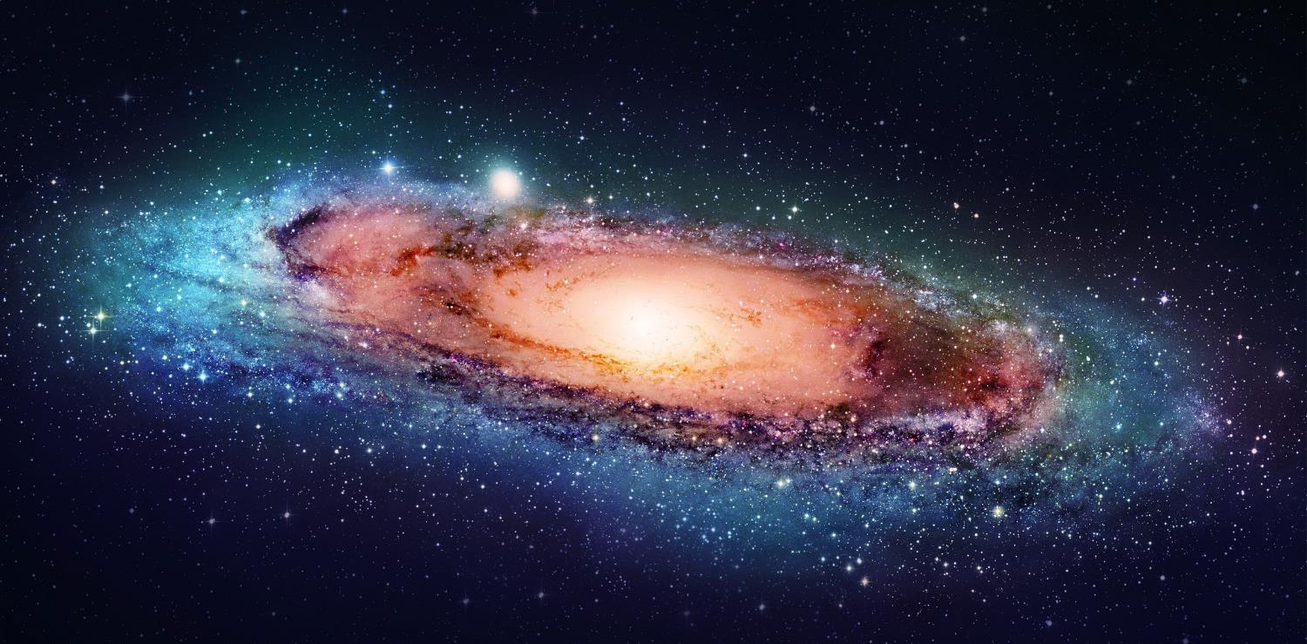
Looking for
Antimatter
Understanding the very first
moments of our Universe after the Big Bang
Understanding Dark Matter
  Probing the fundamental structure of the Universe.
Notes:
At CERN, physicists are probing the fundamental structure of the universe.
They use accelerators to study the basic constituents of matter — the fundamental particles, their interactions and the fundamental laws of nature.
By reproducing the conditions of the first instants of the Universe liife, we want to get insights on fondamental questions on why matter has won over antimatter and shading light on dark matter.

Slide 4
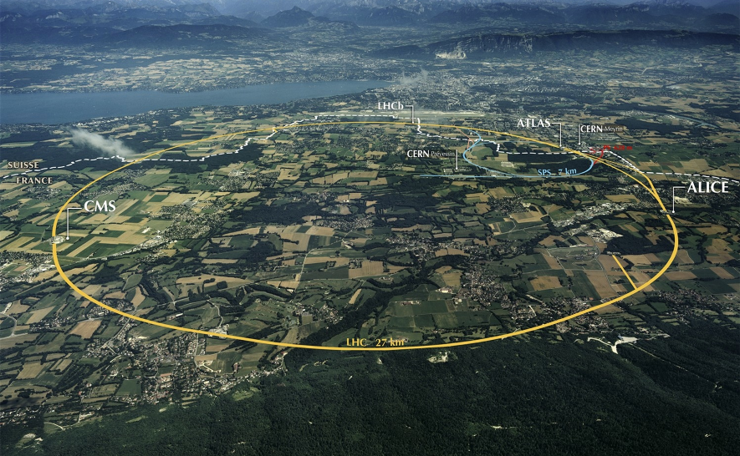
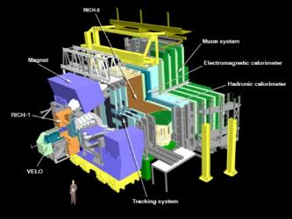
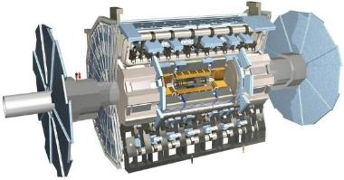
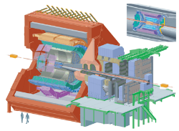
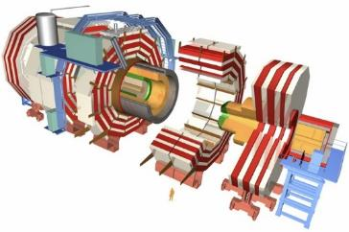
The Large Hadron Collider (LHC)
>1 GB/s
~700 MB/s
A new frontier in Energy & Data volumes:
LHC experiments generate 50 PB/year in Run 2
~10 GB/s
>1 GB/s
Notes:
Largest scientific apparatus ever build
27km around
2 general purpose detectors: Huge microscopes – to explore the very small – using a long lever arm
2 specialized detectors

Slide 5
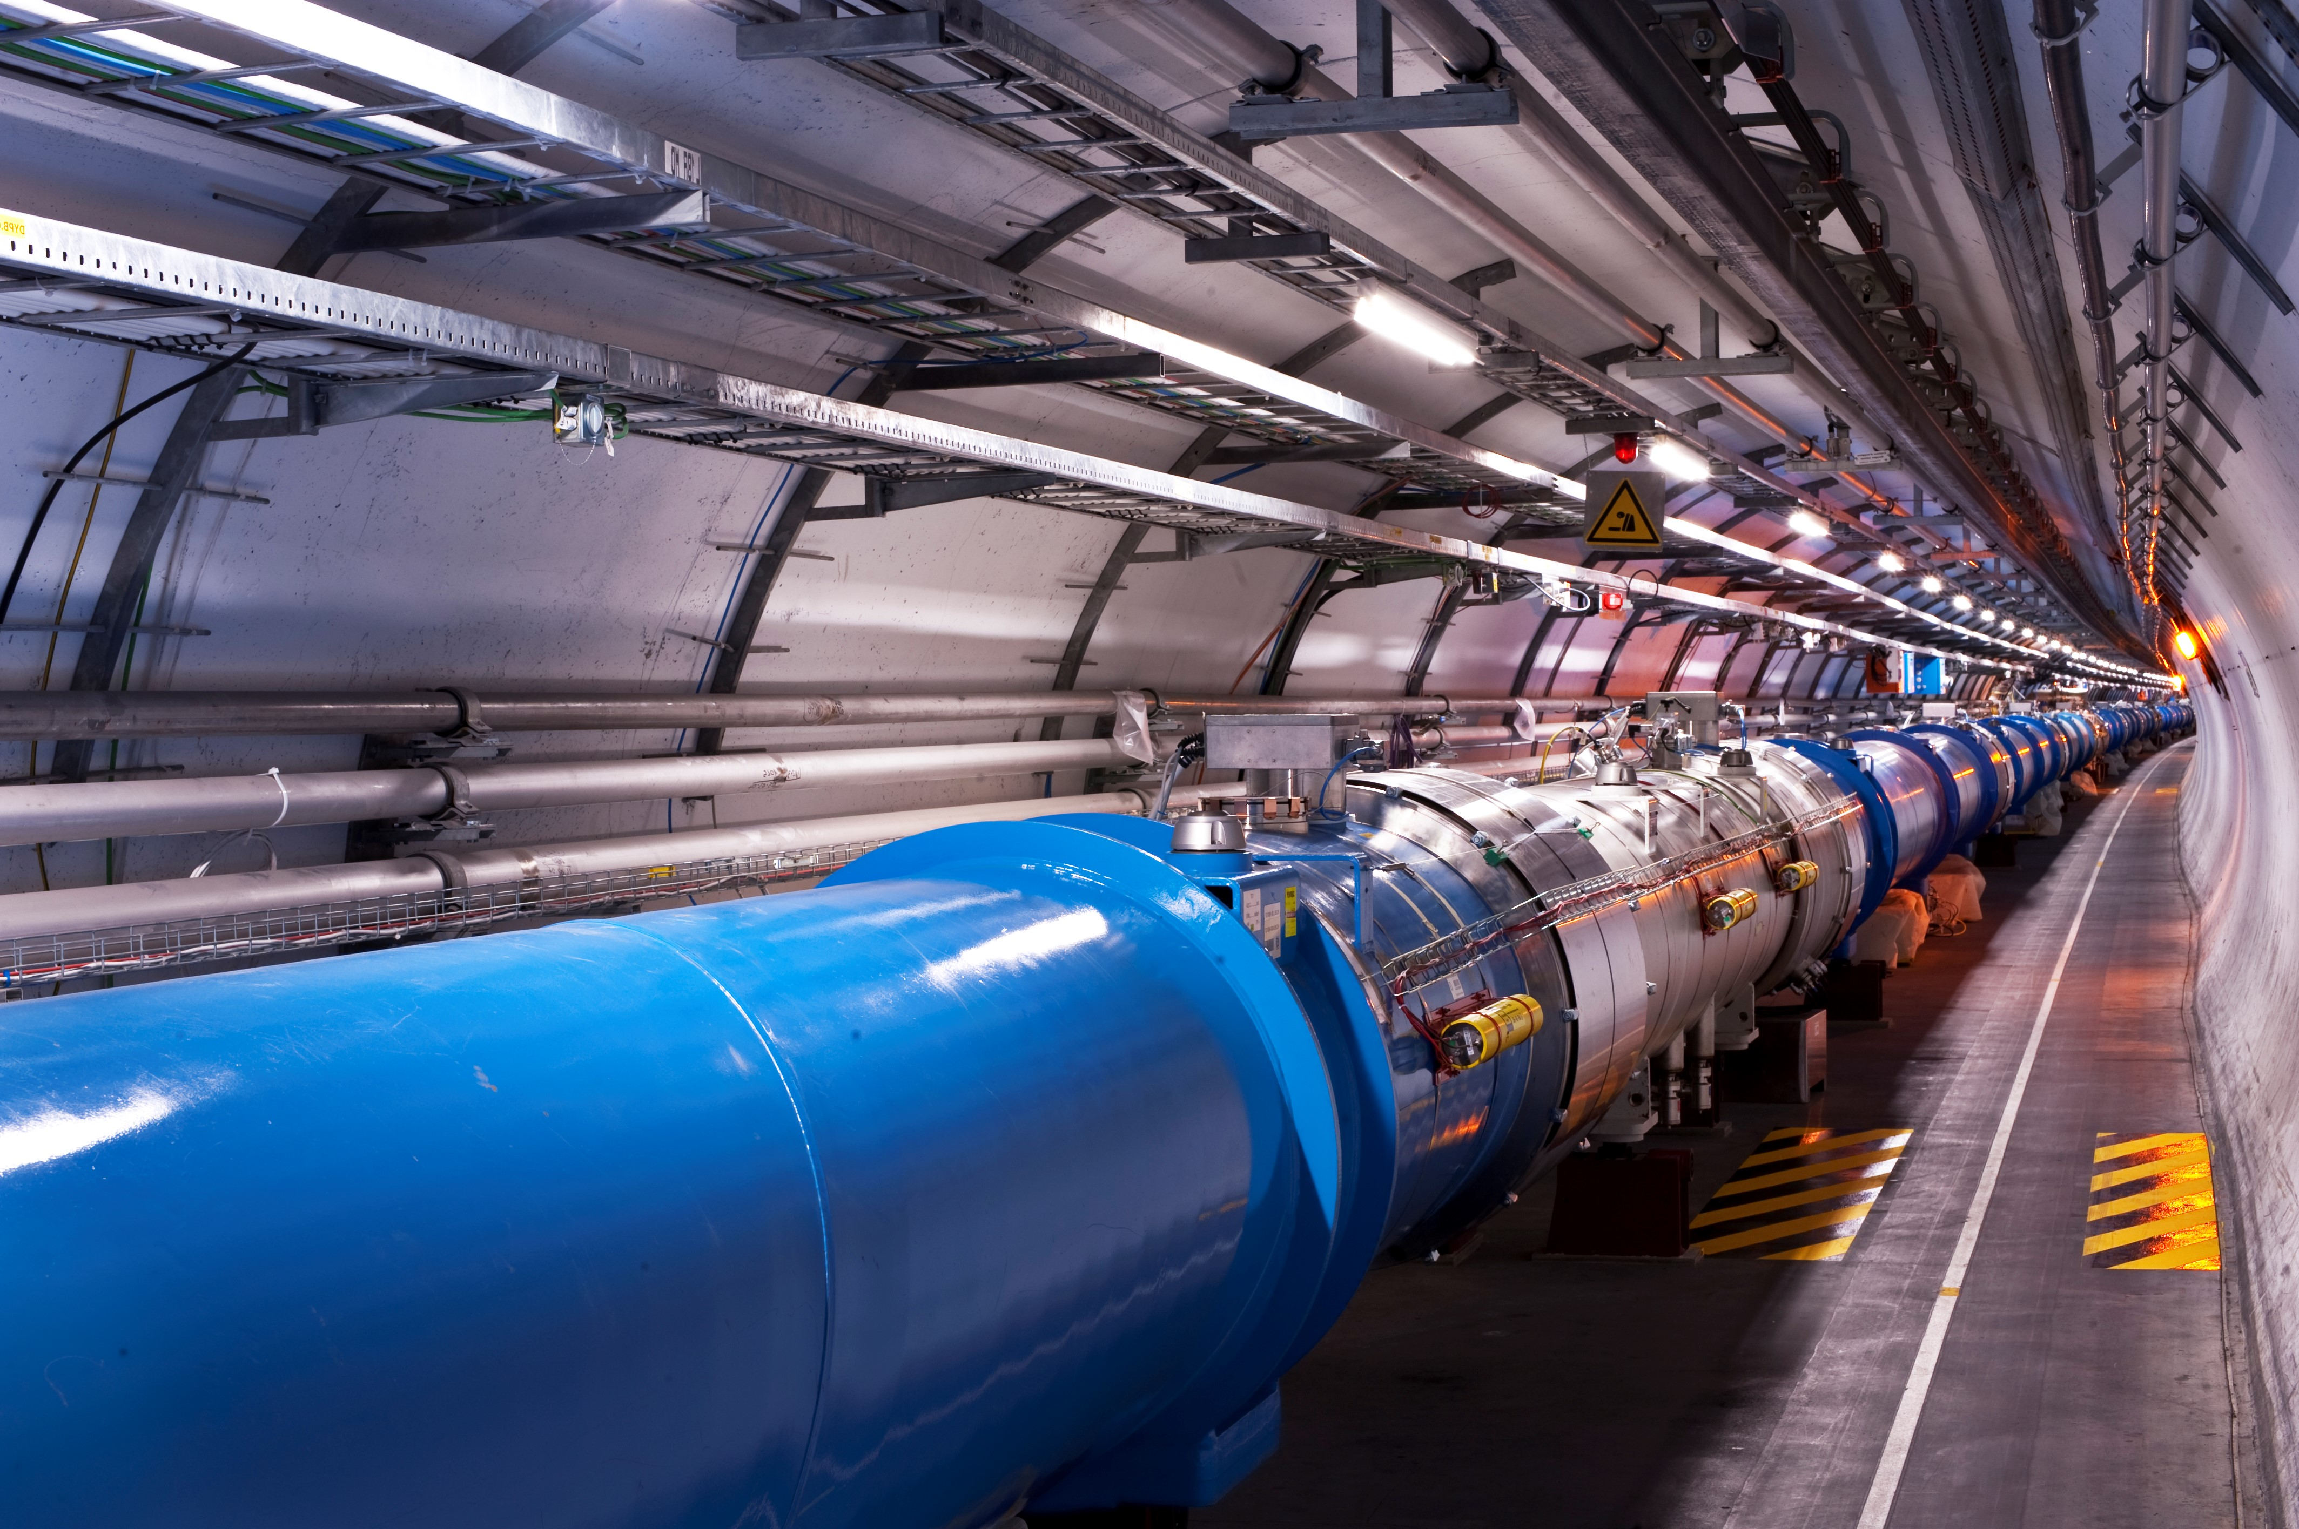
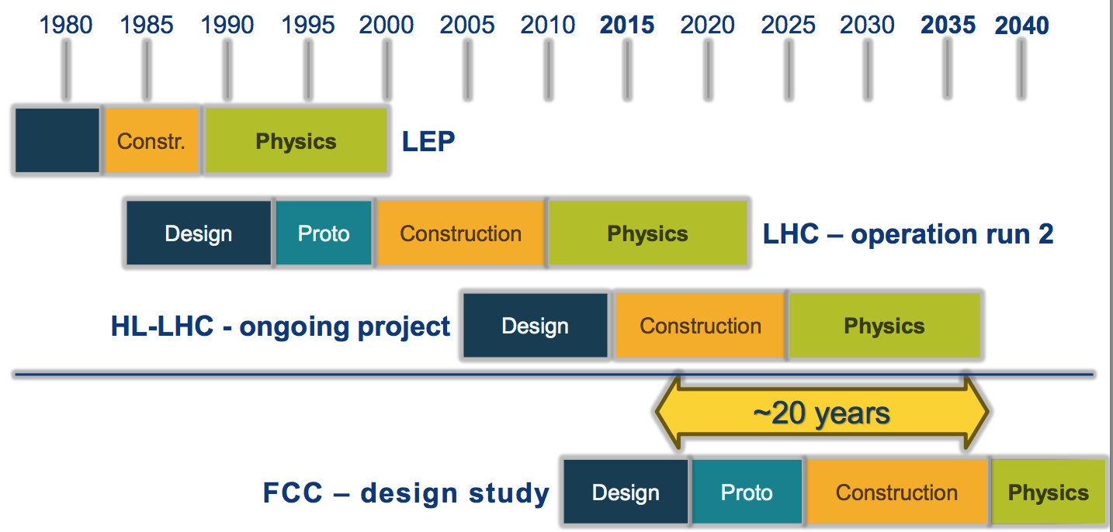
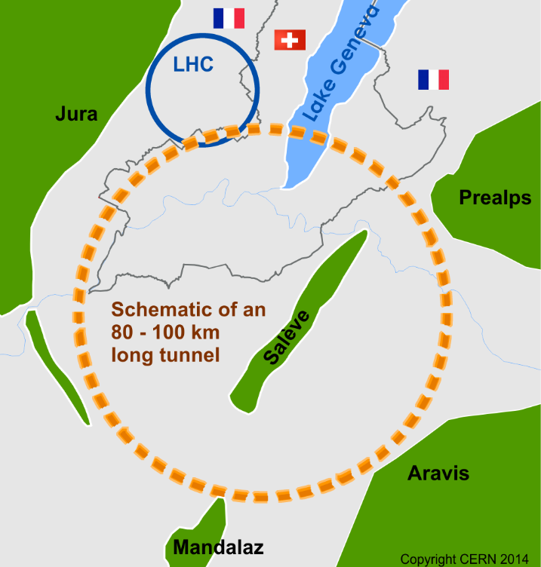

Slide 6
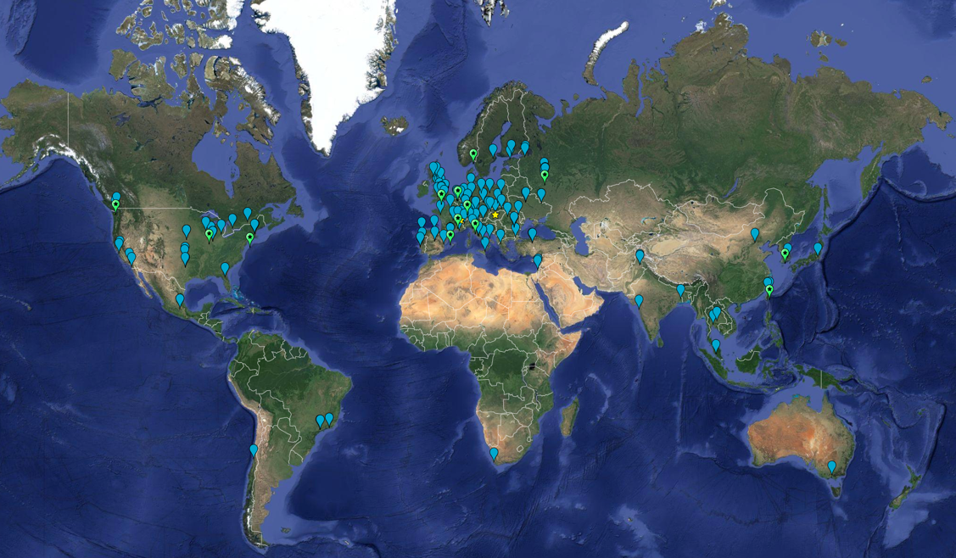

Slide 7
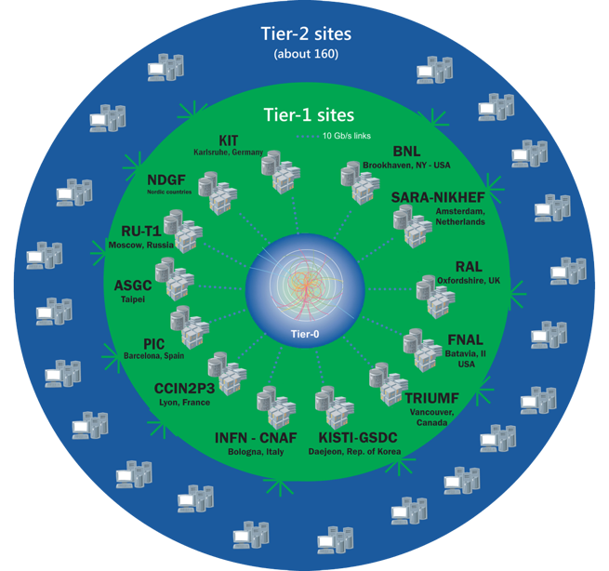
The Worldwide LHC Computing Grid
Tier-0
(CERN and Hungary):
data recording, reconstruction and distribution
~170 sites,
42 countries
~1M CPU cores
Tier-1: permanent storage, re-processing,
analysis
~1 EB of storage
> 2 million jobs/day
Tier-2: Simulation,
end-user analysis
10-100 Gb links
WLCG:
An International collaboration to distribute and analyse LHC data
Integrates computer centres worldwide that provide computing and storage resource into a single infrastructure accessible by all LHC physicists

Slide 8
HL-LHC
HL-LHC is the Phase 2 upgrade of the LHC to higher luminosity (more interactions/s)
  On-line in 2027
Upgrade of the 2 large detectors (ATLAS & CMS)
  LHCb and ALICE upgrades are now
Increases the discovery potential of the LHC significantly,
  expected lifetime to ~2035
Implications for computing:
  5 EB of data per year per experiment
  Huge increase in compute needs

Slide 9
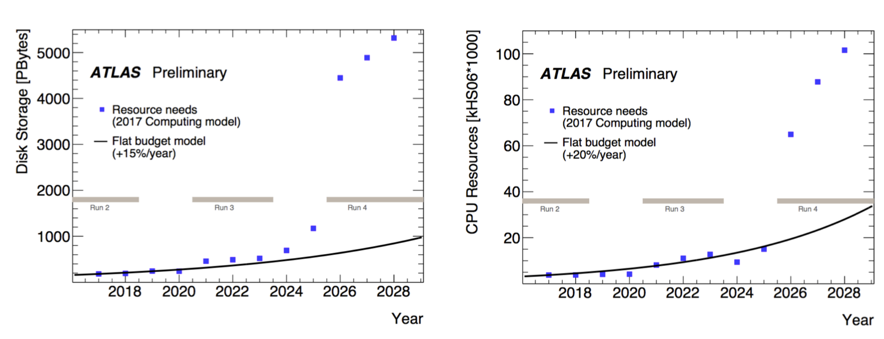
The HL-LHC computing challenge
HL-LHC needs for ATLAS and CMS are above the expected hardware technology evolution (15% to 20%/yr) and funding (flat)
The main challenge is storage, but computing requirements grow 20-50x

Slide 10
10 Billion of these

Slide 11
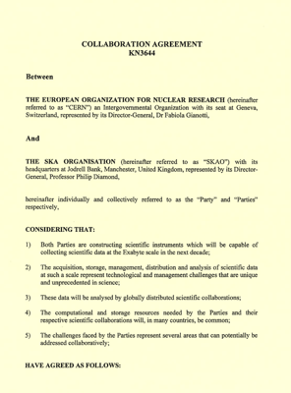
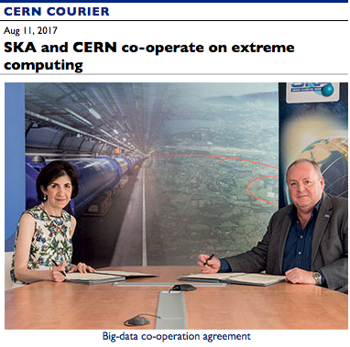
Collaboration CERN – SKA
Recognition on both sides of potential synergies and requirements
  Various ad-hoc interactions between communities
  Reviews and panels etc.
  Held a CERN-SKA “Big data”
  workshop in the UK Alan Turing Inst.
In July 2017 CERN and SKAO signed a
collaboration agreement on computing, data
management, etc.
  Recognizing that both HL-LHC and SKA will be
  Exabyte-scale scientific experiments on a
  10-year timescale

Slide 12
Evolution of WLCG
Community White Paper
  1 year – bottom up review of LHC computing topics
  13 working groups on all aspects
  Outlines how HEP computing could evolve to address computing challenges
  https://arxiv.org/abs/1712.06982
WLCG Strategy Document
  Prioritisation of topics in the CWP from the point of view of the HL-LHC challenges
  Set out a number of R&D projects for the next 5 years
    Running global system should evolve towards HL-LHC
  http://cern.ch/go/Tg79

Slide 13
HL-LHC Computing Strategy – main themes
Software performance – embodied in HEP Software Foundation (HSF)
  application level: algorithmic changes & improvements, re-engineering
  system level: overall performance, efficiency, strategies for performance
  Skills building and training
Data management – overall project “DOMA”
  Data organization – data lakes (or data cloud), and associated technologies
  Data management – high level management workflows, policies, etc
  Data access - streaming, caching, protocols, SDN, etc.
Use of compute resources – pledged and opportunistic
  Use of cluster, HPC, clouds, and others, permanent resource or time-limited
  Delivery of data to these – (DOMA – streaming, caching, placement)
Data preservation and re-use – “FAIR”
  Open data portal
  Integration of main workflows and re-use,
  Delivery of open data sets (data lake as mechanism)
Evolving AAI model – towards token-based away from old “grid” model
Addressed in
ESCAPE

Slide 14
CERN-WLCG-EOSC-ESCAPE …
Believe that technologies that address the HL-LHC (and ESCAPE partner) problems will be generally useful for EOSC to manage and deliver large-scale open data
ESCAPE will be a testbed for these technology ideas and a mechanism to ensure they are suited to a broad range of use cases
Architecture is open to inclusion of public and commercial resources
Pathways to collaborate with other EC actions:
  GEANT, PRACE,
  XDC, Indigo-next, HNSciCloud/OCRE, ARCHIVER
CERN/WLCG technologies potentially interesting in EOSC:
  FTS, EOS, Rucio, Zenodo, SWAN, REANA, Open Data portal, …

