Slide 1
Work Package Six: «ECO» Engagement and Communication
Stephen Serjeant & Rita Meneses
ESCAPE Kick-Off Meeting, February 2019

Slide 2
Vision
Task 6.1
ESCAPE science community
Mass Participation Experiments
Society at large
Task 6.2

Slide 3


Trust-IT Services – Who are we?
A digital marketing & communication company, dynamic SME founded in 2002 HQ in the UK, operational premises in Pisa (Italy)
Involved in cutting-edge projects undertaking formidable challenges, in the European & global scenario:
Specialised in pan- European collaborations & European Commission’s Research Agenda opportunities
Renowned for putting together complex yet pragmatic international consortia within EC Framework programmes & answering the Call objectives;
Cover prestigious, policy role within the EOSC landscape (current chair of the 2nd EOSC High Level Expert Group is Trust-IT’s CEO);
Lead the Common Dissemination Booster liaising with over 250 project clusters in the EU to build their dissemination.
Lead the Communication & Dissemination of the EOSC-hub (EC DG Connect) and EOSCpilot (EC DG RTD) projects, the 2 pioneering initiatives in the EOSC landscape.
Involved in ASTERICS project Communication Activities

Slide 4
WP6 - Engagement and Communication
Role: Leading “Task 6.1 Public Engagement and Communication”
Timing: M1-M48;
Lead: Trust-IT Services (28PM)
Partners Involved: CNRS-LAPP (12PM) & OU (2PM)
Deliverables:
  D6.1 – ESCAPE website live (June19)
  D6.2 – Dissemination & Exploitation Plan (January20) – Lead by CNRS-LAPP
  D6.3 – Brochure publication (June20)
Contributions requested within the next 6 months:
  D6.1 – eSpecifications for the project website
  Relevant Content updates for social media (+ website when online)
Synchronyse our efforts of communication by liaising well with all WPs to ensure that a consistent message is carried out throughout the 48 months

Slide 5



WP6 - Engagement and Communication
Role: Leading “Task 6.1 Public Engagement and Communication”
  Develop ESCAPE website & portal (for internal coordination) tailored to different stakeholders, including the gateway for the catalogue of services
  Share with us relevant updates from your WP
  Discuss specs of both website & internal portal
Generate ESCAPE Communication Toolbox (PR, flyers, posters, videos, stands).
  To use at events at exhibitions when engaging with stakeholders
Support attendance at external high-level events and meetings.
  Online visibility through social media channels
  Fill in the “events excel” to track events’ presence
  Inform us what events you are joining, to get our dissemination support
Communication & Community User Engagement are continuous tasks, to engage directly with stakeholders with content rich insights

Slide 6




WP6 - Engagement and Communication
Role: Leading “Task 6.1 Public Engagement and Communication”
Establish & execute a dissemination and exploitation plan: quantitative KPI definition & monitoring, social media impact and website visits, amongst others
  D6.2 – Dissemination & Exploitation Plan
Co-ordinate translation and adaption of resources for different national communities & compile master Classes and MPE online resources
  EN, DE, ES, FR & IT
Disseminate internally ESCAPE results, within the community and beyond.
  We are all ESCAPE’s ambassadors
Support ESCAPE final Event to showcase the final results of the ESCAPE project
Communication & Community User Engagement are continuous tasks, to engage directly with stakeholders with content rich insights

Slide 7







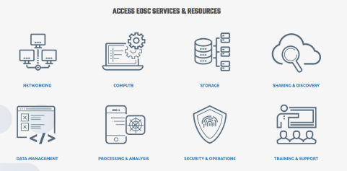
ESCAPE Stakeholders
Engagement between ESCAPE and stakeholders, building on partners’ networks
STAKEHOLDERS
e-Infrastructures
ESFRI
projects
Industry
(Namely SMEs)
EOSC
Governance
Policy
Bodies
Pan-European
Research Organisations
What is the value proposition for each of these stakeholders use ESCAPE’s outputs?
How can ESCAPE’s assets fit the EOSC offer for EU/ international researchers?
Engagement with scientific, research, industrial & policy communities, to produce active end-users of ESCAPE results

Slide 8

ESCAPE Website - http://escape2020.eu/
  ESCAPE’s website 1st iteration already online
  Launch of the full-website by June 2019 (M5)
    Features:
      Internal coordination
      Internal & external dissemination of ESCAPE
Next activities
    New website URL with “ESCAPE EU” (CNRS-LAPP)
    Publish “ASTERICS EOSC in Practice” story
    Website diagram & homepage mockup
    INFORM US YOUR MILESTONES & UPDATES TO INCLUDE ON WEBSITE
ESCAPE’s website will be the shop window for project results, besides promoting ESCAPE’s activities

Slide 9
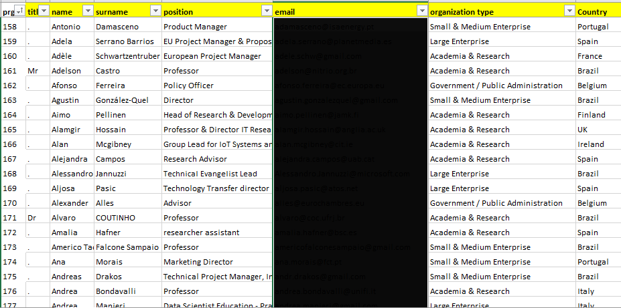
ESCAPE Community Profile Database
Individual profile database
organisation type, discipline, professonal role, country and stakeholder.
ALL PARTNERS TO CONTRIBUTE ON IDENTIFYING INDIVIDUAL STAKEHOLDERS
(events, meetings, partnerships, co-workers)
Identify diverse community of stakeholders, multipliers and influencers,
to support dissemination of results

Slide 10
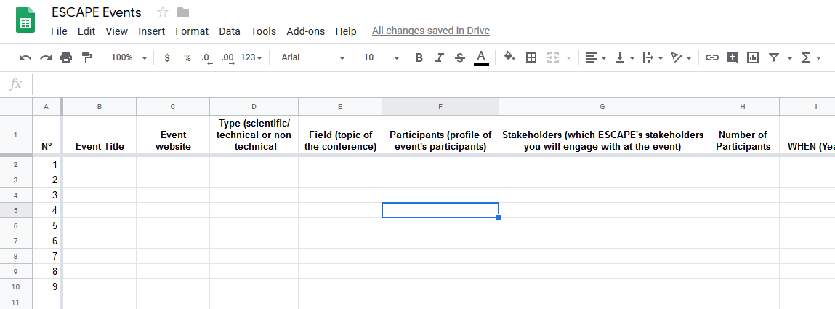
Events Communication Procedures
Communicate the attendance/organization. Please indicate:
  Who is going to attend, where & when.
  What is going to present (Overview of presentation/topic).
  Provide the poster, papers & output, to be published on ESCAPE website.
Upload the information
https://docs.google.com/spreadsheets/d/11uKWq8j89fQCAmAes1yisaKrgqnsontLDoYiEKJzGQc/edit#gid=0
We will: timely publish the event on the website; publish the presentation slides & posters; provide communication material, set up a dedicated Social Media campaign
EXTRA VISIBILITY FOR YOU @All partners to contribute to the shared doc

Slide 11


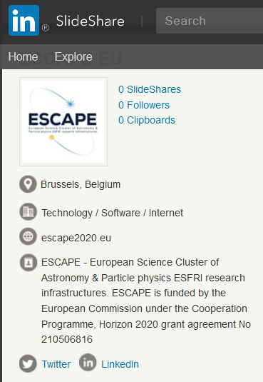
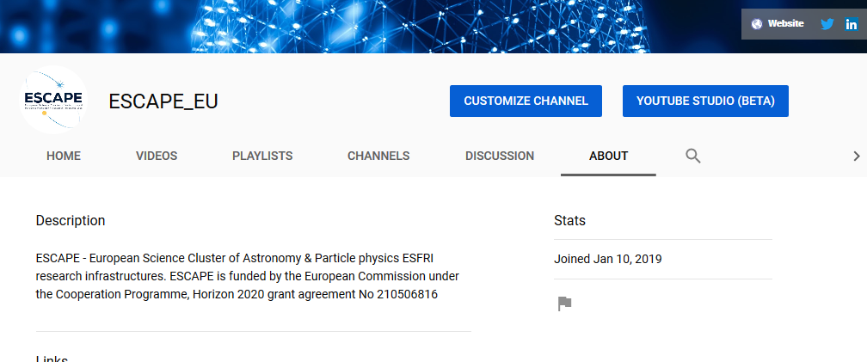
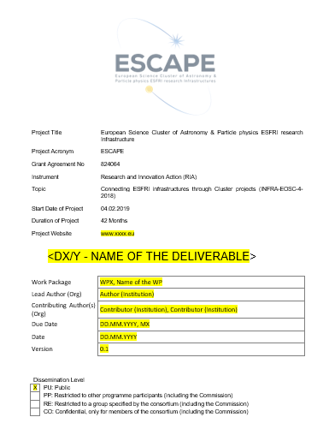
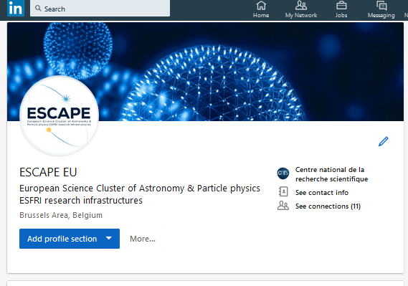
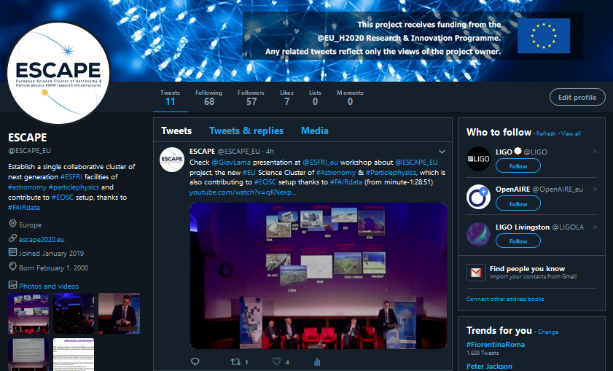
Task 6.1 Public Engagement and Communication Done to date?
Roll-up banner
PPT and Word templates
4 Social media accounts
FOLLOW US ☺
1 Contact database of relevant partners
3 answers for KO interviews
      On board ASTERICS social media community to ESCAPE channels
Communication Channels & Materials to
set the basis for stakeholders’ engagement

Slide 12
T6.1 Timeline of Actions & Outlook for M1-M48
TODAY
Social Media networks
Interviews
Branding & Identity
KoM Annecy
Website Active
D6.1 Dissemination & Exploitation Plan
Brochure
Final Event
M0
M1
M5
M12
M18
M48
Identification and Tracking the Participation at Events
Identification of organisations for synergies
Populating the website & social media with project’s updates and other content rich insights
Production of communication materials: flyers, posters
Setup the editorial plan based on ESCAPE’s main developments
Populating the ESCAPE database in a weekly basis
ACTIONS
    Define a Communication Manager from each partner
    Schedule monthly calls, to inform each WP updates & publish online
Website on M5, brochure M18, along with continuous communication activities, thanks to a timely plan and specific actions monitoring

Slide 13
Task 6.1: public engagement and communication
Establish and execute a dissemination and exploitation plan
Generate standard branding and public engagement materials

Slide 14
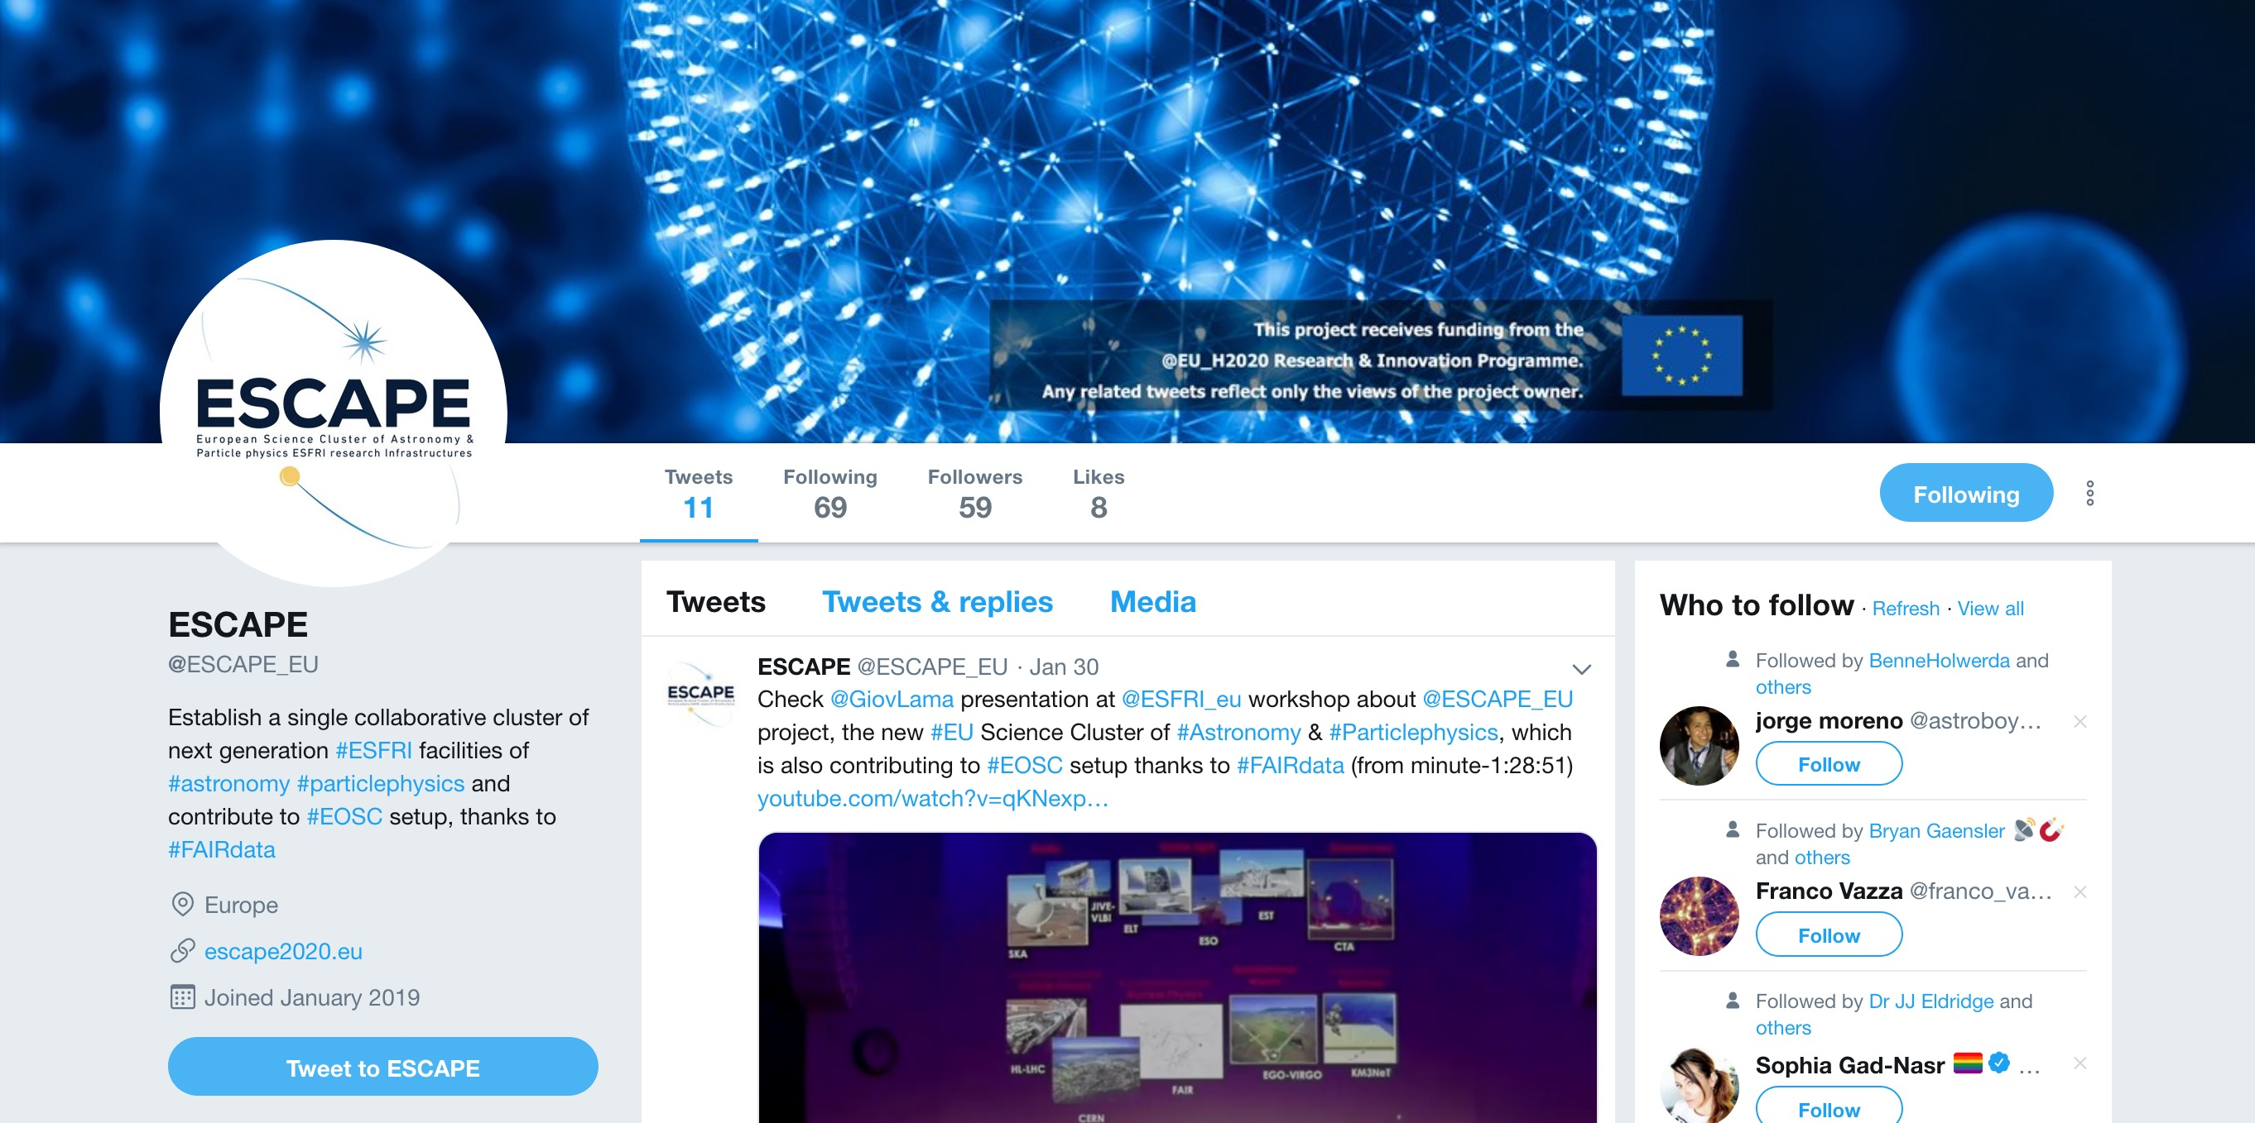
Task 6.1: public engagement and communication

Slide 15
Task 6.1: public engagement and communication
Establish and execute a dissemination and exploitation plan
Generate standard branding and public engagement materials
Project website

Slide 16

Task 6.1: public engagement and communication

Slide 17
Task 6.1: public engagement and communication
Establish and execute a dissemination and exploitation plan
Generate standard branding and public engagement materials
Project website
Create brochures
Translation and adaptation of resources
Run masterclasses / test citizen science
Internal dissemination
Integrating event

Slide 18
WP6 - Engagement and Communication
“Task 6.2 Open Education and Citizen Science”
Timing: M6-M48;
Lead: OU (37PM)
Deliverables:
  D6.4 – Citizen science experiments with embedded educational resources (month 24)
  D6.5 – Promotional education animation video (month 36)
  D6.6 – Citizen science experiments with embedded educational resources (month 41)
Contributions requested within the next 6 months:
  Soliciting ideas for new crowdsourcing experiments
Liaising with all ESCAPE ESFRIs and their pathfinders/precursors to create a harmonised suite of crowdsourcing experiments

Slide 19
T6.2 Timeline of Actions & Outlook for M1-M48
TODAY
D6.6: Citizen Science experiments & education
Branding & Identity
KoM Annecy
Recruit ML/CS PDRA
D6.4: Citizen Science experiments & education
D6.5: Promotional videos
Final Event
M0
M1
M5
M24
M36
M41
M48
Two hands-on workshops to generate projects for D6.4 and D6.6
e-eco@escape2020.eu

Slide 20
WP6 - Engagement and Communication
“Task 6.2 Open Education and Citizen Science”
New citizen science experiments for the ESFRIs and their precursors/pathfinders
Liaising with all ESCAPE ESFRIs and their pathfinders/precursors to create a harmonised suite of crowdsourcing experiments

Slide 21
CITIZEN SCIENCE IS NOT OUTREACH

Slide 22
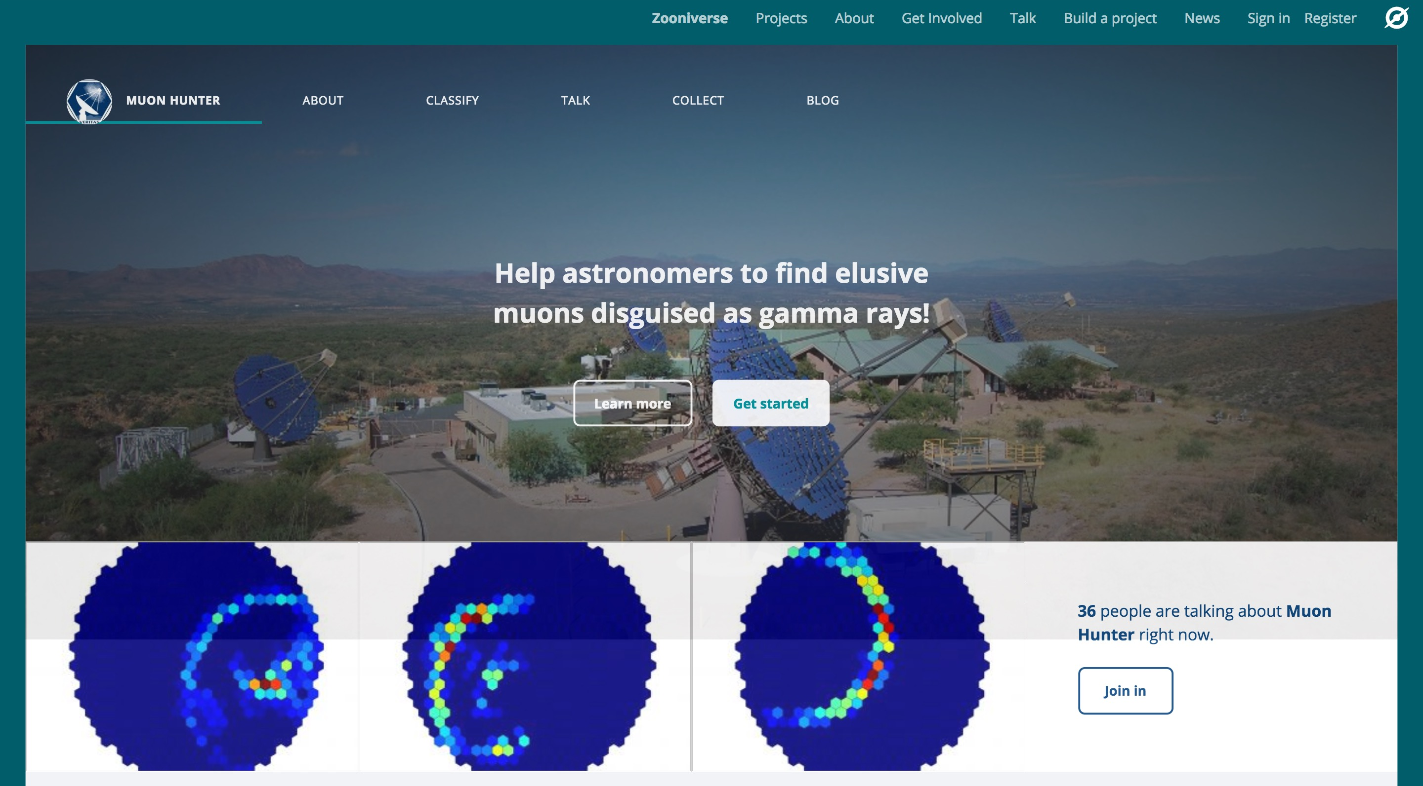
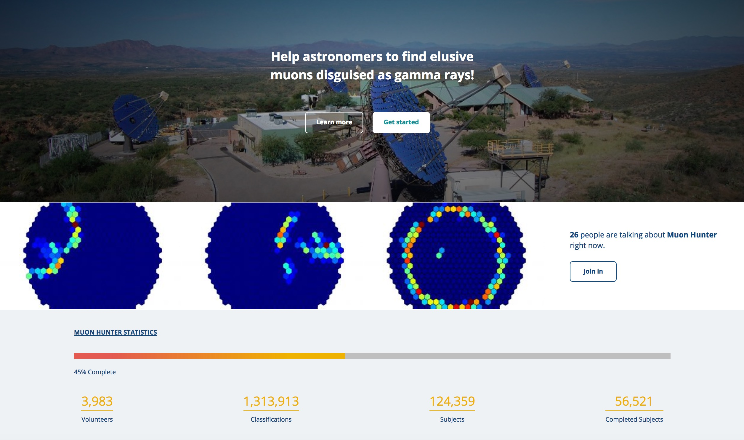
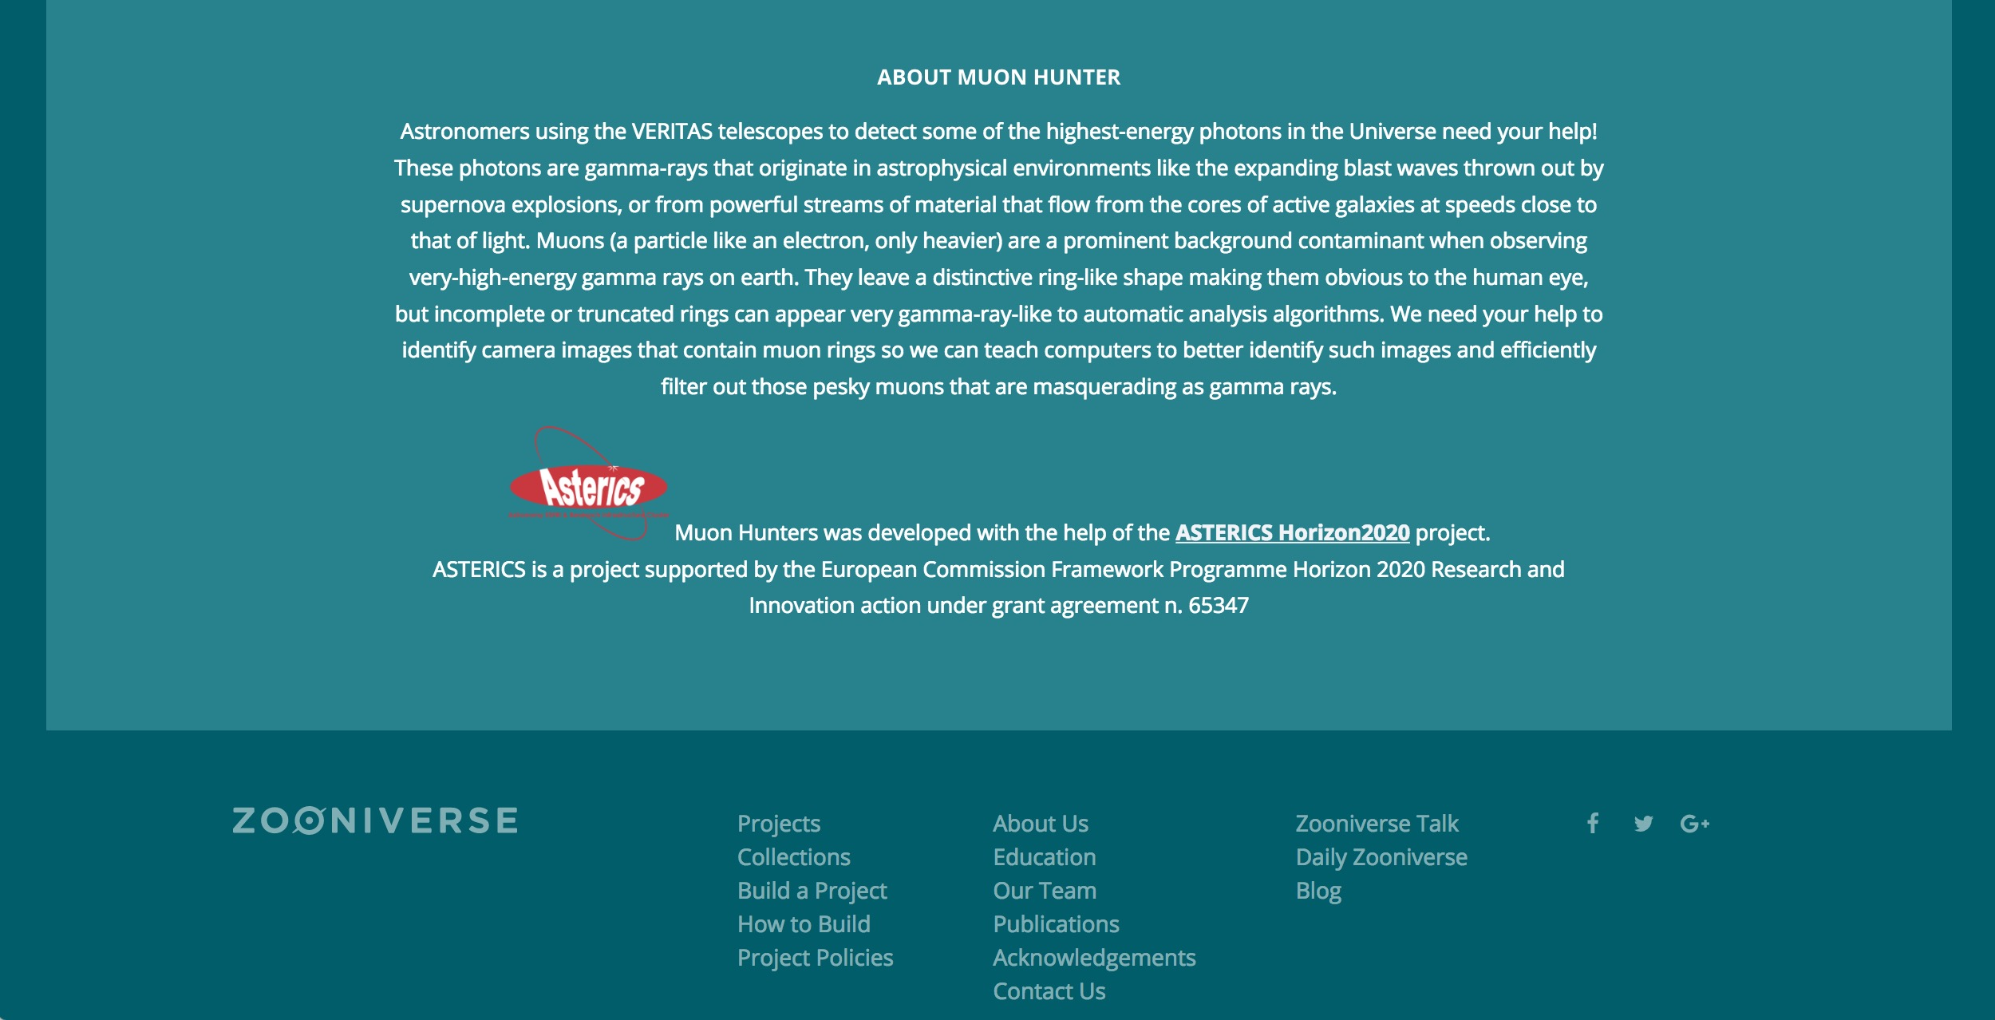
1.3 million classifications in the first five days!

Slide 23
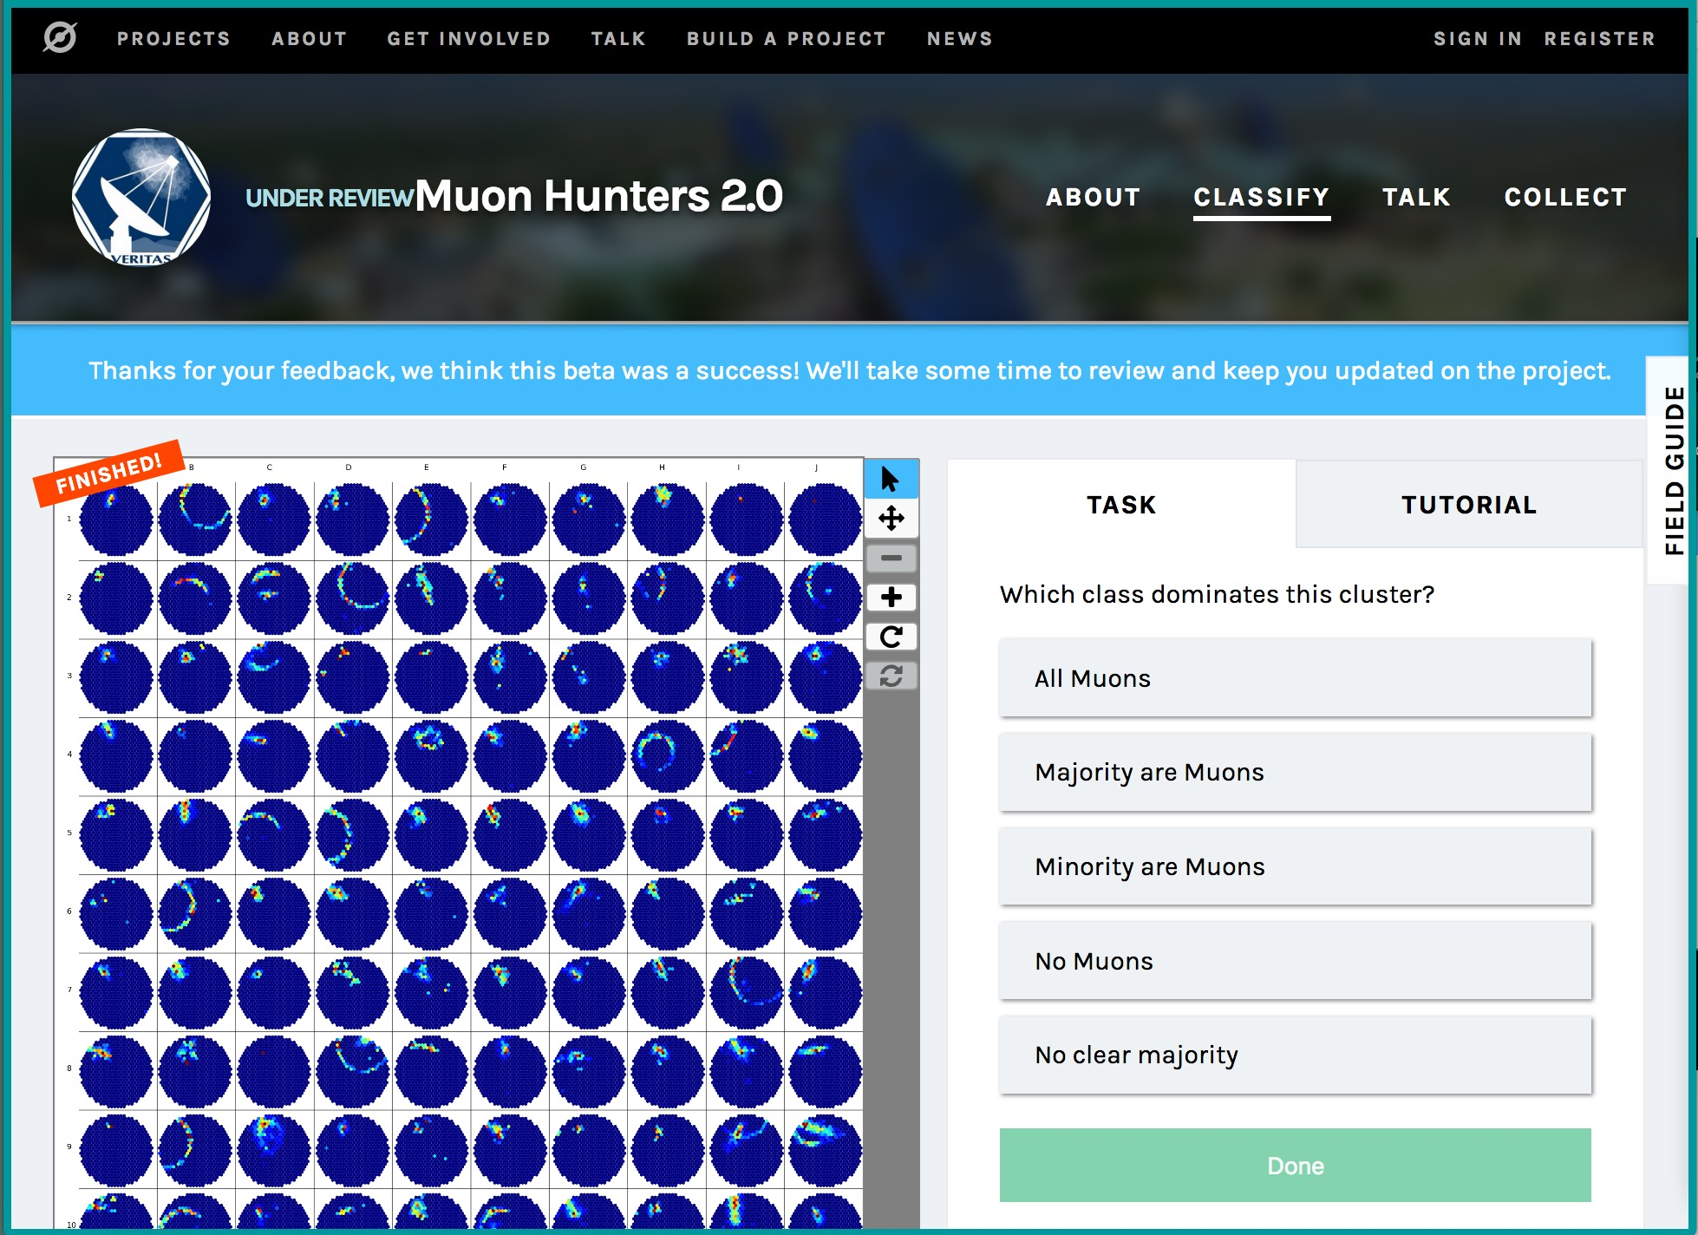

Slide 24
WP6 - Engagement and Communication
“Task 6.2 Open Education and Citizen Science”
New citizen science experiments for the ESFRIs and their precursors/pathfinders
Create embedded educational resources and online forums for two-way dialogue with professional scientists
Liaising with all ESCAPE ESFRIs and their pathfinders/precursors to create a harmonised suite of crowdsourcing experiments

Slide 25
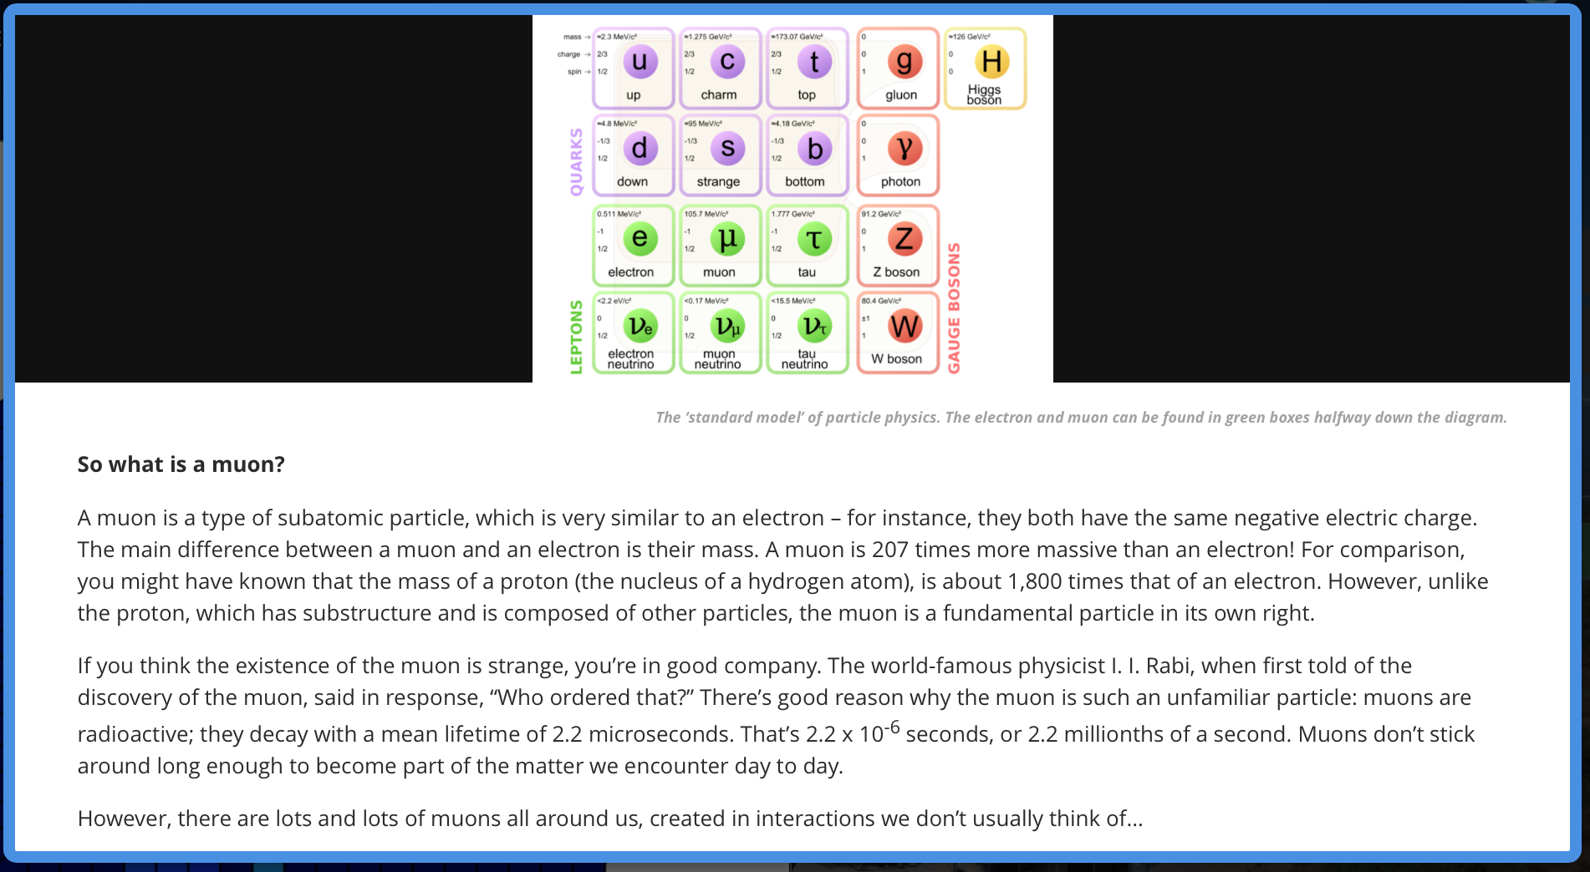
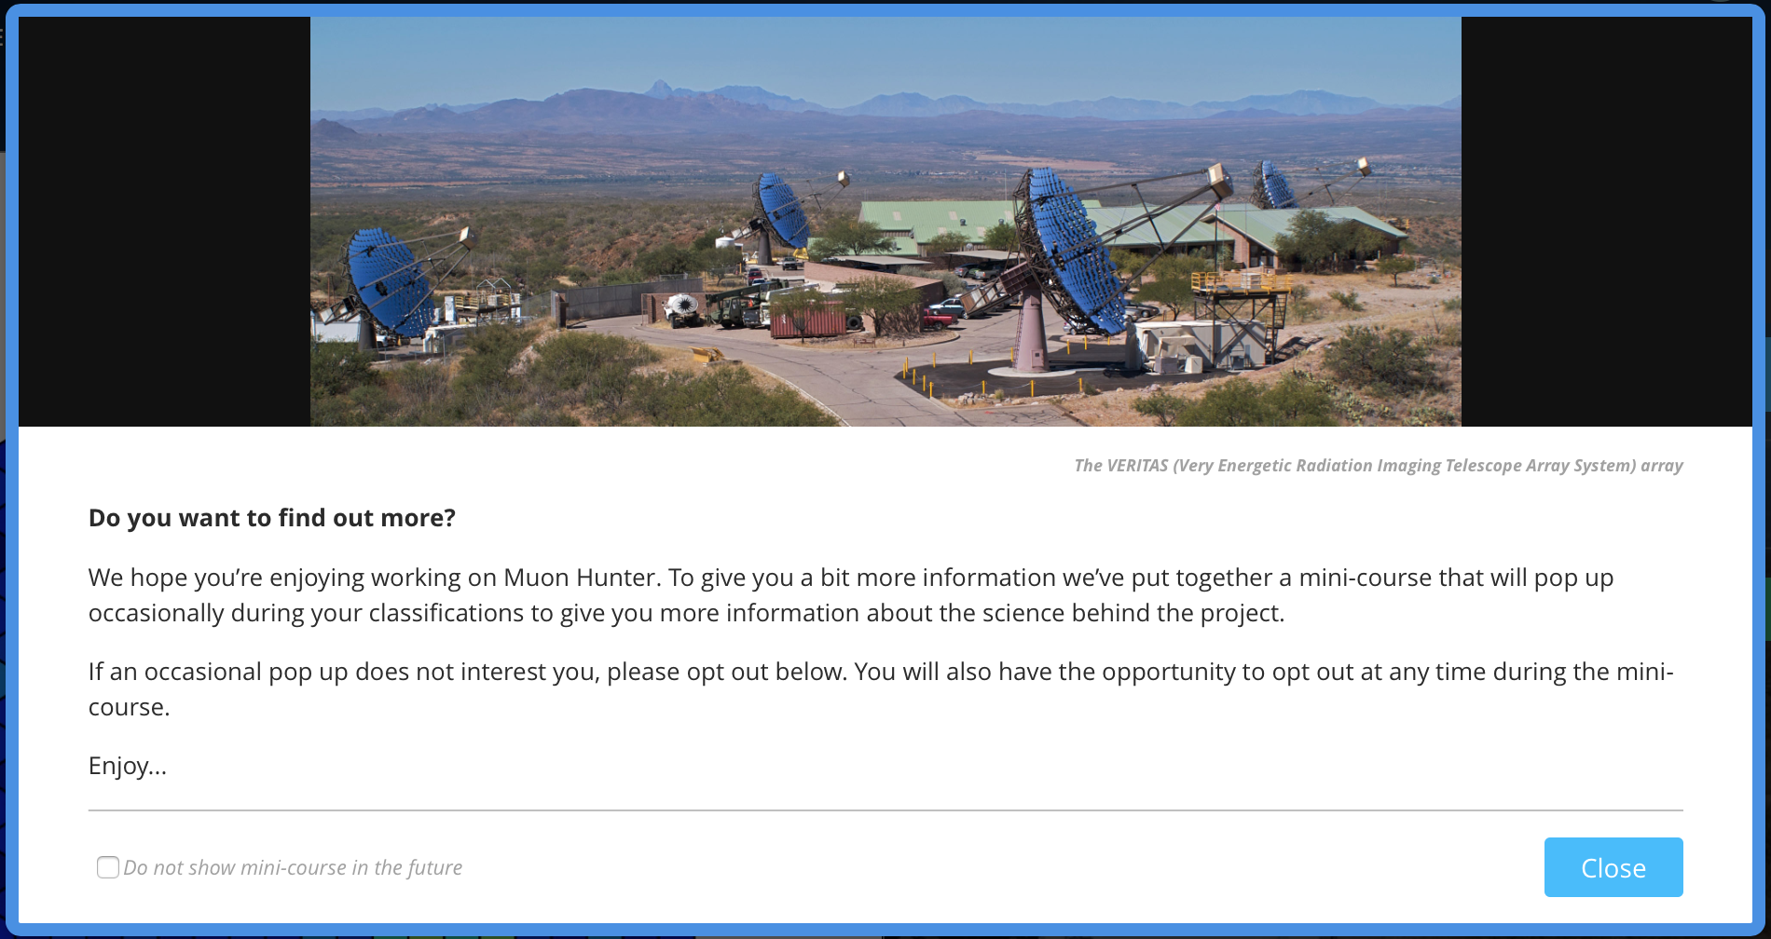
Notes:
EDUCATIONAL RESOURCES DELIBERATELY DESIGNED TO BE EMBEDDED WITHIN CITIZEN SCIENCE EXPERIMENT

Slide 26
WP6 - Engagement and Communication
“Task 6.2 Open Education and Citizen Science”
New citizen science experiments for the ESFRIs and their precursors/pathfinders
Create embedded educational resources and online forums for two-way dialogue with professional scientists
Organise two international Citizen Science workshops
Liaising with all ESCAPE ESFRIs and their pathfinders/precursors to create a harmonised suite of crowdsourcing experiments

Slide 27
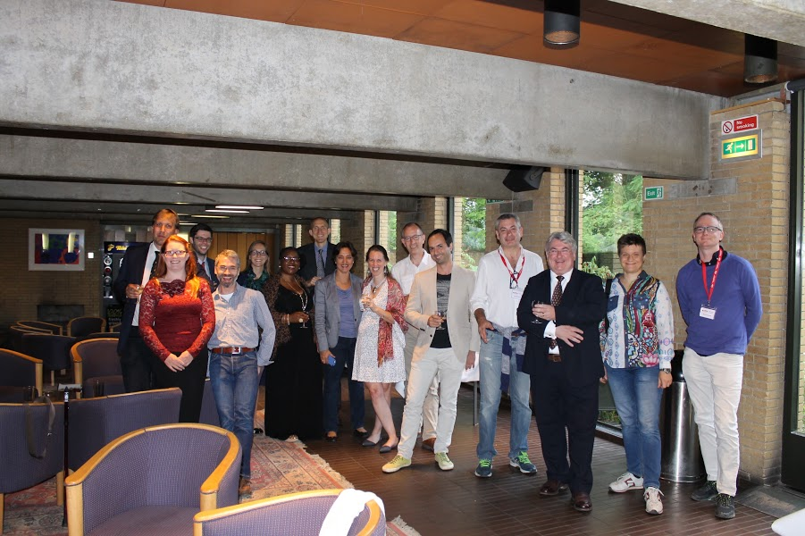
Notes:
EDUCATIONAL RESOURCES DELIBERATELY DESIGNED TO BE EMBEDDED WITHIN CITIZEN SCIENCE EXPERIMENT

Slide 28
WP6 - Engagement and Communication
“Task 6.2 Open Education and Citizen Science”
New citizen science experiments for the ESFRIs and their precursors/pathfinders
Create embedded educational resources and online forums for two-way dialogue with professional scientists
Organise two international Citizen Science workshops
Commission the creation of sixty-second promotional animations
Liaising with all ESCAPE ESFRIs and their pathfinders/precursors to create a harmonised suite of crowdsourcing experiments

Slide 29


Slide 30
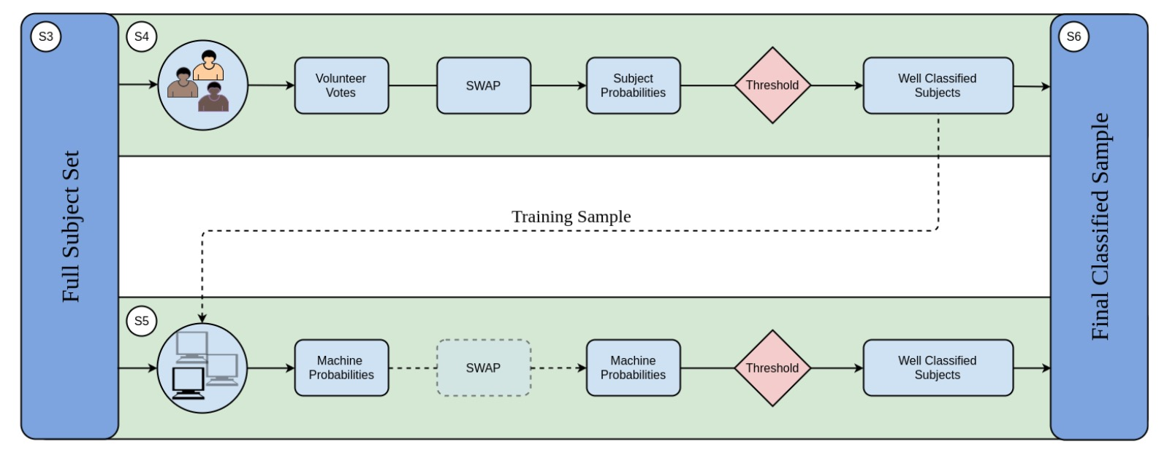
WP6 - Engagement and Communication
“Task 6.2 Open Education and Citizen Science”
Homework for tomorrow: what data sets would you like to crowdsource?
Recruiting ML + crowdsourcing PDRA, starting June 2019
x8 faster classification!
Beck+ arXiv:1802.08713

Slide 31
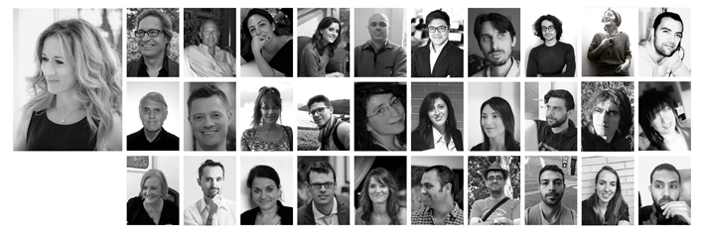
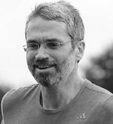



Thank you very much!
Stephen Serjeant: stephen.serjeant@open.ac.uk
Rita Meneses: r.meneses@trust-itservices.com
Niccolò Zazzeri: n.zazzeri@trust-itservices.com
Follow ESCAPE on
@ESCAPE_EU
/in/escape-eu
slideshare.net/ESCAPE3

