Slide 1
WP4: ‘CEVO’
Connecting ESFRI projects to EOSC through the Virtual Observatory framework
Mark ALLEN
Strasbourg astronomical Data Centre (CDS)
Observatoire astronomique de Strasbourg - CNRS
Annecy, 7 February 2019

Slide 2
WP4 Objectives
  Assess and implement the connection of ESFRI and other astronomy research infrastructures to the EOSC by the Virtual Observatory
  Refine and pursue implementation of FAIR principles for astronomy data via common interoperability standards - extending the VO to new communities
  Establish data stewardship practices for adding value to scientific content of ESFRI data archives

Slide 3
Connecting ESFRI to the EOSC via the VO
In practice: ESFRI-VO-EOSC connection
Inclusion of VO registry will be a key factor
Implement FAIR principles via the use of common interoperability standards
VO next-steps of connection to computing, and extension to new communities (in particular EST)
Stewardship – technical and human. Adding value to the scientific content
Following all steps of EOSC evolution :
EOSCpilot, EOSC-hub, eInfraCentral, …

Slide 4
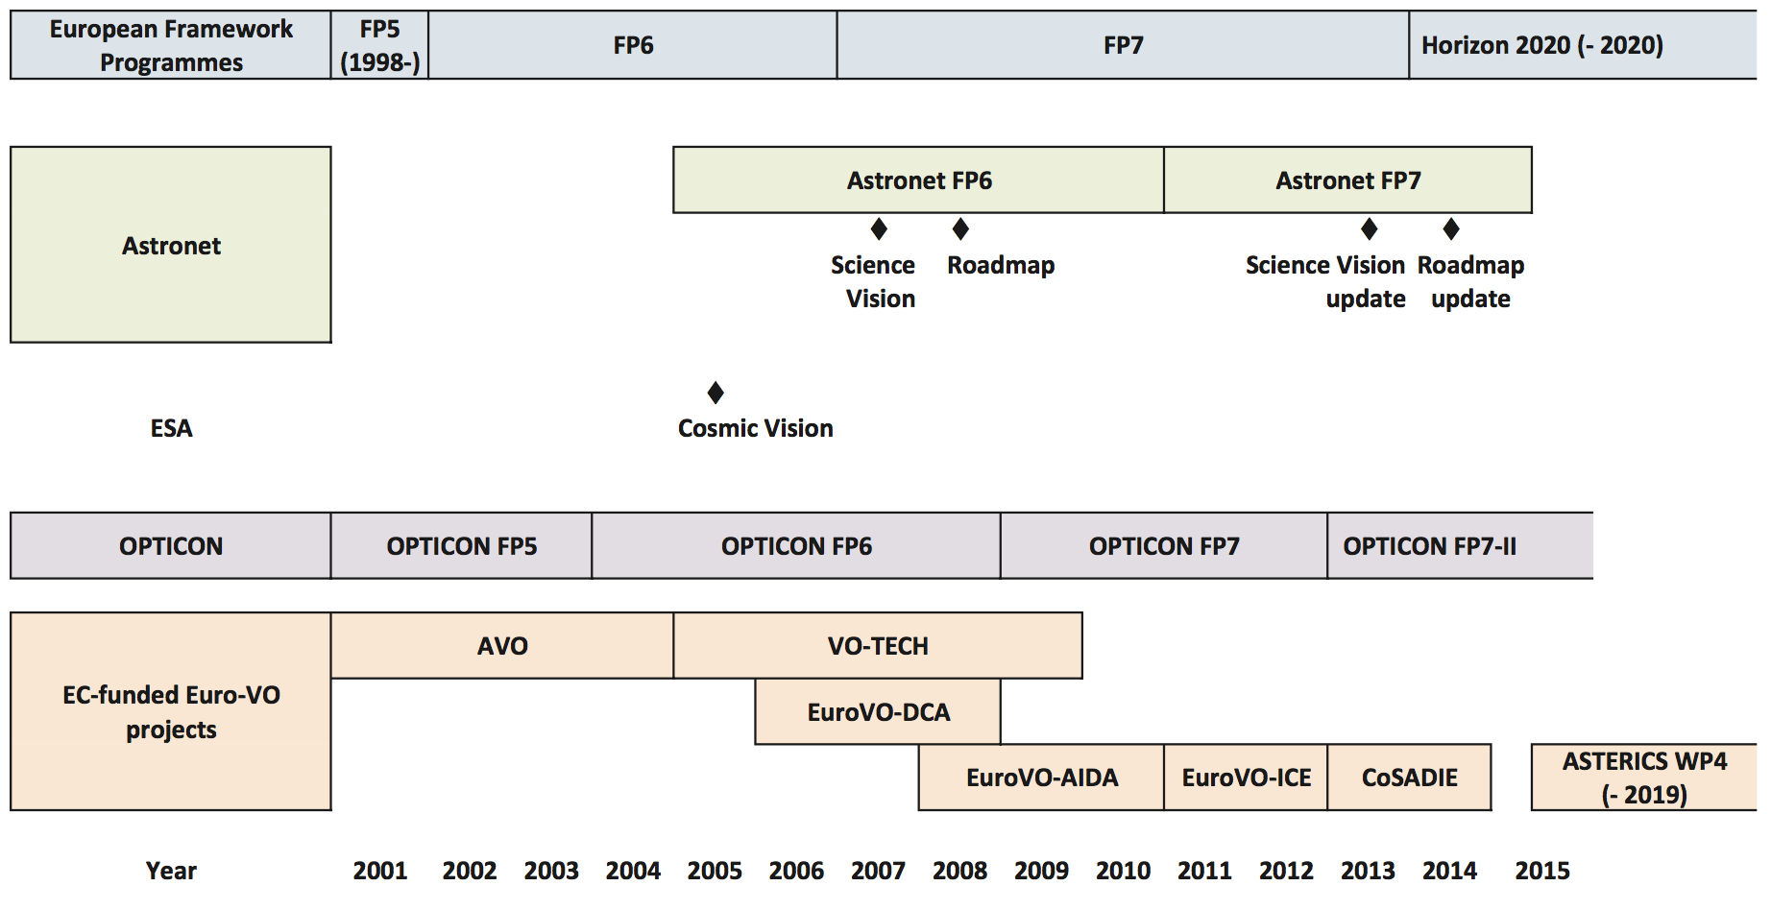



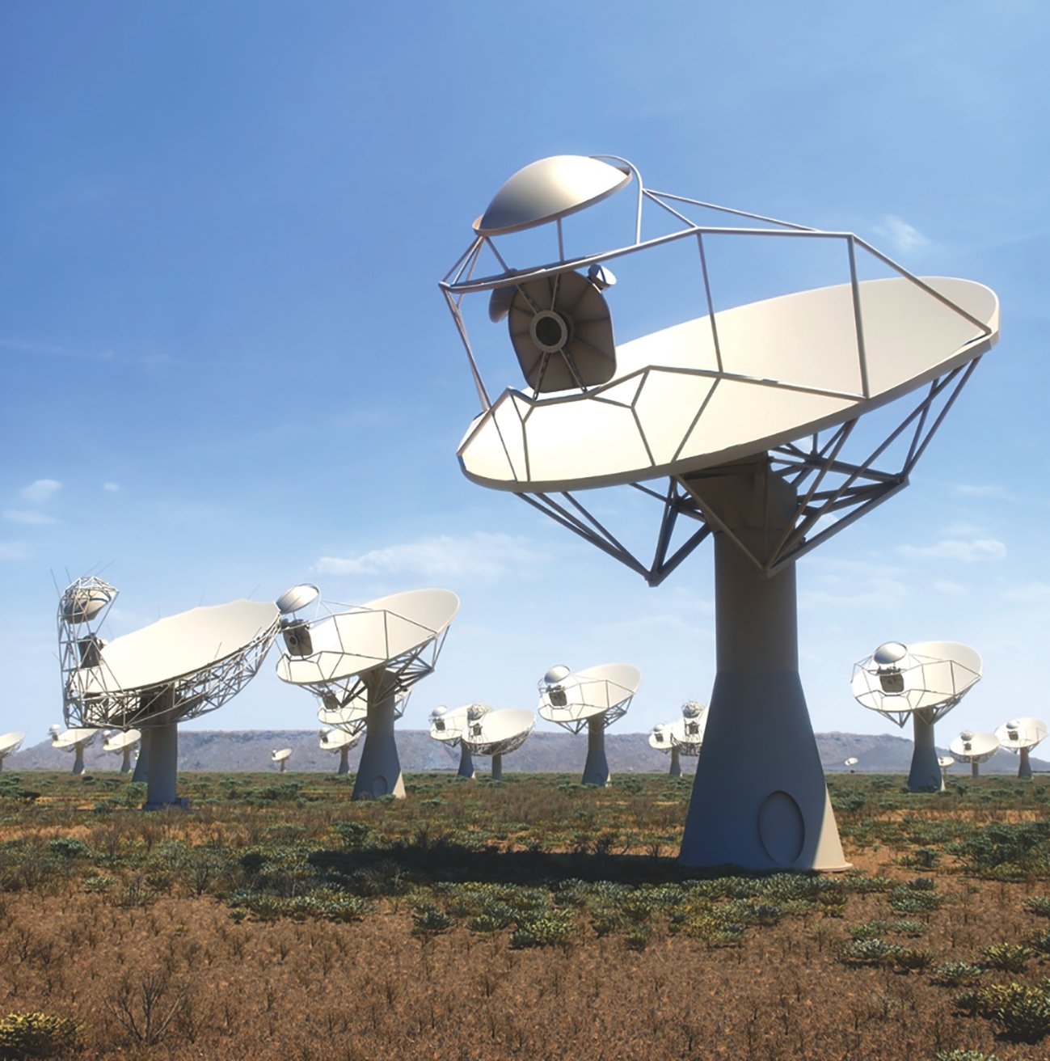
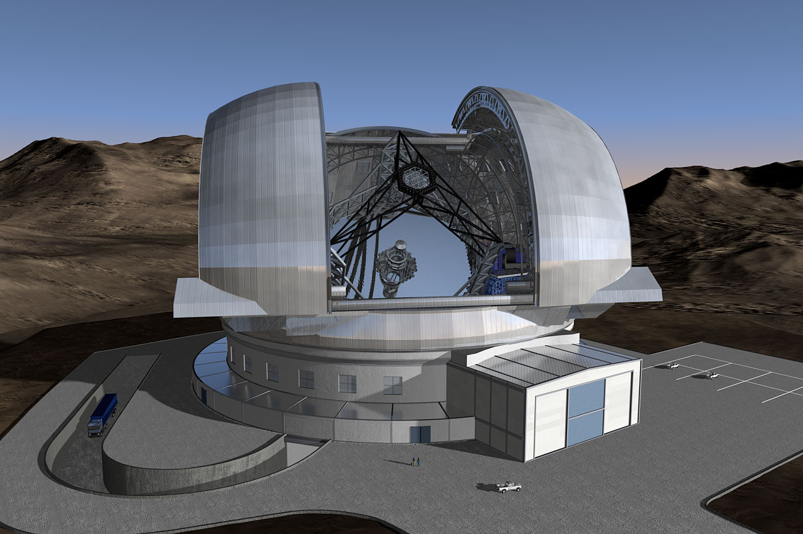
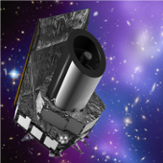
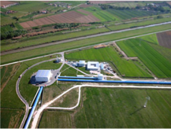
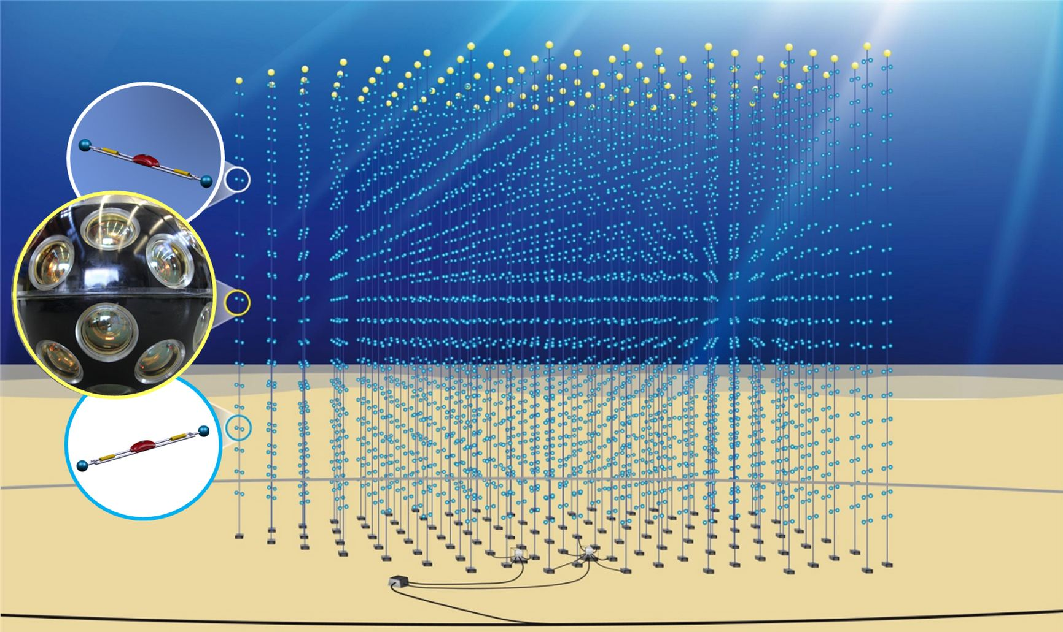
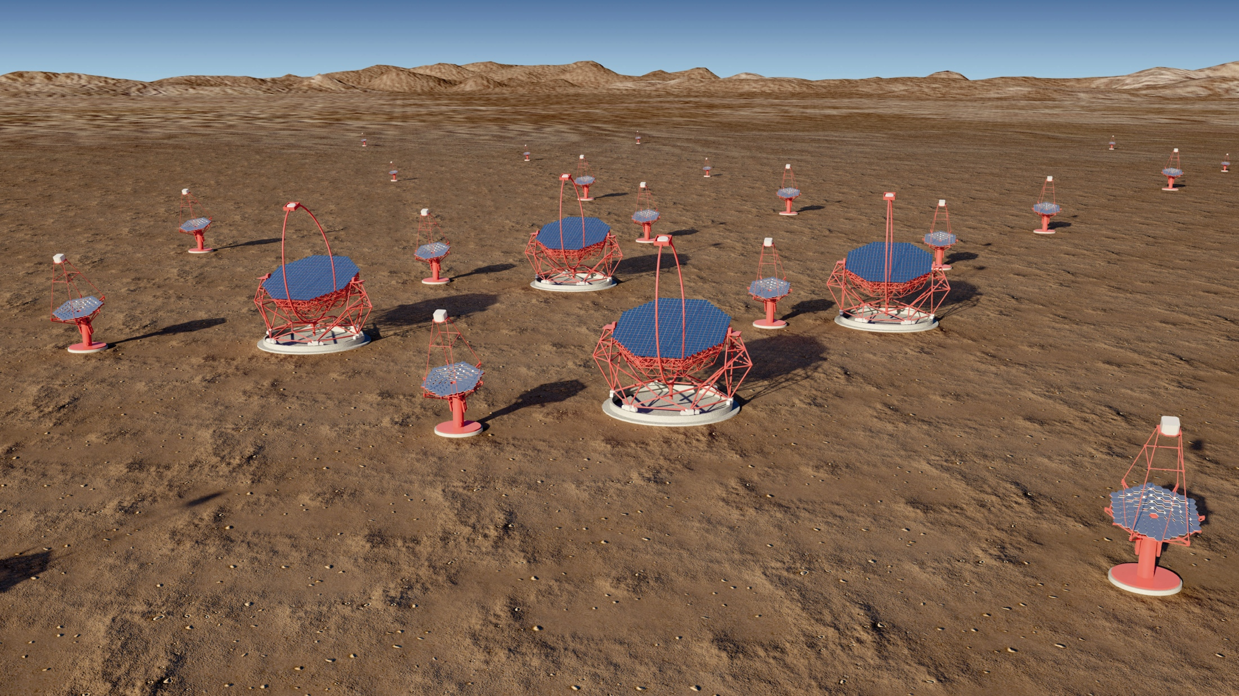
Background…
How we got here, and where we’re going
Virtual Observatory infrastructure for astronomy
Genova et al. 2015

Slide 5
What is the Virtual Observatory?
Operational framework for interoperable access to astronomical data and services across all areas of astronomy
Provides unique scientific capabilities, opening up new ways of using rich data in astronomy archives and services
A pioneer of FAIR data sharing - an existing global framework – populated by major data providers (space and ground based) that is heavily used by the community (e.g. Gaia data access is fully VO)
Re-used and customized by planetary science (EuroPLANET), atomic and molecular physics (VAMDC) and materials sciences (via RDA Working Group)

Slide 6
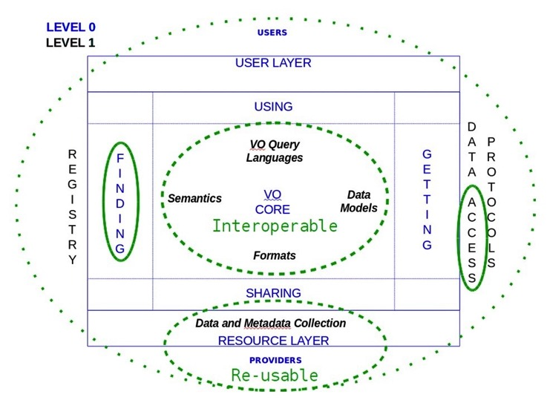
VO is FAIR

Slide 7
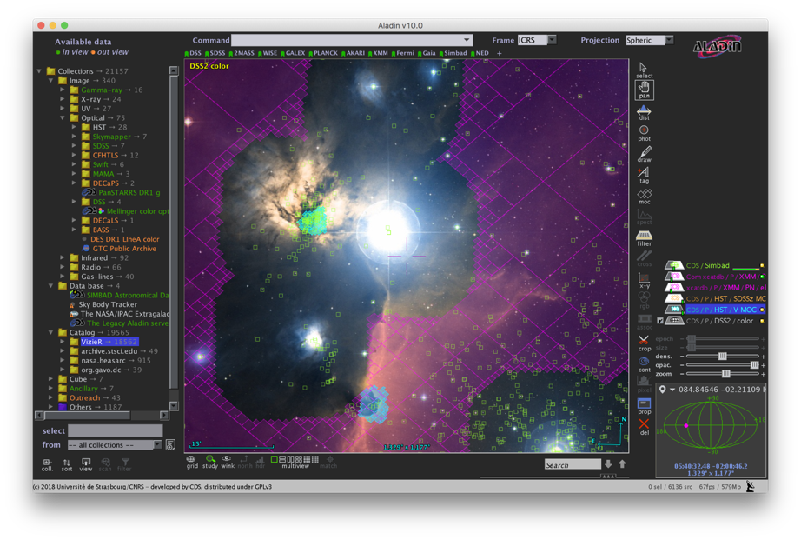
One view of the VO from an application:
Largest catalogues: PanSTARRS, Gaia etc.
1000s All-Sky data sets
Built from VO Registry
Complex ADQL queries
Multi-resolution techniques for Big Data
Data from many observatories and missions
Interoperability of data
Interoperability between applications

Slide 8
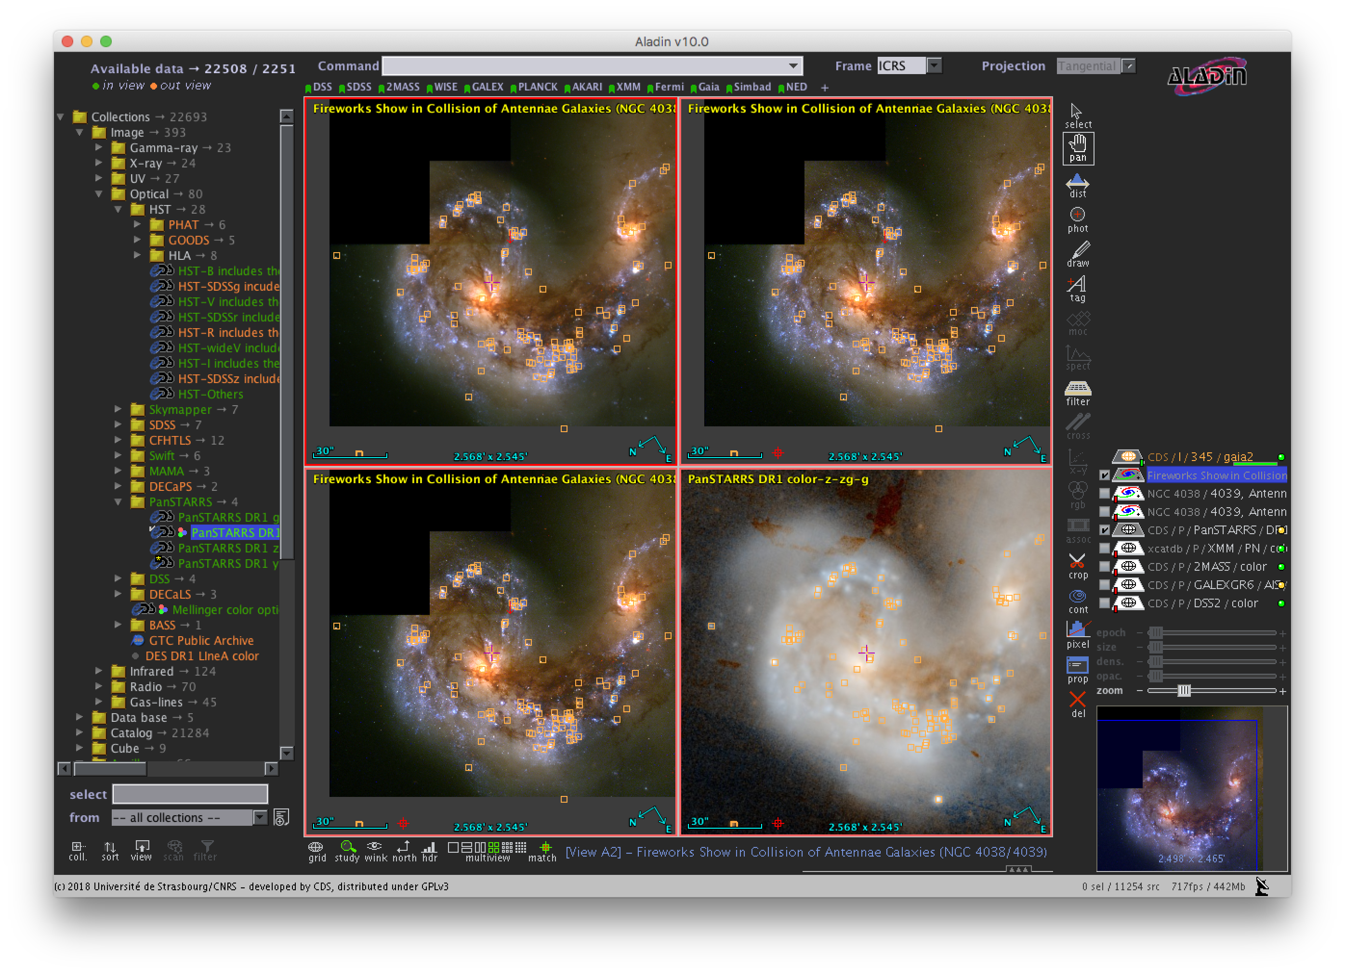
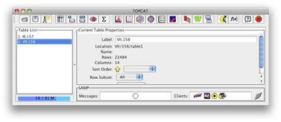
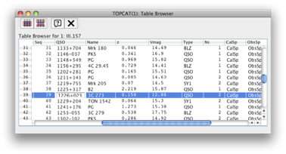
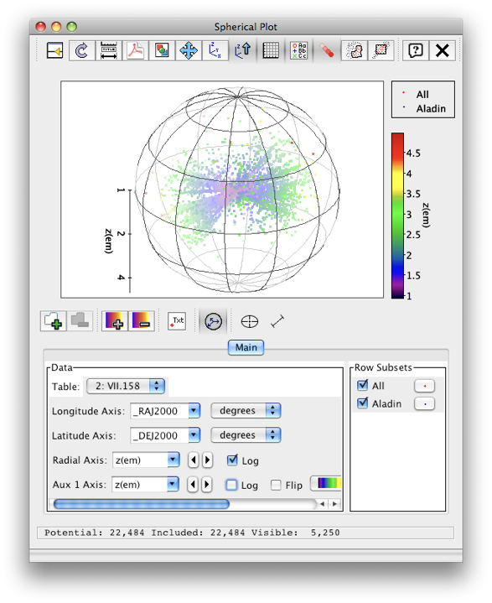


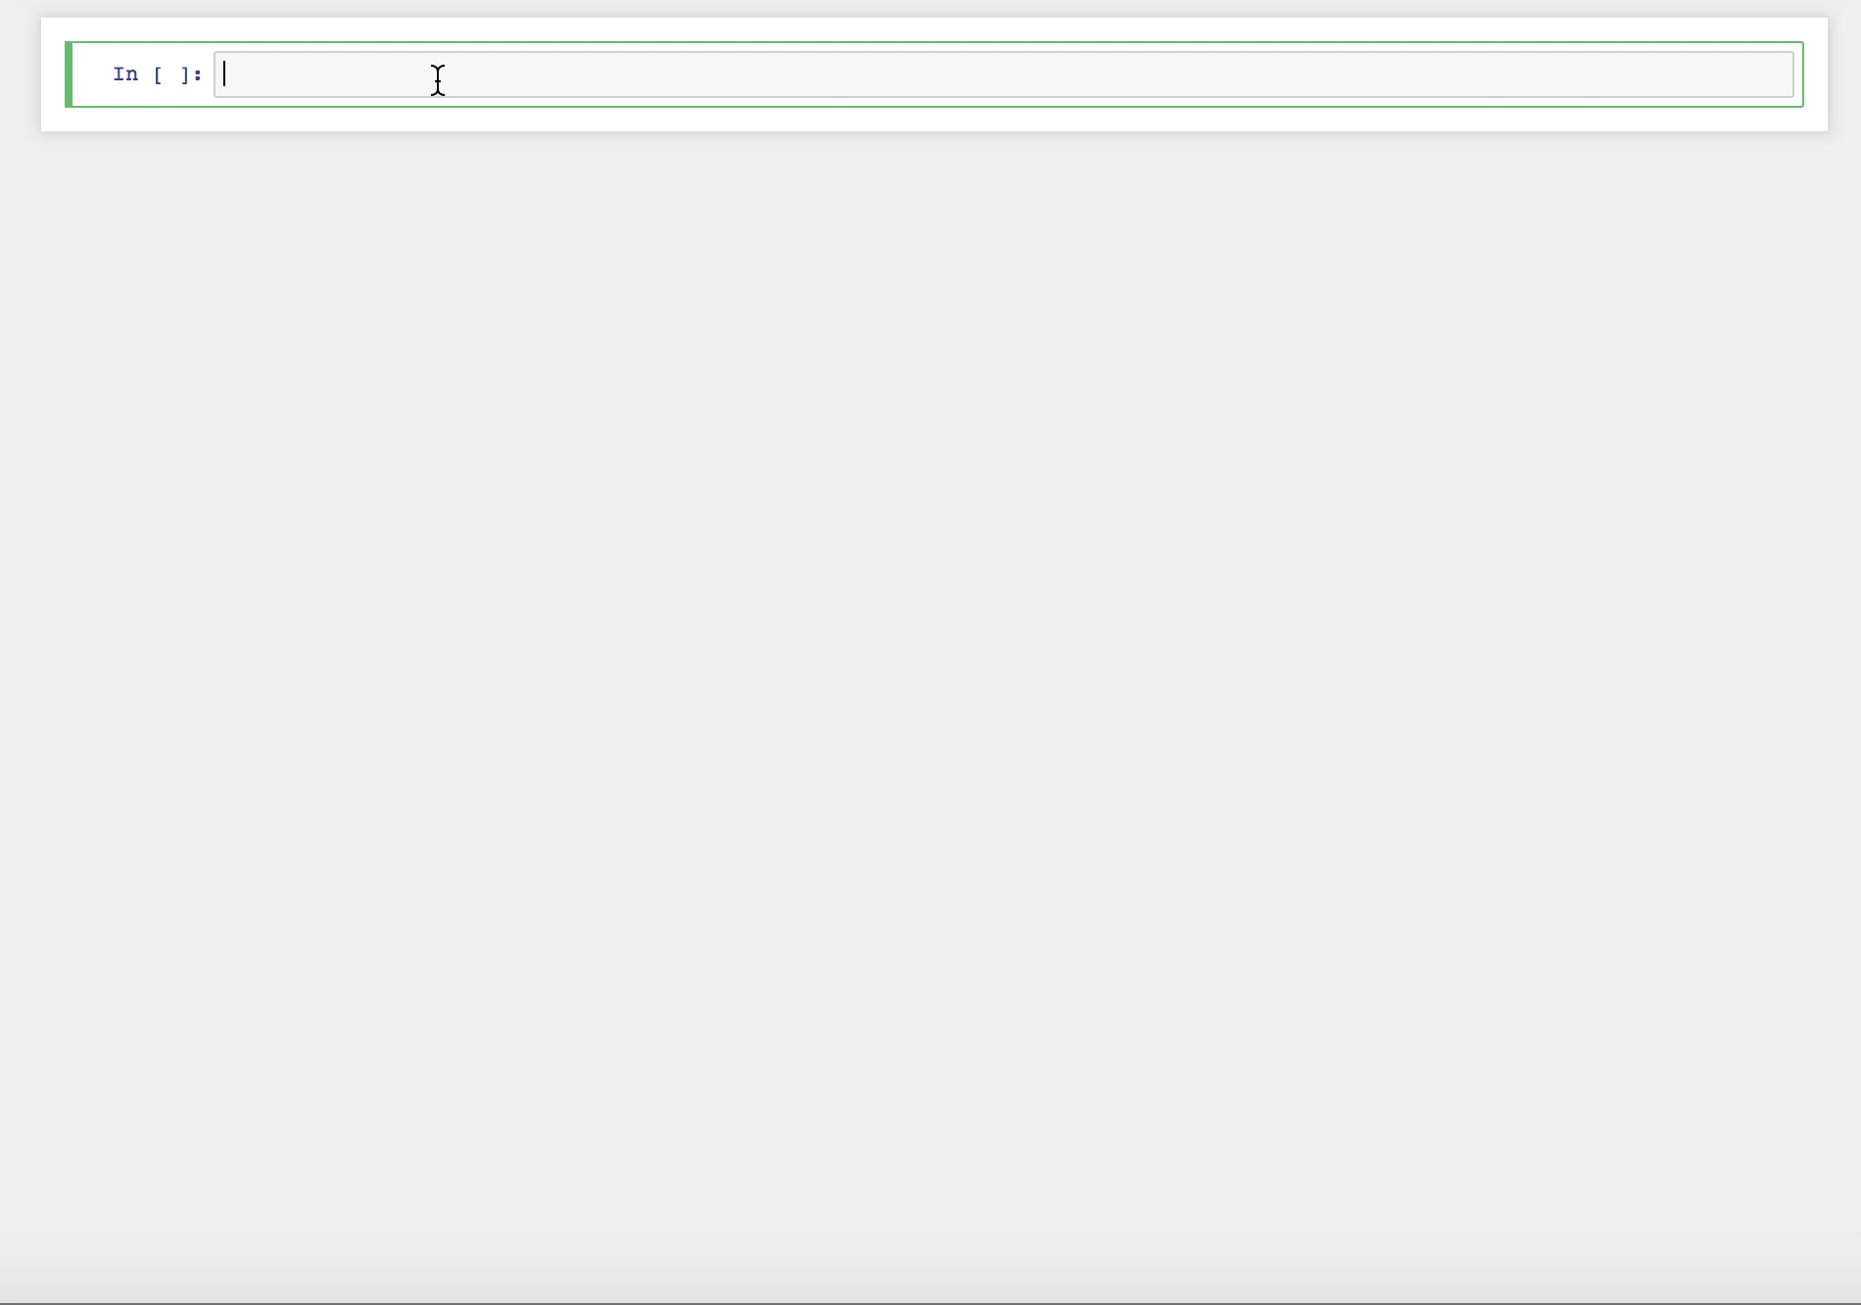
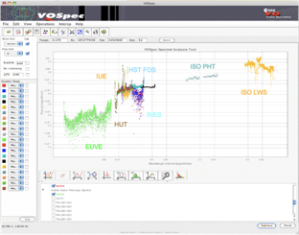

Interoperable applications and services
Aladin
Your apps
& programs
Notebooks
TOPCAT
Spectral tools

Slide 9
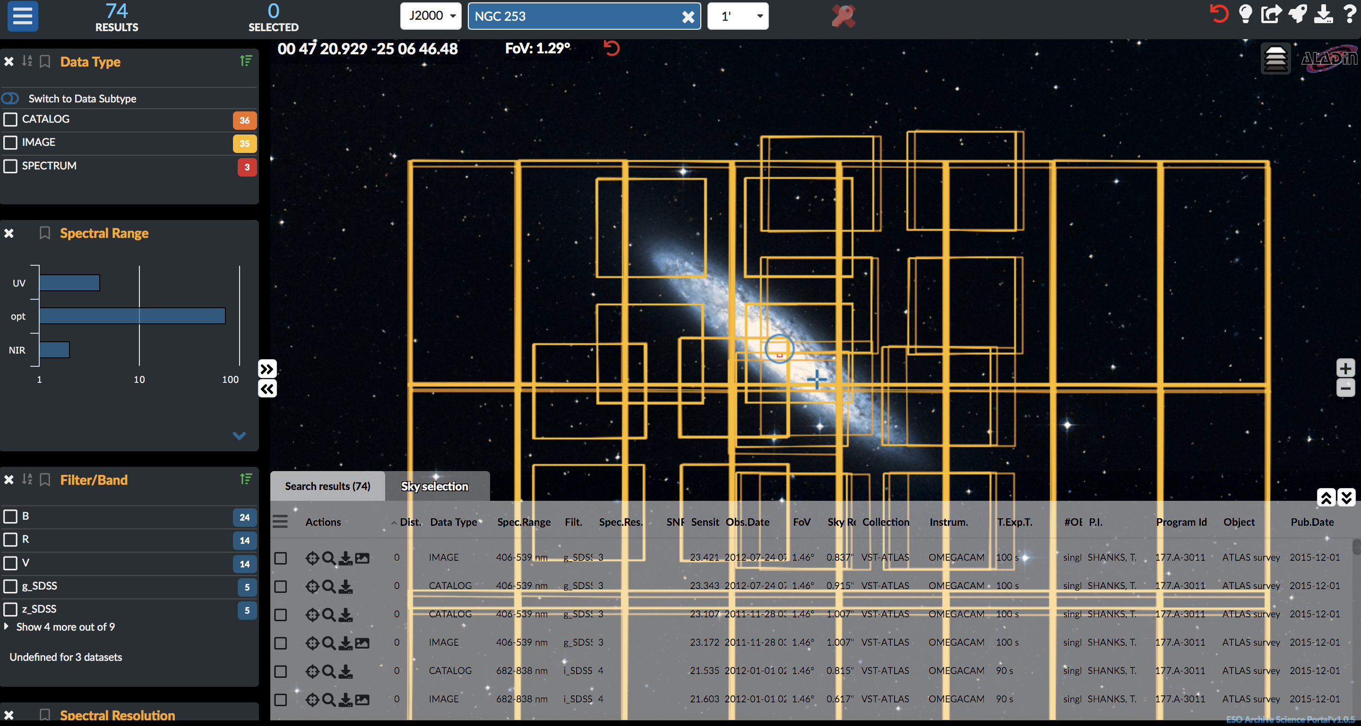
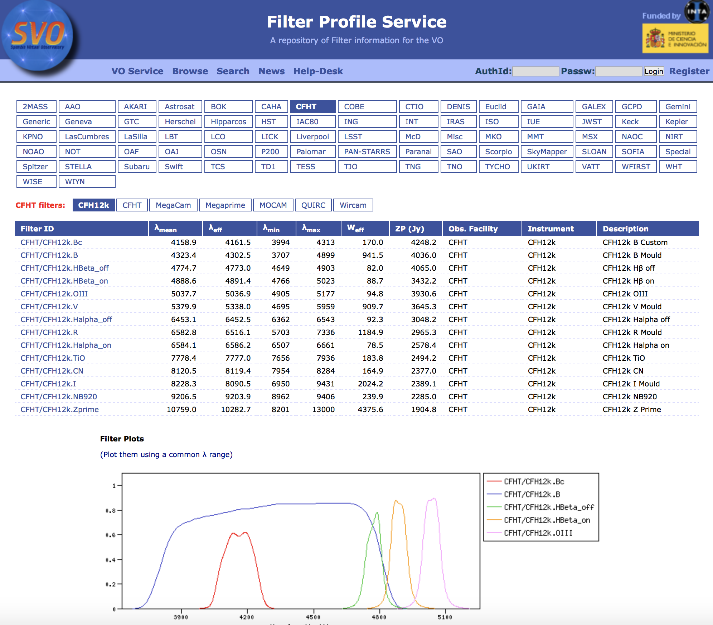

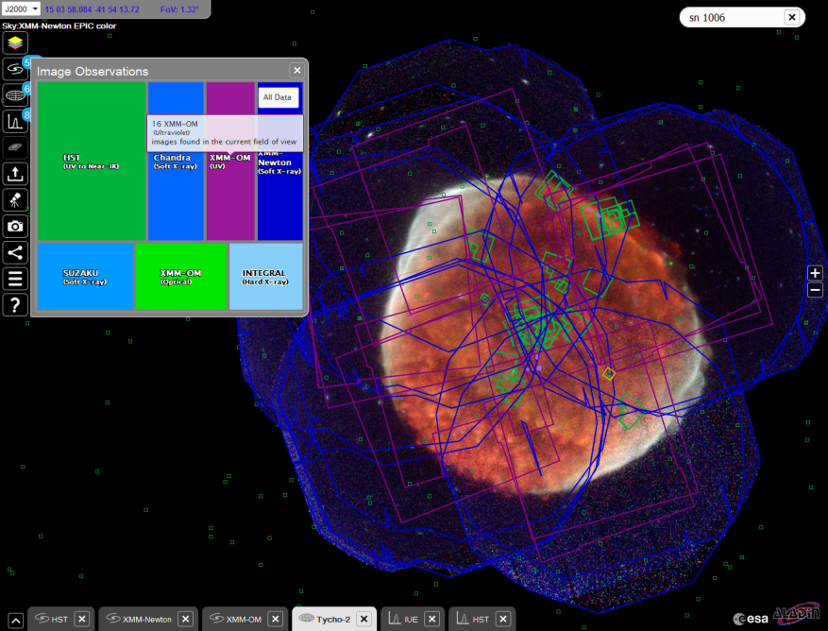
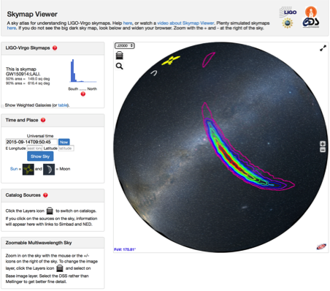
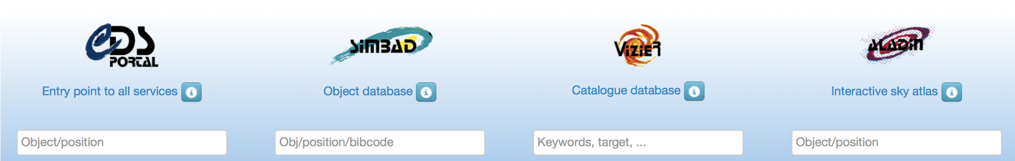
VO embedded in astronomy services
SVO Filter Profile service
ESO Science Portal
Grav. waves
CDS reference data services
ESA Sky

Slide 10
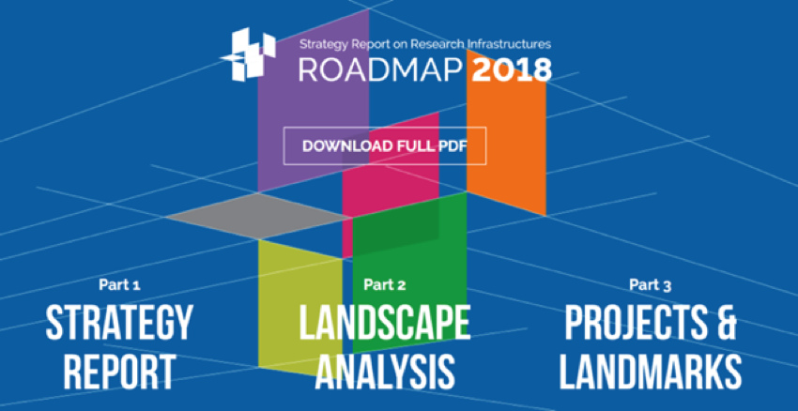
VO and ESFRIs
ESFRI Roadmap 2018

Slide 11
WP4 Tasks
Task 4.1 Integration of astronomy VO data and services into the EOSC
Task 4.2 Implementation of FAIR principles for ESFRI data through the Virtual Observatory
Task 4.3 Adding value to trusted content in astronomy archives
Building on the work of ASTERICS DADI

Slide 12













WP4 Partners
Partners from ESFRIs and astronomy Research Infrastructures
Partners bringing experience from European Virtual Observatory projects

Slide 13
Task 4.1 Integration of astronomy VO data and services into the EOSC
Map the VO framework to EOSC
  Aim to include the VO enabled archive services from ESFRI into EOSC
VO Registry in EOSC
Portfolio of astronomy VO services
Contribution to EOSC hybrid cloud
Containerised domain-specific services

Slide 14
Task 4.2 Implementation of FAIR principles for ESFRI data through the VO
Definition and adoption of common open IVOA standards based on ESFRI requirements
Gathering requirements from ESFRI for use of VO framework
Update and definition of standards based on priorities of ESFRI, representing ESFRI interests in IVOA
  Specific example of inclusion of Solar data (EST)
Practical problem solving platform – facilitate implementations
Support to scientific community – Schools/Training

Slide 15
Task 4.3 Adding value to trusted content in astronomy archives
Next generation functionalities for creation and publication of high-level, value-added data products from ESFRIs
Assessment and application of new techniques – machine learning analytics. (connection to WP3)
  Specific example applied to ESO archives data products
Identification of stewardship best practices
  Curation and publication of next-generation data products via ESFRI archives
  Technical and human aspects

Slide 16
Partnerships
WP4 — WP3 - Machine Learning classification
WP4 — WP5 - Platform – exploration as one mode of interface between VO and EOSC services
WP4 — WP2 - Connection to computing
Direct liaison needed with technical EOSC expertise at WP/task level
EST – connection to Euro-VO partners (just begun in ASTERICS)

Slide 17
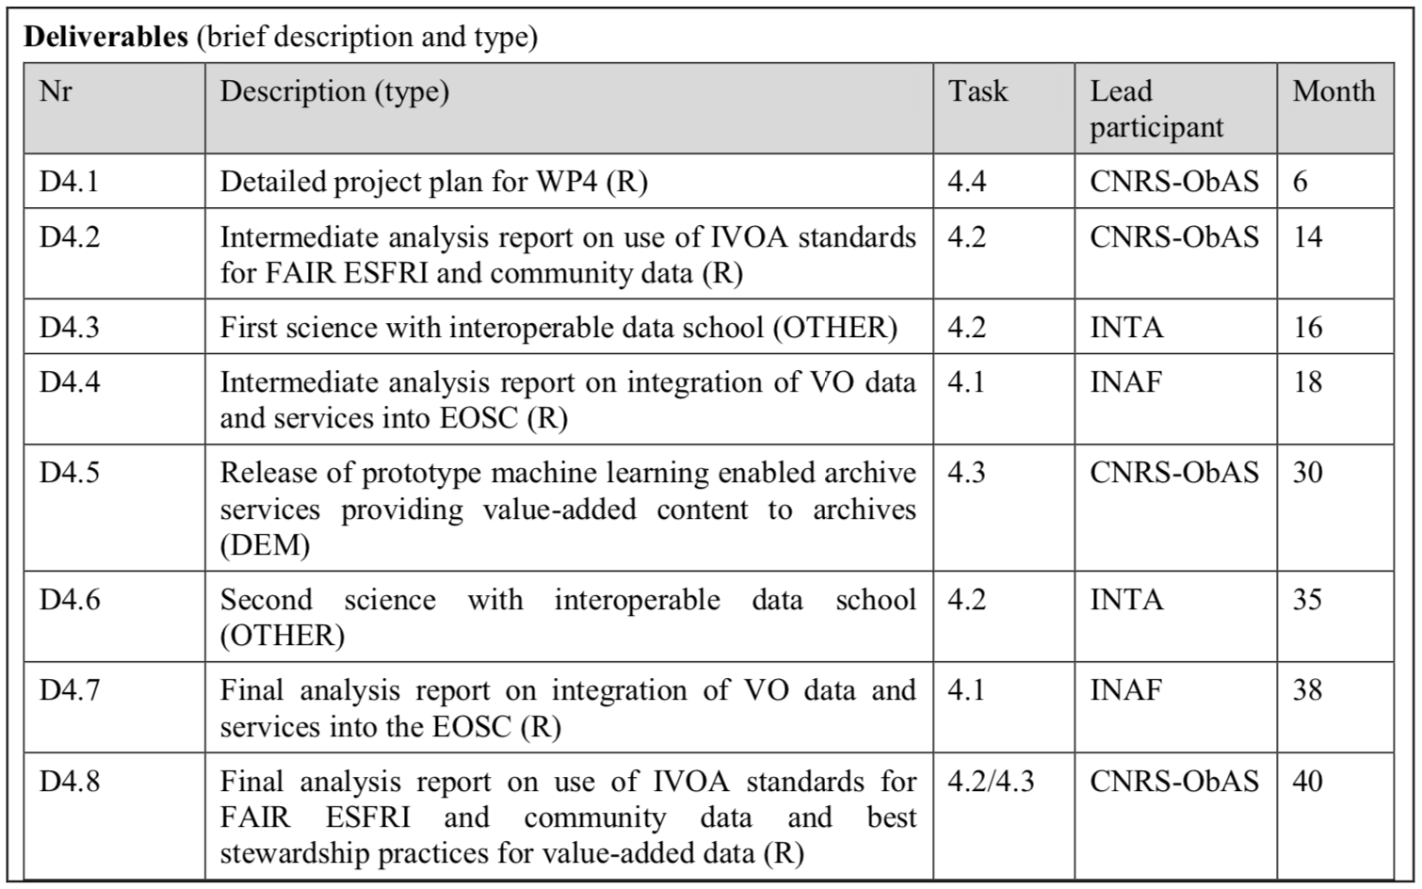
WP4 Deliverables

Slide 18
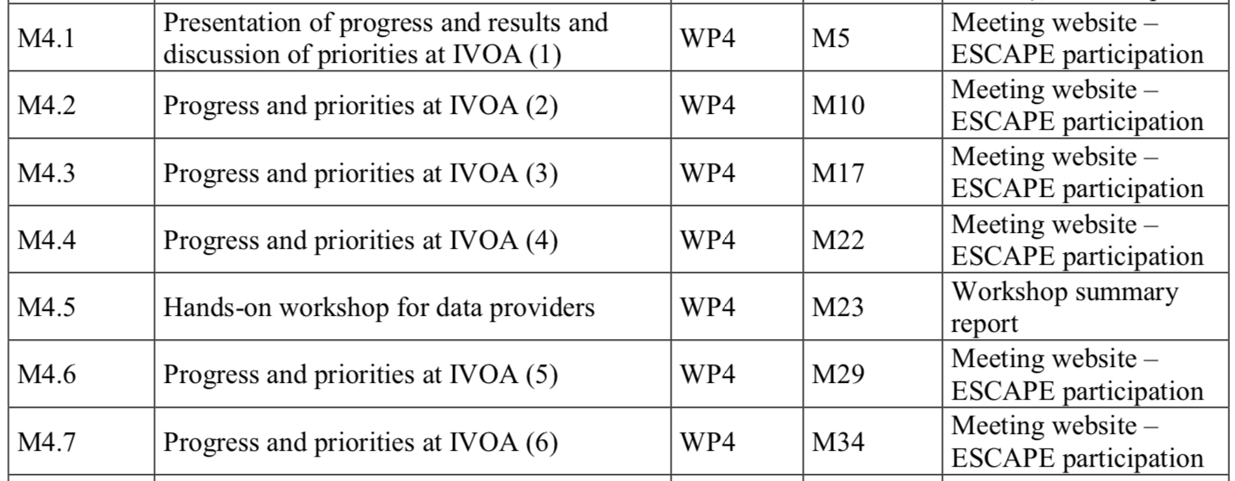
WP4 Milestones

Slide 19

Expected Impacts
Connection of the existing (operational, heavily used, global) VO framework to the EOSC
  Astronomy specific services on EOSC
  Contributing to the setting up of EOSC
Training astronomers, ESFRI and RI on use of interoperable tools for science and data sharing
Extension of the VO framework to new communities, and VO next-steps (computing, Bigger Data)
Significant added value to ESFRI archive services (e.g. machine learning classification)

