Slide 1
ASTRONOMY & PARTICLE PHYSICS
CLUSTER
Giovanni LAMANNA
ESCAPE Kick-off meeting @ LAPP, 7 February 2019

Slide 2
Outline
Cluster projects and ESCAPE
About EOSC
Today meeting
2

Slide 3


Slide 4
Domain Cluster projects
H2020-INFRAEOSC-04-2018 call
Clusters to ensure the connection of the EFRI RIs with EOSC (and the construction of EOSC)
Expected impact:
Improve access to data and tools leading to new insights and innovation
Facilitate access of researchers to data and resources for data driven science.
Create a cross-border open innovation environment.
Rise the efficiency and productivity of researchers through open data services and infrastructures for discovering, accessing, and reusing data.
Foster the establishment of global standards.
Develop synergies and complementarity between involved research infrastructures.
Adopt common approaches to the data management for economies of scale.
4

Slide 5

Domain Cluster projects
H2020-INFRAEOSC-04-2018 call
Clusters to ensure the connection of the EFRI RIs with EOSC (and the construction of EOSC)
Expected impact:
Improve access to data and tools leading to new insights and innovation
Facilitate access of researchers to data and resources for data driven science.
Create a cross-border open innovation environment.
Rise the efficiency and productivity of researchers through open data services and infrastructures for discovering, accessing, and reusing data.
Foster the establishment of global standards.
Develop synergies and complementarity between involved research infrastructures.
Adopt common approaches to the data management for economies of scale.
Making data FAIR …
5

Slide 6
(The magnificent …) Five EOSC Clusters
EOSC-LIFE: Life science RIs
ENVRI-FAIR: Environmental Research Infrastructures
ESCAPE: The two infinites …
PANOSC: Photon and Neutron sources RIs
SSHOC: Social Sciences and Humanities
6

Slide 7

Background
ESCAPE is based on the capacity building of the H2020 ASTERICS cluster of ESFRI projects (in astrophysics and astroparticle physics) addressing Big Data challenges and already succeeding in:
  enabling interoperability between the facilities,
  minimising fragmentation,
  encouraging cross-fertilisation and
  developing joint multi-messenger capabilities.
Astronomy ESFRI & Research Infrastructure Cluster
ASTERICS - 653477

Slide 8
Astronomy and Particle Physics
ESCAPE is a step forward…
The astronomy-related ESFRI projects and the accelerator-based particle physics ESFRI facilities will open together new paths towards the understanding of the Universe through a multi-probe approach.
Enhance the coordination leveraging two major complementary excellences in data stewardship:
  i) the astronomy Virtual Observatory infrastructure;
  ii) long-standing expertise of the particle physics community in large-scale
  distributed computing and big-data management.

Slide 9
ESCAPE ESFRI facilities aligned expectations
Big-data generators up to multi-Exabyte scale level: not only early adapters of the latest ICT and data-management developments but also constantly pushing the envelope of the current state-of-the-art.
“Observatory” and “Facility” type of operation requires global open access and long-term sustainability of the extremely large volume of FAIR research data and services of the ESFRI facilities.
Training and extension of FAIRness standards and tools for data access and data preservation.
Operating a common open innovation environment.
Already existing inter-RI cross-talk, intersections; overlapping competence and authority of national stakeholders.

Slide 10
ESCAPE in a nuthshell
ESCAPE convenes a large scientific community
31 partners (including 2 SMEs)
7 ESFRI projects & landmarks: CTA, ELT, EST, FAIR, HL-LHC, KM3NeT, SKA
2 pan-European International Organizations: CERN, ESO (with their world-class established infrastructures, experiments and observatories).
4 supporting ERA-NET initiatives: HEP (CERN), NuPECC, ASTRONET, APPEC
1 involved initiative/infrastructure: EURO-VO
2 European research infrastructures: EGO and JIV-ERIC
Budget: 15.98 M€
Started: 1/2/2019
Duration: 42 months (end date 31/7/2022)
Coordinator: CNRS
Home page: https://escape2020.eu ; Twitter: @ESCAPE_EU

Slide 11

ESCAPE in a nuthshell
ESCAPE convenes a large scientific community
31 partners (including 2 SMEs)
7 ESFRI projects & landmarks: CTA, ELT, EST, FAIR, HL-LHC, KM3NeT, SKA
2 pan-European International Organizations: CERN, ESO (with their world-class established infrastructures, experiments and observatories).
4 supporting ERA-NET initiatives: HEP (CERN), NuPECC, ASTRONET, APPEC
1 involved initiative/infrastructure: EURO-VO
2 European research infrastructures: EGO and JIV-ERIC
Budget: 15.98 M€
Started: 1/2/2019
Duration: 42 months (end date 31/7/2022)
Coordinator: CNRS
Home page: https://escape2020.eu ; Twitter: @ESCAPE_EU

Slide 12
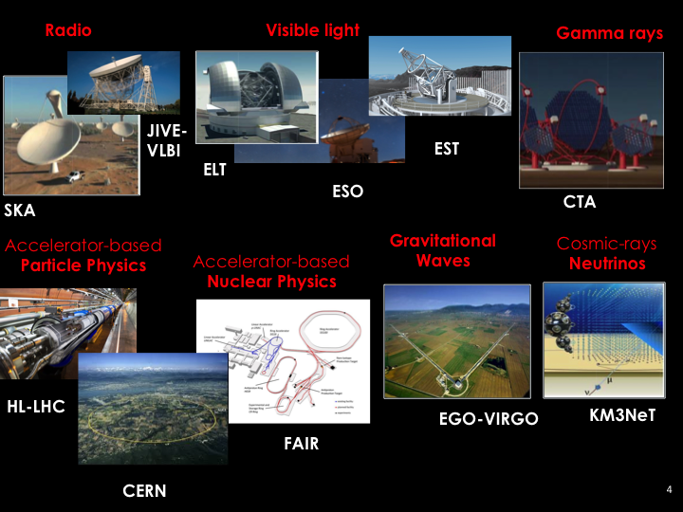

Slide 13































13

Slide 14
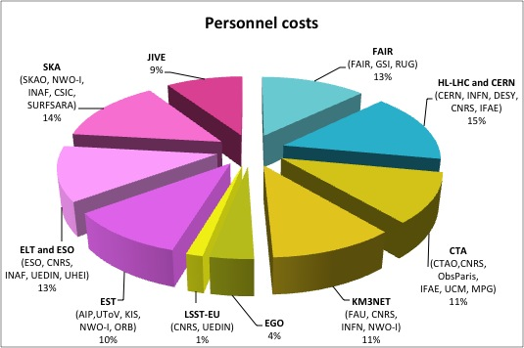
ESCAPE in a nuthshell
As per H2020 INFRAEOSC-04-2018 call - CLUSTER MEMBERSHIP and PARTNERSHIP:
The EC funding contributions in line with the number of pan-European research infrastructures (EUR 1.5 - 2 million for each ESFRI project/landmark) the cluster connects to the EOSC.
In ESCAPE
Each RI commits, teaming
up with a sub-set of
associated national
stakeholders.
Distribution of personnel costs among partners grouped by RI
14

Slide 15
ESCAPE goals
Implementing Science Analysis Platforms for EOSC researchers to stage data collections, analyse them, access ESFRIs’ software tools, bring their own custom workflows.
Contributing to the EOSC global resources federation through a Data-Lake concept implementation to manage extremely large data volumes at the multi-Exabyte level.
Supporting “scientific software” as a major component of ESFRI data to be preserved and exposed in EOSC through dedicated catalogues.
Implementing a community foundation approach for continuous software shared development and training new generation researchers.
Extending the Virtual Observatory standards and methods according to FAIR principles to a larger scientific context; demonstrating EOSC capacity to include existing frameworks.
Further involving SMEs and society in knowledge discovery.

Slide 16
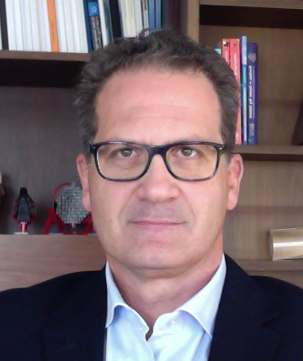
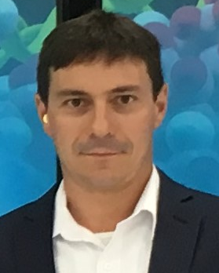
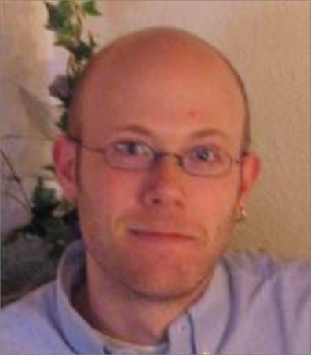
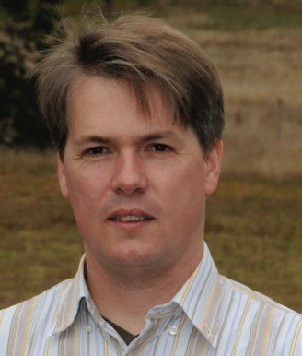
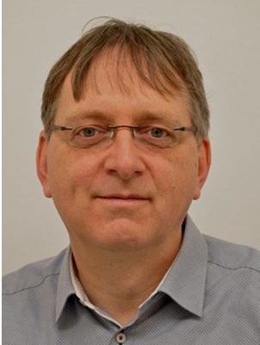
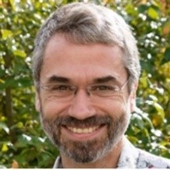
ESCAPE work programme
WP1 MIND. Leader: Giovanni Lamanna, LAPP-CNRS
Management and policy.
WP2 DIOS. Leader: Simone Campana, CERN
Contribute to the federation of global EOSC resources through an implementation of the Data-Lake concept (evolution of WLCG and other ESFRI RIs computing models) to manage extremely large volumes of data up to the multi-exabyte scale
WP3 OSSR. Leader: Kay Graf, FAU
Support for "scientific software" as a major component of the ESFR-RI “data” to be stored and displayed in EOSC via dedicated community-based catalogues. Implementation of a community-based approach for the continuous development of shared software and for training of researchers and data scientists.
WP4 CEVO. Leader: Mark Allen, CDS-CNRS
Extend FAIR standards, methods, tools of the Virtual Observatory to a broader scientific context; demonstrate EOSC's ability to include existing platforms.
WP5 ESAP. Leader: Michiel van Haarlem, ASTRON-NWO
Implementation of scientific analysis platforms enabling EOSC researchers to organize data collections, analyse them, access ESFRI's software tools, and provide their own customized workflows.
WP6 ECO. Leader: Stephen Serjeant, Oxford Open University
Citizen Science, Open Science et Communication
16

Slide 17
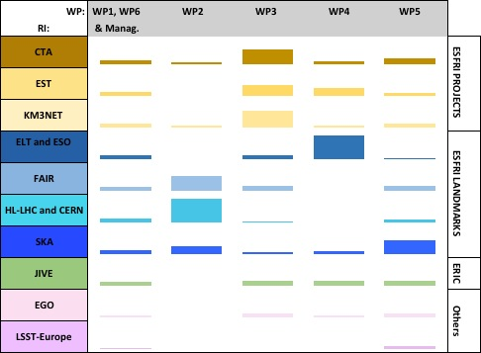
ESCAPE work programme
An optimal matrix:
Some clear priorities per each RI
RIs’ use-cases in almost all WPs
Sub-sets of RIs driving a WP
All RIs involved in the EOSC support
PMs per WP and per each RI.
The allocated staff effort is proportional to the respective boxes’ surface areas.
17

Slide 18
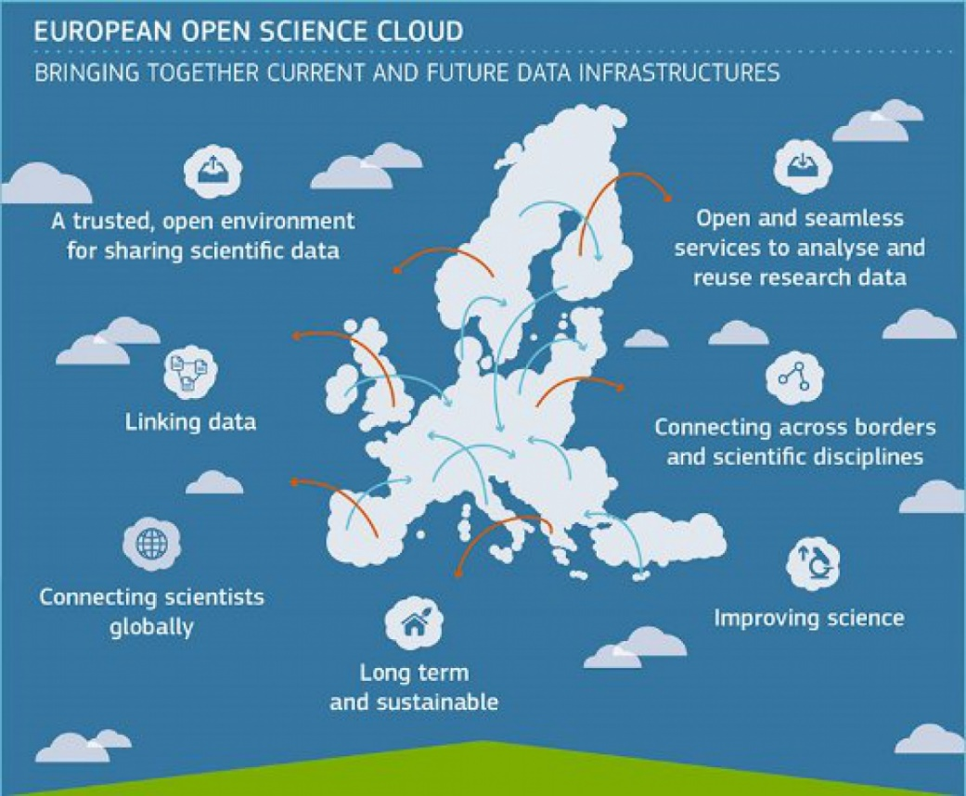
About EOSC …
Bridging todays fragmented and ad-hoc solutions, towards a federation of data infrastructures
FAIR data and services for data storage, management, analysis and re-use across borders and disciplines
Added value for data-driven science, reproducible science, interdisciplinary research, digital innovation
18

Slide 19



About EOSC …
Some readings…
EOSC Summit of 12 June 2017
  FAIR Data Expert Group
https://ec.europa.eu/research/openscience/pdf/eosc_declaration.pdf
  2nd HLEG on EOSC
  https://doi.org/10.2777/1524
  https://ec.europa.eu/info/events/2nd-eosc-summit-2018-jun-11_en
19

Slide 20
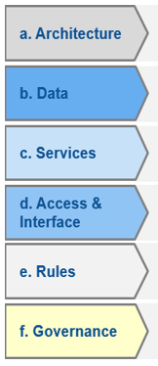
About EOSC …
European
Cloud initiative
Implementation Roadmap
Council conclusions
H2020 – WP 2018-20
2016
Vision for the European Open Science Cloud
2017
INFRAEOSC 2018-2019 Calls
Federated model with 6 action lines
2018
Set up of EOSC governance framework by end 2018
20

Slide 21
About EOSC …
  EOSC Board of MS/AC and EC representatives to ensure effective supervision of EOSC implementation
  Executive Board of stakeholder representatives to help ensure proper EOSC implementation and accountability
    Commission expert group
  Stakeholder Forum to provide input from a wide range of actors
    Self-organised with EC support
Governance Board
(MS/AC + EC)
CLUSTERS
Oversight – strategic orientation
Coordination
structure
(CSA)
Support
Executive Board (representatives of stakeholders)
Steering implementation
WG
WG
WG
Stakeholders Forum
WG
WG
WG
Users, RIs, Service providers, public sector, industry, SME,…
Advice
Advice
IMPLEMENTATION
Realising the federating core: EOSCHub, eINfraCentral, …
eInfrastructures
Research communities / Research Infrastructures
International Inittiatives
National Initiatives
Coalition of Doers…

Slide 22
EOSC for Big Science
A cluster action of Big-Science ESFRI RIs for setting up EOSC,
implies technical and policy challenges.
(As per the European Commission “EOSC Declaration”)
  EOSC as a data infrastructure commons serving the needs of scientists, providing functions delegated to community level, federating resources.
  Researchers should contribute to define the main common functionalities needed by their own community.
  A continuous dialogue to build trust and agreements among funders, scientists and service providers is necessary for sustainability.
  Data Sharing and Data Stewardship are critical issues for the next generation ESCAPE RIs

Slide 23
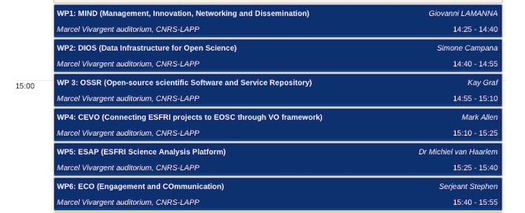
Kick-off Meeting – Day 1
23

Slide 24
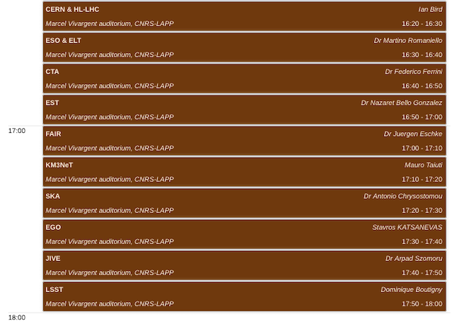
Kick-off Meeting – Day 1
24

Slide 25
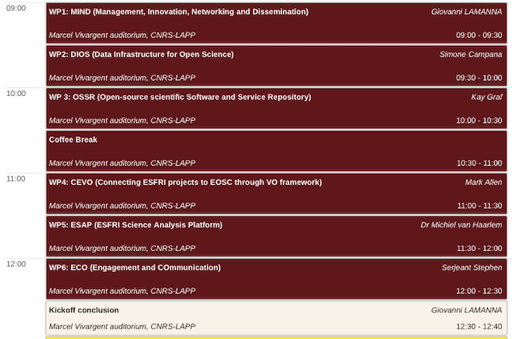
Kick-off Meeting – Day 2
25

Slide 26
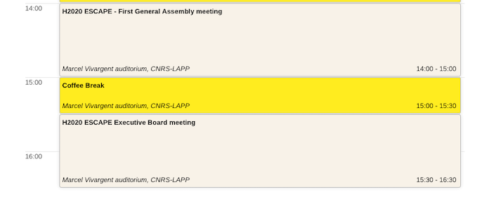
Kick-off Meeting – Day 2
26

Slide 27
Kick-off Meeting
Welcoming our external guests:
  ASTRONET
  Ronald Stark - Chair
  APPEC
  Teresa Montaruli - Chair
  PANOSC (cluster)
  Jordi Bodera Sempere - Project Manager
  EOSC-HUB
  Giacinto Donvito, Baptiste Grenier and Bjorn Backeberg
  (from the technology support community team)
27

Slide 28
Thank you !

