Slide 1
CTA/LST Monitoring and Control System 07 Juin 2018 LAPP – Info - Dev

Slide 2
LST Control Software : Global design
TelescopeACTL Interface
LST Interface
LST
Telescope Control
(ACS Master Component)
ACS communication
ACS Bridge
ACS Bridge
ACS Bridge
ACS Bridge
ACS Bridge
ACS Bridge
Camera
Eng.
Interface
Drive
Eng. IF
AMC
Eng. IF
CCD
Eng. IF
Power Cont.
Eng. IF
Cond. Mon.
Eng.IF
Assembly business logic
CACO OPCUA
OPCUA
OPCUA
OPCUA
OPCUA
OPCUA
Camera Control
(CACO Business Logic)
Drive
System
AMC
System
CCD
(offline pointing correction)
Power
Control
Condition
Monitoring
Telescope Control Unit (TCU) interacts with the assemblies via ACS mechanism
ACTL interacts with TCU only.
1-1 mapping to communicate with the logic : ACS implementation
Business logic implemented in the assembly
OPCUA communication with the upper layer

Slide 3
LST Control Software : Objectives
Control and Monitoring of the different assemblies : Mount, Camera, AMC , Aux , …
Implementation of the top level use cases.
Graphical User Interface (Expert , Semi-Expert, Operator)
Integration of the telescope to the common CTA framework : ACS

Slide 4
Decomposition of the control software layers
Expert level (low level)
Very specific software with very specific functionalities. "Standalone" software without any integration purposes
Semi-expert level (intermediate level)
Associated to each assembly with higher functionalities.
This layer needs a global integration in the LST architecture scheme and allow to test individually each assembly.
ICD is mandatory
Operator Level (High Level)
Complete integration with all the assemblies. Based on the level ”Semi-expert” level to achieve the high level functionalities of the LST1.
Telescope integration in the array
Depends on ”OES” proposal and use cases.

Slide 5
Technical choices
Based on ACTL choices :
OPCUA for the device control including the device business logic.
ACS (Alma Control Software) framework for the integration in the global CTA scheme for the array control.
Web-based operator GUIs :
Server: Pyramid, a lightweight python web framework.
Data access / buffering: mongodb, ACS.
Asynchronous communication: sockeit.io web-sockets.
Front-end framework:
Polymer : a Material Design, Google’s Web Component framework.
Data visualization: d3.js (v4.*) Javascript libraries using SVG, HTML5 & CSS for real-time interactive data visualization.

Slide 6
LST Control Software : Current responsibilities
ACTL
TelescopeACTL Interface
I.E.E.C
LST
Operator
GUIs
Semi-expert
GUIs
Semi-expert
GUIs
Semi-expert
GUIs
Telescope Control
(ACS Master Component)
L.A.P.P
L.A.P.P
ACS Bridge
ACS Bridge
ACS Bridge
ACS Bridge
ACS Bridge
ACS Bridge
Assembly Team
Camera
Eng.
Interface
Drive
Eng. IF
AMC
Eng. IF
CCD
Eng. IF
Power Cont.
Eng. IF
Cond. Mon.
Eng.IF
CACO OPCUA
OPCUA
OPCUA
OPCUA
OPCUA
OPCUA
Camera Control
(CACO Business Logic)
Drive
System
AMC
System
CCD
(offline pointing correction)
Power
Control
Condition
Monitoring

Slide 7
Current LAPP Responsabilities
Coordination of the slow-control team.
Providing all the ACS bridges of the telescope components
How :
ICD (Interface Control Document) as an input files
Code generator (Jean-Luc) to provide :
All the files needed to implement an ACS bridge (xml, idl , java code, ...) with the compliant ACS organization
XML describing the OPCUA interface
Used by MOS to initialize the OPCUA name space
Can be used in production (if MOS used) or as a device simulator (without real device connection)
Providing the complete environment for the LST Drive system
From the PLC OPCUA up to the Drive ACS bridge
Expert layer for the commissioning

Slide 8
Current status of the sofware at LAPP
Current status of the Control Software implementation :
Drive expert implementation ready , tested at LAPP first and currently used at La Palma since mid of July.
Drive ICD and ACS bridges ready and tested at LAPP before the drive shipment ➔
Semi-expert layer ready to be tested and used at La Palma (this week)
Semi-expert GUIs (not TCU GUIs) is going to be used unitil TCU is ready.
Camera and AMC are under implementation but :
We are still waiting for the ICDs

Slide 9
Current status of the LST Control software
TCU Guis :
a prototype for the drive is available but needs a consequent improvement to be user-friendly.
It has been delayed due to a lack of manpower in the TCU team.
A new version of the TCU Guis and control is supposed to be used during this week for testing the drive system.
Camera should be the second component to integrate but it is not clear how and when.
AMC in April
Top level uses cases

Slide 10
Bending model #1 (Quentin Piel)
Différents points modifient légèrement le pointé du télescope:
La structure se déforme sous son propre poids et celui de la camera => Prédictible et reproductible
Le vent la déforme => variable
Position que l’on pense pointer (donnée par les capteurs)
Position que l’on pointe réellement
Les effets reproductibles peuvent être évalués et corrigés en avance
Des observations dédiées permettent d’évaluer l'erreur moyenne de pointé en fonction de l'orientation du télescope
Effet exagéré ici

Slide 11
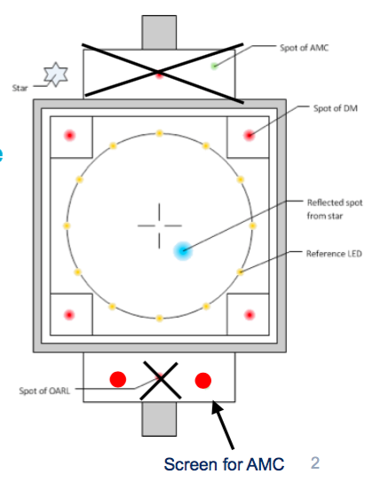
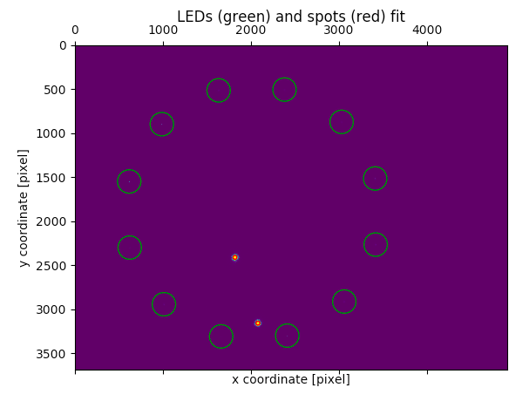
Bending model #2 (Quentin Piel)
Developpement d'un SW calculant l'erreur de pointe a partir de la position du spot d'une etoile sur la face avant de la camera
Etoile
LED références
LEDs
Lasers références
Lasers
Doit être testé sur site début 2019

