Slide 1

The fast developping synergy between
Astroparticle Physics and Geoscience
APPEC-GEO8 workshop
11 February 2018
S. Katsanevas
Director EGO, APPEC Functional Centre

Slide 2
Where is the synergy ?
Science
The geosphere, a direct object of study of the geosciences, is both the target and the detecting medium for astroparticle observatories, the precise understanding of the Geosphere is a prerequisite of the precise understanding of the Cosmos
We are entering the era of the study of Exoplanets as alternative realisations of Earth
Instruments and Methodology
Both deal with complex natural systems at a much larger scale than the human, deploy large sensor networks in hostile environments (sea, desert, underground, space);
Both use multi-messenger imaging (gravimetry, seismography, acoustic, and more recently radiography with muon/neutrinos);
Both use long series of precise observations acquired over a range of time scales and/or high precision dating;
Both use big-data analytics , new data harvesting methods (machine and deep learning) worldwide networking, including the distribution of alerts.
Societal Impact
The proper understanding of the Earth environment and the imbedding of an infrastructure in the environment has become an urgent societal task
Innovation through new “smart” technologies (Industry 4.0), optical fibers, …
Teaching scientific methodology and critical thinking on societal issues, promoting citizen’s science and participation are finally equally urgent issues
In short we need to revisit the 3 antique notions of Cosmos/Mundus
Cosmos as the Universe, Cosmos as the Earth, Cosmos as the Society

Slide 3
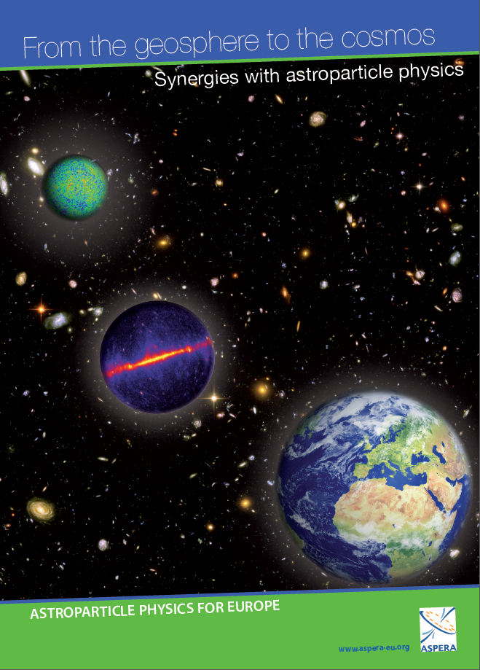
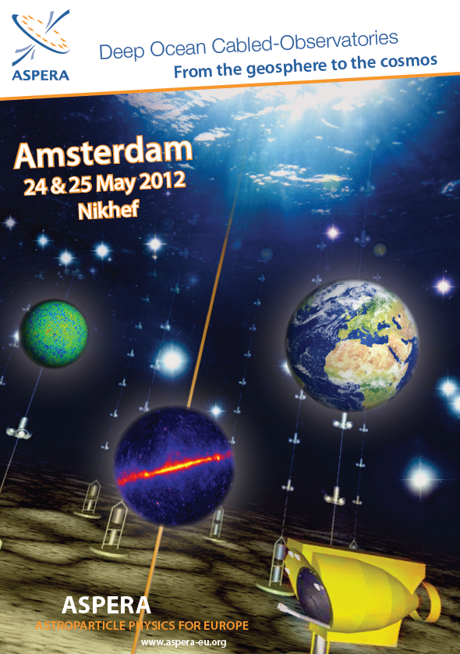
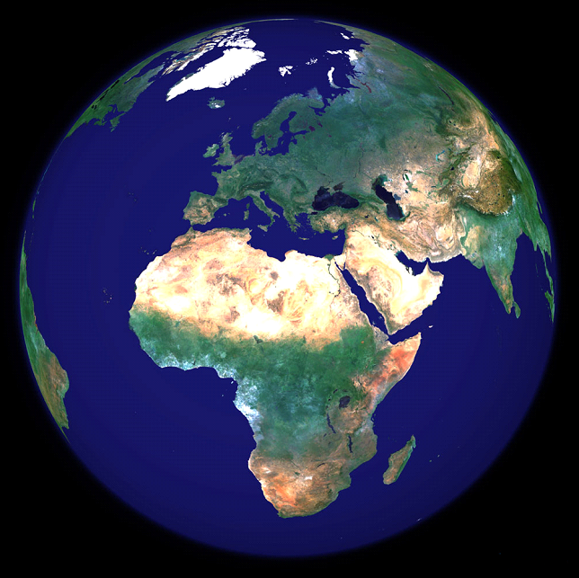
Previous APPEC work: a brochure and program:
FROM THE GEOSPHERE TO THE COSMOS
(EU-funded ASPERA ERANET)
3 workshops:
2011-2012
Paris
Amsterdam
Durham
Notes:
Astroparticle Physics in its study of the cosmos uses the natural environment as a detecting medium.
As a result accurate knowledge and monitoring of the properties of this environment is essential.
These tasks are usually carried out by scientists in other disciplines – biologists, geologists, oceanographers etc.
Thus, by restoring the continuity between the study of the cosmos and the study of our environment, Astroparticle Physicists have been collaborating with scientists in other disciplines.
ASPERA has been stressing the strengthening of relations of ApP with these other sciences since 2008, when its first Roadmap was published. The importance of these collaborations was also stressed in the update of the “European Roadmap for Astroparticle Physics” presented earlier in a special event in the College de France last November.
In addition, in December 2010, ASPERA organised a workshop entitled “From the Geosphere to the Cosmos”, at the Palais de la Découverte in Paris, where existing synergies between Environmental Sciences and Astroparticle Physics were presented. The event was especially successful given the large number of participants coming from all across Europe and the many articles published in leading journals and newspapers.

Slide 4
Some Scientific/Societal challenges for the 21st Century
2.
UNDERSTANDING THE EARTH
5.
UNDERSTANDING BIODIVERSITY
1.
UNDERSTANDING
THE ATMOSPHERE
3.
UNDESTANDING THE OCEANS
4. UNDERSTANDING EARTHQUAKES
Geo-ApP
Notes:
I will present some of these 37 synergies and will do so according to the broad challenge each synergy most relates to. Understanding
The Atmosphere
The Earth
The Oceans
Earthquakes
Biodiversity

Slide 5
33 points of synergy
 | ATMOSPHERIC AND TERRESTRIAL | UNDERGROUND | UNDERWATER-ICE
UNDERSTANDING THE ATMOSPHERE | 1. SPACE WEATHER 2.ATMOSPHERIC MONITORING 3. COSMOCLIMATOLOGY 4. THUNDERSTORMS and LIGHTNING | 1. COSMOCLIMATOLOGY | 1. ATMOSPHERIC TEMPERATURE VARIATION
UNDERSTANDING THE EARTH | 1. EROSION RATE CALCULATION 2. VOLCANO TOMOGRAPHY 3. EARTHQUAKE MONITORING GRID | 1. COASTAL ROCK CLIFF EROSION 2.PALEOENVIRONMENT CHRONOLOGY 3. EARTH’s INTERIOR – GEONEUTRINOS 4. SEISMO-ELECTROMAGNETIC COUPLINGS 5.. EARTHQUAKE PRECURSORS 6. . SLOW EARTHQUAKE MONITORING | 1. PALEOCLIMATE 2. EARTH RADIOGRAPHY 3. EARTHQUAKE AND TSUNAMI MONITORING 2. STUDYING THE LAKE ENVIRONMENT
UNDERSTANDING THE OCEANS |  | 1. CORAL CHRONOLOGY | 1. CONTINUOUS OCEANOGRAPHIC DATA 2. SEDIMENT TRANSPORT 3. OXYGEN DYNAMICS 4. RADIOACTIVITY 5. INTERNAL WAVES
UNDERSTANDING BIODIVERSITY |  | 1. IMPACT OF RADIATION 2. EXTREMOPHILES | 1. UNDERWATER SOUND MONITORING 2. DEEP SEA BIOLUMINESCENCE 3. BIODIVERSITY UNDER ICE 4. BIODEGRADATION 5. MICROBIOLOGY 6. BIOFOULING
Notes:
ALREADY at least 37 such scientific achievements can be identified
In this table, existing points of synergy are first categorised
according to the scientific challenge that the synergy most relates to and
then according to the location of each existing ApP infrastructure (Atmospheric and Terrestrial, Underground, Underwater/Ice).
Only some of these synergies were presented in the “From the Geosphere to the Cosmos” workshop, proving that this is a growing field with a lot more potential than currently realised.
This table is of course not exhaustive, but merely meant to serve as a stimulus for the development of further successful collaborations between ApP and other scientific fields.

Slide 6
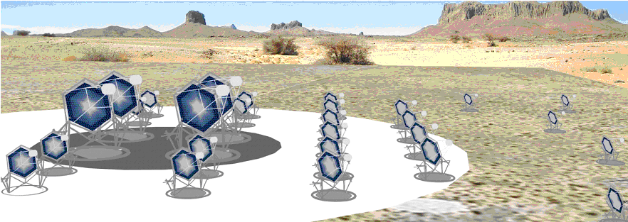
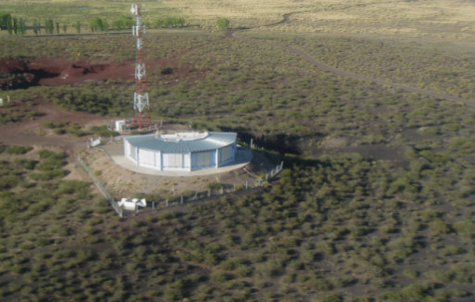
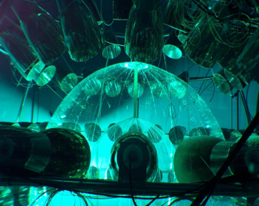
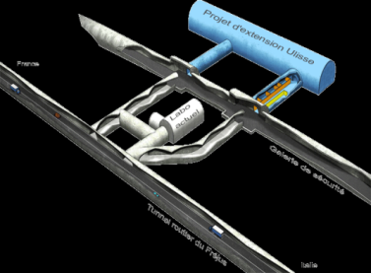
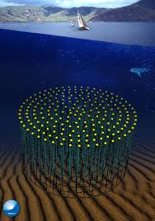
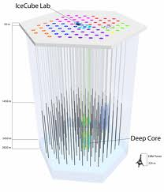
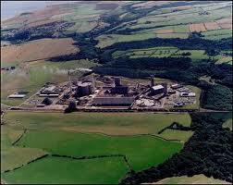
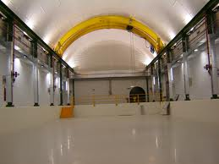
Astroparticle Physics Research Infrastructures…
Relationships to
EMSO
EPOS
ARGO
LifeWatch
ABOVE GROUND
CTA
VIRGO
UNDERGROUND
UNDERWATER
Pierre Auger
Gran Sasso
Modane
UNDER-ICE
Boulby
Canfranc
KM3NeT
IceCube
Notes:
The breath of collaborations is great since in all ApP – future or current – research infrastructures, in this move from the lab to nature, our environment is turned into an ally, a tool, a proxy, a detecting medium or a target.
More precisely
the atmosphere is used as a target and a Cherenkov light detecting medium in telescopes such as CTA and as a fluorescence detector medium in telescopes as the Pierre Auger Observatory and H.E.S.S.
Mountains are turned into shields to protect experiments devoted to the detection of rare events in the underground labs: Gran Sasso, Modane, Boulby and Canfranc.
Finally, ice or water are or will be used as a shield and Cherenkov light detecting mediums, for underwater (KM3NeT)/ice(IceCube) neutrino telescopes.
All these infrastructures have four key strengths in common, which could also be of benefit to other sciences:
1) competence in complex sensing systems.
2) technologies that allow the processing of large quantities of extremely pure and/or exotic materials.
3) advanced systems for data acquisition, processing, and dissemination.
4) they are placed in remote or hostile environments (ice, deep sea, deserts, caves, space).
For all these reasons, the use of ApP infrastructures by scientists from other disciplines is not just a wise and efficient use of resources, but also leads to great scientific advancements.

Slide 7
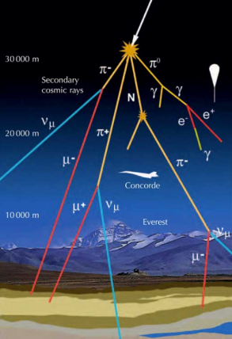
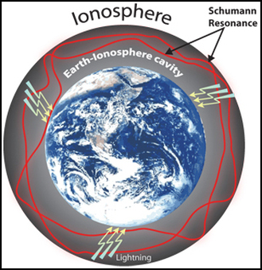
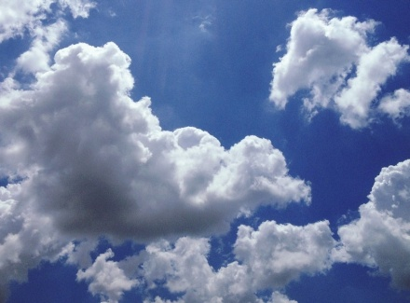
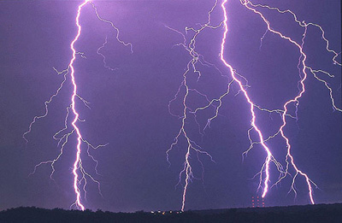
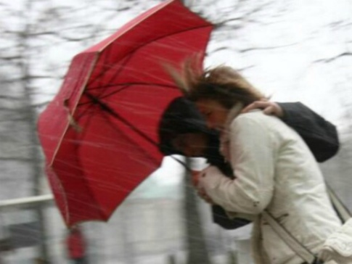
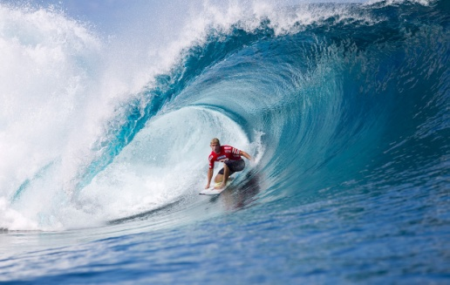
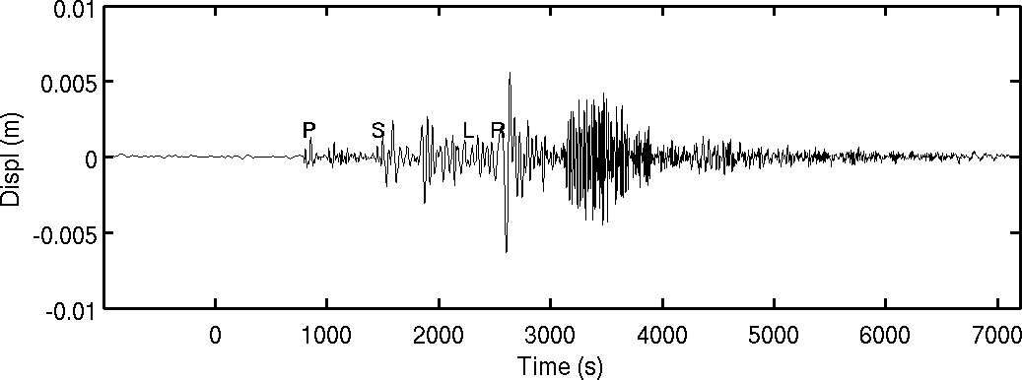
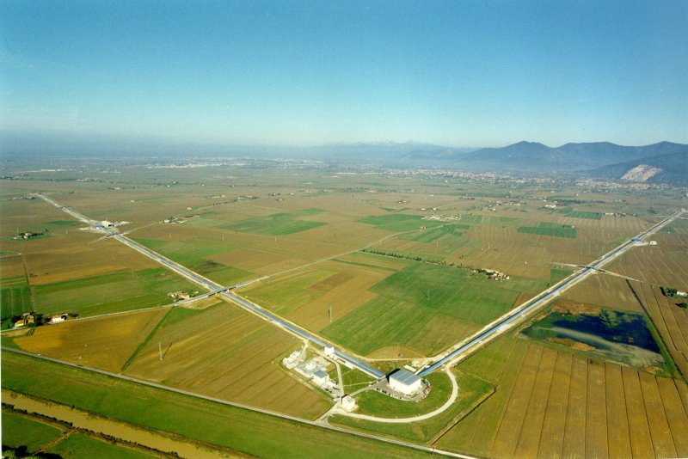
ApP Observatories sites of rich interdisciplinary relationships with Geoscience
Extreme embedding
Impact on Virgo sensitivity of:
  Wind,
  Earthquakes,
  Storms,
  Geomagnetic fields,
  Cosmic Rays,
  Soil and atmosphere
  density fluctuations
A collaboration with geoscientists on data has already started (COST action E. Cuoco)

Slide 8
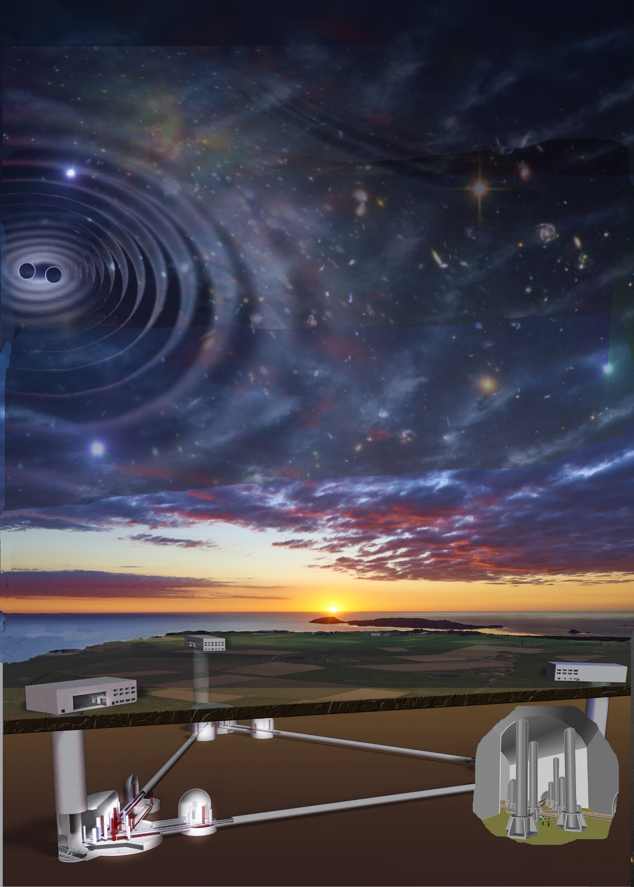
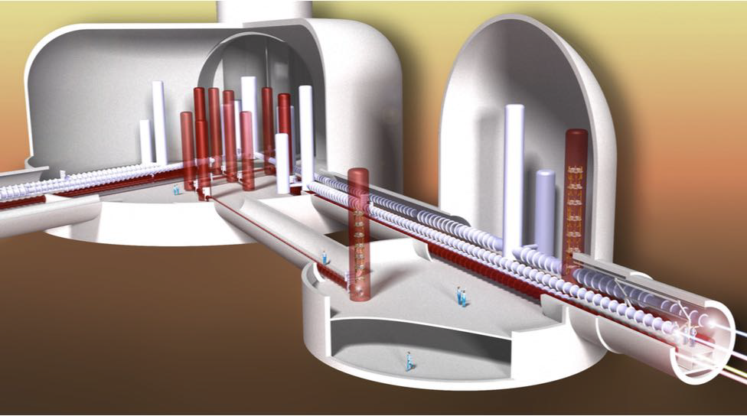
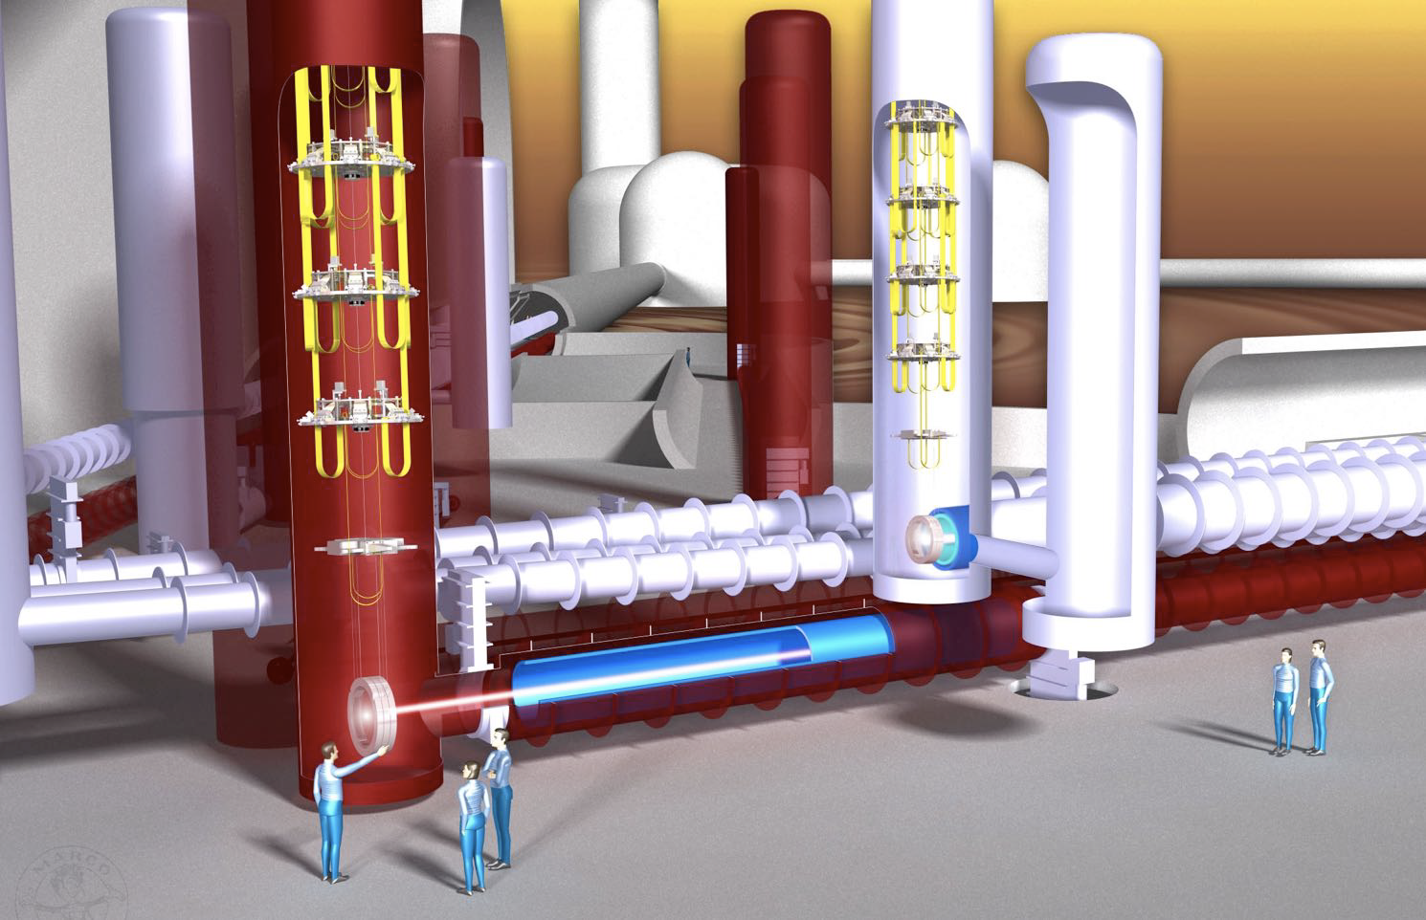
Preparing the next generation of ApP (3G in GW)
  ET is an underground10km long triangular detector configuration capable of achieving a factor of 10 increase in sensitivity (2034)
The interlinked sensor network monitoring and mitigating noise of the interferometers is at the avant-garde of the technological front of “smart infrastructures”
The environmental studies can become a source of innovation in geological and atmospheric matters (early warnings, earth, cloud and sea monitoring). Synergies.
The 3G civil-infrastructure is a large part (>90%) of the cost, there are technological, innovation synergies to be developed with other fields (HEP , ν) with the same concerns of civil infrastructure

Slide 9
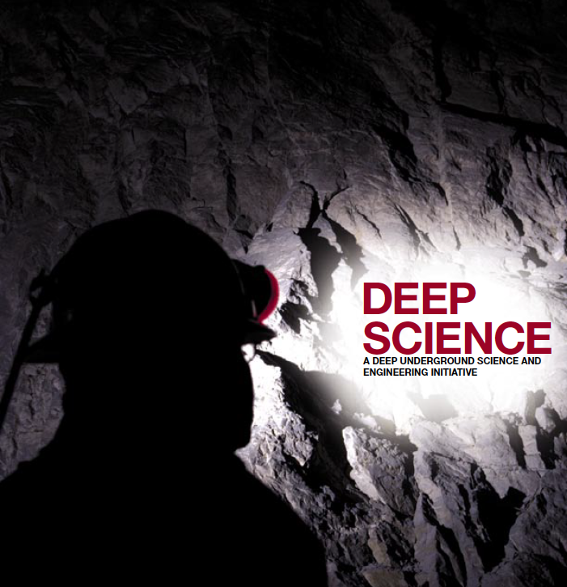
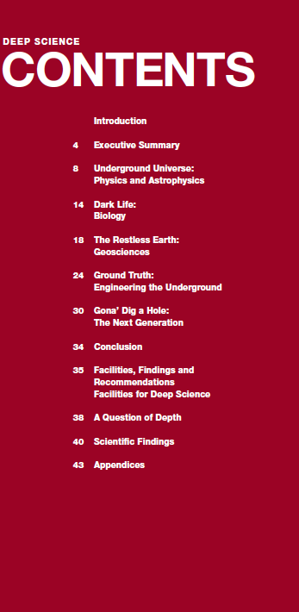
Similar interdiciplinary studies in the US
the NSF study during the same period (2011-2012)

Slide 10
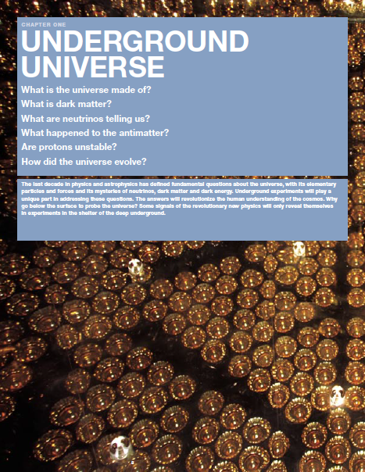

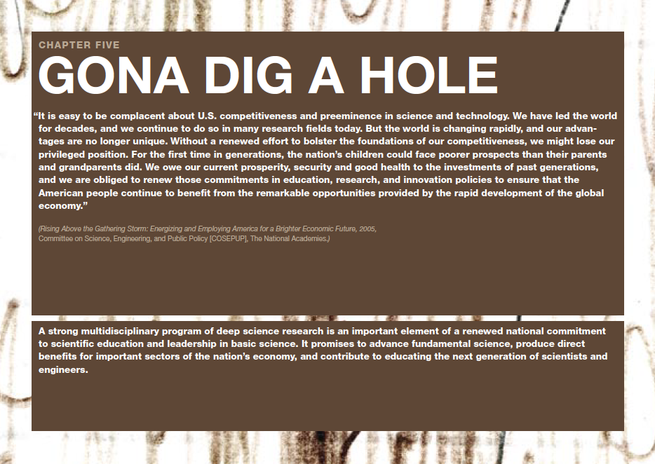
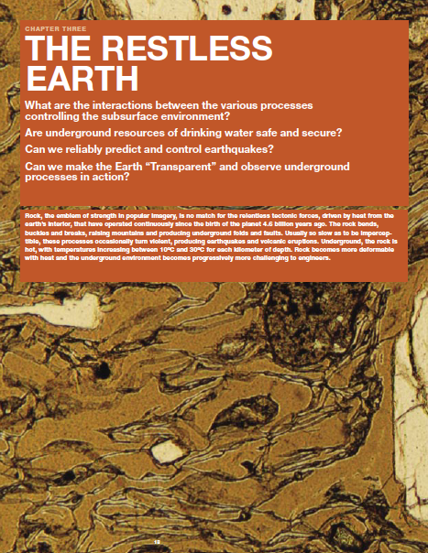
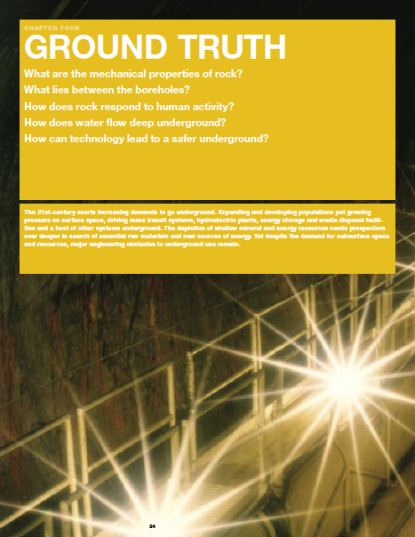

Slide 11
How can we enhance the synergy ?
A first list
Establish a yearly workshop (including agencies)?
  implicate all ESFRI and OWC infrastructures
Form common groups to work on technology development
  propose FET, ERC synergy,…
Prepare a common MSCA-COFUND (September 2019) ?
Lobby for the inclusion in FP9 of
  Interdisciplinary Integrating Activities (>2020)
  ERANET
  EOSC actions on data
Contact our colleagues in other continents and attempt to form a world-wide collaboration on the App-GeO synergy?

Slide 12
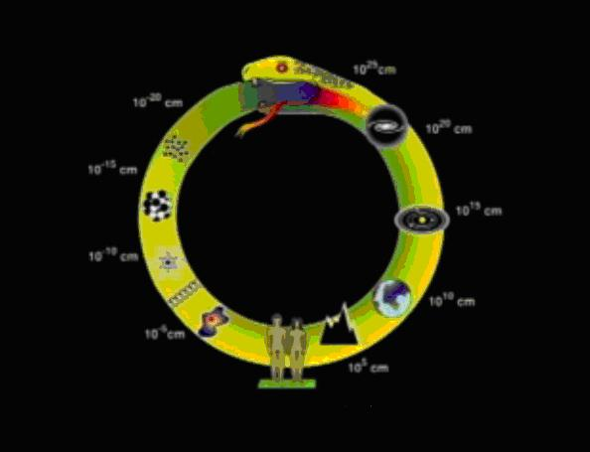
10⁻³⁰⁻³³ cm
ν− mass, proton decay
Event horizon 10²⁸ cm
Inflation, Dark energy/matter
10⁻²⁴⁻²⁷ cm
High Energy processes ,
SUSY, Higher Dim
GZK horizon 10²⁶ cm
HE CR,γ, ν, GW
10⁻²¹ cm
LHC physics
Galaxy 10²² cm
Supernova HE γ, ν, Origin of CR,
∂
From
Geosphere
To
Cosmos
∂
10⁻¹⁵⁻¹⁸ cm
Nuclear physics
n-star EOS
Solar system 10¹⁵ cm
Nucleosynthesis
Solar ν,
Ενδ οφ Σταρσ
∂
10⁻⁵ cm
Astroparticle infrastructures help study underground and ocean floor biodiversity
Astroparticle detectors use the geosphere as detecting medium 10⁵⁻¹⁰ cm
∂
Underground and Deep Sea Obs
(DM, ν) KM3net
Large Astroparticle Observatories
Virgo/LIGO, CTA, AUGER, KM3NEt
Astroparticle helps us understand our origins

