Slide 1
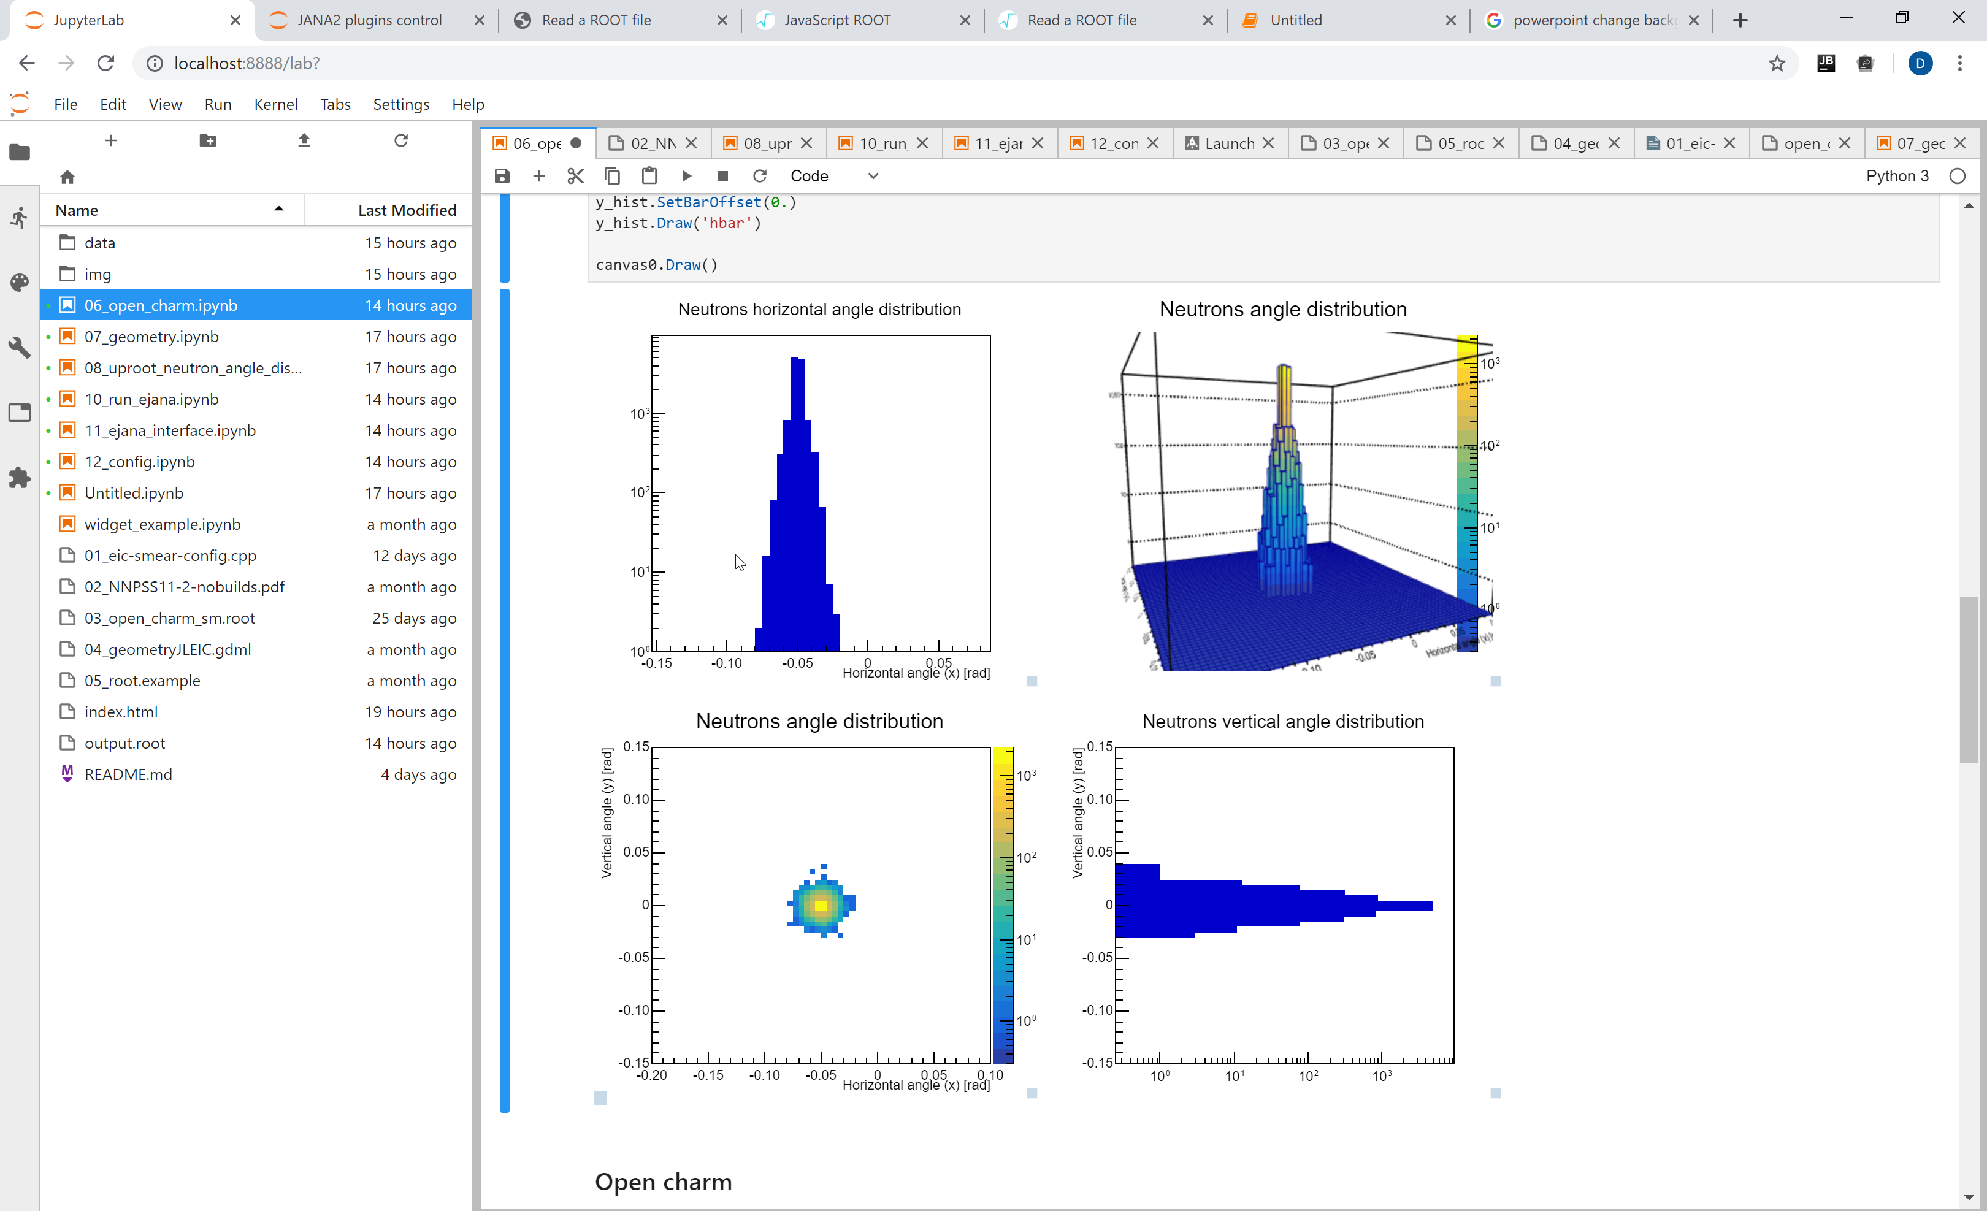
Entry point for EIC software
Interactive tutorial
Dmitry Romanov

Slide 2
Start the docker
docker pull eicdev/epic

Slide 3
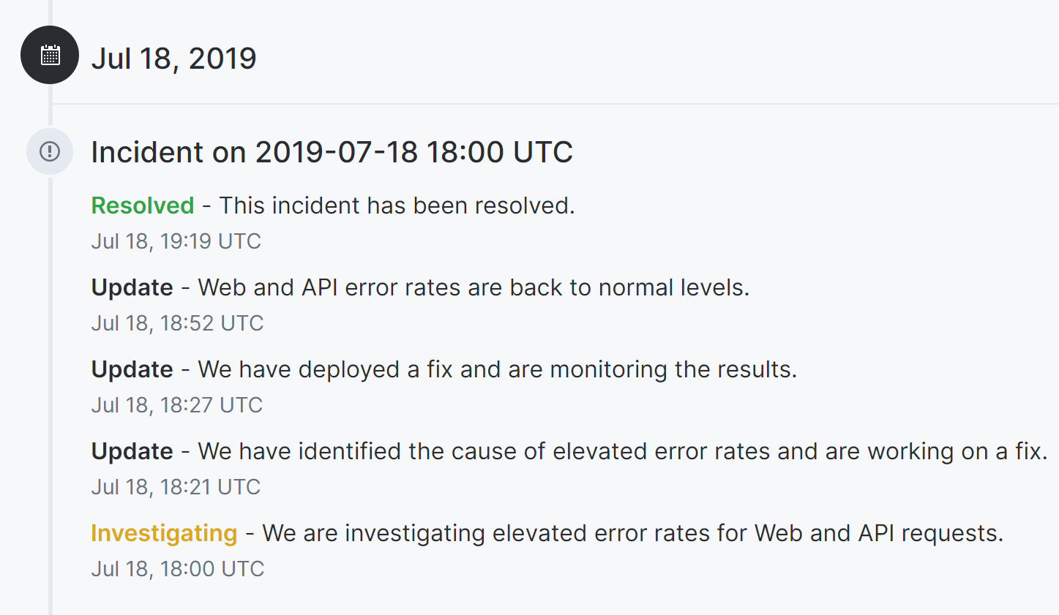

Slide 4
Software chain
MC generators
Fast
detector
simulation
Full
detector
simulation
Reconstruction and analysis

Slide 5
What software is in the docker container
MC sample files
EIC Smear
BNL & Jlab effort on
Fast detector prototyping
Pythia
Beagle
Herwig
g4e = Geant 4 EIC
C++ genue GEANT4 with JLEIC detector in it
Fast simulation
Full simulation
ejana = EIC Jana
Community reference reconstruction
EIC Smear
g4e Geant4
Reconstruction and analysis
ejana – EIC JANA(2)

Slide 6
What software is in the docker container
MC sample files
Pythia
Beagle
Herwig
This tutorial coverage
Fast simulation
Full simulation
EIC Smear
g4e Geant4
Reconstruction and analysis
ejana – EIC JANA(2)

Slide 7
Software chain
EIC Containers
Docker for EIC = deic
Use containers as light VM
Entry Point for EIC = EPIC
Workflow driven interactive environment
Configuration
MC sample files
Pythia
Beagle
Herwig
EIC Jana Packet Build
Managaer = ejpm
Unified builder for the software stack
Fast simulation
Full simulation
EIC Smear
g4e Geant4
Reconstruction and analysis
ejana – EIC JANA(2)

Slide 8
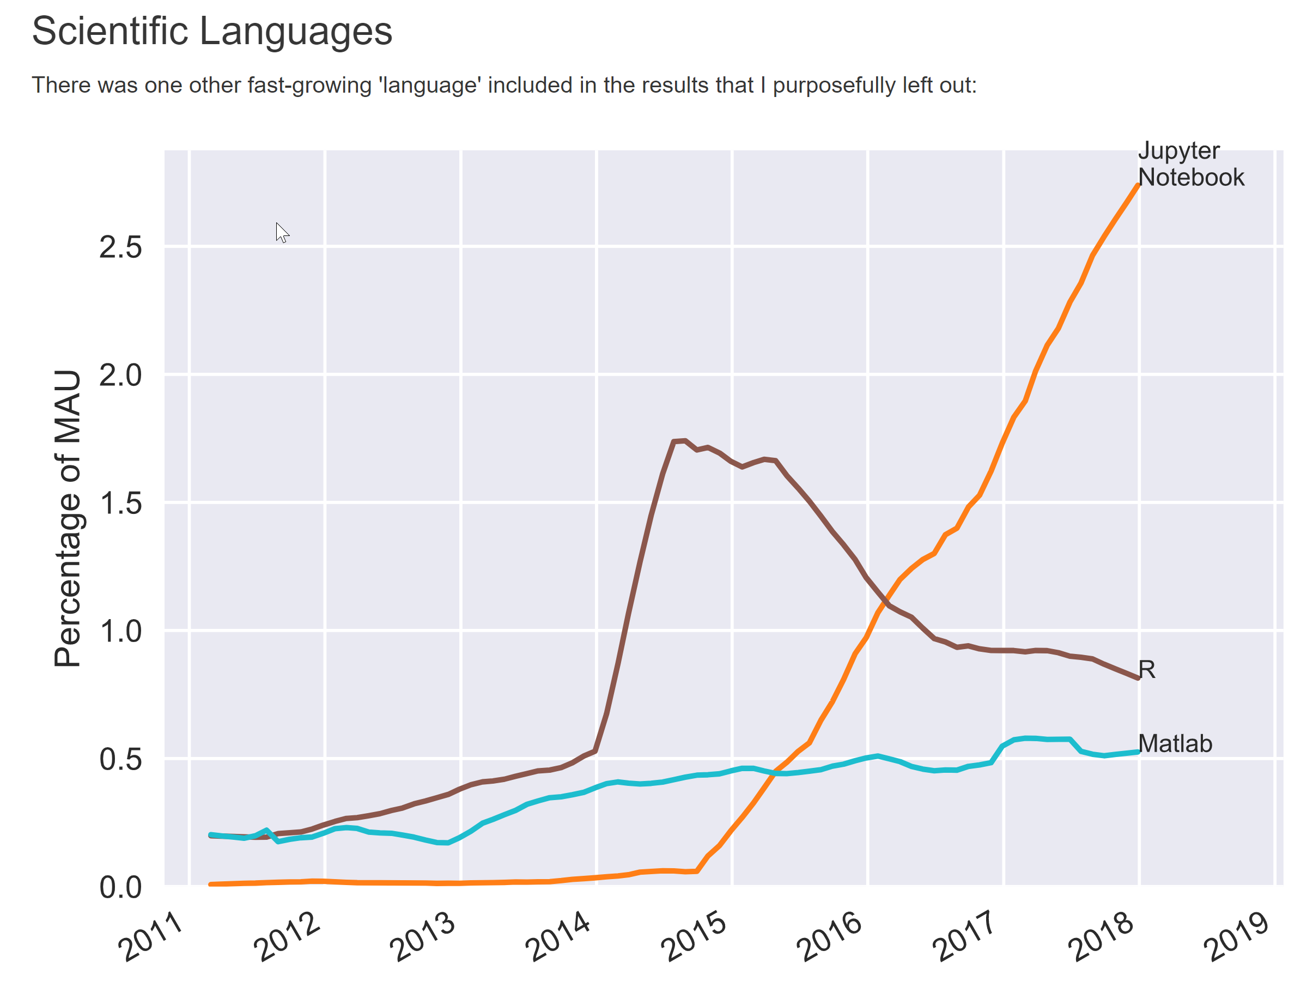
Jupyterlab new interface to Jupyter

Slide 9
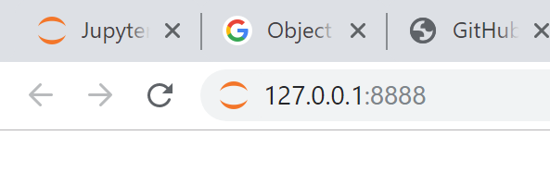
Start the docker
docker run --rm -p 8888:8888 eicdev/epic
…
[I 20:42:19.975 LabApp] The Jupyter Notebook is running at:
[I 20:42:19.975 LabApp] http://127.0.0.1:8888/
[I 20:42:19.975 LabApp] Use Control-C to stop this server

Slide 10
Jupyter lab, Jupyter notebooks, EPW, epic…

Slide 11
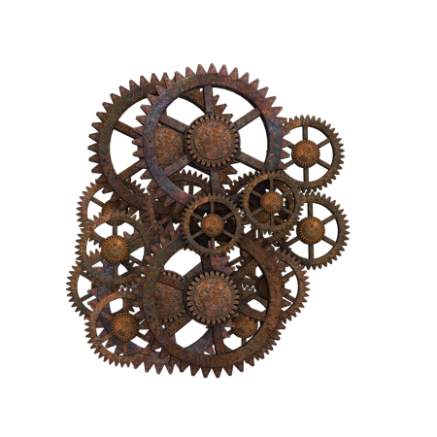
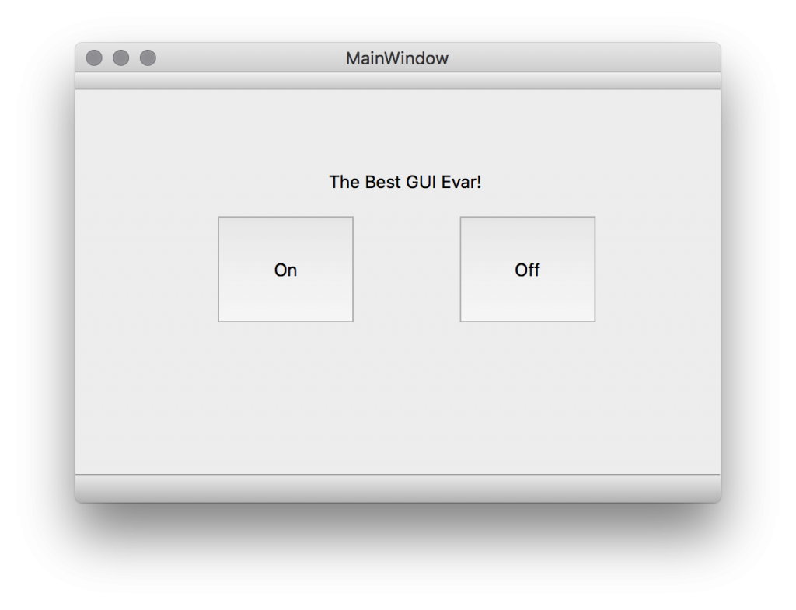
Do we hide complexity?
Jupyter lab, GUI,
Python, scripts, analysis
C++, eJANA, plugins
JANA, eic-smear, ROOT, Geant4

Slide 12
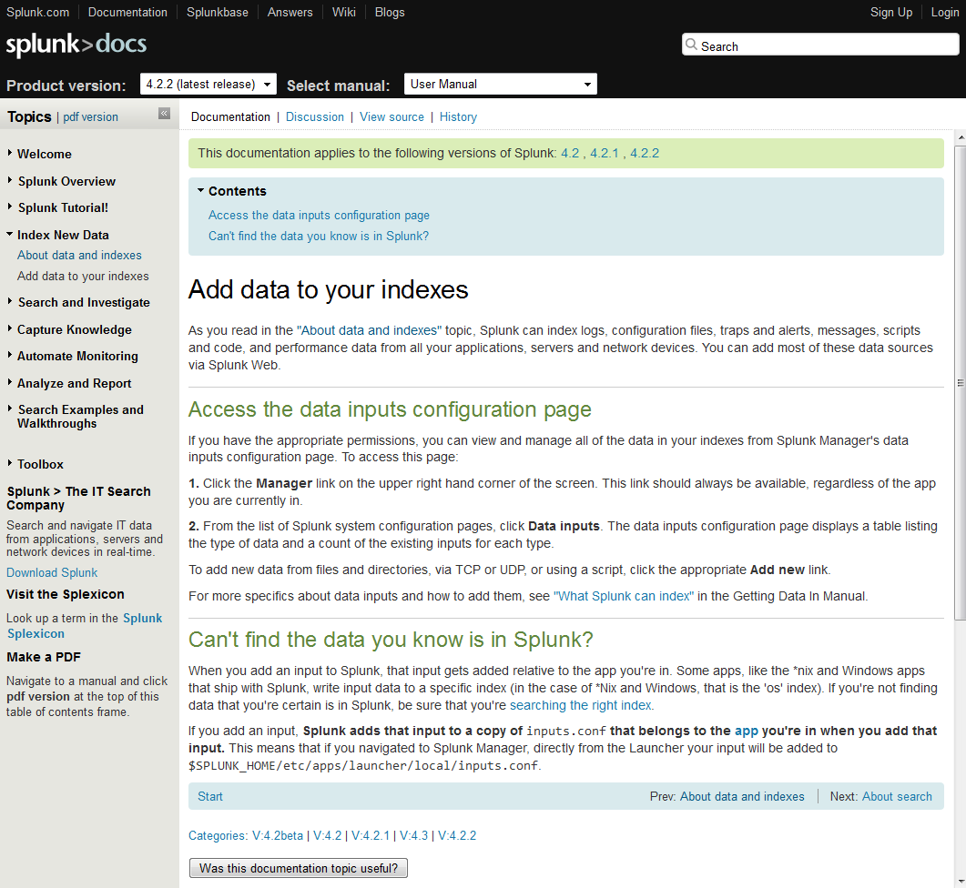
Usually just tools
Users also need workflows
Providing just tools and documentation in form of wikis/sites to it make learning curve steep and prevents users from doing their job effectively
Workflows of how users achieve their tasks must be overthought on each step of software development

Slide 13
Workflow oriented
OSG, farms
Configuration
Run (sim, recon, analysis)
Introspect results
Tamper with code

Slide 14
Future tutorials
EIC Smear (quick parametrization of a detector) (HowTo create your own EIC detector or tweak existing)
Geant 4 (Right in the JupyterLab)
Jana2 and C++ backend (Write your own analysis, open custom files, etc)
ROOT7 tools (RDataFrame and others) (What if tensorflow was developed by root team? )
Data science tools (HowTo live without root, but with uproot, scy-hep + data science tools)

Slide 15
Software distribution
NO EFFORT AT ALL
Novice
Some effort
Experts
Efforts required axis
Cloud
Containers
Farms (BNL, Jlab, Argon)
Conda
Workstation Compilation EJPM
Main accent now

Slide 16
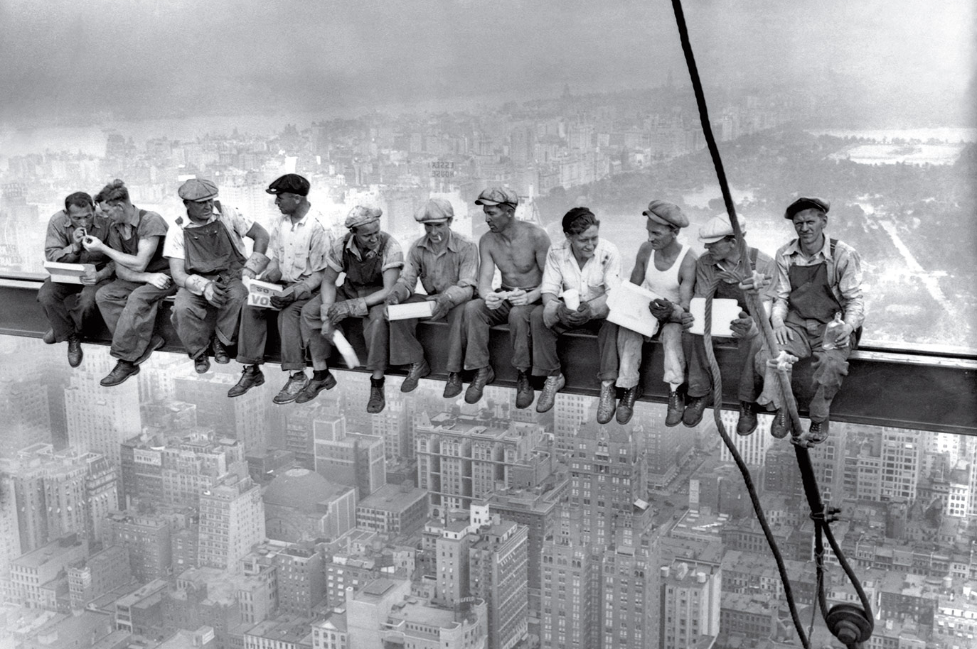
Users input needed!
We’ve built a base for our software stack. Users are welcome to steer and drive the further development

Slide 17
Thank you!

Slide 18
What software is in the docker container
MC sample files
Pythia
Beagle
Herwig
Fast simulation
Full simulation
EIC Smear
g4e Geant4
Reconstruction and analysis
ejana – EIC JANA(2)

Slide 19
What software is in the docker container
MC sample files
Beagle
Pythia
Herwig
Fast simulation
Full simulation
EIC Smear
g4e Geant4
Reconstruction and analysis
ejana – EIC JANA(2)

Slide 20
What software is in the docker container
MC sample files
Beagle
Pythia
Herwig
Fast simulation
Full simulation
EIC Smear
g4e Geant4
Reconstruction and analysis
ejana – EIC JANA(2)

Slide 21
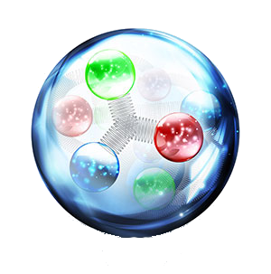
e^{JANA -} Community reference reconstruction
e^{JANA} - stands for EIC JANA
Basic reconstruction
Physics analysis
Users detector codebase integration
Reconstruction
Tracking - Genfit
Vertex finding – Rave
Physical analysis:
ROOT C++ or
Python data science tools (Jupyter, Seaborn, Pandas, etc.
Any existing C++ (or even others) code can be:
- compiled as JANA plugin
- run parallelized in eJANA
- accessed by other plugins
EIC jana

Slide 22
Jana plugins

Slide 23
Complexity scaling explained
Failed complexity scaling:
Some complex system
Complex → Simple
Simple → Complex
Will fail most of the times
because of
complexity scaling problem
We try to make complex - simple

Slide 24
Escaping complexity scaling trap
Provide interfaces to internal complexity (and better for everything) (and even better – each step must be replaceable)
Interaction between layers must be clear
Simple
Moderate
Complex
Expert
(And working on modularity… true modularity is the way to make it)

Slide 25
Do we hide the complexity?
Jupyter lab, GUI,
Python, scripts, analysis
C++, eJANA, plugins
JANA, eic-smear, ROOT, Geant4

Slide 26
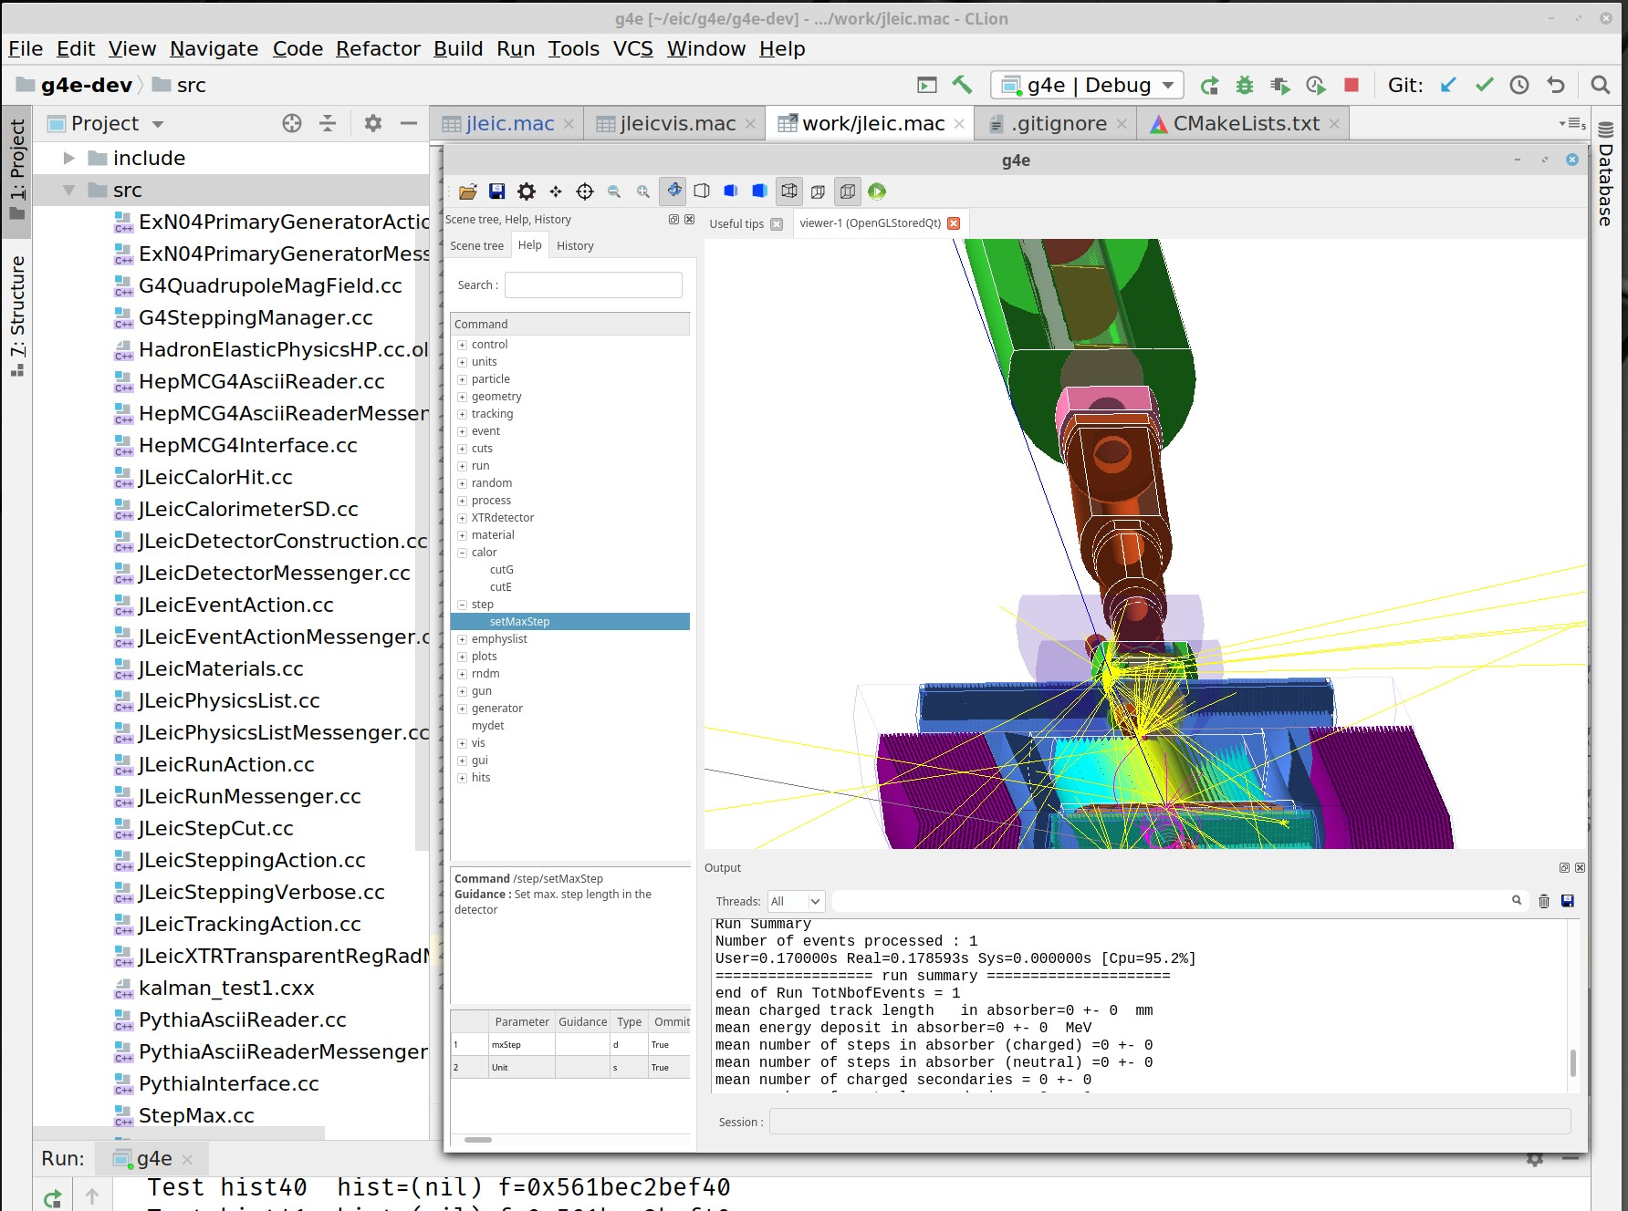
How it relates to a common simulation tools?
What is ready now?
Mid term (1 year)?
Long run?

Slide 27
What is ready now EIC Smear
Working with EIC-Smear through EPIC is what is developed now
Interacting with EIC Smear configuration/detector design (C++ now, Python – coming)
Seamless integration of backend with Jupyter
Workflow run -> configure -> adjust -> run on farm (later is limited now, working on it!)

Slide 28
What is ready now Geant4
Interacting with Geant4 configuration
C++ code (limited) and Python code (better)
Interactive widgets (GUI) for running Geant
Display the geometry (root, GDML, others are possible VRML (X3D), STEP, CADs)
Workflow run -> configure -> adjust -> run on farm (later is limited now, working on it!)

Slide 29
Mid term
Seamless integration between jupyter/jupyterlab and Geant4 related framework
Fully support workflow run -> configure -> adjust -> run on farm
Full featured Documentation and Examples directory for users

Slide 30
Long term
Too many ideas! (Steering from users is needed) General trends:
Python data science tools and Jupyter conquers the scientific world
Classical NP tools are getting bridged with modern Data Science tools
Interacting with code (web-based editors, etc) are getting powerful -> more ways to collaborate and stay with one set of tools
Easier to run jubs on farms, clouds, hyper-mega-giga computing

Slide 31
Target audience
Users from specific collaborations
Detector design groups
General audience (users, who wants to do physics studies)

Slide 32
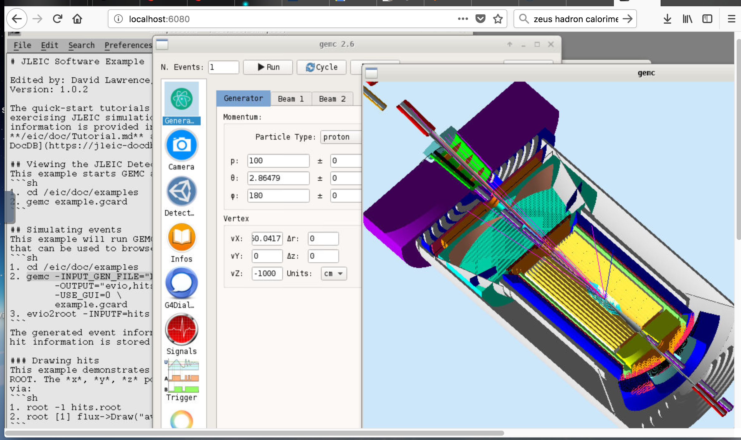
Software for detector simulation and reconstruction
Geant 4 EIC (G4E) Plain C++ implementation for √s 100 GeV design (Driven by the community request)
GEMC Geant 4 based simulation
For those who prefer scripting over compilation Geant 4 python can be used

Slide 33
Geant 4 EIC
The codename g4e – Geant 4 EIC
Beta stage
√s 100 GeV design is implemented
Imports CAD, accelerator group data
Exports final Geometry in various formats
Plain flattened analysis ready ROOT files

Slide 34
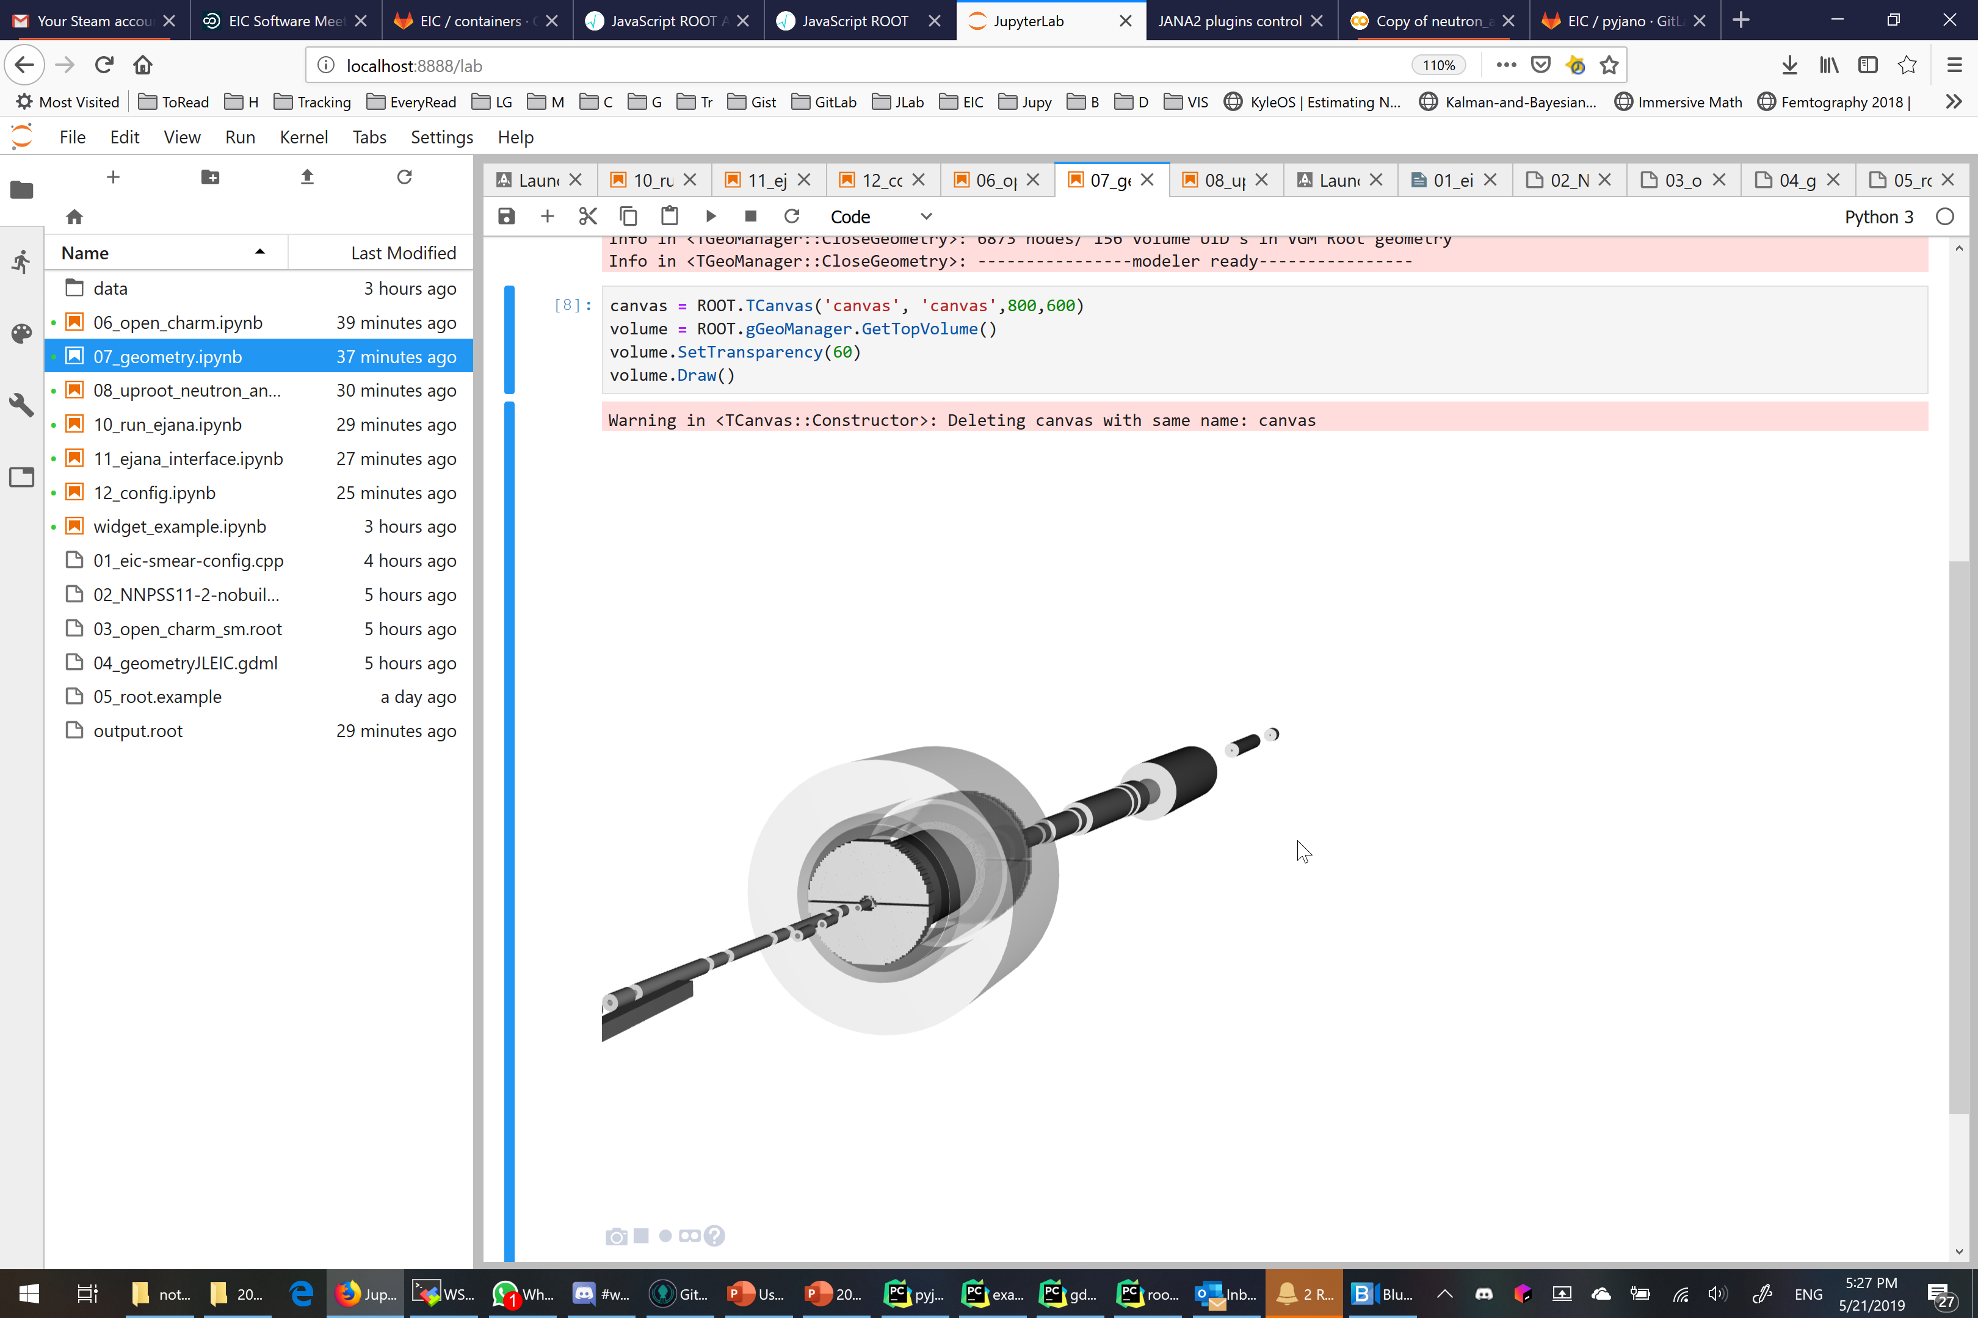
Geometry can be opened right in jupyter notebook

Slide 35
e^{JANA -} Community reference reconstruction
e^{JANA} - stands for EIC JANA
Basic reconstruction
Physics analysis
Users detector codebase integration
Reconstruction
Tracking - Genfit
Vertex finding – Rave
Physical analysis:
ROOT C++ or
Python data science tools (Jupyter, Seaborn, Pandas, etc.
Any existing C++ (or even others) code can be:
- compiled as JANA plugin
- run parallelized in eJANA
- accessed by other plugins
EIC jana

Slide 36
Why 76 degrees?
At apple stores laptop screens must all be set at exactly 76 degrees. Why?

Slide 37
Can we identify entry point workflows
How it really works
Configuration
Run (sim, recon, analysis)
Introspect results
Tamper with code

Slide 38
Status
JANA2 – C++ framework for NP data processing - beta
e^{JANA} – EIC community reference reconstruction - beta
g4e – Geant 4 EIC – beta
ejpm – Packet manager builder - beta
deic – Docker helper for EIC users - in project
Eic-smear – Integrated into ejpm, (full integration into ejana in progress) - beta (June)
pyjano – Python JANA Orchestrator – alpha
eic-jupyterlab – GUI for users entry point – prototype-> alpha
Future announces? Follow EIC User Group meeting

Slide 39
Users input needed!
We’ve built a base for our software stack. Users are welcome to steer and drive the further development

Slide 40
Software strategy
We cannot write everything and do all physics analysis by just our team
Thus we will provide tools, documentation and support to users, to help users to grow and direct the software.
Thus ease of user experience is one of our priorities

Slide 41
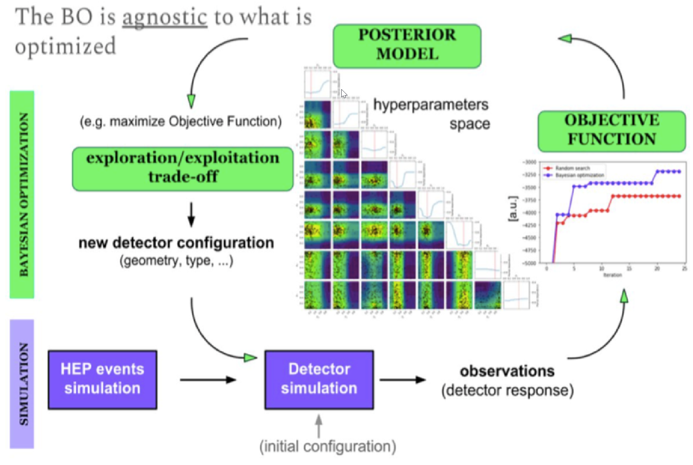
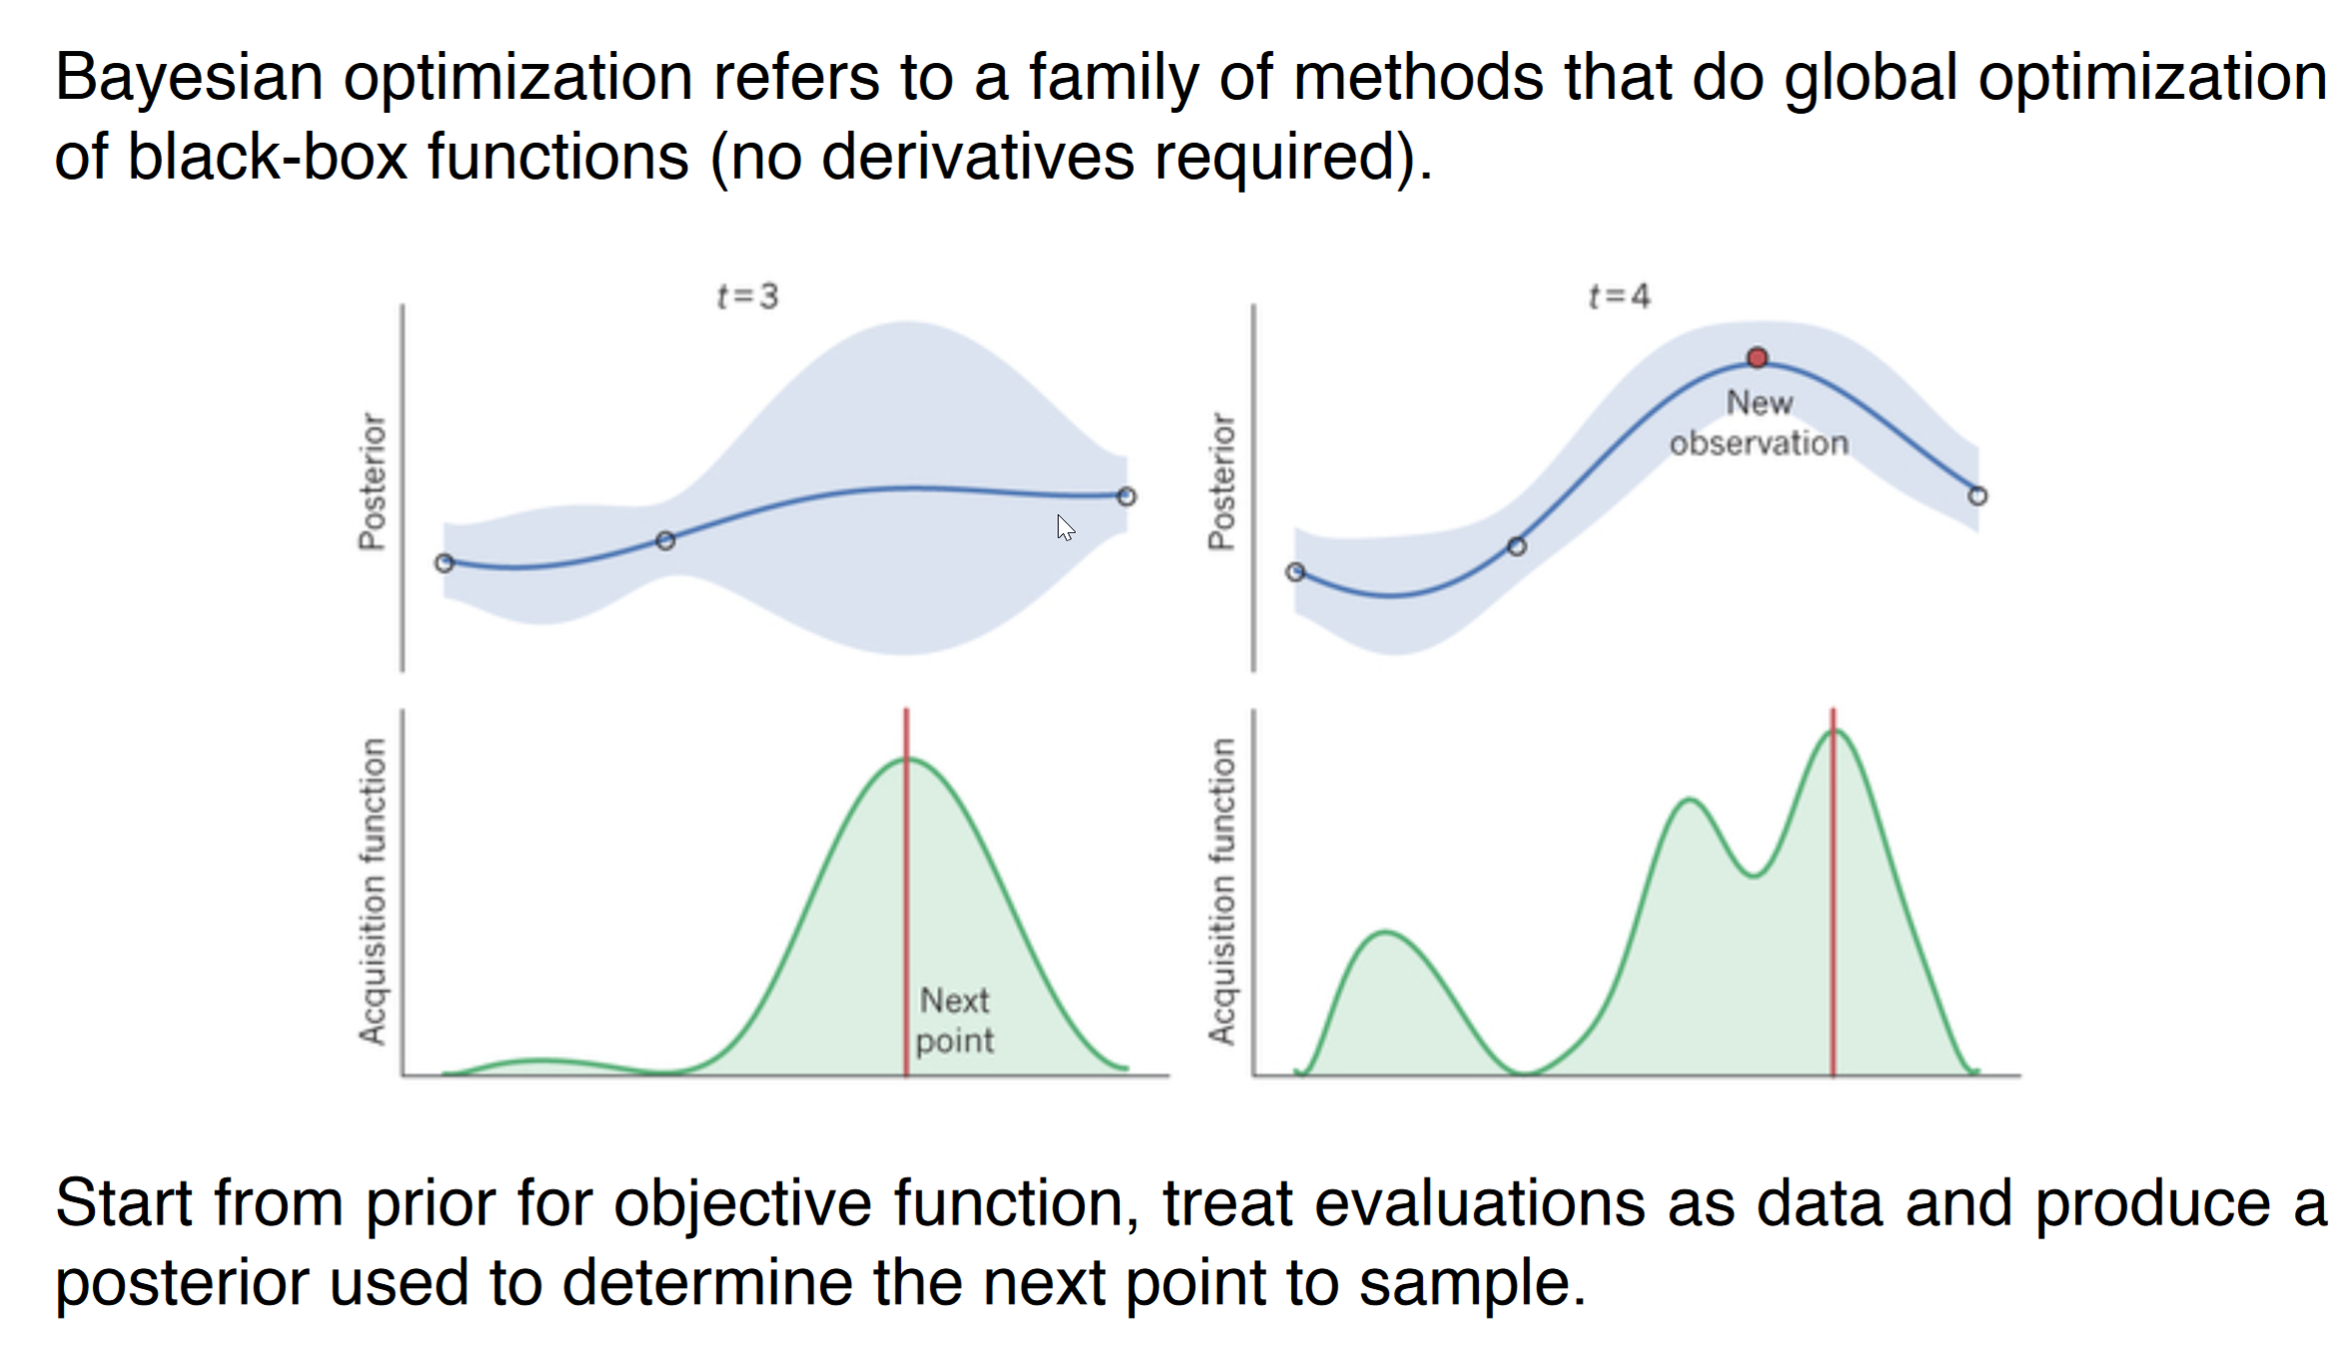
Can we Bayesian optimize everything?
Bayesian optimization for DIRC detector
Barrel DIRC optimization is a short-term goal with a deliverable
Using Bayesian optimization in as a tool for detector design – in general

Slide 42
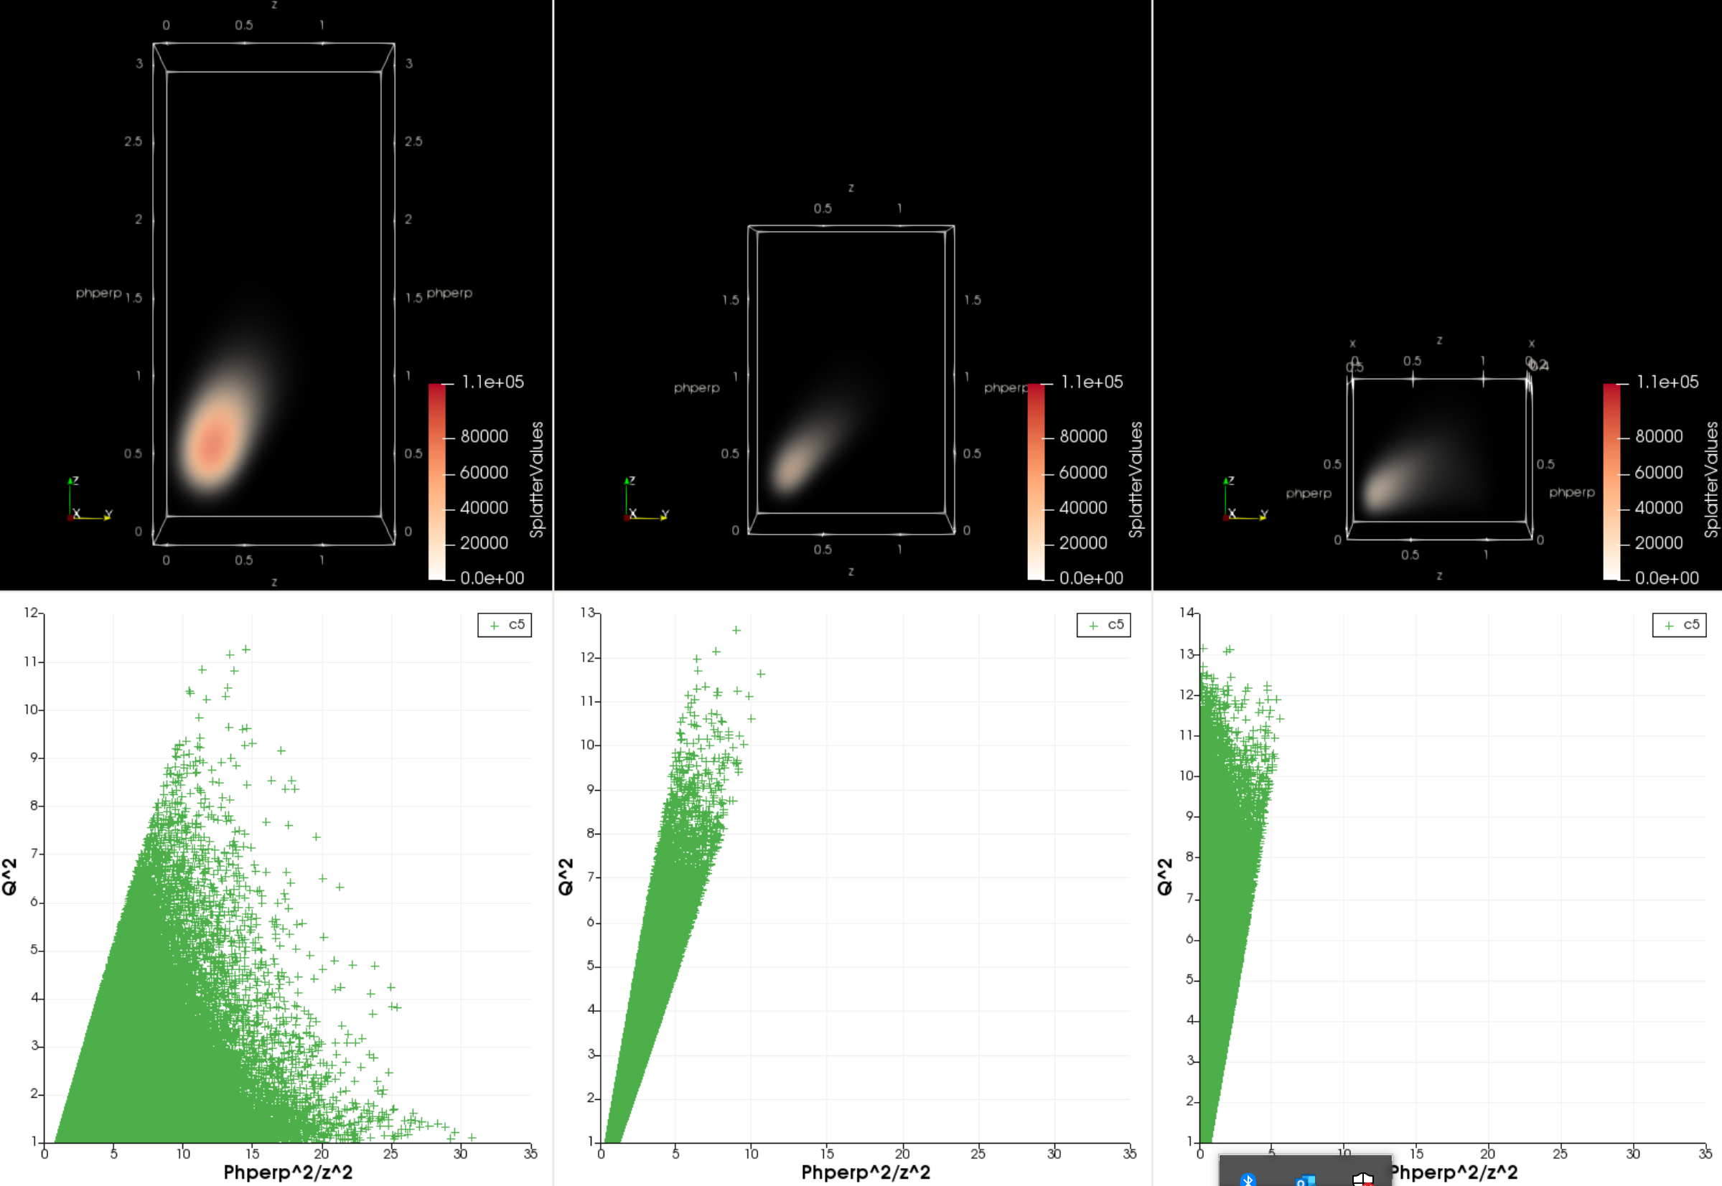
Keep track on modern ML and data science methods for detector design
SIDIS events: Studying TMD factorization testing semantic interactions to explore kinematic correlations and constraints in SIDIS data
Capsule networks for pixelated detectors (JLab + ODU)
GEM neural networks to FPGA
Visual Analysis Workspace for Nuclear Femtography Data (JLab + VTech)
(JLab + ODU)
ML track reconstruction
(JLab tracking ML effort)

