Slide 1
(Some of the) crossing angle effects
Loss of azimuthal symmetry of the main detector
Loss of acceptance of the main detector (and e.g. increase of the calorimetry and PID fiducial volume cut)
Tracker resolution worsening
“Target point” spot horizontal broadening -> P_{t} resolution becomes worse for both Roman Pots and the large acceptance dipole in the forward direction
Acceptance cut in the forward direction

Slide 2
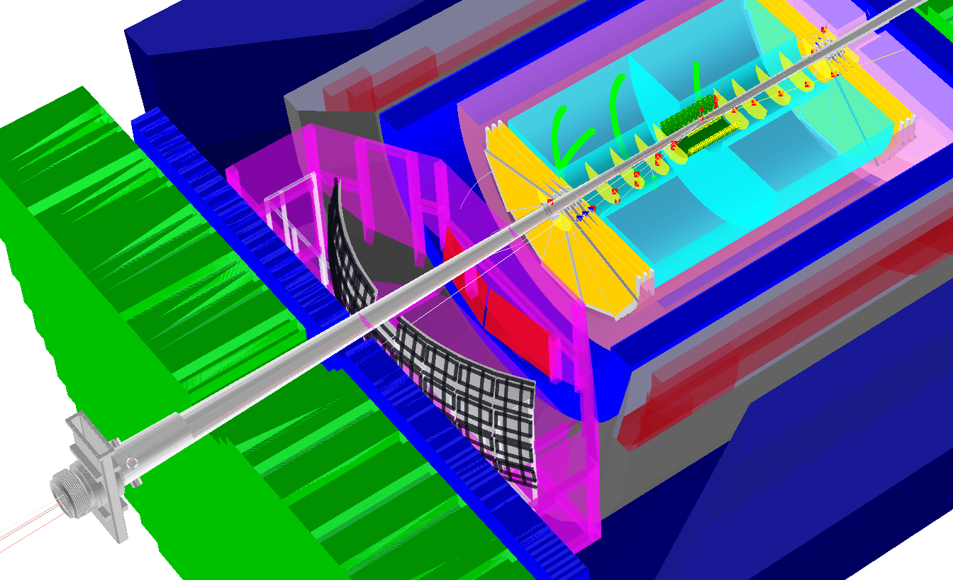
eRHIC IR illustration#1a
hadronic calorimeters
e/m calorimeters
RICH detectors
silicon trackers
trackers
GEM trackers
TPC
-> compare: η=4 is ~ 2⁰, 50 mrad is ~ 3⁰, η=3.5 is ~ 60 mrad

Slide 3
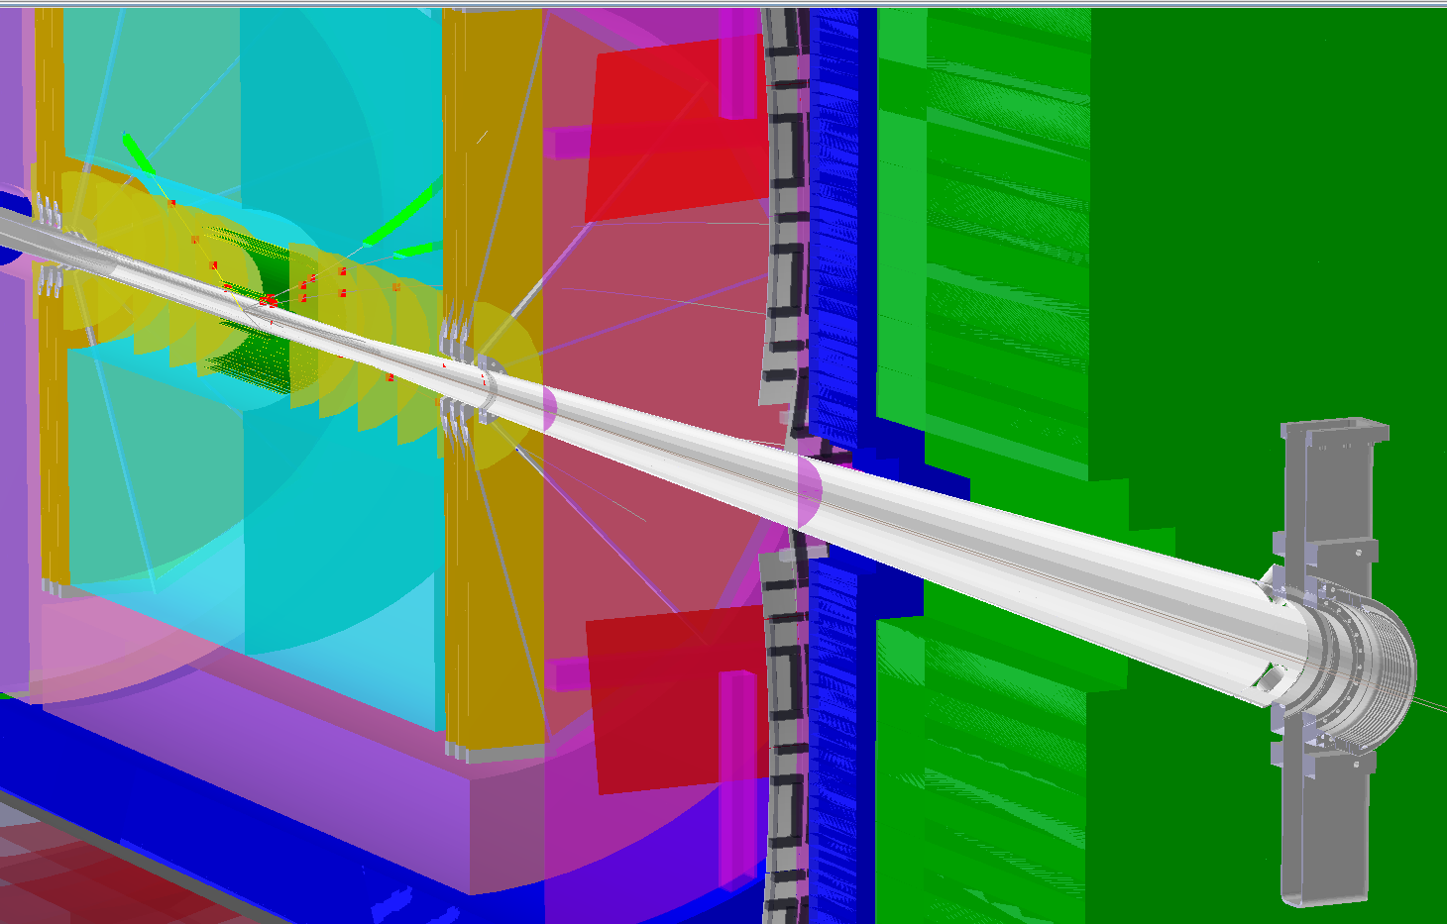
eRHIC IR illustration#1b
hadronic calorimeters
e/m calorimeters
RICH detectors
silicon trackers
trackers
GEM trackers
TPC
-> compare: “20mrad” conical pipe around H-going direction;
HCal tower size (green) is 10x10 cm² ; pump stand is around +5m from the IP

Slide 4
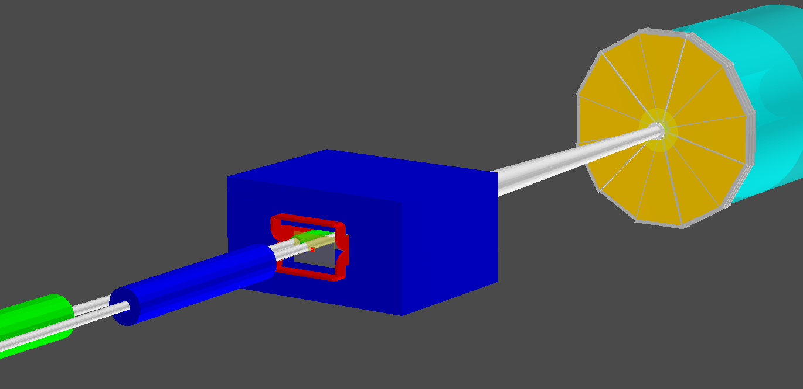
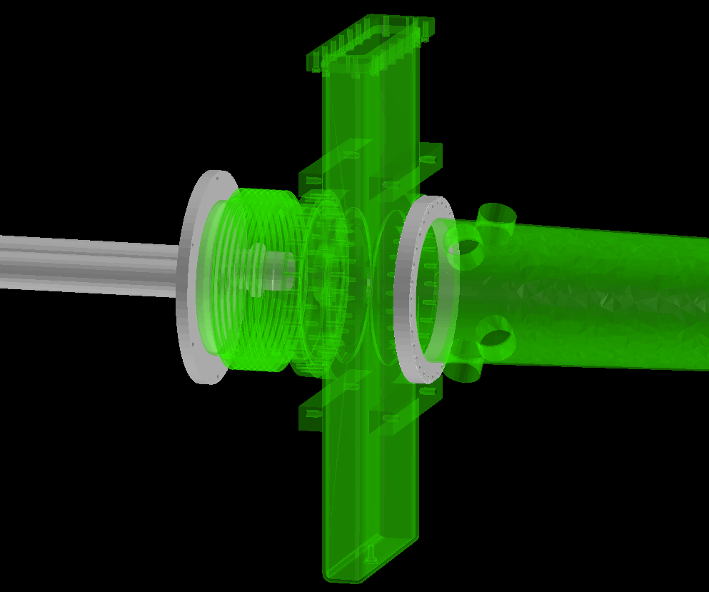
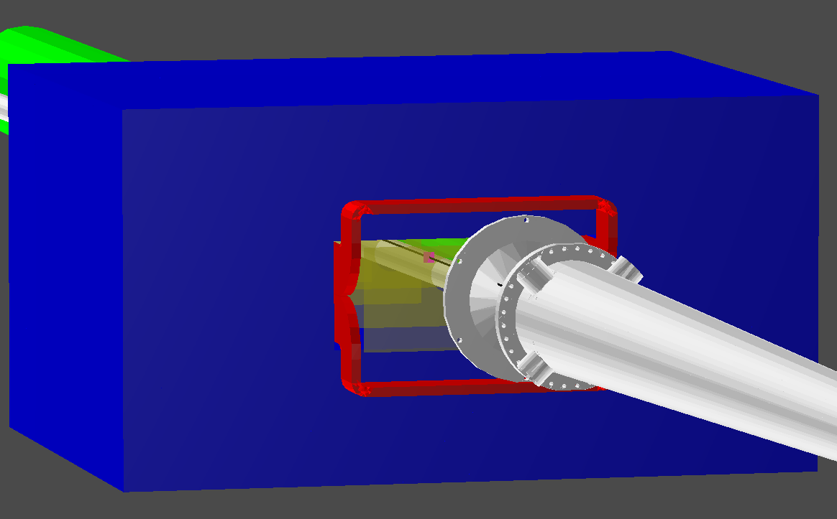
eRHIC IR illustration#2a
Rear view
Pump stand “ghost” volume
B0
e
Main tracker
Q2E
Q1H
Q2E
B0 Si tracker
ROOT event display
p
B0 Si tracker
20mrad vacuum pipe
p
Front view →
B0
vacuum chamber exit window

Slide 5
eRHIC IR illustration#2b
275 x 18 GeV
Reasonably complete GEANT simulation of DVCS events
~10σ away from beam line
Q2E
RP
20mrad vacuum pipe
B0 Si tracker
100 x 10 GeV
p
first quad aperture & beam pipe
B0
vacuum chamber exit window
41 x 5 GeV
vacuum system ~20mrad cone
-> see acceptance cut in the 41x5 GeV configuration
B0

