Slide 1

Quarkonium production in ep and pp collisions within a TMD approach
U. D’Alesio in collaboration with
Francesco Murgia, Cristian Pisano,
Sangem Rajesh and Pieter Taels

Slide 2
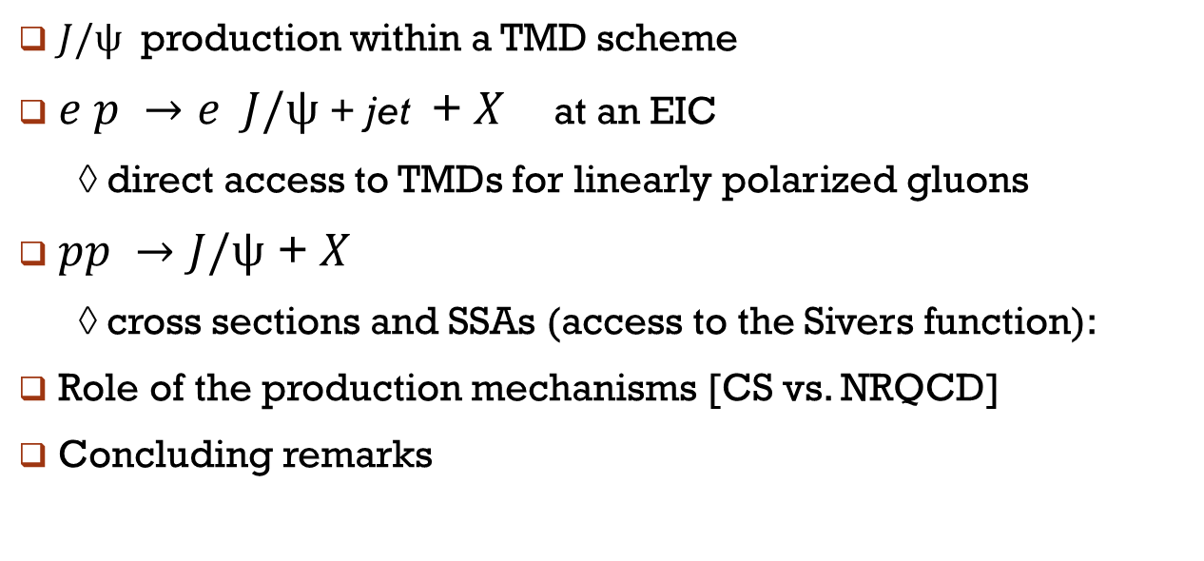
Outline
$J/ψ$ production within a TMD scheme
$e p →e J/ψ$ + jet + $X$ at an EIC
◊ direct access to TMDs for linearly polarized gluons
$pp →J/ψ \text{+ }X$
◊ cross sections and SSAs (access to the Sivers function):
Role of the production mechanisms [CS vs. NRQCD]
Concluding remarks

Slide 3
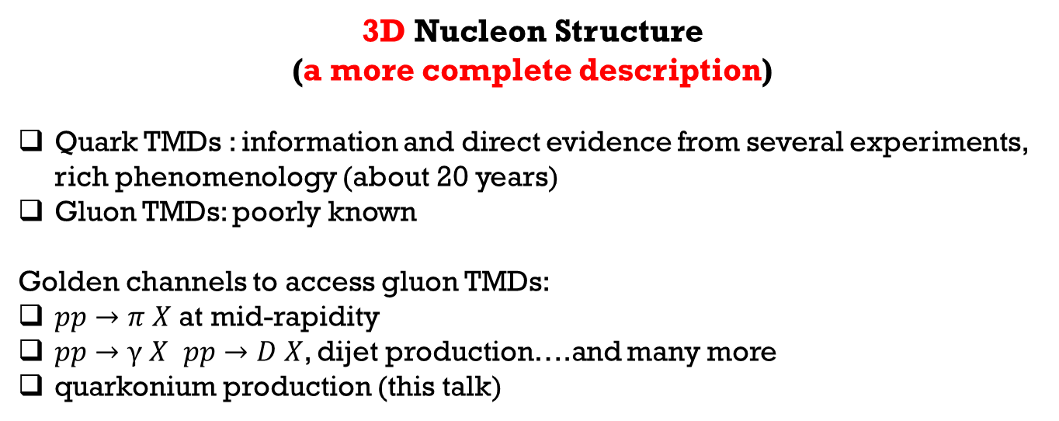
3D Nucleon Structure
(a more complete description)
Quark TMDs : information and direct evidence from several experiments,
rich phenomenology (about 20 years)
Gluon TMDs: poorly known
Golden channels to access gluon TMDs:
$pp→π X$ at mid-rapidity
$pp→γ X$ $pp→D X$, dijet production….and many more
quarkonium production (this talk)
First phenomenological
studies
Disclaimer
A challenging (open) issue: production mechanisms/polarization states
…a lot of work and many papers [see Lansberg 2019 for a review]
Here: A phenomenological TMD approach within NRQCD focused on azimuthal and spin asymmetries as a tool to access gluon TMDs

Slide 4
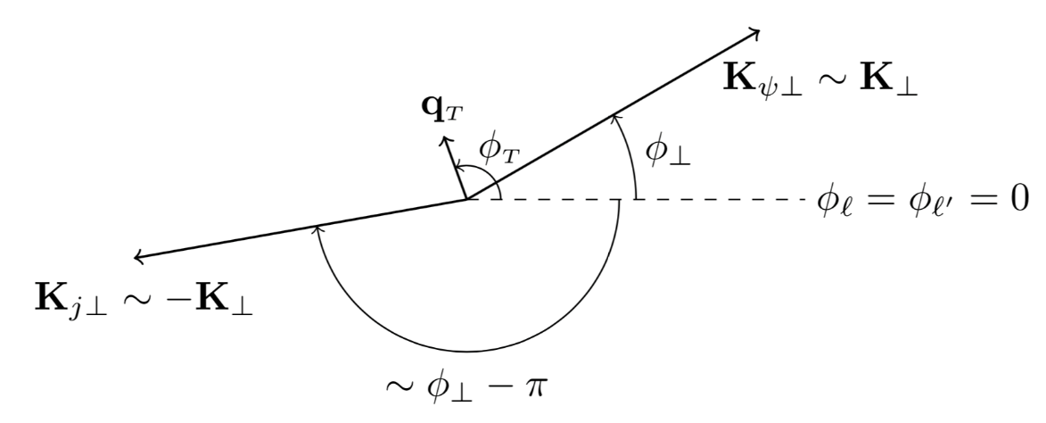
[UD, Murgia, Pisano, Taels, in progress]
Transverse variables
Collinear variables
Two ordered scales
Bacchetta, Boer, Pisano, Taels 2018

Slide 5



cross section
intrinsic $p_{T}$
Lepton tensor
$$2$$
Hard
part
Plus binding mechanism
$Γ_{g}$ Gluon correlator

Slide 6
Gluon correlator
Linearly polarized
gluon TMD
Unpolarized target
Unpol. TMD
Gluon Sivers
TMD
Circularly polarized
gluon TMD
Transversely polarized target
Linearly polarized gluon TMDs

Slide 7
Gluon TMDs at leading twist
collinear

Slide 8
Cross section
T-even TMDs: no need of initial/final state interactions
Similar to heavy-quark
pair production

Slide 9
T-odd TMDs

Slide 10
Spectroscopic notation:

Slide 11
As in SIDIS
Unpolarized
target
Transversely
polarized
target

Slide 12
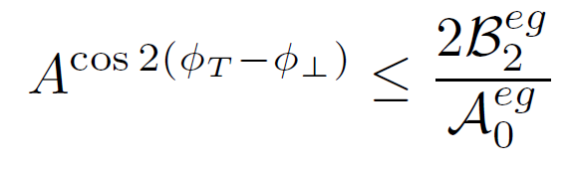
Positivity bounds
for TMDs
Model independent

Slide 13
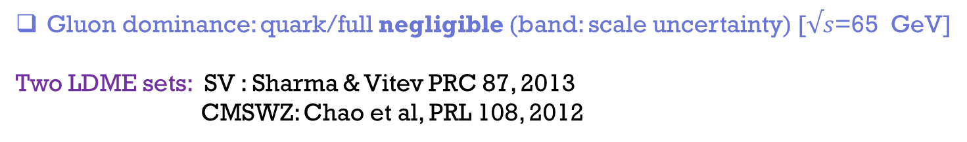
Maximized asymmetries
No direct energy dependence in the maximized values
Gluon dominance: quark/full negligible (band: scale uncertainty) [$√s$=65 GeV]
Two LDME sets: SV : Sharma & Vitev PRC 87, 2013
CMSWZ: Chao et al, PRL 108, 2012

Slide 14
Maximized asymmetries
CSM: almost negligible
Sizeable effects for Color Octet Mechanism
Quark contribution under control (negligible)
Strong dependence on LDMEs

Slide 15

$pp →J/ψ X$
[UD, Murgia, Pisano, Rajesh, in progress]
TMD scheme
Effects: no separable (like for pion production)
Integration over intrinsic azimuthal phases implies
  Unpolarized cross section: only unpol. TMDs
  Single spin asymmetry: only Sivers effect survives
again use of NRQCD: 30 Feynman diagrams
[UD, Murgia, Pisano, Taels (2017);
Godbole et al. (2017)]

Slide 16

NRQCD at low $p_{T}:$ infrared divergences (LDMEs at $p_{T}$>2-5 GeV)
Resummation, $k_{T}$-factorization, Color Glass Condensate…
In a TMD scheme, intrinsic $k_{T}$ (Gaussian $k_{T}$ dep.) can “help”…
& IR regular.
LDMEs from
Butenschoen, Kniehl 2008
Data from PHENIX [Adare et al. 10]
No feed-down: its inclusion could improve the description

Slide 17
Sivers effect
Maximized contributions:
Quark contributions almost zero
Small differences between CS and CS+CO
Predictions adopting the GSF from
UD, Flore, Murgia, Pisano, Taels 19
Data from PHENIX [Aidala et al. 18]

Slide 18

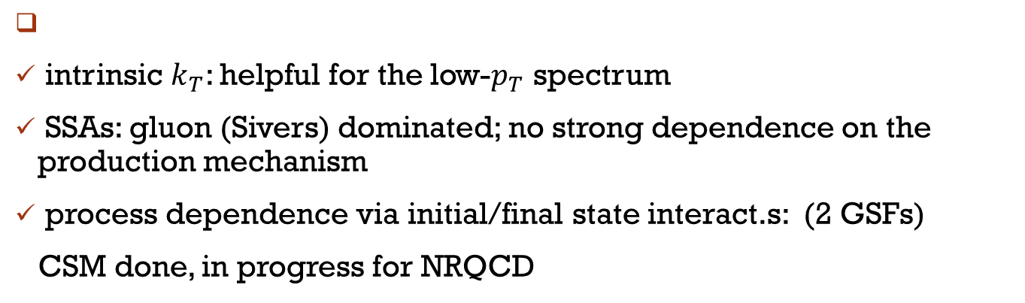
Concluding Remarks
Quarkonium production in a TMD scheme & NRQCD
sizeable asymmetries over a large kinematic range (@EIC)
quark contribution negligible (even at “low” EIC energy )
strong dependence on LDMEs
direct access to TMDs for linearly polarized gluons
intrinsic $k_{T}$: helpful for the low-$p_{T}$ spectrum
SSAs: gluon (Sivers) dominated; no strong dependence on the production mechanism
process dependence via initial/final state interact.s: (2 GSFs)
CSM done, in progress for NRQCD

Slide 19
Back-up slides

Slide 20
Full transversely polarized cross section

Slide 21
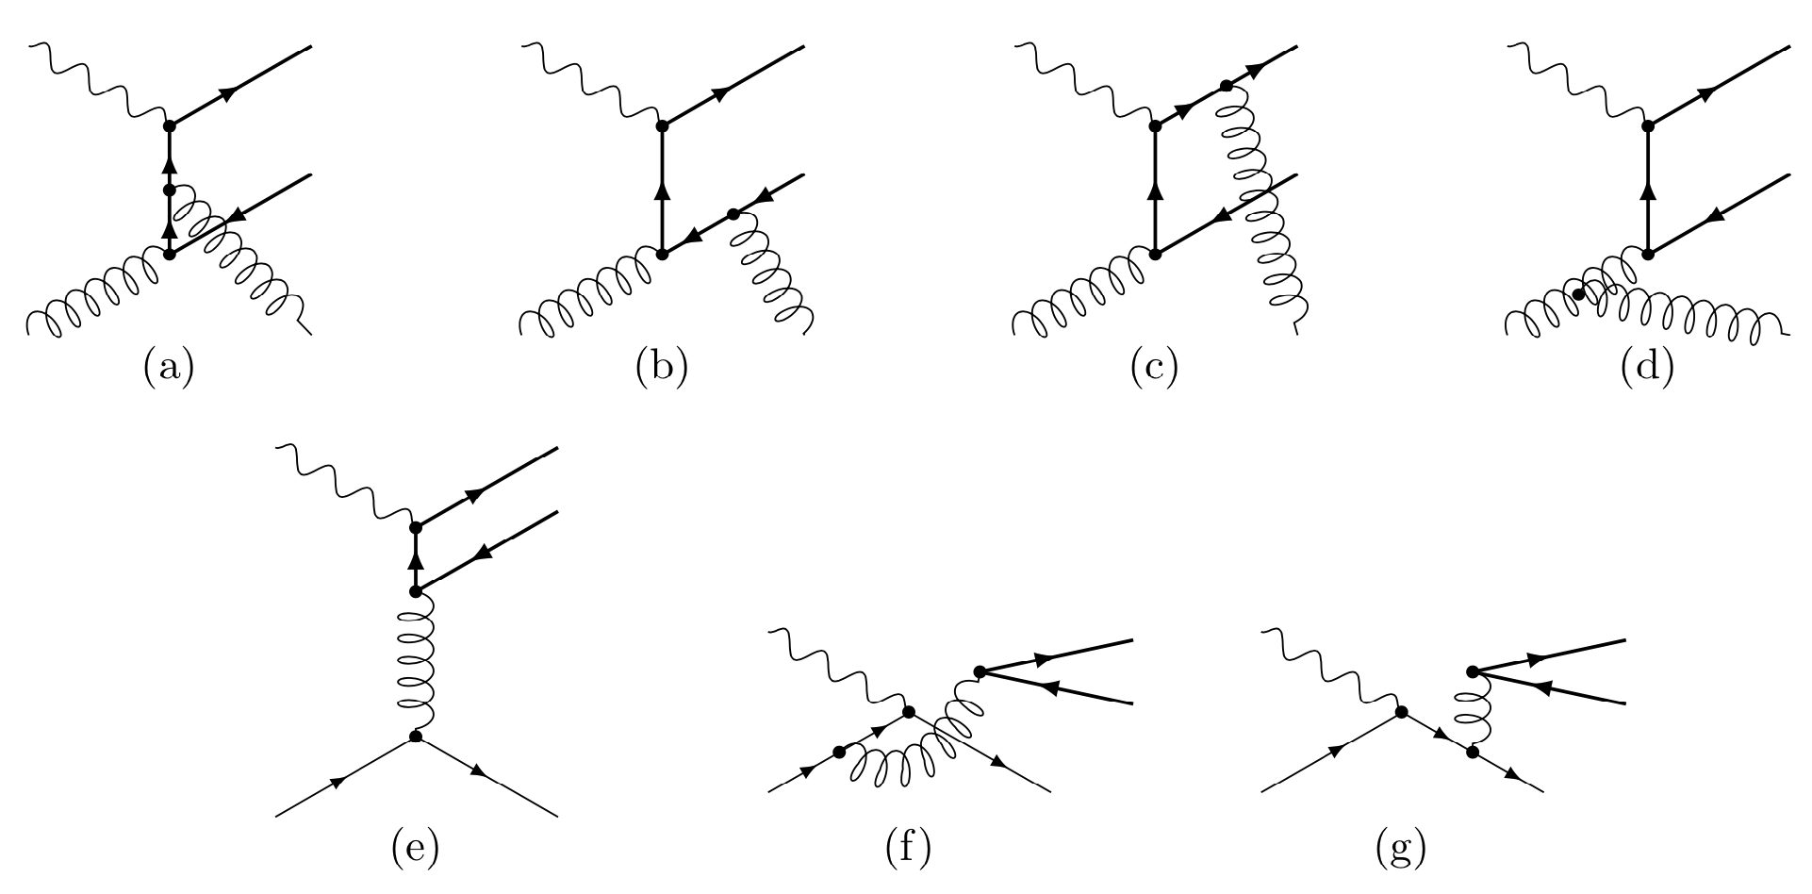
Feynman Diagrams at LO

Slide 22
NRQCD decomposition

Slide 23

Model calculation
Valence quarks: static sources of color for the classical gluon fields
McLerran-Venugopalan (1994)
McLerran-Venugolapan Low-$x$ Model
Gluon TMDs within this model as
Weizsäcker-Williams
Dominguez, Marquet, Xiao, Yuan (2011)
Metz, Zhou (2011)

Slide 24

Model calculation
EIC@100 GeV $x\sim 0.01$

Slide 25


$A^{W}$ for production
$$Υ$$

