Slide 1
RF Systems for EIC
Qiong Wu
July 23, 2019

Slide 2
Outline
RF systems for accelerators
RF systems for EIC
eRHIC
JLEIC
Summary

Slide 3
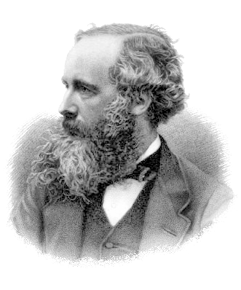
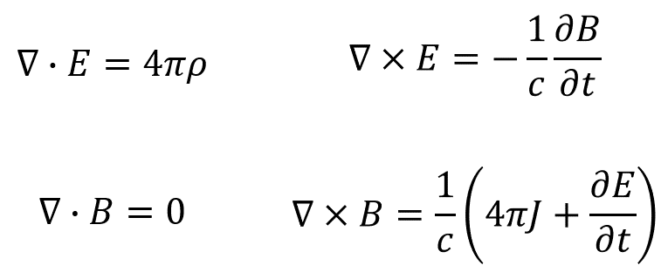
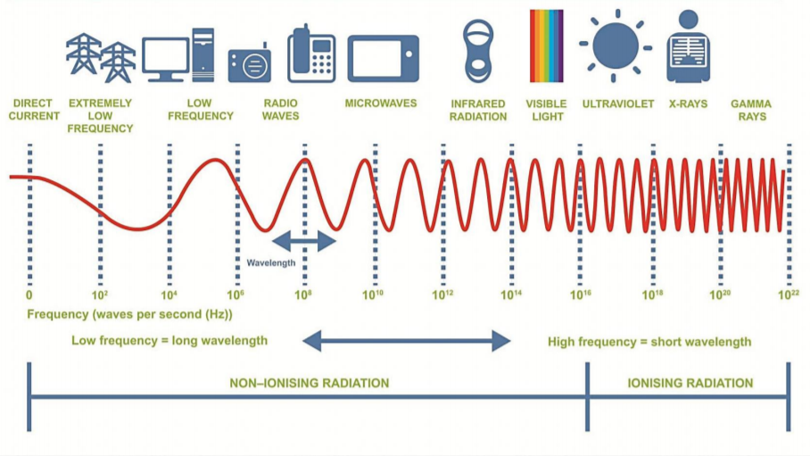
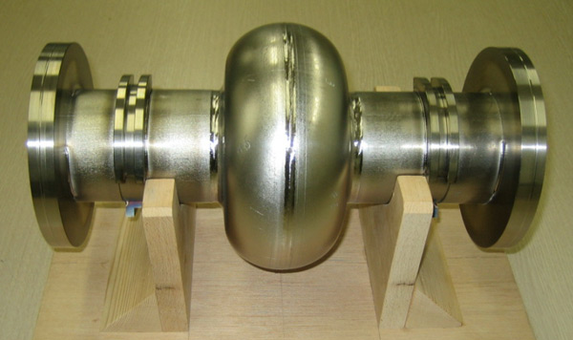
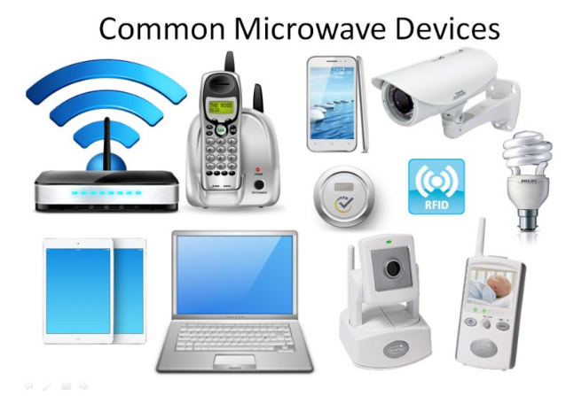
RF systems
Radiofrequency (RF) systems are
Systems that deliver or store energy in forms of electro-magnetic field
Easy to define direction and easy to shield
Parameters of characterization: frequency, phase, amplitude, power dissipation…
Precise and “instant” control of high power through small signals
Well understood, from basic theory to applications
Widely used, all the time
https://www.scampstudy.org/wp-content/uploads/2014/05/The-electromagnetic-spectrum1.pdf

Slide 4
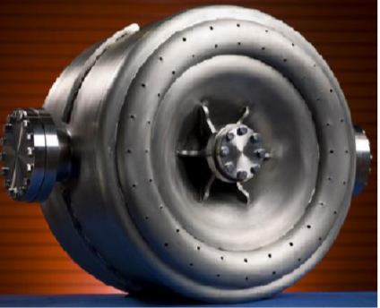
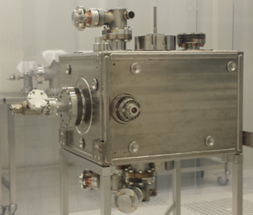
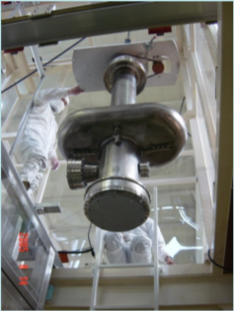
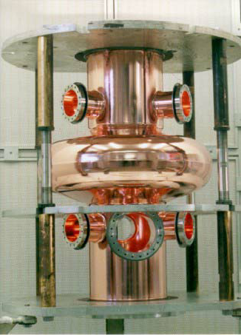
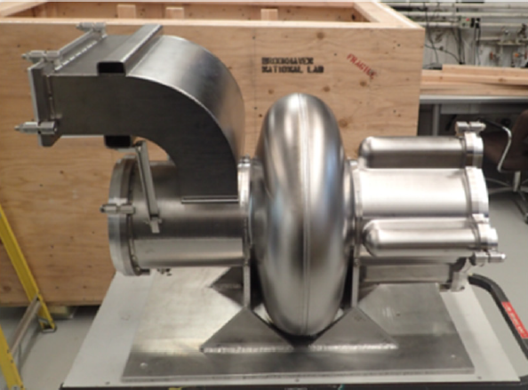
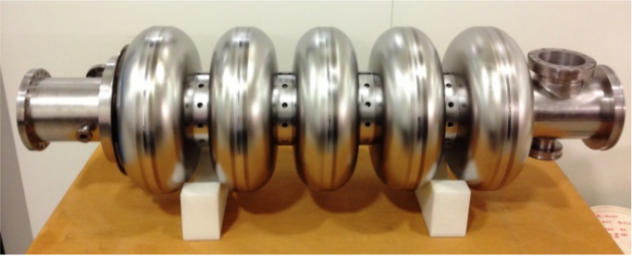
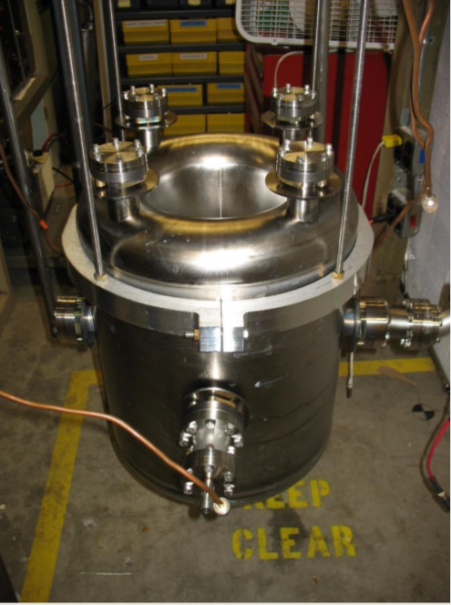
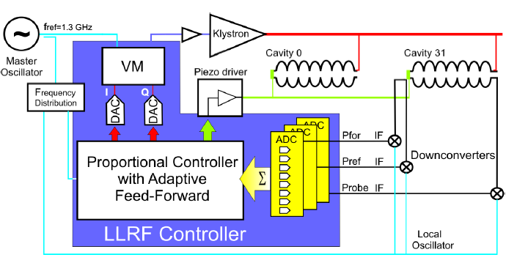
RF systems for Accelerators
Add damping
LCLS-II 1.3 GHz 9-cell cavity
Project X 325 MHz prototype Spoke cavity
Add power
Add ports
Add control
KEK 509 MHz crab cavity
ESS 704 MHz 5-cell cavity
RHIC 56 MHz quarter wave cavity
FRIB 322 MHz half wave cavity

Slide 5
RF systems for Accelerators
RF systems for accelerators:
Provide energy exchange for charged particles
Have closed boundary condition, not aiming for propagation
Usually single frequency (1 MHz ~ 15 GHz in most cases) devices, wide tuning range for hadrons
Low loss, high efficiency (high Q)
No instant on/off
High power and can generate harmful radiation
Sensitive to environment
Require precise control of amplitude and phase
LCLS-II 1.3 GHz 9-cell cavity
Project X 325 MHz prototype Spoke cavity
KEK 509 MHz crab cavity
ESS 704 MHz 5-cell cavity
RHIC 56 MHz quarter wave cavity
FRIB 322 MHz half wave cavity

Slide 6
RF systems for Electron Ion Collider
RF related accelerator features:
Corresponding RF system features:
High average beam current
High RF input power
Accelerating, bunching, and store hadrons and leptons
2 sets of different RF systems with precise timing and various demands
Time dependent transverse kick (crab crossing)
Crab cavity
Well defined impedance budget for beam instability
Dedicated RF design and damping of higher order modes in all cavities

Slide 7
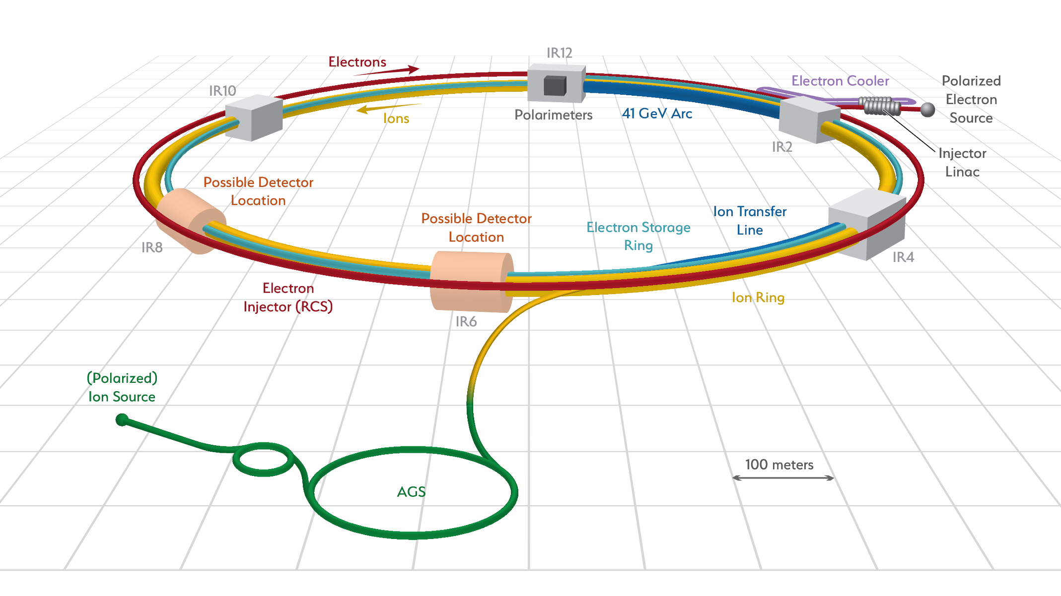
eRHIC
BNL EIC, aka eRHIC is
using the existing RHIC complex with modifications and upgrades to generate electron ion collisions
$I_{proton}=1 A$
$$I_{electron}=2.5 A$$
$σ_{proton}=6 cm$
$$σ_{electron}=2 cm$$
Full crossing angle is 25 mrad

Slide 8
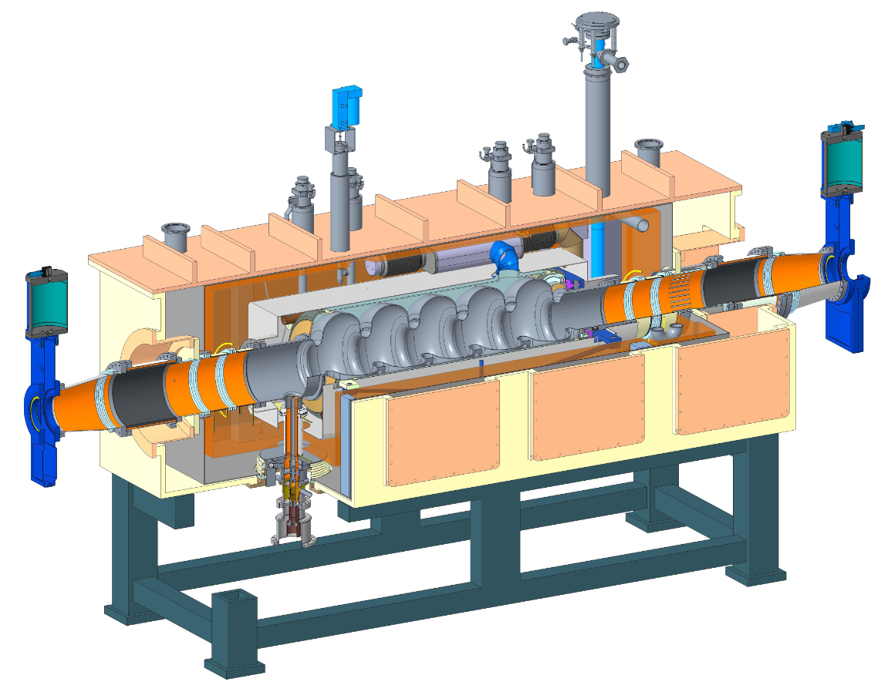
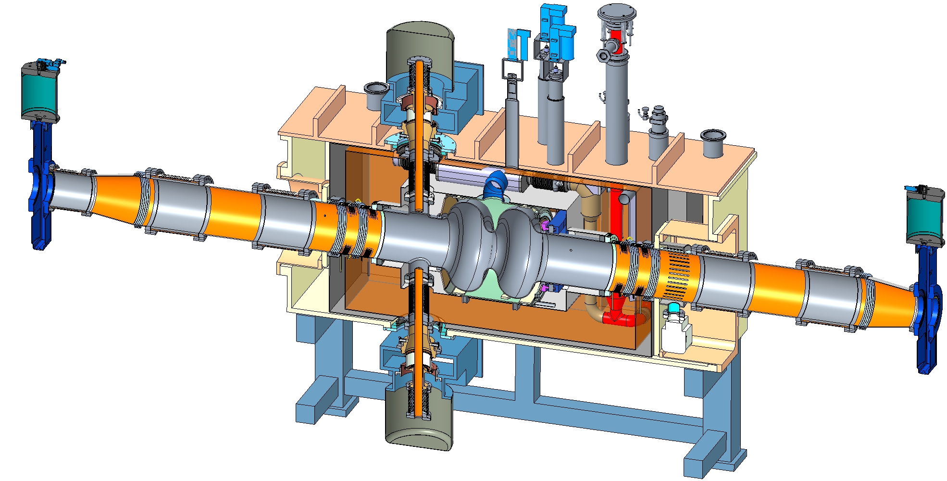
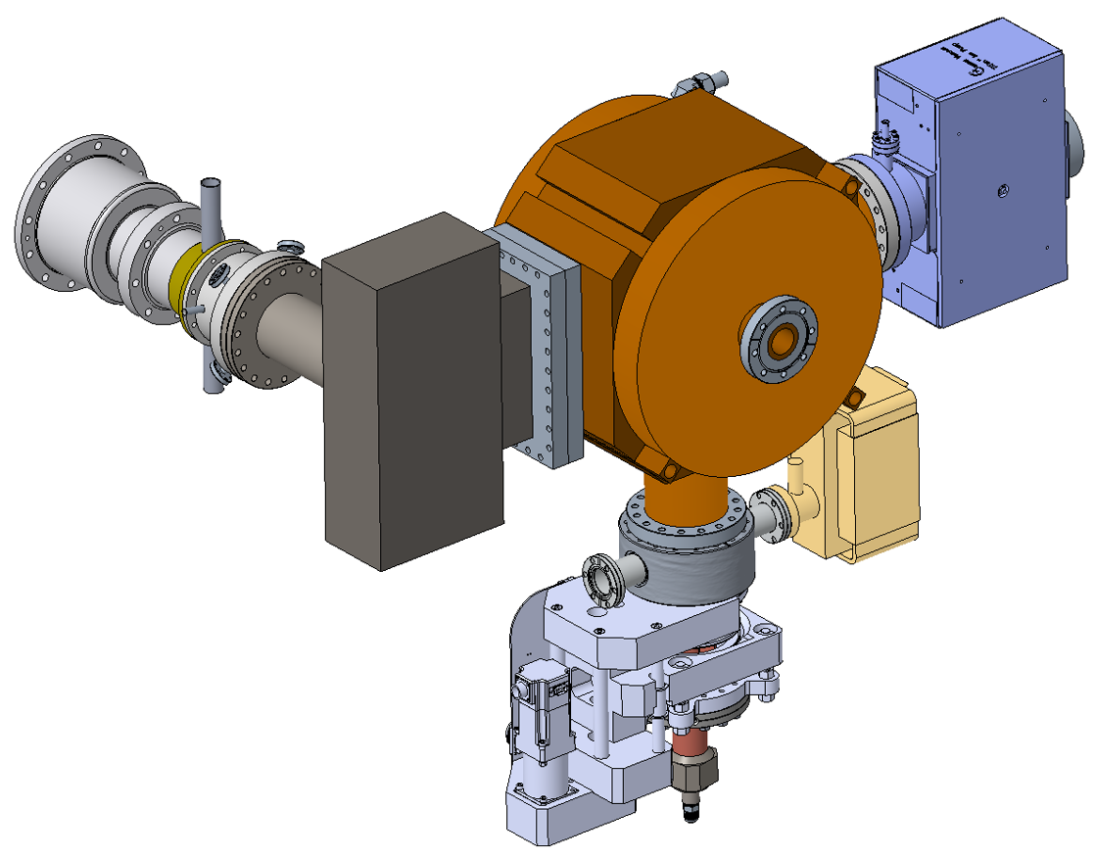
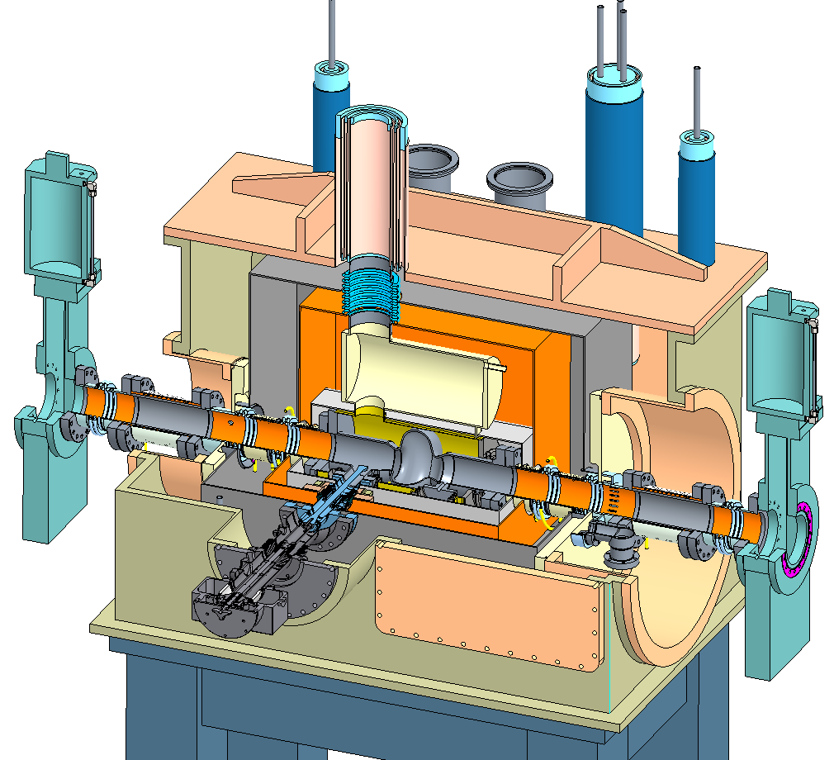
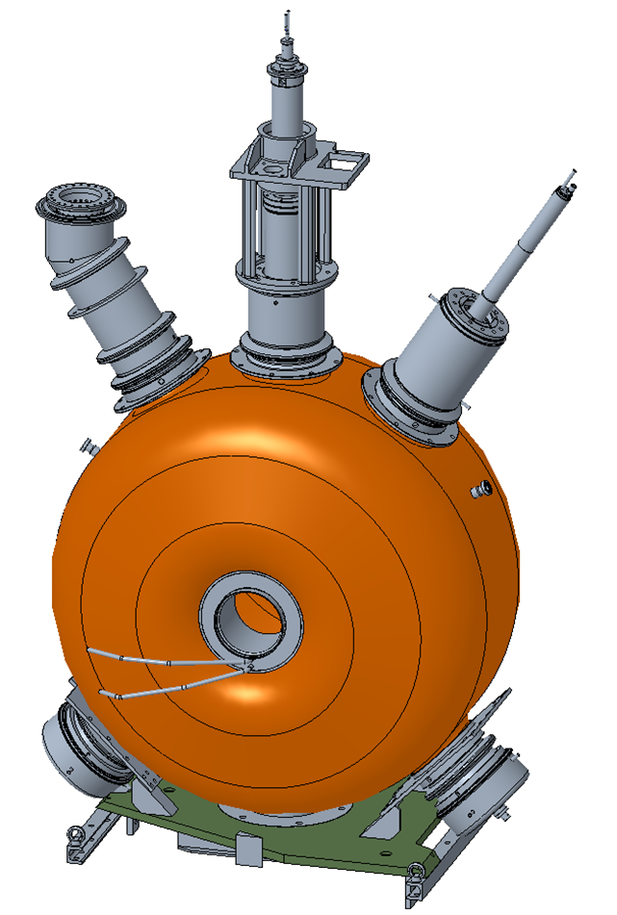
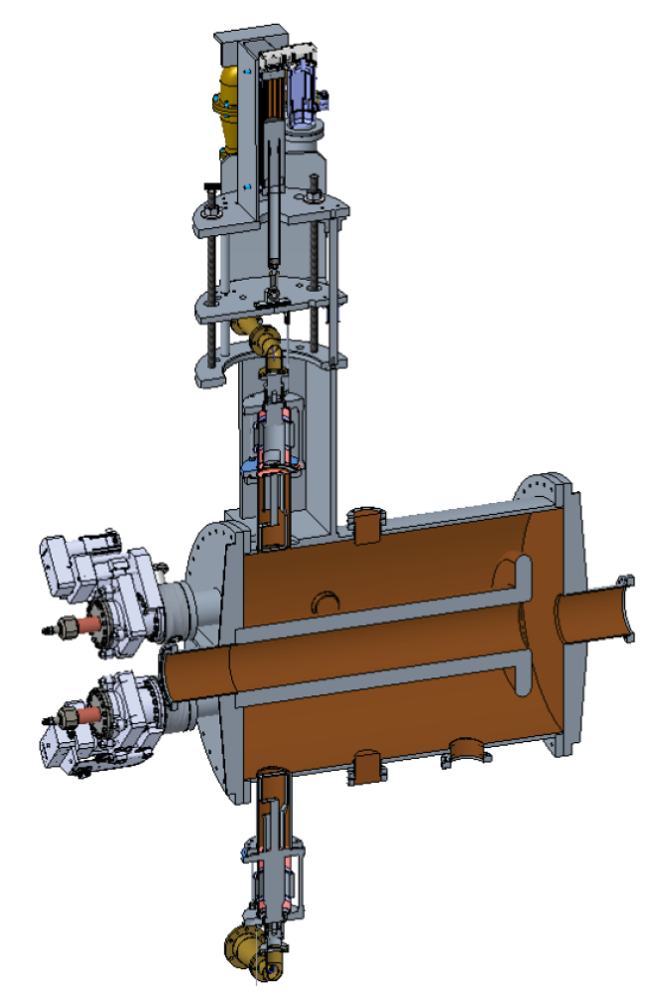
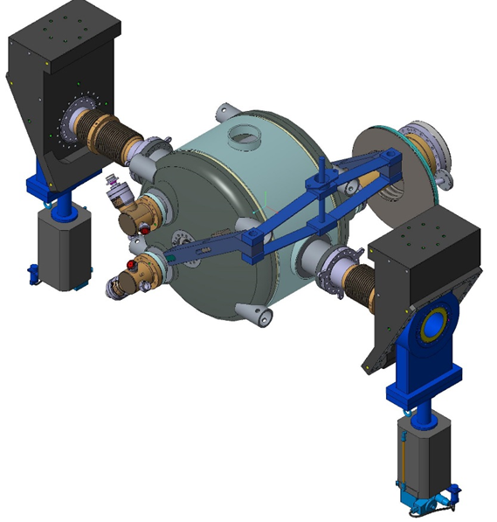
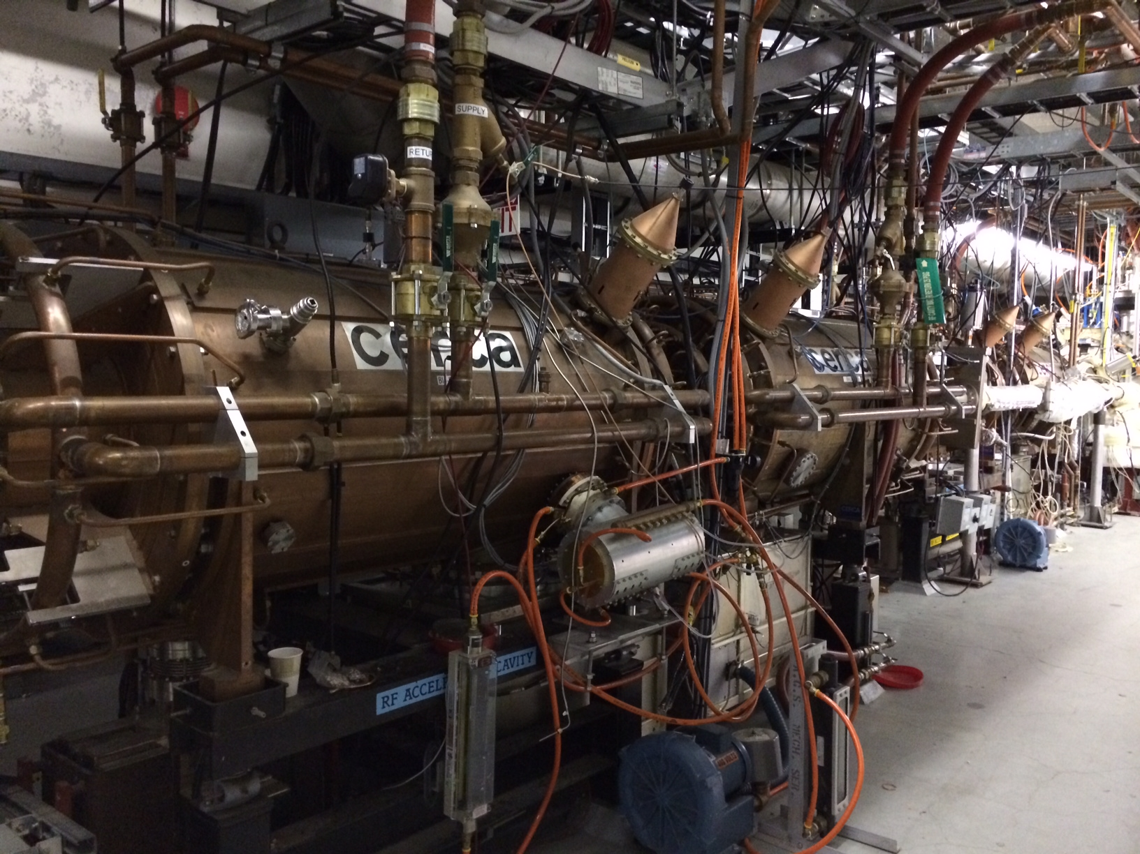
Hadron - 591 MHz bunch compression cavity
Hadron Cooling - 591 MHz acceleration cavity
Electron - 591 MHz electron storage cavity
Injector - 571 MHz bunch compression cavity
Electron - 1773 MHz 3rd harmonic cavity
Hadron - 197 MHz bunch compression cavity
Hadron – 24.5 MHz acceleration cavity
Rapid Cycling Synchrotron - 591 MHz acceleration cavity
Both rings – 400 MHz crab cavity
Hadron – 49.2 MHz and 98.5 MHz bunch splitter cavity

Slide 9
eRHIC RF system | RF sub system | Freq [MHz] | Type | Location | # of Cavities
Electron Storage Ring | Fundamental | 591 | SRF, 2-cell | IR-10 | 14
 | Third Harmonic | 1773 | SRF, 1-cell | IR-10 | 5
Rapid Cycling Synchrotron | Fundamental | 591 | SRF, 5-cell | IR-10 | 3
Pre-Injection LINAC | Bunch Compression 1 | 114 | Copper, capacitor loaded | IR-2 | 1
 | Bunch Compression 2 | 571 | Copper, 1-cell | IR-2 | 1
 | 400 MHz LINAC | 2856 | SLAC type LINAC | IR-2 | 8 x 3m sections
Hadron Ring | Capture/Acceleration | 24.6 | Copper, Quarter Wave | IR-4 | 2
 | Bunch Splitter 1 | 49.2 | Copper, Quarter Wave | IR-4 | 2
 | Bunch Splitter 2 | 98.5 | Copper, Quarter Wave | IR-4 | 2
 | Bunch Compression 1 | 197 | Copper, 1-cell | IR-4 | 12
 | Bunch Compression 2 | 591 | SRF, 5-cell | IR-10 | 2
Crab Cavity | Hadron | 394 | SRF, Double Quarter Wave | IR-6 | 8
 | Electron | 394 | SRF, Double Quarter Wave | IR-6 | 2
Hadron Cooling | SRF Booster | 118 | SRF, Quarter Wave | IR-2 | 2
 | Bunch Compression | 591 | Copper, 1-cell | IR-2 | 1
 | Fundamental | 591 | SRF, 5-cell | IR-2 | 9
 | Third Harmonic | 1773 | SRF, 5-cell | IR-2 | 2

Slide 10
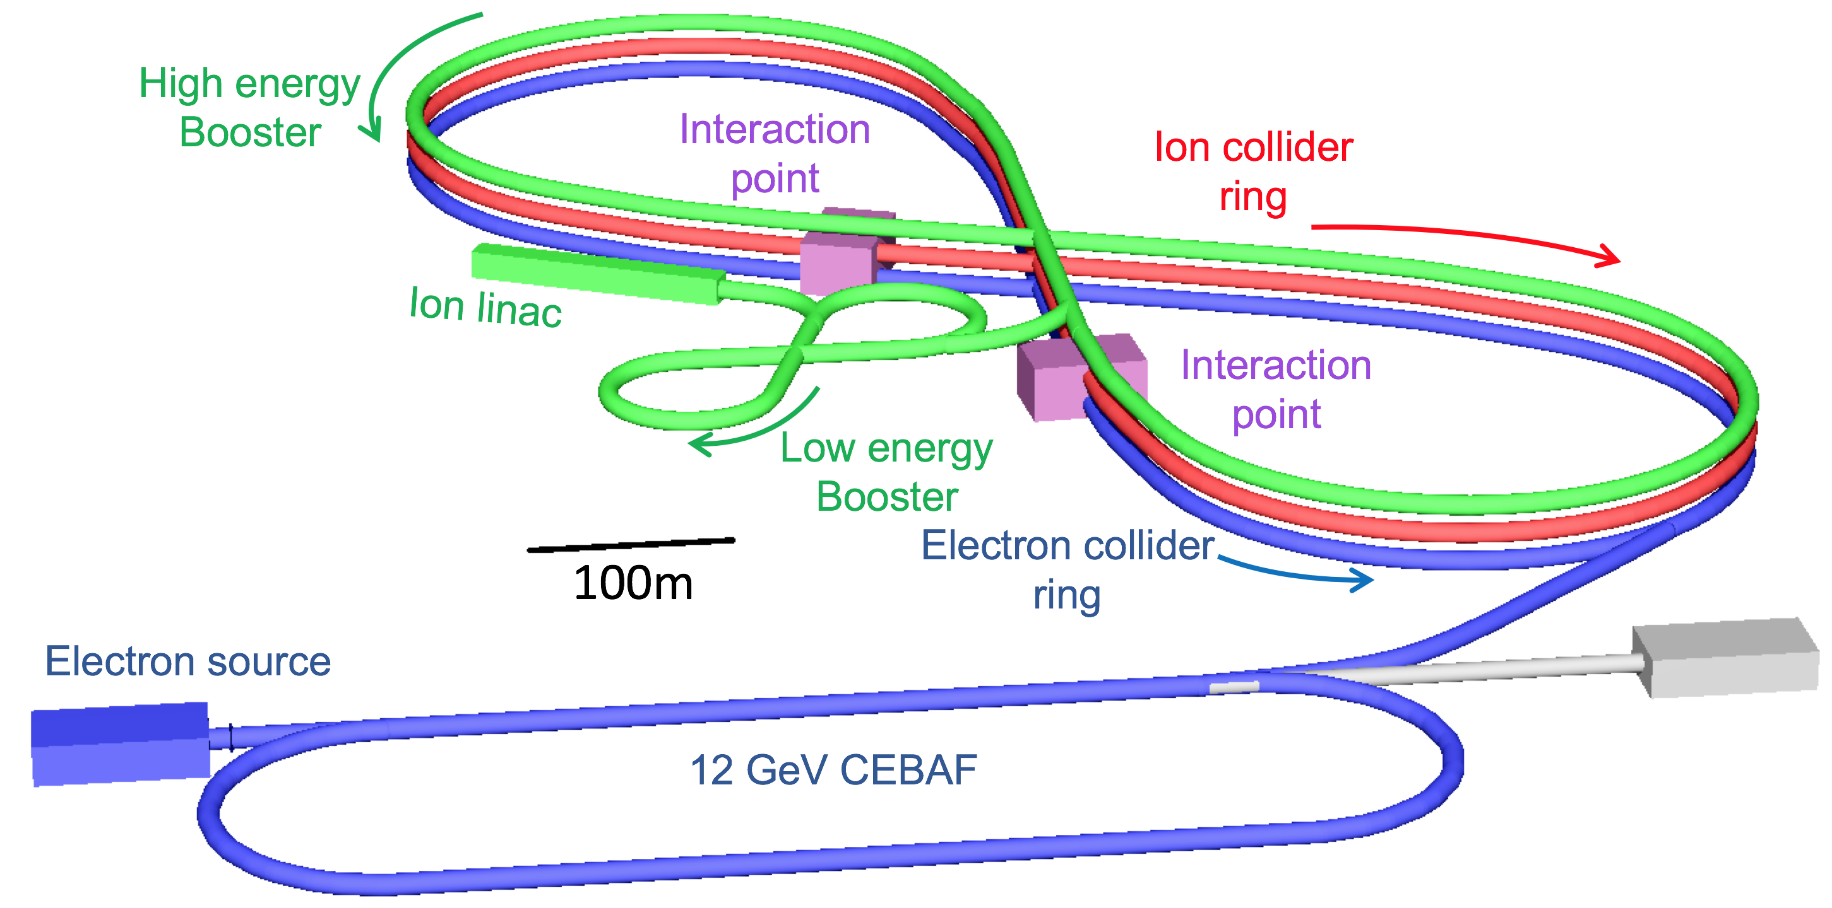
JLEIC
JLEIC is
using the existing CEBAF complex with modifications and upgrades to generate electron ion collisions
$I_{proton}=0.75 A$
$$I_{electron}=2.58 A$$
$σ_{proton}=2.1 cm$
$$σ_{electron}=1 cm$$
Full crossing angle is 50 mrad

Slide 11
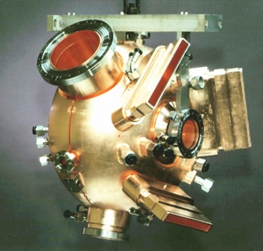
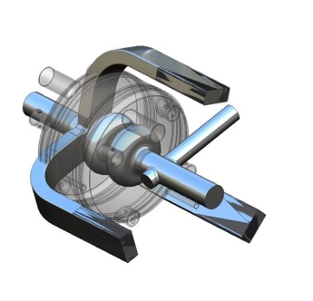
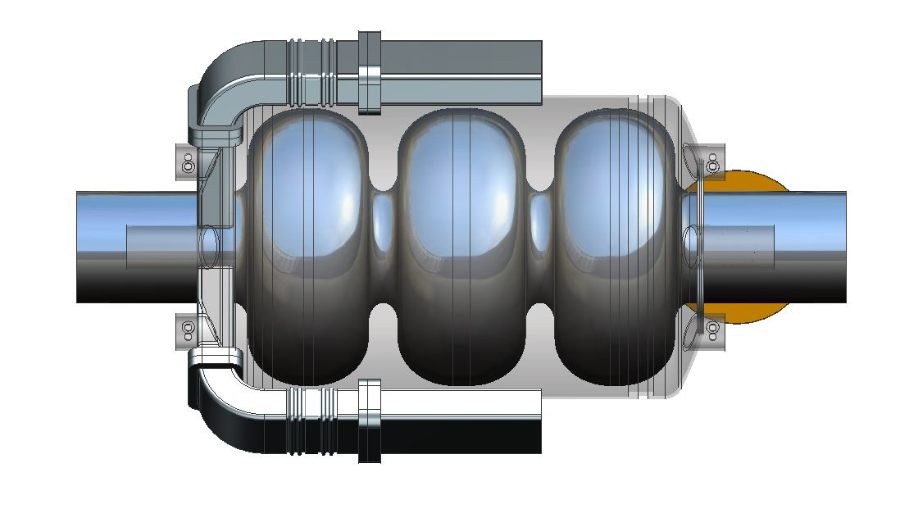
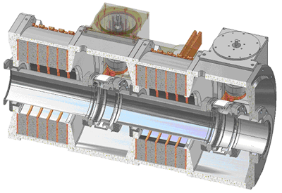
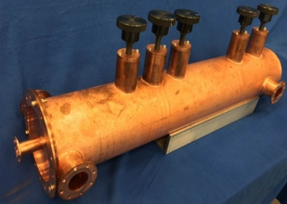
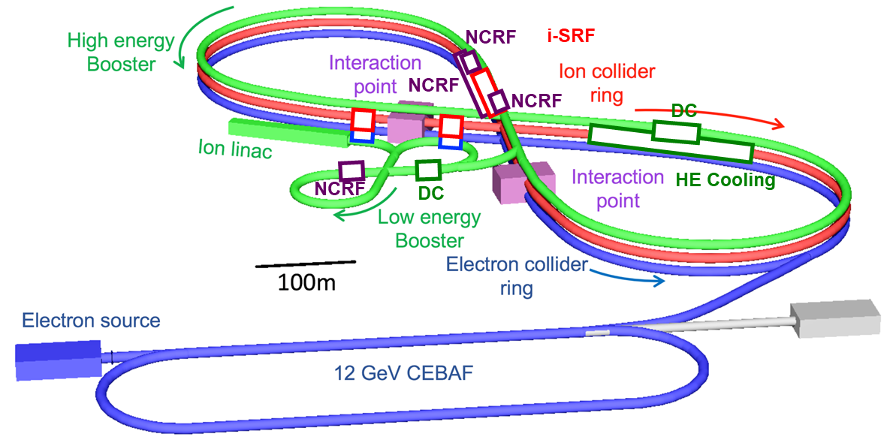
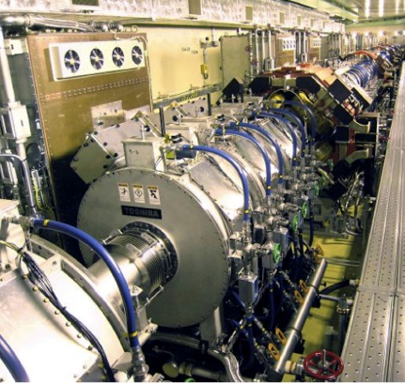
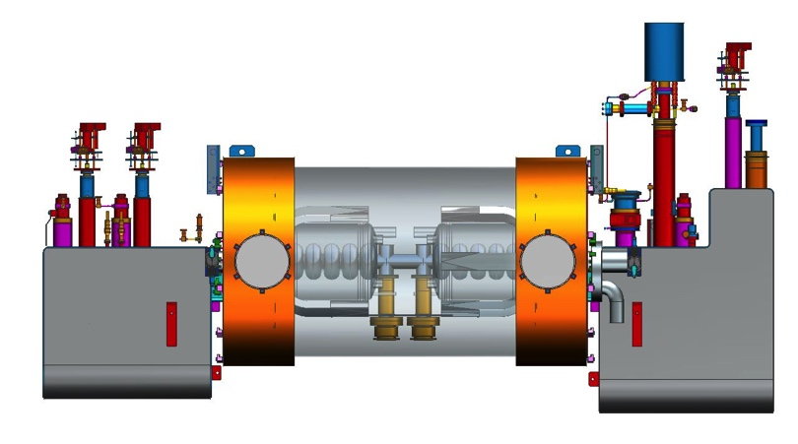
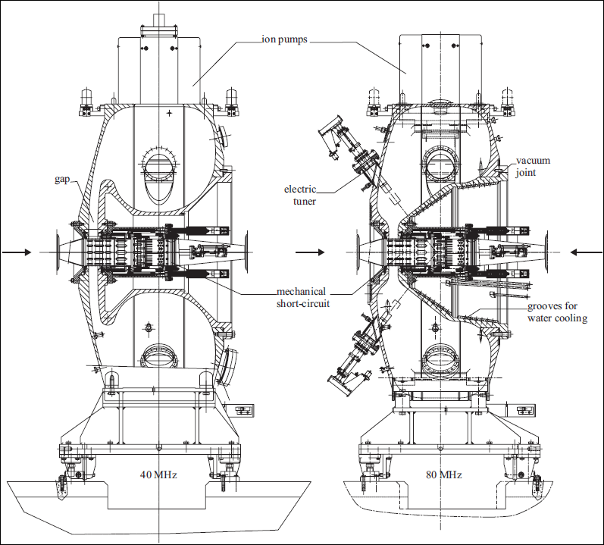
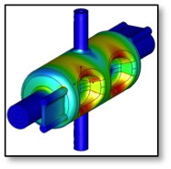
Hadron Cooling – 476.3 MHz accleration cavity
Electron Collider – 476.3 MHz acceleration cavity
Hadron – 952.6 MHz acceleration cavity
Hadron Low Energy Booster – 7 MHz bunch splitter cavity
Hadron Cooling – Harmonic fast kicker cavity
Hadron Low Energy Booster – 0.14 – 0.49 MHz acceleration and compression cavity
Hadron Cooling – 1429 MHz third harmonic cavity
Hadron High Energy Booster – 14.7 MHz and 29.3 MHz bunch splitter cavity
Hadron High Energy Booster – 7 MHz acceleration cavity
Both rings – Crab cavity

Slide 12
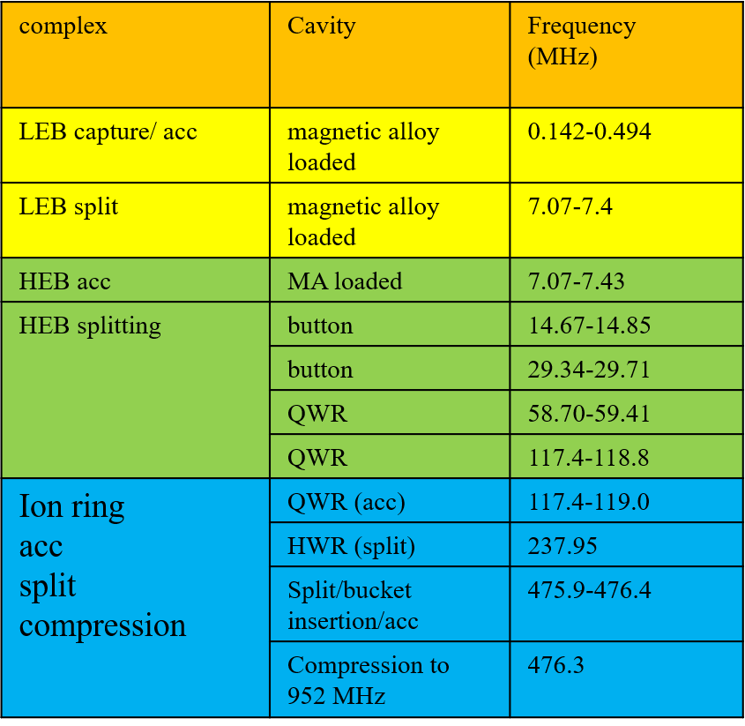
JLEIC RF system* | RF sub system | Freq [MHz] | Type | # of Cavities
Electron Collider Ring | Bunching | 476.3 | PEP-II, 1-cell | 16
 | Bunching | 476.3 | SRF, 1-cell | 12
Ion Linac (pulsed) | RFQ | 100 | Copper, RFQ | 2 (1 ea. for heavy/light ions)
 | LINAC | 100 | Copper, IH-DTL | 3
 | QWR | 100 | SRF, β=0.15 | 21
 | HWR | 200 | SRF, β=0.30 | 21
Ion Collider Ring | Bunching | 952.6 | SRF, 2-cell | 24
Crab | Hadron | 952.6 | SRF, RF dipole 2-cell | 20 per IP
 | Electron | 952.6 | SRF, RF dipole 2-cell | 4 per IP
Circulating Cooler Ring/ERL | ERL Fundamental | 476.3 | SRF, 3-cell | 8
 | ERL Third harmonic | 1429 | SRF, 5-cell | 2
 | ERL Chirper | 952.6 | SRF, 2-cell | 4
 | Booster fundamental | 433 | SRF, 1-cell | 3
 | Booster 3rd harmonic | 1299 | SRF, 1-cell | 1
 | injection /extraction Harmonic Kicker | 86.6×1,3,5,7,9 | Copper QWR harmonic (5 harmonics in one cavity) | 4
 | pre-/post-kicker | 952.6 | Copper, DQW | 2
* Omitting bunch generation cavities

Slide 13
Summary
RF systems for EIC are design specific and very challenging.
Both eRHIC and JLEIC designs have included multiple RF systems to achieve goals in acceleration, replenish energy, bunch splitting, maintain beam stability, recover geometric loss in crossing angle scheme, etc.
Optimization will continue for all RF systems with state of art SRF and RF technologies.

Slide 14
Acknowledgement
Special Thanks to
Jiquan Guo (Jlab), Robert Rimmer (Jlab), Kevin Smith (BNL), and Wencan Xu (BNL) for providing material for this presentation.

Slide 15
Reference
D. Makowski et al, Prototype Real-time ATCA-based LLRF Control System, EuCARD, June 2010
F. Furuta, et al, RF Test Result of a BNL N-Doped 500 MHz B-Cell Cavity at Cornell, IPAC18, pp 2440
S. Bauer et al, Test Results of Superconducting Cavities Produced and Prepared Completely in Industry, EPAC04, pp 635
G. Devanz et al, ESS Elliptical Cavities and Cryomodules, SRF13, pp 1218
J. Holzbauer, Superconducting Half Wave Resonator Design and Research, USPAS 2012, Grand Rapids, MI
T. Raubenheimer, LCLS-II-HE FEL Facility Overview, Workshop on Scientific Opportunities for Ultrafast Hard X-rays at High Rep. Rate SLAC, September 26-27, 2016
J. Delayen, Applications of Spoke Cavities, LINAC2010, Tsukuba, Japan, pp 377

Slide 16
Thank you

