Slide 1
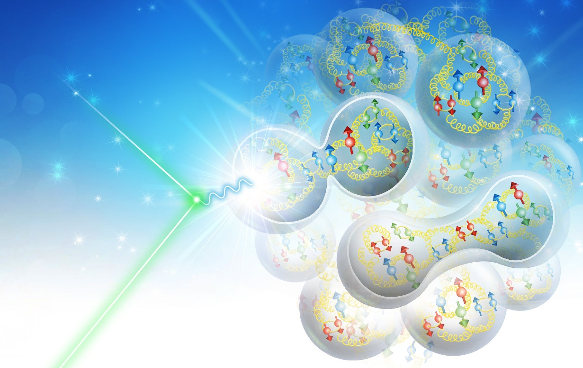
Polarized Positron in Jefferson Lab Electron Ion Collider (JLEIC)
Jiquan Guo
EIC User Group meeting, Paris, July 22-26, 2019

Slide 2
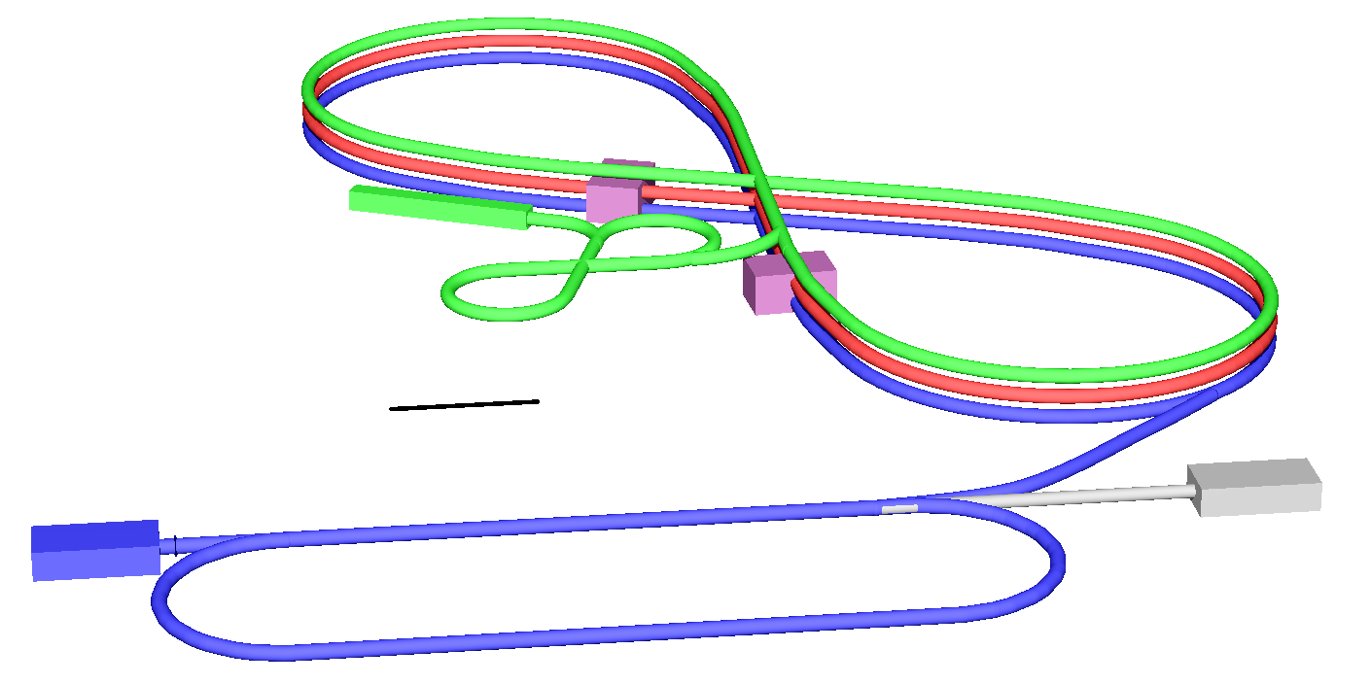
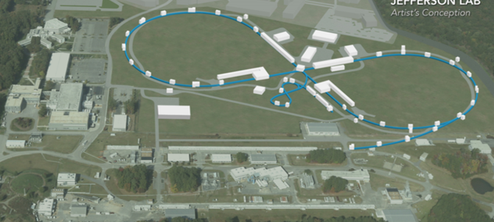
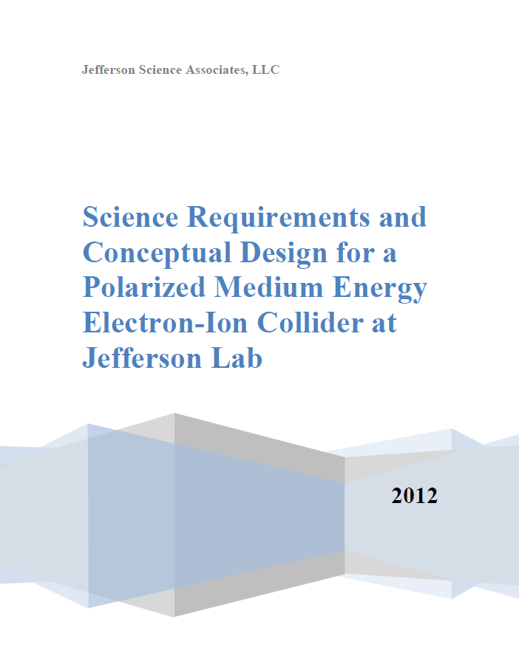
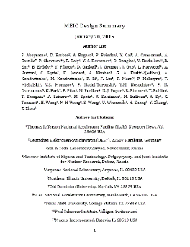
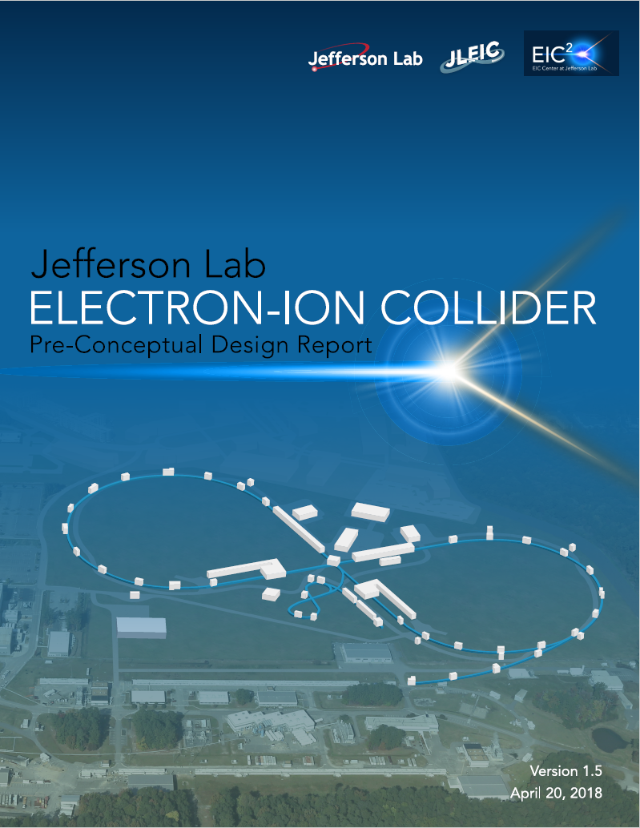
JLEIC Overview
Electron complex
  CEBAF as electron injector
  Electron collider ring: 3-12 GeV/c
Ion complex
  Ion source
  SRF linac: 150 MeV for protons
  Low Energy Booster: 8.9 GeV/c
  High Energy Booster: 13 GeV/c
  Ion collider ring: 200 GeV/c
Up to two detectors at
minimum background
locations
13 GeV/c
High energy
Booster
Interaction
point
200 GeV/c
Ion collider ring
150 MeV Ion linac
Low energy
8.9 GeV/c Booster
Interaction
point
3-12 GeV/c
Electron collider ring
100m
Electron source
12 GeV CEBAF
2012
2015
arXiv:1209.0757
arXiv:1504.07961
pCDR-65
October 2018
pCDR-100
Coming soon

Slide 3
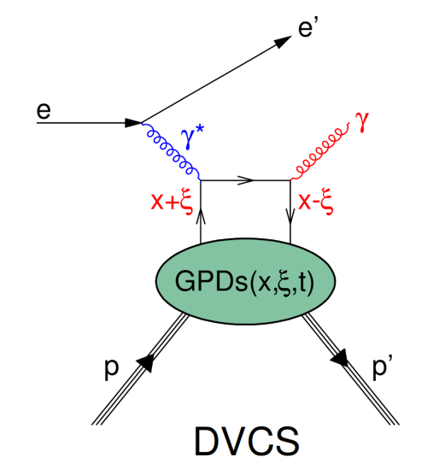
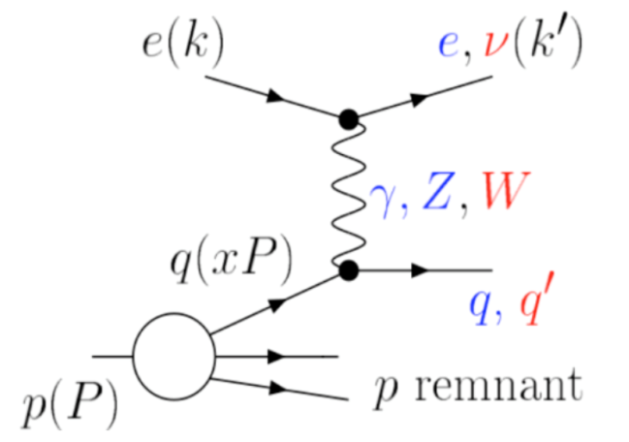
Positrons for JLEIC
Accelerator systems:
  Minor configuration changes needed for the collider rings and CEBAF, mainly changing the polarity of the DC power supplies or magnets.
  The main challenges are in the generation and accumulation of polarized positrons
Plenty of nuclear physics opportunities
  Deeply Virtual Compton Scattering (DVCS)
  Deep Inelastic Scattering (DIS)
DIS

Slide 4
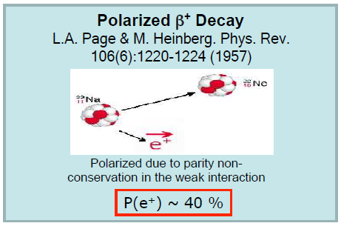
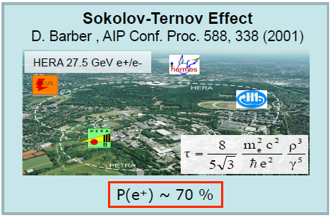
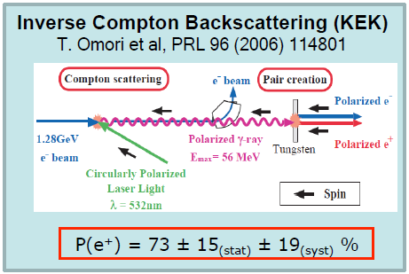
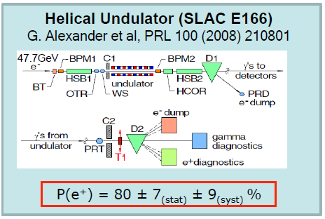
Generation of Polarized Positrons

Slide 5
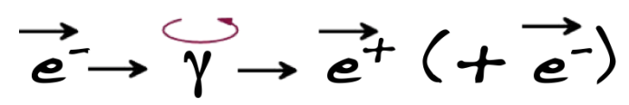
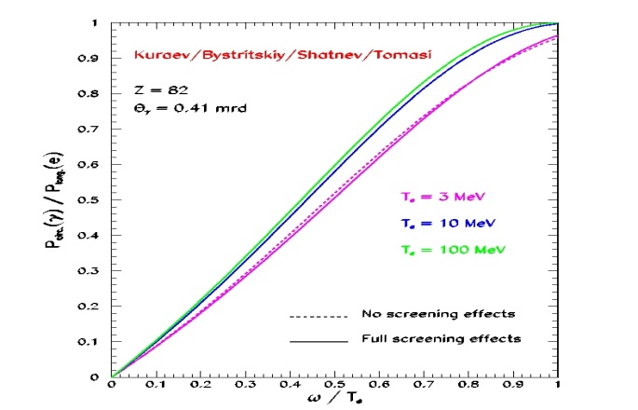
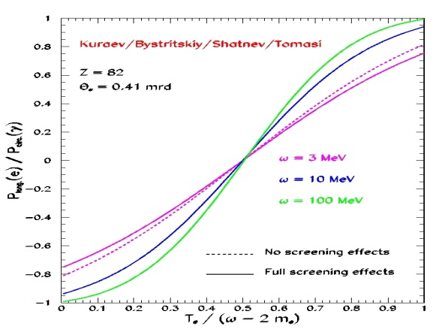
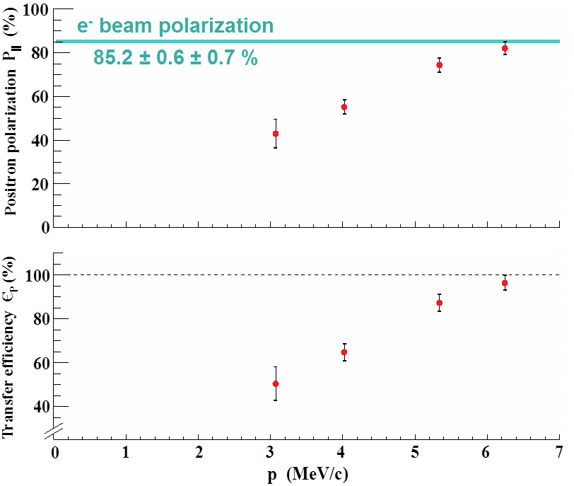
Generation of Polarized Positrons in CEBAF: PEPPo
Polarized Electrons for Polarized Positrons (PEPPo) Concept
Polarized Bremsstrahlung
Polarized Pair Creation
E.G. Bessonov, A.A. Mikhailichenko, EPAC (1996) A.P. Potylitsin, NIM A398 (1997) 395
P_{circ}(γ) / P_{z} (e⁻)
P_{z} (e⁺) / P_{circ} (γ)
E.A. Kuraev, Y.M. Bystritskiy, M. Shatnev, E.Tomasi-Gustafsson, PRC 81 (2010) 055208
PEPPo Experiment
E_{γ} / T_{e-}
T_{e+} / (E_{γ} – 2m_{e+})
S₁
P_{e-}
(PEPPo Collaboration) D. Abbott et al., Phys. Rev. Lett. 116 (2016) 214801
e⁻
D
T₁
S₂
P_{T}
P_{e+}
D
Calorimeter
e⁺
T₂

Slide 6
JELIC Electron Injection with CEBAF
Injected beam, first turn
Injected beam after several turns
circulating beam, kickers on
circulating beam, kickers off
septum
Example of transverse electron injection: Kickers turn on for a few μs to form an orbit bump, then wait at least 2×transverse damping time to reduce the orbit difference between the circulating beam and injected beam before the next kick.
JLEIC e-ring kicker pulse: 50-200ns rise/fall time, ~4µs flat top, 2-60Hz
CEBAF has a high CW e⁻ current (~90µA extracted), but the charge per bunch of up to 0.2pC for current operation is low for JLEIC injector purpose. Even if we upgrade CEBAF to 20-50pC (and reduced reprate to 17-68MHz), it still needs multiple injection cycles to accumulate higher charge per bunch (up to 8nC) in the ring.
During each cycle, kickers will be on for ~4μs to reduce the orbit difference between the freshly injected bunches and the circulating bunches in the electron storage ring, and then wait for about 2× transverse synchrotron radiation damping time (proportional to E⁻⁴ , 6-400ms for JLEIC) for the two bunches to merge. However, during that waiting time, we can also inject the other half ring one time. If the damping time is shorter than the kicker recovery time (assumed 60Hz), the waiting time will be the kicker recovery time.
Duty factor for CEBAF is really low under this operation, in the order of 10⁻³ or even 10⁻⁵

Slide 7
Challenge for PEPPo Based Positron Injection for JLEIC
The low e⁺/e⁻ yield (10⁻⁵ -10⁻³) of PEPPo, in addition to the low duty factor injection beam (10⁻⁵ -10⁻³ again) required by the e⁺/e⁻ storage rings, will pose a major challenge to the JLEIC positron bunch formation.
Although the electron-positron yield increases with energy, the positron yield per unit electron beam power will more or less flatten out at 50-100 MeV, if we change to limit Δp at 1 MeV (instead of limiting Δp/p). The charge per bunch for the electron beam needs to be extremely high.
A natural idea to address the challenge is to accumulate multiple smaller bunches into a larger one, with an accumulator ring at 50-100 MeV
J. Dumas, Doctorate Thesis (2011)
Yield of electron-positron conversion at 10-100MeV
Assuming Δp/p<10%, 75% electron polarization transfer

Slide 8
JLEIC Positron Production Scheme
Accumulator Ring (35.6m)
500-turn
phase-space painting
Positron Conversion/Collection Efficiency ~ 10⁻⁵ - 10⁻³
60%-75% e⁻ polarization transfer
Polarized Electron
P~90%
50 MeV Injector
Bunch
Management
Harmonic kicker
Extraction
to CEBAF
50 MeV polarized e⁻
4 pC @ 748.5 MHz
~60μs bunch train @2-60Hz
50 MeV polarized e⁻
2 nC bunches
@ 748.5 MHz
50MeV polarized e⁻
2nC @ 17 MHz,
~4μs bunch train @2-60Hz
~25 MeV Polarized e⁺
1 pC @ 17 MHz
1100m bunch train @2-60Hz
748.5 MHz e⁻ bunch train, 44500 bunches, 60μs
I_{pulse} up to 3mA
4 pC/bunch
………..
17 MHz e⁺ bunch train,
60 bunches, 4 us
I_{ave} up to 6 nA
1-2 pC
……
17-100ms, up to 60 Hz

Slide 9
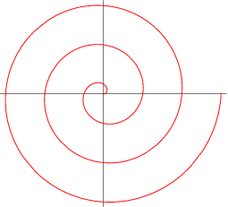
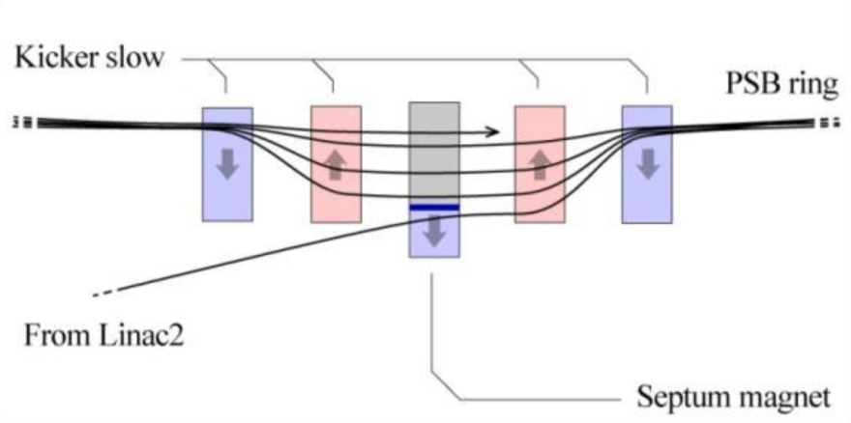
Accumulator Ring: Phase Painting Injection
x′
Concept: an orbit bump created near a septum and then slowly reduced as beam being injected (phase-space painting)
A number of painting schemes have been developed
Process can also be simultaneously occurring in vertical and
longitudinal dimensions
CERN’s LEIR has a design for 75-turn injection of Pb⁵⁴⁺,
We plan to push this number to ~500 in the accumulator using low electron emittance
Main injection system components
  Magnetic or electrostatic septum
  Four bumper magnets with ~60 μs fall time for 50MeV, reasonably fast rise time and ~10 mrad maximum deflection
> Septum thickness +
bunch width
Accumulator ring
x
Injected beam

Slide 10
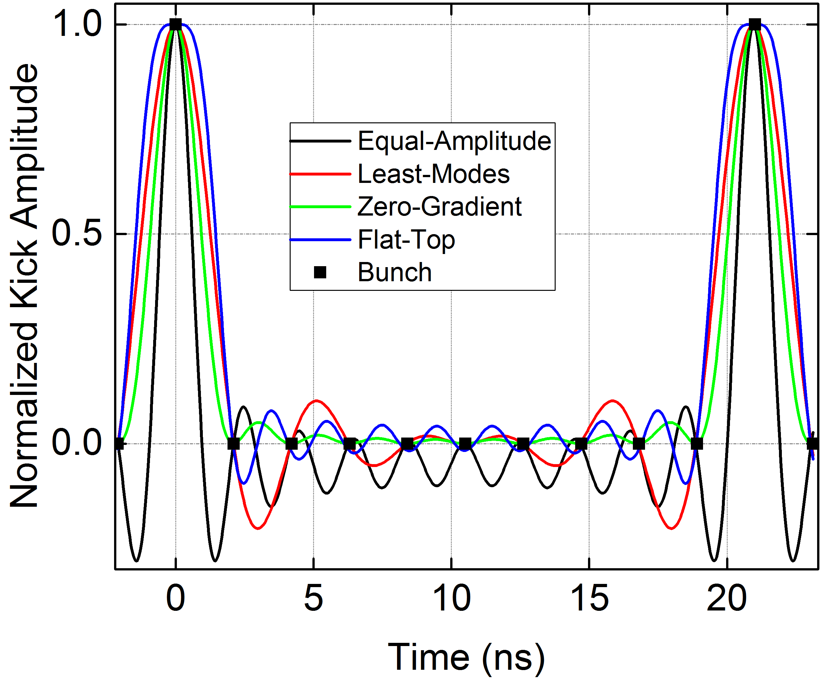
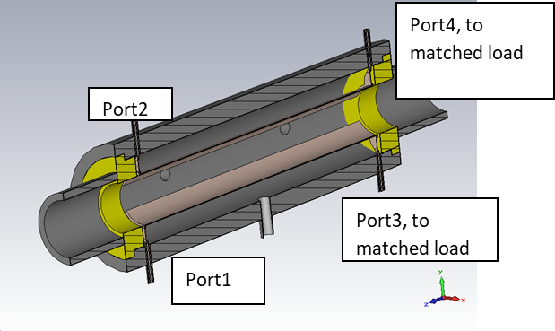
Accumulator ring: Harmonic RF Kicker Extraction
JLEIC injection requires 17MHz (or 34/68MHz) beam in bunch trains with ~1100m in length (63 bunches for 17MHz). However, we can build a ring containing 63 bunches with 748.5MHz spacing, so the bunch train length in the ring can be reduced to 24m. We can use a kicker to extract the beam at 17MHz (1/44 of 748.5MHz), kicking every 44th bunch out.
To leave N continuous gaps in the ring to accommodate the kicker burst rise time, the ring’s harmonic number needs to be picked at 44N+1. In our case, the ring harmonic number will be 89. The ring circumference will be 35.6m, with two gaps of ~6m (20ns) each, and two 12m bunch trains.
Harmonic stripline RF kickers will be the right technology choice to provide <1ns pulse rise time, <1ns pulse width and ~20ns burst rise time, with >60 pulses in one burst. Lot of harmonic kicker R&D effort already made for the JLEIC Circulating Cooler Ring (Y. Zhang’s talk)
A ring using a harmonic kicker to extract a bunch train 5× longer from a 11 bucket ring
n
Empty gap buckets to accommodate kicker burst rise time
2
11
9
n
Empty ring buckets already extracted to the transfer line
7
Ring buckets still occupied by bunches
4
5
n
Empty transfer line buckets
6
3
n
Transfer line buckets occupied by extracted bunches
8
1
3
2
1
10
Harmonic kicker that kicks every 5th bunch
Ideal kicker pulse
Different mode combination schemes
(kicks every 10th bucket)
Y. Huang PRAB19, 084201
Use RF stripline as harmonic kickers
J. Guo, COOL’15, TUPF10

Slide 11
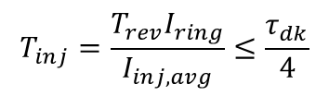
JLEIC Electron Ring Top-off for Polarization Retention
JLEIC e+/e- polarization has a limited lifetime proportional to E⁻⁵ due to Sokolov–Ternov effect.
Continuous top-off injection (and removing the same amount of recirculating particles) needed to keep the polarization
Equilibrium polarization is determined by
To retain ≥80% of the injected polarization, the initial injection time needs to be less than 1/4 of depolarization time
Assuming ~90% polarization from the e⁻ source, 60-75% e⁻ to e⁺ polarization transfer, and 80% polarization retention by top-off, we will get e⁺ polarization of 43-54%
$$T_{inj}=\frac{T_{rev}I_{ring}}{I_{inj, avg}}≤\frac{τ_{dk}}{4}$$

Slide 12

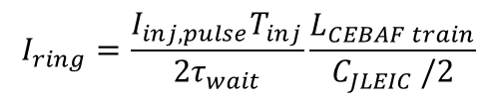


JLEIC Polarized Positron Injection Performance
$$I_{ring}=\frac{I_{inj, pulse}T_{inj}}{2τ_{wait}}\frac{L_{CEBAF train}}{C_{JLEIC }/2}$$
$$I_{inj, pulse}=\frac{I_{e−gun}N_{Accu}ε_{e+/e−}}{N_{extr}}$$
$$T_{inj}=MIN(30min, \frac{τ_{depol}}{4})$$
$$τ_{wait}=MAX(16.7ms, τ_{d,SR})$$
The beam current is limited by the long damping time at low energy end; at high energy, the limit is the kicker wait time, as well as a faster drop in polarization lifetime.
  JLEIC positron current peaks at 7GeV, as both the injection time and the kicker wait time are close to the limit.
With damping wigglers in the JLEIC e-ring, low energy performance can be improved. The chart above assumes that a 4 meter 4 Tesla sinusoidal wiggler is used at energies up to 8 GeV. Beam current is ~1/3 of the electron case for E>=7GeV, but much worse at 3-5 GeV.
Higher conversion e⁻ energy helps to increase e⁺ yield and suppress instabilities (such as space charge tune shift) in the accumulator ring, but also increases the peak power required in the e⁻ linac and the extraction kicker, as well as the ionizing radiation dosage around the target.

Slide 13
JLEIC e⁺p parameters
CM energy | GeV | 21.9 |  | 38.0 |  | 49.0 |  | 75.0 |  | 98.2
 |  | p | e⁺ | p | e⁺ | p | e⁺ | p | e⁺ | p |  | e⁺
Beam energy | GeV | 40 | 3 | 60 | 6 | 100 | 6 | 200 | 7 | 200 |  | 12
Collision frequency | MHz | 476 |  | 476 |  | 476/4=119 |  | 476/4=119 |  | 476/4=119
Particles per bunch | 10¹⁰ | 0.63 | 0.39 | 1.06 | 1.30 | 4.23 | 6.08 | 4.23 | 6.08 | 4.23 | 0.41
Beam current | A | 0.45 | 0.28 | 0.75 | 0.93 | 0.75 | 0.93 | 0.75 | 1.08 | 0.75 | 0.10
Polarization | % | 80 | >40 | 80 | >40 | 80 | >40 | 80 | >40 | 80 | >40
Bunch length, RMS | cm | 2.5 | 1 | 2 | 1 | 2 | 1 | 2 | 1 | 2 | 1
Norm. emitt., horiz./vert. | μm | 0.5/0.2 | 18/3.6 | 0.8/0.16 | 143/29 | 1.5/0.3 | 143/29 | 1.5/0.5 | 228/46 | 1.5/0.5 | 1147/382
Horizontal & vertical β* | cm | 8/1.3 | 10/5 | 8/1.3 | 8/1.2 | 8/1.3 | 8/1.3 | 19.6/1.6 | 8/0.8 | 19.6/1.6 | 4/0.8
Vert. beam-beam param. |  | 0.002 | 0.081 | 0.003 | 0.023 | 0.007 | 0.088 | 0.004 | 0.042 | 0.0002 | 0.024
Laslett tune-shift |  | 0.061 | small | 0.049 | small | 0.072 | small | 0.018 | small | 0.018 | small
Luminosity/IP, w/HG, 10³³ | cm⁻²s⁻¹ | 0.44 |  | 2.2 |  | 7.3 |  | 6.8 |  | 0.39

Slide 14
Summary
We preliminarily developed a positron bunch formation scheme for JLEIC, based on PEPPo.
The key element of the scheme is a 500 turn e⁻ accumulator ring, including its extraction kicker.
  With a small (35.6m) ring and an RF harmonic stripline kicker that converts the 748.5MHz beam into a 17MHz beam, we can increase the extracted pulsed e⁻ current by a factor of 11, and the extracted bunch train length matches the half of JLEIC e-ring bunch train length.
As a result, we can form a (40-50%) polarized positron beam current of 0.2-1A in the JLEIC e-ring, making it possible to achieve ~10³³ luminosity
The work presented was mainly completed with a small study group, including Joe Grames, Fanglei Lin, Vasiliy Morozov, and Yuhong Zhang.
We also thank all the JLEIC accelerator R&D colleagues for their support.

Slide 15
Thank you

