Slide 1

A Generic Software Adapted for EIC Simulation and Reconstruction
It’s exciting and fun for all
but you need a sled

Slide 2
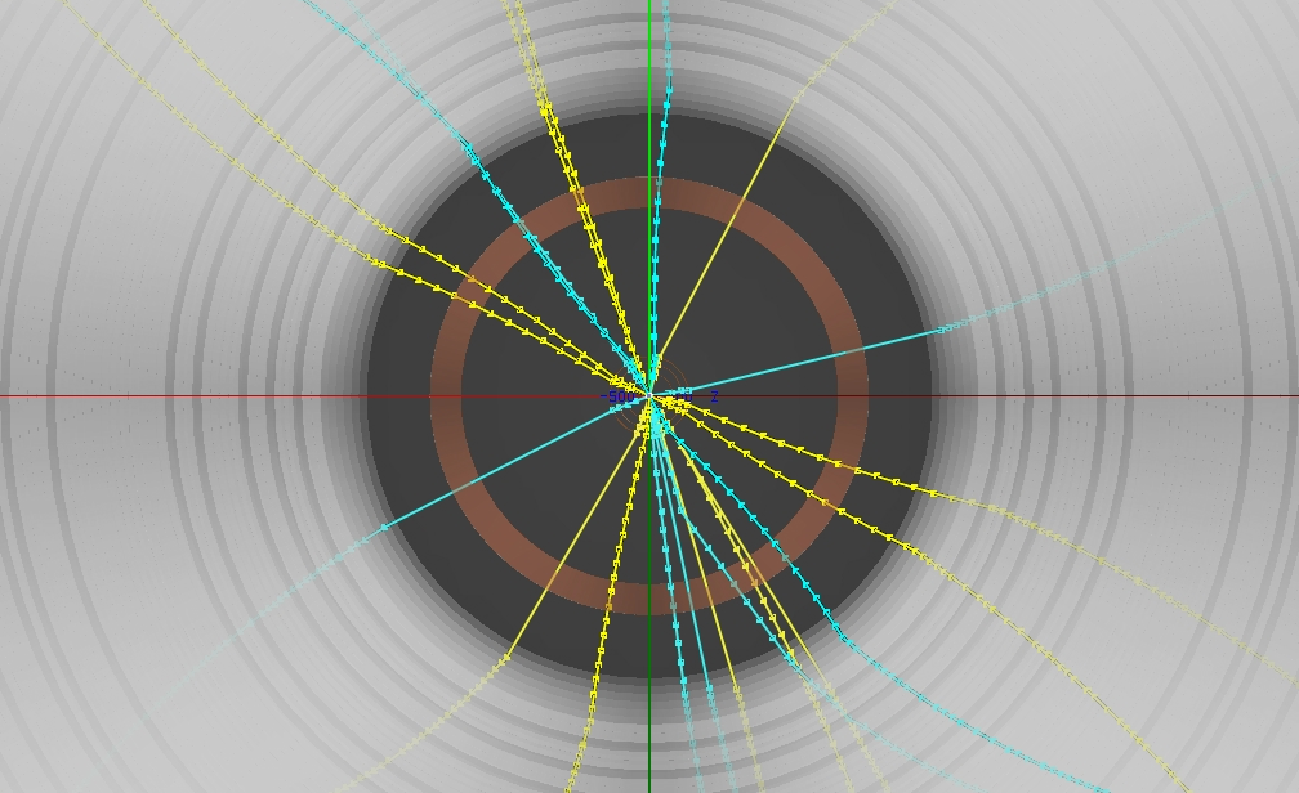
Brief History of Fun4All the sled
2003 Developed to process incoming PHENIX data continuing improved/development since.
  Development driven by analysis needs
  Workhorse for PHENIX, supports embedding, simulations and analysis
  Enabled Analysis Train which is now the common model for LHC data analysis
  PBs processing for analysis every month
2011 added GEANT4 as module for designing a new detector
Lesson learned from the past: Keep everything in the same framework!
2015 become a separate project for sPHENIX
  moved code to github: https://github.com/sPHENIX-Collaboration
  major cleanup of the code infra structure, CI (Jenkins) catches problems
Not only RHIC
Fun4All @ E1039 (Spinquest)
Fun4All is a very flexible battle tested framework which is used for large scale processing and analysis. Users like it for its simplicity and have bought into it.
Modularity is key, it is basically a collection of building blocks
Special emphasis on fast turnaround development and debugging

Slide 3
Structure of Fun4All the sled
You
Fun4AllServer
Input Managers
Node Tree(s)
Output Managers
DST
DST
Raw Data (PRDF)
Raw Data (PRDF)
Analysis Modules
HepMC/Oscar
HepMC
Event Generators
Calibrations
Histogram Manager
Empty
Root File
PostGres DB
File
That’s all there is to it, no backdoor communications – steered by ROOT macros

Slide 4
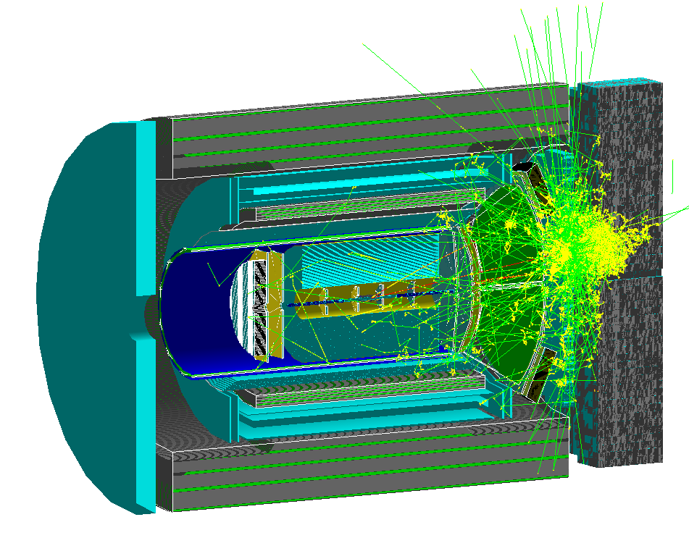
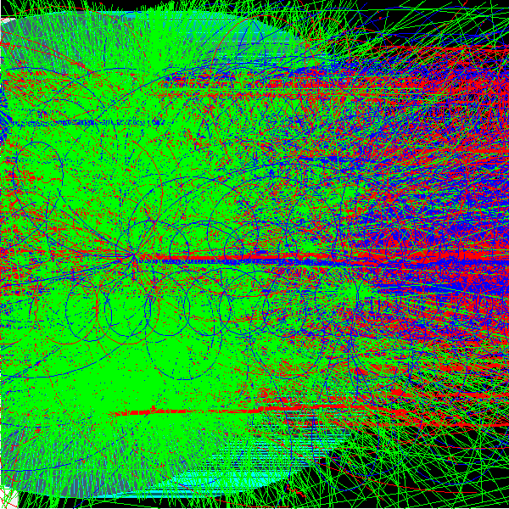
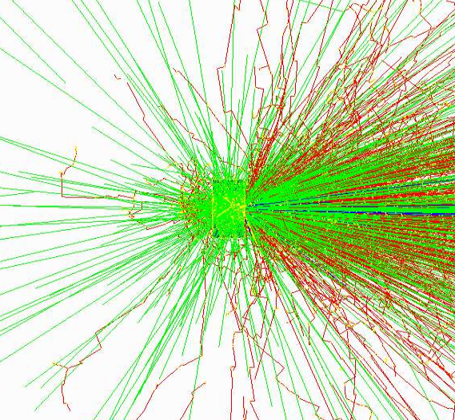
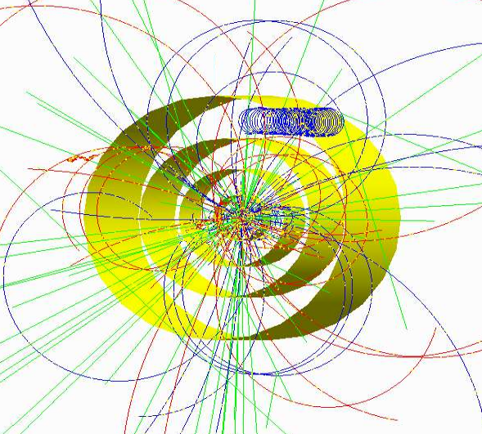
Currently implemented event generators
Via Eic-Smear interface
PYTHIA
DPMJet
PEPSI
gmc_trans
Djangoh
Milou
Rapgap
LEPTO
Very peripheral heavy ion collision from hijing
Sarte as seen by EIC detector
Via Fun4All
  Pythia6
  Pythia8
  Sartre
  Jetscape
  Generic HepMC 2/OSCAR
  Single Particle Generators
  Embedding in existing events
10 GeV Au on
water phantom
(NSRL)
Pythia8 in a 6 layer silicon detector mockup and 2T field
Full Truth information preserved: anything can be traced back to the input particle

Slide 5
G4 program flow within Fun4All
Modular: Each detector is its own entity providing the flexibility needed for complex setups
Fun4AllServer
Geant4
Event generator (input file, single particle, pythia8)
PHG4Reco
Initializes Geant4 before detectors are added
The processing is done by chaining up modules. At every step the state of the Node Tree can be saved and the analysis can pick up where it left
Node tree
Interface Detector 1
Construct() → Geometry
Stepping Action (Hit extraction)
Generic detectors like boxes, cylinders, cones exist and can be configured on a macro level
Interface Detector 2
Construct() → Geometry
Stepping Action (Hit extraction)
Digitisation
Raw Data
RCdaq
Common reco for raw and simulated data
Setup
Tracking,Clustering
calls
Jet Finding, Upsilons, Photons,…
dataflow
Output Files

Slide 6
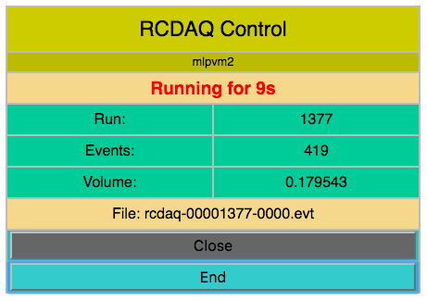
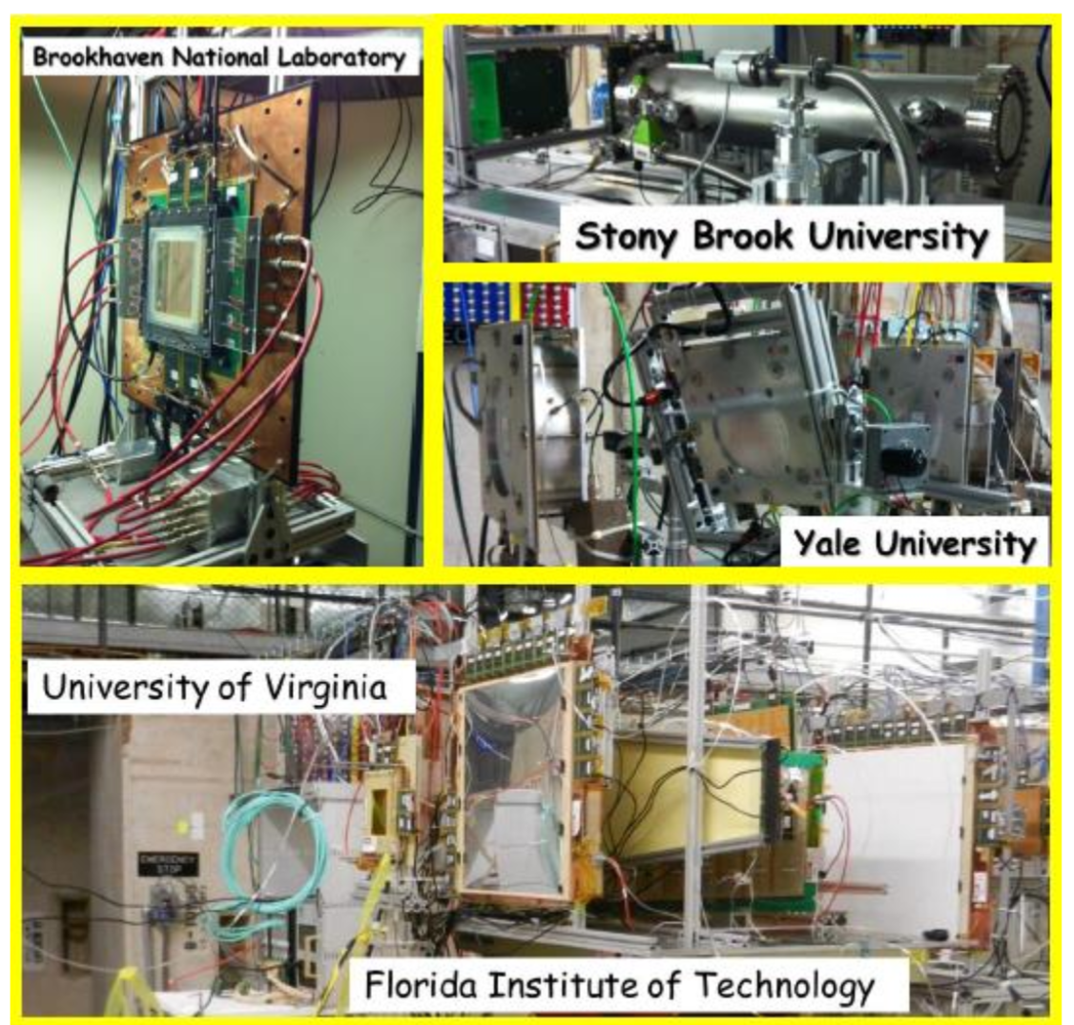
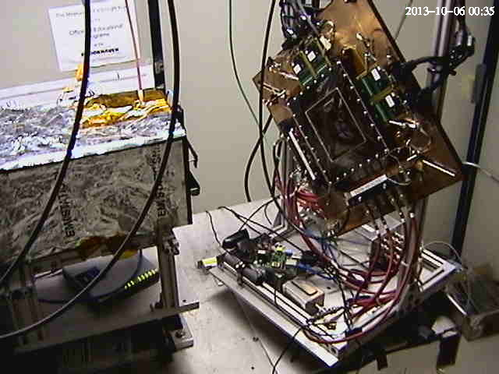
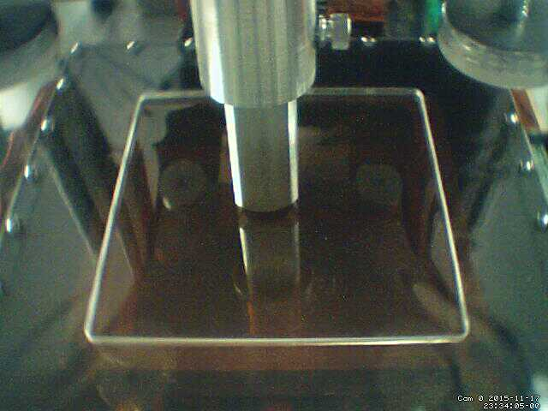
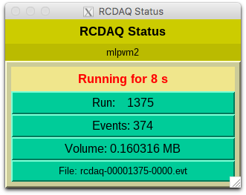

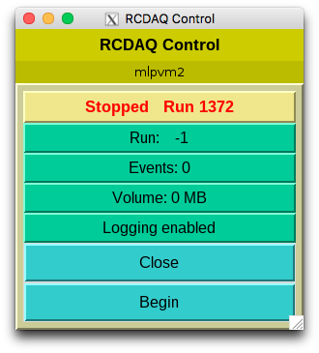
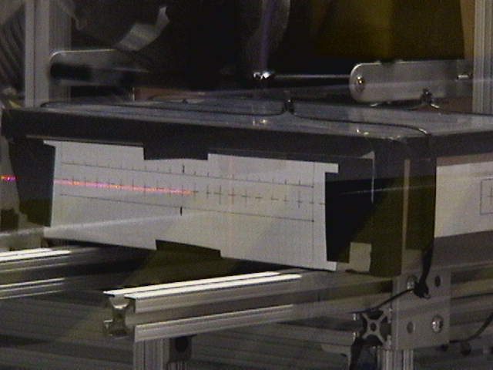
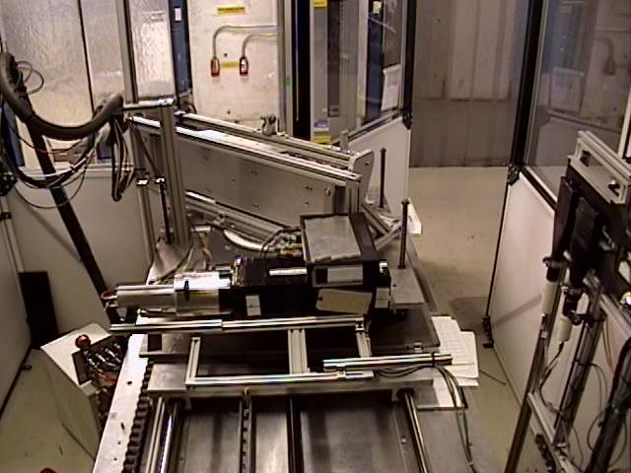
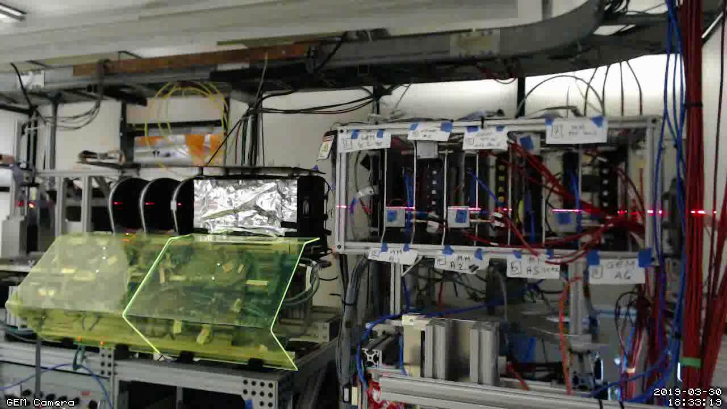
EIC-themed measurement campaigns
ZigZag Readout (2016)
Minidrift TPC (2013)
FLYSUB consortium (2014)
Dual-sided PWO readout (2017)
PWO prototype (2018)
MPGD-LDRD (2019)

Slide 7
Combining data reconstruction and simulations
Simulation chain and reconstruction has been verified with real data. Many standard analysis modules e.g. jet reconstruction readily available
Hadronic Calorimeter Test Beam
EmCal Test Beam

Slide 8
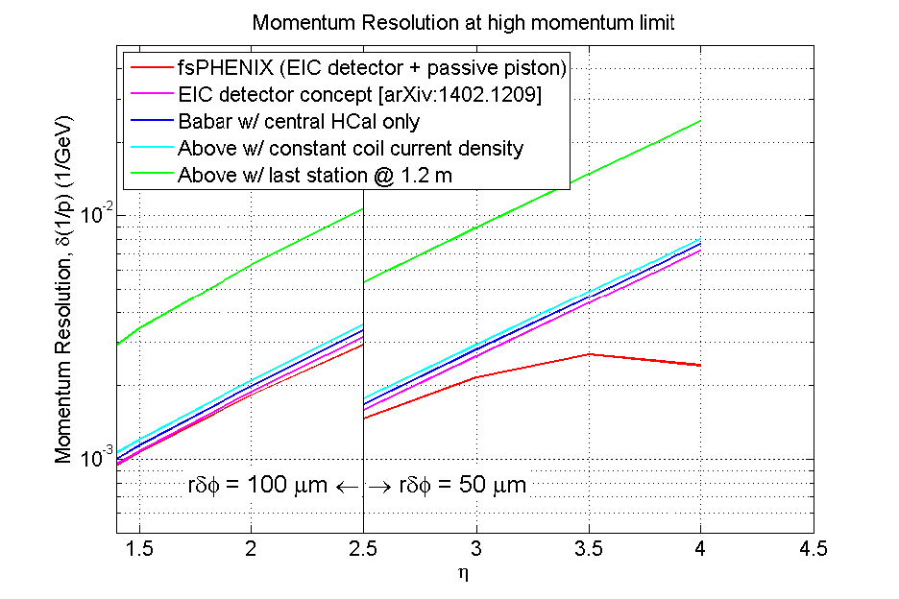
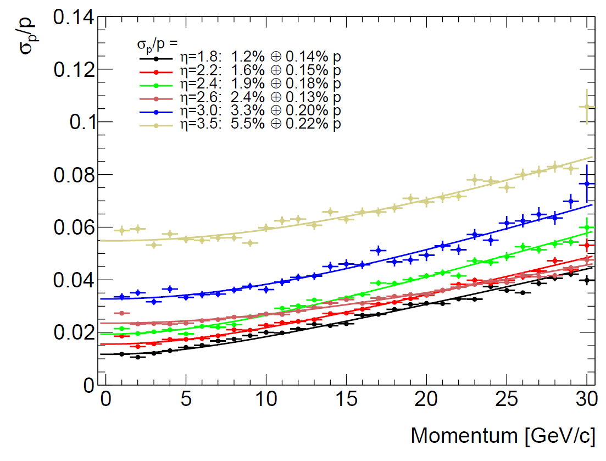
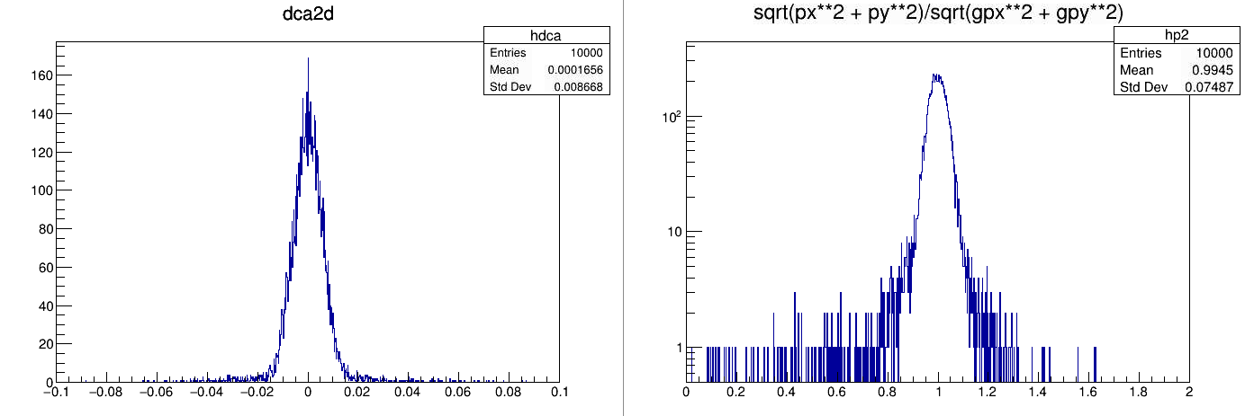
Fast Momentum Resolution Estimate during Design Stage
What are the first questions any tracking design has to answer?
  What is the momentum resolution?
  What is the distance of closest approach?
  Can you do better?
  Do you have any idea how much this costs??? How about fewer layers?
Welcome to our full GEANT4 simulation with Kalman Filter reconstruction and vertexing.
  Put a detector together from simple shapes in a ROOT macro (cylinders, boxes)
  Pick your particle and a couple of energies
  tell the tracking the error on the hits and run
  Wash, rinse, repeat until you(r boss) like(s) the result
Quick test of a 6 layer silicon pixel detector, 50um thick followed by 12 layers of 10μm silicon with 20μm granularity using 10 GeV/c electrons and a 1.5T field

Slide 9
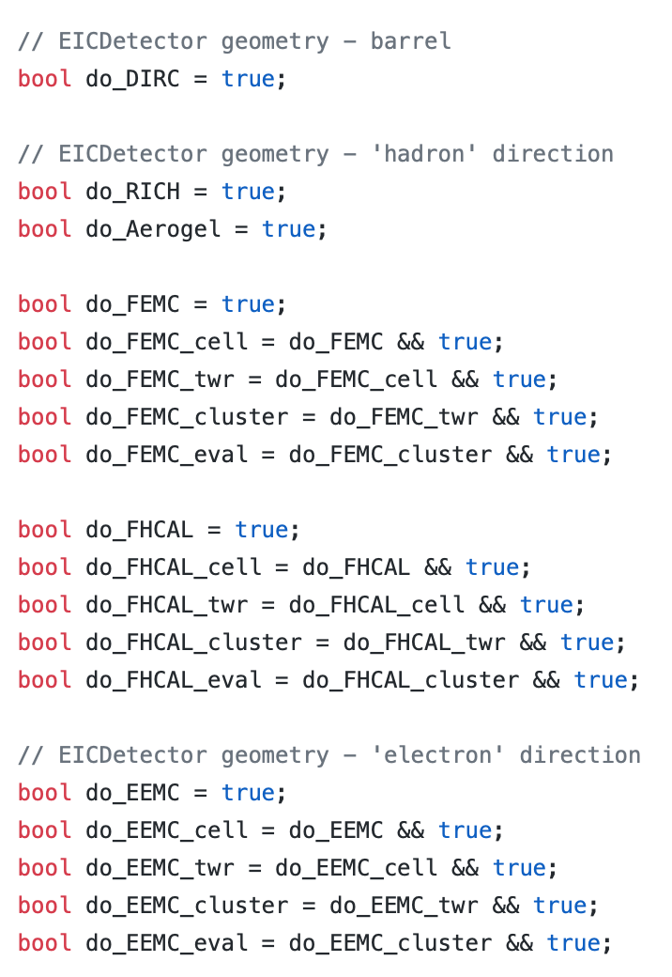
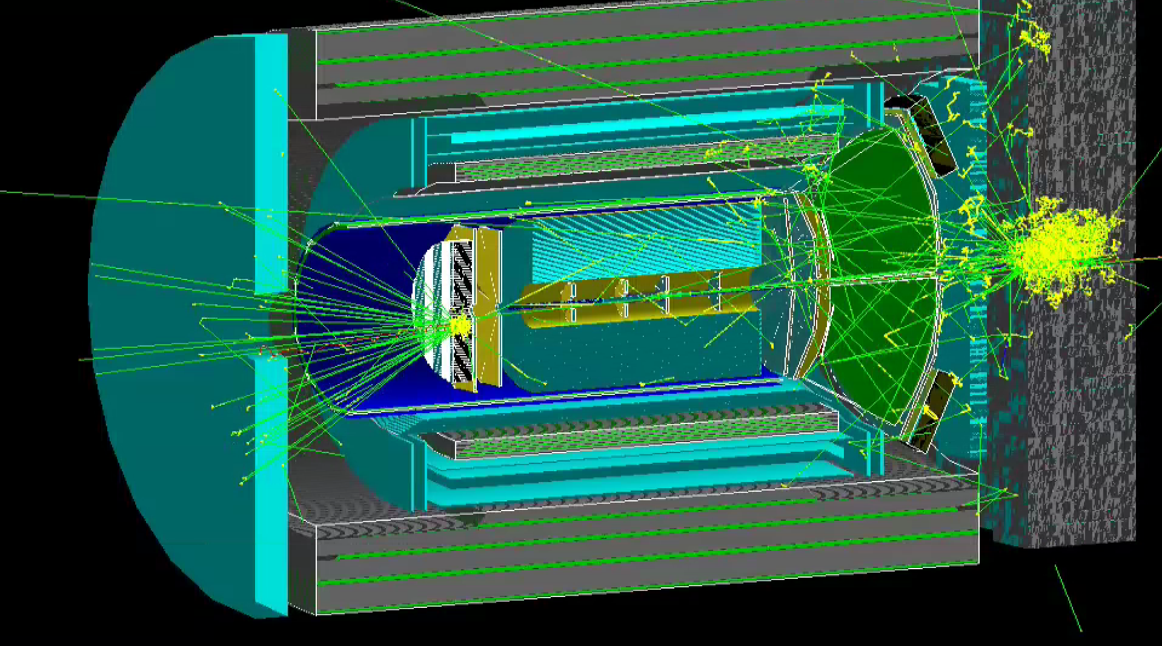
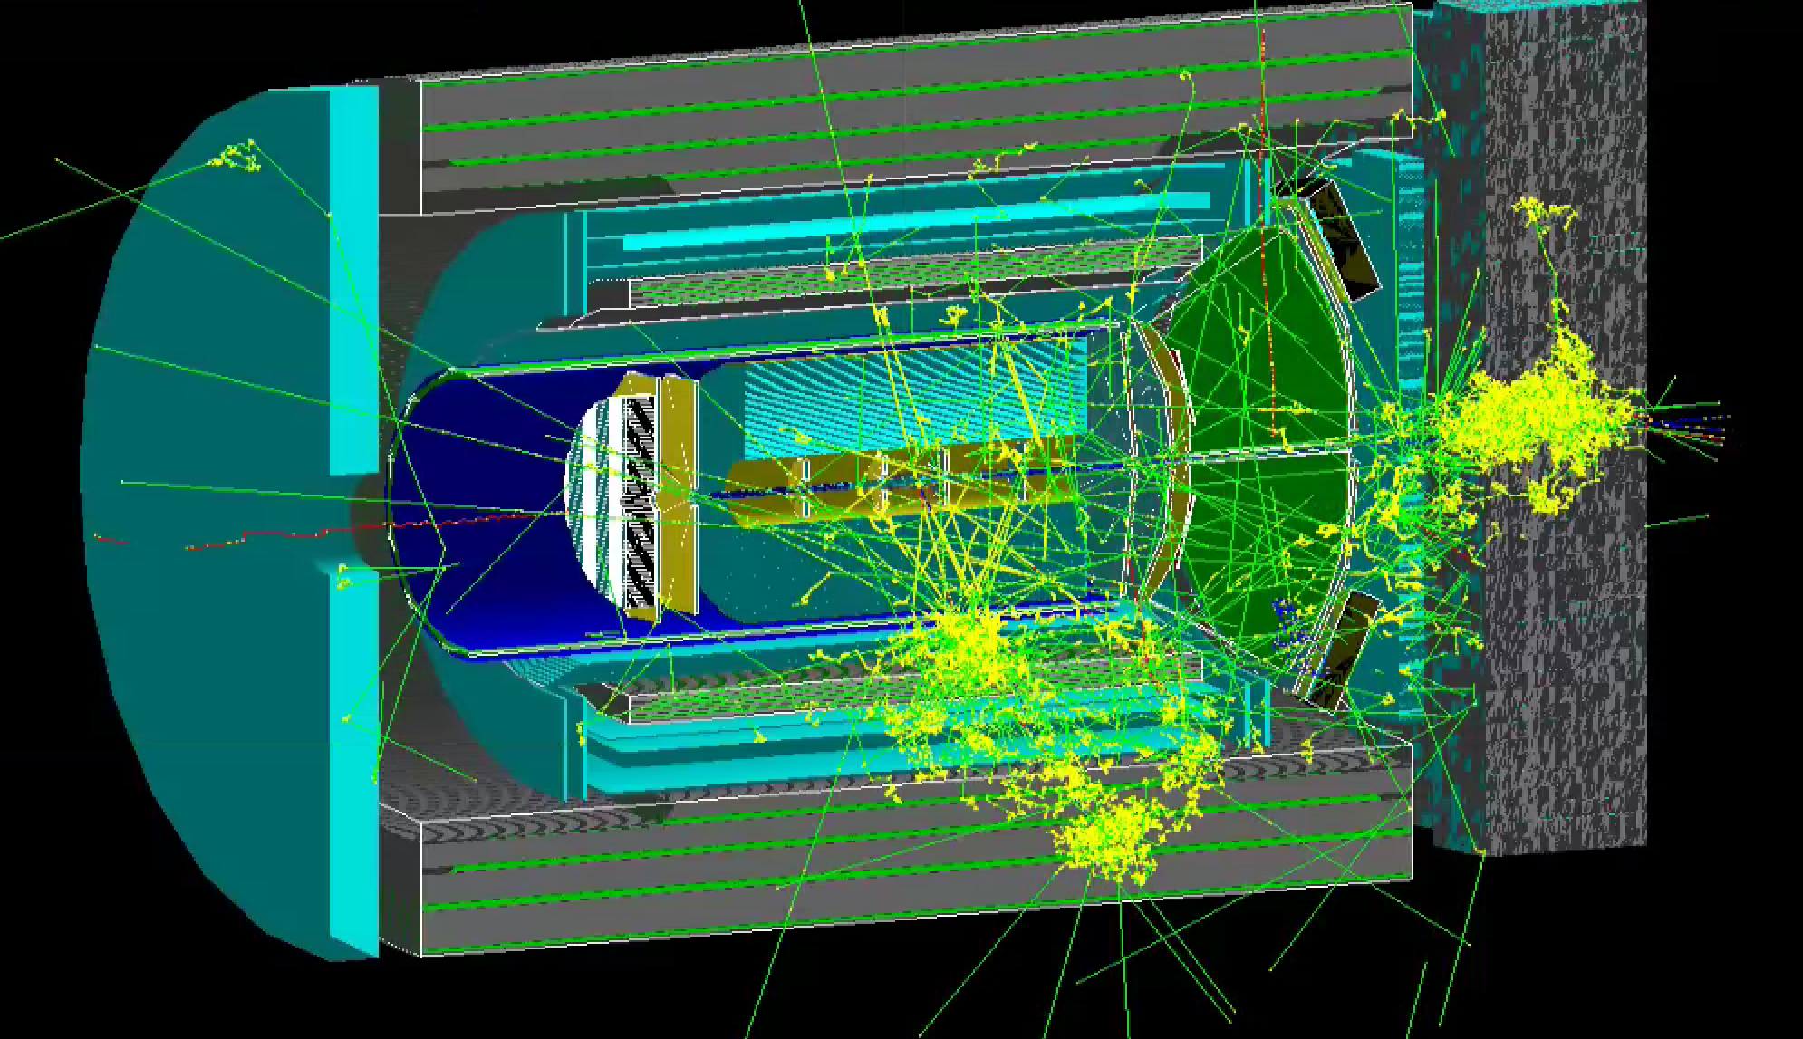
Fun4All Interface to EIC Detector GEANT Simulation
One possible EIC Detector fully implemented
Subdetectors are easy to switch on and off for detector studies
Event Generators available via on/off switches
Optional overlap check can be run for debugging new additions
Full reconstruction implemented for calorimeters and tracking
Jet reconstruction also available via on/off switch
e18xp275 Pythia6 event with Fun4All_G4_EICDetector.C
Sample of Fun4All ROOT macro used to configure and run the EIC Detector GEANT simulation
Neutral Current DIS
Charged Current DIS
Courtesy of Kara Mattioli, Dillon Fitzgerald, Cynthia Nunez, Desmond Shangase, Enrique Gamez, Michigan

Slide 10
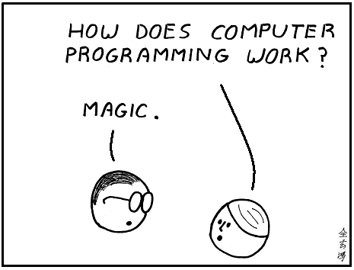
Implement your own modules
Needs basic knowledge of
ROOT (histograms, plots, macros)
C++ (Basic knowledge like “what is a class?”)
Implement your analysis class:
  Init → Initialization
  InitRun → Initialization for a given Run (read calibrations)
  process_event → Do this for every event
  ResetEvent → Reset your internals to clear out the current event
  EndRun → Last call for this Run
  End → We are done, let’s do this and go home
We do not want to teach our students this.
Computing proficiency is a valuable skill
We keep examples of how to do things up to date,
we also have a large user base who works on analysis which keeps us on our toes
And we have many existing modules you can just reuse

Slide 11
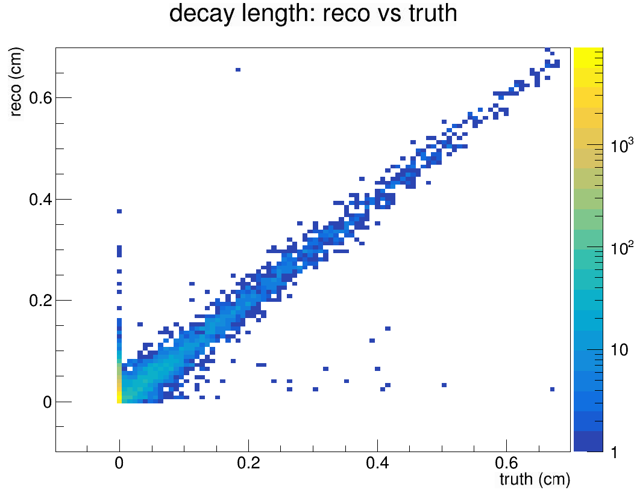
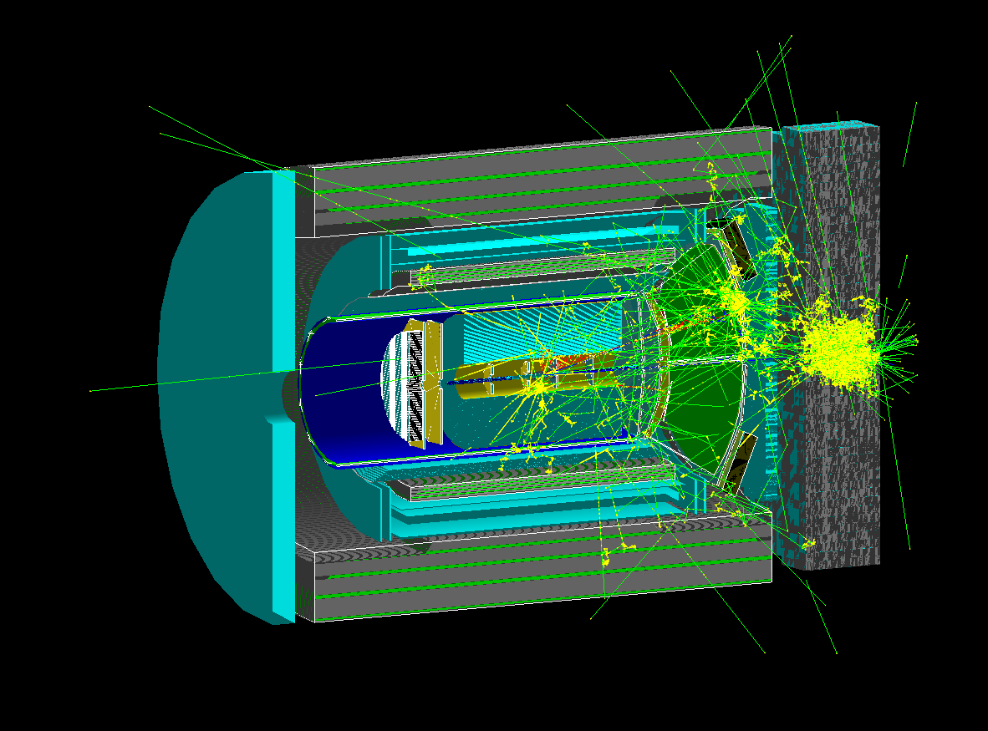
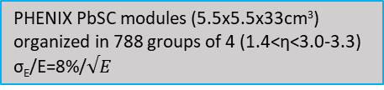
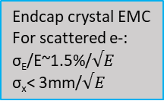
Leptoquark Study for an EIC Detector Based on Babar Magnet
Full detector simulation, tracking, vertex and secondary vertex finding using Fun4All infrastructure
LQGENEP for signal
DJANGOH/PYTHIA for SM bkgd
Outer HCAL
GEM/sTGC Tracking Stations(z=120,165, 50-100μm in φ, 1cm in r)
EMCAL
Central DIRC for PID
Inner HCAL
Pb/Sc sandwich hadronic calorimeter (NEW) 10x10x100cm³ towers (1.2<η<4.0)
Reconstructed tau decay vertex
Forward RICH for hadron PID
20x20 array of 2.2x2.2x18cm³ PbWO₄ crystals (PHENIX MPC) with 10x10cm square hole (300 crystals total) 3.0-3.3<η<4.0
Truth tau decay vertex
Courtesy of Jinlong Zhang, Stonybrook
Endcap crystal EMC
For scattered e-:
σ_{E}/E~1.5%/$√E$
σ_{x}< 3mm/$√E$
PHENIX PbSC modules (5.5x5.5x33cm³) organized in 788 groups of 4 (1.4<η<3.0-3.3) σ_{E}/E=8%/$√E$
See Parallel talk https://indico.in2p3.fr/event/18281/contributions/71617/

Slide 12
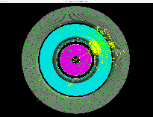
Software Distribution via Singularity and CVMFS
Singularity is easy to install on many platforms
  Allows users to run it outside of the RHIC computing facility, no credentials required for download
  Allows us to have to support only one environment, libraries are installed in a public cvmfs repository
  Is supported on the OSG and HPC
The Aidala group has successfully demonstrated the ease of installation and use
  Setup on group workstations in about an hour (installation/mounting of cvmfs) – All students in the group have access to it, 2-3 students use it regularly
  Setup on personal computers for OSX, Windows and Linux (Ubuntu 16.04 LTS) systems
Installation instructions under
Including running large scale simulation production at LLNL
https://github.com/sPHENIX-Collaboration/Singularity
Featuring
also
Tutorials:
https://github.com/sPHENIX-Collaboration/tutorials
Join slack channel for support:
https://join.slack.com/t/eic-design-study/signup
Ross Corliss, MIT
Ron Soltz, LLNL

Slide 13
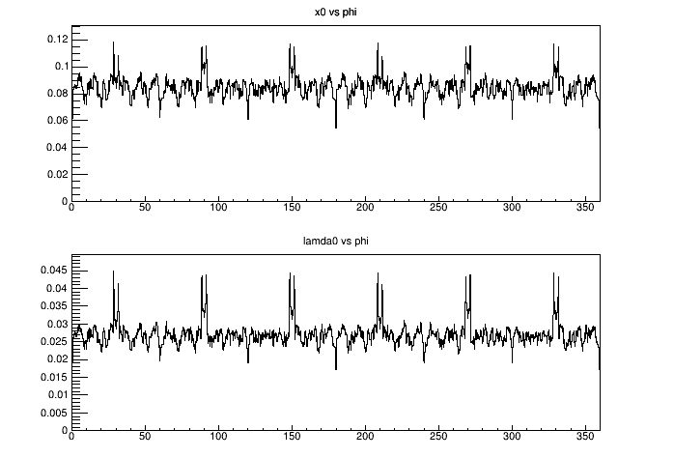
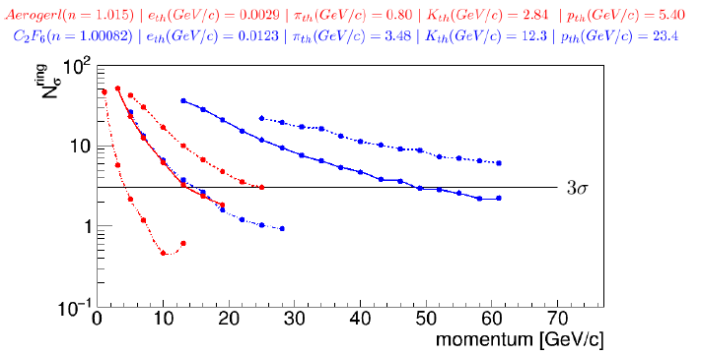
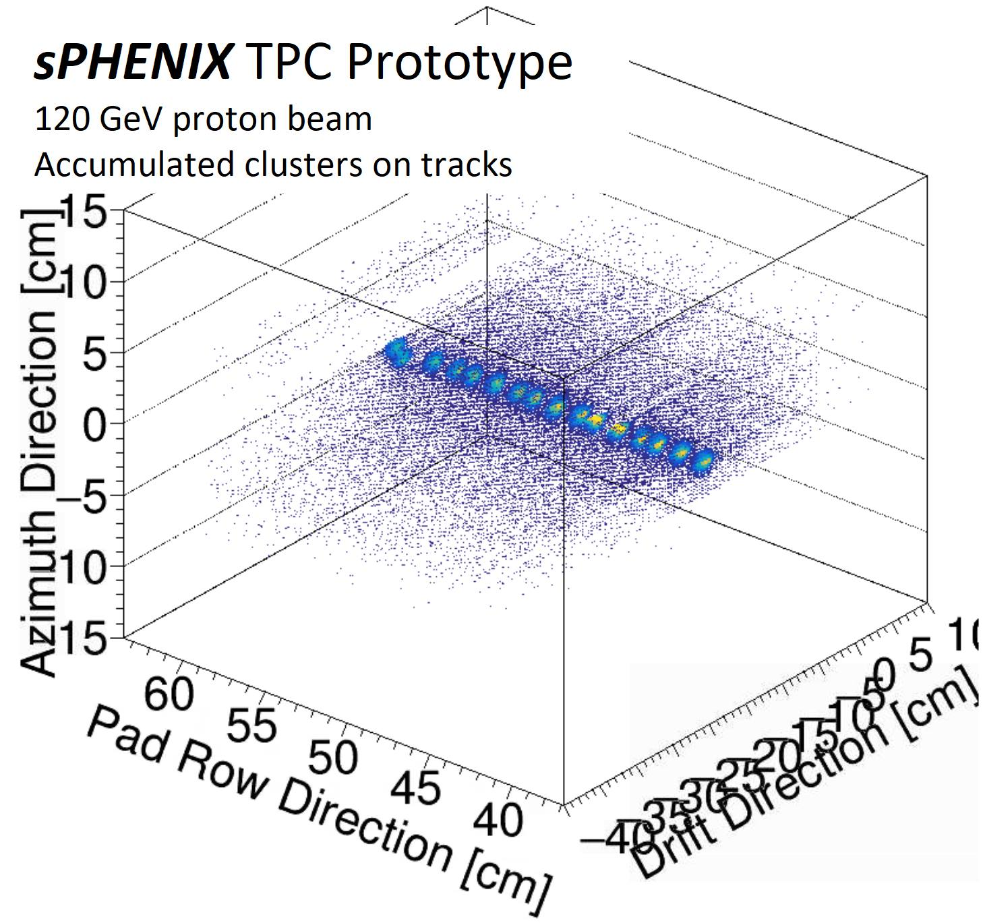
Rich PID
Forward Quarkonia
Forward Momentum Resolution
Material budget of sPHENIX inner tracker
Central Barrel Jet Energy Resolution
Fun4All Framework is ready for use NOW
Modularity allows easy re-use of existing components
Chain from event generator/raw data to final user output
Snapshots of chain can be saved, chain can pick up from there
Runs in Singularity Container and uses cvmfs for libraries
  Use on a farm or on a laptop
  Running on the OSG and HPC will be possible
30+ detectors implemented so far
No geometry model enforced
  low bar to add existing GEANT4 based projects
Large and active user base already
  support via slack channel
Tracking Efficiency
Forward Jet Energy Resolution
Physcis List Calorimeter Test
TPC with streaming readout

Slide 14
You have gone too far
Backup Zone

Slide 15
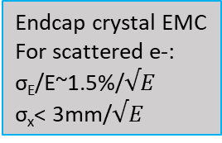
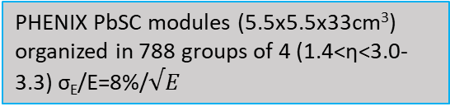
Outer HCAL
GEM/sTGC Tracking Stations(z=120,165, 50-100μm in φ, 1cm in r)
EMCAL
Central DIRC for PID
Inner HCAL
Pb/Sc sandwich hadronic calorimeter (NEW) 10x10x100cm³ towers (1.2<η<4.0)
Forward RICH for hadron PID
20x20 array of 2.2x2.2x18cm³ PbWO₄ crystals (PHENIX MPC) with 10x10cm square hole (300 crystals total) 3.0-3.3<η<4.0
Endcap crystal EMC
For scattered e-:
σ_{E}/E~1.5%/$√E$
σ_{x}< 3mm/$√E$
PHENIX PbSC modules (5.5x5.5x33cm³) organized in 788 groups of 4 (1.4<η<3.0-3.3) σ_{E}/E=8%/$√E$

Slide 16
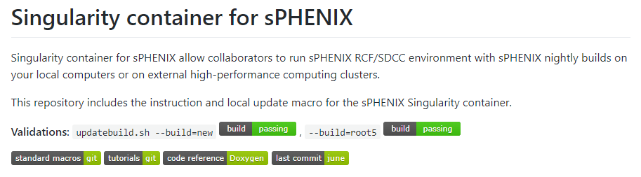
Distribution of sPHENIX-EIC simulation
Now the sPHENIX software + tool set available via singularity container
Distributed via CVMFS to computing centers
And available for download to use on laptop
Daily updates and validations
https://github.com/sPHENIX-Collaboration/Singularity

Slide 17
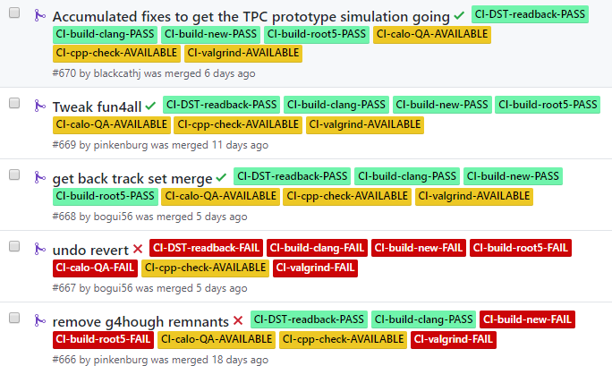
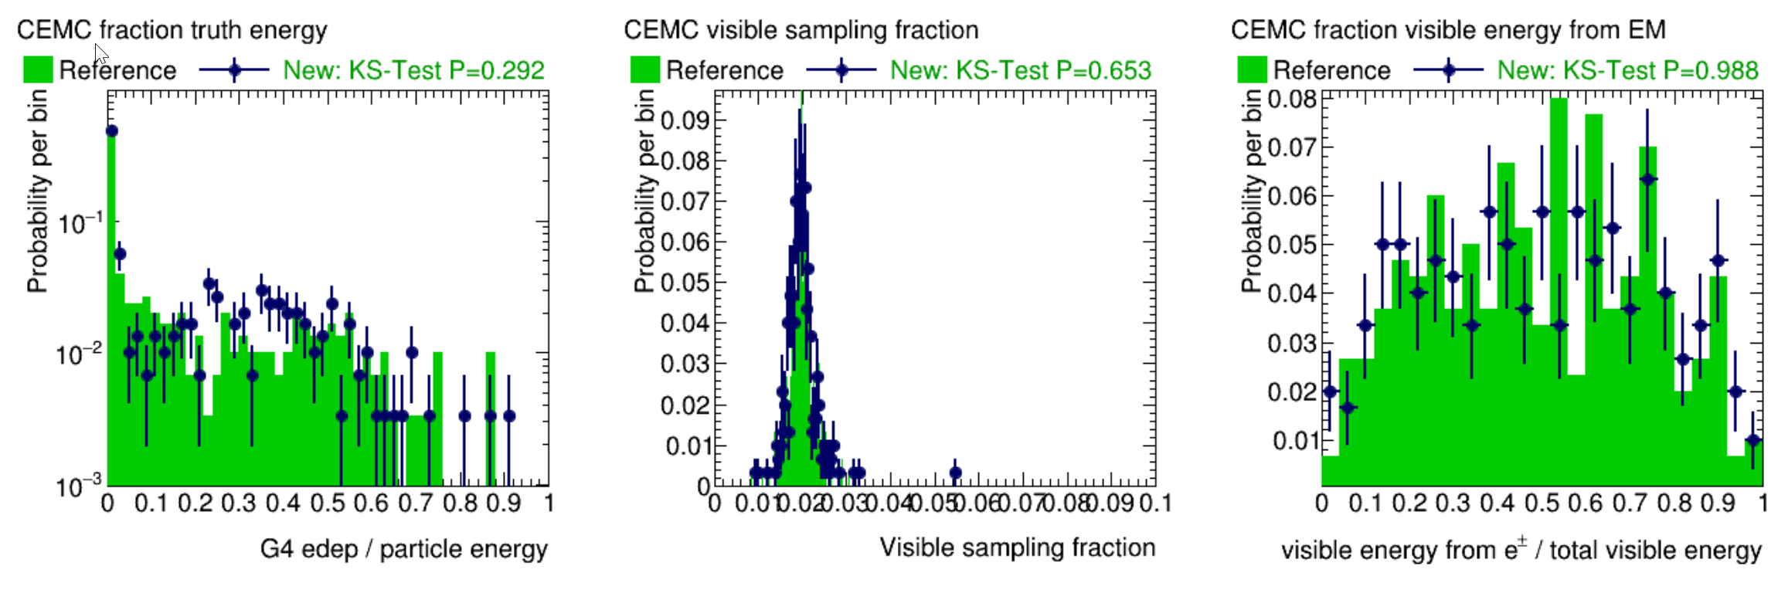
Daily QA Check
https://github.com/sPHENIX-Collaboration/coresoftware/pulls?q=is%3Apr+is%3Aclosed
sPHENIX Continuous Integration automatically check every Pull Request and daily builds
It will be useful to have such validation for PID detectors too
  e.g. calorimeter is check from G4-basics to jet reconstruction

Slide 18
OSG Running
Singularity is supported on the Open Science Grid and our cvmfs repository will soon be visible in OASIS
Running a condor job on the OSG will look like:
  Requirements = HAS_SINGULARITY == TRUE
  +SingularityImage = "/cvmfs/sphenix.sdcc.bnl.gov/singularity/rhic_sl7_ext.simg
This opens the OSG as a computing resource for users with no access to a farm
singularity
https://github.com/sPHENIX-Collaboration/Singularity

Slide 19
Keep it simple – Analysis Module Baseclass
You need to inherit from the SubsysReco Baseclass (offline/framework/fun4all/SubsysReco.h) which gives the methods which are called by Fun4All. If you don’t implement all of them it’s perfectly fine (the beauty of base classes)
Init(PHCompositeNode *topNode): called once when you register the module with the Fun4AllServer
InitRun(PHCompositeNode *topNode): called before the first event is analyzed and whenever data from a new run is encountered
process_event (PHCompositeNode *topNode): called for every event
ResetEvent(PHCompositeNode *topNode): called after each event is processed so you can clean up leftovers of this event in your code
EndRun(const int runnumber): called before the InitRun is called (caveat the Node tree already contains the data from the first event of the new run)
End(PHCompositeNode *topNode): Last call before we quit
If you create another node tree you can tell Fun4All to call your module
with the respective topNode when you register your modue

Slide 20
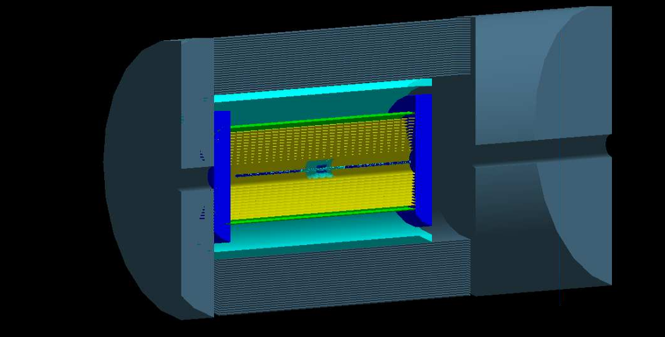
JLeic
Started a week ago based on g4e https://gitlab.com/jlab-eic/g4e/
10 GeV electron
In central tracking

