Slide 1


EIC Accelerator Overview
Ferdinand Willeke, BNL
EICUG Annual Meeting, Paris 2019

Slide 2
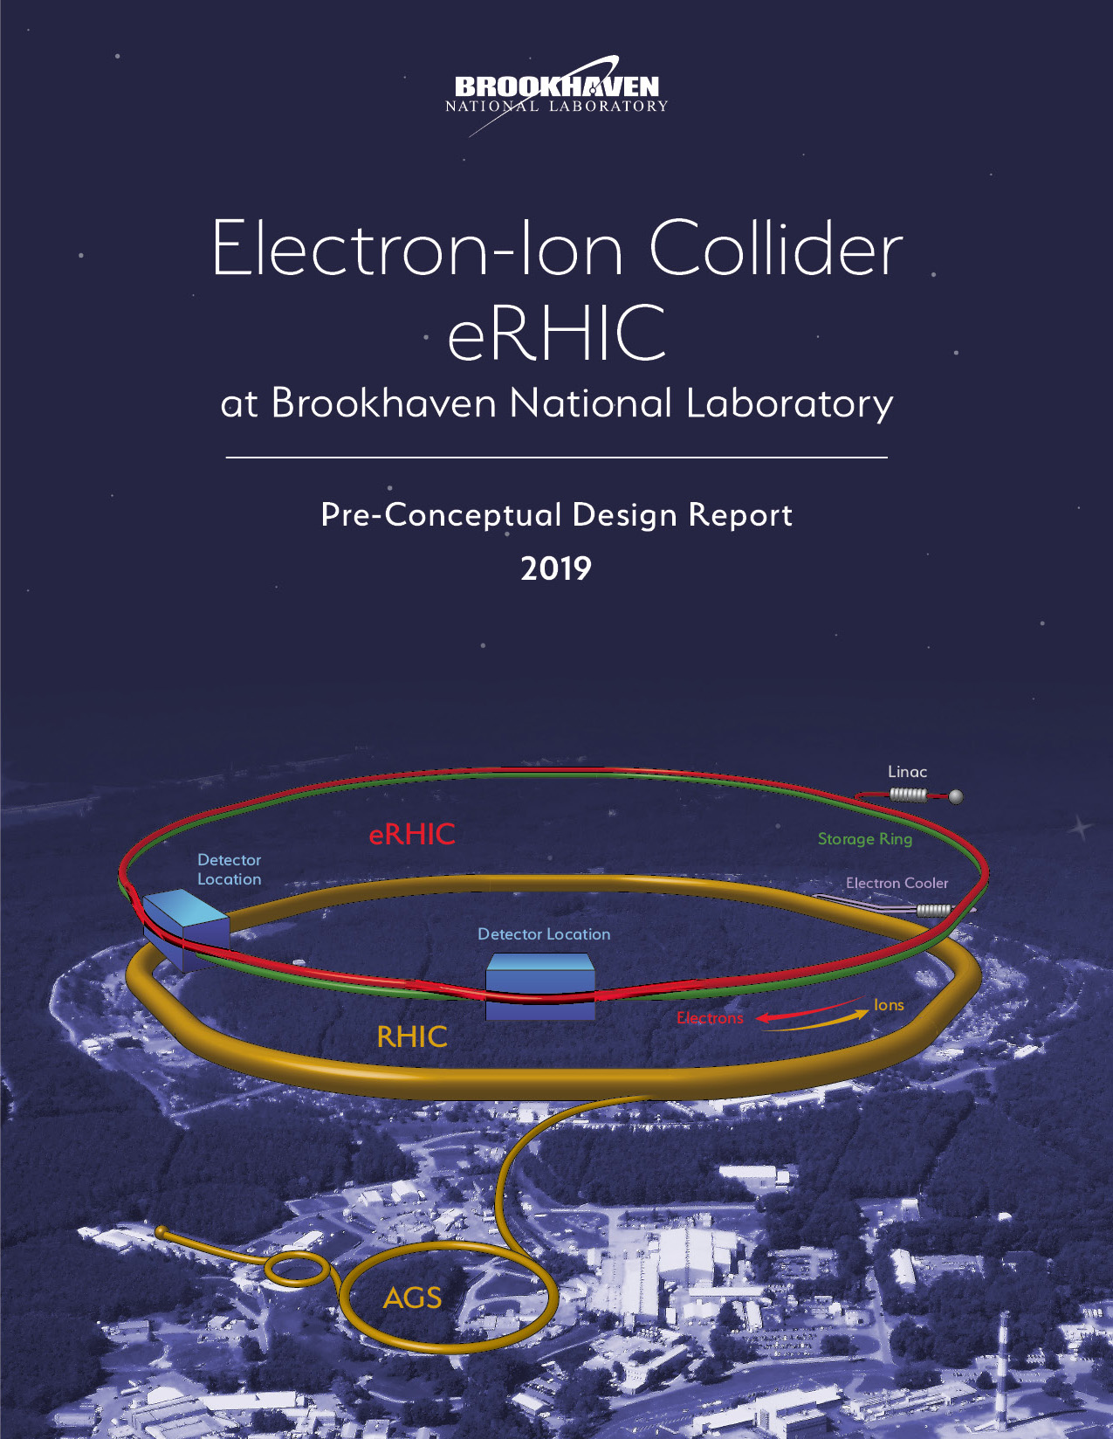
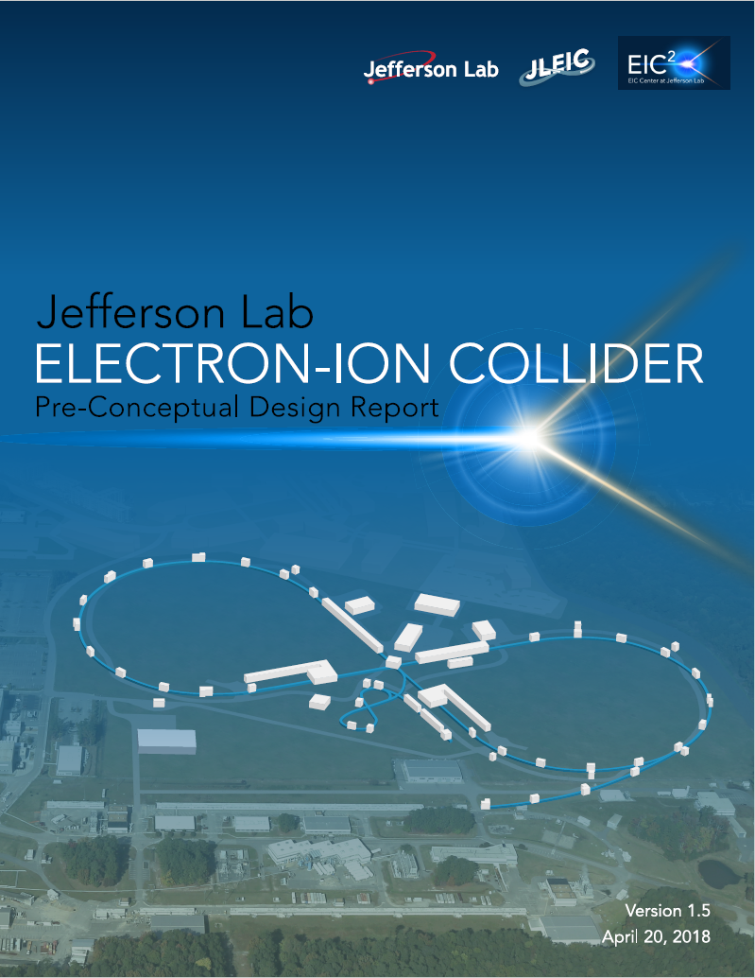
Outline
Requirements
Design concepts
Luminosity
Polarization
Hadron Cooling
Beam Dynamics Consideration
R&D
Summary

Slide 3
Electron Ion Collider (EIC) Physics Questions
Nuclear Physics Community compiled an EIC WHITE PAPER^{*)} (2014/5):
How are quarks, gluons & their spins distributed in space & momentum in nucleus?
How do nucleon properties emerge from quarks and gluons and their interactions?
How do color-charged quarks, gluons & colorless jets, interact with a nuclear medium
How do confined hadronic states emerge from quarks & gluons
How do the quark-gluon interactions create nuclear binding?
How does dense nuclear environment affect the quarks-gluons correlations & interactions?
Does gluon density in nuclei saturate @ high energy
result in gluonic matter with universal properties?
*) A. Accardi et al, Eur. Phys. J. A529:268 (2016)

Slide 4
Requirements on EIC Performance
The EIC is designed to meet the requirements set forth in NSAC Long Range Plan, which was emphasized by the NAS report:
Highly polarized (~70%) electron and nucleon beams
Ion beams from deuterons to the heaviest nuclei (uranium or lead)
Variable center of mass energies from ~20 - ~100 GeV, upgradable to ~140 GeV
High collision luminosity ~10³³ – 10³⁴ cm⁻²s⁻¹
Possibilities of having more than one interaction region

Slide 5
There are two proposals:
JLEIC to be constructed at Jefferson Lab
eRHIC to be constructed at Brookhaven National Lab
Both design benefit from existing Nuclear Physics infrastructure and are based on the same accelerator principles:
Electron Storage Rings with frequent injection of fresh polarized beams
Hadron storage rings with strong cooling or alternatively frequent injections

Slide 6
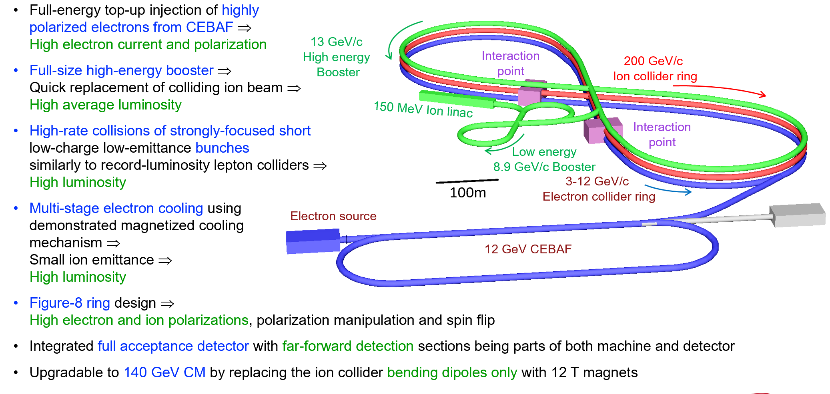
JLEIC Layout
Courtesy: V Morozov, A Seryi

Slide 7

eRHIC
Hadrons up to 275 GeV
eRHIC is using the existing RHIC complex:
Storage ring (Yellow Ring), injectors, ion
sources, infrastructure,
Need only few modifications for eRHIC
Todays RHIC beam parameters are close
to what is required for eRHIC
Electrons up to 18 GeV
Electron storage ring with up to 18GeV ➔ E_{cm} = 20 GeV -141 GeV installed in RHIC tunnel. Beam current are limited by the choice of installed RF power 10 MW.
Electron beams with a variable spin pattern accelerated in the on-energy, spin transparent injector: Rapid Cycling Synchrotron with 1-2 Hz cycle frequency in the RHIC tunnel
Polarized electron source and 400 MeV s-band injector linac in existing tunnel
Design meets the high luminosity goal of L = 10³⁴cm⁻²s⁻¹

Slide 8
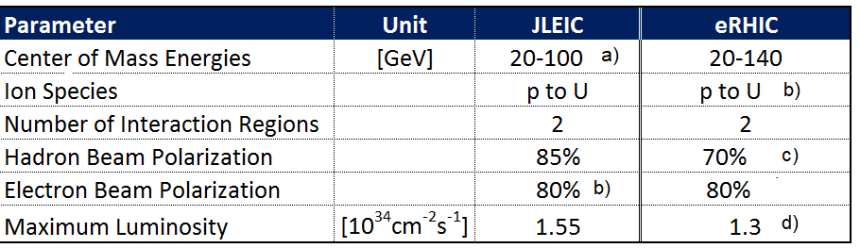
Key EIC Machine Parameters
as required by the NSAC LRP & NAS
80%
b) c)
f)
80%-85%
a) upgradable to 140 GeV

Slide 9
High Luminosity Implementation
As both designs, JLEIC and eRHIC are storage ring designs, the same ingredients are required for large luminosity
Large bunch charge
Many bunches ➔ large total beam currents
➔ crossing angle collision geometry
Small beam size at collision point achieved by
* small emittance
➔ Small hadron emittance requires strong hadron cooling
(or frequent injection)
* and strong focusing at IR (small β)
➔ required short bunches ➔ need strong cooling
Beam-Beam Limit: Transverse beam density at collision point limited by the detrimental effect of the corresponding nonlinear lens

Slide 10
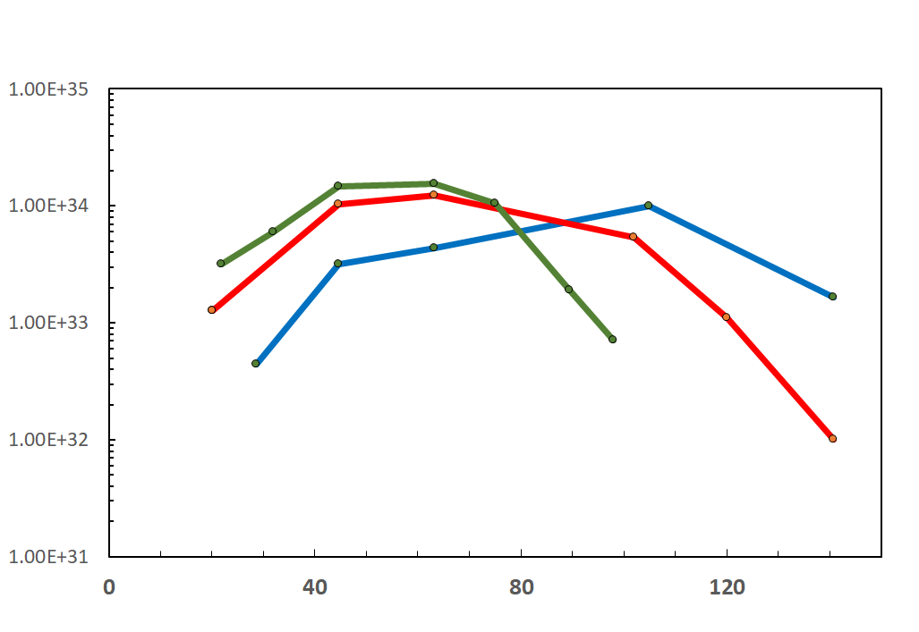
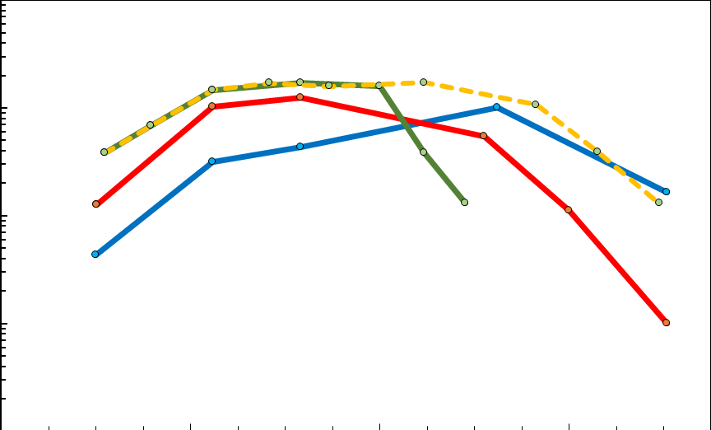
EIC Luminosity
IR Designs can be adjusted to obtain peak luminosity at different center of mass energies. The curves below show luminosity vs E_{cm} with IRs optimized for high or low center of mass energy. With two IRs, in principle both optimization can coexist in the same machine
10³⁴
10³³
10³²
10³¹
Accumulated Luminosity [fb⁻¹y⁻¹]
Luminosity [cm⁻²s⁻¹]
Tomography (p/A), Transverse Momentum
Distribution and Spatial Imaging
JLEIC
eRHIC
Optimization for high E_{cm}
-
-
-
-
100
10
1
Spin and Flavor Structure of
the Nucleon and Nuclei
eRHIC
Optimization
for E_{cm}=45 GeV
JLEIC Energy Upgrade
Internal
Landscape of the Nucleus
QCD at Extreme Parton Densities-
Saturation
Center of Mass Energy [GeV]
Note: For electron ion collisions, the E_{cm} scale needs to be reduced by a factor (Z/A)^{1/2}

Slide 11
Strong Hadron Cooling and High Luminosity
For high luminosity operation of the EIC strong hadron cooling is desirable if not necessary to avoid rapid decay of the luminosity caused by emittance blow-up due to intrabeam scattering
The two proposals operate at different ranges of hadron energy and the cooling systems are optimized accordingly.
JLEIC uses a multi-turn magnetized bunched electron beam cooling ring fed by an energy recovery linac to balance IBS growth time between 15 and 40 minutes. This cooling increases the luminosity at lower energies, however JLEIC is not relying in this cooling for reaching NSAC goals, as it can use short fills with rapid turn arounds for achieving high average luminosity quoted as 1·10³⁴ cm⁻²s¹.
eRHIC has only modest IBS growth rates of t>2h for highest luminosity. It uses micro-bunched electron cooling as an option but does not rely on cooling to operate at highest luminosity as there is an on-energy for frequent injections available which results in an average luminosity which is still 90% of the peak luminosity.

Slide 12
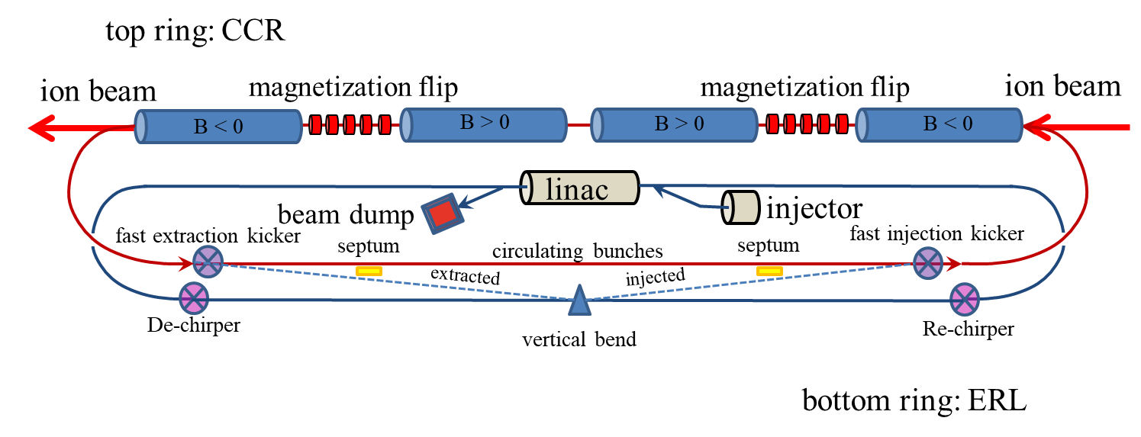
Strong Hadron Cooling Scheme for JLEIC
Magnetized electron beam for higher cooling efficiency
Cooling electron beam is energy-recovered to minimize power consumption
11-turn circulator ring with 1 amp of beam current relaxes electron source requirements
Fast harmonic kicker to kick electrons in and out of the circulator ring
Pre-cooling a low energy is essential to achieve the anticipated performance
Courtesy: V Morozov, A Seryi

Slide 13
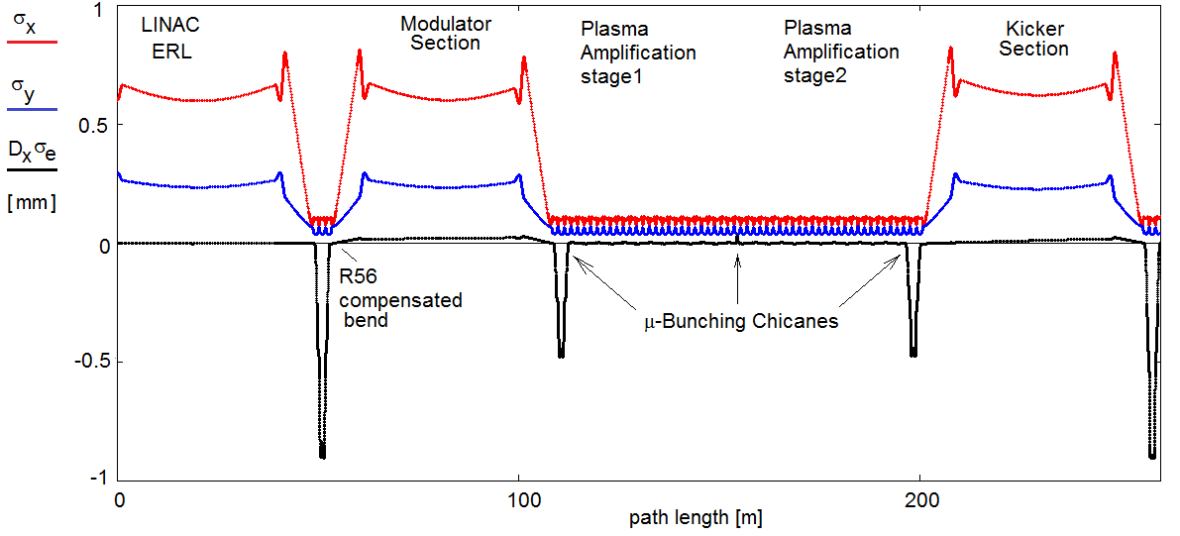
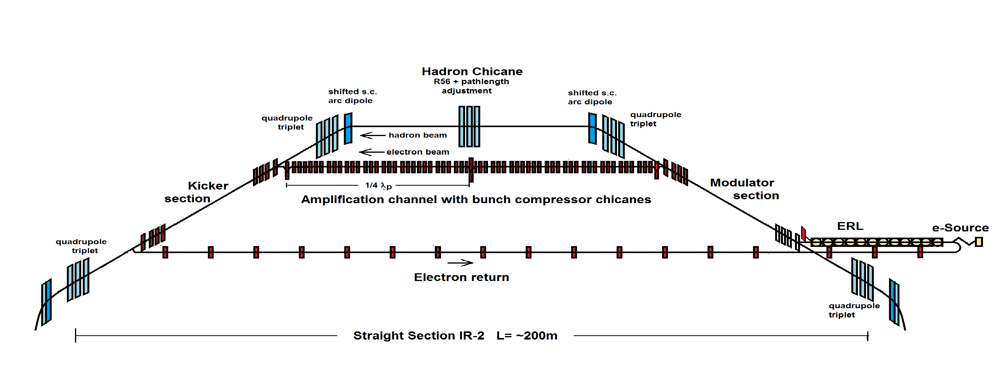
eRHIC Strong Hadron Cooling
Coherent Electron Cooling with μ-bunching amplification
Electron Beam Optics
Micro-bunched cooling is a novel scheme based on available technology
For eRHIC, strong cooling as desirable but not necessary for high luminosity (especially high average luminosity) as the hadron beam could be replaced frequently on-energy using the existing second ring of present RHIC. As the JLEIC scheme, this option requires electron cooling at low energy.

Slide 14
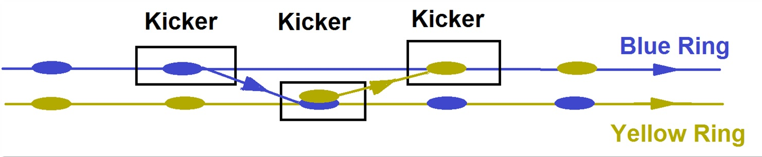
Alternative to Strong Hadron Cooling in eRHIC
eRHIC maximum luminosity of 1·10³⁴ cm⁻²s⁻¹ does not depend on the feasibility of strong hadron cooling.
Since RHIC has a second superconducting ring, the Blue Ring, on-energy injections into the collider ring, the Yellow Ring will replace the hadron bunches after one hour of storage.
Transfer takes 13 μs and will preserve the total charge in both machines, no transient injection effect.
The emittance growth between injections is so small that an average luminosity of 0.9·10³⁴ cm⁻²s⁻¹ will be achieved.
The required small vertical emittance ε_{Ny} = 0.5 μm will be achieved with standard DC electron beam cooling in the AGS.
No new hardware for spin transparency is required

Slide 15
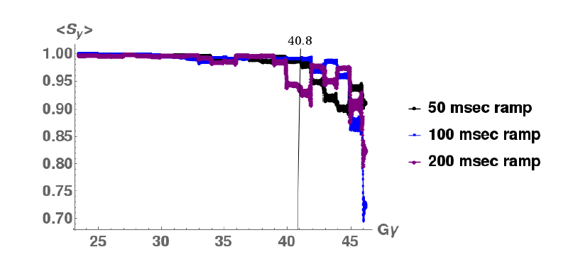
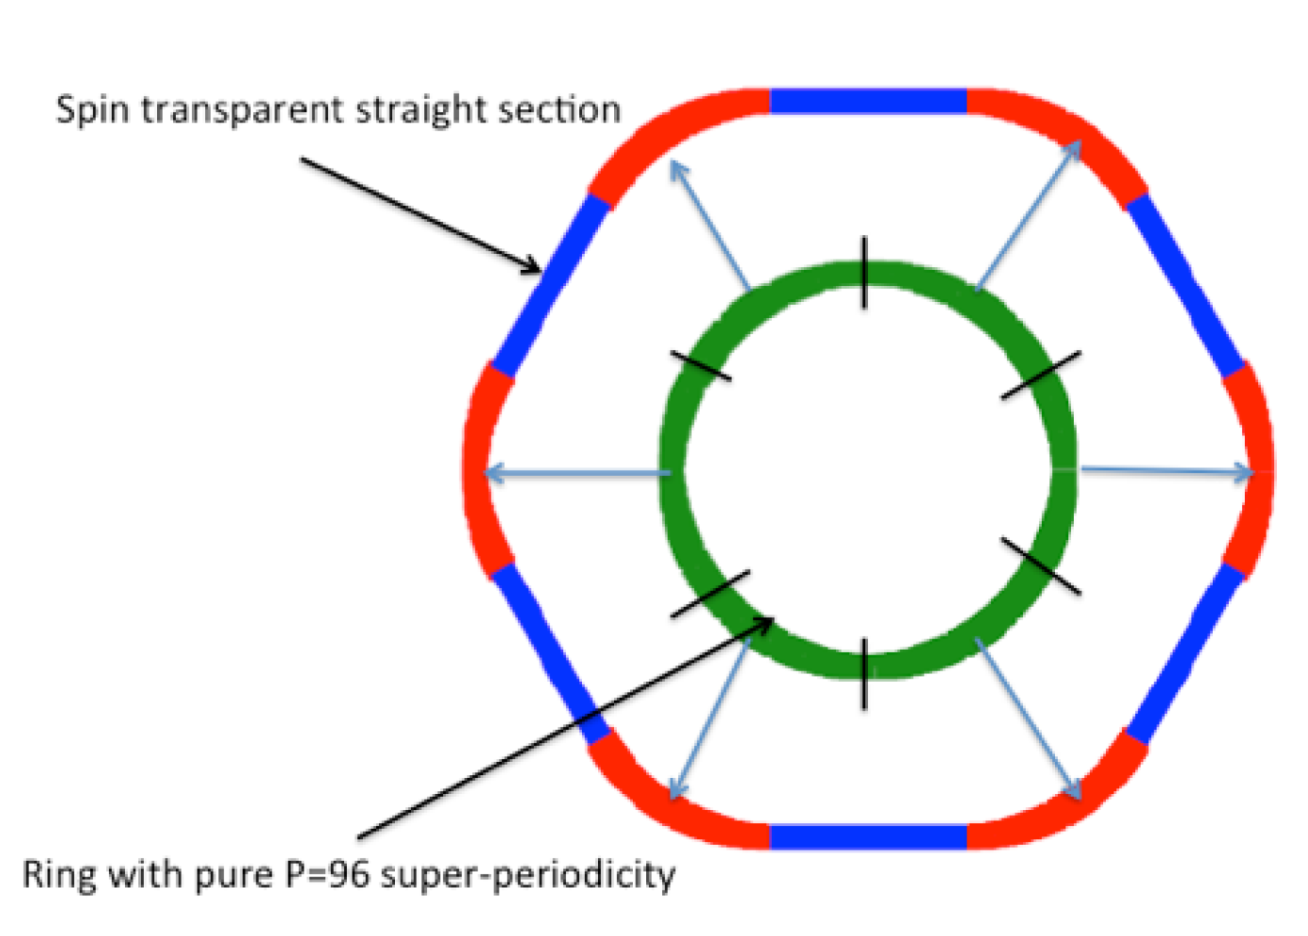
eRHIC Rapid Cycling Synchrotron Polarization
Ingenious optical design: High periodicity arcs and unity transformation in the straights suppresses all systematic depolarizing resonances up to Gγ =45
➔ resonance free acceleration up >18 GeV ➔ no loss of polarization on the entire ramp up to 18 GeV (100 ms ramp time)
Need well aligned quadrupoles and rms orbit ≤ 0.5 mm and good reproducibility
➔ Well within the present state of the art of orbit control and achieved today by NSLS-II Booster synchrotron

Slide 16
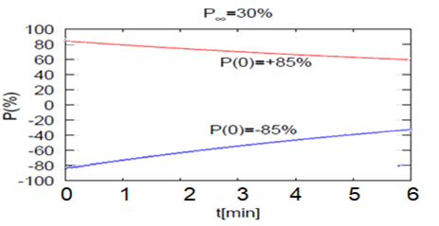
Polarization in the electron storage ring
Solenoid based Spin rotators ➔ longitudinal spin in collisions (arcs: vertical polarization)
High initial polarization of 85% will decay towards equilibrium polarization P∞ due to Sokolov-Ternov effect
P ∞ of 40-50% achievable (HERA experience and eRHIC simulations)
Time evolution of high polarization of bunches injected into the eSR at 18 GeV (worst case) RCS cycling rate = 2Hz ➔ on average, every bunch refilled in 2.2 min
B P
B P
Refilled every 1.2 minutes
Refilled every 3.2 minutes
Re-injection
P_{av}=80%
P_{av}=80%
Re-injection
Note: Calculation with P ∞=30% is conservative as P ∞= 50% was shown feasible

Slide 17
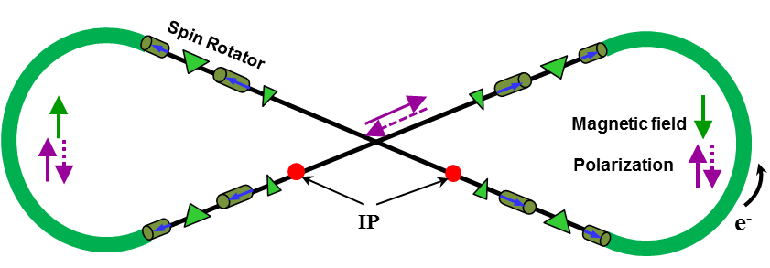
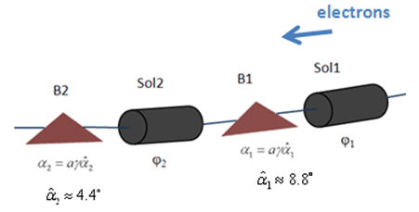


JLEIC High Electron Polarization
Two highly polarized bunch trains maintained by top-off
Universal spin rotator
  Minimizes spin diffusion
  by switching polarization
  between vertical in arcs
  and longitudinal in straights
  Sequence of solenoid and
  dipole sections
  Geometry independent of energy
  Two polarization states with equal
  lifetimes
  Basic spin match
Advantage of figure-8 geometry:
negligible depolarization demonstrated by spin tracking
Energy (GeV) | 3 | 5 | 7 | 9 | 10
Lifetime (hours) | 66 | 8 | 2.2 | 0.9 | 0.3
E | Solenoid 1 |  | Dipole set 1 | Solenoid 2 |  | Dipole set 2
 | Spin Rotation | BDL | Spin Rotation | Spin Rotation | BDL | Spin Rotation
GeV | rad | T·m | rad | rad | T·m | rad
3 | π/2 | 15.7 | π/3 | 0 | 0 | π/6
4.5 | π/4 | 11.8 | π/2 | π/2 | 23.6 | π/4
6 | 0.62 | 12.3 | 2π/3 | 1.91 | 38.2 | π/3
9 | π/6 | 15.7 | π | 2π/3 | 62.8 | π/2
12 | 0.62 | 24.6 | 4π/3 | 1.91 | 76.4 | 2π/3
Arc
IP
$$\vec{s}$$
$$\vec{s}$$
Courtesy: V Morozov, A Seryi

Slide 18
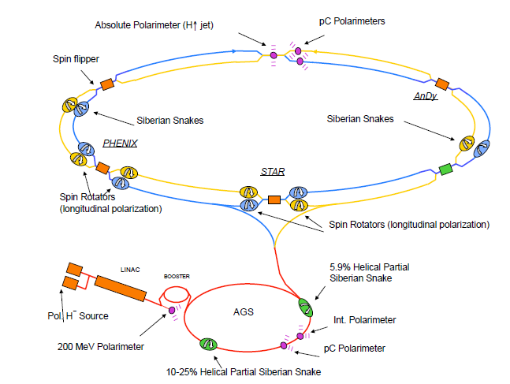
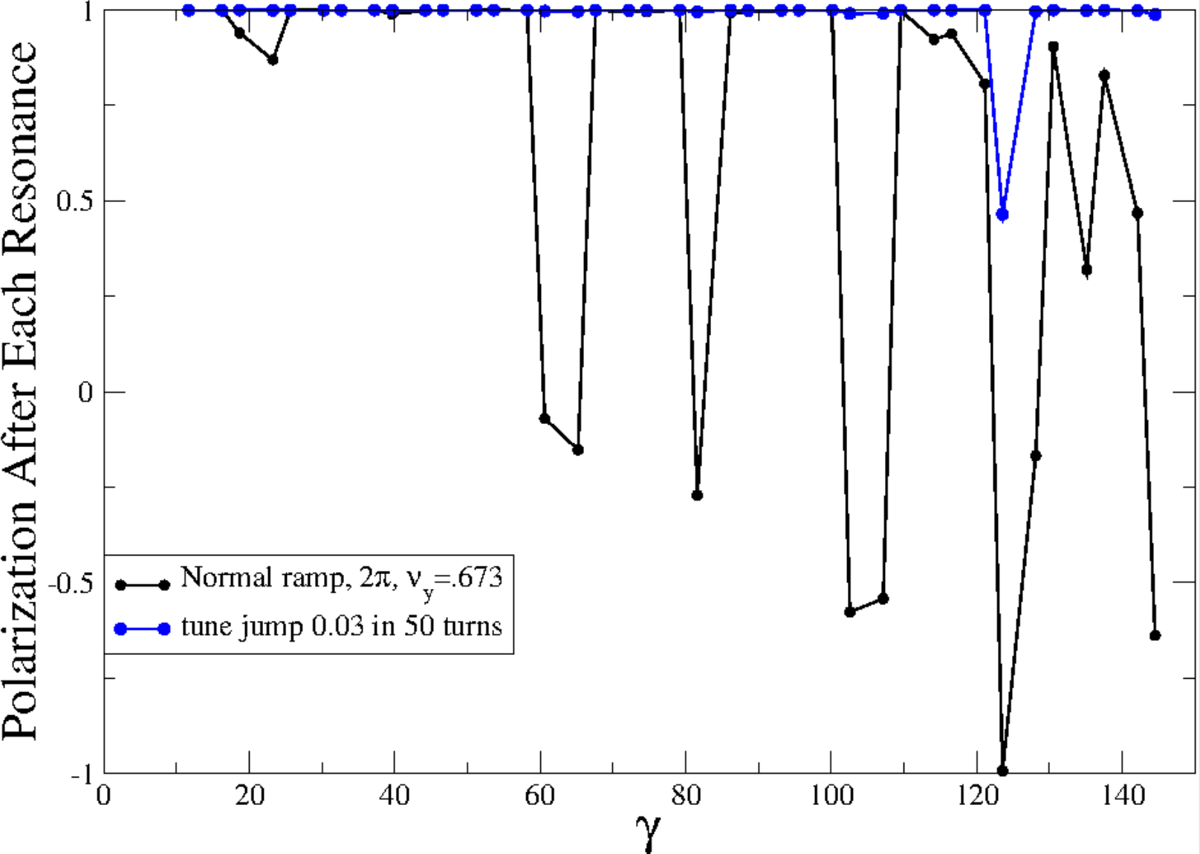
eRHIC Hadron Polarization
eRHIC will fully benefit from present RHIC polarization and near future upgrades
Measured RHIC Results:
Proton Source Polarization 83 %
Polarization at extraction from AGS 70%
Polarization at RHIC collision energy 60%
Planned near term improvements:
AGS: Stronger snake, skew quadrupoles,
increased injection energy
➔expect 80% at extraction of AGS
RHIC: Add 2 snakes to 4 existing no polarization loss
expect 80% in Polarization in RHIC and eRHIC
Expected results obtained from simulations which are benchmarked by RHIC operations
³He in eRHIC with six snakes
Achieved 85% polarization in 3He ion source
Polarization preserved with 6 snakes for up to twice the design emittance
Deuterons in eRHIC:
Requires tune jumps in the AGS, then
benchmarked simulation show 100% Spin transparency
No polarization loss expected in the eRHIC hadron ring

Slide 19
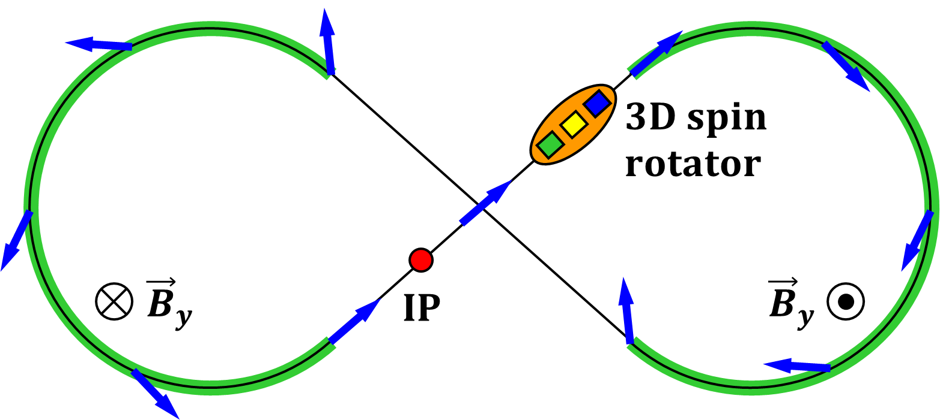
Ion Polarization in JLEIC
Figure-8 concept: Spin precession in one arc is exactly cancelled in the other
Spin stabilization by small fields: ~3 Tm vs. < 400 Tm for deuterons at 100 GeV
  Criterion: induced spin rotation >> spin rotation due to orbit errors
3D spin rotator: combination of small rotations about different axes provides
any polarization orientation at any point in the collider ring
No effect on the orbit
Polarized deuterons
Frequent adiabatic spin flips
Courtesy: V Morozov, A Seryi

Slide 20
Interaction Region Design
The interaction regions are the most challenging part of a EIC design.
It needs to fit several essential components into a relatively small area
Such as: Strong focusing, spin rotators, crab cavities, auxiliary detectors, mask and collimators, diagnostic equipment
The accelerator components should not compromise the detector acceptance
Design has to take into account that there are beam dynamics constraints:
IR chromaticity and related dynamic aperture issues, beam-beam tune shift, tight tolerances for magnet errors, residual crab cavity effects, …

Slide 21
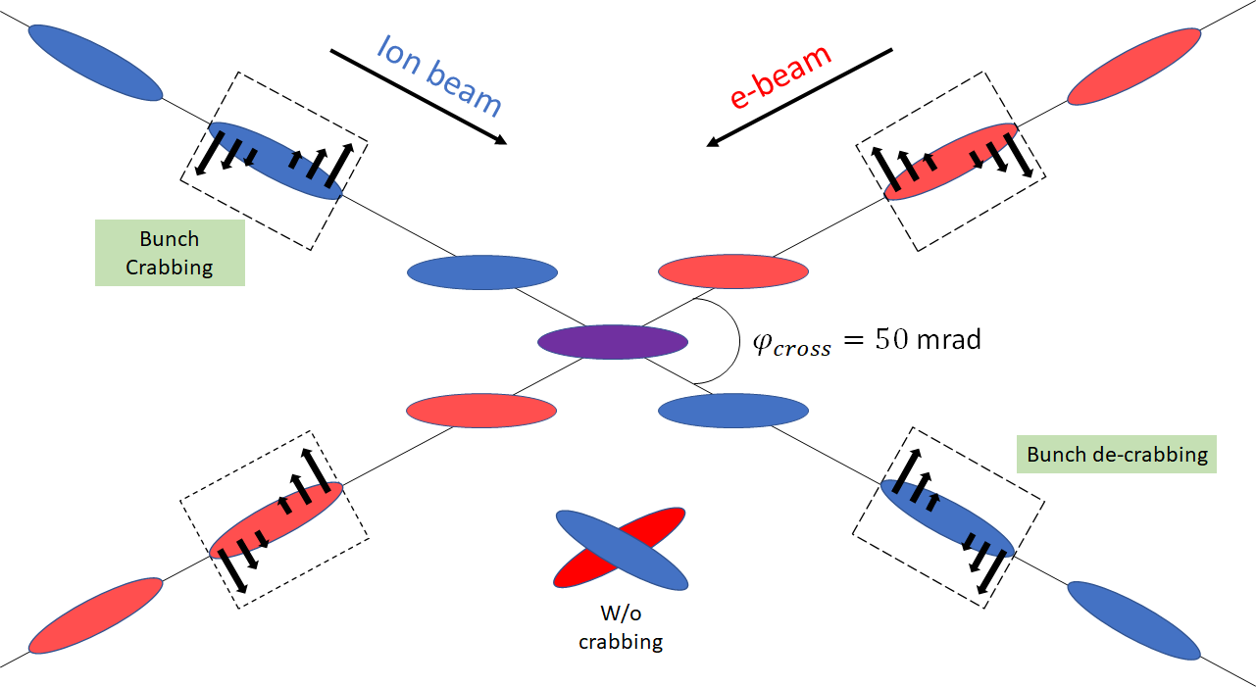
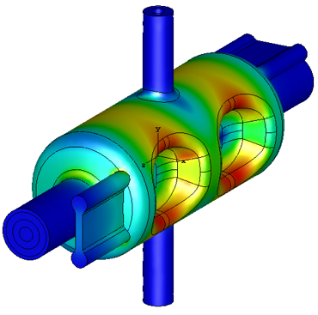
EIC High Luminosity with a Crossing Angle
crossing angle is necessary to avoid parasitic collisions due to short bunch spacing, make space for machine elements, improve detection and reduce detector background, q =50 mrad (JLEIC), 25mrad (eRHIC)
However, crossing angle causes
Low luminosity
Beam dynamics issues
Crab Crossing
Effective head-on collision
restored and most severe beam dynamic issue resolved
Both JLAB and BNL developed prototypes which have been tested with beam in the Cern-SpS
Courtesy V. Morozov and Andrei Seryi

Slide 22
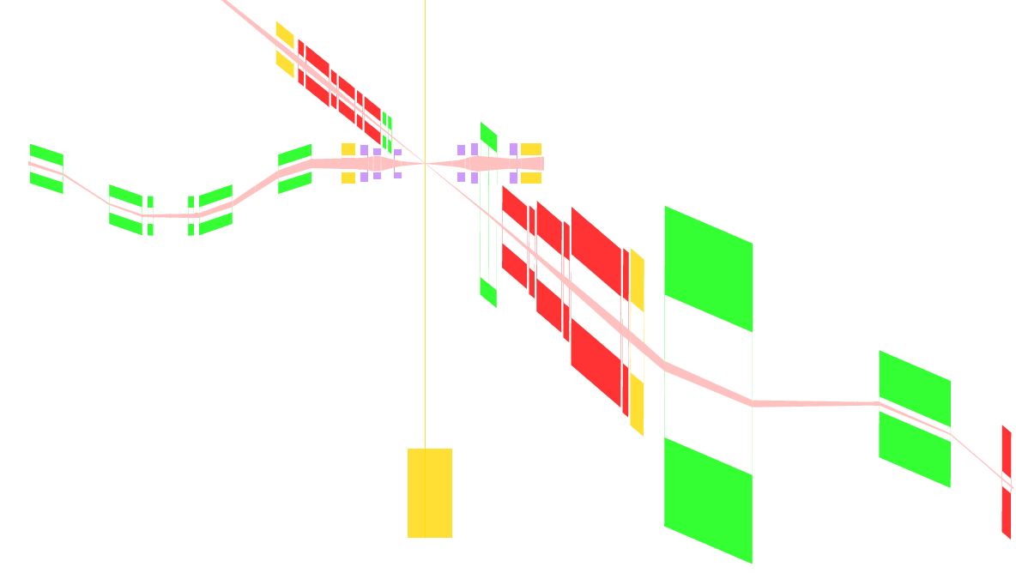



JLEIC Full Acceptance IR Layout
50 mrad crossing angle
Forward hadron detection in three stages
  Endcap
  Small dipole covering angles up
  to ~3°
  Far forward, ~10 mrad,
  for particles passing through
  accelerator quads
Low-Q2 tagger
  Small-angle electron detection
Large beta functions in the IR up to 4 km
but manageable chromatics and dynamic
aperture
End caps
Roman pots
hadrons
electrons
$±50$ mrad
Secondary
focus
Low $Q^{2}$ tagger
Central detector
$±10$ mrad
Courtesy V., Morozov, A. Seryi

Slide 23
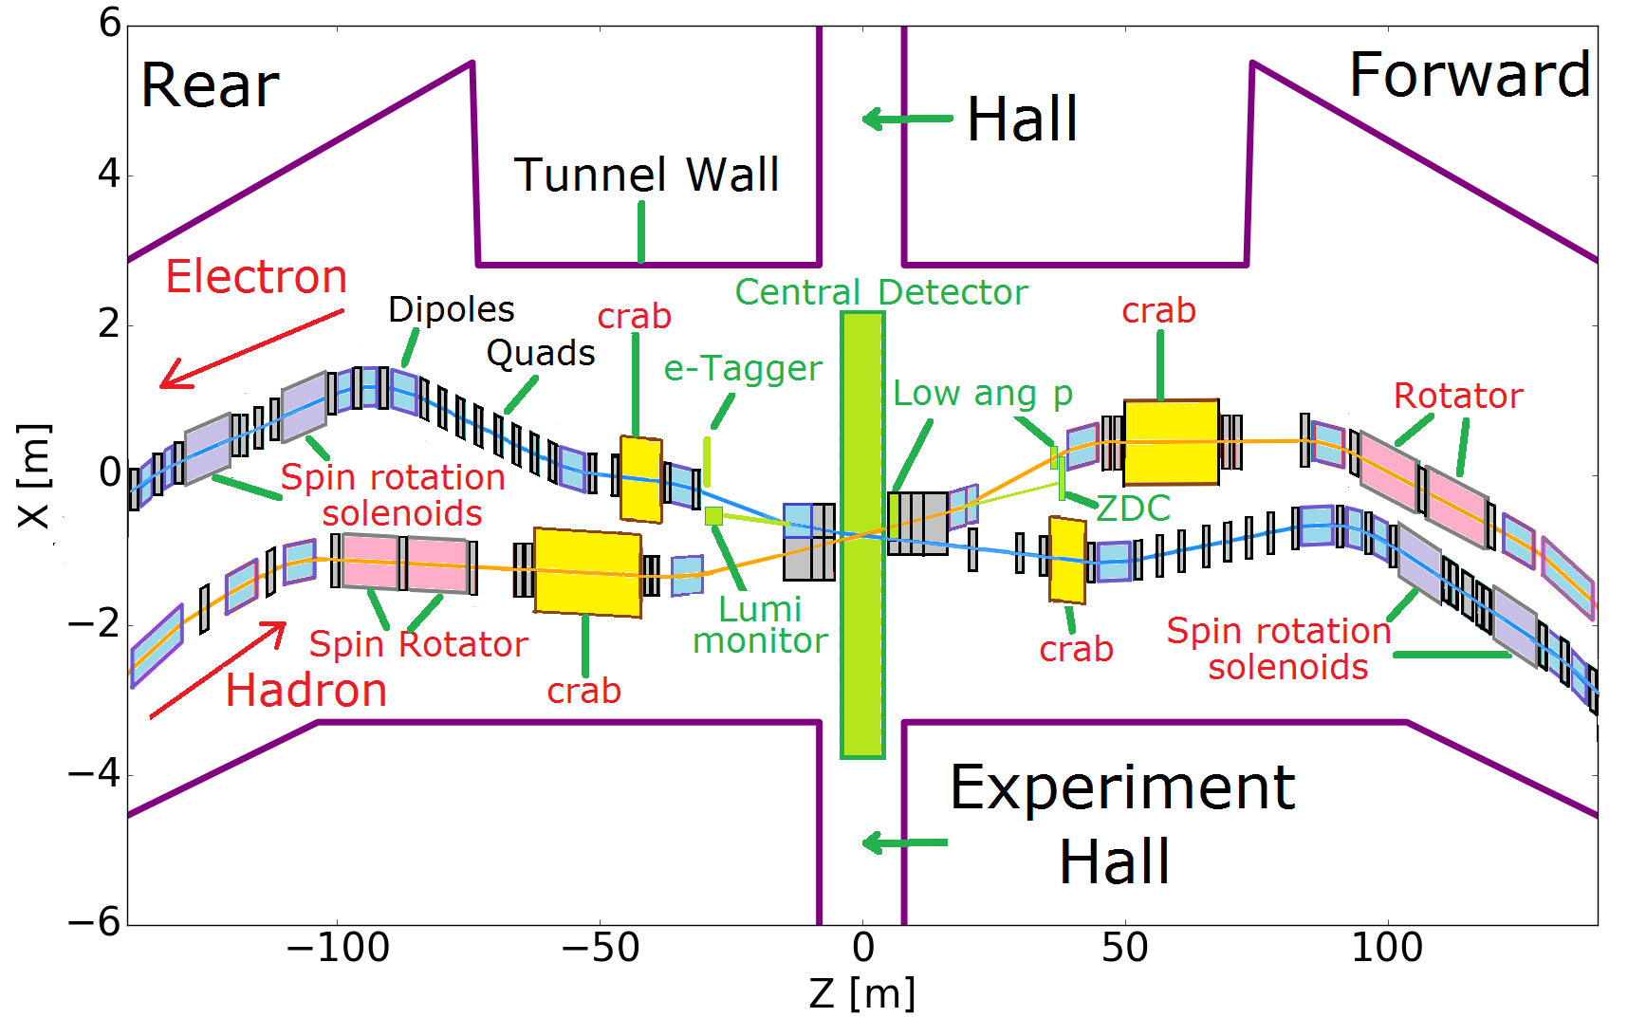
Full Acceptance eRHIC IR Layout
Design
All superconducting magnets
Only 5 magnets need collared Nb-Ti coils
All other magnets can be built with direct wind of Nb-Ti wire
Full acceptance e.g.
P_{t} =200 MeV/c-1.3 GeV/c
Neutrons 4 mrad
Large Aperture Dipole with instrumented gap
Modest IR chromaticity
Hadrons up to β<200m
Manageable dynamic
aperture optimization
e-Tagger
LUMI Mon.

Slide 24
EIC Beam Dynamics Challenges
Proton Beam Stability (emittance growth, halo forming) in presence of strong, crab-enhanced beam-beam effects, strong chromatics
Electron cloud in the hadron vacuum, suppression of secondary emission yield
Fast Ion instability for the electron beam
Multi-bunch stability and feedback: Feedback noise and hadron emittance growth
Impedance optimization in the IR
Dynamic aperture with extreme beta in the IR

Slide 25
On-Going EIC R&D Effort
Component Development
Crab Cavity design development and prototyping
IR magnet development and prototyping
HOM damping for RF structure development
Variable coupling high power forward power couplers development
Effective in situ Cu coating of the beam pipe (BNL hadron only)
High average current electron gun development
Polarized ³He source
Bunch by bunch polarimetry
Accelerator Physics R&D
Strong hadron cooling CeC, cooling development (simulation and experimental)
Strong hadron cooling bunches electron beam cooling (simulation and experimental)
ERL development for strong hadron cooling
Test of suppression of intrinsic depolarizing resonances
Study of collisions with different revolution frequencies (JLAB only)
Experimental verification of figure-8 configuration
Study of residual crab cavity effect on beam emittance
Instrumented accelerator magnet
Crab cavity
Crabbed beam dynamics

Slide 26
Conclusion
Designs of EIC made significant progress since the last EICUG meeting
There is good collaboration on accelerator physics and accelerator R&D between accelerator laboratories
The two designs rely for the most part on established accelerator technology
Crab cavity, IR magnets, and ERL are close to state of the art
strong hadron cooling is beyond, but is well mitigated
BNL and JLab are committed to working together and with the community to advance the EIC.
We welcome further collaboration with our European colleagues

