Slide 1
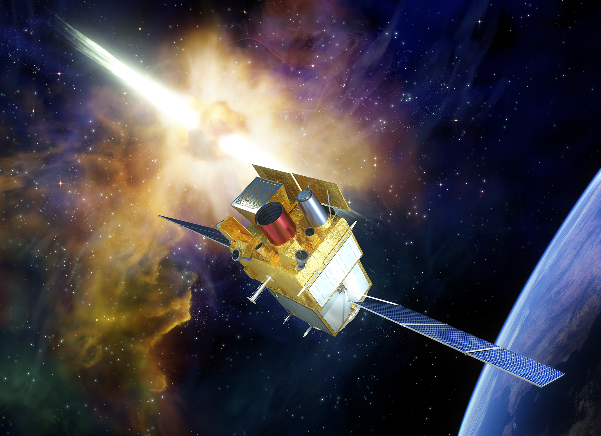

the Svom mission
Latests News
Bertrand Cordier & Wei Jianyan
on behalf on the Svom collaboration
2019 June Toulouse Eridanus workshop

Slide 2
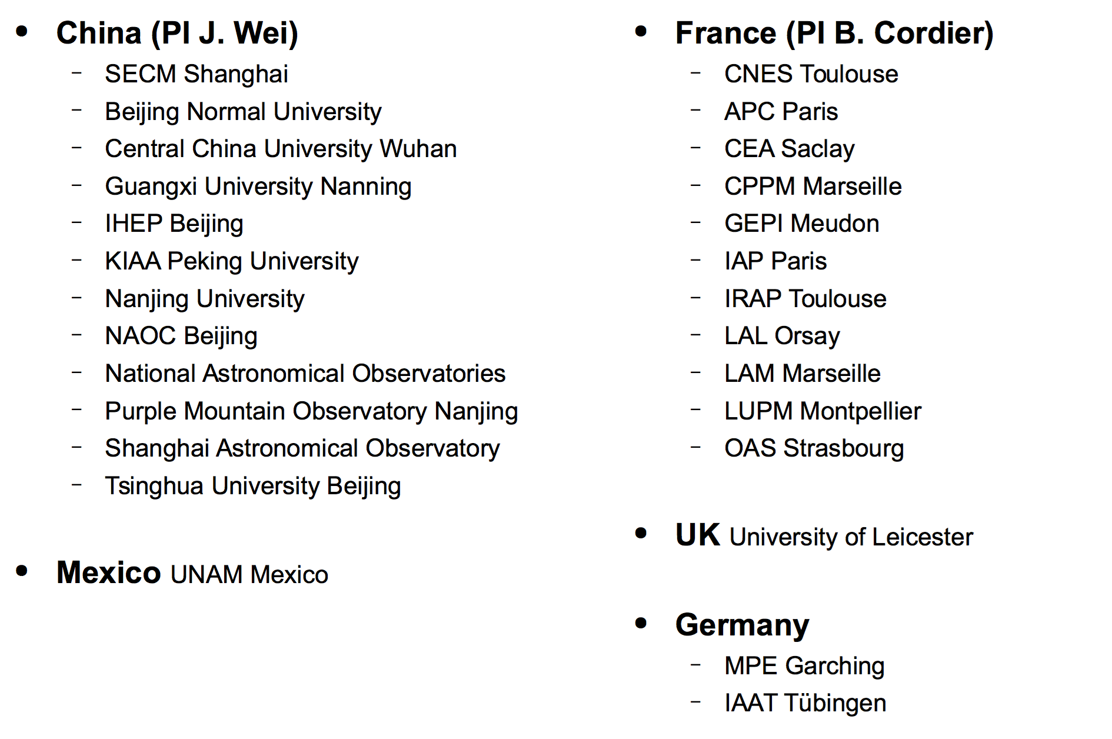






the Svom consortium
svom overview
Taking into account
the feedback from
Neil Gehrels Swift obs.
& Fermi
for space observations
TAROT
for ground observations
Frédéric Daigne and Bing Zhang are the mission scientists in charge of the core program

Slide 3
SVOM “Space-based multi-band astronomical Variable Objects Monitor”
a Sino-French mission dedicated to GRBs and transient sources
to be launched end 2021, duration 3+2 years

Slide 4
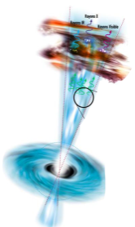
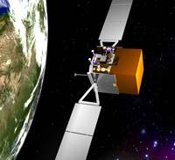
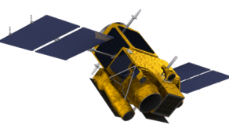
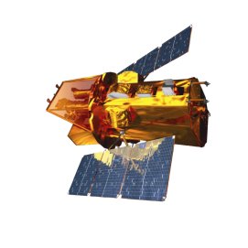
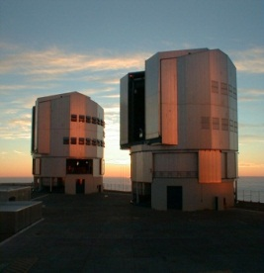
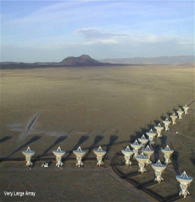
GRB Observation scenario
GRB
waiting
Auto slew
T0 GRB trigger
On board
VHF
T0+5min
VT,MXt observation
On Ground
F SC
Other SC mission center
T0+30s
Inside SVOM
Outside SVOM
C SC
T0+1min
GCN
GRB coordination distribute
Large telescope

Slide 5
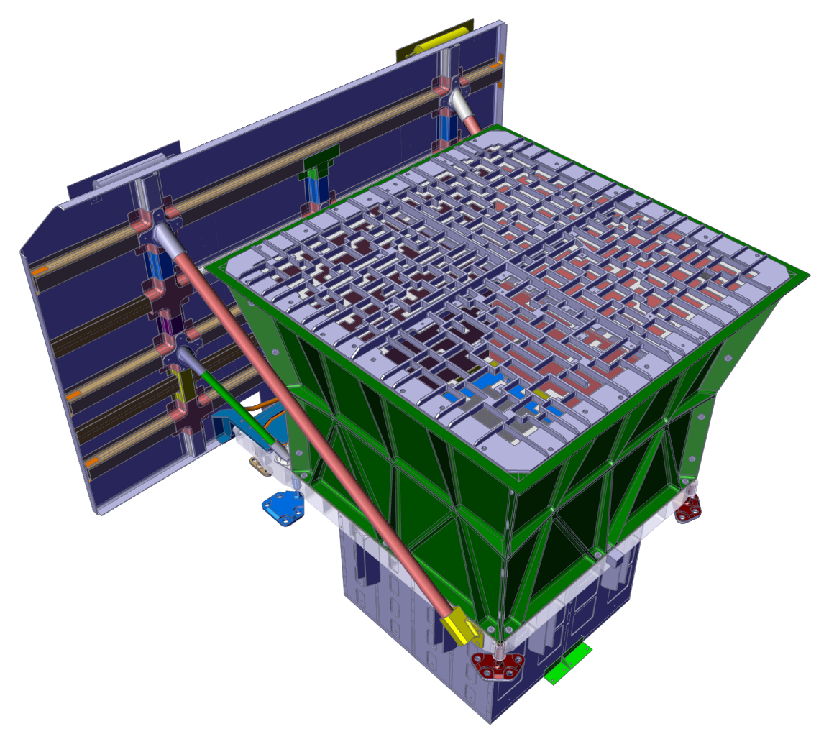
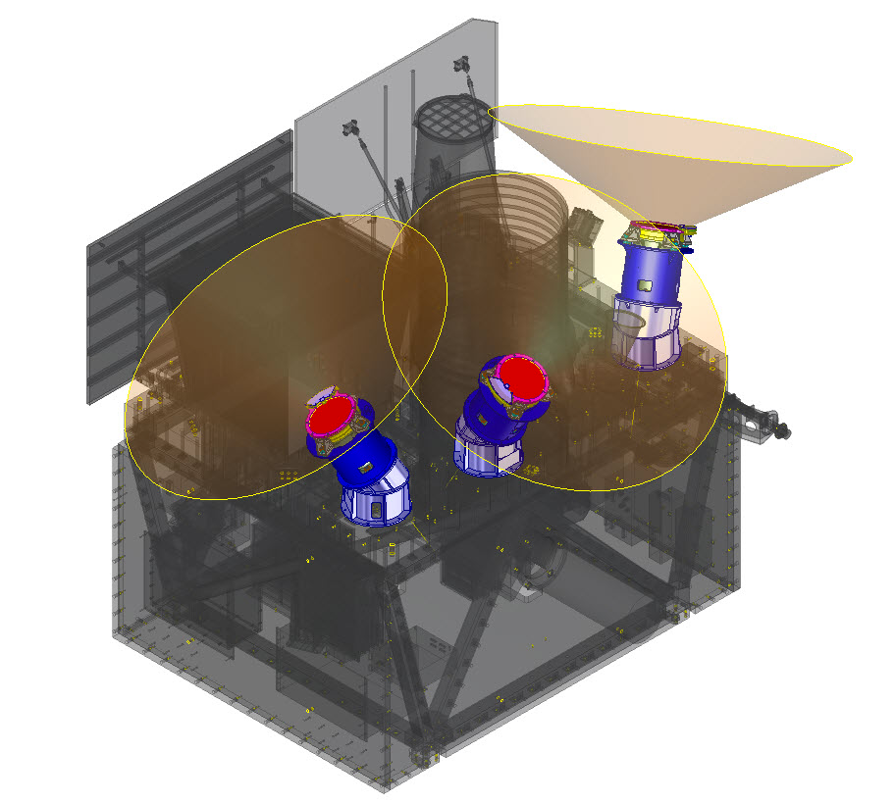
instruments (with large field of view)
The space segment –the payload
ECLAIRs (CNES, IRAP, CEA, APC)
40% open fraction
Detection plane: 1024 cm²
6400 CdTe pixels (4x4x1 mm³)
FoV: 2 sr (zero sensitivity)
Energy range: 4 - 150 keV
Localization accuracy <12 arcmin for 90% of sources at detection limit
Onboard trigger and localization: ~65 GRBs/year
Well adapted for the detection of lGRB with low EPEAK
-> See Nicolas Dagoneau talk
GRM Gamma-Ray Monitor (IHEP)
3 Gamma-Ray Detectors (GRDs)
NaI(Tl) (16 cm Ø, 1.5 cm thick)
Plastic scintillator (6 mm) to monitor particle flux and reject particle events
FOV: 5,6 sr 3 GRDs, 1,0 intersection of 3 GRDs
Energy range : 30-5000 keV
Aeff = 190 cm² at peak
Rough localization accuracy
Expected rate: ~90 GRBs / year
Will provide EPEAK measurements for most ECLAIRs GRBs
Will detect short GRBs in & out of the ECLAIRs FOV

Slide 6
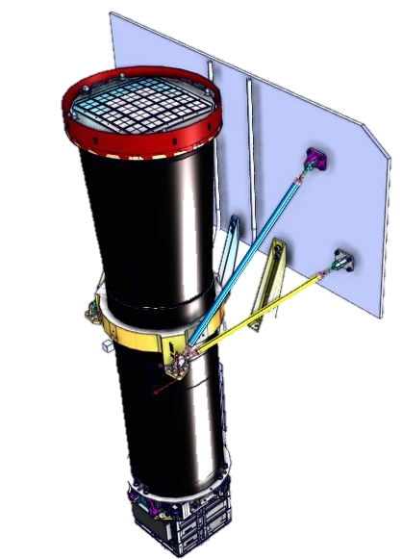
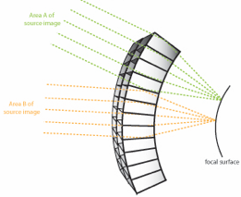
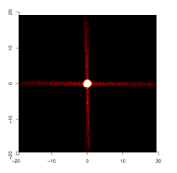
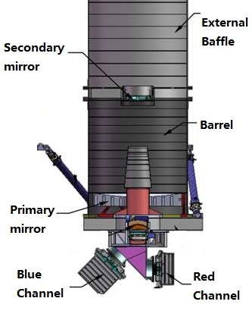
instruments (with narrow field of view)
THE SPACE SEGMENT – THE PAYLOAD
MXT Micro-channel X-ray Telescope (CNES, CEA, UL, MPE)
Micro-pores optics (Photonis) with 40 µm square pores in a “Lobster Eye” conf. (UL design)
pnCCD (MPE) based camera (CEA)
FoV : 64x64 arcmin²
Focal length: 1 m
Energy range : 0.2 – 10 keV
Aeff = 27 cm² @ 1 keV (central spot)
Energy resolution: ~80 eV @ 1.5 keV
Localization accuracy <13 arcsec within 5 min from trigger for 50% of GRBs (statistical error only)
Implements innovative focussing X-ray optics based on « Lobster-Eye » design
Will reduce the ECLAIRs error box
Will be able to promptly observe the X-ray afterglow
VT Visible Telescope (XIOMP, NAOC)
Ritchey-Chretien telescope, 40 cm Ø, f=9
FoV: 26x26 arcmin², covering ECLAIRs error box in most cases
2 channels: blue (400-650 nm) and red (650-1000 nm), 2k * 2k CCD detector each
Sensitivity MV=23 in 300 s
Will detect ~80% of ECLAIRs GRBs
Localization accuracy <1 arcsec
Able to detect high-redshift GRBs up to z~6.5 (sensitivity cutoff around 950 nm)
Can quickly provide redshift indicators due to the presence of two channels

Slide 7
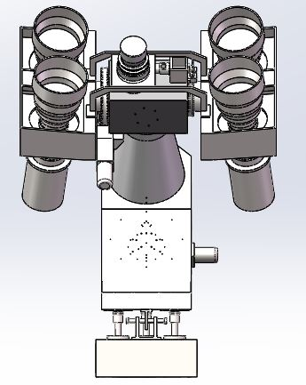
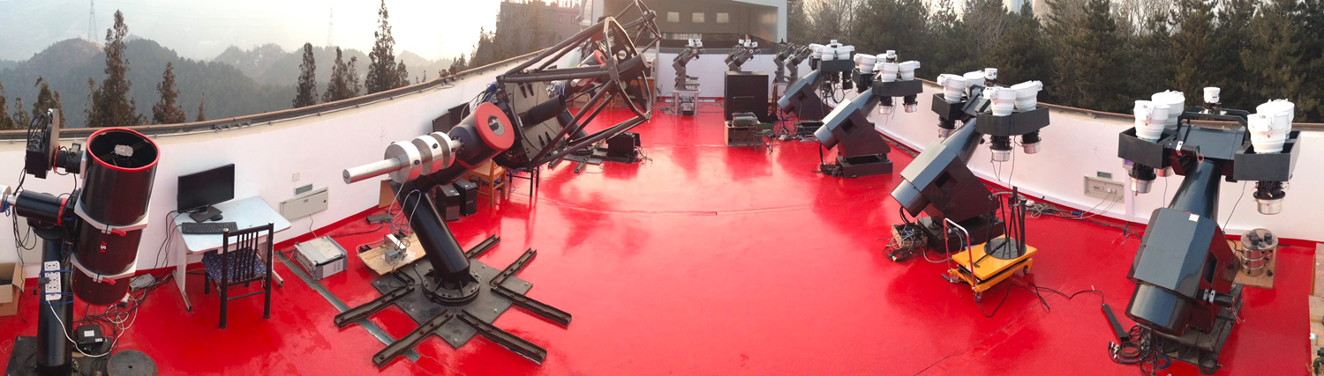
Ground Wide Field CamEras (GWACs)
The Ground segment
Cameras： 40
Diameter： 180mm
Focal Length： 220mm
Wavelength： 500－800nm
Total FoV： ~6000Sq.deg
Limiting Mag： 16.0V（5σ，10sec）
Self Trigger: ~13*5sec

Slide 8


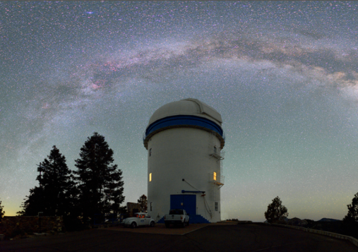
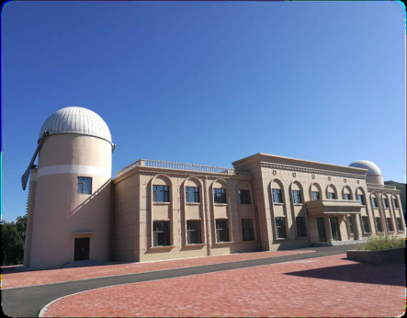
The Ground Follow-up telescopes (GFTs)
The Ground Segment
GFTs permit the fast identification and measure of early optical/NIR afterglows (light-curve, SED) using the ECLAIRs positions, while the spacecraft is slewing to the source.
C-GFT is located at Changchun observatory (Jilin province)
F-GFT is located at San Pedro de Martir (Mexico)
Diameter : 130 cm
FOV : 26 x 26 arcmin
400 – 1700 nm
Diameter : 120cm
FOV : 90 x 90 arcmin
400 – 900nm

Slide 9
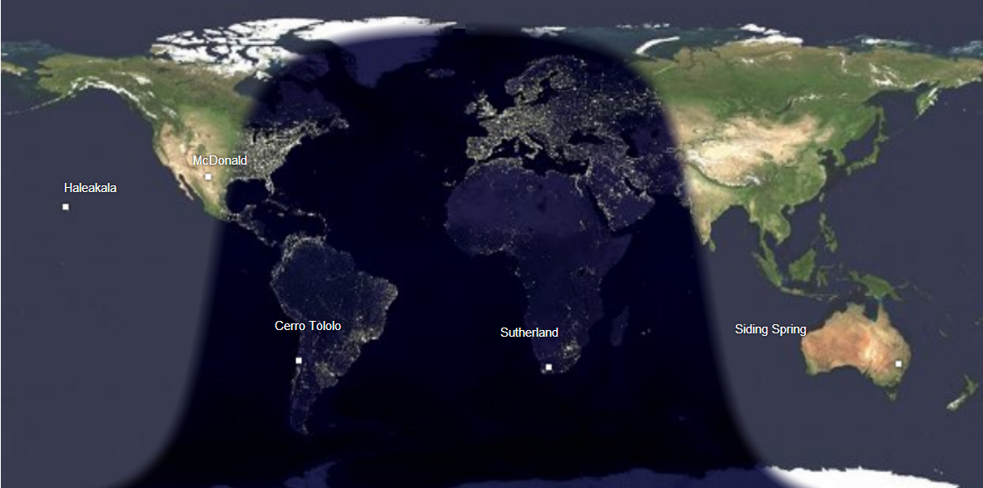
The GrOund segment
LCOGT 1m sysyem as a sumplement of GFTs
NAOC and GXU contribute one LCOGT 1m at Ali (Tibet)
China will share LCOGT 1m system ~2000hr/yr

Slide 10

SVOM payload : development logic)
ECLAIRS Status
Lancement
16/12/21
2015
2016
2017
2018
Today
Start
01/09/14
2019
2020
2021
2022
Phase B
01/09/14 - 01/01/17
Phase C
01/01/17 - 20/10/19
Phase D
01/01/20 - 17/12/21
E1
End
09/03/22
Delivery of EQM
02/19
Delivery of STM
06/19
Delivery of PFM
12/20
RRV
09/03/22
Proto Flight Model-oriented development logic
Engineering and Qualification Model (electronic units): Delivered
Objective: Mechanical, thermal and EMC qualification
Participation in Flat Sat (Electrical + Functional) and QM Sat (Functional + Environmental Qualification) tests
Structural and Thermal Model : Integration in progress, Delivery summer 2019
Objective: Mechanical and thermal qualification of instrument level
Validation of the integration sequence, Validation of the levels seen at the interfaces and in some critical points
Participation in Environmental Qualification tests of the satellite
Proto Flight Model : Delivery at the end of 2020
Performance characterization
Integration of the Proto Flight Model of the satellite

Slide 11

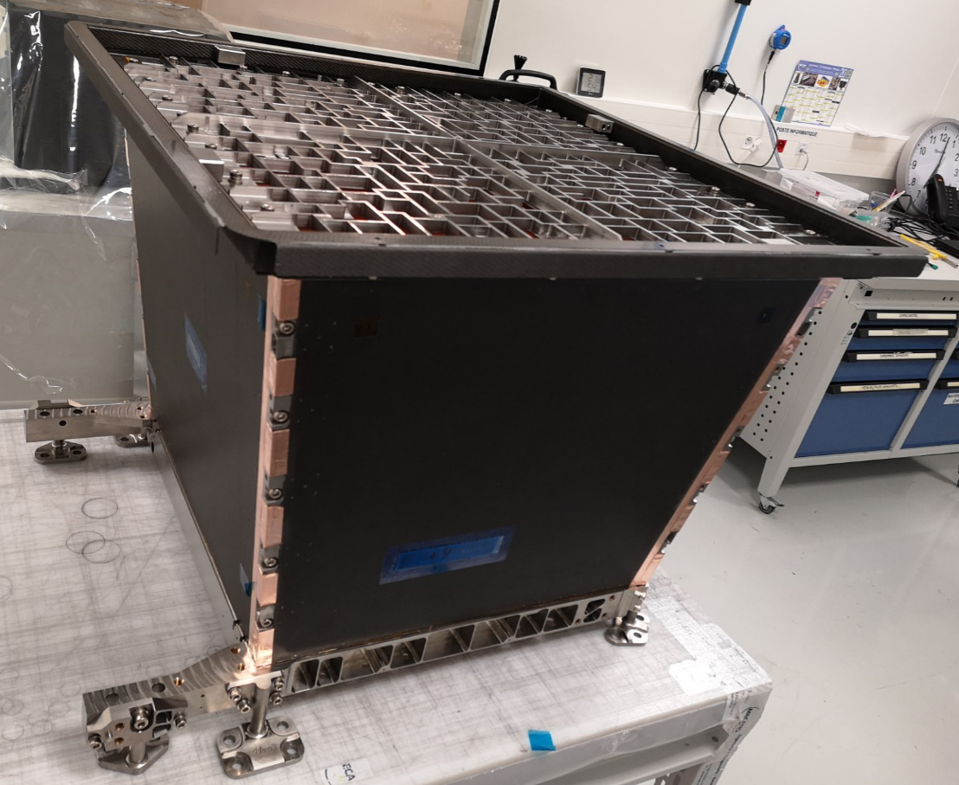
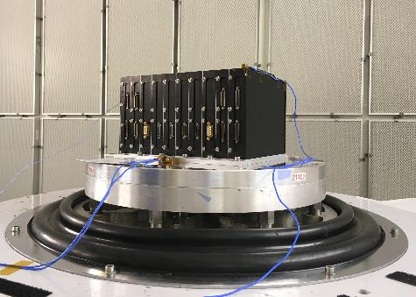
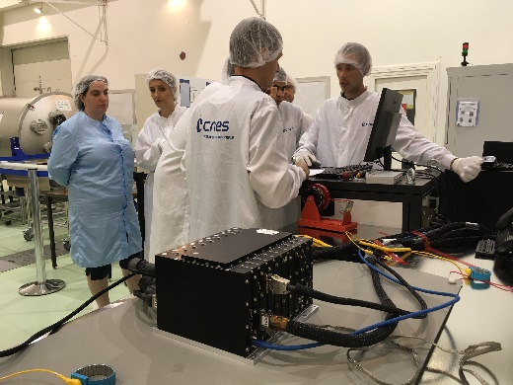
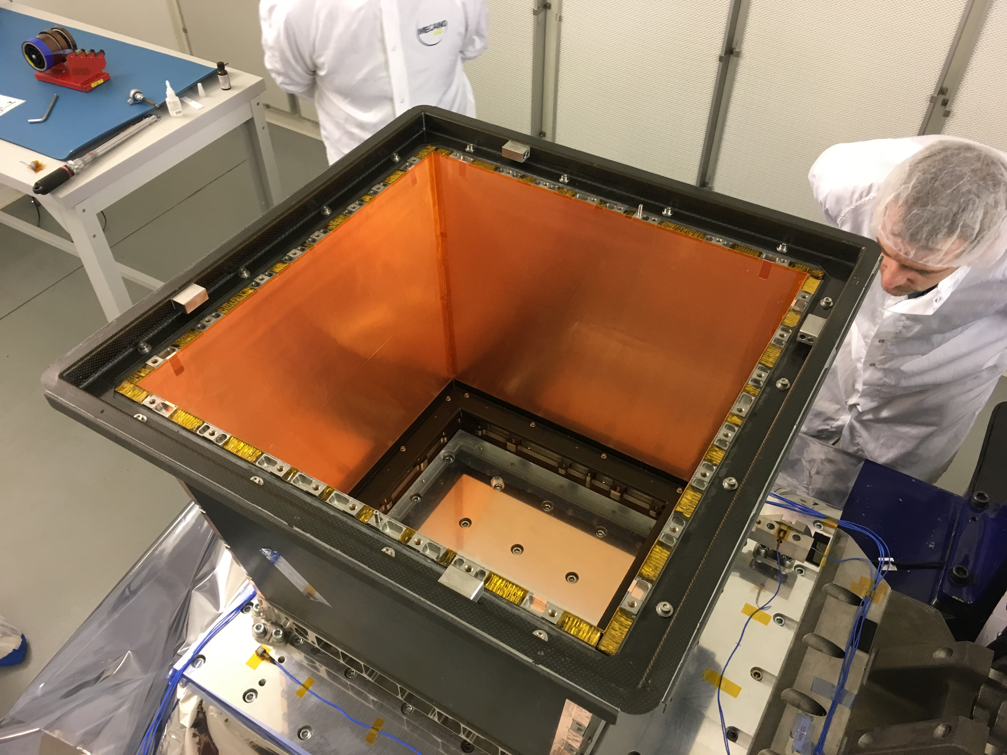
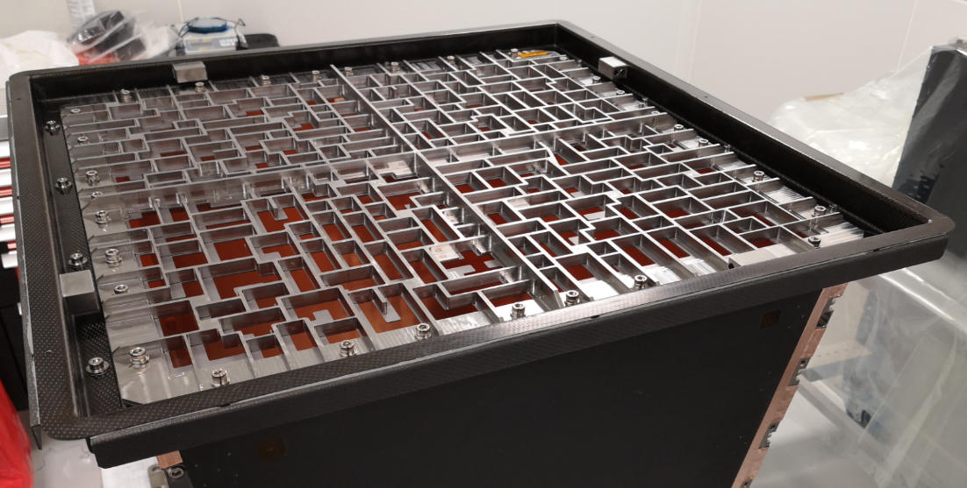
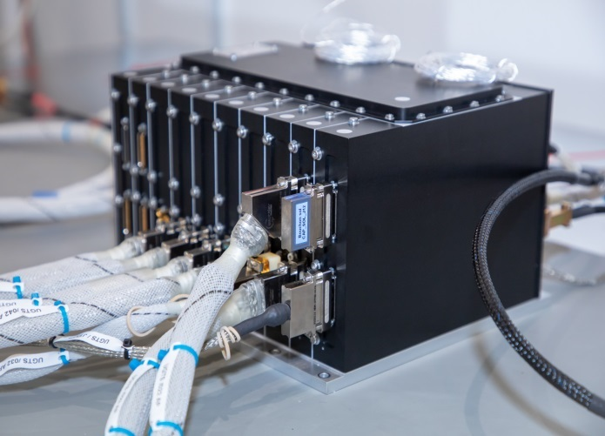
The space segment – ECLAIRS STATUS
STM
EQM
  ECLAIRs STM
    Shielding ready
    Mask already qualified !
    Thermal bus and DPIX ready
    Integration at CNES
  ECLAIRs EQM
    Qualification tests (vibration, electrical) performed
    Hardware / Software integration at CNES
    Integration to the flat satellite model at SECM
  ECLAIRs PFM fabrication
    All parts are procured (EEE components, detectors, MLI, connectors, …)
    Waiting for sub-system qualification tests before going ahead in PFM fabrication
PFM

Slide 12
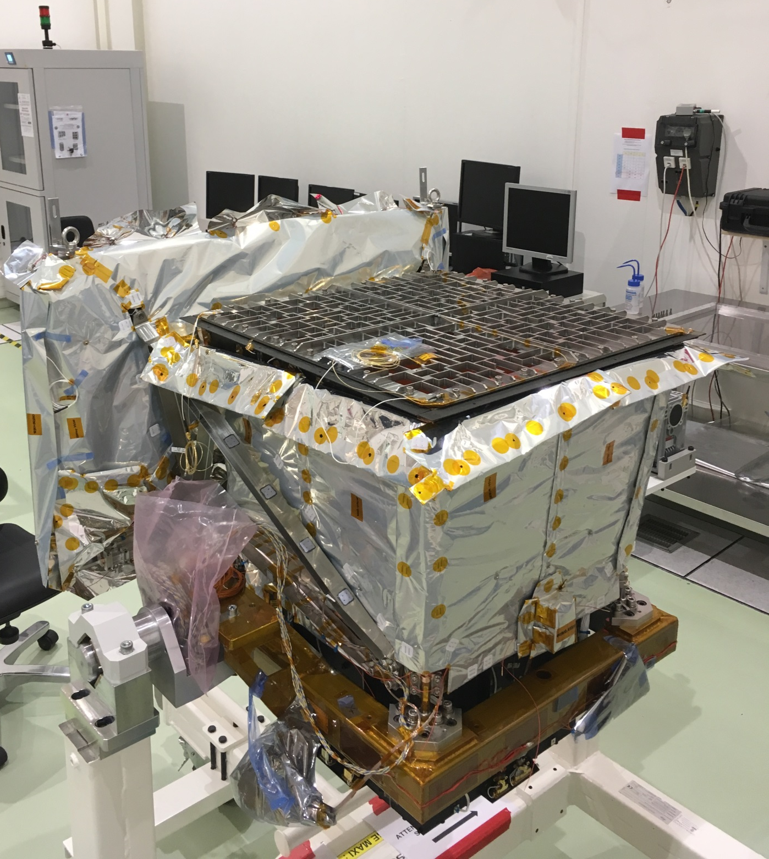
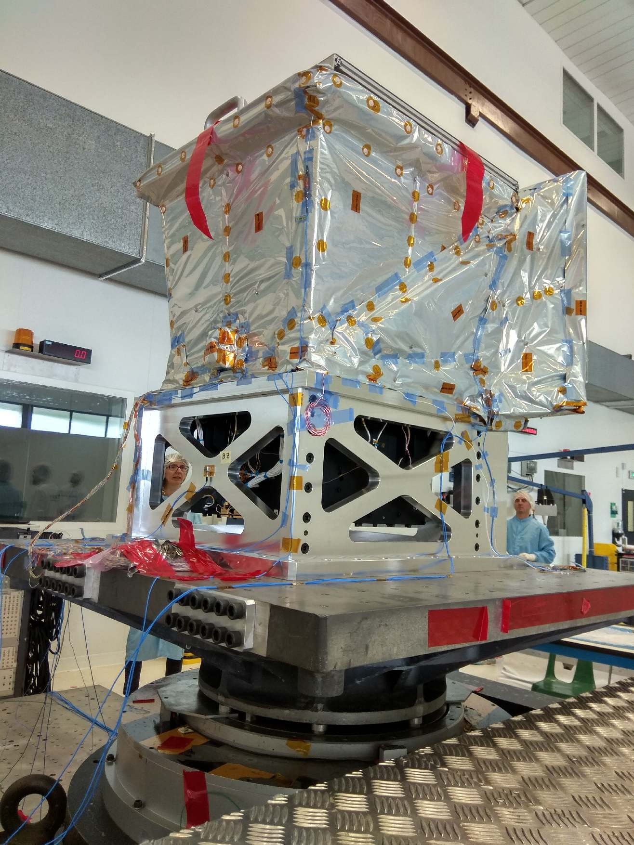
The space segment – ECLAIRS STATUS
ECLAIRs Structural and Thermal model ready for vibration tests

Slide 13

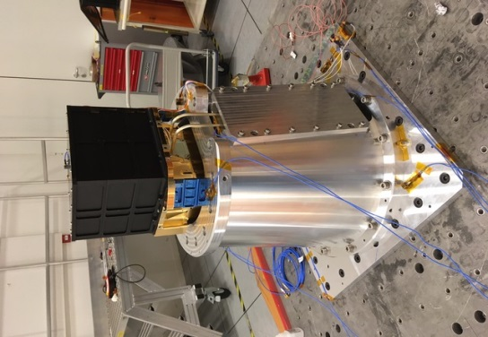
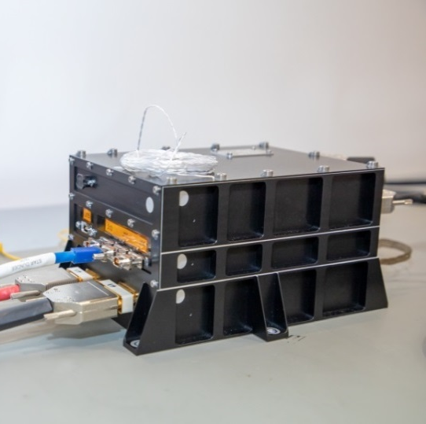
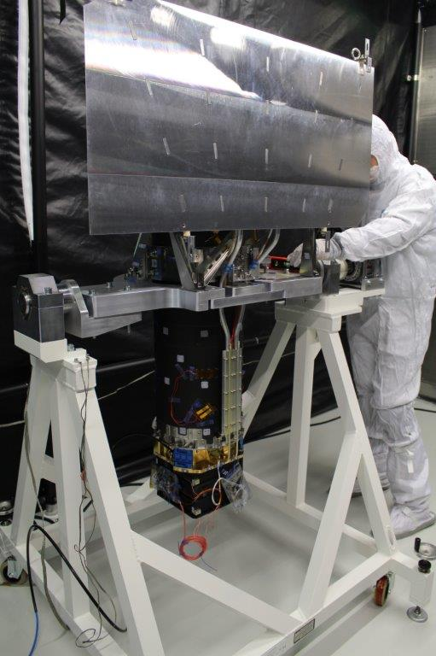
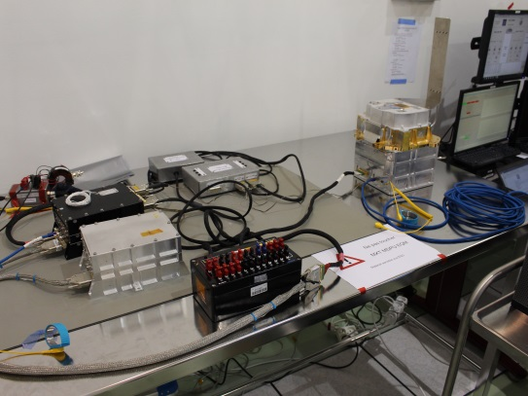
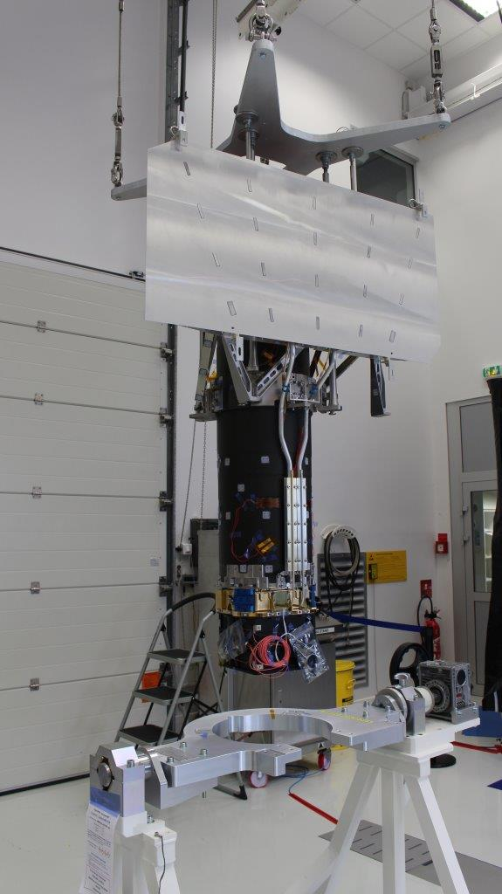
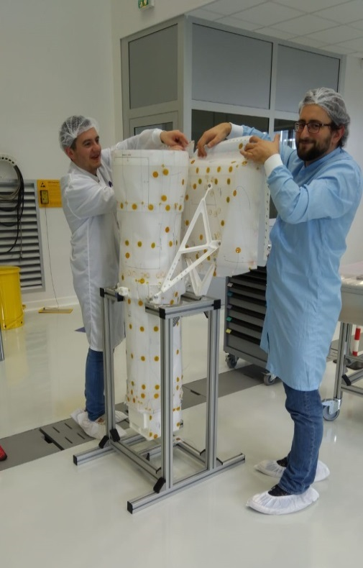
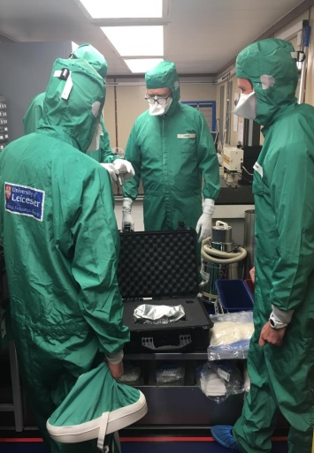
The space segment – MXT STATUS
STM
EQM
  MXT Structural Thermal Model
    Camera ready
    Tube readdy
    Optics dummy ready
    Thermal bus ready
    Integration at CNES
  MXT EQM
    Qualification tests (vibration, electrical) at sub-contractor level
    Hardware / Software integration at CNES
    Integration to the flat satellite model at SECM
  MXT Proto Flight Model fabrication
    All parts are procured (MPO Plates, EEE components, detectors, MLI, connectors, …)
    Waiting for sub-system qualification tests before going ahead in PFM fabrication
STM MCAM
PFM
MXT MLI check-out
MPO FM #02 at Leicester

Slide 14
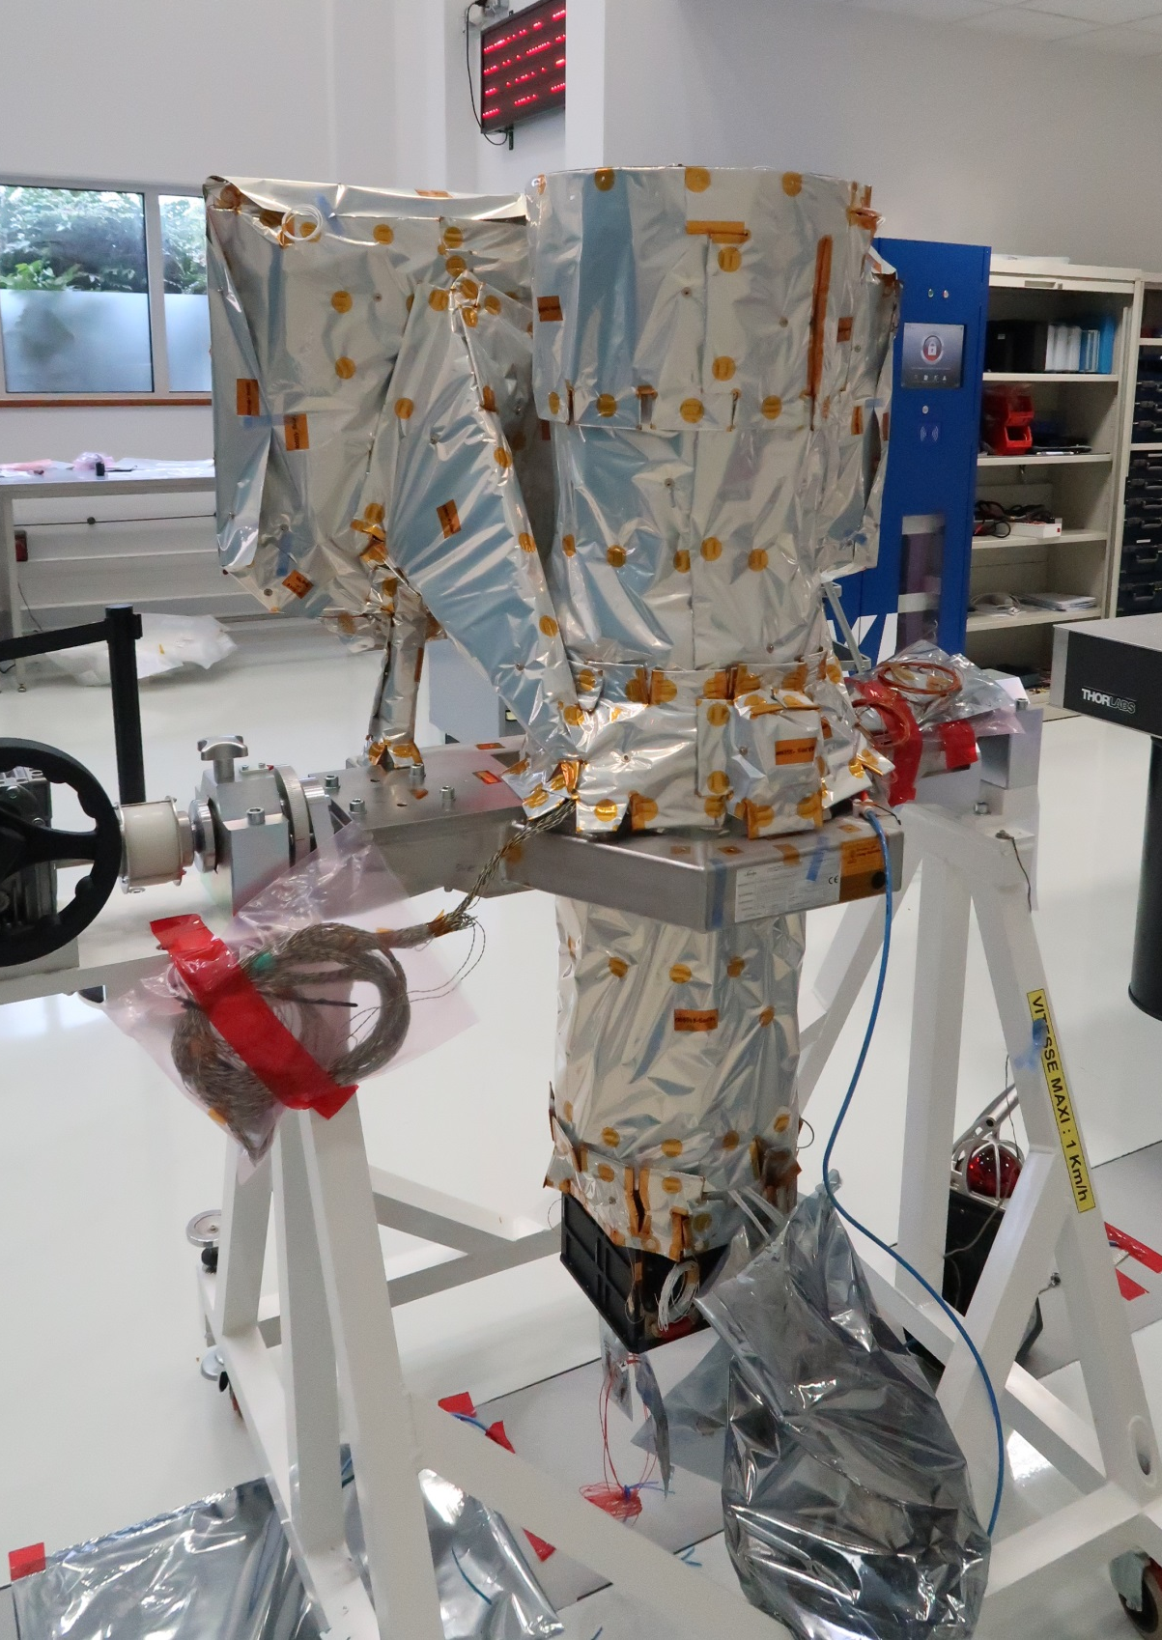
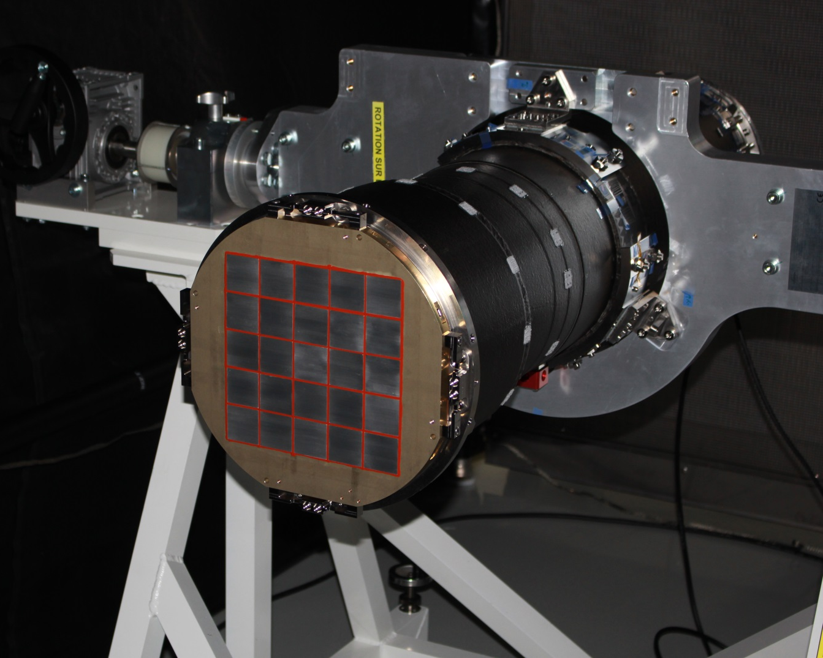
The space segment – MXT STATUS
MXT Structural and Thermal model ready for vibration tests

Slide 15
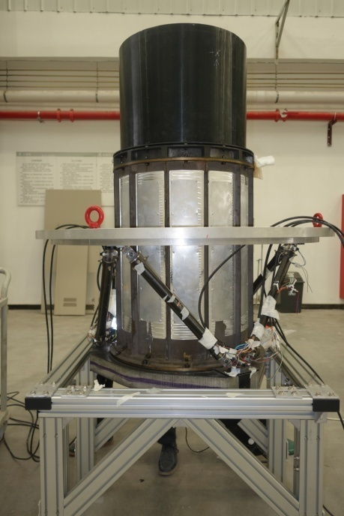
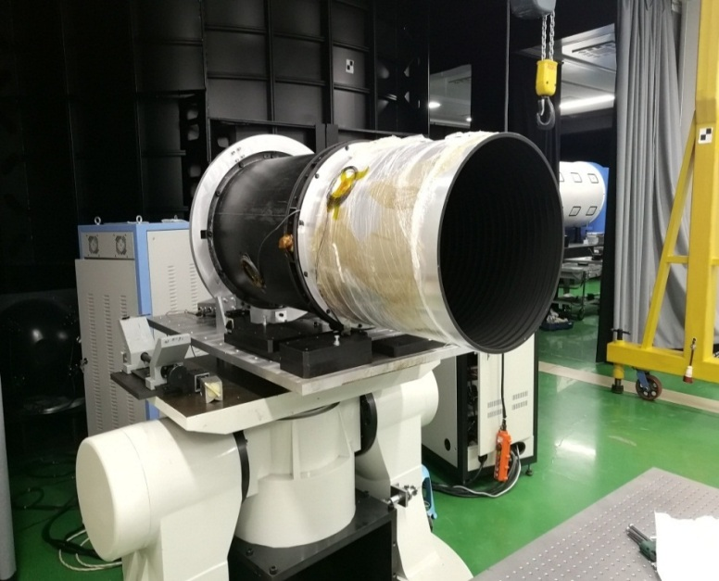
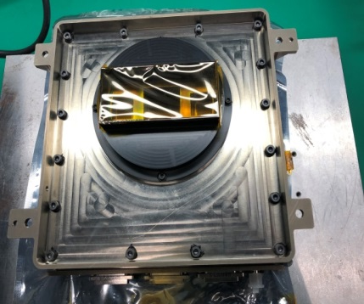
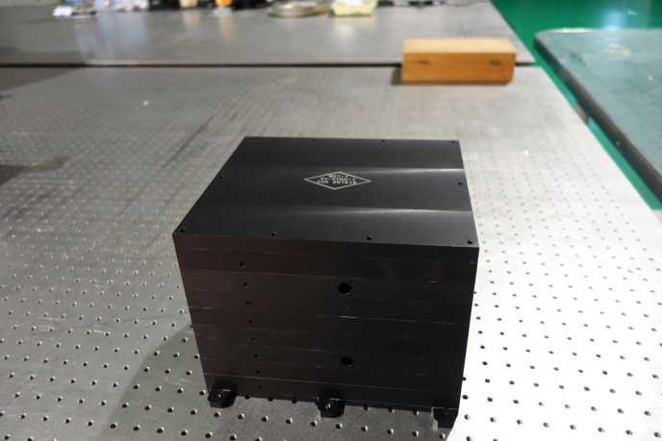
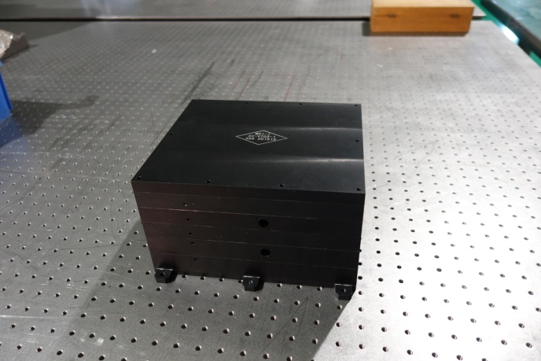
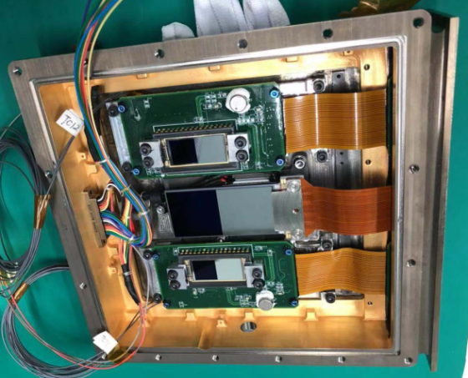
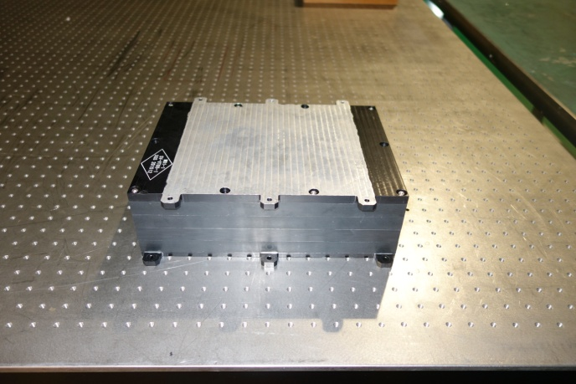
The space segment – VT STATUS
STM
QM
  VT STM fabrication
    Telescope ready
    Thermal bus ready
    Integration at SECM
  VT QM fabrication
    Hardware / Software integration at XIOPM
    Qualification tests (vibration, shockl) performed
    Thermal cycle on going
    Calibration campaign at NAOC
  VT Flight Model fabrication
    All parts are procured (EEE components, detectors, MLI, connectors, …)
    Waiting for sub-system qualification tests before going ahead in PFM fabrication
CCD
FGS
MPO FM #02 at Leicester

Slide 16
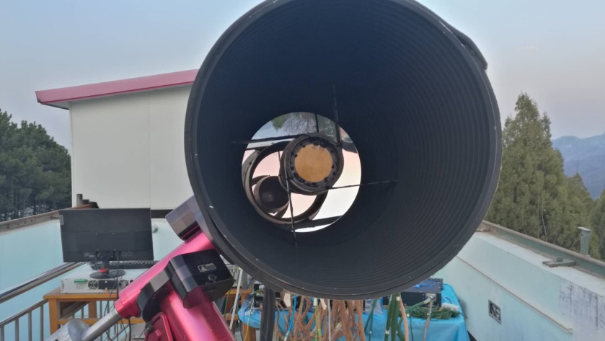
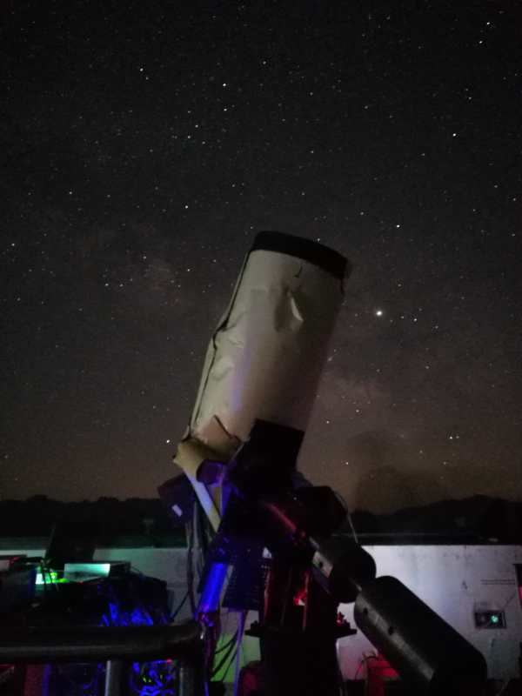
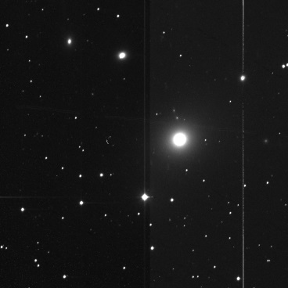
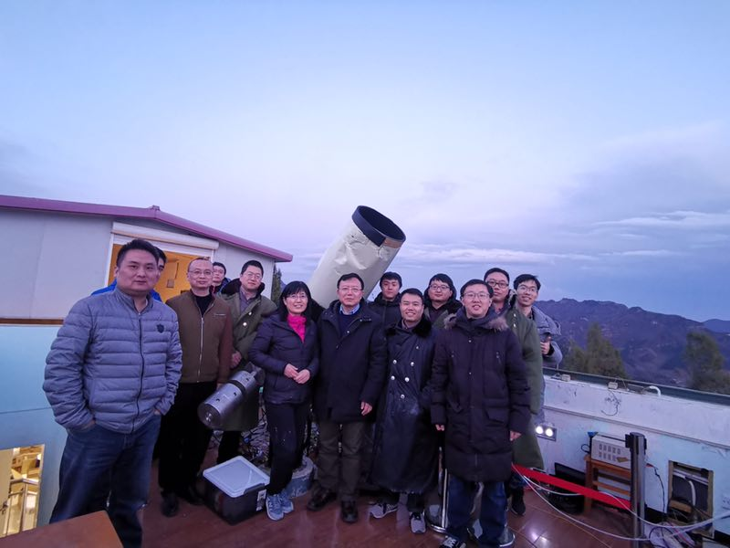
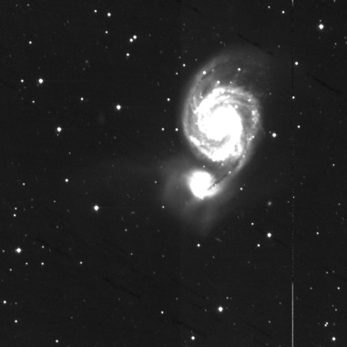
The space segment – VT STATUS
QM performance campaign
Blue Channel
M87
M51
Xinglong Observatory
QM of VT achieves the required sensitivity

Slide 17
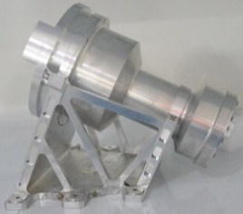
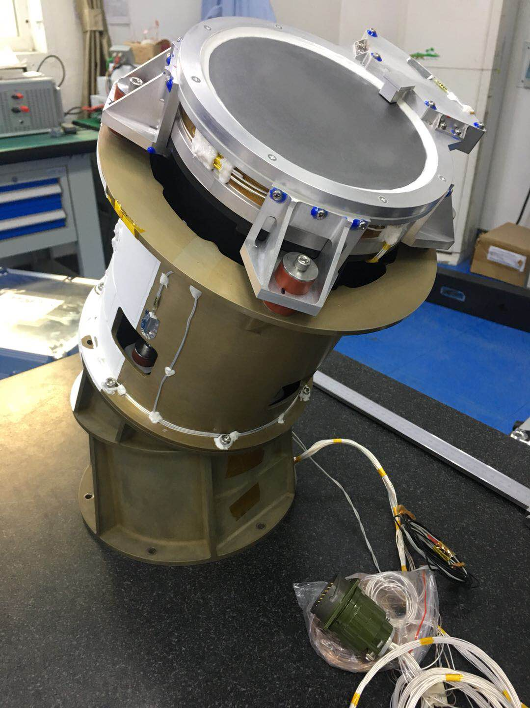




The space segment – GRM STATUS
STM
QM
  GRM STM fabrication
    Developed
    Integration at IHEP
    Delivered
  GRM QM fabrication
    Hardware / Software integration at IHEP
    Vibration and shock tests performed
    Calibration campaign at IHEP
  GRM Flight Model fabrication
    All parts are procured (EEE components, detectors, MLI, connectors, …)
    Waiting for sub-system qualification tests before going ahead in PFM fabrication
MPO FM #02 at Leicester

Slide 18


The space segment – GRM STATUS
QM mechanical tests
QM electrical tests

Slide 19





The space segment – Flat satellite campaign
EQM’s tested in SECMfacilities
from February 18th to March 13th 2019

Slide 20



svom alert system
The VHF NETWORK
Alerts are transmitted to a network of ~40 VHF receivers on Earth
Goal: 65% of the alerts received within 30 s at the French Science Center

Slide 21


The VHF NETWORK
First installation in South Africa
First reception on the NOA19 satellites
First Tests of the VHF Ground Station Prototypee
Excellent Results !

Slide 22

Kourou, French Guyana
The VHF Network
Station installed on 2019 May 14
Next station will be installed at GuanXI University on Spetember 19
The San Pedro station is part of the next batch (Fall 2019)

Slide 23



The Ground Follow-up Telescope of SVOM
at Changchun Observatory
Zhe Kang
Changchun Observatory, NAO, CAS

Slide 24

That's ALL
launch 2021 !

Slide 25




orbit and pointing strategy
svom Mission Profile
Optimizing the ground follow-up of GRB candidates (should increase the success of the ground redshift measurement)
NIGHT SIDE
SUN
Nearly anti-solar pointing
=> Earth in the field of view
65% of duty cycle for ECLAIRs
about 50% for MXT and VT
Waiting between the detection of two GRB candidates…
Avoidance of the galactic plane (most of the time) and also intense sources such as Sco X-1
ECLAIRs exposure map
(65 GRBs/year, 1 ToO per day)
- 4 Ms in the direction of the galactic poles
- 500 ks on the galactic plane

Slide 26


Core Program : a complete GRB sample
GRB trigger
ECLAIRs
42-80 GRBs/yr
SVOM is sensitive to all classes of GRB (long/short/soft/…)

Slide 27

Core Program : a complete GRB sample
Prompt emission
ECLAIRs+GRM
Prompt GRB emission over 3 decades
(4 keV-5.5 MeV)
GWAC
prompt visible emission
in ~16% of cases
The multi-component spectrum of the Fermi/GBM burst GRB 100724B simulated in ECLAIRs+GRM.

Slide 28


Core Program : a complete GRB sample
Afterglow & distance
slew request: 36-72 GRB/yr
MXT
X-ray afterglow
(>90% of GRBs after a slew)
VT
Visible and NIR afterglow
+photometric redshift
GWAC
C-GFT/F-GFT
Very large telescopes
The X-ray afterglow of the Swift burst GRB 091020 simulated in MXT.
Redshift in ~2/3 of cases
-> See Frederic Daigne presentation

Slide 29

besides GRBs …svom as an open observatory
svom ProGRAMS
The general program (GP)
  Observation proposals being awarded by a TAC (a SVOM co-I needs to be part of your proposal) for astrophysical targets of interest mostly compliant with the satellite attitude law
  Only 10% of the time can be spent on low Galactic latitude sources during the nominal mission, up to 50% during the extended mission
Target of Opportunity (ToO) programs
  ToO-NOM is the nominal ToO which covers the basic needs for efficient transient follow-up alerts sent from the ground to the satellite (GRB revisit, known source flaring, new transient)
  ToO-EX is the exceptional ToO which covers the needs for a fast ToO-NOM in case of an exceptional astrophysical event we want to observe rapidly.
  ToO-MM is the ToO-EX dedicated to EM counterpart search in response to a multi-messenger alert. What differs from the ToO-NOM and ToO-EX is the unknown position of the source within a large error box…
  Initially 1 ToO/day focussed on time domain astrophysics, will increase during the extended mission

Slide 30

One year of SVOM Observation
svom ProGRAMS
Core Program GRBs 61 pointings,
ToOs Program 318 pointings
General Program 1293 pointings

