Slide 1
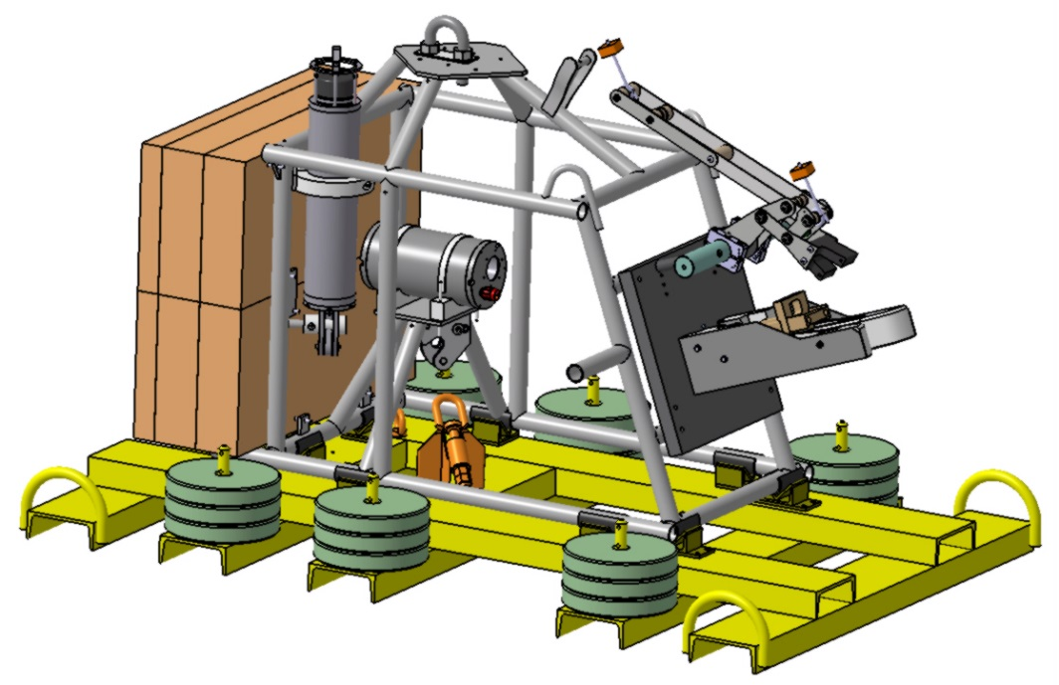
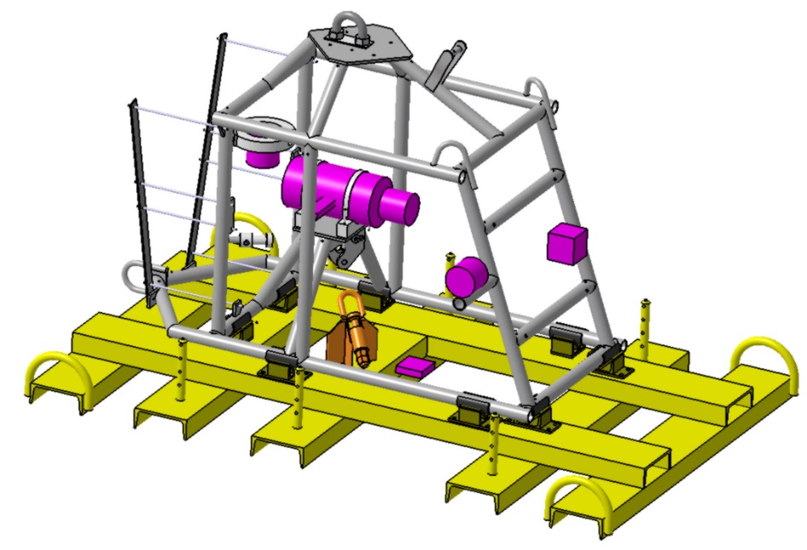
REMINDER (1/2)
Design
Design of the structure (oct / dec 2018)
Two CAD models (in air / in water) for the Centre of gravity calculations
Calculation of the behavior of the struture : in air, during the deployment and recovery phases, on the sea bed
Philippe LAGIER – october 15, 2018

Slide 2
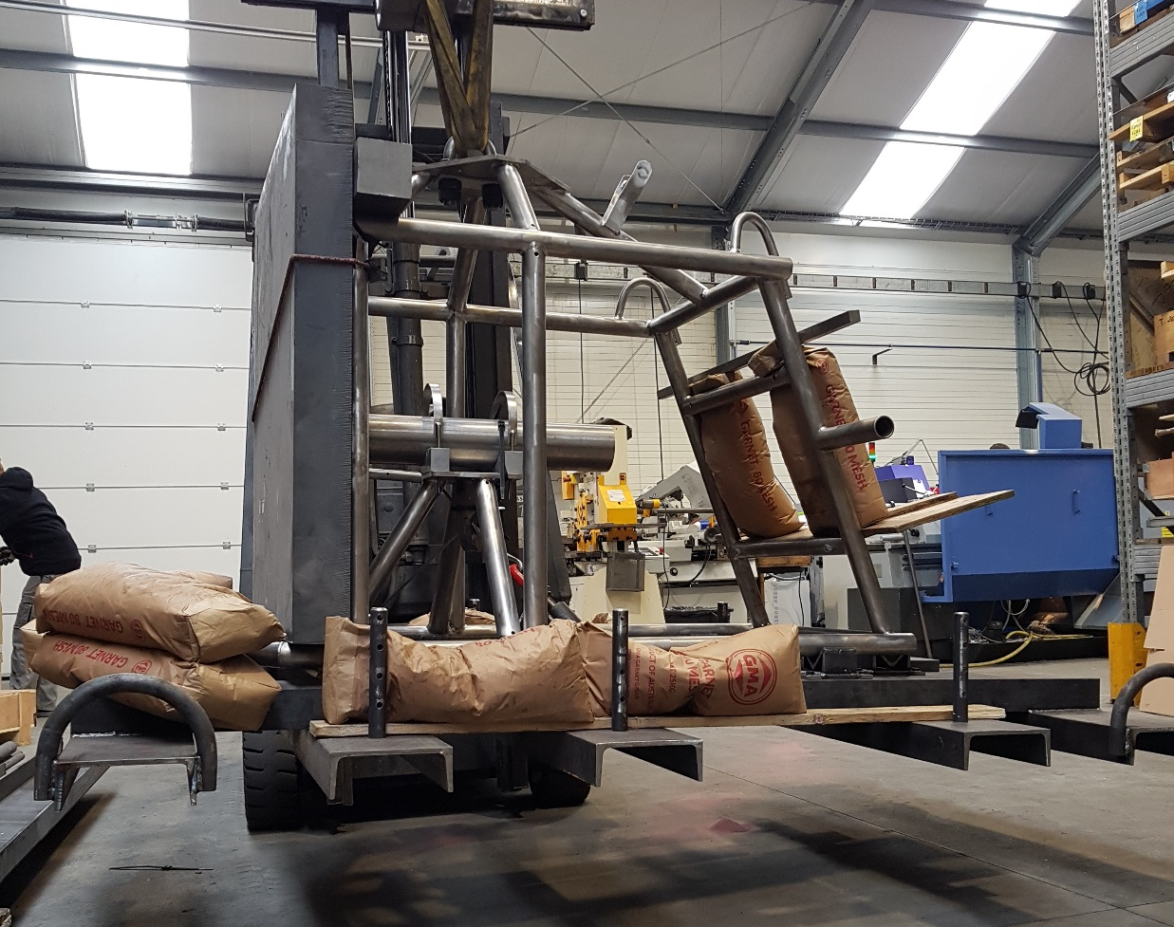
REMINDER (2/2)
Manufacturing
Tender : january to april 2018
Normafil, a french firm specialised in titanium machining / soldering
Load test of the structure performed by the firm (march 25, 2018)
Checking of the titanium soldering with dye penetrant performed by Institut de Soudure (march 29, 2018)
Delivery @ CPPM of deadweight, recoverable part and fixation parts (april 10, 2018)
Philippe LAGIER – october 15, 2018

Slide 3
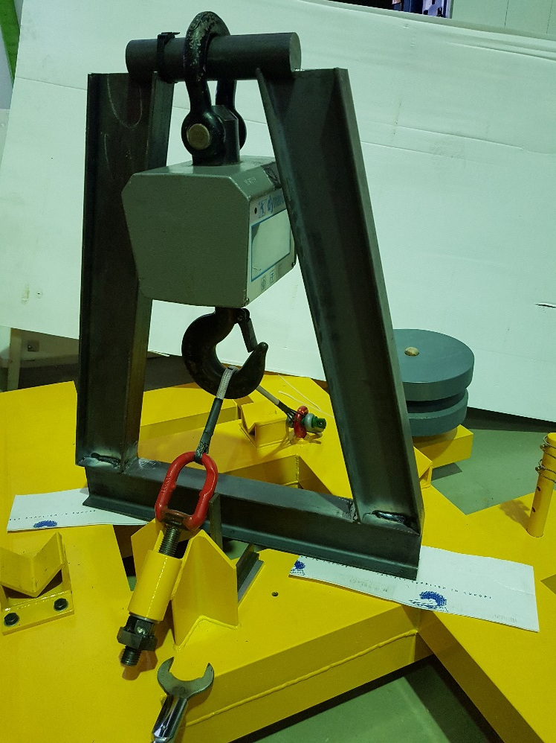
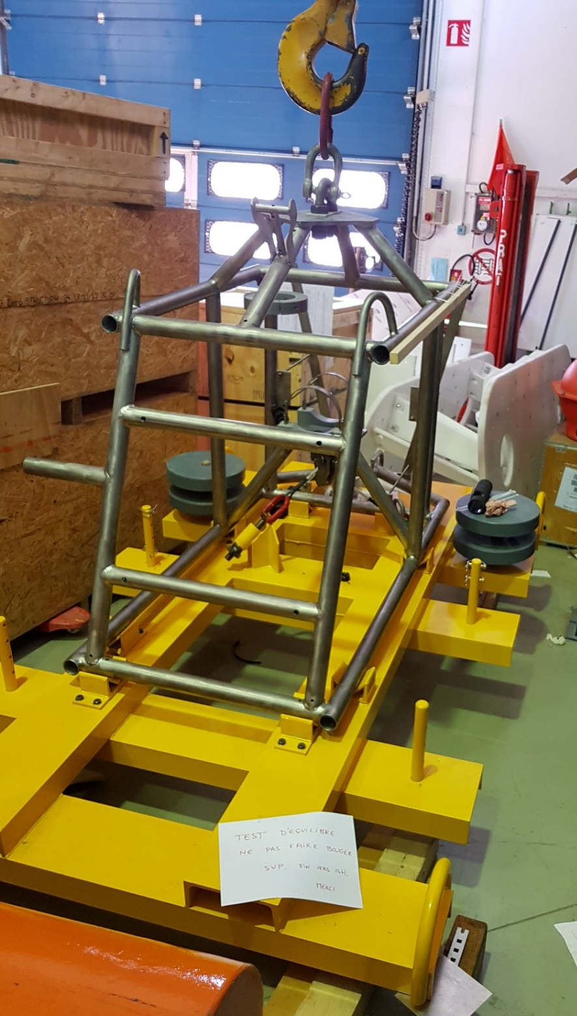
WORK in PROGRESS @ CPPM
Checking of the structure at delivery : dimensions, mounting, solderings, release system...
Study of the Dynema link between Deadweight and Recoverable part :
- specialized companies in Dynema ?
- tests of the link : tension max ? elongation ?
breaking strength ?...
Release tests of the Recoverable part
Philippe LAGIER – october 15, 2018

Slide 4
APPENDICES

Slide 5
MAINS SPECIFICATIONS of the ANCHOR
S1 :
Fix the inductive line and ICC without damages during sea operations
S6 :
Use the maximum of validated technologies on the DU
S2 :
Allow the deployment of the line with the winch of the boat
S7 :
Support the IU/CB cable during inspection by the ROV
S3 :
Allow the recovery of the IU for maintenance, ordered by the ROV
S8 :
Life time of 10 years minimum in the sea environment : 250 bars, seawater T° 13°C, storage T° -10/+60°C, salinity
S4 :
Fix the mechanical elements : Connection block, Electronic container, Inductive line and Inductive Cable Coupler, Acoustic release
S9 :
To be transportable with lorry
S10 :
Withstand to efforts, chocks, vibrations, handling (whorkshop, lorry, boat)
S5 :
Allow the mate/demate of the IU/CB cable by the ROV
S11 :
Limit manufacturing costs
Ph. LAGIER – CPPM – Manufacturing review – 01.03.2018
p.2

Slide 6
LIST of the STUDYED POINTS for DESIGN (RANDOM ORDER)
1. ICC : fixation, movements, protection against galvanic corrosion
2. Accoustic release : no masking, safe position, mounting
3. Release system : redundant system, decoupling of the acoustic release, maintenance
4. Materials : lifetime, mechanical fonctions, machining
5. Costs : frames shapes, technological choices
6. Mass : additional masses, air/water calculations, structures behavior
7. Deadweight/Recoverable part interface : adjustable supports, galvanic protections, releasable link
8. Validated technologies (DU) : release hook, electrochemical insulation, connection block, Dynema link
9. Connection block : height positionning, arm angle and design same as DU
10. Buoyancy block : trade blocks, fixation design, fixation/buoyancy yield
11. Overall volume : compatible with the road transport, height under the hoist of the boat
12. Jumper cable path : lenghts, curves, fixation
13. Galvanic corrosion : deadweight/recoverable part, fixation of the inductive cable
14. Electronic container : safe location, jumper cable orientation, mounting
15. Recoverable part release : behavior, no sucking
16. Standardization : bars profiles, materials, screws, technological choices
17. Assembling : procedures, adjustings, accessibilities
S11
S6
S8
S11
Ph. LAGIER – CPPM – Manufacturing review – 01.03.2018
p.3

Slide 7
MASSES CALCULATIONS
(work document)
SPECIFICATION : S3
(IU recovery)
p.7

Slide 8
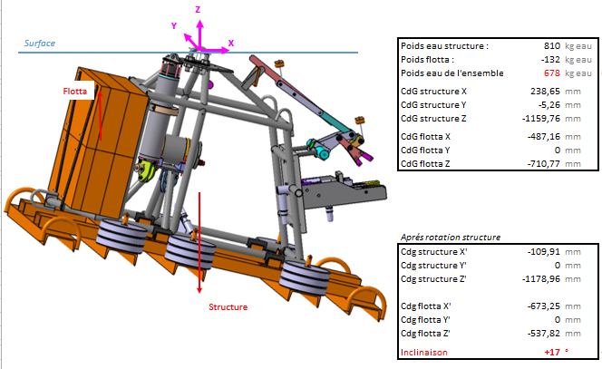
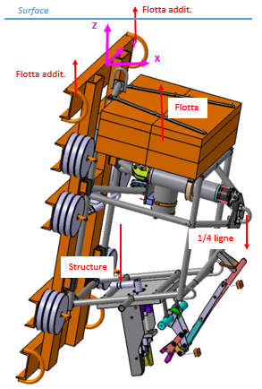
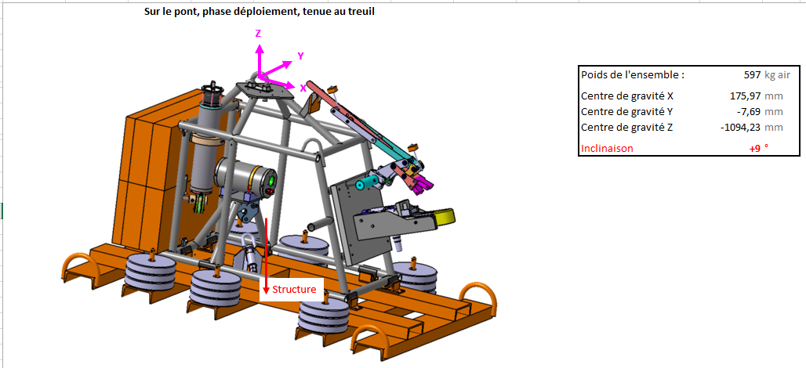
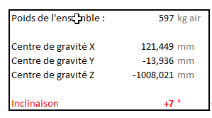
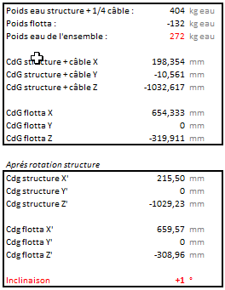
BEHAVIOR CALCULATIONS of the ANCHOR
SPECIFICATION : S1
(no damages on the Inductive cable)
On the deck, under the hoist, deployment phase
Sea surface, under the hoist, deployment phase
Sea surface, under +buoyancy, deployment phase
With additional masses
Without additional masses
p.9

Slide 9
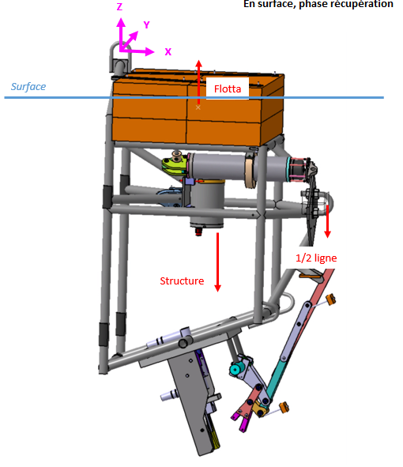
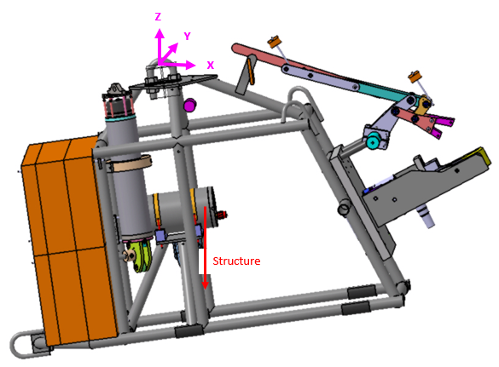
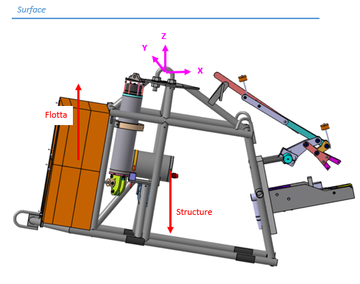
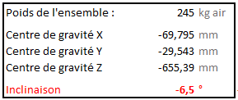
BEHAVIOR CALCULATIONS of the ANCHOR
Recovery, buoyancy with top buoy + recoverable part
Sea surface, recovery phase
On the deck, under the hoist, recovery phase
EVOLUTIONARY BEHAVIOR
validated !
Ph. LAGIER – CPPM – Manufacturing review – 01.03.2018
p.10

