Slide 1
Tracker TEDD project at IPNL
CMS Tracker Upgrade France
05/12/18
M. Bouhelal, P. Calabria, N. Chanon, F. Charlieux, P. Dené, T. Dupasquier, A. Eynard, L. Germani, N. Lumb, E. Schibler, F. Schirra, S. Viret

Slide 2
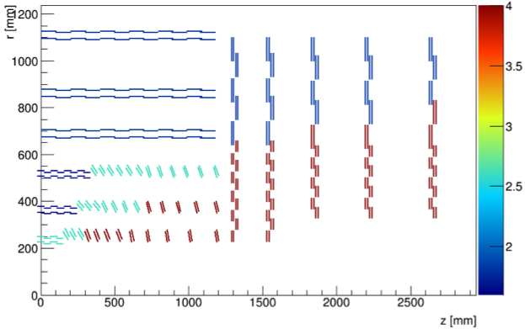
TEDD: Tracker Endcap Double Disks
TEDD2
TEDD1
TEDD:
1 TEDD1 is made of 2 double-disks of the same type
1 TEDD2 is made of 3 double-disks (quasi-identical, last one has additional 4mm 2S module ring)
1 double-disk is formed of 4 Dees

Slide 3
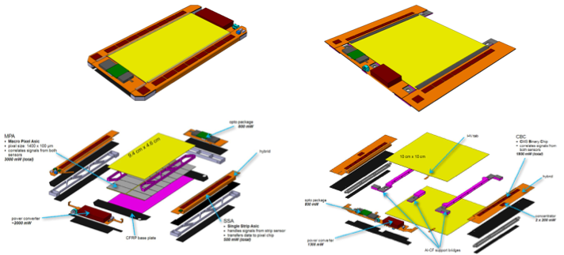
2S and PS modules
PS module
2S module

Slide 4
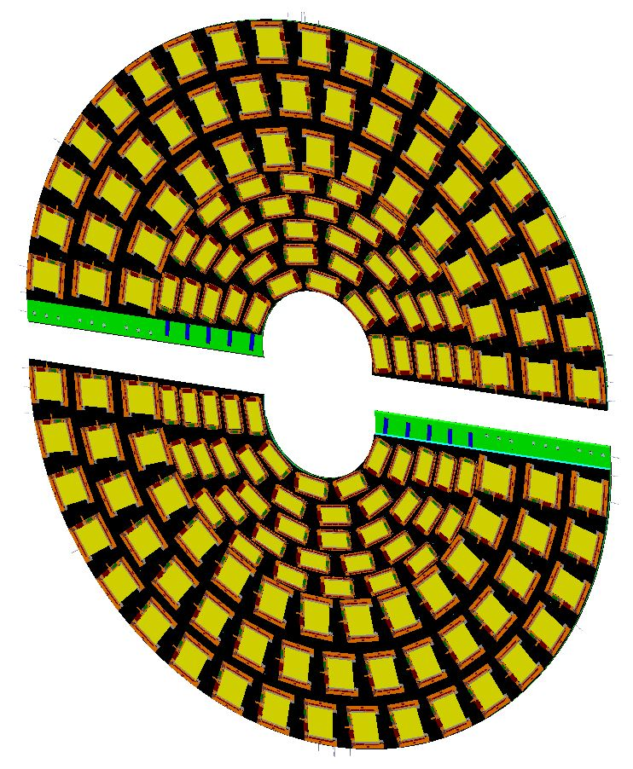
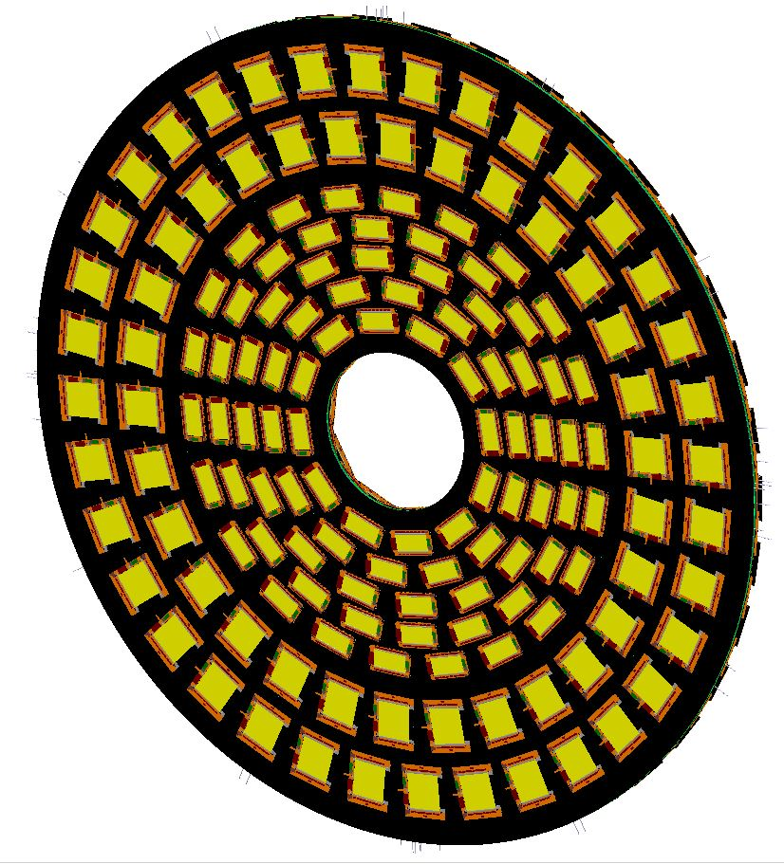
Double-disks concept: overview
2x
Two thin (10mm) composite disks make up the Double-Disk system
Each single disk comprised of two semi-circular ‘Dees’
Integrated cooling
Module/Dee | PS | 2S
TEDD1 odd | 76 | 96
TEDD1 even | 84 | 66
TEDD2 odd | 52 | 96
TEDD2 even | 70 | 64

Slide 5
IPNL responsibilities
IPNL responsibilities in TEDD project:
Design of all type of Dees
Construction and qualification of all TEDD2 Dees (24)
Integration of 12 TEDD2 Dees
Mechanical design of TEDD
Axe ‘Dees’
→ Axe ‘Superstructure’
The team at IPNL
Nicolas Chanon, Sébastien Viret: Physicists
Nick Lumb: Dees design and prototyping, technical coordination
Thierry Dupasquier: TEDD mechanical design and integration, Dees prototyping
Pierre Dené: TEDD mechanical design and integration
Emilie Schibler: TEDD mechanical simulations
Florent Schirra, Peter Calabria, Florence Charlieux: Running of CO2 cooling system (thermal tests)
Malik Bouhelal, Alexis Eynard, Lionel Germani: Technical support

Slide 6
Axe ‘Dees’
S. Mersi**
G. Hugo**
tkLayout
N. Lumb
CAO
Conception globale
N. Lumb
Interface entreprises
Suivi construction
T. Dupasquier*
CAO détaillé, gabarits
A. Eynard*, L. Germani*
Construction
Prototypage
M. Bouhelal (installation)
P. Calabria (éléctronique/DAQ)
F. Charlieux (slow CTRL)
N. Lumb
F. Schirra
Test/validation
A. Eynard*
Contôles mécaniques
(coordination/analyse)
Production en série
2021-2025
Même équipe
+ physiciens
+ CDDs
* Bureau d’études IPNL
**CERN
Intégration modules Si

Slide 7
Axe ‘Superstructure’
N. Chanon
N. Lumb
Conception
P. Dené*
T. Dupasquier*
N. Chanon
N. Lumb
Simulation
E. Schibler*
Prototypage
Test/validation
* Bureau d’études IPNL

Slide 8
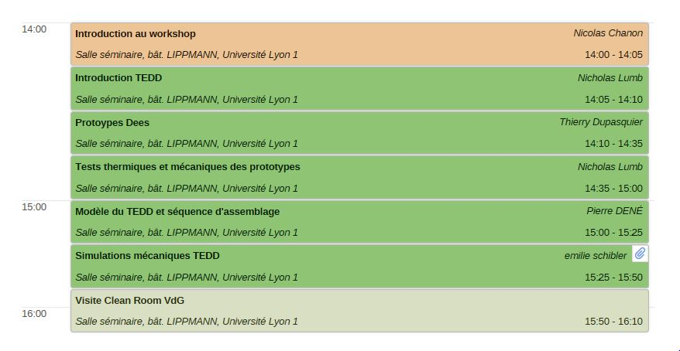
Afternoon session
‘Dees’
‘Super-
structure’

