Slide 1
Test beam facility
at IPHC(Strasbourg)
Jeremy Andrea,
Ulrich Goerlach, Jean-Marie Brom
On behalf of the IPHC team
With the participation of Demokritos :
Patrick Asenov, Dimitris Loukas.
1

Slide 2
Introduction
CYRCé CMS beam line will provide protons at 25 MeV at high rate.
  Large energy deposition in silicone sensors,
  ~3 mm before being stopped,
  Potentially large multiple scattering.
How can we design and build a telescope that can reconstruct good tracks ?
Strategy :
  Study energy deposition in silicone modules, what it is, how bad is the multiple scattering, what is the cluster size ?
  Geant4 simulations of CMS pixel phase1 and 2S phase 2 modules,
  Study the mechanics,
  Prepare the DAQ.

Slide 3
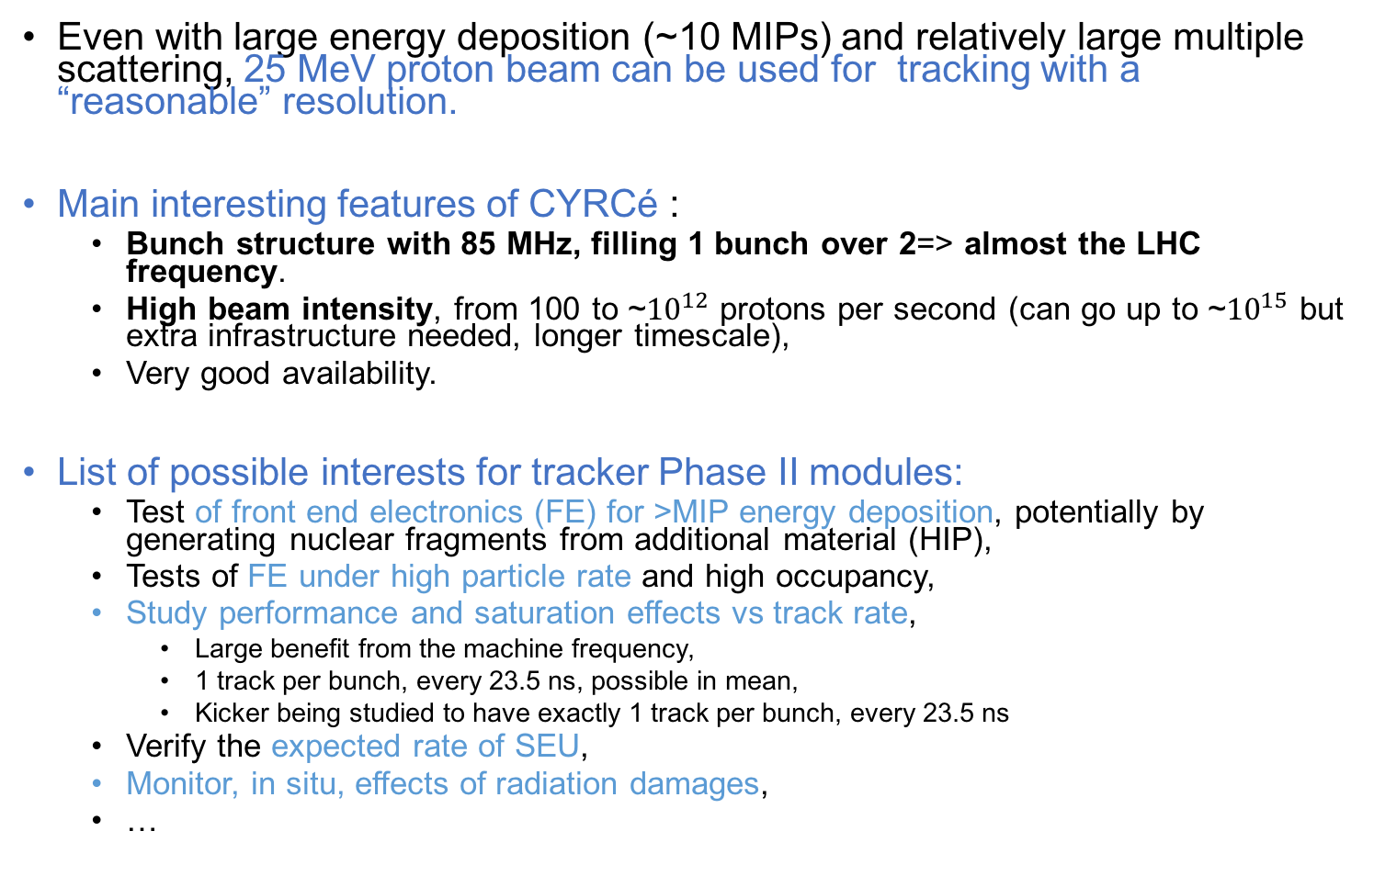
Possible interests for CMS Tracker
Even with large energy deposition (~10 MIPs) and relatively large multiple scattering, 25 MeV proton beam can be used for tracking with a “reasonable” resolution.
Main interesting features of CYRCé :
  Bunch structure with 85 MHz, filling 1 bunch over 2=> almost the LHC frequency.
  High beam intensity, from 100 to ~${10}^{12}$ protons per second (can go up to ~${10}^{15}$ but extra infrastructure needed, longer timescale),
  Very good availability.
List of possible interests for tracker Phase II modules:
  Test of front end electronics (FE) for >MIP energy deposition, potentially by generating nuclear fragments from additional material (HIP),
  Tests of FE under high particle rate and high occupancy,
  Study performance and saturation effects vs track rate,
    Large benefit from the machine frequency,
    1 track per bunch, every 23.5 ns, possible in mean,
    Kicker being studied to have exactly 1 track per bunch, every 23.5 ns
  Verify the expected rate of SEU,
  Monitor, in situ, effects of radiation damages,
  …

Slide 4
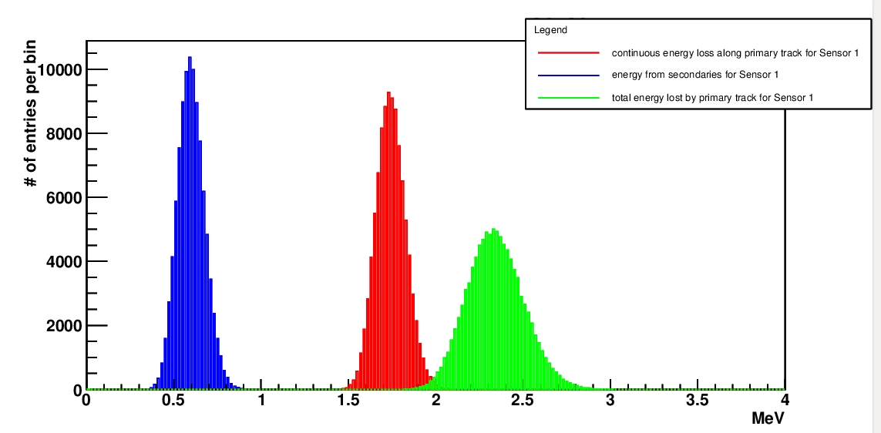
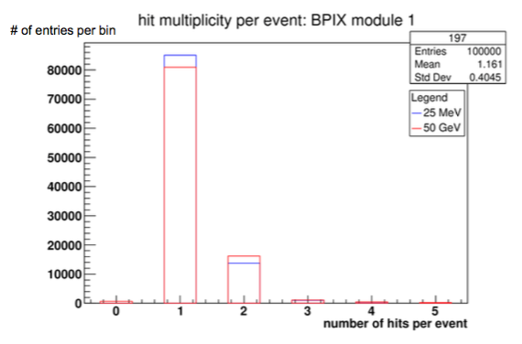
Energy deposition
Energy deposition in a pixel phase 1 module (320 microns).
The total loss of beam energy of 2.3 MeV (~10%).
With large energy deposition comes potential larger cluster size => charged shared on more than 1 pixel.
Can potentially affect the resolution of cluster position.
Can give more than one cluster per track.
Results from simulation : most of the events have only 1 pixel fired per track.
4

Slide 5
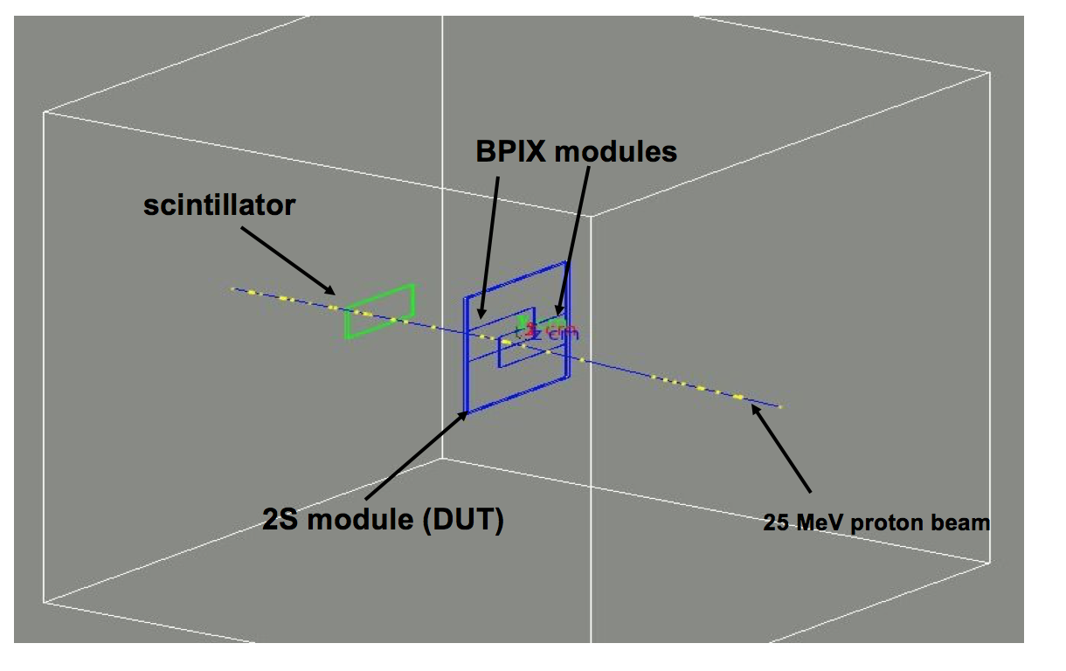
Design of mini-telescope
Geant 4 simulation of the entire device (excluding mechanics, which should be off beam anyway).
To deal with beam specificities :
  low material budget, only 2 pixel planes (320 micons),
  Reduced effect of the multiple scattering, pixel modules at 1 cm of the DUT,
  DUT is a 2S modules (460 microns for each sensors).

Slide 6
Cluster size in the mini-telescope
Pixel 1
Pixel 2
2S mod1
2S mod3
Most of the events have only 1 pixel/strip fired per track.

Slide 7
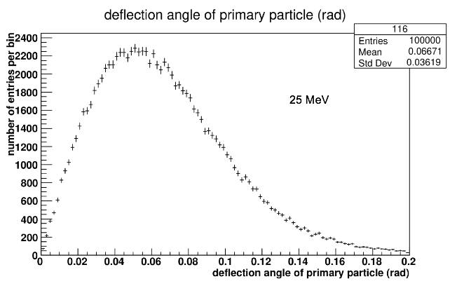
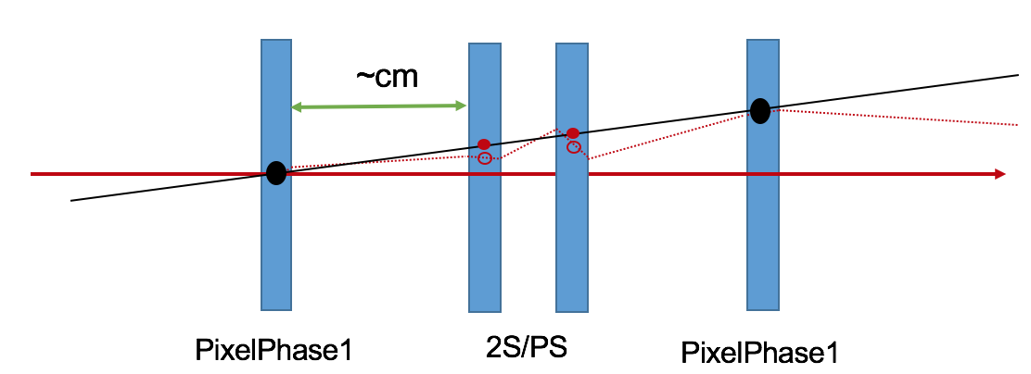
Multiple scattering and residuals
real track
reconstructed track
strip length // x-axis
strip pitch // y-axis

Slide 8
Mini-telescope mechanics
Constrains :
  Keep a low material budget,
  Have reference planes as close as possible to the Detector Under Test (DUT),
  Device capable of adapting different DUT sizes,
  Cooling…
Design :
  Two Pixel Phase I module planes,
  Modules sandwiching the DUT, on shifting (on trail) planes to accommodate different sizes of DUT,
  Pixel modules positioned at ~+(-)1 cm from the DUT,
  DUT on a x-y table, with 15x15 cm shifts.
Pixel modules
Movable support
trail
DUT on x-y table

Slide 9
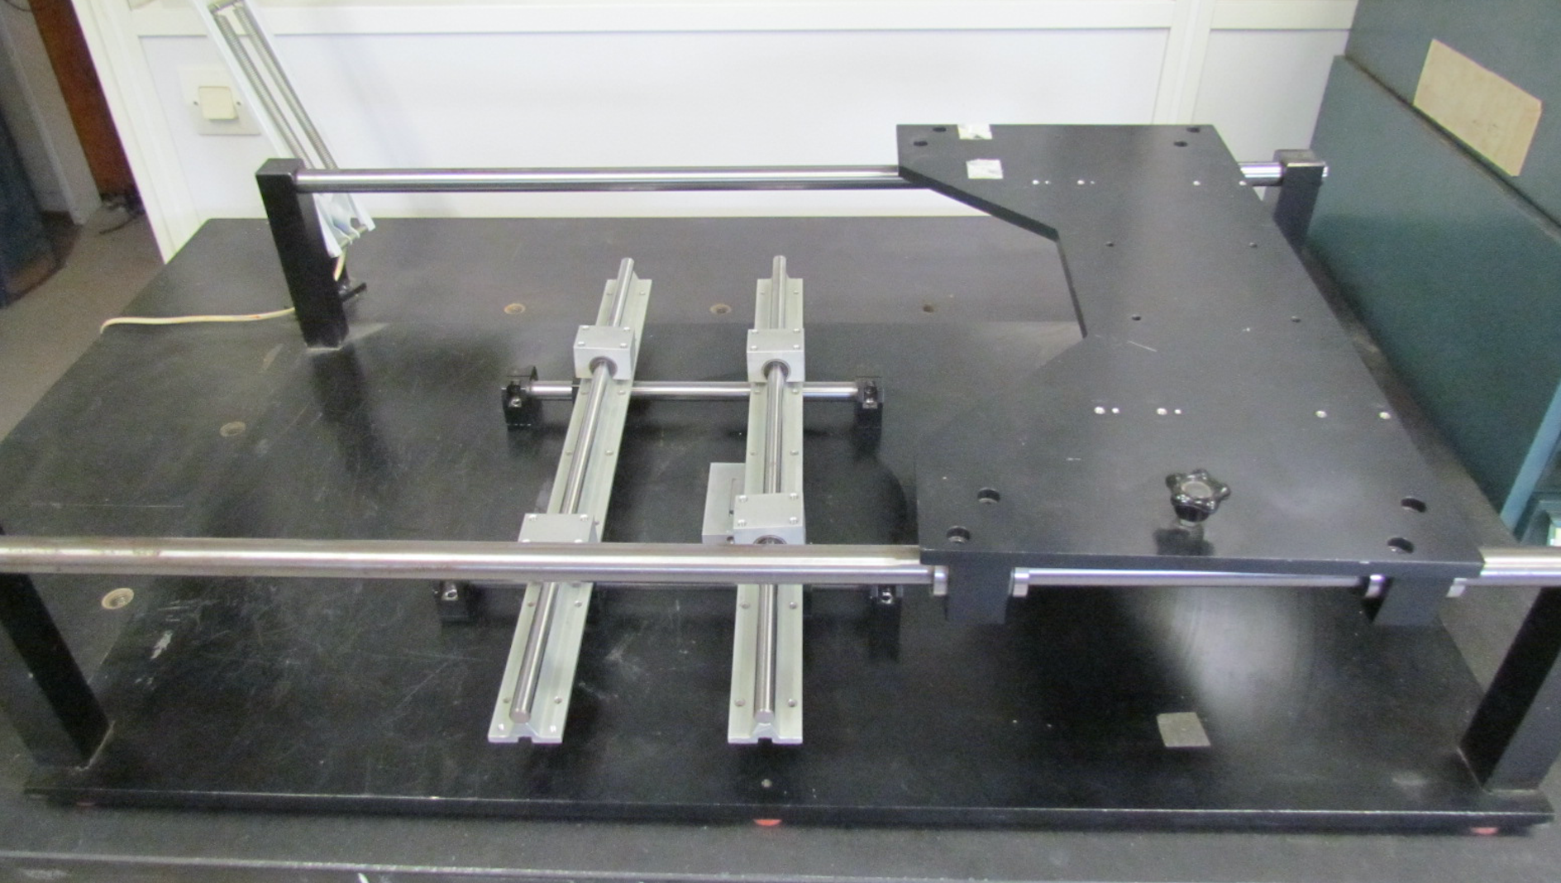
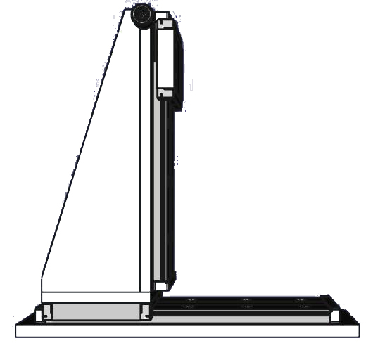
Mini-telescope mechanics
DUT
Y
X
Status of the mechanics :
  The trains and movable planes are being build on an existing,
  X-Y table has been ordered.
  The telescope will be in a box for light tight (to be designed and build)
  Cooling still under investigation : by “cold” water (~15°), by cold air flow (need fanes and cooling machine), Peltier would add to much material budget ?

Slide 10
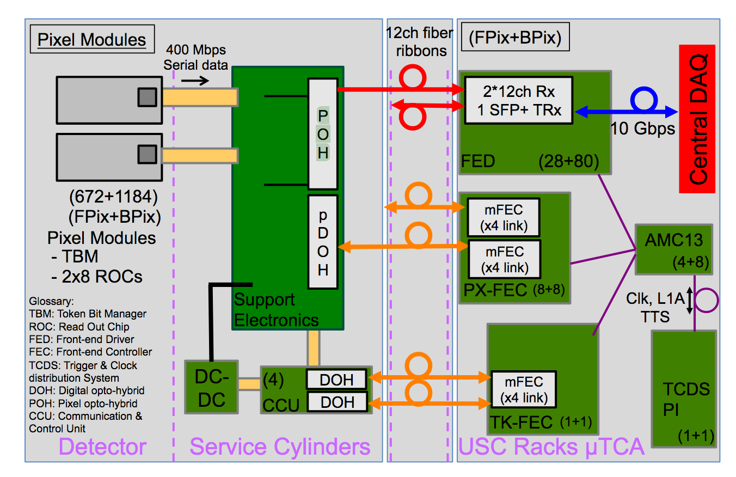
Mini-telescope sensors and DAQ
2 pixel plans :
  4 Layer 3-4 BPix modules of grade C, furnished by pixel phase I responsible in early 2019,
  Power Supply for LV => we already have
  Power Supply for HV => ordered.
DAQ for the pixel modules, inspired from CMS pixel and CHROMIE (pixel telescope link). Different ingredients still being identified :
  uTCA crate,
  One AMC13 distribute clock and trigger to all FC7s via back plane of uTCA crate,
  One FC7 card : FED, Tracker FEC (program the supply electronics), Pixel FEC (fast control and trigger to the FE),
  FEDKit using FEROL for FED-computer data transfer,
  Service electronics card “MotherBoard”, which is a re-design of the one in CMS. Produced by Budapest’s group.
Exact implementation of the DAQ is still being investigated. ”Training” with the CHROME telescope planed.

Slide 11
Summary
The CYRCé-CMS beam line needs a telescope !
Preliminary studies and design finished:
  Configuration of the mini-telescope fixed (2 pixel planes +1/2 scintillators),
  Performance of the telescope estimated from simulation, enough for performance measurements,
  Design of the mechanics fixed, mini-telescope is being constructed.
Still a significant amount of work required :
  Finalized the cooling system,
  Implement monitoring !! (temperatures, humidity, voltages),
  Get the all the materials for the DAQ, and make it work,
  Perform commissioning (all the calibrations and debugging,
In parallel, we need to define with CMS a clear plan for beam tests at high rate in 2019. There is room for collaborations with Lyon on the analyses of test beam !

