Slide 1

TEDD Structure on 2018-12-05
Not for diffusion
IPNL internal use only
V.02
2018 December 05th - IPNL

Slide 2
Purpose of this document
To show the developments of the TEDD structure
To list the remaining tasks

Slide 3
TEDD structure until now
TEDD current structure:
  12 beams
  4 Strap rings
  Back-disk
Simulations and calculations were made until now with this configuration.

Slide 4
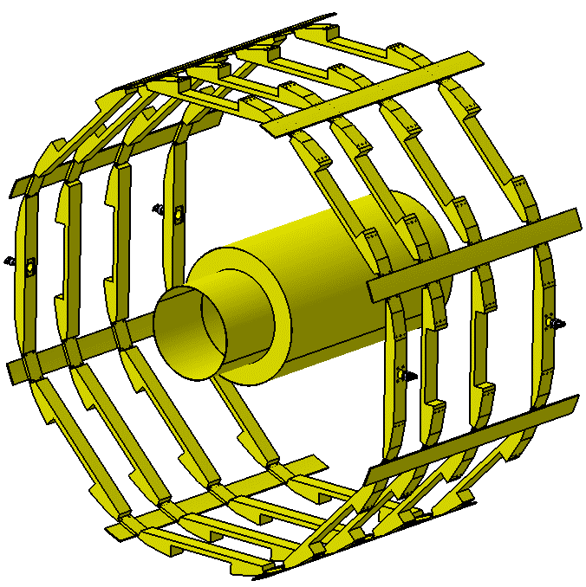
New configuration of structure
New features:
  8 beams
  4 Strap rings
  NO Back-disk
This design is only for the geometrical principles of the structure.
Straps shown here have to be re-designed.

Slide 5
New configuration of structure
Design trials…
Straight straps.
The 4 straps with deplacement wheel are not studied yet.
Curved straps with ridge.
The 4 straps with deplacement wheel are not studied yet.

Slide 6
To-Do List…
STRAPS:
  Work on the strap design to obtain an adapted shape and easy to manufacture.
  The 4 straps with deplacement wheel have to be redesigned.
  Ongoing talks with Louvain (patch-panels design) to have their needs about the function and a design of the straps.
INNER-TUBE:
  Simulations have to be done to define the necessity of the inner-tube.
  Considering the possibility to split the inner-tube into sections ?
WHOLE TEDD STRUCTURE:
  Simulations have to be done with the new configuration.

