Slide 1
CMS Tracker Upgrade France
Tests mécaniques et thermiques d’un prototype d’un Dee
Nick Lumb
Institut de Physique Nucléaire de Lyon
05/12/2018

Slide 2
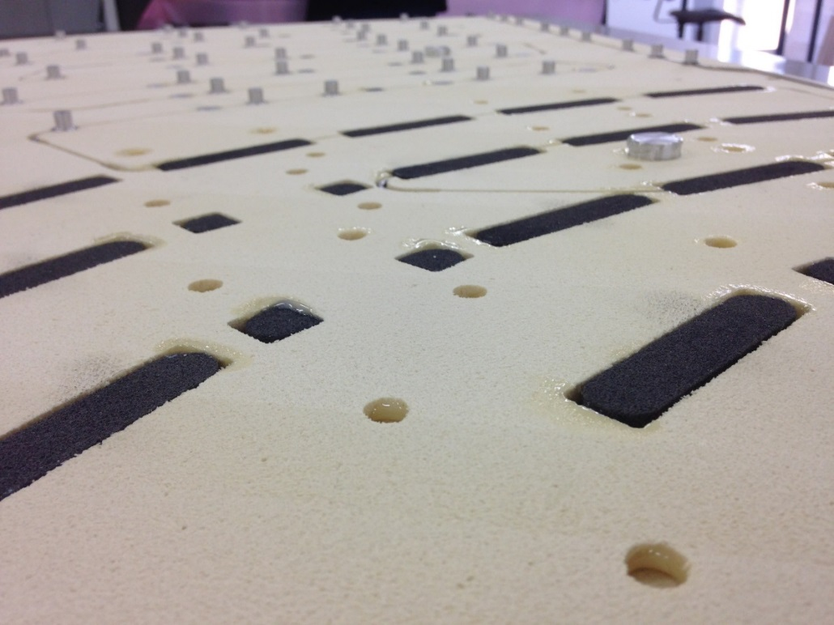
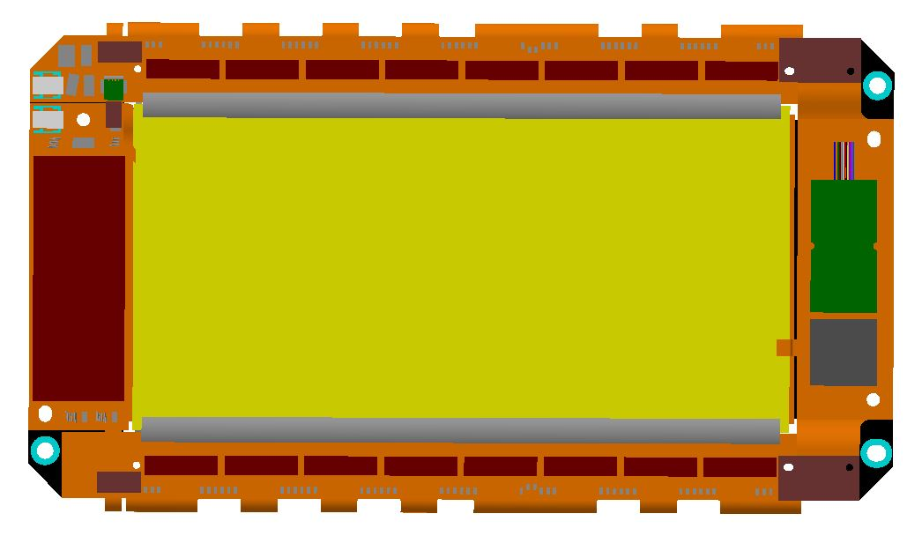
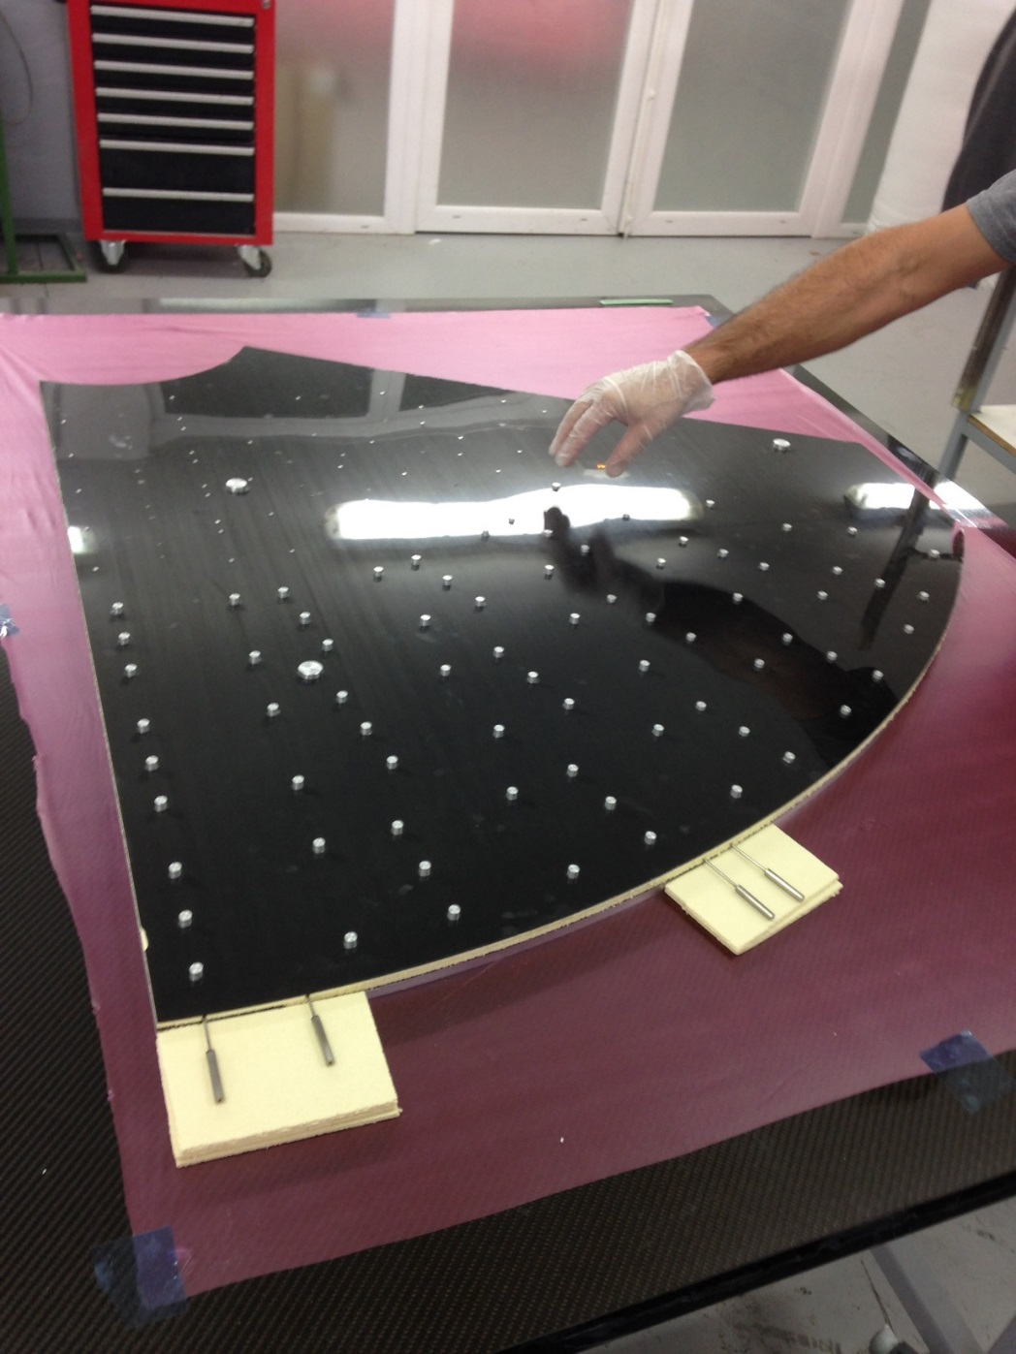
PS modules
Glued directly to carbon fiber skins above carbon foam thermal contacts
Inserts in Dee for 3x positioning screws per module

Slide 3
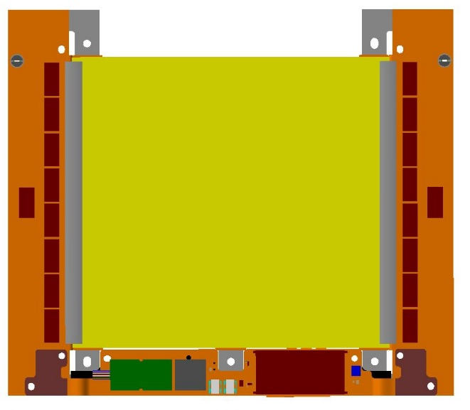
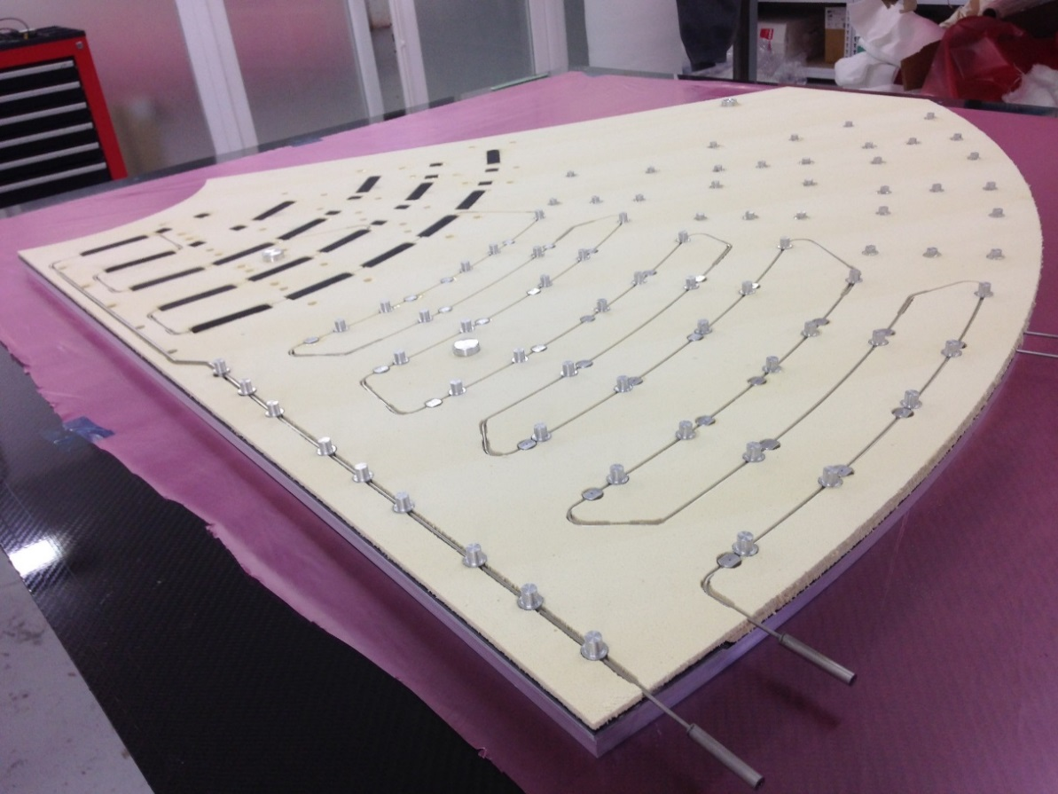
2S modules
5x aluminium inserts per module
For positioning and thermal contact

Slide 4
Objectifs des tests
Tests mécaniques
  Planéité globale
  Epaisseur du sandwich
  Précision en XYZ des inserts PS et 2S
Tests thermiques
  ∆T de 10°C entre fluide de refroidissement (CO2) et les modules
  Variation entre modules

Slide 5
Mechanical precision

Slide 6
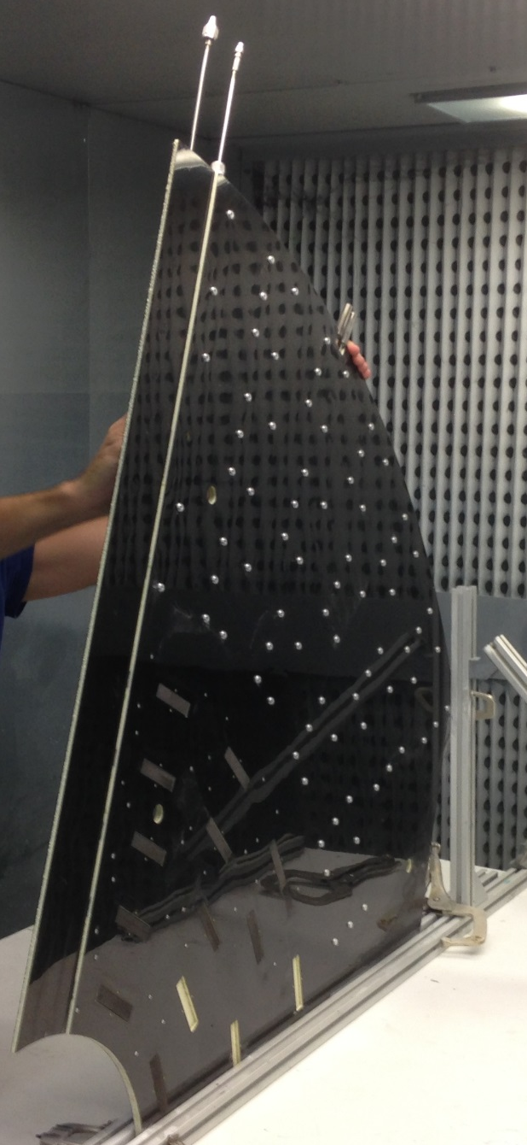
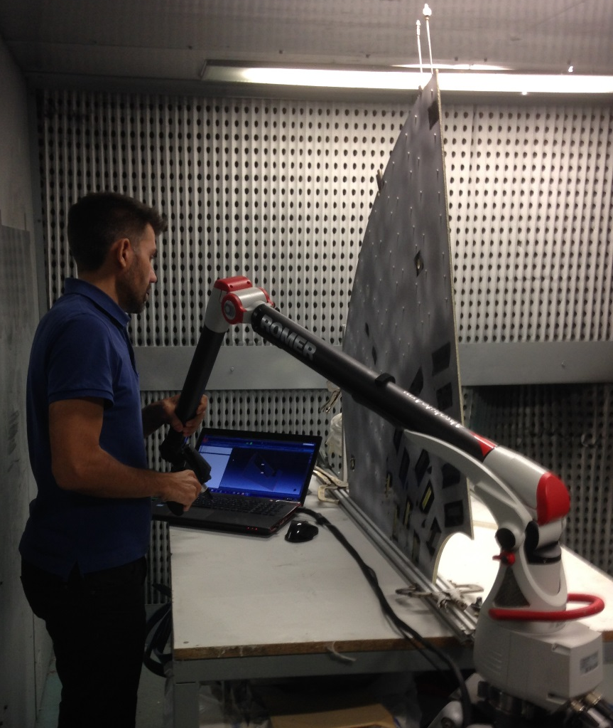
Overall flatness: laser scan (M3Axes)
Measurements performed with no constraints on prototype

Slide 7
Overall flatness: laser scan
+3.5mm
+3.5mm
-3.5mm
-3.5mm
+0.4mm
+0.4mm
-0.4mm
-0.4mm

Slide 8
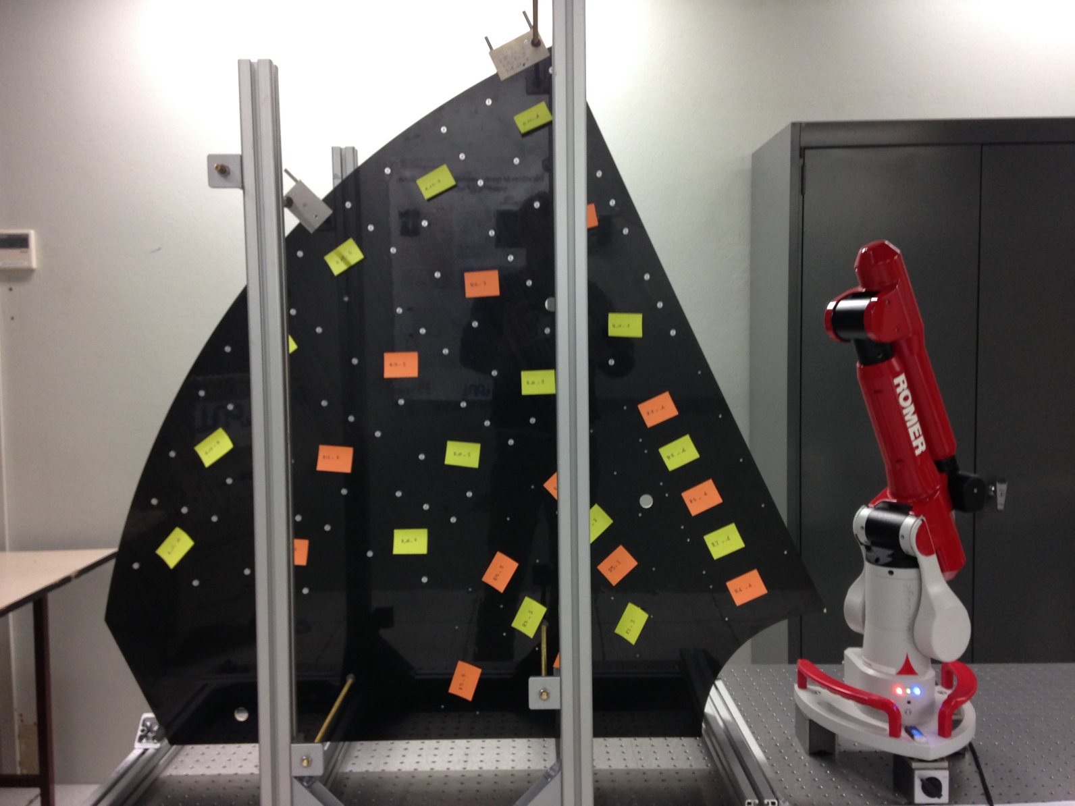
IPNL measurements
Romer measurement arm, ruby tip (3mm/6mm); prototype minimally constrained in vertical position

Slide 9
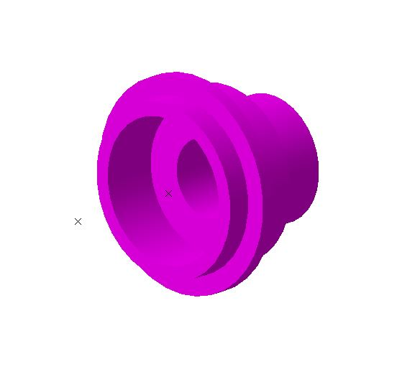
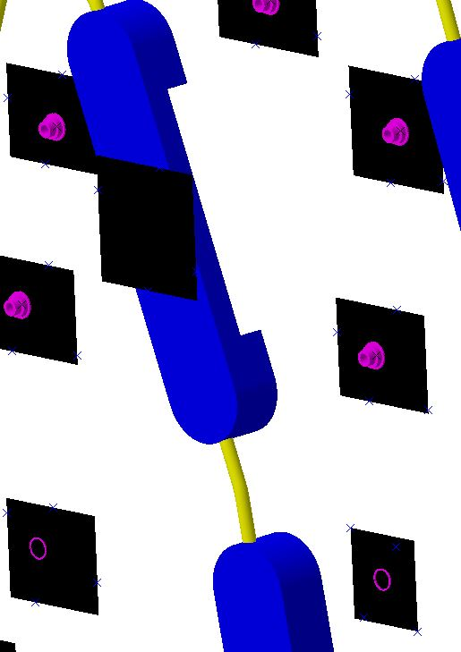
Measurement points - PS
CF skin height
above C-foams
Insert center and height (6mm ruby measurement tip in 3mm hole)
CF skin height
local to inserts

Slide 10
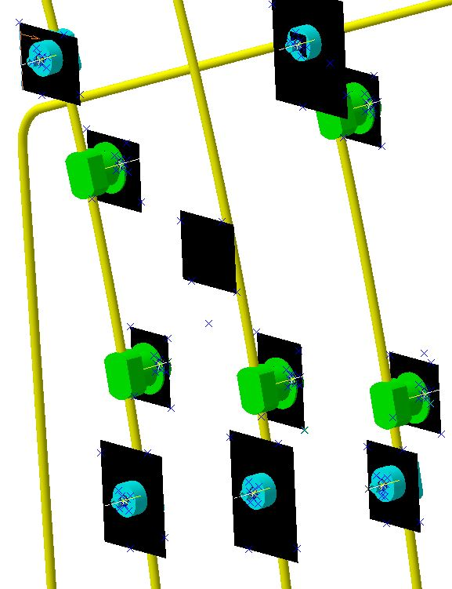
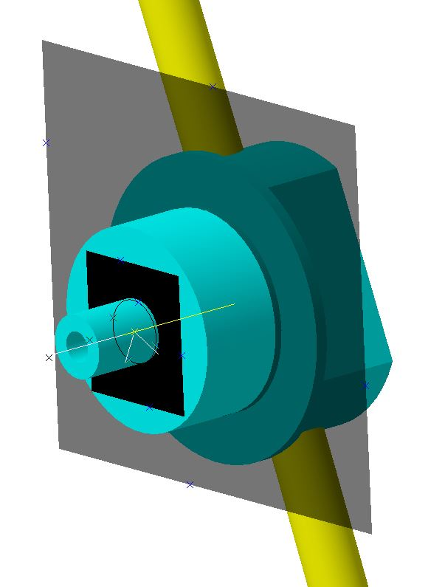
Measurement points - 2S
Center of circle reconstructed from points on insert nipple (3mm ruby tip)
CF skin height at module center
Height of module mounting surface
CF skin height
local to inserts

Slide 11
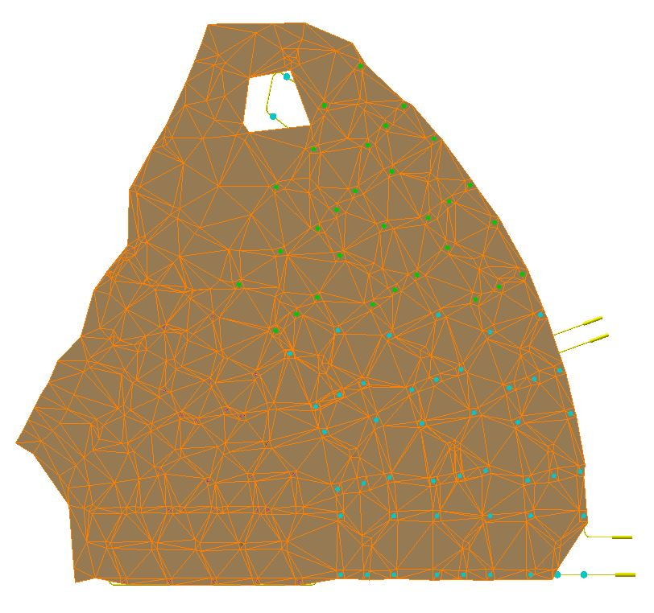
Meshed measurement points on CF skin (Z+ side)

Slide 12
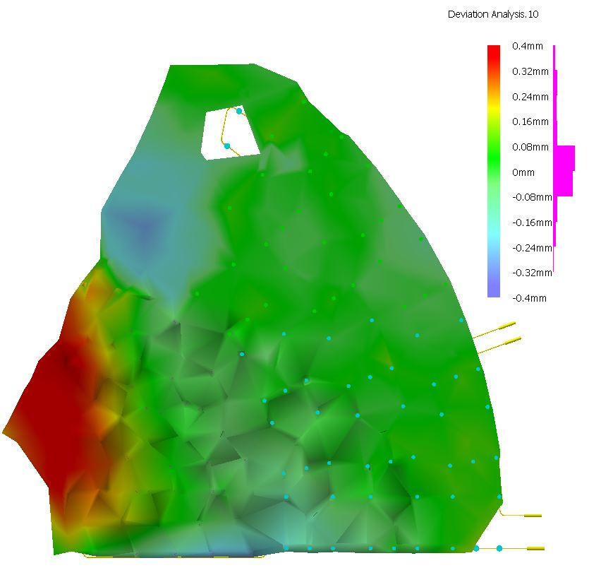
Surface deviation from nominal: Z+ side
IPNL measurements
+0.4mm
-0.4mm
Third party laser scan (M3Axes)
80% of surface within +/- 160 microns of nominal
But some zones with deviations of up to 0.4mm
OK for planarity spec. but could cause problems for PS module mounting – see later

Slide 13
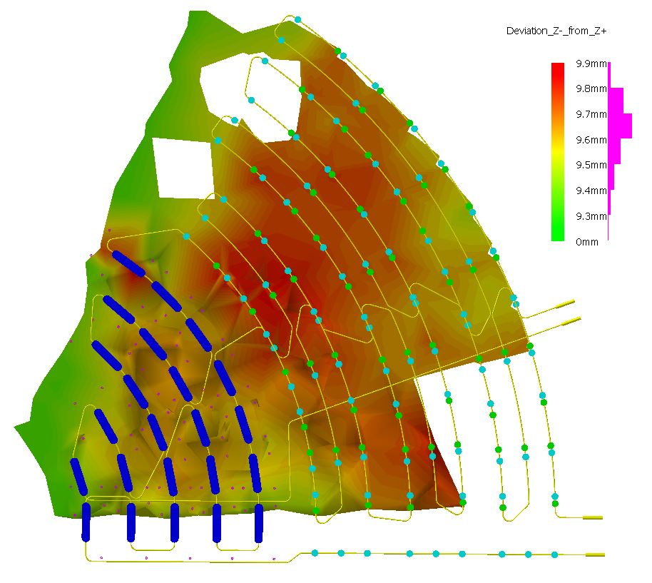
Distance between Z+ and Z- meshes
3 distinct zones:
2S region: 9.7-9.8mm
PS region: 9.6-9.7mm
Regions without inserts or C-foams: 9.3-9.4mm
Target thickness: 9.8mm
(9.0mm Airex + 2x 0.4mm skins)

Slide 14
Insert XY precision within modules
Spec. limits
Groups of inserts for each module individually fitted to CAD model

Slide 15
Z precision within modules – 2S
6 inserts on ‘step’
For each of the groups of 5 inserts, calculate mean Z and bin offset of each insert from mean

Slide 16
Absolute Z positions – 2S
Mean | +0.014
RMS | 0.059
Mean | -16.514
RMS | 0.082
Distance between mounting surfaces on the two sides of the prototype should be difference between the means of the distributions: = 16.53 +/- 0.10mm
Target was 16.44 +/- 0.10mm

Slide 17
Thermal tests

Slide 18
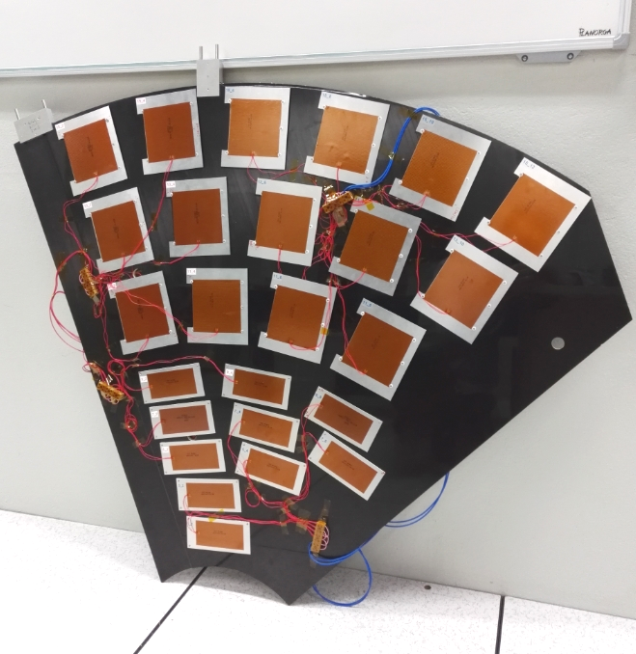
Prototype equipped with dummy modules
2x cooling inlet/outlet blocks
Dummy modules: 1.5mm thick aluminium plates equipped with Minco heating foils

Slide 19
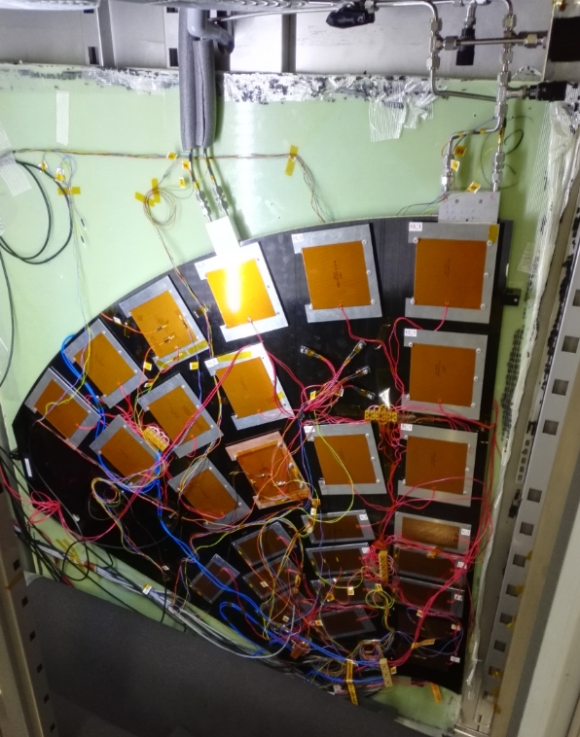
Fridge installation
1x pt100 per dummy module reads temperature on plate surface
Fridge air temp. set to target module temp. (-20°C for CO2 @ -30°C)
Air temp. monitored
Pre-heaters on inlets (8W per inlet)
Module average powers
  2S: 5.5W
  PS: 7.8W
All tests performed for CO2 temp. of -30°C max.

Slide 20
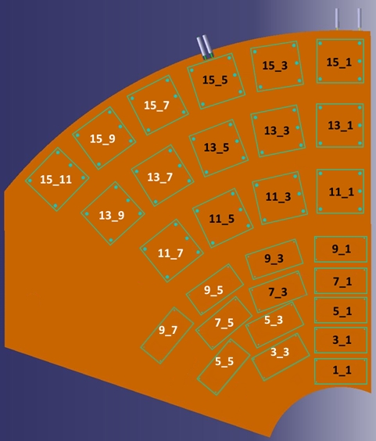
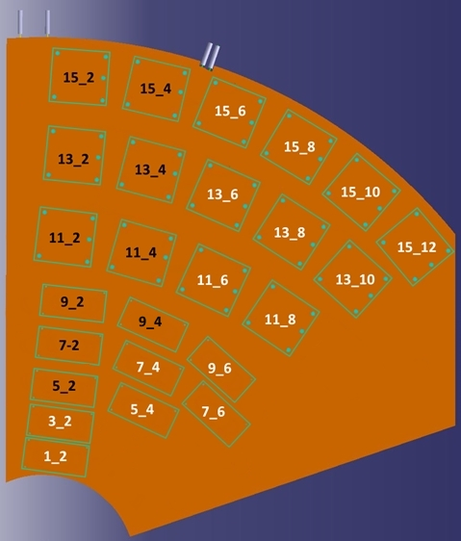
Module naming and cooling segmentation
Z+ side
Z- side
Black = S1
White = S2

Slide 21
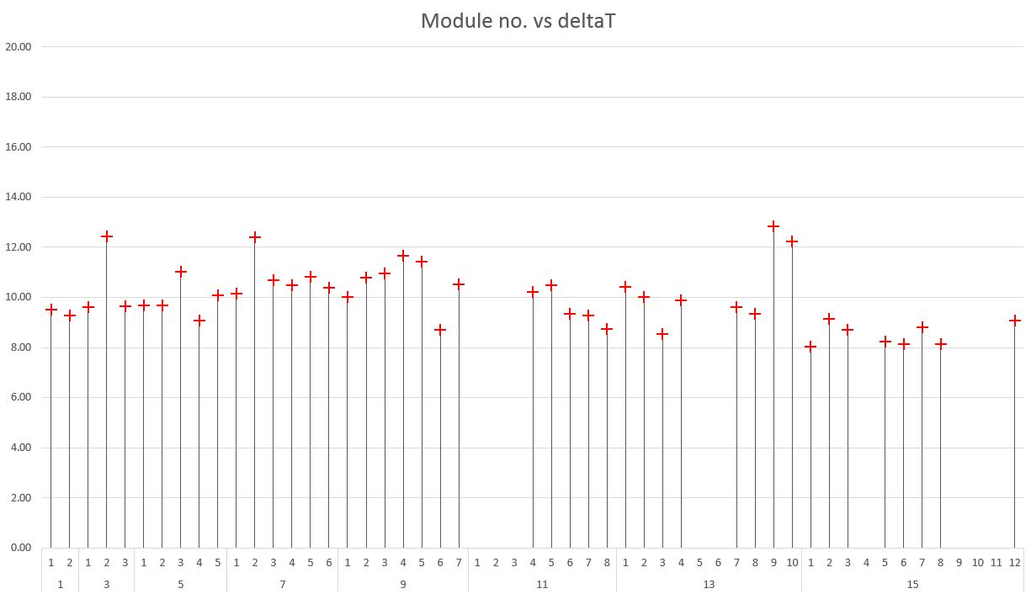
Baseline* results (all modules)
*Best overall results obtained in a single run (no averaging), after system optimisation
(Red cross used in all following plots to display same baseline data)
PS modules
2S modules

Slide 22
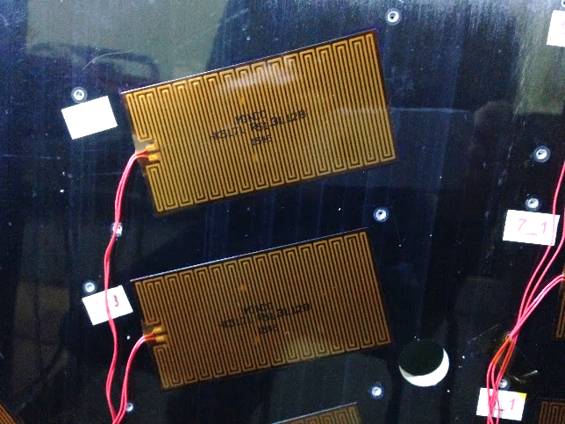
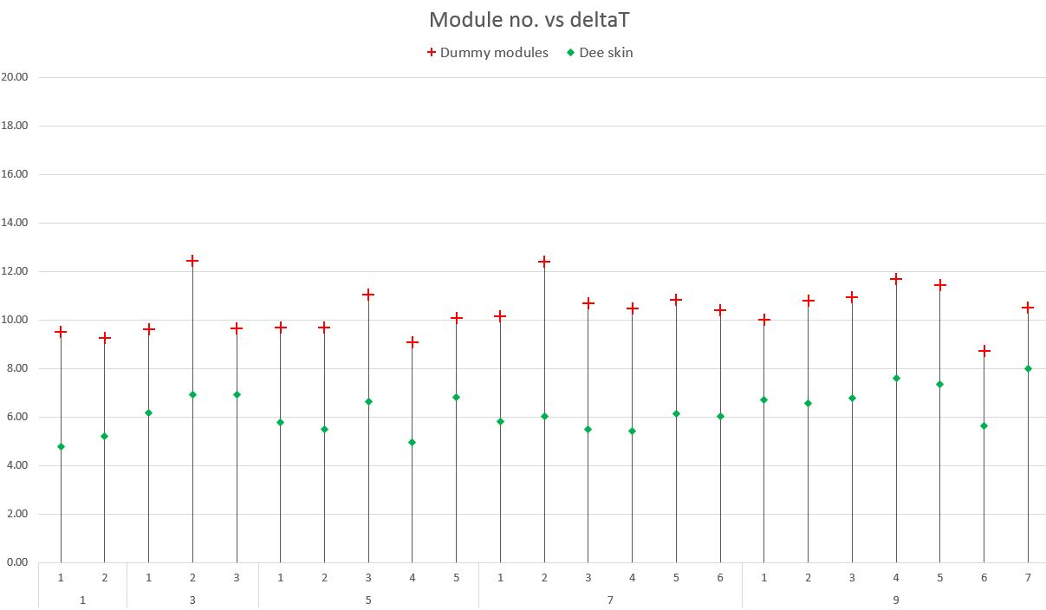
PS modules
DeltaT on the Dee carbon fiber skin

Slide 23
PS modules
Correlation ∆T-module / ∆T-skin

Slide 24
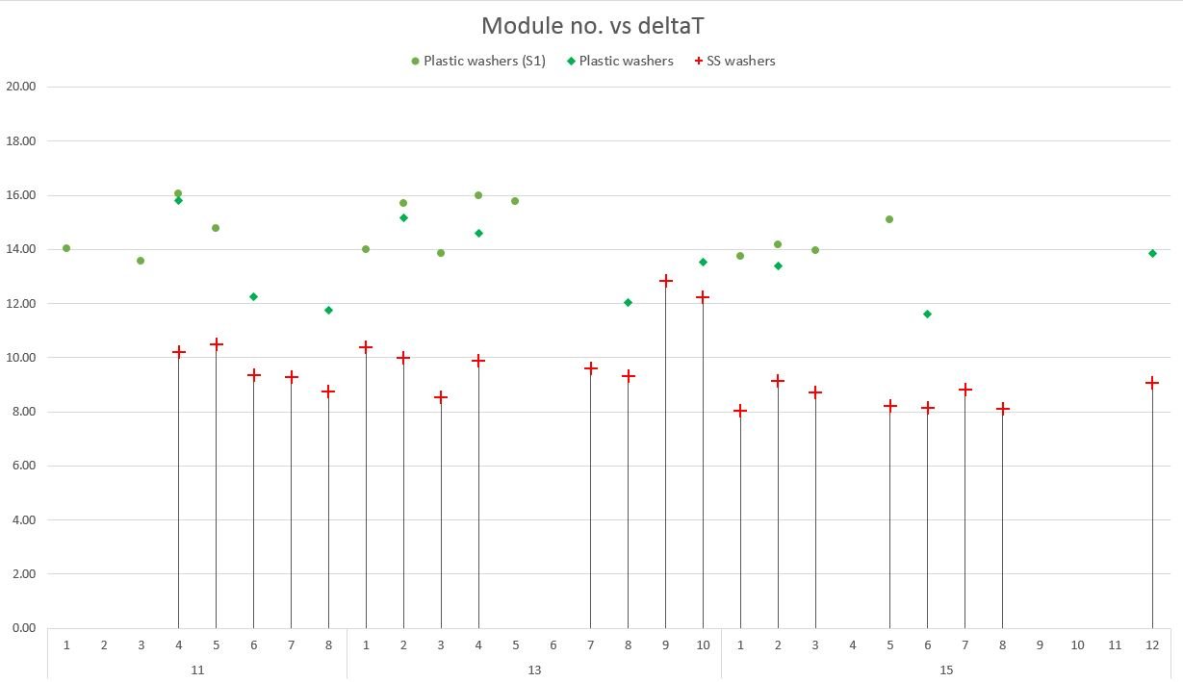
2S modules
Effect of washer type (plastic or SS)

Slide 25
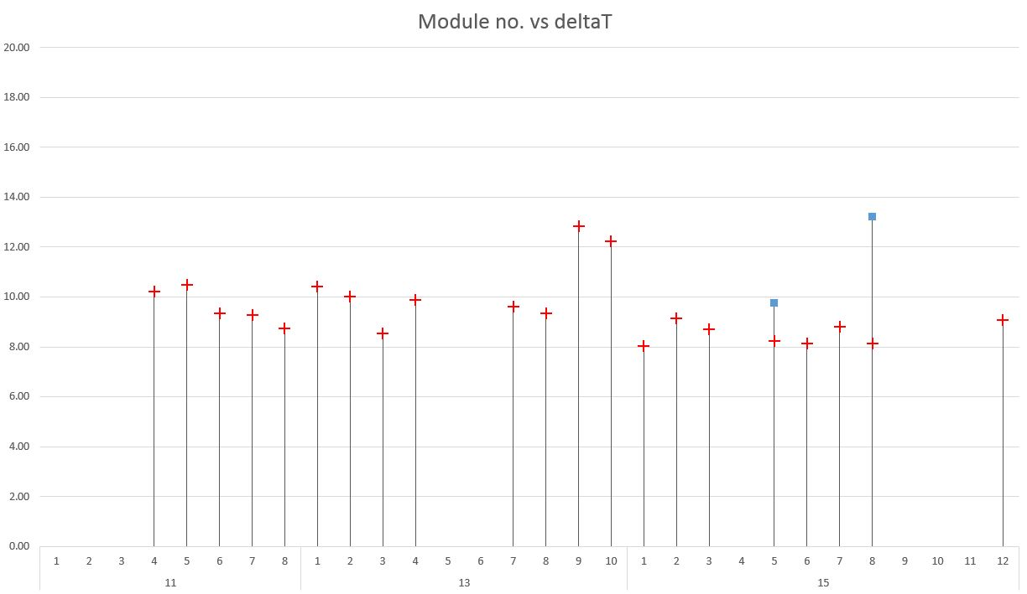
2S modules
Effect of thermal paste on inserts (2 modules only)
All other modules without themal paste
Before thermal paste added

Slide 26
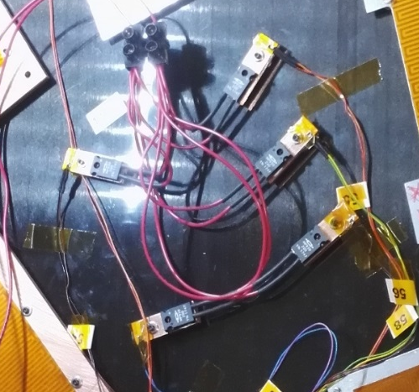
2S modules
Measurements on individual inserts
1x small copper plate/ insert
Pt100 on plate
1.1W / insert
Open diamonds: MIN/MAX of group of 5

Slide 27
Conclusions + perspectives
Globalement:
  Précision mécanique: OK ✓
  Performance thermiques: OK ✓
Des améliorations à faire mais on sait comment procéder
Prochain étape: prototype Dee entier
  Commandes déjà placées
  Construction Q2 2019

Slide 28
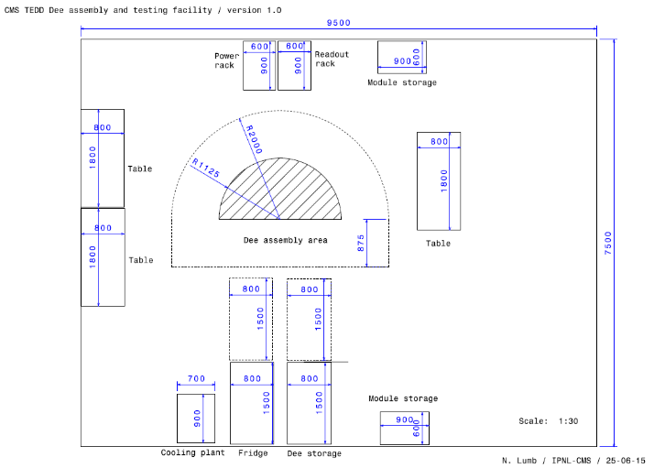
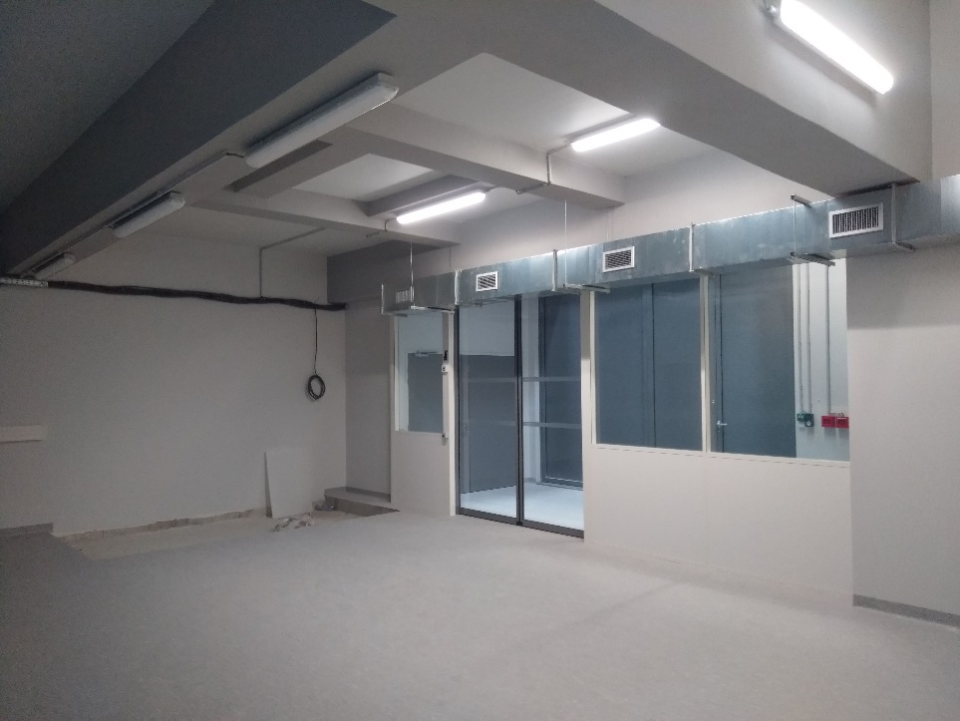
Perspectives 2019-2025
2019:
  Fabrication d’un prototype « Dee » entier
  Construction centre d’assemblage des « Dees »
  Mise en place équipe technique pour l’assemblage des Dees
2020:
  Pré-production: 4 « Dees » entiers
  Tests mécanique et thermique
  2021-25:
  Production en série des 24 « Dees »
  Intégration des modules en silicium
  Tests système
  Installation bouchon dans CMS

