Slide 1
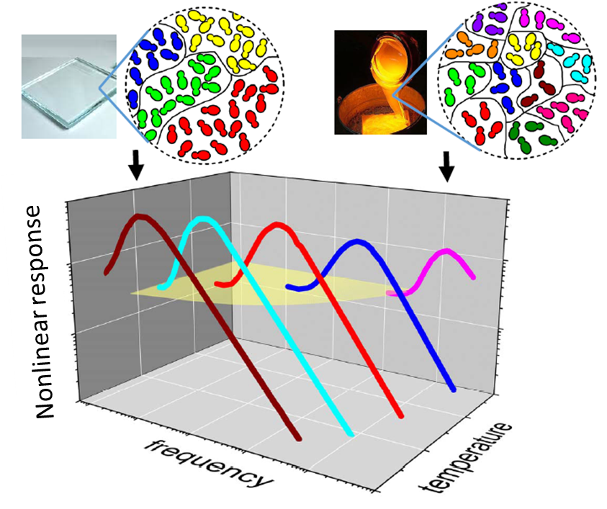
L’ordre amorphe dans les verres dévoilé par les réponses non linéaires.
Started the 11/09/2004 thanks to:
G. Biroli (CEA/IPhT-ENS), J.-P. Bouchaud (CFM)
Since then:
CEA/SPEC: D. L’Hôte, R. Tourbot, F.L. + C. Crauste, C. Brun, S. Albert, P. Gadige
Augsburg Univ.: P. Lunkenheimer, A. Loidl + Th. Bauer, M. Michl
Perpignan Univ.: P. M. Déjardin
Albert et al. Science (2016).
For a review see "Nonlinear Dielectric Spectroscopy" Springer series ⬄ArXiv : 1807.03984

Slide 2
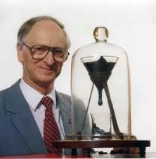
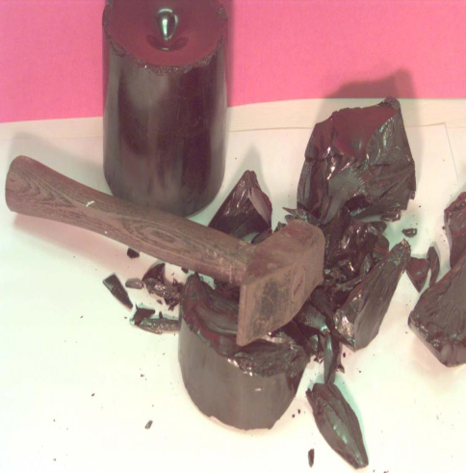
Glasses : the simplest experiment…
http://en.wikipedia.org/wiki/Pitch_drop_experiment
Bitumen :
A hammer breaks it…
And yet … it flows !!!...
Since 1927: 9 drops !!!
The physicist who started this experiment deceased after 2 drops …
Glasses would be both solid AND liquid. There are long time scales

Slide 3
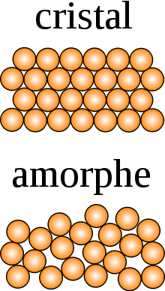
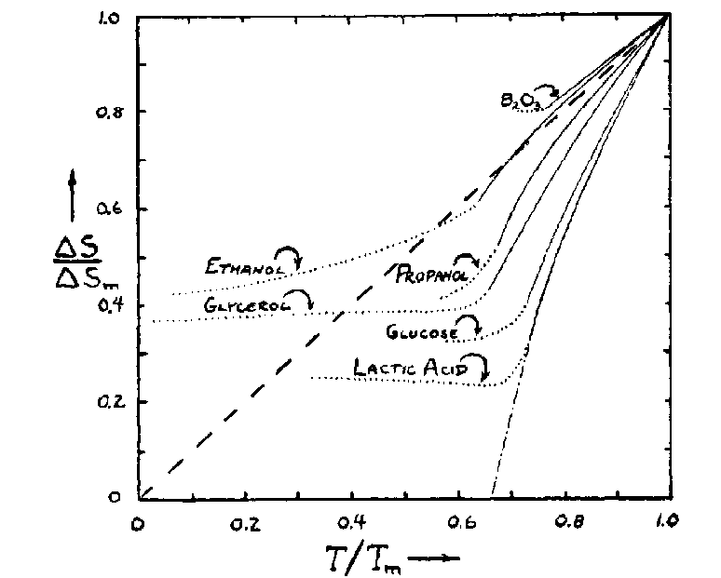
Glasses: two key observables (τ_{α} and S_{c})
S_{c}(T)=S(T)-S_{cryst}(T)
τ_{α}
W. Kauzmann (1948)
Glass (out of Eq.)
Supercooled liquid
Liquid
(Crystal)
τ_{α}=100s
τ_{α}~10⁻¹²s
T₀
T_{g}
T_{m}
T
• Supercooled dynamics is (would be?) related to thermodynamics :
←Adam Gibbs (1965)
• + other (semi)-universal features…
Would there be an underlying critical point driving the glass transition ?

Slide 4
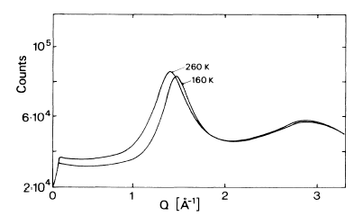
Criticality ? Nothing is obvious …!
Polybutadiene, T_{g}≈ 180K
Hurley, Harowell, PRE, 52, 1694, (1995)
S(q) [a.u.]
N_{corr}
The glass looks like the liquid
Dynamical Heterogeneities (DH)
Theories:
Kinetic theories:
Thermodynamic theories:
→ Kinetically Constrained Models (Garrahan, Chandler, et al…): Trivial thermo., only kinetic rules matter.
→ RFOT (Wolynes etc…) : Amorphous order
→ Frustration (Tarjus, Kivelson, etc…) : locally prefered structure
Glasses ⬄ ultra viscous liquids at any T
Glasses ⬄ driven by a thermo. critical point
Can we test the existence of a thermodynamic critical point (N_{corr} ↑ at low T) ?

Slide 5
Outline:
Why measuring χ₃ and χ₅ in glasses.
  A long story
  Dimensional analysis
  Bouchaud Biroli’s predictions
Orders of magnitude.
  Definition of χ₃ and χ₅
  Worst case analysis
Results & interpretations.
  ω and T behavior of χ₃ and χ₅
  Discussion.
Summary and Perspectives.

Slide 6
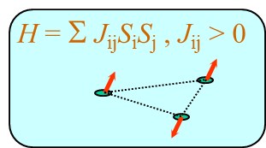
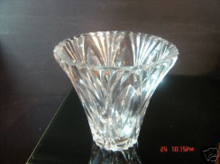
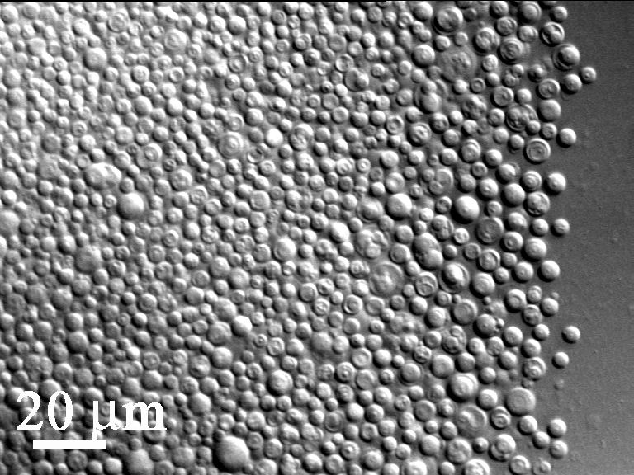
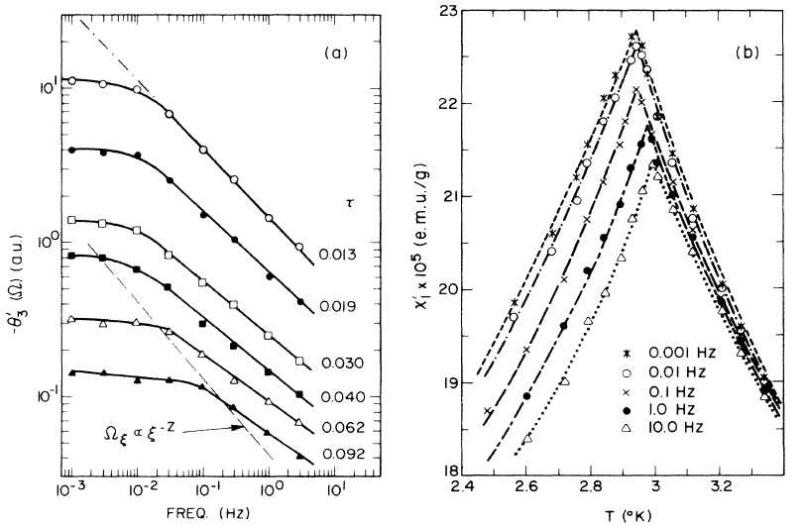
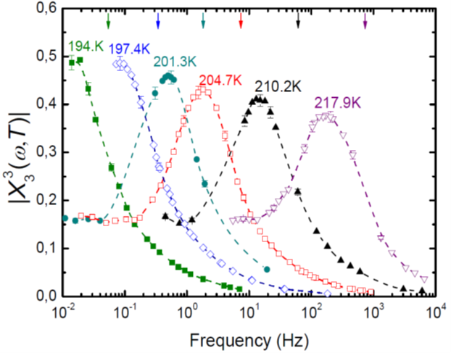

3rd and 5th order responses in glasses: a long story
P = χ₁ E + χ₃ E³+ χ₅ E⁵ +…
→ contrarily to χ₁, χ₃ (and χ₅ …) are predicted to reveal collective effects in glasses
Tests of predictions
Spin glasses
Molecular glasses
Colloïdal glasses
Cu: Mn (1% at.),
Levy PRL (1986)
Glycerol,
Crauste, PRL (2010)
PNIPAM,
Seybolt, Soft Mat. (2016)
$$\frac{T−Tc}{Tc}$$
χ₃ (a.u.)
Frequency (Hz)
Frequency (Hz)
Frequency (a.u.)
Frozen disorder ? YES Detailed balance ? YES
Frozen disorder ? NO Detailed balance ? YES
Frozen disorder ? NO Detailed balance ? NO
Even though these 3 glasses are different: anomalous features in χ₃ reveal L_{glassy}

Slide 7

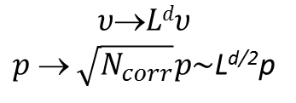
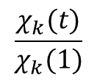
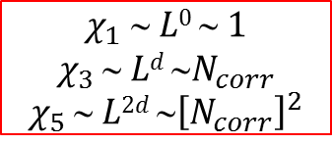

The interest of X₃ and X₅ in a nutshell: a dimensional analysis
Thermodynamics of independent dipoles:
$P=\frac{p}{υ}ℒ\left(\frac{pE}{kT}\right)=\frac{1}{3}\frac{p^{2}}{υ}\left(\frac{E}{kT}\right)−\frac{1}{45}\frac{p^{4}}{υ}{\left(\frac{E}{kT}\right)}^{3}$+ $\frac{2}{945}\frac{p^{6}}{υ}{\left(\frac{E}{kT}\right)}^{5}$+…
Amorphous ordering phase transition :
Independent « paquets » of N_{corr}∼ L^{d} dipoles
$$χ_{1}  L0  1$$
$$χ_{3 } Ld {N}_{corr}$$
$$χ_{5 }∼ L2d {∼\left[N_{corr}\right]}^{2}$$
$$υLdυ$$
$p → \sqrt{N_{corr}}p\sim$L^{d/2}p
L
$$\frac{χ_{k}(t)}{χ_{k}(1)}$$
If $L(Tc)→∞$
----- k=5
The higher the order k ≥ 3, the stronger the divergence in T.
----- k=3
----- k=1 (linear resp.)
1
t = $\frac{T−T_{C}}{T_{C}}$
0
1
If ∃ thermod. amorphous ordering: χ₁ is blind to it, contrarily to χ₃, χ_{5…}

Slide 8
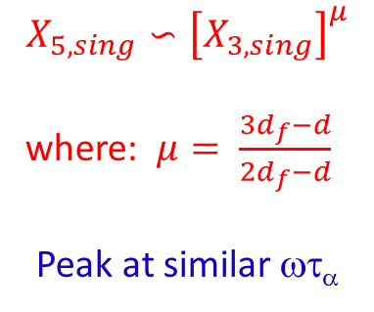

Bouchaud-Biroli’s prediction [PRB, (2005)] for χ₃ at any frequency:
If N_{corr}~ L^{df} is large enough
X_{3,}
X_{3, sing}
X₃ = X_{3, sing}+ X_{3, trivial}
$$X_{3}^{\left(k\right)}(ω,T)=N_{corr}(T)H_{3}^{\left(k\right)}(ωτ_{α})$$
« 1 »
ωτ_{α}
Because of S_{c}, the spin glass (increasing) plateau of X₃ becomes an (increasing) peak
Generalizing to χ₅: Albert et al. Science (2016)
X_{5, sing}
The higher the order k≥3, the more anomalous the ω and T dependences.
X₅
$$X_{5,sing}∽{\left[X_{3,sing}\right]}^{μ}$$
where: $μ= \frac{3d_{f}−d}{2d_{f}−d}$
Peak at similar ωτ_{α}
« 1 »
ωτ_{α}
X₅ = X_{5, sing}+ X_{5, trivial}
These predictions can be tested experimentally…

Slide 9
Outline:
Why measuring χ₃ and χ₅ in glasses.
  A long history
  Dimensional analysis
  Bouchaud Biroli’s predictions
Orders of magnitude.
  Definition of χ₃ and χ₅
  Worst case analysis
Results & interpretations.
  ω and T behavior of χ₃ and χ₅
  Discussion.
Summary and Perspectives.

Slide 10
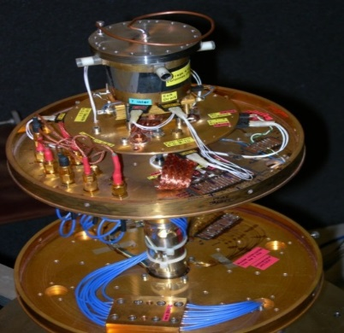








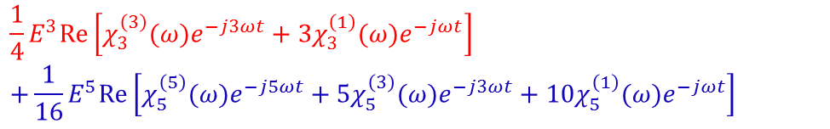


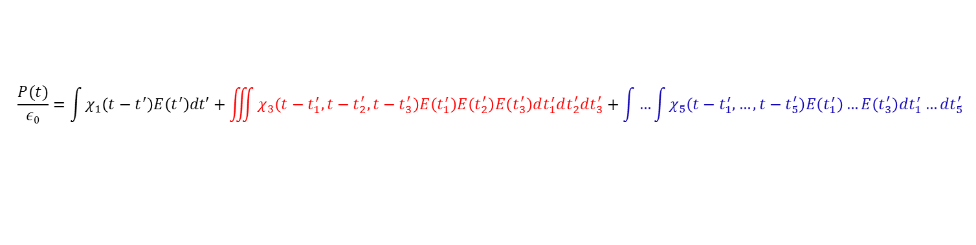

Definitions of χ₃ and of χ₅:
V_{S} (t)
Supercooled liquid, controled T
e
P
For “low enough” E
$$\frac{P(t)}{ε0}=\int{χ_{1}\left(t−t^{′}\right)E\left(t^{′}\right)dt′}+\iiint{χ_{3}\left(t−t_{1}^{′},t−t_{2}^{′},t−t_{3}^{′}\right)E\left(t_{1}^{′}\right)E\left(t_{2}^{′}\right)E\left(t_{3}^{′}\right)dt_{1}^{′}dt_{2}^{′}dt_{3}^{′}}+\int{…}\int{χ_{5}\left(t−t_{1}^{′},…,t−t_{5}^{′}\right)E\left(t_{1}^{′}\right)…E\left(t_{3}^{′}\right)dt_{1}^{′}…dt_{5}^{′}}$$
$$E\left(t\right)=E\cos{(ωt)}$$
$$+E_{st}$$
$$\frac{P\left(t\right)−P_{1}}{ε0}=$$
$$\frac{1}{4}E^{3}Re\left[χ_{3}^{\left(3\right)}(ω)e^{−j3ωt}+{3χ}_{3}^{\left(1\right)}(ω)e^{−jωt}\right]$$
$$+\frac{1}{16}E^{5}Re\left[χ_{5}^{\left(5\right)}(ω)e^{−j5ωt}+{5χ}_{5}^{\left(3\right)}(ω)e^{−j3ωt}+{10χ}_{5}^{\left(1\right)}(ω)e^{−jωt}\right]$$
$+3E E_{st}^{2}Re\left[χ_{2;1}^{\left(1\right)}(ω)e^{−jωt} \right]$+even harmonics
$$χ_{3}^{\left(3\right)}\left(ω\right)=F.T. {\left\{χ_{3}\right\}}_{(ω,ω,ω)}$$
$$χ_{5}^{\left(5\right)}\left(ω\right)=F.T. {\left\{χ_{5}\right\}}_{(ω,ω,ω,ω,ω)}$$
$$χ_{3}^{\left(1\right)}\left(ω\right)=F.T. {\left\{χ_{3}\right\}}_{(−ω,ω,ω)}$$
$$χ_{5}^{\left(3\right)}\left(ω\right)=F.T. {\left\{χ_{5}\right\}}_{(−ω,ω,ω,ω,ω)}$$
$$χ_{2;1}^{\left(1\right)}\left(ω\right)=F.T. {\left\{χ_{3}\right\}}_{(0,0,ω)}$$
$$χ_{5}^{\left(1\right)}\left(ω\right)=F.T. {\left\{χ_{5}\right\}}_{(−ω,−ω,ω,ω,ω)}$$
$E<{10}^{8}\frac{V}{m}: χlin E≫$ $χ3 E3≫$ $χ5 E5$
Safer to detect χ_{k} at the k^{th} harmonics

Slide 11




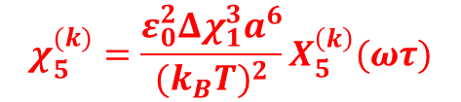

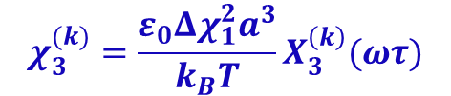



Which sensitivity/field values are needed ? A worst case analysis
Ideal gaz of dipoles:
$P=\frac{p}{υ}ℒ\left(\frac{pE}{kT}\right)=$…
$\frac{χ_{3}E^{3}}{χ_{1}E}≈\frac{χ_{5}E^{5}}{χ_{3}E^{3}}≈{10}^{−4}$ for {p=4D; 10MV/m; 200K}
Measuring χ₃ (or χ₅) is (very) difficult
Which frequency dependence ?
[W. Coffey et al, P. R. I. A.(1978) and P. M. Déjardin (2016)]
$$χ_{1}={Δχ}_{1}\frac{1}{1−iωτ}$$
$$χ_{3}^{(k)}=\frac{ε_{0}{Δχ}_{1}^{2}a^{3}}{k_{B}T}X_{3}^{\left(k\right)}(ωτ)$$
$$χ_{5}^{(k)}=\frac{ε_{0}^{2}{Δχ}_{1}^{3}a^{6}}{(k_{B}T)^{2}}X_{5}^{\left(k\right)}(ωτ)$$
$$\left|X_{n}^{(n)}\right|$$
The X_{n}^{(k)} are dimensionless
$$1$$
N.B.: f_{α} ⬄ peak of χ₁’’(ω), as in supercooled liquids
0.2
ωτ_{α} ≡ f/f_{α}
$$0.06$$
$$1$$
$$ωτ$$
For an ideal gaz, |X₁|, |X₃| and |X₅ |→ have no hump in ω
→ do not depend on T
Contrasts with BB close to Tg

Slide 12
Outline:
Why measuring χ₃ and χ₅ in glasses.
  A long history
  Dimensional analysis
  Bouchaud Biroli’s predictions
Orders of magnitude.
  Definition of χ₃ and χ₅
  Worst case analysis
Results & interpretations.
  ω and T behavior of χ₃ and χ₅
  Discussion.
Summary and Perspectives.

Slide 13
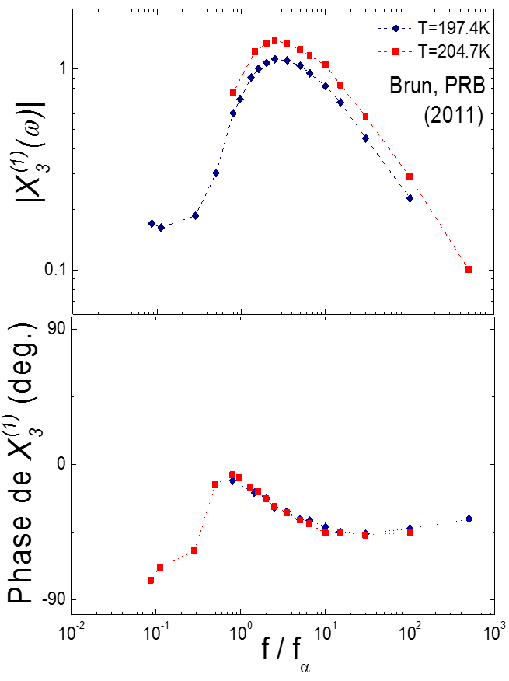
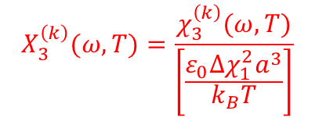

Behavior of X₃(ω,T):
Bauer, PRL (2013)
Brun PRB (2011)
• 3ω susceptibility measured on many liquids:
→ Crauste-Thib., Brun, L’Hôte, F.L., PRL (2010), PRL (2012)
→ Bauer, Michl, Lunkenheimer, Loidl, PRL (2013), PRL(2015)
→ Casalini, Fragiadakis, Roland, JCP (2015), (2017)
Richert, Kim, Young-Gonzales, JCP(2016)
Young-Gonzales, Adrjanowicz, Paluch, Richert, JCP(2017)
$$X_{3}^{\left(k\right)}(ω,T)=\frac{χ_{3}^{\left(k\right)}(ω,T)}{\left[\frac{ε_{0}Δχ_{1}^{2}a^{3}}{k_{B}T}\right]}$$
• Main features of X₃⁽³⁾ :
→ Humped shape for |X₃⁽³⁾|, for a fixed value of f/f_{α}
→ Arg [X₃⁽³⁾] depends only on f/f_{α}
→ Low frequency plateau does NOT depend on T
$$Tχ_{T}=\frac{dLn\left(τα\right)}{dLn(T)}$$
→ The hump increases as
Contrary to X₁, X₃ has qualitative anomalies in {ω,T}
All these features are consistent with B&B’s prediction ⇒ N_{corr}(T) ∼ Tχ_{T}

Slide 14
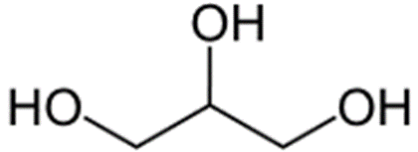
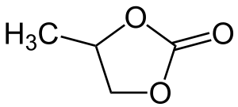


The three X₃’s:
f/f_{α}
f/f_{α}
Striking similarities for the moduli and for the phases
$Arg\left[X_{3}^{(1)}\right]≈Arg\left[X_{2;1}^{\left(1\right)}\right]+π$ for f > 0.5 f_{α}
$Arg\left[X_{3}^{(1)}\right]≈Arg\left[X_{3}^{\left(3\right)}\right]$ for f > 5 f_{α}
Strongly suggests a common physical origin for the three X₃’s : OK with B&B

Slide 15
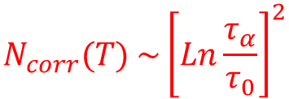
How much is the increase of Ncorr upon cooling ?
$$N_{corr}(T) \sim {\left[Ln\frac{τ_{α}}{τ_{0}}\right]}^{2}$$
X_{3max}~ N_{corr}(T) ↑ very slowly in T :
|X₃⁽³⁾(ω,T)|
See criticality ⬄see x10 on X_{3,max}
N_{corr} /N_{corr}(eq)
T_{initial}
T_{g}
Aging: observables depend on t_{a}
T_{final}
Brun et al. PRL 109, 175702 (2012)
t_{a}=0
t_{a}
t_{a}, [s]
τ₀= 10⁻¹⁴ s and τ_{α, min} = 10⁻⁴ s → τ_{α, max} = 10¹⁸ s … !!! ≈ Age of the Universe
Alternative way to test criticality: compare χ₃, χ₅, χ₇

Slide 16
The interest of X₃ and X₅ in a nutshell: a dimensional analysis
Thermodynamics of independent dipoles:
$P=\frac{p}{υ}ℒ\left(\frac{pE}{kT}\right)=\frac{1}{3}\frac{p^{2}}{υ}\left(\frac{E}{kT}\right)−\frac{1}{45}\frac{p^{4}}{υ}{\left(\frac{E}{kT}\right)}^{3}$+ $\frac{2}{945}\frac{p^{6}}{υ}{\left(\frac{E}{kT}\right)}^{5}$+…
Amorphous ordering phase transition :
Independent « paquets » of N_{corr}∼ L^{d} dipoles
$$χ_{1}  L0  1$$
$$χ_{3 } Ld {N}_{corr}$$
$$χ_{5 }∼ L2d {∼\left[N_{corr}\right]}^{2}$$
$$υLdυ$$
$p → \sqrt{N_{corr}}p\sim$L^{d/2}p
L
$$\frac{χ_{k}(t)}{χ_{k}(1)}$$
If $L(Tc)→∞$
----- k=5
The higher the order k ≥ 3, the stronger the divergence in T.
----- k=3
----- k=1 (linear resp.)
1
t = $\frac{T−T_{C}}{T_{C}}$
0
1
If ∃ thermod. amorphous ordering: χ₁ is blind to it, contrarily to χ₃, χ_{5…}

Slide 17
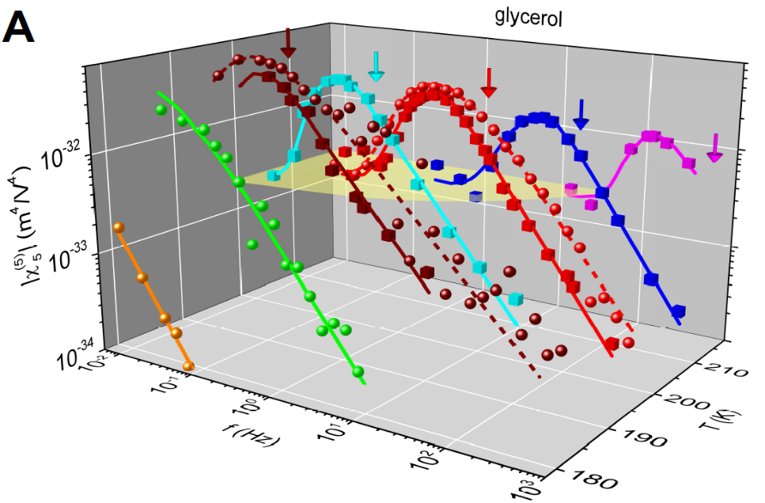
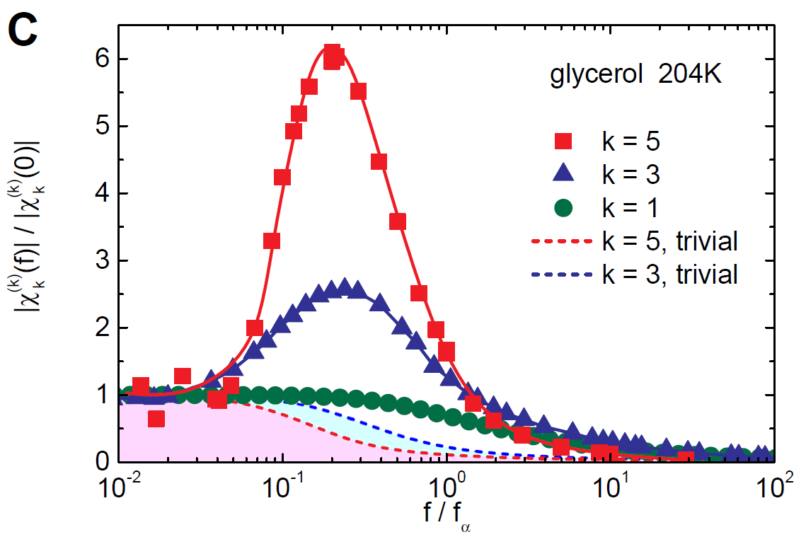
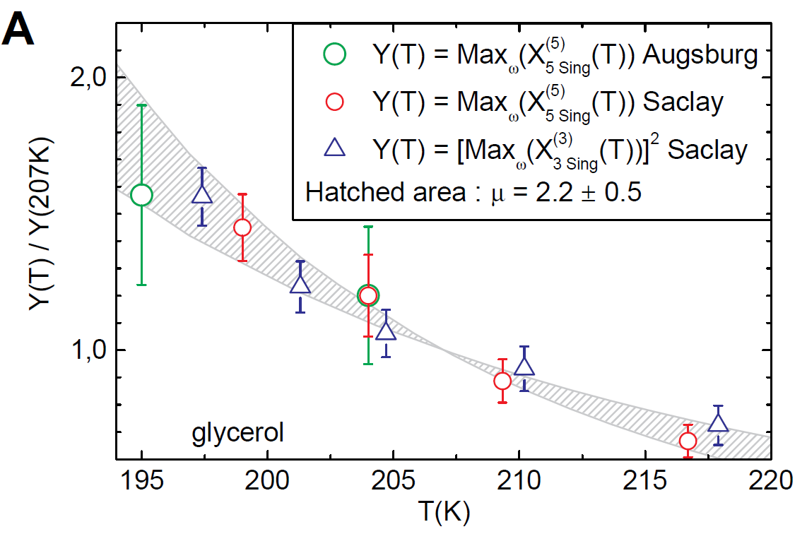
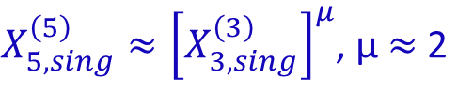
Behavior of χ₅(ω,T):
At fixed T: |χ₅(ω)| has a « super peak »
→ At the peak:
$X_{5,sing}^{\left(5\right)}≈{\left[X_{3,sing}^{\left(3\right)}\right]}^{μ}$, µ $≈$ 2
χ₅ behaves as predicted by B&B
≈ 2 ⇒ compact amorphous domains
Propylene Carbonate ≈ Glycerol

Slide 18
Outline:
Why measuring χ₃ and χ₅ in glasses.
  A long history
  Dimensional analysis
  Bouchaud Biroli’s predictions
Orders of magnitude.
  Definition of χ₃ and χ₅
  Worst case analysis
Results & interpretations.
  ω and T behavior of χ₃ and χ₅
  Discussion.
Summary and Perspectives.

Slide 19
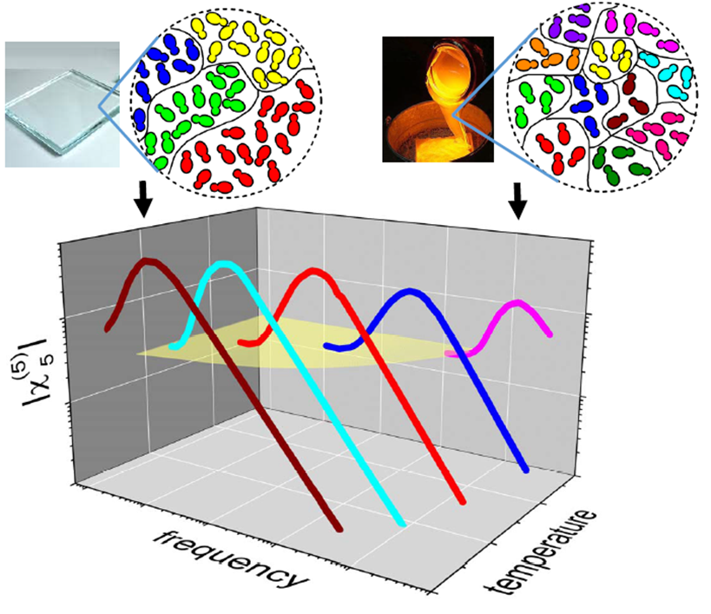
Which kind of length in X₃ and X₅ : dynamic or static ?
• The hump lies at f ≈ f_{α} so the length should be considered as dynamic
BUT: → δS_{c} works quite well for X₃⁽³⁾ and X_{2;1}⁽¹⁾ [see Richert et al. (2015)-(2016)].
→ … and something more can be drawn from available theories of glasses…
Our experimental results
Consistent with…
NOT consistent with…
• Theories with non trivial thermodynamics (T_{c} drives the physics around Tg):
  RFOT (T_{c}=T_{K})
  Frustration (T_{c}≈T_{M})
• Theories where only dynamical rules matter:
  Standard version of Kinetically Constrained Models (KCM) seem unable to account for χ₅ and χ₃.
There exists a thermodynamic critical point (static length) driving the physics around Tg

Slide 20

How to define thermodynamic amorphous order ? The Point to Set length L_{PS}:
State α
Frozen in α
→ compare two states at a given T.
R
≈ q_{EA} ⬄ R<L_{PS}
q = <s_{α} s_{R,α}>_{α}
≈ 0 ⬄ R>L_{PS}
■≈ molecular volume
Not frozen in R³
s_{α} = <occupation of ■>_{α}
s_{R,α} = <occupation of ■>_{R,α}
G. Biroli, J.-P. Bouchaud, A. Cavagna, et al., Nat Phys. (2008)
Bidisperse soft-spheres (d=3)
q(R)
R [in molecular diameters]
(Extensive) Monte Carlo simulations do show L_{PS} increasing upon cooling.

Slide 21
Does L_{PS} diverge or not ?
Our χ₃-χ₅ experimental results are consistent both with :
  RFOT (T_{c}=T_{K})
  FLD (T_{c}≈T_{m})
Wolynes, Kirkpatrick, Thurumalai et al (1989)…(2012)
G. Tarjus, Kivelson et al. J.Phys.CondensMat (2005)
• T>T_{K}: mosaic state (because of S_{conf} >0)
• S_{conf} vanishes at T_{K} (⇒τ_{α}→∞): Ideal Glass
• ∃ Locally Favored Structure (e.g. icosaedron)
• τ_{α} is exponentially large above T_{K} ⇒ unreachable critical point at T_{c} = T_{K}
• The growth of LFS is frustrated: avoided critical point at T_{c} ≈ T_{m}
L_{PS}
----- RFOT
----- FLD
a
T_{K}
≈T_{g}
T
Do glasses tend towards a genuine solid state or are they very peculiar liquids ???

Slide 22
Random pinning as a way to test the ideal glass phase.
Theoretical seminal work:
Numerical works:
L. Berthier, W. Kob PRE (2012)
M. Ozawa, W. Kob, A. Ikeda, K. Myazaki PNAS (2015)
C. Camarota, G. Biroli PNAS (2012)
T
...τ_{α} increases…
...τ_{α} decreases…
(...S_{c} decreases…)
S_{c} =0 ⬄Ideal glass phase
c > 1/(L_{PS})³
Fraction “c” of pinned molecules
Random Pinning decreases S_{conf} without changing the structure
Random pinning changes τ_{α}⬄ ∃ critical point at c=0 and ideal glass phase.

Slide 23
Summary:
→ X₃, as well as X₅, has anomalous features in ω and T
For molecular glasses: X₃ captures L_{glassy}(T).
Amorphous domains are ≈ compact
→ Striking similarities (modulus and phase) of the X₃’s
BB’s prediction is consistent with the X₃’s and X₅ data
µ = 2 + inspection of theories: suggests that there is a thermodynamic critical point driving the glass transition.
Perspectives:
Where is T_{c} ? ⬄ Do glasses tend towards a solid state ? … :
    X_{3,max}(T) has been measured only for 6 glass formers : do more ?
    Investigate X₃ around T_{MCT} ?
    Find a way to measure directly the static length L_{PS} ?
Colloids: on going work by Fuchs et al.
What about polymers ?

Slide 24
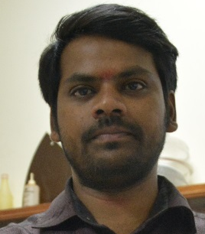

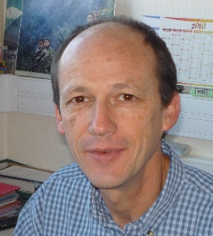

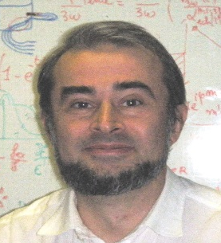


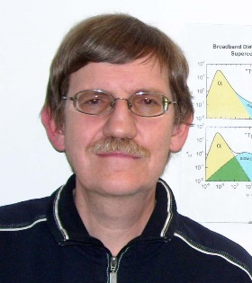
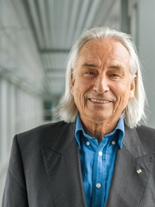
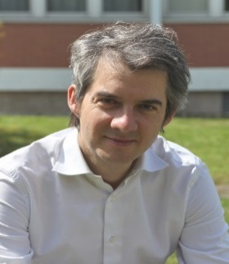
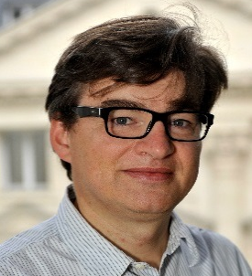

The nonlinear team (2014-2018):
CEA Saclay
(SPEC/SPHYNX)
P. Gadige
S. Albert
R. Tourbot
C. Wiertel
F. Ladieu
-Gasquet
Augsburg Univ.
Th. Bauer
M. Michl
P. Lunkenheimer
A. Loidl
Theorists:
G. Biroli
J.-P. Bouchaud
P.-M. Déjardin
CEA (IPhT) and ENS Paris(LPS)
CFM
Perpignan Univ

Slide 25





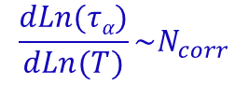
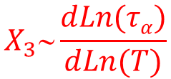

Phenomenological approaches of nonlinear responses:
→ Toy model (Ladieu et al. (2012))
→ Each domain ⬄ µ = µ_{m}$\sqrt{Ncorr}$
$$X_{3}N_{corr}$$
→ Pragmatical model (Buchenau (2017))
$$X_{5}[X3]2$$
Oversimplified energy landscape
compatible with BB’s general theory
→ Entropy effects (Johari JCP (2013), Richert et al. (2015),(2016))
$$S_{c}∼{\left[N_{corr}\right]}^{−q/2}$$
$$X_{3}∼{\left[N_{corr}\right]}^{q}$$
$$q≈1$$
$${\frac{dLn(τα)}{dLn(T)}\sim N}_{corr}$$
→ Box model (Schiener et al. (1996))
$$X_{3}∼\frac{dLn(τα)}{dLn(T)}$$
Energy « absorption »
The various interpretations are (or so) reunified (Gadige PRE (2017))

Slide 26

Genericity of the peak in ω and of its T behavior ?
Is there a hump for | YES | NO
|X₃⁽³⁾| ? | Gly, FAN, SNGN, c-Oct, 2E1H, PC*,PG*, vinyl-PC | 2PC derivatives, 1Prop.
|X_{2;1}⁽¹⁾| ? | Gly, NMEC, MTHF, SAL, c-Oct, PVac, CPDE, PC,PG, vinyl-PC, 6Me3H, 2E1H, 2E1B | 2PC derivatives
|X₃⁽¹⁾| ? | All –or so- of the tested liquids | No exception (?)
At least 6 groups involved: Arizona, Augsburg, Gottingen, Katowice, Saclay, Washington DC.
This hump at ωτ_{α} ∼ 1 in the various |χ₃| seems generic
Augsburg group :Bauer et al PRL (2013), Michl et al JCP(2015), (2016)
→ 6 liquids including 2 plastic crystals (SNGN, c-oct)
→ 33 ≤ fragility ≤ 110
$$H≅\frac{dLn\left(τ_{α}\right)}{dLn\left(T\right)}≡Tχ_{T}$$
The T increase of the hump upon cooling seems generic, as mainly goes as Tχ_{T}

Slide 28
Saclay setup :
(See C. Thibierge et al, RSI 79, 103905 (2008))
V_{s}cos(ωt)
Z₁ = thin
capacitor
Z₂ = thick
capacitor (2×thin)
2 I_{Lin} +8 I₃
+ 32 I₅
I_{Lin}+I₃+I₅
V_{A}
V_{B}
Kill linear and cubic signals before measuring
⬄ Passive notch filters
r_{A}
r_{B}
Filters killing 1ω and 3ω
Filters killing 1ω and 3ω
U_{A}
U_{B}
δV_{s} and χ₅⁽⁵⁾ are the same for the two samples
⬄ We can extract automatically the χ₅⁽⁵⁾ signal
3 Lockin detectors in // measuring U_{A}; U_{B} and U_{A}-U_{B}
Does it work ?

Slide 29
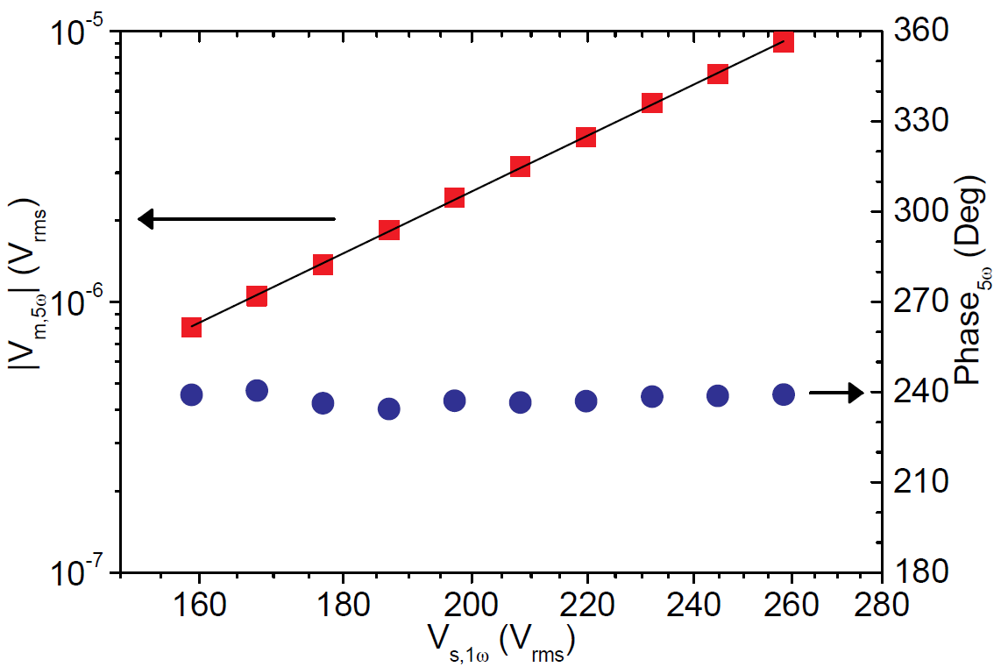
Does our experiment work ?
Saclay, glycerol, 199K, f = 0.15Hz
⬄ It works

Slide 31
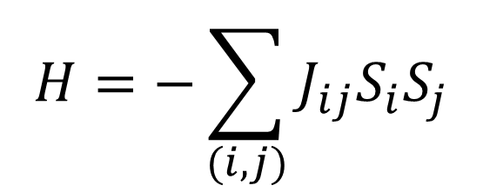

Spin Glasses … (1/3)
P(J)
$$H=−\sum_{(i,j)}{J_{ij}S_{i}S_{j}}$$
Frustration AND quenched disorder [e.g. Cu: Mn (1% at.)]
Anti-Ferro
with
Ferro
0
J
L. Levy, T. Oglieksi PRL57, 3288 (1986), L.Lévy, PRB, 38, 4963 (1988)
$$\frac{T−Tc}{Tc}$$
χ₃ (@10mHz)
χ_{lin} (a.u.)
χ₃ (a.u.)
T (K)
Frequency (Hz)
T (K)
For Spin Glasses at T_{c} : χ_{lin} does NOT diverge contrarily to χ₃

Slide 32

Spin Glasses (2/3): scaling relations between χ₃, χ₅, χ₇…
L. Lévy, PRB, 38, 4963 (1988):
$$\frac{T−Tc}{Tc}$$
|χ₅|h²/|χ₃|
|χ₃| (a.u.)
|χ₇|h²/|χ₅|
|χ₃| (other a.u.)
Frequency (Hz)
T_{c} determination is no longer an issue
The best evidence of criticality ⬄ Plot one critical quantity vs another one

Slide 33
S.G. (3/3): Spin glasses versus structural glasses (S_{i} → δρ_{i}):
Thermodynamical Amorphous ordering:
1
1
1
1
χ_{lin} is blind to ξ
χ₃ , χ₅, χ₇ … related to N_{corr} ∼ ξ^{df}
Spin glasses ARE different from structural glasses

Slide 35
What about χ₃ in the excess wing regime ?
Augsburg group :Bauer et al PRL (2013)
The break in the slope seen in χ₁’’ is not seen in |χ₃⁽³⁾|
Excess wing regime : local relaxation. Contrary to the α relaxation (collective)

Slide 37
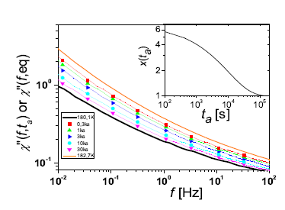


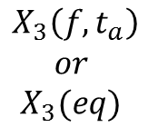
Aging of X₃⁽³⁾ [Brun et al PRL (2012)]
$$\frac{f_{α}(t_{a})}{f_{α}(eq)}$$
T_{initial}
T_{g}
Aging: observables depend on t_{a}
T_{final}
t_{a}=0
t_{a}
$$X_{3}\left({f,t}_{a}\right)$$
$$or$$
$$X_{3}(eq)$$
$$χ_{1}′′\left({f,t}_{a}\right)$$
$$or$$
$$χ_{1}′′\left(eq\right)$$
X₁ and X₃ do not age similarly.

Slide 38
Aging of X₃⁽³⁾ (continued):
N_{corr} /N_{corr}(eq)
Brun et al. PRL 109, 175702 (2012)
t_{a}, [s]
N_{corr} increases during aging.

Slide 40
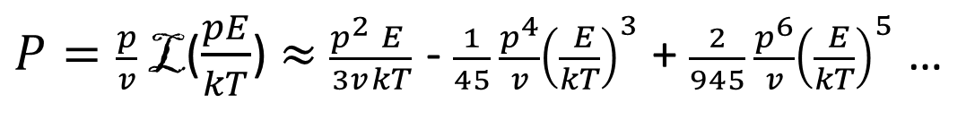
High order susceptibilities close to a standard para/ferro phase transition
$P=\frac{p}{v}$ L($\frac{pE}{kT}$) $≈$ $\frac{p^{2}}{3v}\frac{E}{kT}$ - $\frac{1}{45} \frac{p^{4}}{v}{\left(\frac{ E}{kT}\right)}^{3}$+ $\frac{2}{945} \frac{p^{6}}{v}{\left(\frac{ E}{kT}\right)}^{5}$ …
For independant dipoles:
Standard para/ferro phase transition :
Independant « paquets » of N_{corr}~ L^{d} dipoles
L
----- k=5
----- k=3
----- k=1 (linear resp.)
1
0
1
The higher the order k, the stronger the divergence in Temperature.
Another test of criticality: compare all the various χ_{k}.

Slide 42
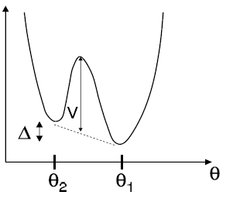
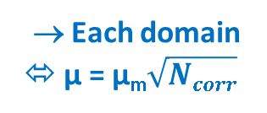
« Toy » (Ladieu et al 2012) and « Pragmatical » models (Buchenau,2016)
Two phenomenological approaches yielding X₃ ~ N_{corr}
→ Each domain ⬄ µ = µ_{m}$\sqrt{Ncorr}$
→ N_{corr} , δ=Tanh(Δ/T) and τ_{ex}/τ_{α} ⬄ three free parameters
Buchenau, ArXiv:1512.00188v2, Prop. Carbonate
N_{corr} ≈ 100 @ T_{g}+9K
N_{corr}=15@Tg+17K; δ=0.60; τ_{ex}/τ_{α} = 7
E
µ
θ₂-θ₁ << π
→ Crossover to Trivial is enforced at f<<f_{α}
…with a link to viscous flow
Good fits for X₃⁽¹⁾ (phase+modulus). N_{corr} is reasonnable, but model dependent.

Slide 43
« Toy » and « Pragmatical » models (2/2):
N_{corr}=10; δ, τ_{ex}/τ_{α} unchanged
N_{corr}=5 ; δ, τ_{ex}/τ_{α} unchanged
• Bad point : N_{corr} should be the same for all X₃’s ⇨ these models are too naive.
• (Partially) answered questions :
→ Fit ALL the X₃’s with a single mechanism involving N_{corr}?
→ Yes, with N_{corr} = 10-100
→ Similarities between the various H₃^{(k)} (modulus AND phase) ?
• Remaining questions :
Are there subdominant terms in X₃ ?
→ The link between N_{corr}(T) and ∂ Ln(τ_{α})/ ∂ Ln(T) is missing : can we recover it ?

Slide 45
An idea of G. Johari (JCP (2013)) for X_{2,1}⁽¹⁾ (⬄E_{st}+E_{ac}cos[ωt]).
δS ≈ δS_{c}
• Adam Gibbs:
JCP (1965)
• RFOT :
Wolynes et al
• More generally
B&B JCP (2004) and d=3
• Amplitude and ω dependence

Slide 46
Unification of different perspectives:
Samanta, Richert JCP (2015)
L’Hôte et al. PRB (2014)
218K
197K
glycerol
E_{st} = 40kV/m
f/f_{α}
→ Unification provided N_{corr}(T) ~ ∂ Ln(τ_{α})/ ∂ Ln(T)
f/f_{α}

Slide 47
Extending entropy effects to pure ac cubic responses :
Richert (2016), Kim, Young-Gonzales, Richert JCP (2016)
δS depends on time …
yields χ₃^{(3),δS}
(with no subdominant term
and with f_{S}=0.64)
+ argument to kill δS at f>f_{α}
χ₃^{(3),δS} (+χ₃^{(3),trivial} )
Good fits for X₃⁽³⁾ (modulus) with the same model fitting X_{2;1}⁽¹⁾

Slide 48
Summarizing :
Striking similarities (phase and modulus) between all the X₃’s in ω and T
BB’s prediction (the most general)
Johari: δS≈δS_{c} and Ln(τ_{α})~1/TS_{c}
Toy and pragmatical phenomenological models
Richert et al (2016): extension to X₃⁽³⁾ and X₃⁽¹⁾
N_{corr} is the origin of (the dominant part of) all X₃’s
N_{corr} increases upon cooling

Slide 50

Box Model (Schiener et al. Science (1996)):
→ Designed to account for NHB experiments:
• Each DH « k » has a Debye dynamics: {τ_{k}} chosen to recover χ_{lin}(ω) at each given T.
• Applying E: each DH « k » is heated by δT_{k} (τ_{therm}) with τ_{therm} ∼ τ_{k}.
⌠ as{τ_{k}} ∼ τ_{α} heat diffusion over one DH takes a macroscopic time close to Tg.
Richert et al. PRL (2006)
→ Box model:
χ₃ does NOT contain N_{corr}
Works well for X₃⁽¹⁾ above f_{α}:
e.g. R.Richert’s group: PRL (2006); PRB (2007); EPJB (2008); PRL (2010)…
Small contribution to X₃⁽³⁾
Negligible contribution for X_{2;1}⁽¹⁾
Which relation with other approaches ??

Slide 51
Box Model (2/2):
• BM has nothing to do with homogeneous heatings (⬄heat propagation eq. Brun JCP(2010))
• Box Model: {δT_{k}} are « fictitious temperatures »
fictitious ?
A « hard task for physical intuition » since at Tg: ξ_{glassy}≈ 3 nm and τ_{α} = 100s
• Two remarks:
→ T dependence:
→ ω dependence of X₃⁽¹⁾ :
← ← A (real) constant !
For X₃⁽¹⁾ above f_{α} : we propose to recast the Box model in the {N_{corr}; S_{c}} langage.

Slide 54

Definition of f_{α}:
f_{α} ⬄peak of χ_{lin}’’(ω)
ωτ_{α} ≡ f/f_{α}
|χ_{lin}(ω)| has no peak

Slide 55
How to measure cubic susceptibilities
Either push E as high as possible OR use a bridge with 2 samples of different thicknesses
V_{ac} e ^{j ω t} + V_{st}
Z₂ = thick
capacitor
(2×thin)
Z₁ = thin
capacitor
ΔV = V_{meas}(V_{ac},V_{st})
V_{meas}
- V_{meas}(V_{ac},0)
I_{Lin} +
I_{NonlLin}
2 I_{Lin} +
8 I_{NonlLin}
r₁
r₂
• when r₁Z₁=r₂Z₂ : P_{lin} cancels
gives P_{NonLin}
C. Thibierge et al, RSI 79, 103905 (2008))
ΔV~ V_{st}² V_{ac}
Phase (ΔV) = cte

