Slide 1
spatial fluctuations of multiplying systems close to the critical point: neutron clustering Andrea Zoia (CEA/Saclay) Eric Dumonteil (IRSN)
Workshop IPhT – Phénomènes hors d’équilibre|
Andrea ZOIA| DEN/DANS/DM2S/SERMA/LTSD
October 2nd 2018

Slide 2
Outline
Neutron fluctuations close to the critical point
The emergence of spatial clustering
Physical origins and evolution equations
The impact of delayed neutrons
The role of population control
Perspectives

Slide 3
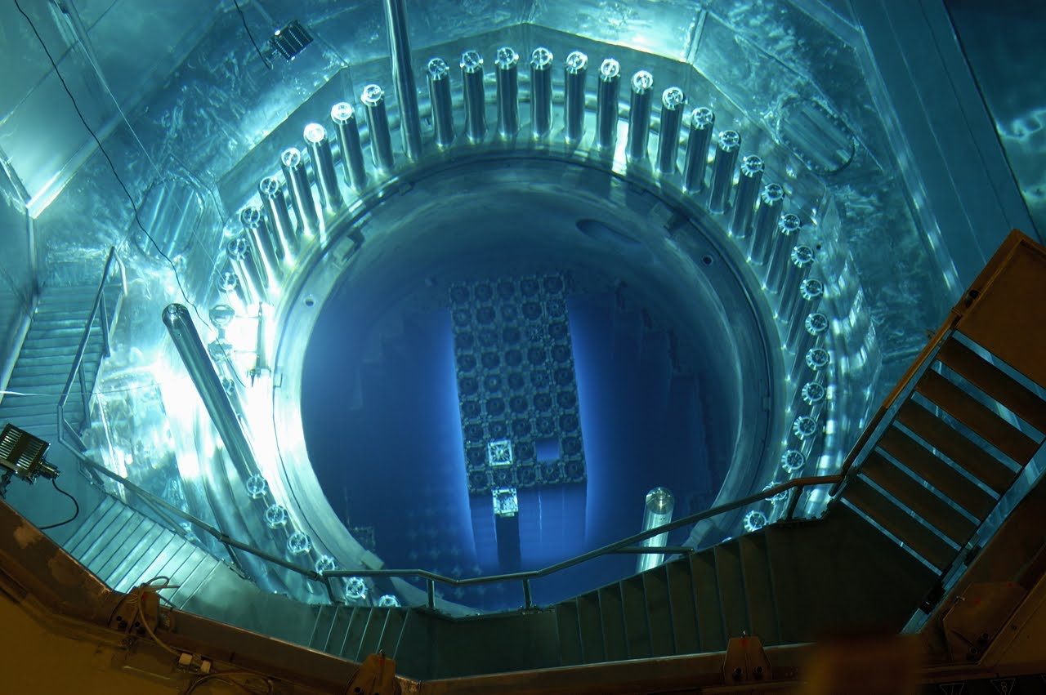
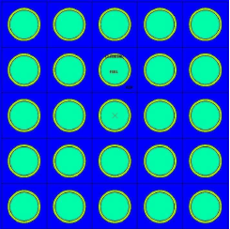
Everything you always wanted to know …
… about nuclear reactors, and were afraid to ask
Uranium
Water
Fission chain: neutron → fission → neutrons + energy → capture or fission → …
Goal: constant power, i.e., keep the fission chains stable (critical regime)
Balance between births and deaths, on average
Sources of fluctuations in the neutron population: spatial diffusion, fission & capture

Slide 4
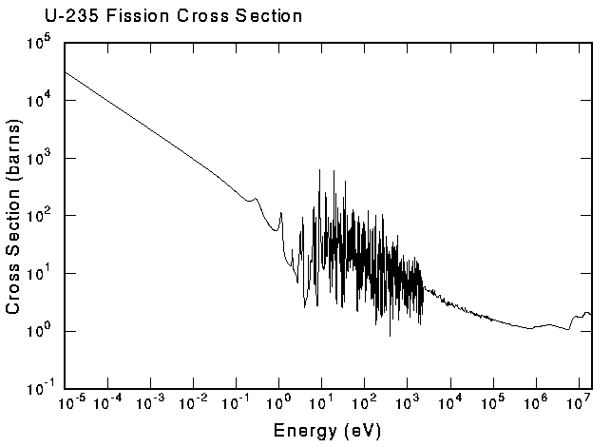
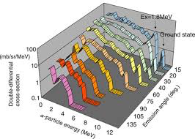
Neutron-Nuclei interactions as a random walk
Neutrons as a (diluted) gas of diffusing particles
with birth and death
t
z(t) = { r, Ω, E }
scattering
Stochastic process z(t) = { r, Ω, E }(t):
branching exponential flights
capture
fission
z
Jump kernel:
Σ(E):
cross section
Collision densities:
Σ(E)
Ω
E
The medium is spatially heterogeneous

Slide 5
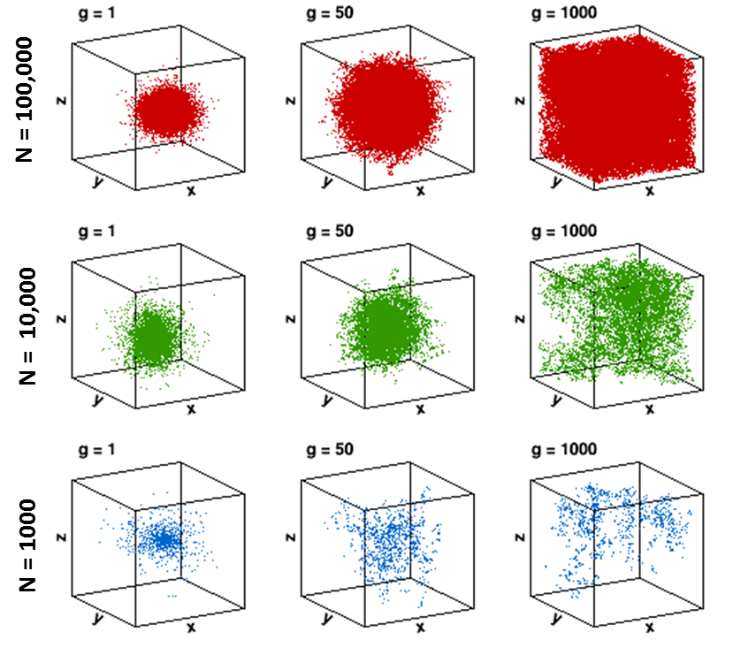
Monte Carlo simulations of a critical reactor
generations
Stationary distribution
Fluctuations around equilibrium
Arbitrary source
Wide range of average neutron densities at criticality : 1 ÷ 10⁸ n/cm³

Slide 6
Monte Carlo simulations of a critical reactor
generations
Stationary distribution
Fluctuations around equilibrium
Stationary distribution
Neutron “clustering”

Slide 7
A prototype model of A nuclear reactor
Neutrons in a box
Assumptions:
The reactor is critical, i.e., β (ν - 1) = γ
No population control
Key ingredients for the model:
Displacements: Brownian motion with diffusion coefficient D [cm²/s]
Fission with rate β [1/s] and capture with rate γ [1/s]
If fission, k descendants with probability p_{k} and average ν = Σ_{k} k p_{k}
Reflecting boundary conditions

Slide 8
Global fluctuations at criticality
At the critical point, the total population N(t):
Galton-Watson theory
Non-ergodic system
Extinction time:
However, within a “typical” time
“Critical catastrophe”: equilibrium is a mathematical fiction !
What about the spatial behaviour of the neutron population ?

Slide 9
The physical observables
Average neutron density:
Pair correlation function:
Probability generating function:
For a single starting particle at x₀
Including N source particles:
Each distributed according to q(x₀)
Obtain the moments:

Slide 10
The Pal-Bell equation
The P.G.F. W_{t}(u,v) satisfies the (nonlinear) backward equation:
[L. Pal, G. Bell, 1965]
With:
The moments ψ_{t}(x) and h_{t}(x,y) satisfy linear equations
whose solutions can be expressed in terms of the Green’s function:
Diffusion
Birth
Death

Slide 11
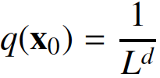
The average neutron density
x
Detection
For an equilibrium source
the average density is flat
x
x₀
and insensitive to fluctuations
t
Source

Slide 12
The pair correlation function
x’→x₀
x→x’
y→x’
Correlated detection
x
y
Average rate of particle pairs
from fission events
x
x₀
t
Source

Slide 13
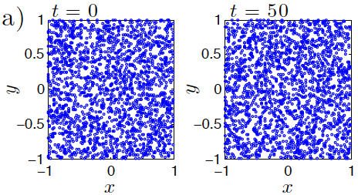
spatial fluctuations: ideal particle gas
Pure diffusion (ideal gas)
β = γ = 0
Independent trajectories
Self-correlations
Initial condition: N₀ particles with uniform density

Slide 14
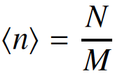
spatial fluctuations: ideal particle gas
Fluctuations:
M spatial meshes of size L^{d} / M
Maxwell-Boltzmann distribution
Initial condition: N₀ particles with uniform density

Slide 15
spatial fluctuations: ideal particle gas
Mixing time
Fluctuations:
Initial condition: N₀ particles with uniform density
Probability R of having exactly s empty meshes:

Slide 16
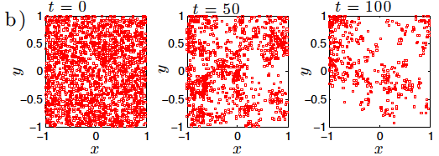
spatial fluctuations: critical particle gas
Diffusion + fission + capture
(critical gas)
Average rate of particle pairs:
Correlation function:
Initial condition: N₀ particles with uniform density
Ideal gas
Bounded
Tent-shaped
Divergent

Slide 17
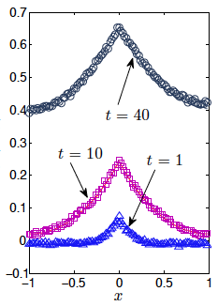
The pair correlation function
Without population control
Symbols: Monte Carlo; lines: theory

Slide 18
spatial fluctuations: critical particle gas
Fluctuations:
M spatial meshes of size L^{d} / M
Initial condition: N₀ particles with uniform density

Slide 19
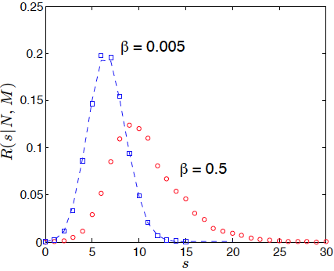
spatial fluctuations: critical particle gas
Mixing time
Fluctuations:
Probability R of having exactly s empty meshes:
Initial condition: N₀ particles with uniform density
Clustering
Capture
Fission
Diffusion

Slide 20
spatial fluctuations: critical particle gas
Mixing time
Extinction time
Initial condition: N₀ particles with uniform density
Clustering
Critical catastrophe
Capture
Fission
Diffusion

Slide 21
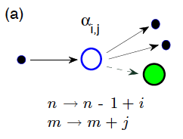
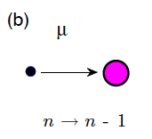
Fission with delayed neutrons
fission
capture
i prompt neutrons
nucleus
Equilibrium (critical reactor):
Net gain rate
Loss rate

Slide 22
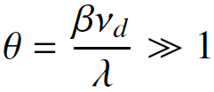
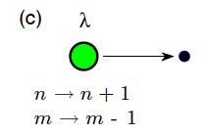
Fission with delayed neutrons
fission
capture
i prompt neutrons
nucleus
j precursors
Precursor importance:
nuclear decay
delayed neutron
Equilibrium (critical reactor):

Slide 23
Clustering with delayed neutrons
Close to the critical point:
Neutron density
Spatial correlations
Extinction time
Precursors are very effective in “quenching” clustering
Qualitative picture unchanged: population is doomed to catastrophe

Slide 24
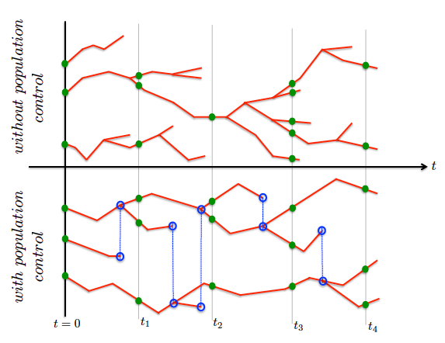
Enforcing Population control
Population control :
Imposing a constraint on the total number of neutrons N(t) = N₀
Each time that a particle is duplicated, another is killed

Slide 25
Enforcing population control

Slide 26
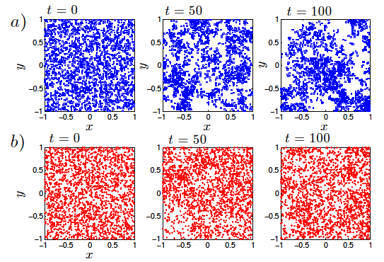
Correlations with population control
Average rate of particle pairs:
Correlation function:
Ideal gas
Bounded
Tent-shaped
Uniform initial condition

Slide 27
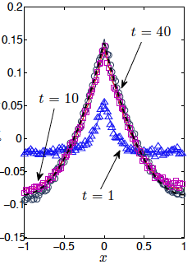
The pair correlation function
Without population control
With population control
Symbols: Monte Carlo; lines: theory

Slide 28
Correlations with population control
Average rate of particle pairs:
Correlation function:
Ideal gas
Bounded
Tent-shaped
Key parameter:
Uniform initial condition

Slide 29
spatial Fluctuations with population control
Bounded fluctuations:

Slide 30
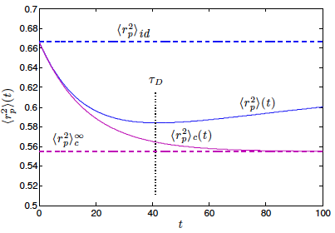
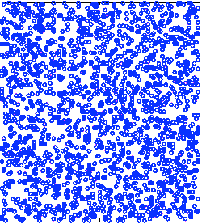
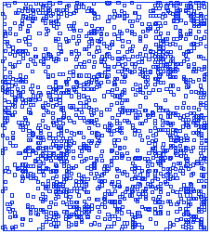
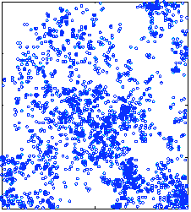
Analysis of Spatial moments
Average square distance between particle pairs:
β = γ = 0
Critical gas
Uniform initial condition

Slide 31
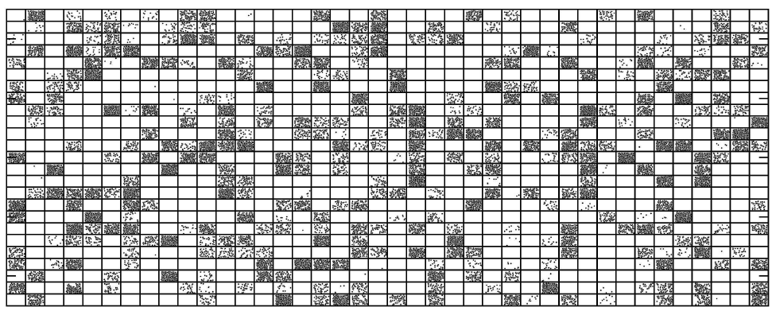
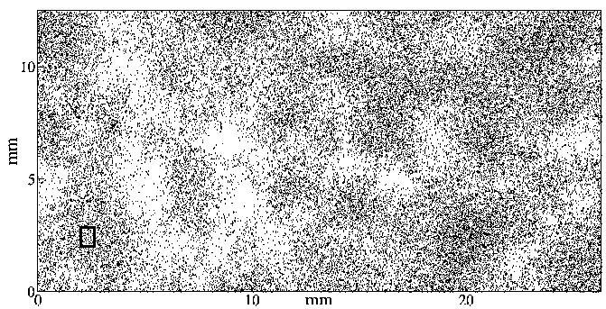
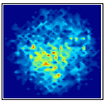
Clustering: past and future
First works on clustering: theoretical ecology (Cox & Griffeath, 1980)
Fluctuations of individuals subject to diffusion, reproduction and death
Monte Carlo simulations
Experiments
Houchmandzadeh & Vallade (2009)
Neutron clustering in reactor physics (Dumonteil et al., 2013)
Monte Carlo simulations
Experiments

Slide 32
Thanks for your attention
References
E. Dumonteil, F. Malvagi, A. Zoia, A. Mazzolo, D. Artusio, C. Dieudonné, C. de Mulatier, Proceedings of SNA+MC2013, Paris, France (2013).
E. Dumonteil, F. Malvagi, A. Zoia, A. Mazzolo, D. Artusio, C. Dieudonné, C. de Mulatier, Ann. Nucl. Energy 63, 612-618 (2014).
A. Zoia, E. Dumonteil, A. Mazzolo, C. de Mulatier, A. Rosso, Phys. Rev. E 90, 042118 (2014).
C. de Mulatier, E. Dumonteil, A. Rosso, A. Zoia, J. Stat. Mech. P08021 (2015).
B. Houchmandzadeh, E. Dumonteil, A. Mazzolo, A. Zoia, Phys. Rev. E 92, 052114 (2015).
M. Nowak, J. Miao, E. Dumonteil, B. Forget, A. Onillon, K. Smith, A. Zoia, Ann. Nucl. Energy 94 856-868 (2016).
A. Zoia, E. Dumonteil, Proceedings of the M&C2017 conference, Jeju, Korea (2017).

Slide 33
DEN/DANS DM2S SERMA
Commissariat à l’énergie atomique et aux énergies alternatives
Centre de Saclay | 91191 Gif-sur-Yvette Cedex
T. +33 (0)1 69 08 62 75 | Secr :+33 (0)1 69 08 39 61
Etablissement public à caractère industriel et commercial | RCS Paris B 775 685 019

