Slide 1

DIRAC Services for Grid and Cloud Infrastructures
A.Tsaregorodtsev,
CPPM-IN2P3-CNRS, Marseille,
3 July, EGO, Cascina

Slide 2
Plan
DIRAC in a nutshell
DIRAC Communities
Framework
Services
Interfaces
Conclusions
Notes:
Qui a besoin de plus qu’un seul ordinateurs pour le travail ?

Slide 3
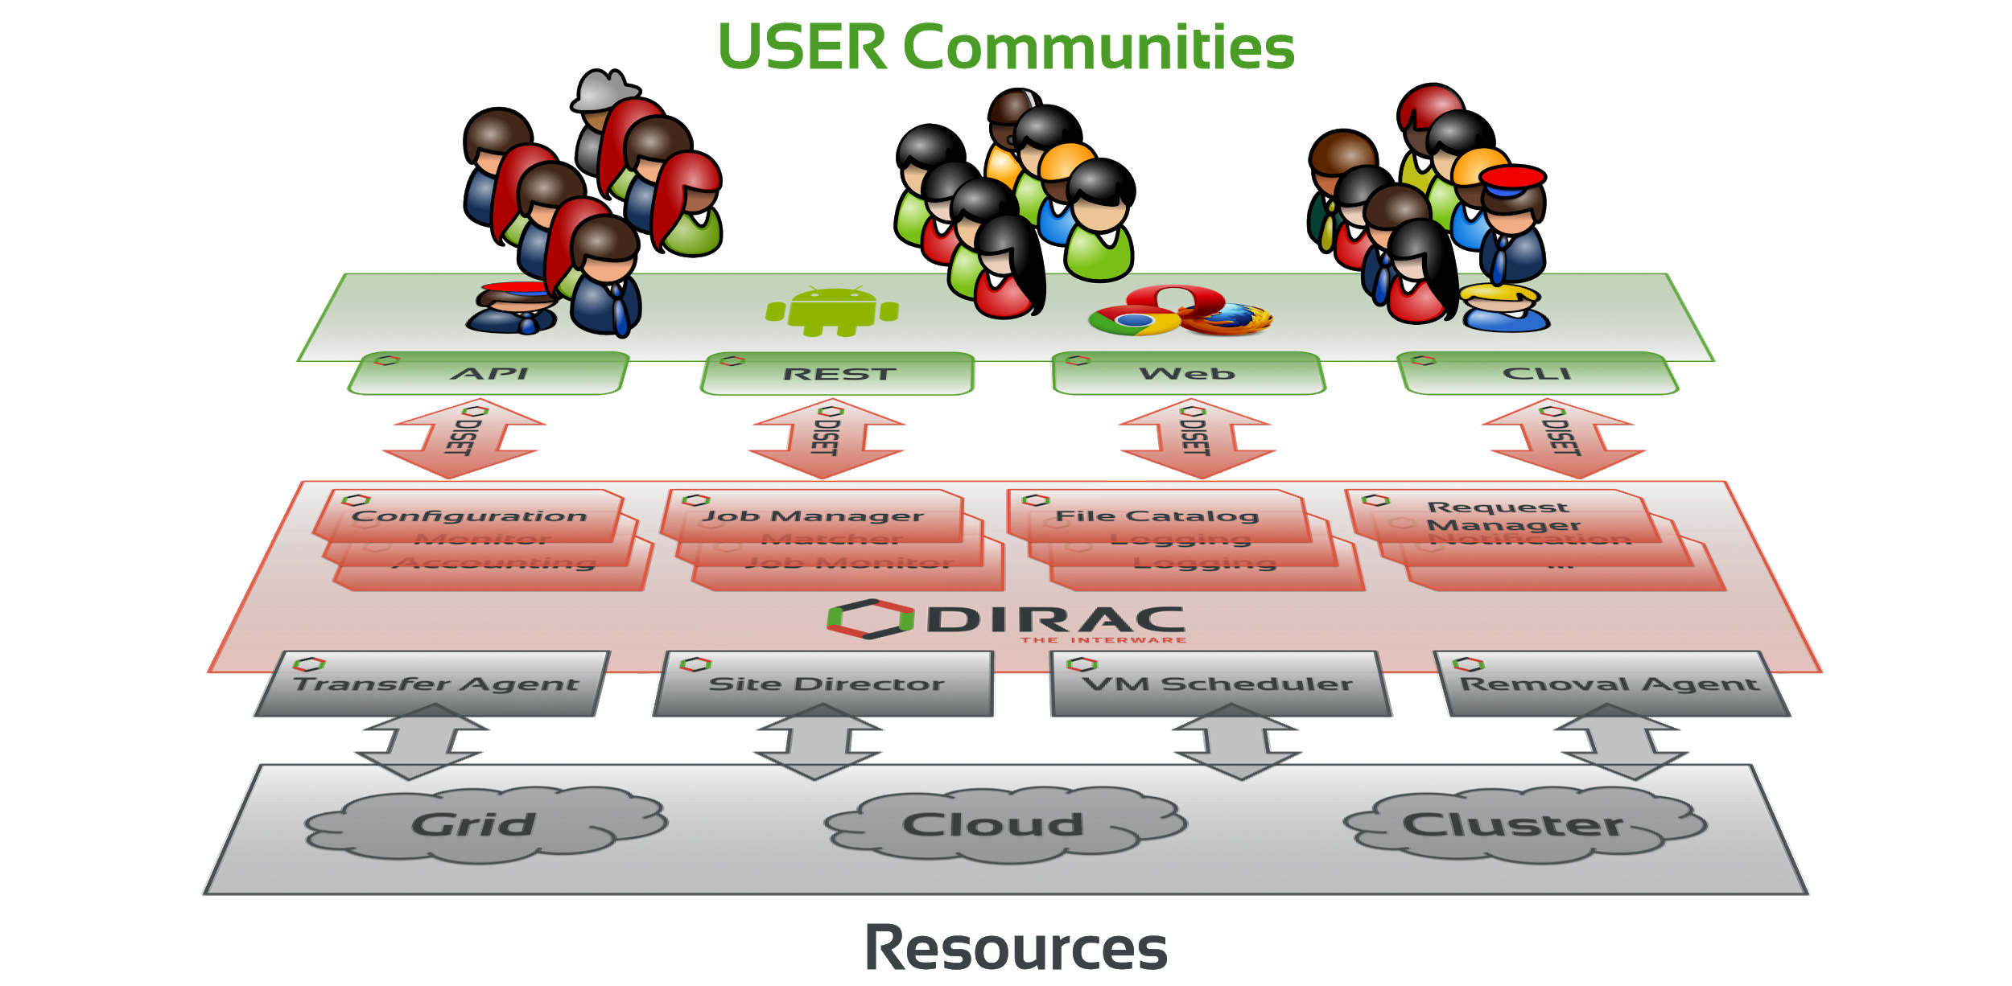
DIRAC: the interware
A software framework for distributed computing
A complete solution to one (or more) user community
Builds a layer between users and resources

Slide 4
… a few examples of what DIRAC can be used for
sending jobs to “the Grid”
  the obvious one
interfacing with different sites
  with different computing elements
    and batch systems
  with different storage elements
interfacing with different information systems
managing productions
managing dataset transfers
  and removals...
providing a failover system
  your jobs won’t fail because a certain SE is down, nor because of central service are down
transfer data from the experiment to a Grid SE
… and more

Slide 5
An open source project
Started as an LHCb project, became experiment-agnostic in 2009
  First users (after LHCb) end of 2009
Developed by communities, for communities
  Open source (GPL3+), GitHub hosted, python 2.7
  No dedicated funding for the development of the “Vanilla” project
  Publicly documented, active assistance forum, yearly users workshops, open developers meetings
  4 FTE as core developers, a dozen contributing developers
The DIRAC consortium as representing body
  CNRS, CERN, University of Barcelona
  IHEP, KEK, PNNL, University of Montpellier

Slide 6













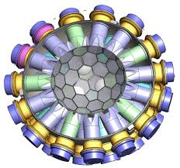






Users/communities/VOs
A framework shared by multiple experiments/projects, both inside HEP, astronomy, and life science
Experiment agnostic
Extensible
Flexible

Slide 7
LHCb Computing System
The project was started in 2003 for the LHCb experiment at CERN
  First focusing on the workload management for the LHCb data production system
Now DIRAC is the basis for almost all the aspects of the LHCb distributed computing
  Workload Management
  Data Management
  High level production services
  Monitoring of resources, activities and services
  Accounting
  Interfaces

Slide 8
LHCb Computing
Supporting various activities
  MC production
  Real data processing
  User analysis
Accessing all the resources available to LHCb
  HTC/WLCG
  Cloud (running DIRAC pilots via Vac/VCycle)
  BOINC
  Standalone, e.g.
    Online HLT farm
    Yandex (container based) cloud
    Non-CE clusters

Slide 9

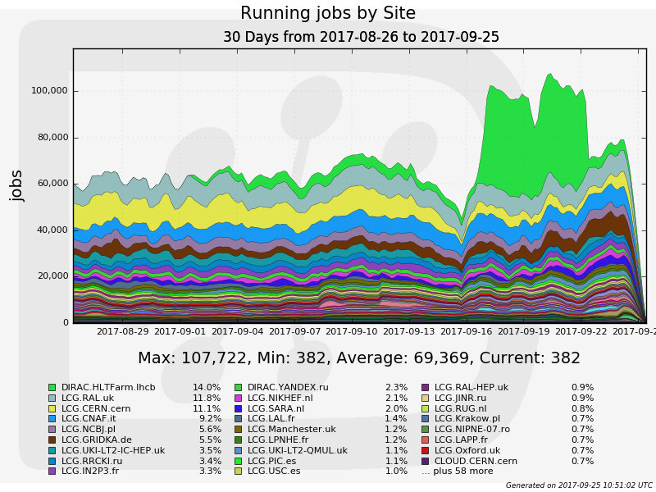
LHCb Collaboration
More than 100K concurrent jobs in ~120 distinct sites
  Limited by available resources, not by the system capacity
Further optimizations to increase the capacity are possible
  Hardware, database optimizations, service load balancing, etc

Slide 10





Community installations
Belle II Collaboration, KEK
  First use of clouds (Amazon) for data production
ILC/CLIC detector Collaboration, Calice VO
  Dedicated installation at CERN, 10 servers, DB-OD MySQL server
  MC simulations
  DIRAC File Catalog was developed to meet the ILC/CLIC requirements
BES III, IHEP, China
  Using DIRAC DMS: File Replica and Metadata Catalog, Transfer services
  Dataset management developed for the needs of BES III
CTA
  CTA started as France-Grilles DIRAC service customer
  Now is using a dedicated installation at PIC, Barcelona
  Using complex workflows
Geant4
  Dedicated installation at CERN
  Validation of MC simulation software releases
DIRAC evaluations by other experiments
  LSST, Auger, TREND, Juno, ELI, NICA, …
  Evaluations can be done with general purpose DIRAC services

Slide 11
Multi-community services
Maintaining DIRAC services for small communities is not affordable
  Need for multi-VO installations
  DIRAC framework was updated to support this kind of installations
Several services provided by grid infrastructure projects
  FG-DIRAC, France
  GridPP, UK
  DIRAC4EGI
Some dedicated installations evolved into multi-community services
  CERN: ILC, CALICE
  IHEP: BES III, Juno, CEPC
Recently added services
  PNNL: Belle II, Project8, MiniCLEAN, SuperCDMS, nEXO
  DIRAC@JINR: NICA, Dubna University

Slide 12
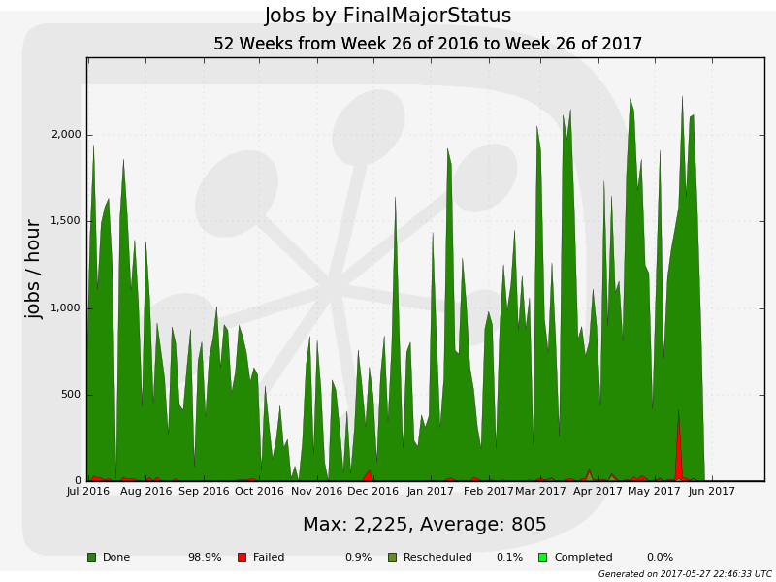
DIRAC4EGI service
In “best effort” production since 2014
Partners
  Operated by EGI
  Hosted by CYFRONET
  DIRAC Project providing software,
  consultancy
10 Virtual Organizations
  enmr.eu, vlemed, eiscat.se
  fedcloud.egi.eu
  training.egi.eu
Usage
  Workload Management solution
    > 6 million jobs processed in
    the last year
  Data Management solution
    E.g. Eiscat 3D
Starting from 2018 DIRAC
becomes a Core Service of EGI
  WMS replacement
  Serving both Grid and FedCloud resources
DIRAC4EGI activity snapshot

Slide 13
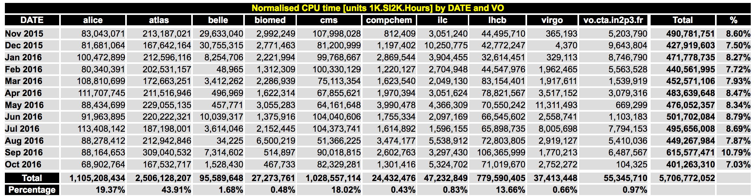
5 out of Top-10 EGI communities used heavily DIRAC for their payload management in the last year
  4 out of 6 top communities excluding LHC experiments
    belle, biomed, ilc, vo.cta.in2p3.fr

Slide 14
EGI Virgo support
VO virgo is configured in the DIRAC4EGI service
  No automatic VOMS synchronization yet
Sites supporting virgo are added
  Computing and Storage Elements
Dedicated File Catalog is deployed and maintained at CNAF
  Populated with ~1M of entries
Some basic tests are done
Ready to use test bench for experimenting virgo workflows (pipelines)

Slide 15
DIRAC Framework

Slide 16
DIRAC Framework
DIRAC systems consist of well defined components with clear recipes for developing
  Services
    passive components reacting to client request
    Keep their state in a database
  Agents
    Light permanently running distributed components, animating the whole system
  Clients
    Used in user interfaces as well as in agent-service, service-service communications

Slide 17
DIRAC Framework
All the communications between the distributed components are secure
  DISET custom client/service protocol
    Focus on efficiency
    Control and data transfer communications
  X509, GSI security standards
    Users and services are provided with digital certificates
    User certificate proxies ( passwordless, time limited temporary certificate copies ) are used for distributed operations on the users’s behalf
  Fine grained service access authorization rules

Slide 18
DIRAC Framework
Framework allows to easily build these components concentrating on the business logic of the applications
  Development environment: Python, MySQL
  Using base services for configuration, monitoring, logging, etc
  Specific functionality can be provided in many cases as plugin modules, e.g.
    Data access policies
    Job scheduling policies

Slide 19
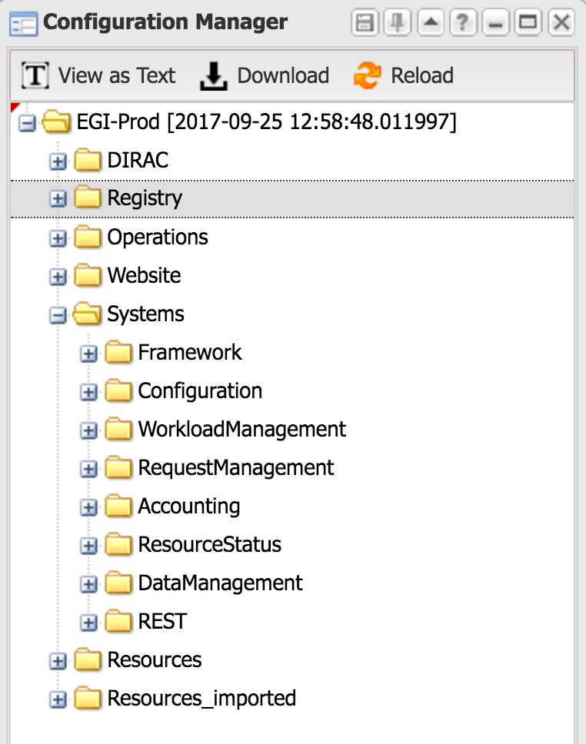
Configuration Service
This is the DIRAC information index:
  All the static configuration information
  Services description for configuration
  and discovery
  Resources description
    Computing
    Storage
    Third party services (data transfer,
    catalogs, message queues, etc)
  User registry
    Including VO and group membership,
    access rights
  Operational parameters
    For various activities
    For various communities

Slide 20
Configuration service
Redundant highly available
service
  Multiple distributed slaves
  synchronized with the master

Slide 21
Resources Management
Automatic synchronization of resources description with external information services (BDII or …)
  Resource access information
  VO access rights
Resource Monitoring Service
  A framework to define and run various probes and update the resource status appropriately
    E.g. downtimes announced in the GocDB, testing access to storage and computing resources, VOMS servers, etc
Resource Status Service
  Serve resource status information to interested clients

Slide 22
Other base services
Full featured proxy
management system
  Proxy storage and renewal
  mechanism
  Support for multiuser pilot jobs
System Logging service
  Collect essential error messages from all the distributed components
Monitoring service
  Monitor the service and agents behavior
Security Logging service
  Keep traces of all the service access events

Slide 23
DIRAC WMS

Slide 24



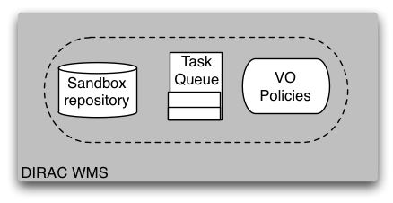





Physicist
User
Production
Manager
Matcher
Service
EGI/WLCG
Grid
NDG
Grid
Amazon
EC2 Cloud
CREAM
CE
EGI
Pilot
Director
NDG
Pilot
Director
Amazon
Pilot
Director
CREAM
Pilot
Director

Slide 25
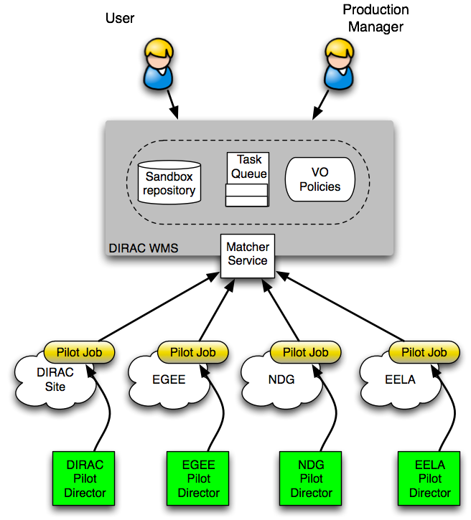
Job scheduling
Pilot jobs are submitted to computing
resources by specialized Pilot Directors
After the start, Pilots check the
execution environment and
form the resource description
  OS, capacity, disk space, software, etc
The resources description is presented to the Matcher service, which chooses the most appropriate user job from the Task Queue
The user job description is delivered to the pilot, which prepares its execution environment and executes the user application
In the end, the pilot is uploading the results and output data to a predefined destination

Slide 26
Pilot based WMS
One evident advantage is that the users’ payload is starting in an already verified environment
  In early days of the grid and even now users saw an important decreasing of their jobs failure rate
The environment checks can be tailored for specific needs of a particular community by customizing the pilot operations

Slide 27
Pilot based WMS
Site resources providers does not need to distinguish individual users
  One user identity represents the whole community to the sites
  Simplifies site management but needs special trust relation between the site and the community
Sites does not need to organize local resources to meet the community requirements
  E.g. special queues per community groups with special fair sharing
Adding new sites to the pool of DIRAC managed resources is considerably simpler
  DIRAC does not require special services to be deployed on sites
    There are exceptions (see the HPC case below)

Slide 28
Pilot based WMS
User jobs submitted to the system are not passed immediately to a selected site but wait in the central repository – Task Queue
  Very efficient job matching to the site properties (see below)
  Possibility to apply community policies by dynamically adjusting the job priorities
    Similar mechanism to batch systems fair sharing mechanism
    Job priorities can be adjusted using community specific plugins
    Standard plugins include static group shares
    Job priorities of users in the same group are dynamically adjusted based on the recent history of the consumed resources as provided by the Accounting service

Slide 29
Job matching
What makes job matching efficient
  Single central Task Queue serving requests from the army of pilots (>100K simultaneous jobs demonstrated)
  User jobs are classified in groups with identical requirements which reduces by orders of magnitude the number of entities to match
  Very efficient matching mechanism based on the MySQL databases engine
    No JDL matching operation
  Typical O(10⁻¹) sec matching time
    Even with O(10⁵) jobs in the waiting queue

Slide 30
Computing Grids
DIRAC was initially developed with the focus on accessing conventional Grid computing resources
  WLCG grid resources for the LHCb Collaboration
It fully supports gLite middleware based grids
  European Grid Infrastructure (EGI), Latin America GISELA, etc
    Using gLite/EMI middleware
  Northern American Open Science Grid (OSG)
    Using VDT or HTCondor middleware
  Northern European Grid (NDGF)
    Using ARC middleware
Other types of grids can be supported
  As long we have customers needing that

Slide 31
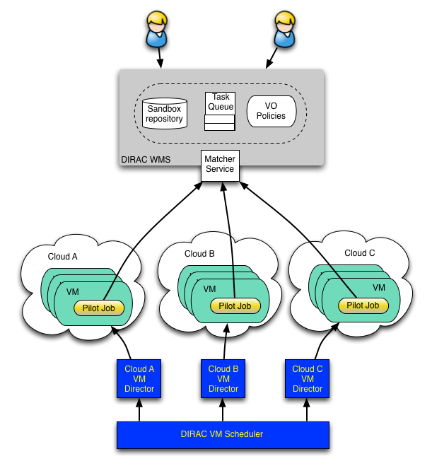
Clouds
VM scheduler developed for Belle MC production system
  Dynamic VM spawning taking Amazon EC2 spot prices and Task Queue state into account
  Discarding VMs automatically when no more needed
The DIRAC VM scheduler by means of dedicated VM Directors is interfaced to
  OCCI compliant clouds:
    OpenStack, OpenNebula
  apache-libcloud drivers
  Amazon EC2

Slide 32
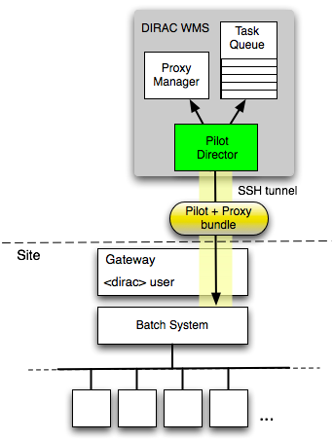
Standalone computing clusters
Off-site Pilot Director
  Site must only define a dedicated local user account
  The payload submission through an SSH tunnel
The site can be:
  a single computer or several computers without any batch system
  a computing cluster with a batch system
Pilots are sent as an executable self-extracting archive with the pilot proxy bundled in
The user payload is executed with the owner credentials
  No security compromises with respect to external services

Slide 33
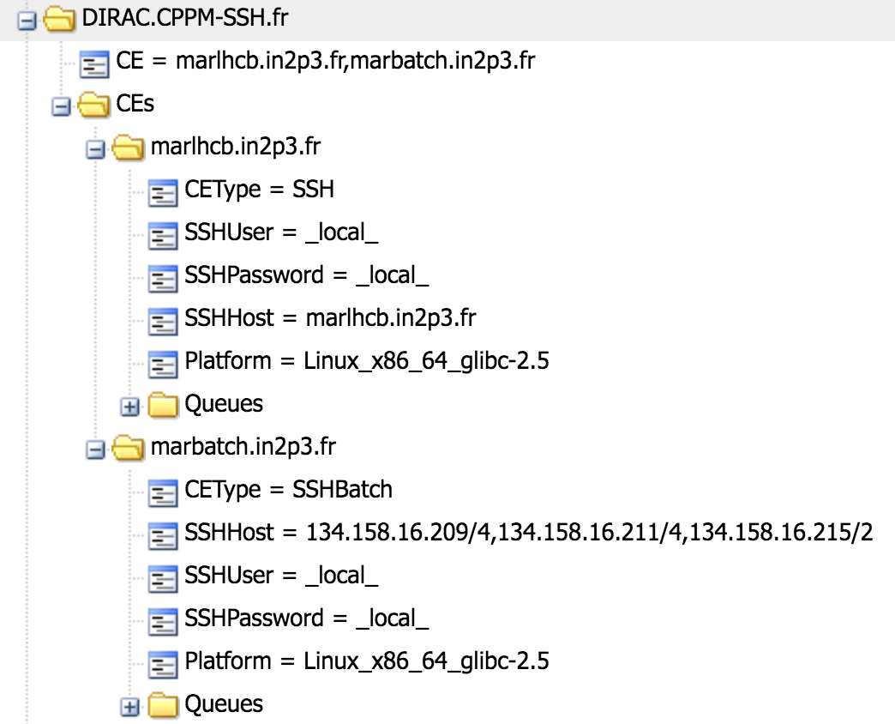
SSH CE: simplest case
SSH CE simplest case:
  One host CE with one job slot
SSHBatch CE
  Several hosts form a CE
    Same SSH login details
    Number of job slots per host can be specified
Pilots are sent as an executable self-extracting archive with the pilot proxy bundled in

Slide 34
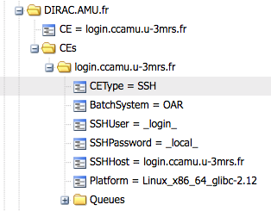
SSH CE with a batch system
SSH login to the cluster interactive host
  Copy several tools, e.g. BatchSystem plugin at the first
  time
Submit pilots to the local cluster using a relevant BatchSystem plugin
  Condor, GE, LSF, Torque
  SLURM, OAR
Pilots are sent as an executable self-extracting archive with the pilot proxy bundled in

Slide 35
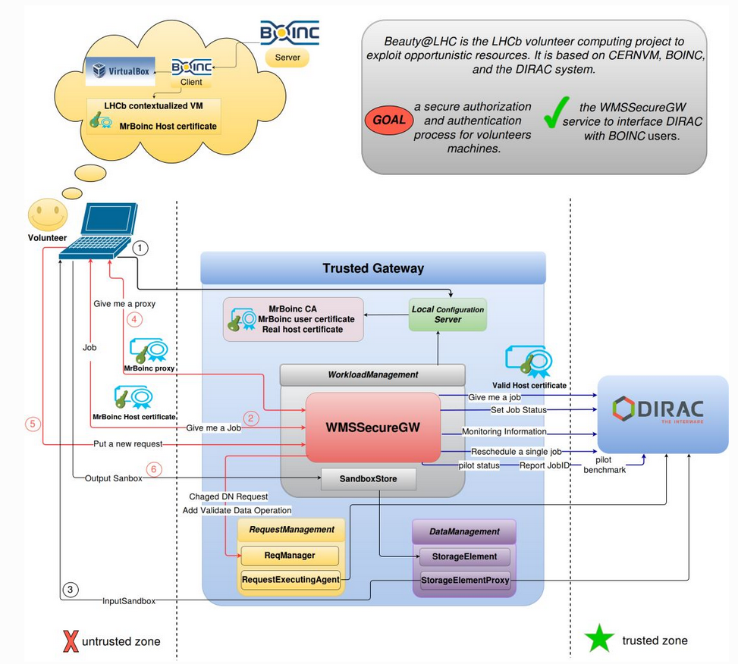
Boinc resources: LHCb case

Slide 36
The HPC case
HPC clusters are usually not part of any distributed infrastructure
  We have to agree that the HPC site delegates control of user jobs to the central DIRAC service
We can easily use HPC centers if:
  There is SSH login to the center interactive interface
  Worker nodes have world-wide outbound connectivity
  CVMFS available on worker nodes to deploy application software
  The payloads have no requirements to use HPC special features, e.g. MPI, GPUs, etc

Slide 37
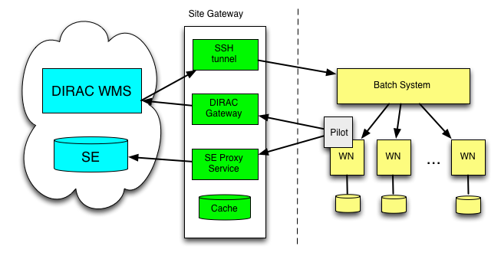
No WN connectivity case solution
Pilot communicates with the DIRAC central services through the Gateway proxy service
Download Input Data and upload output data to the target SE through the SE proxy

Slide 38
DIRAC DMS

Slide 39
DM Problem to solve
Data is partitioned in files
File replicas are distributed over a number of Storage Elements world wide
Data Management tasks
  Initial File upload
  Catalog registration of replicas and metadata
  File replication
  File access/download
  Integrity checking
  File removal
Need for transparent file access for users
Often working with multiple ( tens of thousands ) files at a time
  Make sure that ALL the elementary operations are accomplished
  Automate recurrent operations

Slide 40
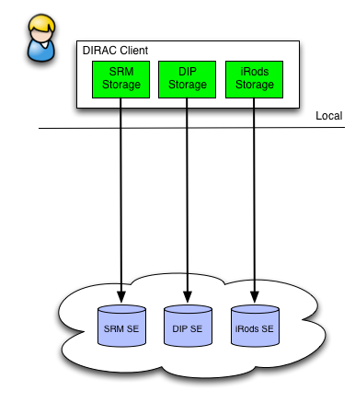
Storage plugins
Storage element abstraction with a client implementation for each access protocol
  DIPS, SRM, XROOTD, RFIO, etc
  gfal2 based plugin gives access to all
  protocols supported by the library
    DCAP, WebDAV, S3, …
Each SE is seen by the clients as a
logical entity
  With some specific operational properties
  SE’s can be configured with multiple protocols

Slide 41
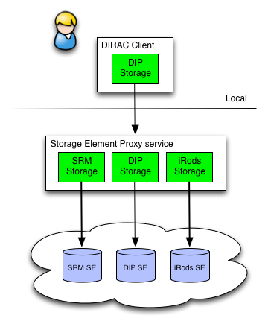
Storage Element Proxy
SE Proxy Service translates the DIRAC data transfer protocol to a particular storage protocol
  Using DIRAC authentication
  Using credentials specific to the target
  storage system
  Example: access to iRods storage
    Using login/password authentication
SE Proxy Service allows access to
storages not having access libraries
on a given client machine
  DIRAC or HTTP protocol

Slide 42
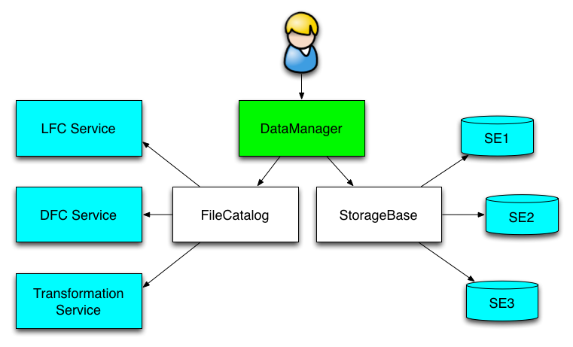
File Catalog
Central File Catalog ( DFC, LFC, … ) is
maintaining a single global logical name
space
Several catalogs can be used together
  The mechanism is used to send
  messages to “pseudocatalog”
  services, e.g.
    Transformation service (see later)
    Bookkeeping service of LHCb
  A user sees it as a single catalog
  with additional features
DataManager is a single
client interface for logical
data operations

Slide 43
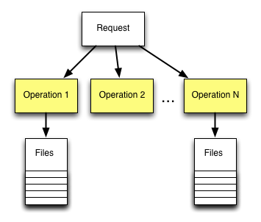
Asynchronous operations
Request Management System (RMS)
  Keeps the database of Requests
Request is a sequence of Operations
executed in a certain order
  Operations can have associated
  Files
Each Operation type has a
dedicated Executor
  Execution is done with the credentials
  of the Owner of the Request
    E.g. user defined operations
  Examples: ForwardDISET, ReplicateFile,
  RemoveFile
Executors are invoked by an agent
running in a background
  Retry logic in case of failures

Slide 44
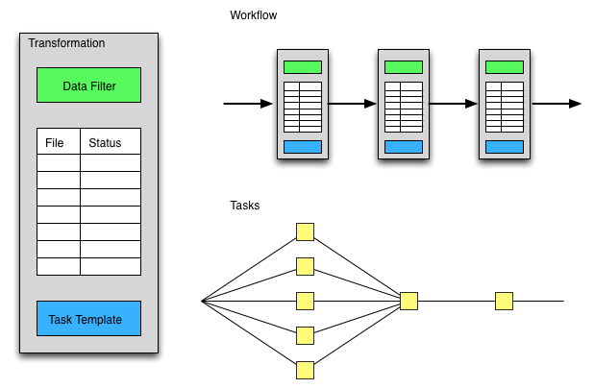
Transformation System
Data driven workflows as chains of data transformations
  Transformation: input data filter + recipe to create tasks
  Tasks are created as soon as data with required properties is registered into the system
  Tasks: jobs, data operations,
  etc
Transformations can be
used for automatic data
driven bulk data
operations
  Scheduling RMS tasks
  Often as part of a more
  general workflow

Slide 45
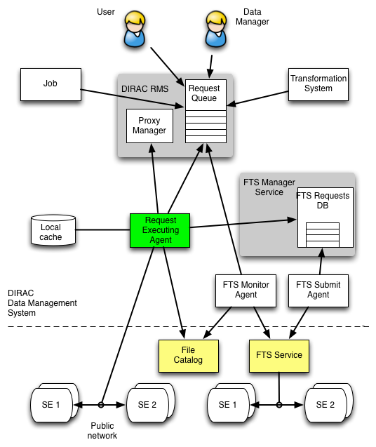
Bulk transfers
Replication/Removal Requests with multiple files are stored in the RMS
  By users, data managers, Transformation System
The Replication Operation executor
  Performs the replication itself or
  Delegates replication to an external service
    E.g. FTS
  A dedicated FTSManager service keeps track of the submitted FTS requests
  FTSMonitor Agent monitors the request progress, updates the FileCatalog with the new replicas

Slide 46
File Catalog
DFC is the central component of the DIRAC Data Management system
Defines the single logical name space for all the data managed by DIRAC
Together with the data access components DFC allows to present data to users as single global file system

Slide 47
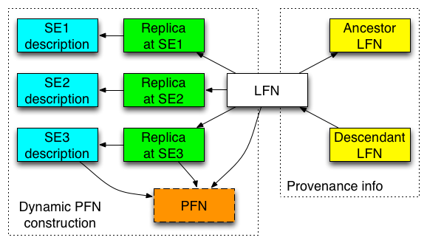
File Catalog: Replicas
File standard metadata
  Size, ownership, time stamps,
  ACL, checksum
Standard Replica
Catalog functionality
  Optimized for bulk
  queries
On the fly PFN
construction
  Small database footprint
  Full PFN can be stored if
  necessary
Ancestor-descendent relations
Efficient storage usage reports

Slide 48
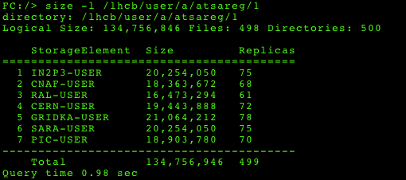
Storage Usage
Report of storage usage for any directory
  Whole community data
  Per user data
  “Logical” storage
    LFNs, sum of the LFN sizes
  “Physical” storage
    Physical replicas, total volume per Storage Element

Slide 49
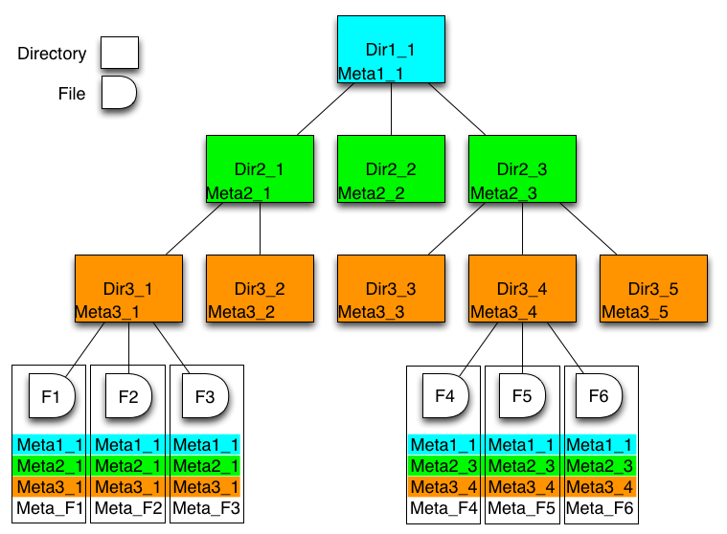
File Catalog: Metadata
DFC is Replica and
Metadata Catalog
  User defined metadata
  The same hierarchy for
  metadata as for the
  logical name space
    Metadata associated
    with files and directories
    Allow for efficient searches
Example query:
  find /lhcb/mcdata LastAccess < 01-01-2012 GaussVersion=v1,v2 SE=IN2P3,CERN Name=*.raw

Slide 50
Support for datasets
Datasets defined as a resulting list of files from a given metaquery
  Particular case: all the files under a given directory
Dataset objects are stored in the same directory hierarchy as files
  ACLs, ownership, show up in the output of ls command as for files
Datasets can be frozen in order not to change from one query to another
  Can be refreshed by an explicit command, a quick check if changed since the last update
Datasets can be annotated
Operations on datasets
  Replica lookup for all the files in a dataset
  Total size, number of files report
  Replication, removal, etc

Slide 51
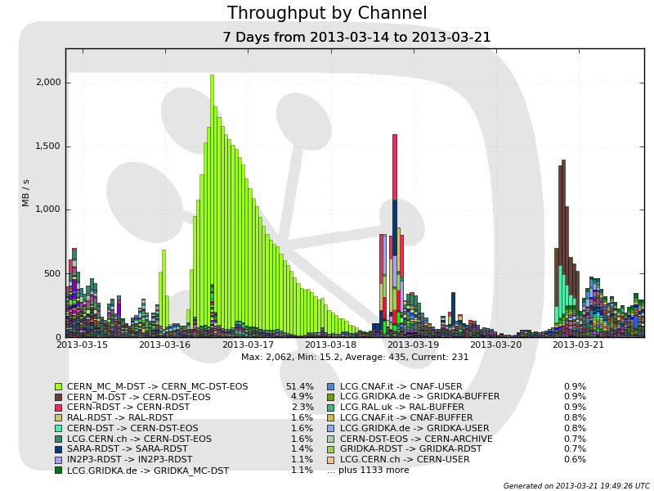
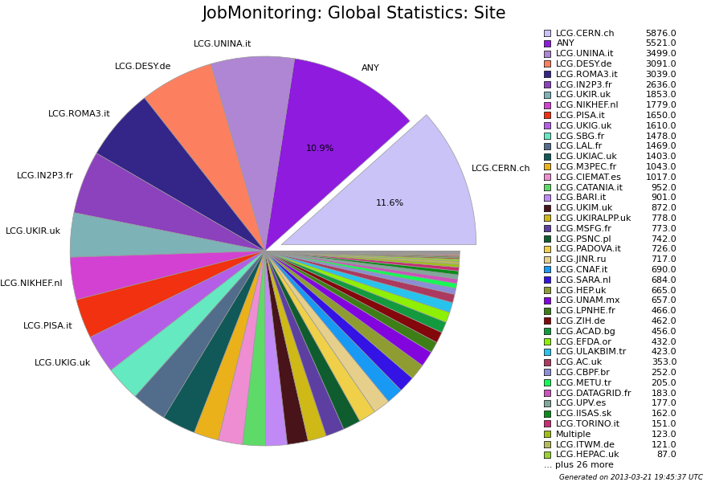
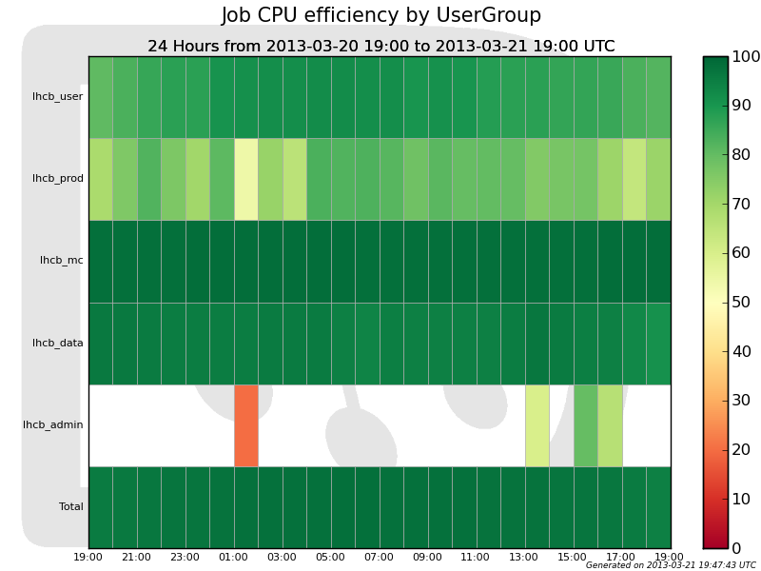
Accounting
Comprehensive accounting of all the operations
Using MySQL backend and custom plotting
Work in progress:
  Using ElasticSearch/Kibana set of tools

Slide 52
Interfaces
Command line for all the operations
  “gLite-style”
    dirac-wms-job-submit job.jdl
  COMDIRAC style
    dsub echo Hello World !
    dls, dput, dget, …
Web Portal for the most common user and administrator operations
Python API
REST service interface for third party developments using DIRAC services

Slide 53
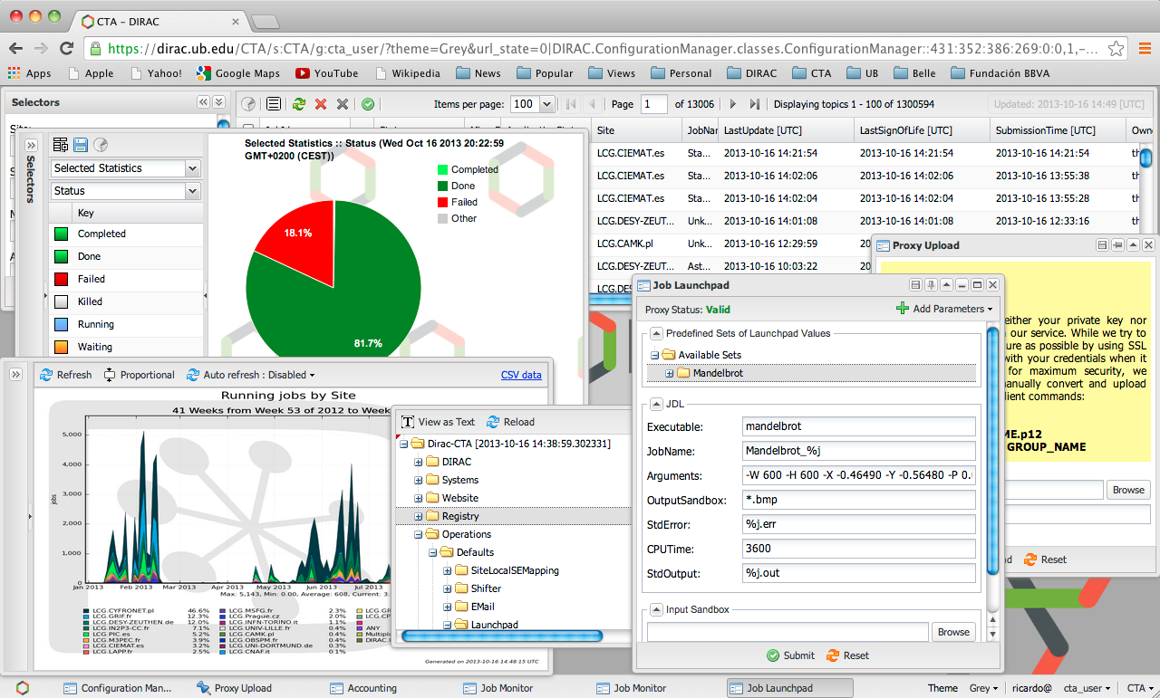
Web Portal examples

Slide 54

Conclusions
DIRAC provides a framework for building distributed computing systems aggregating multiple types of computing and storage resources
The list of services available for users of multi-community DIRAC installations provided by grid and cloud infrastructure projects includes basic framework services, resources, workload and data management.
High level services as well as customized services can be added on demand by interested user communities
http://diracgrid.org

Slide 55
Backup slides

Slide 56
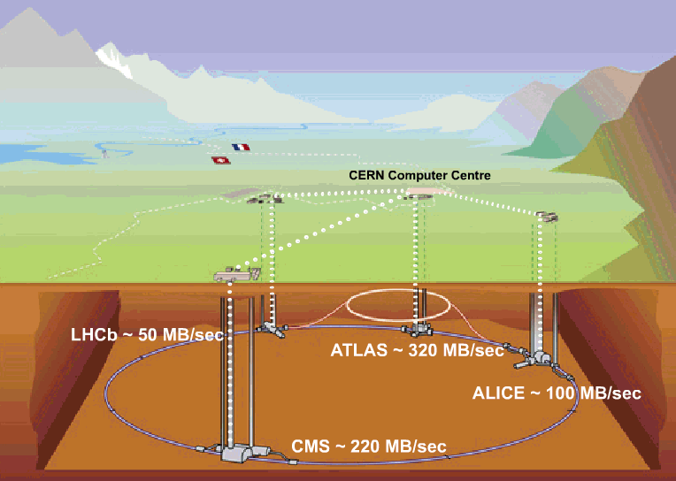
Data flow to permanent storage: 4-6 GB/sec
200-400 MB/sec
1-2 GB/sec
~ 4 GB/sec
1-2 GB/sec

Slide 57
Massive computations: HEP
LHC experiments pioneered the massive use of computational grids as a solution to the High Energy Physics Big Data problem
  10s of PBytes of data per year
  100s of thousands CPUs in 100s of centers
  10s of Gbyte/s data transfers
  100s of users from 100s of institutions
CERN Director General Rolf Heuer about the Higgs discovery:
  "It was a global effort and it is a global success. The results today are only possible because of the extraordinary performance of the accelerators, including the infrastructure, the experiments, and the Grid computing.”
Other domains are catching up quickly with the HEP experiments
  Life sciences, earth sciences, astrophysics, social sciences, etc
Notes:
Ce n’est pas an introduction dans les grilles de calculs

Slide 58
Worldwide LHC Computing
Grid Collaboration (WLCG)
Distributed infrastructure of 150 computing centers in 40 countries
300+ k CPU cores (~ 2M HEP-SPEC-06)
The biggest site with ~50k CPU cores, 12 T2 with 2-30k CPU cores
Distributed data, services and operation infrastructure

Slide 59
Other resources
Cloud resources
  Commercial clouds: Amazon, Google, …
  Since recently computing centers started to provide their resources using cloud technologies
Standalone clusters
  Different batch systems or ad hoc clusters
Supercomputers
  Very different architectures, access restriction, etc
Volunteer grids
Large scientific collaborations can have access to multiple computational resources of different types
Problem: how to integrate all those heterogeneous resources into a uniform infrastructure from the user perspective

Slide 60
DIRAC Grid Solution
LHC experiments, all developed their own middleware to address the above problems
  PanDA, AliEn, glideIn WMS, PhEDEx, …
DIRAC is developed originally for the LHCb experiment
The experience collected with a production grid system of a large HEP experiment is very valuable
  Several new experiments expressed interest in using this software relying on its proven in practice utility
In 2009 the core DIRAC development team decided to generalize the software to make it suitable for any user community.
  Consortium to develop, maintain and promote the DIRAC software
    CERN, CNRS, University of Barcelona, University of Montpellier, IHEP
The results of this work allow to offer DIRAC as a general purpose distributed computing framework

Slide 61
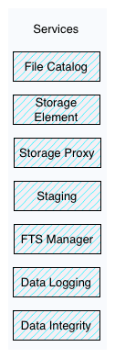
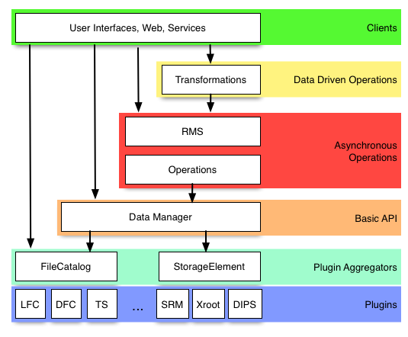
DM Software Stack

