Slide 1
Atmosphere parameters and Atmosphere Transmission at OHP in 2018 : application to Stardice analysis
Sylvie Dagoret-Campagne
LAL
LSST-France, APC

Slide 2
Goal
Provide typical OHP atmospheric transmission
Distinguish typical winter/summer
Need to collect relevant atmospheric parameters
Use MERRA2 data in 2018 (January-August)

Slide 3
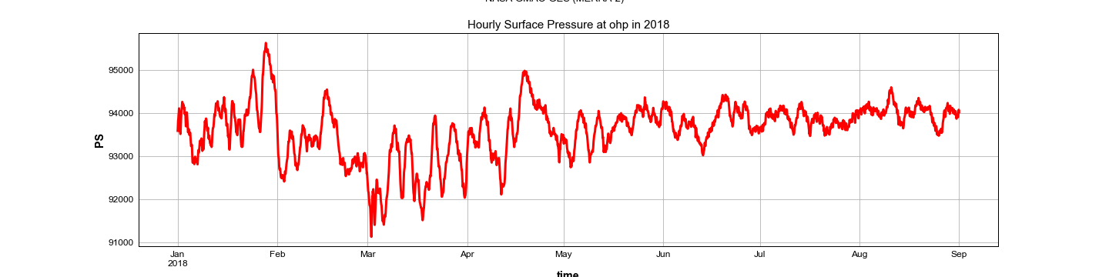
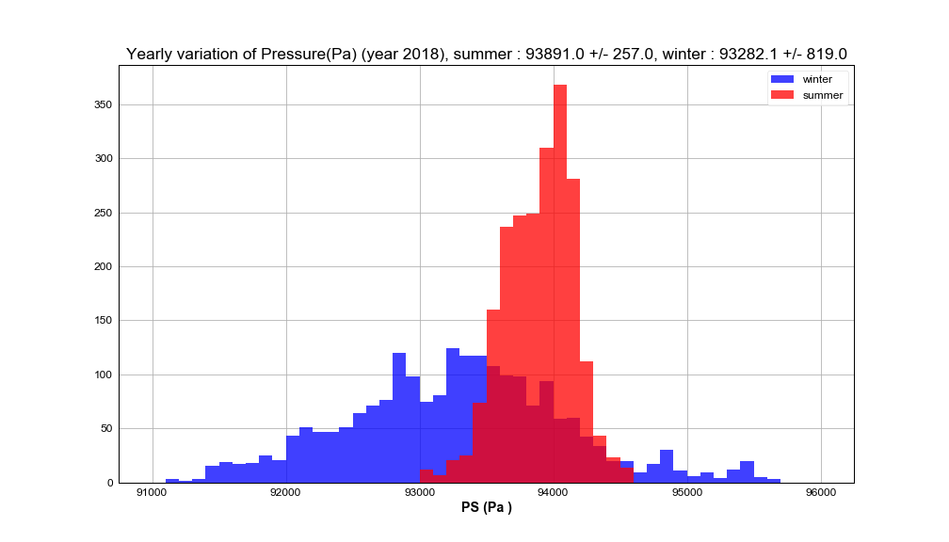
Pressure
Winter
Summer
Winter
P = 933 hPa
Summer
P = 939 hPa
Higher pressure
In summer

Slide 4
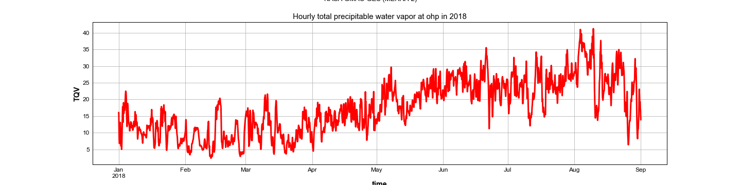
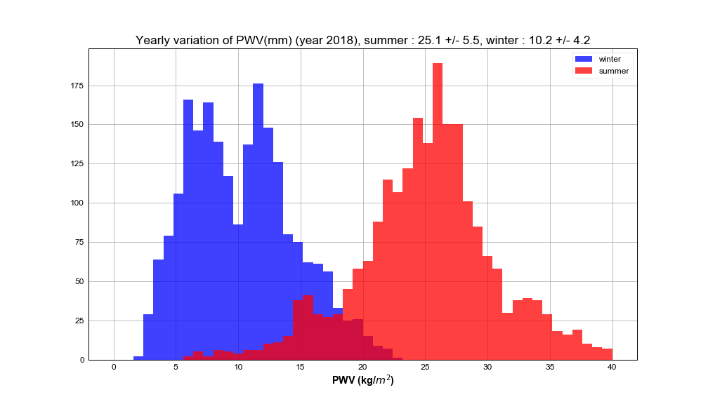
Precipitable water vapor
Winter
Summer
Winter
PWV = 10mm
Summer
PWV = 25mm
Higher PWV
in summer

Slide 5
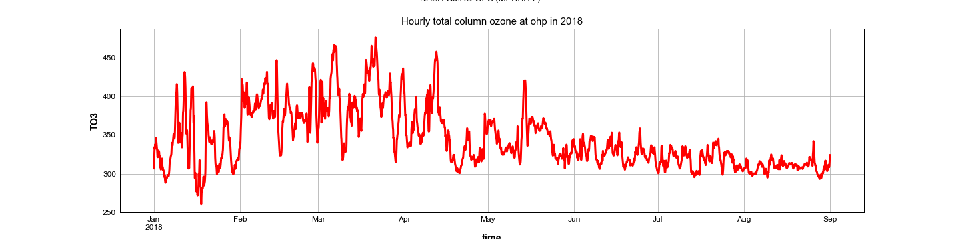
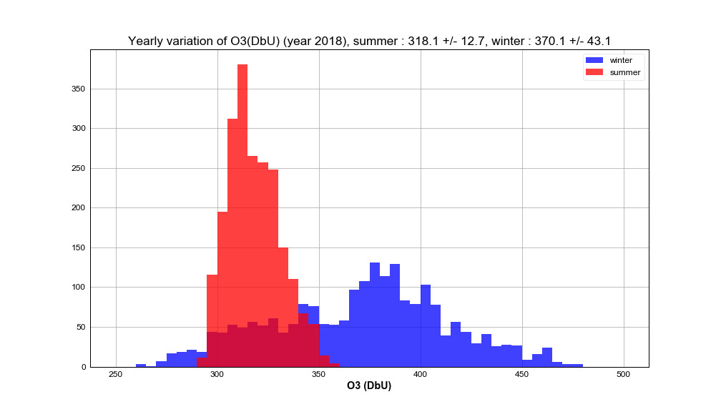
Ozone
Winter
Summer
Summer
O3 = 318 DbU
Winter
O3 = 370 DbU
Higher Ozone
in winter

Slide 6
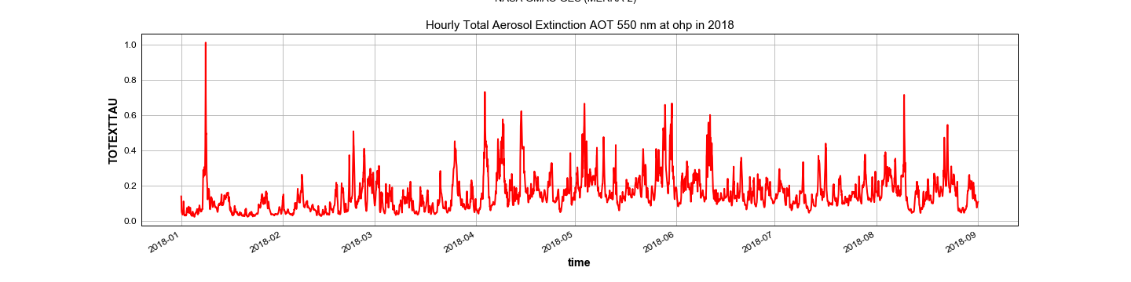
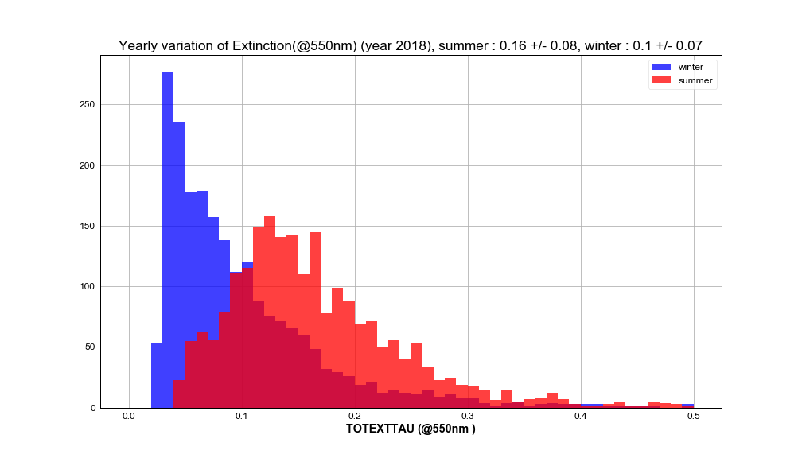
Aerosols optical depth
Winter
Summer
Winter
tau₀ = 0.10
Summer
tau₀ = 0.16
τ₀ Higher in
summer

Slide 7
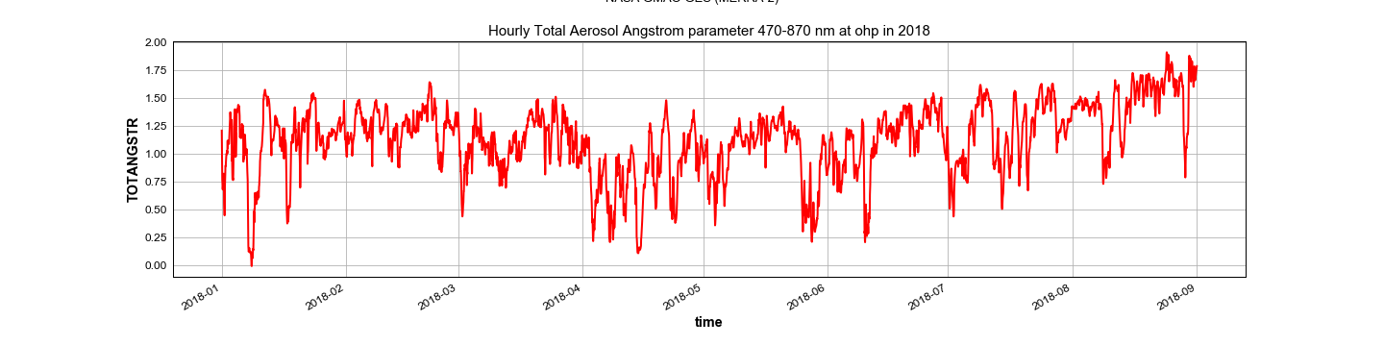
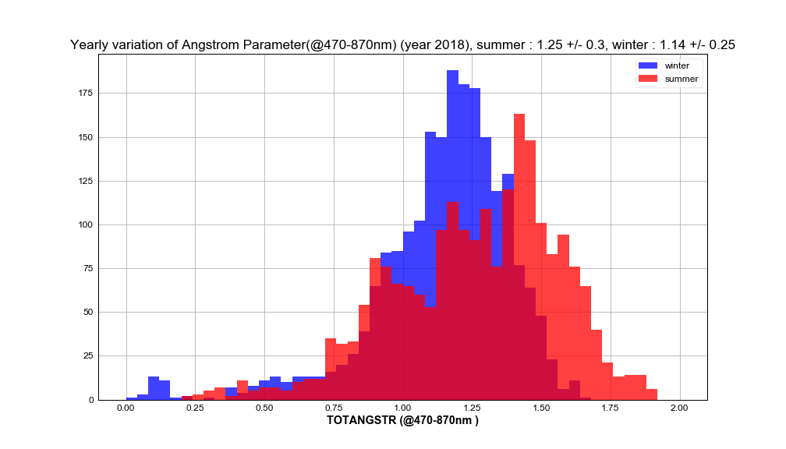
Angstrom coefficient
Winter
Summer
Winter
a = 1.14
a
Summer
a = 1.25
Steeper
Wavelength
Attenuation
in summer

Slide 8
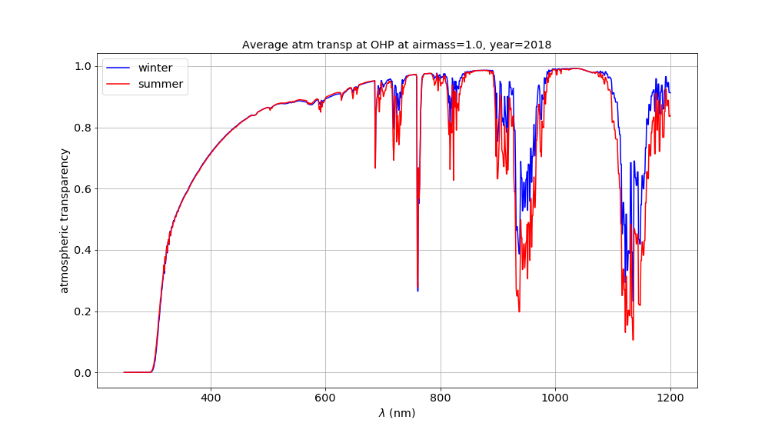
Average transmission Summer & Winter
Airmass = 1
Transmission calculated by LibRadTran simulation

Slide 9
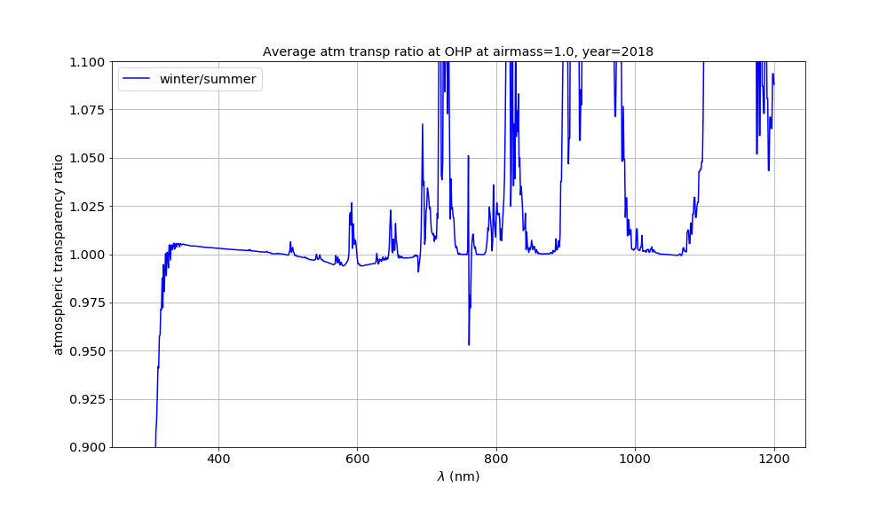
Average Transmission Winter/Summer ratio
Airmass = 1
Pressure
(Rayleigh)
0.5%
Ozone
Chappuis
0.6%
Ozone Huggins
cutoff
PWV

Slide 10
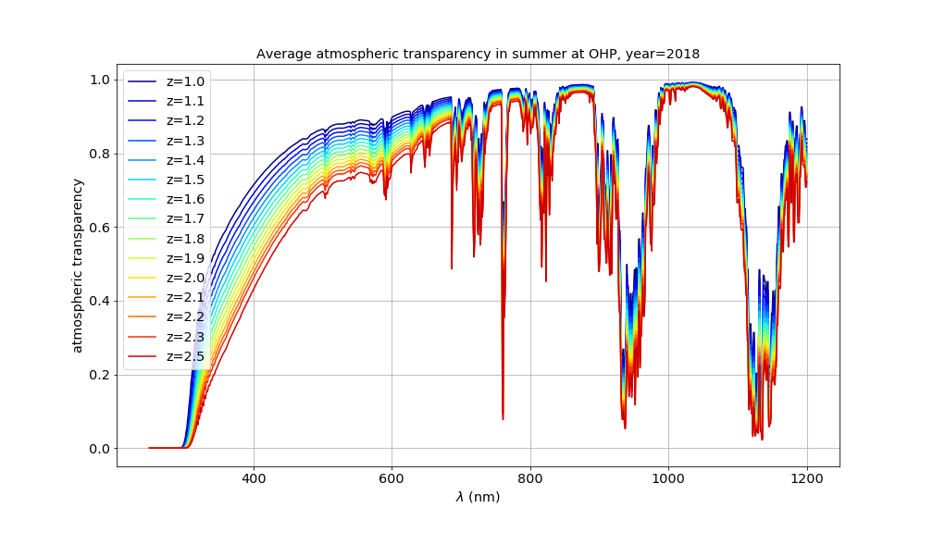
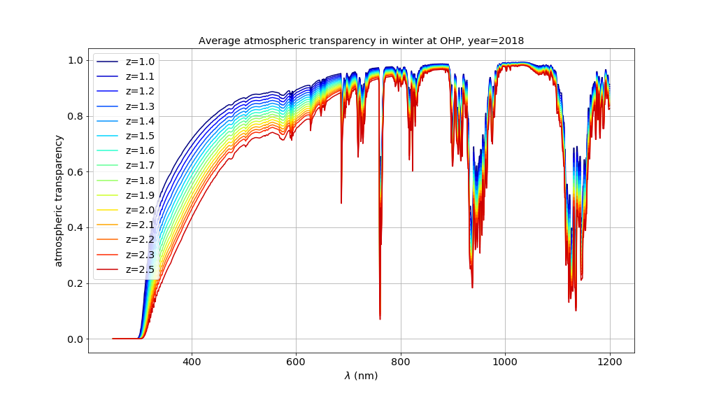
Winter/Summer Libradtran Profiles generated for Stardice analysis at several airmass
Summer
Simulations
Required for
Data analysis
Winter

Slide 11
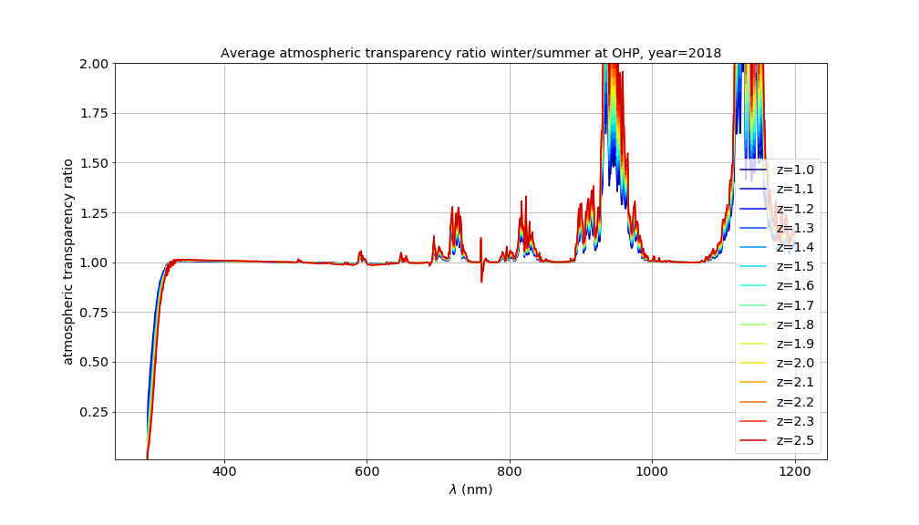
Winter/Summer Libradtran transmission ratio generated for Stardice analysis at several airmass

Slide 12
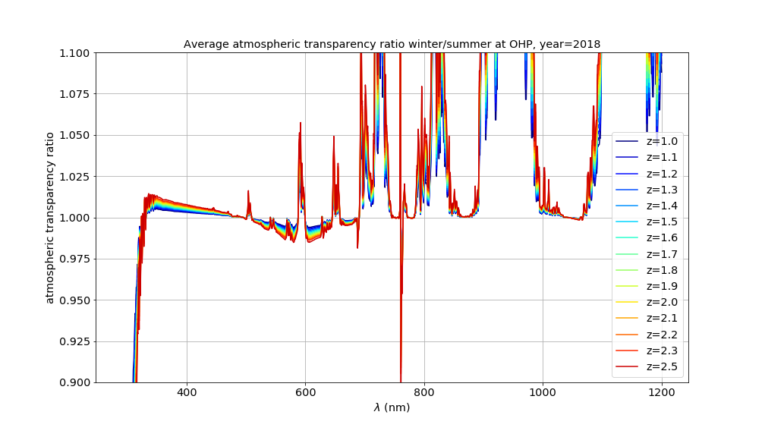
Zoom on Winter/Summer Profiles ratio generated for Stardice analysis at several airmass
Pressure
(Rayleigh)
1.25%
Ozone
Chappuis
1.25%
Ozone Huggins
cutoff
PWV

Slide 13
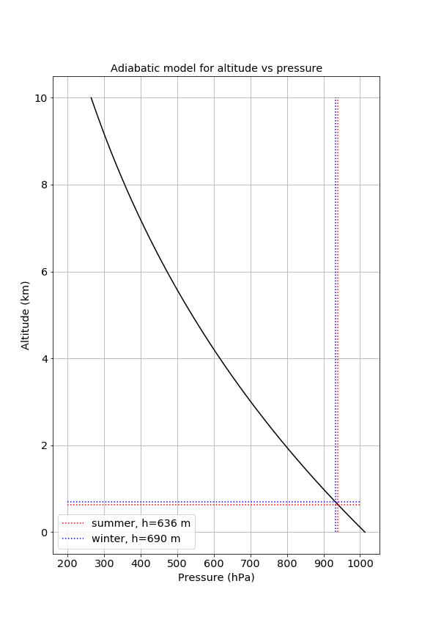
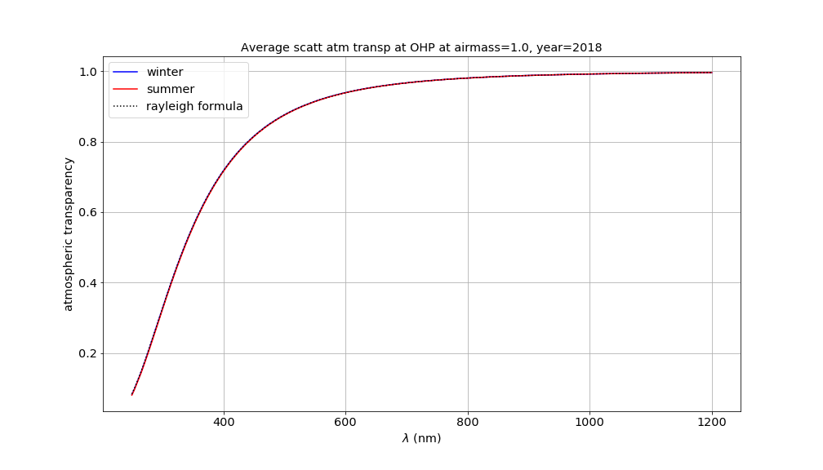
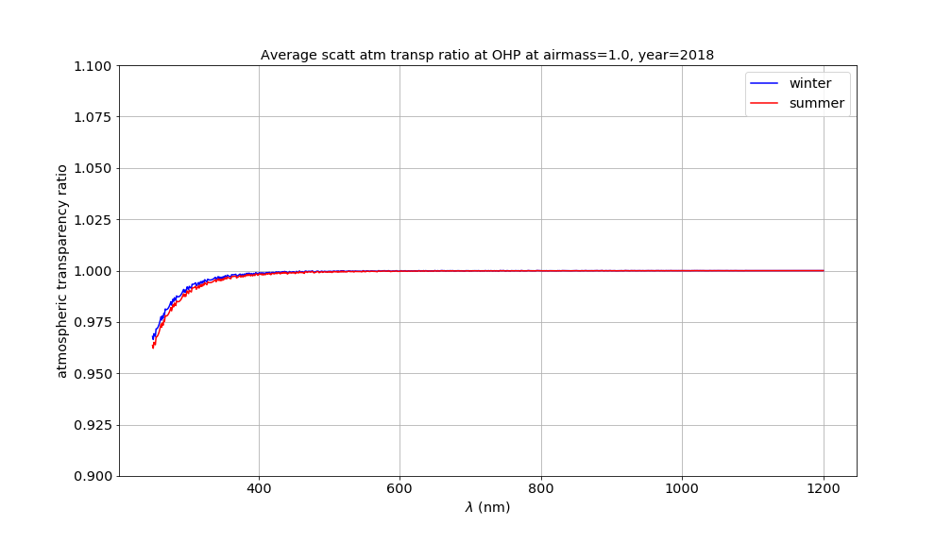
Analytical model for Molecular scattering
Analytic model : altitude vs pressure :
Airmass=1
OHP
Altitude
650m
Molecular transparency profiles
Libradtran : absorption switched off
Airmass=1
Summer : h~636 m
Ratio Molecular transparency profiles :
Libradtran/analytical model
Winter : h~690 m
1%@(300nm)

Slide 14
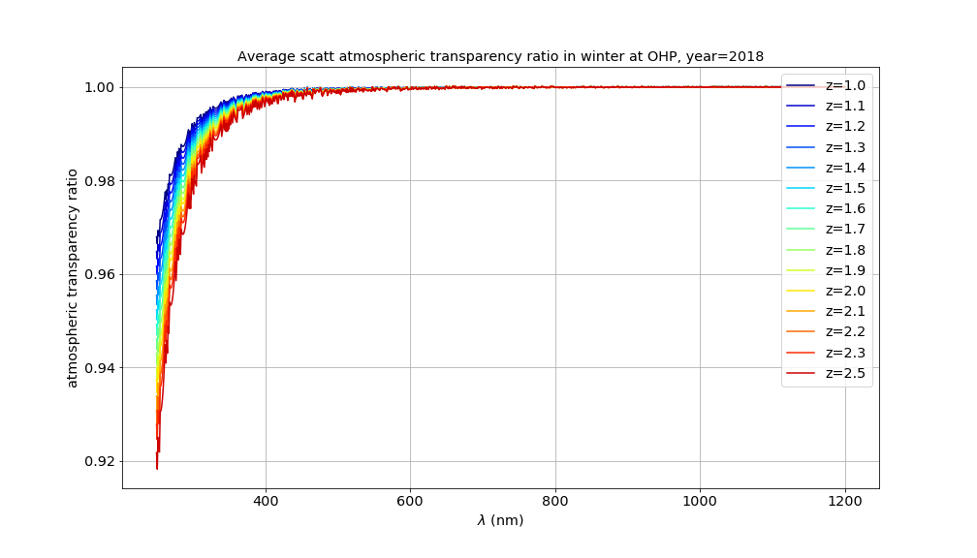
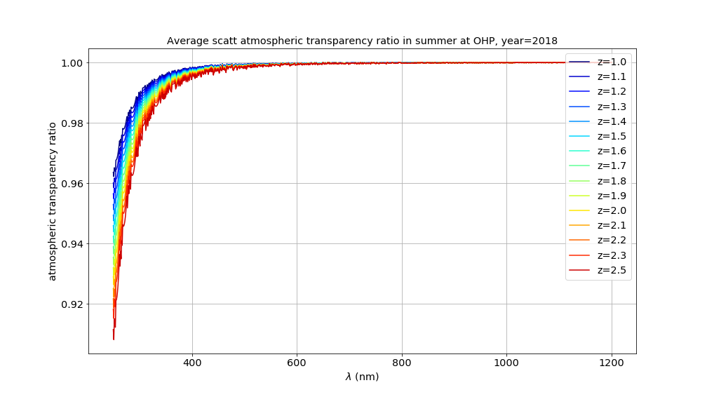
Libradtran/analytical-formula transparency ratio at all airmass
Winter
1%(am=1)-2%(am=2.5) @(300nm)
Summer
1%(am=1)-2%(am=2.5) @(300nm)

Slide 15
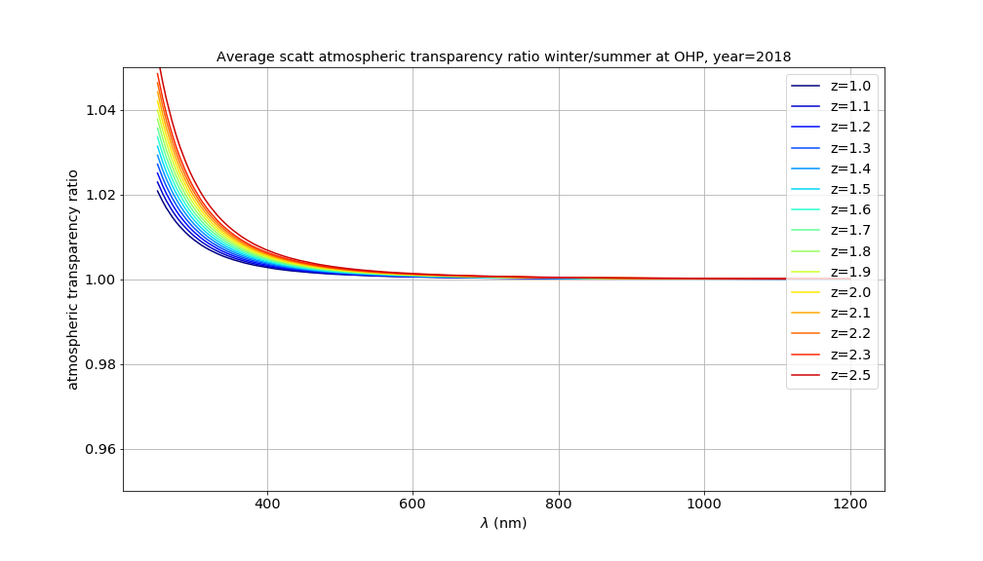
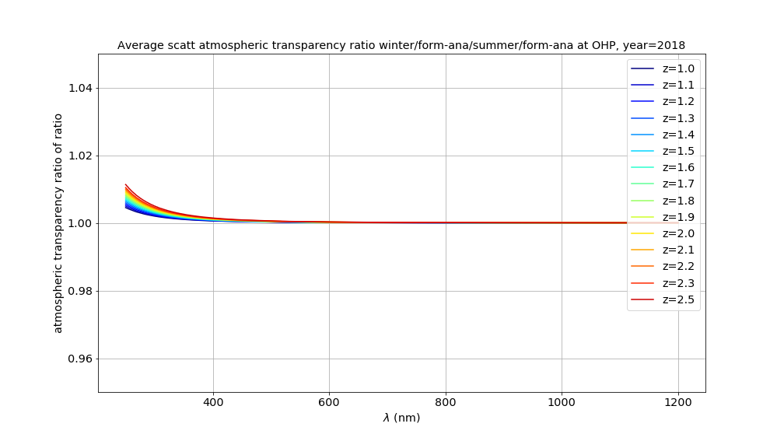
Winter/Summer transparency ratio at all airmass
1%(am=1)-2%(am=2.5) @(300nm)
Winter/Summer transparency ratio
Conclusion:
Better use analytical formula to
correct profile for Pressure variation
<0.5% @(300nm)
Winter/Summer transparency ratio normalized to
Analytical transparency ratio

Slide 16
Take home message
Typical winter/summer atmospheric profiles at various airmass are provided for Stardice.
  Average pressure, precipitable water vapor,ozone.
  Simulated transparency
  data
A numerical-analytical formula for atmospheric transparency to correct for daily pressure variation (auxiliary data) lead to an accuracy better than 0.5% for λ>300 nm

