Slide 1
News from raft construction and CCD optimization
Claire Juramy
LSST-France Novembre 2018

Slide 2
Dipoles in ITL sensors
Solved by integrating with two parallel phases high (out of three) instead of one

Slide 3
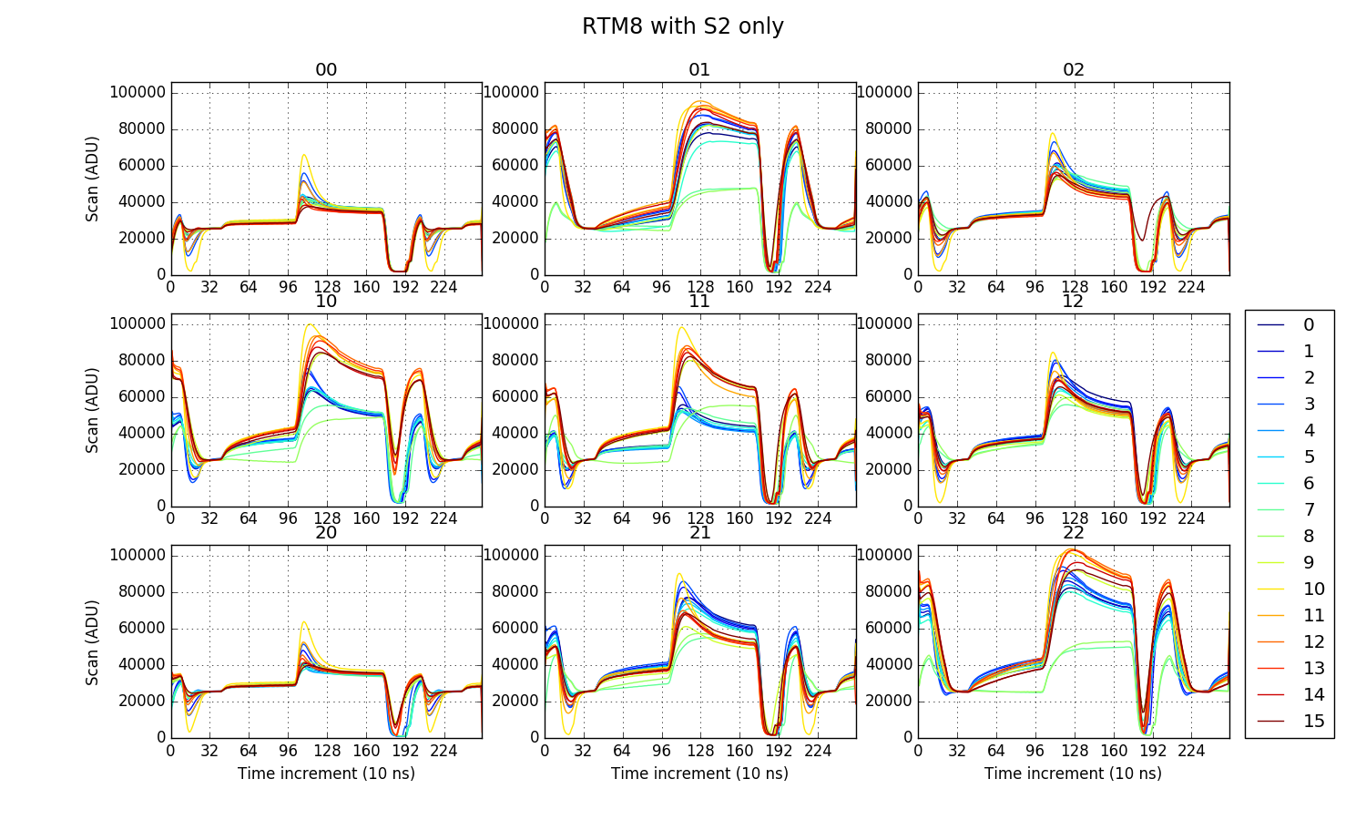
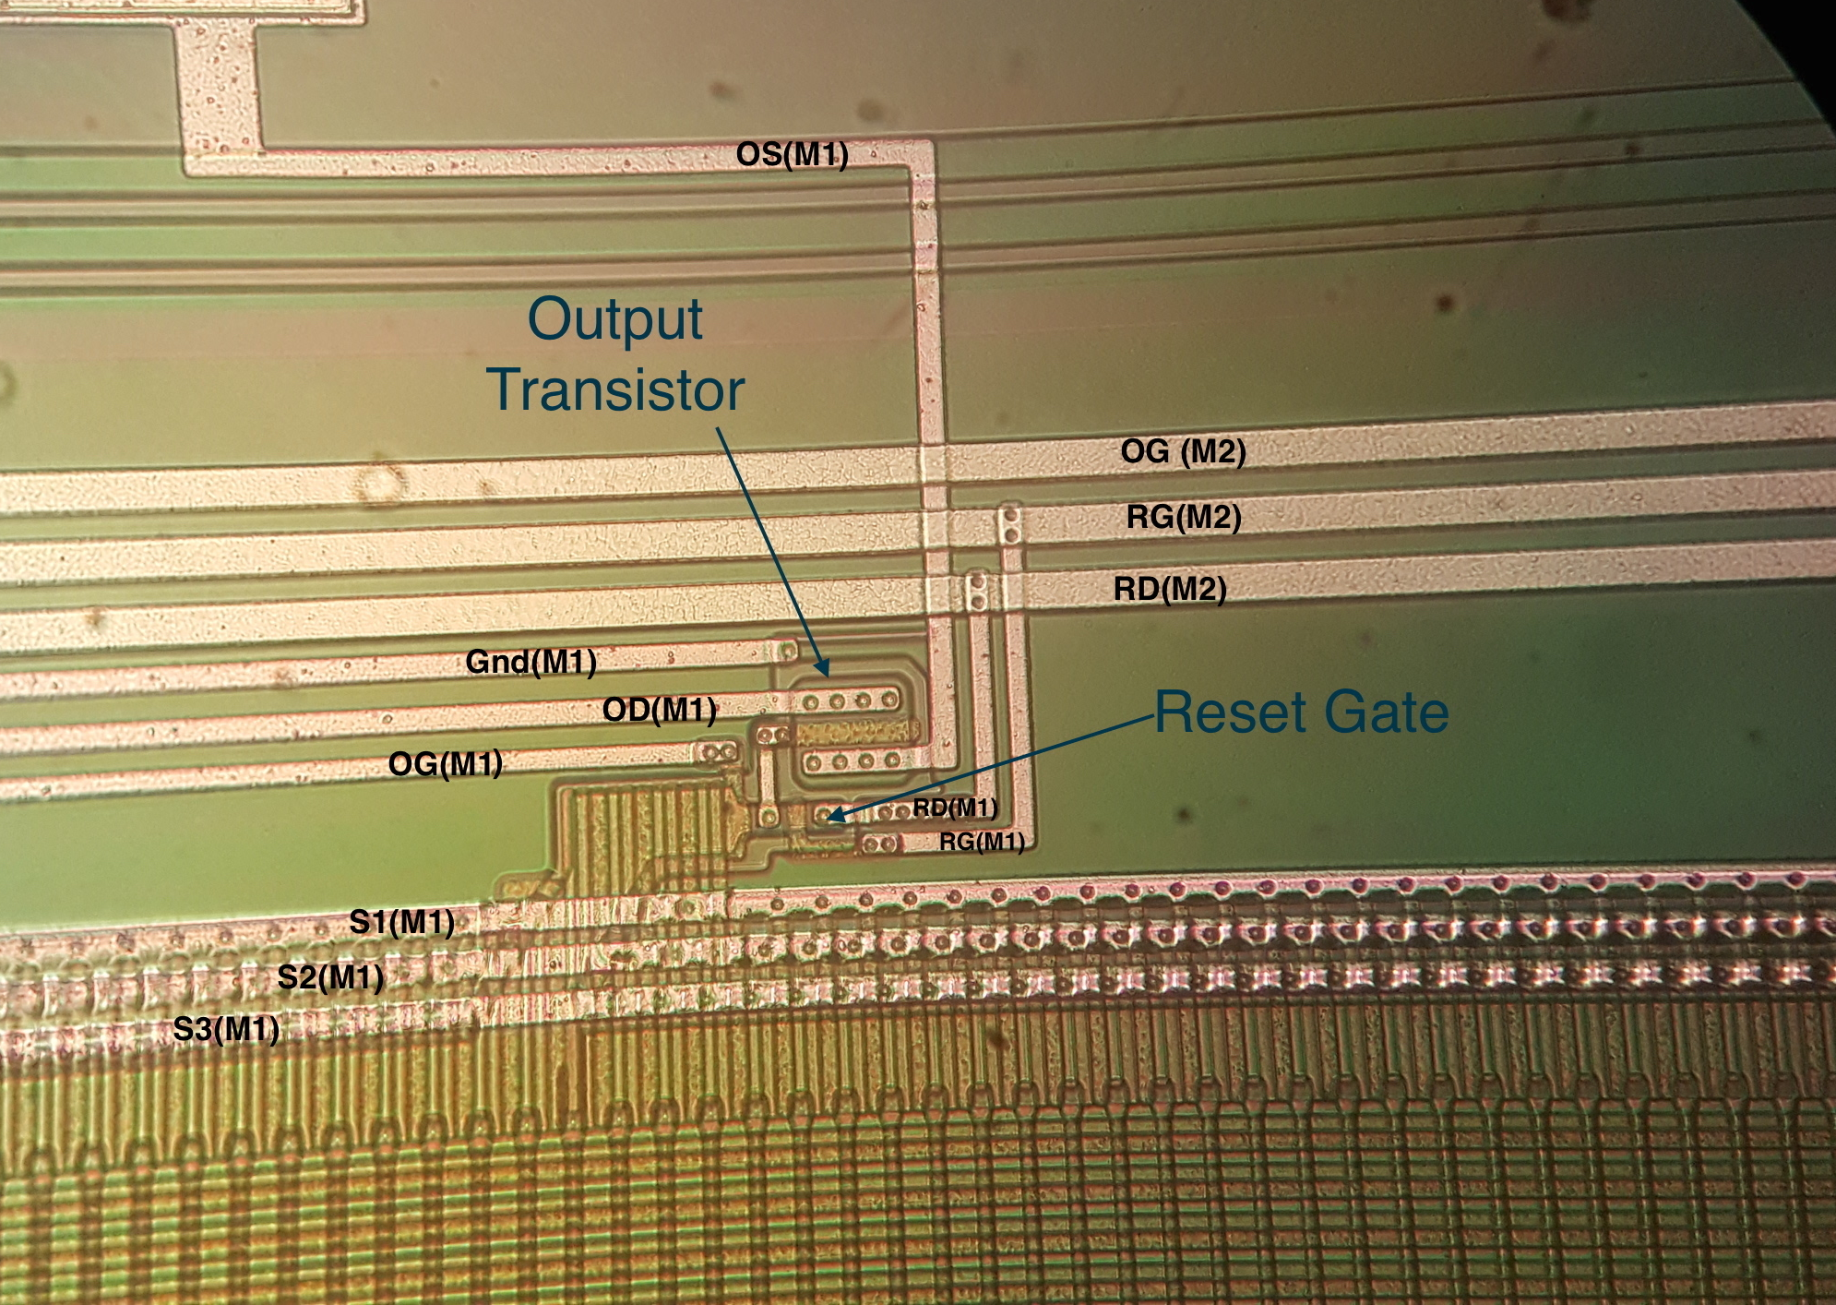
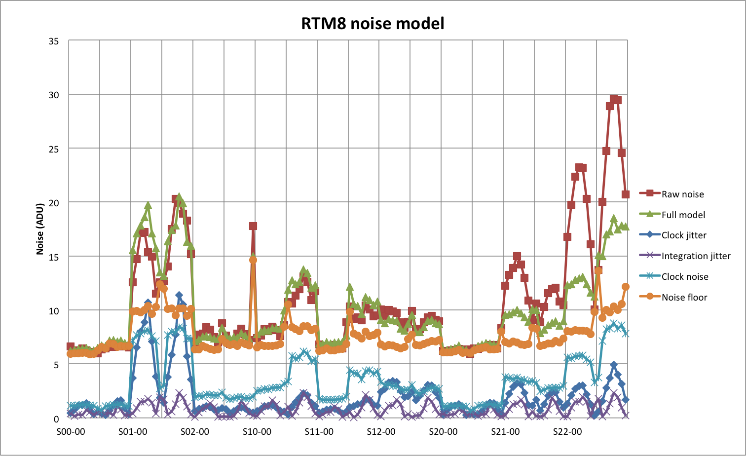
Clock injection in ITL sensors
Issue: in some sensors, up to 5% of the serial clocks is injected right into the sensor output
Creates a noise contribution up to 20 e-

Slide 4
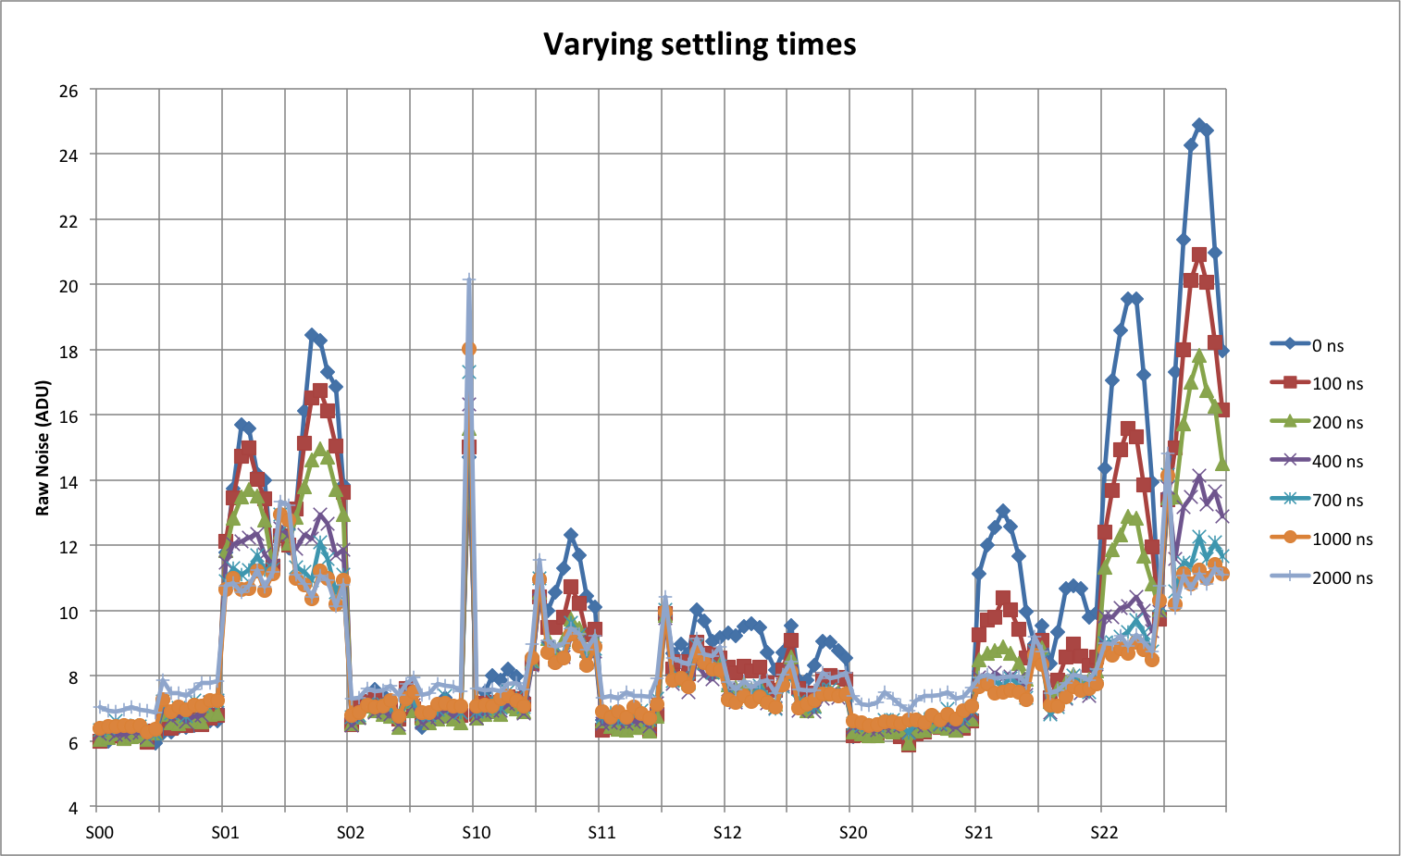
Clock injection in ITL sensors
Attributed to bad grounding on the substrate below the output transistor
Solution: grade sensors based on measurement on single-CCD test-stand at BNL
Also a solution: read slower…

Slide 5
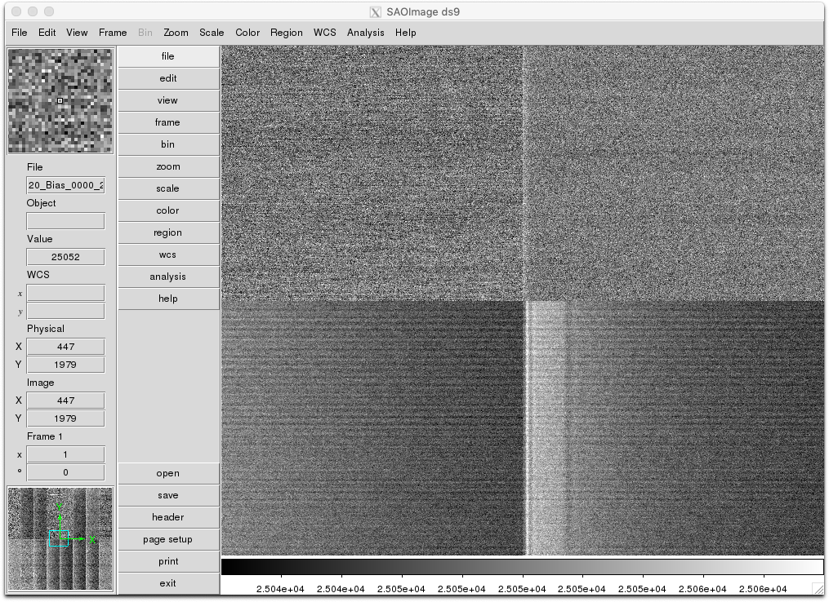
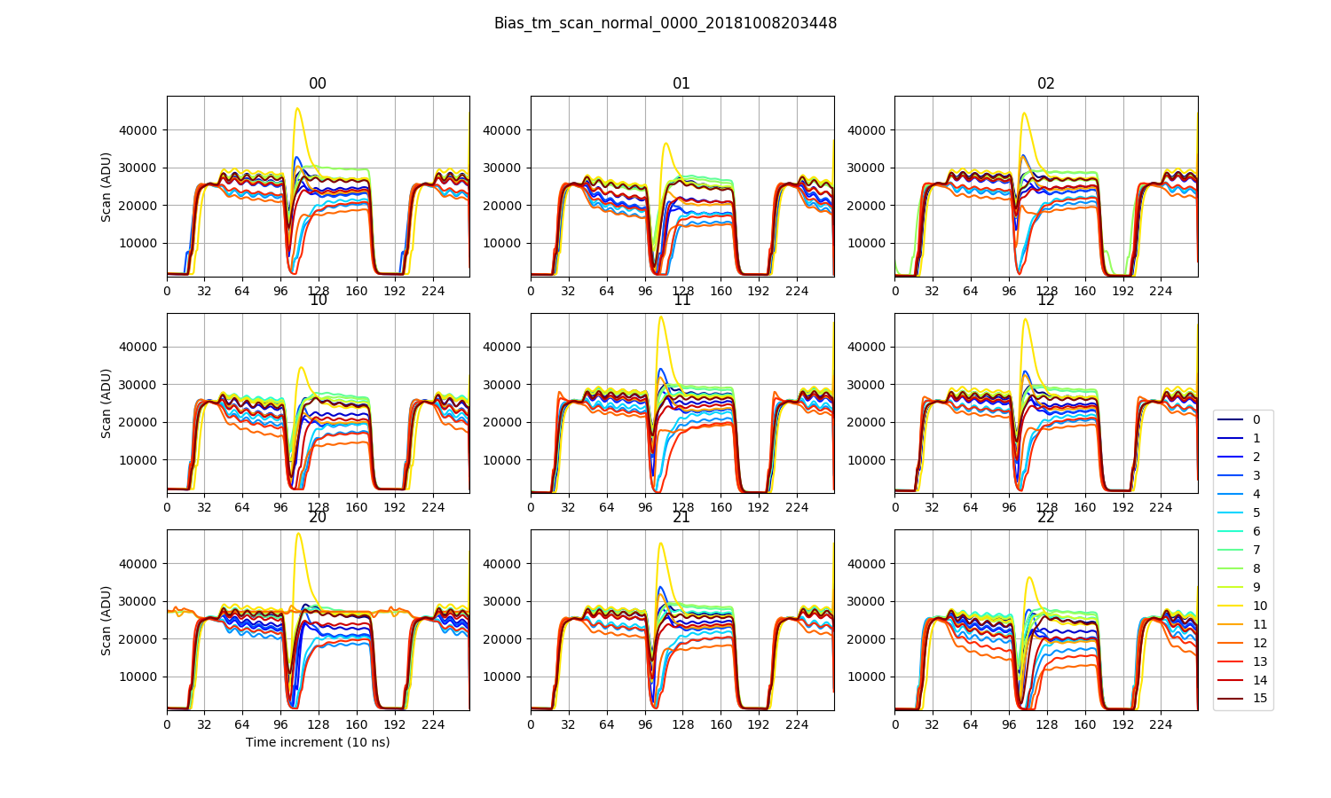
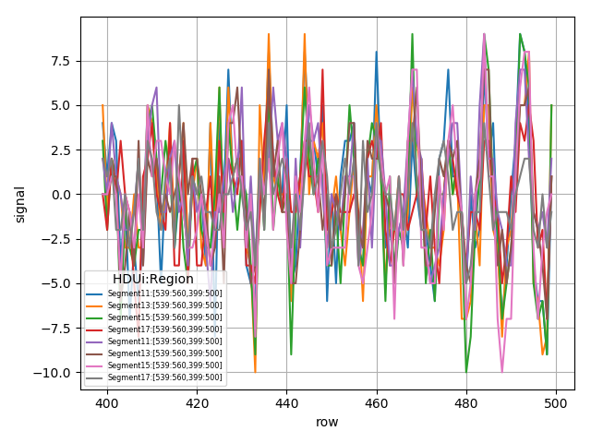
Noise issue in ITL rafts
Appeared after shipping from BNL to SLAC
All ITL rafts, only ITL rafts
Correlates with ringing pattern in output

Slide 6
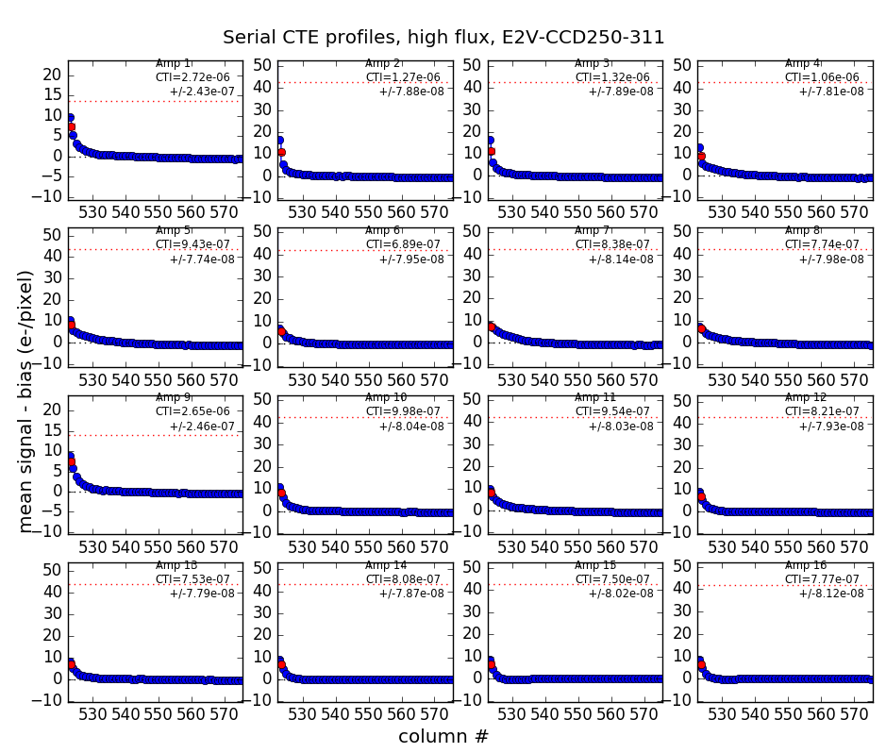
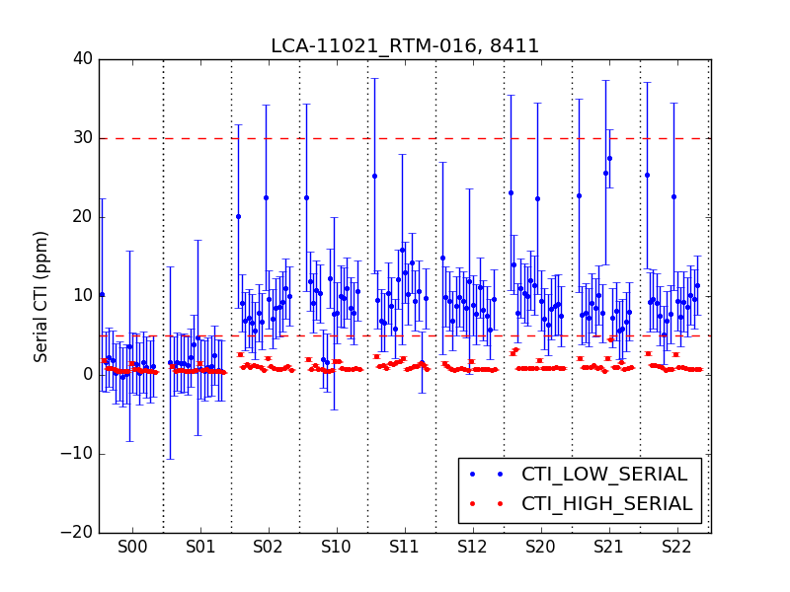
CTE and reset issue in E2V rafts
Long tail after end of “flat” frame
Seen in some channels at SLAC first
Affected massively RTM-016 at BNL

Slide 7
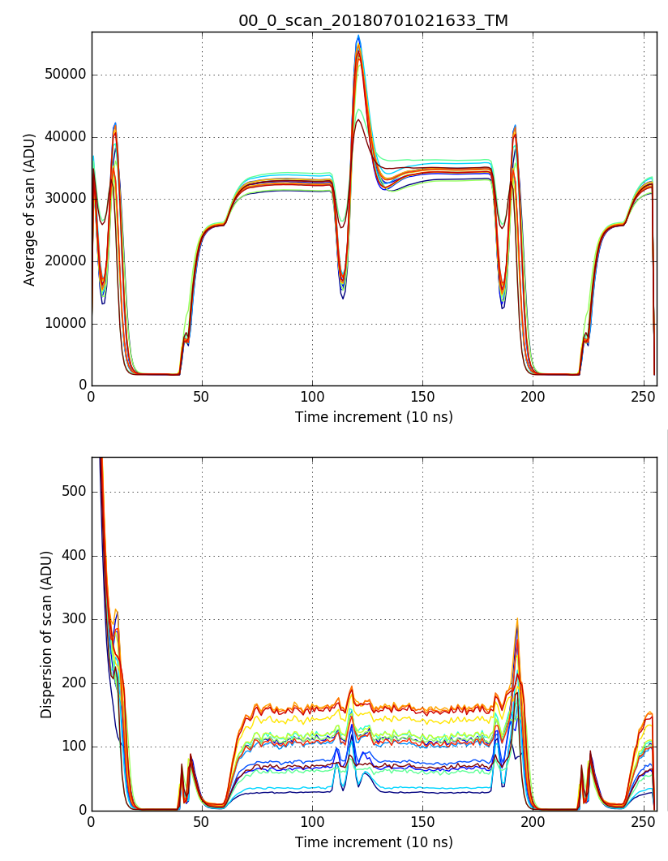
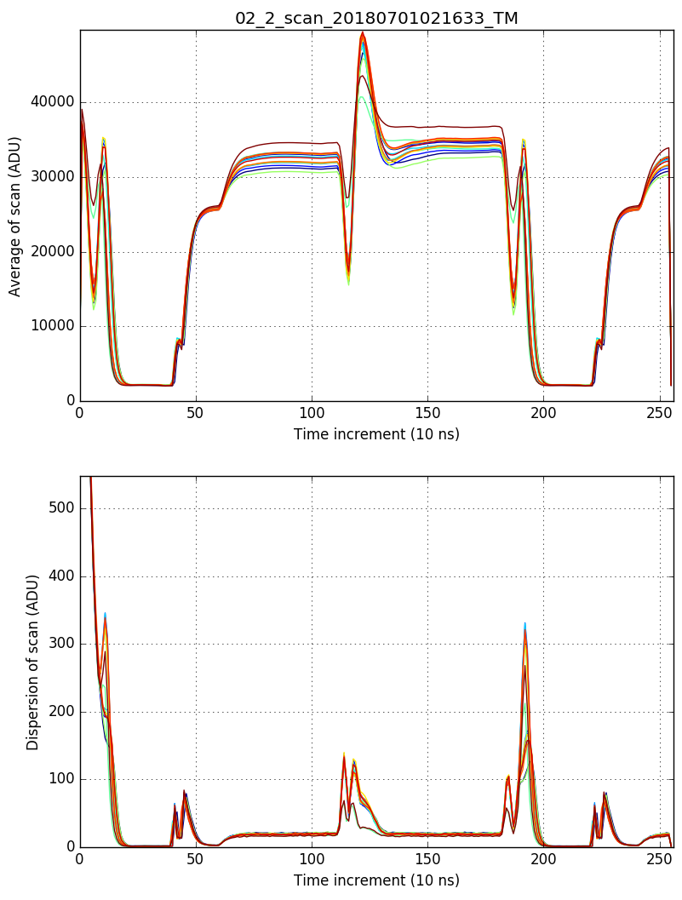
CTE and reset issue in E2V rafts
Statistics on scan mode + ASPIC in transparent mode
no kTC reset noise!

Slide 8
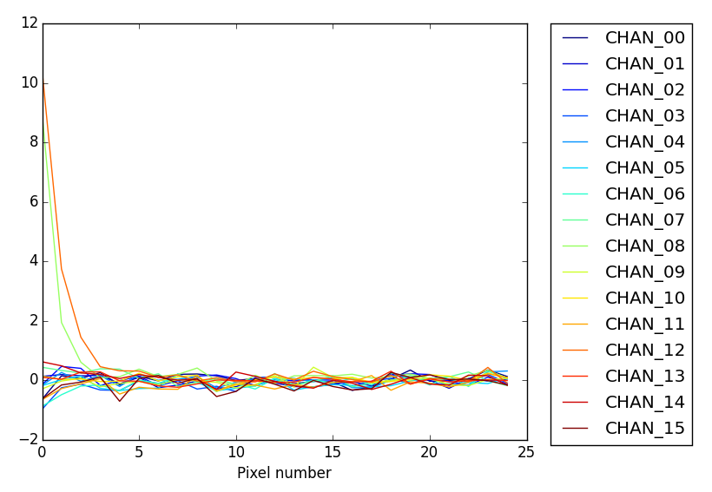
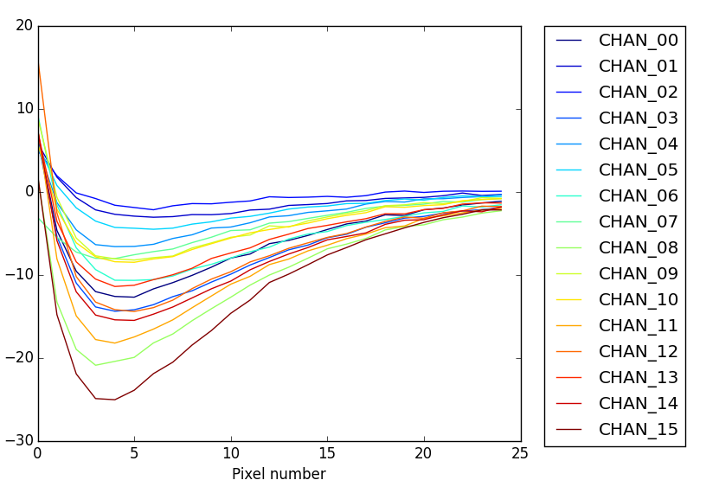
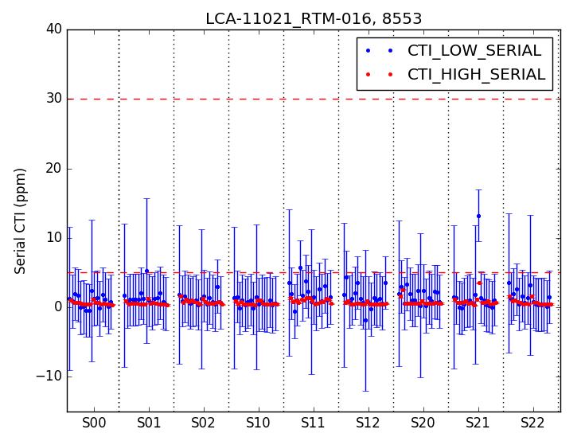
CTE and reset issue in E2V rafts
⬅ RG-high at 11.7 V
RG-high at 11.0 V ➔
Zener diode for safety between clock rails, <12 V amplitude nominally, threshold decreases with temperature: 10.7 V at -30C (REB temperature)
Tested at LPNHE: CCD reset only happens if RG-high is close enough to RD (18 V)
Set RG-low to +1 V instead of 0 V, can increase RG-high to +11.7 V instead of +10.7 V -> fixed reset and CTE

Slide 9
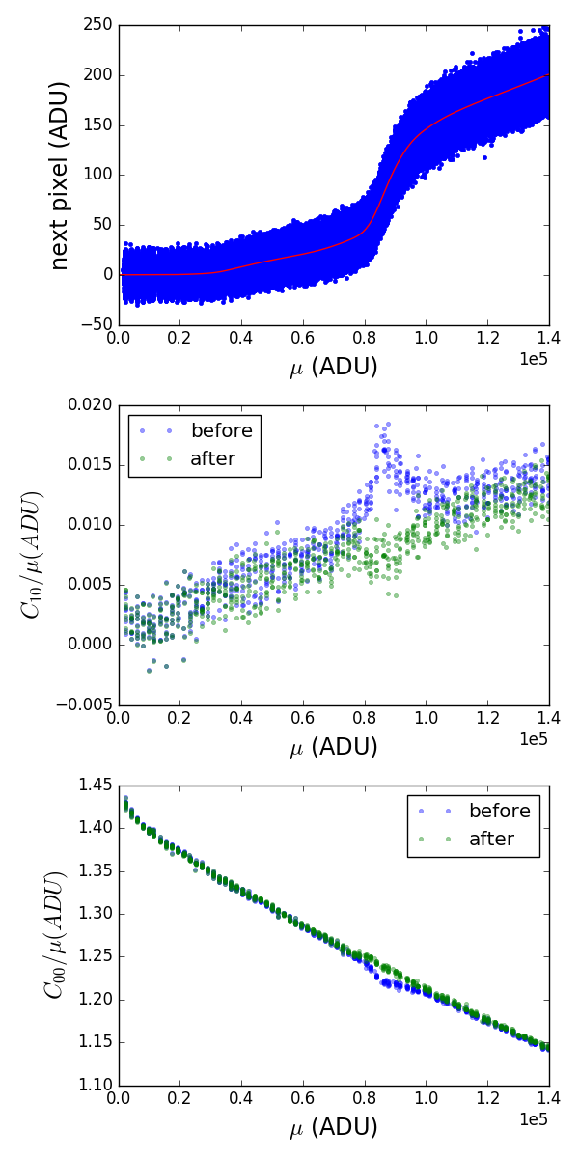
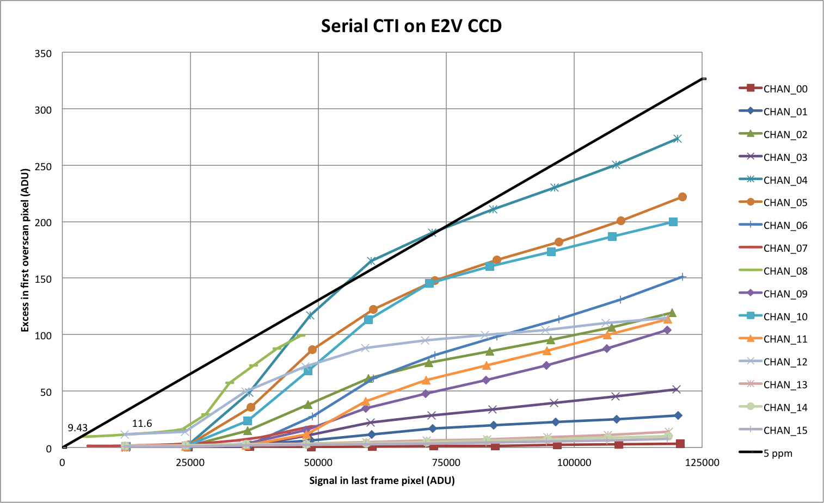
E2V sensors: traps and CTE jumps
Traps: electrons in serial register are captured as soon as they are available, and released in the first empty pixel
Serial Charge Transfer Efficiency depends on flux in some channels
Fine look at Photon Transfer Curves in E2V sensors

Slide 10
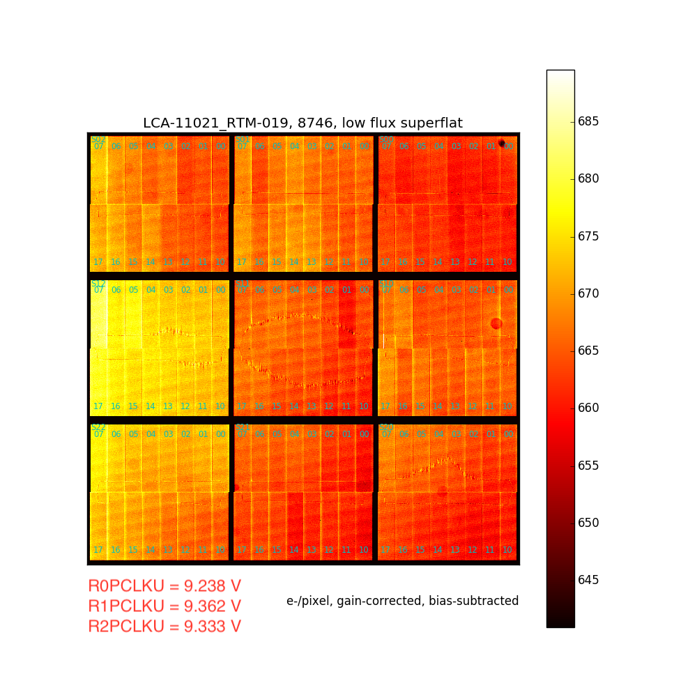
E2V sensors: tearing

Slide 11
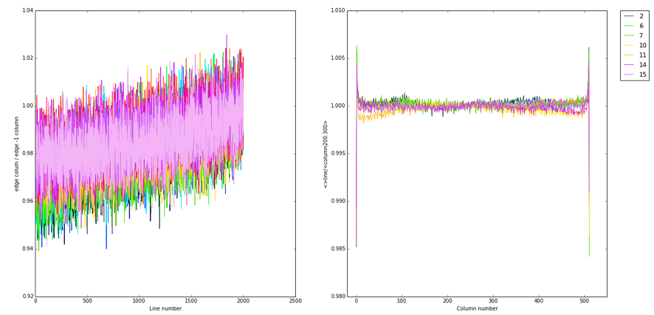
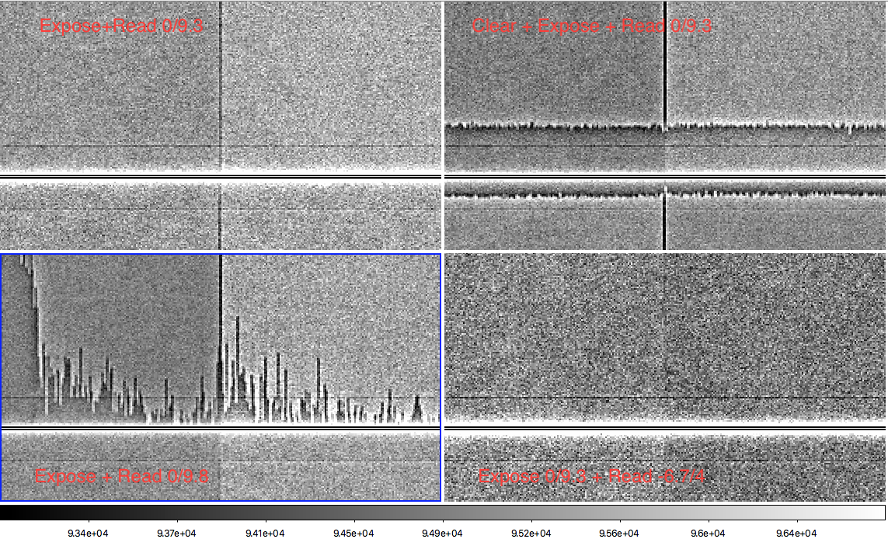
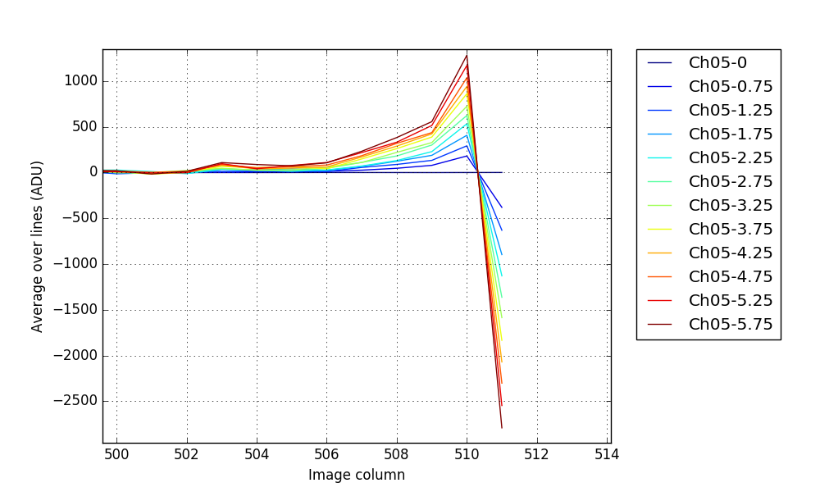
E2V sensors: segment edge pattern
Lots of ad-hoc solutions to solve tearing: fast clear, decrease P-high, overlaps between clock phases
Tearing pattern disappears, but “rabbit ears” pattern at segment edge remains

Slide 12
E2V sensors: segment edge pattern
Continuity between tearing patterns and segment edge pattern
Shifting to bipolar readout with P-low ≤ -6.5 V removes the segment edge pattern

Slide 13
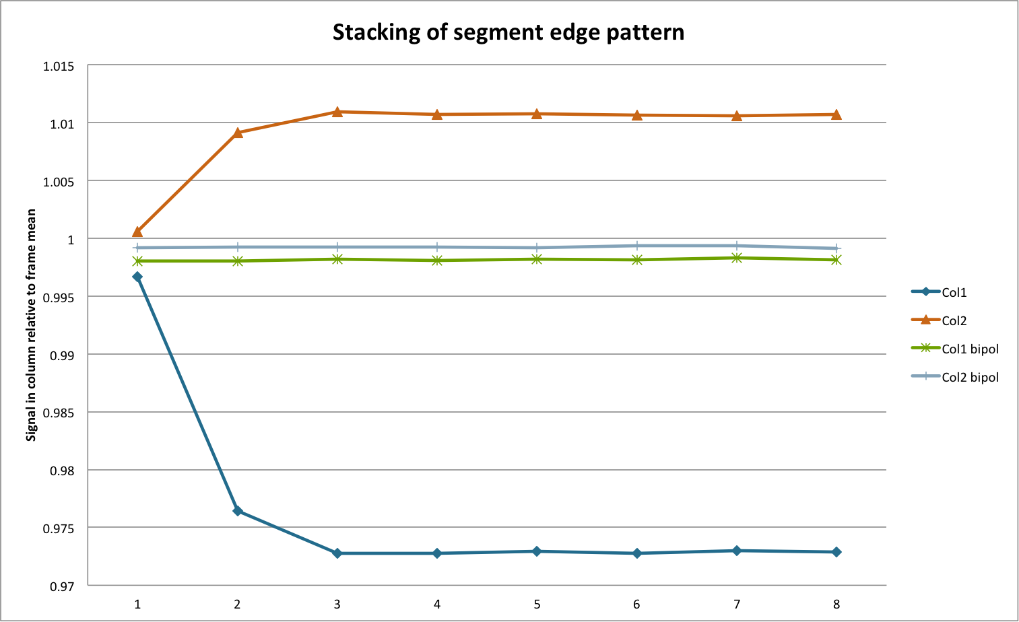
E2V sensors: tearing
In most sensors, using parallel clocks with P-low = -7 V is sufficient to remove the patterns
In some cases a purge right before each frame is required to get rid of holes
Purge = put all parallel clocks to < -7 V for ~ 2 ms = put the sensor in inversion (front-side surface becomes conductive for holes)

Slide 14
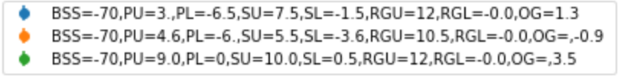
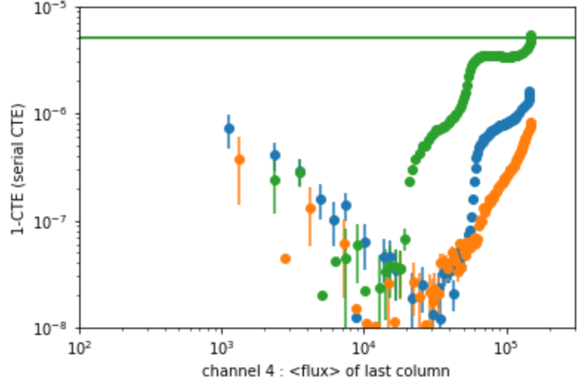
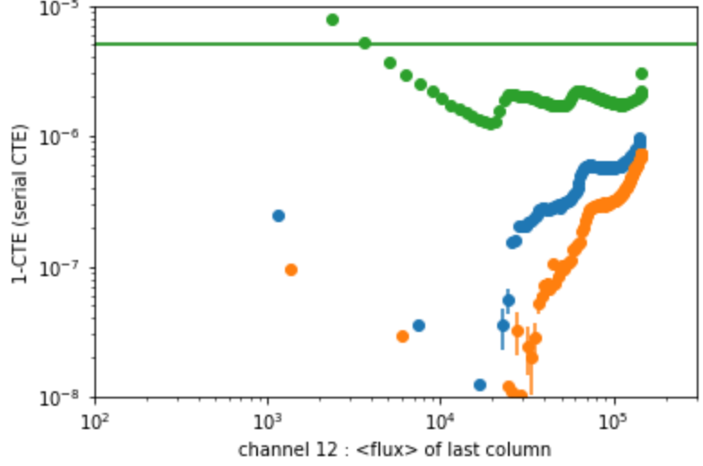
E2V sensors: the case for bipolar clocking
Running with bipolar clocks had the unexpected effect to remove traps and jumps in serial CTE
Cost of running in bipolar clocking: lower voltage difference between front and back of sensor = weaker drift field -> need to lower BSS

Slide 15
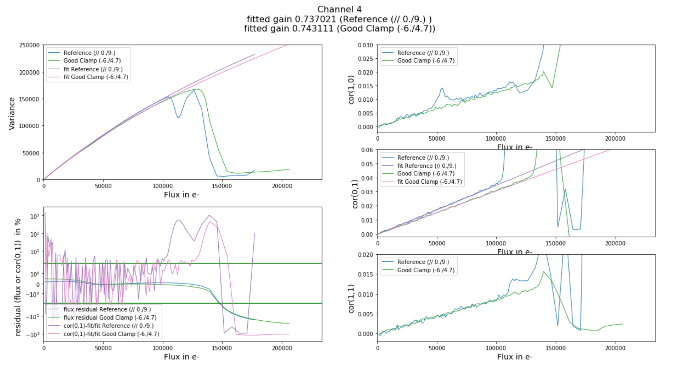
E2V sensors: optimizing bipolar voltages
For P-low = - 7 V, all other voltages on the sensor need to be adjusted: set of rules given by E2V
Additional constraint: parallel clock used for reset of second stage in E2V CCD output
Check with Photon Transfer Curves for multiple configurations: linearity, full well, blooming

