Slide 1
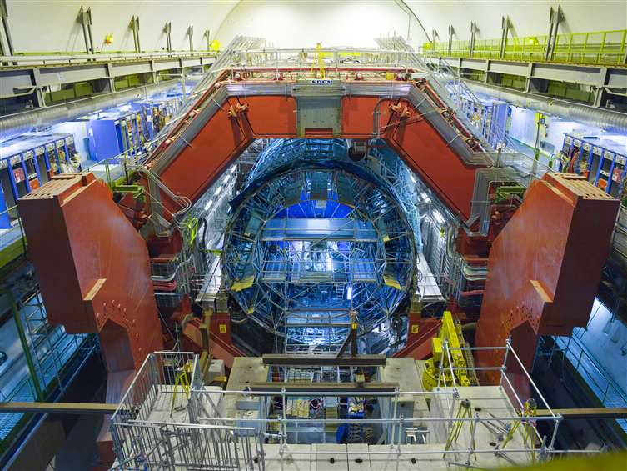
CERN between science and Technology
Guy Paic
Instituto de Ciencias , UNAM

Slide 2
CERN a scientific, sociological and technological showpiece
Going to the extreme frontier of knowledge
Achieving remarkable results with an unconventional management style based on cooperation and collaboration and a universal coverage
Undoubtedly a pioneer in innovation and breaking the technological barriers

Slide 3
The apparent contradiction
"Particle physics is the unbelievable in pursuit of the unimaginable. To pinpoint the smallest fragments of the universe you have to build the biggest machine in the world. To recreate the first millionths of a second of creation you have to focus energy on an awesome scale.”
The Guardian
lhc-machine-outreach.web.
cern.ch/lhc-machine-outreach/

Slide 4
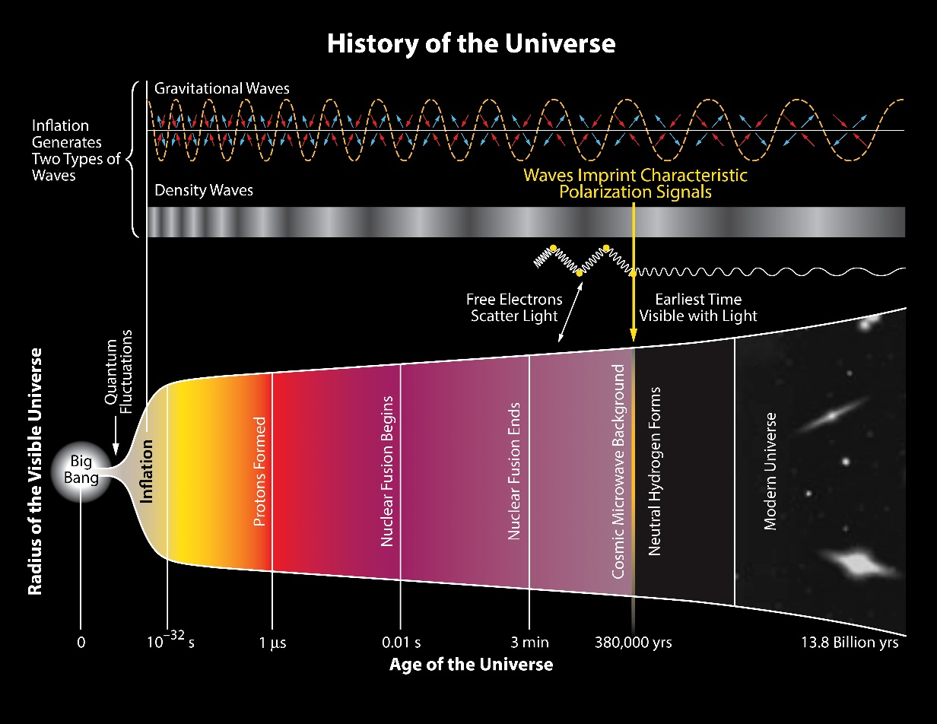
The question is why all that?
The origin of the world is central to all cultures
The answers are central to the science and are pursued for centuries
In the latest interpretation of our origin it is linked to the understanding of the first moment of the evolution of the Universe

Slide 5
The central tool of the present search - LHC

Slide 6
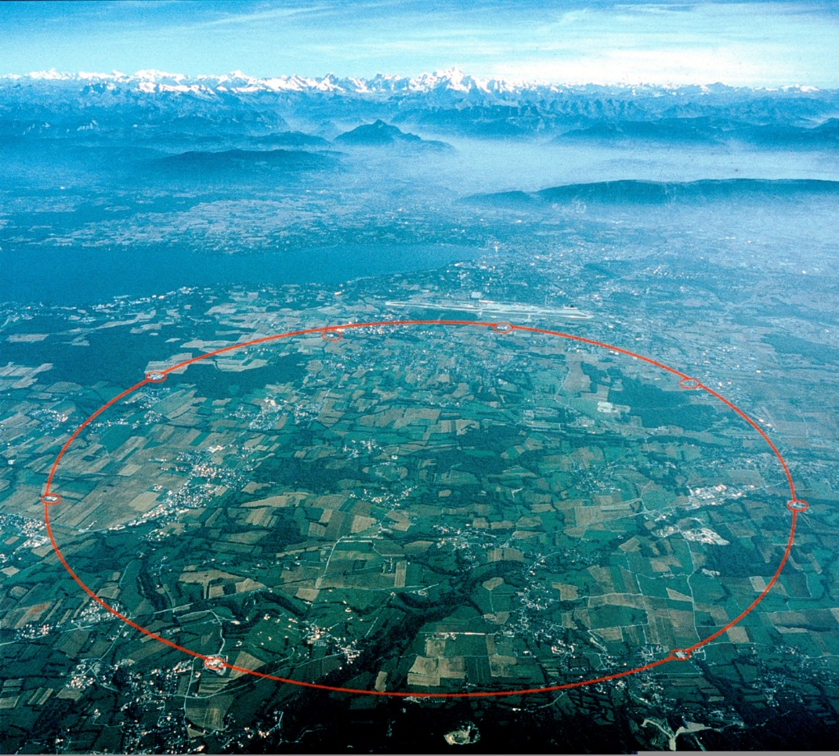
THE STRUCTURE OF THE LHC
The Large Hadron Collider (LHC) is located in a circular tunnel 27 km (17 miles) in circumference. The tunnel is buried around 100 m (about the size of a football field) underground.
It straddles the Swiss and French borders on the outskirts of Geneva..
lhc-machine-outreach.web.cern.ch/lhc-machine-outreach/

Slide 7
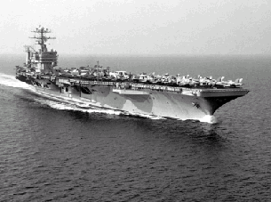
LHC (in big numbers)
Proton parameters
Energy: 7 TeV
Magnetic field 7 TeV: 8.3 T
3*10¹⁴ Protons / beam ( 3000 bunches)
Current: 0.56 A
Luminosity: 10³⁴ cm²/s
Superconducting magnets. Criogenics:
12 million litres of liquid nitrogen are evaporated during the cooling process of 31000 tons of material and then 700000 litres of liquid helium will be necessary to keep the temperature less tan 2 K
Stored energy:
ENRGY in the two beams: 0.7 GJ
50 tons at 600 km/h
Energy in the magnets : 10.4 GJ
a 40 km/h
Total:
11 GJ
at nominal beam current the two LHC beams together could melt nearly one tonne of copper

Slide 8
The vacuum in the LHC
10⁻¹⁰ Torr (~3 million molecules/cm³) , to prevent colisions of particles with gas
Equal to the pressure at altitude of 1000 km in the atmosphere.
The vacuum around the superconductive shield ( 10⁻⁶ Torr) to pump ~9000 m³ = cathedral!.

Slide 9
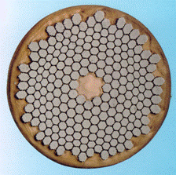
The magnetic field in the LHC
The cryogenics uses superfluid helium 1.9 K the coldest place in the Universe 700,000 litres of helium!
Each strand contains 6,426 twisted niobium-titanium filaments with a diameter of 6-micrometers embedded in an oxygen free copper matrix
Total superconducting cable required 1200 tonnes which translates to around 7600 km of cable (the cable is made up of strands which is made of filaments, total length of filaments is astronomical - 5 times to the sun and back with enough left over for a few trips to the moon).

Slide 10
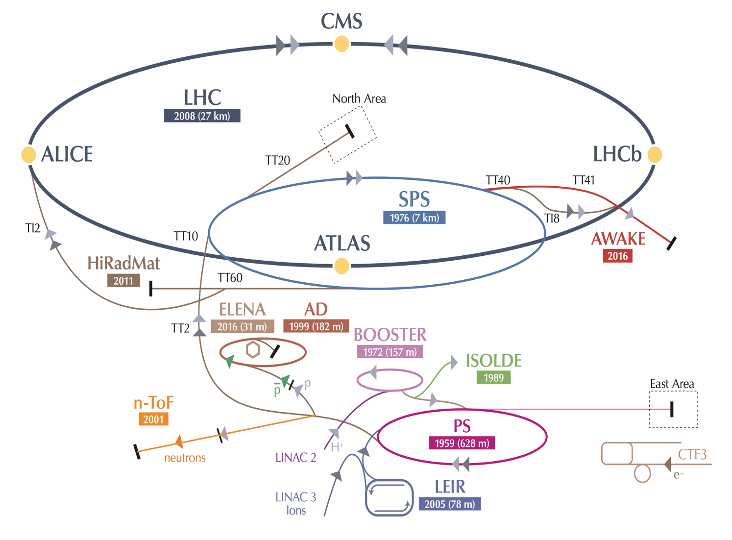
CERN is not only LHC!
AD: Antiproton Decelerator for antimatter studies
AWAKE: proton-induced plasma wakefield acceleration
CAST, OSQAR: axions
CLOUD: impact of cosmic rays on aeorosols and clouds → implications on climate
COMPASS: hadron structure and spectroscopy
ISOLDE: radioactive nuclei facility
NA61/Shine: heavy ions and neutrino targets
NA62: rare kaon decays
NA63: radiation processes in strong EM fields
NA64: search for dark photons
Neutrino Platform: 𝛎 detectors R&D for experiments in US, Japan
n-TOF: n-induced cross-sections
UA9: crystal collimation
~20 experiments, > 1200 physicists
10

Slide 11
25 ns
:
N ≈ 1,000,000,000 interactions/s
Interesting hard events are rare
→ very powerful detectors needed
Selection of 1 in
10,000,000,000,000
Notes:
Principle of the accelerators. collisions and experiments, many collision to look at rare things, high energy to look at small things and go back to conditions far back in the development of the universe
Need better slide -

Slide 12
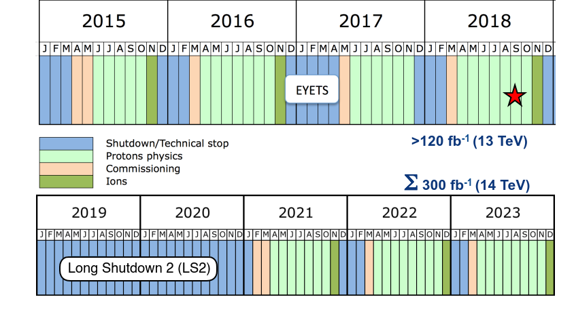
The Agenda!

Slide 13
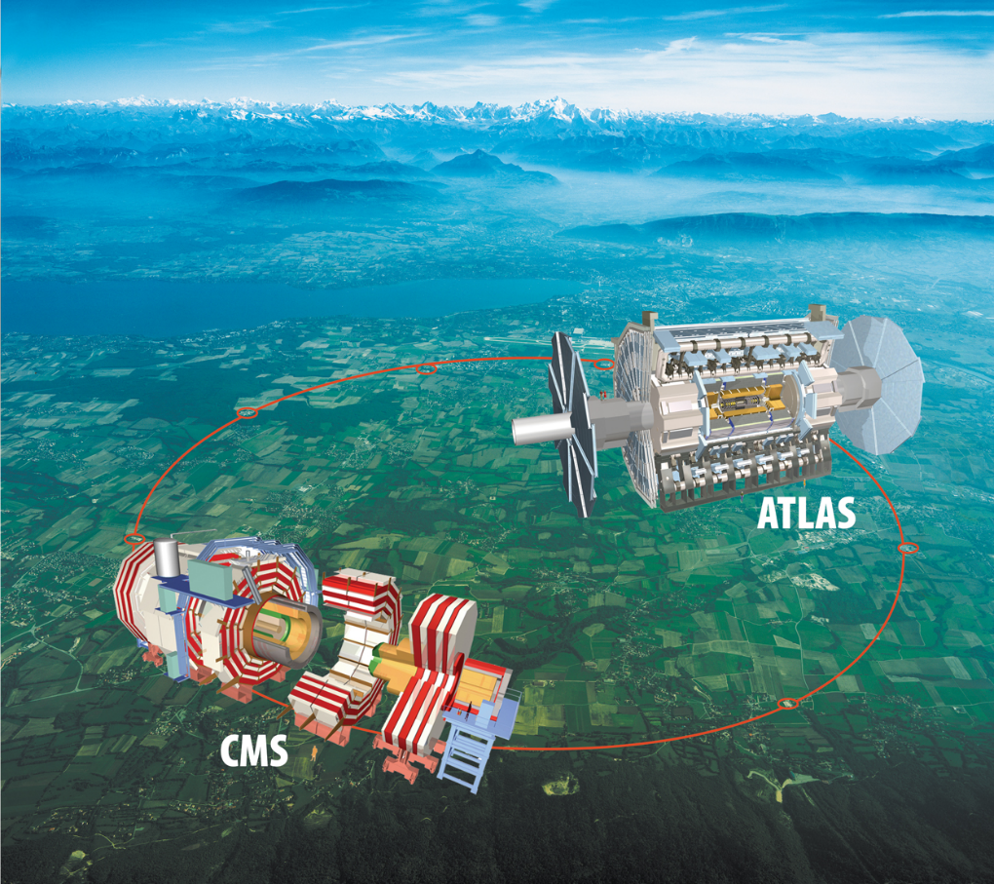
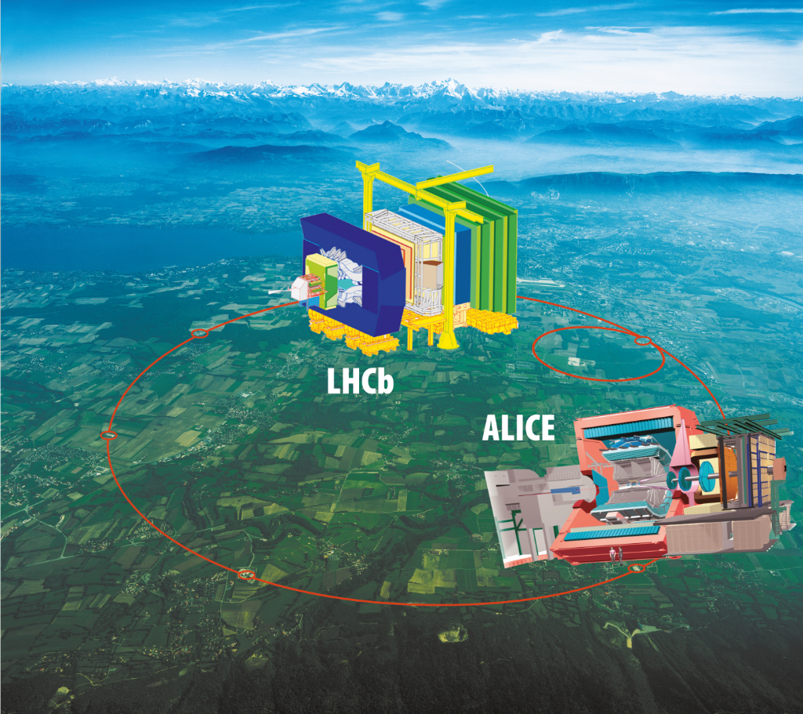
And Now the experiments

Slide 14
THE Higgs

Slide 15
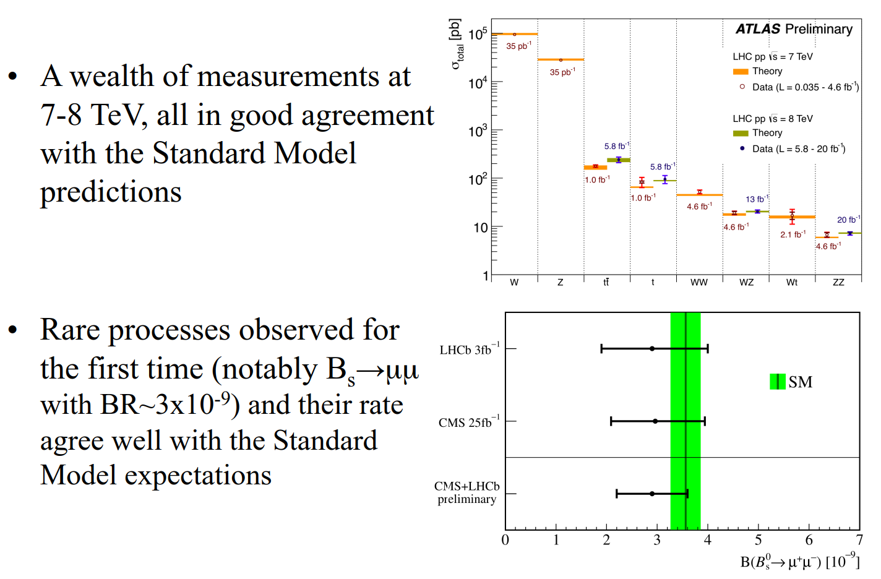
The good/bad news

Slide 16
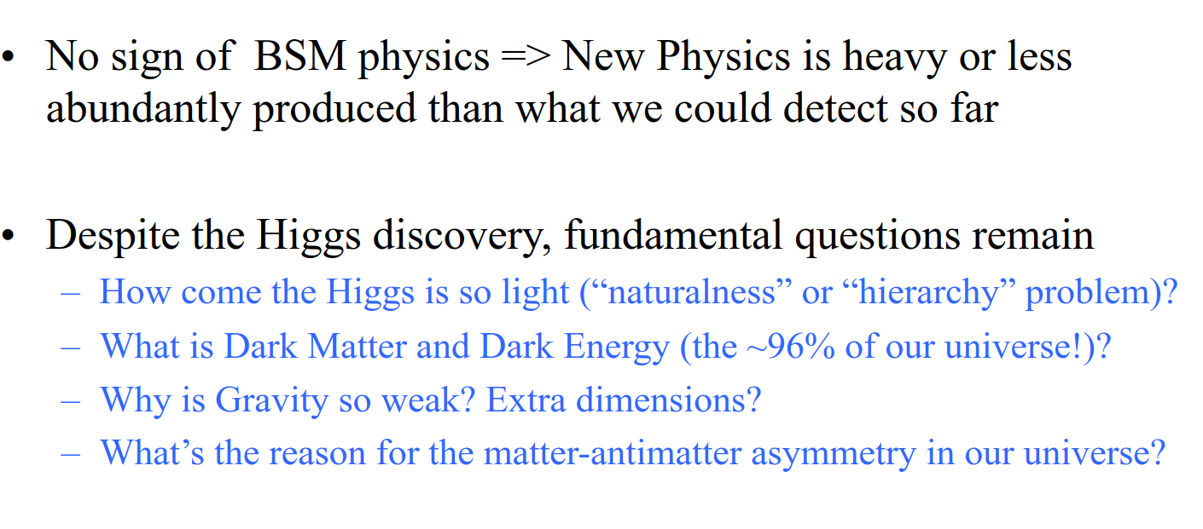
The Standard model has come out triumphant until 13 TeV

Slide 17
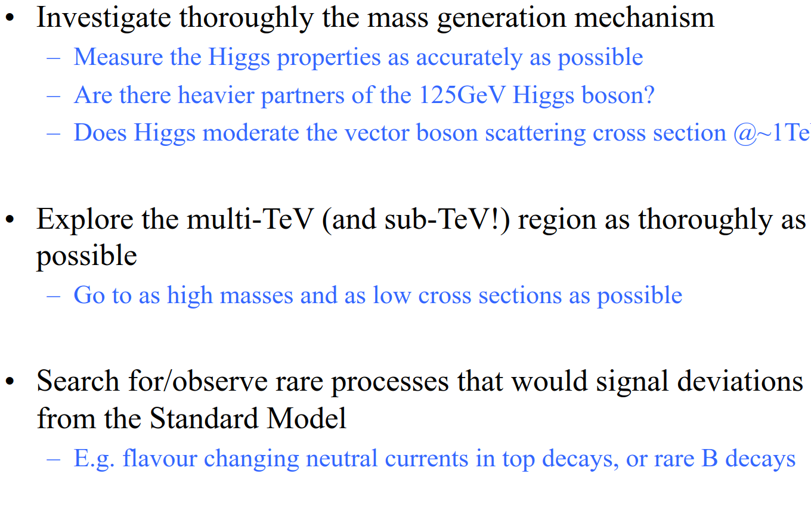
The aims of the future investigations

Slide 18
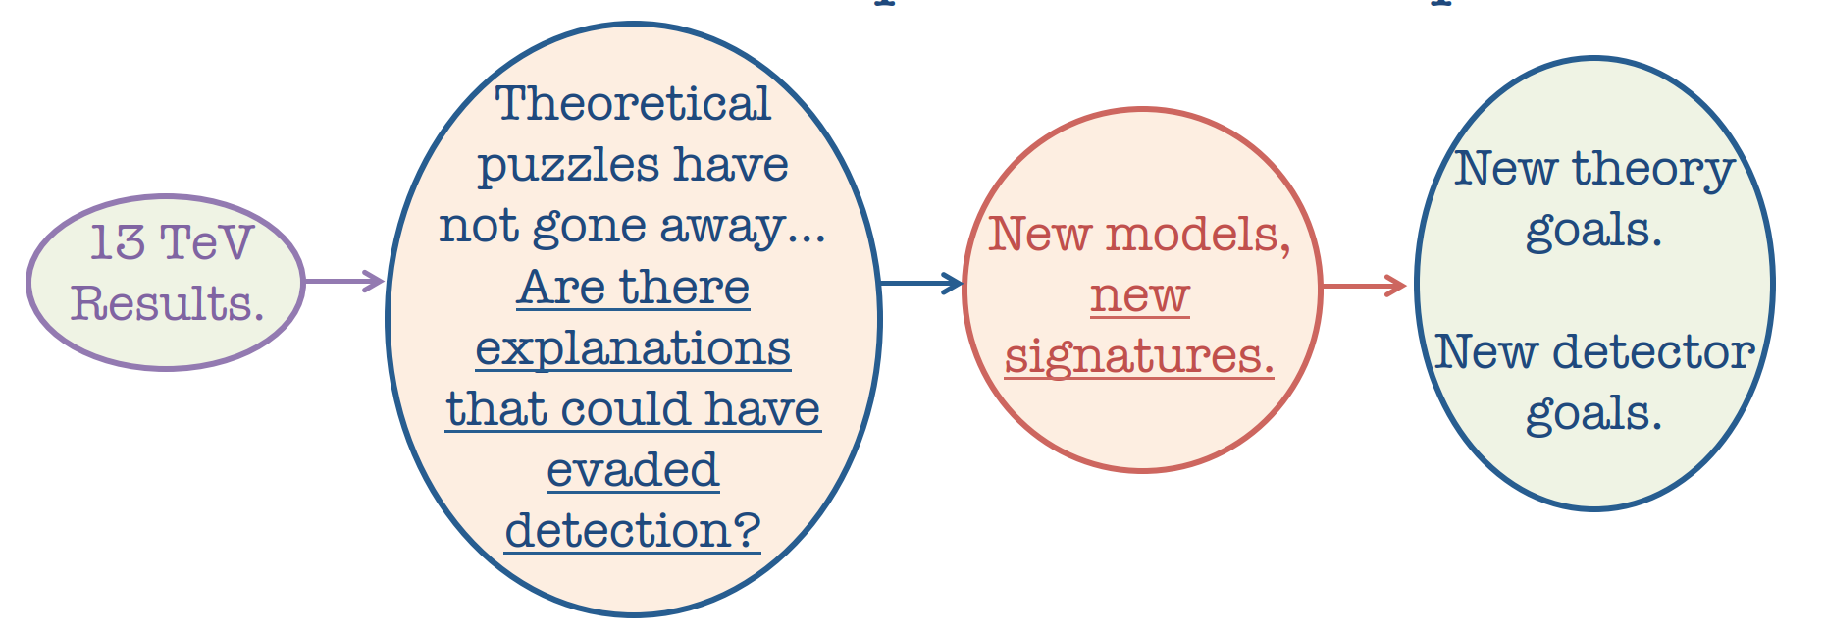
The next stage 2025-2035

Slide 19
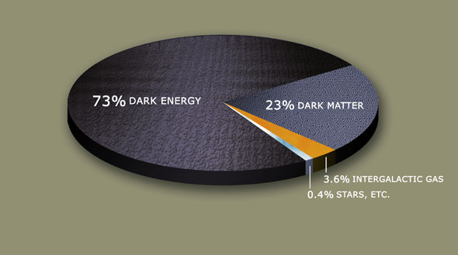
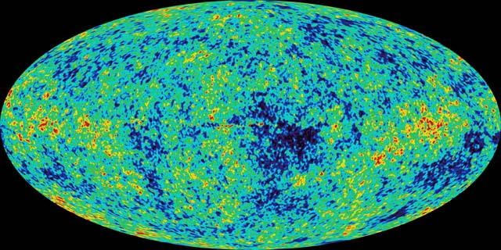
The search for Dark Matter
Cosmology requires the existence of dark matter
How do we know this?
  Galactic rotation curves
  Collision of cluster galaxies
  Cosmic microwave background temperature fluctuations
Notes:
Last topic, What is dark matter, and how can we find some. Bottom line is we know it is out there, but don’t know what it is…
Based on a lecture by James Wells
Dark matter does not interact with electromagnetic force but does with gravity.
Below are some reasons why we think there is dark matter.
a. Galactic rotation curves
b. CMB-Cosmic Microwave Background temperature fluctuations
Collision of two galaxies
3. The next slides will talk a little about Galactic Rotation and collision of cluster galaxies as related to dark matter.

Slide 20
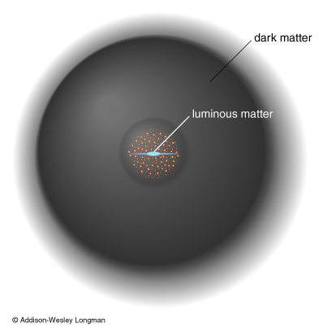
What is Dark Matter?
Properties of simplest Dark Matter
  Must be stable (have immutable qualities)
  Density 1 particle per hand
  Z₂ charge invariance with an odd charge
  R-parity
Possible Candidates
  Lightest Supersymmetric Particle (LSP)
  Lightest Kaluza-Klein
  Technibaryons
  Singlet Fermion
  Gravitons
  WIMP
Notes:
In the search for dark matter, we feel that dark matter must possess some of the following properties. If you want to talk more about these properties I have made a few notes below. I don’t think it is necessary…
Important points is that dark matter must be stable…
Picture above shows how dark matter may reside in outer regions of a galaxy. More on this in the next slide. LSP and WIMPS are the only two types of dark matter candidates discussed in this talk.
Lighest Supersymmetric Particle or LSP is the most celebrated candidate for dark matter (more in a couple slides)
WIMPs are another candidate and will be discussed in a later slides
1. Dark matter must possess, Z₂ charge invariance.
a. Z₂ is a quantum numbers where the product is conserved*. This is also referred to as parity.
*Most conserved quantum numbers are additive. Thus, in an elementary particle reaction, the sum of the quantum numbers should be the same before and after the reaction.
Source:http://en.wikipedia.org/wiki/Quantum_number
b. For dark matter Z₂ is odd. Odd implies stable
2.Dark matter has the property of R-parity.
a. R-parity is a conserved quantity of supersymmetry theory (hypothesized) This is a Z₂ symmetry.
Source:http://en.wikipedia.org/wiki/R-parity
b. With R-parity being preserved, the lightest supersymmetric particle (LSP) can not decay. This lightest particle (if it exists) may therefore account for the observed missing mass of the universe that is generally called dark matter.

Slide 21
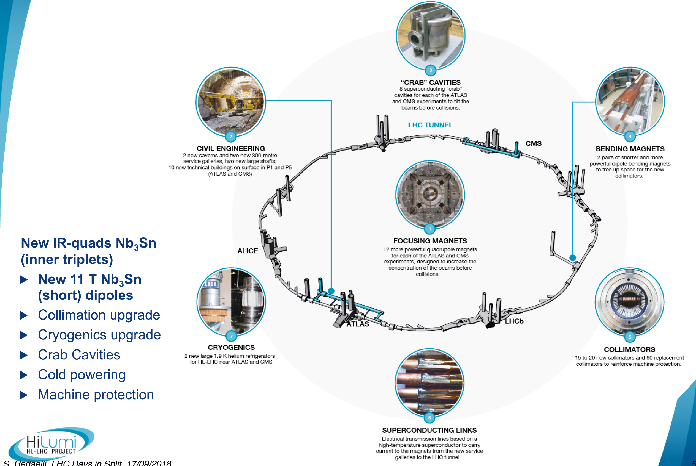
Many improvements to the facility needed

Slide 22
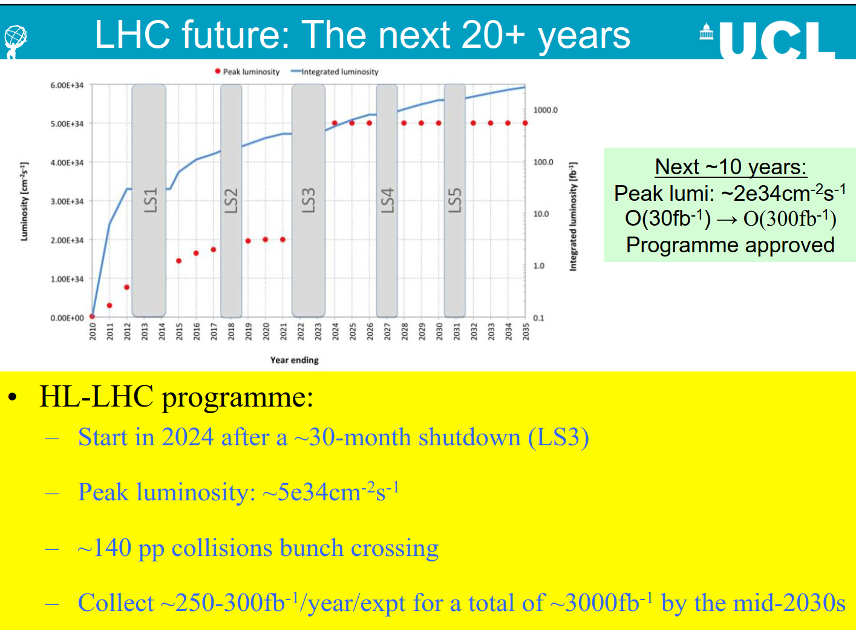

Slide 23
Detectors – almost all are renewed (upgraded)
Impossible to review all the innovations in the upgrade!

Slide 24
From Freeman Dyson:
New directions in science are launched by new tools much more often than by new concepts.
The effect of a concept-driven revolution is to explain old things in new ways.
The effect of a tool-driven revolution is to discover new things that have to be explained

Slide 25
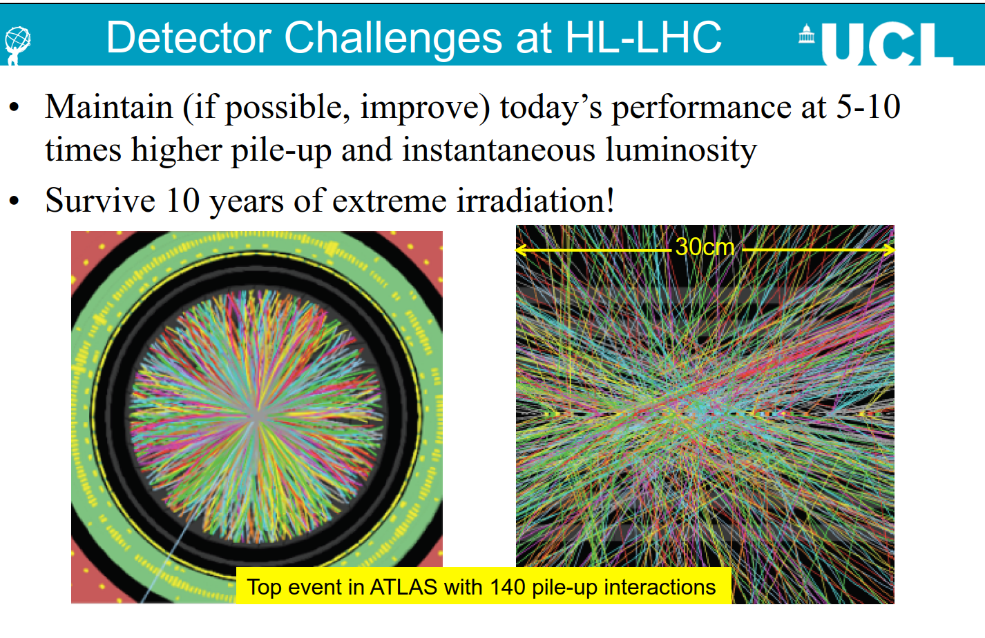
Computational challenges!

Slide 26

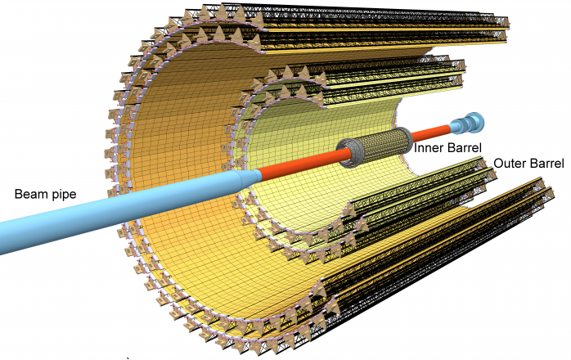
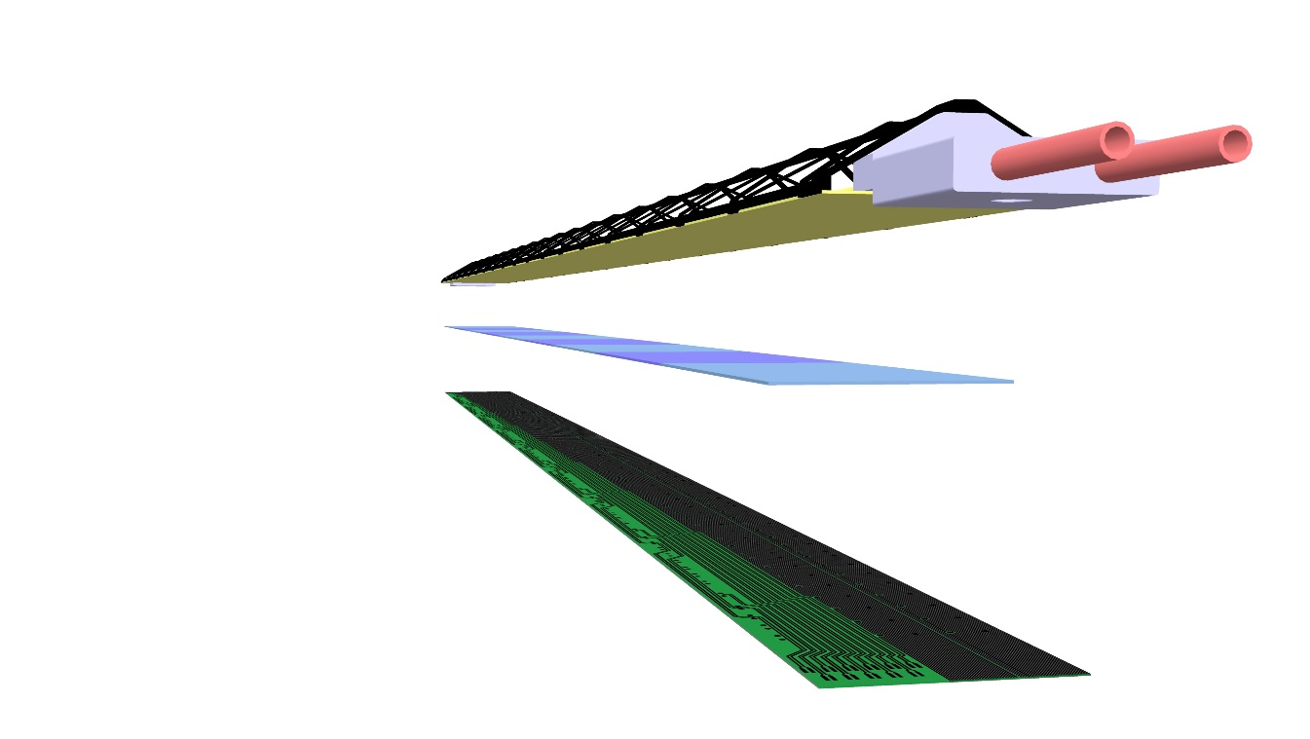
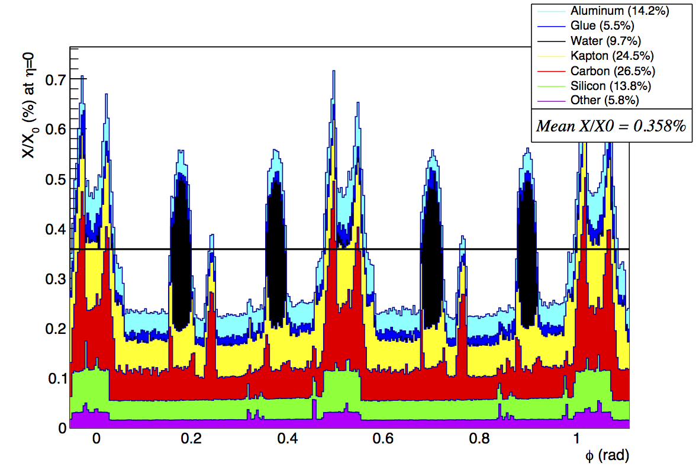
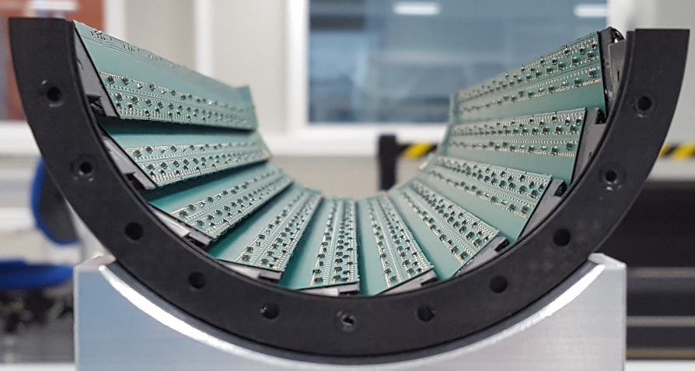
The new Internal Tracker System for ALICE
ITS2
40 cm
Flex Printed Circuit
9 Pixel Sensors
Cold Plate
Space Frame
Cooling Pipe
147 cm
Inner half-barrel
Silicon pixel sensor a only 15% of the total material budget
L. Musa (CERN) – ALICE Week, 17 July 2017

Slide 27
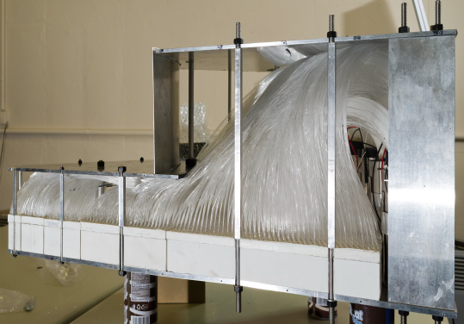
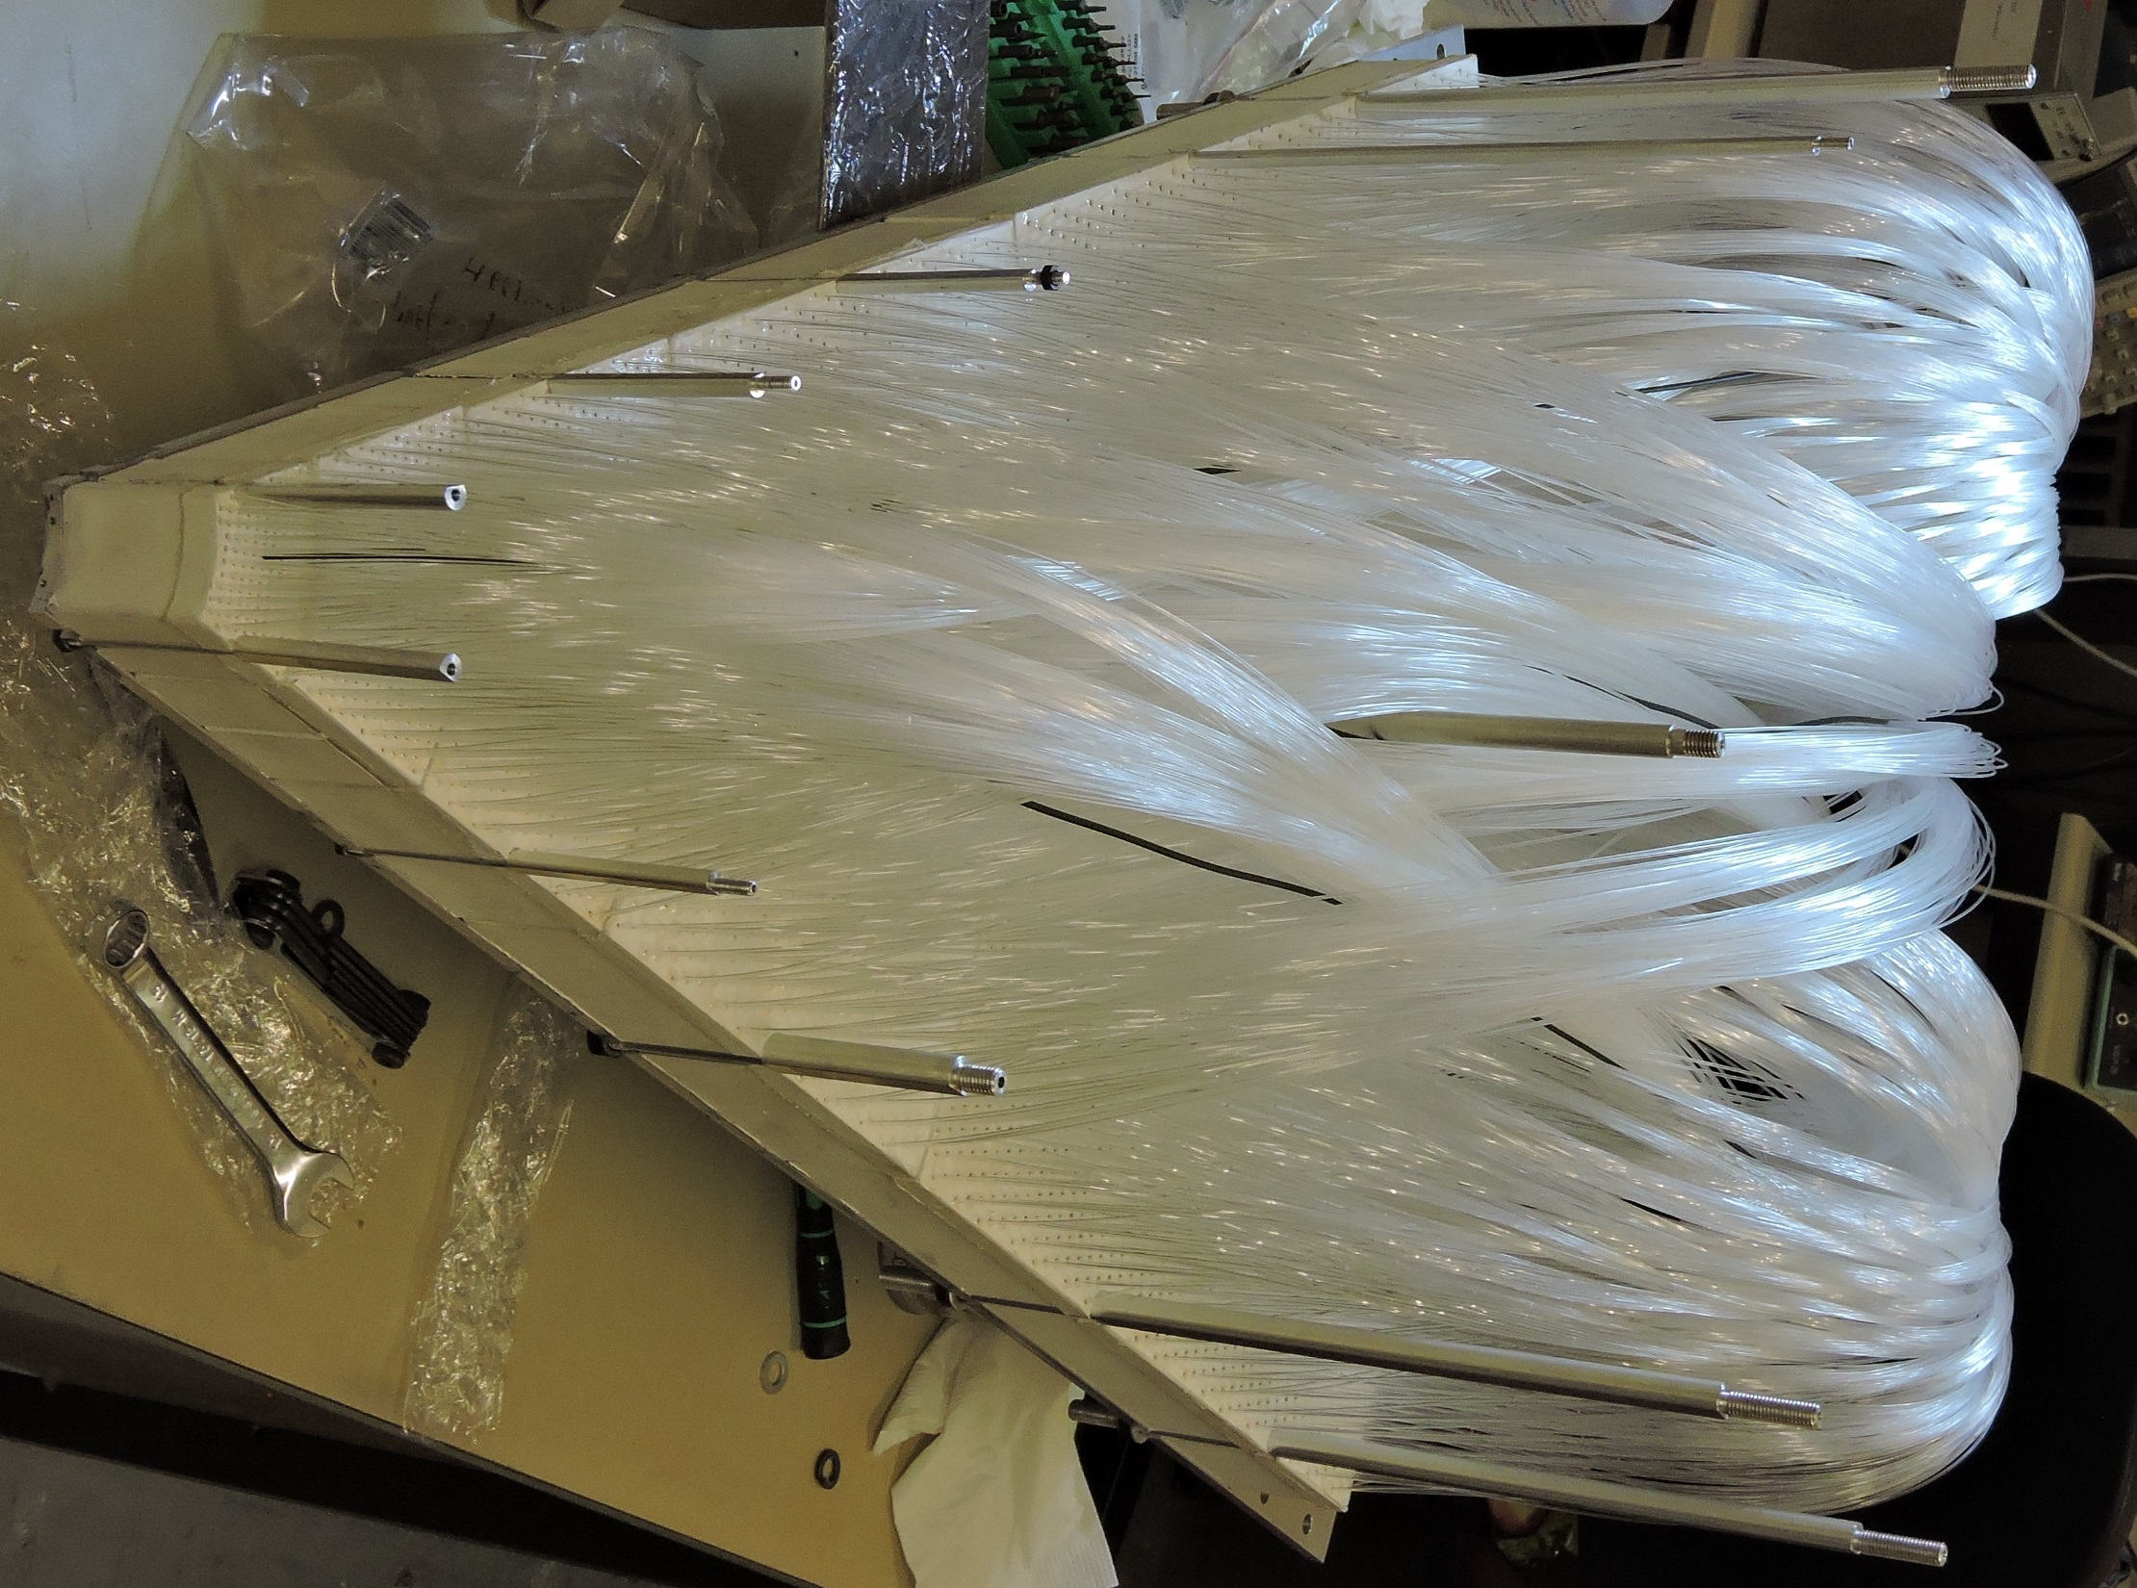
Mexico is not sleeping (some Examples)
Pico ammeter for the readout of GEMs in the ALICE TPC upgrade (BUAP –ICNUNAM)
Development of a completely new concept of a large area scintillator of excellent time resolution (IF UNAM)

Slide 28
And even more outlandish for the LS3!

Slide 29
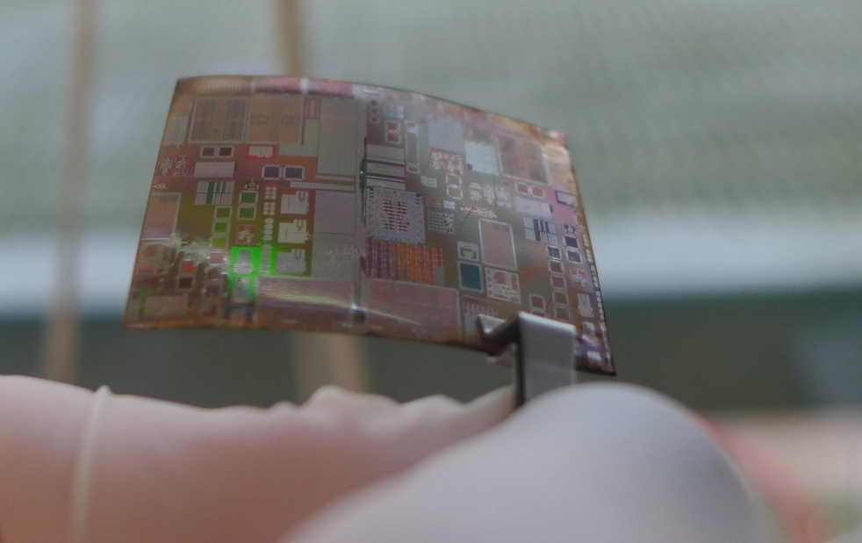
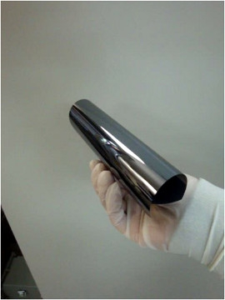
Ultra thin curved silicon foilssilicon chips
Can we exploit flexible nature of thin silicon ?
Silicon Genesis: 20 micron thick wafer
Chipworks: 30µm-thick RF-SOI CMOS
Ultra-thin chip (<50 um): flexible with good stability
L. Musa (CERN) – ALICE Week, 17 July 2017

Slide 30
Planning for the next generation!

Slide 31
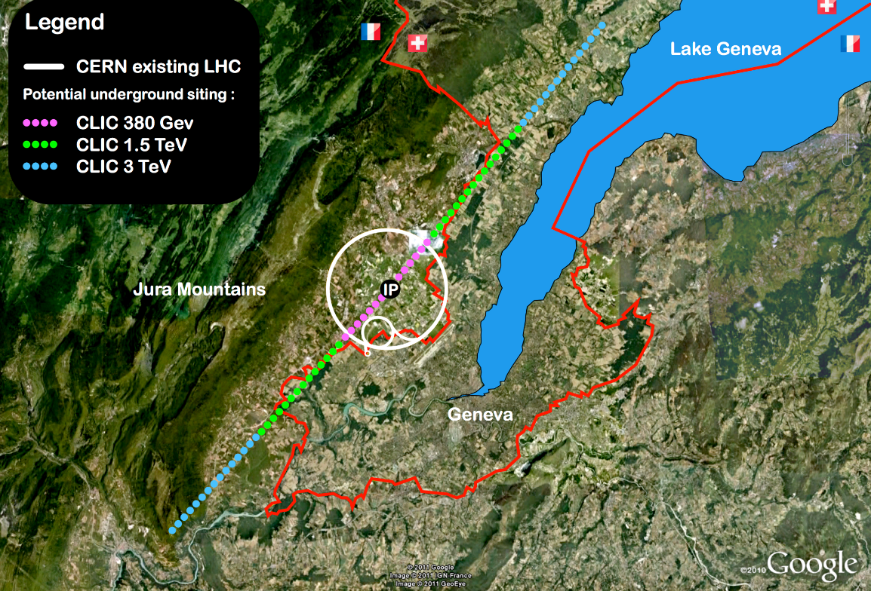
Compact Linear Collider (CLIC)
Linear e⁺e⁻ collider √s up to 3 TeV
100 MV/m accelerating gradient
needed for compact (~50 km) machine
based on normal-conducting
accelerating structures and a
two-beam acceleration scheme
Direct discovery potential and
precise measurements of new
particles (couplings to Z/γ*) up
to m~ 1.5 TeV
Measurements of “heavy” Higgs
couplings: ttH to ~ 4%, HH ~ 10%
Parameter | Unit | 380 GeV | 3 TeV
Centre-of-mass energy | TeV | 0.38 | 3
Total luminosity | 10³⁴cm⁻²s⁻¹ | 1.5 | 5.9
Luminosity above 99% of √s | 10³⁴cm⁻²s⁻¹ | 0.9 | 2.0
Repetition frequency | Hz | 50 | 50
Number of bunches per train |  | 352 | 312
Bunch separation | ns | 0.5 | 0.5
Acceleration gradient | MV/m | 72 | 100
Most recent operating scenario: start
at √s=380 GeV for H and top physics

Slide 32
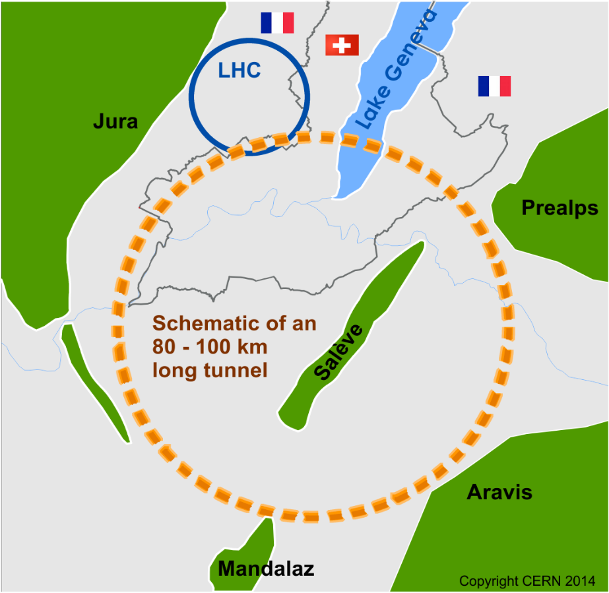
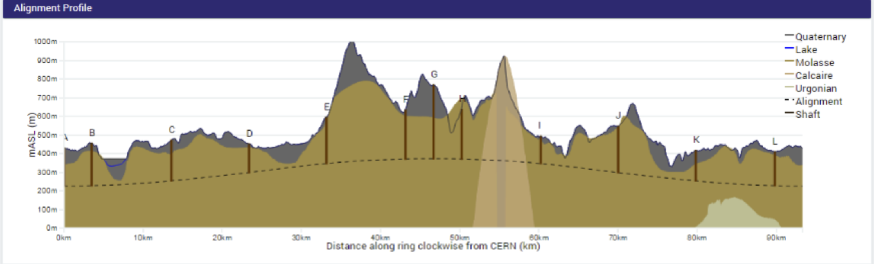
(not so ) Future Circular Collider (FCC)
Conceptual design study of a ~100 km ring:
pp collider (FCC-hh): ultimate goal → defines infrastructure requirements
√s ~ 100 TeV, L~2x10³⁵; 4 IP, ~20 ab⁻¹/expt
e⁺e⁻ collider (FCC-ee): possible first step
√s = 90-350 GeV, L~200-2 x 10³⁴; 2 IP
pe collider (FCC-he): option
√s ~ 3.5 TeV, L~10³⁴
Goal: CDR in time for next ES
Also part of the study: HE-LHC: FCC-hh dipole
technology (~16 T) in LHC tunnel → √s ~ 30 TeV
90-100 km ring fits geology
Machine studies are site-neutral.
However, FCC at CERN would greatly
benefit from existing laboratory infrastructure and accelerator complex

Slide 33
There is a lot to learn,
lots to achieve,
a lot of challenges
…..

Slide 34
Backups

Slide 35
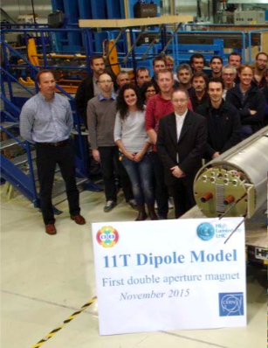
FCC
FCC-hh: ~100 TeV pp collider is expected to:
explore directly the 10-50 TeV E-scale
conclusive exploration of EWSB dynamics
say the final word about heavy WIMP dark matter
FCC-ee: 90-350 GeV
measure many Higgs couplings to few permill
indirect sensitivity to E-scale up to O(100 TeV) by improving by ~20-200 times
the precision of EW parameters measurements, ΔM_{W} < 1 MeV, Δm_{top} ~ 10 MeV
The two machines are
complementary and
synergetic
Many huge technological, design and operational challenges: e.g. ~16 T Nb₃Sn magnets
“Natural” continuation of LHC and HL-LHC programmes: step-wise
approach, each step deployed and operated in a (big) accelerator:
LHC: Nb Ti technology: 8.3 T
HL-LHC: Nb₃Sn technology
(11 T dipoles in IR7, 12-13 T peak field low-𝛽 quads in IR1, IR5)
End 2015: Nb₃Sn dipole (1.8 m) reached 11.3 T (> nominal) w/o quenches
March 2016: Nb₃Sn quadrupole (1.5 m long, aperture =150 mm) reached
18 kA (nominal: 16.5 kA). 2 coils from CERN + 2 coils from US

Slide 36
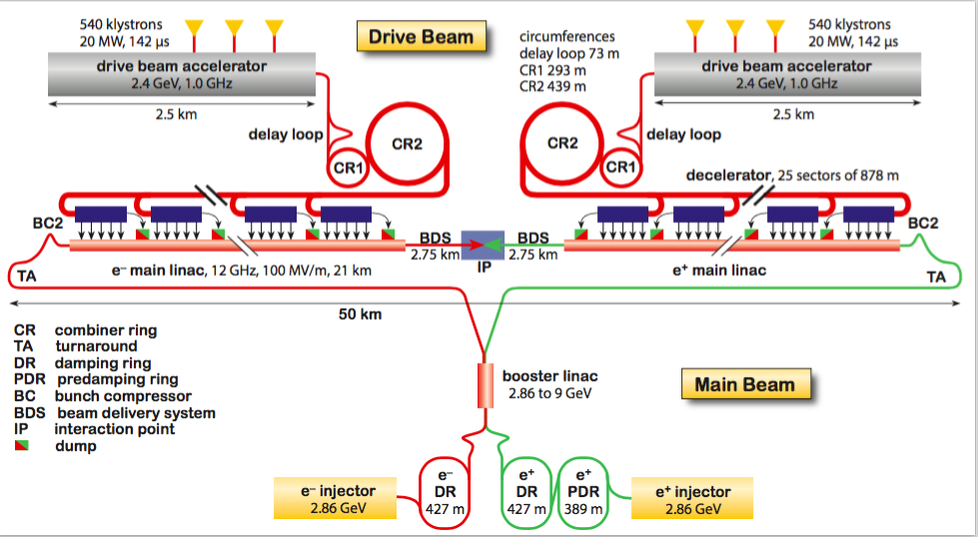
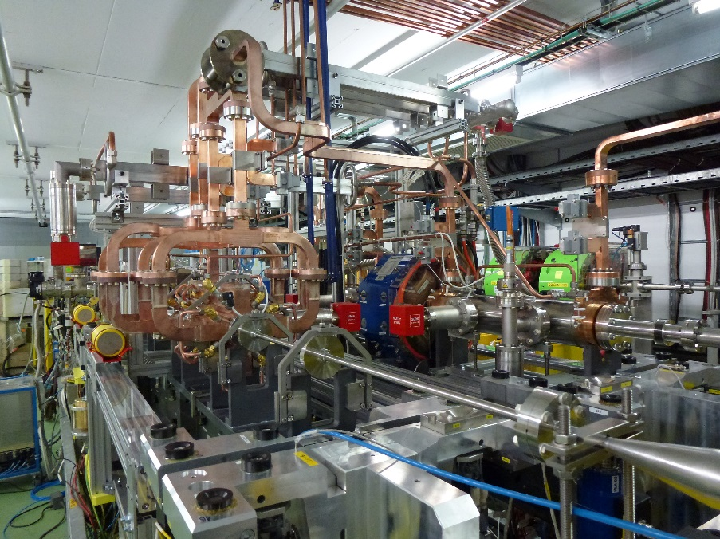
CLIC
Challenges:
minimise RF breakdown rate in cavities
efficient RF power transfer from drive to main beam
reduce power consumption (600 MW at 3 TeV)
nm size beams, final focus
huge beamstrahlung in detectors
CDR completed end 2012 :
develop plan for staged implementation
complete key R&D studies
review cost and schedule
CTF3 facility: testing two-beam acceleration concept: efficient power transfer from
high-intensity low-E “drive” beam to the accelerating structure of the main (“probe”) beam.
→ to be completed in 2016
CLIC construction could technically start ~2025,
duration ~6 years for √s ~ 380 GeV (11 km Linac)
→ physics could start by ~2035
CLIC two-beam module under test in CTF3

Slide 37
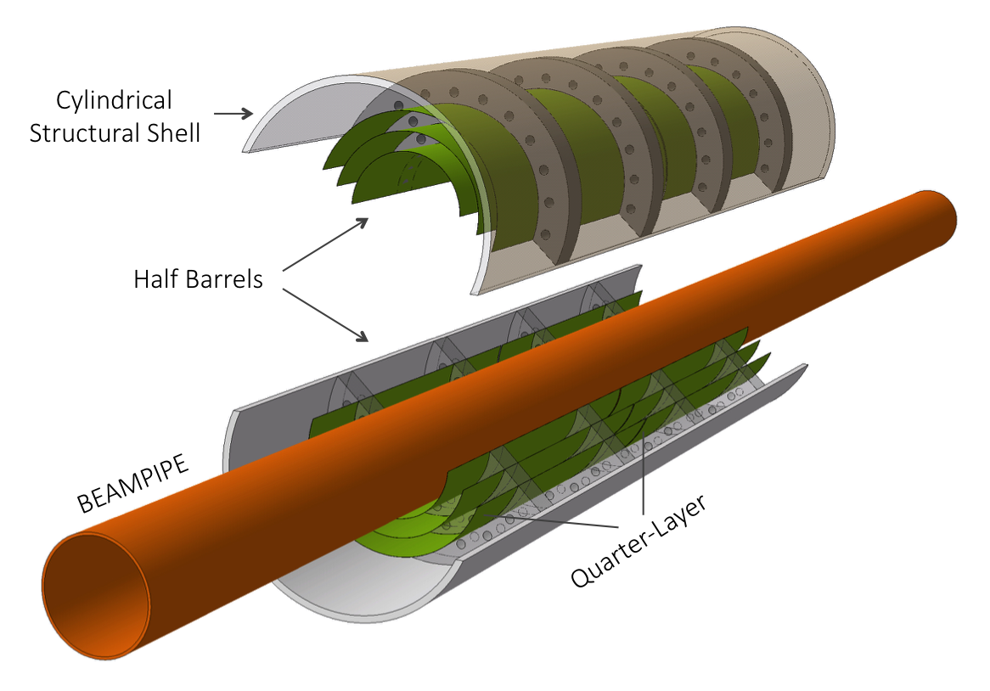
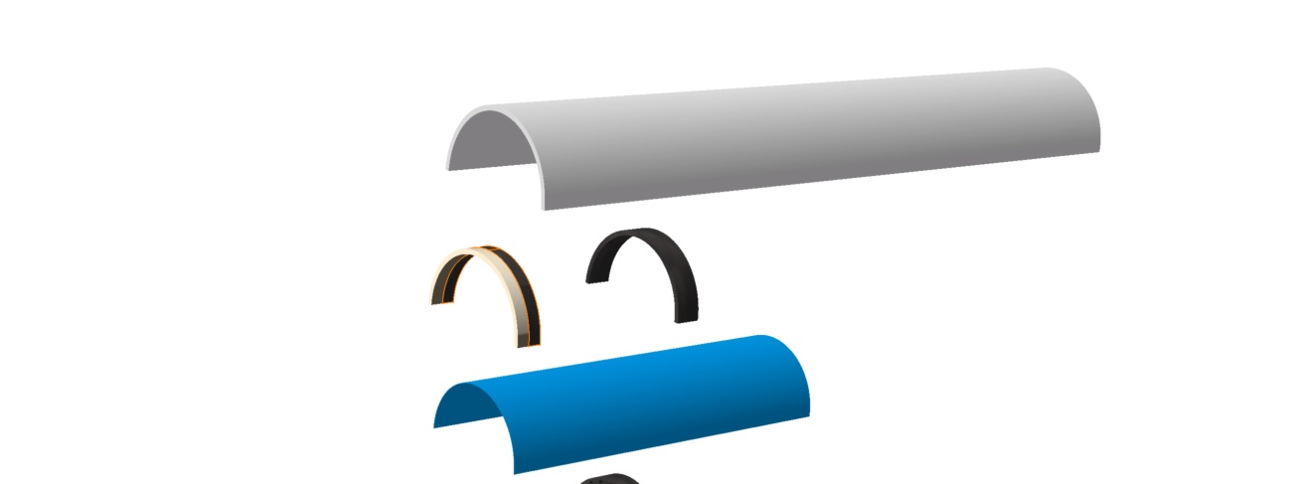
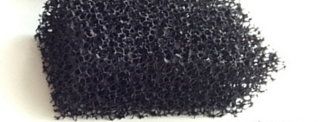
ITS3 Mechanical Layout
Layers supported by high-thermal conductive carbon foam (half-ring)
Open cell carbon foam
L. Musa (CERN) – ALICE Week, 17 July 2017

Slide 38

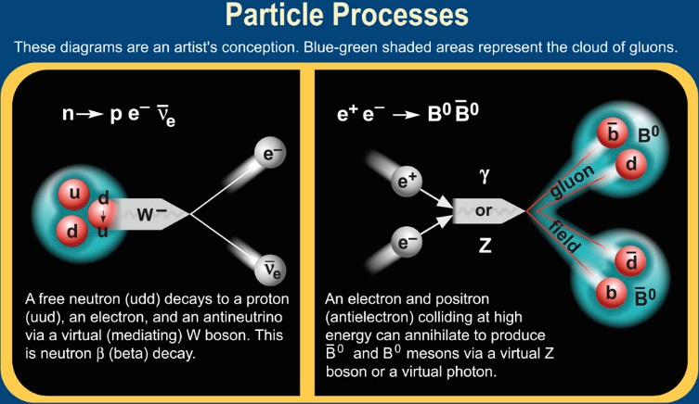
Solved and Unsolved
The Standard Model answers many of the questions about the structure and stability of matter, but???
  Are quarks and leptons actually fundamental, or are they made up of even more fundamental particles?
  Why can't the Standard Model predict a particle's mass?
  How does gravity fit into all of this?
  Why is there more matter than antimatter in the universe
  What is this "dark matter“?
Notes:
Standard model-The Standard Model of particle physics is a theory that describes three of the four known fundamental interactions between the elementary particles that make up all matter.
What can we expect to learn at the LHC?
What gives particles their mass.
What dark matter is
Solving the Hierarchy problem. Or how does gravity fit into the Standard Model
Why there more matter than antimatter in the universe
Each of these topics will be discussed in this lecture

Slide 39

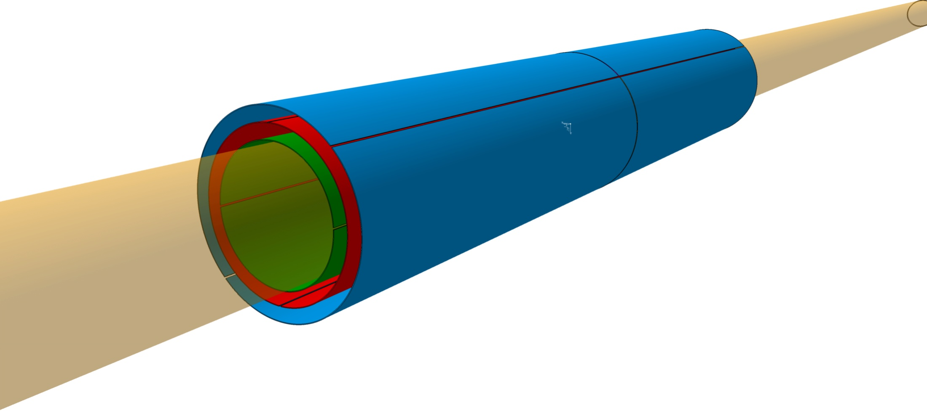
Geometrical Parameters of ITS3
Pipe: r ≈ 16mm , ΔR = 0.5mm
L0: r ≈ 18mm , L1: r ≈ 24mm. L2: r ≈ 30 mm
~14cm
Beampipe
IR 16 mm
ΔR 0.5mm
Beam pipe thickness: 500μm (0.14% X₀)
Sensor thickness: 20 − 40μm (0.03 - 0.05% X₀)
L. Musa (CERN) – ALICE Week, 17 July 2017

