Slide 1
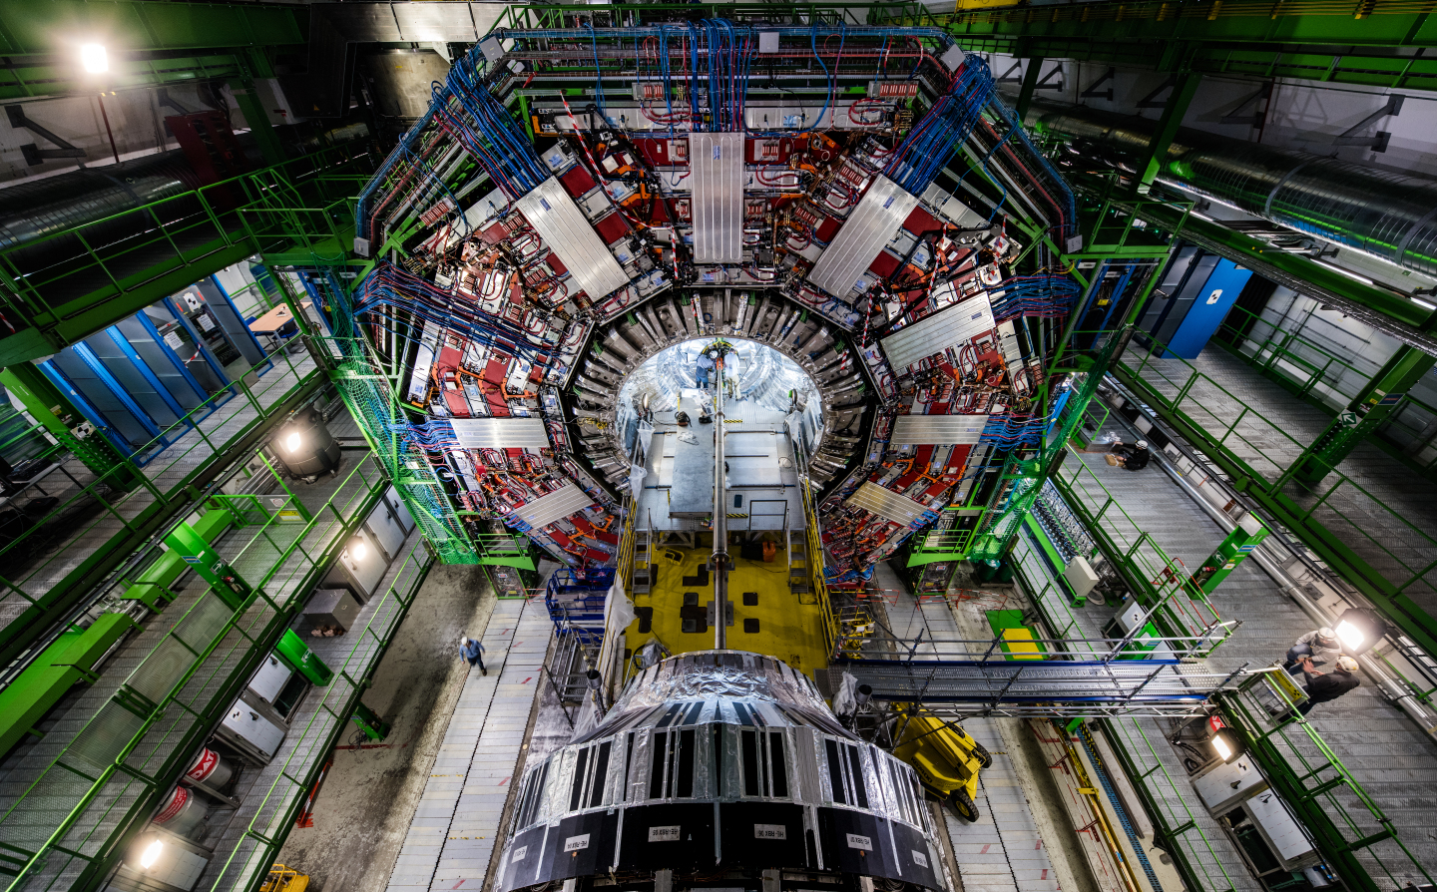
The CMS Experiment of LHC CERN
Isabel Pedraza
Benemérita Universidad Autónoma de Puebla
Notes:
Replace image placeholder: Click on image -> Click on ‘Replace image’ -> Choose your image.
Send image placeholder to back: Right click on image -> Order -> Bring to Back

Slide 2
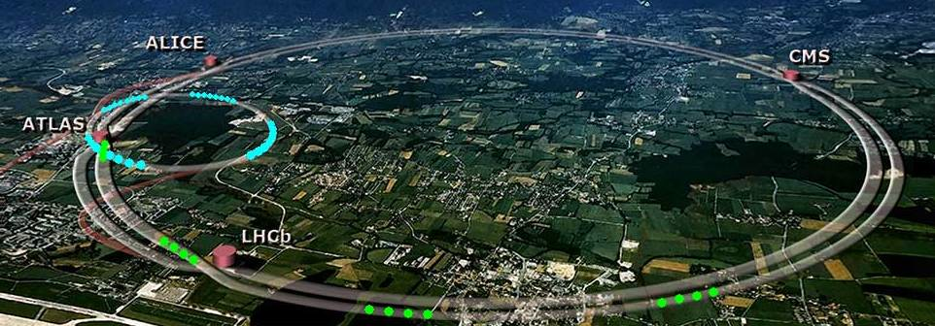
LHC, the biggest accelerator in the World
27km circumference, 50-150m below ground, across French-Swiss border
2132 magnetic dipoles of 15 m.
392 Quadrupoles of 5-7 m.
pp collisions @ √s = 7 TeV in 2010-2011, 8 TeV in 2012, and 13 TeV in 2015-2018.
Each beam ~ 1400 proton bunches, each bunch ~ 1.5×10¹¹ protons
~ 20 pp collisions per bunch crossing times 20 MHz bunch crossing rate = 400 M pp collisions per second
Reduced by trigger systems to ~500 events/sec.

Slide 3
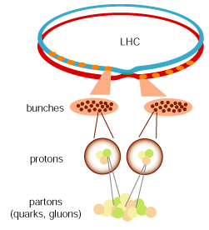
Interlude 1: luminosity and pile-up
LHC = proton-proton collider ?
doesn’t collide protons, but proton bunches (~ 10e11 p. per bunch)
when the bunches collide, many protons collide within the bunches
the amount of pp collisions per bunch crossing is called pile up
pileup is proportional to the intensity N of the bunch
We hope at least one pp/qq collision is energetic enough to produce interesting physics (W, Z, h, exotic particles, ...)
The luminosity (cm⁻²s⁻¹) is a measure of the collision rate, which depends on the LHC parameters → increase the luminosity
Technically not so easy...

Slide 4
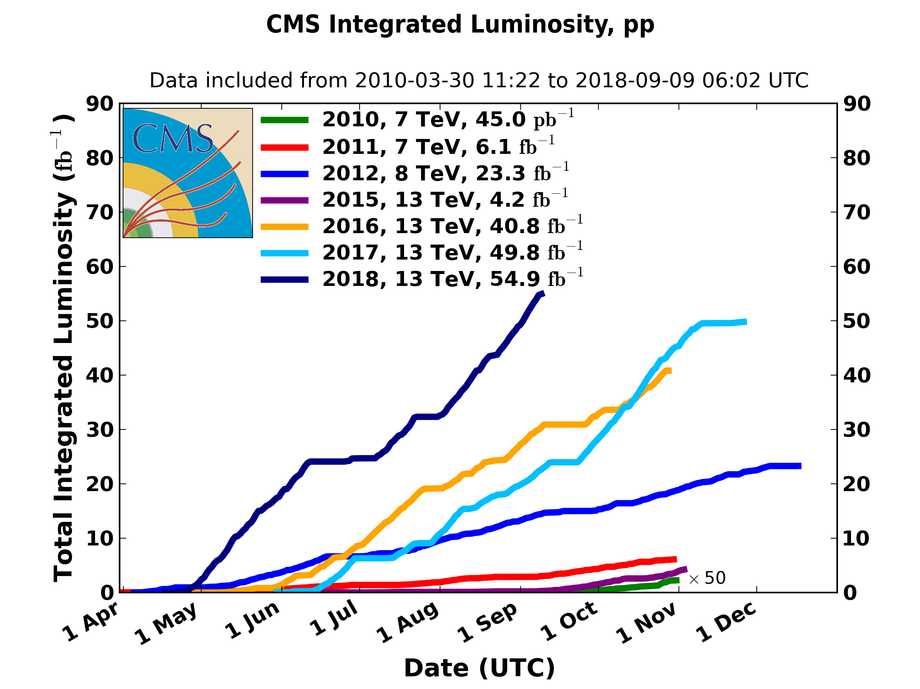
LHC numbers and performance
Delivered
physics
data
LHC design parameters
energy: 7 TeV per beam, c.m. = 14 TeV
luminosity: 10e34 cm⁻²s⁻¹
expected average pileup: <PU> = 30
integrated luminosity: 300 fb⁻¹
We are here: currently running at 1.7e34! @ 13 TeV, <PU> 38

Slide 5
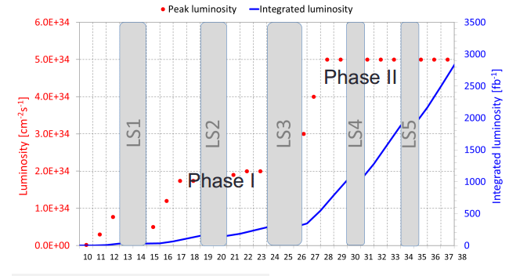
High-Luminosity LHC
New nominal/ultimate scenarios
instantaneous luminosity 5/7.5e34 cm⁻²s⁻¹
average pile-up <PU> = 140/200
integrated luminosity up to 3000/4000 fb⁻¹
=> Ten times the luminosity reach of first 10 years of LHC operation
We are here: currently running at 1.7e34! @ 13 TeV
Phase II upgrade installations

Slide 6
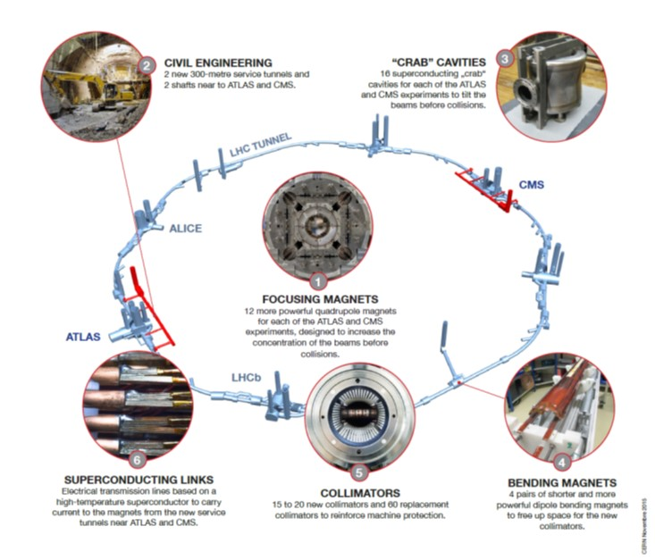
HL-LHC (High Luminosity LHC)

Slide 7
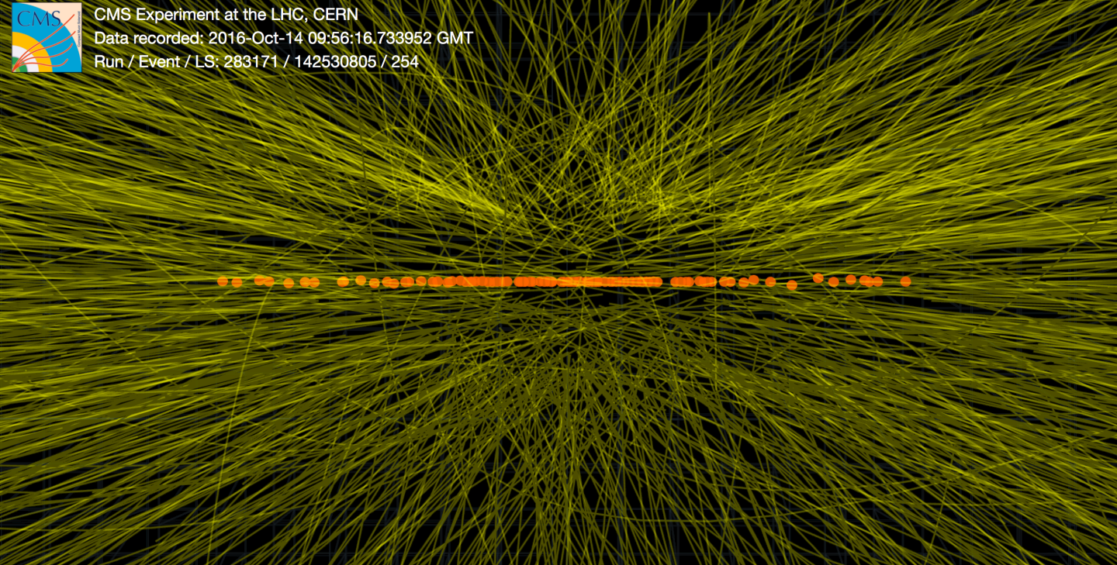
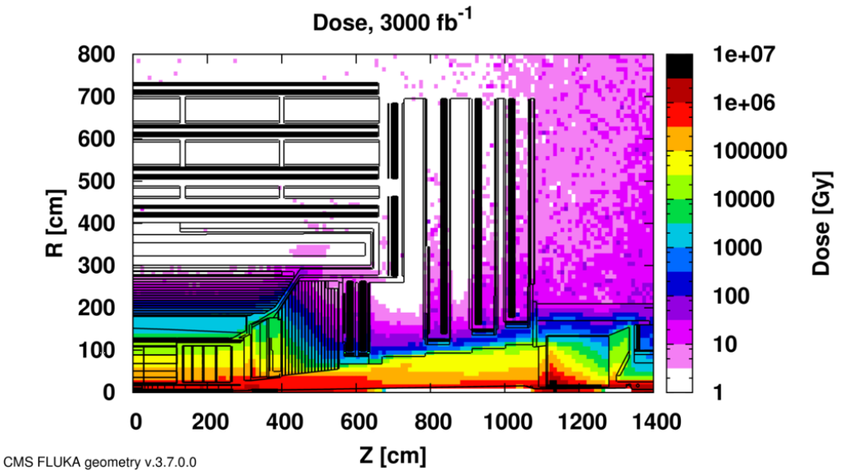
Implications on CMS of HL-LHC
Real-life event with HL-LHC-like pileup from special run in 2016 with individual high intensity bunches : ~130 vertices
High luminosity
leads to high PU (up to 140 - 200 depending on lumi)
higher detector granularity needed to distinguish tracks and fake tracks and pileup mitigation
adaptations of trigger system and faster electronics
Cumulative radiation damage
most of sub-detectors approved up to 300 fb⁻¹ (LHC)
longevity studies needed for both detector and electronics performance
Upgrade of sub-detectors and electronics needed in order to maintain physics performance as during Phase I

Slide 9
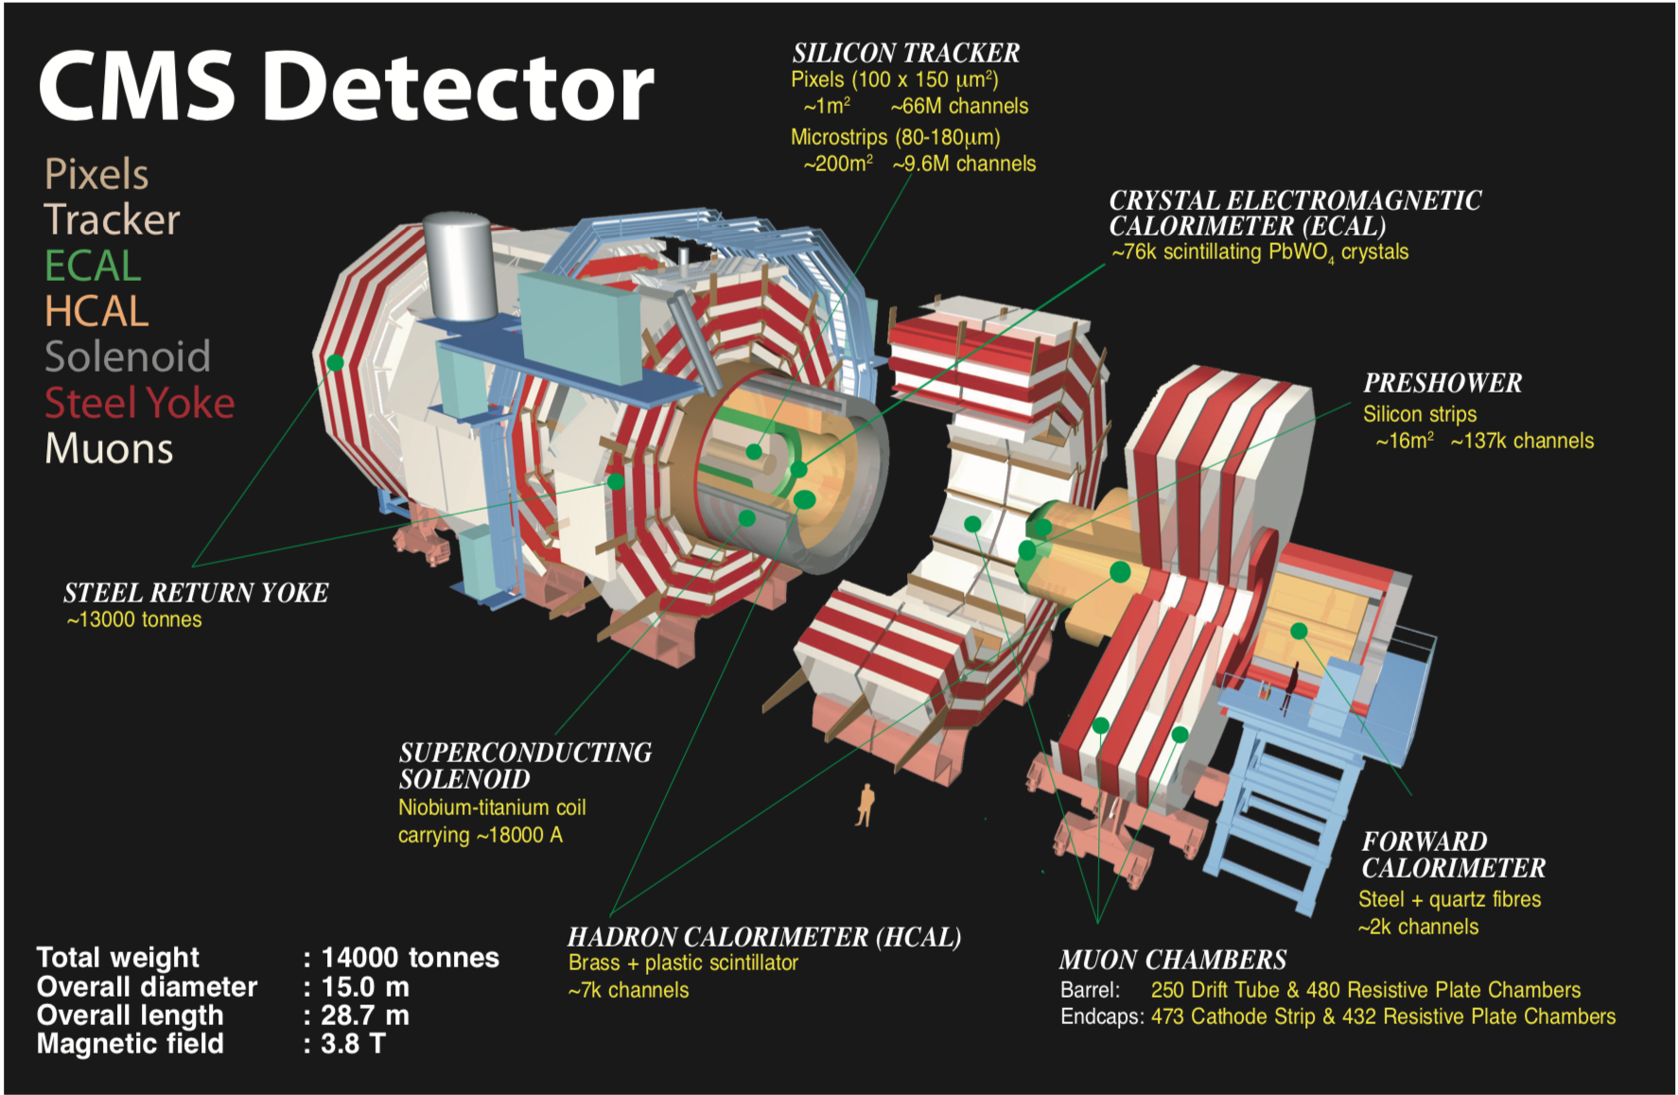

Slide 10
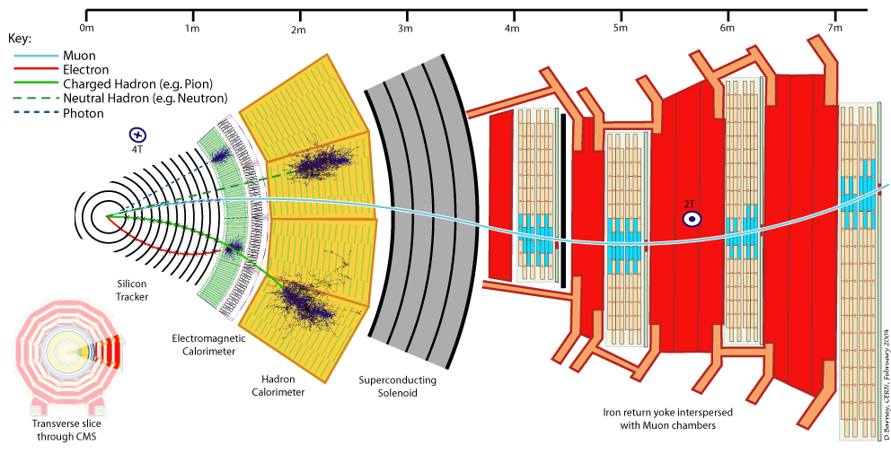
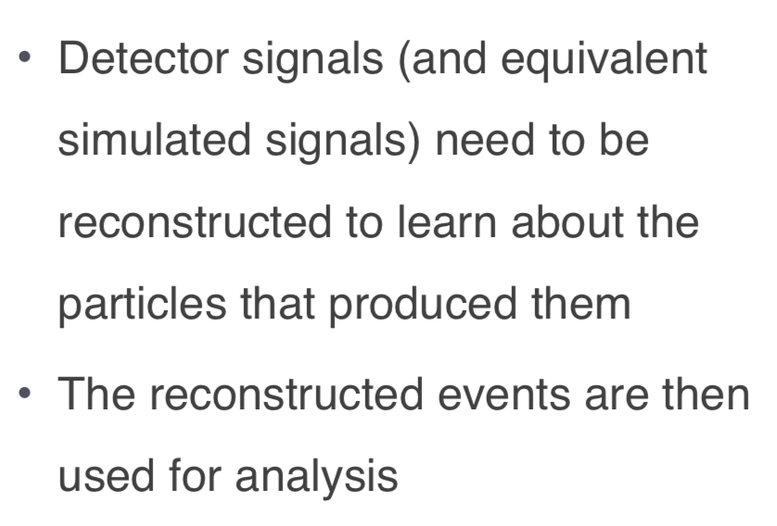
CMS slide
------- ν (Neutrinos = Energía Perdida)

Slide 11
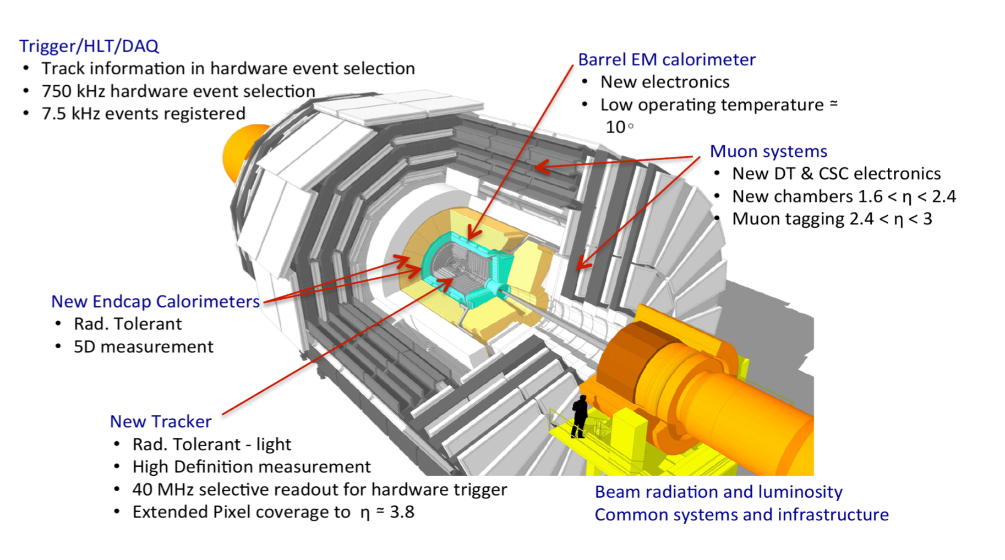
CMS upgrades

Slide 12
Interlude 2: Trigger
Collision rate = 40 MHz (each 25 ns)
Event size ~ 1 mb → 40000 TB/s
impossible to store all this information on disk!
select only the interesting events = triggering (i.e. the energetic events)
L1: selection based on coarse detector information (rough)
HLT: full detector readout (accurate)
→ L1: from 40 MHz to 100 kHz
→ HLT: from 100 kHz to 100 Hz (1000x reduction)
→ 10 TB/day storage

Slide 13
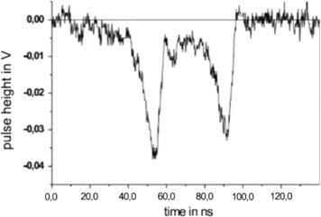
Interlude 3: Electronics and DAQ
Detector response is an analogue signal
tracker: signal in silicon strips
calorimeters: signal amplitude is proportional to the energy deposit
muon chambers: signal coming from gas ionization and avalanche
2) The Front-End electronics digitizes the analogue signals → positioned close to the detector
3) The digital signals are sent through optical links to the trigger and to the DAQ = Data Acquisition System
The front-end electronics must be fast (40 MHz!), amplify the signal, shape and digitize it → special electronic designs needed for each detector (+ radiation resistant)

Slide 14
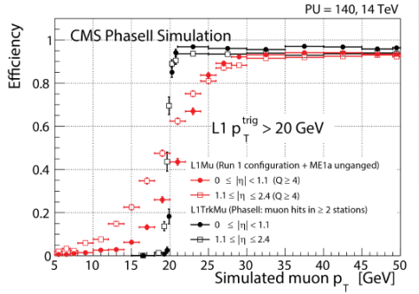
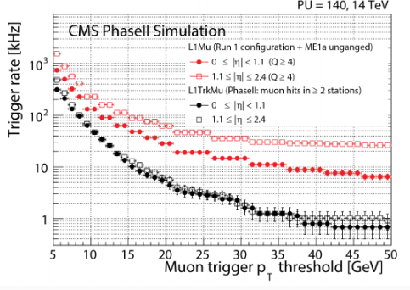
Trigger
New L1 design
rate of 500 kHz (PU 140) or 750 kHz (PU 200) (now limited to 100 kHz)
inclusion of tracker (outer) and forward muon regions
finer calorimeter trigger primitives
maximize incorporation of particle-flow algorithm for all physics objects
latency of 12.5 us (mainly driven by tracker)
HLT
reduction of factor 1000 to 750 Hz (no reduction change)
limit driven by computing resources rather than DAQ limitations
→ higher efficiency and purity
→ rate reduction O(10)

Slide 15
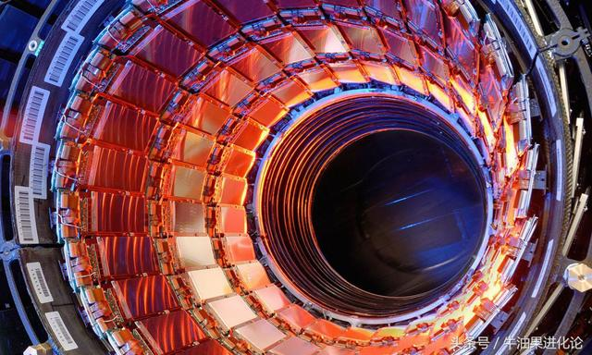
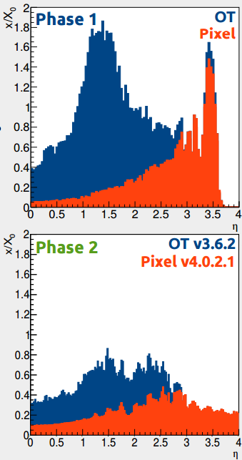
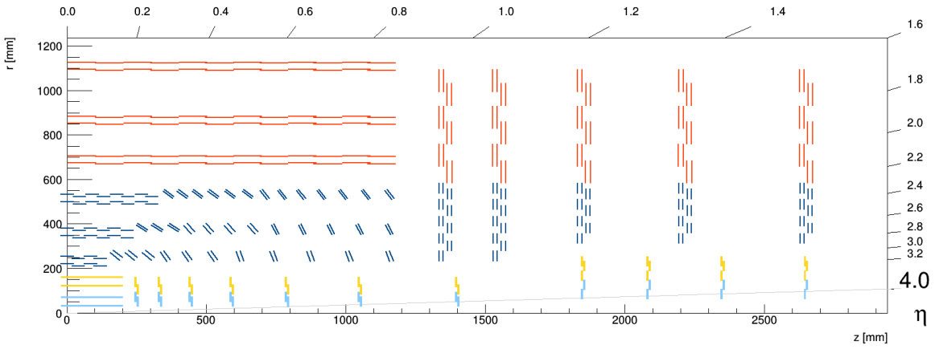
Tracker
Tracker consists of outer tracker (OT) and inner pixel detector (pixel)
full replacement to cope with radiation up to 3000 fb⁻¹
higher granularity needed for tracking under high pile-up (up to 200)
optimized material budget and usage of radiation tolerant materials
adaptations needed for L1 trigger inclusion (next slide)
Material amount [x/x₀]
Outer Tracker (strips)
Pixel

Slide 16
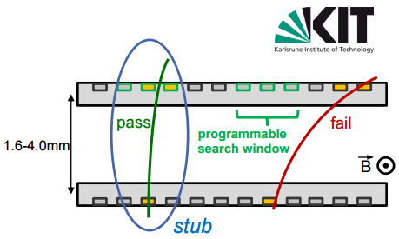
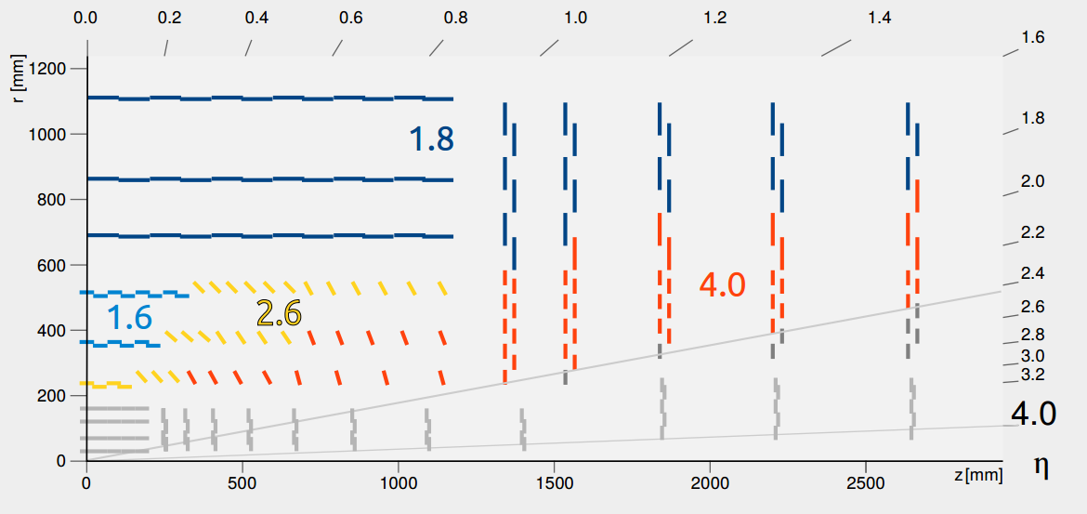
Tracker L1 and p_{T} modules
high pT
low pT
Outer tracker design optimized for inclusion in L1 trigger by means of p_{T} modules:
two planar cell readout per module (FPGA electronics)
only track pT > 2 GeV in single module based on bending and hit displacement in single module
different thickness across the tracker region
using all tracker hits → too high bandwidth (10 GBps)
only outer tracker (r > 20 cm) (no pixel)

Slide 17
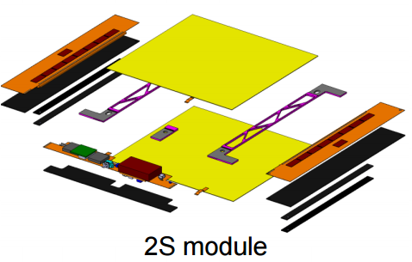
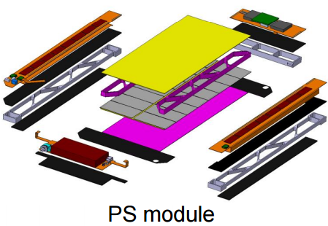
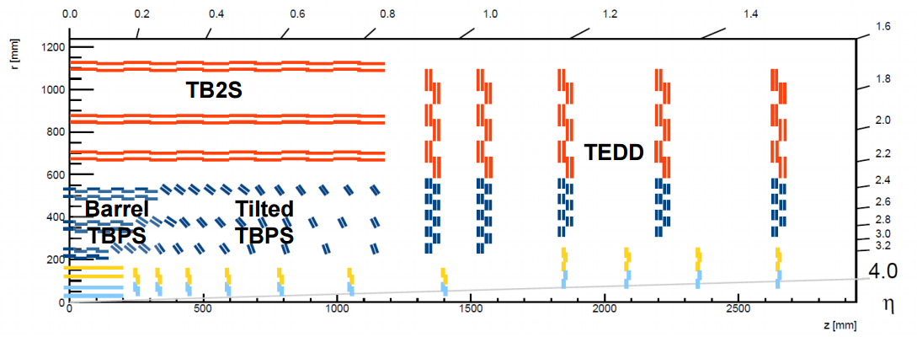
Outer Tracker
Baseline: 6 barrel layers and 5 endcap disks consists of p_{T} modules
tilted for hermetic coverage
module design ~ completed: 2S and PS designs
readout, correlation logic, data concentration, data transmission and power conversion all integrated in the module
2S Module
- 2 strip planes (10x10 cm)
- strip size: 5 cm x 90 um
- active thickness: 200-300 um
PS-s
PS-p
PS Module = PS-s + PS-p
- 2 strip planes (5x10 cm)
- strips PS-s: 2.5cm x 100 um
- strips PS-p: 1.5 mm x 90 um
- active thickness 200-300 um
Total 43.7 M strips

Slide 18
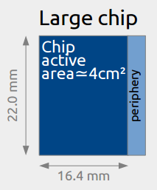
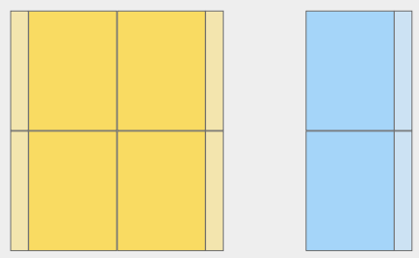
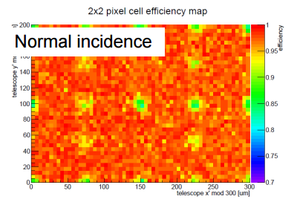
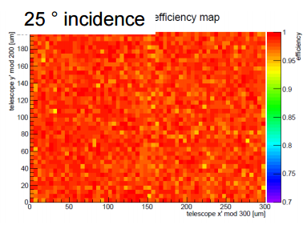
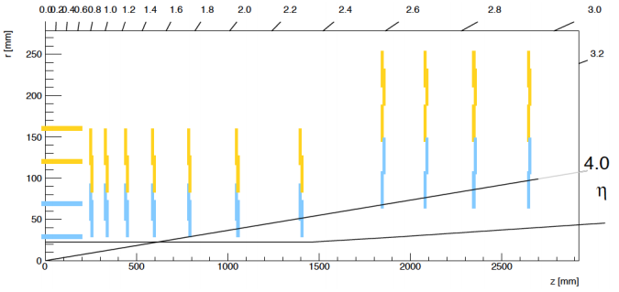
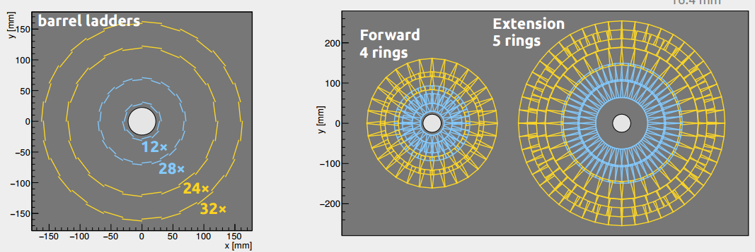
Pixel
Extended tracking up to |η| = 4
barrel and endcap built from planar modules: 1x2 chip and 2x2 chip (reduction of cooling pipes)
higher granularity: pixel dimensions 25x100 μm² or 50x50 μm²
3D chips under consideration/testing
Extraction of pixel detectors preserved during YETS to extract and replace components (especially later close to the beam pipe due to radiation damage)
2x2
1x2
Extension (+ lumi)
Barrel
Forward endcap

Slide 19
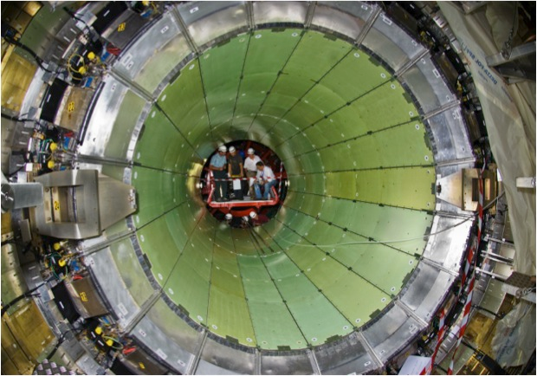
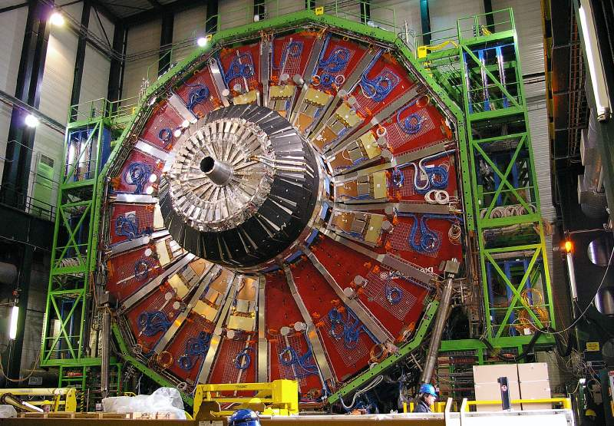
Calorimetry
Needed to replace detectors and electronics for improved L1 trigger readout and to cope with radiation damage
EM barrel: upgrade of electronics
HCAL barrel: upgrade of electronics and plastic scintillator replacement
EM/HCAL endcap: full replacement needed due to radiation damages → HGCAL
EM/HCAL endcap
Higher radiation in endcap w.r.t barrel
BARREL EM

Slide 20
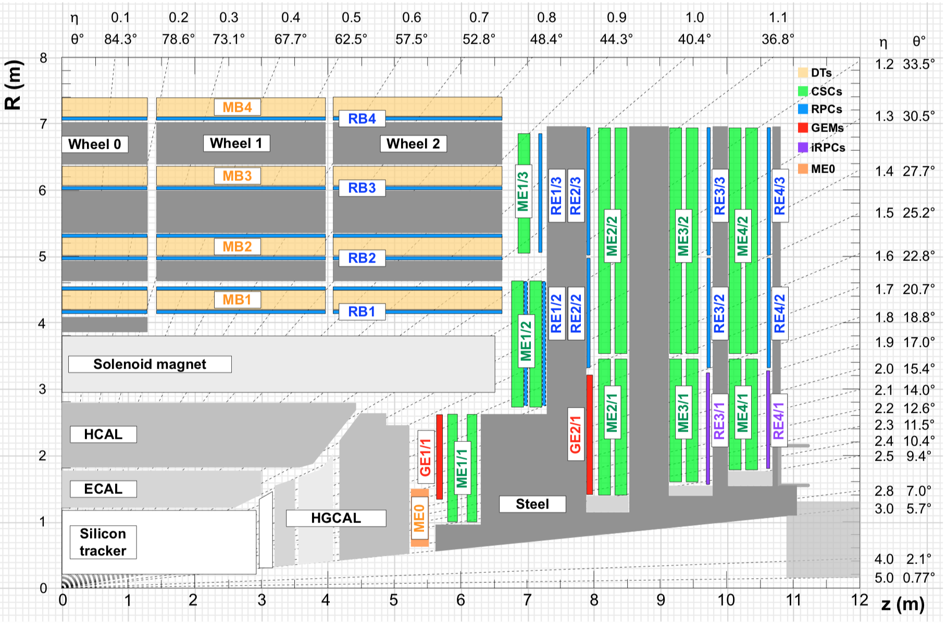
Muon system
L1 triggering and identification up to |η| < 3
No aim to replace existing detectors, but consolidation studies of present system ongoing
longevity studies: detector aging up to 3000 fb⁻¹
high rate capability studies
eco-gas studies (lower greenhouse gas emission)
Upgrade activities
electronics upgrade
new forward detectors with GEMs and improved RPCs
ME0: forward muon tagger up to |η| < 3
ME0
GE1/1
GE2/1
iRPCs

Slide 21
Muon electronics upgrade
DT (Drift Tubes, barrel)
minicrates housed on DT chambers fulfilling trigger, readout, control and link electronics
move large fraction of minicrate functionality outside experimental cavern
new minicrates only containing TDCs, optical links and slow control services
new electronics faster to cope with new L1 rate (now limited up to 300 kHz)
CSC (Cathode Strip Chambers, endcap)
FEBs have limited buffering, resulting in large data loss at 750 kHz
replace FEBs on all chambers with optical data output of 3.2 GBps
trigger/data/readout boards to be replaced
RPC (Resistive Plate Chamber, barrel+endcap)
replacement of the linkboards whose readout is limited to 25 ns

Slide 22
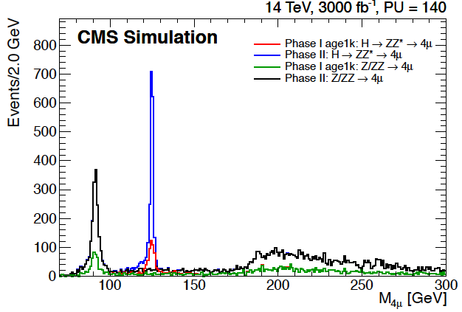
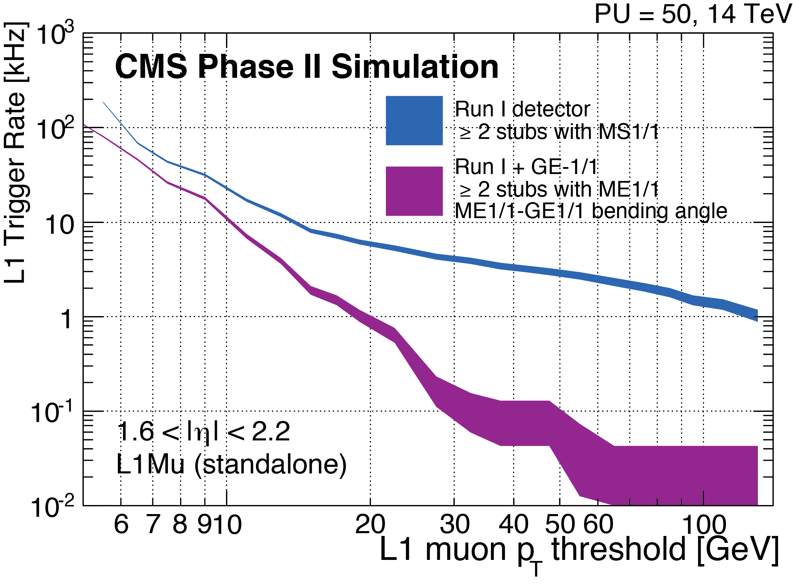
Forward muon system
Forward region
highest rate, yet barely redundancy installed (only CSCs)
improving acceptance up to |η| < 3
new detectors should sustain a hit rate of 2 kHz/cm² → new technologies needed:
GEMs in stations 1 and 2
iRPCs in stations 3 and 4
Include GEMs/iRPCs in L1 trigger
increase trigger efficiency and purity
possible to maintain 15 GeV online threshold on p_{T} at full luminosity

Slide 23
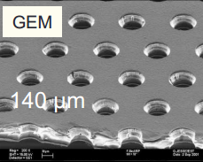
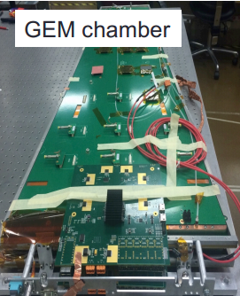
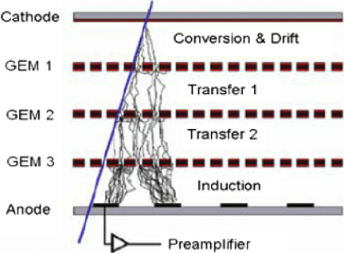
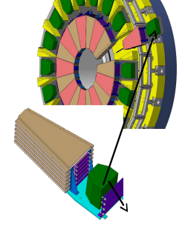
Forward muon system
1) Gas Electron Multiplier (GEM): GE1/1 and GE2/1
GE1/1 installation foreseen during LS2
2x36 triple GEM chambers (10 degree)
production and quality control ongoing at CERN
pilot system of 5 chambers installed in EYETS 2016 for testing, gain installation experience and for inclusion in CMS DAQ
inclusion in L1 trigger
2) Forward muon tagger: ME0
very high rate (large eta, close to IP)
only single coverage (no other redundant station in this region)
6 layers of triple GEMs arranged in 20 degree super-module wedges

Slide 24
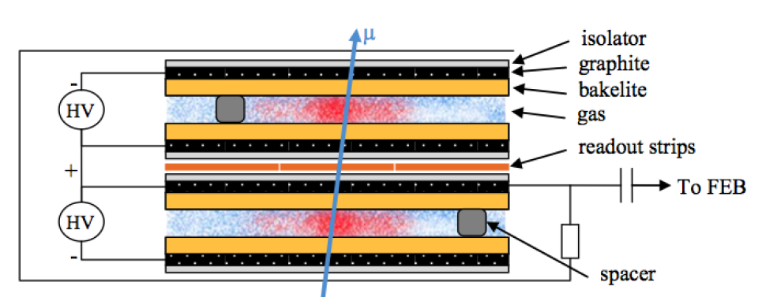
Forward muon system
3) Improved RPCs in RE3/1 and RE4/1
2x2 stations with 72 chambers in each station (same design as present system)
new RPC design needed to sustain high rate up to 2kHz/cm² (present RPCs certified up to 300 Hz/cm²)
bakelite: thinner bakelite and gas gap
glass: lower resistivity, thin, multigap
new electronics
most probable choice: double gap RPC with bakelite and gap thickness of 1.4 mm → promising results with small prototype
large prototypes under construction and testing including new electronics

Slide 25
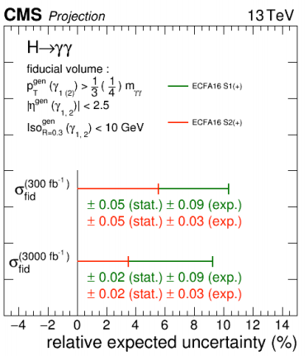
Overview and scope of the upgrade
Importance of physics at TeV scale
testing of SM processes at higher energy scale
search for evidence of new physics (partially) answering open questions
High-Luminosity LHC will deliver one order of magnitude more data, allowing
precision measurements, especially in Higgs sector (couplings)
increase of accuracy: scale down of stat. and syst. uncertainties
search for rare SM/non-SM processes
→ study of reference analysis/scenarios (H→ ZZ, H→γγ , ...) allows prediction of performance at full 3000 fb⁻¹ data collection
Exp = extrapolated syst. uncertainties

Slide 26
https://cds.cern.ch/record/2221747/files/DP2016_064.pdf

Slide 27
http://physikseminar.desy.de/sites2009/site_physikseminar/content/e212/e120413/e156858/e164826/Contardo_slides.pdf
https://cds.cern.ch/record/2221747/files/DP2016_064.pdf

Slide 28
http://physikseminar.desy.de/sites2009/site_physikseminar/content/e212/e120413/e156858/e164826/Contardo_slides.pdf

Slide 29
Plays a central role to probe the non-Abelian gauge structure of the electroweak (EW) interaction
http://physikseminar.desy.de/sites2009/site_physikseminar/content/e212/e120413/e156858/e164826/Contardo_slides.pdf

Slide 30
http://physikseminar.desy.de/sites2009/site_physikseminar/content/e212/e120413/e156858/e164826/Contardo_slides.pdf

Slide 31
https://indico.ifj.edu.pl/indico/event/124/session/10/contribution/13/material/slides/0.pdf

Slide 32
https://indico.ifj.edu.pl/indico/event/124/session/10/contribution/13/material/slides/0.pdf

Slide 33
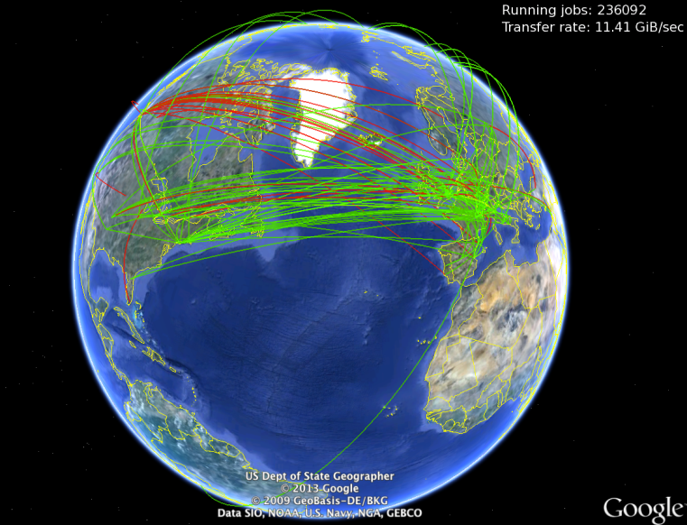
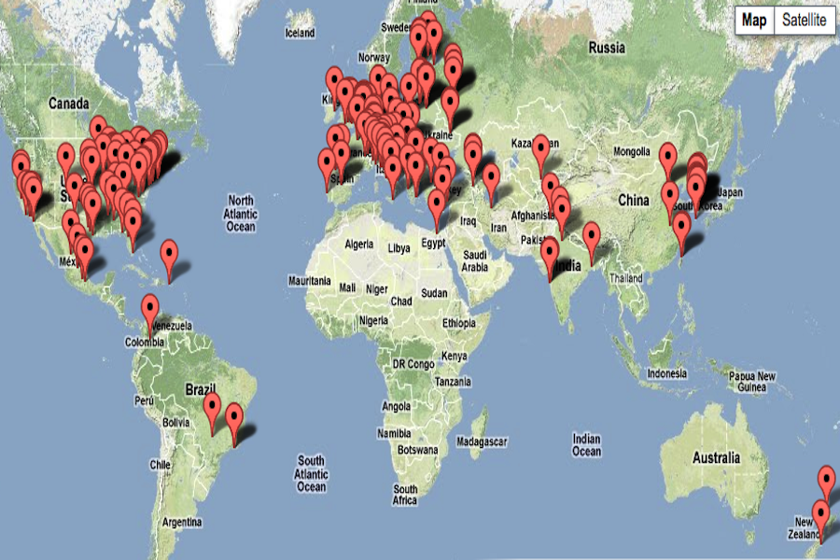
The CMS Collaboration

Slide 34
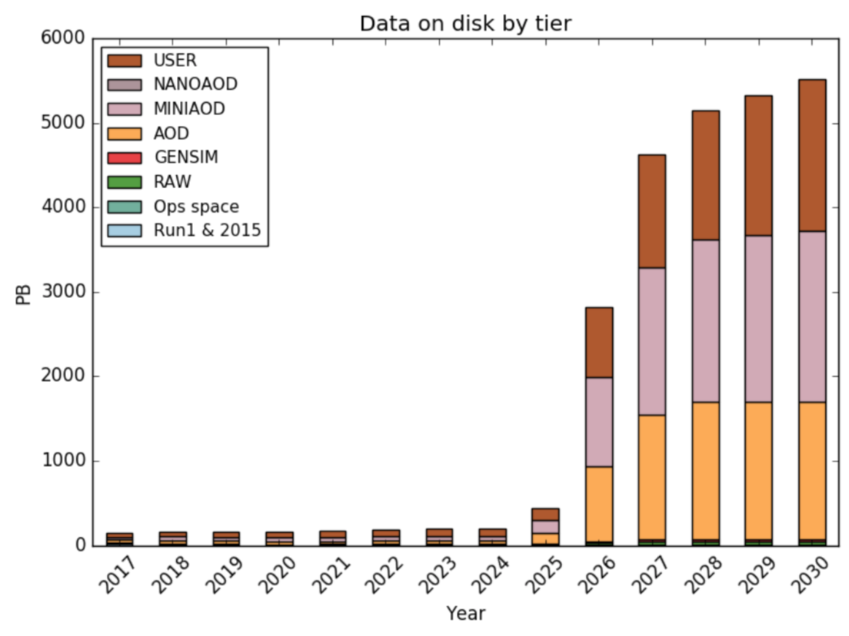
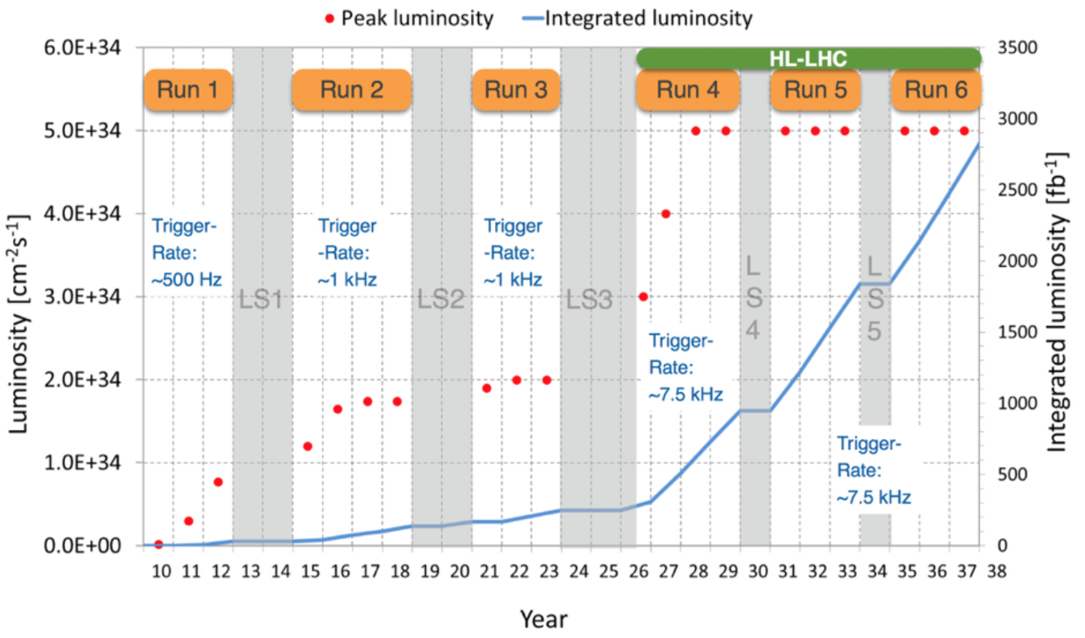
HL-LHC Big-Data Challenge

Slide 35
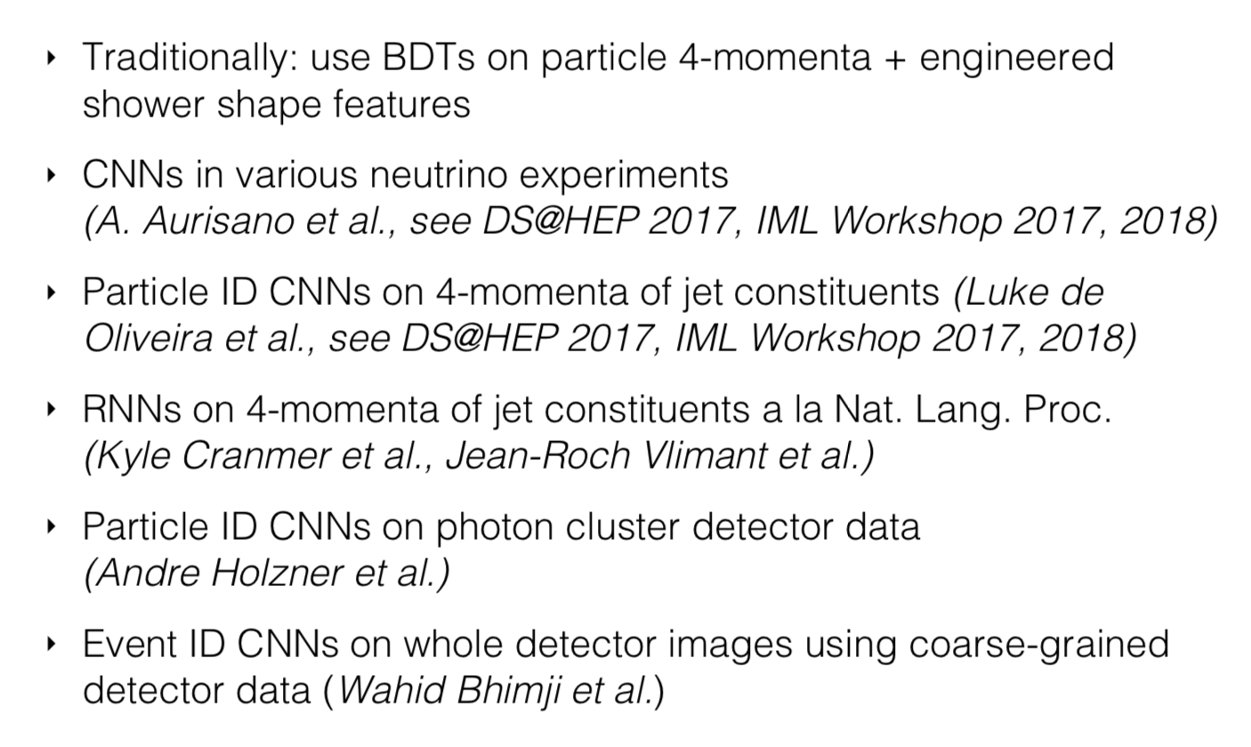
Deep learning applications on High Energy Physics

Slide 36
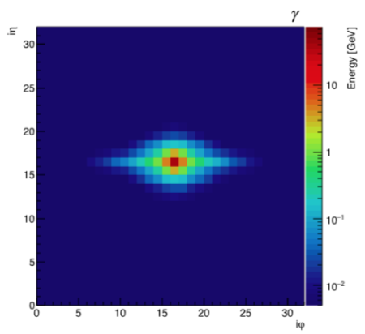
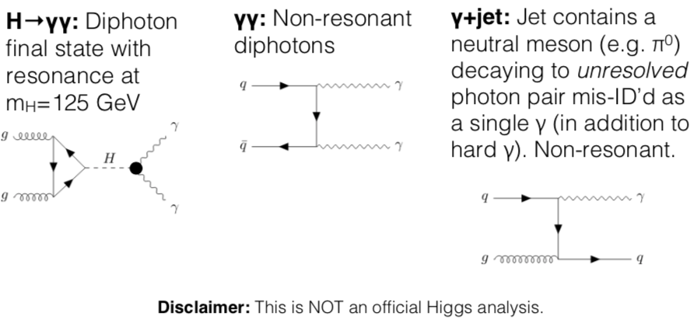
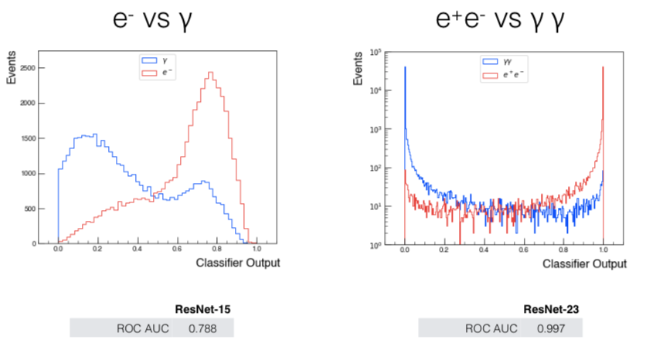
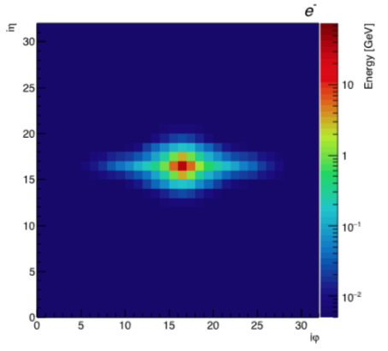
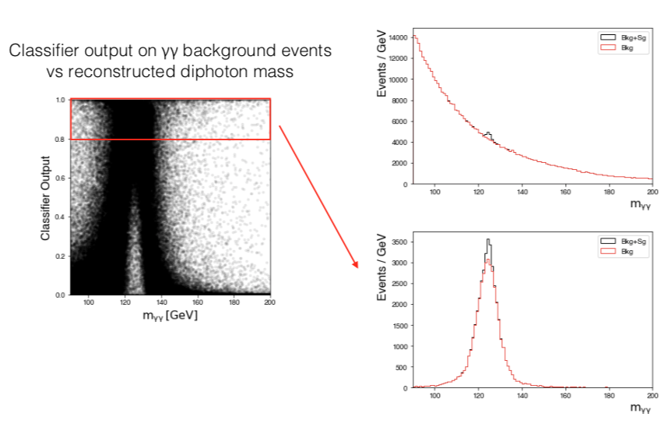
End-to-end for event classification
Deep Learning Applications for Event Classification at CMS

Slide 37
Quality monitoring

Slide 38
Final remarks
New model for resource need projections in use in CMS for short-term and long-term studies and reviews.
Pieces of the structure are still evolving (as more test cases are considered). We hope to reach a releasable codebase this year
HL-LHC and Phase 2 upgrades bring significant challenges: ➢ Need more events, more accuracy, in more complicated geometry w/ relatively smaller fraction of total CPU usage.
CMS is actively pursuing a variety of ML based solutions to push more process towards higher level of automation.

Slide 39
LHC Upgrade Goals: Performance optimization
Luminosity recipe :
1) maximize bunch intensities
2) minimize the beam emittance
3) minimize beam size (constant beam power);
4) maximize number of bunches (beam power);
5) compensate for ‘F’;
6) Improve machine ‘Efficiency’
Injector complex
LIU ⬄ IBS
triplet aperture
25ns
Crab Cavities
minimize number of unscheduled beam aborts

Slide 40
Publications

Slide 41
HL-LHC: Civil Engineering Pt 1 and Pt5 has started

Slide 42
Barrel EM
FE = Front End
Replacement of VFE, FE and OD electronics to cope with L1 requirements, spike removal and pile-up rejection:
full crystal granularity instead of 5x5 trigger primitives
suppression of spikes → improve timing and granularity
increase FE bandwidth from 1 to 10 GB/s
timing very promising up to 30 ps (preliminary)
Radiation damage suppression:
noise (dark current) dominant factor of performance loss
reduce noise due to radiation by lowering temperature
cooling ADPs from 18 to 10-8-5 degC
technical investigations still ongoing
VFE = Very Front End
APD =Avalanche Photo Diodes
Lead Tungsten Crystals

Slide 43
Barrel HCAL
Current HCAL: 17 layers of brass absorber/plastic scintillator/WLS (= wave length shifter)
Suffers from high radiation damage, but understood as formation of color centers in plastic scintillator which attenuates the light
→ proposed solution: replace first (6) layers of scintillator
→ replace electronics to cope with new trigger requirements

Slide 44
Endcap calorimeters - HGCAL
New design of endcap calorimeters = High Granularity cal.
3D shower profile (layered structure)
based on silicon radiation resistant sensors
high granularity
fast timing, order of tens of ps
Design: electromagnetic and hadronic
EE – silicon with tungsten absorber – 28 layers – 25 Xo (~1.3 λ) (-30 degC)
FH – silicon with brass absorber – 12 layers – 3.5 λ (-30 degC)
hexagonal silicon sensors
Remaining hadronic endcap BH: “traditional” plastic scintillator with brass absorber – 11 layers – 5.5 λ (room temp.)

