Slide 1




The Mesoamerican Centre for
Theoretical Physics
Luis F. Rodríguez
General Coordinator of MCTP
October 9, 2018 Puebla

Slide 2

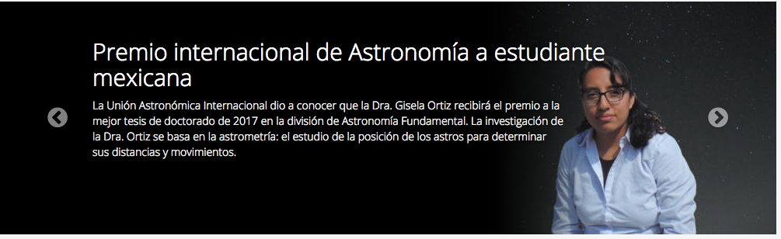
AIM
THE MAIN FOCUS OF MCTP IS
TO OPEN OPPORTUNITIES TO YOUNG RESEARCHERS OF THE MESOAMERICAN REGION FOR SCIENTIFIC GROWTH.

Slide 3
History
2011, December 20, Memorandum of Understanding to create MAIS (MESOAMERICAN INSTITUTE FOR SCIENCE)
2012, August 27, Decree of creation of a prototype: the MESOAMERICAN CENTRE FOR THEORETICAL PHYSICS (MCTP)
2013, June 14, Opening Ceremony of MCTP, Scientific Council Meeting
2015, Approval of UNESCO to convert MCTP into MAIS as Centre Category 2 under the auspices of UNESCO.

Slide 4
Identity of MCTP
Mission of MCTP
To contribute to the development of basic and applied science, particularly in physics, mathematics, energy and environment, in the region of Central America, the Caribbean and Mexico.

Slide 5
Identity of MCTP
Vision
To be the center of education, academic mobility, extension and research in basic and applied sciences that promotes scientific and technological development of high quality and excellence in the region of Central America, the Caribbean and Mexico.

Slide 6
Identity of MCTP
Government Bodies
  Advisory Council
    The Advisory Council is the top advisory body of MCTP. This body analyzes and makes decisive recommendations about the major policies of MCTP.
    The Advisory Council is chaired by the President of UNACH and the Director of ICTP.

Slide 7
Identity of MCTP
Government Bodies
  Scientific Council
  The Scientific Council of MCTP is a body of opinion and evaluation in scientific – academic issues. It consists of a body of 10 internationally recognized scientists, in which scientists from the region of Central America, the Caribbean and Mexico are included .
  The current president of the Scientific Council is Sheldon Glashow.

Slide 8
Programs of MCTP
MCTP Programs
  Schools and Conferences
  Associates researchers
  Visiting Scientists
  Postdoctoral stays
  Mexican laboratories

Slide 9
Schools and Conferences Program
The MCTP program of Schools and Scientific Conferences is planned according to the details of the proposals received at MCTP and subject to the amount granted by Conacyt . It includes also other activities organized with the financial support of ICTP and with additional support granted by other agencies such as APS and IOP.
This program includes the four research areas of the Centre: Energy, Physics, Mathematics and Environment.

Slide 10
Schools and Conferences Program
MCTP is able to finance local and travel expenses for some lecturers and for some participants from Mesoamerican countries.
Proposals should be discussed by the Scientific Council after the organizers submit their proposal using the online application form.

Slide 11
Schools and Conferences Program
Attendance statistics 2014
 | Mexico | Usa | France | Brazil | Guatemala | Panamá | Costa Rica | Colombia | Bolivia | Honduras | El Salvador | Nicaragua | Venezuela | Peru | Cuba | Argentina | Spain | Germany | United Kingdom | Bulgary | Italy | TOTAL
X International Symposium on Radiation Physics | 30 | 2 |  |  |  |  |  |  |  |  |  |  | 1 |  |  | 1 |  | 1 |  | 1 | 1 | 37
ICTP-ICO-MCTP College on Optics and Energy | 26 | 3 |  |  | 1 |  |  | 2 | 1 |  | 5 |  | 1 |  | 1 |  | 2 |  |  |  | 1 | 43
Professional Skills Workshop for Young Scientific | 32 |  |  |  | 1 |  |  | 3 |  | 1 |  |  |  |  | 2 |  |  |  |  |  |  | 39
Introduction to Modern Cosmology | 26 |  |  |  | 1 |  |  | 1 |  | 2 | 4 |  | 3 |  |  |  |  |  | 1 |  |  | 38
TOTAL | 114 | 5 | 0 | 0 | 3 | 0 | 0 | 6 | 1 | 3 | 9 | 0 | 5 | 0 | 3 | 1 | 2 | 1 | 1 | 1 | 2 | 157

Slide 12
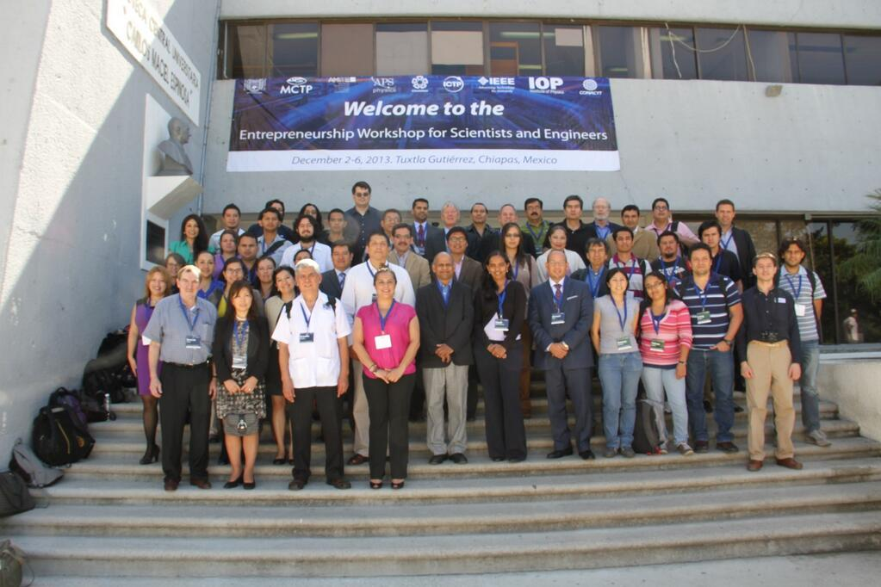
Schools and Conferences Program
Entrepreneurship Workshop for Scientists and Engineers 2013 (december 2013)

Slide 13
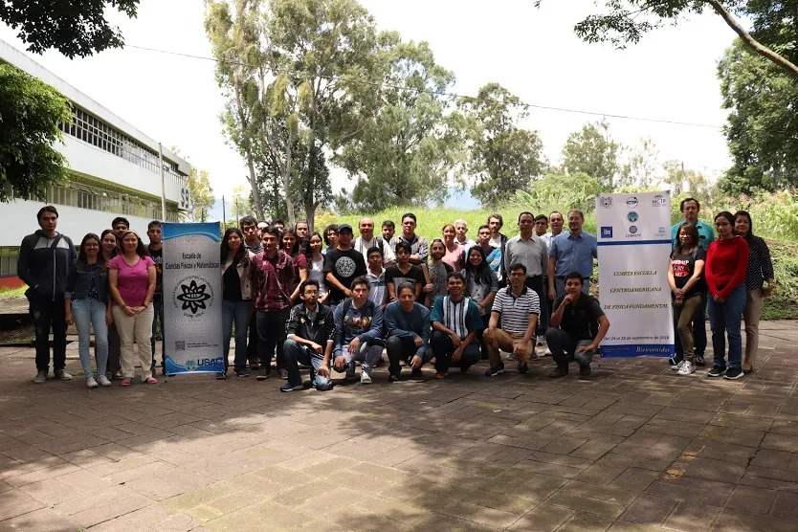
IV ESCUELA CENTROAMERICANA DE FISICA FUNDAMENTAL
Guatemala, Septiembre de 2018

Slide 14
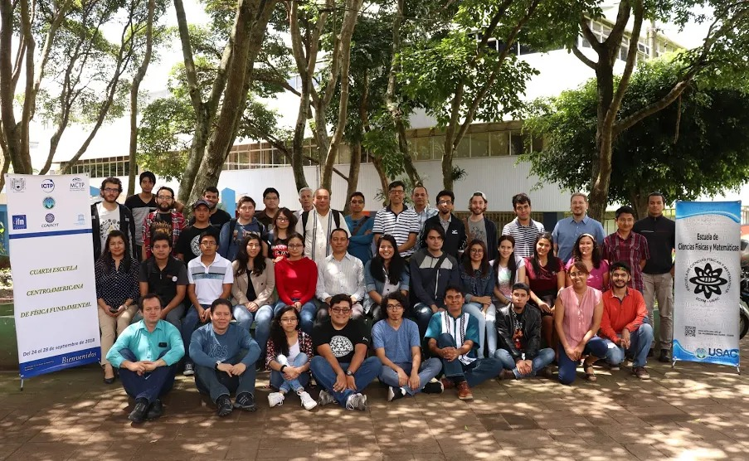
IV ESCUELA CENTROAMERICANA DE FISICA FUNDAMENTAL

Slide 15
Participantes
Un total de 45 participantes
25 guatemaltecos
6 hondureños
6 mexicanos
3 salvadoreños
2 ecuatorianos
1 costarricense

Slide 16
Programa

Slide 17
Education
  Propedeutic courses in Physics
    The purpose of these courses is to improve and level the academic preparation of students in Mesoamerica interested in applying to graduate programs in Physics.
    Courses:
      Mathematical Methods
      Electromagnetism
      Thermodynamics
      Classical Mechanics

Slide 18
ICTP – MAIS: A UNESCO Institute Category 2

Slide 19
ICTP – MAIS
In 2014 the Autonomous University of Chiapas begun the process to obtain the recognition for the MCTP as a Research Center Category II sponsored by UNESCO
The feasibility study instructed by Mrs. Irina Bokova, General Director of UNESCO, showed that the proposal is fully viable.
The Secretariat of the Executive Council submitted for consideration of the 38 session of the General Assembly in November 2015 the recommendation that the proposal of Mexico is approved. The General Assembly approved it.
In order to accompany academically this process, the following activity was organized: Regional Seminar UNACH-ICTP-UNESCO Science for Development.
The process of transforming MCTP into MAIS is underway.

Slide 20
Conclusions
MCTP doing well. Just received COCITECH distinction to best scientific institution.
MCTP will shortly become MAIS, a UNESCO category 2 center.
MAIS will need a long term budget for its yearly planning.
THANK YOU FOR YOUR ATTENTION.

