Slide 1
pwv_kpno: A Python Package for Modeling PWV transmission using SuomiNet GPS
Daniel Perrefort
University of Pittsburgh
DESC Photometric Calibration
2018/10/04

Slide 2
Project Goal
“Use dual band GPS measurements of localized PWV to simulate the atmospheric absorption due to H₂O as a function of date and time.”
Project deliverable must also be:
Easily extensible to user definable locations
Intuitive and simple to use
Conducive to a collaborative effort

Slide 3
Dual Band GPS
Dual band signals pick up phase shift
  Clock shift
  Doppler effect
  Atmospheric contribution
Zenith Total Delay (ZTD)
  Zenith Hydrostatic Delay (ZHD)
  Zenith Wet Delay (ZWD)
PWV = Q(T) * ZWD
Frequency Independent

Slide 4
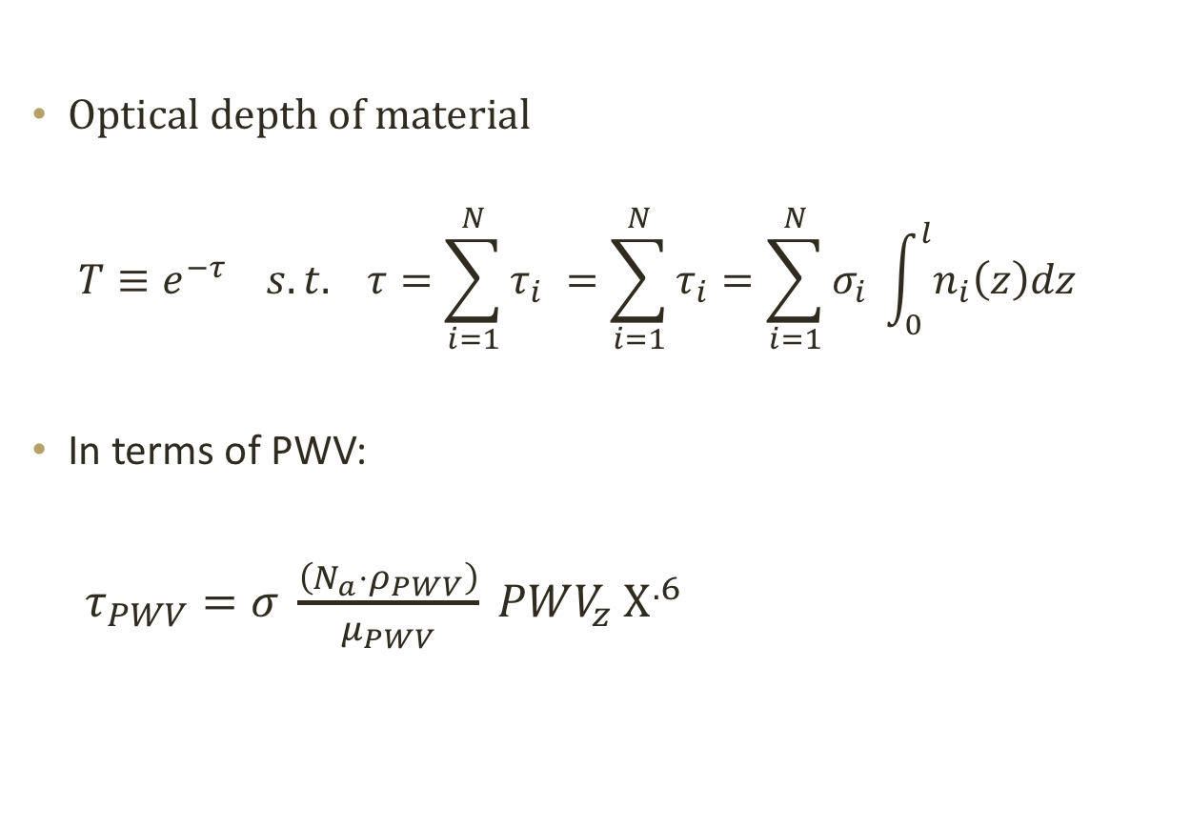
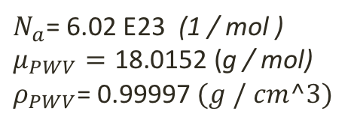
Calculating Transmission
Optical depth of material
$$T≡e^{−τ} s.t. τ=\sum_{i=1}^{N}{τ_{i}} =\sum_{i=1}^{N}{τ_{i}}=\sum_{i=1}^{N}{σ_{i} \int_{0}^{l}{n_{i}\left(z\right)dz} }$$
In terms of PWV:
$τ_{PWV}=σ \frac{\left(N_{a}⋅ρ_{PWV}\right)}{μ_{PWV}} PWV_{z} Χ^{.6}$
$$N_{a}\text{= 6.02 }\text{E}\text{23}\text{ (}\text{1 / }\text{mol}\text{ )}$$
$$μ_{PWV}=\text{18.0152}\text{ (}\text{g}\text{ / }\text{mol}\text{)} \\ ρ_{PWV}\text{= 0.99997} (g / cm^3)$$

Slide 5
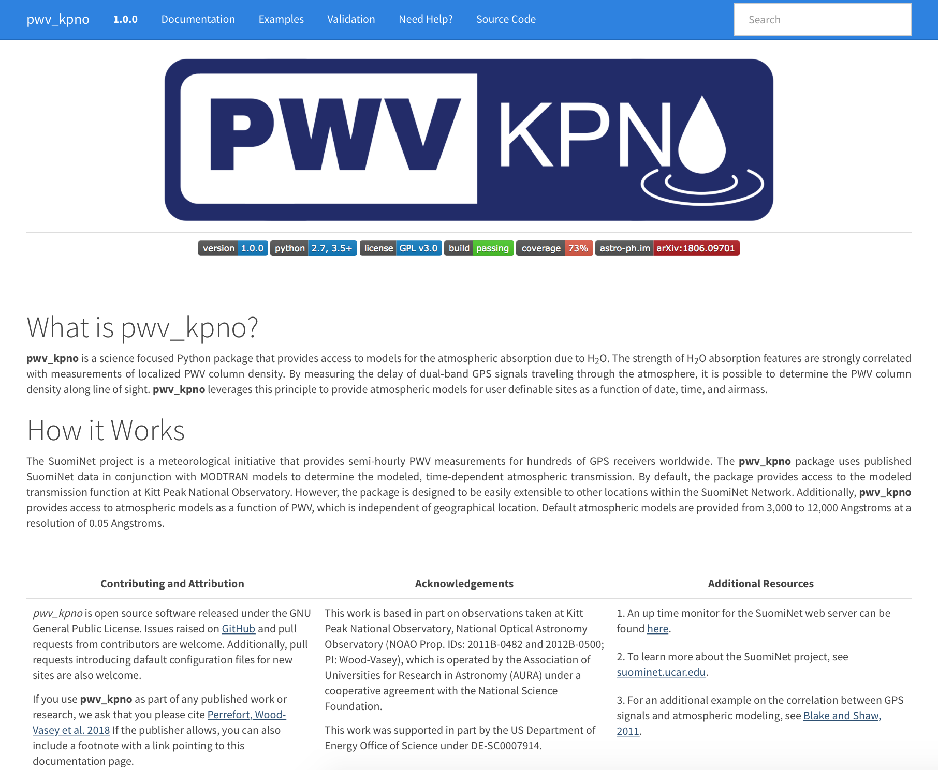
https://mwvgroup.github.io/pwv_kpno/

Slide 6
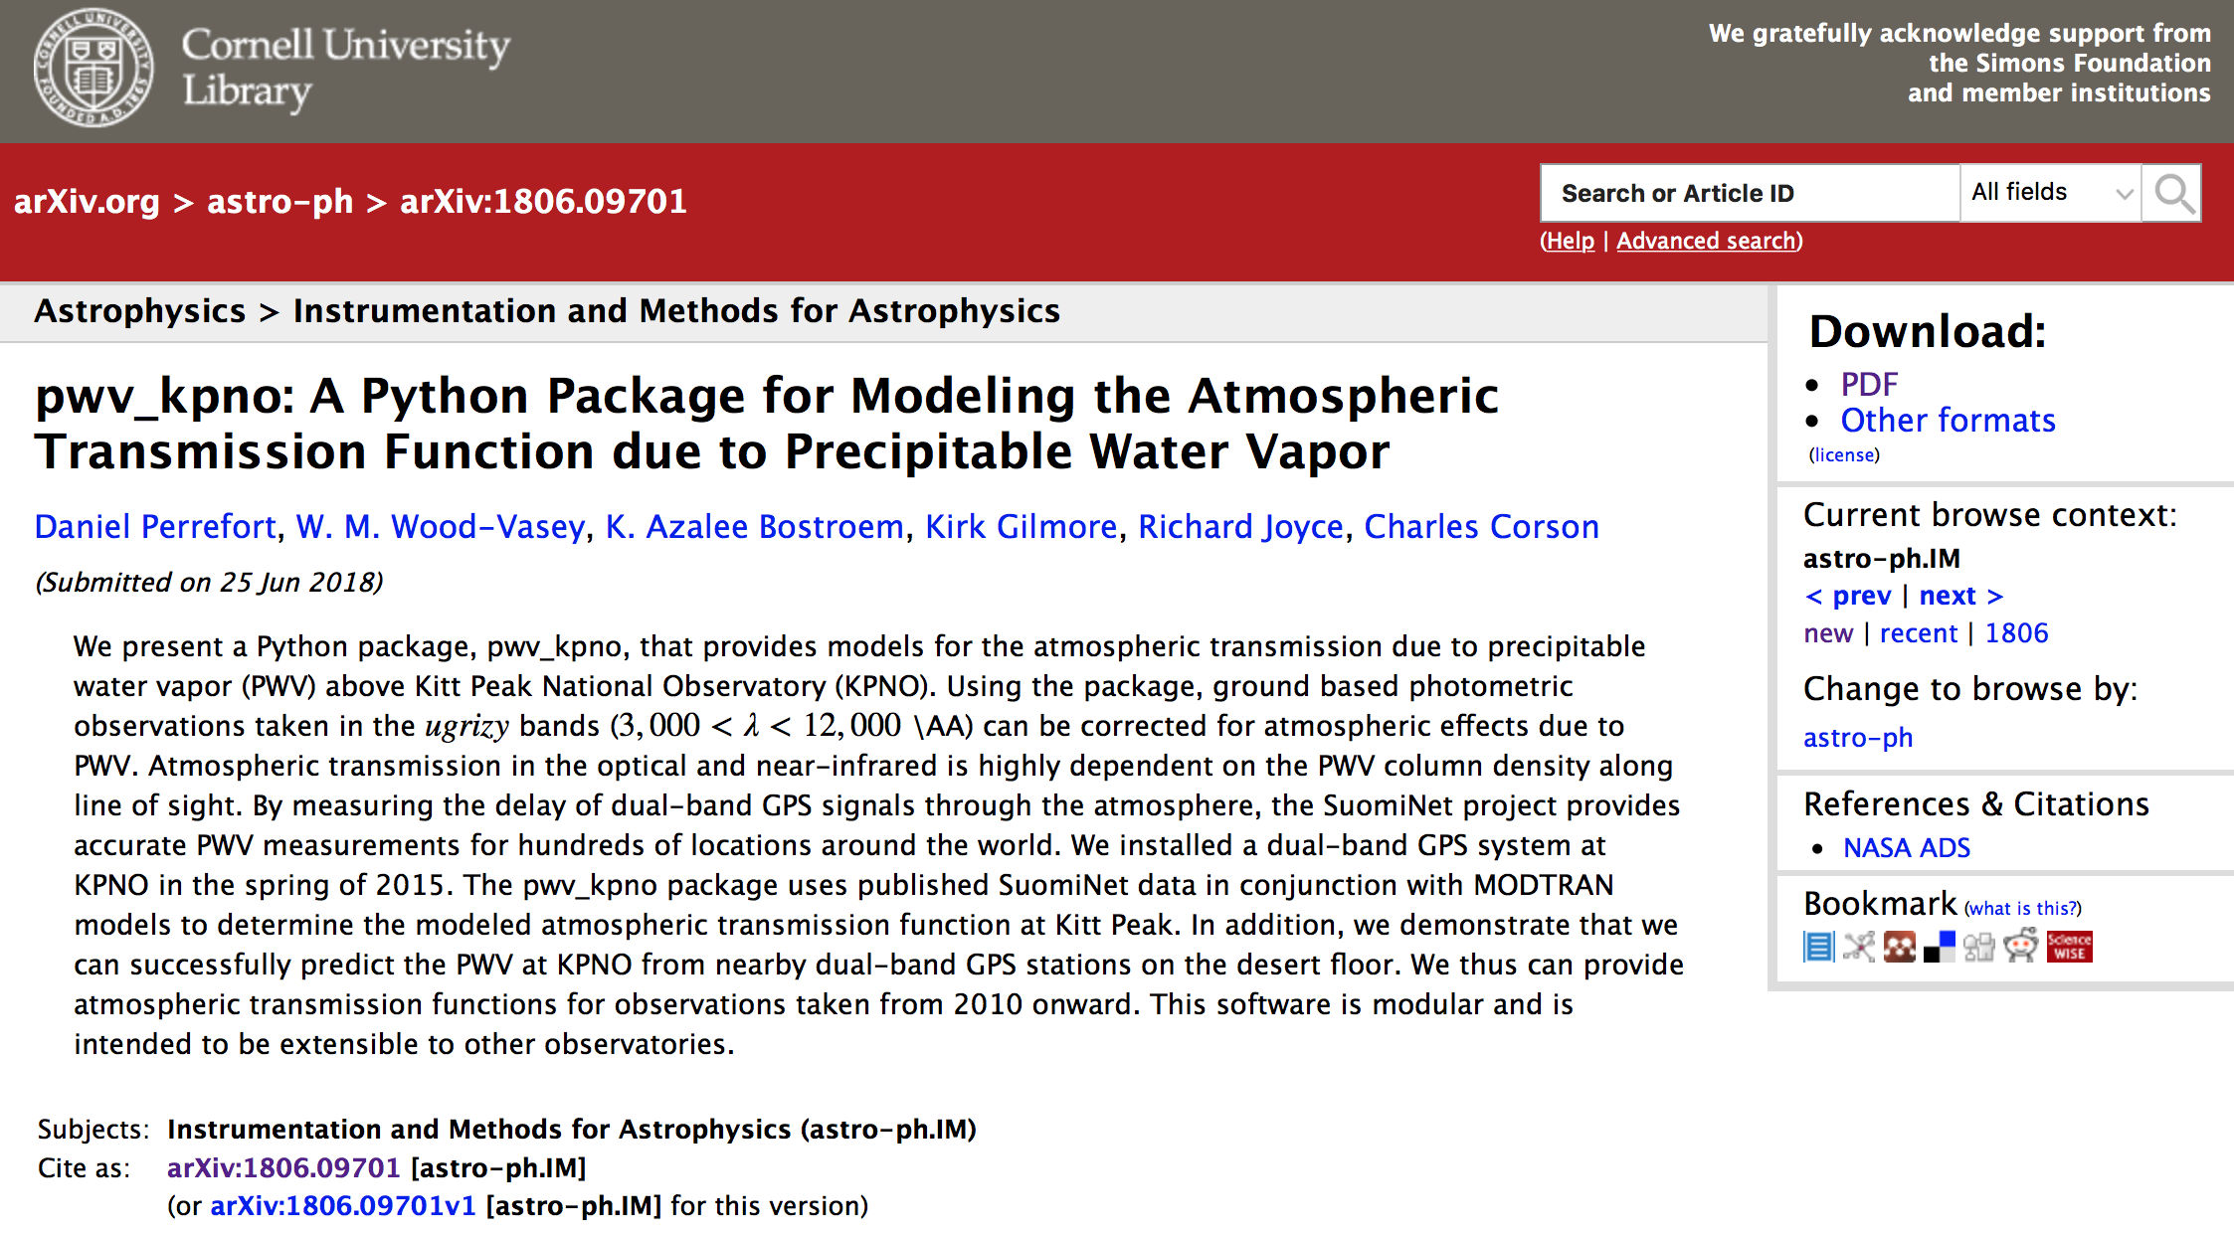

Slide 7
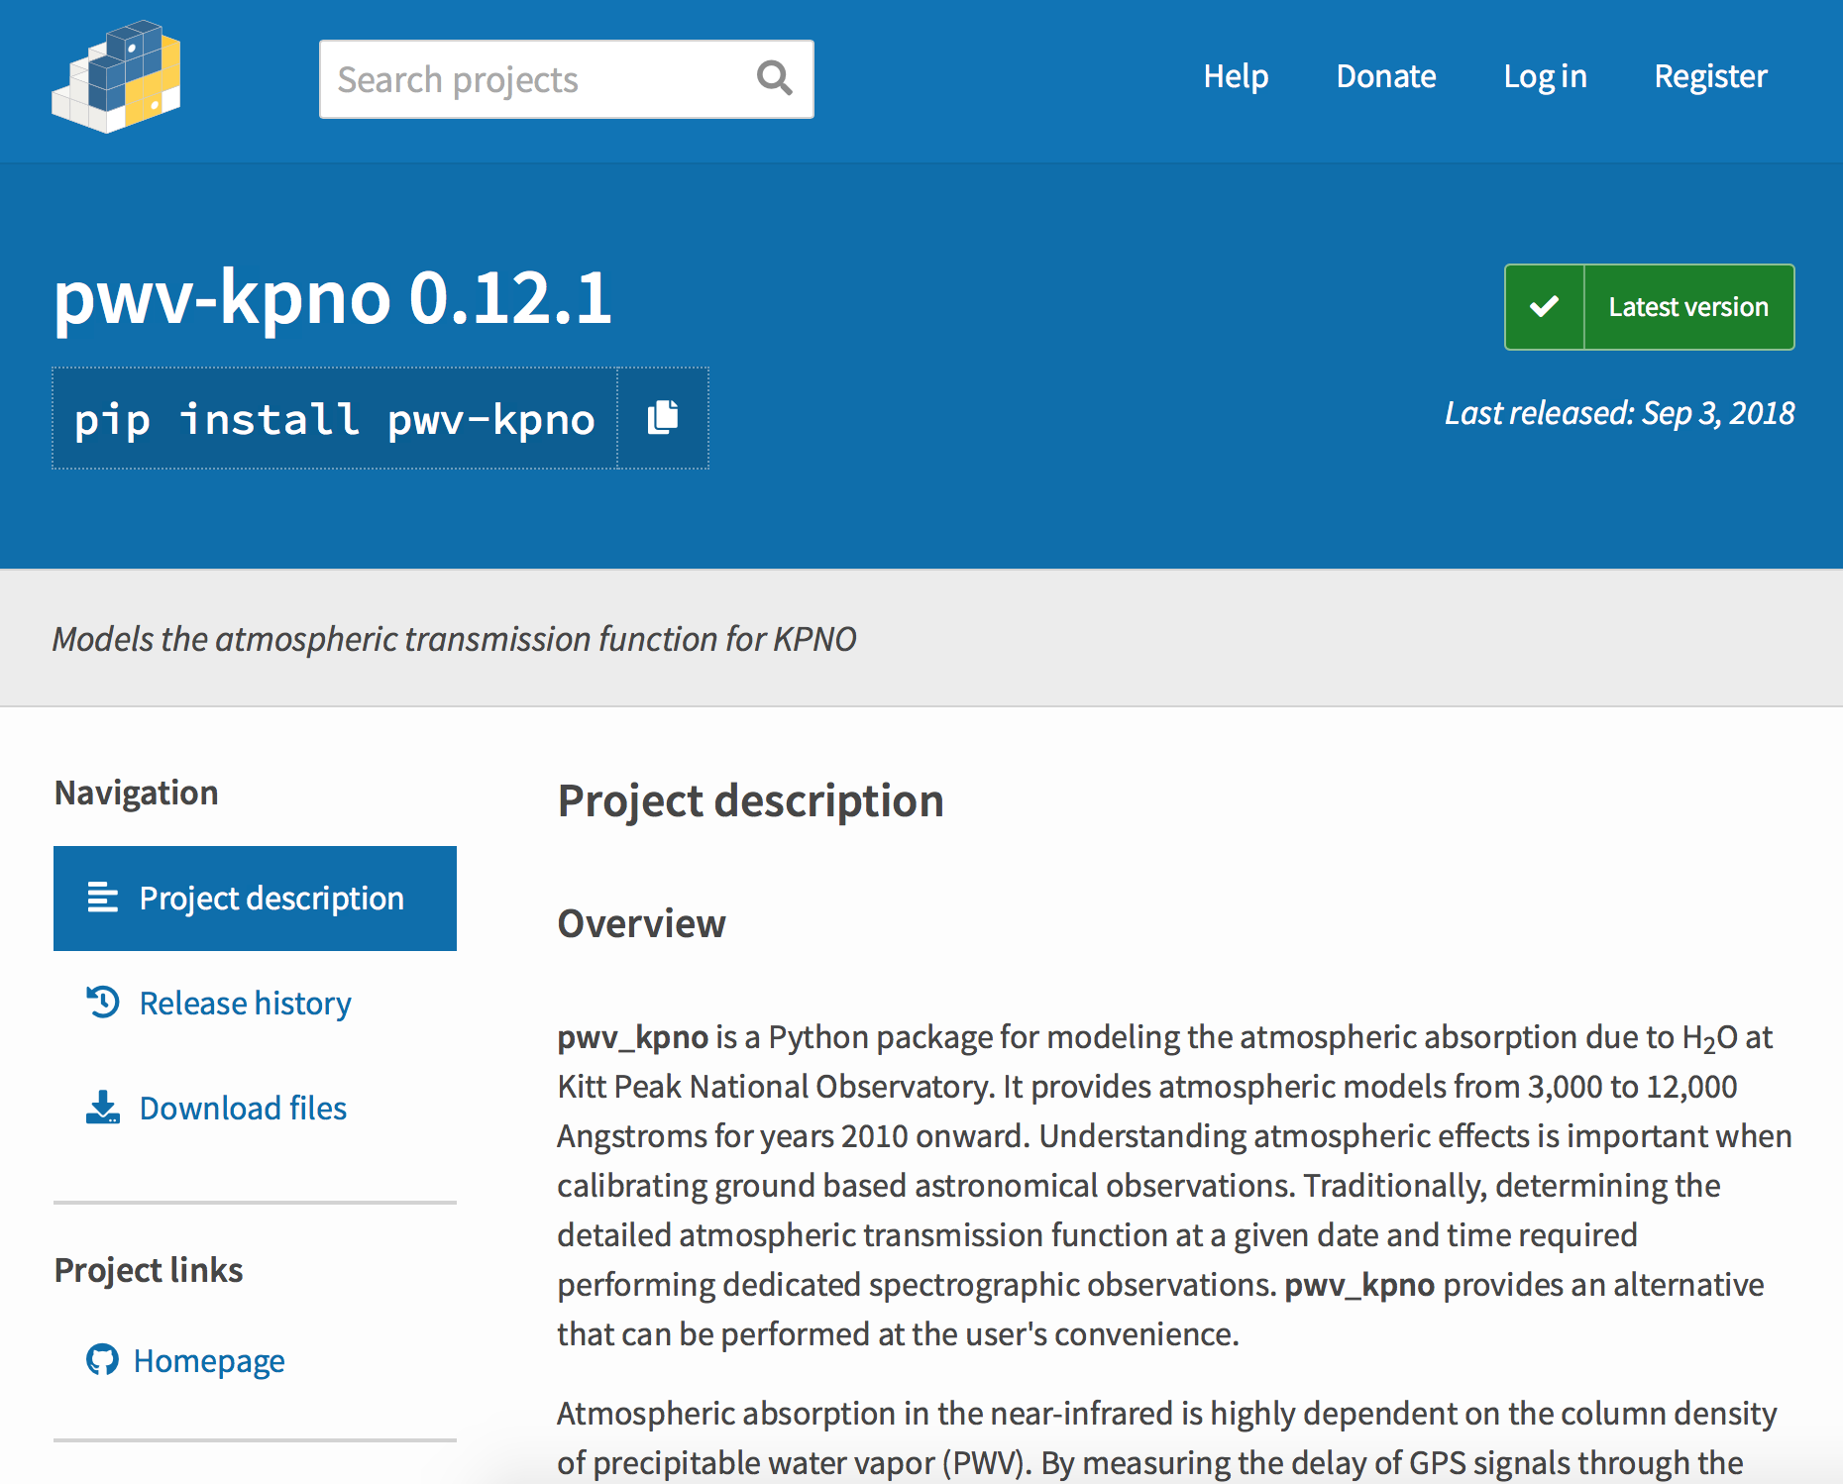

Slide 8
Package Features
Automatic download and parsing of new SuomiNet Data
Access to full set of (downloaded) SuomiNet data
PWV transmission model for given date, time, and airmass
  3,000 to 12,000 Å at 0.5 Å resolution
PWV transmission model for given PWV
Transmission models can be easily binned
Guided process for extending to user defined sites
Sharable config files for each site
Black body spectral energy distribution with atmospheric features
Full, online documentation, examples, and validation overview

Slide 9
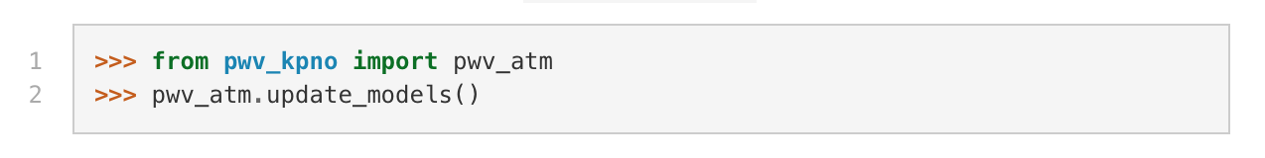
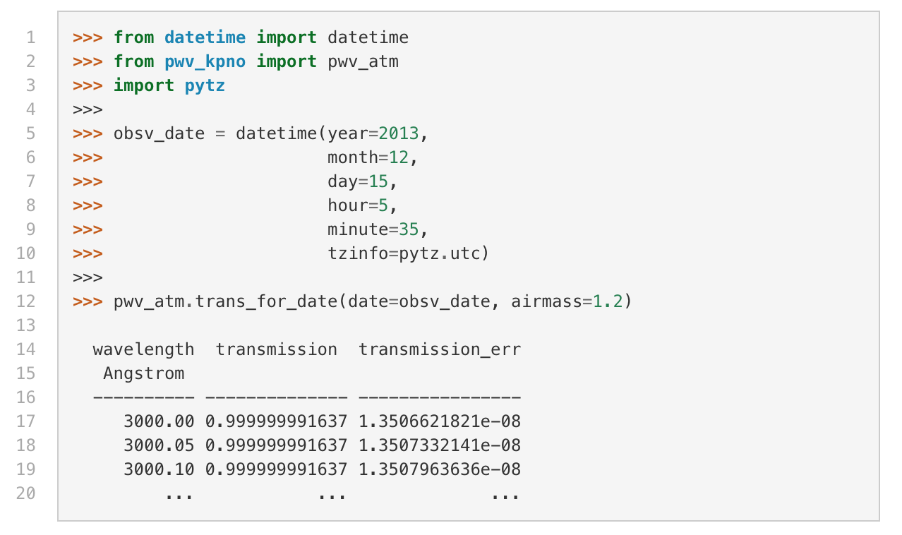
Download Data from SuomiNet:
Model the Atmosphere:

Slide 10
From install to transmission function in minutes.
So how does it work?
And how well?
Notes:
The r, i and z band mosaic filters of Kitt Peak National Observatory (grey) compared against the MODTRAN modeled atmospheric transmission function due to precipitable water vapor (blue).
1mm, 15mm, 30mm PWV

Slide 11
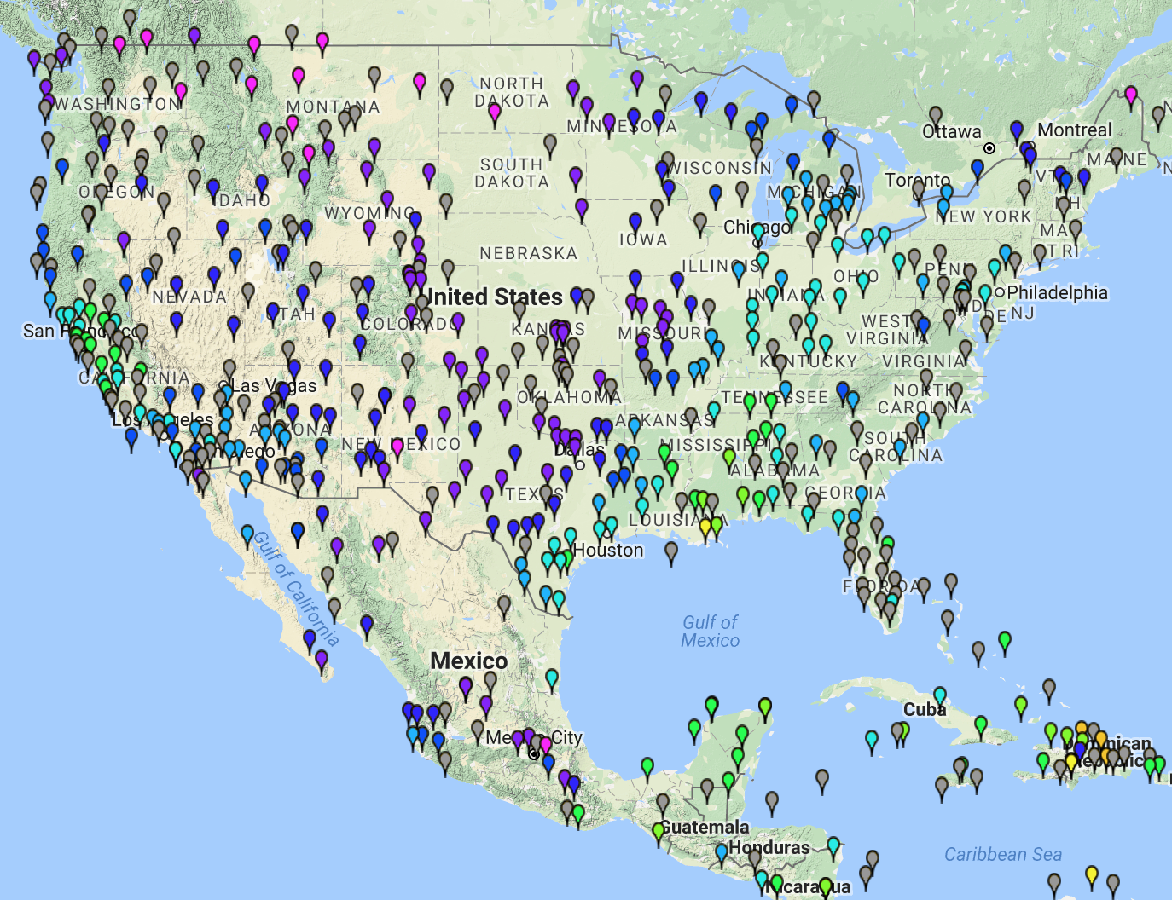
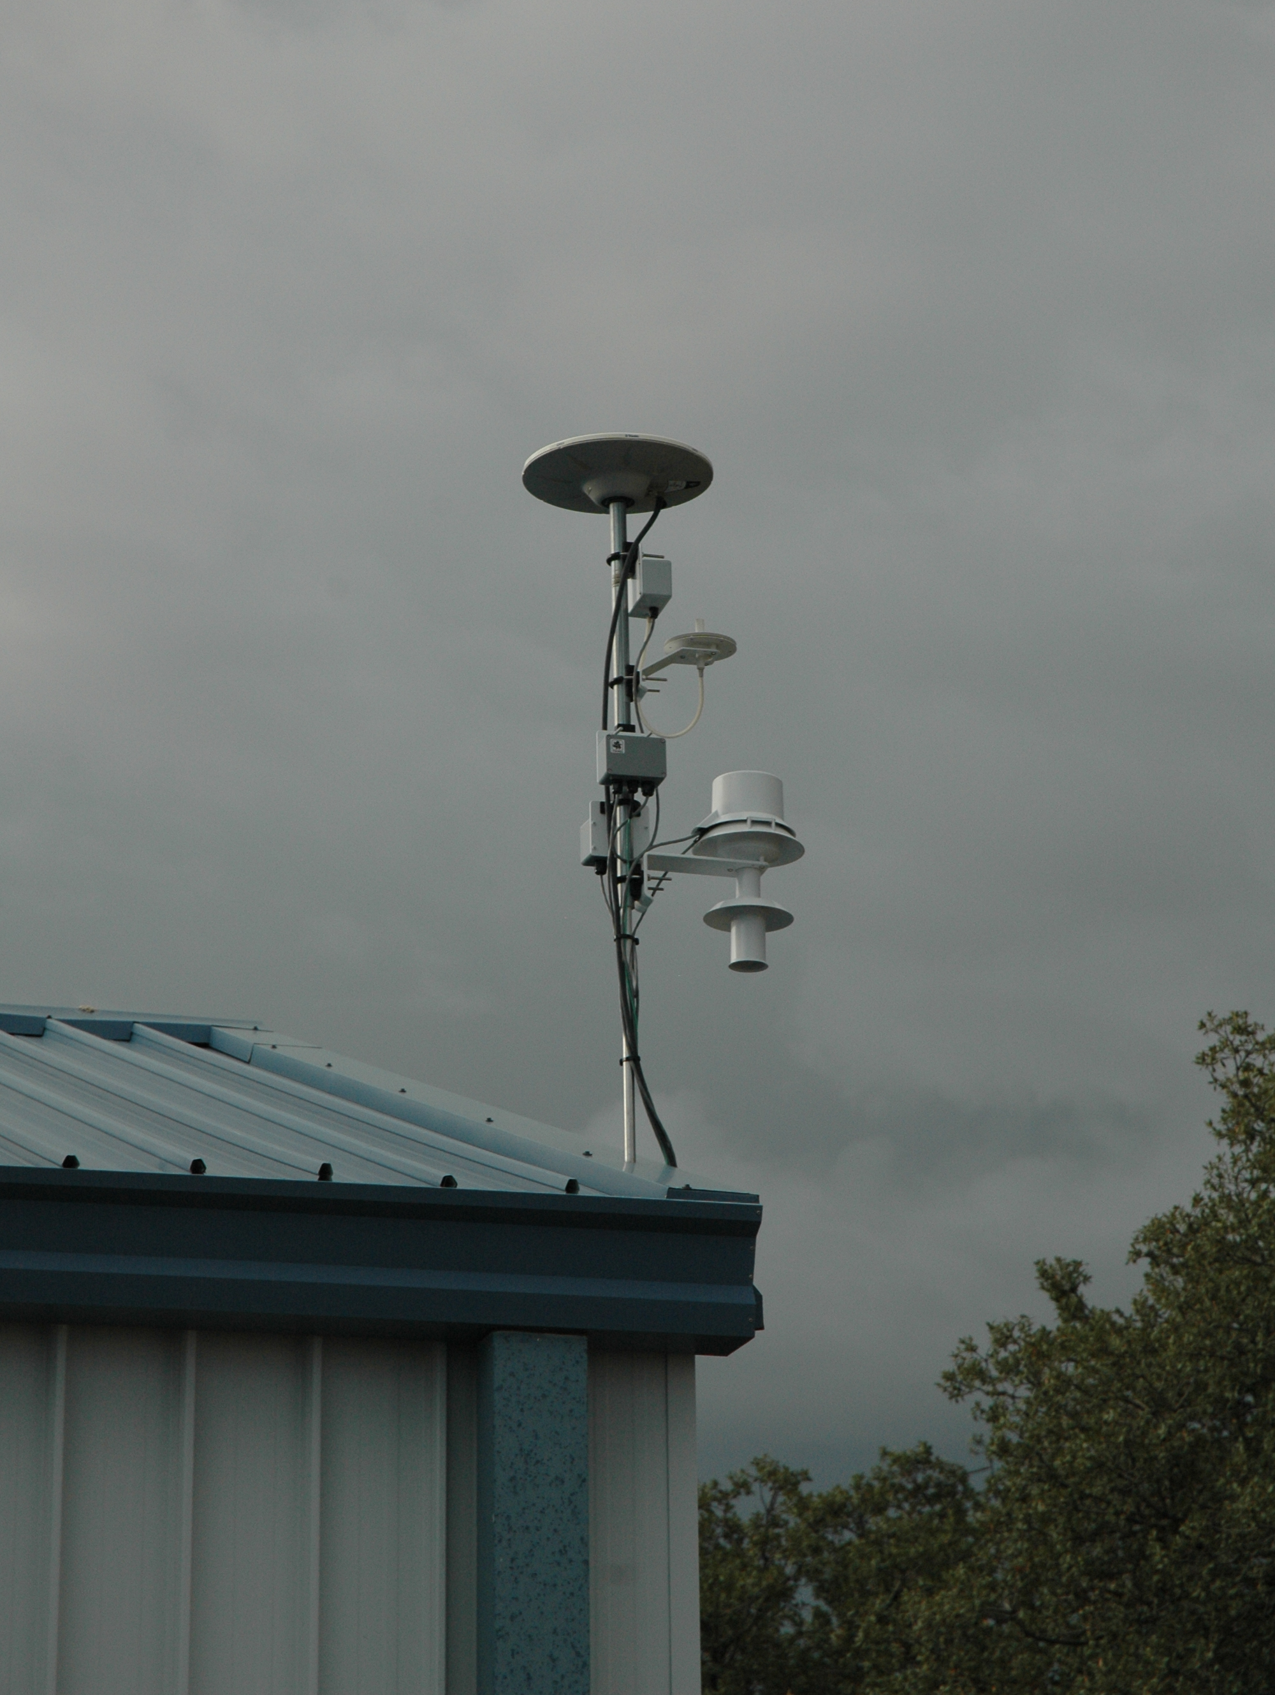

Slide 12
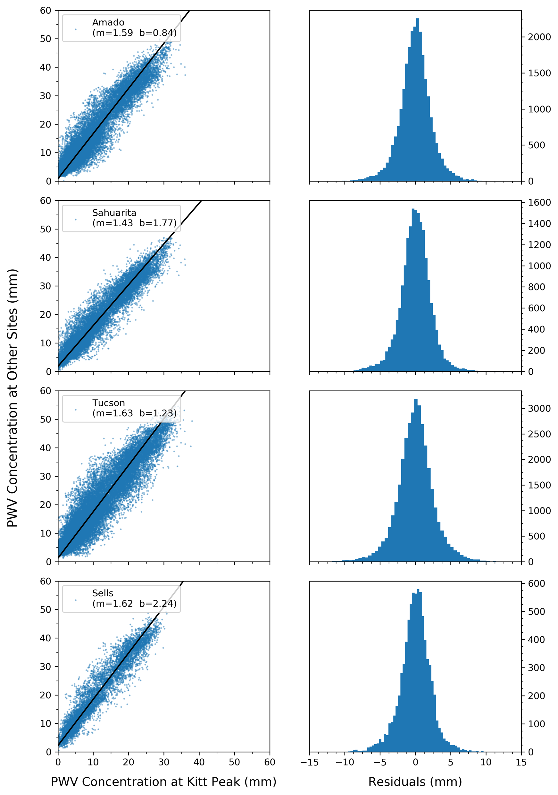
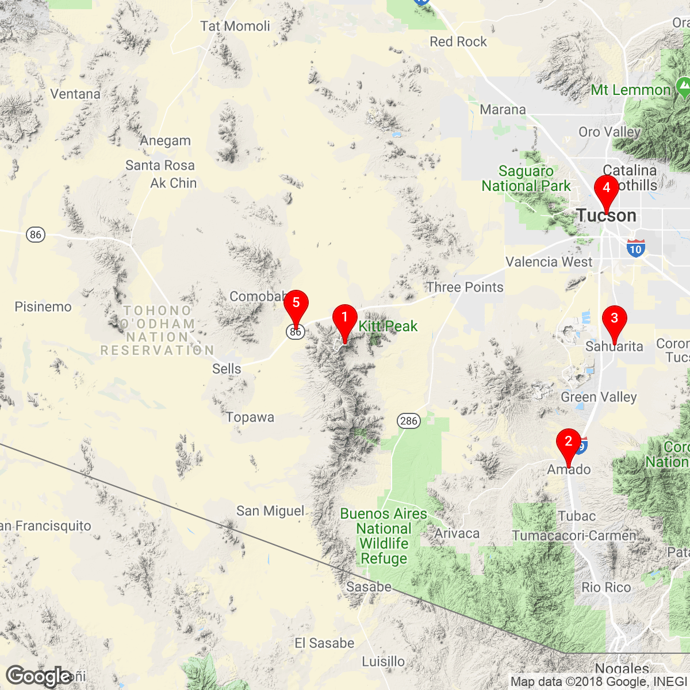
Kitt Peak National Observatory (KITT)
Amado Arizona (AZAM)
Sahuarita Arizona (P014)
University of Arizona (SA46)
Tohono O'odham Community College (SA48)

Slide 13
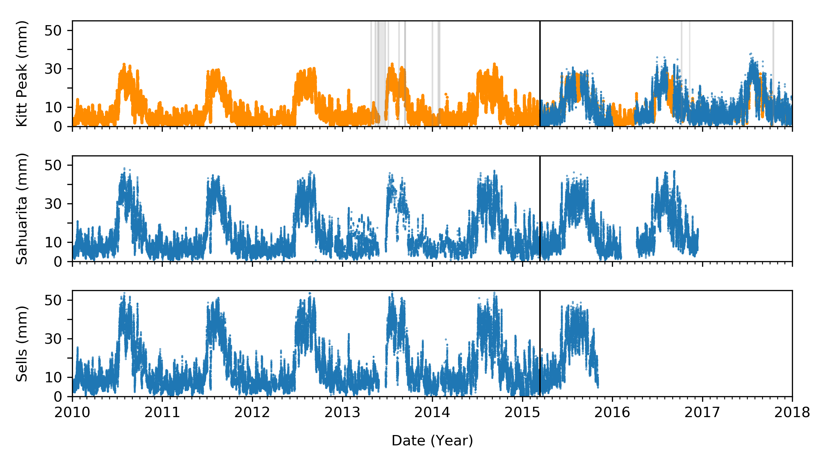
Atmospheric Models for each site are averaged together
Users can include as many or as few supplementary sites as desired
No modeling for data gaps of 1 day or longer

Slide 14
SuomiNet Data Isn’t Perfect
Rounding Error in public data
  Add 0.025 to all reported errors
Unidentified error increase in 2013
Duplicate data records (uncommon)
  Isolated to specific instance
  Ignore disagreements, keep agreements
Hourly data for Conus, but daily for international
Subject to PWV spikes for hardware malfunctions

Slide 15
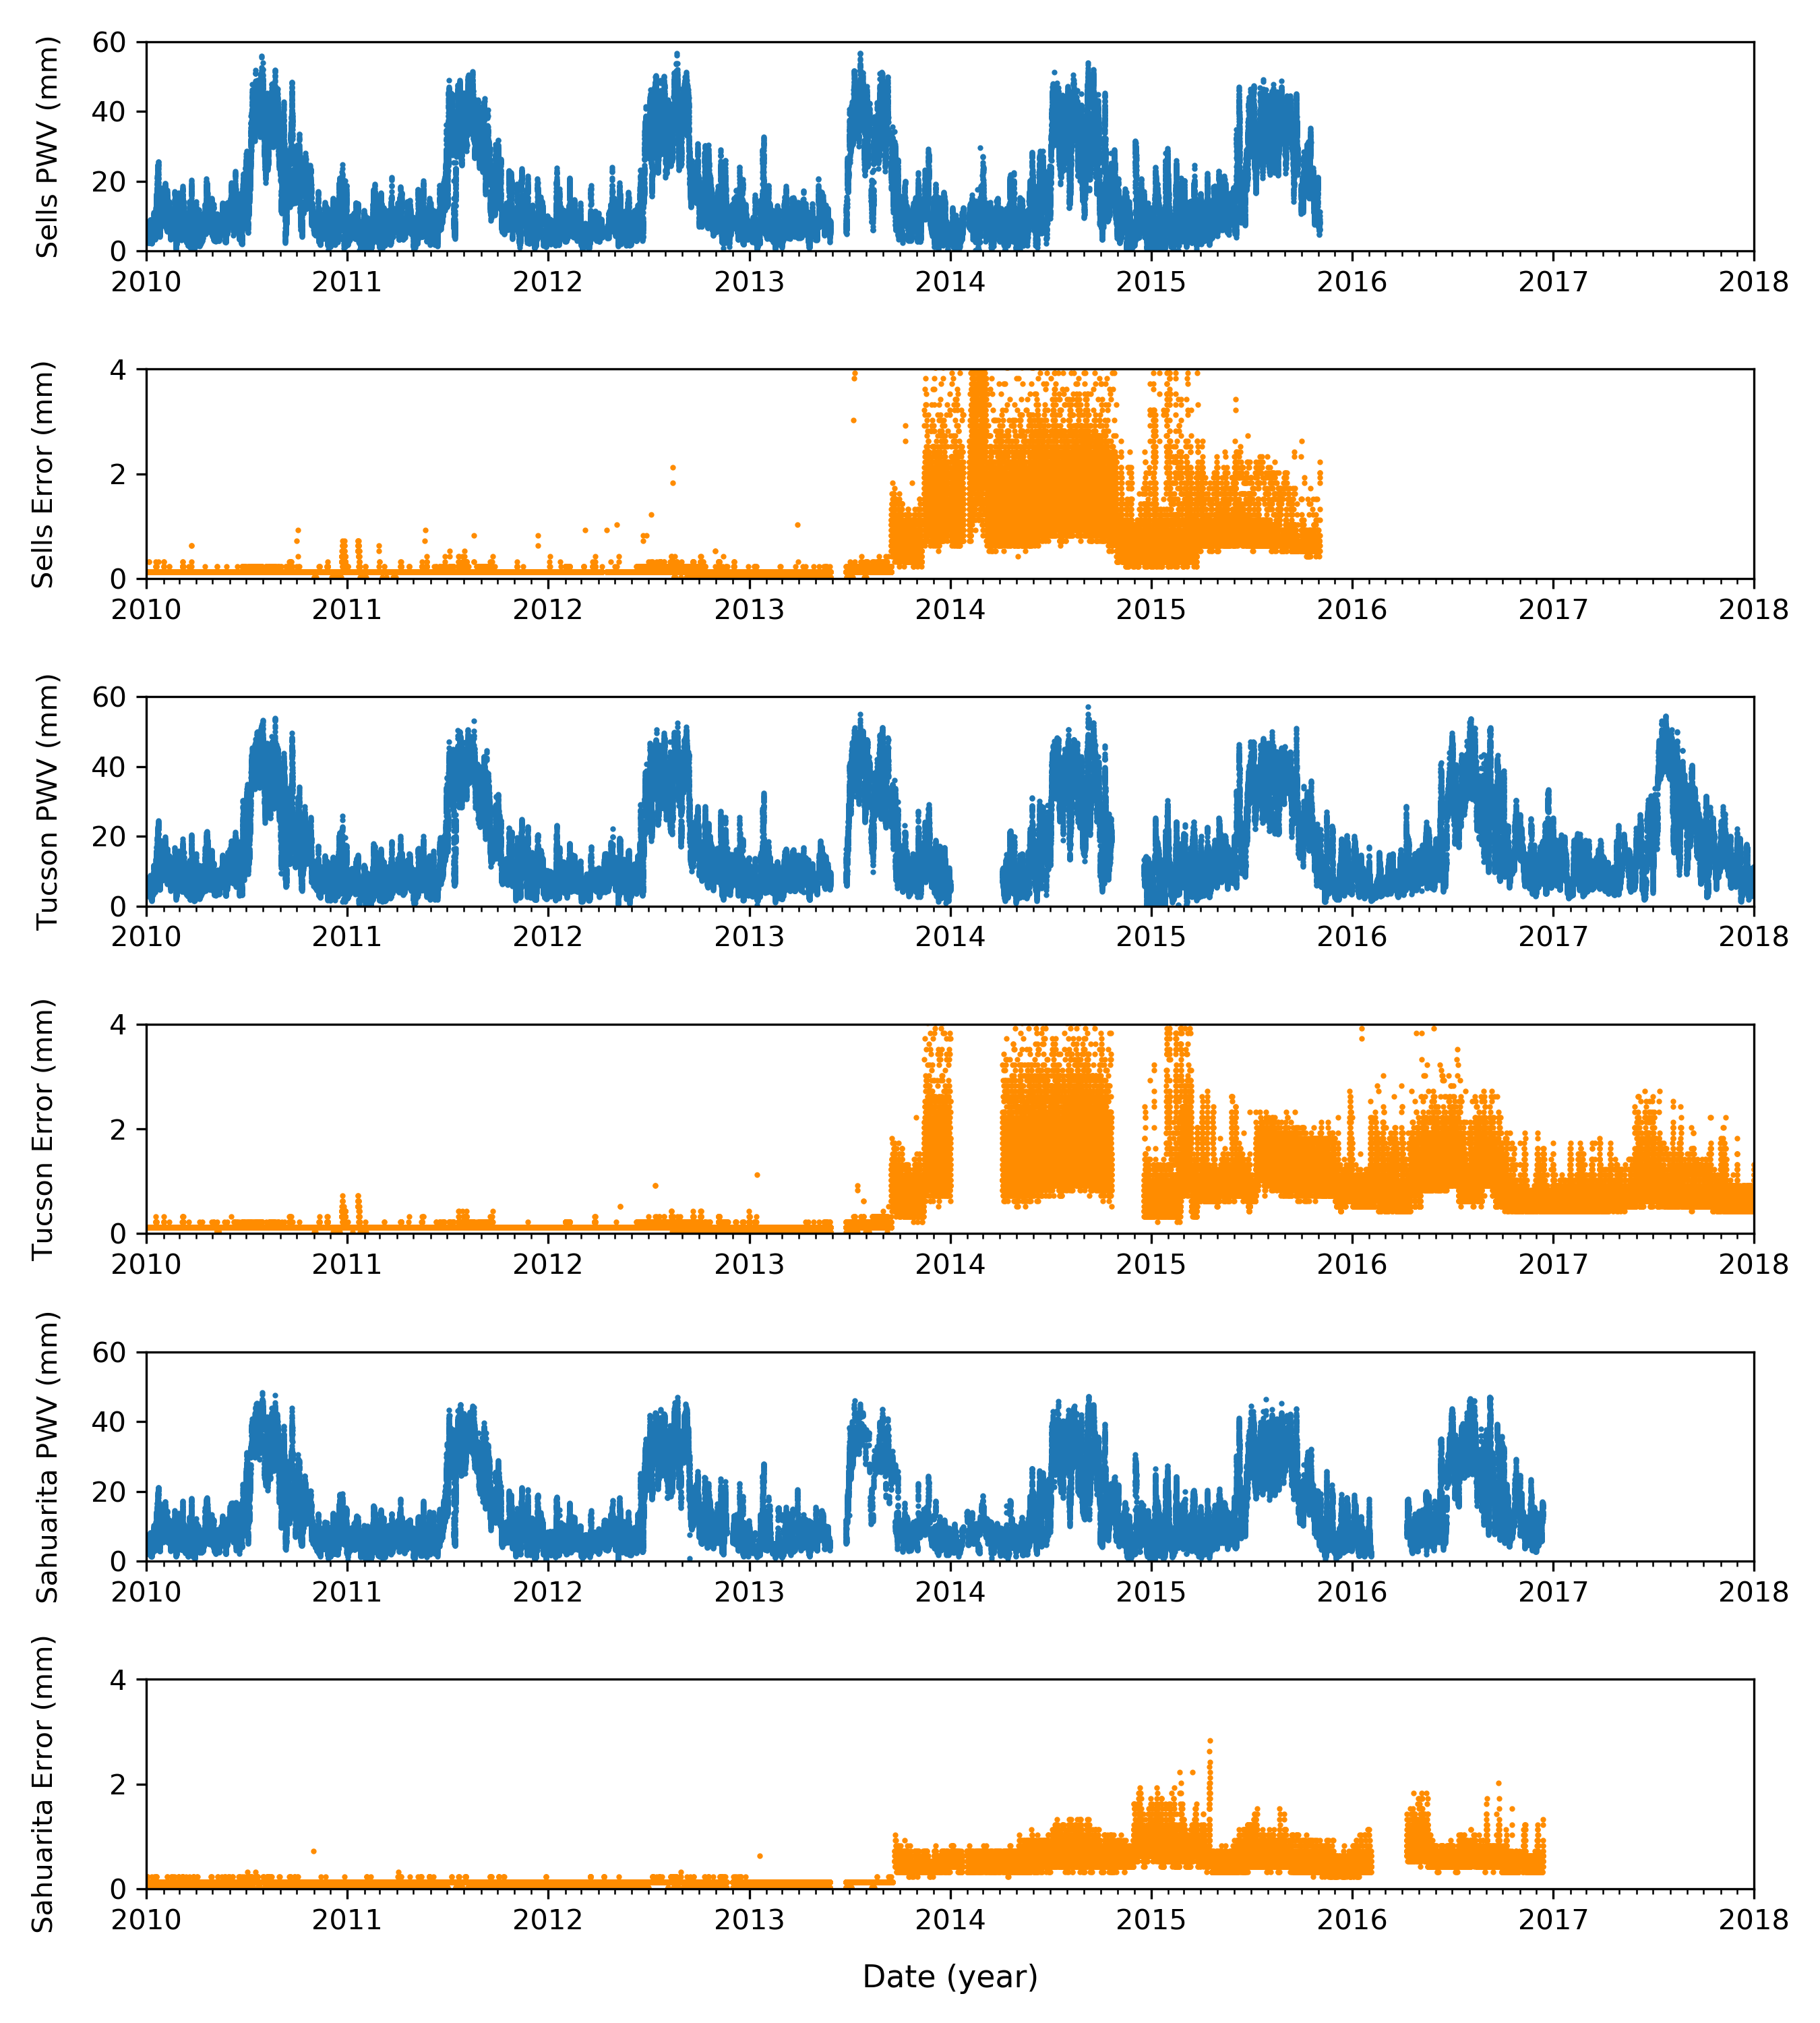
Unexplained error increase occurs across multiple sites
Likely a change in SuomiNet pipeline
error propagation

Slide 16
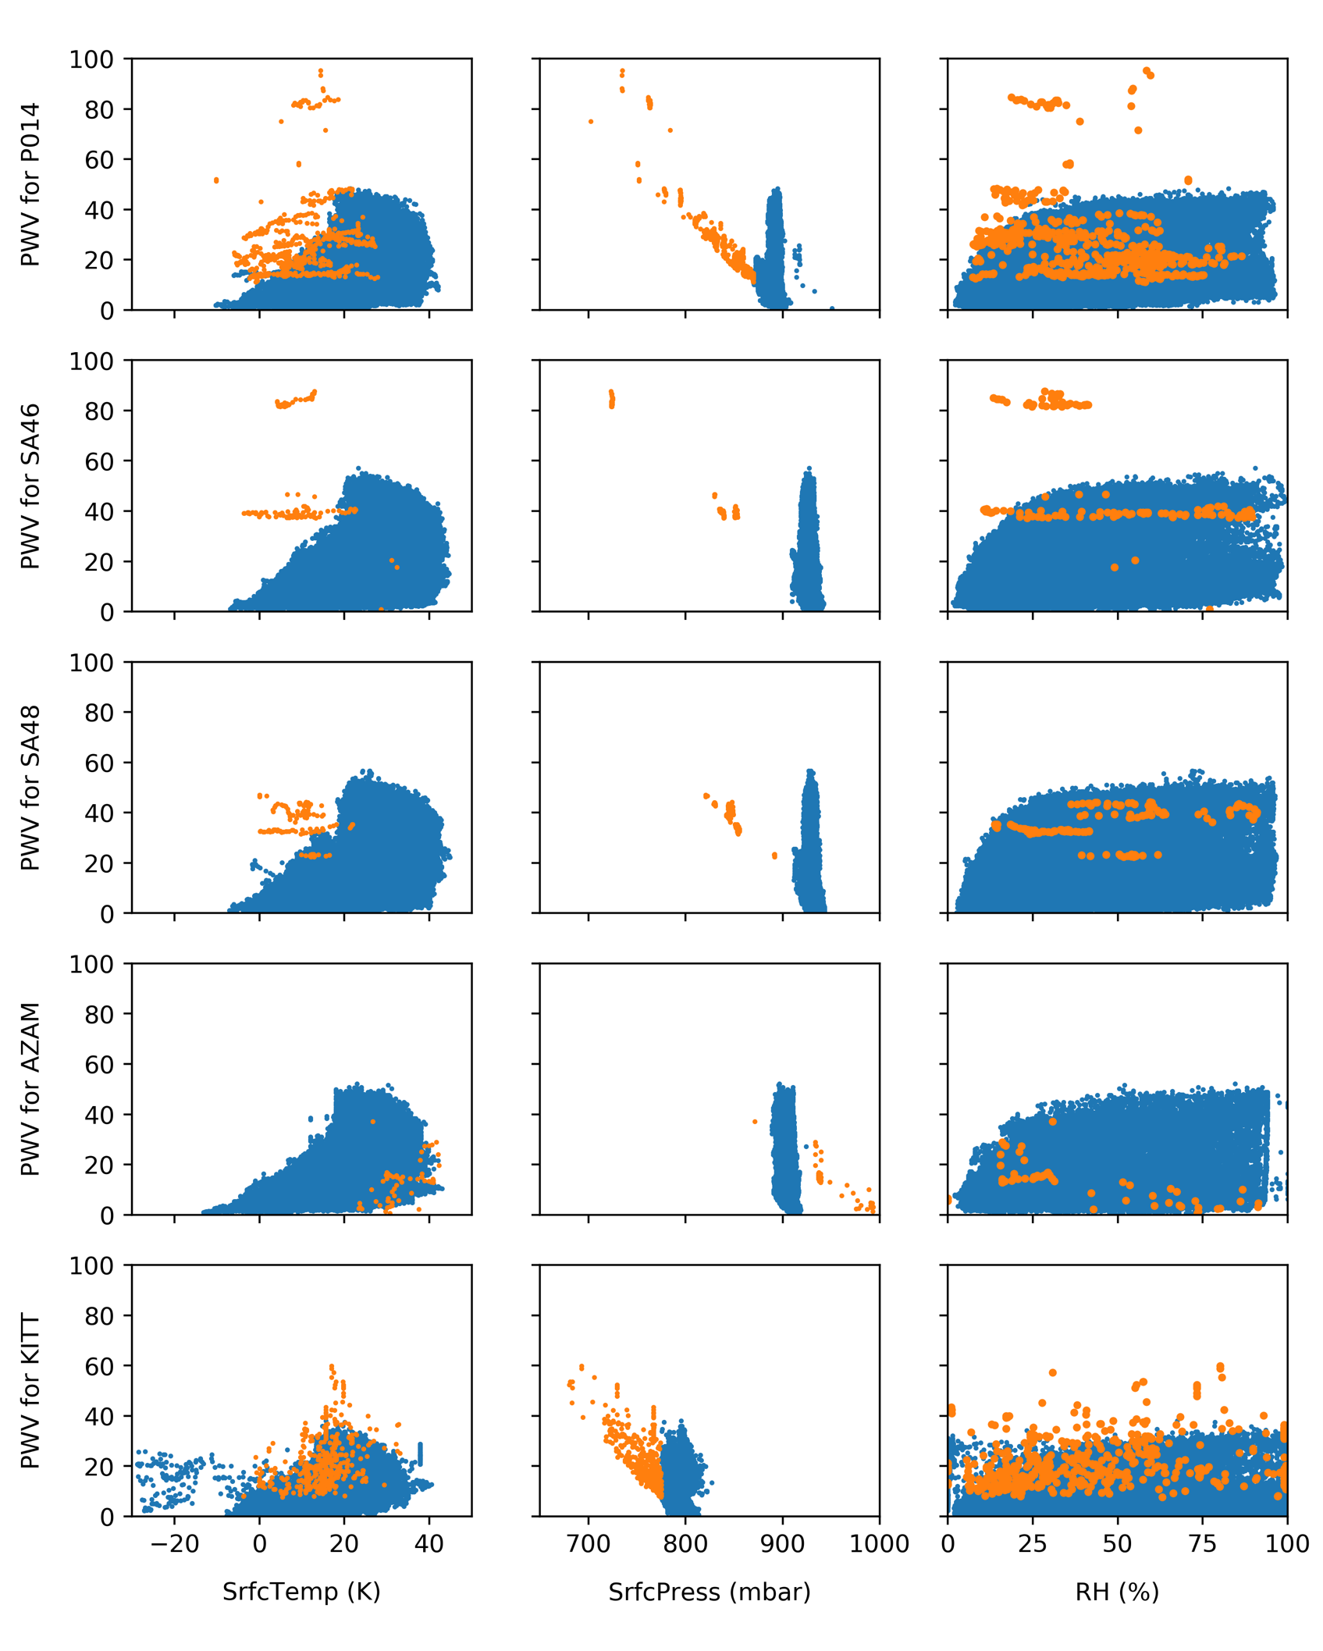
Available Parameters:
Date
PWV
PWV Error
Zenith Delay
Temperature
Pressure
Relative Humidity

Slide 17
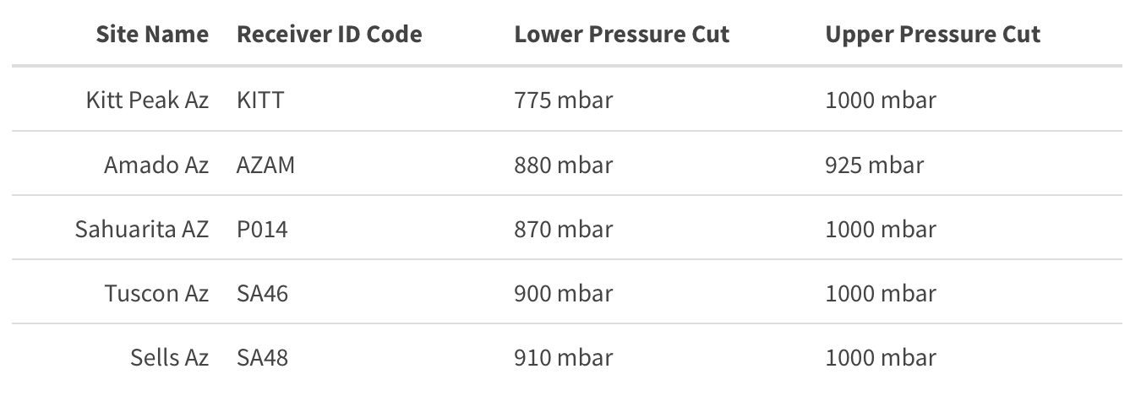

Slide 18
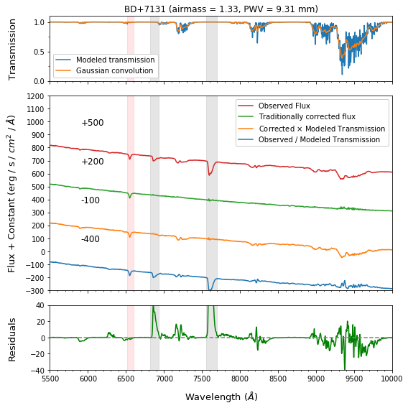

Slide 19
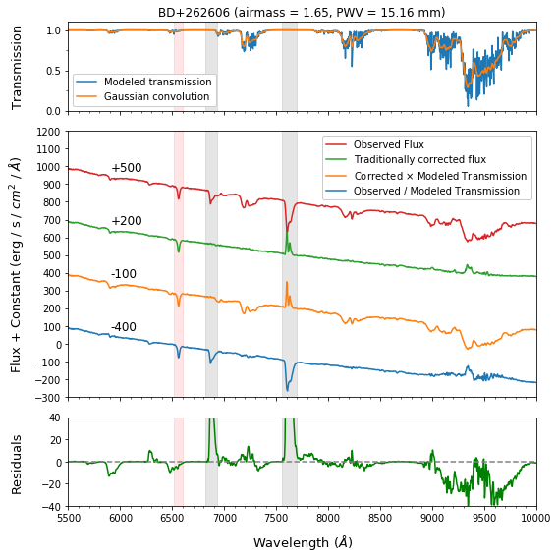

Slide 20
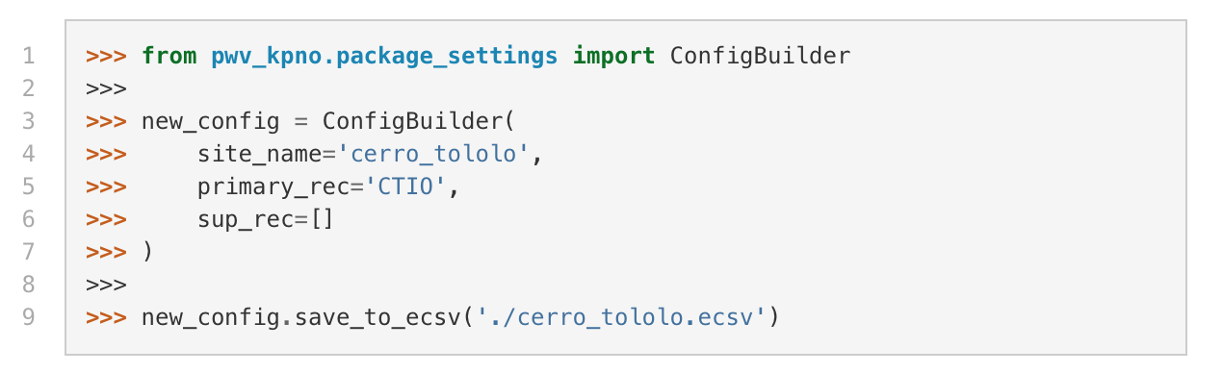
Custom Site Modeling
Includes options for:
Site name (Site ID)
Primary and supplemental receivers
H₂O cross sections
Data Cuts

Slide 21
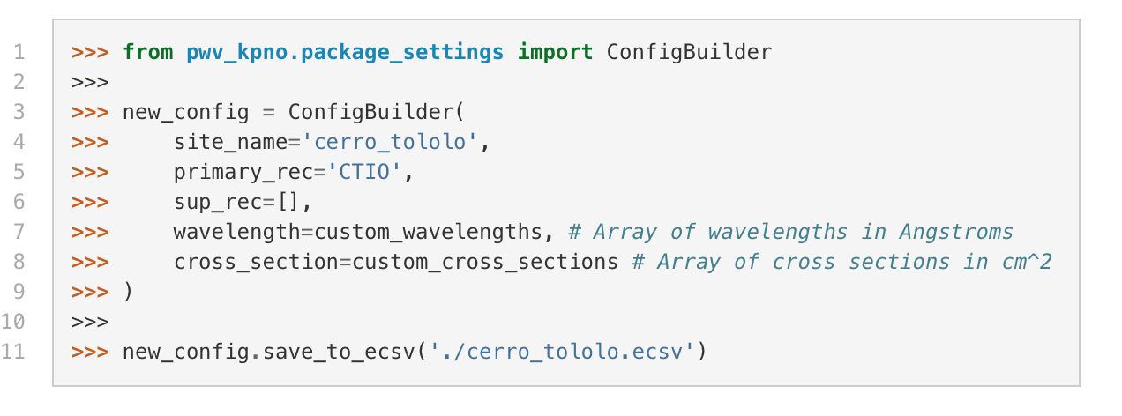
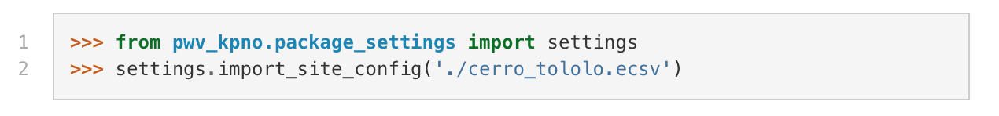
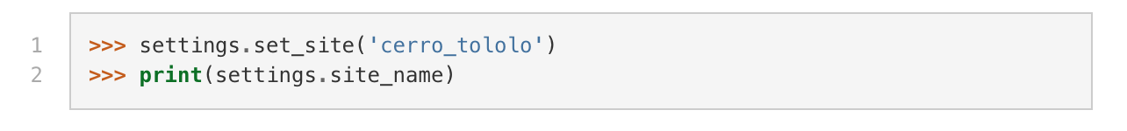
Custom Site Modeling
Add your new site to the package:
Easily switch between different sites:

Slide 22
Moving Forward
  Version 1.0 coming soon! (Public release ~1.5 weeks away)
  Improved modeling of PWV between sites
    Machine learning favored over meteorological models
  Further investigation into effects of line saturation (>9,000 Å)
    Fit EW of observations to compare PWV
  Additional validation on real world observations
  Fine tuning of airmass dependence

Slide 24
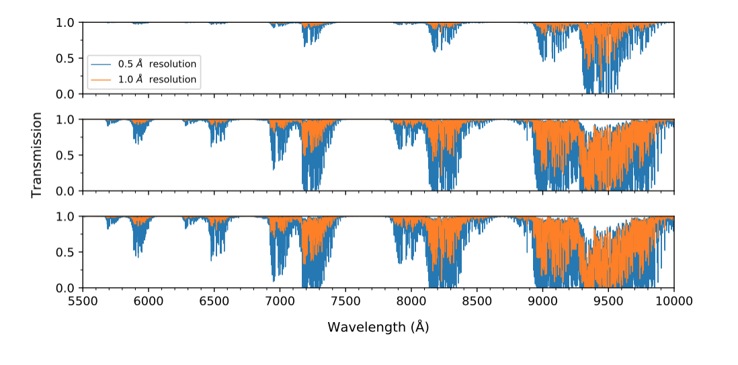

Slide 25
